Slide 1
RF feedback and dynamic tuning in CSNS/RCS
Li Xiao
Institute of High Energy Physics, CAS
2018.12.11 @ APEC workshop

Slide 2
Outline
Introduction
CSNS/RCS RF system
Beam commissioning issue
RF feedback
Dynamic tuning system
Future plan

Slide 3
Introduction

Slide 4
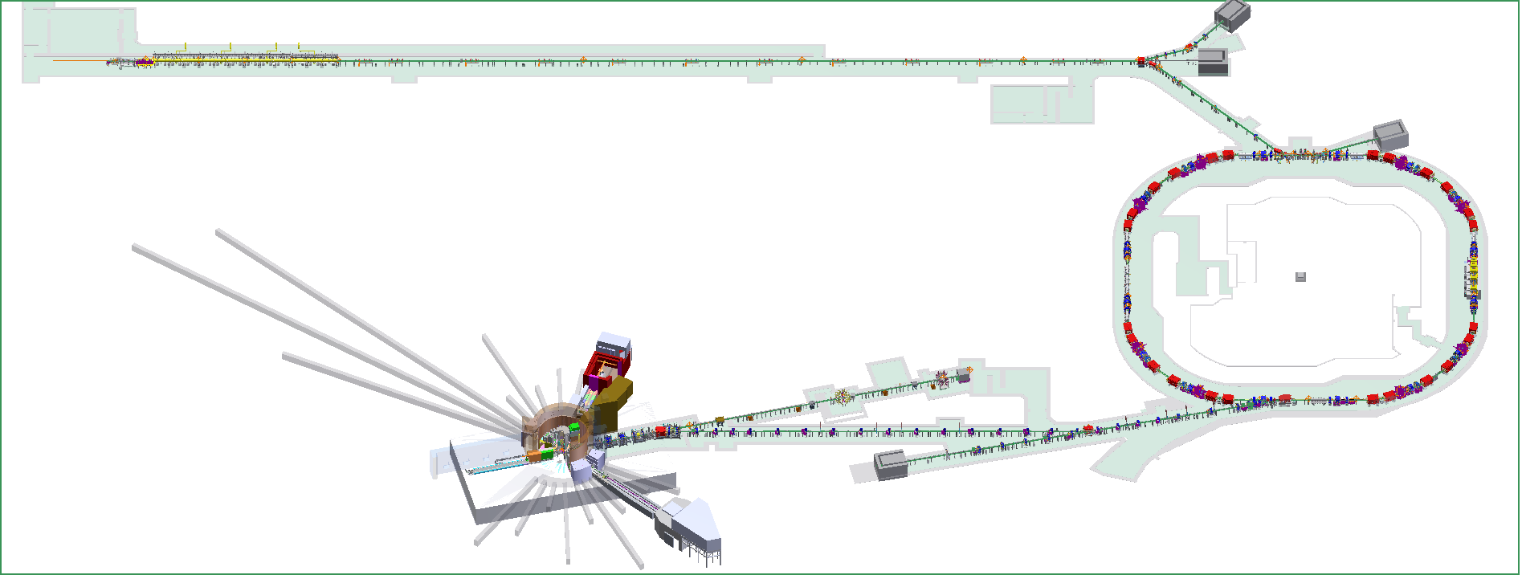
Introduction
China Spallation Neutron Source (CSNS)
80MeV H⁻ Linac
1.6GeV
25Hz
RCS
Target

Slide 5
Introduction
Milestones
Feb. 2001 | Idea of CSNS discussed
Jun. 2005 | Proposal approved in principle by the central government
Sep. 2011 | Construction started, component fabrication started
Apr. 2017 | Linac commissioning 60MeV
May 2017 | RCS commissioning start
Aug. 2017 | first beam on target, first neutron beam
Nov. 2017 | Increase beam power to 10kW
Jan. 2018 | Linac/RCS commissioning 80MeV
Mar. 2018 | Passed National Acceptance Test, pre-open to users
Apr. 2018 | First Experiment Results Published in Nano Energy
Aug. 2018 | Passed National Acceptance
 | 6.5 years in total

Slide 6
Introduction

Slide 7
RF system

Slide 8
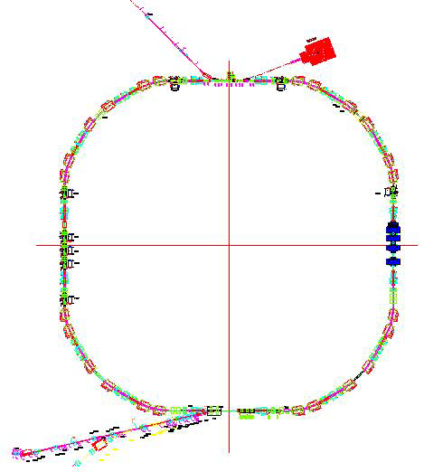
RF system
Parameter | Value
Beam power (kW) | 100
Energy (GeV) | 0.08~1.6
Intensity (ppp) | 1.56E13
RCS circumference (m) | 228
Circulating dc current (A) | 1.5/ 3.5
Repetition rate (Hz) | 25
Harmonic number | 2
RF frequency (MHz) | 1.02~2.44
Peak RF voltage (kV) | 165 (h=2)
CSNS/RCS
8 fundamental harmonic cav.
h=2
3 second harmonic cav.
h=4

Slide 9
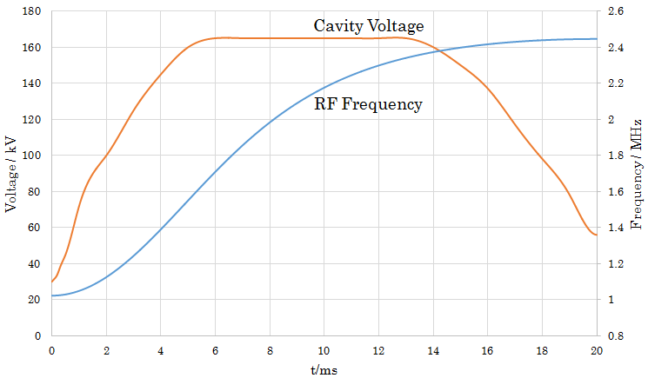
RF system
RF pattern

Slide 10
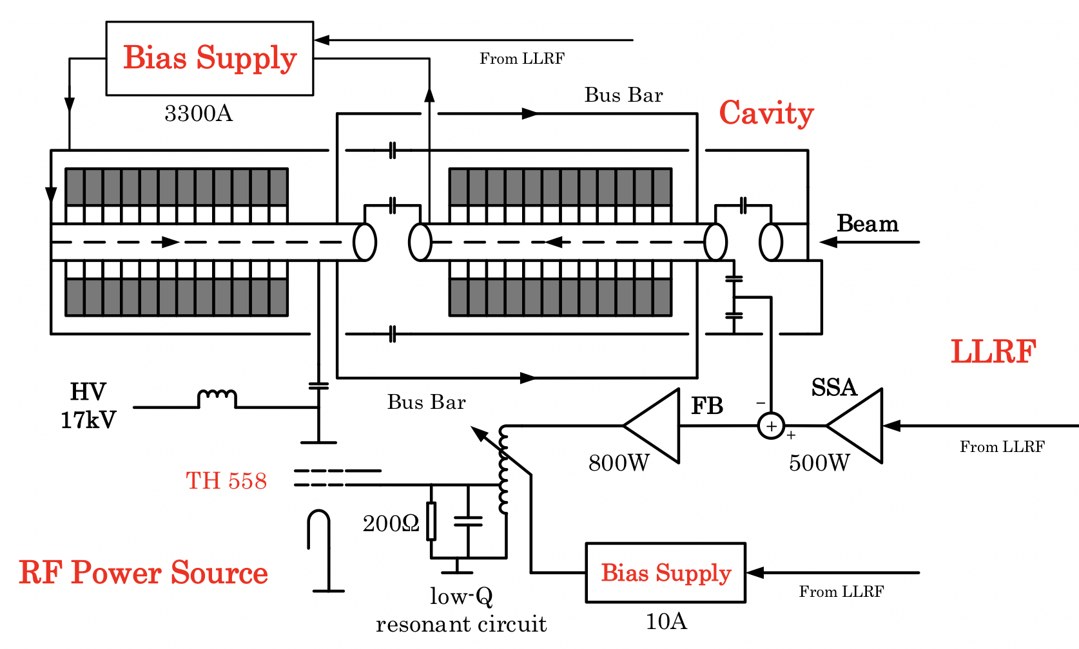
RF system

Slide 11
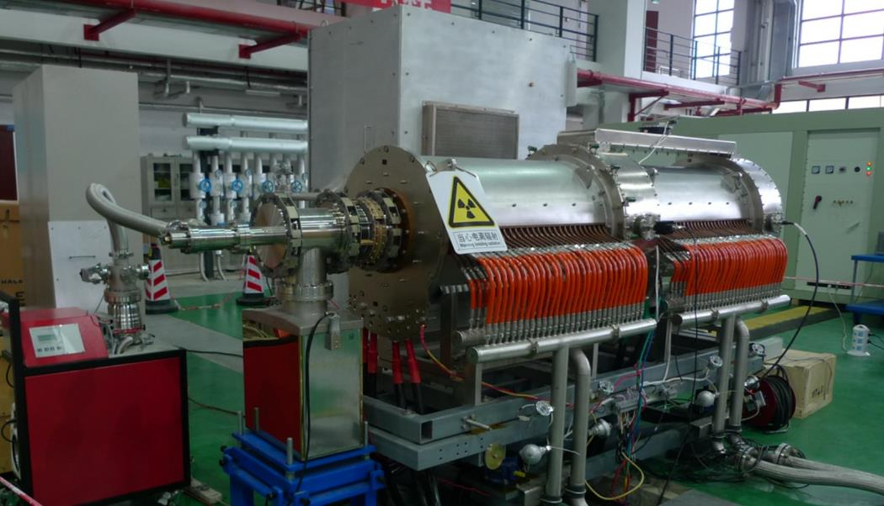
RF system
Ferrite loaded cavity
Bus bar
RF power source
Cables for bias current
Cooling plates and ferrite rings
Two gaps of the cavity

Slide 12
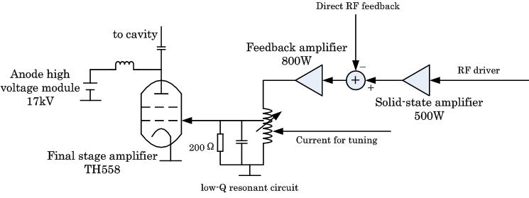
RF system
The RF power source
500W wide-band solid-state preamplifier.
800W feedback amplifier for direct RF feedback.
500kW final stage amplifier (TH558).

Slide 13
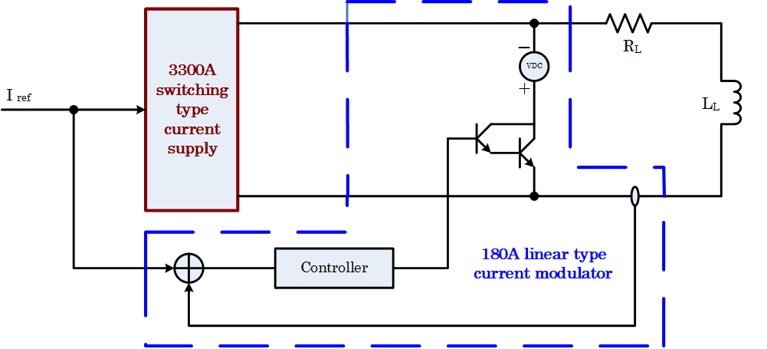
RF system
Bias supply
3300A switch type plus 180A linear type.
20kHz small signal bandwidth.
Without beam, about 200~3000A corresponding to 1.022~2.444MHz.

Slide 14
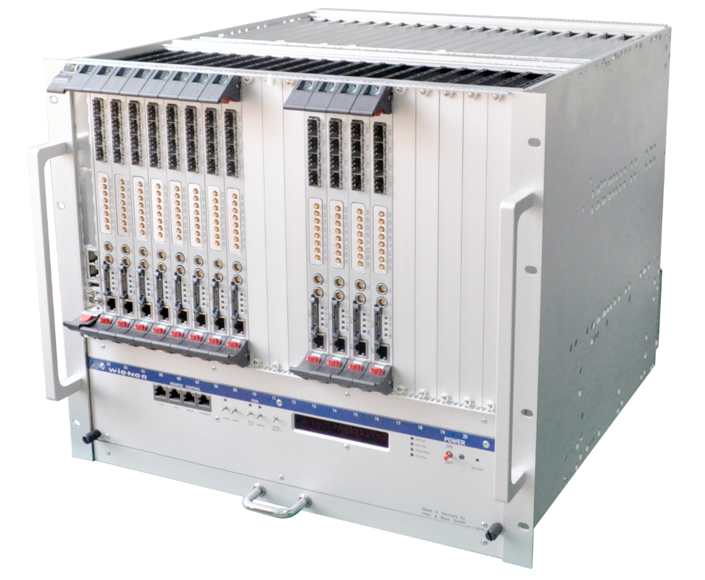
RF system
LLRF
6U/21slots CPCI crate
CPU board (CPCI6200)
8 FPGA boards
Control function for 8 RF systems
4 FPGA boards
Beam signal processing

Slide 15
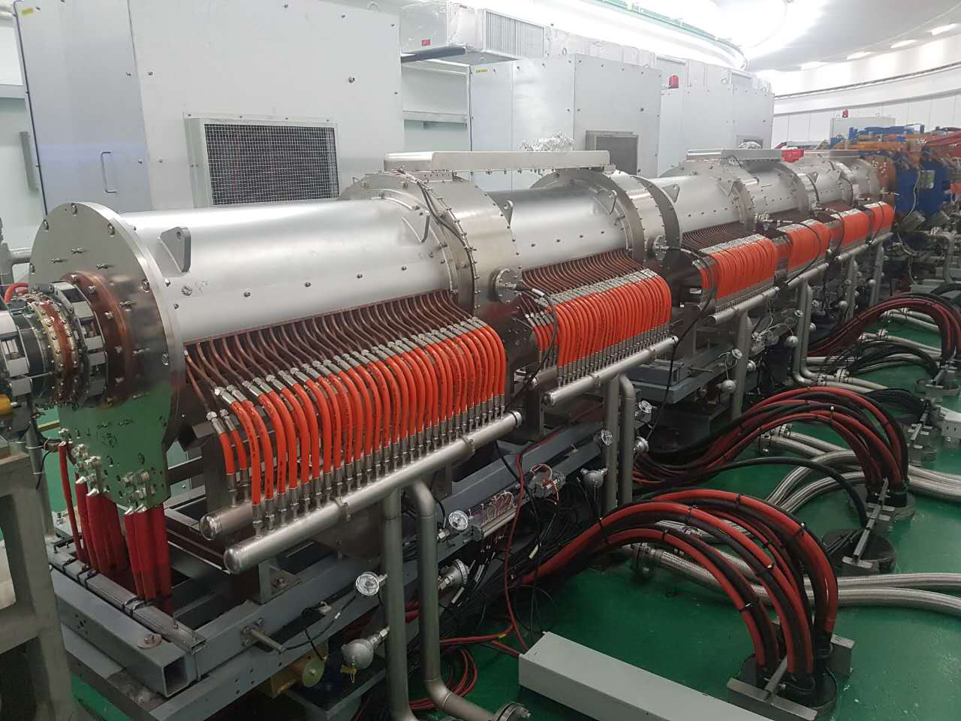
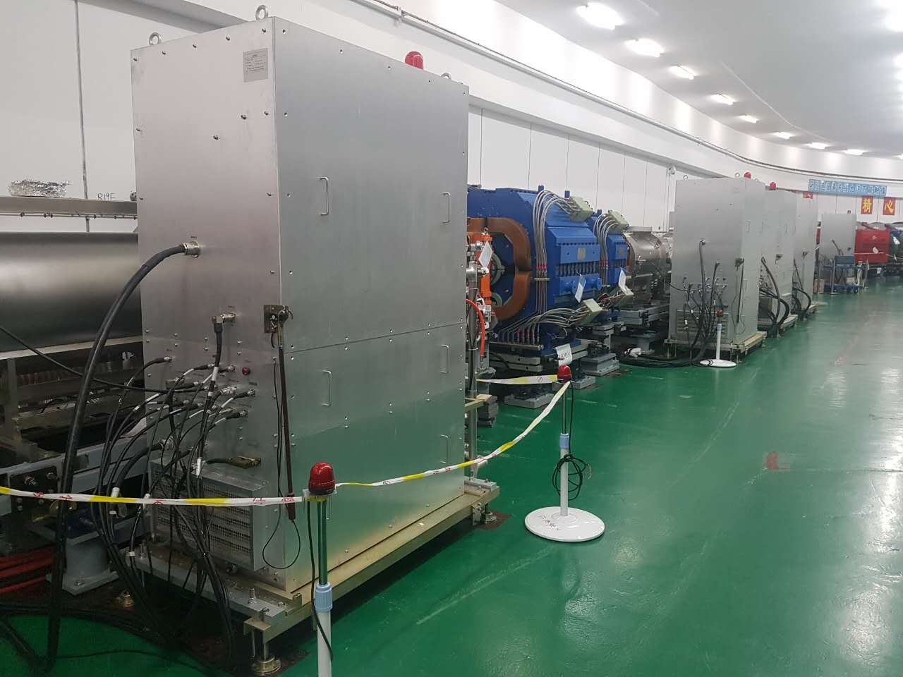
RF system
RCS tunnel

Slide 16
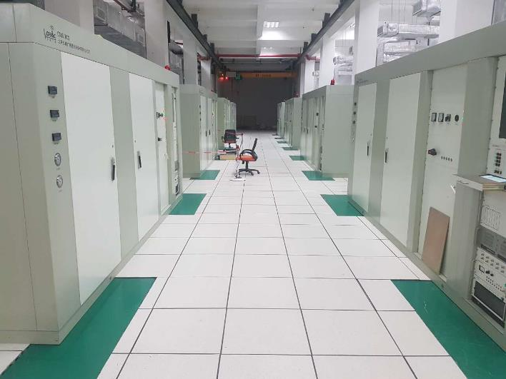
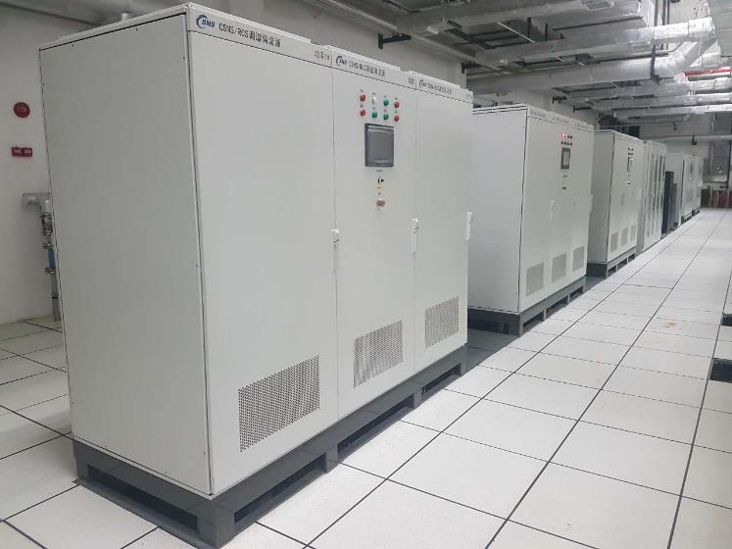
RF system
Equipment hall

Slide 17
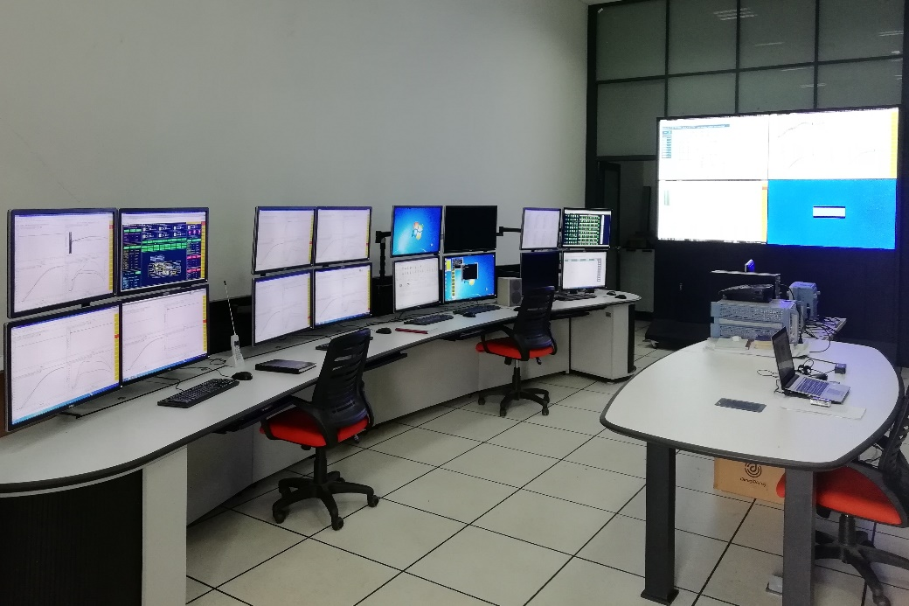
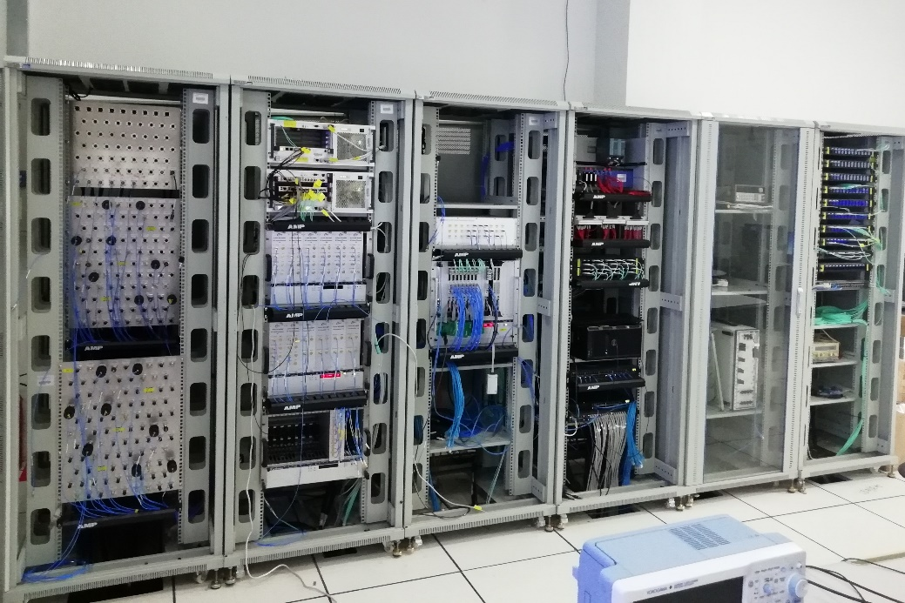
RF system
Local station

Slide 18
Beam commissioning issues

Slide 19
Beam commissioning issues
60MeV injection
Linac
(10 days)
RCS/DC
(10 days)
RCS/AC (13 days)
RCS/DC (8 days)
2017.04.15~04.24
2017.05.26~06.07
2017.06.30~07.12
2017.07.13~07.20
First beam on target, first neutron beam
Increase beam power to 10 kW
RCS/AC (8 days)
RCS/AC (18 days)
2017.07.21~07.28
2017.08.11~08.28
2017.08.28
2017.11.01~11.09
67 days to reach 10% of design beam power！

Slide 20
Beam commissioning issues
DC mode
To control the beam loss during the beam commissioning, the single shot mode is adopted. In the first step, the beam commissioning was started in DC mode without acceleration.
In May 31st, the first beam was injected into the RCS, and successfully accumulated in the RCS. The maximum accumulated particle number is about 1/3 of the design target.
In June 5th/ 6 days, the first beam was extracted to RCS dump.

Slide 21
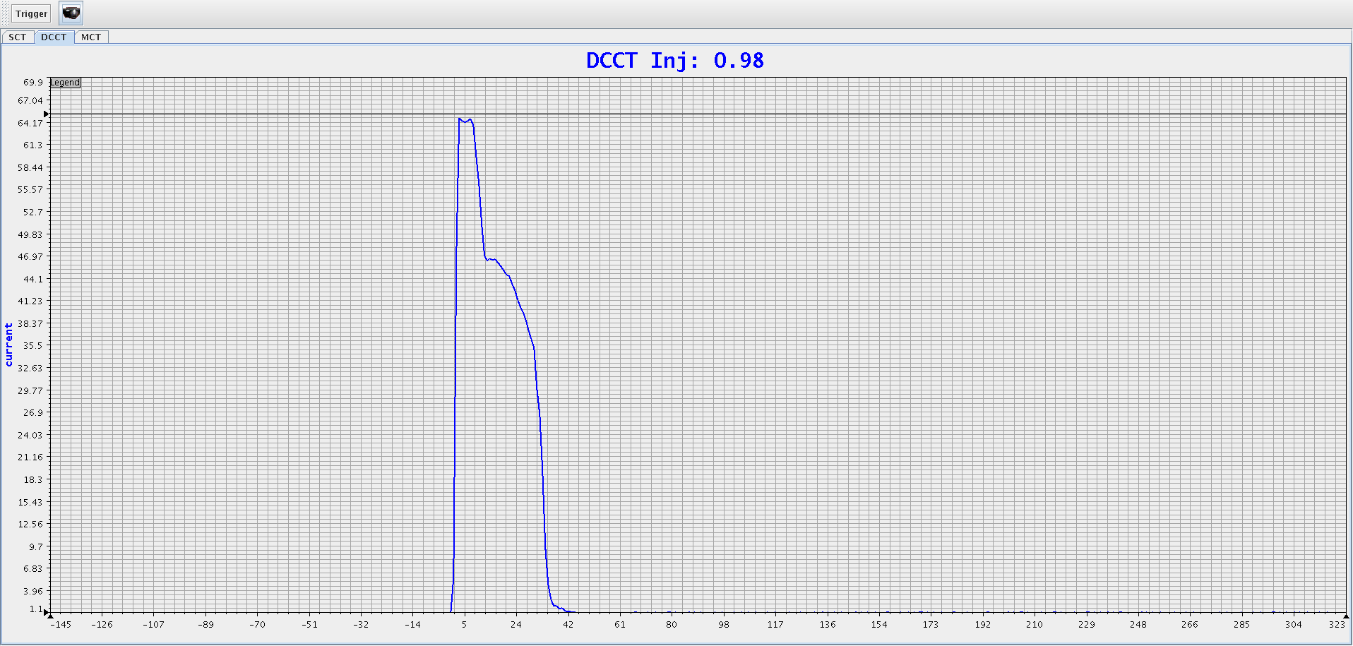
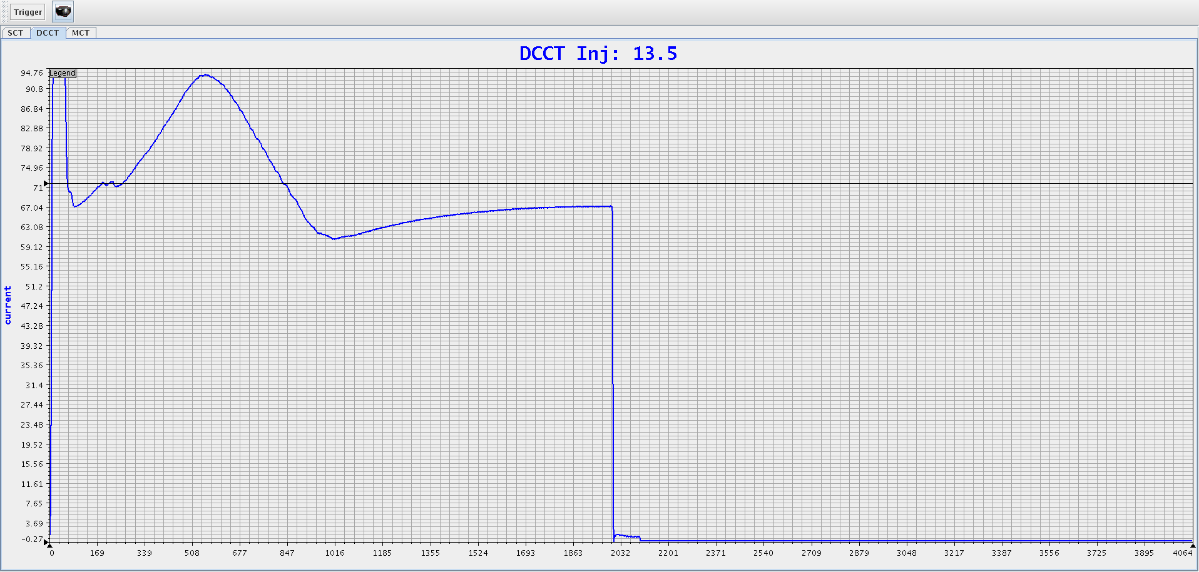
Beam commissioning issues
AC mode
July 7th, the first beam was accelerated from 60MeV to 1.6 GeV.
Beam life time was 4ms in the first shot.
On the same day, via shifting timing between RF and B field, the major part of beam was accelerated to 1.6GeV and extracted.

Slide 22
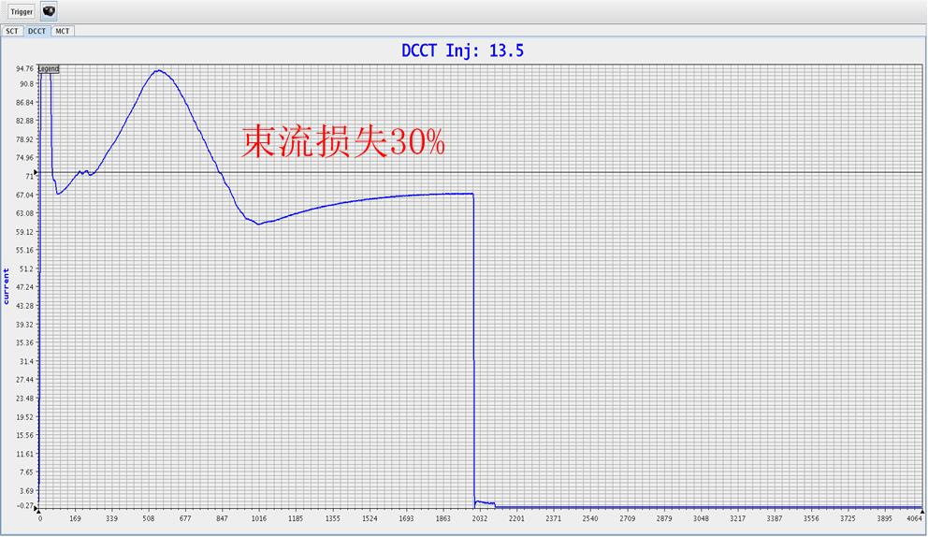
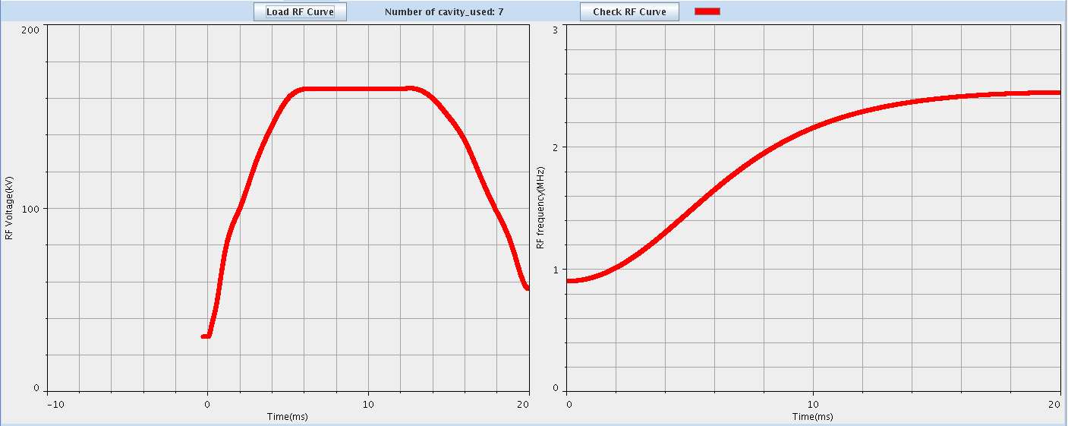
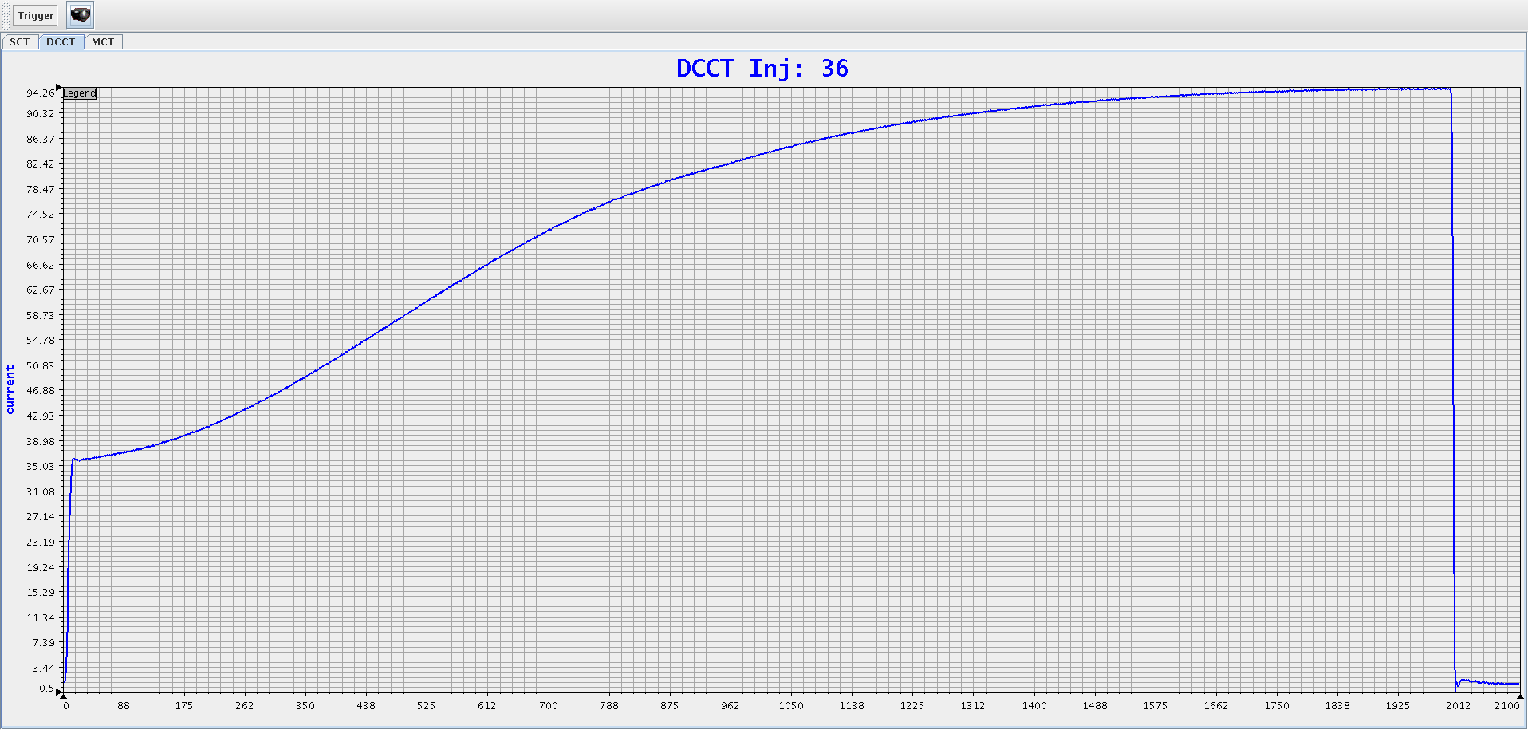
Beam commissioning issues
AC mode
Tuning RF amplitude, frequency, injection phase…
July 9th, the 99% beam transmission rate was achieved with the RF frequency pattern form 0.9018 to 2.444MHz.

Slide 23
Beam commissioning issues
Interface
Timing
10MHz master clock/120MHz digital working clock
Cycle start pre-trigger
Trigger
LEBT chopper
Extraction kicker
BPM
Interlock
Local equipment interlock
MPS/FPS/PPS
EPICS
Standard EPICS interface
Real time control data display and storage

Slide 24
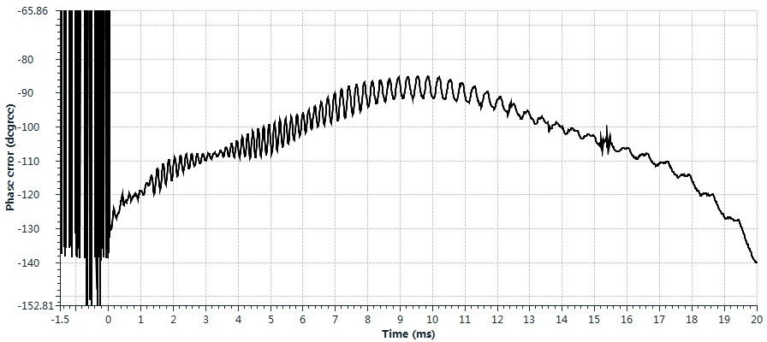
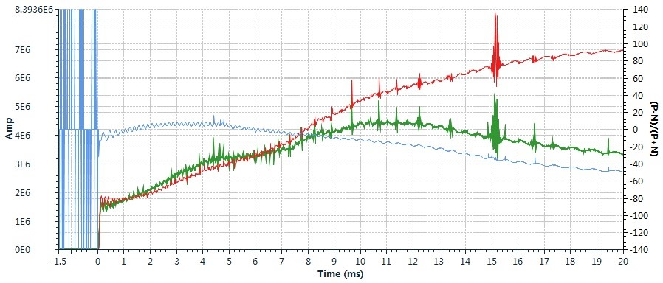
Beam commissioning issues
Beam signal processing
Beam position
Beam phase
Beam amplitude / fundamental harmonic component

Slide 25
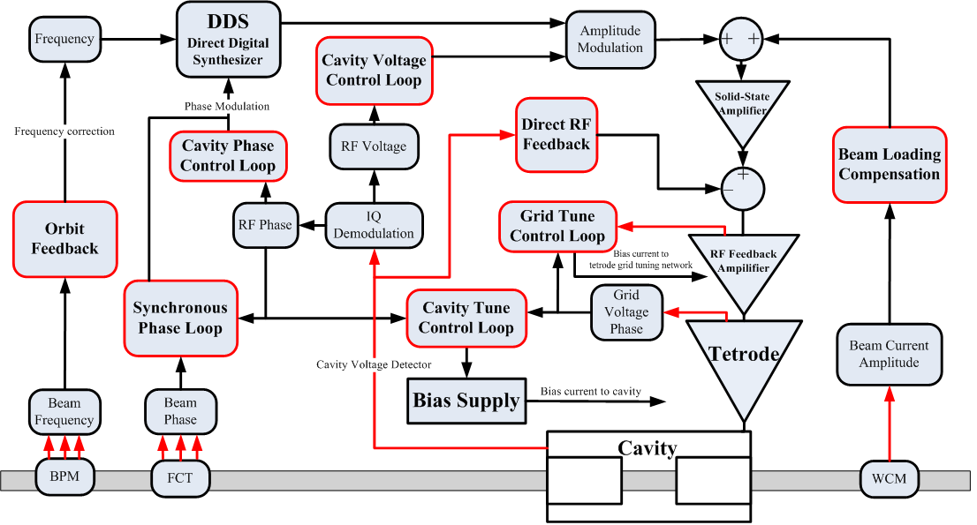
Beam commissioning issues
Control architecture

Slide 26
Beam commissioning issues
Control loops
Cavity voltage control
Cavity phase control
Cavity tune control
Grid tune control
Direct RF control
Beam loading compensation
Synchrotron oscillation damping
RF frequency correction
Cavity control module
Now in used
Beam control module

Slide 27
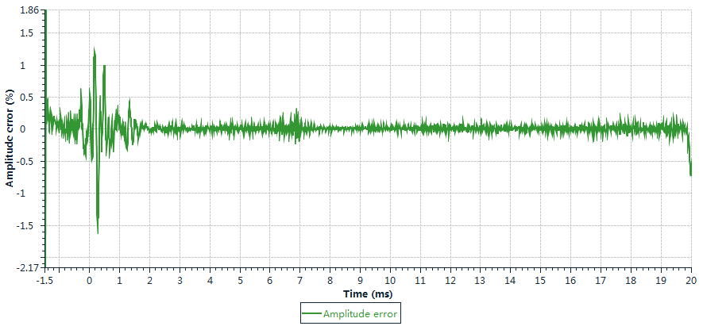
Beam commissioning issues
Cavity voltage control

Slide 28
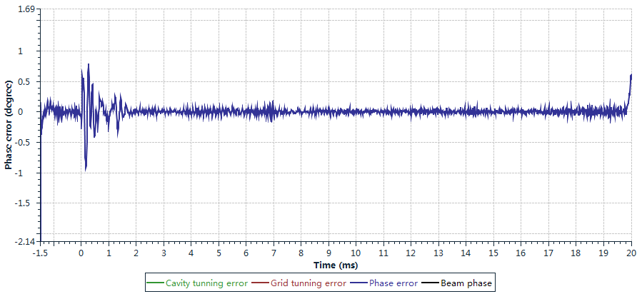
Beam commissioning issues
Cavity phase control

Slide 29
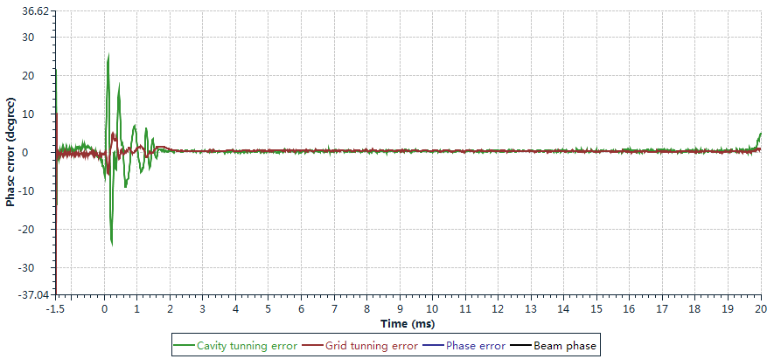
Beam commissioning issues
System tuning control

Slide 30
Beam commissioning issues
Running statistics
2017.5 ~ 2018.7
Beam time 2400 hours
Fault time 14 hours
2018.9.30 ~ 2018.11.28
Beam time 1025 hours
Fault time 2.65 hours
99.4%
99.74%

Slide 31
RF feedback

Slide 32
RF feedback
To increase the dynamic performance of control system.
To compensate beam loading effect.
Cavity voltage signal from pickup

Slide 33
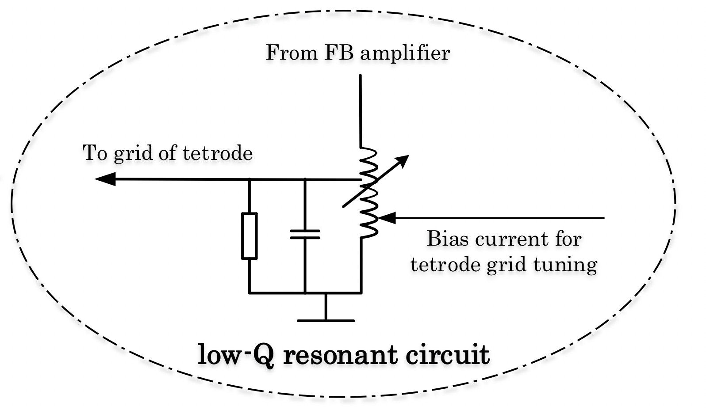
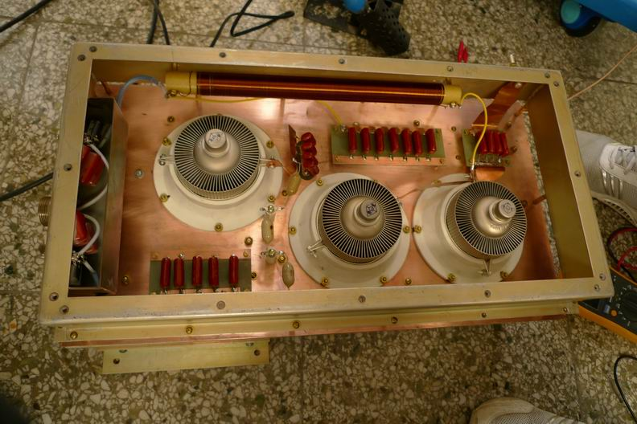
RF feedback
Implement of RF feedback
Tetrode grid tune control
Feedback amplifier

Slide 34
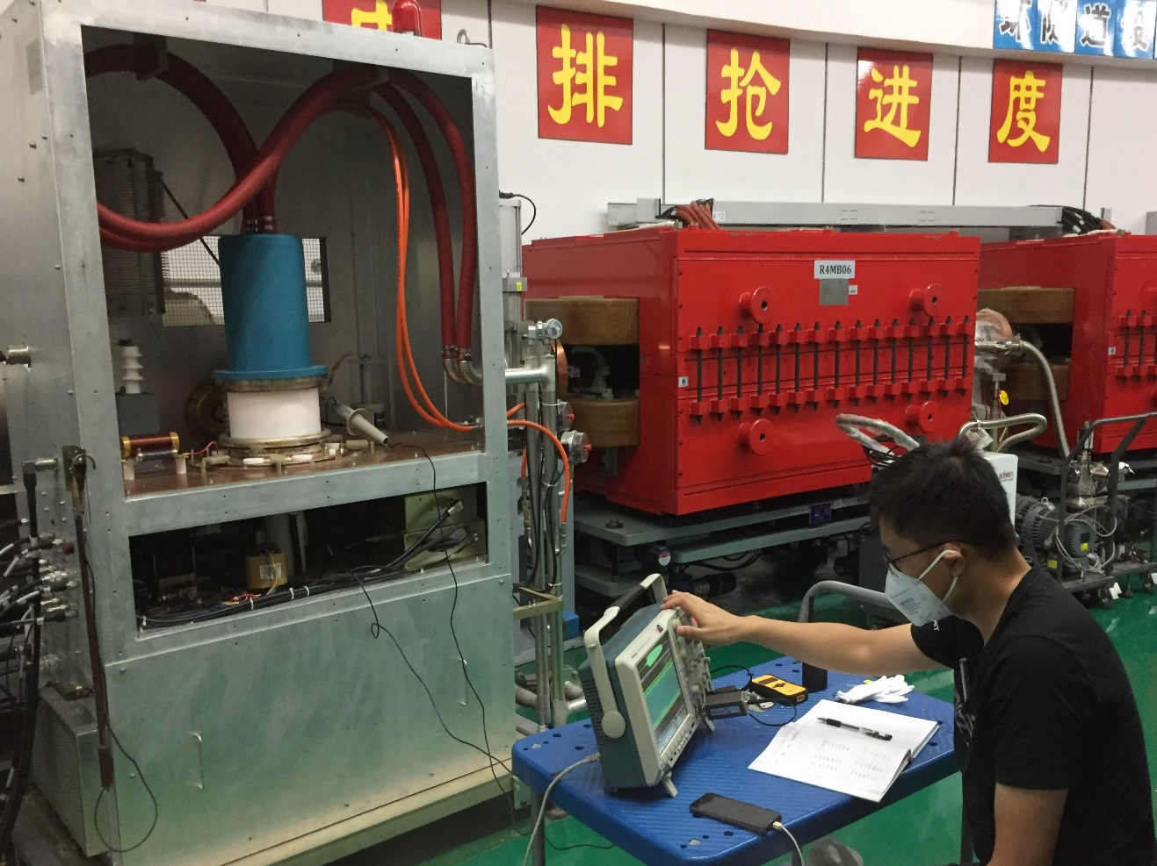
RF feedback
Feedback amplifier
Specifically designed for direct RF feedback.
Located in front of final stage amplifier adjacent to the cavity.
High reliability

Slide 35
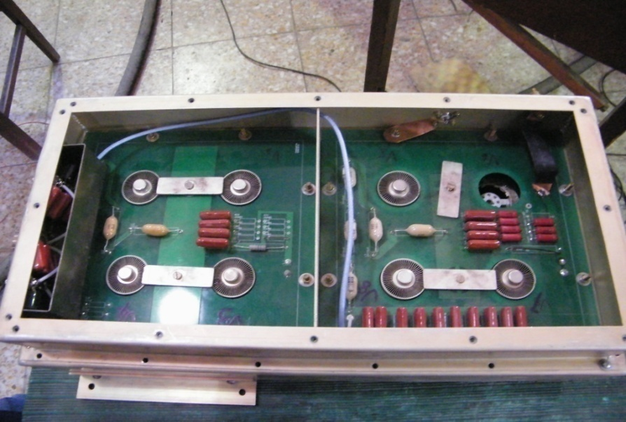
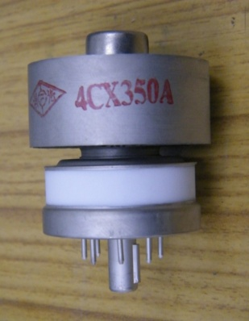
RF feedback
Feedback amplifier
Prototype adopted AGS scheme.
2 stages, 4 push 4.

Slide 36
RF feedback
Feedback amplifier
Output power was not enough (AGS TH537/300kW)
Low reliability in impedance mismatch condition
High broken probability for long running

Slide 37
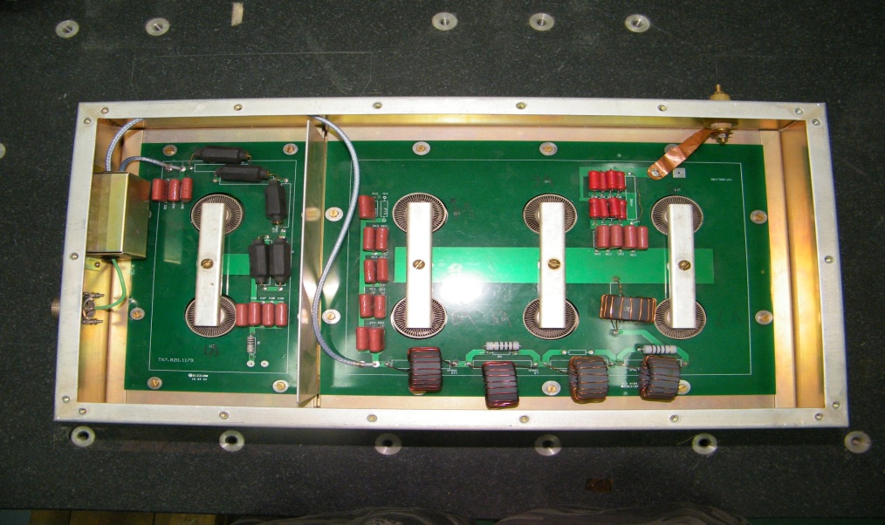
RF feedback
Feedback amplifier
2 stages, 2 push 6
Output power was solved
High broken probability still remained
Impedance increase between stages leads to big phase shift

Slide 38
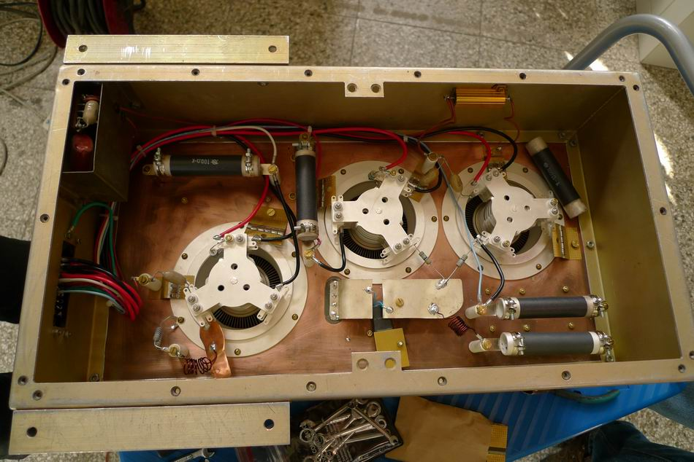
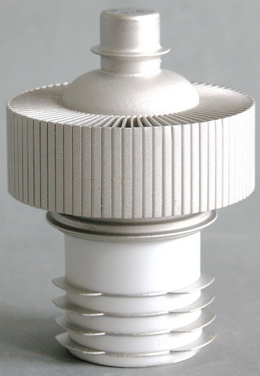
RF feedback
Feedback amplifier
2 stages, 1 push 2
A matching network between stages is used to increase gain
Stable working condition and very low broken probability

Slide 39
RF feedback
The principle is very simple.
Major problem is to deal with the rapid sweeping working condition.
The phase shift is guaranteed by the two stage of tuning loops.
The feedback gain is set about 20dB.
Detuning may cause self-oscillation
should be interlocked with bias supply.
Very effective for cavity voltage and cavity tuning.
30 kW operation without beam loading compensation loop.

Slide 40
Dynamic tuning system

Slide 41
Dynamic tuning system
In general, the load voltage should be in anti-phase to the grid voltage.
The resonant frequency is adjusted by bias supply.

Slide 42
Dynamic tuning system
CSNS/RCS RF tuning system configuration

Slide 43
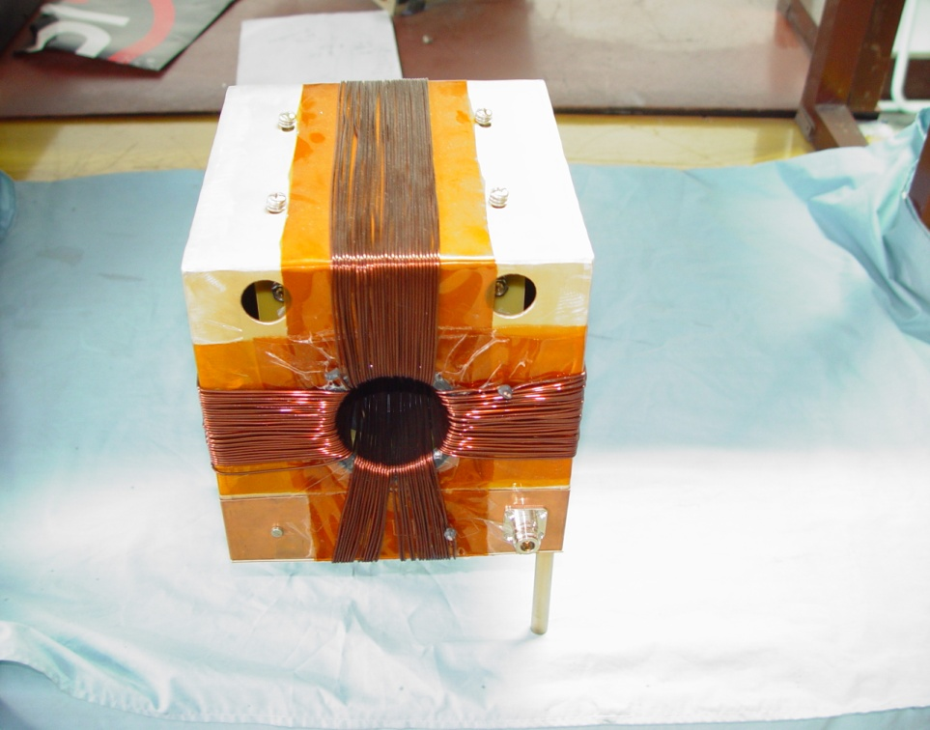
Dynamic tuning system
Tetrode tuning system
Similar principle with cavity tuning system
Compensate the parasitic capacitance of tetrode grid
Ensure the gain and stability of RF power source
Ensure the phase shift for the RF feedback control

Slide 44
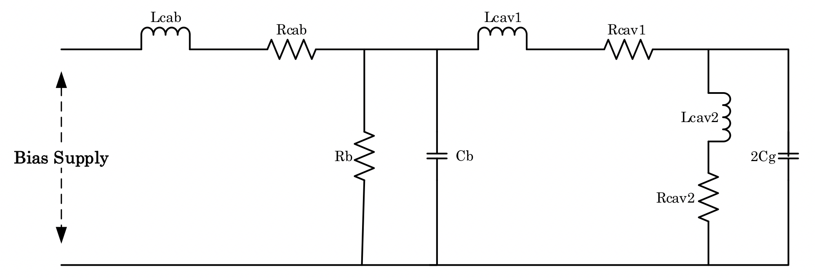
Dynamic tuning system
Cavity tuning system
Equivalent circuit of the bias supply load
Resistance and capacitance of bypass is used to damp the oscillation

Slide 45
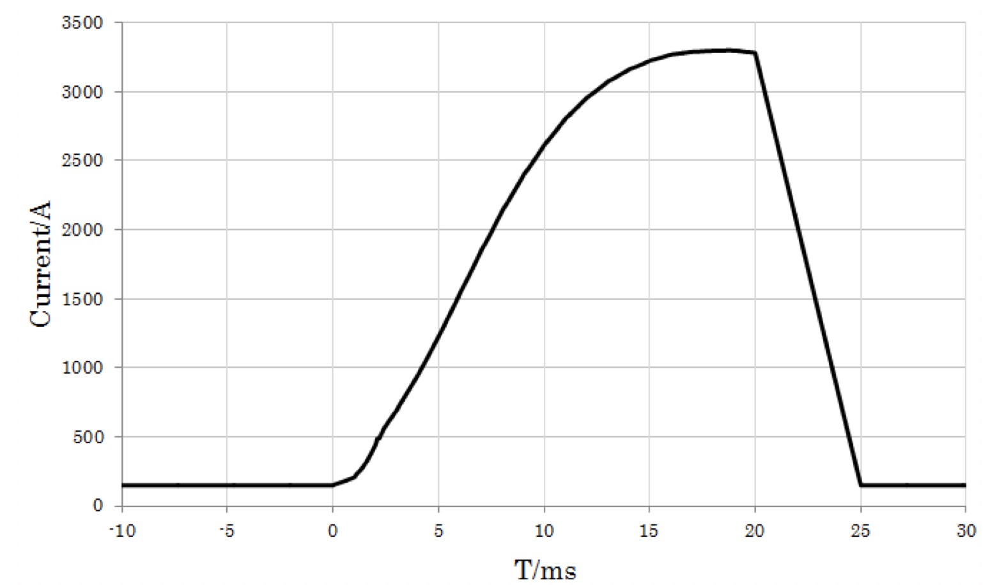
Dynamic tuning system
Typical current curve in one cycle
The maximum current is about 3000A
Rapidly decreases to a low value (~150A) in about 1ms.

Slide 46
Dynamic tuning system
Requirement of dynamic performance
Nonlinear characteristic of ferrite
Transient beam loading compensation
Limit of tuning system
Control system ～ level of dozens of kHz
Bias supply ～ several kHz
3 prototypes were developed
Switch type
4 IGBT modules
High efficiency / low bandwidth / voltage ripple
Linear type
1392 transistors in parallel
Low efficiency / high bandwidth / stability
Combined type

Slide 47
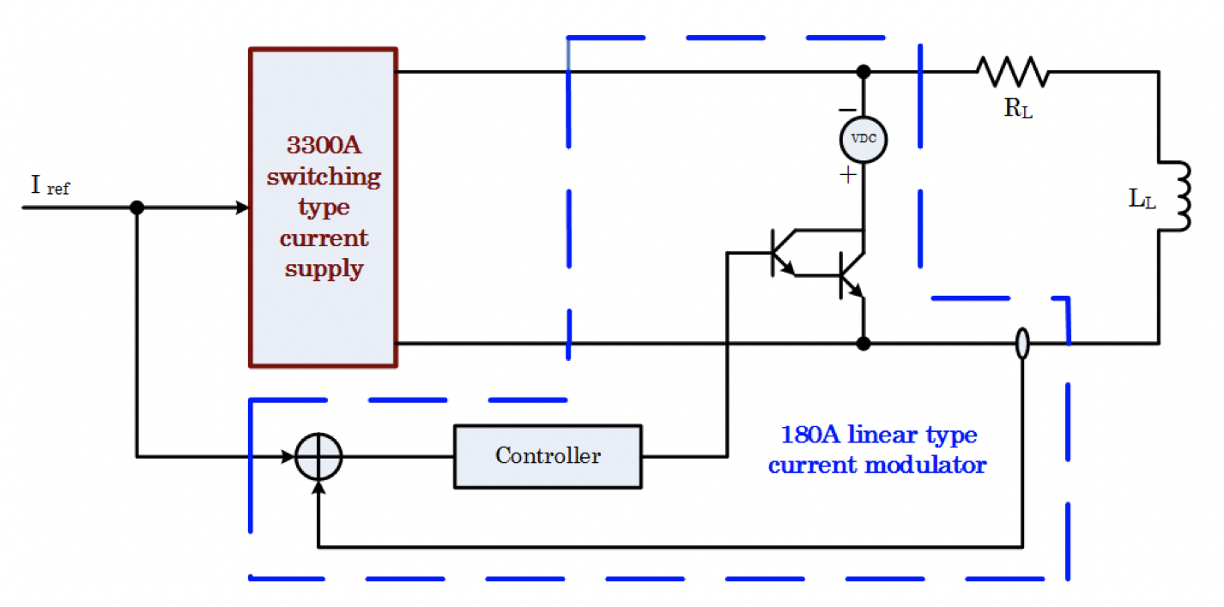
Dynamic tuning system
Combined type bias supply
3300A switch type bias supply
180A linear type modulator

Slide 48
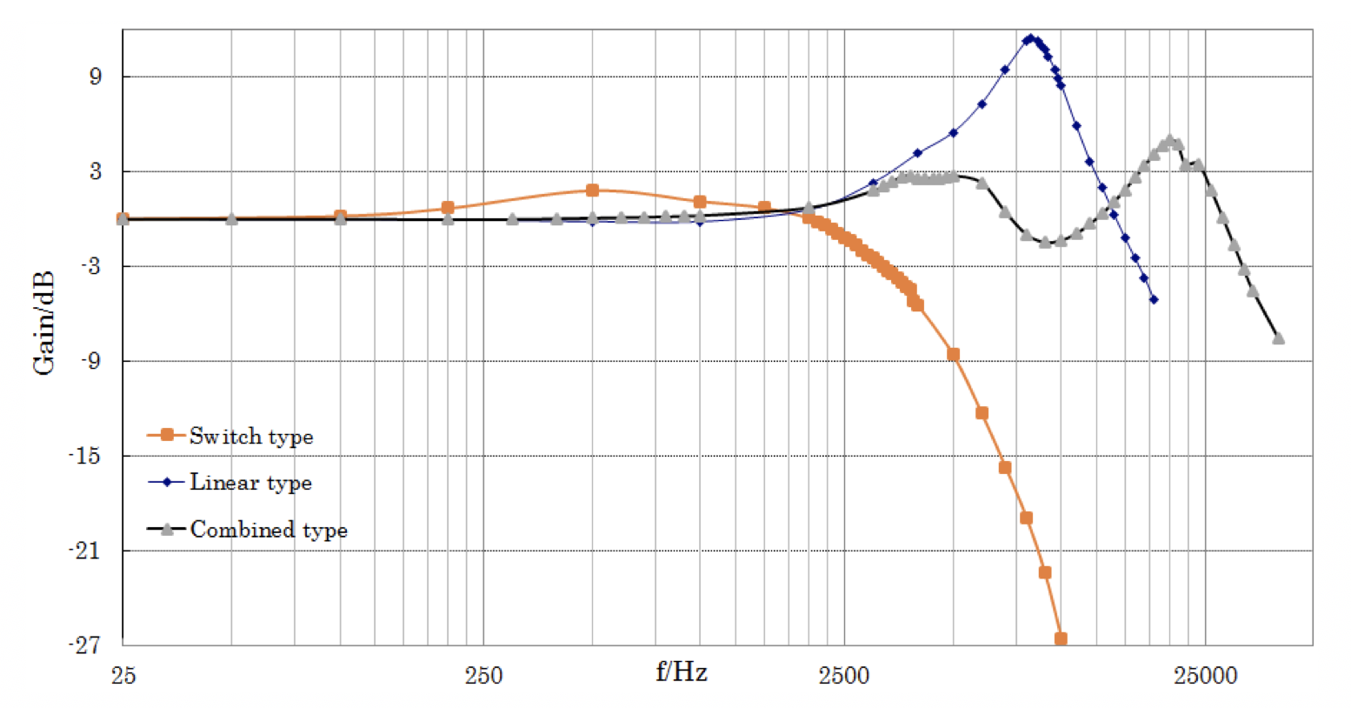
Dynamic tuning system
Small signal bandwidth (SSWB) comparison

Slide 49
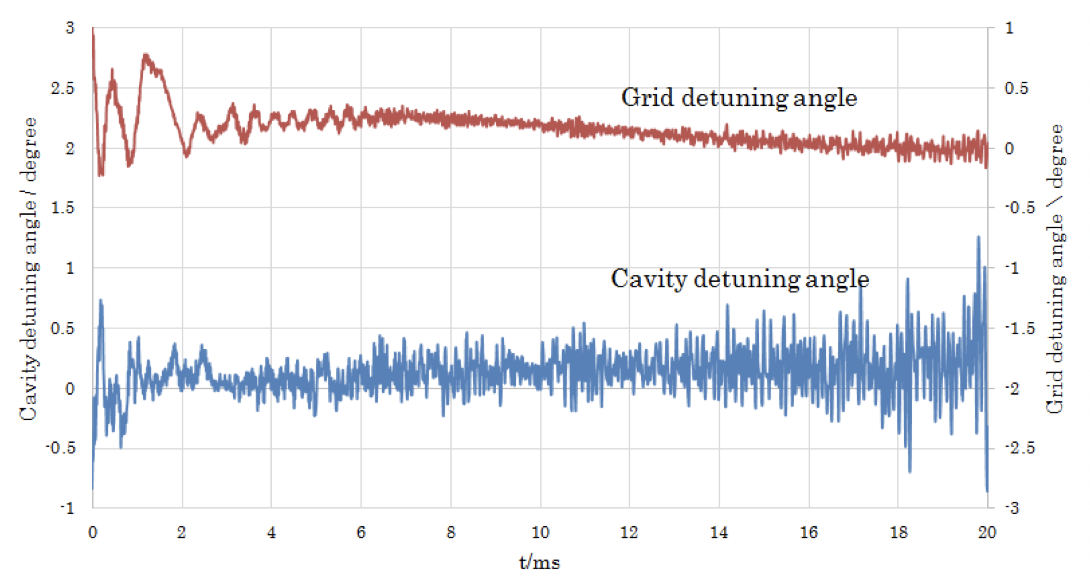
Dynamic tuning system
Detuning phase in 1 cycle

Slide 50
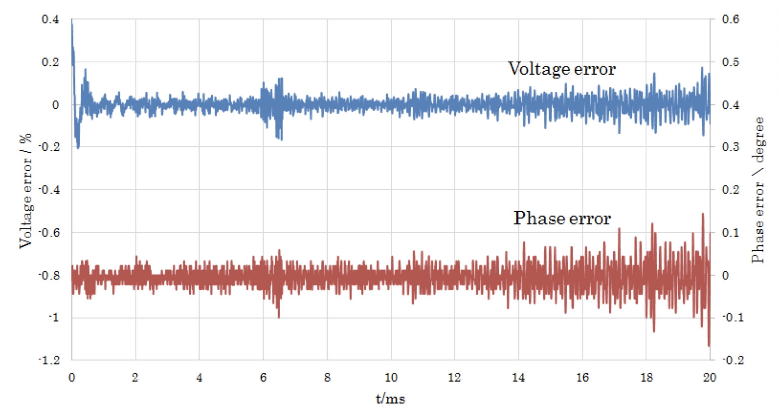
Dynamic tuning system
Amplitude and Phase error in 1 cycle

Slide 51
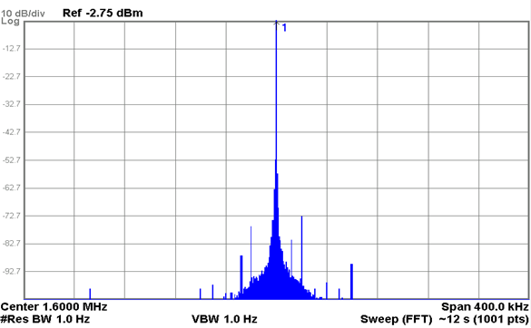
Dynamic tuning system
In practice, SSWB is the most important technical indicator.
Not like the power supply used in magnet system, the requirement of tracking precision could be relaxed due to the existence of tuning control system.
The voltage ripple doesn’t seem to affect the cavity voltage.

Slide 52
Future plan

Slide 53
Future plan
System running and beam commissioning
20～25kW running
50～100kW
Beam control loops
Beam loading compensation
Synchrotron oscillation damping
Second harmonic system-500kW
Manufacture of MA ring
Cavity design
High power test
LLRF
New digital platform based on OpenVPX

Slide 54
Thank you for your attention!

