Slide 1
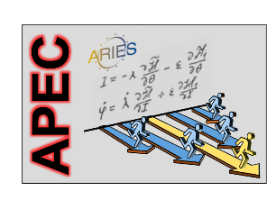
transverse beam instability
and Landau damping
head-tail tune shifts
Landau damping
electron cloud
RF quadrupole
second order chromaticity
Frank Zimmermann, APEC 2018 Frankfurt, 11 December 2018
Work supported by the European Commission under Capacities 7th Framework Programme, Grant Agreement 312453

Slide 2
1. coherent coupled-bunch head-tail tune shifts and growth rates
Sacherer formalism
effective impedance
$$ω_{ξ}≡\frac{Q′ω_{β}}{η}$$
Gaussian weight function
simplified expression for
denominator

Slide 3
2. Landau damping
effect occurs in systems consisting of a high number of
oscillators having different oscillation frequencies and
performing a collective motion
L.D. Landau, 1946, J. Phys. USSR 10 (1946)
plasma physics
N.G. van Kampen, 1955, Physica 21 (1955)
mathematics
C.E. Nielsen, A.N. Sessler, K.R. Symon,
HEACC Geneva (1959)
accelerator physics
R.D. Kohaupt, “What is Landau Damping?
Plausibilities, Fundamental Thoughts, Theory”
DESY M-86-02
accelerator physics
the beam is Landau damped if the decay time due to the frequency spread is ‘shorter’ than the instability rise time

Slide 4
frequency distribution
centroid
linear “wake force”
Bromwich integral
(all singularities above
the path C)
Fourier-Laplace-transform
z
α
C

Slide 5
initial conditions
cut
–ω(η_{max})<Rez<ω(η_{max})
singularities at z_{k}
analytic otherwise
z_{k}
cut
C

Slide 6
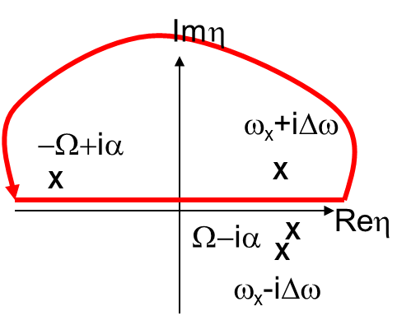
example:
Lorentz spectrum

Slide 7
singularities z_{k} in the upper z-plane describe coherent
stability and those in the lower z-plane coherent
instability; the z_{k} correspond to solutions of
the integral has a finite value for any reasonable
frequency distribution for all z values
there is no solution to (1) for small W!
interpretation: system cannot organize a
collective motion if interaction not strong enough

Slide 8
dispersion relation
α>0: instability growth rate, α->0: border of stability
consider α=0
absolute value of dispersion relation simplifies to |Δω_{coh}|=Δω
if coherent tune shift less than Δω, the beam is stable

Slide 9
with coherent and incoherent wake field:
Fourier-Laplace-transform of impulse excitation:
e.g.
Yokoya factors for flat chamber
dispersion relation including Yokoya factors
$$=$$

Slide 10
general case including incoherent wake field
Fourier-Laplace transform

Slide 11
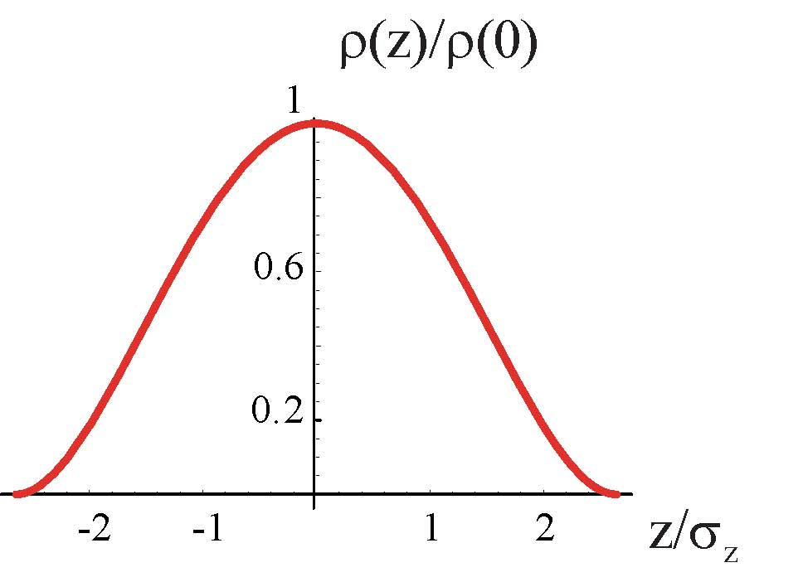
3. stability diagram with pinched electron cloud
model: quasi-parabolic profile
assumed
bunch
profile
linear tune shift along the bunch
ΔQ
ΔQ_{ec,max}
→
assumed e-cloud
tune shift along bunch
z
→
F. Zimmermann, 2006 – unpublished

Slide 12
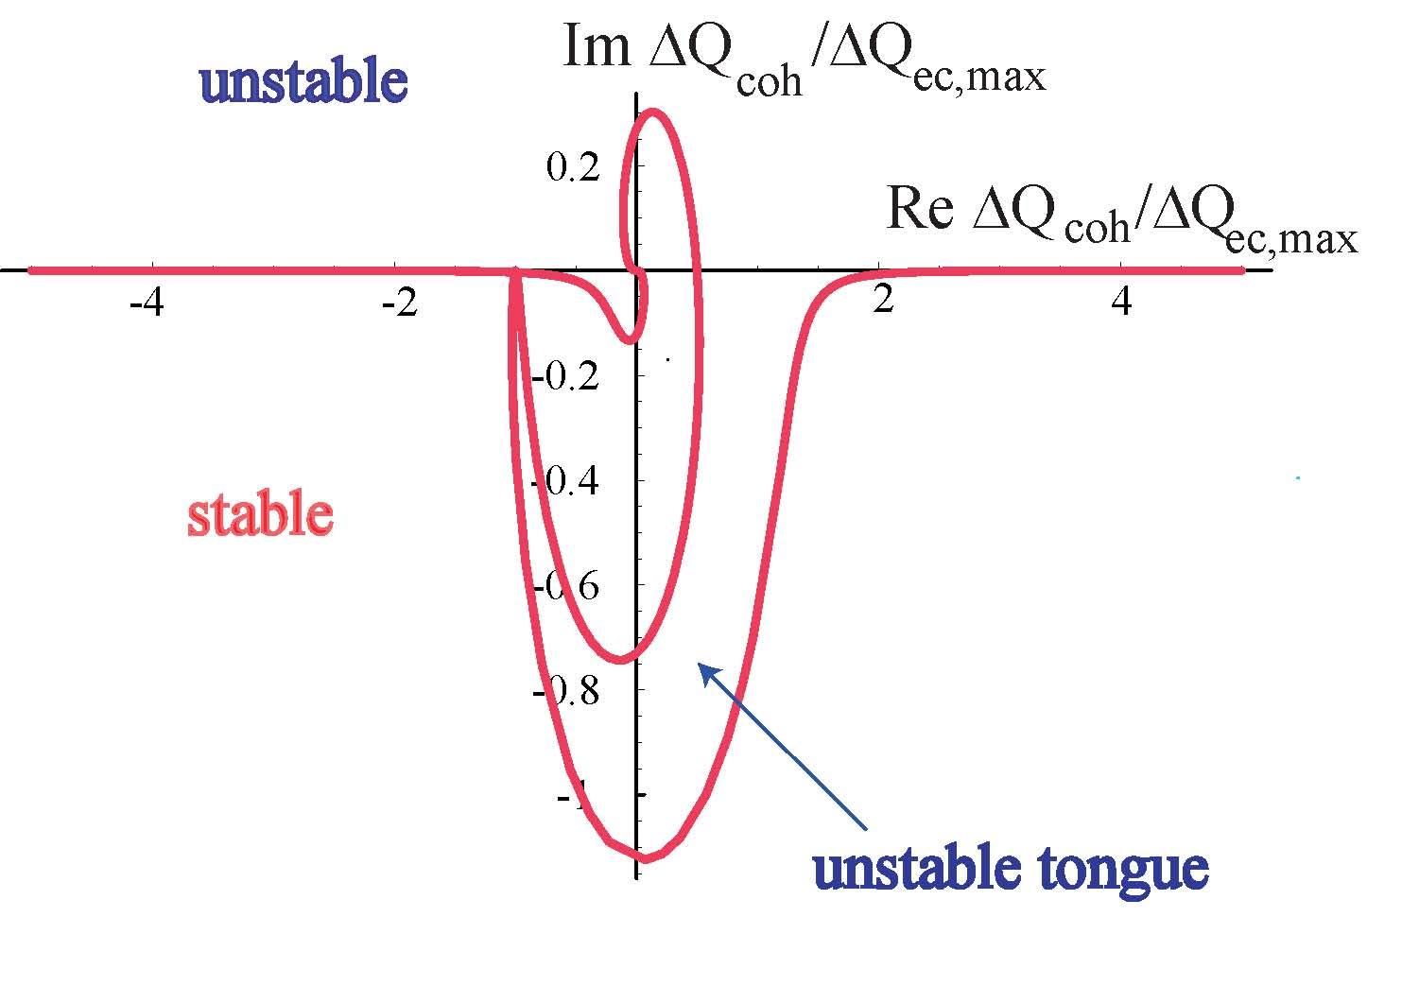
combine results from Hereward, Möhl-Schönauer, Chao, Metral-Ruggiero
& assume synchrotr
period is long compared with
instability rise time
→
dispersion relation
though e- potential moves with beam, the e-cloud alone creates non-trivial stability diagram!??
trace when ΔQ
runs along real axis;
computed by
Mathematica
note: ΔQ_{ec,max} can be huge ~0.1-0.2!
F. Zimmermann, 2006 – unpublished

Slide 13
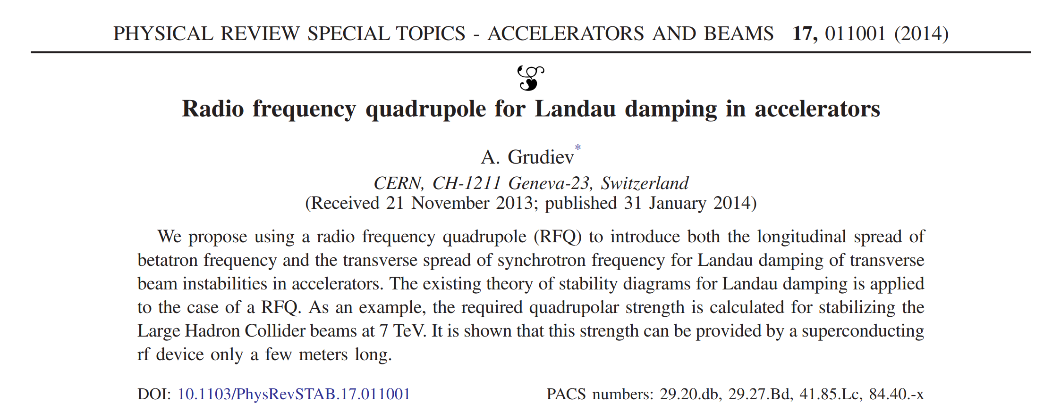
4. RF quadrupole

Slide 14
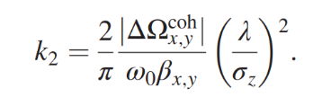
A. Grudiev
$→$betatron tune spread
after averaging over synchrotron period
effective strength
$→$synchroton une spread
strength required
to damp instability
with growth rate ΔΩ

Slide 15
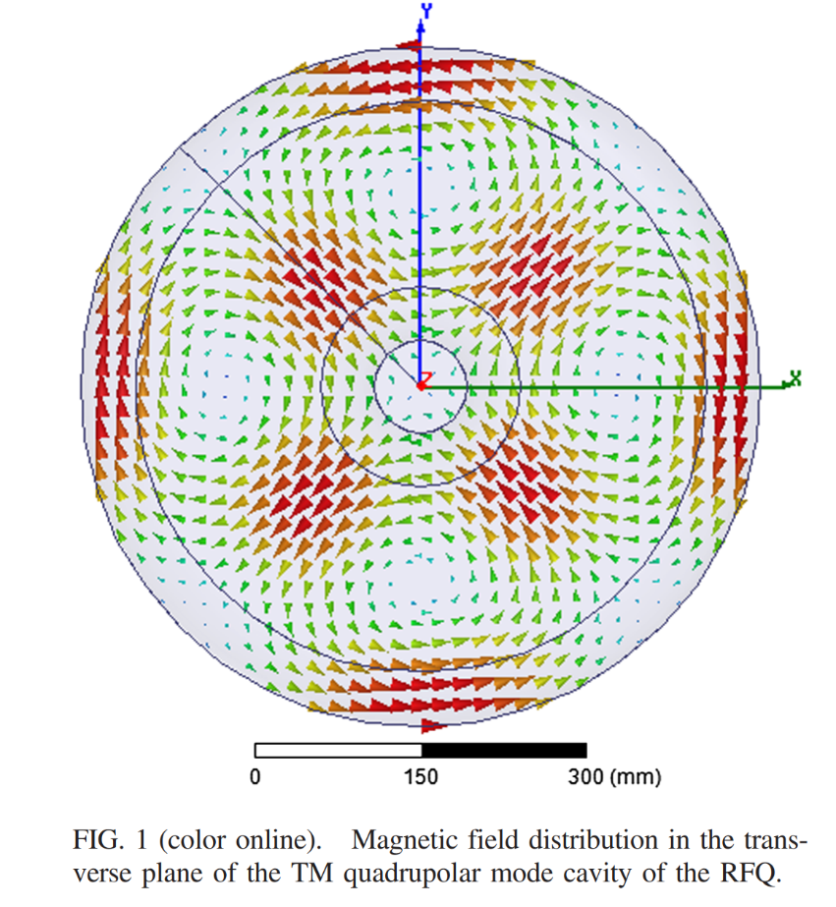
one 1 m long 800 MHz RF quadrupole equivalent to
56 m of magnetic octupoles in the LHC
A. Grudiev

Slide 16
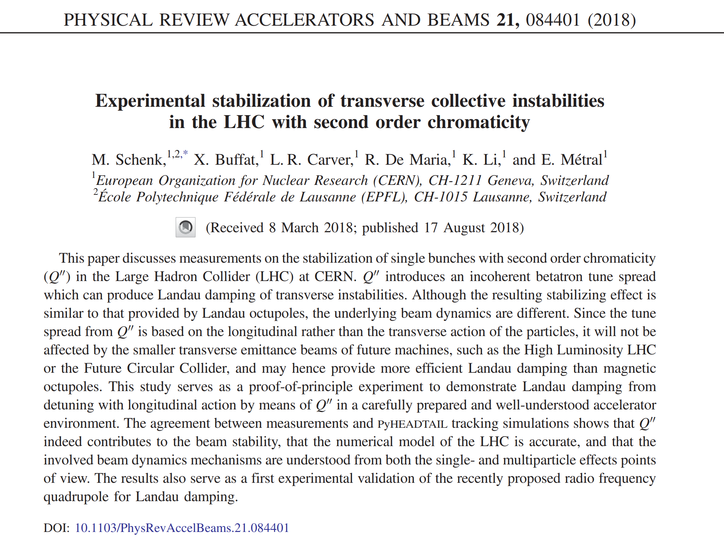
5. second order chromaticity

Slide 17
after averaging over synchrotron period
after averaging over T_{s} equivalent to RF quadrupole with bunch length <<c/ω
M. Schenk et al.

Slide 18
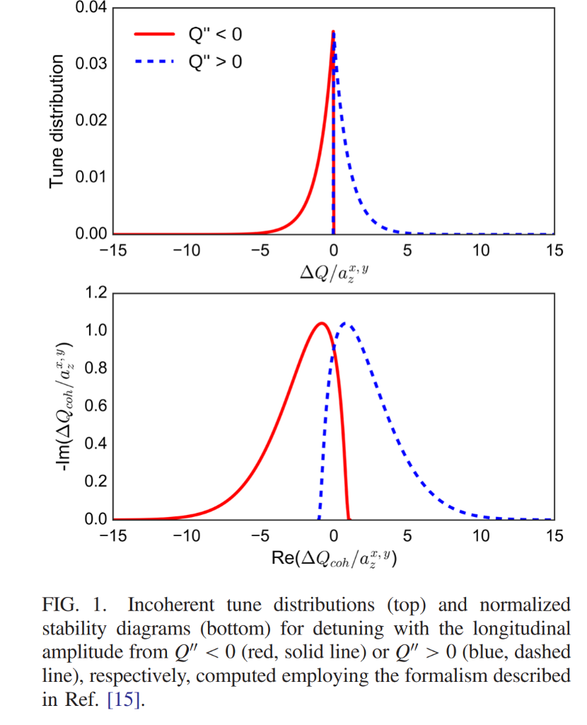
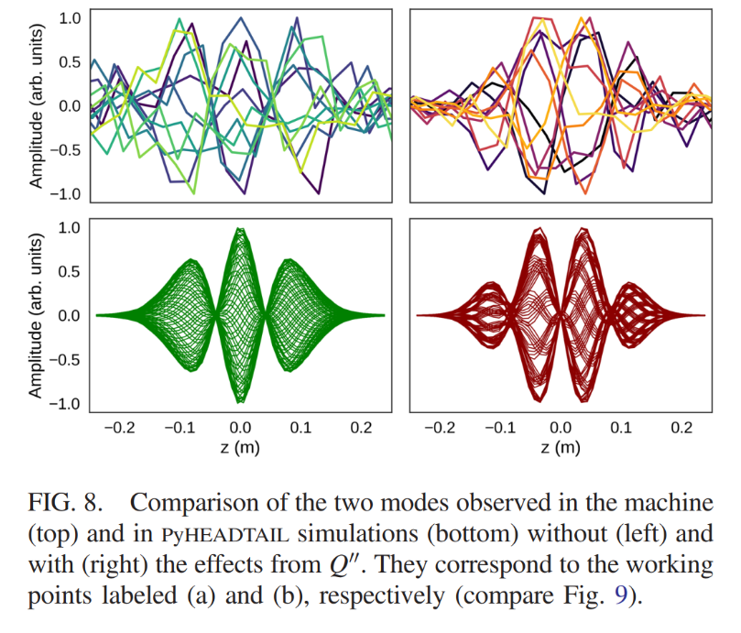
M. Schenk et al.

Slide 19
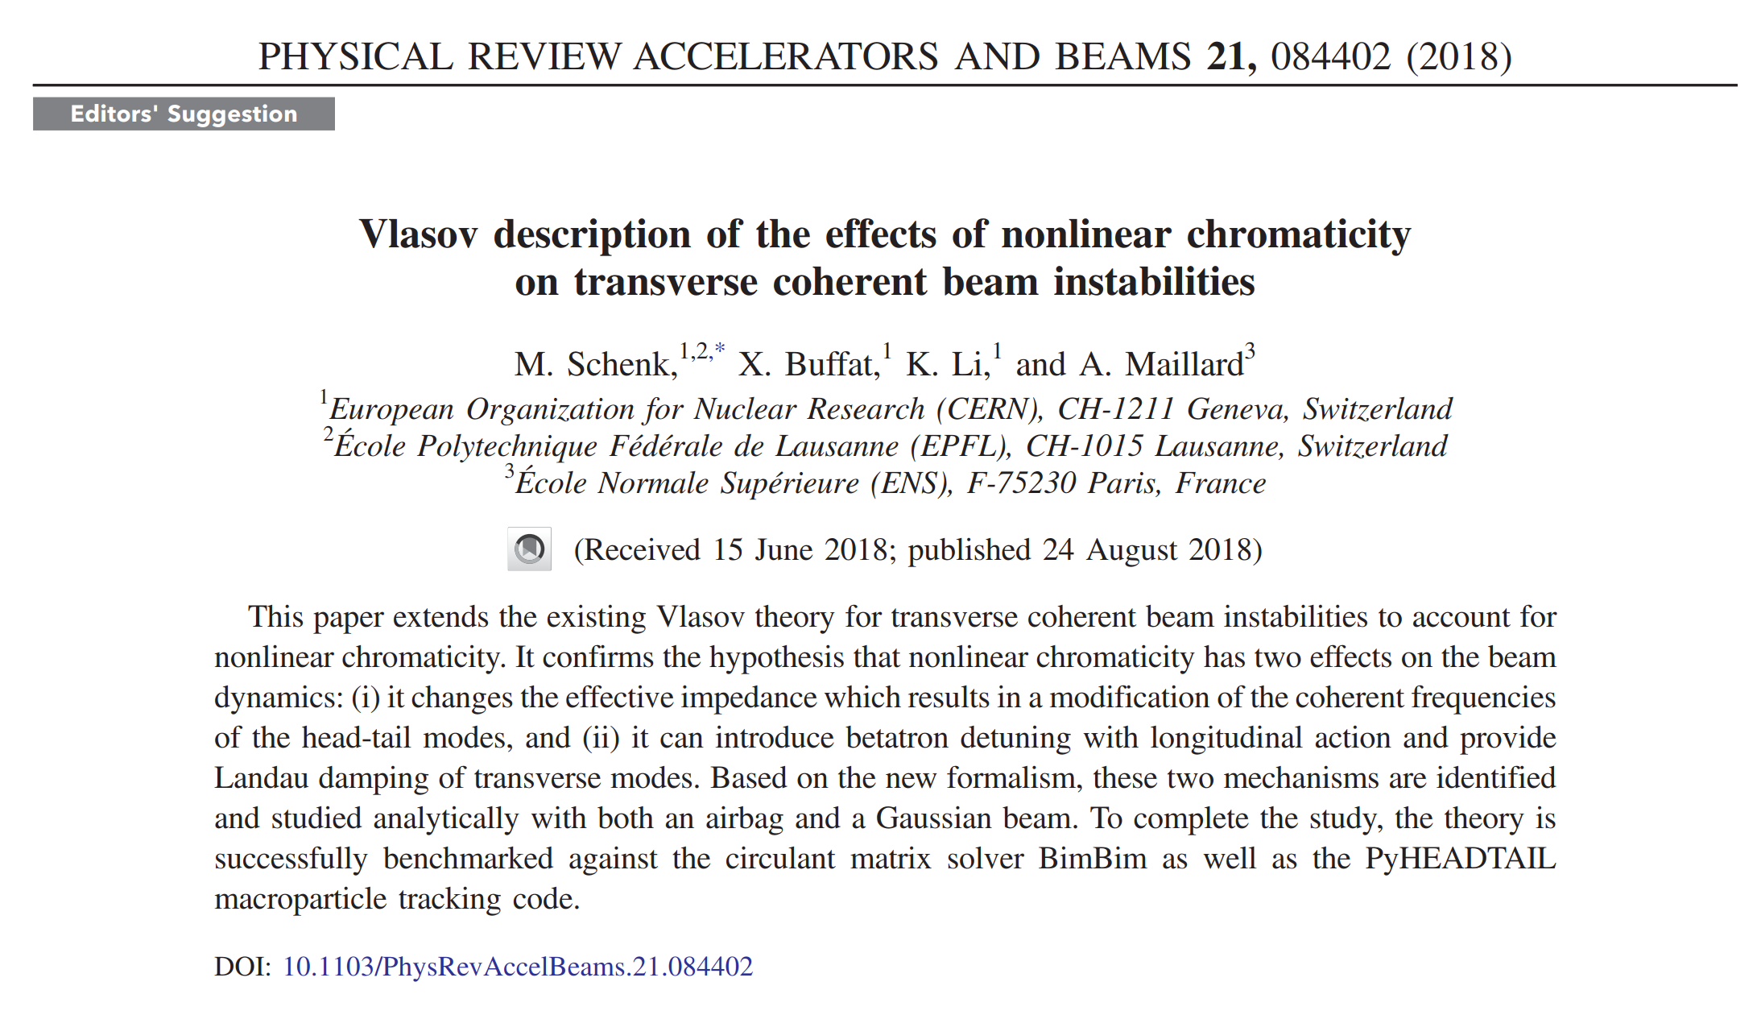

Slide 20
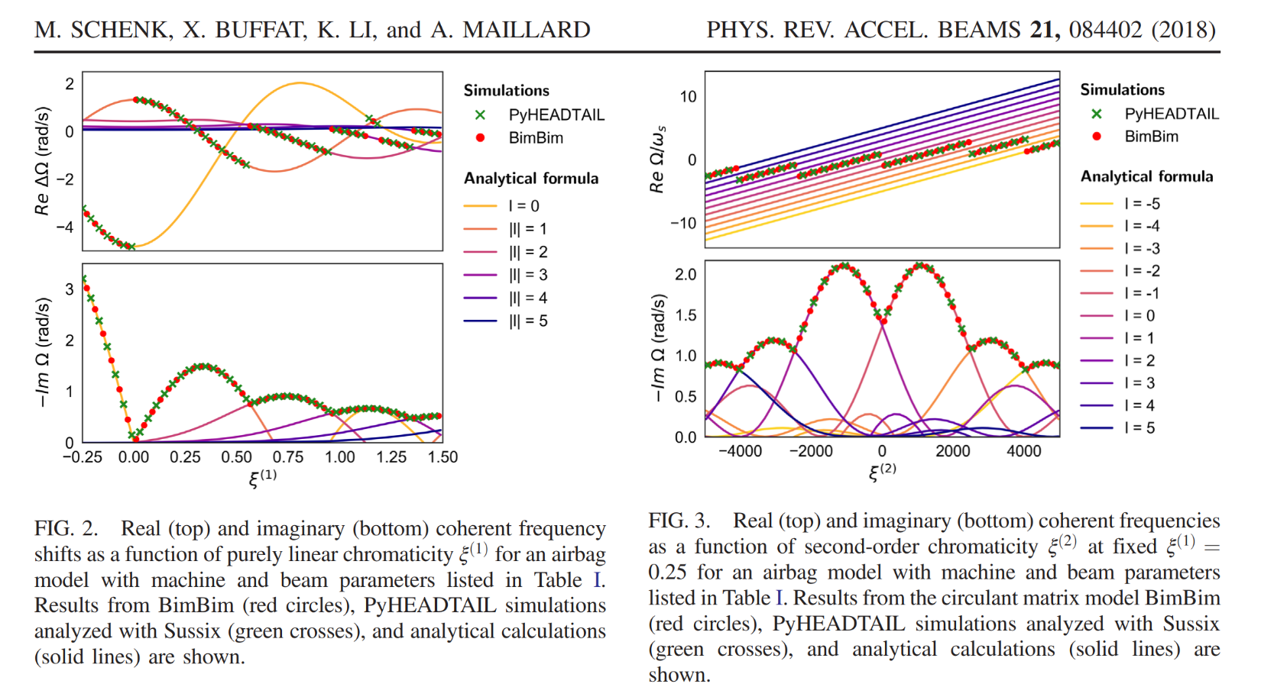

Slide 21
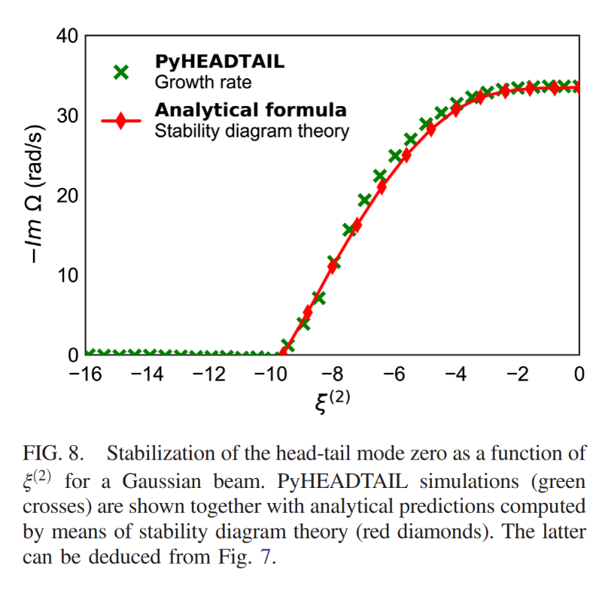
Q’’ changes both Landau damping and the effective impedance !
M. Schenk et al.

Slide 22
conclusion
already 72 years of age, Landau damping still is an extremely active field of development !
additional references and acknowledgements:
in 1999 S. Fartoukh raised the question on the effect of second order chromaticity on coherent beam instabilities in the LHC
In 2000 S. Fartoukh, and J.B. Jeanneret proposed the use of RF quadrupoles for the CLIC final focus

