Slide 1
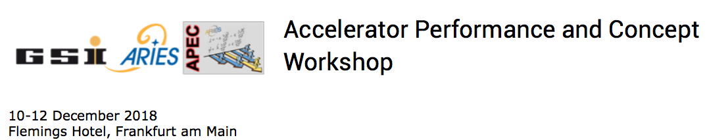
Machine Learning at SNS for Prevention of Errant Beam
W. Blokland†, M. Rescic*, C. Peters†, T. Southern†, R. Archibald†
†ORNL, USA
*University of Huddersfield, UK
This manuscript has been authored by UT-Battelle, LLC, under Contract No. DE-AC05-00OR22725 with the U.S. Department of Energy. The United States Government retains, and the publisher, by accepting the article for publication, acknowledges that the United States Government retains a non-exclusive, paid-up, irrevocable, world-wide license to publish or reproduce the published form of this manuscript, or allow others to do so, for United States Government purposes. The Department of Energy will provide public access to these results of federally sponsored research in accordance with the DOE Public Access Plan (http://energy.gov/down- loads/doe-public-access-plan).
.

Slide 2
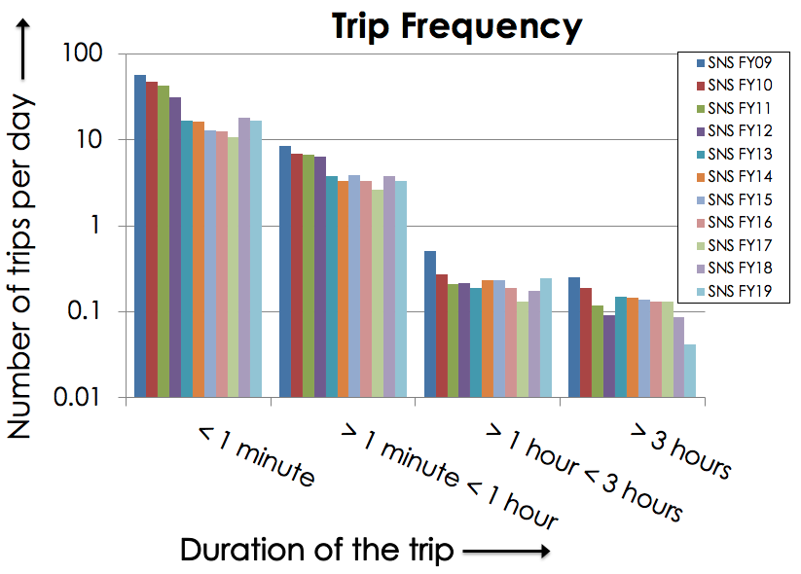
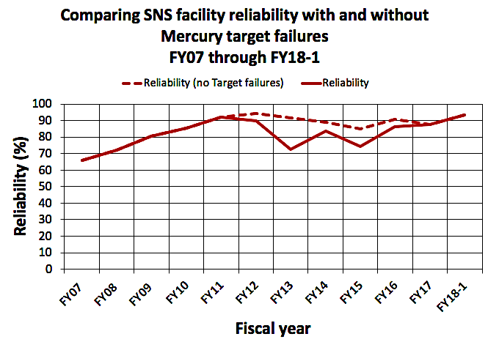
Introduction
The Spallation Neutron Source uses an accelerator to produce neutrons for research
  The Research Accelerator Division’s main task is to deliver these neutrons as scheduled with minimal interruptions to the research program
  We want to see if Machine Learning can minimize the interruptions or down-times due to errant beam
    This talk discusses the available data and initial results of applying Machine Learning to prevent errant beam
  We are also evaluating Machine Learning to improve the SNS target
A major cause for short trips is errant beam
Effect of target failures on reliability

Slide 3
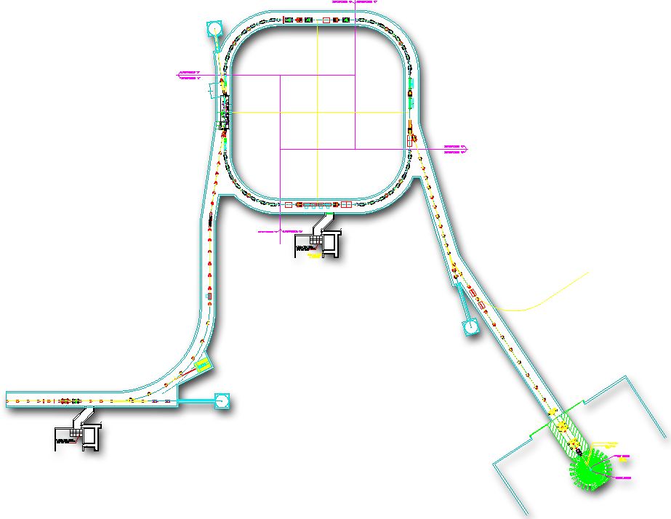
Spallation Neutron Source Complex
Power on Target | 1.4 MW at 1.0 GeV
Pulse on Target | 1.5 E14 protons (24µC)
Linac macro-pulse | ~1000 minipulses of ~24mA avg @1ms at 60Hz
H⁺
Current
Ring
1ms
H⁺
Current
H⁺
Linac
Beam current data
2.5 MeV
87 MeV
186 MeV
387 MeV
1000 MeV
670ns
Target strain data
H⁻
RFQ
DTL
CCL
SCL β=0.61
SCL β=0.81
Target
Source
MEBT
945 ns
Mini pulse
Current
N
Flux
1 ms macro-pulse

Slide 4




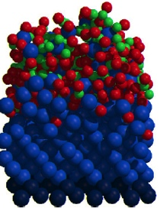
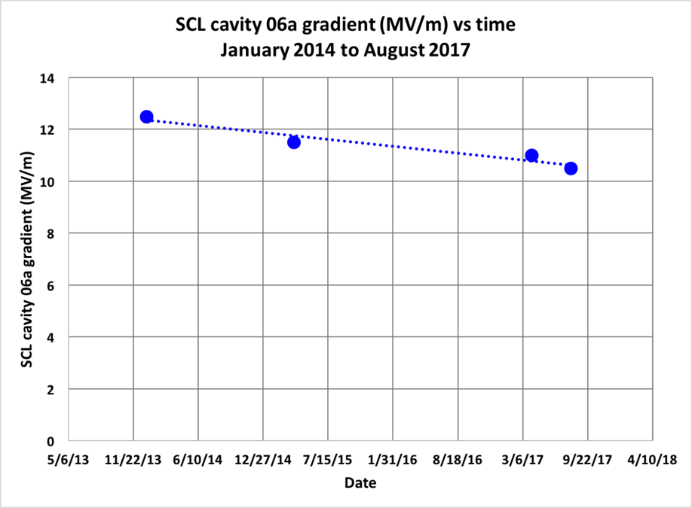
Errant Beam at SNS
Ion, molecule (radical), electron
contaminants
Errant (undesirable) beam increases downtime
  Variations in beam pulse intensity
    Source issues
  Beam losses
    Warm linac: no degradation yet
    Cold linac: cavity degradation
Many causes for errant beam
  RF Issues in warm linac
  Source
  Other equipment glitching
Errant Beam reduction program started 2013
  Many issues (hardware, tuning, etc.) were identified and solved or improved
  Shorten the abort times when beam loss is detected in the SCL
base material
Picture by S. Kim
Graph by C. Peters
Cavity gradient lowering to maintain reliability

Slide 5
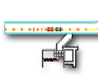


Protecting the Super Conducting Linac
The choice was to implement a single differential BCM with current measurement right before (CCL) and after the SCL (HEBT)
  In place of upgrading many Loss Monitors and the Machine Protection System(MPS) modules
  We use the PXI Platform with LabVIEW Real-time and FPGA
  FPGA needs about 1-2 µs to decide
  Signal and beam propagation and chopper timing, adds 5-6 µs
Linac
CCL102
HEBT01
RFQ
DTL
CCL
SRF, β=0.61
SRF, β=0.81
Amp
Source
MEBT
Electronics
Buildings
Amp
Abort signal
Digitizer FPGA
Differential Current Monitor

Slide 6
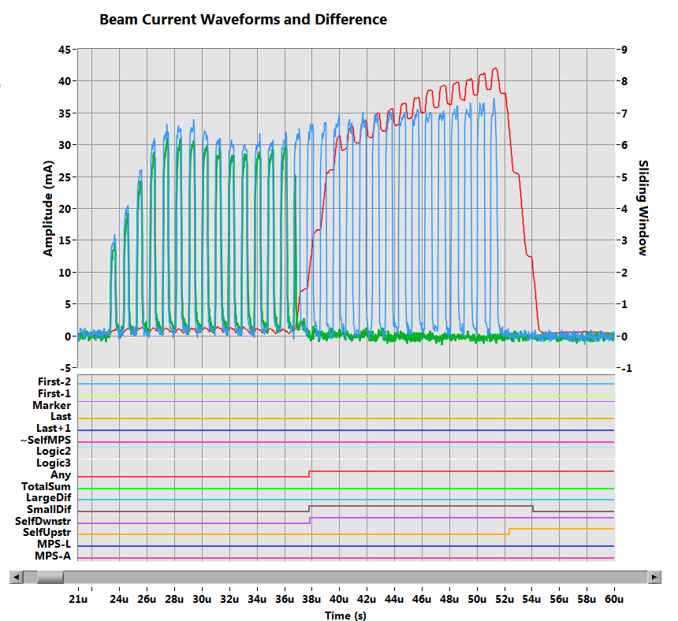
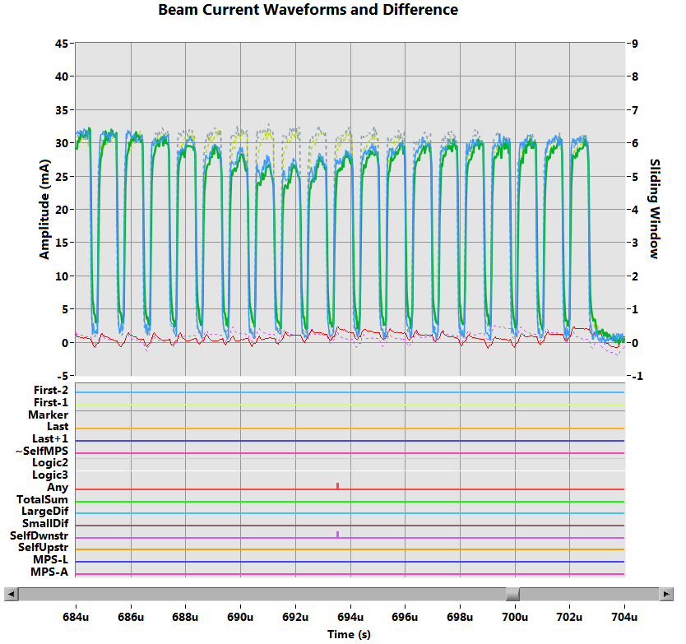

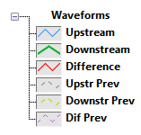
Errant Beam Data for Machine Learning
Alert to MPS
Alert on small window difference
Alert to MPS
Alert on pulse-to-pulse downstream
Alert on pulse-to-pulse downstream
Alert on pulse-to-pulse upstream
Errant Beam with losses in the SCL
Errant Beam with slow drop in current before SCL

Slide 7
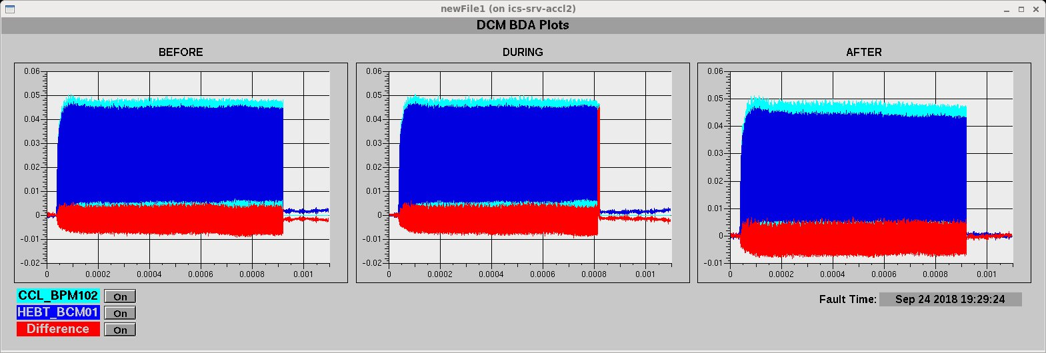
Errant Beam Data for Machine Learning
Currently installed systems are all reactionary to equipment malfunctions that cause Errant Beam
DCM is fastest for losses in the SCL but cannot go faster than signal and beam propagation times
Can we predict errant beam and avoid the bad pulse all together?
DCM saved data before and after the bad pulse
Use this data to train Machine Learning Algorithms!
Before, During, and After beam pulse on an errant beam pulse with losses

Slide 8

Machine Learning on Errant Beam Data
Collaboration with Miha Reščič (Analysis, PhD student with Rebecca Seviour)
Initial analysis with DCM datasets from:
Data set | Pulse waveform length | Number of pulses | Dates
A | 25000 | 1540 | 2015-02-28, 2015-03-01, 2015-03-18, 2015-03-28, 2015-03-29, 2015-03-30
B | 100000 | 490 | 2015-05-05, 2015-05-28
C | 25000 | 1400 | 2015-08-25
D | 25000 | 2640 | 2015-10-25, 2015-10-26, 2015-10-27 2015-10-28, 2015-10-29

Slide 9

Machine Learning on Errant Beam Data
Data analytics: getting to know your data
  - Limited data set for exploration
Initial no-ML techniques applied
  Hidden Markov Models, Electronics Network Frequency Criterion
    No promising results
Initial ML Methods (supervised)
  K-Nearest Neighbors algorithm
  Decision Trees
  Naïve Bayes (no promising results)
  Preprocessing:
    Principle Component Analysis
    Feature extraction to compose datasets

Slide 10
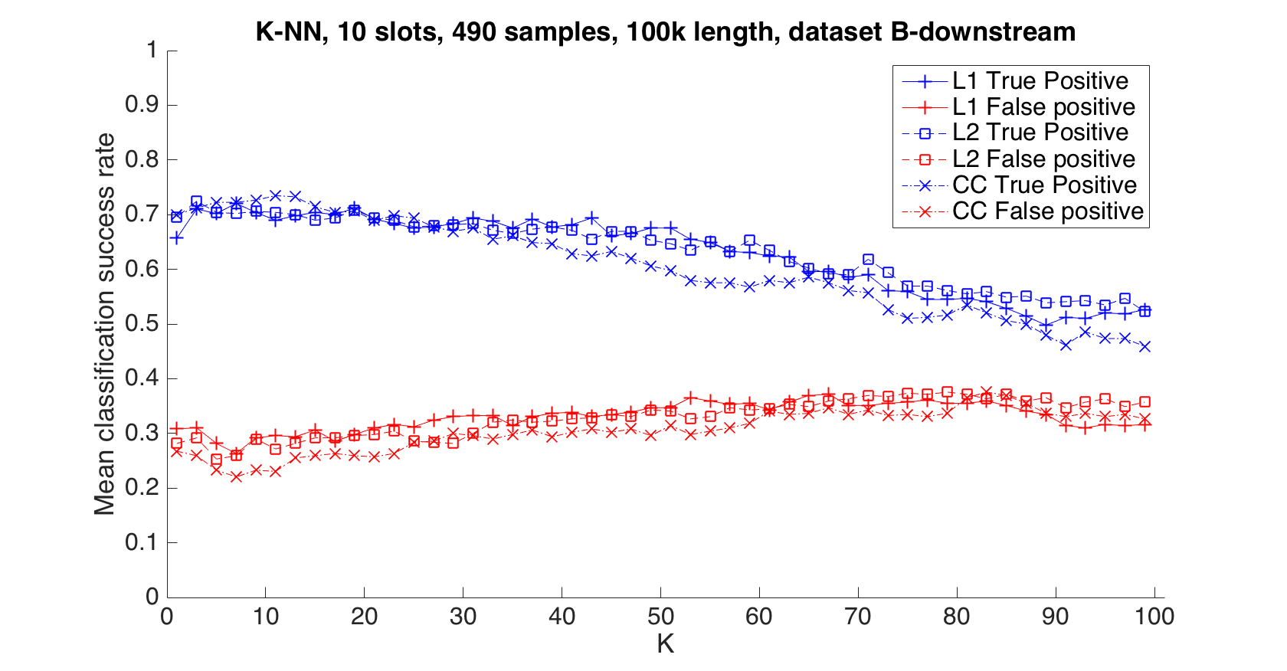
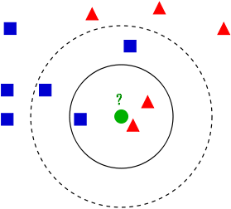
K-NN Method
Initial Results using different distance functions L1, L2, and CC
Very typical of K-NN is to get better success when increasing K at first but eventually for large K it should go to 50% with equal good and bad pulses
At 75% success rate we would abort too many good pulses
Credit: Wikipedia
Assign new data point class based on distance to training set data points
K-NN Plot

Slide 11
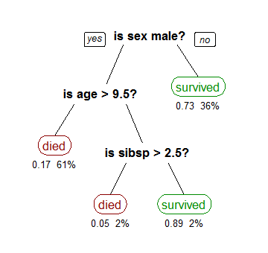
Decision Tree
True Positives Results
Dataset | K-NN TP (var) | Decision Tree TP (var)
A upstream | 0.60 (0.04) | 0.58 (0.02)
A downstream | 0.52 (0.03) | 0.55 (0.04)
B upstream | 0.74 (0.04) | 0.63 (0.06)
B downstream | 0.69 (0.05) | 0.53 (0.05)
C upstream | 0.70 (0.03) | 0.72 (0.03)
C downstream | 0.54 (0.02) | 0.65 (0.02)
D upstream | 0.76 (0.03) | 0.73 (0.01)
D downstream | 0.55 (0.02) | 0.60 (0.01)
Credit: Wikipedia
Decision trees (DT) are a non-parametric supervised learning method used for classification.
Classification is performed by traversing a tree-like structure created in the learning process
Initial results of decision tree are not better

Slide 12
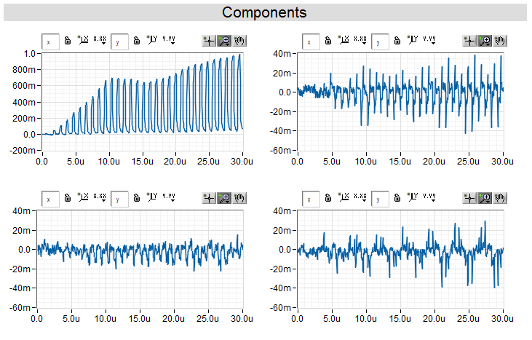
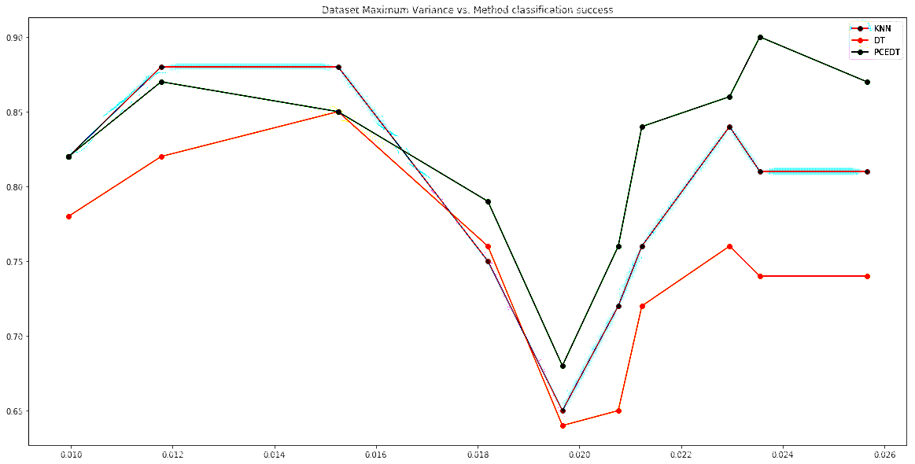
Preprocessing
Adding Principle Component Analysis
  To use components weights instead of current waveforms
Credit: Wikipedia
PCA is a statistical procedure that uses an orthogonal transformation to convert a set of possibly correlated variables into a set of values of linearly uncorrelated variables called principal components (Wikipedia)
First four components
Adding feature selection based on Variance
  To split datasets
  → Some datasets might have a different errant beam cause or issues with the data
True positive % →
Variance in data →
Success depends on variance

Slide 13
Initial Results
Preprocessing and features selection improves the results
This indicates that we can predict (some types of) errant beam
  But this is on a limited data set from the past, accelerator is different now
  Results vary and we desire higher accuracy (we could focus on pulses with higher certainty)
  We want to tie ML results with a physical explanation (e.g. what equipment failed)
Apply PCA
Apply Feature Selection
Dataset | K-NN TP (var) | D. Tree TP (var)
A upstream | 0.60 (0.04) | 0.58 (0.02)
A downstream | 0.52 (0.03) | 0.55 (0.04)
B upstream | 0.74 (0.04) | 0.63 (0.06)
B downstream | 0.69 (0.05) | 0.53 (0.05)
C upstream | 0.70 (0.03) | 0.72 (0.03)
C downstream | 0.54 (0.02) | 0.65 (0.02)
D upstream | 0.76 (0.03) | 0.73 (0.01)
D downstream | 0.55 (0.02) | 0.60 (0.01)
Dataset | K-NN TP (var) | D. Tree TP (var)
A upstream | 0.60 (0.03) | 0.77 (0.03)
A downstream | 0.52 (0.03) | 0.65 (0.04)
B upstream | 0.74 (0.04) | 0.75 (0.05)
B downstream | 0.69 (0.04) | 0.71 (0.06)
C upstream | 0.70 (0.02) | 0.78 (0.06)
C downstream | 0.54 (0.02) | 0.65 (0.02)
D upstream | 0.76 (0.03) | 0.89 (0.06)
D downstream | 0.56 (0.01) | 0.87 (0.02)
Dataset | K-NN TP (var) | D. Tree TP (var)
C upstream set 1 | 0.64 (0.03) | 0.65 (0.08)
C upstream set 2 | 0.75 (0.04) | 0.65 (0.07)
D upstream set 1 | 0.68 (0.04) | 0.90 (0.02)
D upstream set 2 | 0.82 (0.03) | 0.94 (0.02)
→
→

Slide 14
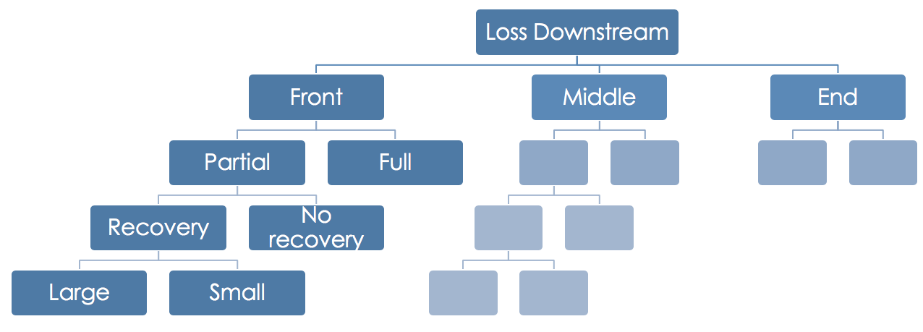
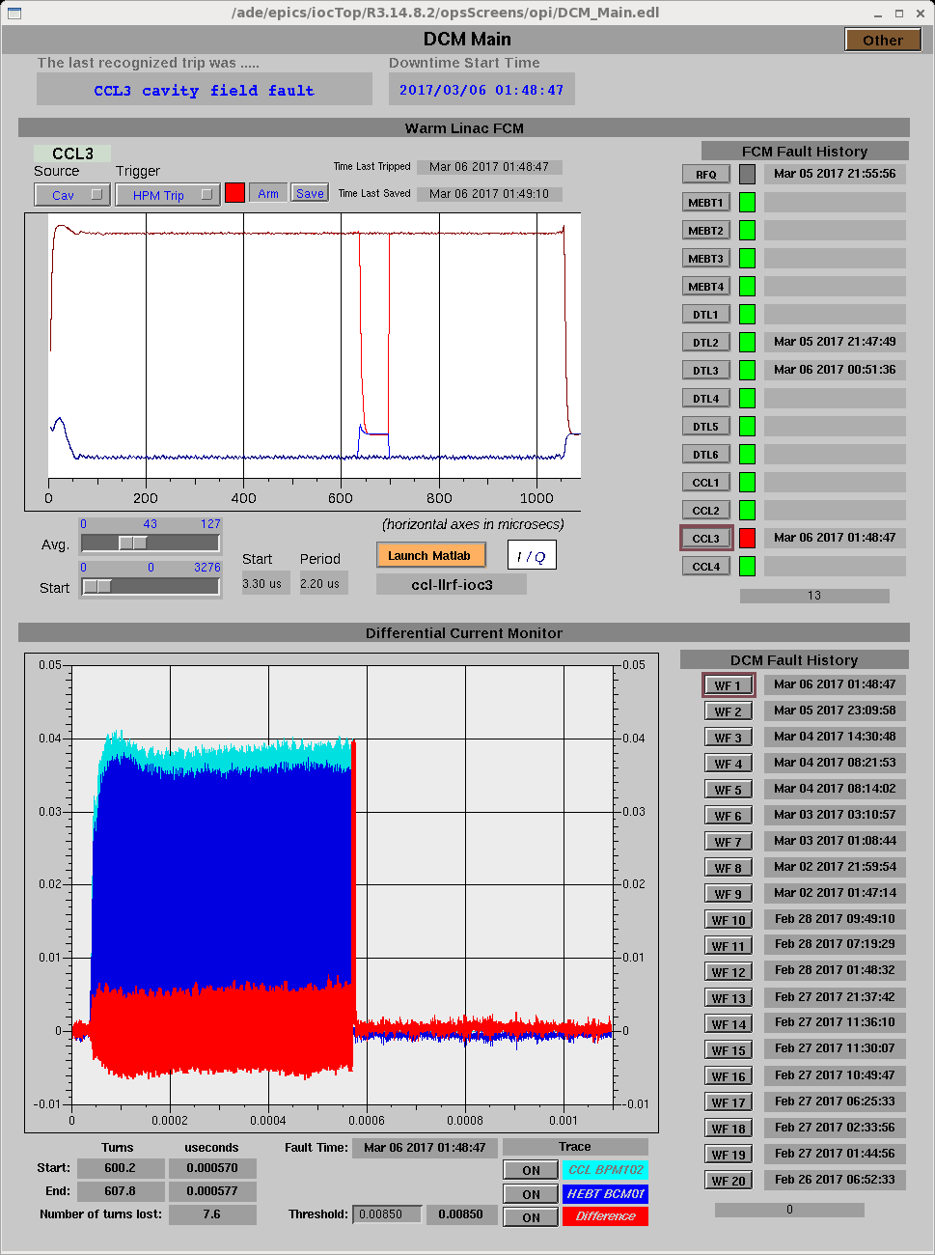
Next steps
Improve the training sets
  Classify training set
    Machine Protection System (MPS) data
    Types of losses: warm or cold linac, total or partial, etc
  Add additional accelerator data e.g. RF waveforms
Apply ML within the errant beam pulse
Test other ML techniques
  Neural networks (these can operate very fast on FPGA)
Implement Machine Learning on Errant Beam softIOC
  Python, Libraries like Scikit-Learn, HDF5 data formats
Beam loss classification
MPS and other accelerator data
Different Current Monitor data
EPICS softIOC to collect all data

Slide 15
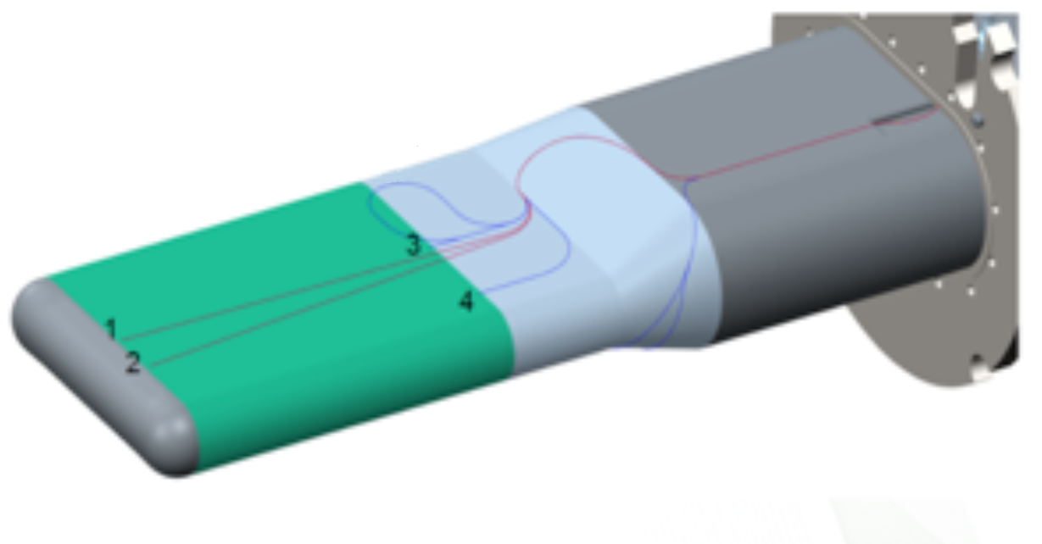
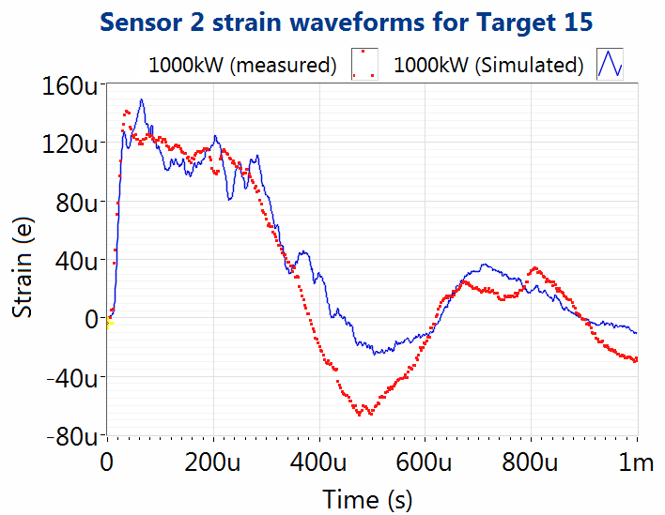
SNS Target Machine Learning
Improve target performance and reliability
We want better simulation to built better targets
  Can simulate for about 1 ms after beam impact but after that model and measurements disagree
  No model yet for gas injection: cloud formation
Use Machine Learning, data analytics, and super computing to improve the simulation
  Use ORNL HPC for target simulation and ML techniques find best parameters for simulation based on the strain measurements
Detect events in the target
  Structural changes
Sensor locations on the Target 15 topside
Strain data and simulation during beam pulse impact at different beam powers

Slide 16
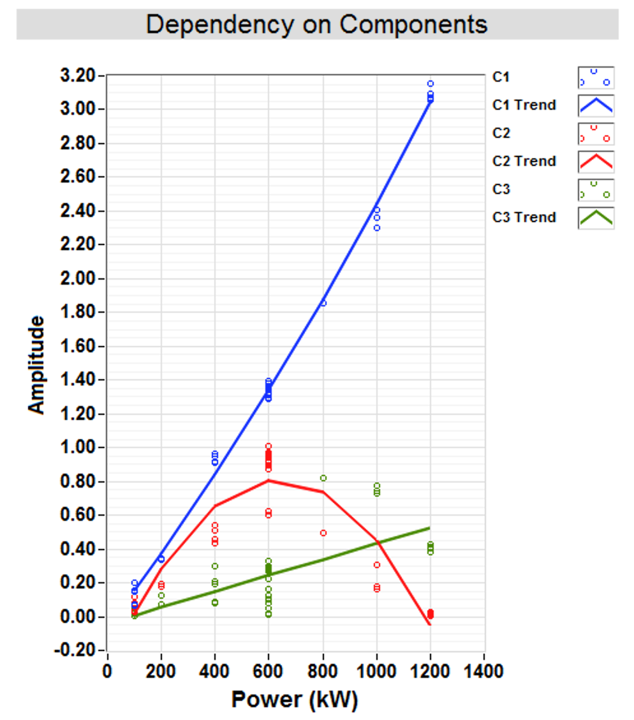
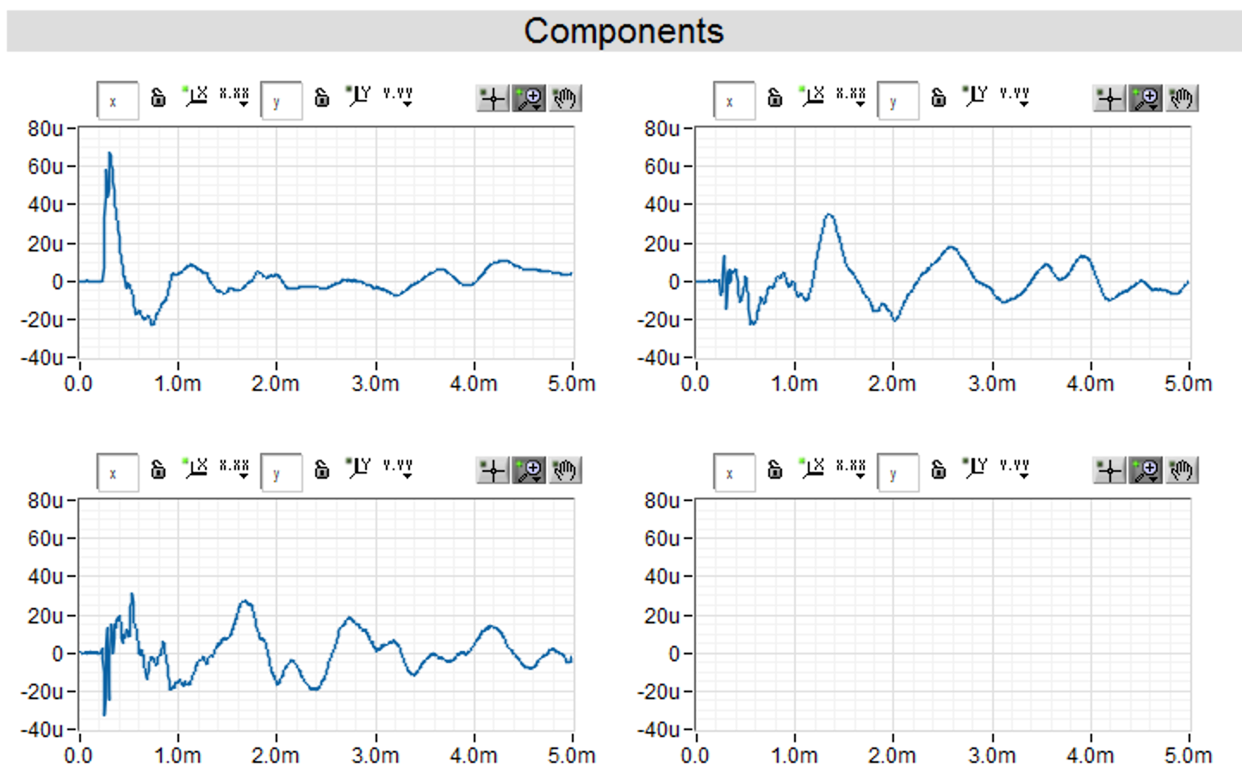
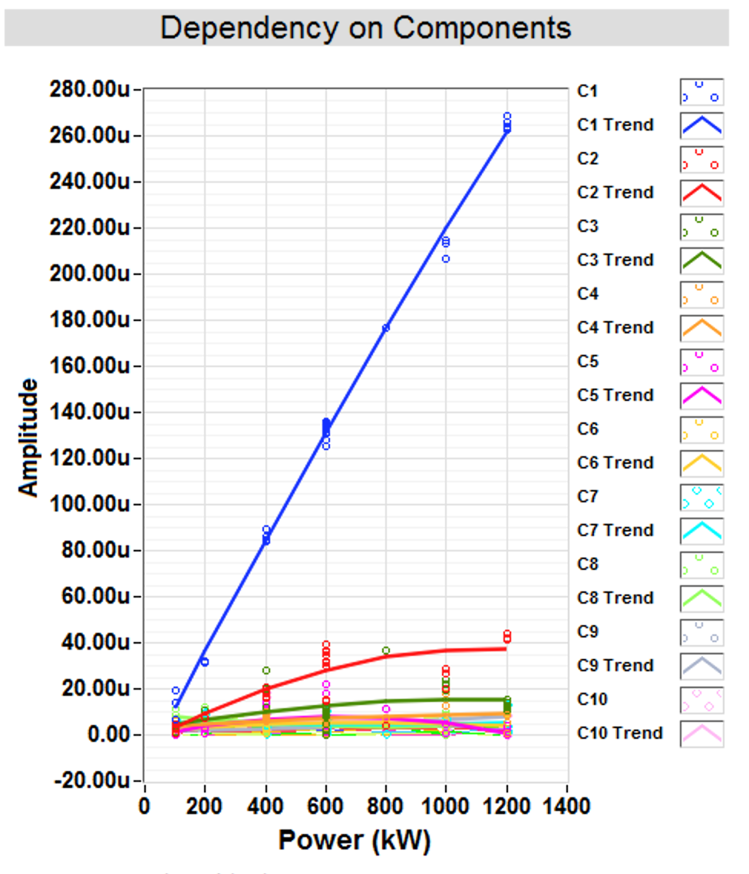
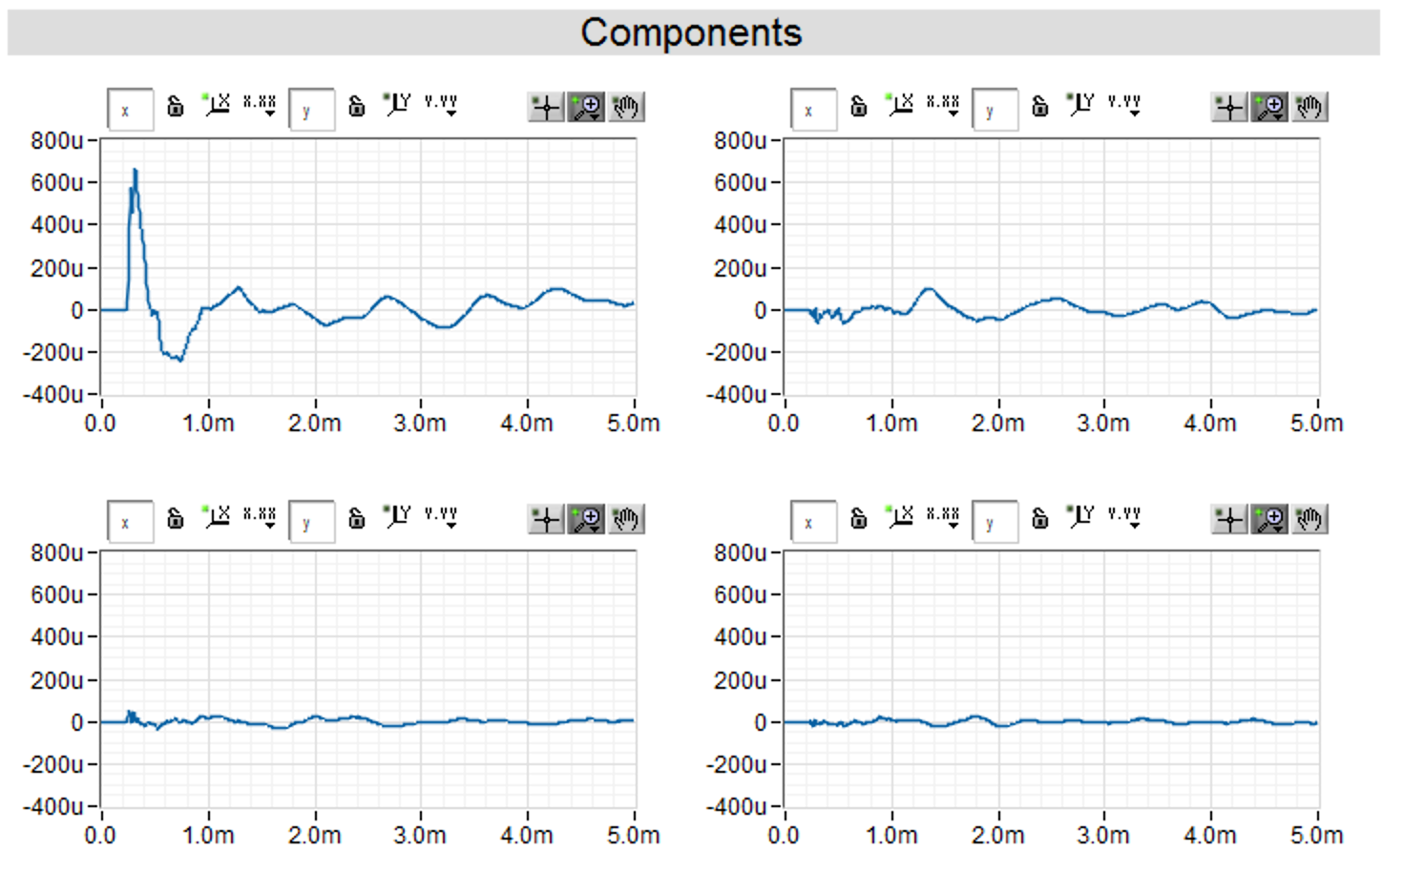
Target Machine Learning
Data exploration/analytics stage
  Collaboration with ORNL computing
  Do we see non-linear behavior versus beam power?
    Hypothesis is that initial strain is linear but secondary response is non-linear and saturates (cloud formation)
We do see non-linear components that decrease with the higher beam powers
  Fast increasing strain components could cause target problems with Proton Power Upgrade but don’t seem present
ICA components
ICA components vs beam power
PCA components
Note: Components contribution normalized to peak to peak of weighted component
PCA components vs beam power

Slide 17
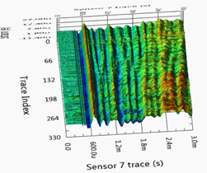
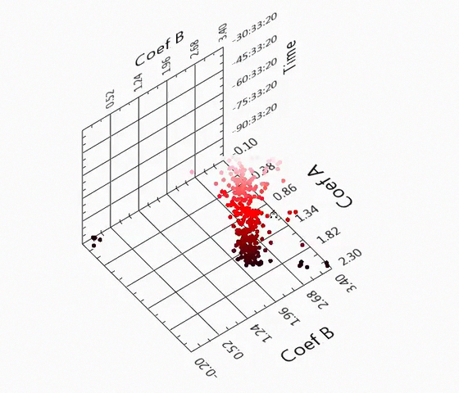
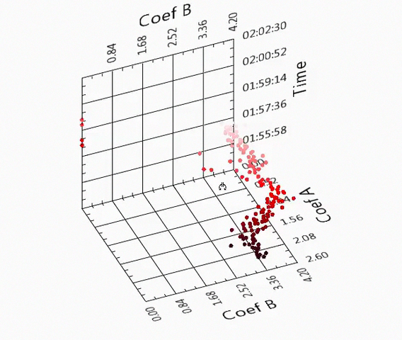
Target Machine Learning
Can we detect events with Machine Learning?
  Just applying ML clustering on strain didn’t find clusters but ARMA model coefficients shows there is info we can feed to Machine Learning algorithms
Event shows in both sensors
T14 Data
(~4 weeks)
from Sensors 4&7
Strain waveforms over time
Coefficients Before event
Coefficients During event

Slide 18
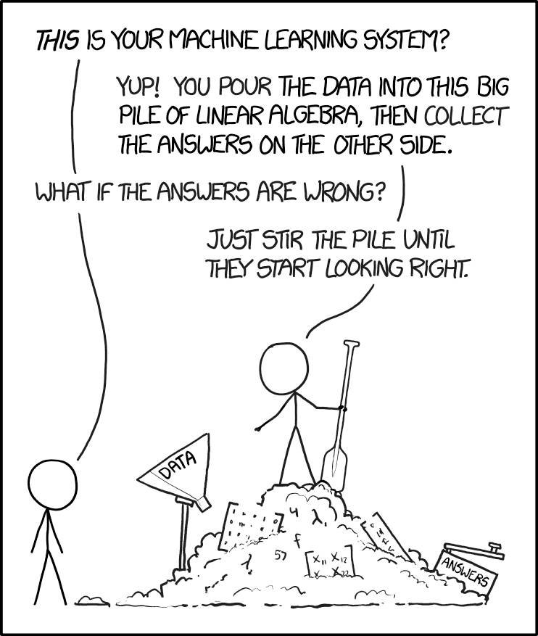
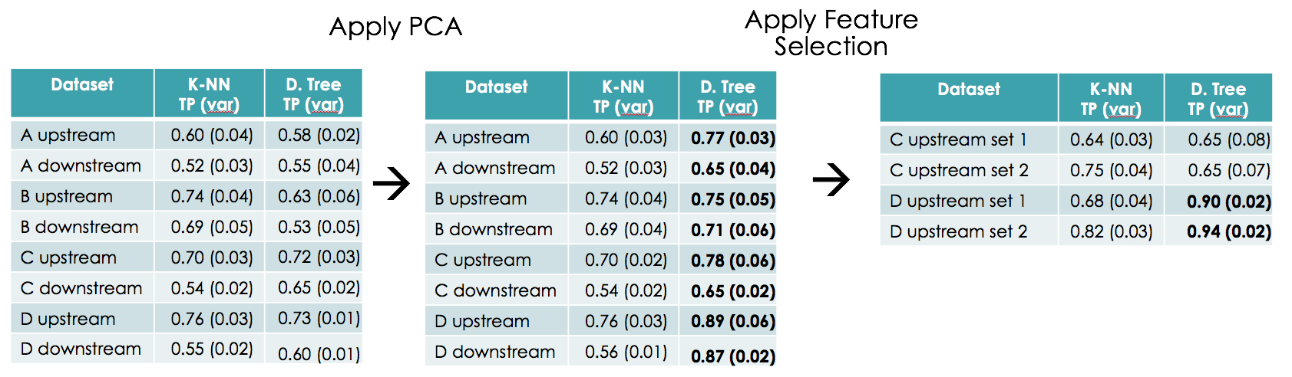
Summary
A limited dataset has been analyzed to find errant beam precursors with ML techniques
  We have a promising results on limited data
    Improvements in analysis and data sets will be made
    Bringing analysis on-line
  Going through the ML process teaches you quite a few things about your data and generates ideas, even outside of ML to improve accelerator operations
Working on Target Machine Learning: SCRUM week to determine scope
https://xkcd.com/1838/

Slide 19
QUESTIONS?

