Slide 1
Experience based adjustments of the usual approaches for a fast and stable control of multi-purpose Accelerators
S. Reimann
Contains the work of W. Geithner, S. Appel, M. Sapinski, R. Steinhagen
With contribution of many colleagues from GSI

Slide 2
Accelerator Performance
Technical Reliability
Many concepts and ideas → ARW2019
Setup Time
Initial setup of parameters
Readjustment time
Recovery time
Beam Quality parameters
users dependent → subject of machine development
Parallel operation modes → Optimal use of accelerator resources to serve as many users as possible in a given time (contradicting to minimizing readjustment time)
Availability of GSI accelerator facility 2014
S. Reimann, P. Schütt, Accelerator Operation Report, GSI, 2015

Slide 3
Outline
3 Important “non-novel” tools
Heuristic Optimization
Machine Learning

Slide 4
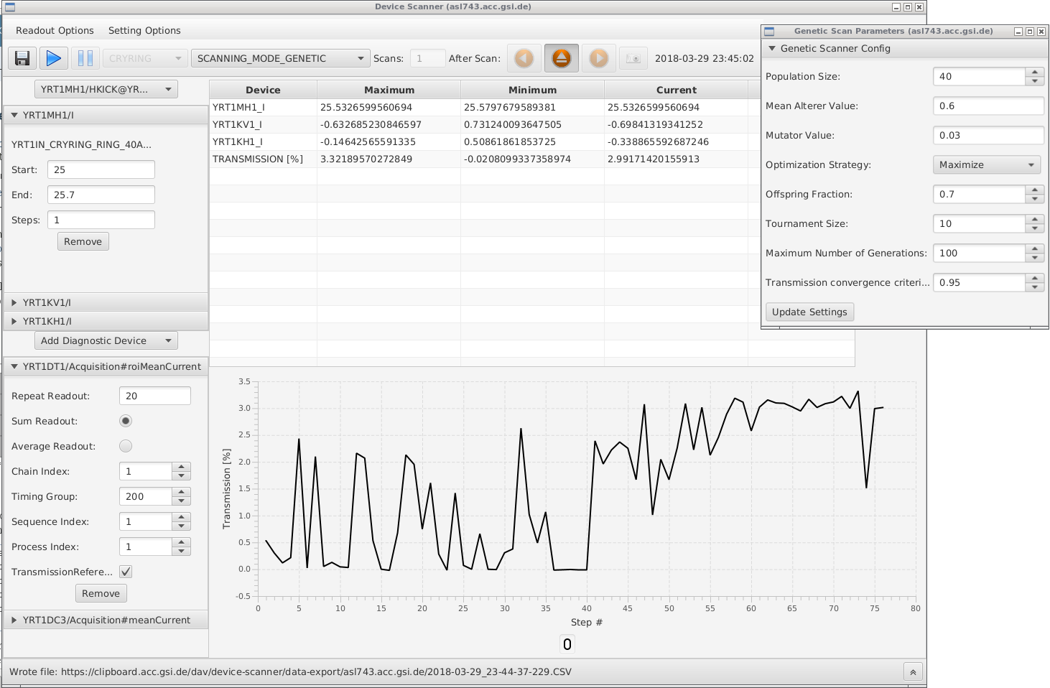
Automate parameter scanning
Example I @GSI → a basic scanning tool
Define 1 or more Parameters (and scanning range)
Define a diagnostic device (e.g. transformer )
Start Scanning → find optimum
GENETIC ALGORITHMS FOR MACHINE OPTIMIZATION IN THE FAIR CONTROL SYSTEM E.
W. Geithner, Z. Andelkovic, S. Appel, O. Geithner, F. Herfurth, S. Reimann, G. Vorobyev

Slide 5
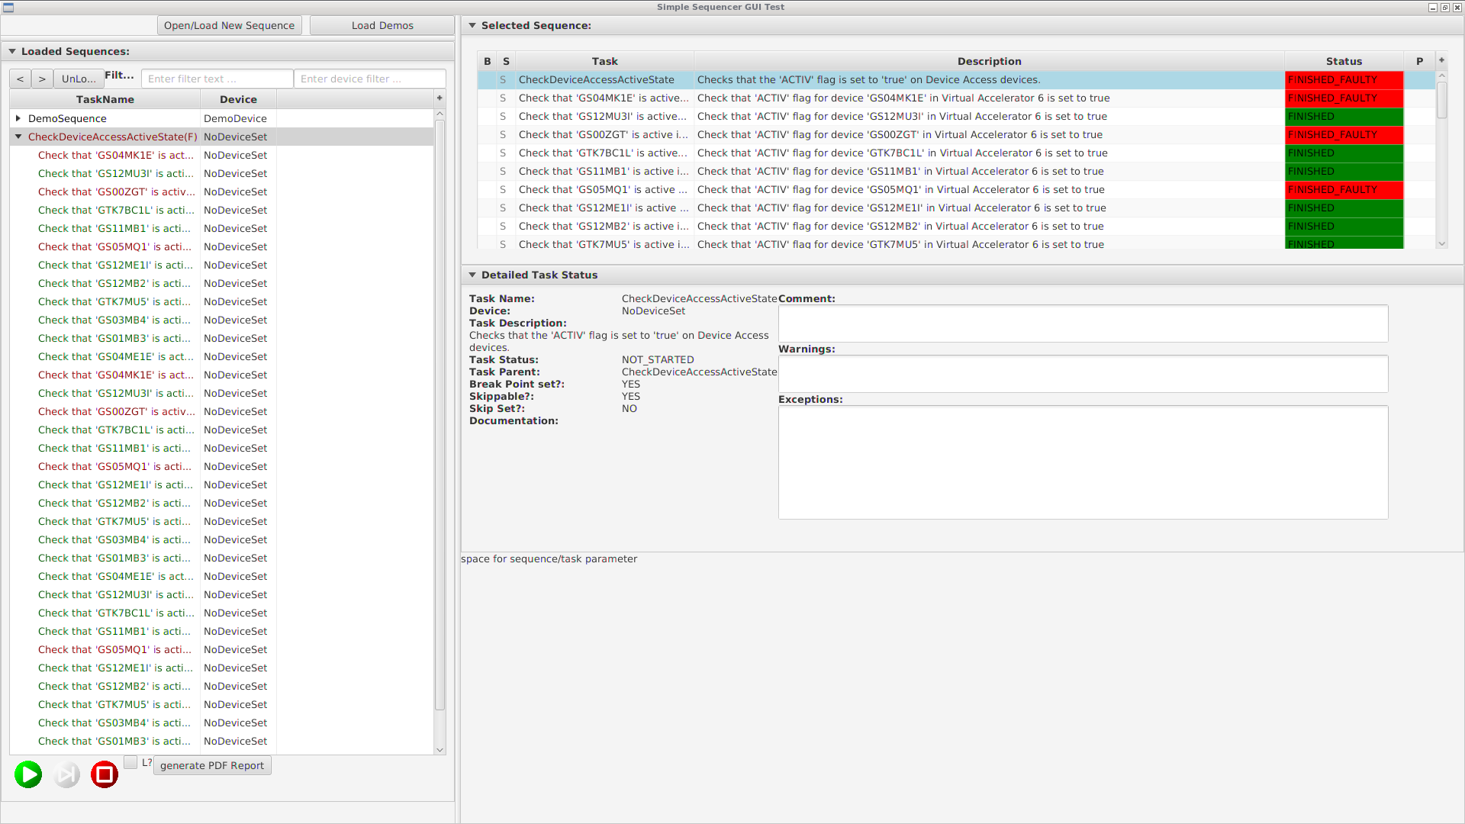
Automate repetitive Tasks of operators
Example II @GSI → the sequencer
An Application and a software interface for self defined sequences Used for:
Switching on all devices
Check status of all devices
Compare set value and actual value
Open valves
…
Sequencer Application
R. Steinhagen

Slide 6
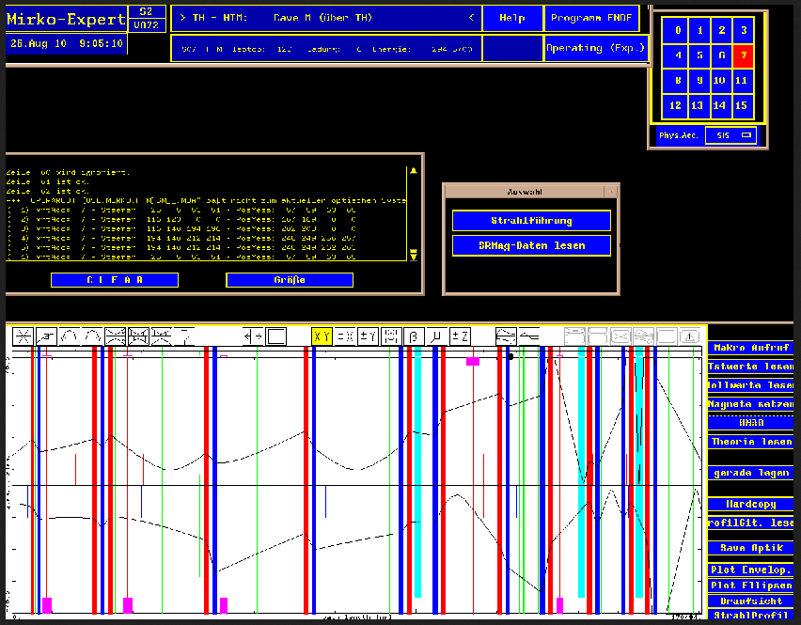
Controls
a parallel running simulation to reflect the actual beam position and optics
GSI, ‘Mirko’ old ion optics tool (unfortunately outdated)
Used for transfer lines
Matching via Mouse click
interactive
IAP, @Franz
Updated – live

Slide 7
Heuristic Optimization & Machine Learning
More novel Trends

Slide 8
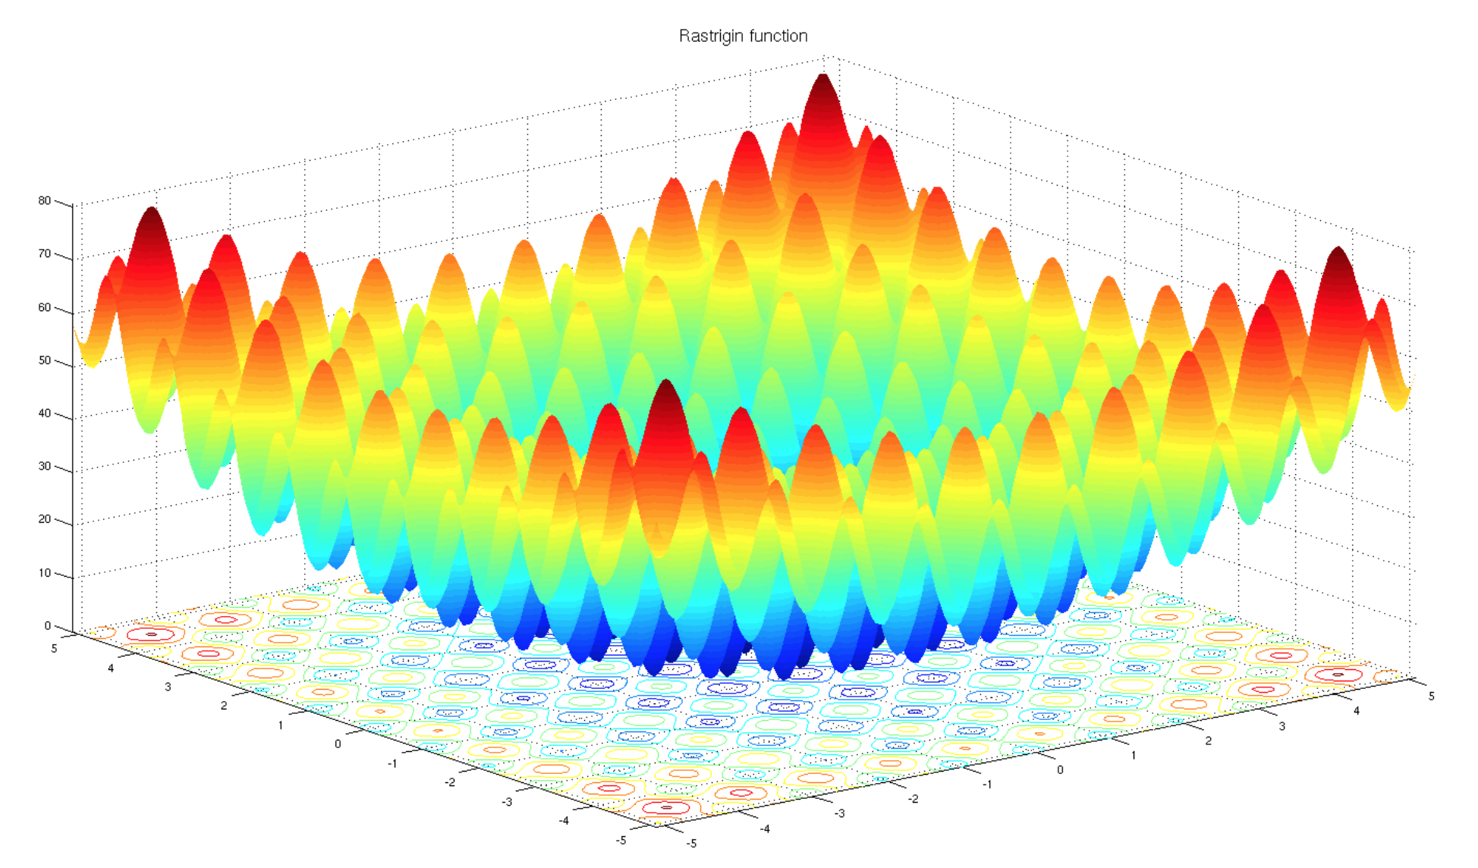
Heuristic Optimization
an Accelerator can be considered as a transformation
Setup of an accelerator is the an optimization of an unknown f
n set values
Accelerator chain
Quelle: Wikipedia, creative common
m measured values (instrumentation)

Slide 9
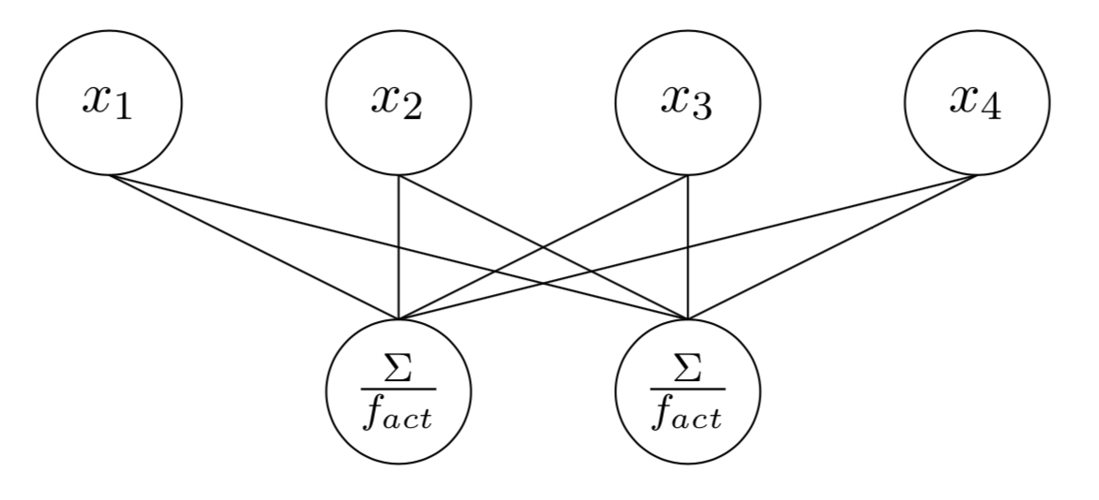
Automated Optimization
Options
Gradient based algorithms (local optimum - problem)
Genetic Algorithms
Particle Swarm Algorithm
BOBYQA
…
Neural network
@GSI: Offline optimization of SIS18 injection parameters using a genetic algorithm
@GSI: The online scanning tool has now an interface to plug in any algorithm - BOBYQA (Bound Optimization By Quadratic Approximation) seems to be the fastest converging algorithm
Heuristic
S. Appel et al., Injection optimization in a heavy-ion syn- chrotron using genetic algorithms,
Nucl. Instrum. Methods A, 852 (2017), pp. 73–79.

Slide 10
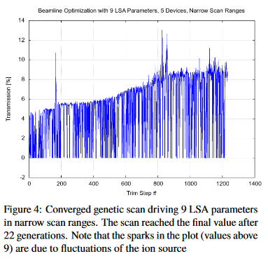
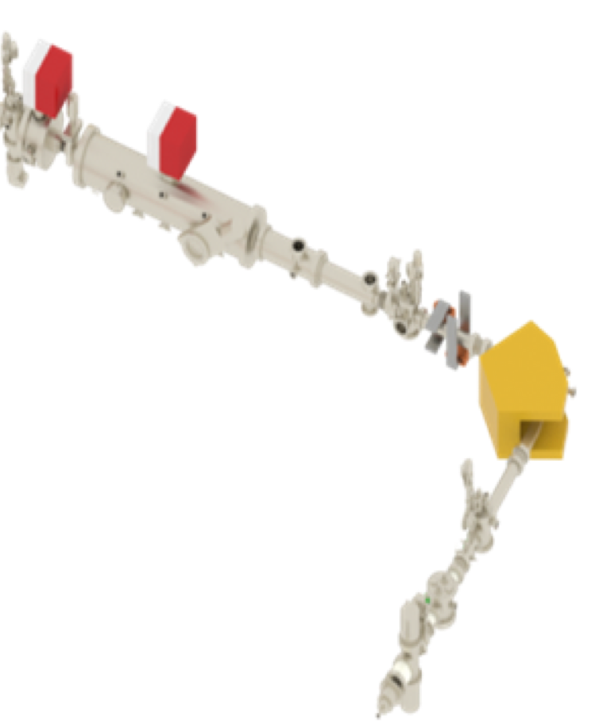
Tested @ local injector of Cryring
AUTOMATIZED OPTIMIZATION OF BEAM LINES USING EVOLUTIONARY ALGORITHMS
S. Appel, S. Reimann, V. Chetvertkova, W. Geithner, F. Herfurth, U. Krause, M. Sapinski, P. Schütt, D. Österle,
IPAC 2017
GENETIC ALGORITHMS FOR MACHINE OPTIMIZATION IN THE FAIR CONTROL SYSTEM E.
W. Geithner, Z. Andelkovic, S. Appel, O. Geithner, F. Herfurth, S. Reimann, G. Vorobyev,
IPAC 2018
Genetic Transmission optimization (auto tune)
Optimize 40keV Deuterium beam (10% D⁺ , 90% D⁺₂)
9 Parameters (el. Stat. Steerers, el. Stat. Quadrupoles)
22 generations (=1200 trims = 135min)
Transmission doubled

Slide 11
Considerations
Long setup-cycle time because we had to be sure, the set values are really reached
Algorithm is robust for fluctuations of ion source only to a certain amount, stable conditions are needed
135min – an operator can do much better → no use for slow cycling machines → optimal for LINACs with high repetition rate (or cw)
The tested injector has low intensity and low energy, so radiation safety is no issue → not suitable for high energy transfer lines (pilot beam)
The devices have to switch values randomly (high to low) → consider remanence effects
Only transmission has been optimized, no information on other beam parameters (You can only optimize what you can measure)
Planned improvement: combine online tool with offline simulations to exclude solutions, that make no sense at all (100% losses)

Slide 12
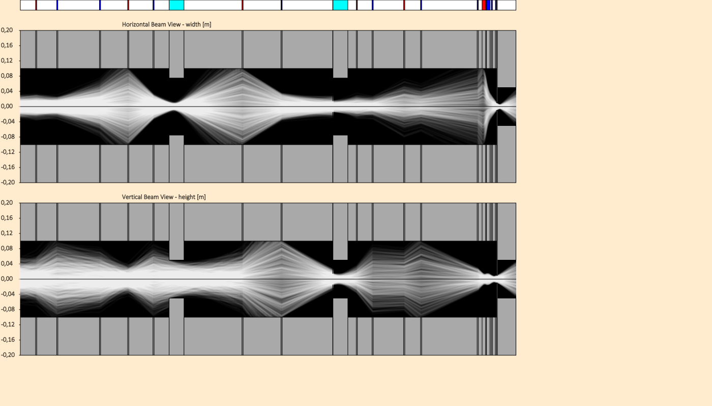
Automated Lattice Design of Transfer Lines
A genetic algorithm to optimize the lattice of transfer lines
The challenge is, to define a suitable fitness function
A Genetic Algorithm for an Automated Lattice Design of Transfer Lines,
S. Reimann, GSI, IAP, IPAC2019

Slide 13
The black box argument
Common statements are like:
“this might work, but even if it does, you don’t know what the algorithm is really doing”
“It is much better to understand your machines and the physics behind.”
“Not satisfying for a physicist.”
…
Understanding and optimization are going hand in hand
better results → lead to new questions → lead to better understanding → helps to improve algorithms
Theory is important- but the beam is always right!
By the way: Operators are sort of black boxes too ;)

Slide 14
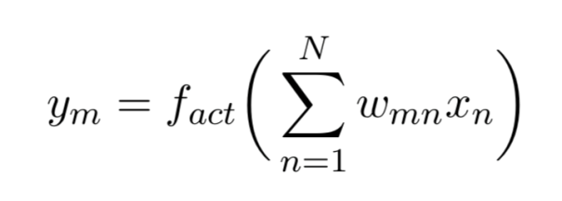
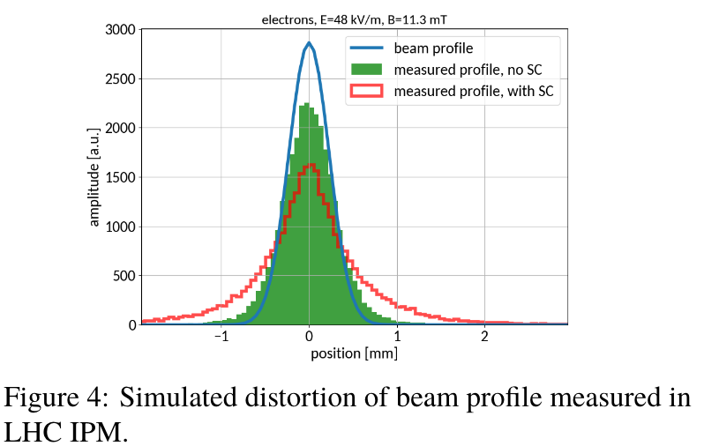
Machine learning / neural networks
A gradient based weight – optimization
Universal Approximation Theorem
Very good results in pattern recognition
Possible Applications in Accelerator Physics?
@GSI: M. Sapinski, R. Singh, D. Vilsmeier, “Application of Machine Learning for the IPM-Based Profile Reconstruction”, in Proc. HB’18, Daejeon, Korea, 2018.
Data mining e.g. in Archiving systems
Prediction of device failures
End of lifetime of devices
Prediction of failure cause
Other ideas? (see → next talks today)

Slide 15
Conclusion
minimizing setup and adjustment time is as important as technical reliability for multi purpose accelerators → the control system plays a very important role to enable
heuristic optimization is working well in many fields and should be further investigated and improved
But there is probably more effect to gain by carefully implementing the first order basics, even if it is not that interesting. Don’t believe the hype!
You can only optimize what you can measure → more, better instrumentation (even redundant) always helps
Real Machine Learning → not much experience in GSI operation yet – what’s the obvious application?

Slide 16
Thank you for attention

