Slide 2
Accelerator Performance and Concept
Workshop
F. Zimmermann, G. Franchetti

Slide 3
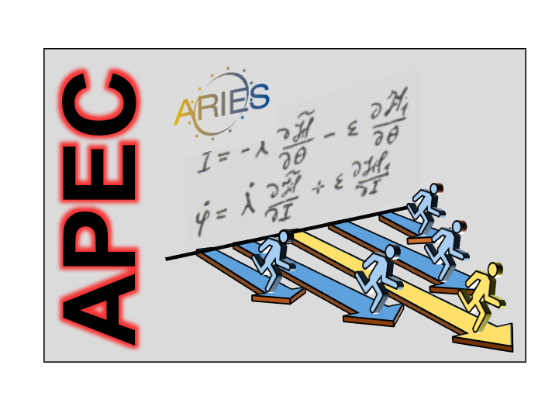

Accelerator Performance and Concepts
APEC
WP 6
Network-Activity

Slide 4
Task 6.1. Coordination and communication
- Coordination of network tasks, interface with other work packages
- Dissemination of network results through public presentations and articles
- Monitoring task progress, contractual compliance and use of resources
Task 6.6: Far Future Concepts & Feasibility
- Analysis of the potential of crystals for charged-particle bending or particle acceleration
- Development of advanced photon colliders, including gamma-gamma and photon-nucleon colliders
- Assessment of advanced muon-collider concepts without ionization cooling
- Assessment of the potential use of large storage rings for gravitational wave detection or generation
- Assessing and ranking a basket of future concepts with regard to “future feasibility” and physics cases
- White list of ranked future options
Task 6.2. Beam Quality Control in Hadron Storage Rings and Synchrotrons
- Compilation and classification of processes causing performance degradation
- Ranking of the identified mechanisms according to their relative importance
- Identification and prioritization of mitigation approaches
- Interfacing with Technology JRAs (electron-lenses, thin films, etc.)
Task 6.3. Reliability and Availability of Particle Accelerators
- Establish standard body of RAMS knowledge for particle accelerator application
- Compile and rank existing RAMS standards, methods and practices in major laboratories
- Analysis of optimal RAMS characteristics for particle accelerator systems
- Spreading the identified best RAMS practices in order to introduce a common baseline
- Assess the feasibility of an Open Data Infrastructure for accelerator reliability
Task 6.5. Beam Quality Control in Linacs and Energy Recovery Linacs
- Expand synergies between proposed future ERL projects and operating or soon-to-be-commissioned linacs/
recirculating linacs and ERLs in Europe
- Establish a parameter database for the various facilities
- Examine innovative and alternative ERL approaches
- Work out synergies between linac developers and source developers for optimum beam quality
- Identify outstanding open questions and develop prioritized R&D guidelines
Task 6.4. Improved Beam Stabilization
- Review existing strategies & methods for beam-impedance assessments and impedance models
- Propose and evaluate novel methods to reduce accelerator impedance
- Identify or develop strategies for electron-cloud mitigation at future accelerators
- Conceptual design of advanced beam feedback systems for future machines

Slide 5
Accelerator Performance and Concepts APEC
Demands of high-quality beams are increasing enormously. Traditional separations and habits are challenged by new demands, which may require a better synergy and improved interaction between all the traditionally separated activities. The Accelerator Performance and Concept Workshop offers a rare opportunity to look outside the box. It is an occasion to discuss the synergies or missing synergies between traditionally confined activities and to initiate a cross talk.
Task 6.2. Beam Quality Control in Hadron
Task 6.6: Far Future Concepts & Feasibility
Task 6.3. Reliability and Availability of Particle Accelerators
Task 6.5. Beam Quality Control in Linacs and Energy Recovery Linacs
Task 6.4. Improved Beam Stabilization

Slide 7
10.12.2018 Schedule
Lunch@FLEMINGs → 12:00 – 12:35
Bus Start 12:40 → GSI @ 13:25
Two groups of ~ 30 people: A, B
FAIR
site
GSI
CC-Linac
½ hour
½ hour
Bus Start 14:30 → FLEMINGs @ 15:00
Welcome Reception @ 7th Floor. Start @ 19:30

Slide 9
Thanks to
Larissi Birli secretariat
Paola Lindenberg secretariat
Harald Hagelkamp FAIR/GSI-visit
Hartmut Vormann FAIR/GSI-visit
Mei Bai, Joerg Blaurock GSI Geschäftsführung
Have a good workshop !!!

