Slide 1
Beam dynamics studies for transverse feedback systems - modelling
J. Komppula (CERN)
Acknowledgements:
W. Hofle, G. Kotzian, K. Li, D. Valuch

Slide 2
Outline
What are transverse feedback systems?
How to model
PyHEADTAIL simulation tools
Recent studies
FCC-hh feedback performance
LHC ADT induced coupled bunch instability
SPS and LHC FIR filter tests
Discussion

Slide 3
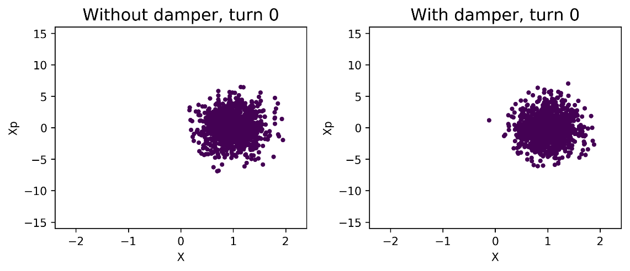
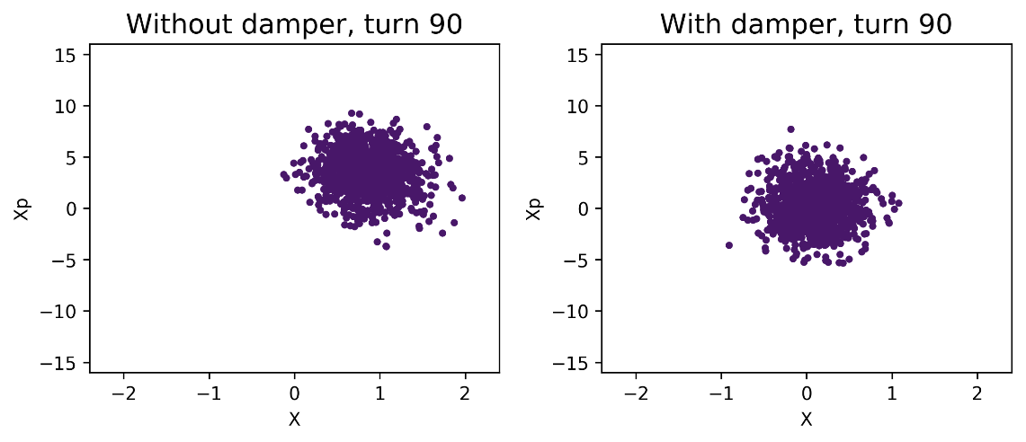
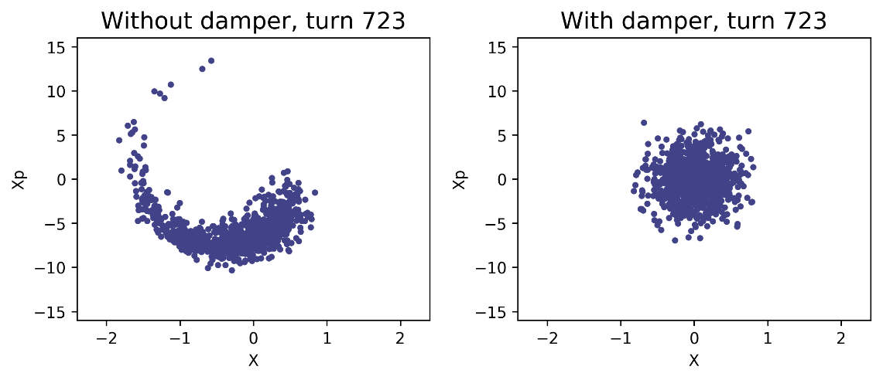
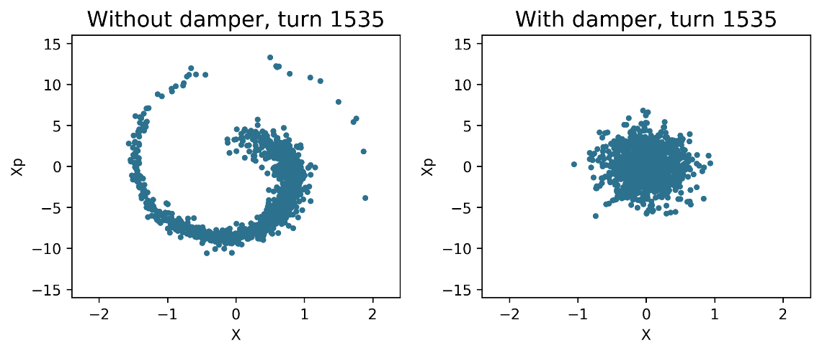
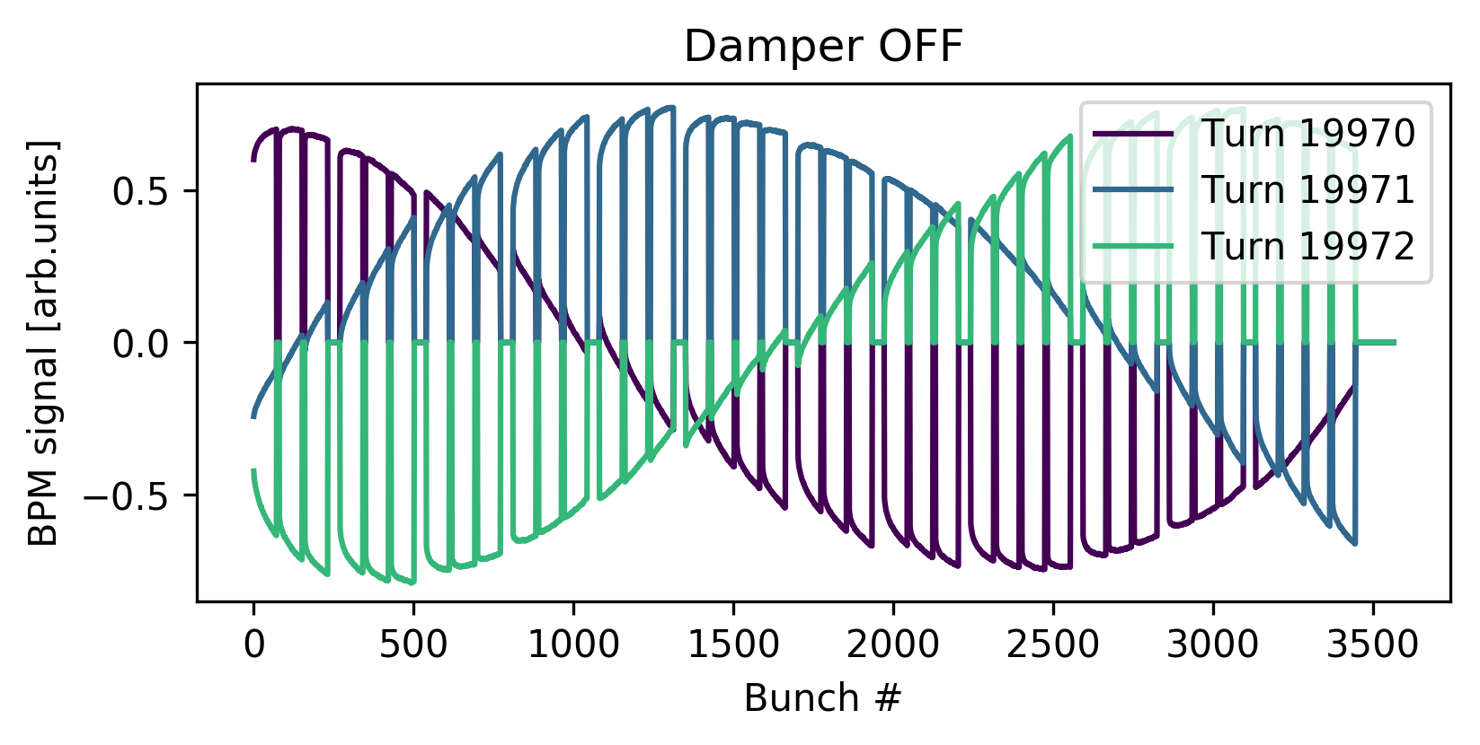
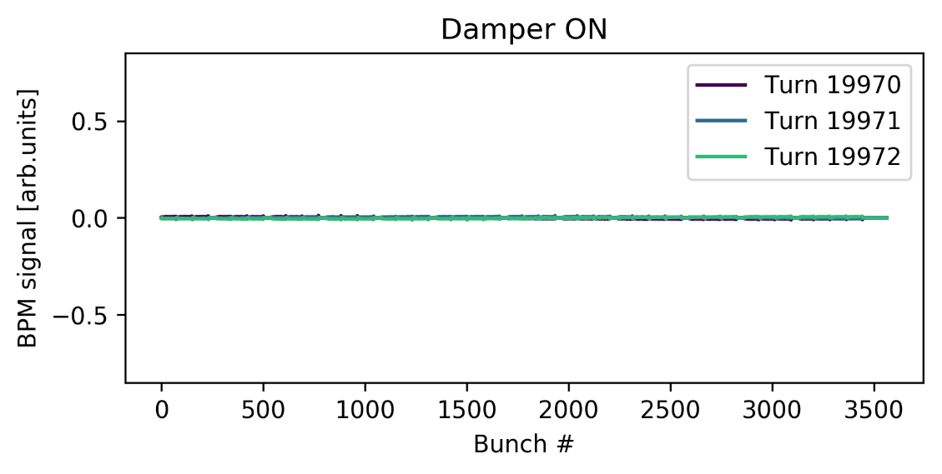
Why transverse feedback systems?
Beam quality
Injection dipole errors cause emittance growth without damping
Beam stability
Stabilization against transverse coherent instabilities
Multipurpose tool for machine development studies and operations
Excitations, tune shift measurements, abort gap cleaning…
Future accelerators rely increasingly on the transverse feedback systems!

Slide 4
What are transverse feedback systems?
Digital signal processing
FIR filters to calculated pickup to kicker phase advances (weighted sum over multiple turns)
FIR filters for correcting analog signal distortions (weighted sum over consecutive bunches)
Analog signal processing
Front end: Pickup signal processing for the ADCs
Back end: Bandwidth limitations of power amplifiers and kickers
Turns
Bunches

Slide 5
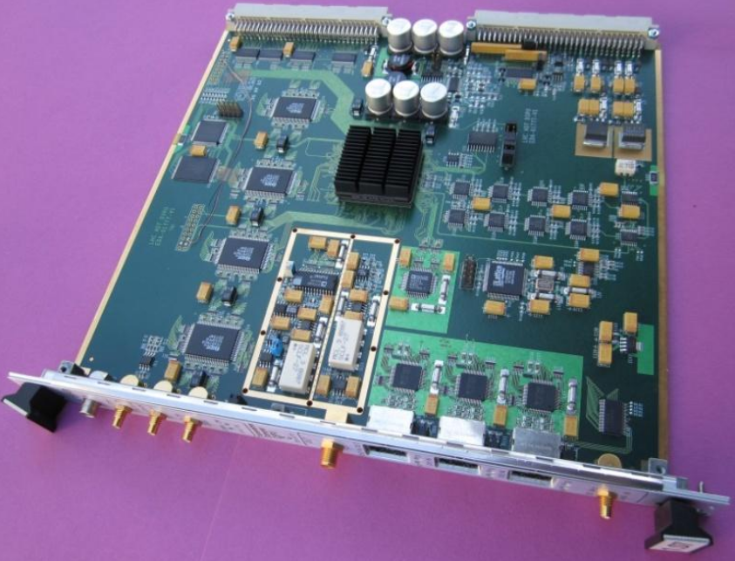
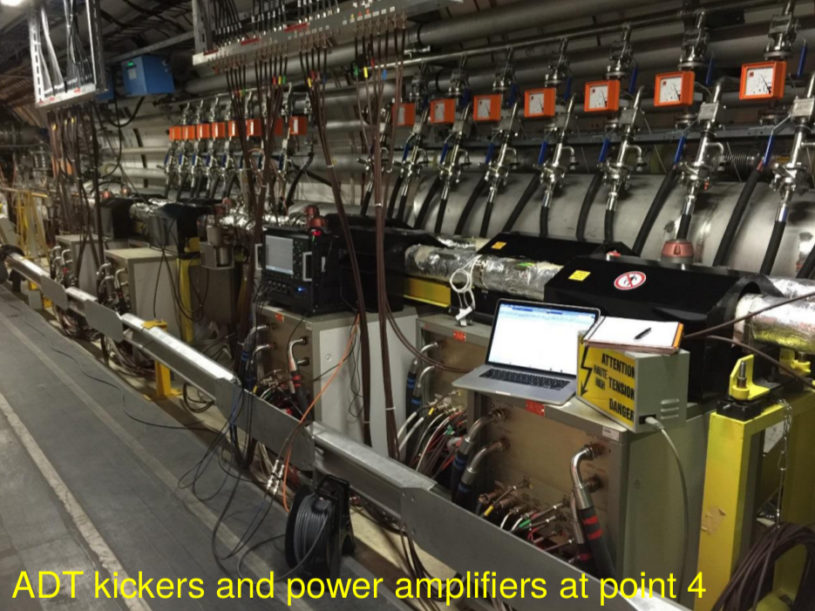
History
Used in every synchrotron at CERN
First systems in the 1970s
All proton injectors upgraded to digital signal processing during the LIU program
The SPS and LHC systems are closest to the FCC-hh requirements
Used during all operation phases from injection to collision/extraction
Single system for both injection oscillations and instabilities
Reliable and robust systems
Photo: D. Valuch

Slide 6
Outline
What is a transverse feedback system?
How to model
PyHEADTAIL simulation tools
Recent studies
FCC-hh feedback performance
LHC ADT induced coupled bunch instability
SPS and LHC FIR filter tests
Discussion

Slide 7
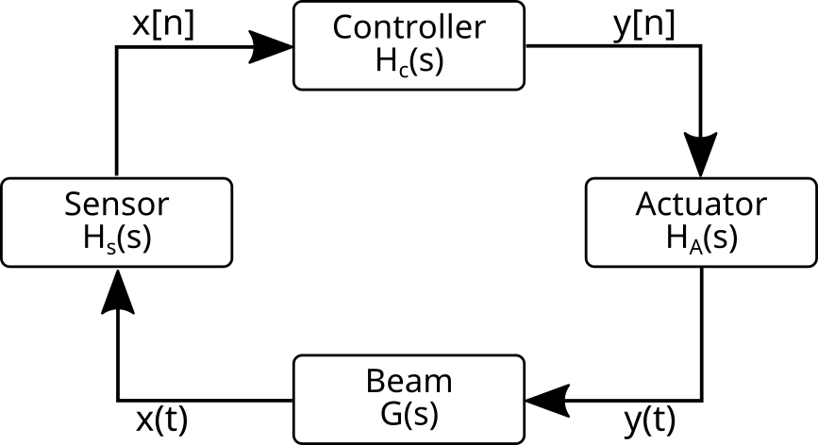
Modelling - engineering point of view
Transverse feedback system is a controller
Control theory is a powerful tool for linear systems
Digital signal processing
Pickups, transmission lines
Power amplifiers, kickers

Slide 8
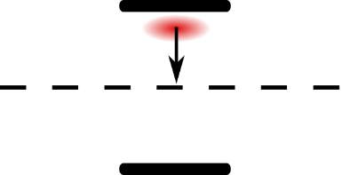
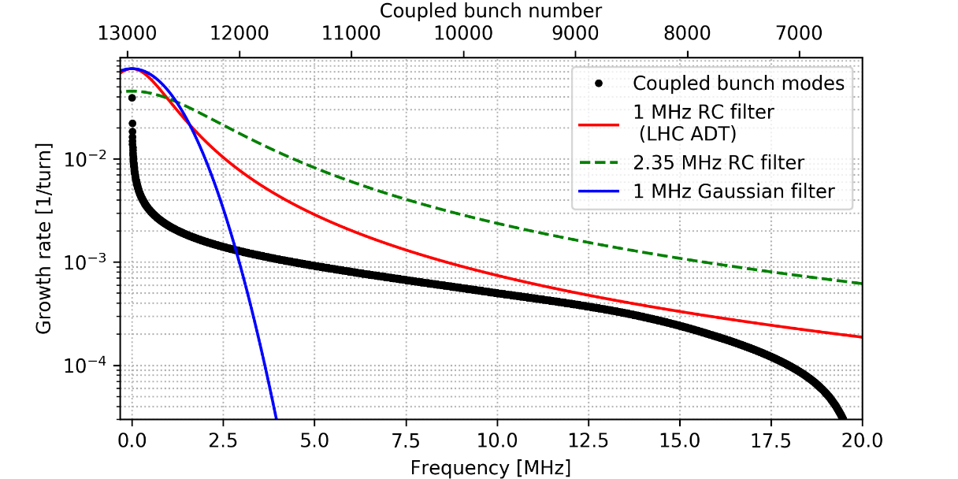
Modelling - beam dynamics point of view
Beam dynamics is complex… keep the models as simple as possible!
Most of the simulation codes include an ideal transverse feedback model
Direct correction
Resistive vs. reactive feedback
Coupled bunch instabilities from theory
Modes where growth rate is lower than damping rate are stable
Recently more detailed models developed by several authors

Slide 9
Do we need better feedback models?
Accelerators will be operated and designed closer the ultimate stability and performance limits
Transverse feedback is one of the key systems
Modelling becomes more challenging
Theories assume linear systems and/or weak kicks
Strong kicks from the wake fields
Strong kicks from the transverse feedback system
Filling scheme
Possible interplay between the beam (chroma, wakes, etc) and the feedback system
Noise propagation
Reliable feedback performance estimates are needed
Where are the limits of the used models?
What happens when the models break?
Macroparticle simulations allow flexible studies for the performance limits and challenges

Slide 10
Outline
What is a transverse feedback system?
How to model
PyHEADTAIL simulation tools
Recent studies
FCC-hh feedback performance
LHC ADT induced coupled bunch instability
SPS and LHC FIR filter tests
Discussion

Slide 11
PyHEADTAIL
Transverse
tracking
Wakes
Transverse
tracking
Transverse
feedback
Longitudinal
tracking
one_turn_map = [... +
wake_map +
transverse_segm_map_5 +
feedback_map +
transverse_segm_map_6 +
ecloud_dipole +
space_charge + ...]
for i in range(nturns):
for m in one_turn_map:
m.track(beam)
A python library of macroparticle beam dynamic tools
Developed 2014-> at CERN
K. Li, A. Oeftiger, M. Schenk at al
Based on HEADTAIL code
Modular design allows easily customized simulations
Transverse and longitudinal tracking, wakes, space charge, e-cloud, etc.
Recently optimized for multibunch beams and new feedback module developed
Full FCC-hh beam simulations including wakes and feedback models possible
Allows also models for multi pickup – multi kicker systems

Slide 12
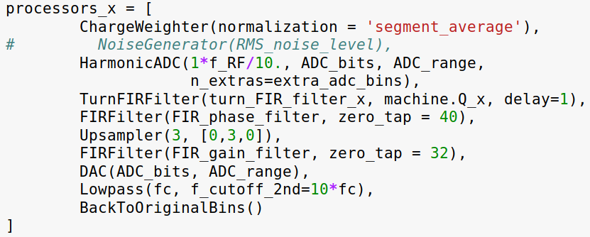
PyHEADTAIL feedback module
Allows detailed feedback models into beam dynamic simulations
Link between the beam dynamics and the real feedback systems
Beam dynamics:
-good models for
beam dynamics
-ideal models for
feedback system
Engineering:
-good models for signal processing
-ideal models for beam
Detailed PyHT feedback model
-Every model step has equivalent signal processing step in the real system
- Beam dynamic effects from the feedback system design choices
- Deeper understanding of the performance limits and challenges
-Model can be simplified by commenting or replacing lines

Slide 13
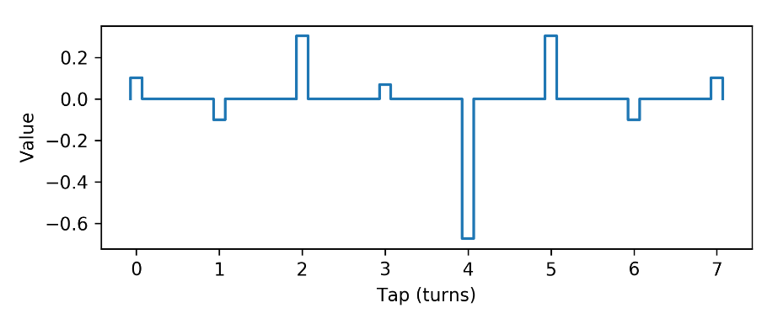
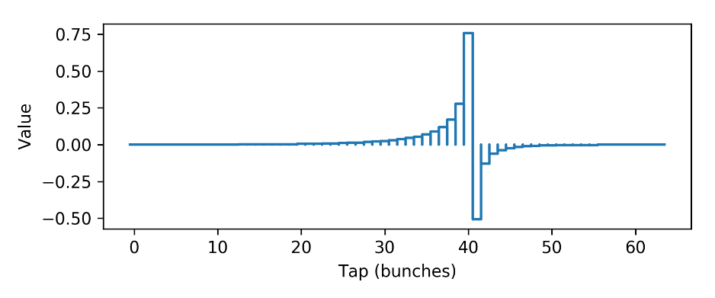
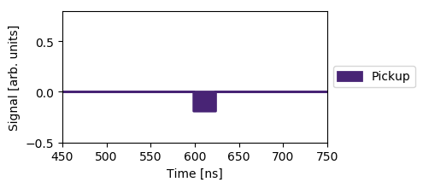
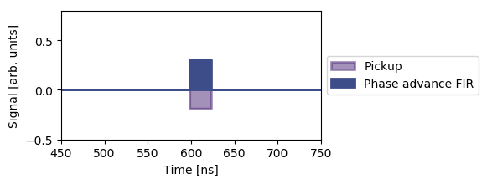
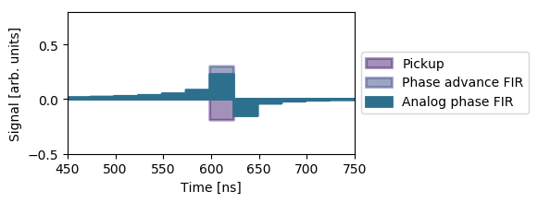
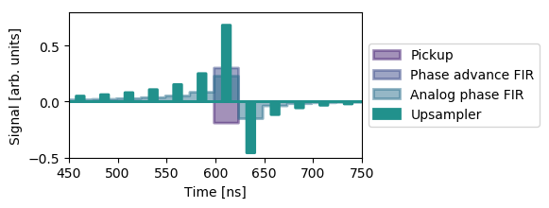
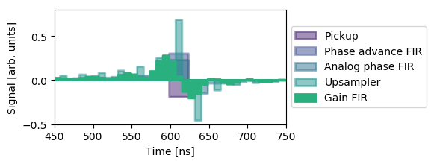
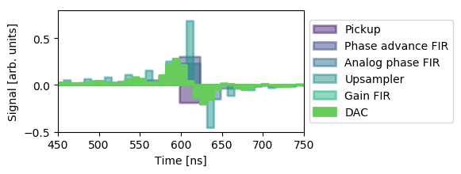
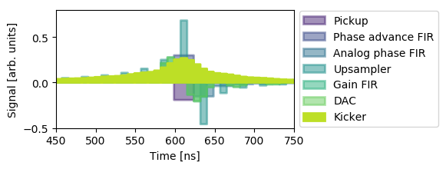
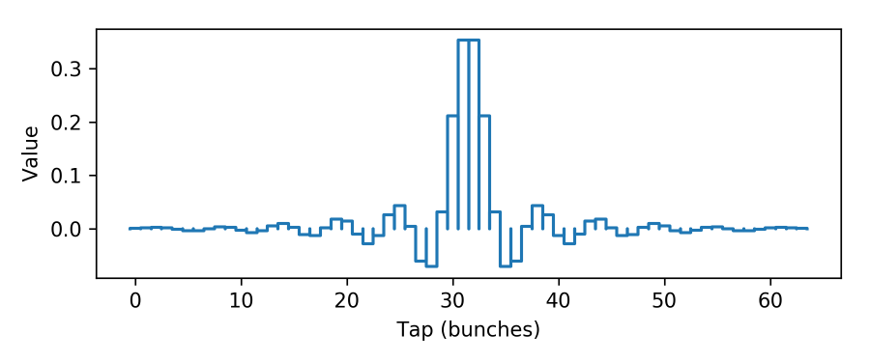
Example: PyHEADTAIL LHC ADT model
Close orbit offset and betatron phase
advance corrections
Power amplifier/kicker
phase correction
Power amplifier/kicker frequency response
Impulse response
Gain and bandwidth
corrections

Slide 14
Outline
What is a transverse feedback system?
How to model
PyHEADTAIL simulation tools
Recent studies
FCC-hh feedback performance
LHC ADT induced coupled bunch instability
SPS and LHC FIR filter tests
Discussion

Slide 15
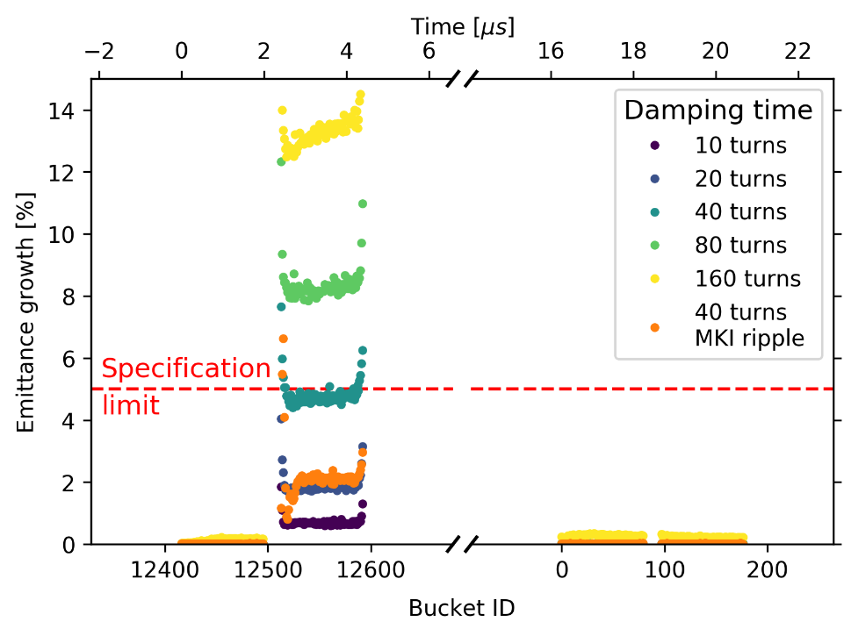
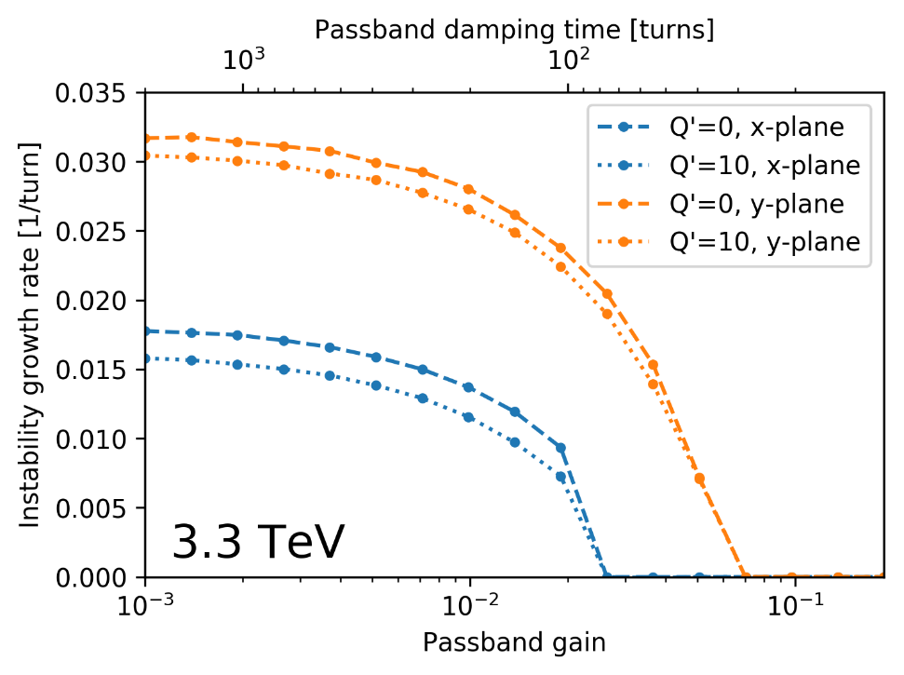
FCC-hh feedback performance
Injected batch
Challenges
Fast coupled bunch instabilities
Rigid beam (3.3 TeV injection energy)
Baseline feedback system based on the LHC ADT
Performance studied with PyHEADTAIL simulations
Up to full beam (>10 000 bunches) simulations including filling scheme, chromaticity, wakes and LHC ADT feedback model
Injection emittance growth
Coupled bunch instability damping

Slide 16
Outline
What is a transverse feedback system?
How to model
PyHEADTAIL simulation tools
Recent studies
FCC-hh feedback performance
LHC ADT induced coupled bunch instability
SPS and LHC FIR filter tests
Discussion

Slide 17
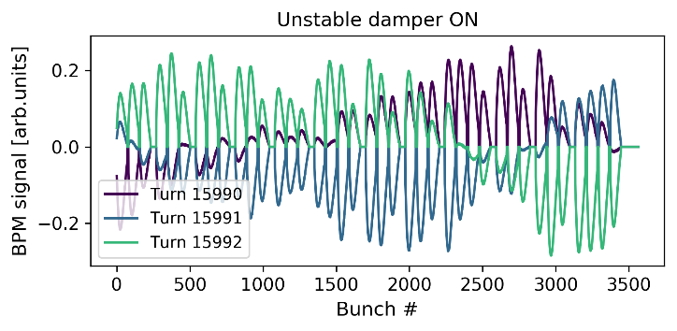
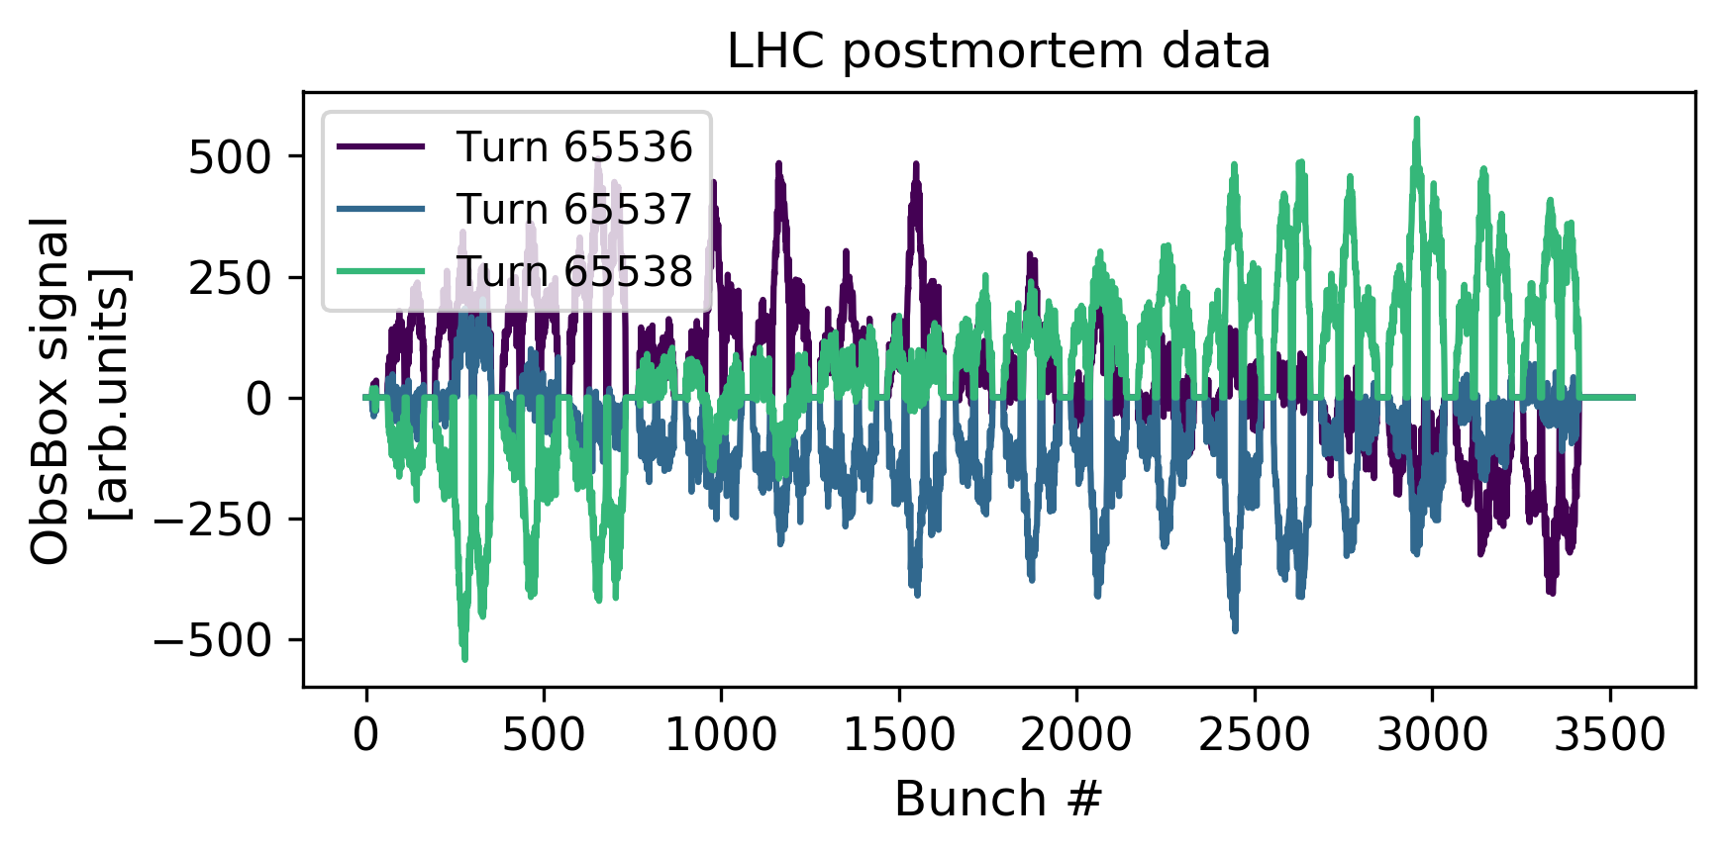
Analysis of the LHC ADT induced instability
Simulation
Measurements
FIR filter normalization issue during the machine development test
Damper loop became unstable due to too high gain
Induced fast coupled bunch instability
Simulations reproduce well the observed beam behavior
Growth rate pattern along the batches
~100 turns growth time and ~0.05 coherent tune shifts

Slide 18
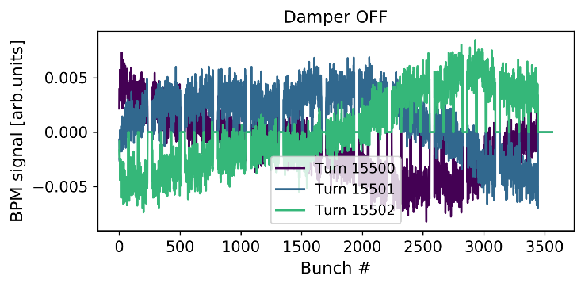
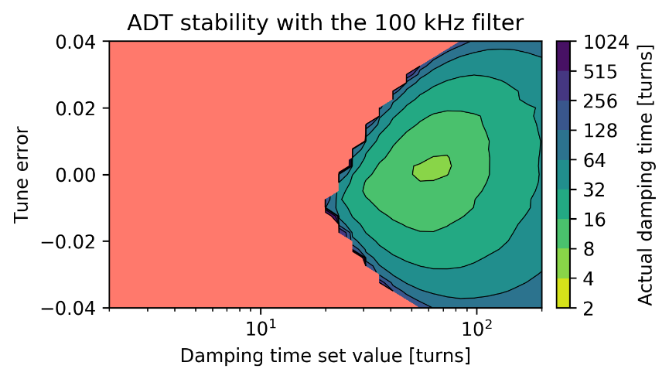
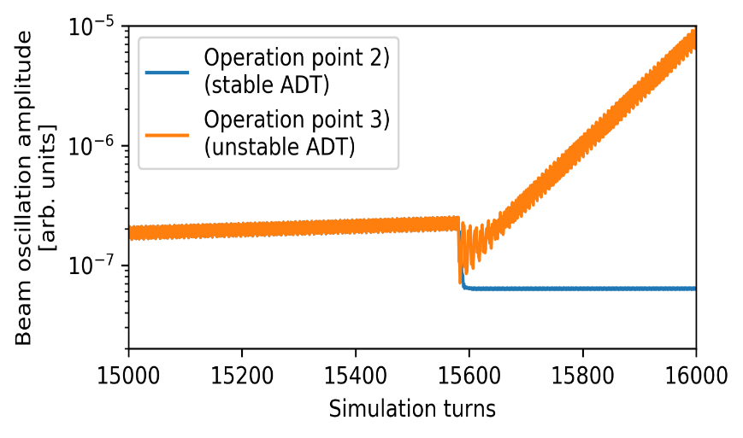
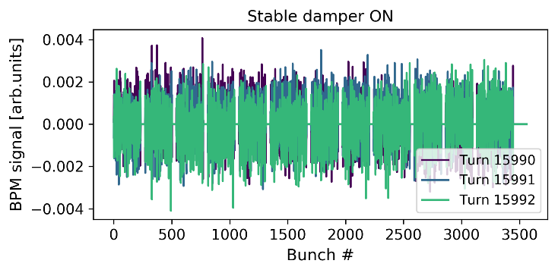
Analysis of the LHC ADT induced instability
4)
Test simulation: What happens when the damper is turned on in the different operation points
3)
2)
Operation point
τ = 95 turns
ΔQ = 0.048
τ = 3000 turns
ΔQ = -5e-5
Damper OFF
Damper ON
Beam was operated with the nominal ”standard bandwidth ” bunch-by-bunch filter
100 kHz filter with (as thought) equal gain was enabled, this moved the stability map
Further 30% increase of gain moved the operation point to the unstable region
Coherent beam-oscillations triggered the loop instability causing fast growth rate and strong real tune shift

Slide 19
Outline
What is a transverse feedback system?
How to model
PyHEADTAIL simulation tools
Recent studies
FCC-hh feedback performance
LHC ADT induced coupled bunch instability
SPS and LHC FIR filter tests
Discussion

Slide 20
LHC and SPS FIR filter tests
Turn by turn FIR filters of the transverse feedback system
Determines operational gain and tune acceptance margins
Currently used FIR filter scheme utilizes Notch+Hilbert filters (8-taps)
3-tap filter allows larger margins and induces less tune shift
Filters tested in the LHC and SPS
Good agreement between the LHC measurements and the PyHEADTAIL simulations

Slide 21
Outline
What is a transverse feedback system?
How to model
PyHEADTAIL simulation tools
Recent studies
FCC-hh feedback performance
LHC ADT induced coupled bunch instability
SPS and LHC FIR filter tests
Discussion

Slide 22
Future possibilities and challenges
Injection oscillations
High energy accelerators (e.g. FCC-hh) require strong kicker systems
Replacement technology for the tetrode amplifiers
Smarter ways than the proportional damping?
Instabilities
Technology feasible for <10 turns coupled bunch instability damping times
Possibilities of the intra bunch feedback systems
How much margin can the FB systems give, where are the hard limits?
Technology, beam dynamics or interplay between them?
Noise
Induces emittance growth and instabilities
Best ways to mitigate
Machine protection
Accelerators will be operated with fast growing instabilities
Is the feedback system a guardian angel or a concern?

Slide 23
Summary
Transverse feedback systems are robust and reliable
Allow performance increases in the existing and future accelerators
Technological and beam dynamics limits must be studied carefully
Feedback systems and beam dynamics can be simulated together
Up to full beam simulations possible
Good agreement with experimental data

Slide 24
Thank you!

