Slide 1

E-could mitigation techniques and relations with vacuum/impedance requirements.
R. Cimino
LNF-INFN Frascati (Rome) , Italy.

Slide 2
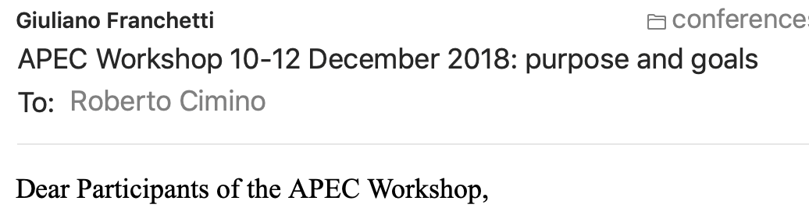
Thanks to Giuliano and Frank… for the first slide of my talk!
……
Normally, in accelerator science and technology, tasks and roles are assigned to well defined groups… Traditionally each of these groups develops its activities independently and stand alone. This happened due to the rich complexity of each of these sectors, which have expanded tremendously over the years. Such an approach was useful because each community created its natural forum for the development of their field. However, at the same time it seems that each of these sectors acquired its own right of existence almost independently of the final goal.
We are now entering a new era in accelerator science and technology, where the demands of high-quality beams are increasing enormously along with the complexity of accelerator systems. At this point, the traditional separations and habits are challenged by new demands, which may require a better synergy and improved interaction between all the traditionally separated activities.
………
Specially true in EU project organized in WP’s…..

Slide 3
The Beam screen in LT accelerators is a very good example!
Introduction
Electron Cloud related Effects
Mitigation methods.
Impedance, Cryogenics and Vacuum issues.
-Conclusion

Slide 4
One real example:
3
Electron Cloud related Effects
450 GeV – 150 ns bunch spacing: Merged vacuum @ LHC
8-10-2010

Slide 5
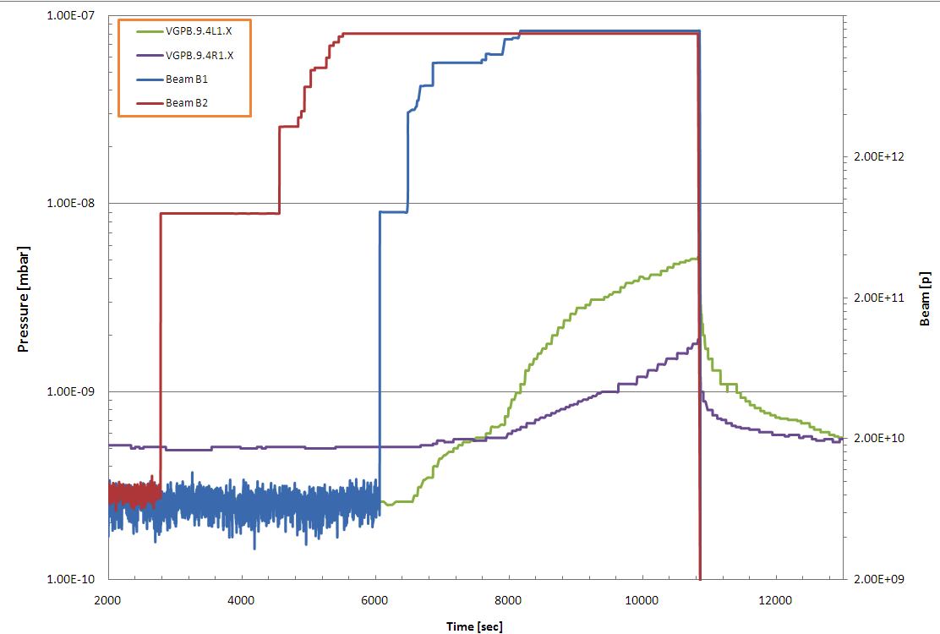
Exotic Vacuum behavior @ LHC
4
Beam 2
Beam 1
Pressure Increase
No pressure Increase
8-10-2010
450 GeV – 150 ns bunch spacing: Merged vacuum

Slide 6
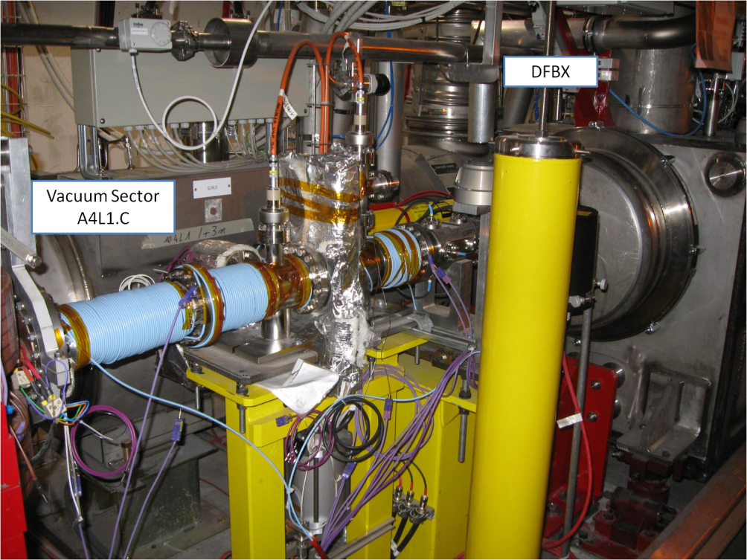
solved by Installing Solenoids

Slide 7
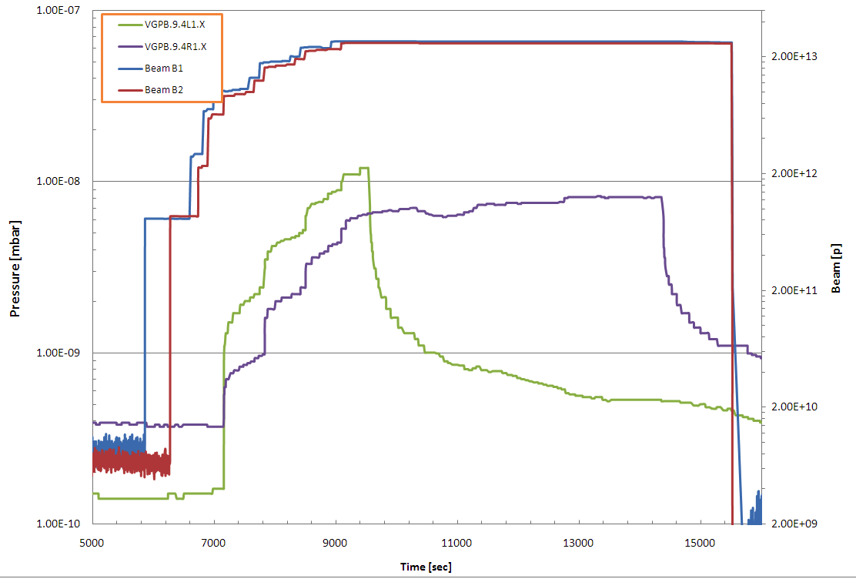
Solenoids have effect on pressure!
Solenoid ON
A4L1
Solenoid ON
A4R1
Beam Intensity
After 20 min
ΔP ≈7·10⁻¹⁰
After 20 min
ΔP ≈7·10⁻¹⁰
Remove multipacting
Still primary electrons

Slide 8
Solenoids have effect on pressure!
Evidence for:
e-Cloud
Instabilities
due to the interaction between beams and Vacuum system walls
Solenoid ON
A4L1
Solenoid ON
A4R1
Beam Intensity
After 20 min
ΔP ≈7·10⁻¹⁰
After 20 min
ΔP ≈7·10⁻¹⁰
Remove multipacting
Still primary electrons

Slide 9
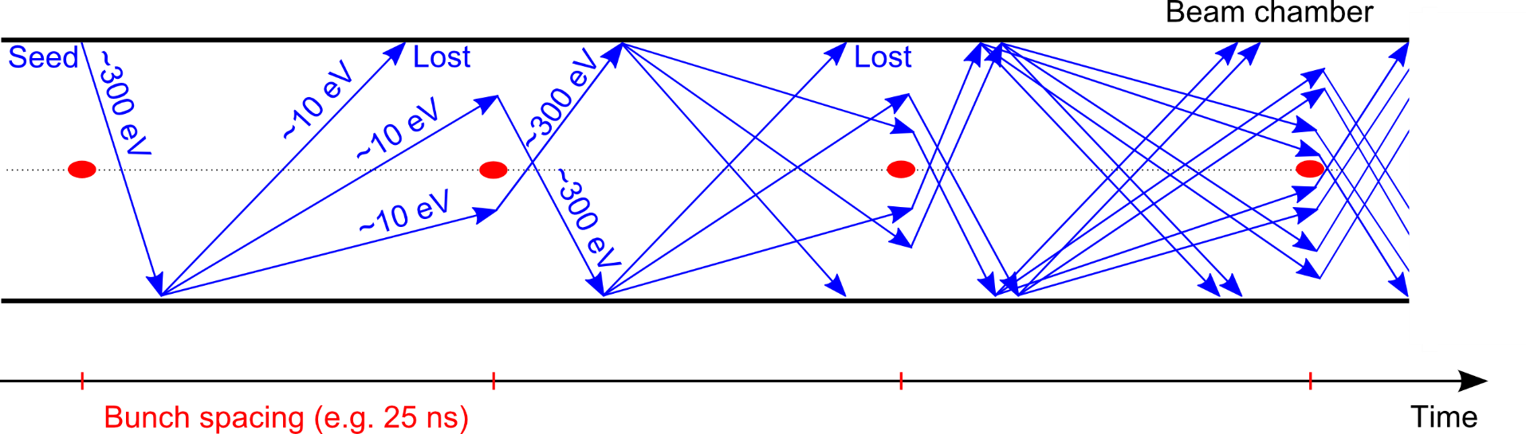
Electron cloud build up (in pills):
    e⁻ is emitted (photoelectric effect)
    Secondary Electron Emission can drive an avalanche multiplication effect filling the beam chamber with an electron cloud
    Proton bunch
    Secondary Electron Emission
SEY measure the number of electrons produced by a surface normalized to the incoming electron flux.

Slide 10
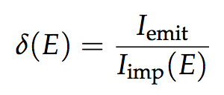
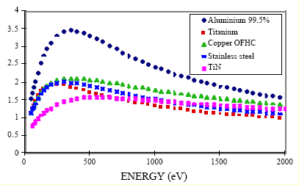
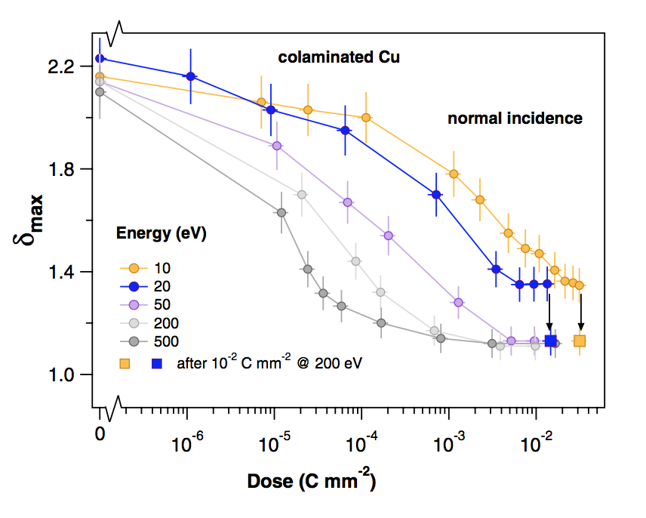
ECE Main ingredients: surface properties
  The main quantity involved is the the Secondary Electron Yield (SEY), defined as as:
Ratio between emitted and impacting electron current as a function of the energy of the impinging electrons
It depends on surface chemical properties
It depends on the history of the surface, in particular on
accumulated electron dose → beam induced scrubbing
N. Hilleret et al., LHC Project Report 433 2000, EPAC 00
R. Cimino et al. Phys. Rev. Lett. 109, 064801 – 2012

Slide 11
ECE Main ingredients: surface properties
  Photoelectric Yield (PY), defined as as: Ratio between emitted el. and impacting Photons as a function of impinging photon energy
It depends : impact geometry, and surface different properties like: material, material finish, surface contaminants…
It depends on the history of the surface, in particular on
accumulated photon dose → SR induced scrubbing
Cu _{L2,3} edge
C K
edge
O K
edge
Essential parameter as seed of ECE
and for Single bunch instabilities

Slide 12
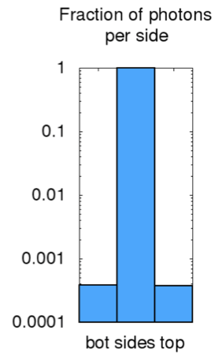

ECE Main ingredients: surface properties
  Photo Reflectivity (R): Ratio between Reflected and impacting Ph.
In the dipoles we are in presence of a strong Magnetic field
See: L. Mether, et al.
In FCC-Berlin 2017
Mainly electrons produced by photons absorbed on the top and bottom of beam screen can seed EC build-up in dipoles
Photoelectrons from scattered radiation
Photoelectrons from direct impacts
It depends on : impact geometry, and surface properties like: material, material finish, surface contaminants…
B
Photoelectrons contributing to
e-cloud build-up mainly from scattered photons
PS: Reflected photons do NOT produce photoelectrons.
See: R. Cimino V. Baglin and F. Schäfers PRL 2015

Slide 13
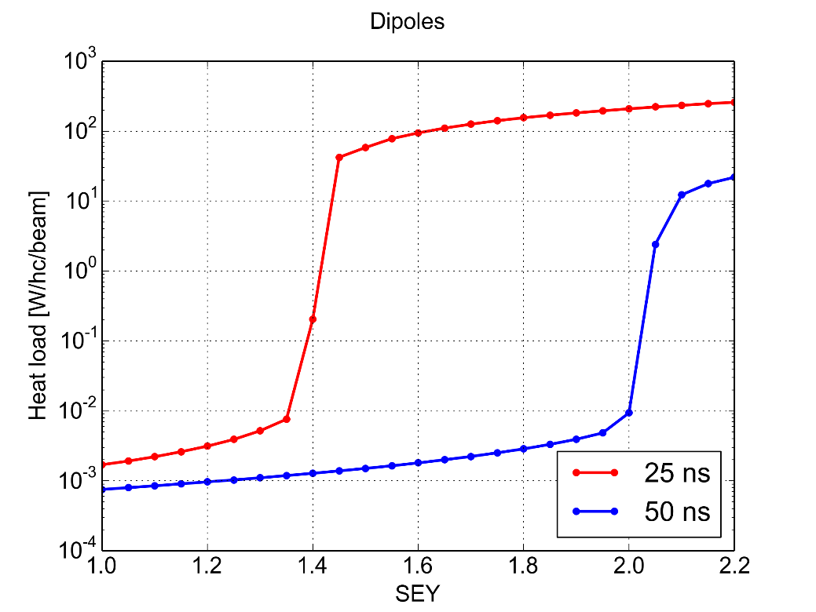
ECE Main ingredients: bunch spacing
PyECLOUD simulations – LHC arc dipole
The bunch spacing determines how many electrons survive between consecutive bunch passages
Significant impact on multipacting threshold, i.e. SEY above which avalanche multiplication (multipacting) is triggered
Multipacting
Multipact.
Accumulation of primary e⁻
Accumulation of primary e⁻
Maximum Secondary Electron Yield (δ_{max})

Slide 14
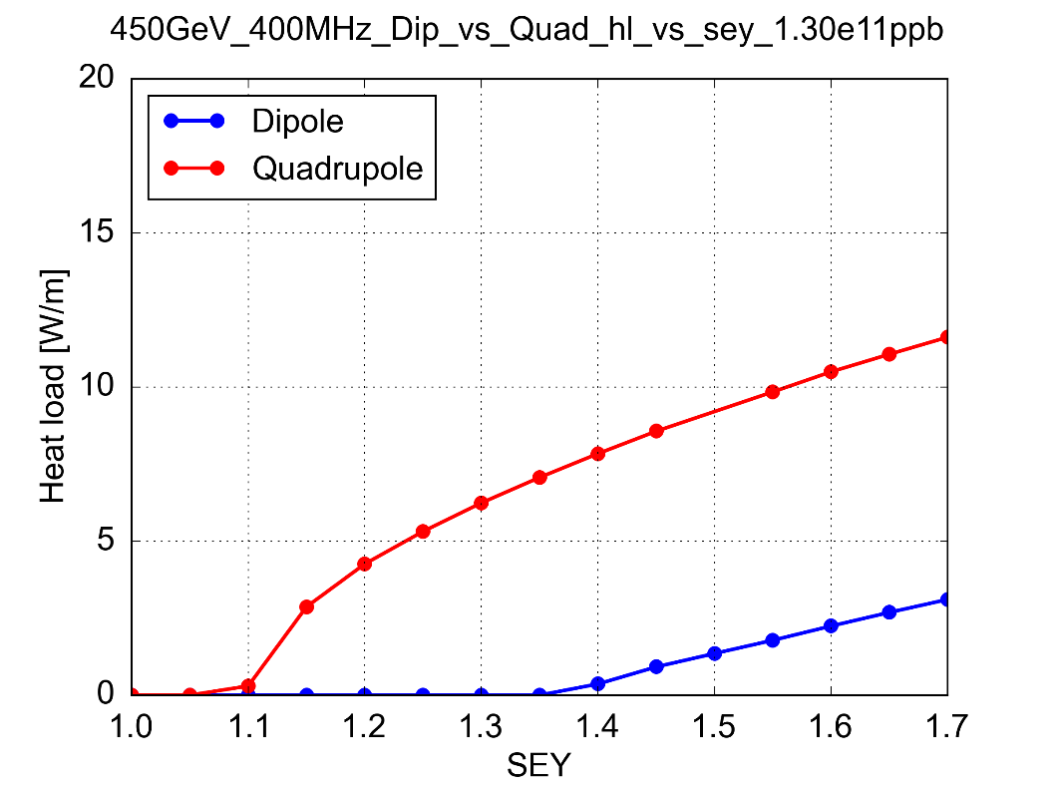
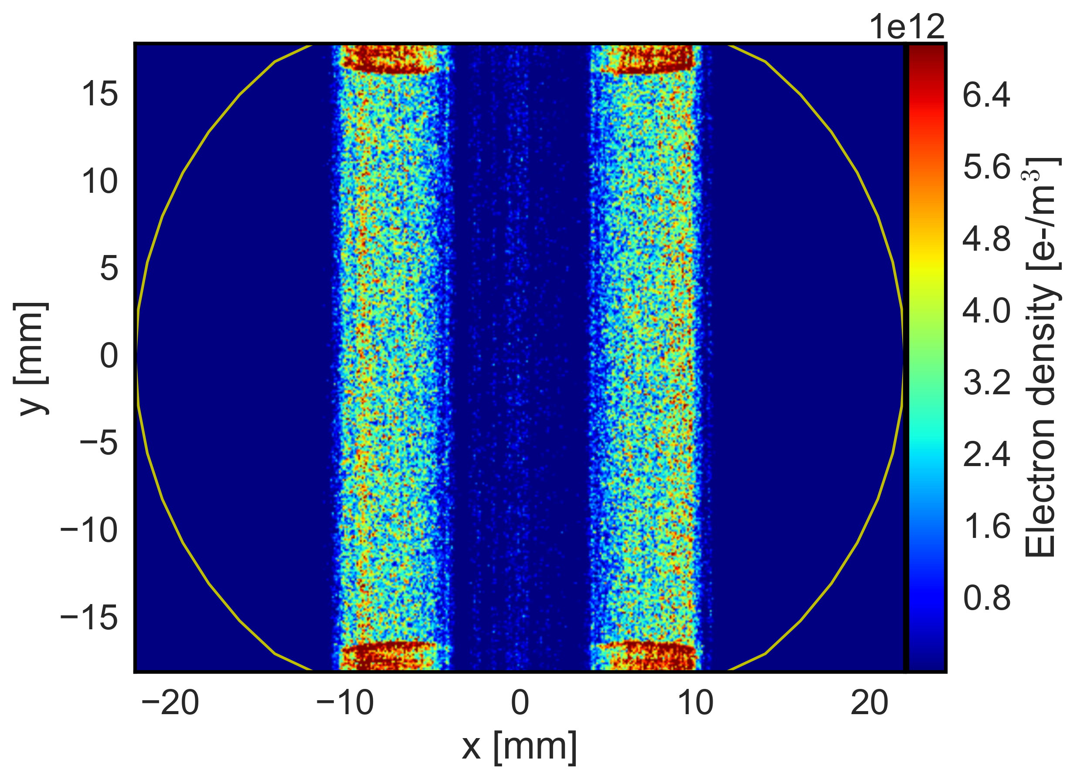
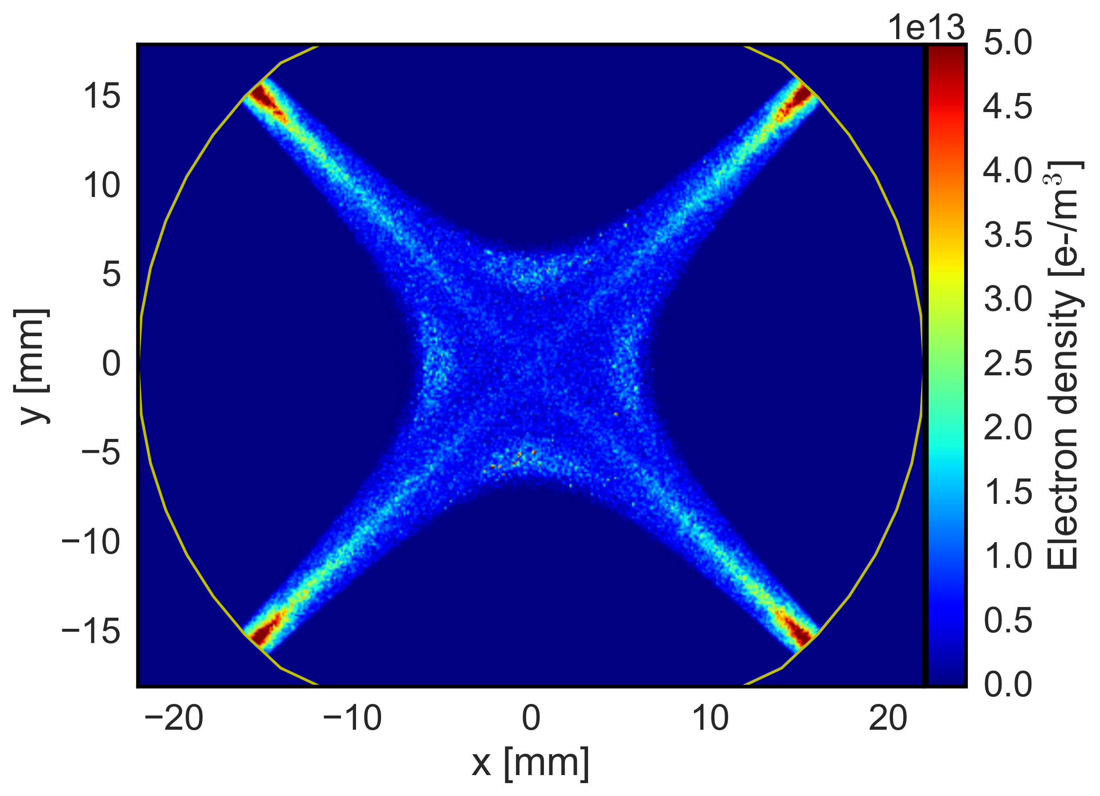
ECE Main ingredients: magnetic fields
LHC Arc Dipole
LHC Arc Quadrupole
Maximum Secondary Electron Yield (δ_{max})
Electron trajectories are strongly influenced by externally applied magnetic fields : Electrons spin around the field lines
In quadrupole magnets magnetic trapping can occur with electrons surviving several bunch passages being accelerated up to a few keV → Much stronger heat loads compared to dipoles

Slide 15
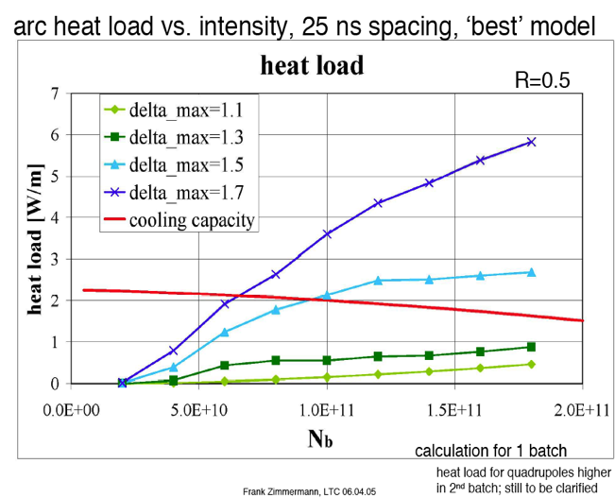
ECE Main ingredients: bunch population
At a given SEY max, bunch population can be limited by ECE
Other ingredients as:
Beam size and length, vacuum chamber dimensions etc. are all set by design to minimize costs and optimize performances

Slide 16
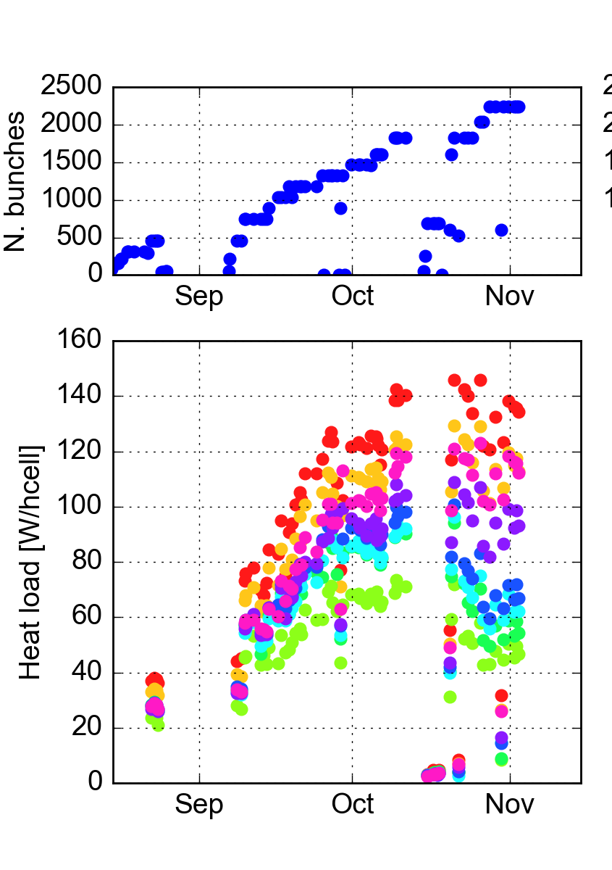
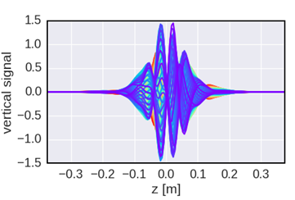
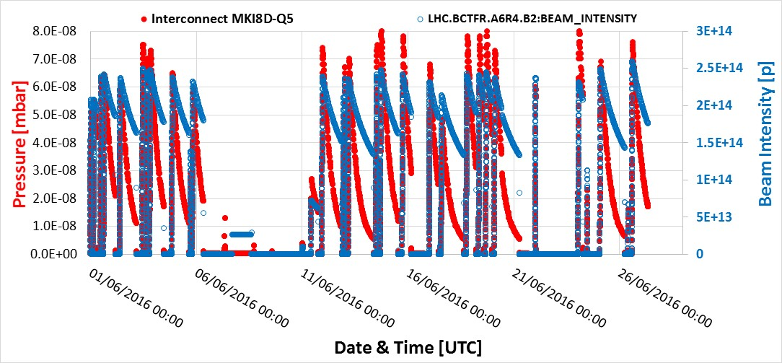
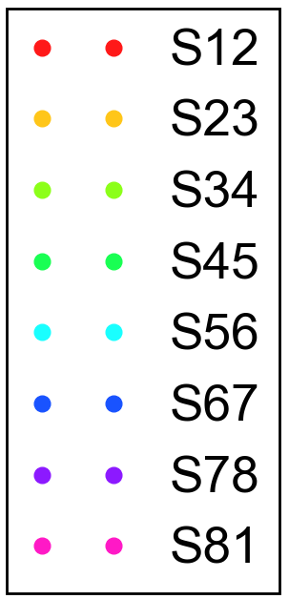
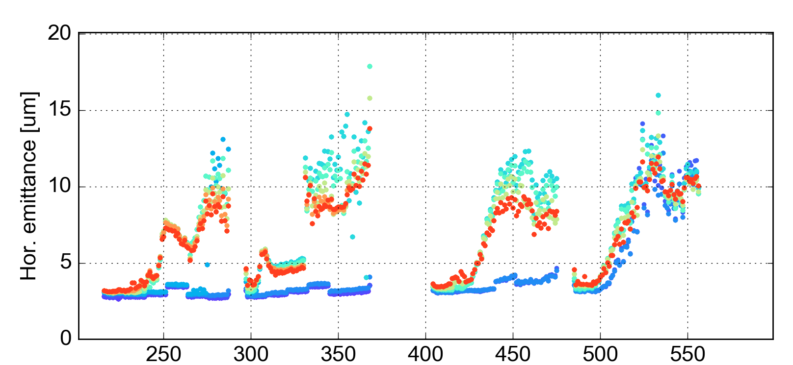
Many consequences of ECE
on machine performance:
  Heat load
  Beam instabilities
  Local vacuum degradation
2015
e-cloud driven instability
Courtesy M. Barnes
Train
type
2x72b
72b
4x36b
Simulation
Measurements (2016)
➔ ECE must be avoided!

Slide 17
Most of the properties governing ECE
are fixed by design:
Magnetic fields are fixed by machine design
Beam Spacing is fixed by design (to optimize Luminosity)
Beam Population should be as high as possible
………
… can we reduce SEY (R, PY) acting on the inner surface material???
Possibly below 1 (so we solve all problems at once!)

Slide 18
R&D intense program to mitigate
ECE by reducing SEY_{Max} below 1.
Mitigation Strategies
External solenoid field
Electrodes in the lattice
Surface Scrubbing
(or conditioning)
Intrinsically low
SEY material
Geometrical modifications

Slide 19
R&D intense program to mitigate
ECE by reducing SEY_{Max} below 1.
Mitigation Strategies
External solenoid field
Electrodes in the lattice
Surface Scrubbing
(or conditioning)
Intrinsically low
SEY material
Geometrical modifications

Slide 20
R&D intense program to mitigate
ECE by reducing SEY_{Max} below 1.
Non-Evaporable Getter (NEG)
Getters are materials capable of chemically adsorbing gas molecules. To do so their surface must be clean. For Non-Evaporable Getters a clean surface is obtained by heating to a temperature high enough to dissolve the native oxide layer into the bulk.
T = T_{a}
T = RT
T = RT
Native oxide layer
-> no pumping
Heating in vacuum
Oxide dissolution -> activation
Pumping
NEGs pump most of the gas except rare gases and methane at room temperature
P. Chiggiato and P. Costa Pinto, Thin Solid Films, 515 (2006) 382-388

Slide 21
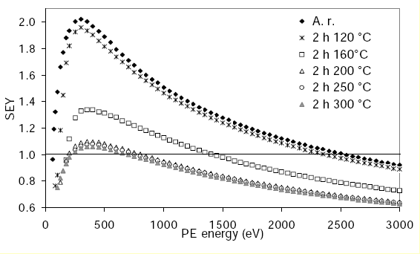
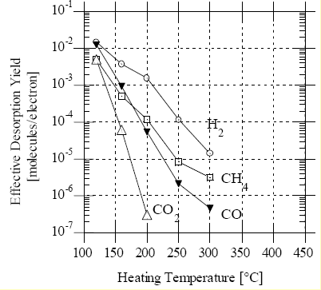
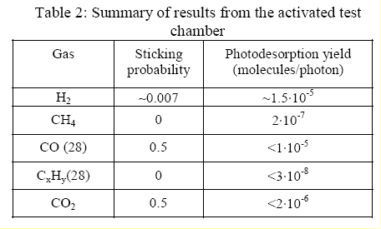
NEG developed at CERN.
TiZrV Performances
PSD Yields
Secondary Electron Yield
ESD Yields
V. Anashin et al. EPAC 2002
Very low Photon stimulated
desorption yield
C. Scheuerlein et al. Appl.Surf.Sci 172(2001)
SEY ~ 1.1 => very low ECE
C. Benvenuti et al. J.Vac.Sci.Technol A 16(1) 1998
Very low Electron Stimulated
Desorbtion
But : Limited pumping capacity, fragile coating sensitive to pollutant (hydrocarbons, Fluor..) and……. Impedance!

Slide 22
NEG developed at CERN.
TiZrV Performances: RESISTIVE WALL IMPEDANCE
RMS bunch length
and RMS energy spread
as a function of the bunch population given by numerical simulations considering only the RW impedance produced by NEG films with different thicknesses. The dashed black line corresponds to the nominal bunch population.
E. Belli, et al.: Electron cloud buildup and impedance effects on beam dynamics in the Future Circular e + e − Collider and experimental characterization of thin TiZrV vacuum chamber coatings” PHYS. REV. AB 21, 111002 (2018)

Slide 23
NEG developed at CERN.
NEG is a great pump (at least at RT) (very appealing for FCC-ee)
Low SEY (1.1) (BUT not < 1)
Need Activation (hard to use in cryogenic environment)
Influence Impedance (depending on its thickness)
R&D still ongoing (optimizing Pumping capacity &thickness)

Slide 24
a-C developed at CERN.
Amorphous carbon
SEY
M. Taborelli et al., ECM workshop, 2008
M. Taborelli et al., ECM workshop, 2008
R. Larciprete et al, App. Surf. Science 2015
Promising R&D still going on

Slide 25
R&D intense program to mitigate
ECE by reducing SEY_{Max} below 1.
Mitigation Strategies
External solenoid field
Electrodes in the lattice
Surface Scrubbing
(or conditioning)
Intrinsically low
SEY material
Geometrical modifications

Slide 26
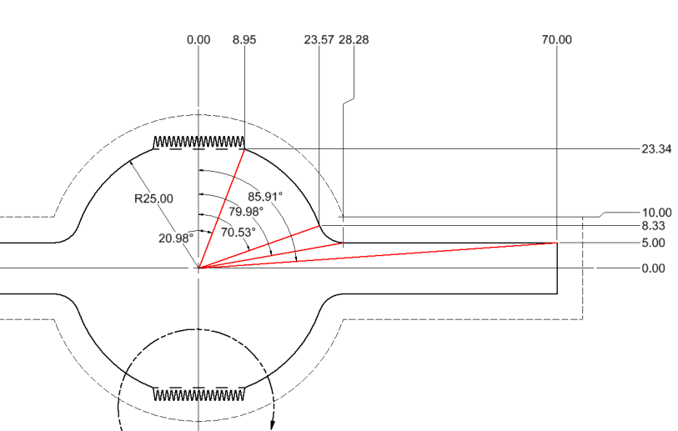
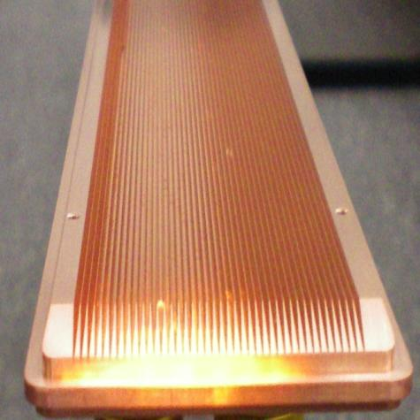
Geometrical Mitigation:
See: . A. Krasnov, Vacuum 73, 195 (2004).
And M. T. F. Pivi et al.,
J. Appl. Phys. 104, 104904 (2008).
SEY_{max}< 0.8
…
Impedence?

Slide 27
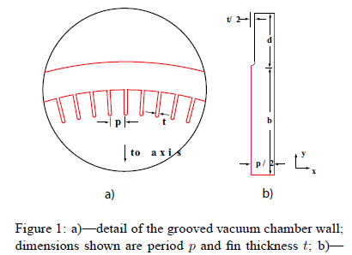
Impedance enhancement factor
(Code : Finite Element Method, PAC07 THPAS067, L Wang)
The total impedance enhancement= η * percentage of grooved surface
p=1.25mm (period)
d=2.5mm (depth)
t=0.125mm (thickness)
p=1.25mm
d=2.5mm
t=0.25mm

Slide 28
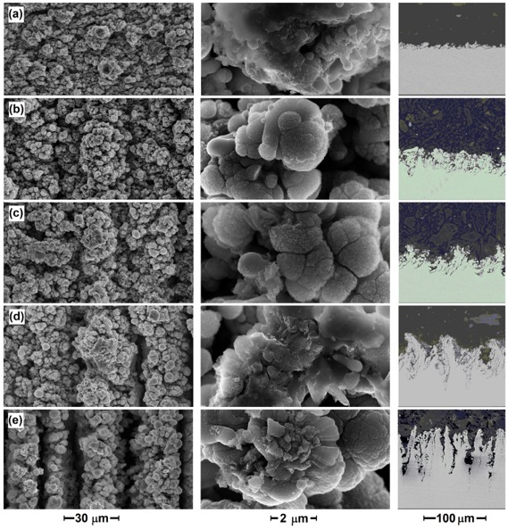
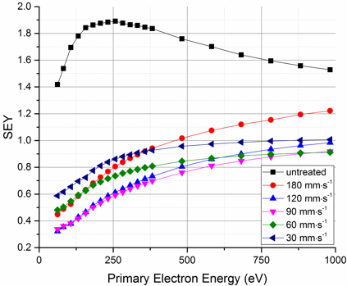
micro/nano geometrical effects
Investigation at STFC includes:
Laser scan speed
Laser wavelenght
laser treatment for e⁻cloud mitigation
See: R. Valizadeh, O.B. Malyshev, S. Wang, T. Sian, M. D. Cropper and N. Sykes. Reduction of Secondary Electron Yield for E-cloud Mitigation by Laser Ablation Surface Engineering. Appl. Surf. Sci. 404 (2017) 370–379
See also: 185. I. Montero et al., in Proc. ECLOUD’12, CERN-2013-002

Slide 29
Sample | Scan speed [mm/s] | Groove depth for LASE (Roughness for untreated metals) [μm] | Rs [Ω] measured with a 7.8-GHz cavity
Cu | untreated | 0.4 | 0.028
(a) | 180 | 8 | 0.078
(b) | 120 | 20 | 0.13
(c) | 90 | 35 | 0.14
(d) | 60 | 60 | −
(e) | 30 | 100 | −
a)
b)
c)
d)
e)
Treatment of copper using a λ = 355 nm laser resulted in creation of three different scales structures as presented:
➔ microstructure grooves ➔ coral-like submicron particles ➔ nano-spheres
Laser speed, power, λ etc. influence SEY and Rs and R&D is ongoing to optimize this technology which has been proposed as potential method to mitigate ECE in FCC-hh etc.
Could be inserted in the FCC-hh and HL-LHC

Slide 30
In LHC, its HL upgrade and FCC-hh SR induced Heat-load is significant:

Slide 31
Such SR can not be deposited on the cold bore (at 1.9 K): need to be intercepted by a beam screen at higher temperature (in LHC at 20K) and for HL-LHC and FCC-hh maybe higher (between 40-60K ?).
To dissipate ~ 5 MW in the FCC-hh :
@ 1.9 K (cold bore temperature) | > 7 GW
@ 4.2 K (Liquid He temperature) | > 3 GW
5 K < T < 20 K (LHC BS temperature) | > 1 GW
40 K < T < 60 K (FCC-hh BS temperature) | Hopefully 100 M W (max. available power!)
At Room temperature | ~ 6 - 10 M W
Running costs and cryogenics hope for highest possible temperature!

Slide 32
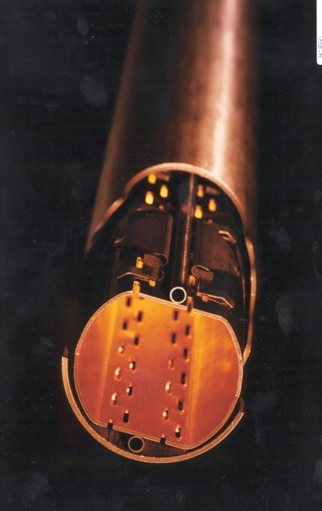
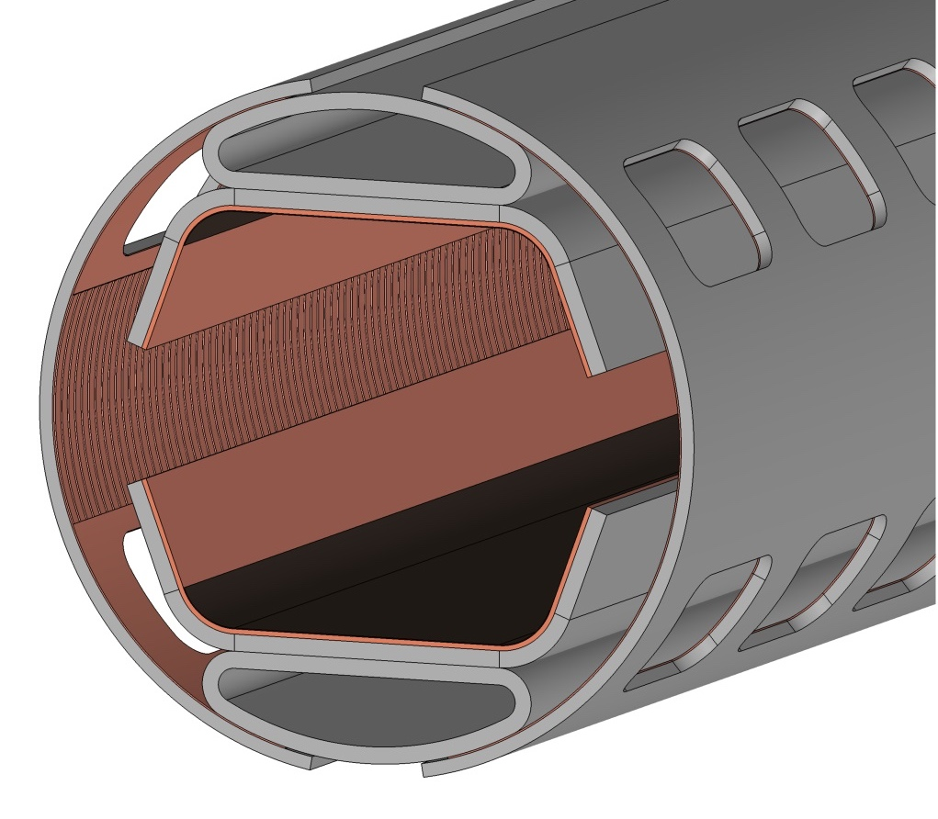
Beam Screen
*See FCC-HH DR
cooling channels
LHC BS
fCC-hh BS*
LHC
Residual Gas
Photons
Electrons
Ions
LASE
INTERACT
with:
sawtooth
surface finishing
perforated baffles

Slide 33
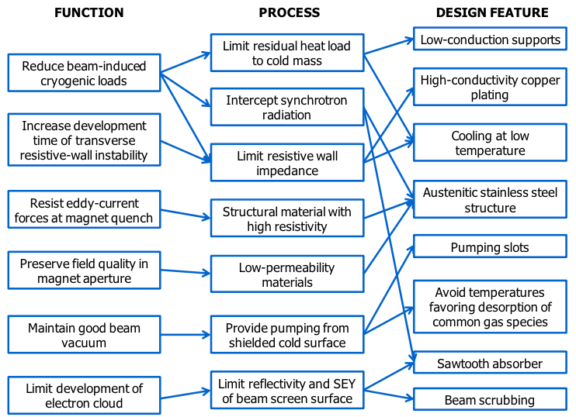
Beam Screen
From: “Cryogenic Beam Screens for High-Energy Particle Accelerators” By: V. Baglin et al CERN-ATS-2013-006 -

Slide 34
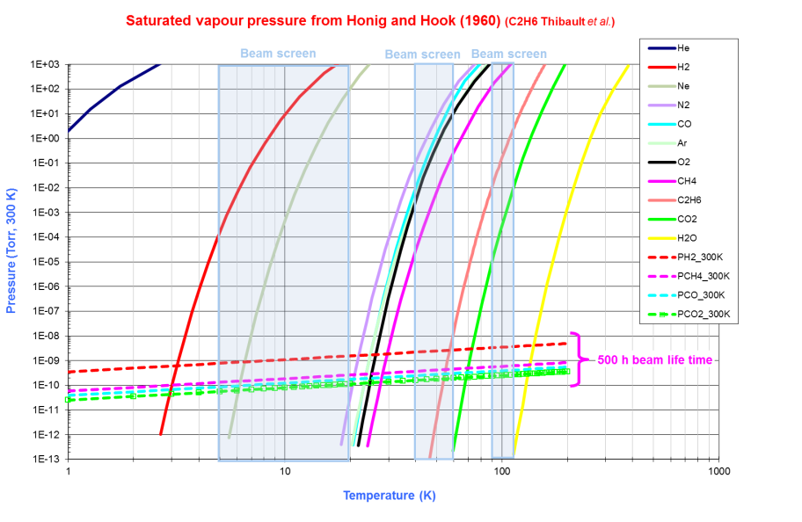
/Residual gas
Beam Screen
Working Pressure (<10⁻¹¹)
BS Temperature Range
Thermal stability must be granted: the chosen T + ΔT should be such that gasses are either always adsorbed or never (within ΔT)
Independently on the substrate treatment, the vacuum stability due to the desorption of residual contaminant gases has to be guaranteed

Slide 35
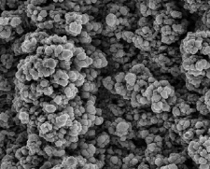
/Residual gas
Beam Screen
LASE modified Cu must therefore grant:
Low SEY
Acceptable impedance
Vacuum stability
Its micro-nano structured surface need validation also in terms of vacuum stability, since porous and under-coordinated defected adsorption sites are known to influence thermal desorption Temperature,
and, possibly, ESD and PSD….

Slide 36
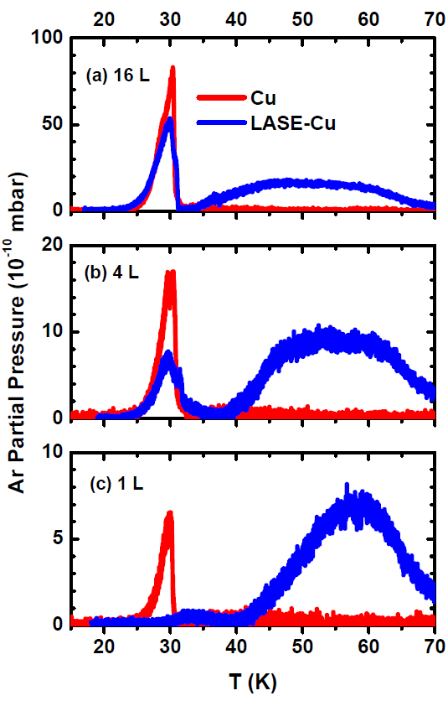
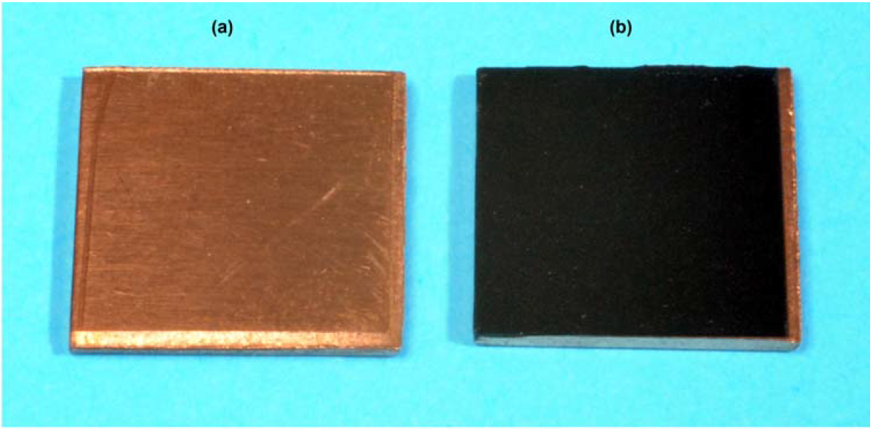
TPD from different Ar doses on a clean Cu and LASE-Cu substrate
Ar TPD results
On flat Cu Ar adsorbs due to the weak Ar-Cu and Ar-Ar Van der Waals interactions and the desorption curve consists of the sharp peak at T~30 K.
For the LASE-Cu substrate the Ar adsorption energy at the under-coordinated surface defect sites increases and desorption occurs at higher T. However, at high coverage, multilayer desorption at T~30 K is also observed.
100L
25L
10L
L. Spallino et al Submitted

Slide 37
TPD from different Ar doses on a clean Cu and LASE-Cu substrate
Ar TPD results
At higher coverages the desorption is dominated by usual Ar/Ar Van- der-Waals interaction
100L
LASE-Cu
25L
10L
LASE-Cu
At low coverages the desorption is dominated by Ar/LASE interaction
L. Spallino et al Submitted

Slide 38
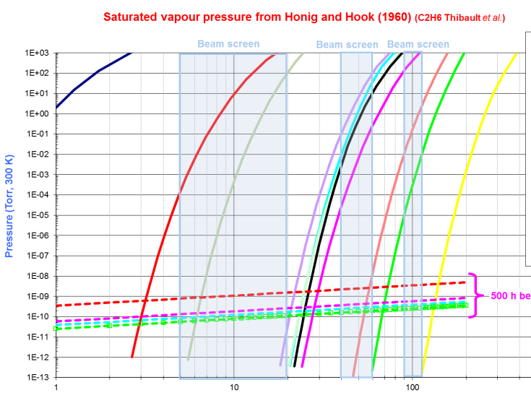
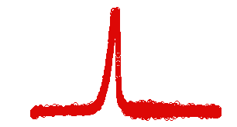
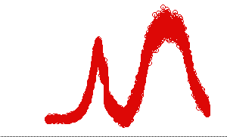
Implications for thermal stability
For ices dominated by Ar-Ar Van-der-Waals bond strength, Ar desorbs as expected T ~ 25-30 K.
For ices dominated by Ar-LASE, Ar desorbs both at T ~ 25-30 K and in a much wider range
Ar
Ar
L. Spallino et al Submitted

Slide 39
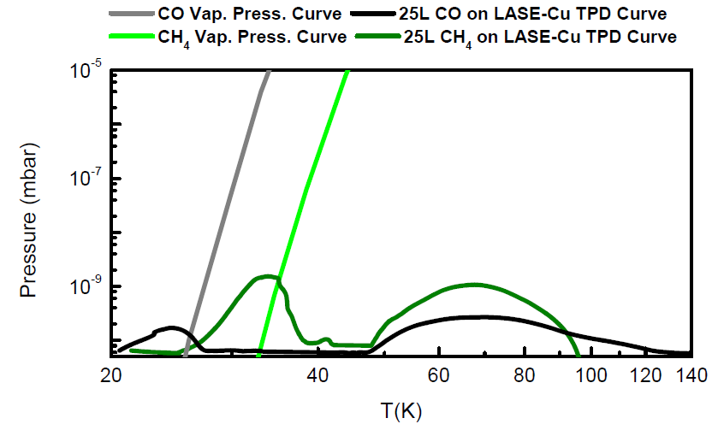
Implication for machine Vacuum Stability
Saturated vapour pressure from Honig and Hook (1960)
Wide desorption contribution over 40 K due to the morphological structuring of the material (intrinsic broad distribution of adsorbing defective sites and pores)
WARNING!
It could render very difficult to find a temperature interval for the LASE-type samples here studied where vacuum stability could be granted for all the molecular species composing the residual gas in the beam pipe components

Slide 40
Implication for machine Vacuum Stability
Nano structures may be optimized to reduce SEY and maintain thermal stability (but the physical reason why SEY is low is the same reason for the broad TPD).
R and PY and all other surface properties must be studied in details, as the effect of condensed gasses on all materials operating at LT.
Electron and photon stimulated desorption must be studied in details.
A combination of state of the art material, vacuum, cryogenics, machine, etc. studies are to be performed to validate any material to be placed within any accelerators vacuum systems
Similar results are expected for all porous materials (a closer look at a-C is than required since it is known it can be growth very porous).

Slide 41
Conclusions
Solutions mitigating ECE must be severely validated to be compliant with the many requirements on materials inside a vacuum vessel of an highest performance accelerator.
Synergy has to be stimulated & encouraged (as done in this workshop).
Multi-techniques & multi-competence laboratories must be involved.
R&D must go on to find ”best” material.
If no “magic” solution is found, compromise may be needed and discussed by the entire community, to fit the needs to the ”blanket” and not only the “blanket” to the needs.

Slide 42
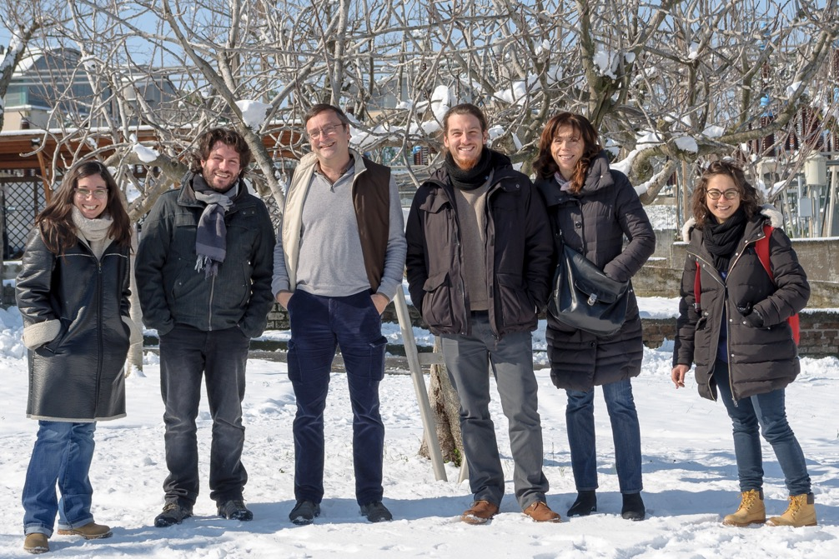
The team at LNF ...
Acknowledgements
R. Cimino
E. La Francesca
R. Larciprete
A. Liedl
M. Angelucci,
L. Spallino

Slide 43



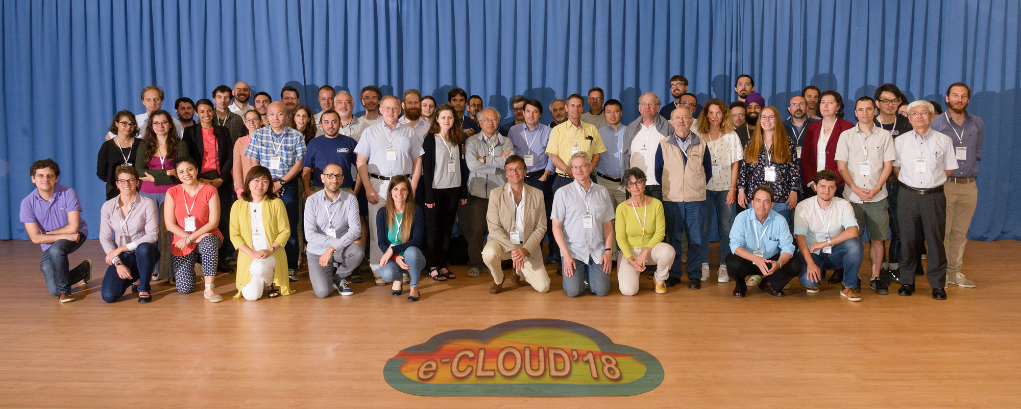
Acknowledgements
L. Gonzalez, Mario Commisso, Theo Demma, Davide Remo Grosso,
Dafne-L and Dafne Accelerator group @ INFN-LNF.
V. Baglin, I. Belafont, P, Chiggiato, R. Kersevan, M. Jimenes, G. Iadarola, G. Rumolo, M. Taborelli, F. Zimmermann etc… CERN, Geneva, Switzerland
Franz Schäfers, M. G. Sertsu, F. Siewert A. Sokolow
Institute for Nanometre Optics and Technology (INT) Berlin
And all the e⁻ cloud community

