Slide 1
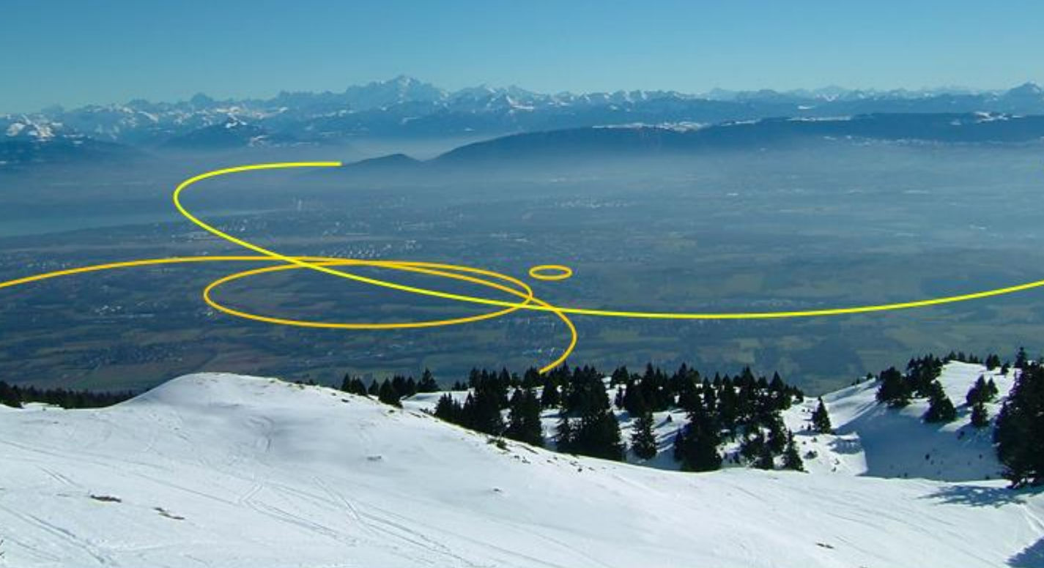

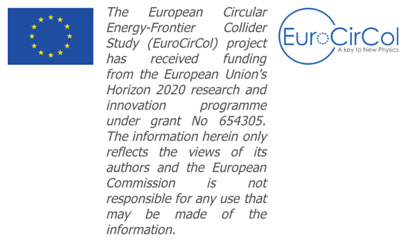
FCC-hh (single beam) collective effects
O. Boine-Frankenheim
S. Arsenyev, D. Schulte (CERN)
D. Astapovych, U. Niedermayer (TU Darmstadt)
V. Kornilov (GSI)
B. Riemann (TU Dortmund)
L. Mether, T. Pieloni, C. Tambasco (EPFL, Lausanne)

Slide 2


Future Circular Collider Study
GOAL: CDR and cost review until 2019
International FCC collaboration (CERN as host lab) to study:
pp-collider (FCC-hh) → main emphasis, defining infrastructure requirements
80-100 km tunnel infrastructure in Geneva area
e⁺e⁻ collider (FCC-ee) as potential first step
p-e (FCC-he) option
HE-LHC with FCC-hh technology

Slide 3
FCC-hh reference parameters (for beam stability)
Circumference [km] | 100
Energy [TeV] | 3-50
Bunch charge | 10¹¹
Bunch spacing [ns] | 25
Bunch length [cm] | 8
Number of bunches | ≈ 10000
Q_{x} / Q_{y} | 108.28 / 107.31
Q_{s} | 10⁻³-5 x 10⁻³
Normalized emittance | 2.2 μm
Luminosity [cm⁻²s⁻¹] | 5 x 10³⁴
FCC vs. LHC
Larger circumference, lower frequency of 1 kHz (5:1)
screen temperature: 50 K (5:2)
Smaller screen diameter (2:3), thicker (4:1) Cu coating
Smaller beam (1:3)
LHC-like bunches (1:1)
Larger average β-function (2:1)
Aim of the studies: Predict instability thresholds
-> Use LHC results together with numerical tools.

Slide 4
Beam stability: LHC vs FCC
Growth rate for transverse coupled bunch instabilities:
TMCI single bunch threshold bunch intensity:
Larger circumference (5:1) -> lower frequency: 1 kHz vs 8 kHz
Smaller screen diameter (2:3) -> larger impedance (factor 3)
screen temperature: 50 K (5:2), maximum field 16 T (2:1) -> changed conductivites
Larger average β-function (2:1) -> growth rates
Smaller beams (1:3) -> weaker Landau damping, e-cloud thresholds
LHC-like bunches and 25 ns spacing (1:1)

Slide 5
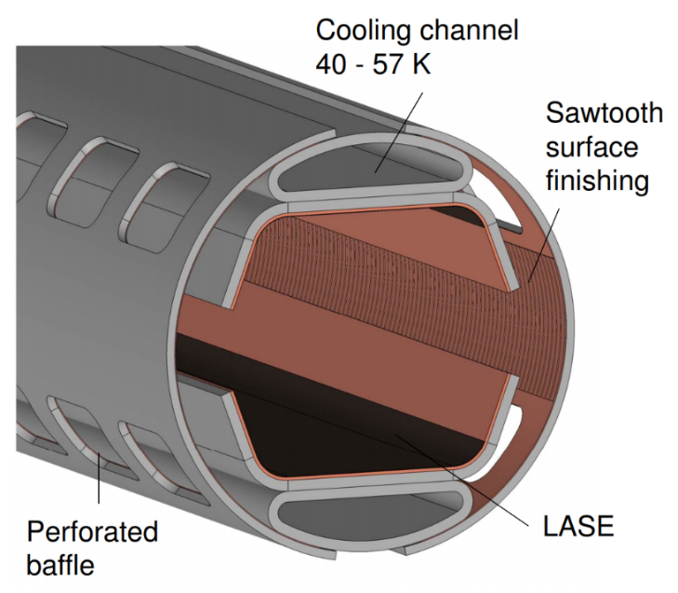
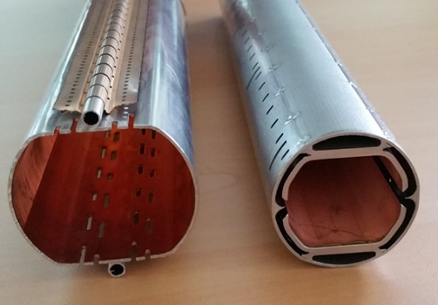
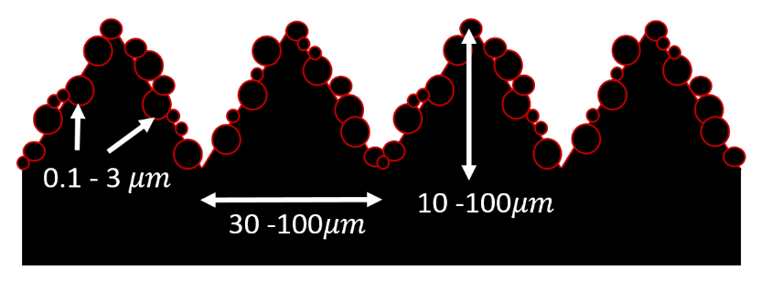
FCC-hh beam pipe design and coatings
Cu coating
for impedance
FCC
(old
design)
FCC
(new)
LHC
FCC beam pipe (right) optimized for
synchrotron radiation and suppression
of photo electrons
or a-C for e-cloud
LHC vs FCC:
20 W/m synchrotron radiation (100:1)
or AC
Laser treated beam screen (option)

Slide 6
Collective effects in FCC and codes
Time-domain:
CST particle studio (3D)
Frequency domain:
BI2D (U. Niedermayer)
beam pipe
e⁻
Bunch
Wake fields and impedances:
(lab system)
Image current
-> heat loads and instabilities
Electron clouds:
created wall emission and other mechanisms.
-> heat loads, emittance growth and instabilities
„Vlasov solvers“:
DELPHI (N.Monet), NHT (A. Burov)
Tracking codes:
PATRIC (V. Kornilov)
OpenCloud (O. Haas, F. Petrov)
PyCloud (G. Iaderola, CERN)
Challenge for simulations:
Interplay of different mechanisms !
Beam-beam interaction:
Can cause coherent instabilities.

Slide 7
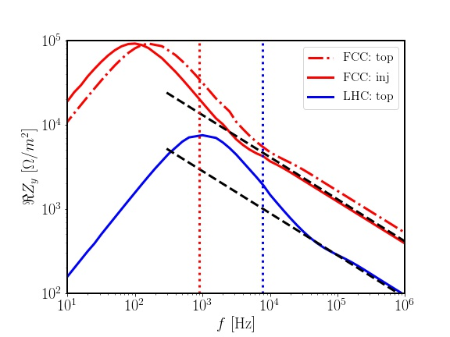
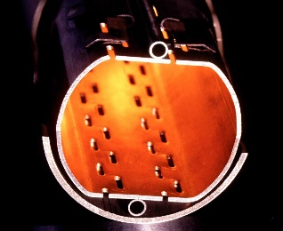

Resistive wall impedance: LHC and FCC-hh
Coupled bunch growth rate:
(Sacherer 1974)
(chromatic phase shift)
FCC
$$ω_{min}=\left(n−Q_{y}\right)ω_{0}$$
Transverse impedances (vertical real part)
(lowest sideband)
growth time at 3.3 TeV:
approx. 50 turns
at 50 TeV:
approx. 500 turns
LHC at 7 TeV:
approx. 2000 turns
b=0.012 m
b=0.02 m
LHC
LHC:
few kHz
FCC: kHz
(Thick) resistive wall impedance
Remark: difference between injection and top energy due to magnetoresistance.

Slide 8
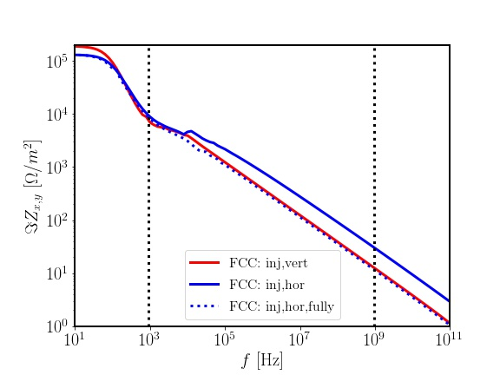
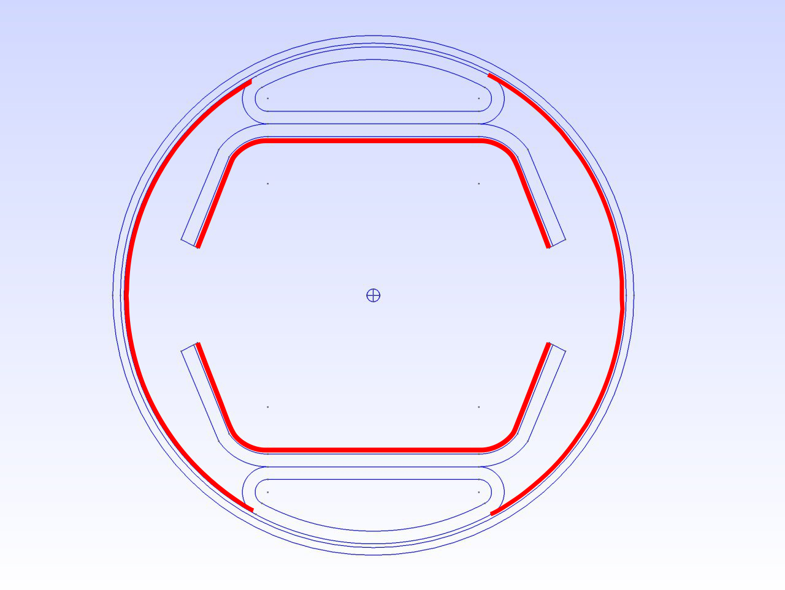
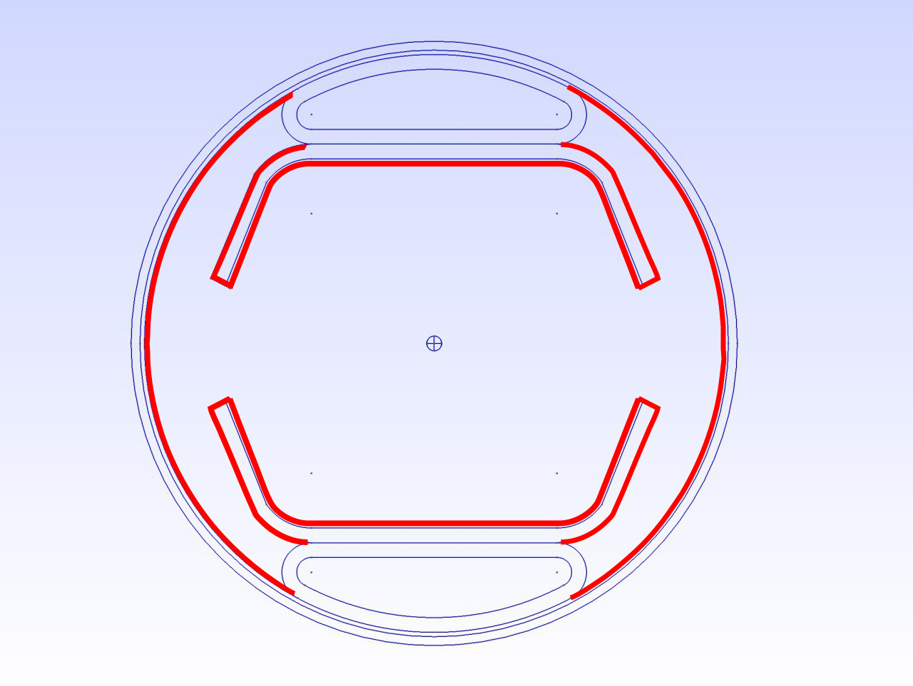
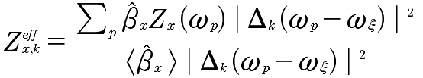
Single bunch TMCI threshold: Effect of coating
Design Cu coating
(d=0.3/0.1 mm)
(tune shift)
(synchrotron tune)
TMCI threshold bunch intensity:
‚Full‘ Cu
coating
„Full“ Cu coated:
Partially Cu coated:

Slide 9
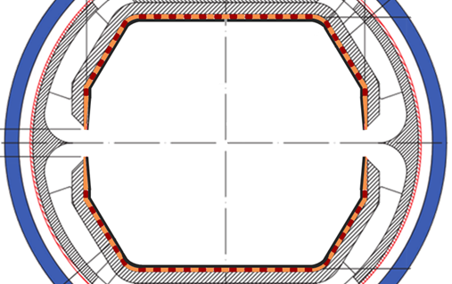
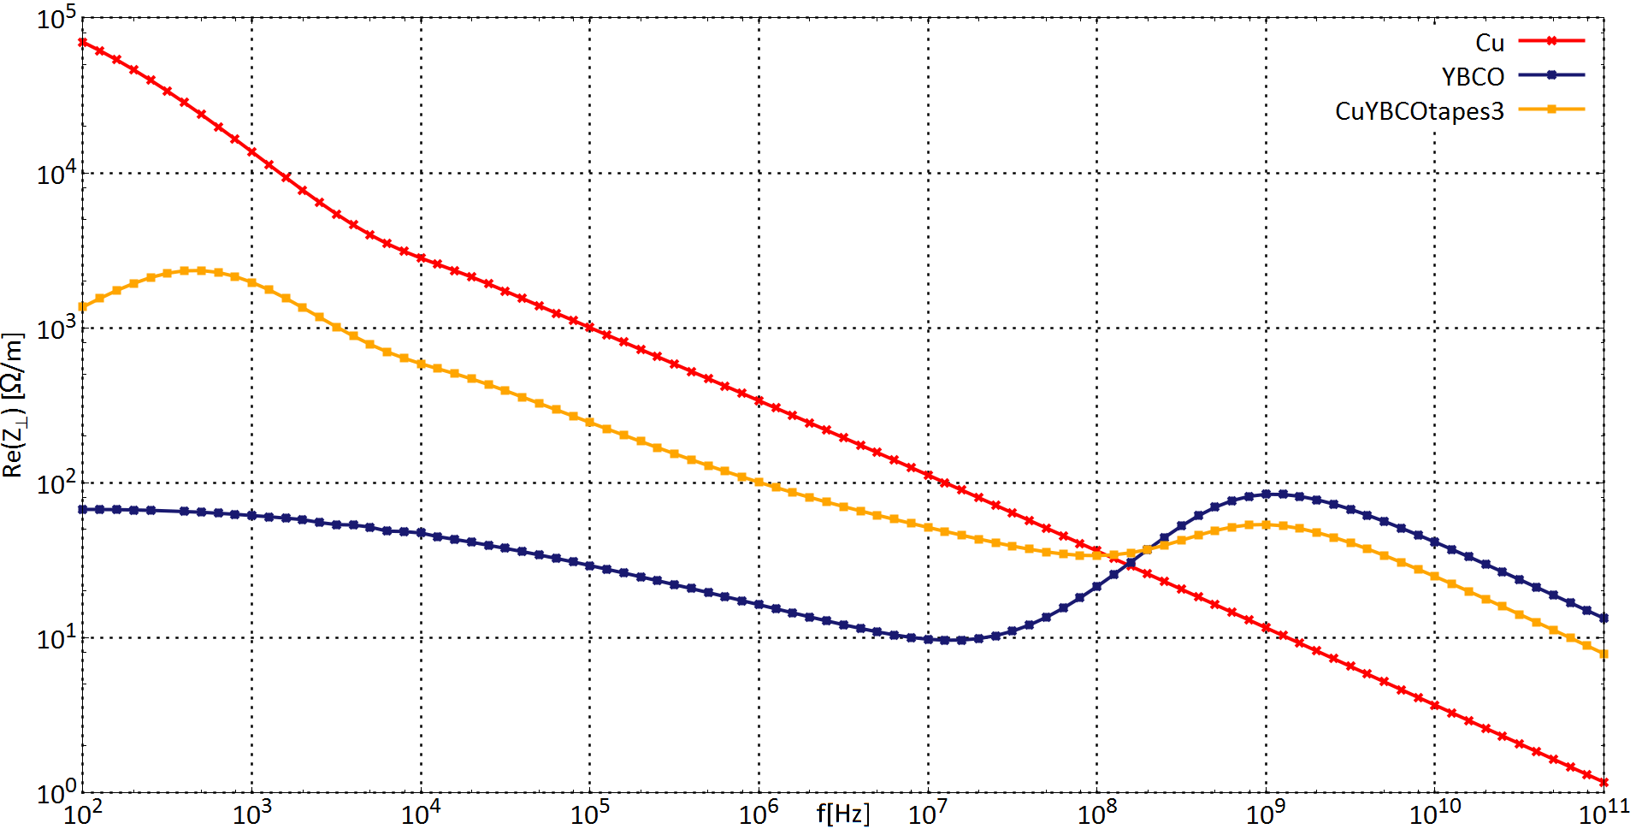

HTS coated FCC screen (R&D)
Hybrid coating (HTS stripes):
Possible reduction of the resistive wall instability growth rates by factor 5-6.
TMCI thresholds !
Hybrid coating
B=16T
P. Krkotic et al., High-temperature superconductor coating for coupling impedance reduction in the FCC-hh beam screen, Nucl. Instr. Meth. A, (2018)
“depinning frequency“
$$f_{p}$$
P. Krkotic,
U. Niedermayer

Slide 10
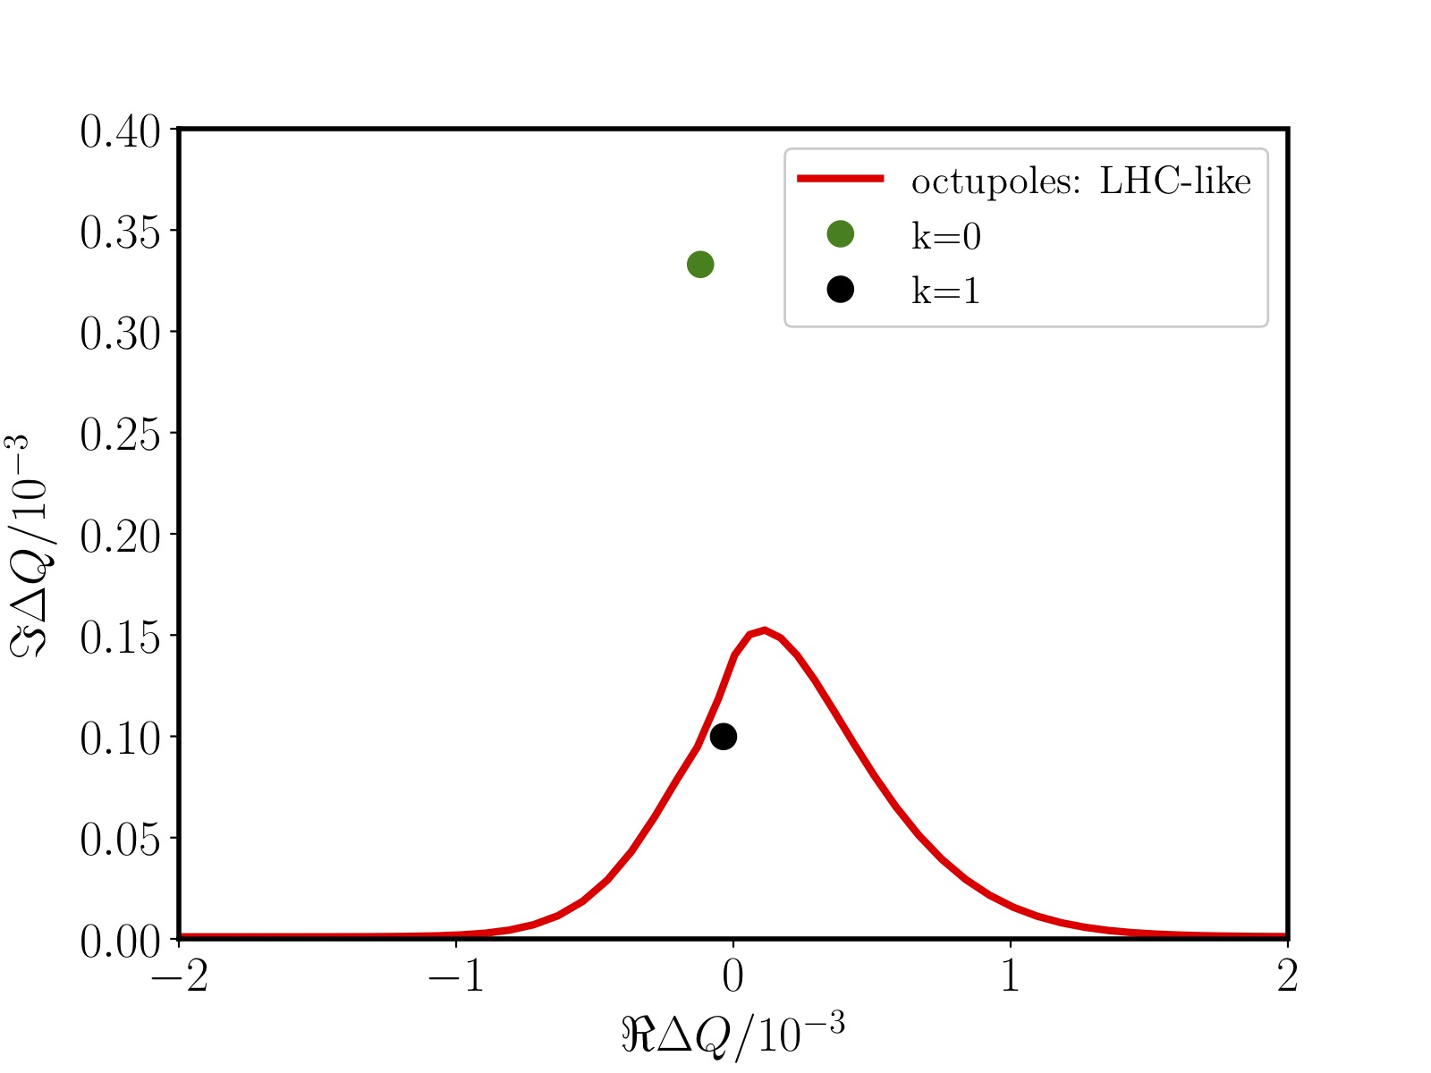
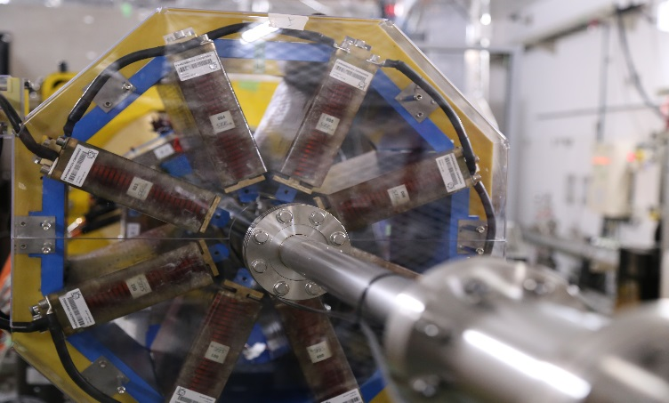





Landau damping with octupoles
2D dispersion relation:
Tune shifts from octupoles:
${( J}_{x,y}:$actions variables )
Scaling with energy:
k=0: transverse feedback system
$$⇒N_{oct}L_{m}∝E_{0}^{2}$$
From LHC to FCC-hh:
7² x 168 octupoles
Landau octupoles
$$E_{0}=γ_{0}mc^{2}$$
$L_{m}:$length of octupole
$N_{oct}:$# of magnets

Slide 11
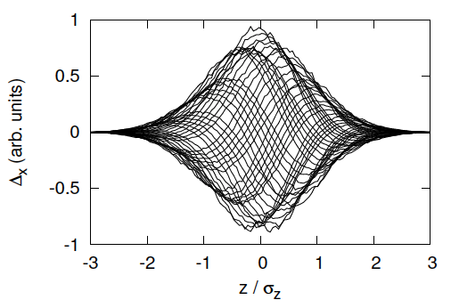
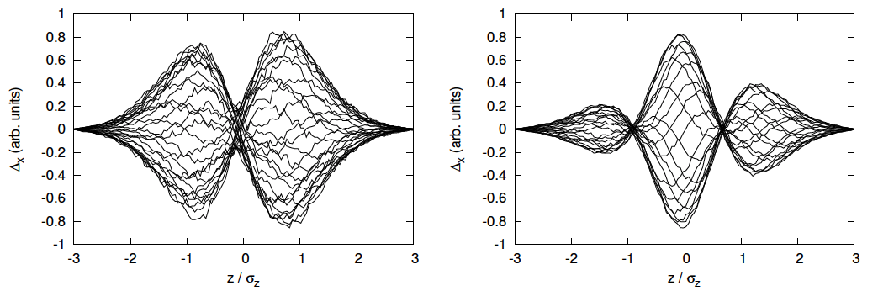
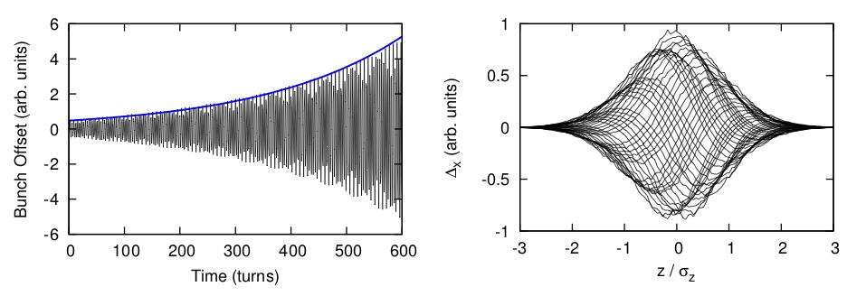
Landau damping of head-tail modes
LD of non-rigid head-tail modes:
k=0 k=1 k=2
PATRIC:
Particle tracking with octupoles and resistive wall wake.
V.Kornilov

Slide 12
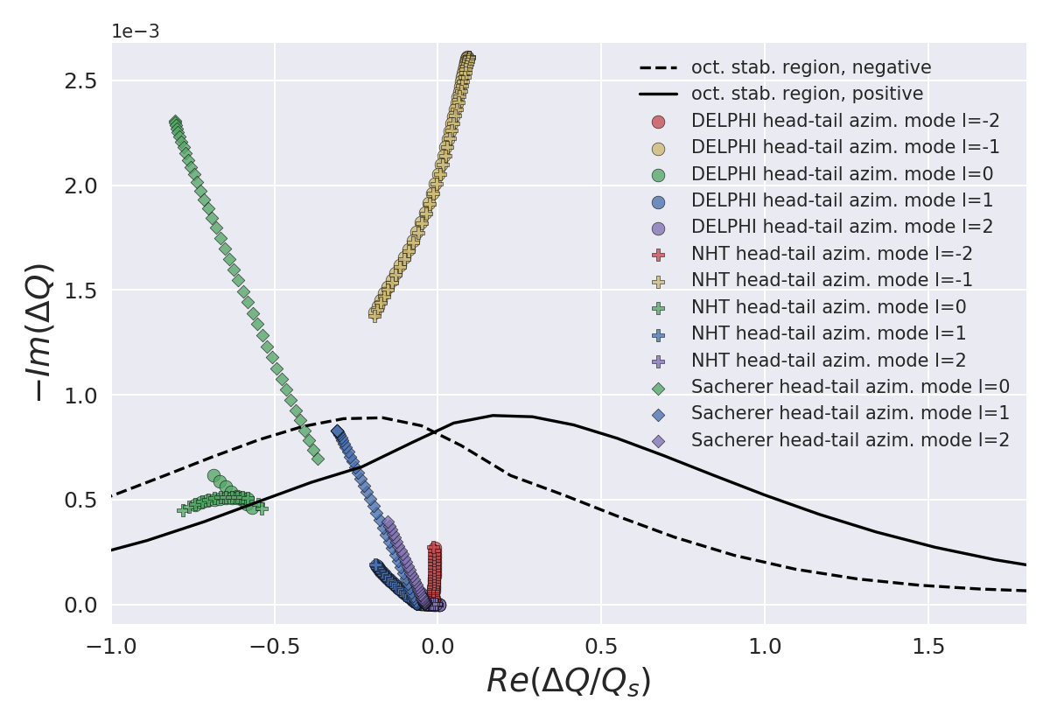
Coupled bunch mode coupling
„Vlasov solvers“: DELPHI (N. Monet), Nested Head-Tail (NHT) (A. Burov)
S. Arsenyev, H. Klinkenberg (2018)

Slide 13

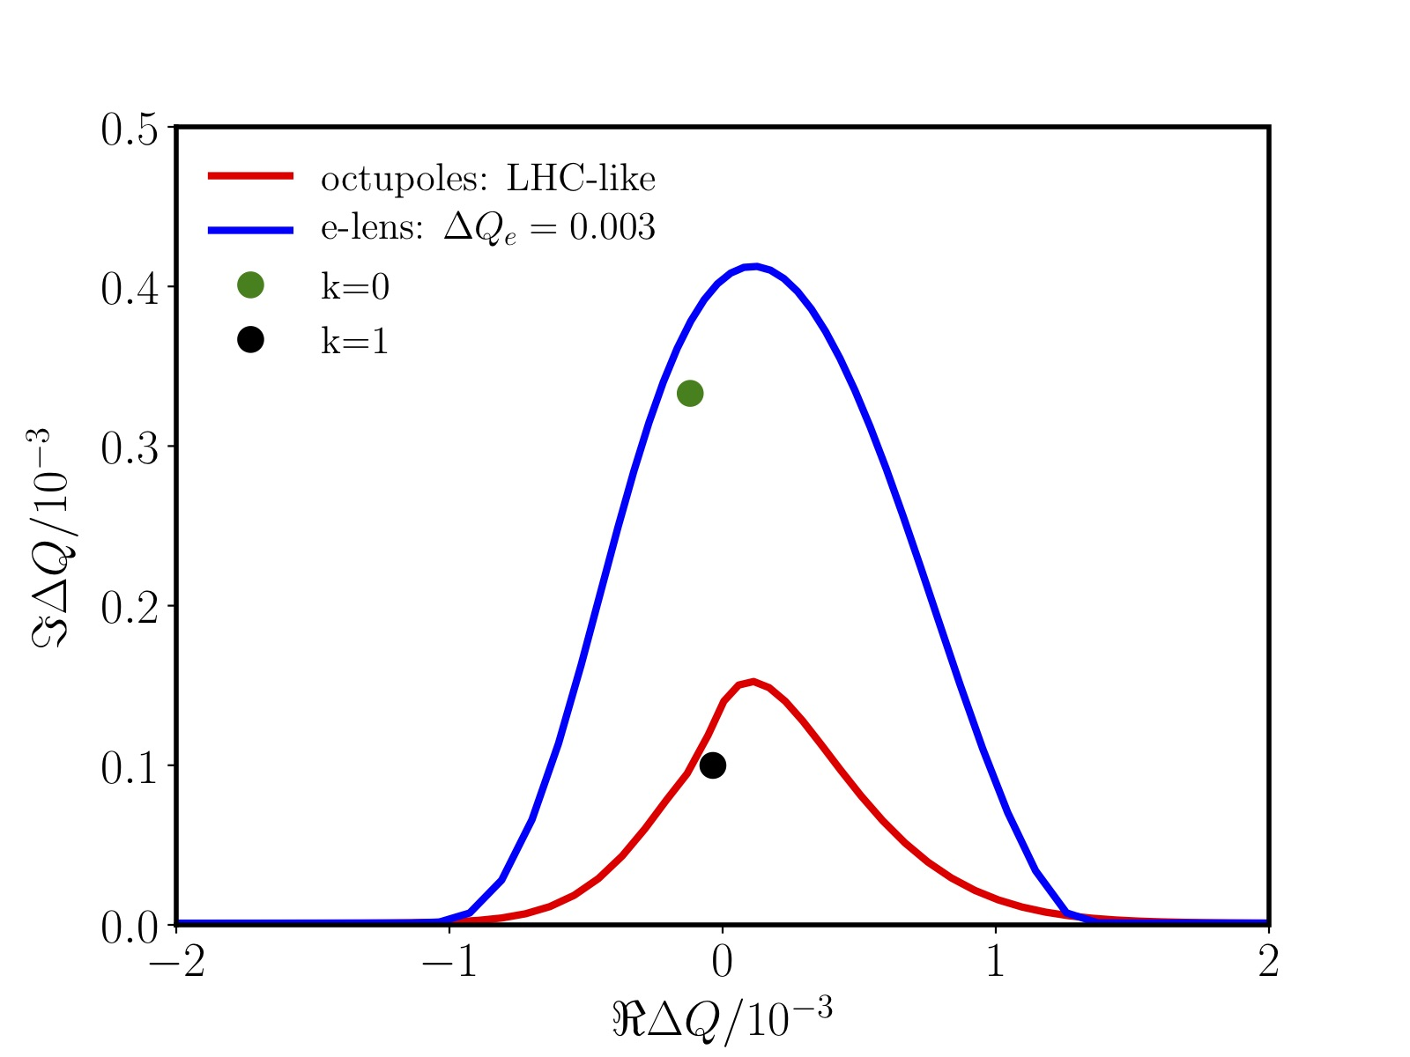
„Advanced“ Landau damping: Electron lenses
Tune shift:
Similar to the beam-beam force !
Electron lenses
Tune shift induced by a
counter-propagating electron beam:
V. Shiltsev et al., PRL (2017)
Remark: Octupoles will also stabilize unstable beams, at the cost of a larger emittance.
Example: One lens (l=2 m, I_{e} <1 A) in FCC would provide a tune spread larger than the LHC-like octupoles octupoles.

Slide 14
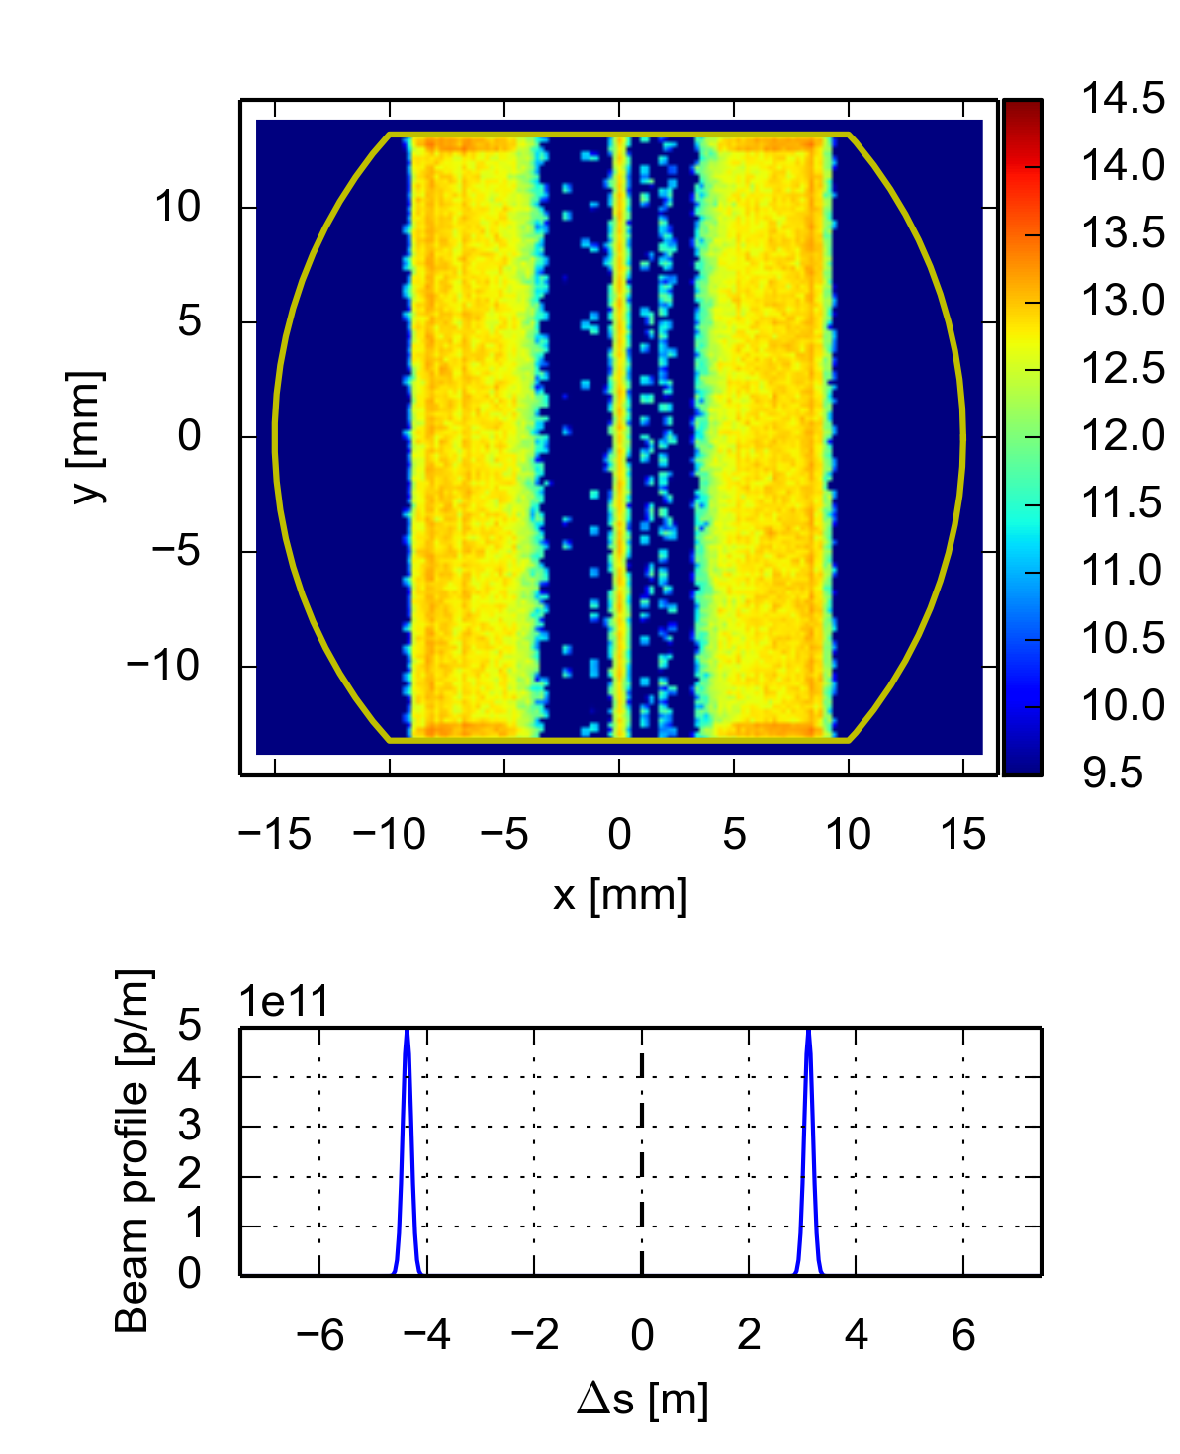
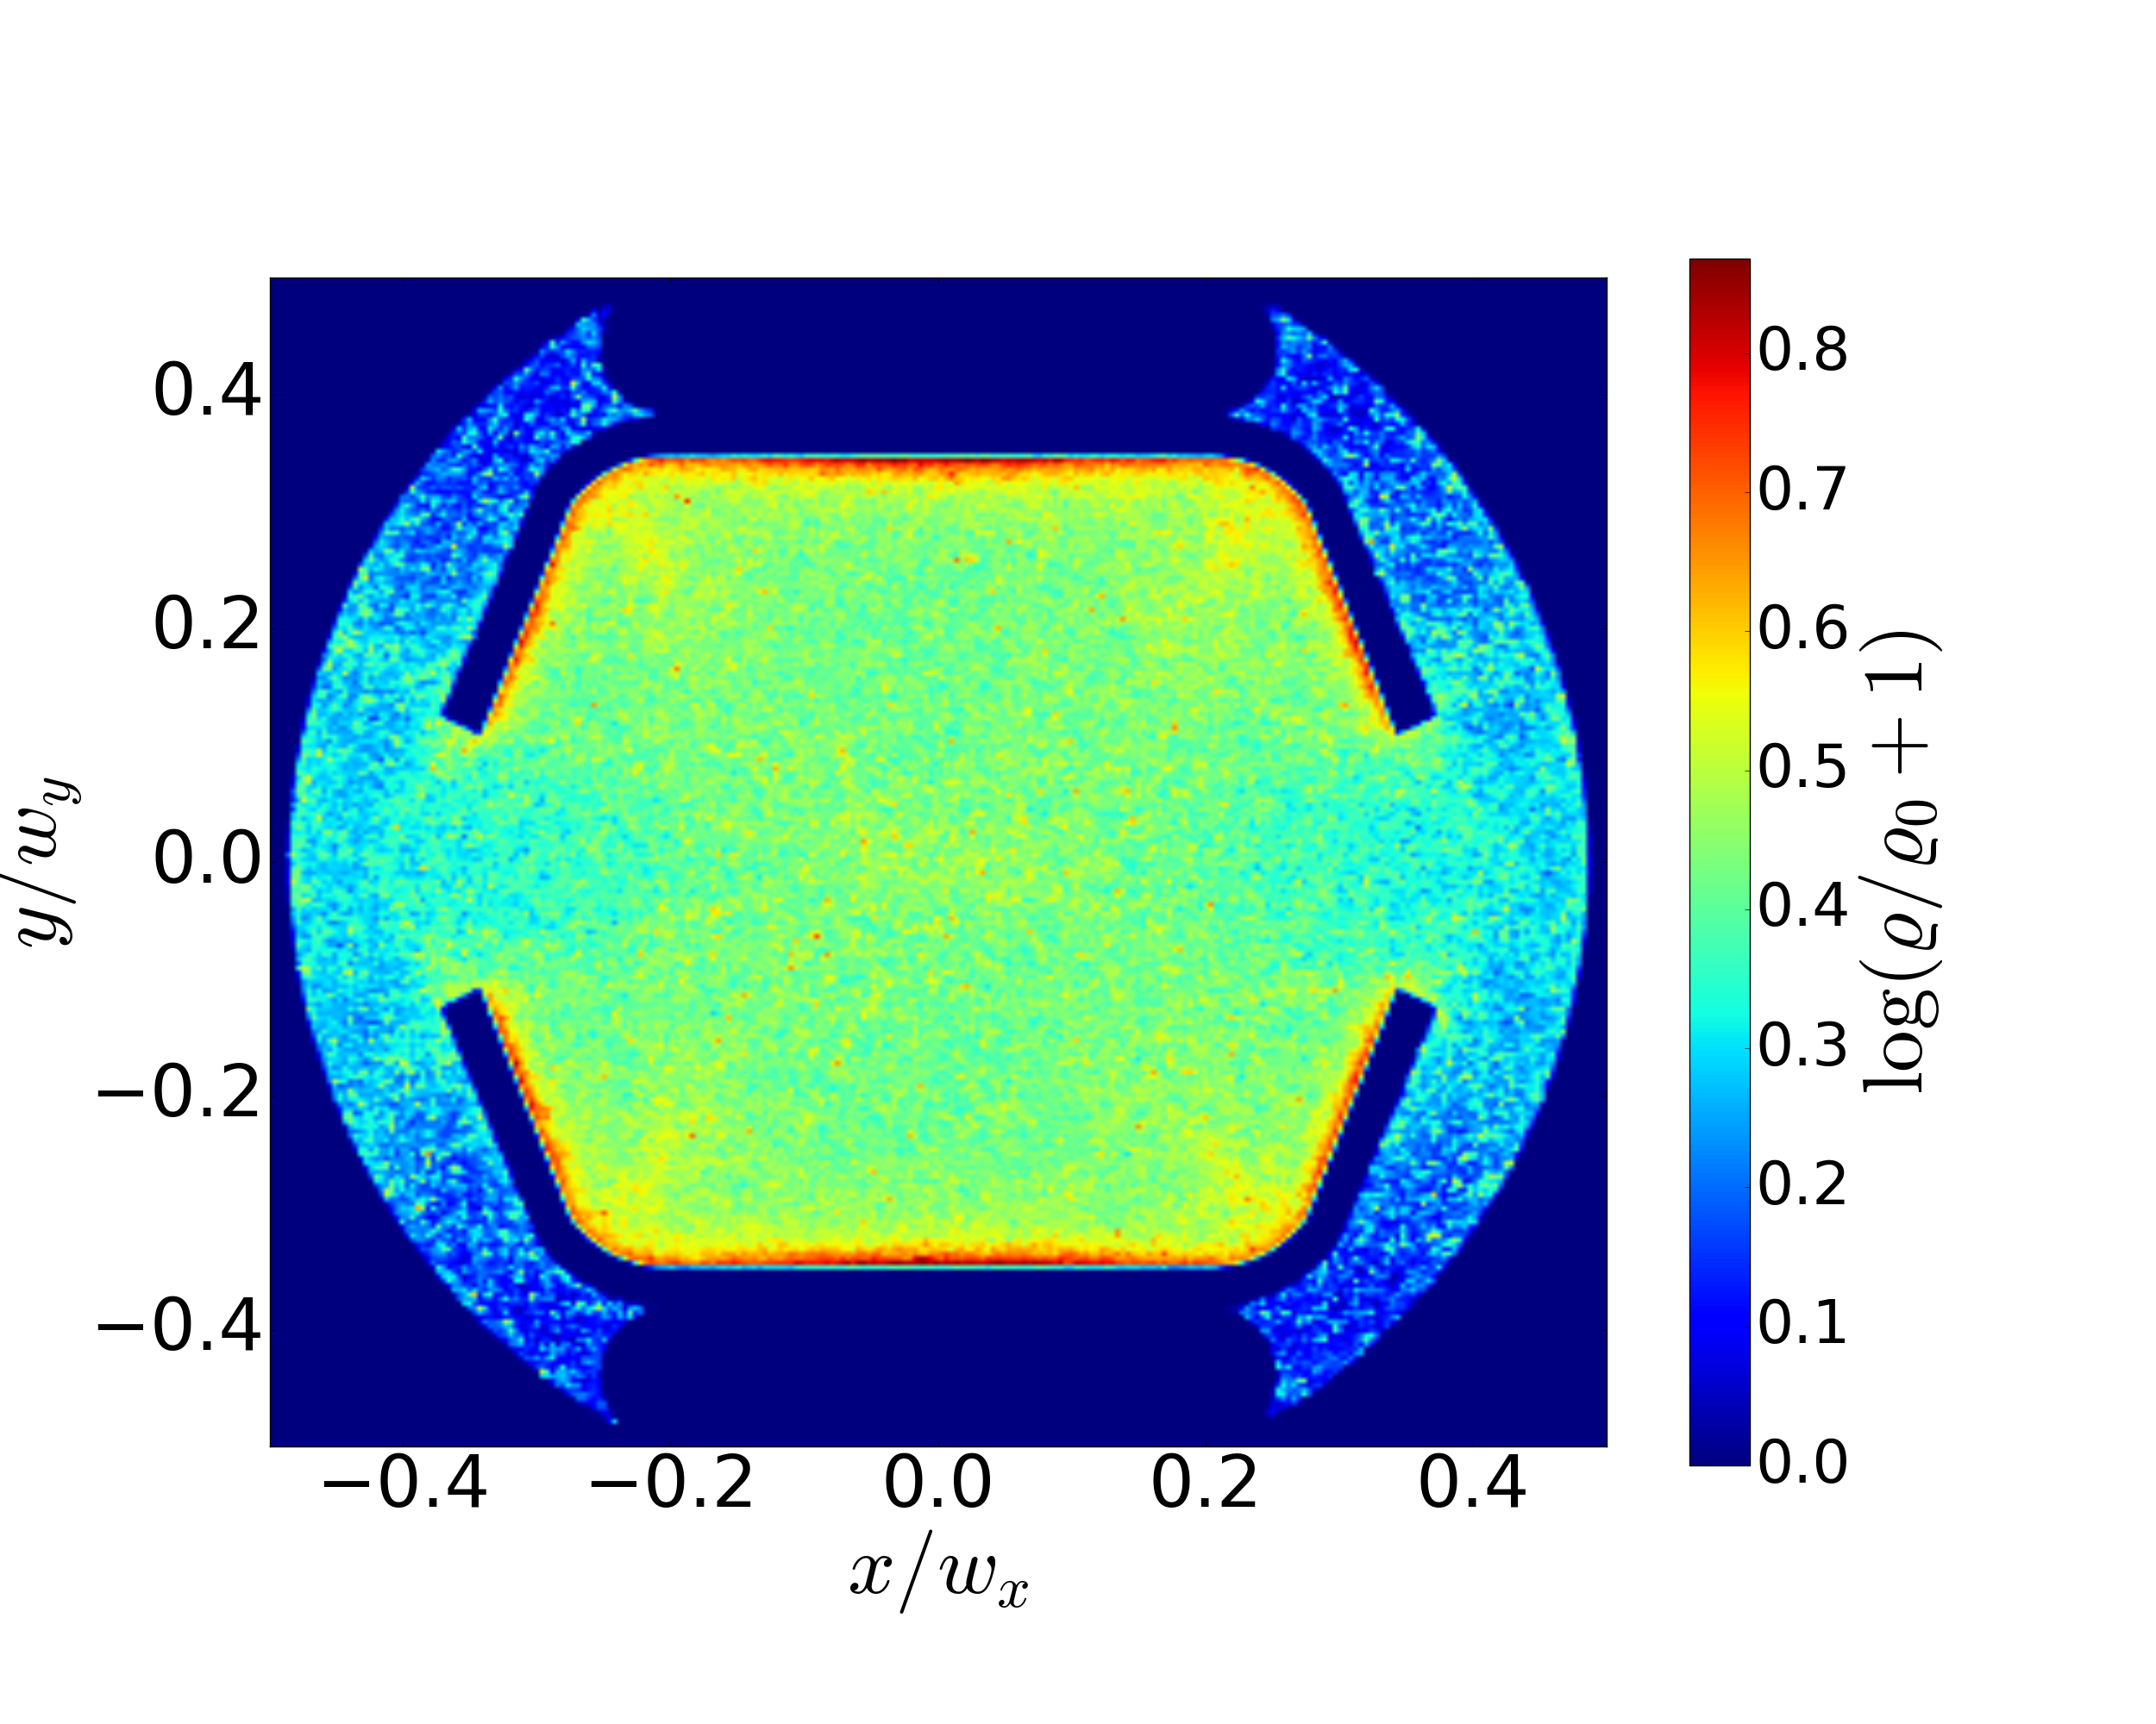
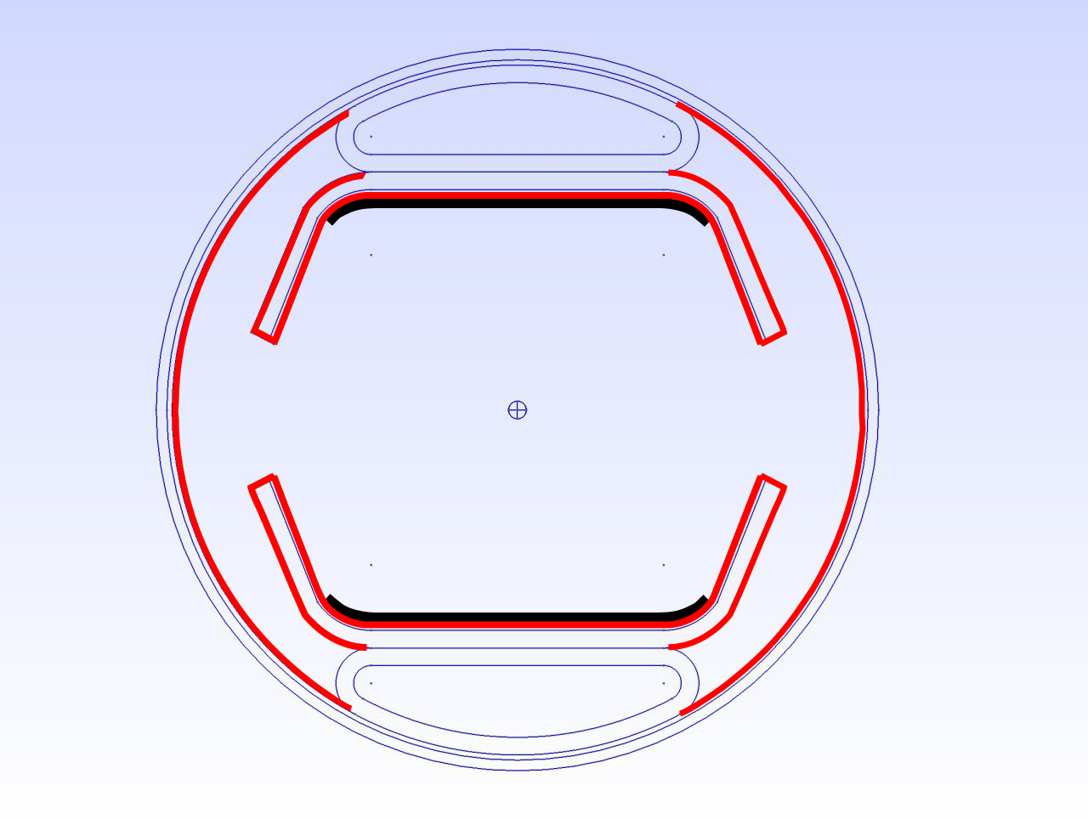
Electron cloud in FCC
Example from openECLOUD:
Saturated e-cloud density in FCC
drift section without any coating
In dipole magnet:
The coating should cover the full top and bottom of the chamber
(pyCloud, L. Mether).
If the the FCC screen will be (partly) a-C coated (with SEY lower/equal 1) and the screen design avoids photoelectron entering in the pipe, electron could induced instabilities should be absent in the FCC.
Pipe with a-C coating

Slide 15
Conclusions
FCC-hh beam stability: Benefit from LHC experience and models. Understand scaling and „error bars“ of simulation predictions.
Impedances studies:
Pipe and coatings: Cu and HTS (option) for impedance , aC or Laser (option) for SEY
Impedance library
Beam stability and limits (remark: head loads dominated by synchrotron radiation).
Coupled bunch damped by Octupoles (k>=0) and Feedback (k=0)
Single bunch TMCI (might be an issue with laser coating and collimators)
Coupled bunch TMCI
Electron lenses and RF Quadrupoles for Landau damping
Electron cloud:
(Minimum) coating for e-cloud suppression
Role of residual photo electrons

Slide 16
Backup

Slide 17

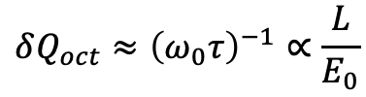

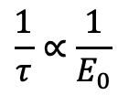



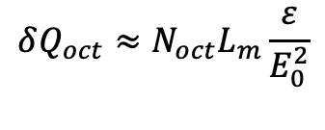

Landau damping at very high energies
The good news:
$$\frac{1}{τ}∝\frac{1}{E_{0}}$$
(instability growth rate)
The OK news:
$$δQ_{oct}≈{\left(ω_{0}τ\right)}^{−1}∝\frac{L}{E_{0}}$$
(tune spread required for LD)
The bad news:
$$δQ_{oct}≈N_{oct}L_{m}\frac{ε}{E_{0}^{2}}$$
(tune spread provided by octupoles)
$$⇒N_{oct}L_{m}∝E_{0}^{2}$$
$$E_{0}=γ_{0}mc^{2}$$
$L:$circumference
From LHC to FCC-hh: 7² x 168 octupoles
$L_{m}:$length of magnet
FCC transverse beam stability:
k=0 coupled bunch modes: Feedback (50 turns)
k>1 modes: Landau damping (octupoles)
$N_{oct}:$# of magnets
$ε:$normalized emittance

Slide 18
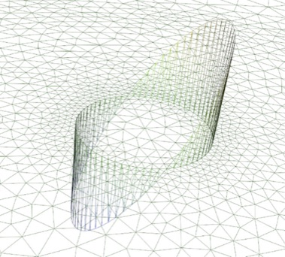
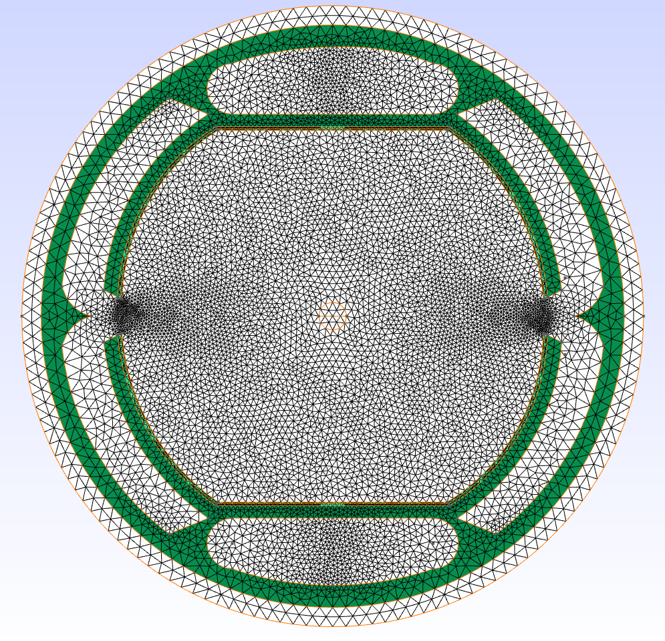
2D impedance code in frequency space
Open source package FEniCS
(A. Logg, K. Mardal, G. Wells et al.)
Mesh from GMSH
(C. Geuzaine, J. Remacle)
Frequency domain
impedance solver:
More accurate at low
frequencies (kHz)
Dipolar current source term
U. Niedermayer et al., Space charge and resistive wall impedance computation in the frequency domain using the finite element method, Phys. Rev. ST-AB 18, 032001, 2015
BeamImpedance2D (PYTHON): https://bitbucket.org/uniederm/beamimpedance2d.git

Slide 19
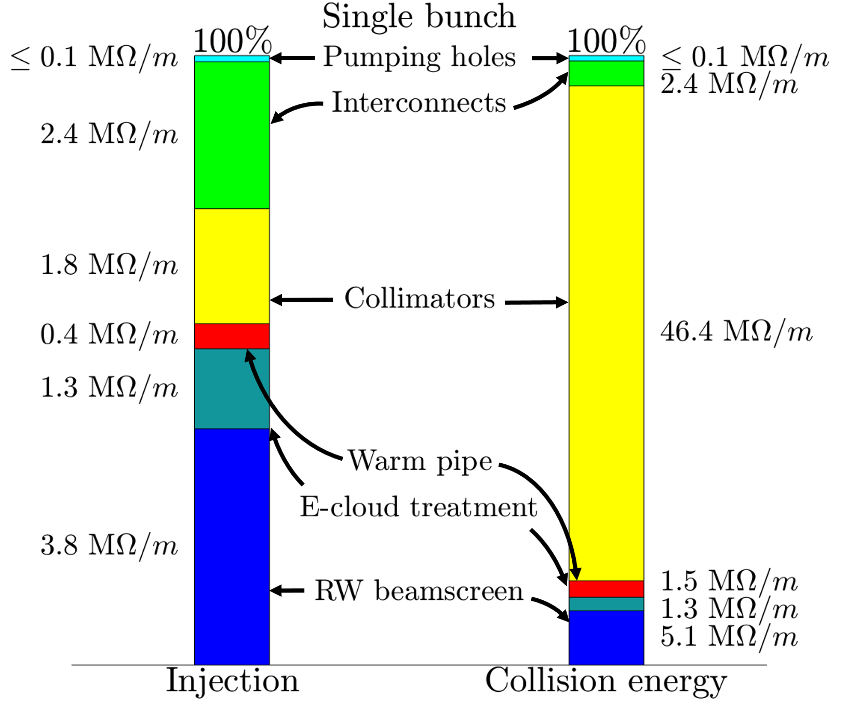
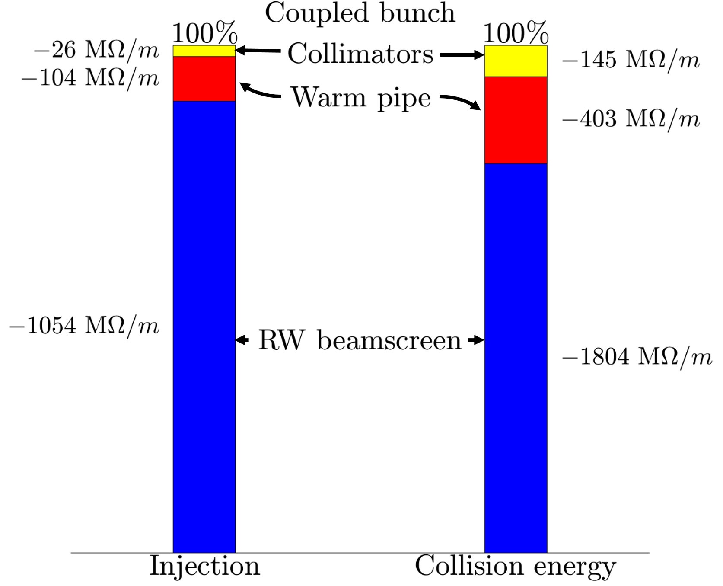
Impedance contributions and database
: Spectrum of head-tail modes
Example: Coupled bunch instability
Example: TMCI
S. Arsenyev (IPAC 18)

Slide 20


Octupoles and Landau damping
Tune shifts from octupoles:
2D dispersion relation [1-3]:
${( J}_{x,y}:$actions variables )
[1] H. G. Hereward, CERN 65-20 (1965)
[2] J. S. Berg, F. Ruggiero, CERN SL-AP-96-71 (1996)
[3] J. Gareyte, CERN-LHC-Project-Report-91 (1997)
Scaling with energy:
2D beam distribution:
$$⇒N_{oct}L_{m}∝E_{0}^{2}$$
From LHC to FCC-hh:
7² x 168 octupoles
rms tune spread:
$$E_{0}=γ_{0}mc^{2}$$
$L_{m}:$length of magnet
$N_{oct}:$# of magnets
Very approximate stability condition

Slide 21
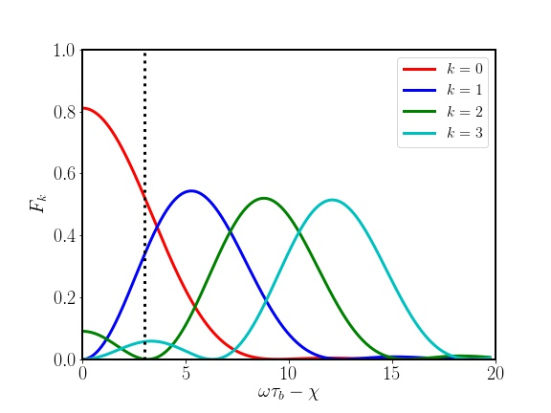
Finite chromaticity
Form factor for different k
Example case Q‘=15: the growth rates for the k=0 coupled bunch mode would be lower by a factor 0.6, but the k=1 mode would be present in addition (growth rate corresponding to 650 turns at injection).
(Sacherer 1974)

Slide 22
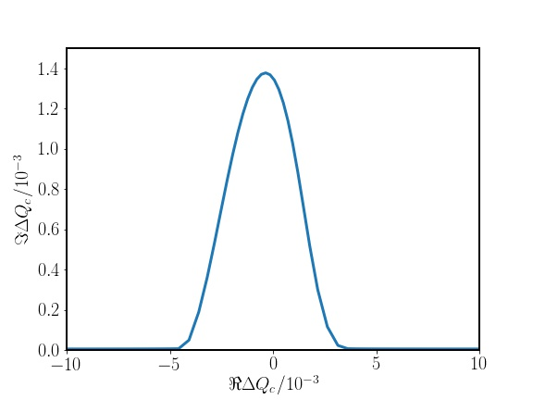



Landau damping: Possible alternative schemes
FCC-hh: Active feedback for k=0 modes, Landau damping for k>1.
Still, additional Landau damping concepts are helpful !
LHC: 10 x larger stability area then with octupoles
Radio-Frequency
Quadrupole (RFQ)
Shiltsev et al
PRL 2017
$$ΔQ^{max}=0.01$$
Electron lenses
$$l_{e}=2 \text{m}$$
Grudiev PRAB 2014
Schenk et al, IPAC17
Shiltsev et al PRL (2017)
$$I_{e}=0.8 \text{A}$$
Tune spread induced by a
counter-propagating electron beam:
(longitudinal action)
No local spread (in z) !
Dispersion relation and Landau damping ?
Detailed particle tracking studies are ongoing (see also V. Kornilov).

