Slide 1
FCC RF beam dynamics and HOM power challenges
Ivan Karpov, CERN
Acknowledgments: P. Baudrenghien, O. Brunner, A. Butterworth, R. Calaga, E. Shaposhnikova, D. Teytelman

Slide 2
Future circular electron-positron collider FCC-ee
Tunnel circumference, $C=\text{97.75}$ km
Experimental program has 4 energy stages
Maximum acceptable power loss per beam due to synchrotron radiation is 50 MW
 | Z | W | H | $$t\overline{t}$$
Energy/beam $E$ [GeV] | 45.6 | 80 | 120 | 182.5
Energy loss/turn $U_{0}$ [GeV] | 0.036 | 0.34 | 1.72 | 9.21
RF voltage/beam $V_{RF}$ [GV] | 0.1 | 0.75 | 2.0 | 10.93
Beam current $I_{b,DC}$ [mA] | 1390 | 147 | 29 | 5.4

Slide 3
Beam-cavity interaction challenges in FCC-ee Z
The Z machine has the highest beam current and the lowest total RF voltage
Power losses due to high order modes (HOM) must be extracted by HOM couplers (maximum 1 kW/coupler in SC RF)
Transient beam loading leads to bunch length spread or/and to shift of collision point, therefore to possible reduction of luminosity

Slide 4
HOM power loss
Simulated cavity
impedance
Normalized Fourier harmonics
of beam current
$$P=I_{b,DC}^{2}\sum_{k=−∞}^{∞}{Re\left[Z_{||}\left(kf_{rev}\right)\right]{\left|I_{k}\right|}^{2}}$$
$I_{b,DC}$ – average beam current
$f_{rev}$ – revolution frequency
$k$ – revolution harmonic number
$→$ Power losses depend on HOM impedance and beam spectrum (ring filling schemes)

Slide 5
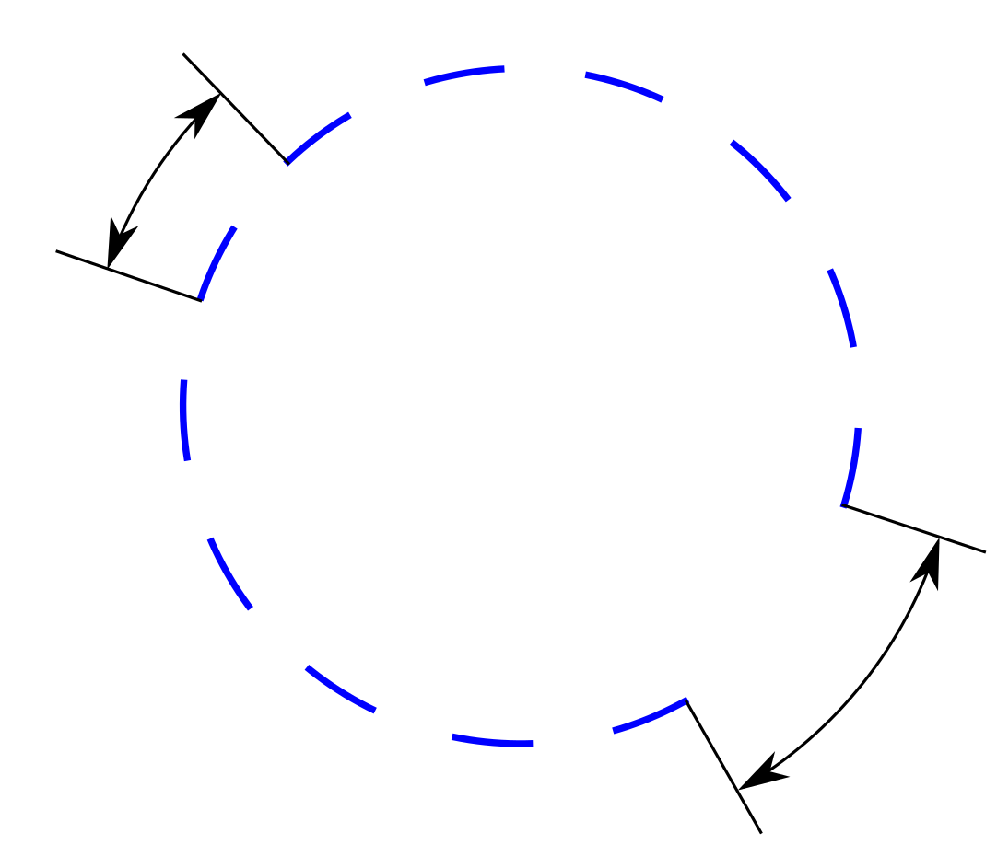
Possible beam filling schemes
Number of trains, $n_{tr}$
Train spacing, $t_{tt}$
Number of bunches
per train, $M_{b}$
Bunch trains
Bunch spacing,
$t_{bb}=$ 2.5 ÷ 17.5 ns
Abort gap,
$t_{gap}$ = 2 μs
Beam spectrum is dominated by:
$1/t_{bb}$ lines (always present)
$1/t_{tt}$ lines (depending on number of trains)

Slide 6
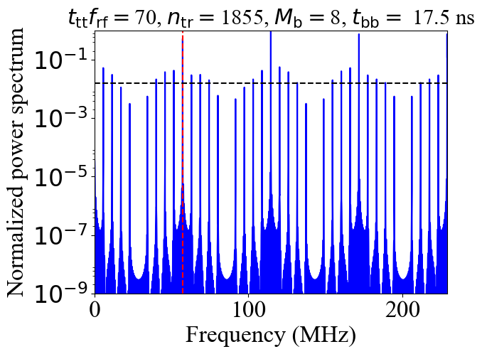
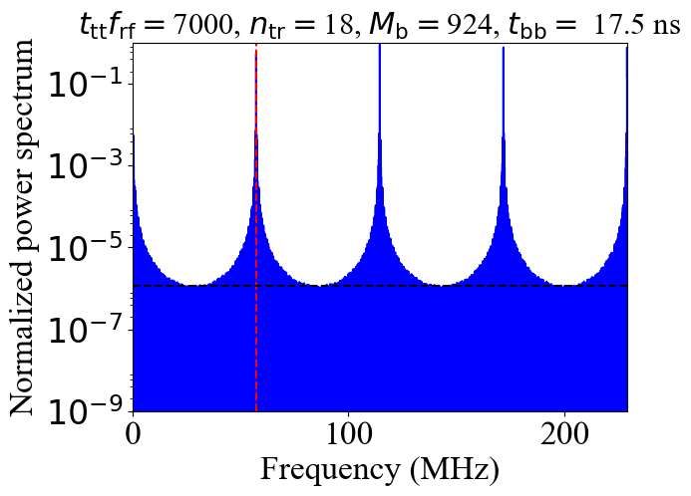
Possible beam filling schemes
Defined by train spacing
Defined by bunch spacing
Beam spectrum is dominated by:
$1/t_{bb}$ lines (always present)
$1/t_{tt}$ lines (depending on number of trains)

Slide 7
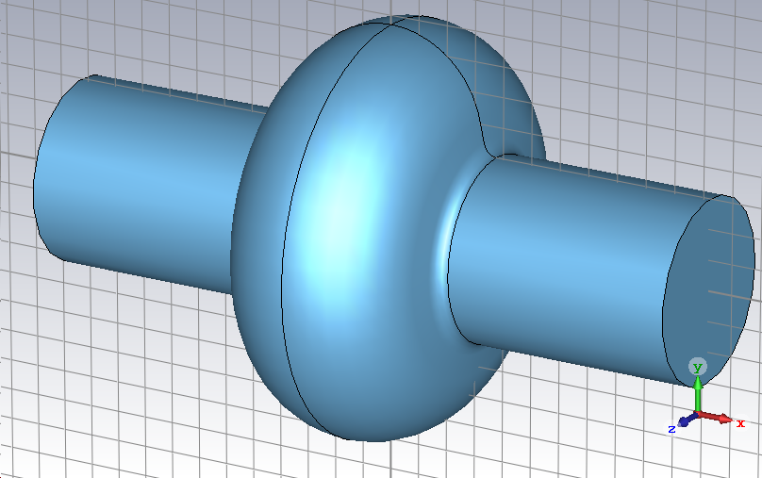
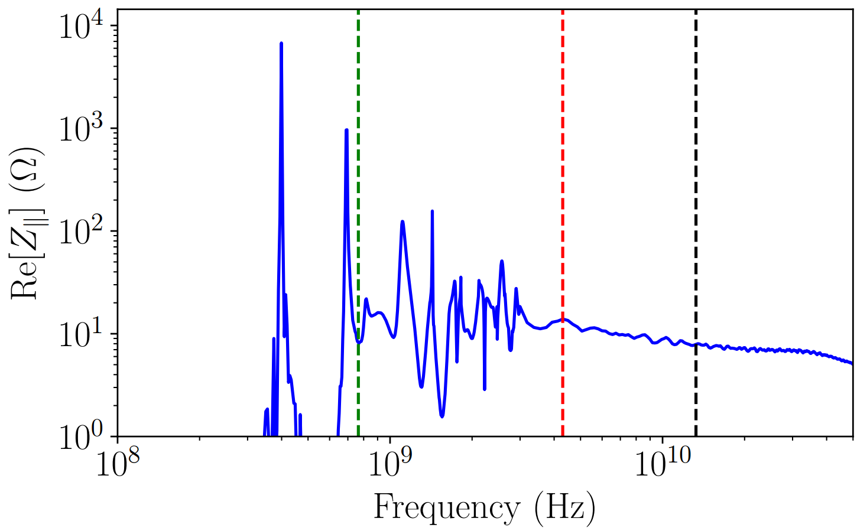
LHC-like superconducting single-cell cavity
Cut-off frequency
1/e – decrease of the beam
power spectrum, $1/2πσ$
HOM
“Continuous” spectrum
Fundamental mode
Collisions on
$σ=40$ ps
Collisions off
$σ=12$ ps
ABCI* and CST** results:
Fundamental mode at 400.79 MHz with $(R/Q)$ = 42.3 Ω
HOM below cut-off frequency at 694 MHz, ${\left(R/Q\right)}_{HOM}≈12 Ω$
$→$ Contributions of impedance below and above cut-off frequency are important for power loss calculations
*Azimuthal Beam Cavity Interaction code, http://abci.kek.jp/abci.htm
**CST EM STUDIO, https://www.cst.com/products/cstems

Slide 8
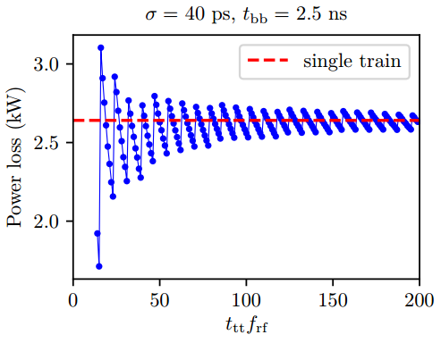
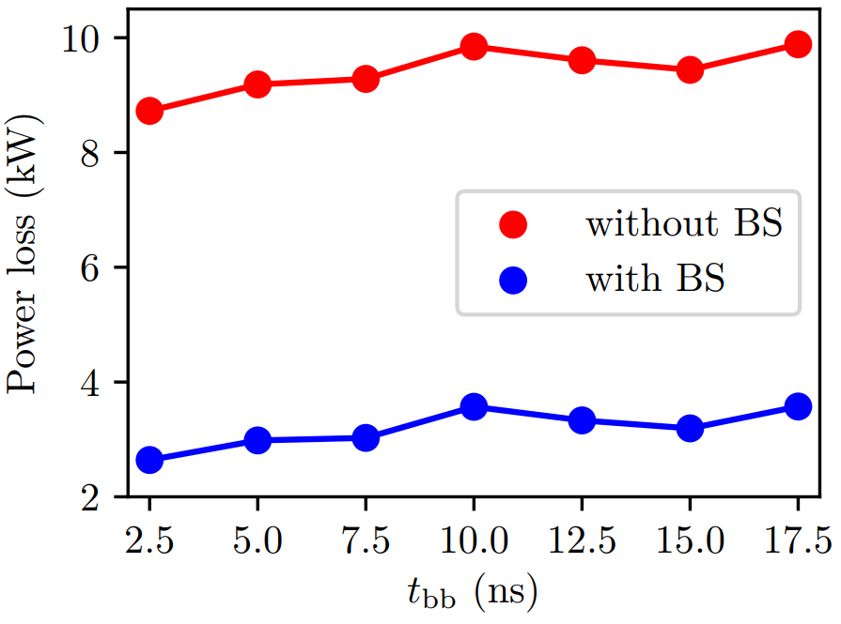
Power loss above cut-off frequency
Assumptions: total current ≤ 1.4 A, number of bunches ≤ 16640, abort gap $≥$ 2 μs, bunch population 1.7e11
Variable parameters: number of bunches in the train, number of trains, train spacing
Collisions off
Collisions on
Collisions on
Train spacing (RF buckets)
$→$Power loss is moderate for the present cavity design for bunches in collisions ($≈3$ kW)
$→$There is a weak dependence on train spacing and bunch spacing

Slide 9
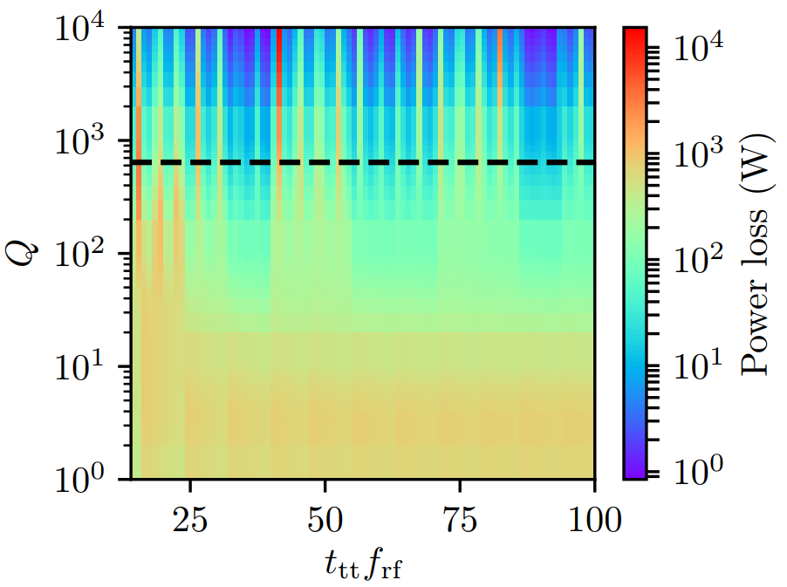
Power loss for HOM below cut-off frequency
$f_{r}≈694$ MHz, ${(R/Q)}_{HOM}≈12 Ω$
Longitudinal coupled-bunch instability growth rate due to HOM
$$\frac{1}{τ}=\frac{e\left|η\right|I_{b,DC}}{2EQ_{s}}f_{r}{\left(R/Q\right)}_{HOM}Q$$
Quality factor, Q
If $τ>τ_{SR}$ $→$ stability
$τ$– growth time
$τ_{SR}$ – radiation damping time
$η$– slip factor
$E$ – beam energy
$Q_{s}$ – synchrotron tune
Train spacing (RF buckets)
Stability threshold
Power losses of about 1 kW are for small $Q$ + “resonant” cases with high $Q$
$→$ Damping of the mode for longitudinal stability should be moderate
$→$ Resonant cases should be identified

Slide 10
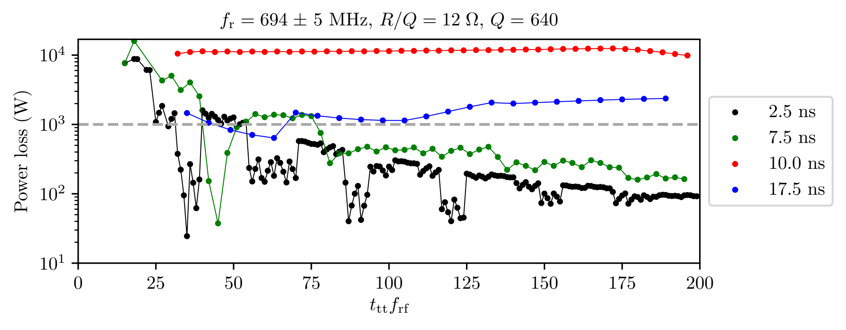
Power losses for different filling schemes
Rounded off value
Resonant case when the beam spectral line overlaps with HOM* $\left|1−\frac{\left[f_{r}t_{tt}\right]}{f_{r}t_{tt}}\right|<\frac{1}{Q}$
$$f_{r}=694±5 MHz, {\left(R/Q\right)}_{HOM}=12 Ω, Q=640$$
Overlap with spectral lines defined by bunch spacing
Train spacing (RF buckets)
$→$Some filling schemes should be avoided in machine operation (restrictions for train and bunch spacings)
*I.Karpov, R. Calaga, E. Shaposhnikova, Phys. Rev. Accel. Beams 21, 071001 (2018)

Slide 11
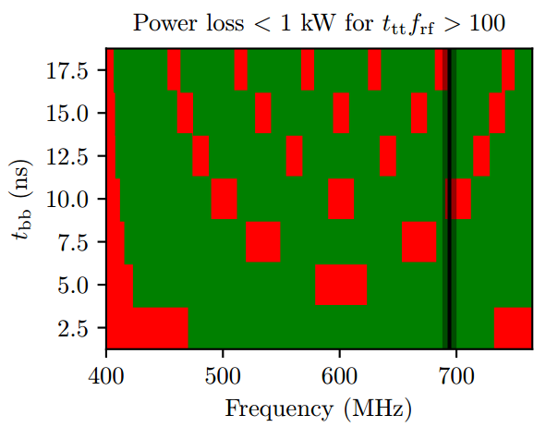
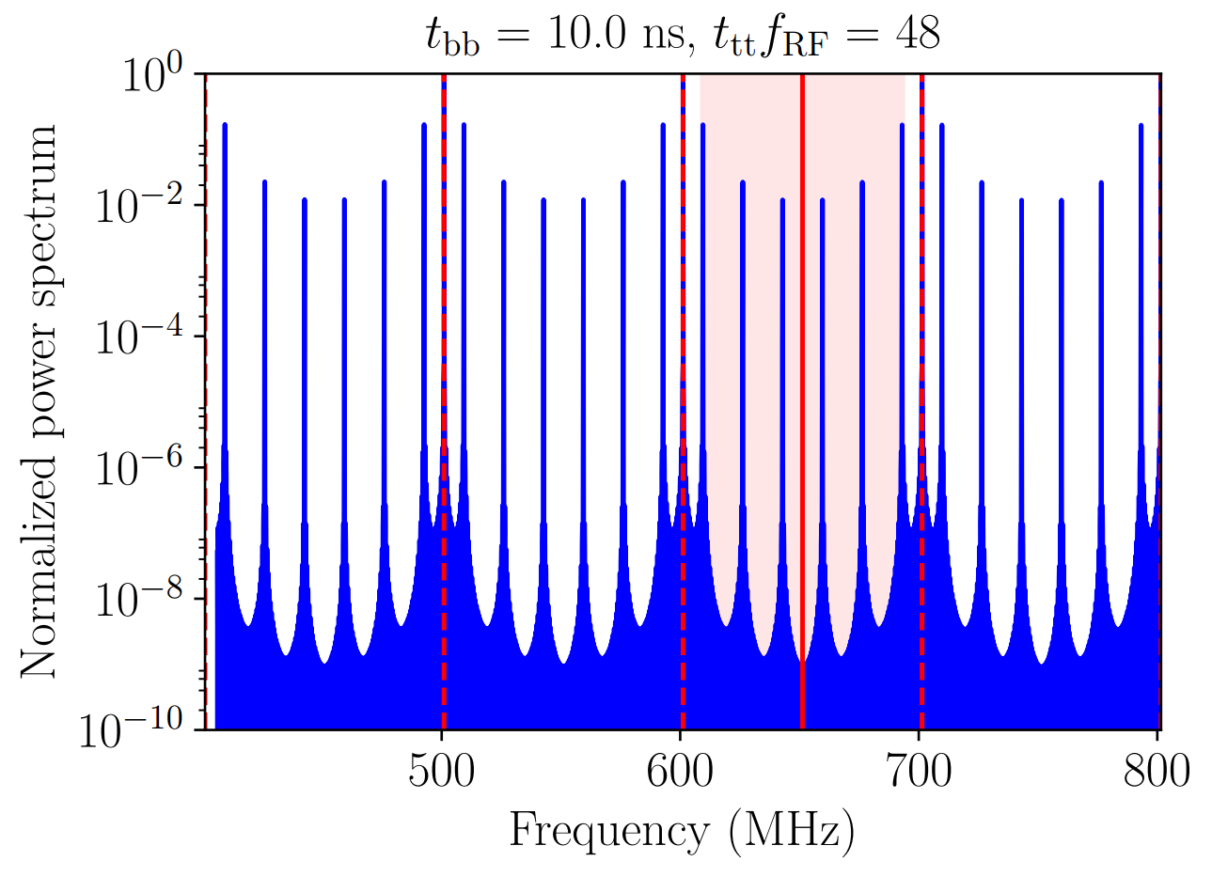
More “general” case
$$n/t_{bb}$$
Resonant frequency scan, $f_{r}$
Dangerous
Safe
Present design
$→$ Operation settings define recommendations for the cavity geometry

Slide 12
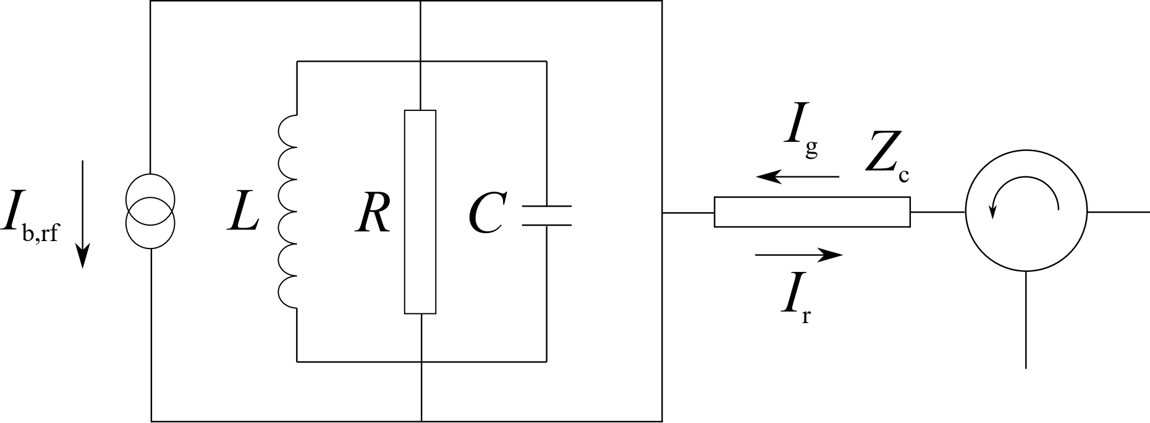
Transient beam loading
Model of superconducting RF cavity linked to generator via circulator*
Transmission line
Circulator
$$V$$
Generator
Load
Reflected current
$$I_{g}=\frac{V\left(t\right)}{2(R/Q)}\left(\frac{1}{Q_{0}}+\frac{1}{Q_{ext}}−\frac{2iΔω}{ω_{RF}}\right)+\frac{dV\left(t\right)}{dt}\frac{1}{ω_{RF}(R/Q)}+\frac{I_{b,RF}\left(t\right)}{2}$$
Generator current**
Cavity detuning is $Δω=ω_{0}−ω_{rf}$, $R=\left(R/Q\right)Q_{0}$, $Z_{c}=$ $\left(R/Q\right)Q_{ext}$
*D. Boussard, CERN-SPS-ARF-DB-GW-NOTE-84-9, 1984 **J. Tückmantel, CERN-ATS-Note-2011-002, 2011

Slide 13
Beam induced transients
amplitude and phase modulations
amplitude and phase modulations
Cavity voltage $V\left(t\right)=A\left(t\right)e^{iφ\left(t\right)}$
Beam current $I_{b,rf}\left(t\right)=A_{b}\left(t\right)e^{−iφ_{s}+iφ_{b}\left(t\right)}$
Average synchronous phase
$e{N_{cav}V}_{cav}\cos{φ_{s}}=U_{0}$
$$I_{g}=\frac{V\left(t\right)}{2(R/Q)}\left(\frac{1}{Q_{0}}+\frac{1}{Q_{ext}}−\frac{2iΔω}{ω_{RF}}\right)+\frac{dV\left(t\right)}{dt}\frac{1}{ω_{RF}(R/Q)}+\frac{I_{b,RF}\left(t\right)}{2}$$
Generator current
Synchronous phase
$$eN_{cav}A\left(t\right)\cos\left[φ_{s}−φ_{b}\left(t\right)+φ\left(t\right)\right]=U_{0}$$
$→$ System of equations for $A\left(t\right), φ\left(t\right), and φ_{b}\left(t\right)$ can be obtained
$→$ Solution depends on the choice of $Δω$ and $Q_{ext}$

Slide 14
Optimal parameters
Generator power* $P_{g}=\frac{1}{2}Z_{c}{\left|I_{g}\right|}^{2}=\frac{1}{2}\left(R/Q\right)Q_{ext}{\left|I_{g}\right|}^{2}$
It can be minimized for given:
average beam current ${〈I}_{b,rf}〉=F_{b}I_{b,dc}e^{−{iφ}_{s}}$, with $F_{b}=2\exp\left[−{\left(ω_{rf}σ\right)}^{2}/2\right]$ - bunch form factor
average cavity voltage $〈V〉=V_{cav}$
$Q_{0}≫Q_{ext}$ for superconducting cavities
Optimal loaded quality factor
$$\frac{1}{Q_{L,opt}}=\frac{1}{Q_{ext,opt}}+\frac{1}{Q_{0}}≈\frac{1}{Q_{ext,opt}}≈\frac{V_{cav}}{F_{b}I_{b,dc}\left(R/Q\right)cosφ_{s}}$$
Optimal detuning
$$Δω_{opt}=−ω_{rf}\frac{F_{b}I_{b,dc}(R/Q) sinφ_{s}}{2V_{cav}}$$
$→$ Beam is unstable for optimal parameters because the second Robinson limit** is reached if there are no loops around cavity
*J. Tückmantel, CERN-ATS-Note-2011-002, 2011
**K. W. Robinson, Stability of beam in radiofrequency system, Rep. CEAL-1010 (1964)

Slide 15
Small-signal Pedersen model
Small modulations: $A\left(t\right)=V_{cav}\left[1+a_{V}\left(t\right)\right]$, $A_{b}\left(t\right)=F_{b}I_{b,dc}\left[1+a_{b}\left(t\right)\right]$
Transfer functions* from beam current amplitude ${\tilde{a}}_{b}$
cavity voltage amplitude ${\tilde{a}}_{V}$
cavity voltage phase $\tilde{φ}$
beam phase ${\tilde{φ}}_{b}$
For “magic” detuning**
$$\frac{{\tilde{a}}_{V}\left(s\right)}{{\tilde{a}}_{b}\left(s\right)}=−\frac{Δω_{opt}τ\cot{φ_{s}}}{1+τs}$$
$$\frac{\tilde{φ}\left(s\right)}{{\tilde{a}}_{b}\left(s\right)}=−\frac{Δω_{opt}τ}{1+τs}$$
$$\frac{{\tilde{φ}}_{b}\left(s\right)}{{\tilde{a}}_{b}\left(s\right)}=−\frac{Δω_{m}τ}{1+τs}$$
$$Δω_{m}=\frac{Δω_{opt}}{\sin^{2}{φ_{s}}}$$
$τ=2Q_{L}/ω_{rf}$ - cavity filling time, $s$ – complex variable
$→$Magic detuning can be used for transient beam loading calculations
*F. Pedersen, Beam loading effects in the CERN PS Booster, IEEE Trans. Nucl. Sci. 22, 1906 (1975)
**F. Pedersen, RF cavity feedback, CERN-PS-92-59-RF, 17 (1992)

Slide 16
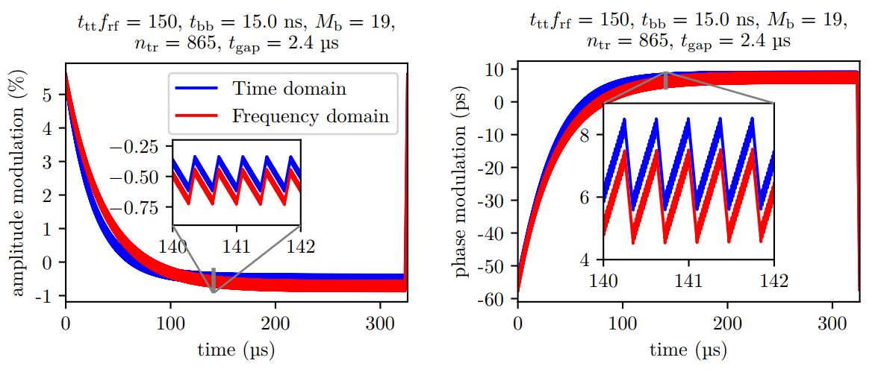
Transient beam loading in FCC-ee Z
$Δω_{m}≈\text{13.1 }\text{kHz}$, $τ≈37 μs$
$→$ There is a strong modulation due to the abort gap and a fine structure due to the gaps between trains
$→$ Reasonable agreement between time-domain and frequency-domain calculations

Slide 17
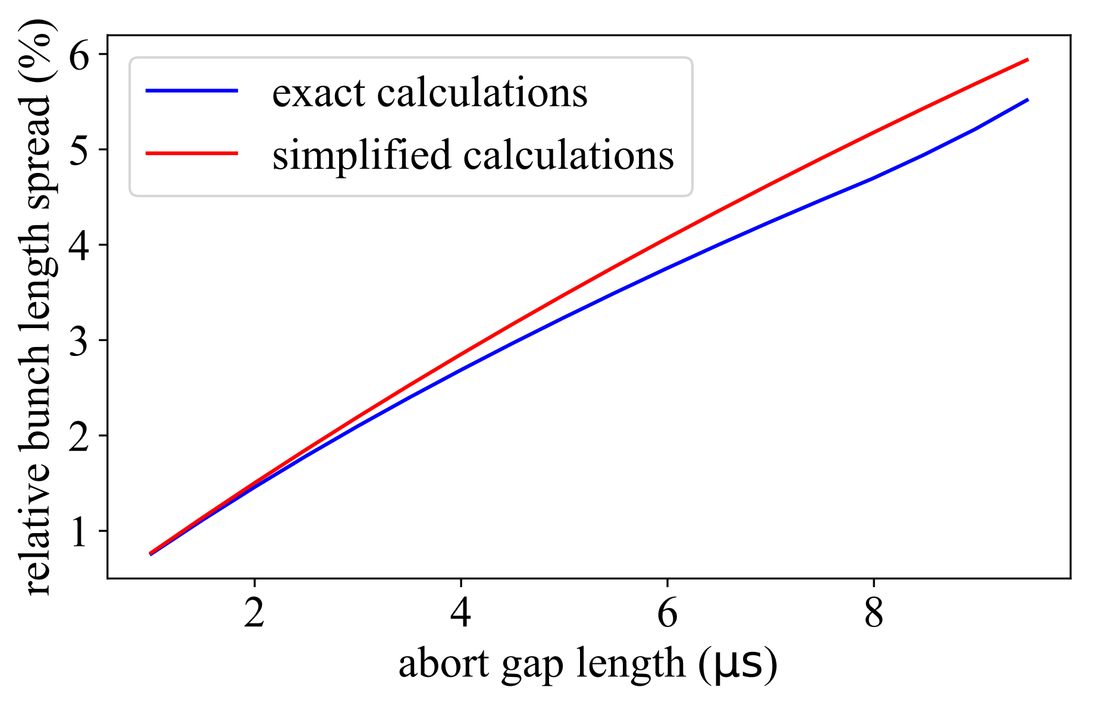
Results for FCC-ee Z
Phase modulations can result in collision point shift, but It can be compensated by proper matching of abort gap transients (for example in the LHC*)
Bunch length modulations can still affect luminosity
Time domain
Frequency domain
Bunch length
$$σ\left(t\right)=\frac{ηΔEC}{{2πQ}_{s}\left(t\right)}$$
$$Q_{s}\left(t\right)=\sqrt{\frac{hηA\left(t\right)N_{cav}}{2πE}\sin{[φ_{s}−φ_{b}\left(t\right)+φ\left(t\right)]}}$$
Synchrotron tune
$h$ – harmonic number
$ΔE$ – energy spread
$→$For baseline parameters, the abort gap length < 2 µs and bunch length spread can be neglected
*T. Mastoridis, P. Baudrenghien, and J. Molendijk, Phys. Rev. Accel. Beams 20, 101003 (2017)

Slide 18
Conclusions
HOM power loss contributions:
From impedance above cutoff frequency is about 3 kW,
From overlap of HOM below cutoff frequency with beam spectral line is below 1 kW for train spacing larger than 100 RF buckets, if 10 ns and 17.5 ns bunch spacing are excluded from operation.
HOM frequency ranges for new cavity designs which are “safe” for given bunch spacings were identified.
Beam induced transient are dominated by abort gap:
collision point shift still can be eliminated by matching abort gap transients,
for $t_{gap}$< 2 µs bunch length spread < 2%.

Slide 19
Thank you for your attention!

Slide 20
Second Robinson limit
Second Robinson limit above transition (no loops around cavity)*
$$Y<−\frac{2\sin{φ_{s}}}{\sin{(2φ_{z})}}$$
$$Y=F_{b}I_{b,dc}\left(R/Q\right)Q_{L}/V_{cav}$$
$$φ_{z}=\arctan{[2Q_{L}Δω/ω_{rf}]}$$
for optimal parameters ($Y=1/\cos{φ_{s}}$ and $φ_{z}={−φ}_{s}$)
*K. W. Robinson, Stability of beam in radiofrequency system, Rep. CEAL-1010 (1964)

Slide 21
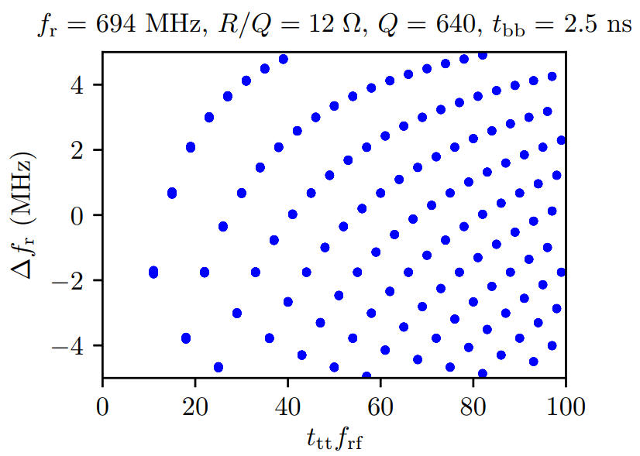
Shift of the resonant frequency
Rounded off value
“Resonant” condition* $\left|1−\frac{\left[f_{r}t_{tt}\right]}{f_{r}t_{tt}}\right|<\frac{1}{Q}$
→ There are many cases when the spectrum line hits the resonant line → Not all of them are dangerous
*I.Karpov et al., CERN-ACC-NOTE-2018-0005 (2018)

Slide 22
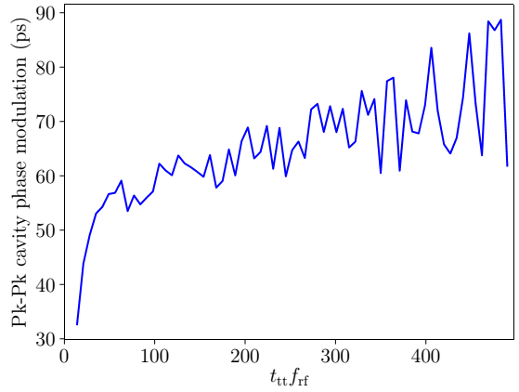
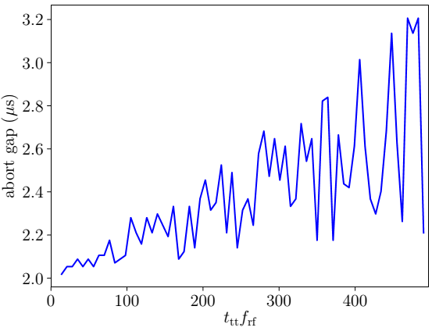
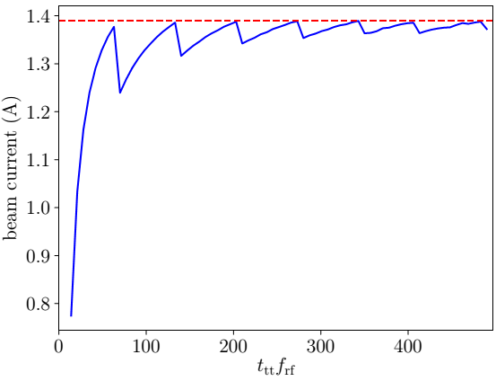
Dependence on the train spacing for bunch spacing of 17.5 ns

Slide 23
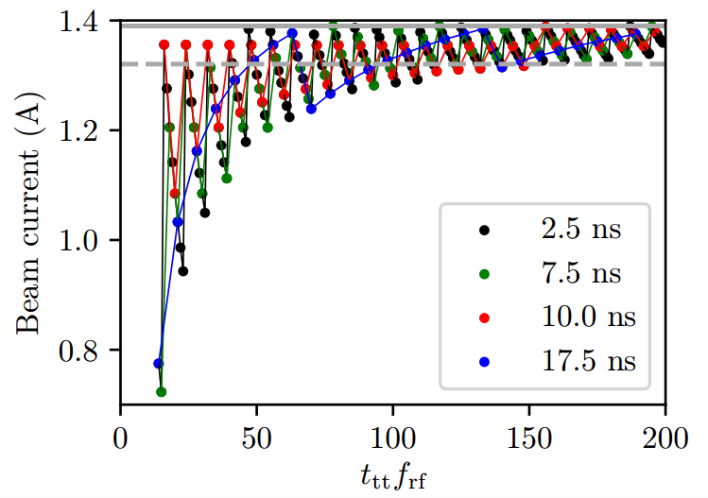
Beam current for different filling schemes

Slide 24
Beam-cavity interaction challenges in FCC-ee Z
Parameter | Value
Beam current, $I_{b,DC}$ | 1.39 A
Number of bunches, $M$ | 16640
Minimum abort gap, $τ_{gap}$ | 2 µs
RF frequency, $f_{RF}$ | 400.79 MHz
$R/Q$ of fundamental mode | 42.3 Ω
Cavity voltage, $V_{cav}$ | 1.91 MV
Number of cavities, $N_{cav}$ | 52
Harmonic number, $h$ | 130680
Radiation damping time, $τ_{SR}$ | 414 ms
→ Power losses due to high
order modes (HOM)
→ Transient beam loading
→ Longitudinal coupled-bunch
instability

Slide 25
Impedance of LHC-like single-cell cavity
Impedance calculation using ABCI
Cut-off frequency
1/e – decrease of the beam
power spectrum, $1/2πσ$
Axisymmetric structure
+
Gaussian bunch
HOM
“Continuous” spectrum
Fundamental mode
Without BS $σ=12$ ps
With BS* $σ=40$ ps
Wake potential
Impedance
$≈400$ MHz
*Beamstrahlung effect
$→$ Only one mode below cut-off frequency with parameters:
$f_{r}≈694$ MHz, $R/Q≈12 Ω$ (CST EMS simulations), quality factor$Q$= ?

Slide 26
Transient beam loading
Model of superconducting RF cavity linked to generator via circulator*
Transmission line
From circuit equations:
$$V$$
Generator
$$V=Z_{c}(I_{g}+I_{r})$$
$$I_{LRC}=I_{g}−I_{r}−I_{b,RF}$$
Load
Reflected current
Assumptions:
all dynamic variables are proportional to $\exp\left(iω_{RF}t\right)$ with varying amplitude
Slow change of the complex voltage amplitude, $\left|dV^{2}\left(t\right)/dt^{2}\right|≪\left|ω_{RF}^{2}V\left(t\right)\right|$
$$I_{g}=\frac{V\left(t\right)}{2(R/Q)}\left(\frac{1}{Q_{0}}+\frac{1}{Q_{ext}}−\frac{2iΔω}{ω_{RF}}\right)+\frac{dV\left(t\right)}{dt}\frac{1}{ω_{RF}(R/Q)}+\frac{I_{b,RF}\left(t\right)}{2}$$
Generator current**
Cavity detuning is $Δω=ω_{0}−ω_{rf}$, $R=\left(R/Q\right)Q_{0}$, $Z_{c}=$ $\left(R/Q\right)Q_{ext}$
*D. Boussard, CERN-SPS-ARF-DB-GW-NOTE-84-9, 1984 **J. Tückmantel, CERN-ATS-Note-2011-002, 2011

Slide 27
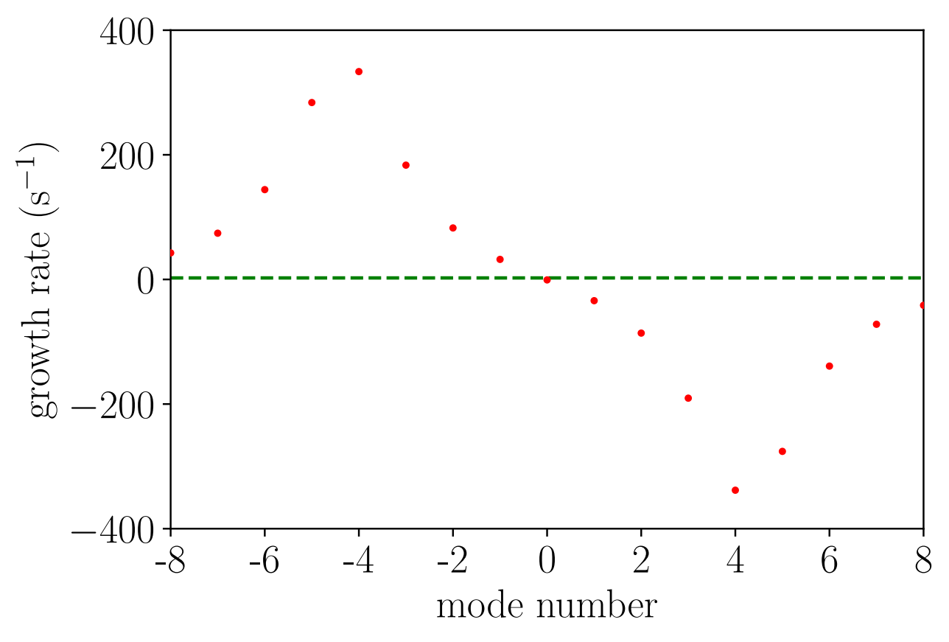
Fundamental impedance driven instability
The growth rate of the longitudinal coupled-bunch mode m*
$$\frac{1}{τ_{m}}≈\frac{eηω_{RF}}{4πEQ_{s}}I_{b,DC}N_{cav}\left(Re{\{Z}_{∥}\left[ω_{RF}+\left(m+Q_{s}\right)ω_{rev}\right]\}−Re{\{Z}_{∥}\left[ω_{RF}−\left(m+Q_{s}\right)ω_{rev}\right]\}\right)$$
Fundamental cavity impedance
Synchrotron radiation damping
$$Z_{∥}\left(ω\right)=\frac{(R/Q)Q_{L}}{1+iQ_{L}\left[\frac{ω_{0}}{ω_{RF}}−\frac{ω_{RF}}{ω_{0}}\right]}$$
$→$ For magic detuning (about $4×f_{rev}$)
the most unstable mode is $m=$ -4
*For example in A. Chao, Physics of Collective Beam Instabilities in High Energy Accelerators, 1993

Slide 28
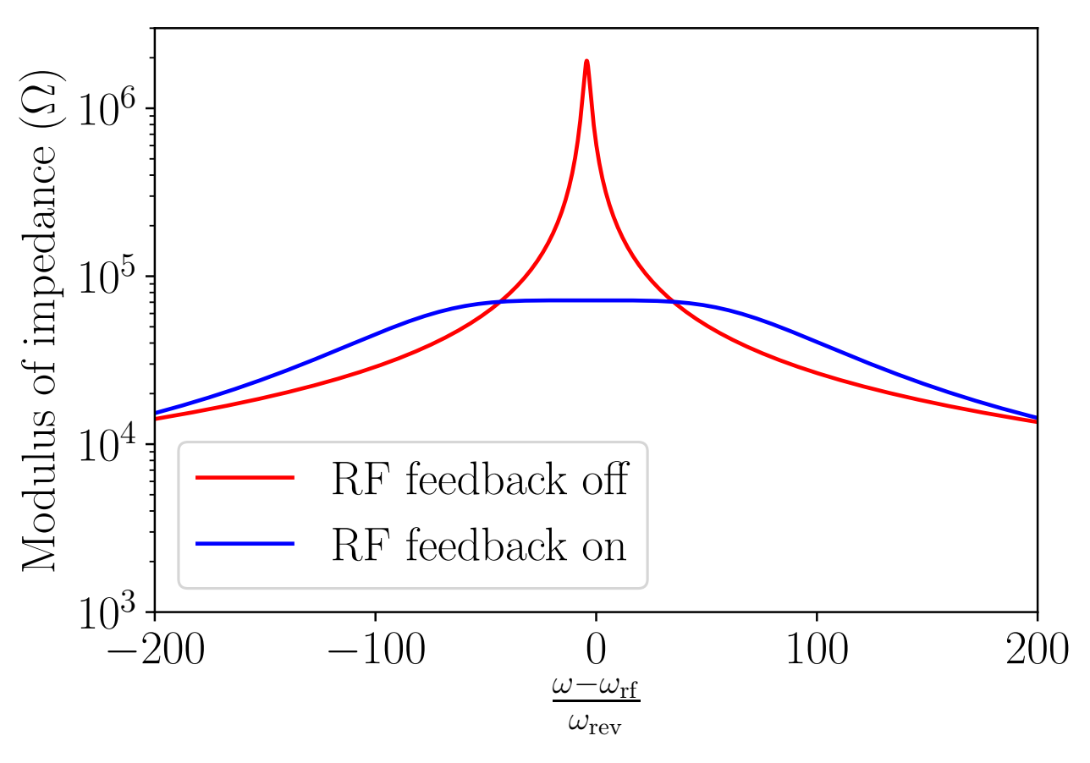
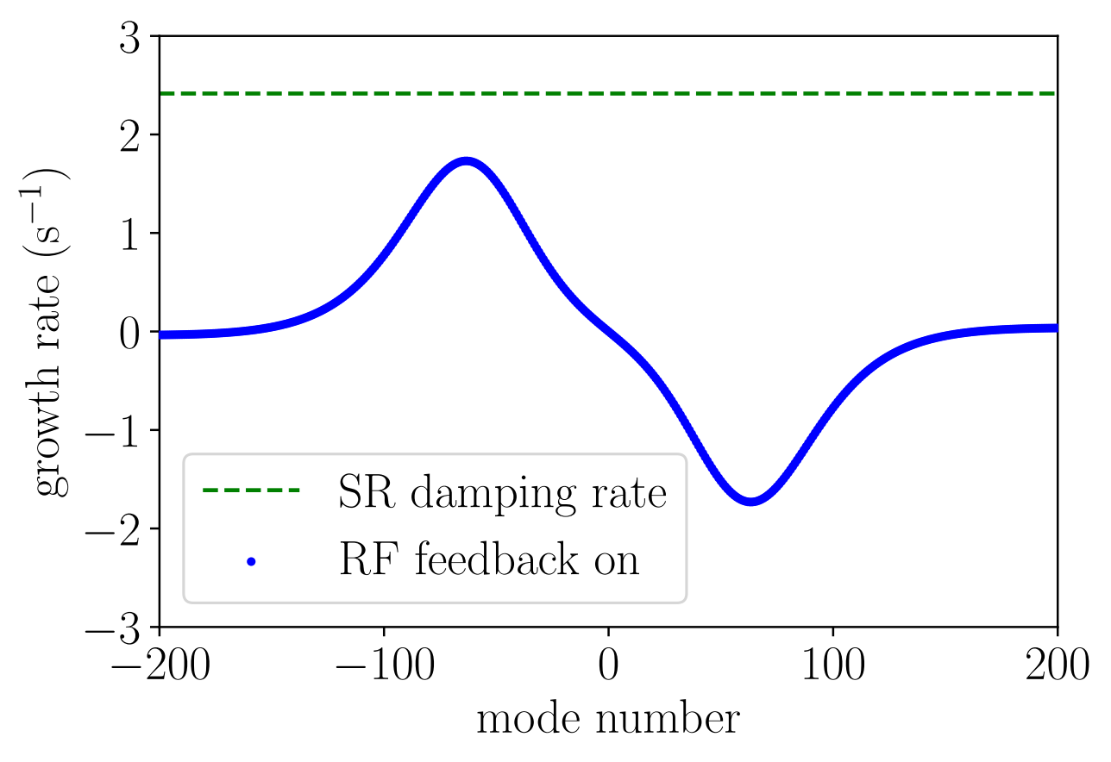
Mitigation by direct RF feedback*
The flat response is achieved for $1/G=R/Qω_{RF}τ_{d}$, loop delay $τ_{d}≈700$ ns (similar to LHC)
$→$ Growth rates of all unstable modes are smaller than synchrotron radiation damping rate
$→$ To increase stability margins one-turn delay feedback (similar to SPS, LHC) or more sophisticated double peaked comb filter (PEP II) can be used
*D. Boussard, Control of cavities with high beam loading, IEEE NS-32 (1985)

