Slide 1
RHIC Operational Modes Enabled by Enhanced Beam Control
V. Schoefer for the RHIC Team
Special thanks to W. Fischer, A. Marusic, M. Minty, T. Shrey
and G. Marr for input on this talk
APEC Workshop Dec. 2018

Slide 2
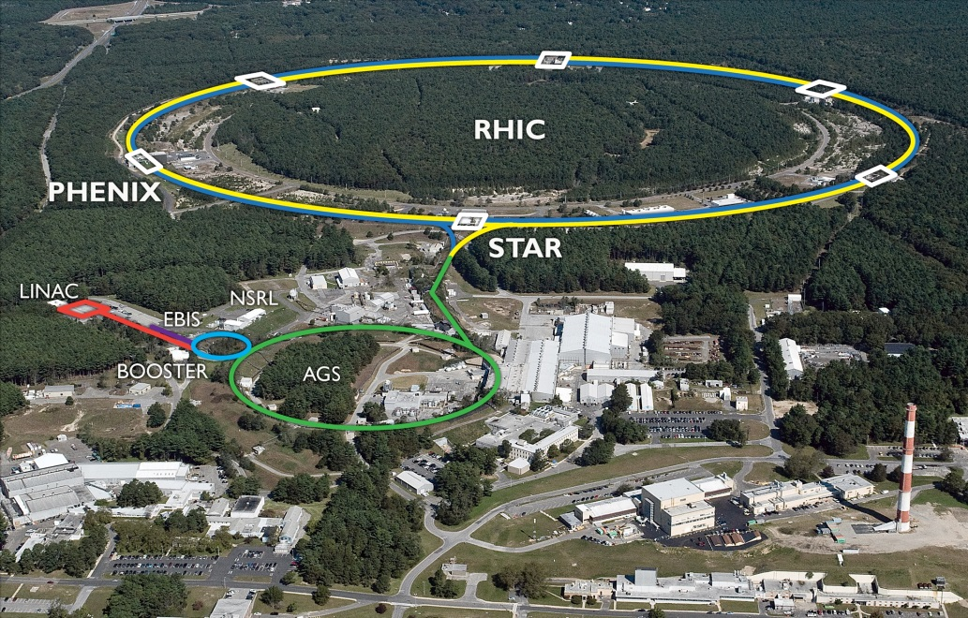
RHIC Accelerator Complex
Absolute Polarimeter (H jet)
E-lenses
Siberian Snakes
RHIC pC Polarimeters
PHENIX (p)
STAR (p)
Typical Top Energies [GeV/N]
Spin Rotators
(longitudinal polarization)
 | Au | Pol. Protons
Booster | 1 | 2.5
AGS | 10 | 25.5
RHIC | 100 | 255
Spin Rotators
(longitudinal polarization)
LINAC
BOOSTER
Pol. H⁻ Source
Helical Partial
Siberian Snake
200 MeV Polarimeter
AGS
Beam Sources
AGS Polarimeters
Heavy Ions | Protons
EBIS | OPPIS
Tandem Van de Graaff | H⁻ (unpolarized)
Strong AGS Snake
Notes:
‘Juggling’ up to four sources. Two or three species in a week in RHIC and NSRL besides….

Slide 3
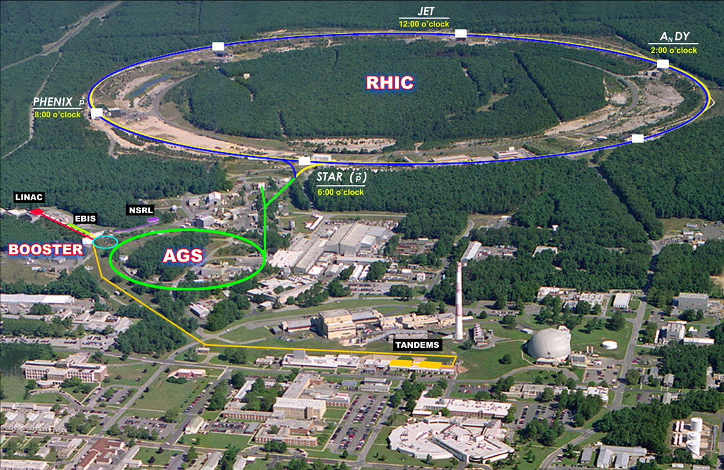
Outline
RHIC ramps controlled by simultaneous feedback systems
Orbit
Tune and coupling
(sometimes) Chromaticity
Commissioned for operations in 2009-2011, orbit and tune feedback used for nearly every ramp (physics or development) since.
Brief technical overview of the feedback systems
Review of operating modes that are enabled wholly or in part by the feedback capability

Slide 4
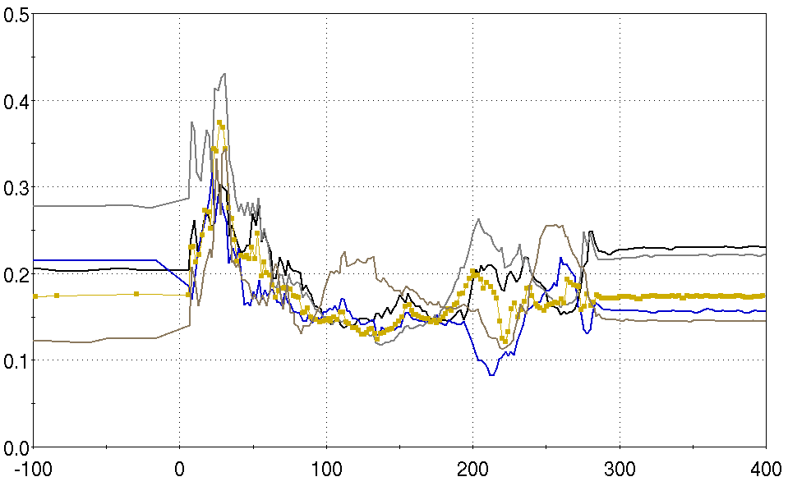
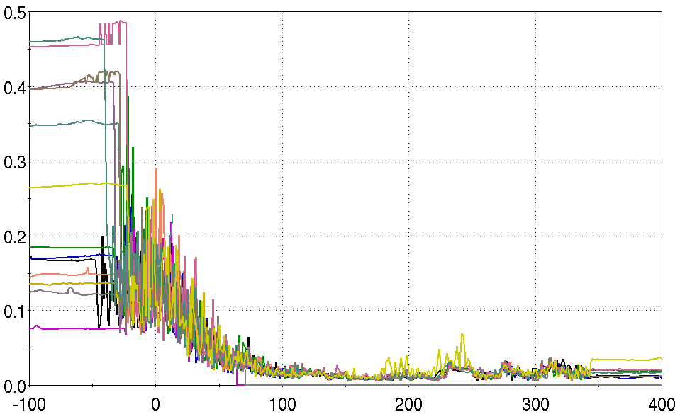
RHIC Feedback Systems: Orbit (Slow)
Orbit RMS During Several Ramps
No orbit feedback
With orbit feedback
Position [mm]
Ramp start
Ramp start
Time [s]
Time [s]
1 second avg orbit measurement
Standard lattice orbit correctors
Correction matrices pre-calc’d based on model, updated at 1Hz on ramp
Iterated SVD corrections also at 1Hz
BPM Filtering and model improvements
Push-button for operations

Slide 5
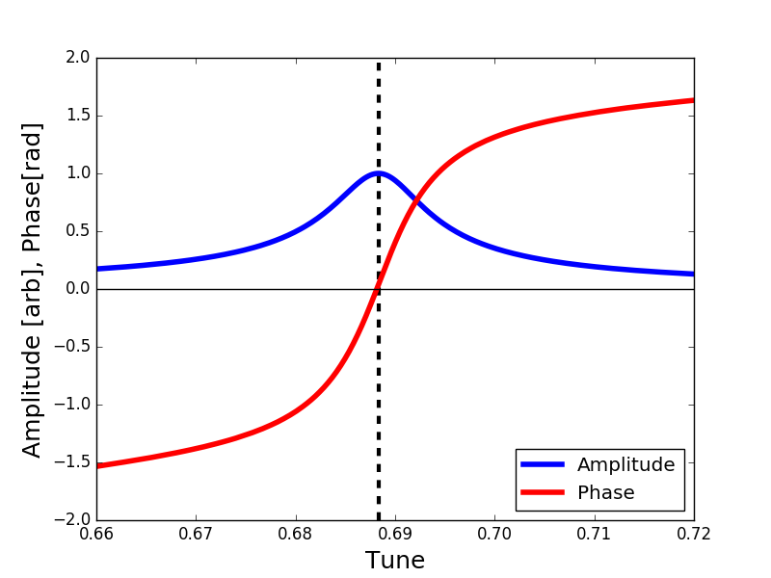
RHIC Feedback Systems: Tune, Coupling : Measurement during the ramp
Pre-2006:
Large single turn kick
FFT of free oscillation
No feedback on measurement
Post 2006:
Continuous driven oscillation
Zero phase determines resonance
Feedback possible
TBT Position
Beam transfer function
FFT
Drive tune
Phase = Δφ between kick and measurement
Notes:
Single kick drawback: Large excitation (sig frac of sigma), slow ~0.25 Hz, no feedback. Chrom necessary, but degrades precision

Slide 6
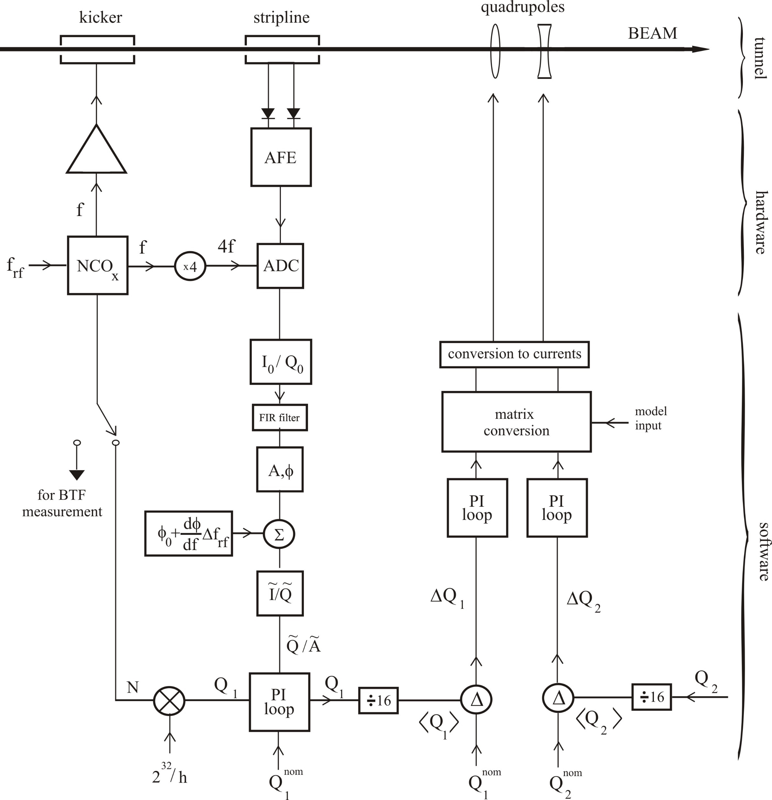
RHIC Feedback Systems: Tune, Coupling
Beam
Sensitivity
Direct diode detection
Allows determination of tune with very small
(10-30 µm) excitation
No emittance growth
Precision
Phase-locked loop
Locks drive frequency to resonance
Tune determined to
10⁻⁵-10⁻⁶
Control
Feedback to magnets
Model inputs

Slide 7
Beam Stability
Control of orbit, tune and coupling improve by factor of 10-100 over open loop operation
Parameter Stability Over Course of RHIC Ramp
 | No feedbacks | With feedbacks
Orbit (x_{rms},y_{rms}) | ~ 500 µm | ~20 µm
Tune (Q_{x},Q_{y}) | ~0.1 | < 0.001
Coupling |C⁻| | ~0.1 | < 0.01
Coupling control critical to tune control
(Hor,Ver PLLs have to be able to clearly distinguish eigenmodes)
Includes fast events like transition,snapback
But what can we DO with it?

Slide 8
Startup Time Improvement
Polarized protons
Heavy ions
Asymmetric
Start routine use of feedbacks
Initial startup times drop from ~ 2-3 weeks, converging to <1 week
First few days are often one shift/day of beam
Beam to flattop often on first ramp
Startups now often include setting up all the ramps we plan to use for the run at once

Slide 9
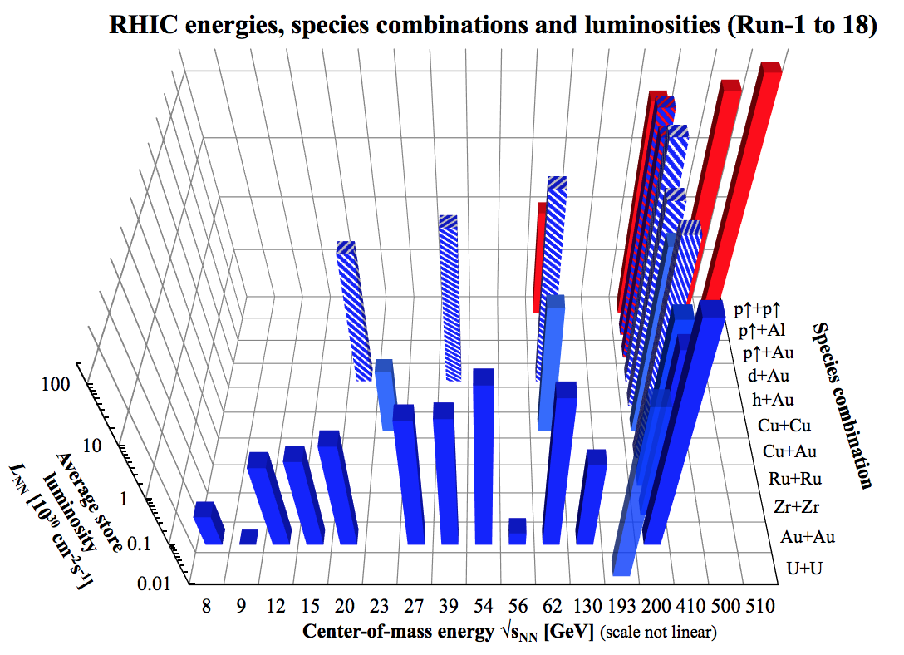
Polarized protons
Heavy ions
Asymmetric
Run 18
Runs 19-20
Notes:
Look ahead to BES II next two years

Slide 10
More modes, then more, then more…
Faster setups means more setups….
Only one mode at a time
All experiments and development done with the physics ramp
Single day ramp setups are possible
Often ions and polarized proton physics in alternating years, this allows polarized proton trials and experiments during ion runs, beneficial for prep ahead of time
Asymmetric collisions become much easier
Polarized protons colliding with Au,Al in 2015
p-Au required proton pre-acceleration: setup and maintain 3 ramps
Culminates in the “Isobar Run” in Run 18
Daily switching of accelerated species in the collider for the first time

Slide 11
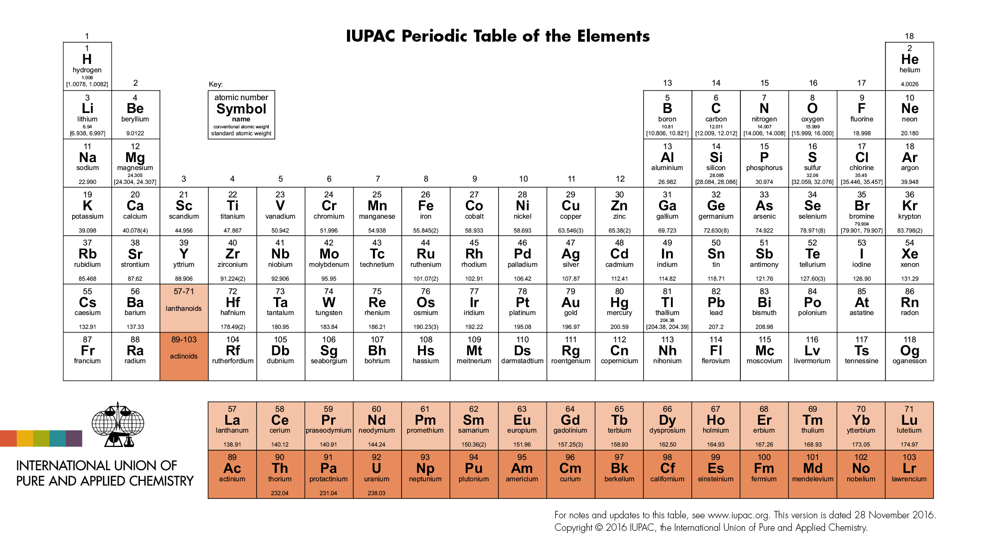
Isobars in Run 18
Ru-96
Zr-96
Same number of nucleons
Different number of protons
Same QGP matter
Different magnetic field
Experimental requirement
Ru-Ru collisions and Zr-Zr collisions
Systematic error from instantaneous luminosity means luminosity leveling
Systematic error from detector aging over days and weeks
Third requirement rules out long run of Ru-Ru followed by long Zr-Zr run
Daily switching of species in the collider! (Never tried before!)

Slide 12
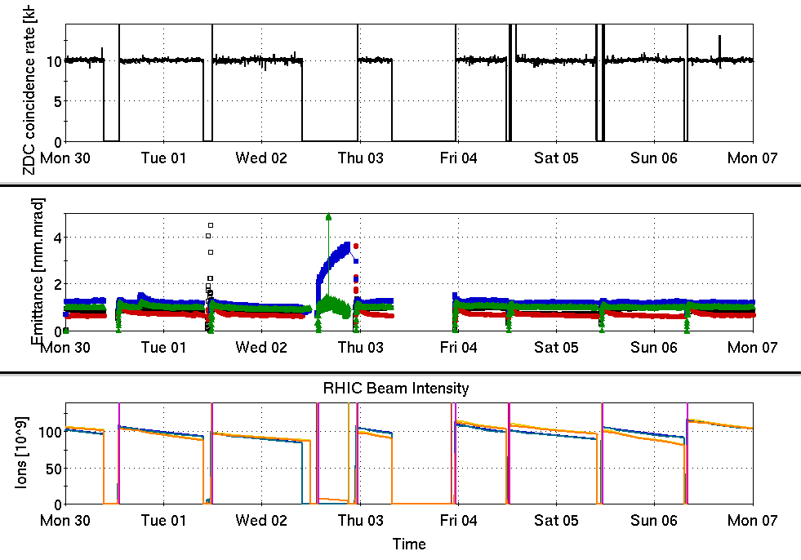
Ru-Ru and Zr-Zr
Collision rate
Lumi leveling
Steering
3D Stochastic cooling
RHIC/switching reliability
Feedbacks!
Flexible sequencer app!
Complex reliability
20+ hour stores
Injector maintenance during physics!
Record 91% availability for Run 18
Ru
Zr
Ru
Zr
Ru
Zr
Ru
Zr
Au
Emittance
Maintenance
1
Intensity
Gold ramp for Coherent Electron Cooling
Proof-of-principle experiment work

Slide 13
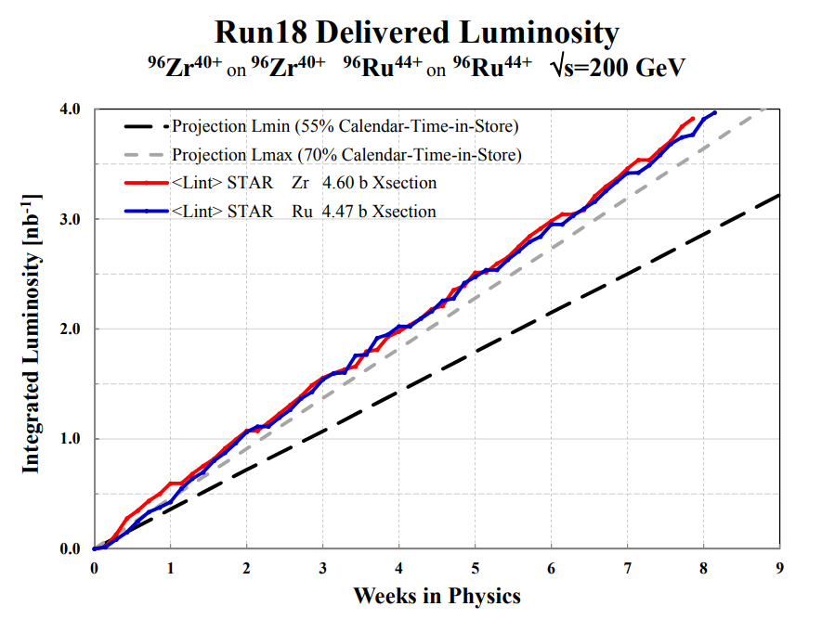
Ru-Ru and Zr-Zr
Lumi leveling
Steering
3D Stochastic cooling
RHIC/switching reliability
Feedbacks!
Flexible sequencer app!
Complex reliability
20+ hour stores
Injector maintenance during physics!
Record 91% availability for Run 18

Slide 14
Of the weird things I did to the beam, I especially like things I did for polarization people.
-- Al, our local feedback guru

Slide 15
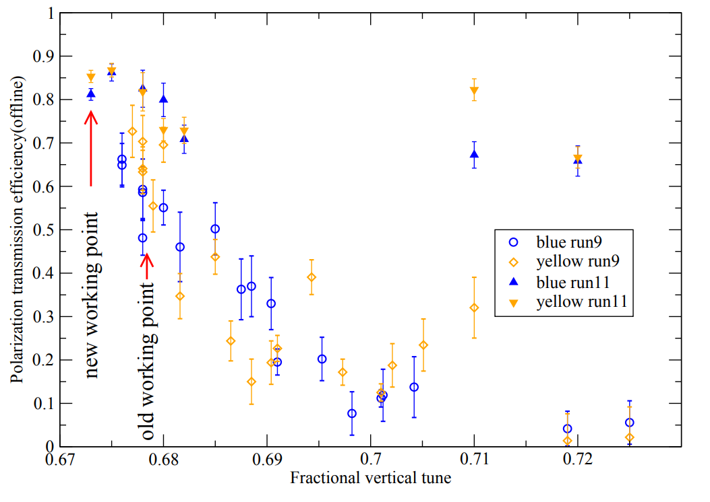
Acceleration Near 2/3 Resonance
Polarization transmission through RHIC acceleration is sensitive to the vertical tune
Snake resonance at : 7/10
Betatron resonance at : 2/3
Figure of merit for double-spin experiments:
FOM = (lumi) * (polarization)⁴
Polarization transmission efficiency
Vertical tune

Slide 16
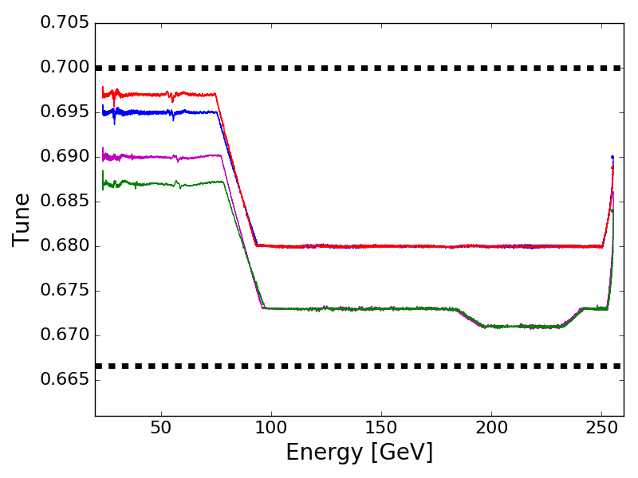
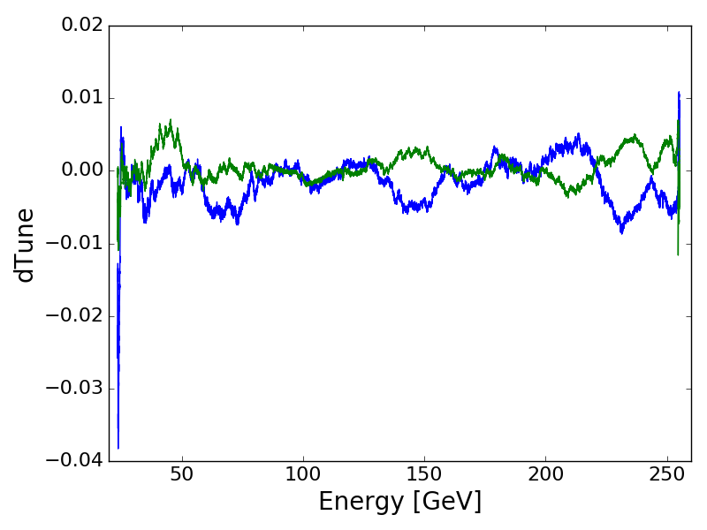
Acceleration Near 2/3 Resonance
Ramp tunes
Polarization transmission through RHIC acceleration is sensitive to the vertical tune
Snake resonance at : 7/10
Betatron resonance at : 2/3
Figure of merit for double-spin experiments:
FOM = (lumi) * (polarization)⁴
Only 0.005 from resonance
Feedback effort
Required feedback effort very close to distance to resonances

Slide 17
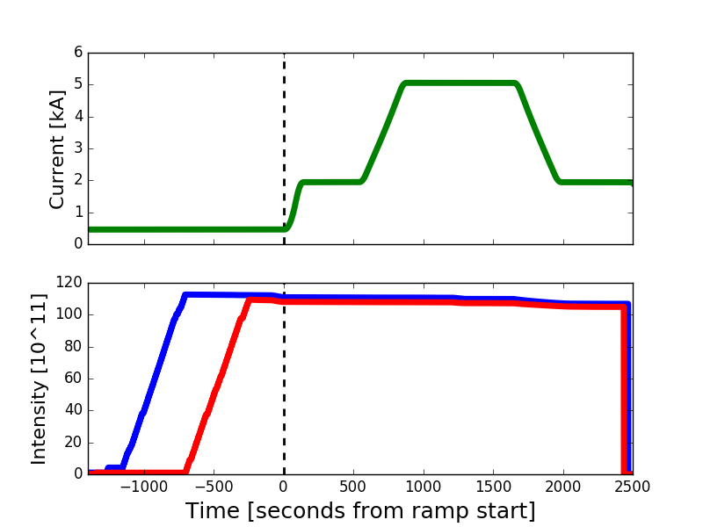
100-250-100 GeV ramp
Polarimeter analyzing power is energy dependent
Useful calibration is to accelerate-decelerate to an energy plateau and compare polarization
Model uncertainty on down ramp
Chromaticity feedback
RF freq modulated at 0.5 Hz
Tune feedback effort deviations over each modulation cycle used to calculate a chrom
Update sent to the sextupoles
Main dipole current
250 GeV
Ramp start
100 GeV
100 GeV
Beam intensity
Blue beam
Yellow beam
Chrom feedback effort during the down ramp was up to 40 units!
Successful measurement completed in one shift with feedback
Would have taken days without it => Would never have been done
Notes:
Figure of merit for this experiment is not precision of chrom feedback, but cost of experiment

Slide 18
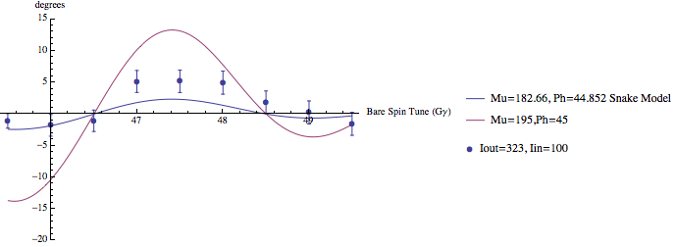
Stable Spin Direction
Spin projection onto H plane
Run 12,15: Observed tilt of stable spin direction away from vertical (ideal)
Injection 25.5 GeV
Spin closed orbit a function of energy and orbit
Depolarizing resonances a function of betatron tune and energy
Scan energy: don’t hit a resonance, don’t change the orbit
Hysteresis in mains -> corrections can change during repeated scans
Store 255 GeV
Energy (Gγ)
Notes:
“minefield”

Slide 19
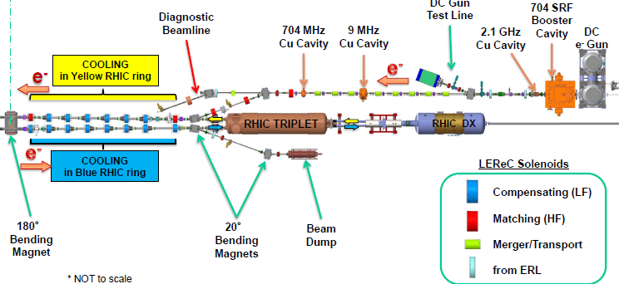
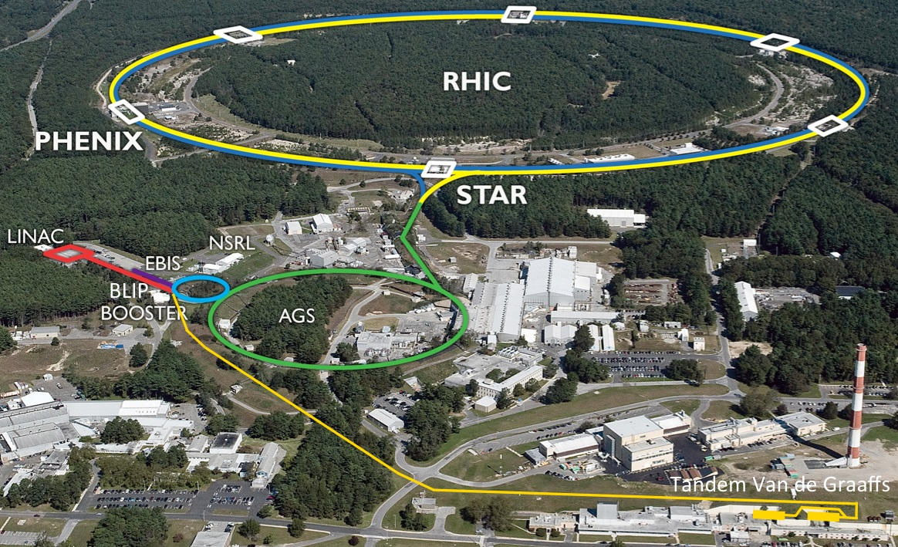
Introduction of New Facilities
Low Energy e-cooler
New facilities added
Fringe fields
Common elements with ion beam
Strong solenoids
Merge dipoles
Changing fields during RHIC injection and stores
Electron lens
“Feedback will handle it”
-- people who previously would have spent several shifts incorporating the new facilities into RHIC.
Coherent e-cooling

Slide 20
Summary
Enhanced beam control led to drastic reduction in setup times
Enabled new kinds of physics operation and experiment, notably recent daily changes of species in the collider
RHIC’s most demanding program is polarized protons but the feedback ‘lessons learned’ are widely applicable to other facilities
Near resonance operation: Enlarging the possible configuration space (near integer for space charge)
Acceleration-Deceleration: Experiments with configurations well outside the model assumptions (magnets in saturation, large momentum offset…)
Stable spin direction: “Delicate” experiments (for us polarization, for a high intensity facility, feedback might allow experiments that would otherwise be unacceptably risky)
Enhanced beam control has operational impacts in reliablility and flexibility that go beyond the immediate improvement in precision

Slide 21
References
Tune/coupling feedback
Direct diode detection
M. Gasior, R. Jones, The Principle and First Results of Betatron Tune Measurement by Direct Diode Detection, LHC Project Report 853, 2005
Phase locked loop tune measurement
R. Jones, P. Cameron, Y. Luo, Towards a Robust Phase Locked Loop Tune Feedback System , C-A/AP Note/#204, 2005
Tune/Coupling feedback
Y. Luo, et al,, Phys Rev ST AB, 9, 124001, 2006, Continuous measurement of global difference coupling using a phase-locked-loop tune meter in the Relativistic Heavy Ion Collider
P. Cameron et al, Simultaneous tune and coupling feedback in the Relativistic Heavy Ion Collider, and possible implications for the Large Hadron Collider commissioning, Phys Rev ST AB, 9, 122801, 2006
Chromaticity Feedback
A. Marusic et al, Chromaticity Feedback at RHIC, IPAC10, Kyoto, Japan

Slide 22
References
Orbit feedback
Fast 10 Hz feedback
R. Michnoff et al, RHIC 10 Hz Global Orbit Feedback System, PAC 11, New York City, 2011
Global slow orbit feedback
M. Minty et al, Global Orbit Feedback at RHIC, IPAC10, Kyoto, Japan
Operational experience with simultaneous feedbacks
M. Minty et al, Simultaneous Orbit, Tune, Coupling and Chromaticity Feedback at RHIC, PAC 2011
M. Minty et al, Precision Beam Instrumentation and Feedback-based beam Control at RHIC, IPAC 2011

Slide 23
Backup Slides

Slide 24
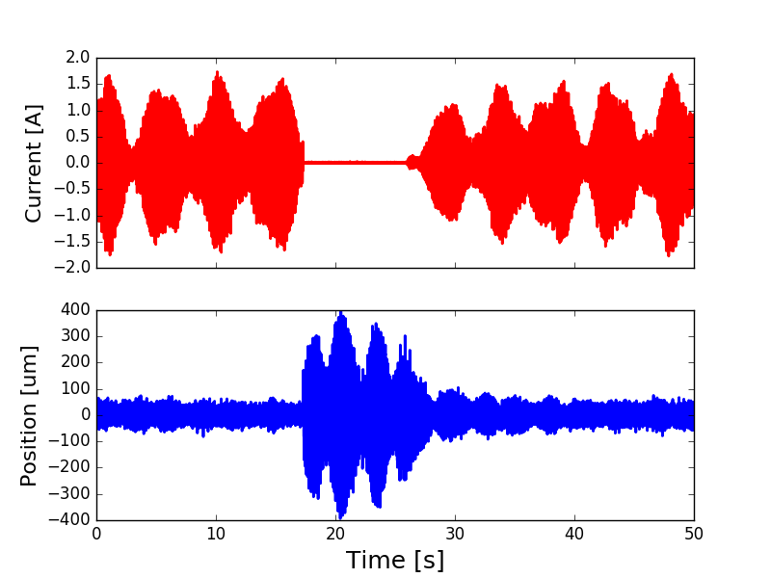
RHIC Feedback Systems: Orbit (Fast)
Several sources
near 10 Hz, beating
Triplet vibrations cause ~10 Hz horizontal oscillation
Fast enough to evade 1 Hz correction
Slow enough to affect 1 Hz avg
12 dedicated warm air-core magnets (per ring)
36 fast (10kHz) BPMs
Corrector current
Feedback
off
Beam position
Notes:
Feedback rather than ‘stiffening’ the triplets

