Slide 1

Accelerator Performance and Concept Workshop, APEC
Concept for high intensity beam and innovative technologies of HIAF
High-Intensity Heavy Ion Accelerator Facility-HIAF
Jiancheng Yang
Institute of modern physics, CAS
Dec. 10-12, 2018, Frankfurt

Slide 2
Outline
Introduction of HIAF project
Concept for high intensity beam
Figure-8 shape ion-ion merging ring
Innovative technologies and developments
Present status and summary

Slide 3
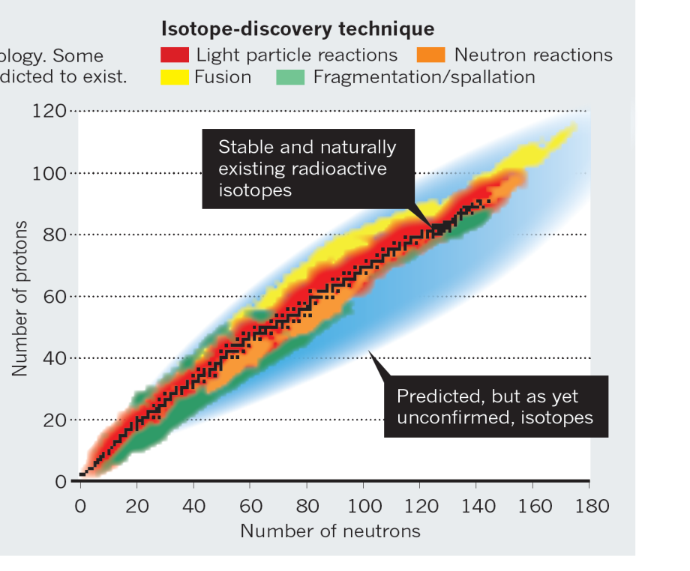
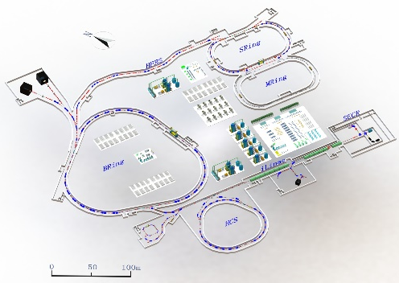
HIAF: background and motivation
Next-generation high intensity facilities are required for advances in
nuclear physics and related research fields:
Fascinating and crucial questions
To explore the limit of nuclear existence
To study exotic nuclear structure
Understand the origin of the elements
To study the properties of High Energy
and Density Matter
……
Available today
Next-generation facilities are being constructed or proposed worldwide:
SPIRAL2 at GANIL in Caen, France
FAIR at GSI in Darmstadt, Germany
FRIB at MSU in the U.S.
NICA at JINR, Dubna, Russia
EURISOL in Europe
High Intensity Heavy-ion
Accelerator Facility
HIAF in China
Notes:
over the past century, scientists have built up a deep understanding of the nuclei through the researches of the stable and known nuclei. Nevertheless, there are still many fascinating and crucial questions, These questions need to be explored in depth.
To answer these fascinating and crucial questions, there is strong need of next generation high intensity RIBs facility to produce unexplored species, and there now a considerable number of facilities have been constructed, are being developed or proposed in the worldwide.
Nevertheless, there are still significant gaps in our knowledge of the nature and evolution of matter on both a cosmic and a microscopic scale and there are many questions to explore, for example....

Slide 4
HIAF: background and motivation
HIAF: One of 16 large-scale research facilities proposed in China in order to boost basic science, next generation high intensity facility for advances in nuclear physics and related research fields.
The HIAF project:
Proposed by IMP in 2009.
Approved in principle by the central government in the end of the 2012.
The final approval was in the December of 2015
Final preparation for starting of construction has been finished and under construction
Science motivations:
High intensity radioactive beams to investigate the structure of exotic nuclei,
nuclear reactions of astrophysics and to measure the mass of nuclei with
high precision.
High charge state ions for a series of atomic physics programs.
Quasi-continuous beam with wide energy range for applied science.
High energy and intensity ultra-short bunched ion beams for high energy and density matter research.
Spontaneous electron–positron pair production

Slide 5
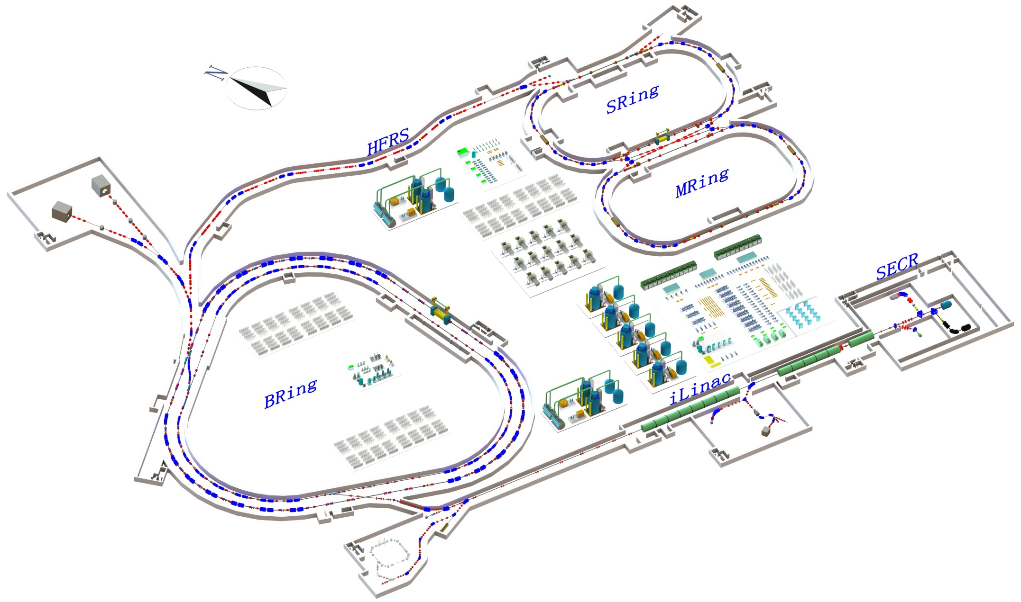
Main accelerator components
SRing: Spectrometer ring
Circumference: 273m
Rigidity: 13-15 Tm
Electron/Stochastic cooling
Two TOF detectors
Four operation modes
BRing-S: Booster ring
Circumference: 650 m
Rigidity: 86 Tm
Beam stacking
Beam acceleration
L: 180m, Bρ: 25 Tm
MRing: Figure “8” ring
Circumference: 273m
Rigidity: 15 Tm
Ion-ion merging
BRing-N: Fast cycle ring
Circumference: 570 m
Rigidity: 34 Tm
Large acceptance (250/120)
Two planes painting injection
Fast ramping rate（5-10Hz, 20Hz）
iLinac: Superconducting linac
Length:100 m
Energy: 17-25 MeV/u(U³⁵⁺⁻⁴⁵⁺)
These tunnels will be built in a cut and cover method and will be filled with 5 m overlay of soil. This conforms to the requirements of radiation safety.
Notes:
The design concept and layout of HIAF facility has evolved from the scientific requirements. This is the whole layout of the HIAF accelerator, it consists of superconducting ECR source, superconducting linac as injector, synchrotron booster, radioactive beam separator, and storage rings for in-ring experiments. ECR source is the next generation ECR source with high operation frequency, the superconducting linac can provide the highest intensity heavy ion beam for low energy research and synchrotron injection. The output energy is the about 17-25MeV, we keep the free space for update to 100MeV/u in the future. The central part of the HIAF facility is a synchrotron complex consisting of two rings. Both rings have nearly the same circumference and will be installed in the same tunnel.

Slide 6

Facility for world class experiments
Unprecedented parameters and unique features:
Highest beam Intensity （Comparison with HIRFL）:
Primary beam intensity increases by x 1000 - x 10000
Secondary beam intensity increases by up to x 10000
Highest heavy ion beam intensity in the world
Precisely-tailored beams - Precision frontiers
Beam cooling (Electron, Stochastic, laser; high quality, very small spot )
Beam compression (Ultra-short bunch length: 50-100ns)
Super long period slow extraction (Super long, high energy, quasi-continuous beam )
Versatile operation modes:
Parallel operation, beam splitting ( increase of target time, high integrated luminosity)
Parallel mode
Chopper
Switch
iLinac
Switch
BRing-N
SECR
Notes:
With this design concept and layout, HIAF can provide unprecedented parameters and unique features for research program. Such as beam intensity, if compare with our exiting facility HIRFL, the
Summarizing the facility goals in one sentence, that is: pushing the ‘intensity’ and the ‘precision frontiers’ to the extremes,

Slide 7
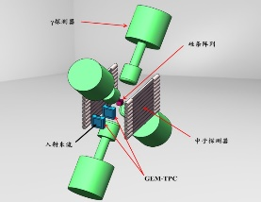
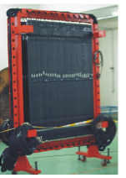
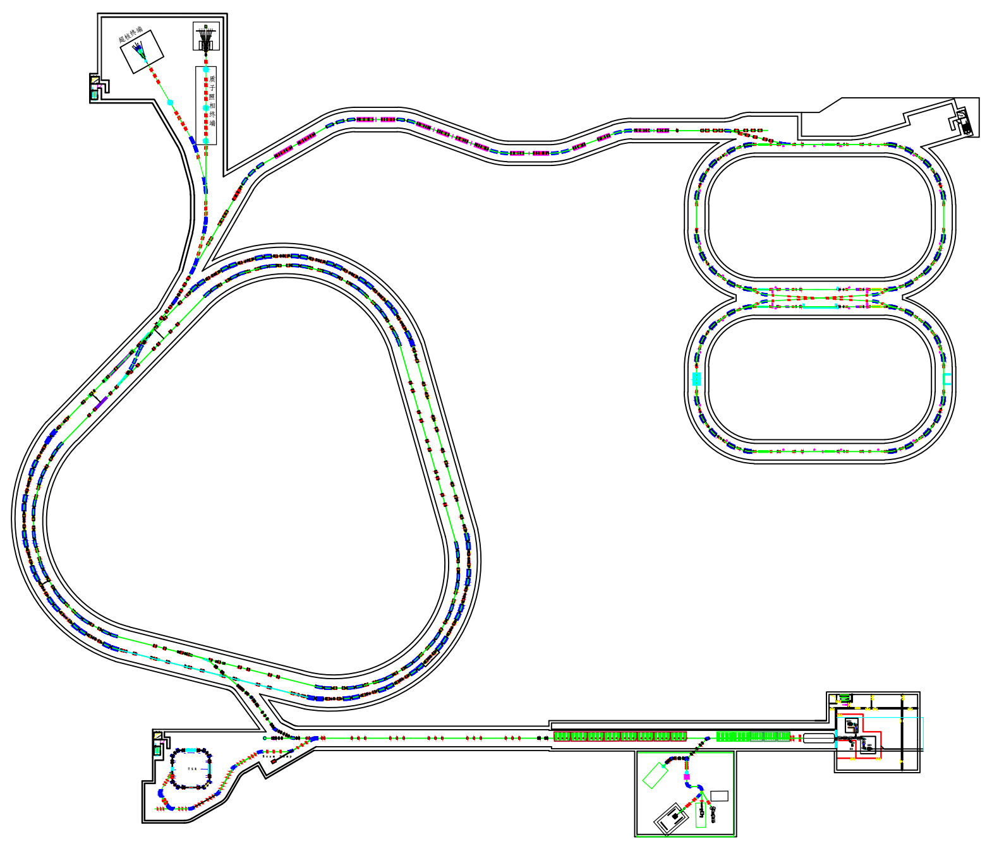
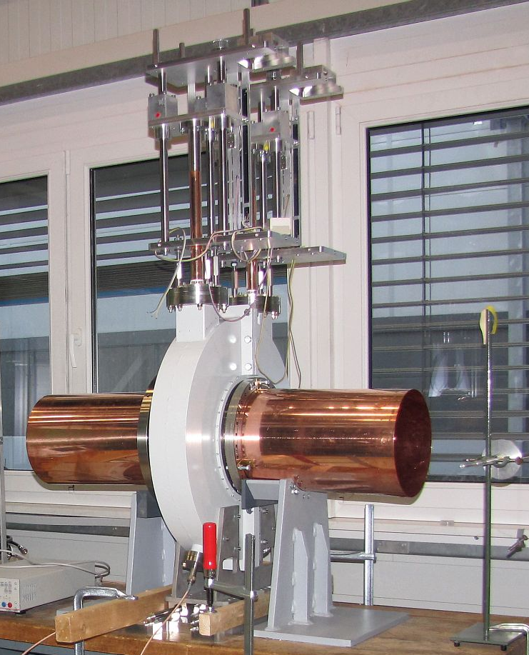
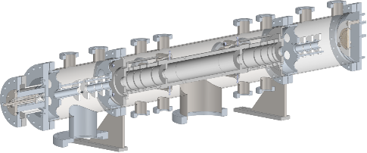
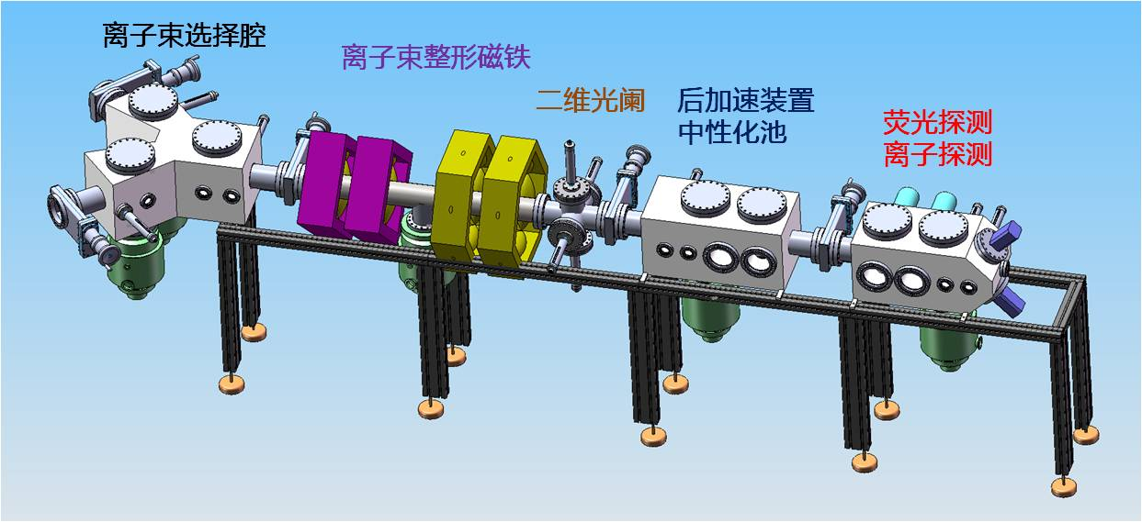
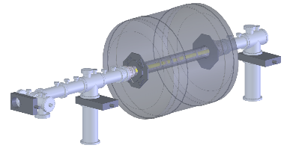
Experiment terminals
RIBs physics station
HFRS
External target station
High Energy Density Physics
Nuclear Matter study-CEE
Hypernuclear
High energy irradiation
SRing
High precision
spectrometer ring
e-ion recombination
spectroscopy
MRing
BRing-S
BRing-N
Ion-Ion Merging
iLinac-100
iLinac-25
SECR
Low energy nuclear
structure terminal
Low energy irradiation
Notes:
Around the whole facility, there are a series of experiments terminals or stations for research programs. Such as low energy nuclear structure terminal and low energy irradiation station, for high energy branches, first is external target station for

Slide 8
Concept for high intensity beam
Notes:
The HIAF project addresses a wide scope of scientific issues similar to the FAIR project of GSI, but with focus on different topics.
As I mentioned, HIAF will be a unique machine with unprecedented beam intensity for some new search field. How can HIAF provide unprecedented beam intensity and be a unique machine, now let me introduce the design concept and unique features of HIAF. First is

Slide 9
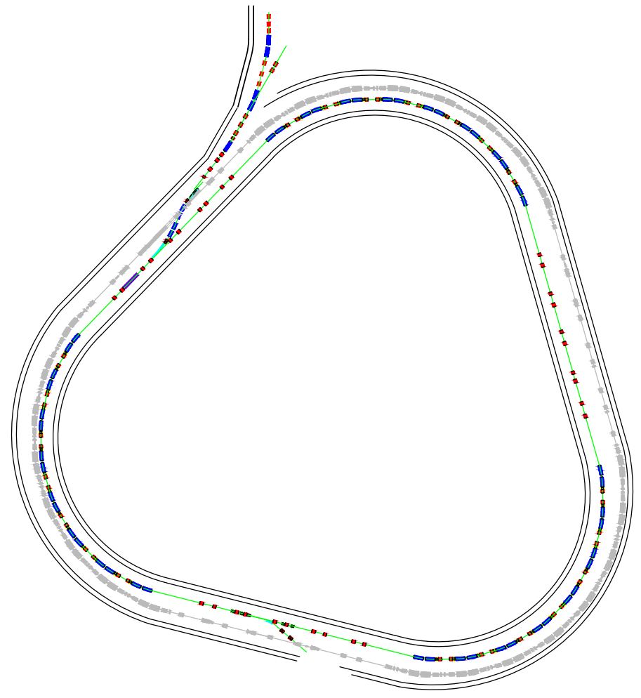
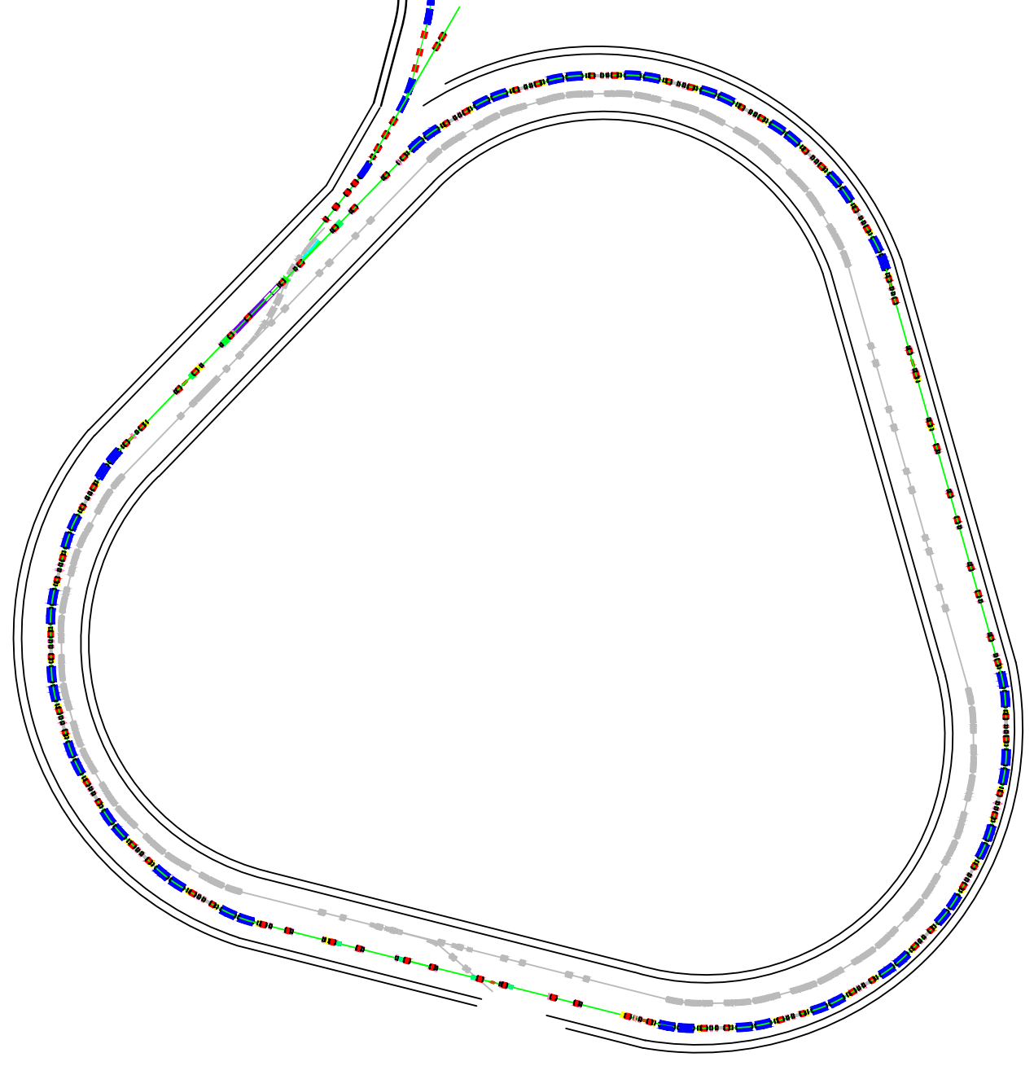
Concept for high intensity beam
Concepts for approaching the highest heavy ion intensity
BRing-N
Novel two planes painting injection scheme - 2.0×10¹¹ ppp
Fast ramping rate operation mode- 3-5 Hz
BRing-N
Barrier bucket stacking longitudinal
BRing-S
Innovative timing system of RF synchronization
5 times increase of intensity
1.0×10¹² ppp
BRing-S
Notes:
Quite different from the FAIR of Germany, HIAF will use the superconducting Linac as the injector, the basic ideas for high intensity are: firstly a novel two planes painting injection scheme with the fast ramping rate mode in BRing-N, and secondly beam stacking from BRing-N to BRing-S with new barrier bucket technology .

Slide 10
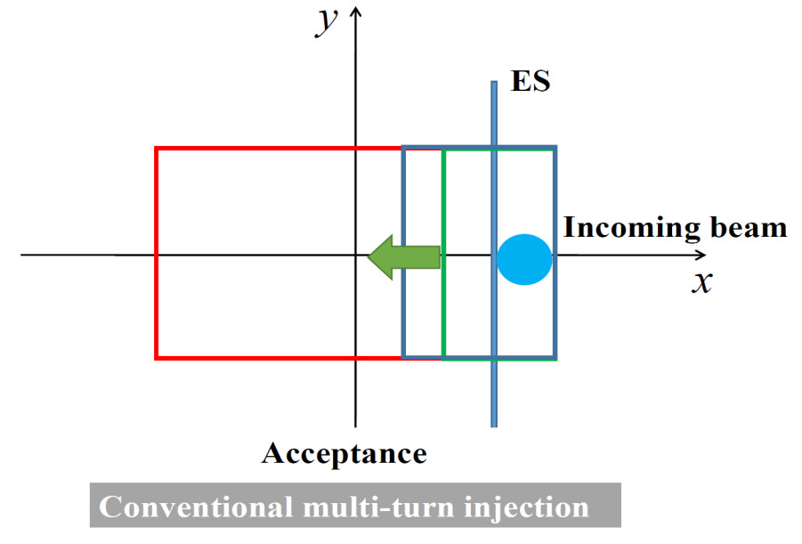
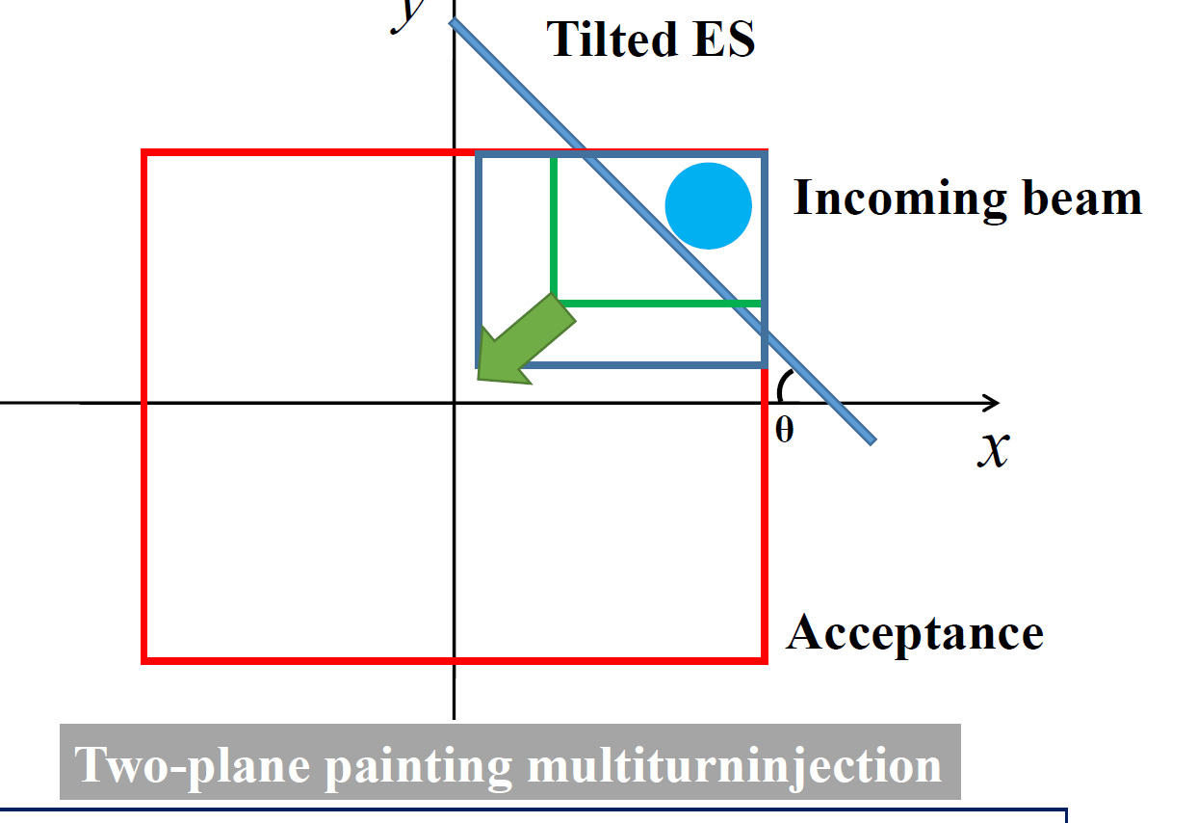
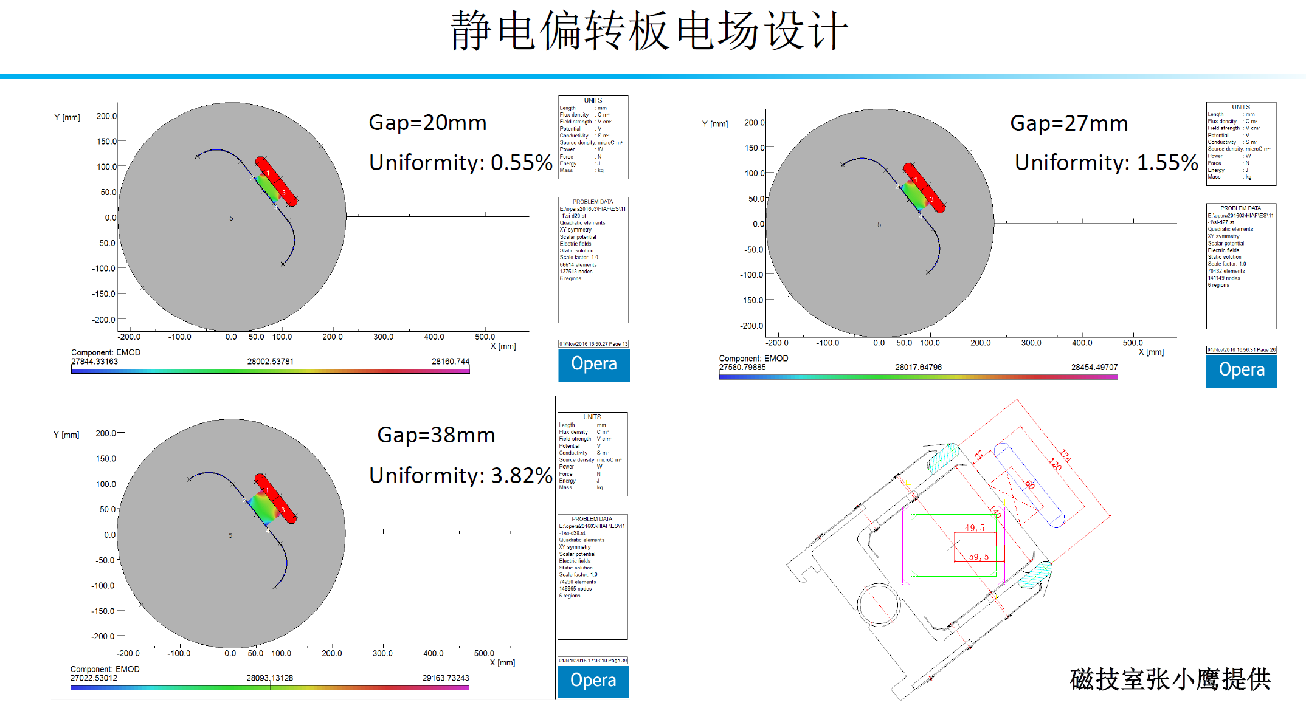
Concept for high intensity beam
Two planes painting injection
Simultaneous injection in H and V planes using tilted septum
The beam intensity could reach 2.0 ×10¹¹ with two planes painting, nearly 10 times over the conventional single-plane injection.
Notes:
Compare with the conventional multi-turn injection scheme, as used in FAIR SIS18 injection, two planes painting injection can conduct both the horizontal and vertical painting simultaneous using the inclined E-Septum. Left is conventional multi-turn injection, only painting in horizontal plane, right is two planes painting and beam is painted in both horizontal and vertical

Slide 11
Concept for high intensity beam
Fast ramping rate mode of BRing-N
Why？
Due to space charge and dynamic vacuum effect, beam should be launched to the high energy as soon as possible.
Extraction
1.58T
Transition
Falling
10T/s
Acceleration
12T/s
Transition
366ms
30
30
30
30
32
84
10
120
Repetition rate：3-5 Hz, 5-10Hz
Notes:
Through two planes painting injection, we can accumulate the beam to high intensity, and the beam should be launched to high energy as soon as possible to avoid the beam loss due to space charge and dynamic vacuum effects, so the fast ramping rate mode was designed for BRing-N, the ramping rate is 12T/s and the repetition rate is 3-5Hz.

Slide 12
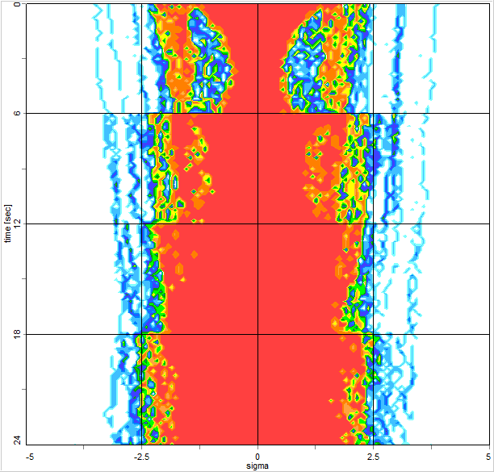
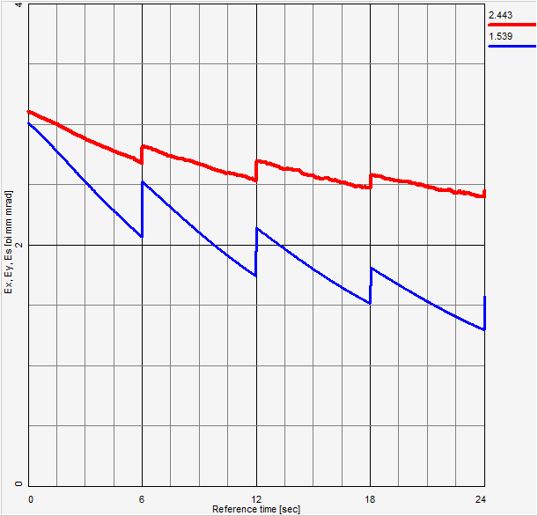
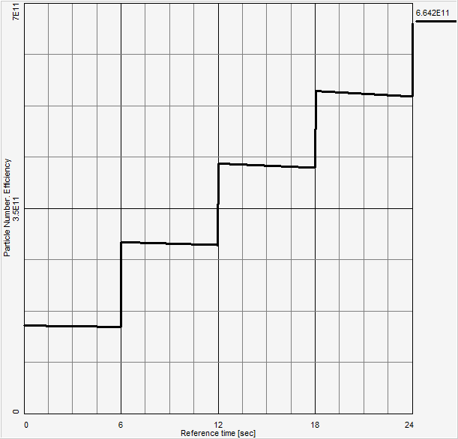
Concept for high intensity beam
Barrier bucket stacking
800MeV/u (²³⁸U³⁵⁺)
2.0×10¹¹
5 times
Barrier bucket
2.3GeV/u (²³⁸U³⁵⁺)
1.0×10¹²
iLinac
Innovative RF timing system
BRing-N
BRing-S
Challenges:
Fast e-cooling for high energy heavy ion
High intensity effect of barrier bucket stacking
Momentum spread
Emittance
Intensity
5 times increase of beam intensity through barrier bucket
Notes:
Then beam will be stacked longitudinal through from BRing-N to BRing-S, a new timing system of RF synchronization is designed, and

Slide 13
Simulation study of two planes painting
Simulation code, particle swarm optimization algorism
Investigation of space charge effect
Tune selection
Free space for tune spread
Resonances compensation
Optimization the injection scheme
Maximize the accumulation gain factor, i.e., maximum gain from the linac beam to the storage ring
Minimize beam loss (on septum and acceptance), to avoid the beam loss due to the dynamic vacuum effect
Minimize emittance dilution (saving the acceptance & cost)

Slide 14
Two planes painting injection
Injection efficiency optimization
Injection efficiency
Closed orbit variation
Ions | Plane | Injection Turns | Single injection
²³⁸U³⁵⁺ | H | 33 | 3.3×10¹⁰
 | V | 16 | 1.6×10¹⁰
 | H+V | 150 | 2.0×10¹¹
The beam intensity could reach 2.0 ×10¹¹ with two planes painting, nearly 10 times over the conventional single-plane injection.

Slide 15
Two planes painting injection
Without SC
With SC
Qx=0.45
Qy=0.43
Qx=0.451
Qy=0.424
The simulation scan tune-efficiency figure with space charge effect
ΔQx≈0.016, ΔQy≈0.027
The selected tune is reasonable, and the optimized work point is
Qx=0.451, Qy=0.424

Slide 16
High intensity heavy ion beam
Basic beam parameters
 | Ions | Energy | Intensity
SECR | ²³⁸U³⁵⁺ | 14 keV/u | 0.05-0.1 pmA
iLinac | ²³⁸U³⁵⁺ | 17 MeV/u | 0.028-0.05 pmA
BRing-N | ²³⁸U³⁵⁺ | 0.8 GeV/u | ~2.0×10¹¹ ppp
BRing-S | ²³⁸U³⁵⁺ | 2.3 GeV/u | ~1.0×10¹² ppp
 | ²³⁸U⁷⁶⁺ | 5.8 GeV/u | ~5.0×10¹¹ ppp
 | ²³⁸U⁹²⁺ | 7.3 GeV/u | ~5.0×10¹¹ ppp
SRing | RIBs: neutron-rich, proton-rich | 0.84 GeV/u(A/q=3) | ~10⁹⁻¹⁰ ppp
 | Fully stripped heavy ions H-like, He-like heavy ions | 0.8 GeV/u(²³⁸U⁹²⁺) | ~10¹¹⁻¹² ppp
Notes:
Here are basic beam parameters of HIAF, you can see from here, for low charge state U35+ the energy is 2.3GeV/u and intensity is 1.0*10^12, we also can get high energy for high charge state with low intensity due to stripping efficiency

Slide 17
Figure-8 shape ion-ion merging ring

Slide 18
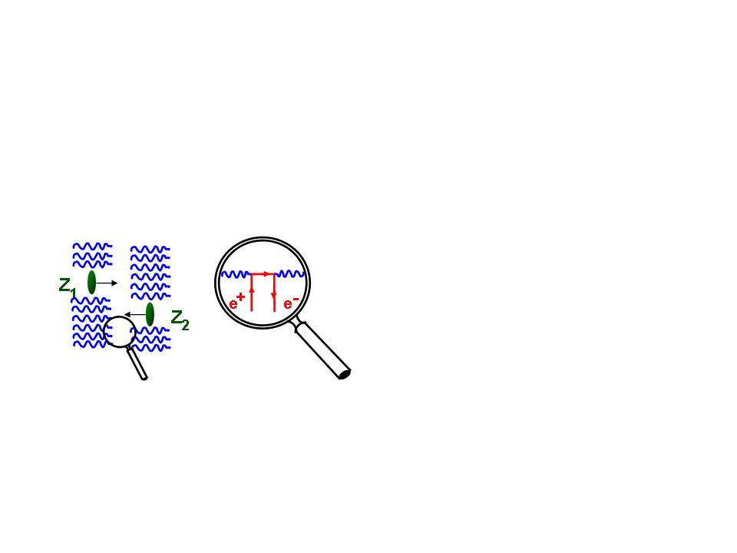
Figure-8 shape ring for ion-merging
Spontaneous electron–positron pair production
QED
Bound pair production
A fundamental question of QED-spontaneous electron-positron pair creation in supercritical Coulomb fields
Theory prediction: occur in the collisions of two very heavy ions with the total atomic number Z1 + Z2 ≥ 173.
Failed to observe in fixed target experiments due to the interference of extranuclear electrons.
Notes:
The third unique feature of HIAF is the ion-ion merging scheme based on figure“8”storage ring. The science motivation is

Slide 19
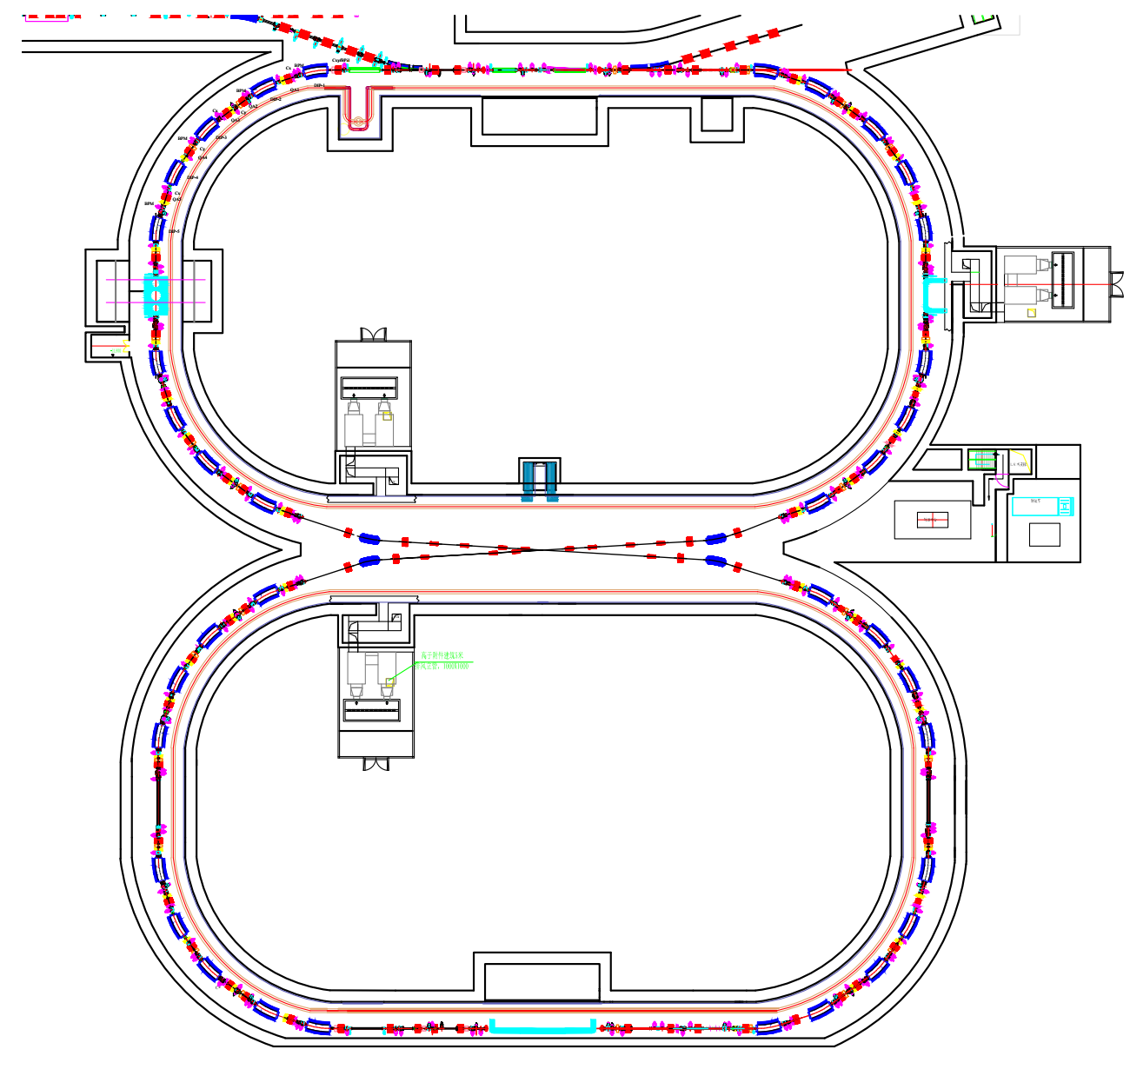
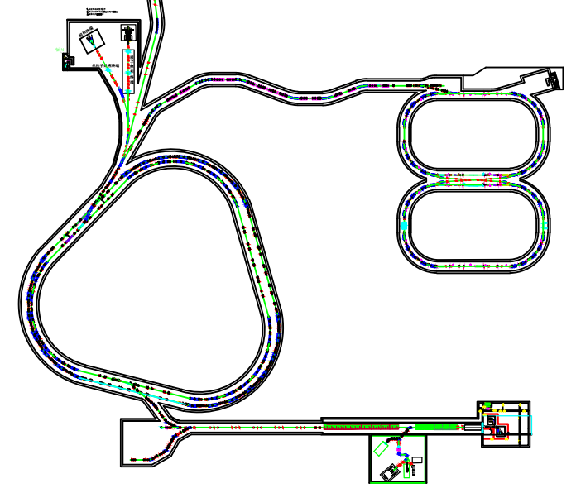
Figure-8 shape ring for ion-merging
First ion-ion merging facility in the world
Unique features:
“8” shape ring
Coasting beam merging with itself scheme
Based on SRing
Sharing the injection and cooling system
No powerful RF system
SRing
Advantages:
No electron-electron correlation
Ultra-low background signals
Small angle collision provides the energy (6~8MeV/u) to cross column barrier
MRing
Bare heavy nuclei, e.g. ²³⁸U⁹²⁺,
Z1 + Z2 =184 ≥ 173
Notes:
This is the first ion-ion merging machine in the world. The features are: Figure 8 shape and coasting beam can support the ion merging with itself. This design is based on SRing, Sharing the injection and cooling system with SRing, the coasting beam confirm the merging without the powerful RF system for beam bunching, so this is a cost-effective scheme

Slide 20
Figure-8 shape ring for ion-merging
Merging beam parameters - First phase
Parameter | Value
Ion | ²³⁸U⁹²⁺
Energy(MeV/u) | 637(800)
Circumference(m) | 483.8
Frequency(MHz) | 0.50(0.52)
Crossing angle(◦) | 6.8
CM energy(MeV/u) | 6(8)
Particle number | 7(8)×10¹⁰
ε_{x,rms}/ε_{y,rms} (π mm mrad) | 1/1
β∗_{x}/β∗_{y}(m) | 1/0.03
σ_{x,rms}/σ_{y,rms} (mm) | 1/0.173
Laslett tune shift | -0.1(-0.077)
Hourglass factor | 0.9
Luminosity(cm⁻²s⁻¹) | 4.4(5.4) ×10²³

Slide 21
Figure-8 shape ring for ion-merging
Merging beam parameters – Update- 1000 times
Parameter | Value
Ion | ²³⁸U⁹²⁺
Energy(MeV/u) | 4300
Circumference(m) | 472.7
Frequency(MHz) | 0.624
Crossing angle(◦) | 1.93
CM energy(MeV/u) | 8
Particle number | 3×10¹²
ε_{x,rms}/ε_{y,rms} (π mm mrad) | 1/1
β∗_{x}/β∗_{y}(m) | 0.1/0.02
σ_{x,rms}/σ_{y,rms} (mm) | 0.316/0.141
Laslett tune shift | -0.08
Hourglass factor | 0.9
Luminosity(cm⁻²s⁻¹) | 4.1×10²⁶
SRing
MRing
Update-1：SC magnet to 4T
Update-2：New interaction section with small cross angle

Slide 22
Innovative technologies and developments
Notes:
These unprecedented parameters and unique features can only be met with new technical solutions. So a series of new and innovative technologies have been proposed for HIAF accelerator. Now let me introduce the new technology developments.

Slide 23
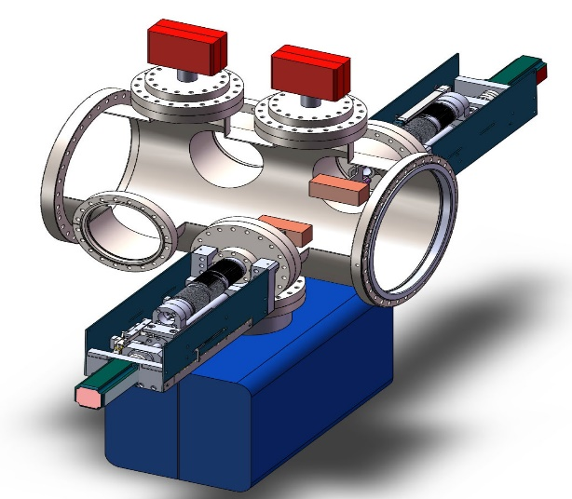
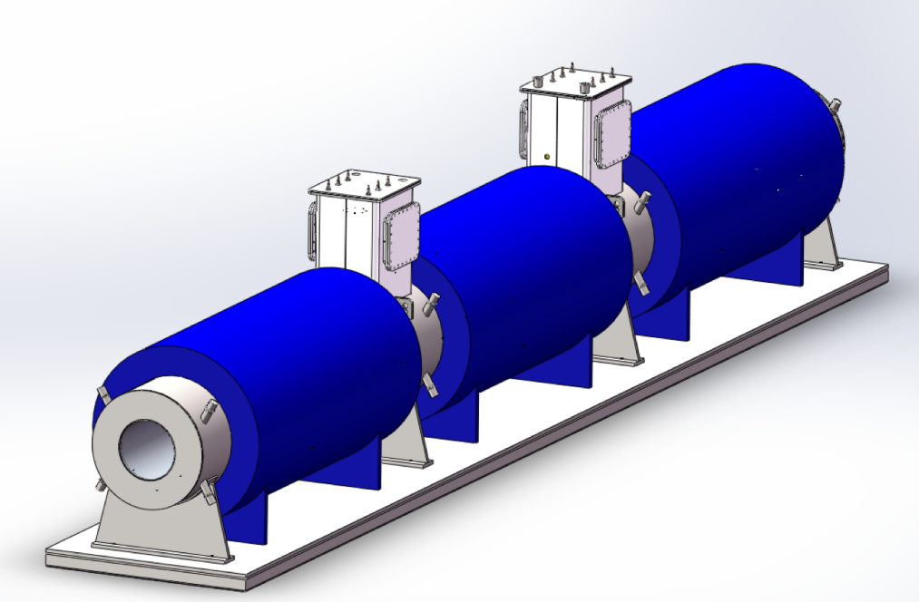
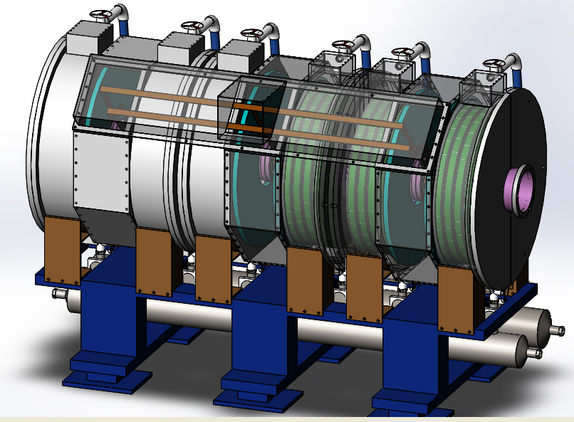
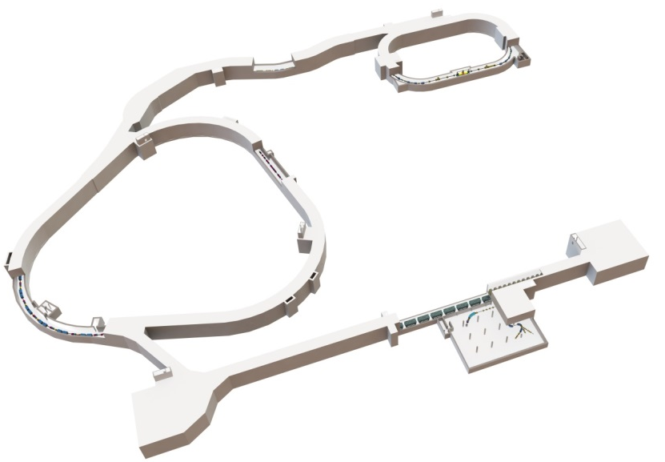
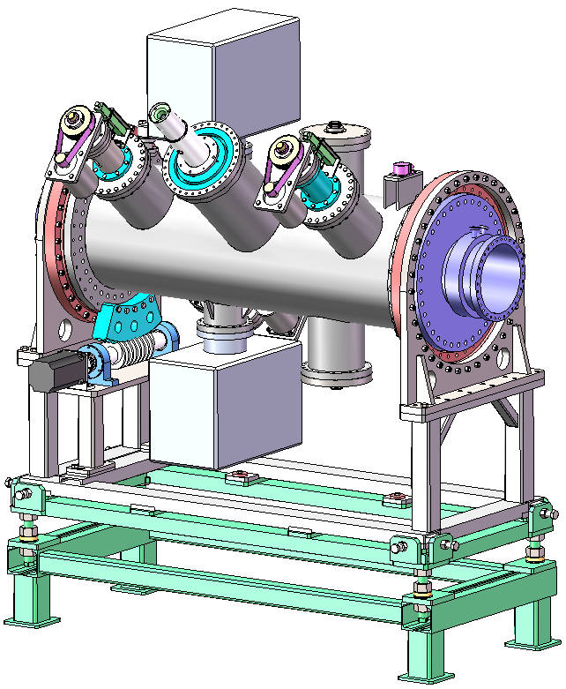
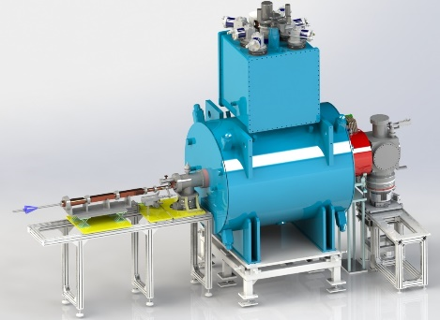
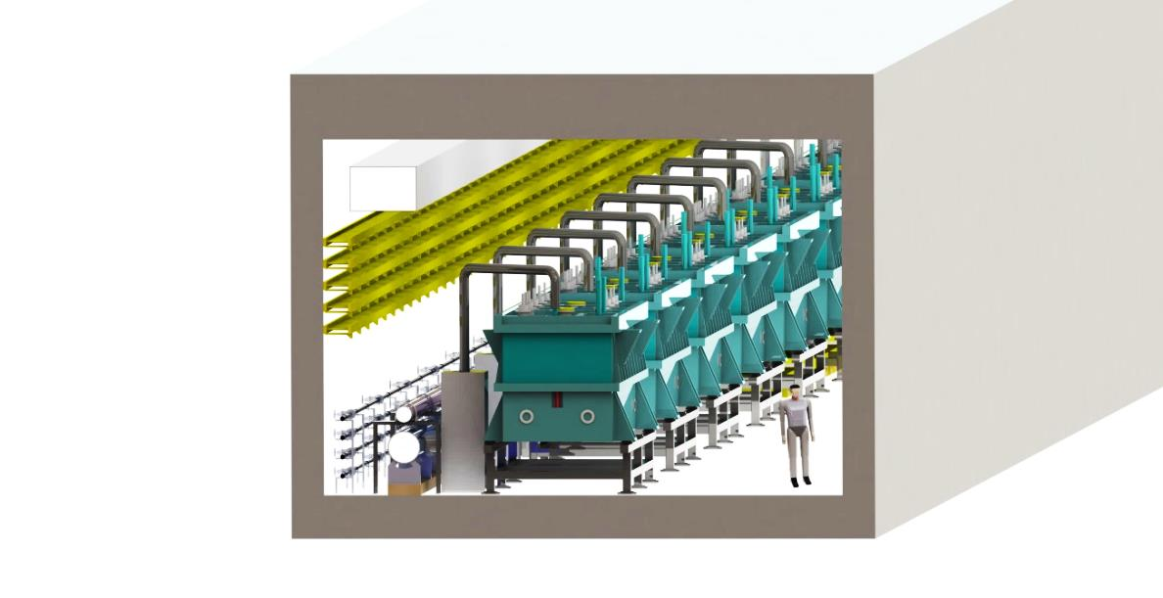
Innovative technology development
Dynamic vacuum collimator
HFRS-CCT（Canted Cosine Theta）coils
Magnetic alloy core loaded cavity
HIAF
Inclined electro-static septum
Superconducting ECR ion source-45GHz
高真空
旋转密封
High intensity super conducting linac
旋转
驱动系统
Notes:
A series of new and innovative technologies have adopted for HIAF, such as …….Here is just a selection of these technologies. The prototypes have been developed for these system for the varication of the feasibility, reliability and performance.

Slide 24
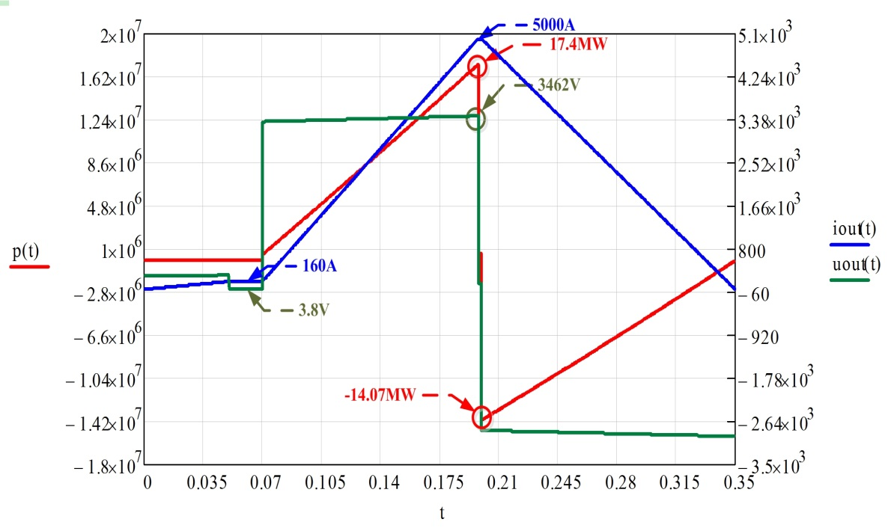
Fast cycling power supply
The main magnets for BRing consist of 48 dipoles in twelve groups of four magnets, load specification and performance requirement featured by fast ramping rate
Parameters | Values
Resistance of load | 24mΩ
Inductance of load | 88mH
Current | 5000A
Voltage | 3462V
Rising time | 130ms
Max. ramping/falling rate | ±38000A/s
Tracking error | ≤±1×10⁻⁴
Platform error | ≤±5×10⁻⁵
Operation Waveform
Challenges:
A broad dynamic current range
A high precision and reproducibility
Very low tracking errors relative to current reference
The strong shock of large return power to the power grid
Notes:
A plenty of experience have been got from LEAF and ADS demo linac for HIAF injector. There are also challenges for fast ramping rate high intensity synchrotron, first is

Slide 25
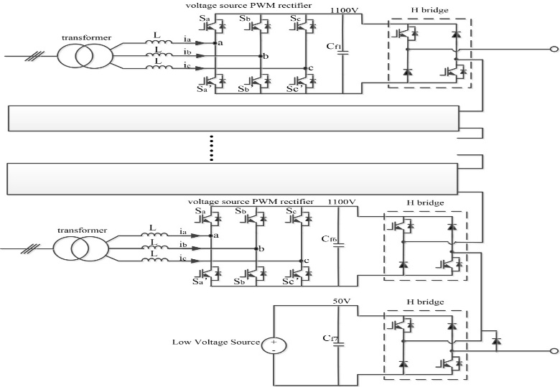
Fast cycling power supply
Innovative concept based on full-energy store principle
Voltage-changed stimulation asymmetrical multi-level cascaded PWM
Low voltage source for injection & extraction platform, high voltage source for fast ramping stage
Energy capacitor will be used to store energy.
High voltage source
The energy can be controlled by PWM rectification technology, only active power will be taken from the grid!
Asymmetrical PWM cascade Structure: keep high accuracy and fast output dynamic response
Low voltage source
Modular designed circuit schematic diagram
Notes:
So innovative concept based on full-energy store principle was designed for HIAF, this new technology based on

Slide 26
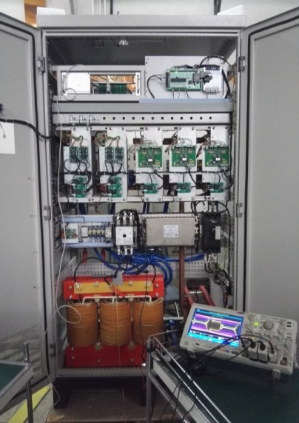
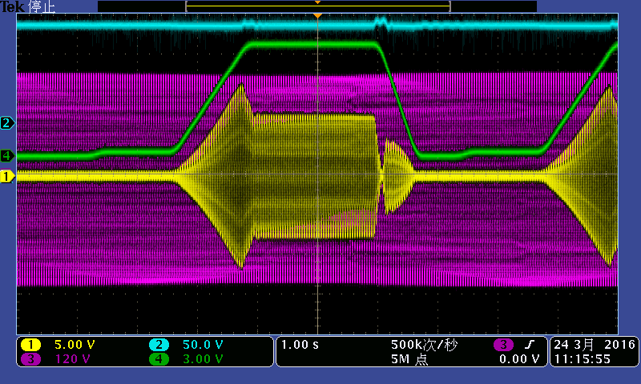
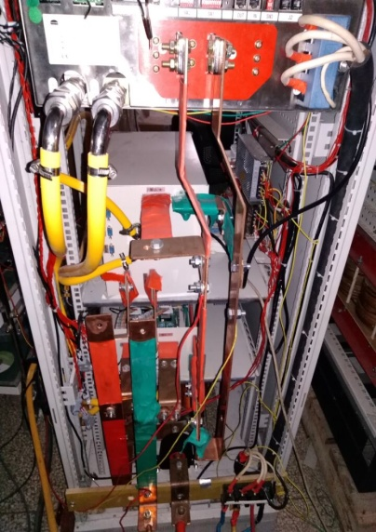
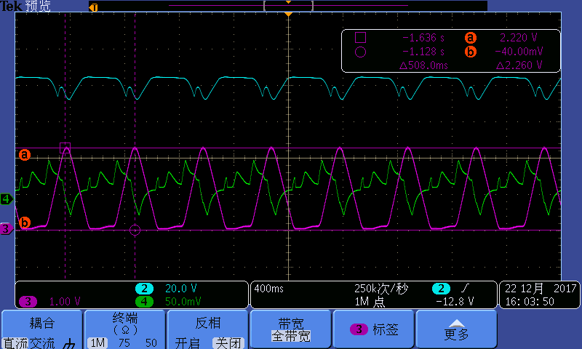
Fast cycling power supply
PWM rectification and full energy storage technology have been tested on the low power prototype, for the verification of this new design concept.
Power supply based on PWM rectification technology
Results of the PWM rectifier prototype
Full energy storage testing prototype
450A full energy storage technology test

Slide 27
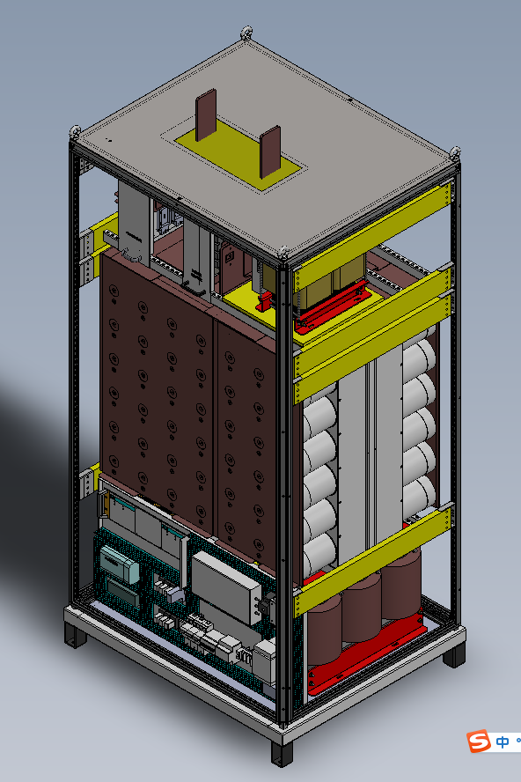
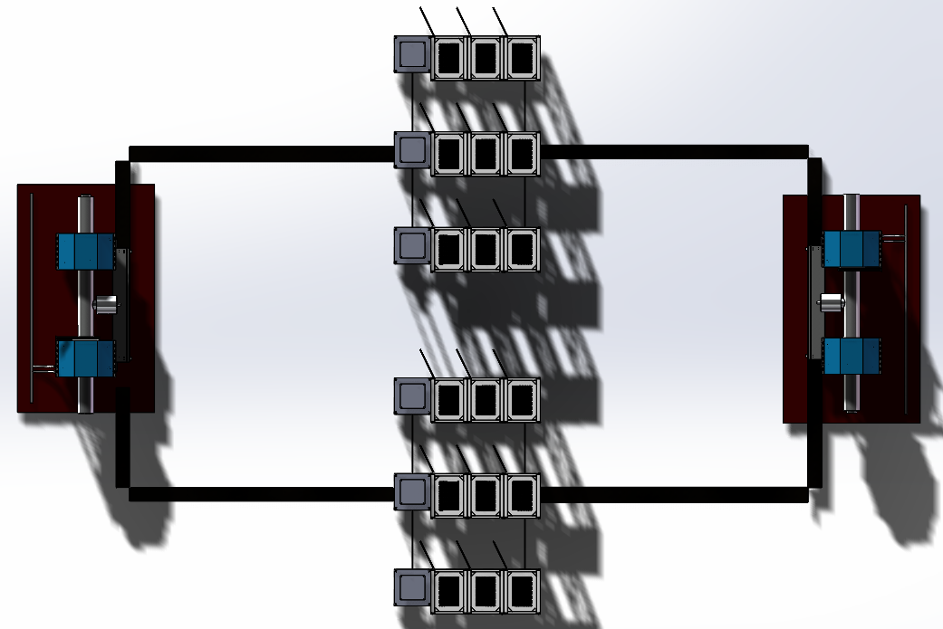
Fast cycling power supply
A full size prototype (4000A/2770V) is being manufactured in the factory. The distribution and process structure design have been established already.
Distribution of the prototype
Structure of one power unit

Slide 28
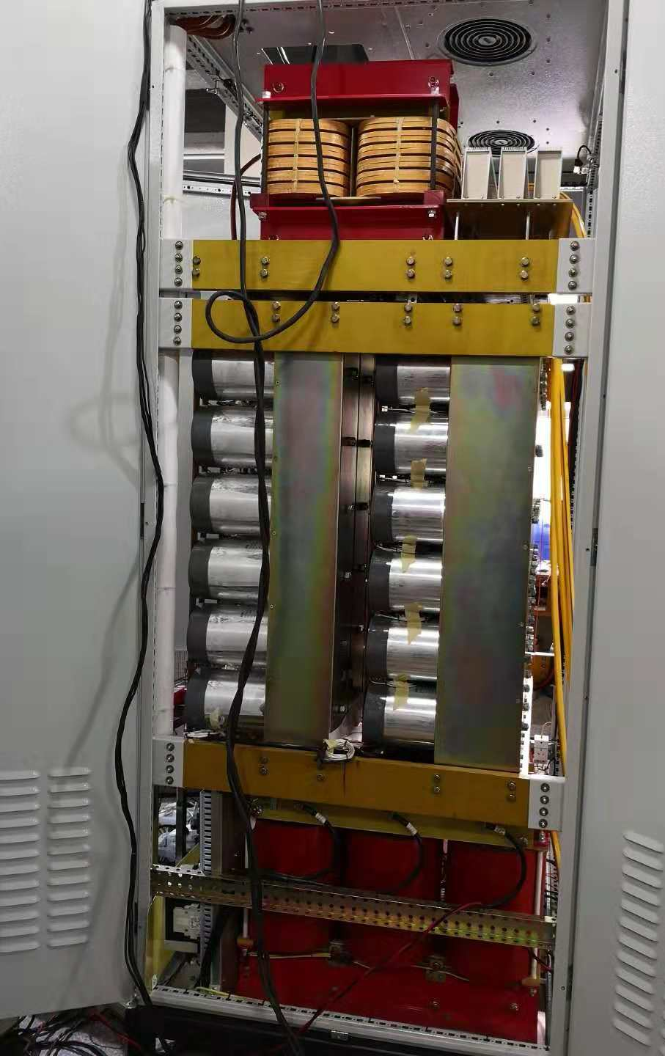
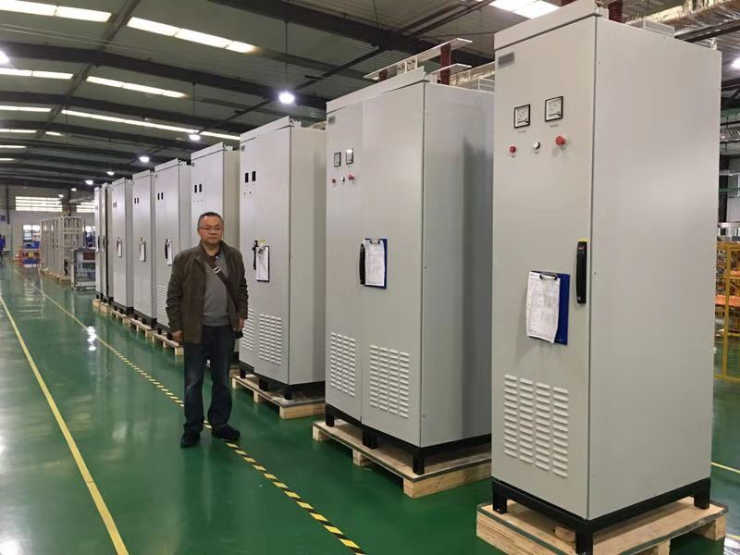
Fast cycling power supply
Power unit of 2000A/1100v

Slide 29
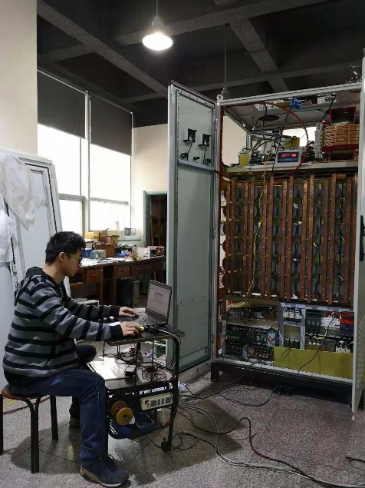
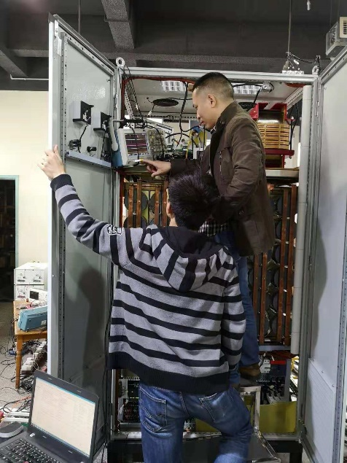
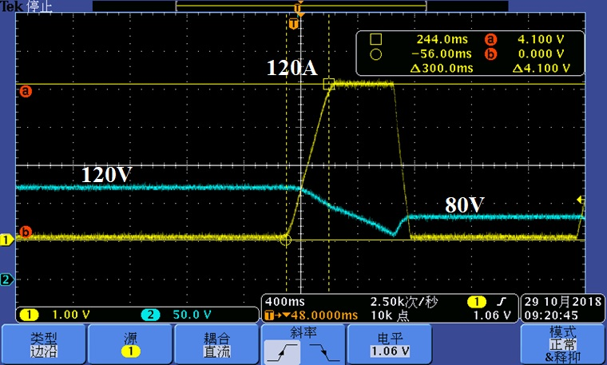
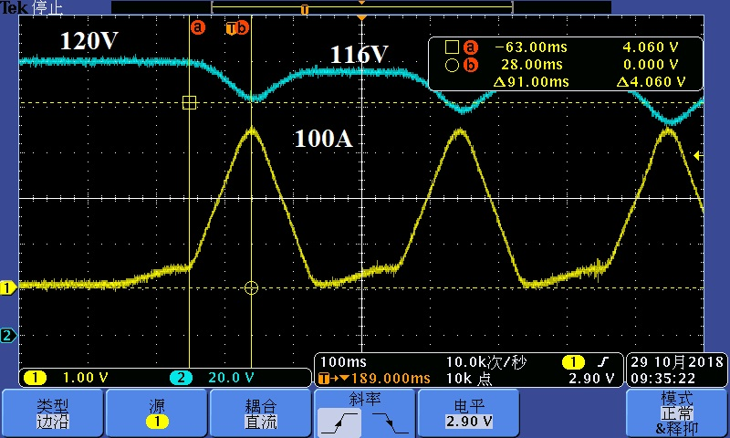
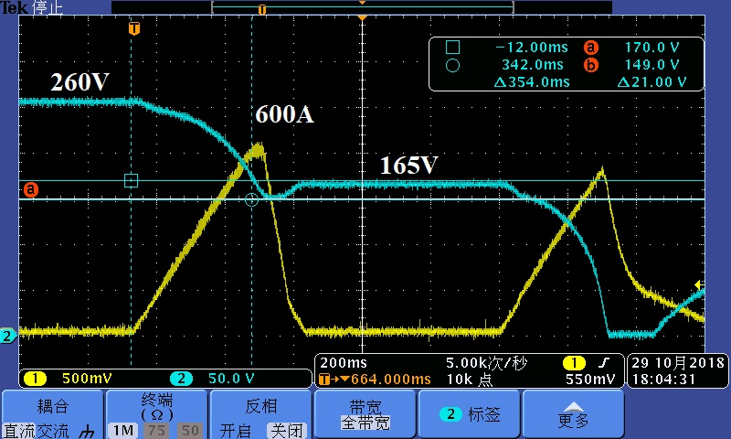
Fast cycling power supply
The test results show the feasibility and reliability of full-energy store principle, will go into production

Slide 30
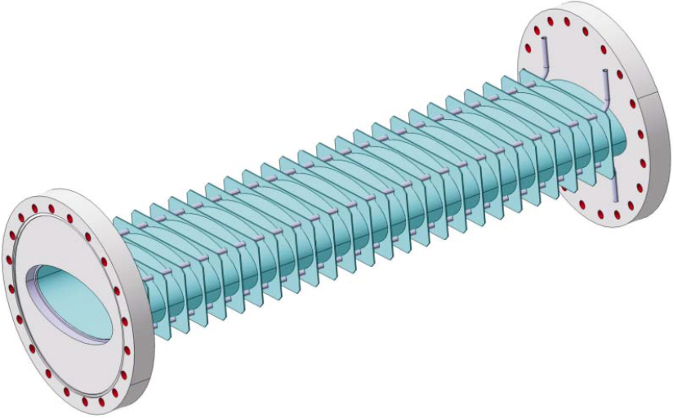
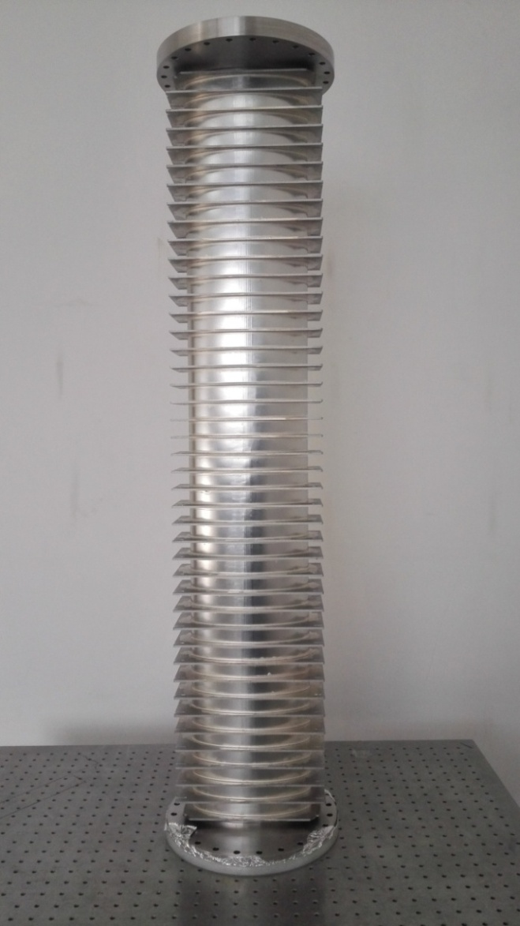
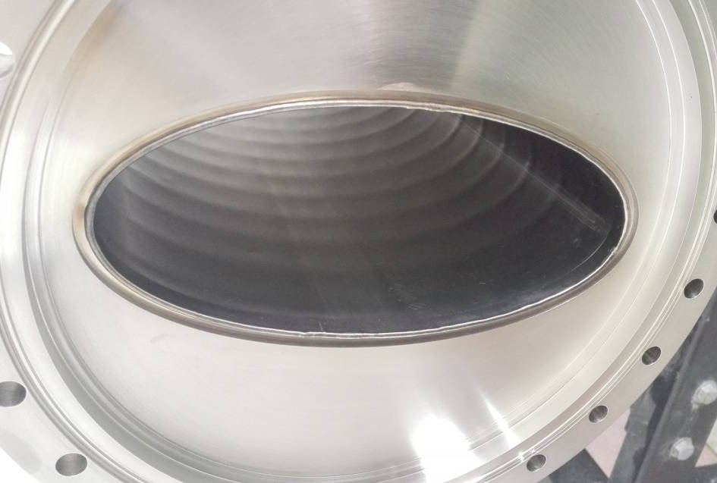
Thin wall vacuum chamber
Due to high ramping rates, thin wall vacuum chambers are needed for all magnets to keep eddy currents at a tolerable level.
The traditional technology is ribs supporter thin wall chamber, ribs supporter parallel to the magnetic field lines
Stainless steel-0.3mm
L=1.2m, 2.0m long, curved thin wall chamber prototype have been developed

Slide 31
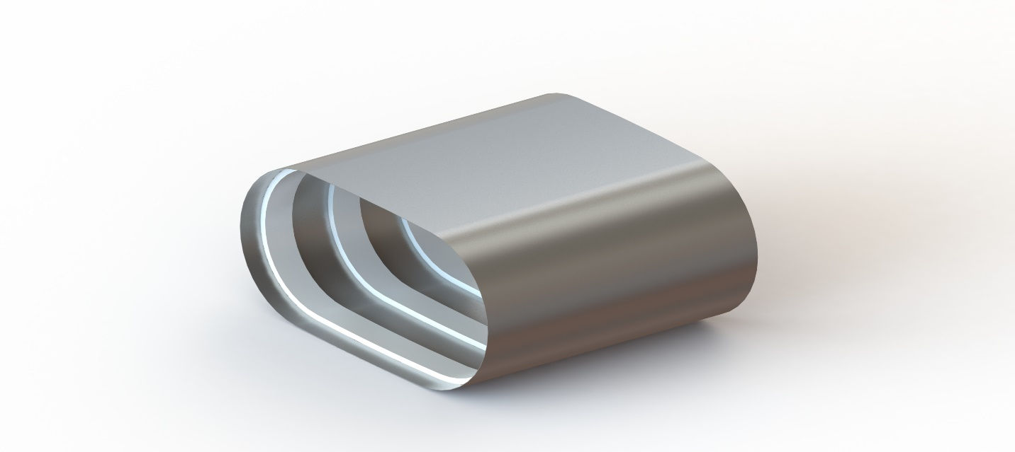
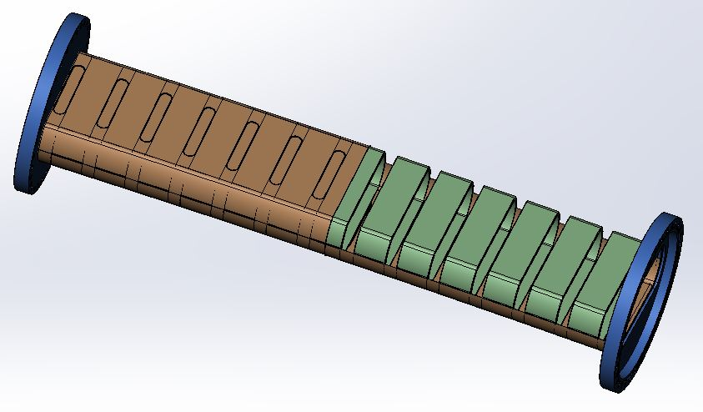
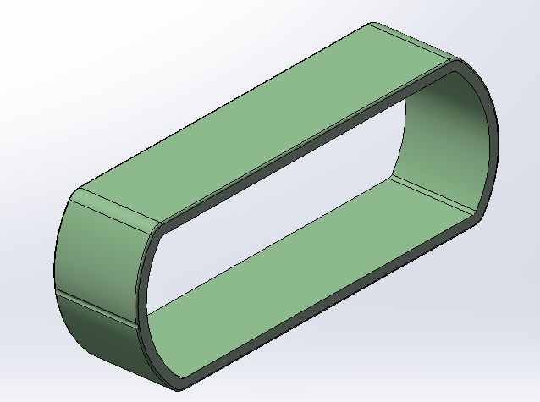
Thin wall vacuum chamber
A novel thin wall vacuum chamber are designed for HIAF
(chamber supported by ceramic rings )
Chamber with ceramic supporter
Static structural equivalent stress
Notes:
So a novel technique has been successfully developed for HIAF in our institute, the chamber

Slide 32
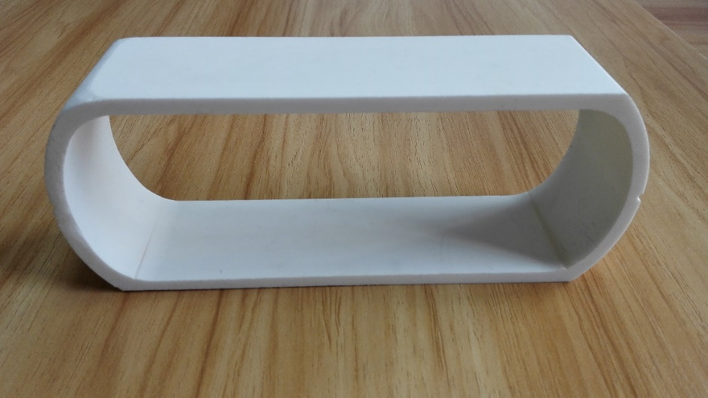


Thin wall vacuum chamber
Chamber supported by ceramic rings
Fabrication process

Slide 33





Thin wall vacuum chamber
Chamber supported by ceramic rings
Inside view of chamber
4.0×10⁻¹² mbar
Outgassing
Bake system

Slide 34


Thin wall vacuum chamber
Chamber supported by ceramic rings
This new technology greatly reduce the cost of manufacture process, the difficulty, shorten the production cycle, and improve the quality.

Slide 35
Present status and summary
Notes:
Last is present status and summary, in the past several years, a series of prototypes have been developed for technical challenges and critical issues. The machine design was optimized based on these prototypes developments, details of technical design has been finished and some hardware systems already go into production.
A series of new design concepts and innovative technologies have been adopted based on the experience of the exiting facilities.
Up to now, prototypes have been developed for the test and demonstration of all technology challenges. The details of technical design of all hardware system have been finished.

Slide 36





Present status and summary
Tunnel utilities and mechanical installation
iLinac section
BRing arc section
BRing straight section
Beam transfer line
SRing arc section
Tunnel mechanical installation
Notes:
The civil construction and common system are also going smoothly,

Slide 37










Present status and summary
Layout of tunnel and cross sectional view of the tunnels
Notes:
Also engineering design of the tunnel.

Slide 38



Present status and summary
Notes:
The campus civil construction started serval months ago, this is the view before groundbreaking, and this is the latest view
the legal and regulatory procedures have been passed smoothly.

Slide 39

Present status and summary
2025-Huizhou, HIAF welcome all of you !!!

Slide 40
Thanks for your attention!

Slide 41
Budget
Items | 1st phase (MRMB)
iLinac | 360
BRing | 350
Beam transfer line | 50
Experiment setups | 240
Cryogenics | 80
Civil engineering | 190
Tunnel construction | 160
Contingency cost | 100
Total of facility | 1530 (central government)
Infrastructure & common systems | 1000 (local government)
Total | 2530

Slide 42

Schedule
2018.12—2025.12
2025
2018
Notes:
The planed construction period is about 7 years, and we hope we can finished the projector in end of 2025.

Slide 43



New campus
HIAF site
HIAF site
HIAF

Slide 44

Key technical-1
Inclined E-Septum
Inclined E-Septum
Electromagnetism design
Notes:
The septum foil is tilted by 30°to cope with the combined longitudinal and transverse injection scheme. A new septum has been constructed to cope with the extremely tight vacuum requirements of LEIR. By optimising the internal surface under vacuum and increasing the pumping speed and beam scrubbing, a dynamic vacuum in the low 10-12 mbar range is expected. The technical specification is shown in Table 3 and a
cross section in Fig. 3.

Slide 45

Key technical-1
Inclined E-Septum
Inclined E-Septum
Big challenge – Vacuum seal in the extreme high vacuum -10⁻¹² mbar
Multi-Differential Vacuum System was designed, a small prototype has been developed
for the verification of this system
Notes:
The rotation system is one of the most challenging aspects, mainly because of the vacuum seal in the extreme high vacuum. A full size prototype is under fabrication and will be accomplished in this year.
2.Finally, we present a new type of XHV electrostatic saddle field ionization gauge which features very small electrode sizes and low outgassing/ sorption rates and high sensitivity.
3. A novel technique has been successfully developed to calibrate the ultra high vacuum ( UHV) and extra high vacuum ( XHV), whichconsists of XHV/ UHV chambers, a flow separation and a gas supply.
4.On the studies of this subject, design and implement a small prototype and the control system. Also research of the nonlinear motion system algorithm for the control system, verification of control system is reasonable.

Slide 46



Two planes painting injection
Simulation results
Ions | Plane | Injection Turns | Single injection
²³⁸U³⁵⁺ | H | 33 | 3.3×10¹⁰
 | V | 16 | 1.6×10¹⁰
 | H+V | 150 | 2.0×10¹¹
The beam intensity could reach 2.0 ×10¹¹ with two planes painting, nearly 10 times over the conventional single-plane injection.
Notes:
We have developed the simulation code, the simulation results show the beam intensity could reach 2.0*10^11, nearly 10 times over the conventional single-plane injection.

Slide 47


Two planes painting injection
Fluctuation of injection efficiency with hollow beam
inject from 1st turn
inject from 30th turn
Fluctuation
H-bump
V-bump
The efficiency of first few turns is very low, if the injection start from 30 turns later, there will be a strong fluctuation of efficiency
Fluctuation introduced by nonlinear space charge effect of hollow beam.
Notes:
First is injection efficiency, considering the dynamic vacuum effect, a important requirement of HIAF injection design is to reduce the beam loss as less as possible. So we study the injection efficiency, this figure show the injection efficiency at successive turns during injection process, and find the beam loss is much larger for first few turns, this caused by the hitting of septum, because the central orbit is close to the septum. So we try to inject beam from 20-30 turns later to avoid beam loss. If the injection starts from this point, we find the strong fluctuation of the efficiency.

Slide 48
Two planes painting injection
Phase space scatter plots of horizontal plane
80th turn
90th turn
100th turn
144th turn

Slide 49
Two planes painting injection
Phase space scatter plots of vertical plane
80th turn
90th turn
100th turn
144th turn

Slide 50


Two planes painting injection
inject from 30th turn
inject from 1st turn
Distortion
The space charge force is nonlinear for this hollow beam, while the force is linear defocusing for a uniform beam. Nonlinear defocusing space charge force between the injected beamlets distorts the final beam distribution and caused the beam loss.
Notes:
So the hollow injection scheme is not applicable.

Slide 51

Simulation study of two planes painting
Beam loss in presence of the space charge effect
Why ?
The beam loss decrease with space charge effect in the case of current less than 1mA
Notes:
Then we investigated the beam loss of different injection currents. Simulations are performed for various beam currents with the optimized injection parameters. With increasing injection beam current the beam losses decrease and result in about 5% for the nominal current of 1.0mA.

Slide 52


Two planes painting injection
Beam loss in presence of the space charge effect
Without space charge effect
With space charge effect
The particles are pushed into the center of the phase space, then avoid hitting the septum at the corner thus decreasing the losses.
With even larger current the tune shift increases and the particles on the outside hit the ES thus yielding more losses.

Slide 53
High intensity heavy ion beam
The highest pulse heavy ion beam intensity in the world
Institute | Machine | Planned Intensity | Achieved Intensity | Ion species | Repetition rate
BNL | AGS Booster |  | 5×10⁹ | Au³²⁺
CERN | LEIR |  | 9×10⁸ | Pb⁵⁴⁺
JINR | NICA Booster | 4×10⁹ |  | Au³²⁺
GSI | SIS18 | 1.0×10¹¹ | 3×10¹⁰ | U²⁸⁺ | 2.7Hz
FAIR | SIS100 | 4.0×10¹¹ |  | U²⁸⁺
IMP | HIAF-BRing-N | 2.0×10¹¹ |  | U³⁵⁺ | 5-10Hz, 10-20Hz
IMP | HIAF-BRing-S | 1.0×10¹² 2.0×10¹² |  | U³⁵⁺
Notes:
This table shows the beam intensity of the heavy ion machine in the world, a selection of the heavy ion facility, such as AGS booster of BNL and NICA Booster of JINR, for high intensity, such as SIS100 of FAIR can provide 4*10^11, and HIAF

Slide 54




Key technical-3
MA core loaded cavity
Two functions: acceleration & compression
High voltage: 240kV
Short rise time: ≤10μs
MA core loaded cavity
Gap voltage and phase waveform of BRing RF system
Notes:
Beside the fast cycling power supply, another challenge of fast ramping is RF system, the challenges for RF are high voltage and short rise time, the rise time less than 10 microsecond.

Slide 55




Key technical-3
MA core loaded cavity
MA ring core test
Established test bench and completed measurement under power and cold state
Measurement result
Measured under power
Power test result
Notes:
But there will be some challenges for hardware system. Such as RF system and power supply system. The first challenge for RF is high voltage.

Slide 56
Summary
HIAF will be one of the world leading facilities worldwide for nuclear physics and related researches with unique features.
A series of new design concepts and innovative technologies have been adopted based on the experience of the exiting facilities.
From technical aspects, prototypes have been developed for the test and demonstration of technology challenges.
Some of the technologies, such as, superconducting ECR source, superconducting linac and stochastic cooing, plenty of experience has been got through ADS, LIAF and update of our exiting machine.
Technical design has been finished and the engineering design are under progress and will be finished in coming few months.
As a major step towards preparing civil construction, the legal and regulatory procedures have been passed smoothly.

