Slide 2


Present limitations and future performance for the accelerators of the CERN complex
Giovanni Rumolo, CERN, Genève, Switzerland
Accelerator Performance and Concept Workshop
10-12 December 2018, Flemings Hotel, Frankfurt am Main (Germany)
Special thanks to H. Bartosik, G. Iadarola and R. Tomás.
Acknowledgements: S. Albright, R. Alemany, D. Amorim, S. Antipov, F. Antoniou, G. Arduini, M. Barnes, M. Beck, E. Benedetto, N. Biancacci, C. Bracco, R. Bruce, O. Brüning, X. Buffat, M. Carlà, P. Costa Pinto, J. Coupard, H. Damerau, G.P. Di Giovanni, R. Di Maria, S. Fartoukh, V. Forte, M. Fraser, B. Goddard, K. Hanke, A. Huschauer, V. Kain, I. Karpov, A. Lasheen, K. Li, M. Meddahi, L. Mether, E. Métral, B. Mikulec, N. Nasresfahani, Y. Papaphilippou, T. Pieloni, D. Quartullo, S. Redaelli, J. Repond, A. Romano, L. Rossi, B. Salvant, M. Schenk, R. Scrivens, E. Shaposhnikova, G. Skripka, M. Taborelli, H. Timko, M. Van Gompel, F. Velotti, C. Vollinger, C. Zannini.

Slide 3
Why upgrades and what are the upgrades for LHC and its injector chain?
Present limitations and future performance of the LHC injectors
  Present performance limitations → beam dynamics challenges
  How far we can go with the upgrades
Beam dynamics challenges for LHC

Slide 4
Why upgrades and what are the upgrades for LHC and its injector chain?
Present limitations and future performance of the LHC injectors
  Present performance limitations → beam dynamics challenges
  How far we can go with the upgrades
Beam dynamics challenges for LHC

Slide 5
Goals of upgrades in a nutshell (HL-LHC)
The High Luminosity LHC (HL-LHC) upgrade
Aims at 3000 (4000) fb⁻¹ total integrated luminosity over HL-LHC run (2026 – 2037)
Based on operation at levelled luminosity of 5 (7.5) x10³⁴ cm⁻²s⁻¹ by lowering β*
Beam properties @LHC injection
 | N_{b} (x 10¹¹ p/b) | ε_{x,y,} (μm) | Bunch spacing | Bunches
HL-LHC beam | 2.3 | 2.1 | 25 ns | 4x72 per injection
Notes:
Both the consideration of energy deposition by collision debris in the interaction region magnets, and the necessity to limit the peak pile-up in the experimental detector, impose an a priori limitation upon peak luminosity. The consequence is that HL-LHC operation will have to rely on luminosity levelling.

Slide 6
Goals of upgrades in a nutshell (LIU)
The High Luminosity LHC (HL-LHC) upgrade
Aims at 3000 (4000) fb⁻¹ total integrated luminosity over HL-LHC run (2026 – 2037)
Based on operation at levelled luminosity of 5 (7.5) x10³⁴ cm⁻²s⁻¹ by lowering β*
The LHC Injectors Upgrade (LIU)
Aims at matching the beam parameters at LHC injection with HL-LHC target
Needs to deploy means to overcome performance limitations in all injectors!
Beam properties @LHC injection
 | N_{b} (x 10¹¹ p/b) | ε_{x,y,} (μm) | Bunch spacing | Bunches
HL-LHC target | 2.3 | 2.1 | 25 ns | 4x72 per injection
Present | 1.3 | 2.7 | 25 ns | 4x72 per injection
Notes:
Invest on improved shielding, ventilation, etc to make accesses possible when needed

Slide 7
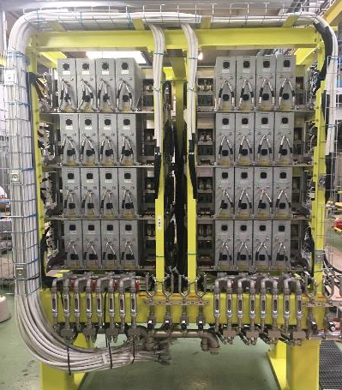
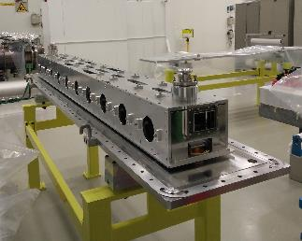
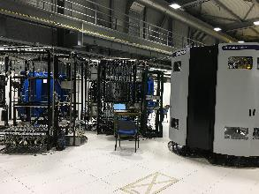
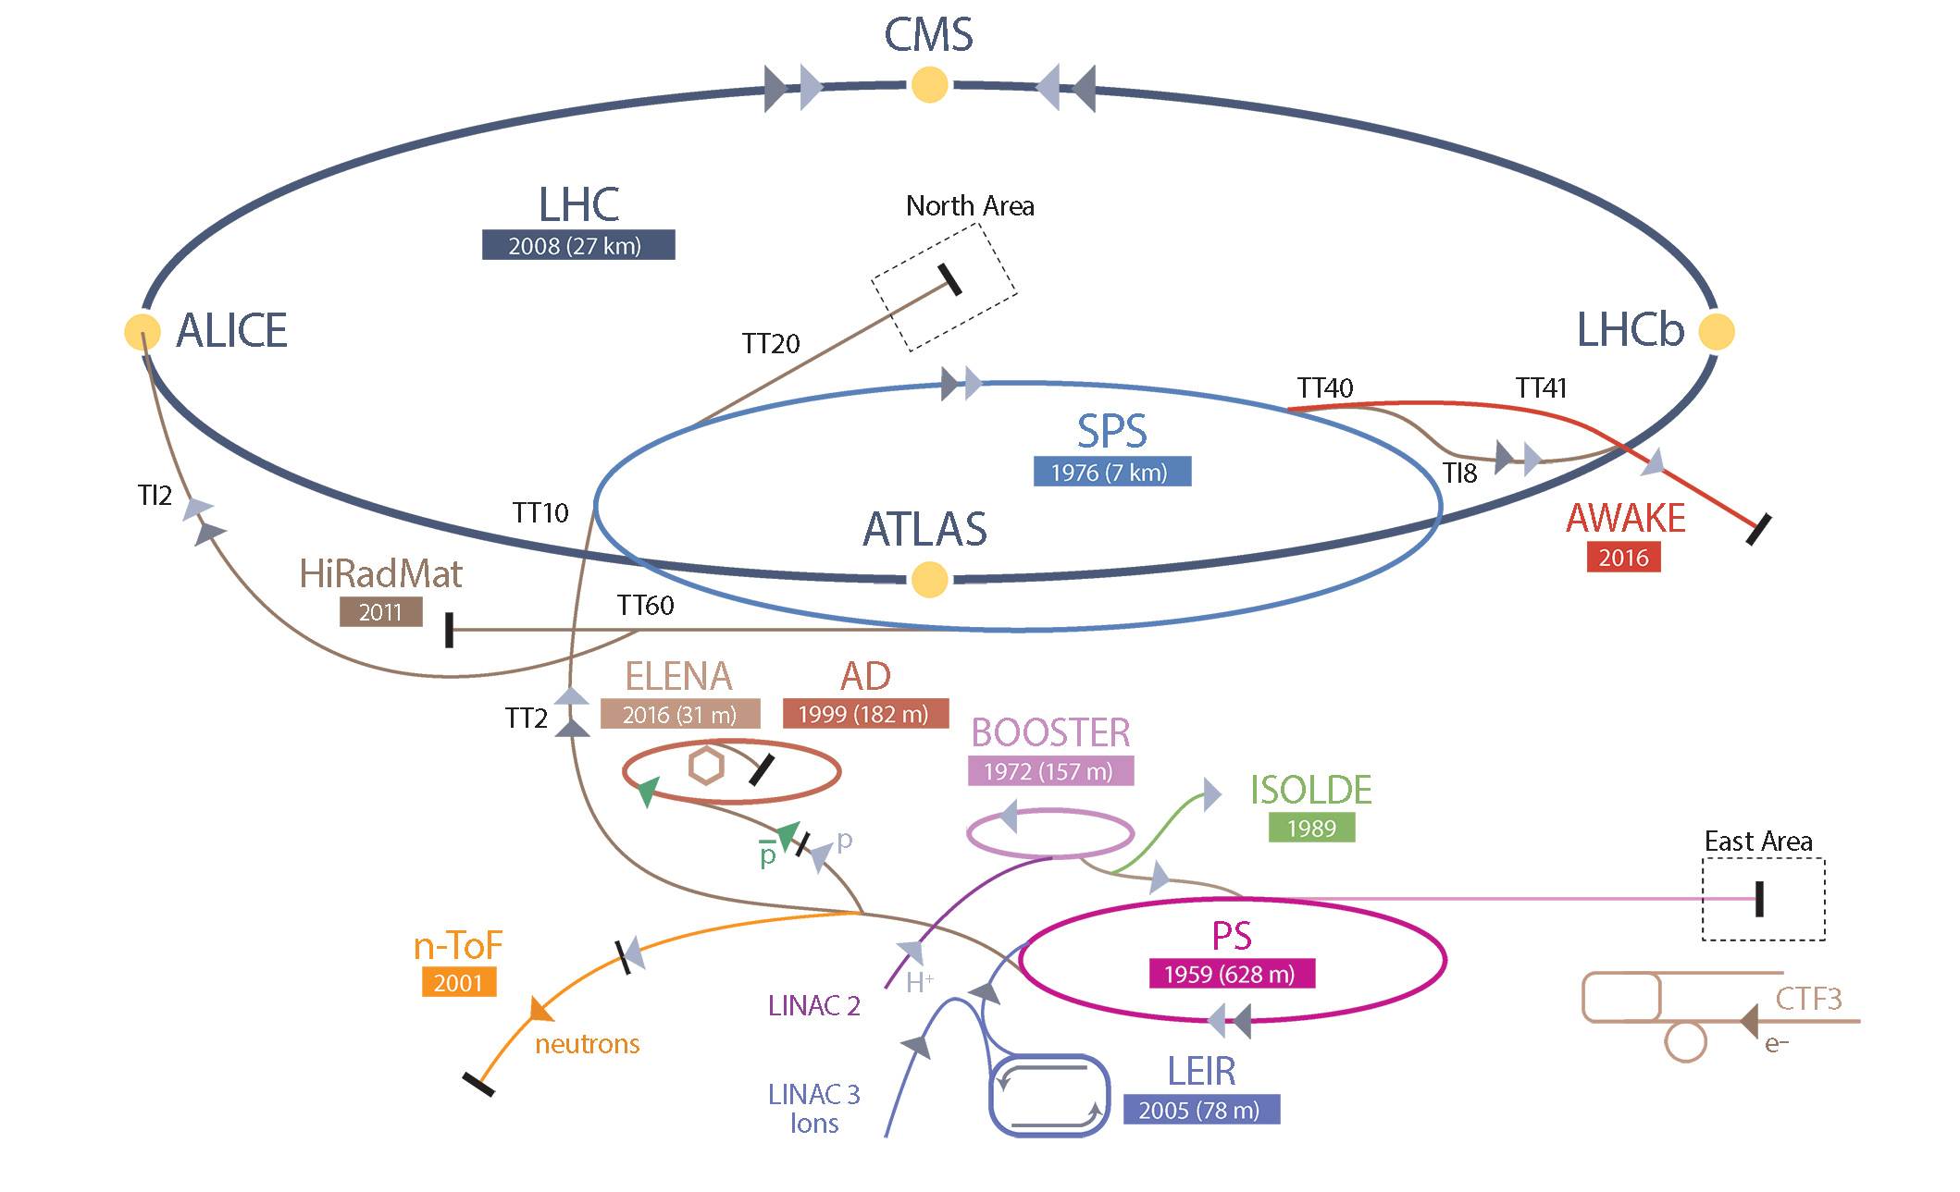
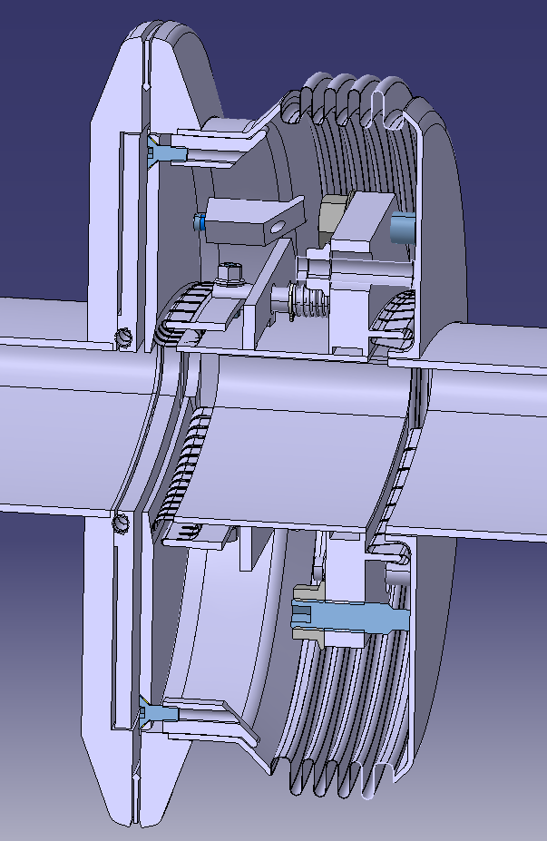
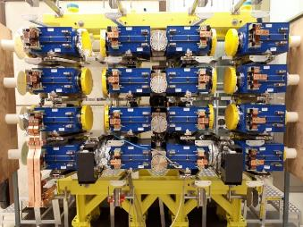
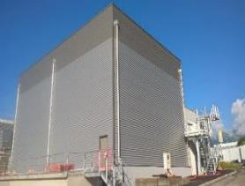
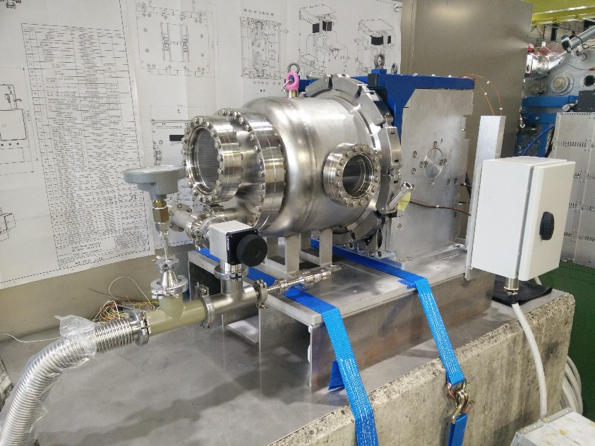
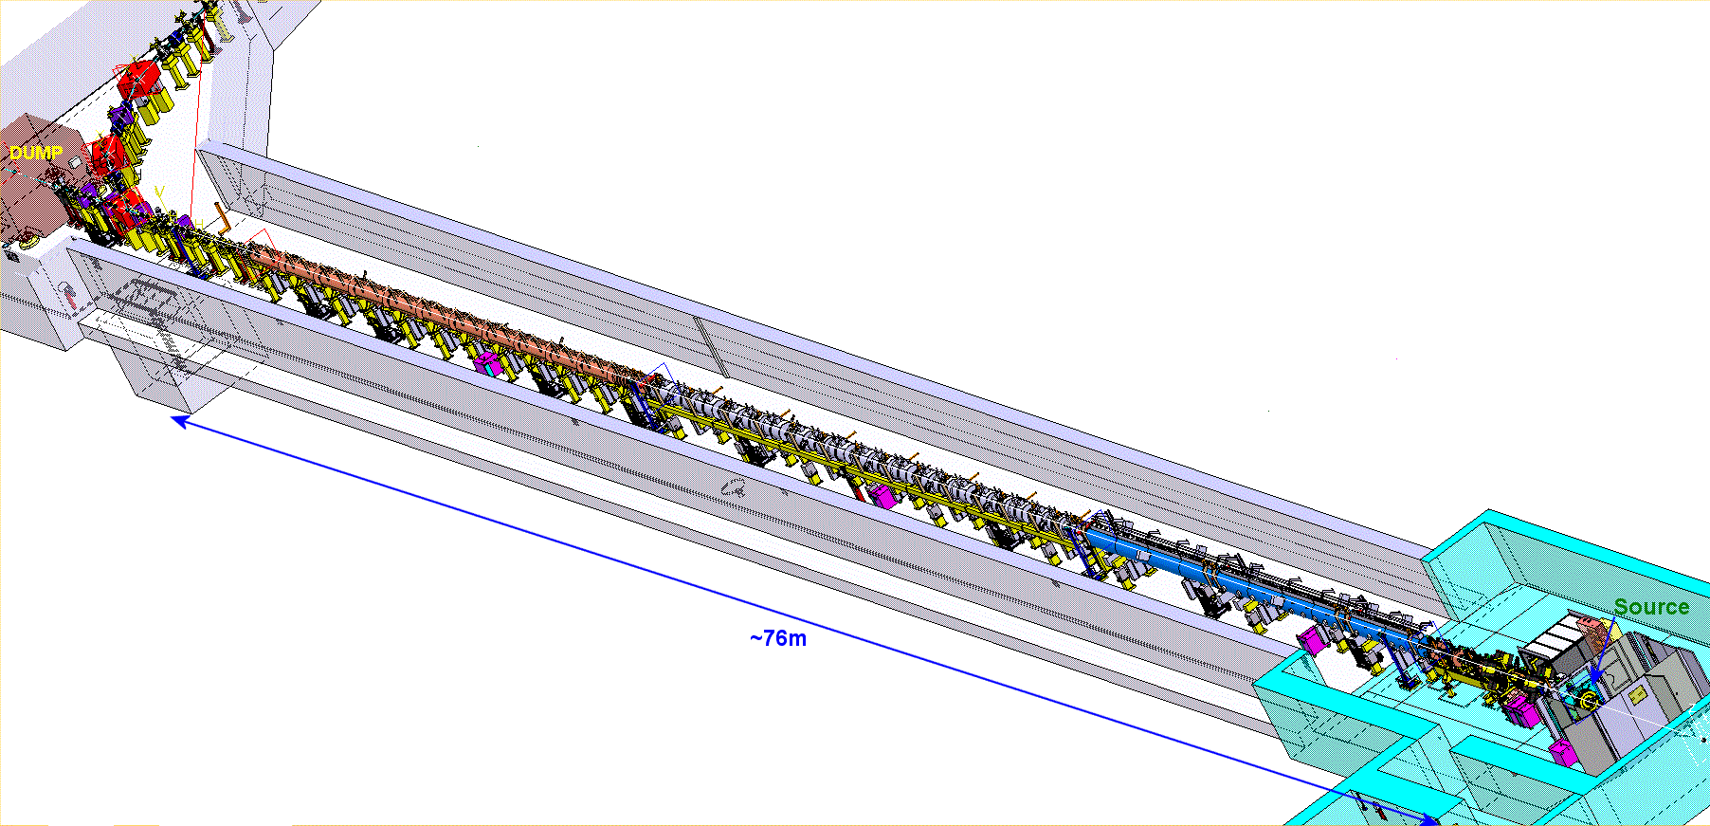
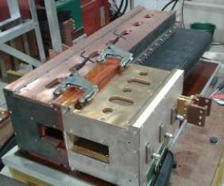

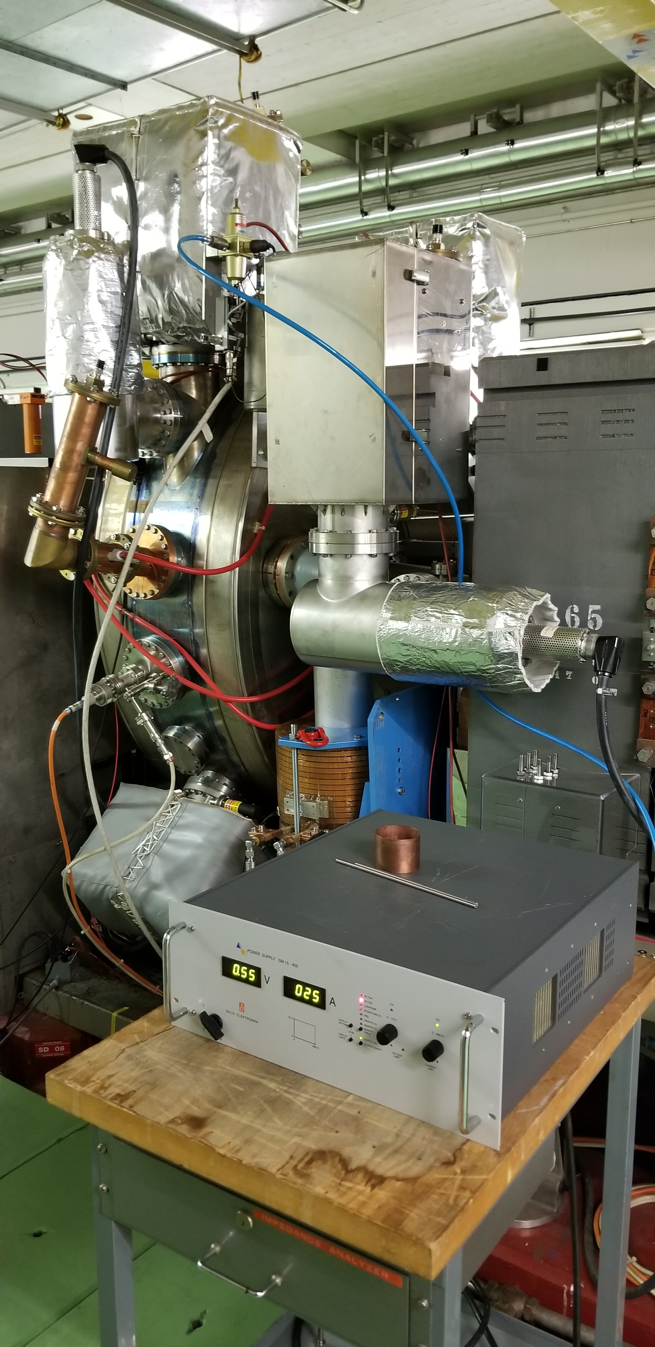
A view on LHC Injectors and LIU
Main RF system (200 MHz) upgrade
Longitudinal impedance reduction & anti-ecloud coating
New beam dump and protection devices
160 MeV H⁻ charge exchange injection
Acceleration to 2 GeV with new main power supply and new RF systems
2 GeV injection
New RF equipment including broad-band feedback
Linac4
Acceleration of H⁻ to 160 MeV
Nominal 40 mA within 0.4 μm
Notes:
PSB
Connection to Linac4 → New H⁻ charge exchange injection at 160 MeV from Linac4 to double brightness of LHC beams
Acceleration to 2 GeV
New main power supply POPS-B
Replacement of C02-C04-C16 RF systems by Finemet based RF system
PS
New injection at 2 GeV for protons to mitigate space charge
RF improvements to improve beam quality and increase longitudinal coupled bunch instability threshold
Impedance reduction of the RF systems
Installation of new Finemet RF system as longitudinal feedback
Operational deployment of transverse feedback system
SPS
200 MHz RF system upgrade
Rearrangement of cavities and power upgrade
New LLRF including slip stacking capability
Electron cloud mitigation and impedance reduction to increase intensity reach
a-C coating of QFs + one full arc
QF-type flange shielding and HOM damping in 200 MHz cavities
New beam dump system in LSS5 and new design of protection devices to comply with the target HL-LHC beam parameter values

Slide 8
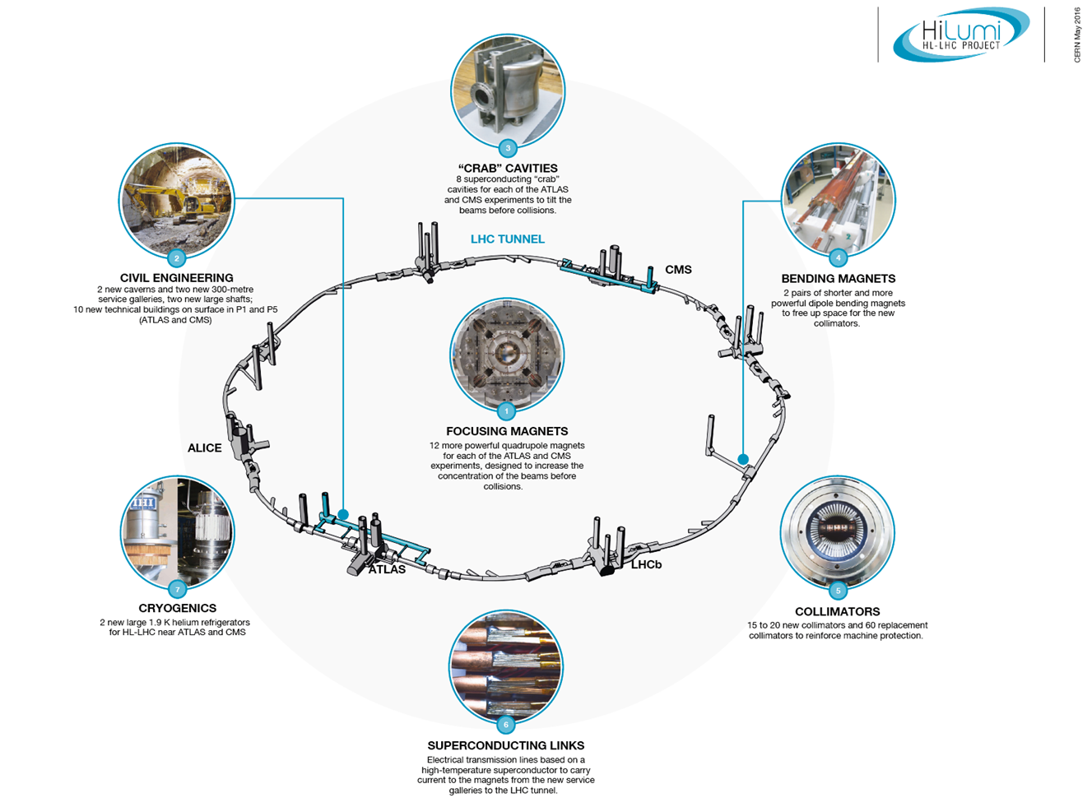
A view on LHC and HL-LHC

Slide 9
Why upgrades and what are the upgrades for LHC and its injector chain?
Present limitations and future performance of the LHC injectors
  Present performance limitations → beam dynamics challenges
  How far we can go with the upgrades
Beam dynamics challenges for LHC

Slide 10
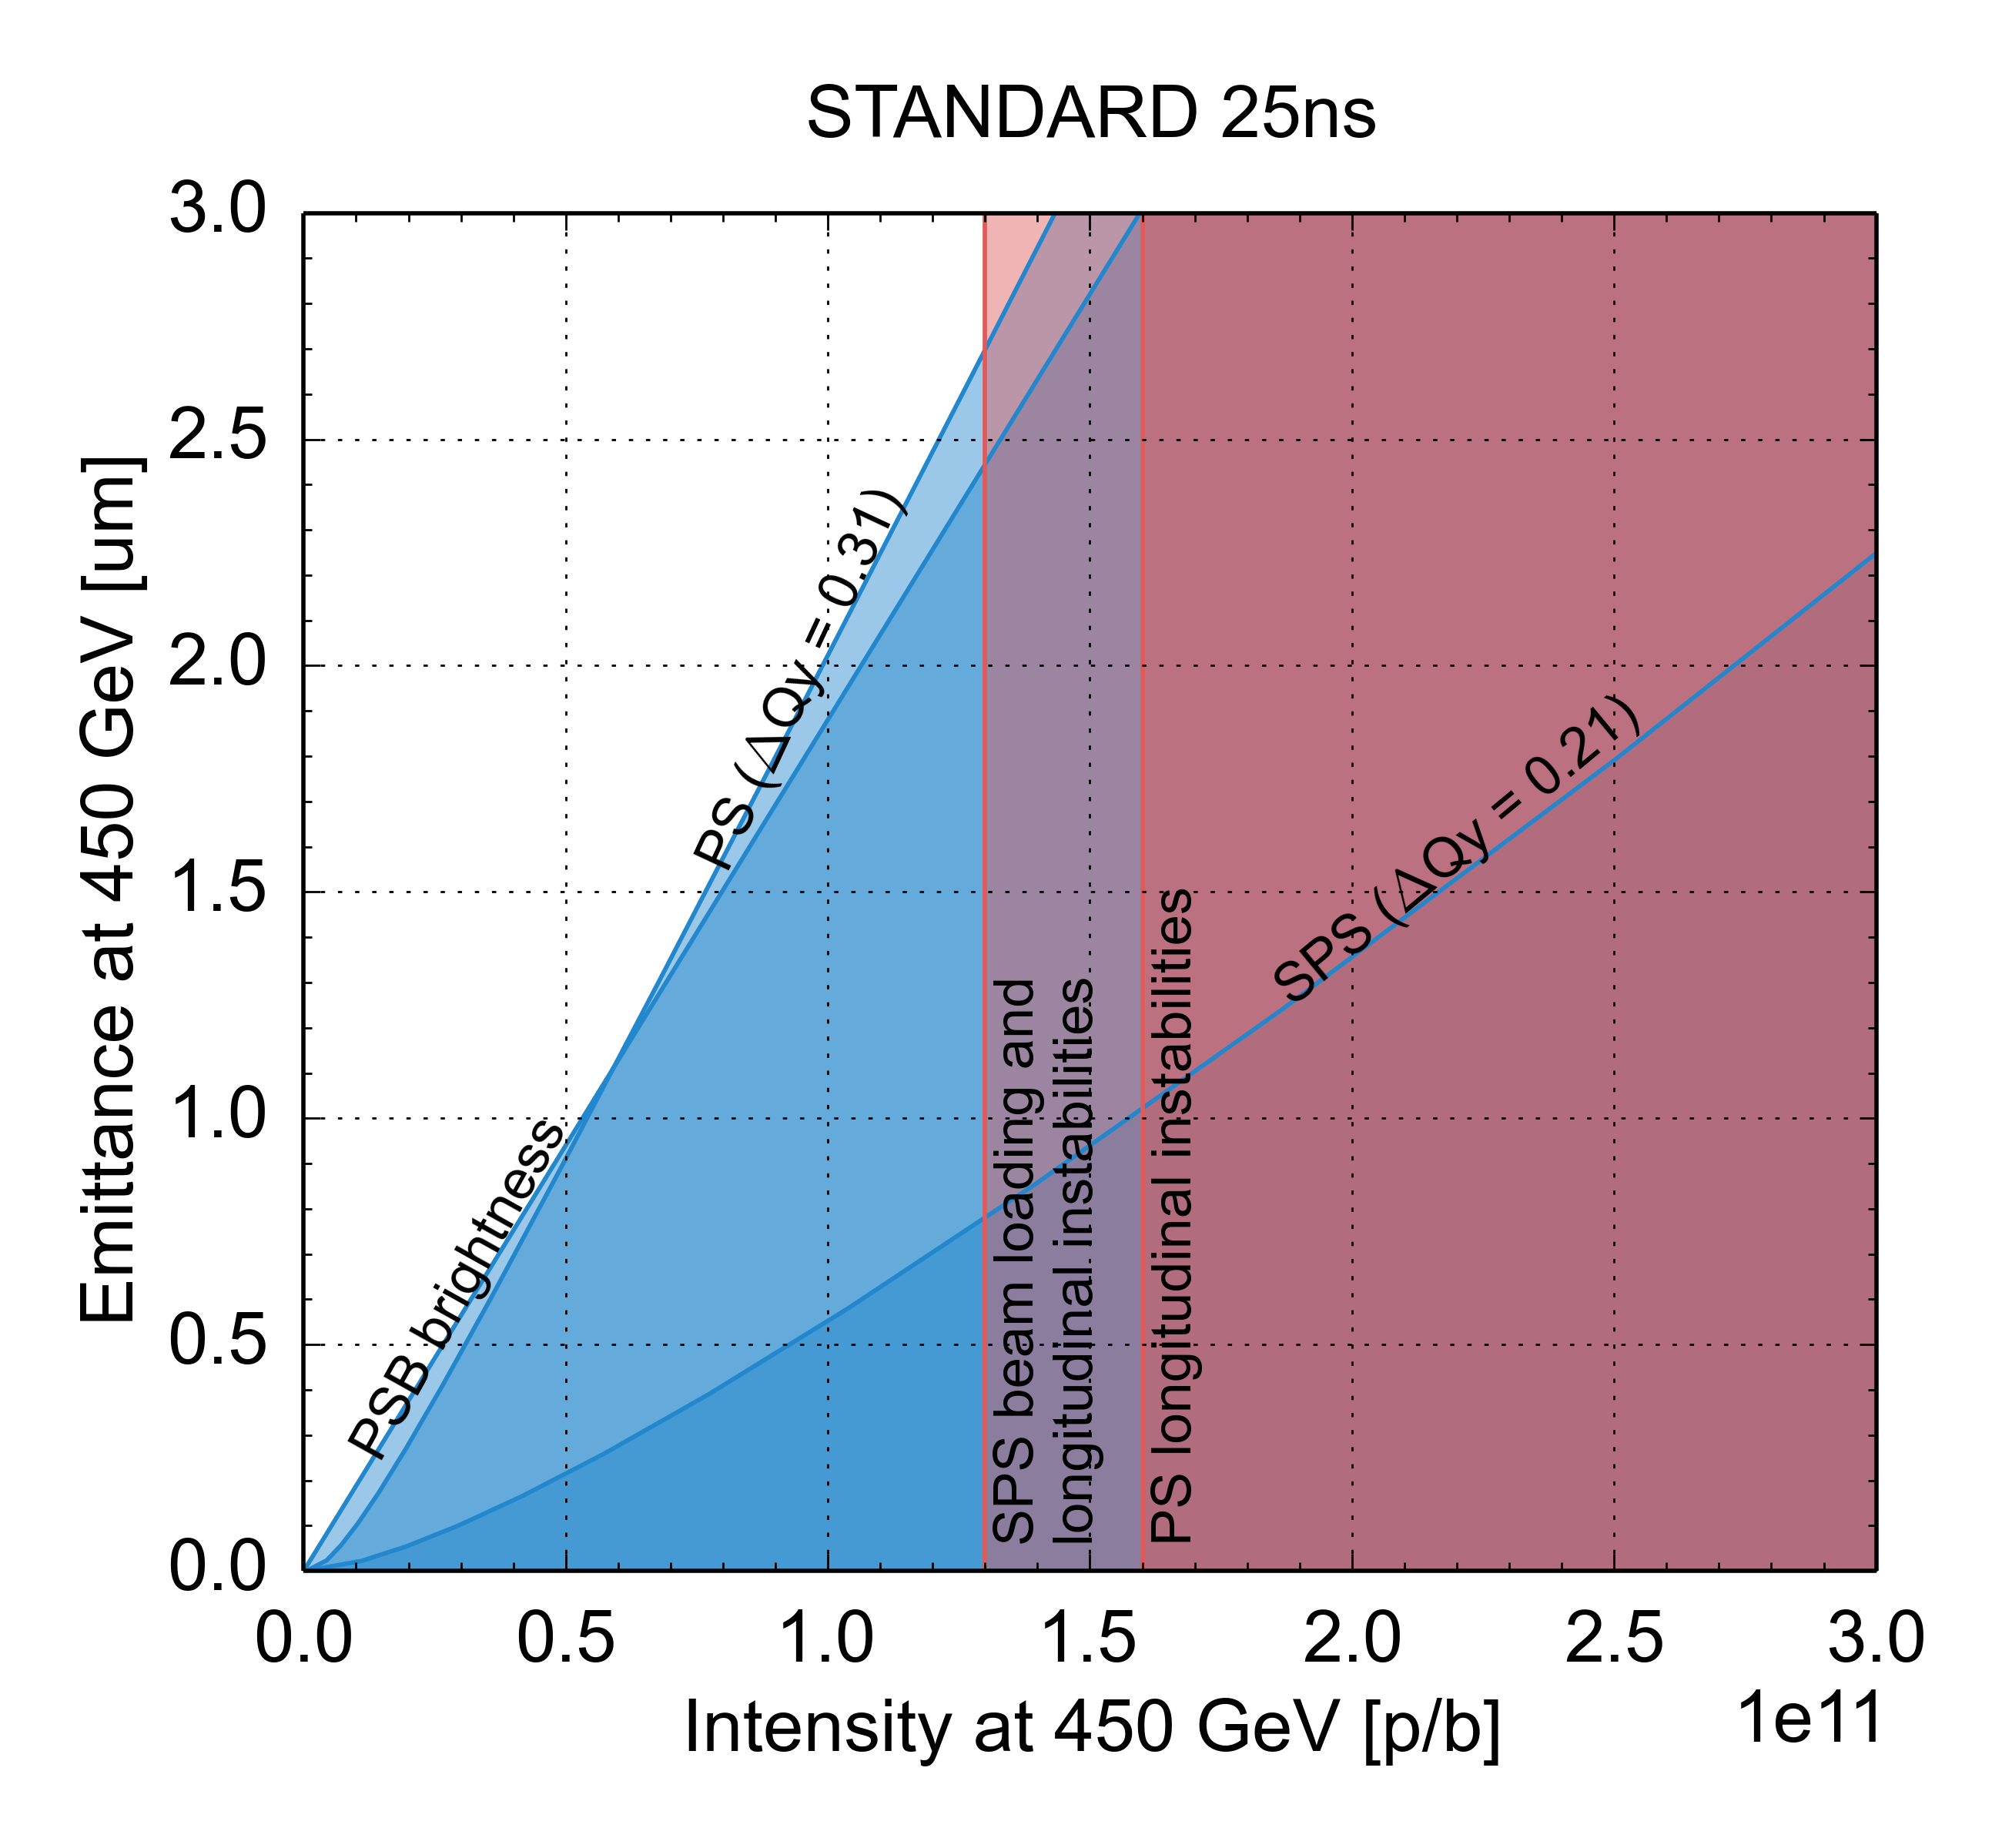
Present performance limitations
 | N_{b} (x 10¹¹ p/b) | ε_{x,y,} (μm)
HL-LHC target | 2.3 | 2.1
Present | 1.3 | 2.7
PSB injection: Brightness limited by efficiency of multi-turn injection process and space charge effects
PS and SPS injection: Brightness limited by space charge – ΔQ<0.31 (PS) and 0.21 (SPS), to limit beam degradation
PS cycle: Bunch intensity limited by longitudinal coupled bunch dipolar instability
SPS cycle: Bunch intensity limited by RF power, longitudinal coupled bunch instability

Slide 11
Present performance limitations
 | N_{b} (x 10¹¹ p/b) | ε_{x,y,} (μm)
HL-LHC target | 2.3 | 2.1
Present | 1.3 | 2.7
PSB injection: Brightness limited by efficiency of multi-turn injection process and space charge effects
PS and SPS injection: Brightness limited by space charge – ΔQ<0.31 (PS) and 0.21 (SPS), to limit beam degradation (H. Bartosik’s talk)
PS cycle: Bunch intensity limited by longitudinal coupled bunch dipolar instability
SPS cycle: Bunch intensity limited by RF power, longitudinal coupled bunch instability

Slide 12
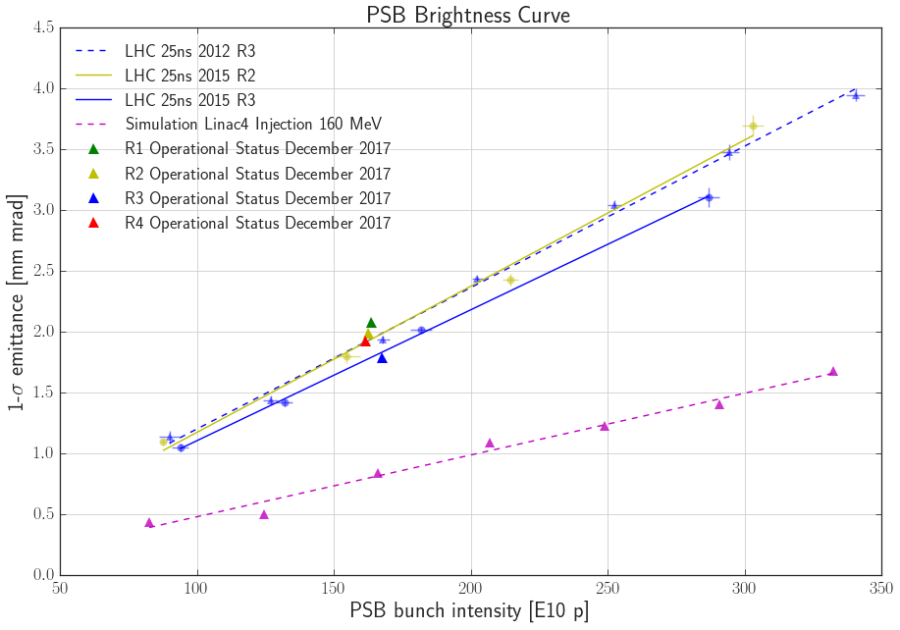
Lifting the brightness limitations
Halve the slope of the PSB brightness line
  160 MeV H⁻ charge exchange injection from Linac4 replacing 50 MeV multiturn injection from Linac2
Measured points (2012 – 2017)
PyORBIT simulations

Slide 13
Lifting the brightness limitations
Halve the slope of the PSB brightness line
  160 MeV H⁻ charge exchange injection from Linac4 replacing 50 MeV multiturn injection from Linac2
Reduce space charge at PS injection to accommodate same tune spread as current LHC beam (ΔQ_{y}=-0.31)
  Increase of PS injection energy from 1.4 GeV to 2 GeV
  Increase of longitudinal emittance (compatibly with other constraints) at transfer in order to gain from decreasing λ_{max} and increasing δ=(δp/p₀)

Slide 14
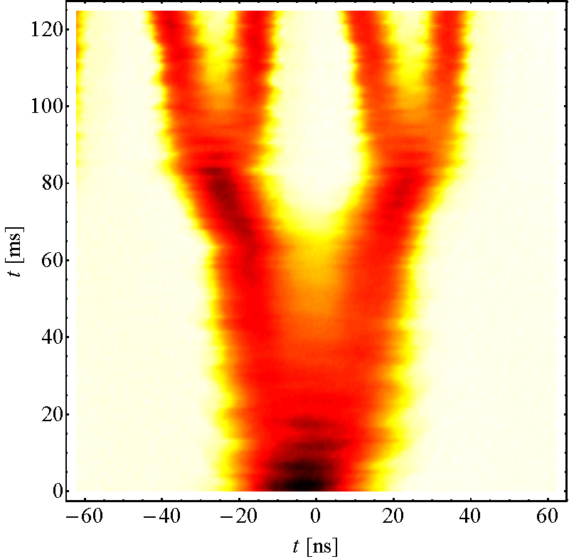
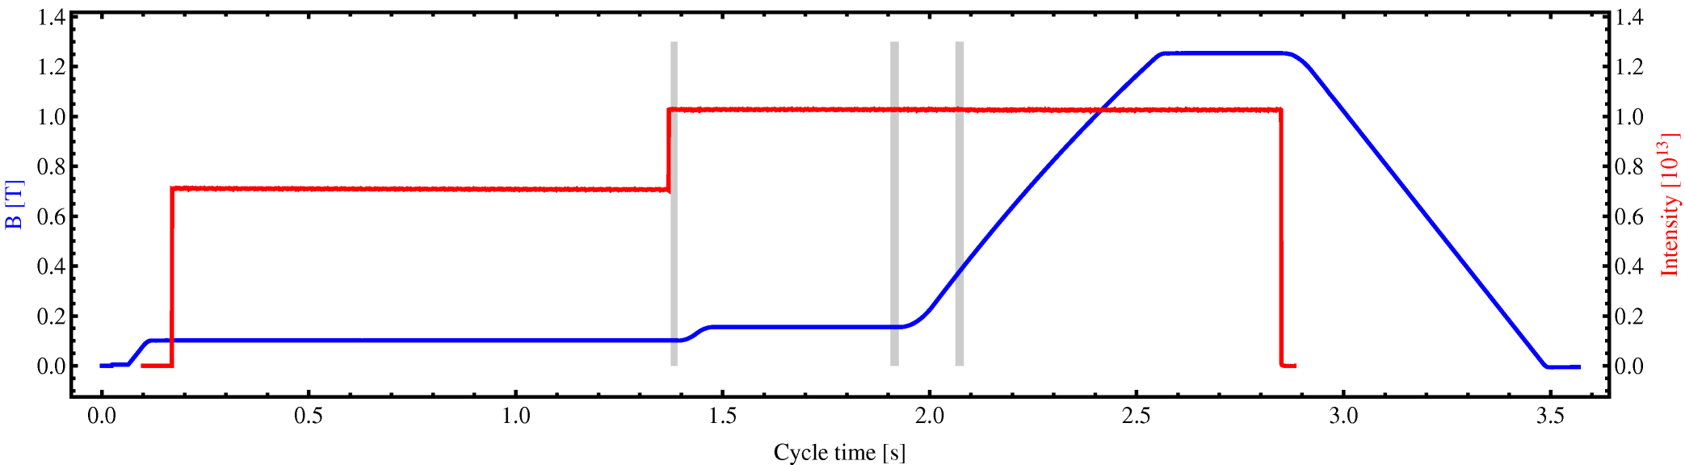
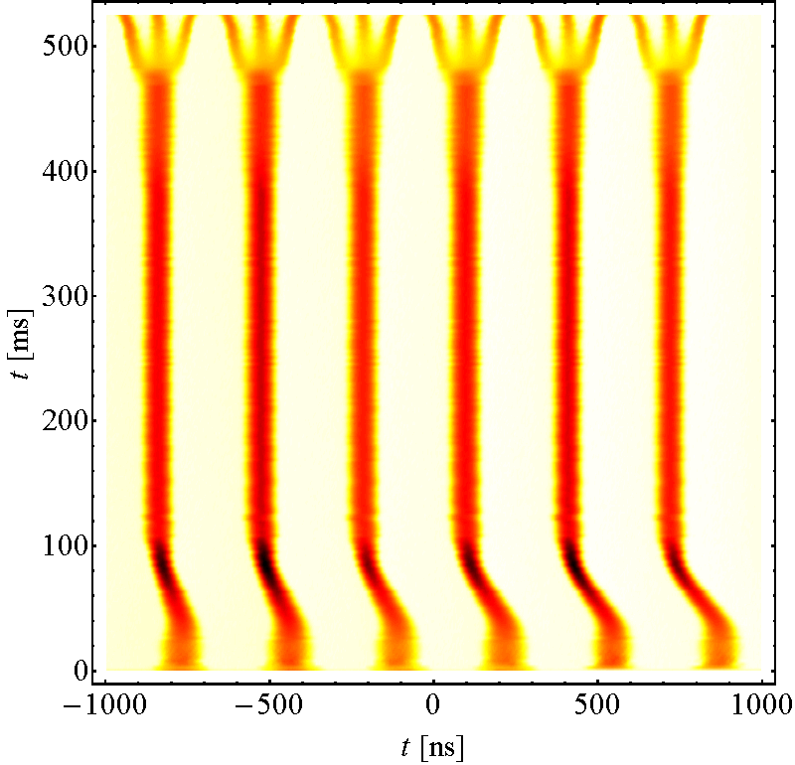
Lifting the PS intensity limitation
Instability
Bunch current limited to 1.6e11 p/b at extraction
Above 1.6e11 p/b longitudinal coupled bunch instabilities appear on the ramp and at flat top for nominal longitudinal emittance
  Dipolar oscillation, caused by 10 MHz RF system impedance (as found also in simulations)

Slide 15
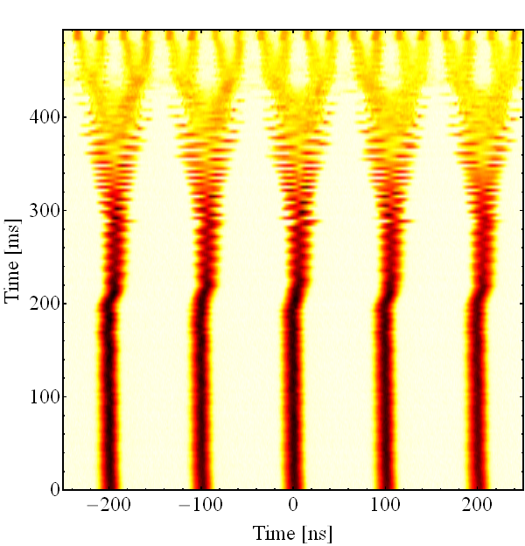
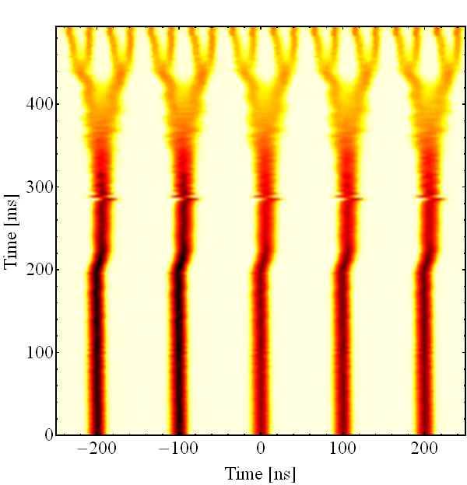
Lifting the PS intensity limitation
Longitudinal feedback based on broad-band Finemet cavity as kicker installed and deployed over the last three years
Feedback off (N_{b} = 1.8 · 10¹¹ ppb)
Feedback on (N_{b} = 1.8 · 10¹¹ ppb)

Slide 16
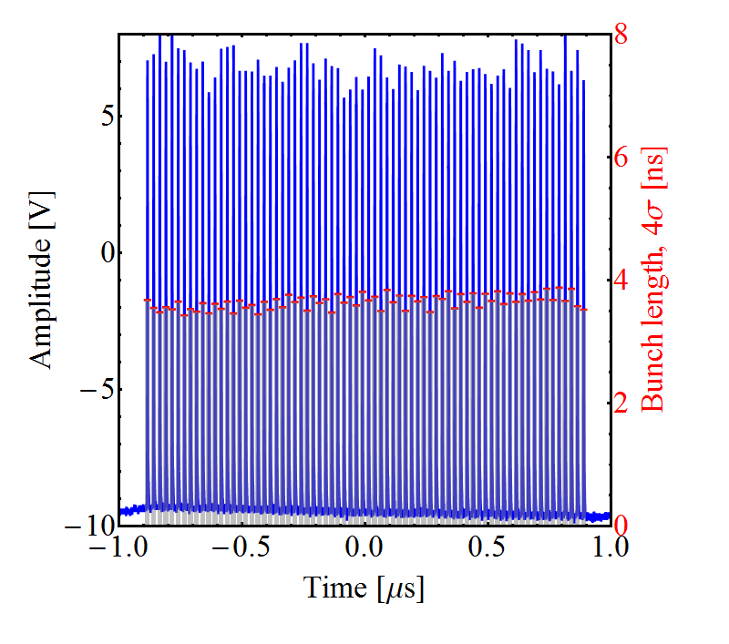
Lifting the PS intensity limitation
Longitudinal feedback based on broad-band Finemet cavity as kicker installed and deployed over the last three years
With transverse optimisation, beam is now stable up to 2.6e11 p/b
N_{b} = 2.6 ∙ 10¹¹ ppb, ΔN/N < 5%

Slide 17
Lifting the PS intensity limitation
Longitudinal feedback based on broad-band Finemet cavity as kicker installed and deployed over the last three years
With transverse optimisation, beam is now stable up to 2.6e11 p/b
Goal in terms of intensity out of the PS reached!

Slide 18
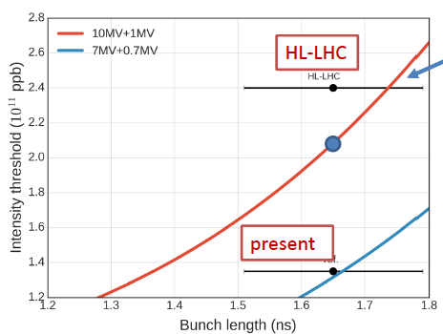
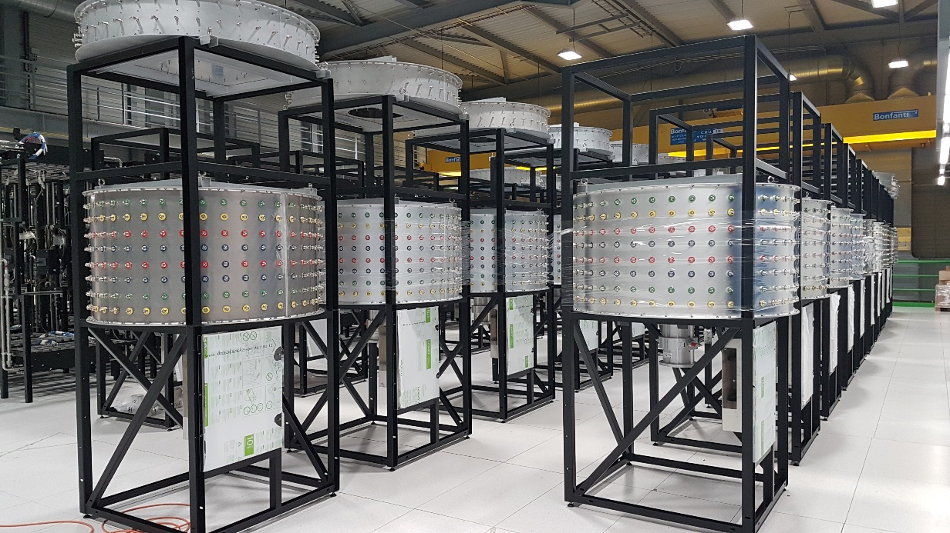
Lifting the SPS intensity limitation
Beam loading in the present 200 MHz TW RF system – intensity limited to about 1.3e11 p/b
Longitudinal instabilities during ramp with very low threshold currently cured by
  800 MHz RF system in bunch shortening mode
  Controlled emittance blow-up (with constraint of 1.7 ns bunch length at extraction)
Bunch length spread
Still lagging 20% below target …
Only RF power upgrade
Notes:
(2x4 & 2x5 section cavities)
Bunch length variation due to controlled emittance blow-up in presence of beam loading
More 800 MHz voltage is available but it is kept at 10% level of 200 MHz voltage to avoid region with ω’(J)=0 during ramp

Slide 19
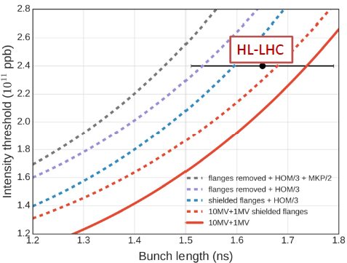
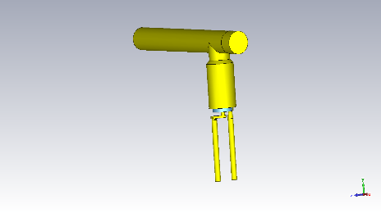
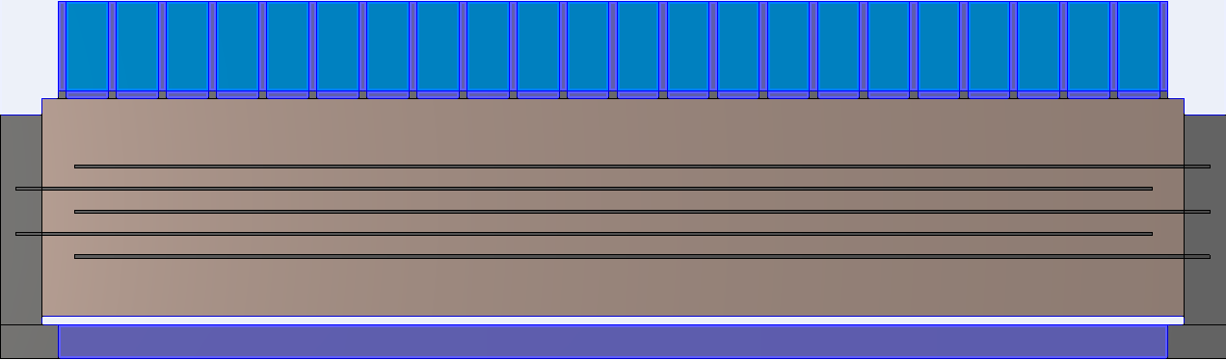
Lifting the SPS intensity limitation
Impedance reduction needed in addition
  Shielding of a subset of vacuum flanges
  Enhanced damping of HOMs of 200 MHz (factor 3 desired) → baseline for LIU
  Serigraphy on the injection kickers MKP
new HOM coupler

Slide 20
Other SPS intensity limitations?
Transverse Mode Coupling Instability (TMCI) threshold was raised from 1.6e11 p/b to 4e11 p/b when switching to a low gamma transition (γ_{t}) optics
original SPS optics
low γ_{t} SPS optics
4.0e11
x2.5
1.6e11
measurements confirm 2.5 times higher threshold!

Slide 21
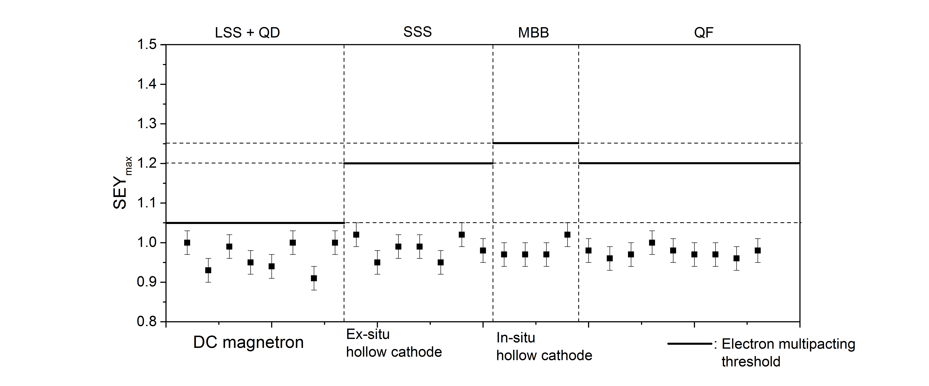
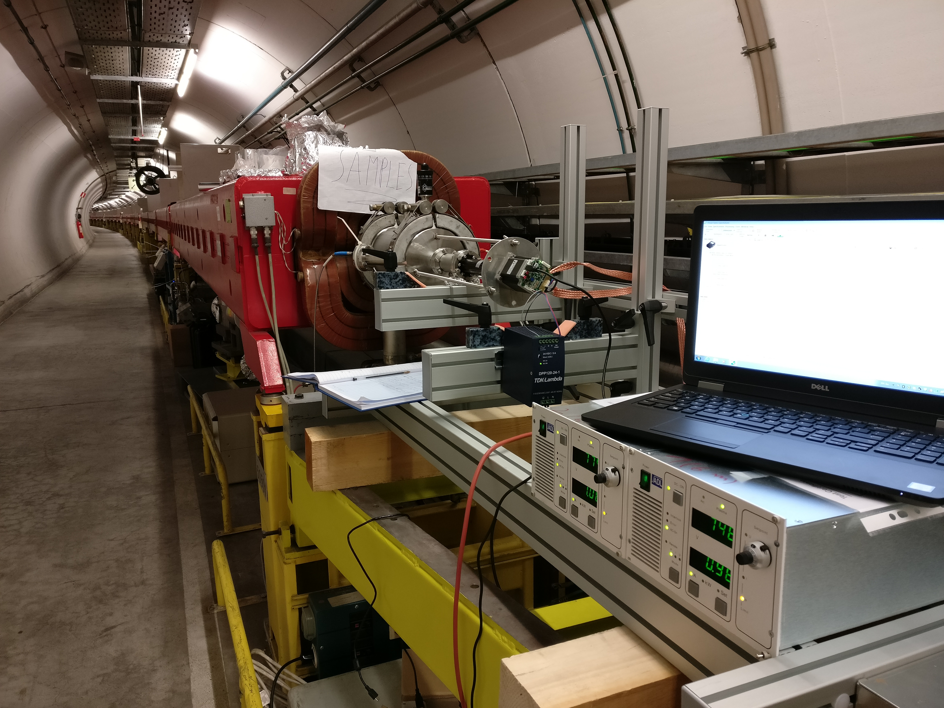
Other SPS intensity limitations?
Electron cloud mitigation relies mainly on
  Beam induced scrubbing (it worked, it still works!)
  Coating with a-C the chambers of the focusing quadrupoles and adjacent drift chambers

Slide 22
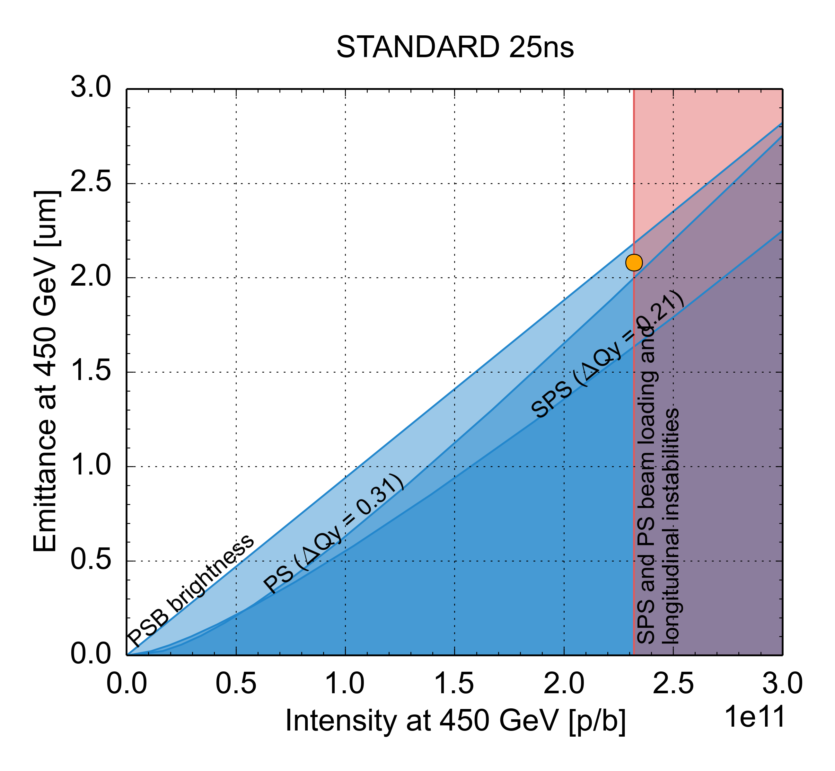
Summary: Future LIU performance
 | N_{b} (x 10¹¹ p/b) | ε_{x,y,} (μm)
HL-LHC target | 2.3 | 2.1
Present | 1.3 | 2.7
LIU matches HL-LHC
PSB injection: from Linac4
PS injection: 2 GeV, larger longitudinal emittance
PS cycle: Longitudinal coupled bunch feedback system, impedance reduction
SPS cycle: RF power upgrade, longitudinal impedance reduction, beam scrubbing & partial a-C coating, low γ_{t} optics

Slide 23
Why upgrades and what are the upgrades for LHC and its injector chain?
Performance of the LHC injectors
  Present performance limitations → beam dynamics challenges
  How far we can go with the upgrades
Beam dynamics challenges for LHC

Slide 24
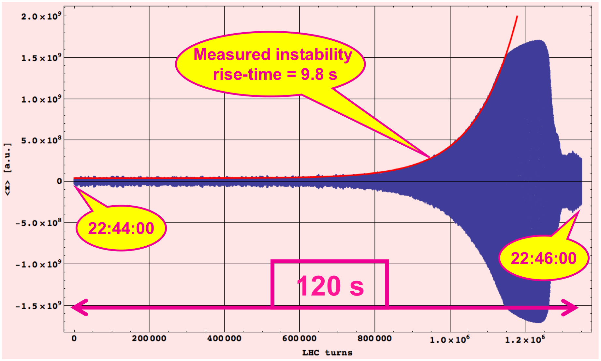
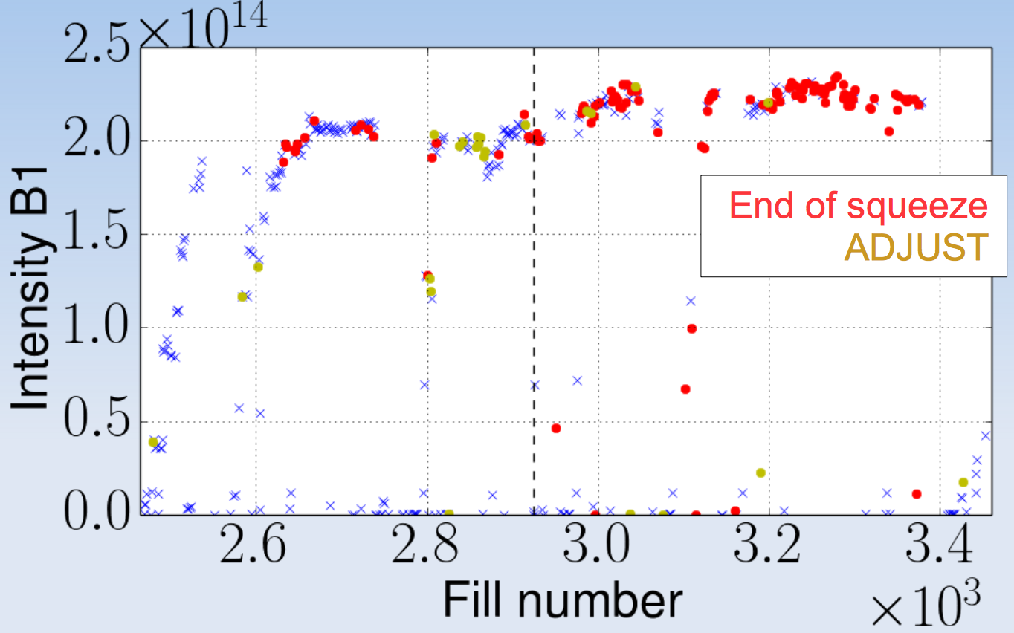
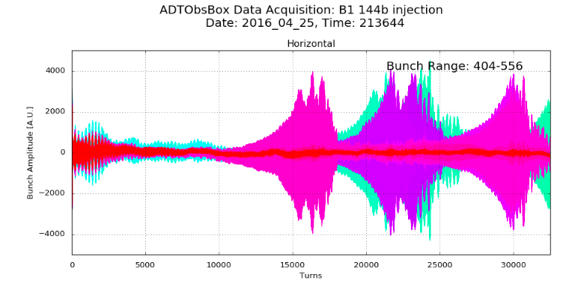
LHC beam stability
LHC transverse beam instabilities observed with different types of beams and at different stages of the LHC cycle
2010, single bunch
during the ramp
2011-12, 50 ns beam
during β* squeeze or while adjusting the beams to collide
2015-18, 25 ns beam
at injection

Slide 25
LHC beam stability
LHC transverse beam instabilities observed with different types of beams and at different stages of the LHC cycle
Sources are mainly transverse impedance (loss of Landau damping) and, at least with 25 ns beams, electron cloud
Controlled through “extreme” machine settings, e.g. at 6.5 TeV Q’=+15, octupole strength close to maximum, maximum damper gain and bandwidth
Need to gain some margin with stabilisation knobs for operation with HL-HLC beam parameters (double intensity) → Impedance reduction

Slide 26
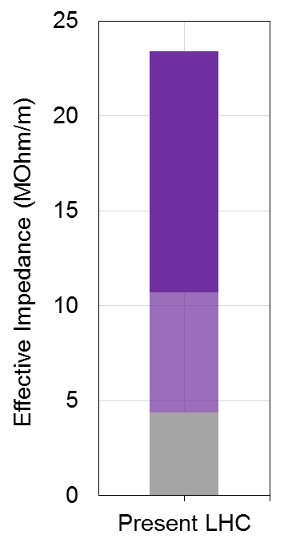
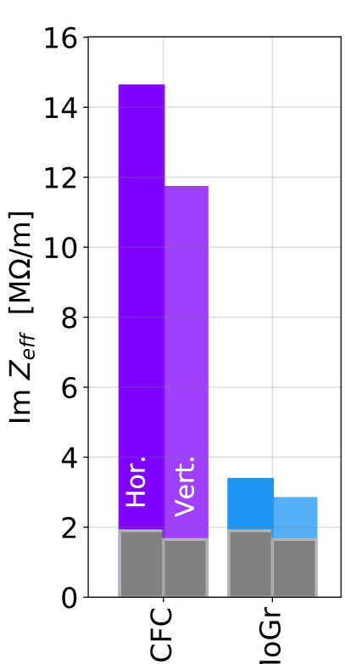
LHC beam stability
Due to the small gaps, at 6.5 TeV the most critical impedance contributor (80%) is collimators
Within HL-LHC secondary collimators replaced by new ones with Mo-Gr jaws having same robustness and higher conductivity → One order of magnitude lower RW impedance
Impedance reduction
secondary collimators
Secondary
collimators in IR-7
Primary
collimators
Resistive wall
Everything
else
Geometric
Present
Upgrade

Slide 27
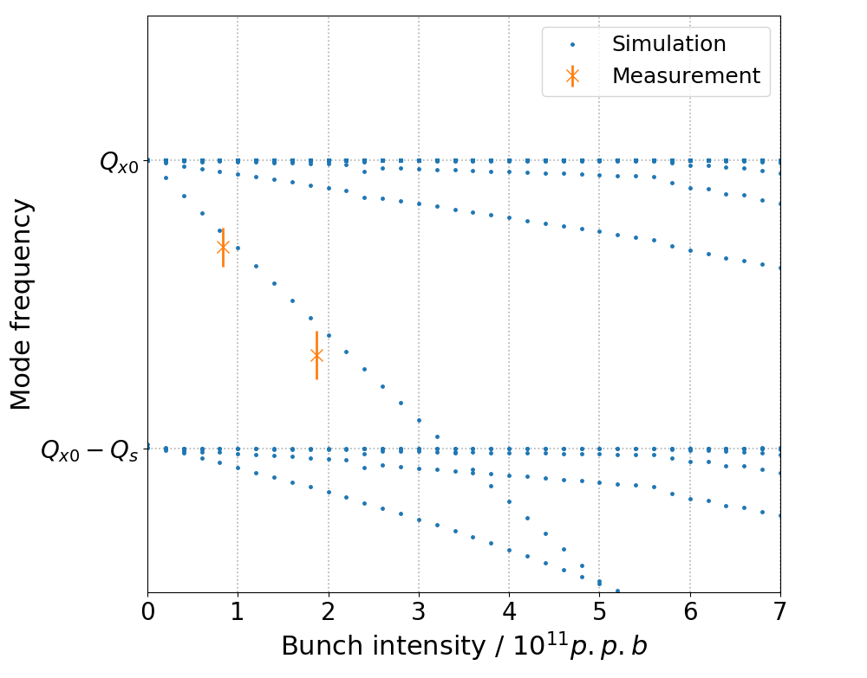
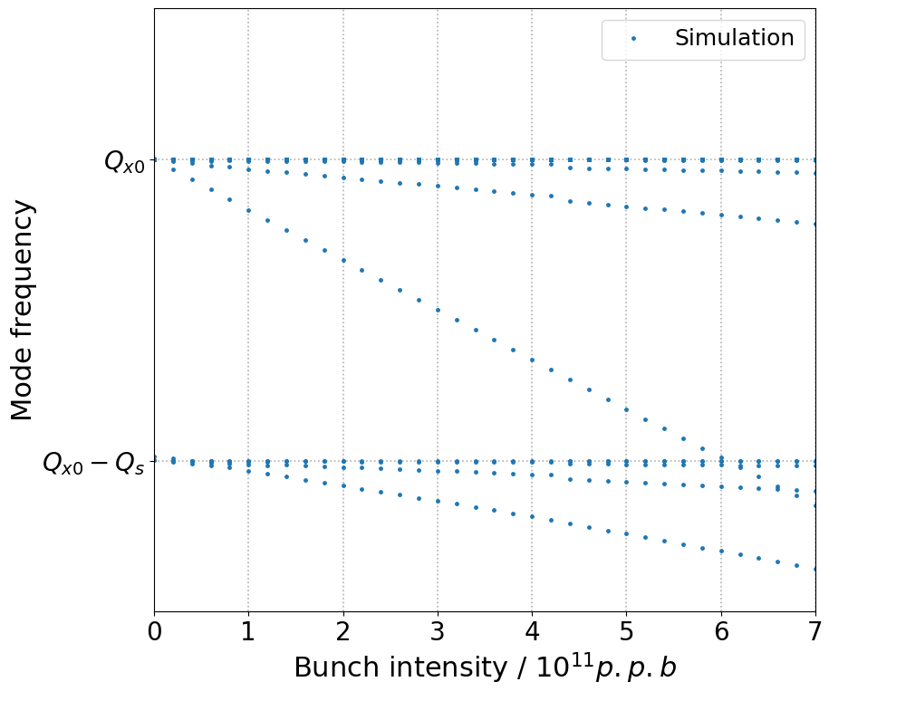
LHC beam stability
Example: Effect of impedance reduction on TMCI threshold
HL-LHC impedance
(after collimator impedance reduction)
Present LHC impedance model
Instability
Instability

Slide 28
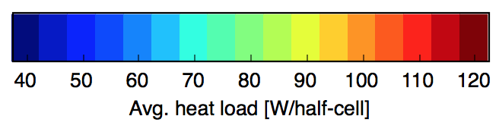
Beam induced heat load in LHC
CMS
S45
S56
High heat load on beam screen in cold regions (cryo limit 160 W/hc in the arcs)
  With 25 ns beams
  Much higher than calculation from impedance + synchrotron radiation
  Different among arcs (factor ~3)
Most observations compatible with electron cloud, probably localised in some magnets
  Spread of Secondary Electron Yield between 1.15 and 1.35
S34
S67
SEY < 1.25
SEY > 1.30
S23
S78
ALICE
LHCb
S12
S81
ATLAS
Notes:
Only 25 ns, scaling with bunch intensity (linear, threshold at just below 4e10 p/b), power loss localised in last bunches of trains from RF measurements of stable phase, at least partly scrubbable, behaviour in dipoles and quadrupoles

Slide 29
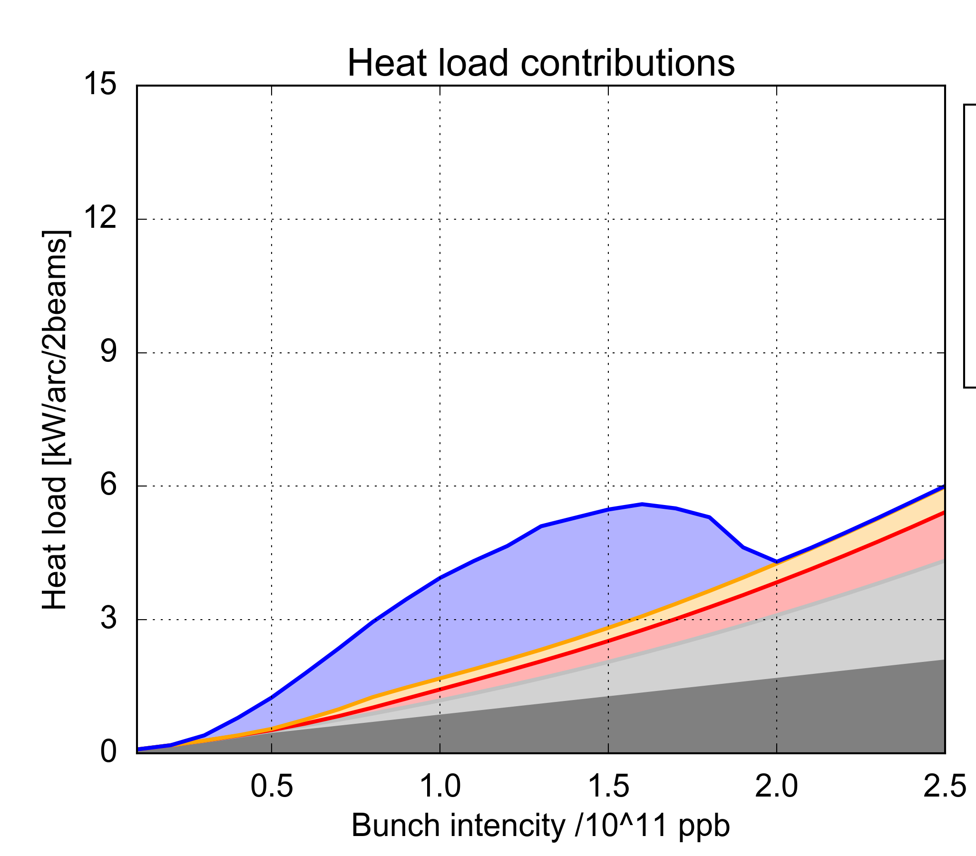
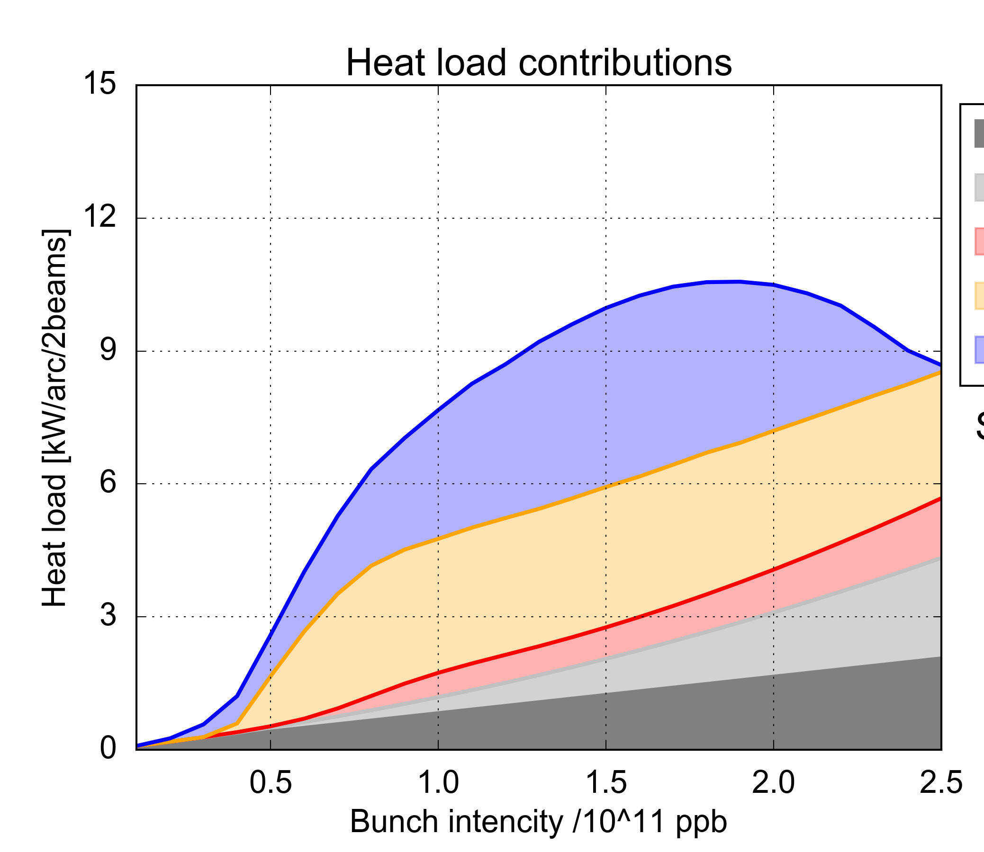
Beam induced heat load in LHC
We can sum up contributions to e-cloud from all parts of the arc assuming SEY from heat load measurements (SEY=1.25 – 1.35)
e-cloud in dipoles
SEY=1.35
Low-load sectors ok with HL-LHC
e-cloud in quadrupoles
High-load sectors above capacity for HL-LHC
e-cloud in drifts
  HL-LHC
  HL-LHC
Impedance
Synchrotron radiation
SEY=1.25
Heat load [kW/arc]
Heat load [kW/arc]
  8 kW/arc (~160W/hcell)
Bunch intensity [10¹¹ p/bunch]
Bunch intensity [10¹¹ p/bunch]

Slide 30
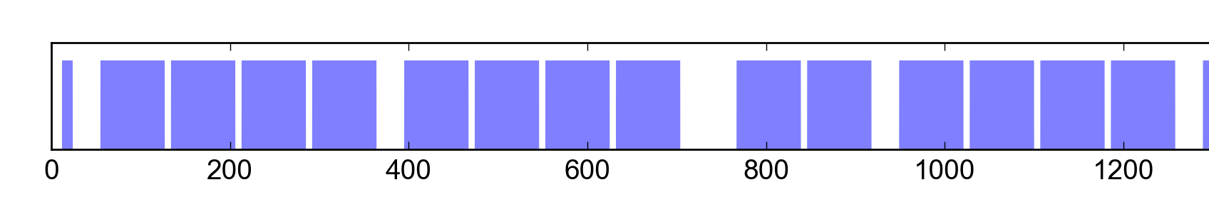
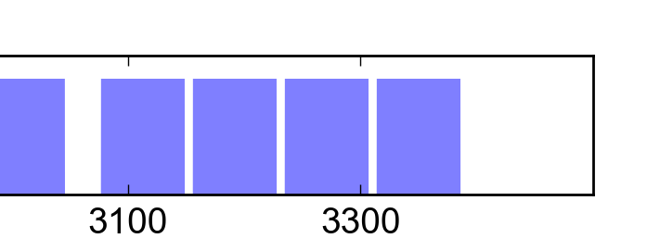
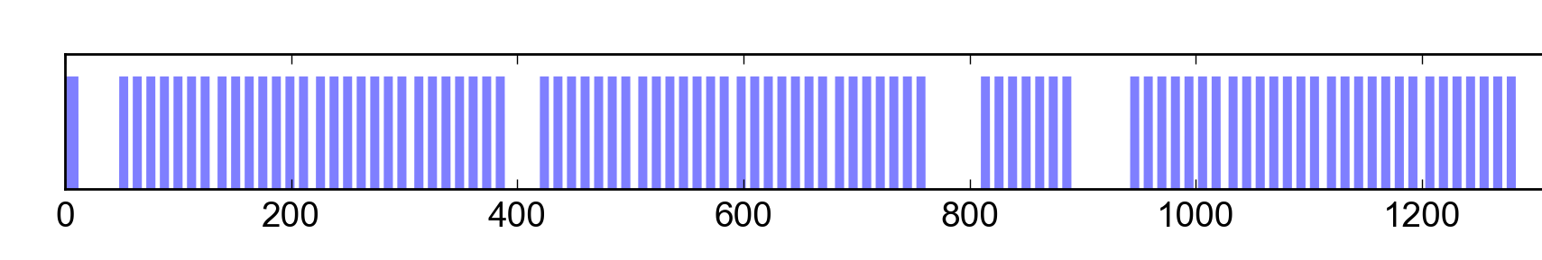
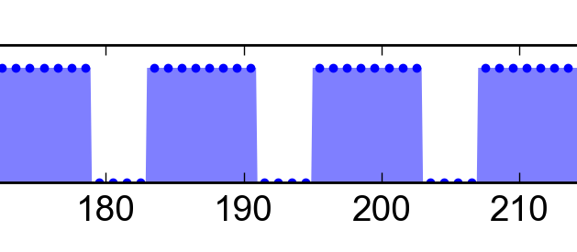
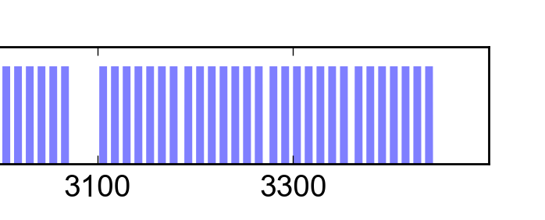
Beam induced heat load in LHC
We can sum up contributions to e-cloud from all parts of the arc assuming SEY from heat load measurements (SEY=1.25 – 1.35)
Although high-load sectors might be not fully compatible with HL-LHC operation, a safety net is the filling scheme …
25 ns (2760b)
72b
25 ns slot
8b+4e (1972b)
8b
4e
8b
4e
8b
4e
8b
25 ns slot
→ Pure 25 ns and 8b+4e can be combined to reach the maximum heat load

Slide 31
To wrap up and conclude
LHC and its injectors set to major upgrades: LIU, HL-LHC
  Injectors upgraded in 2019-2020, LIU beam commissioning in 2021-2024
  LHC upgraded in 2024-2025 and HL-LHC era >2026
Overcoming performance limitations in the LHC injectors
  Produce/preserve higher brightness → Linac4, mitigation of space charge, optimised transfers
  Produce more intense beams → Impedance reduction, electron cloud mitigation, active feedback, longitudinal emittance blow up, enhanced Landau damping, optics change
Beam dynamics challenges for upgrade of LHC
  Preservation of beam stability → Landau damping & impedance reduction, electron cloud build up & instability scaling
  Beam induced heat load → Low e-cloud filling pattern

Slide 32
THANK YOU FOR YOUR ATTENTION

Slide 33
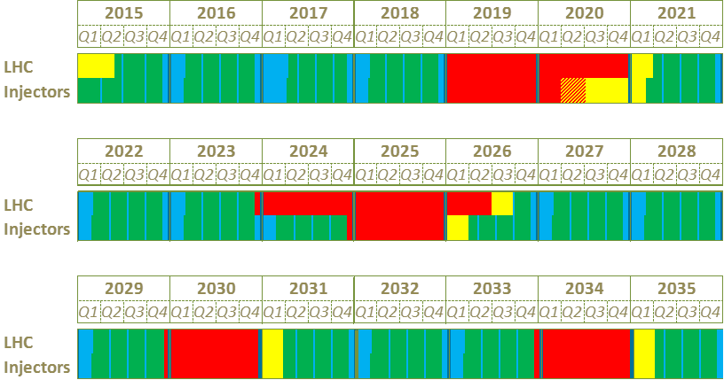
Timeline of the projects
Proton Runs
Technical Stops
Long Shutdowns
Beam Commissioning
We are here
LS2
Run 2
Mainly LIU work
LS3
Run 3: LIU beam commissioning through the injector chain
Run 3
Mainly HL-LHC work
Run 4: HL-LHC run with a period of ‘luminosity learning’
Run 4

Slide 34
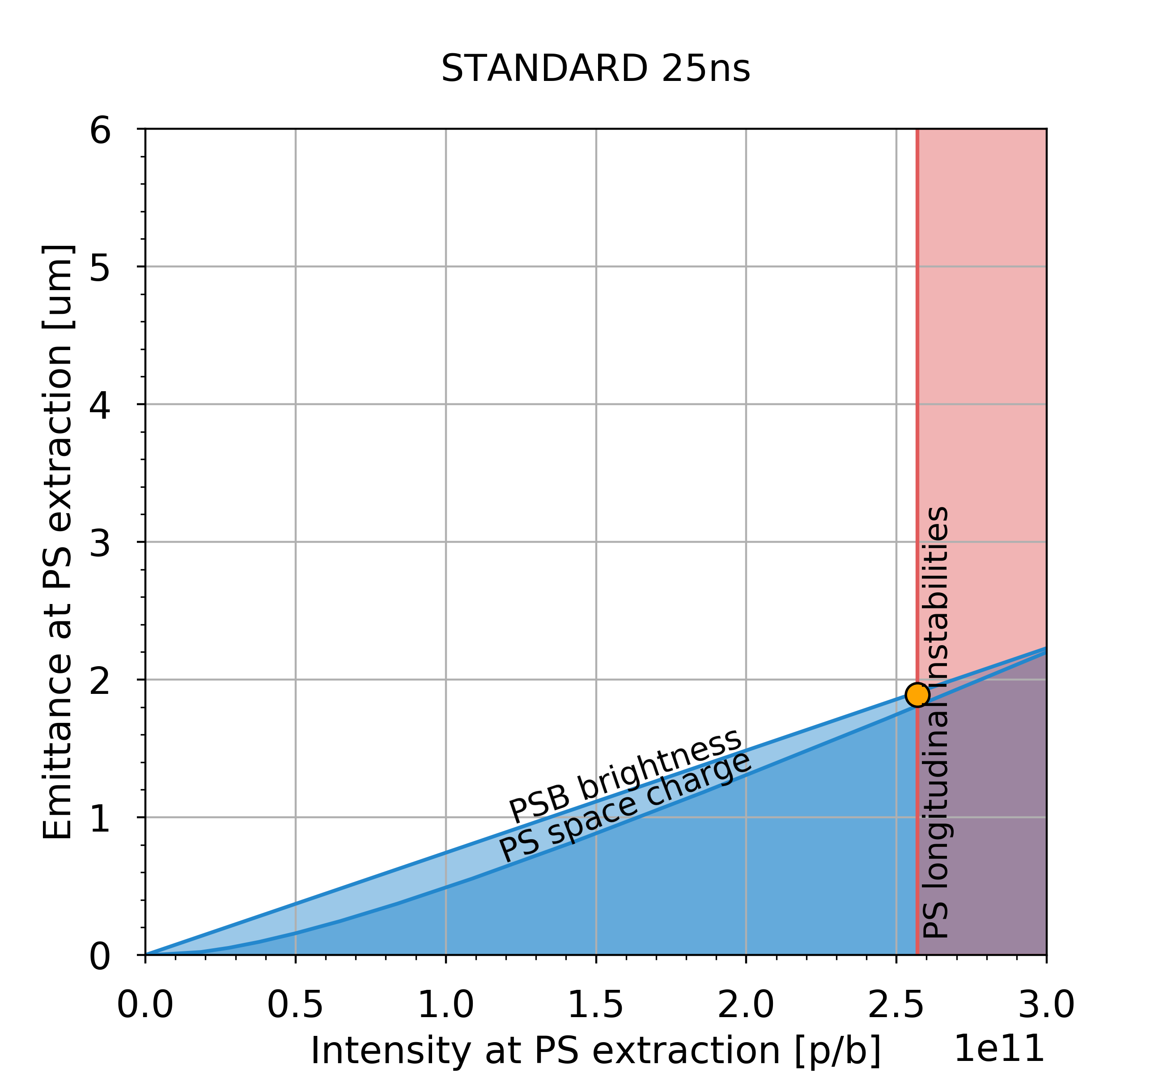
Lifting the PS intensity limitation
Longitudinal feedback based on broad-band Finemet cavity as kicker installed and deployed over the last three years
With transverse optimisation, beam is now stable up to 2.6e11 p/b
Goal in terms of intensity out of the PS reached!
Brightness still pending Linac4 and space charge mitigation in PS
2.6e11 p/b, 5 μm

Slide 35
HL-LHC single particle dynamics
Simulated evolution of an HL-LHC physics fill with baseline parameters
Strong effect of linear and nonlinear errors in IRs due to large β → Low Dynamic Aperture in absence of correction
Pre-computed corrections from magnetic measurements needed even for basic optics measurements
β∗ levelling will require commissioning of a large number of optical configurations → Challenge for efficiency of the optics measurement and correction tools
Notes:
needed to fulfil the tight tolerances coming from DA or coherent stability constraints

Slide 36
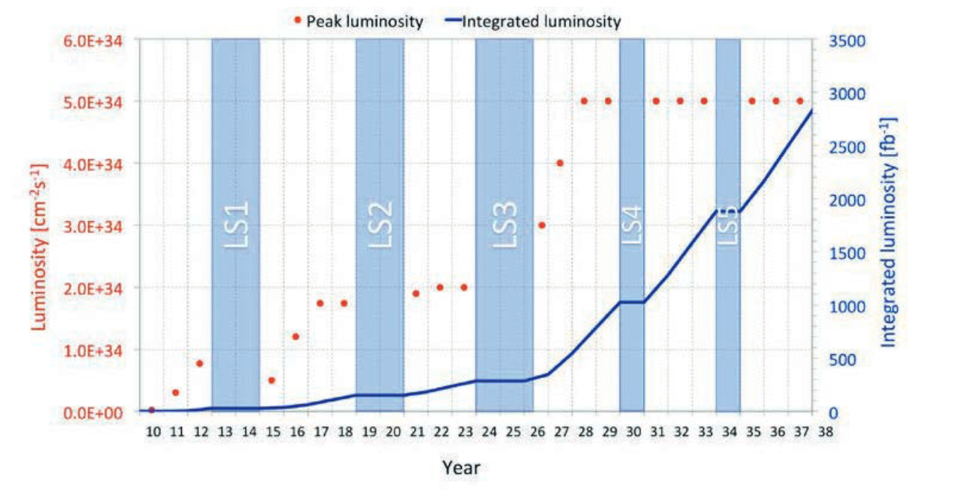
Luminosity projection

Slide 37
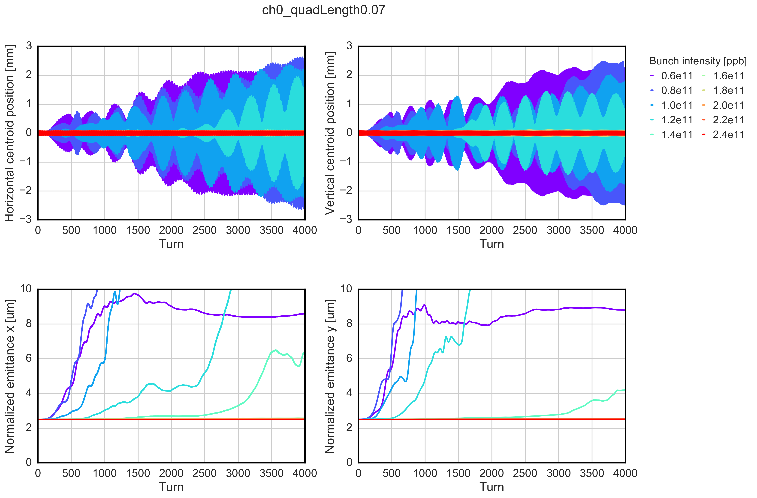
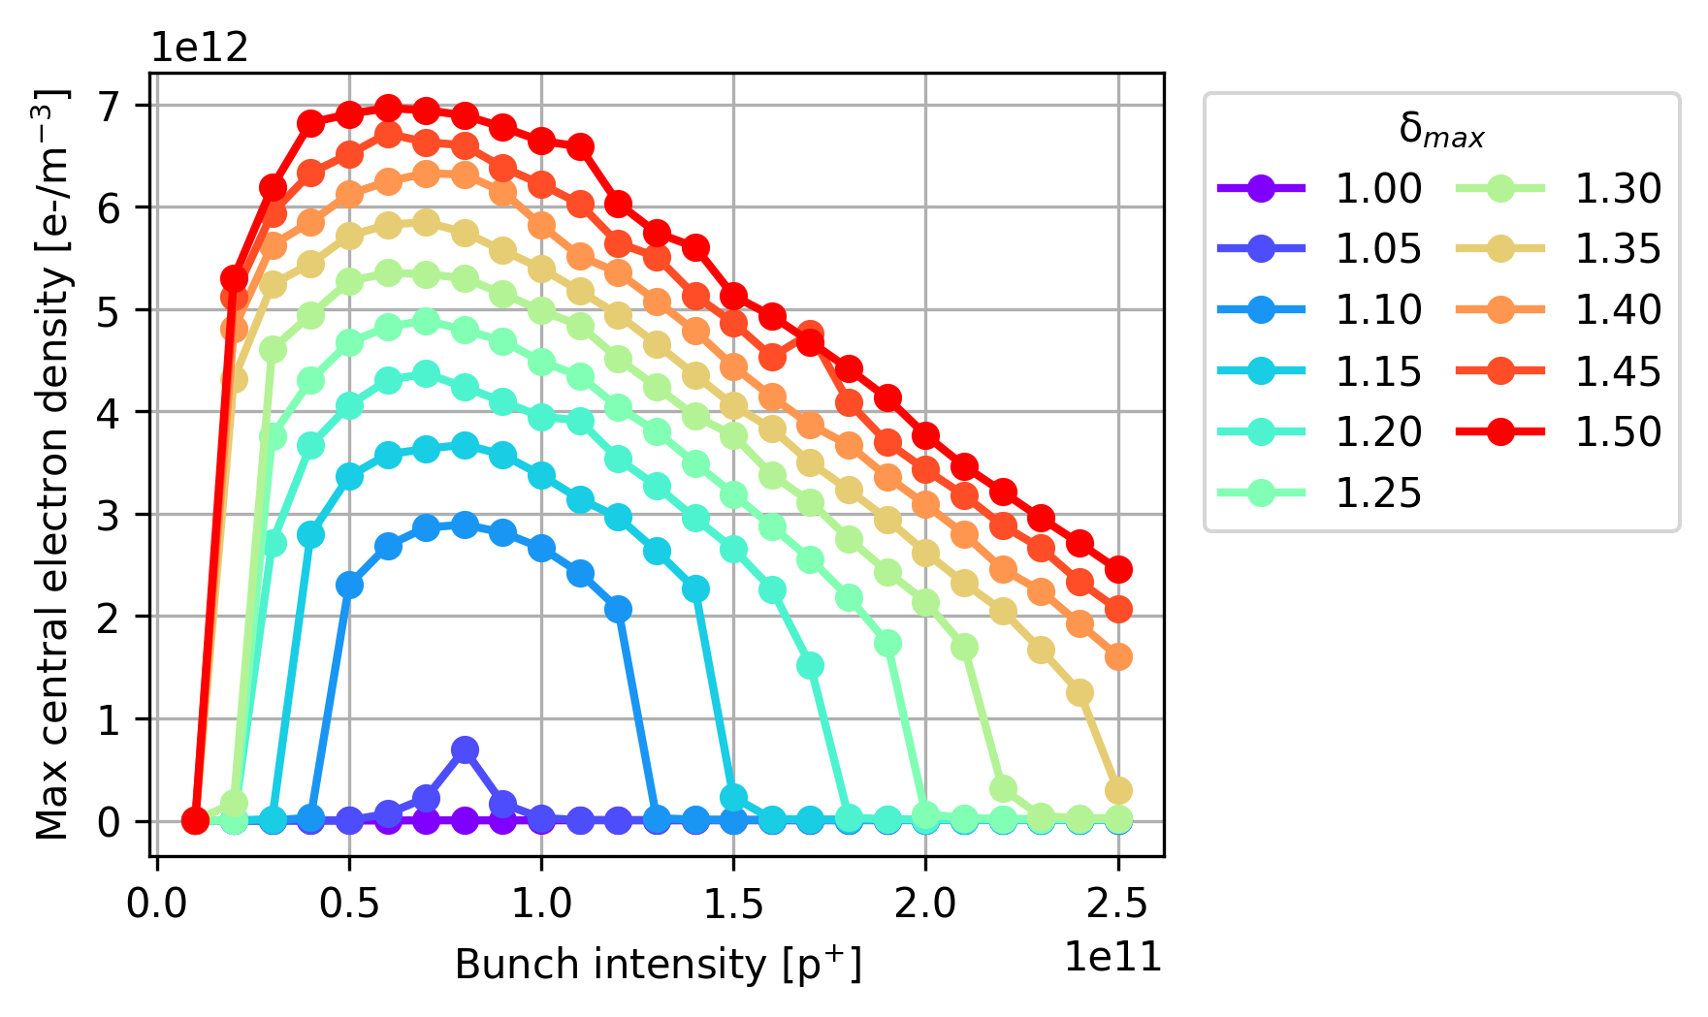
LHC beam stability
Strong instabilities observed at 450 GeV with 25 ns beams, in both x and y
  Stabilized with high chroma (Q’=20), high octupole strength (ΔQ=1.5e-3)
  Caused mainly by electron cloud in quadrupoles
Simulations predict more stability for HL-LHC (thanks to lower electron cloud)
Instability simulations (450 GeV)
(e-cloud in the arc quadrupoles - SEY 1.3)
e-cloud buildup simulations
arc quadrupoles

Slide 38
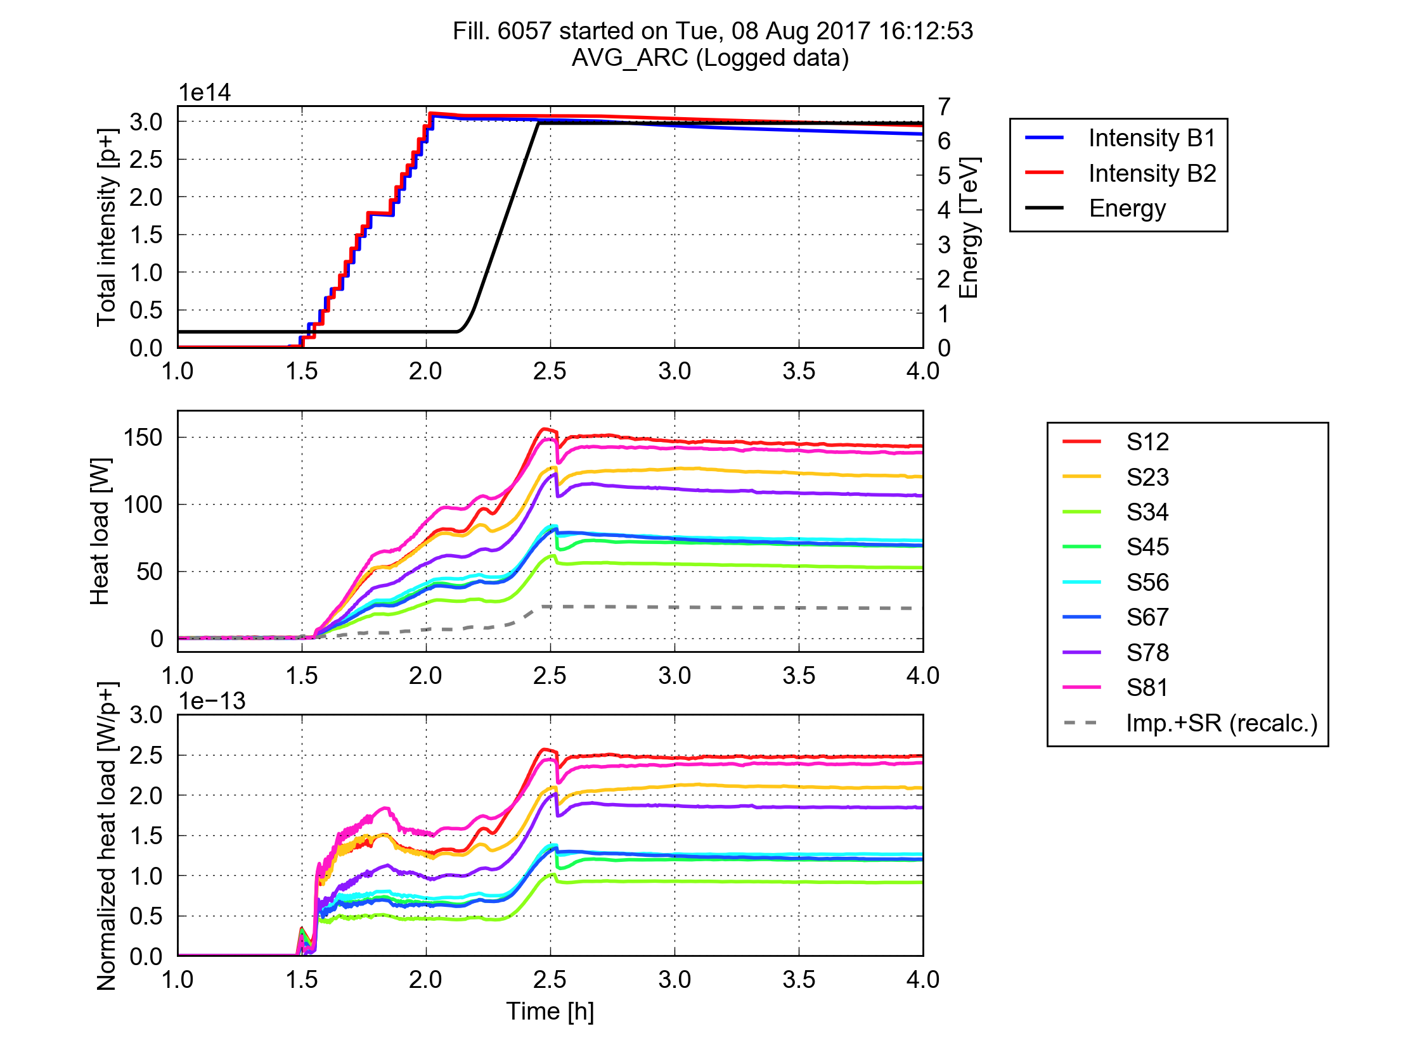
Beam induced heat load in LHC
High heat load on beam screen in cold regions (cryo limit 160 W/hc in the arcs)
  With 25 ns beams
  Much higher than calculation from impedance + synchrotron radiation
  Different among arcs
Most observations compatible with electron cloud, probably localised in some magnets (or even some parts of magnets)
  Coating with a-C for triplet quadrupoles to decrease SEY
8 Aug 2017
Heat load
per half cell
Notes:
Only 25 ns, scaling with bunch intensity (linear, threshold at just below 4e10 p/b), power loss localised in last bunches of trains from RF measurements of stable phase, at least partly scrubbable, behaviour in dipoles and quadrupoles

Slide 39
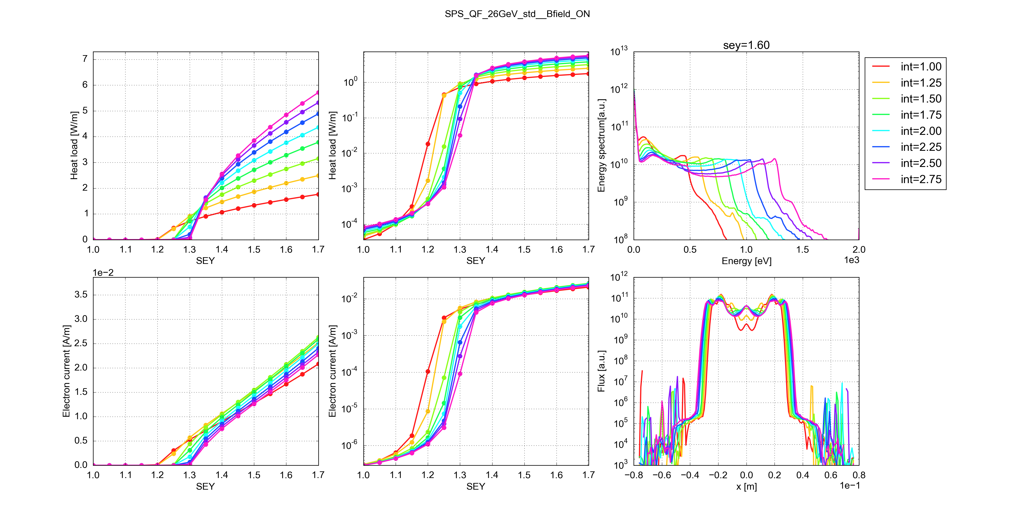

E-cloud build up with intensity
Underlying mechanism:
When the SEY decreases the energy window for multipacting becomes narrower
For high bunch intensity the e- spectrum drifts to higher energies and can move outside the most efficient region

Slide 40


Inferring the average SEY
Simulations
Measurements
6.5 TeV
450 GeV
6.5 TeV
High-load
Low-load

Slide 41

Inferring the average SEY
Simulations
Measurements
450 GeV
450 GeV
6.5 TeV
High-load
Low-load

Slide 42


Beam induced heat load in LHC
Two fold issue for HL-LHC
  Less margin for cryostat with HL-LHC parameters (three-fold contribution from impedance and synchrotron radiation)
  How does the additional load scale with bunch intensity? → We can make a prediction only if we assume it is caused by electron cloud
Maximum allowed by cryogenics
Margin
~7 kW
Margin
~4 kW
e-cloud S12
(2017)
~6 kW
e-cloud S34
(2017)
~2kW
2556b
1.15e11 p/bunch
6.5 TeV
2760b
2.2e11 p/bunch
7 TeV

Slide 43
Some other challenges in LHC
Beam-beam interaction
  Head-on beam-beam tune shift limit (based on past experience) currently surpassed
  Effect of the long-range → 6σ DA comfortably achieved during the whole levelling process, even including the chromaticity and octupole settings necessary for beam stability
Incoherent emittance growth along the cycle
  Larger than expected from Intra Beam Scattering (with margin), but impact de-facto mitigated by β* levelling
  Influence of noise → minimise sources by careful design of power converters, crab cavity controls, transverse damper upgrade (it might also benefit coherent instabilities)
Beam halo active control for machine protection
  Potentially large halo generation with HL-LHC beams, especially during commissioning
  Cleaning techniques under study, option for Hollow Electron Lens
Notes:
→ adjust crossing angle during levelling process to reduce the pile-up density and the radiation on the inner triplets

Slide 44
Some other challenges in LHC
Beam-beam interaction
  Head-on and long range (dynamic aperture during leveling), compensation techniques
Incoherent emittance growth along the cycle
  Sources to be understood, influence of noise
Large beam halo generation with future beams
  Halo active control for machine protection, cleaning techniques under consideration
RF power and longitudinal stability
  Power consumption for future injection voltage, transient beam loading, instabilities at flat bottom, longitudinal emittance blow up
Notes:
→ adjust crossing angle during levelling process to reduce the pile-up density and the radiation on the inner triplets

