Slide 1
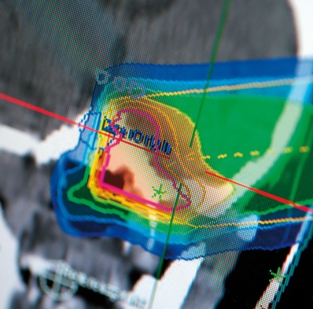
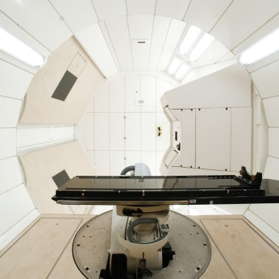
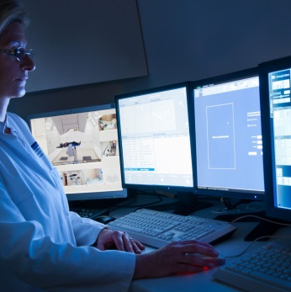
Experience from 10 years of operating accelerators for ion-beam therapy at HIT: What are the key requirements for medical facilities?
12th December 2018
Workshop on Accelerator Performance and Concepts (APEC)
Christian Schömers
R. Cee, M. Ellerbrock, M. Galonska, A. Peters, C. Krantz

Slide 2
What are medical facilities? In the accelerator context
Particle Therapy Centers doing patient treatment with Protons or heavier ions
66 Protons
11 Carbon (+ p)
ptcog.ch/ (Nov. 2018) Facilities in operation only.
20
17
28

Slide 3
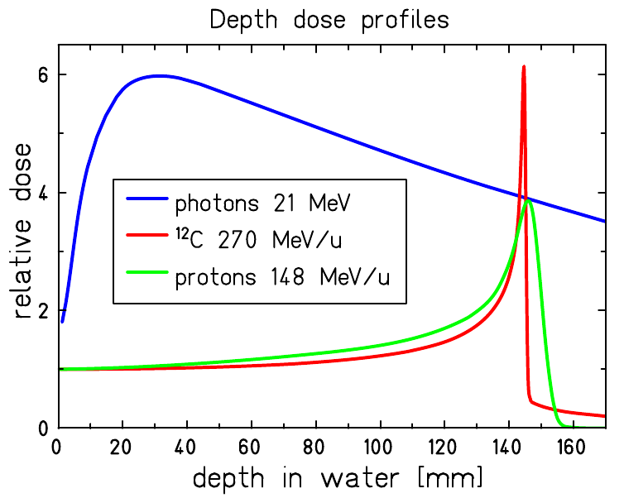
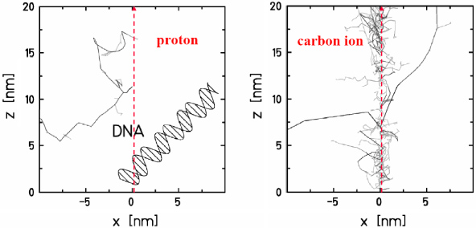
Rationales for ion beam therapy
Depth-dose profile: Bethe-Bloch
Range defined by starting energy (Bragg peak)
Less lateral scattering
Higher biological effectiveness
Possibility of lateral guidance (scanning)
Krämer & Durante, Eur. Phys. J. D 60 (2010)
Amaldi & Kraft, Rep. Prog. Phys. 68 (2005)

Slide 4
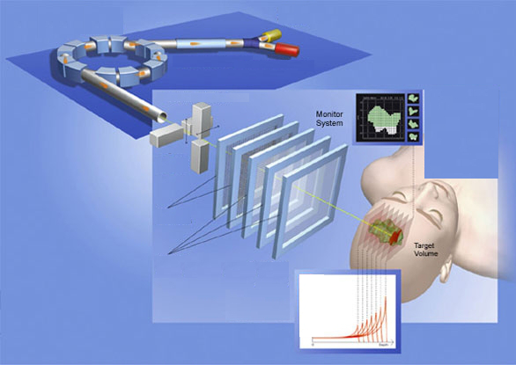
How we do therapy State of the art: raster-scanning
Accelerator delivers a spectrum of ion energies
Pencil beam is
guided by
scanning magnets
monitored by
multi-wire chambers
ionization chambers
Spread out Bragg Peak
courtesy of Siemens Health Care

Slide 5
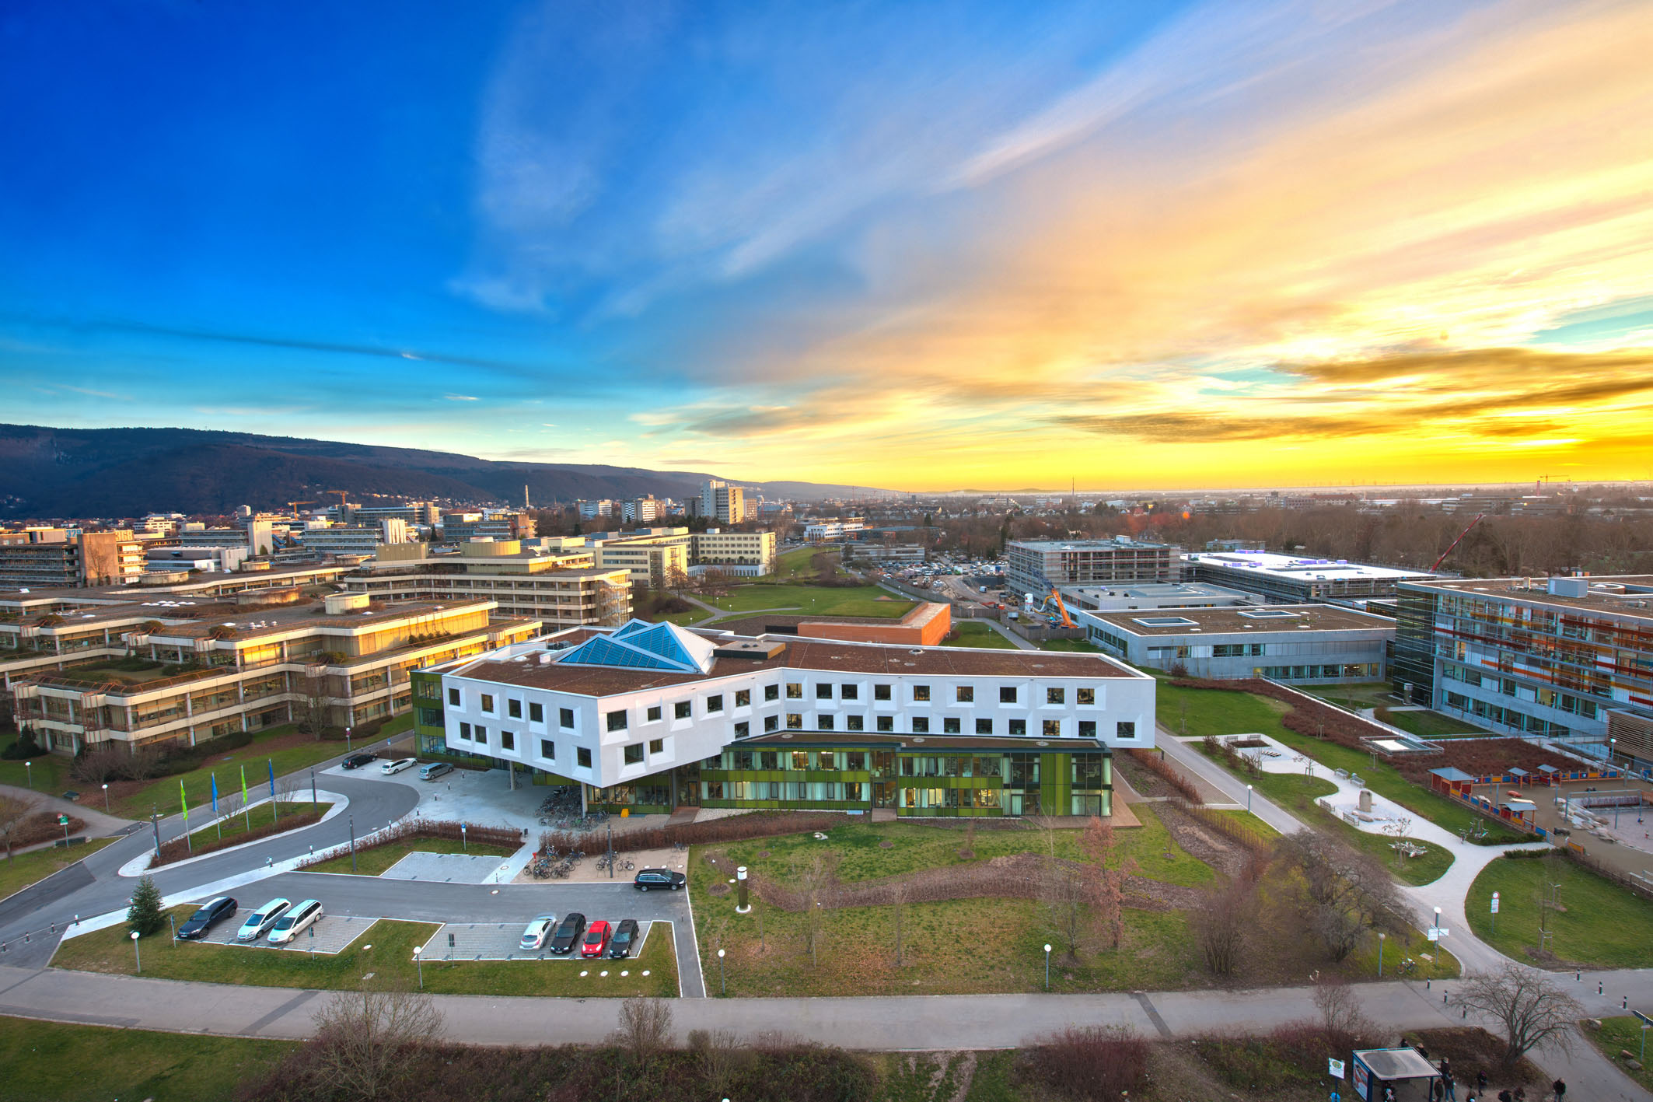
Example of a medical facility: Heidelberg Ion-Beam Therapy Center HIT
More than 5200 patients treated since Nov. 2009
Up to 71 patients treated per day
Treatment performed every day when scheduled
Internal medicine
Surgery
Gynecology
HIT
Radio- oncology
Pediatric clinic
National Center for Tumor Diseases

Slide 6
Key requirements Reliability and Availability
Provide particle beams in therapy quality 335 days / year
Avoid any interruptions to guarantee therapy success
Beam precision and stability
Overview:
Facility design
Data supply
Operating concept
Maintenance concept

Slide 7
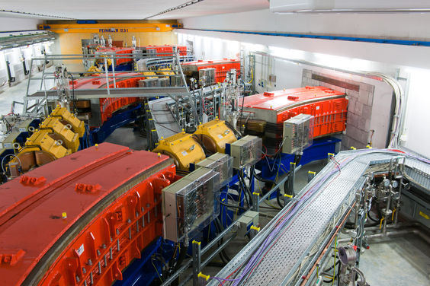
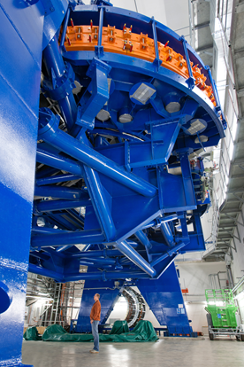
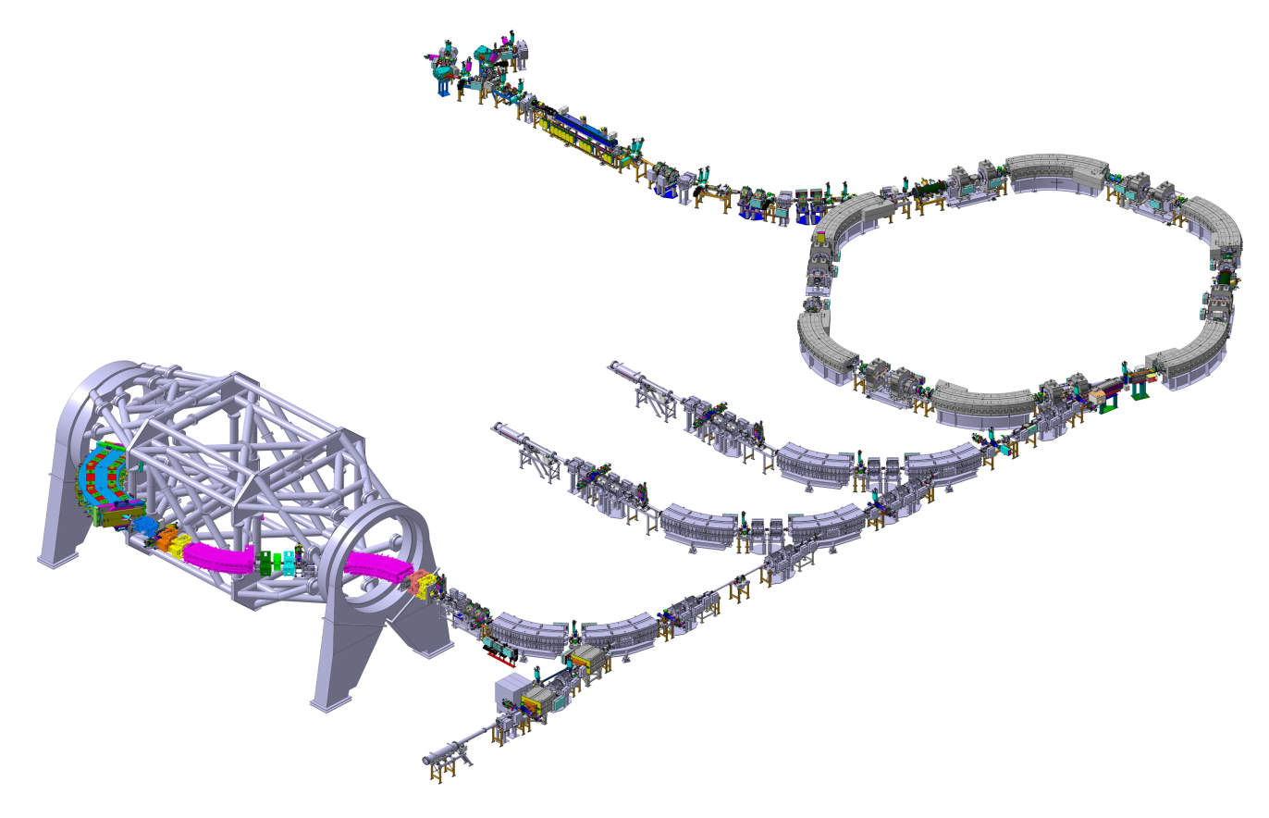
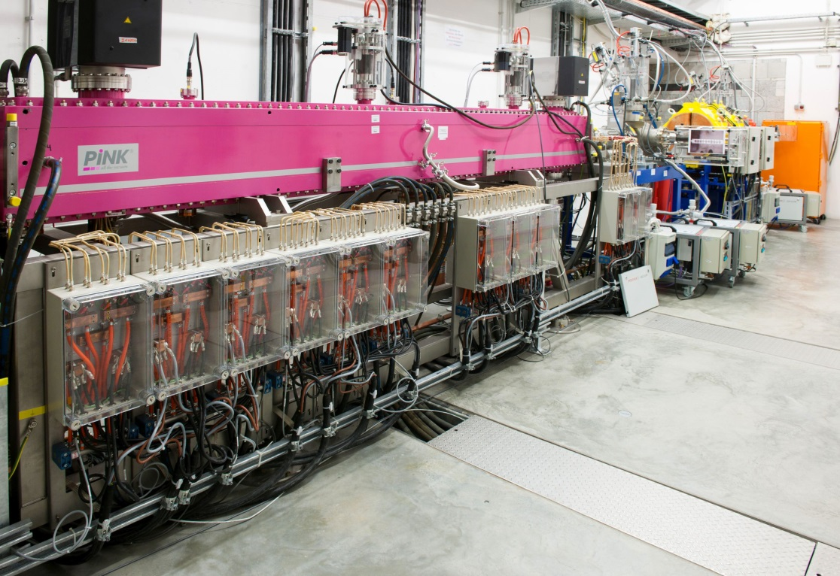
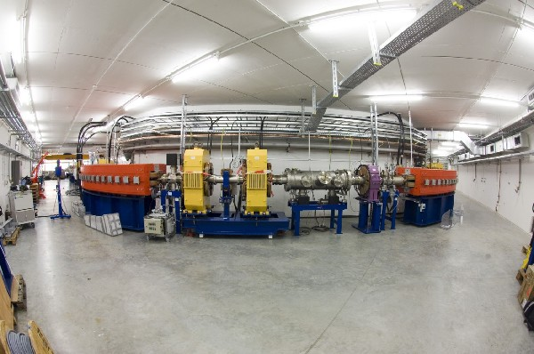
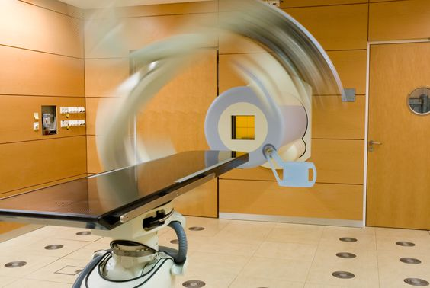
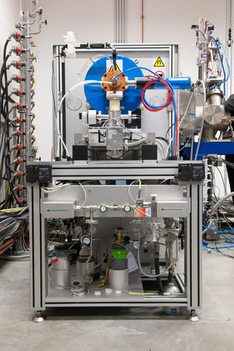
Facility design Accelerator layout
Sources
Injector LINAC
Treatment room
Synchrotron,
(48 - 430 MeV/u)
Beam transport Beam shaping
Abort systems

Slide 8
Facility design Basic strategy
The dose delivery must be:
Safe and precise
Redundant beam abort systems
Stable beam parameters (e.g. excellent power supplies)
Failsafe
Redundancy of important components
Sync-RF
ECR Ion Sources
Reliable components
Warm iron magnets, not superconducting (decision of ~1998)
Moderate field strengths, ~ 1,5 T
Fast: reduction of cycle time only without impact on 1.+2.
Implementation of magnetic field control (2012)
Implementation of dynamic intensity control (2014)

Slide 9
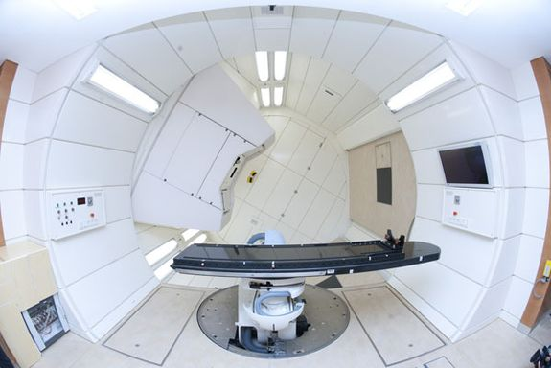
Data supply Beam parameter
beam
Precise dose delivery requires:
Large variety of beam parameters
4 ion types (H, C, He, O)
255 energies (48 – 430 MeV/u)
4 spot sizes (4 – 13 mm)
Intensity spectra (10⁷ – 10¹⁰ part./ spill)
36 gantry angles (0° – 360°)
A control system, that makes any combination available cycle-by-cycle

Slide 10
Data supply Data management
10 000 combinations per ion and target require intelligent...
Storage
Stored in a database and front end controllers
Therapy data stored in non-volatile flash memories
Change of therapy data must be acknowledged (checksum!)
Elsewise irradiation in treatment mode not executable
Check and adjustment procedures:
Only ~2 % of these combinations, covering the whole range
Daily accelerator performance check
Quality assurance by medical physics team
Interpolation algorithm to fill entire parameter space

Slide 11
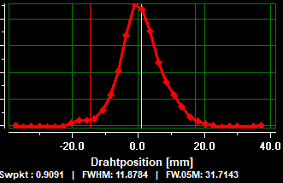
Operating concept Typical therapy day
AccQA
Med. Phys.QA
Patient treatment
QA,
Plan Verification
R & D
or
Beam adjustment
6h 8h 10h 12h 14h 16h 18h 20h 22h 24h 2h 4h
Accelerator QA (1h):
Measurements along the accelerator
Beam size and position
Particle rates and spill structure
Beam currents in LEBT-LINAC-Section
Output energy of LINAC

Slide 12
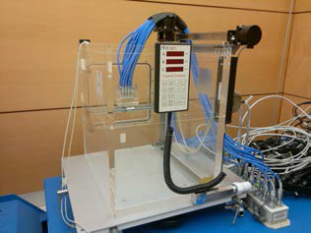
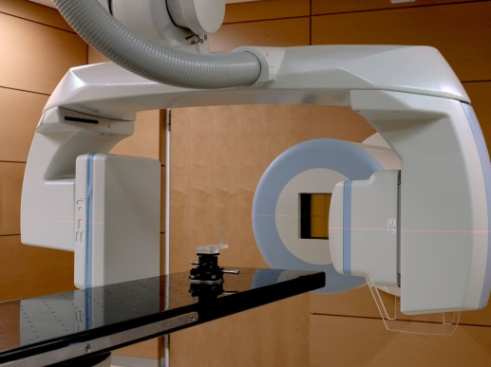
Operating concept Typical therapy day
AccQA
Med. Phys.QA
Patient treatment
QA,
Plan Verification
R & D
or
Beam adjustment
6h 8h 10h 12h 14h 16h 18h 20h 22h 24h 2h 4h
Medical Physics QA (2h):
Room certification
Position and width
Beam abort systems
Patient table movement
Treatment plan verification

Slide 13
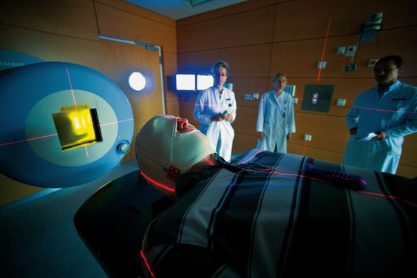
Operating concept Typical therapy day
Room activity (15th Nov. 2018) 71 patients
H1
H2
Gantry
AccQA
Med. Phys.QA
Patient treatment
QA,
Plan Verification
R & D
or
Beam adjustment
6h 8h 10h 12h 14h 16h 18h 20h 22h 24h 2h 4h
Treatment
Up to 71 patients per day
Coordinate 3 room operation
Anesthesia
Complex positioning
19 min./day downtime in av.2018 (facility OR single room)

Slide 14
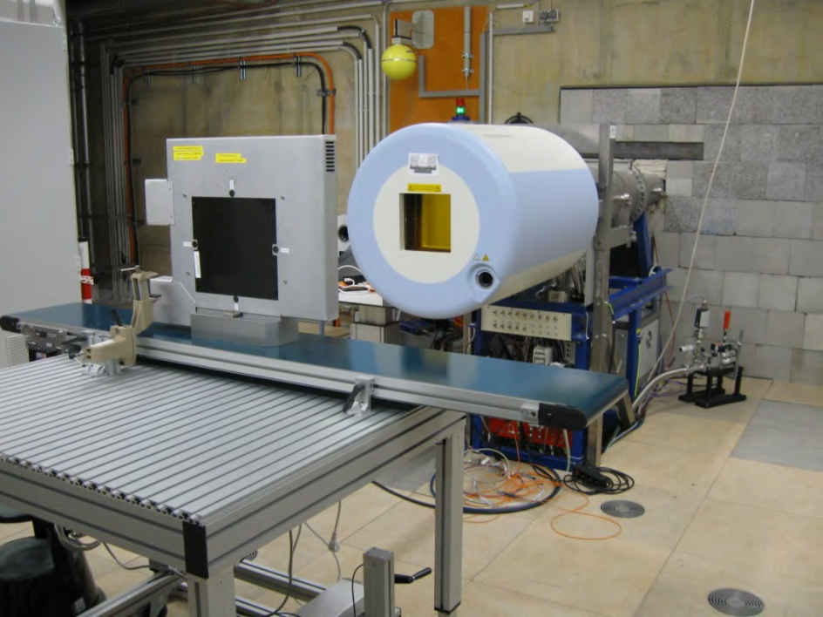
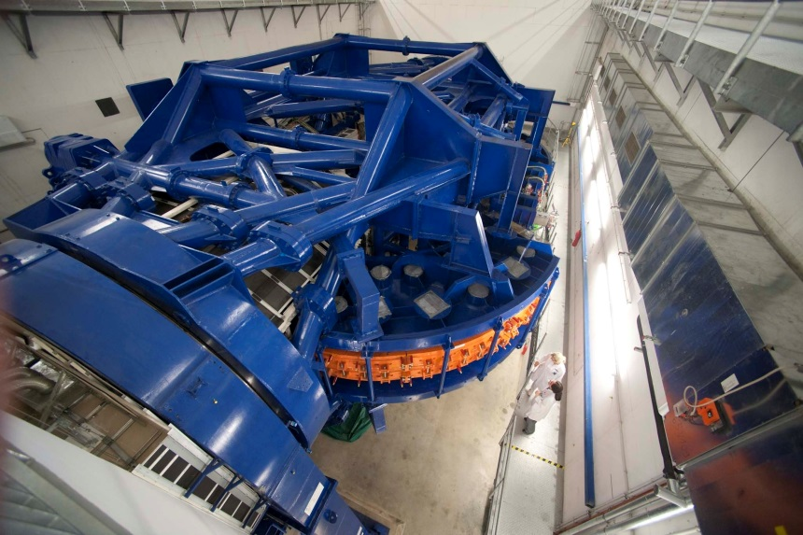
Operating concept Typical therapy day
AccQA
Med. Phys.QA
Patient treatment
QA,
Plan Verification
R & D
or
Beam adjustment
6h 8h 10h 12h 14h 16h 18h 20h 22h 24h 2h 4h
R & D
Bio-physics experiments
Detector development (on-line beam monitoring)
Accelerator R & D
Accelerator beam adjustment

Slide 15
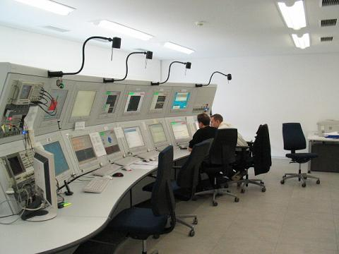
Operating concept People
Accelerator team: ~20 people
Physicists, engineers, technicians
Maintenance/beam adjustment and operating is done by the same people
Availability of personnel:
2 accelerator operators on-site, 24/7
On-call duty for each of the 3 maintenance groups
2nd level support (accelerator control system, Gantry)
In case of failure:
Fast decision necessary, if therapy can restart within minutes
Experienced personnel needed

Slide 16
Maintenance concept Shutdowns
1 long shutdown
Christmas – 1st week in January
Time consuming issues
Bad for patient management
5 maintenance blocks
Maintenance Thursday + Friday
Recommissioning and QA Saturday + Sunday
Patients can continue treatment
12 single maintenance days
Maintenance Monday morning
QA in the afternoon

Slide 17
Maintenance concept
Preventive maintenance
Parallel maintenance, tight schedule:
HIT-internal groups (ion-sources, beam diagnostics, RF, ...)
Siemens customer service for the beam application system
External companies
Infrastructure; cooling system
Control system updates
Gantry structure mechanical maintenance
→ (Spatial) Coordination of different maintenance groups
No failure of a complete day since 2009
Maximum breakdown: 5h

Slide 18
Conclusion
Major criteria for a successful treatment
Safety
Accuracy
Reliability
Beam stability
Ways to get there:
Use well known technology
Redundancy
Regular checks of beam parameters
Experienced personnel
Preventive maintenance

Slide 19
Thank you!
And the entire HIT team, especially: R. Cee, M. Ellerbrock, M. Galonska, A. Peters, C. Krantz (MIT)

