Slide 1

Fully Automated Phase Tuning and Cavity Recovery in the SNS SCL
Charles Peters, Andrei Shishlo
December 11, 2018

Slide 2
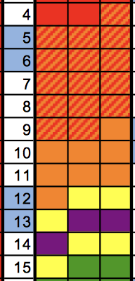
After extended maintenance periods the beam tune-up time allotment is hours
Current accelerator turn on time is 1 week
Equipment turn on is given days to leave contingency for repair of failures
Beam tune-up is given hours to leave contingency for checkout of equipment (specifically beam instrumentation)
Friday
Saturday
Sunday
Monday
Tuesday
Wednesday
Thursday
Friday
Saturday
Sunday
Monday
Tuesday
End maintenance, close tunnels, start source:
Equipment checkout:
Equipment checkout:
Fix issues, equipment checkout, tune source:
Fix issues, equipment checkout:
Begin beam tune-up:
Complete beam tune-up:
Perform target strain measurements:
Accelerator Physics:
Neutron instrument checkout:
Accelerator Physics:
Neutron production:
APEC 2018

Slide 3
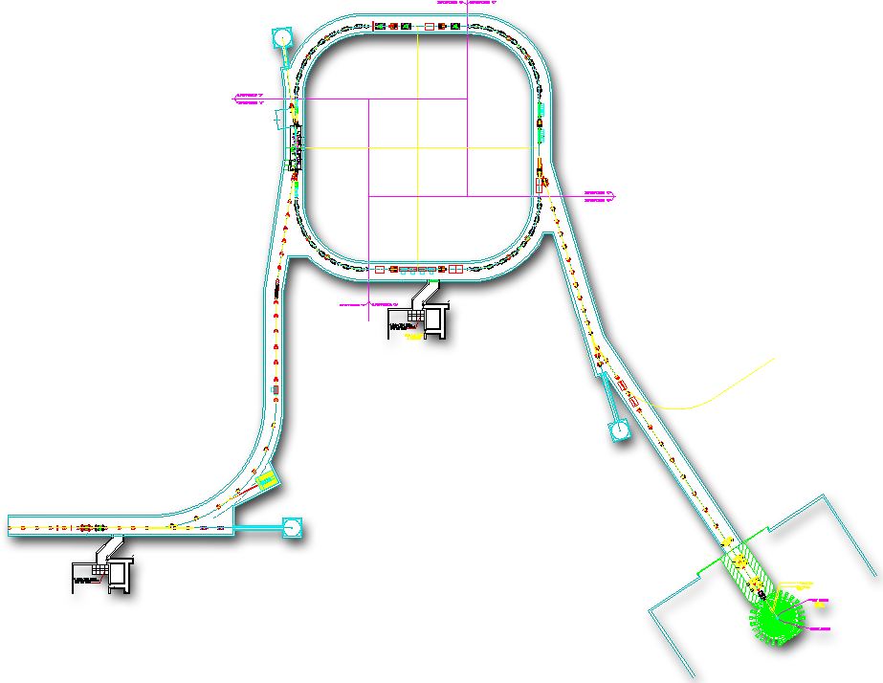
Typically beam tune-up can be done in 4 hours
Beam tune-up
  Restore all magnets to values from previous run (15 minutes)
  Beam to the CCL beamstop (30 minutes)
    Warm linac RF phasing
      Fully automated
  Beam to the Linac dump (1 hour)
    SCL RF phasing
      Fully automated
    Measure beam energy
    Increase beam power and verify losses
  Scale HEBT, Ring, RTBT magnets for new energy (15 minutes)
Allowed beam
timing (microseconds)
Destination
MEBT Beamstop
50
CCL Beamstop
50
Linac Dump
50, 100, 1000
Injection Dump
50, 100, 1000
Let’s focus on how we got here
Extraction Dump
50, 100, 1000
Target
50, 100, 1000
Collimators
  Beam to the extraction dump (2 hours)
    Correct orbits to previously saved orbits
    Verify energy using the Ring and if necessary either adjust energy or magnets
    Increase beam power and tune beam losses empirically
Injection
Extraction
RF
65 kV
2.5 MeV
87 MeV
186 MeV
387 MeV
1 GeV
RTBT
HEBT
IS
RFQ
MEBT
DTL
CCL
SRF, β=0.61
SRF, β=0.81
Liquid Hg Target
APEC 2018

Slide 4
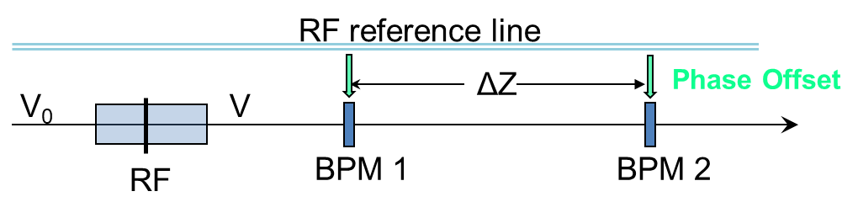
SLACS – Superconducting Linac Automated Cavity Setter (XAL Application, J. Galambos)
Select
cavity
Scan
cavity
Analyze
Scan
Choose two BPMs
All cavities between them are OFF
Perform RF phase scan
Find minimal phase diff. (max energy gain) and subtract 18º
Energy from TOF for two BPMs
SCL Tune-Up Time:
Dec. 2005: 101 hrs E_{out} = 925 MeV
July 2006: 57 hrs E_{out} = 855 MeV
Oct 2006: 30 hrs E_{out} = 905 MeV
Jan. 2007: 6 hrs E_{out} = 905 MeV
Even 6 hours is too long! And we wanted to improve accuracy.
APEC 2018
Slide courtesy of Andrei Shishlo

Slide 5
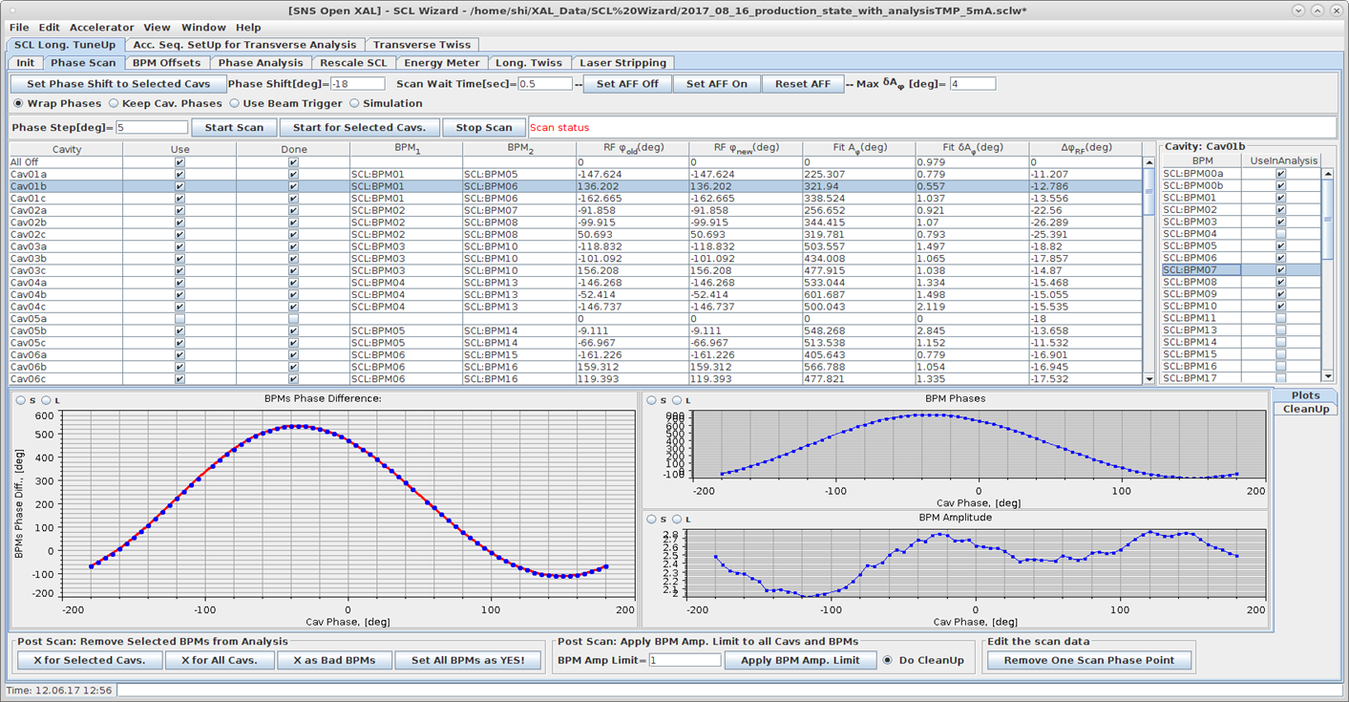
SCL Tuning Wizard
SCL Tuner Wizard:
Phase Scan
BPM Phase Offsets calculations
Model Based Analysis
Model Based Rescale
Energy Meter
Longitudinal Twiss Analysis
Transverse Twiss Analysis
Implementation:
Jython + OpenXAL
“One button” tune up application
Takes about 40 min to tune the whole SCL with 81 cavities
The SCL can be retuned instantly if we have to switch off one of the cavities
Non-destructive scan capability
APEC 2018
Slide courtesy of Andrei Shishlo

Slide 6
Key point #1: Minimize beam lost during phase scans
During RF phase scans all of the beam is lost in the SCL
  Mask Beam Loss Monitors (BLMs) in the linac and straight section of the HEBT
  Typically 5 beam loss events per day during production compared with 3600 beam loss events during the tune-up!!!
Reduce beam duty factor and beam current to minimize beam loss
  Set beam repetition rate to on demand or at most 1 pulse per second
  Use an electrostatic beam chopper before the RFQ to reduce beam length from 1000 microseconds to 5 microseconds
  Insert an aperture just after the RFQ to reduce the beam current from 40 mA to 5 mA
BPM current levels along the linac
Normal current level
Current during scans
APEC 2018

Slide 7
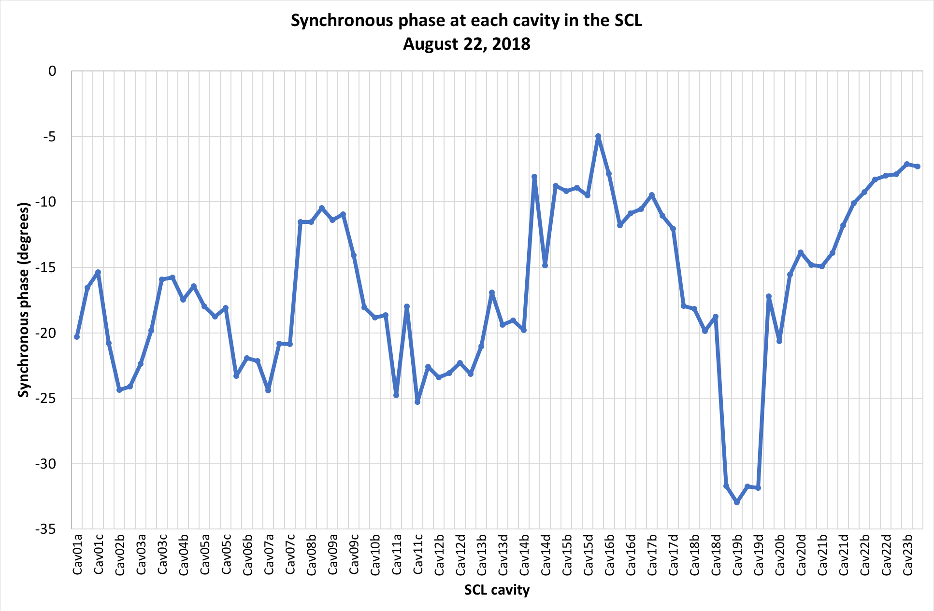
Key point #2: Non-destructive scans are extremely important
Synchronous phases don’t need to be perfect for the lowest loss tune
We do the following:
  For an initial tune-up set the synchronous phases based on some goal (for us -18 degrees)
  Tune for beam loss empirically
  Perform a non-destructive scan and save synchronous phases
    Measure the beam synchronous phase at each cavity but do not change the phase setting
For consequent beam tune-ups set synchronous phases to previous run settings
  Puts you back to the last tune quickly
  Easy to walk away from the goal synchronous phase
-18º goal
A synchronous phase wave produces the lowest beam loss
APEC 2018

Slide 8
Key point #3: Keep the application simple but smart
Still need to be somewhat of an expert for the initial tune-up
  An accelerator physicist or the machine specialist is needed to run the application for the beam tune-up
  Initial software setup is very important
    Have to know when to initialize the program (RF all up at appropriate setting for example)
It takes time to find issues with equipment before the program will run without errors
  Start program, bad data, find problem, fix problem, start program, …
  The application has been made smarter but still there are pitfalls
Re-phasing SCL RF phases within the program is a simple process done most times by operators
Lots of tabs, selections, buttons and numbers that don’t matter to the novice user
APEC 2018
Re-phasing could be automated!!!

Slide 9

SCL cavity tune around can be automated under the right circumstances
SCL cavities degrade meaning in order to maintain high reliability gradients must at times be reduced
Currently the tune around is an up to 43 step manual process (mostly administrative) that takes about 15-30 minutes for operators
If the administrative steps are eliminated there are only a few things that must be done in order to automate the recovery
  Detune the problematic cavity
    Without detuning, the cavity will absorb energy from the beam and self excite and affect beam
  Re-scale RF phases
    A cavity being off changes beam arrival time downstream so cavity phases have to be shifted
  Load RF Adaptive Feed Forward (AFF) waveforms
    New I and Q correction factors are needed after the RF phase changes
This Photo by Unknown Author is licensed under CC BY-SA-NC
APEC 2018
Let’s cut the red tape and automate!

Slide 10
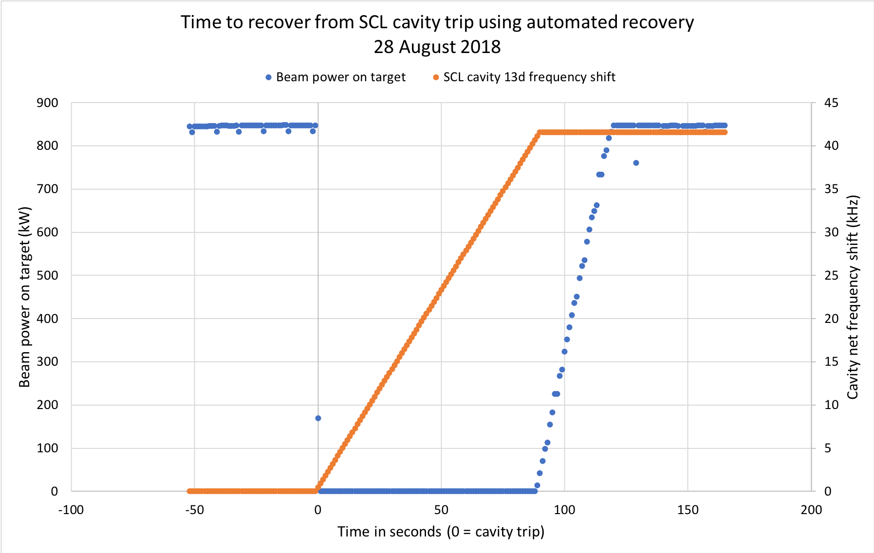
Automated tune around works but it’s slow
We did a test with high power beam to see if an automatic tune around is possible
  Prepare for a problem cavity manually
    Turn off a cavity
    Detune the cavity
    Re-scale and save new RF phases
    Run beam and save AFF waveforms
    Restore cavity to operation
    Restore beam to nominal power
Enable auto-recovery program to monitor cavity status
  When RF cavity is turned off the auto-recovery process begins
Detuning stops
Beam recovery begins
Cavity turned off
Detuning starts
90 sec
30 sec
Most steps finish in milliseconds, but detuning the cavity takes many seconds
APEC 2018
Let’s see how fast we can go

Slide 11
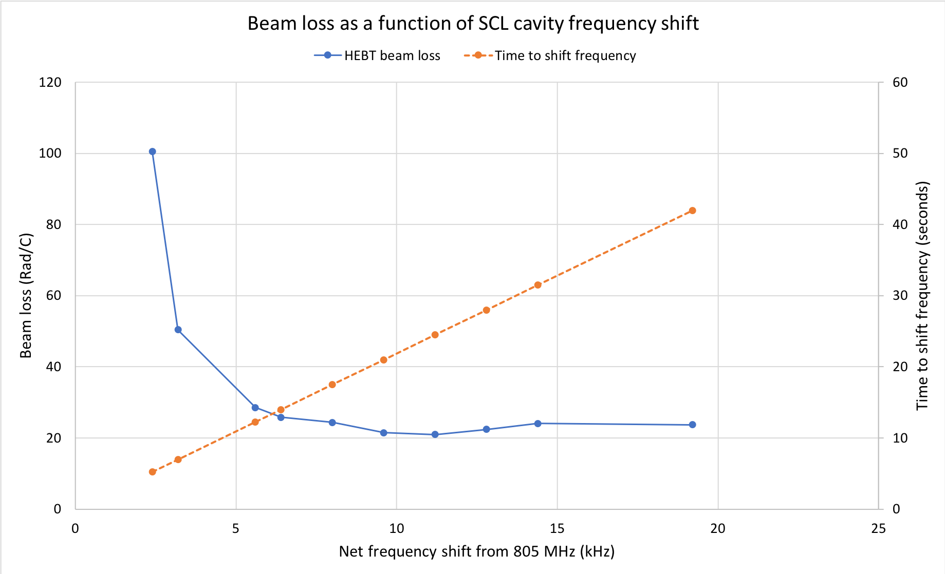
Beam recovery time can be reduced to about 10 seconds
Detuning for us is a slow mechanical process (0.46 kHz per second)
Based on beam loss the fastest the beam can be recovered safely is about 10 seconds
We also found another beam loss issue with tune around
Start beam here as the tuner is moving
APEC 2018

Slide 12
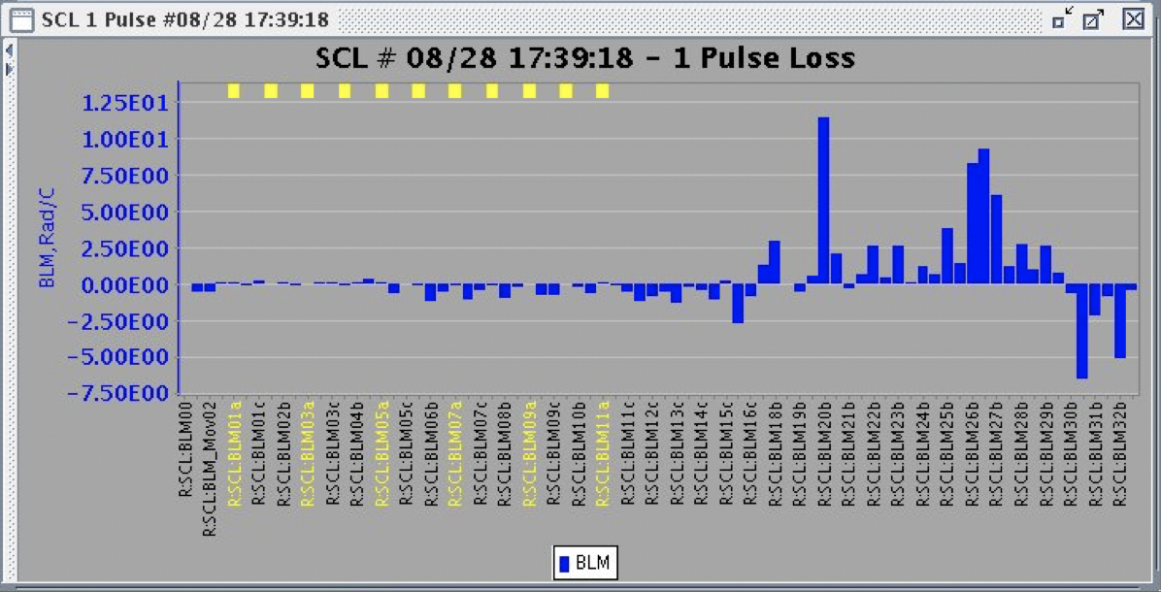
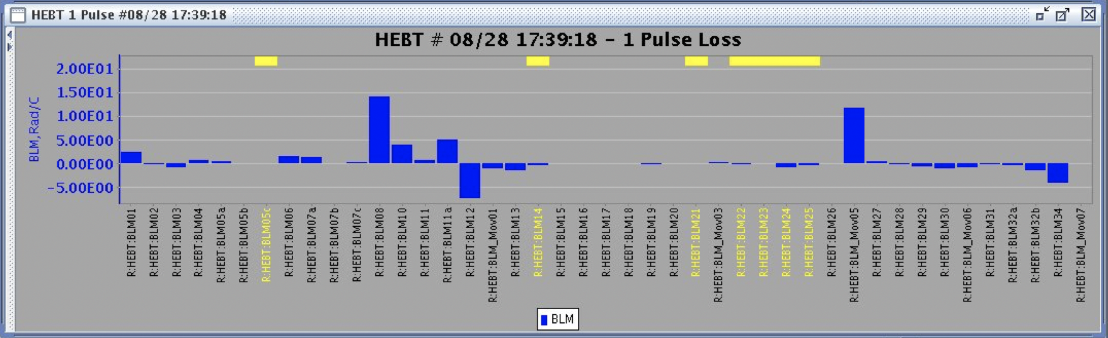
Transverse optics are also important for beam losses
SCL cavity 13d
SCL BLM loss difference
After RF re-phasing the beam losses change downstream of the cavity that was turned off
  Transverse optics also need to be adjusted
Need to spend time to better understand transverse optics setup which deals with intra-beam stripping
  Due to time constraints most beam loss tuning with SCL optics is done empirically
There are other issues
Beam
Direction
HEBT BLM loss difference
Beam
Direction
APEC 2018
Collimators

Slide 13
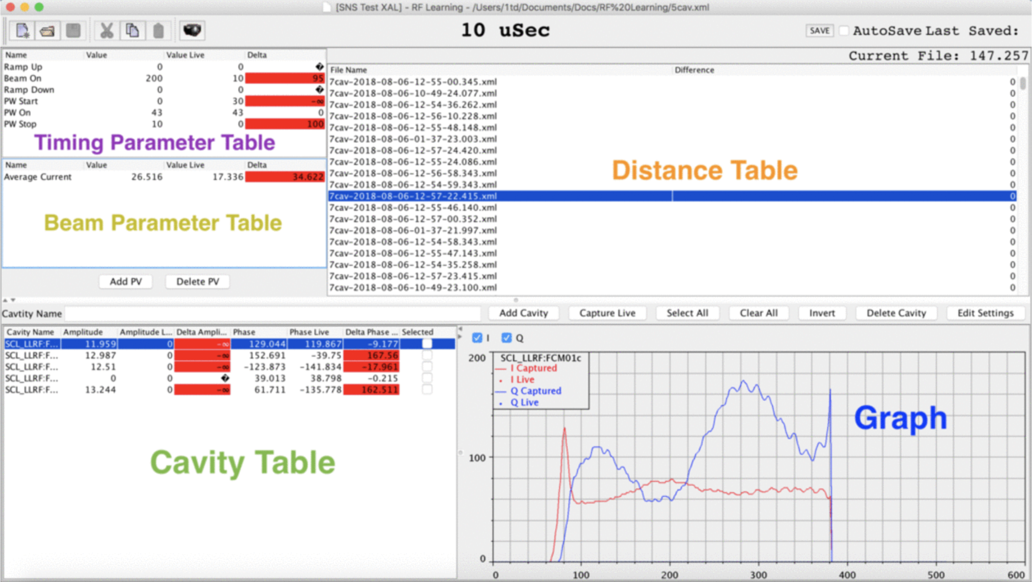
Creating an initial table of settings for all combinations of cavities is impractical
For this test, time was spent setting up for a specific cavity being off
  Impractical to do this for all combinations of all 81 cavities
  Small phase changes are made weekly to RF phasing so RF phase file is only good for short periods of time
Example of new app for comparing AFF waveforms
Two goals to try to eliminate the manual set up time
  Live synchronous phase monitor to be able to adjust RF phase file automatically
  Live AFF waveform monitor that can create new waveforms based on cavity pattern and beam loading levels
APEC 2018

Slide 14
Summary
SCL tuner wizard has been a game changer for beam operations
  Reduced time needed for tune-up and recovery
  Created the ability to do previously time consuming AP studies
A perfect one button click application isn’t a high priority
  Compared to the amount of work needed to make it perfect the gain from a one button click application would be minimal
It is possible to tune around an SCL cavity in milliseconds but we at SNS are limited by the speed of cavity detuning
  A new facility would need to build fast detuning into the cavity design
APEC 2018

Slide 15
QUESTIONS?????

Slide 16
Additional slides

Slide 17
Key point #4: SCL quad settings are already set for low energy
Intra-beam stripping caused the need to increase the beam size in the SCL
SCL quad settings have been lowered empirically to reduce losses

Slide 18
Use previous run synchronous phase settings for setting up a new run
SCL gradients can be changed
Thermal cycling
Plasma processing

Slide 19

Automation can eliminate simple mistakes that occur with repetitive tasks
Initial SCL tune-up was done with operators/physicists scanning each cavity using a button clicking sequence
No matter the experience level people made mistakes
  Sometimes minutes were lost sometimes hours
Simple sequence of clicks
Repetitive task (81 cavities)
Perfect for automation!

Slide 20
Equipment checkout
Secondary systems should be running at the conclusion of maintenance
  Vacuum, cooling, controls
The following systems are turned on Magnet power supplies
High Power RF (HPRF)
Low-Level RF (LLRF)
Ion source is set up during the equipment checkout
  Beam is sent through the RFQ to a beamstop in the MEBT

