Slide 2
The limits in assessing and designing for availability based on practice
Arto Niemi (CERN / Tampere Uni. Tech.)

Slide 3
Content
Motivation
Reliability centred maintenance approach
Data for studies
Conclusion

Slide 4

-Study
FCC-hh 100 TeV collision energy (7x LHC)
16 T Nb₃Sn magnets
Goal: 20 ab⁻¹ of integrated luminosity during 20 years operations
LHC achieves today 80% availability. → How to ensure that 4 times larger machine reaches high availability?

Slide 5
Theory

Slide 6
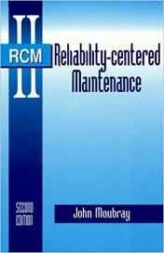

Industrial approach to reliability
Since decades maintenance plans and reliability approach in aviation industry has been based on so-called reliability centred maintenance
Adapted by: Nuclear energy, Industries, Several US Governmental Agencies
Agency guides are often public e.g. NASA: https://fred.hq.nasa.gov/Assets/Docs/2015/NASA_RCMGuide.pdf

Slide 7
Risk analysis
1. Risk identification: What can fail?
2. Risk quantification: How severe the failure is?
3. Risk decision: What to do about it?

Slide 8
RCM Decision tree (NASA example)
Identification
Severity
FMEA
3. Decision
Weibull-analysis

Slide 9
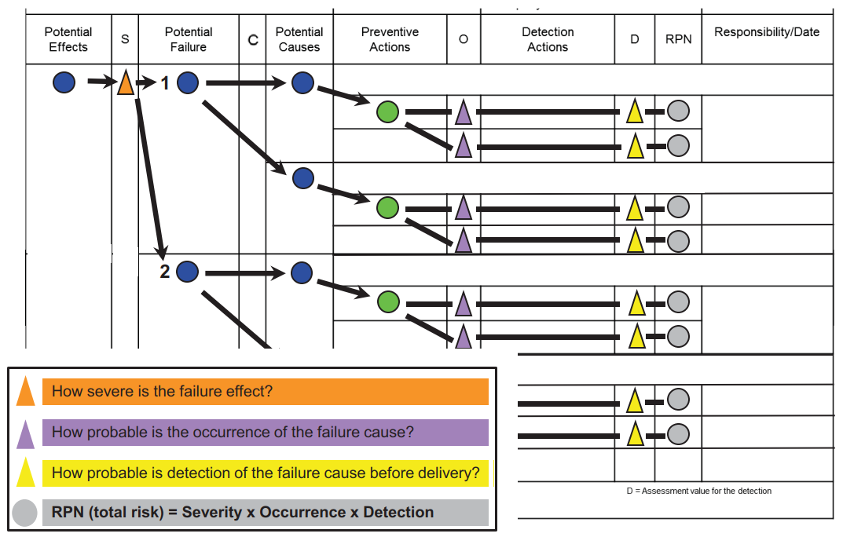
Failure mode & effect analysis
Initial estimate on:
Witch ways a system can fail?
How severe the failure is?
What can cause the failure?
How likely it is?
From Uni. Stuttgart RAMS training

Slide 10
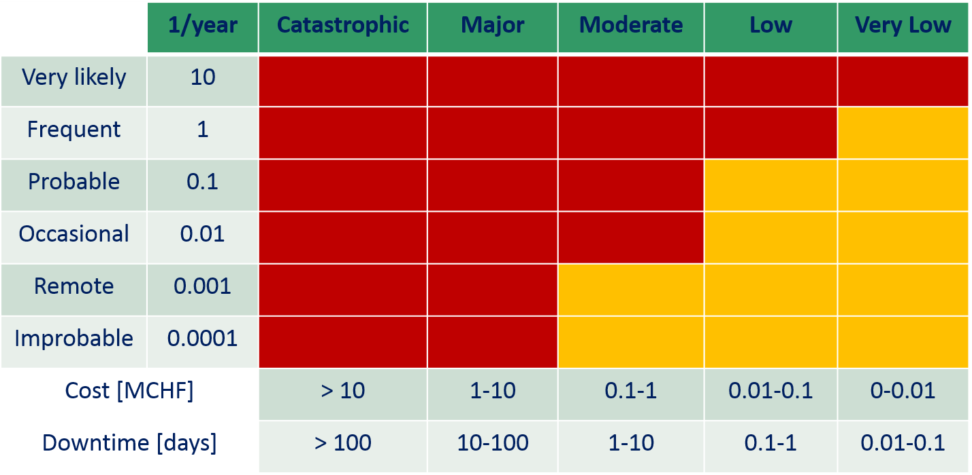
Risk matrix
IMPACT
FREQUENCY
Prioritise risk with high impact and/or high frequency

Slide 11
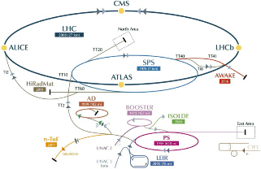
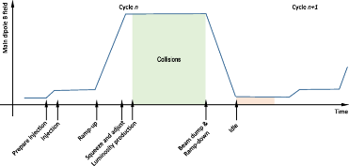
Assessing the impact is not always straightforward
Case: hadron collider
Collisions are produced only in a certain operations phase that requires preparations → Impact of a collider failure is more than the repair time
Collider requires injector chain only for filling→ Injector failure has sometimes no impact on the collider
→ Assessing the impact requires modelling*
*A. Niemi et al. Phys. Rev. Accel. Beams 19, 121003
https://doi.org/10.1103/PhysRevAccelBeams.19.121003

Slide 12
Failure rate types: Classic bathtub
High failure rate early life (teething problems)
High failure rate in late life (ageing)
Correct action: preventive task time dependent before failure rate rises
Rare:
Early life problems typically treated with testing
Ageing usually linked to mechanical fatigue

Slide 13
Failure rate types: Constant rate
No significant change in failure rate
Correct action: Condition monitoring task to detect individual equipment failures
Common

Slide 14
Failure rate types
Significant aging, correct action time based task, rare associated to fatigue
Slight aging, correct action CBM, rare, no clear time for interval based task
Slightly higher reliability early life, correct action CBM, rare, interval based task: no high advantage
High failure rate early life, correct action CBM, common, interval based task = harmful

Slide 15
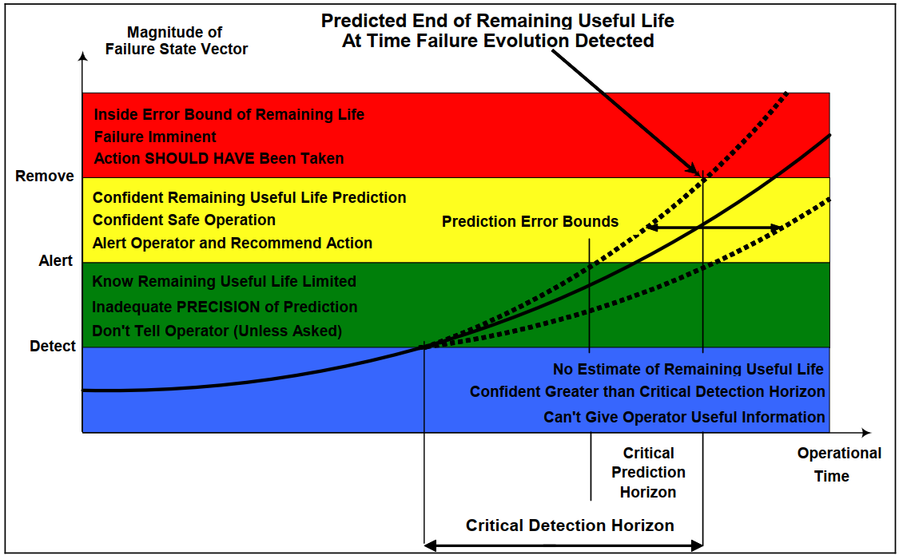
Condition monitoring & prognostics
Practice:
Are there signals that describe the unit condition?
Are they monitored?
Theory

Slide 16
Condition monitoring & prognostics
Two schools of thought:
Knowledge based models
Relies on expert knowledge to build a model to interpret data
Require an in-depth knowledge on the system
Can be demanding to develop
Data-driven models
Relies on data to find correlations between failures and signals
Can require a lot of data
Benefits from modern machine learning techniques
Generally easy to implement

Slide 17
Conclusion on theory
Correct action to improve the reliability depends on equipment’s failure type
Condition based maintenance is possible if equipment’s condition can be monitored

Slide 18
Practice

Slide 19
How to get reliability information?
Maintenance data
Signals

Slide 20

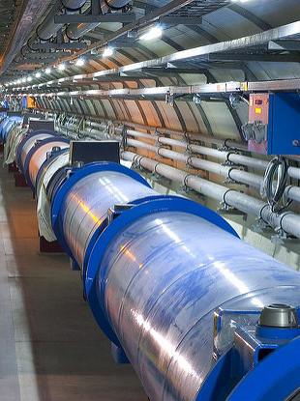
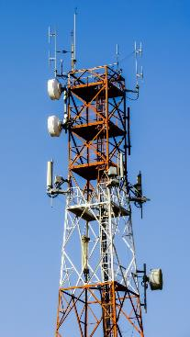
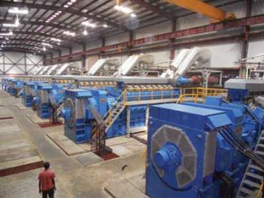
Personal experience from:
Accelerators
Aircraft systems
Telecommunication equipment
Industrial assets

Slide 21
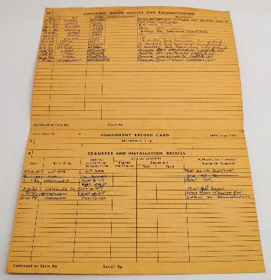
Maintenance records in aviation
Maintenance & repairs
Rigorous record keeping
Component log card showing Back to birth traceability
Paper card ensures that history is always available in written form for technicians
Transfers & installations

Slide 22
Timeline
New item
Preventive maintenance
Current state
Failure
Failure
Essential in age-dependent analysis to understand what was done in maintenance
Example: If the item was replaced it is practically as good as new after the maintenance

Slide 23
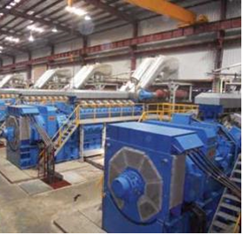
Maintenance records in industry
Varies from very good to very bad
Good example: OREDA in oil industry
Personal experience in not so good case*
  Data with varying levels of quality
  Root causes: No guidelines or incentive for maintenance data collection
Another issue: Lack of data sharing between customer & asset manufacturer
* https://www.researchgate.net/publication/296596963_Importance_of_maintenance_data_quality_in_extended_warranty_simulation

Slide 24
At CERN
Individual equipment groups collect failure data
(Excel ↔ Maintenance DB)
Since 2015, accelerator fault tracking project aims for coherent picture on machine availability
Weekly follow up to ensure data consistency
Individual approaches
AFT: cross group data on failures’ impact on machine operations

Slide 25
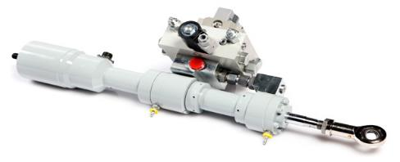
Failure data from signal data (Not easy)
Monitoring original purpose give an alert in case failure. (not prognostics or diagnostics)
Result = hard to find a failure root cause
Aircraft actuator example:
An alert given when actuator does not follow commands
Root cause can be: within the actuator, hydraulic pump, or clogging in the system
(Unrelated example photo)

Slide 26

Telecommunications
Telecommunications radio:
Radio requires a signal from surface that is provided by a cable
Radio produced same alarm both when radio’s cable plug was broken or when cable was broken
Alarm was unsuitable for proper diagnostics
Also Bayes reasoning unsuited as there was no clear correlation between the alarm and one of the causes

Slide 27
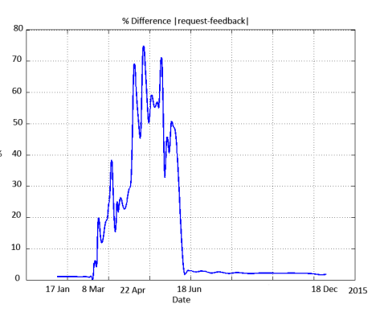
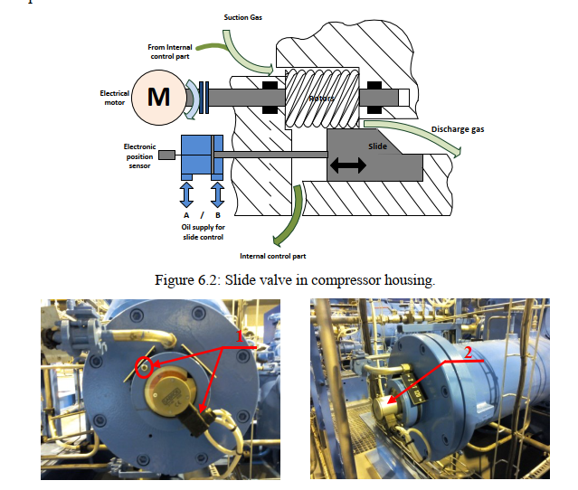
Cryogenics valve
Valve
Sensor
Position sensor indicated erroneous valve position
Root cause → Valve was in correct position but the sensor was moving!
Published as a part of E. Rogova’s Ph.D. thesis
DOI: 10.4233/uuid:17606183-f86f-45c4-8333-417dce87392f

Slide 28
Conclusion 1/2
Condition based maintenance is often the most beneficial way to improve the reliability
Requires way to monitor the system condition
  For a successful implementation this need be taken into account during system design
  Otherwise the end result is usually sub-optimal (Data is not collected or is ill suited for prognostics)

Slide 29
Conclusion 2/2
Data is required to:
  Prioritize the reliability studies and to focus on critical issues
  Recommend correct actions (e.g. where condition based maintenance could be used)
In oil, wind, nuclear industries & in fusion research reliability data (MTTF & MTTR) is shared to ensure knowledge on issue is spread
ARIES task 6.3 studies if this same practice is feasible in the accelerator community

