Slide 1
Performance and Reliability issues in large scale facilities
Operating the FEL complex of the LCLS Facility
Axel Brachmann
Representing the LCLS team.
Accelerator Performance and Concept Workshop
Frankfurt am Main, 10-12. December 2018

Slide 2
Outline
Overview of SLAC’s Main Linear Accelerator Facilities
  LCLS-I → current facility ^{[1]}
  LCLS-II → under construction
  LCLS-II HE → planned extension of LCLS-II
  FACET-I and II ^{[2]} → HEP test beam facility
Performance and Reliability at LCLS
  Linac Coherent Light Source
  Performance and capabilities
  Operation of LCLS as a user facility from 2009, Availability, Downtime
  LCLS-II outlook
  Focus of talk is accelerator and FEL, X-Ray science for context
Conclusions
^{[1]} Linac Coherent Light Source
^{[2]} Facility for Advanced Accelerator Experimental tests

Slide 3
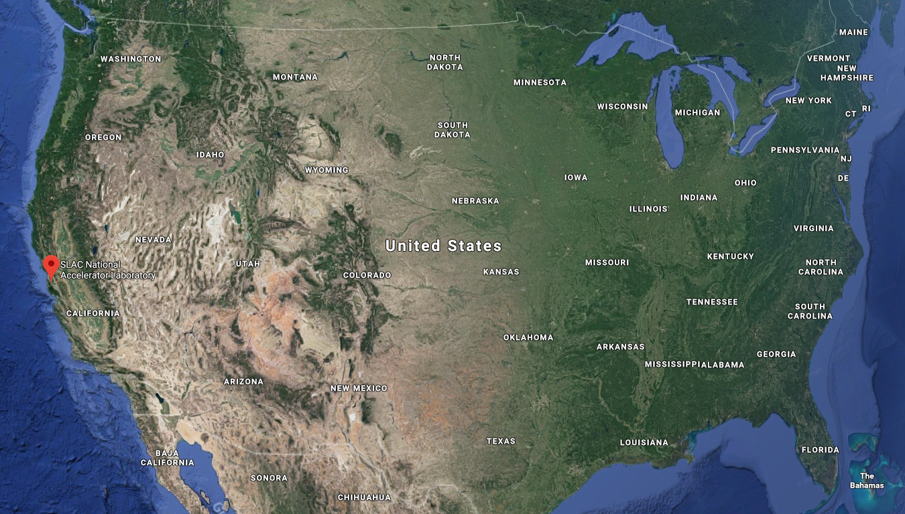
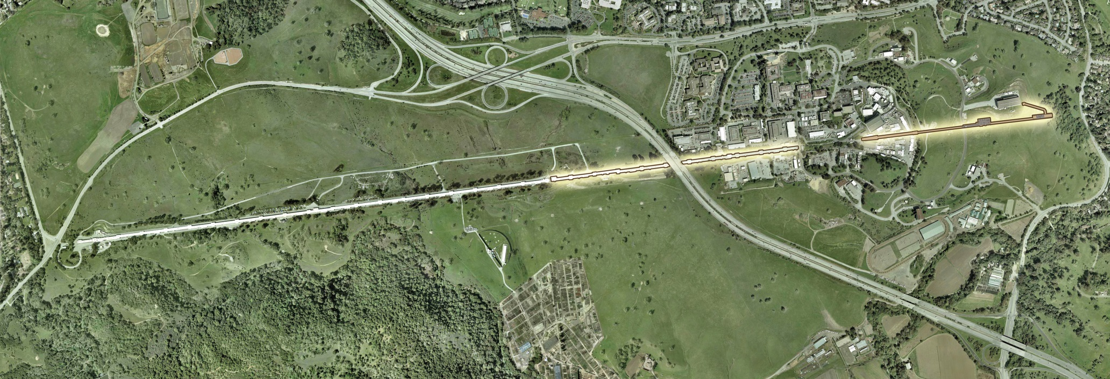
SLAC’s Main Accelerator Facilities
Stanford Linear Accelerator Center
SLAC National Accelerator Laboratory
FACET - II
Linac Coherent Light Source (LCLS – I)
1 km of LINAC + Undulators (FEL) + X-Ray Instrumentation
LCLS – II - HE
This talk will focus on our experience and plans with LCLS.

Slide 4
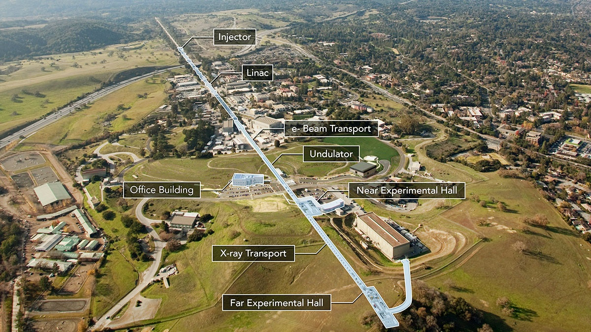
The LCLS Complex
W – Pacific Ocean
San Andreas Fault
N – San Francisco
LCLS uses last kilometer of SLAC’s S-band linac, FEL facility started operating in 2009.

Slide 5
LCLS Accelerator and FEL Systems
System | Parameters
LINAC | 1 km , S-band, Normal Conducting
Electron beam energy | 2.5 GeV → 17 GeV
Repetition rate | 120 Hz
Bunch Charge | few pC → 1 nC; ~ 180 nC is standard
Bunch length | 0.5 ~ 100 fs
Undulators | ~ 100 m, K = 3.51, fixed gap
Photon Energy | 250 → 12.8 keV
Photon Pulse Energy | up to 6 mJ
Photon Bandwidth | .1-.2 % for SASE, few eV or <1 eV for seeded beams
Full set of parameters at: https://lcls.slac.stanford.edu/parameters

Slide 6
Performance of LCLS FEL’s

Slide 7
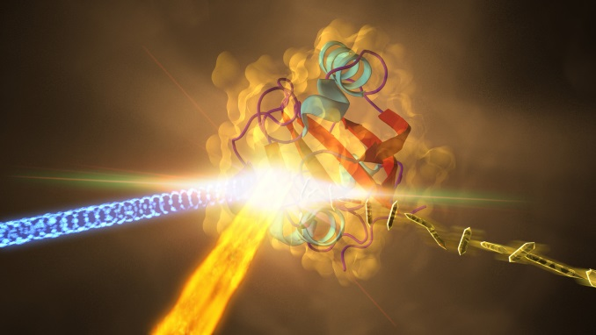
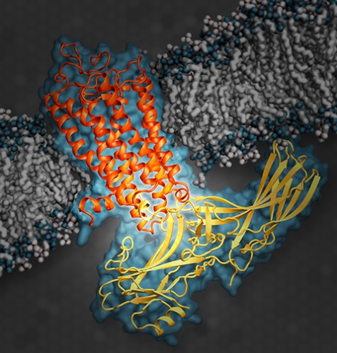
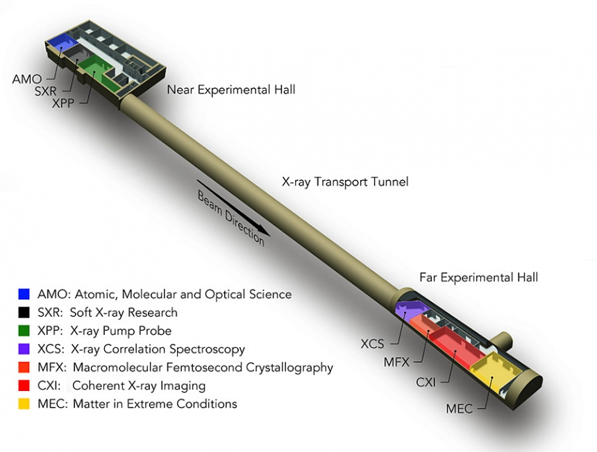
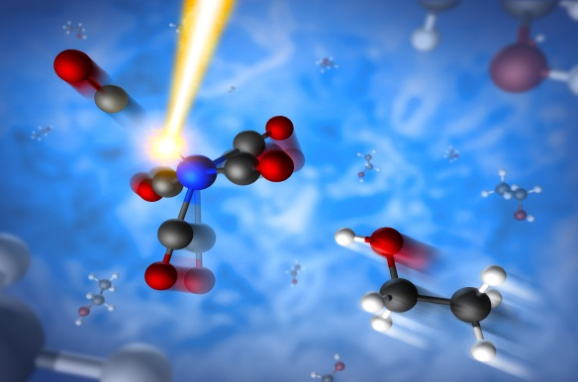
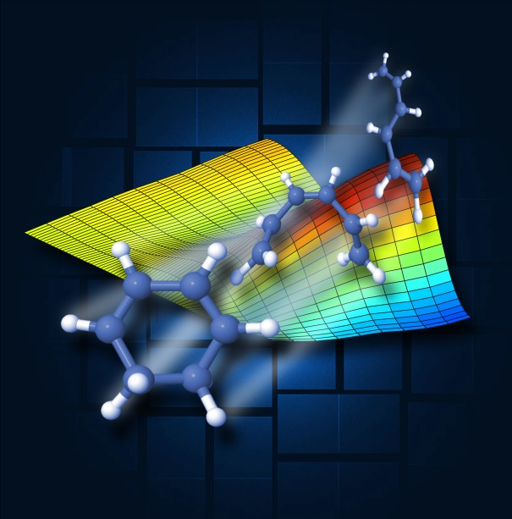
LCLS X-Ray Instrumentation and Science
LCLS currently operates 7 instruments.

Slide 8
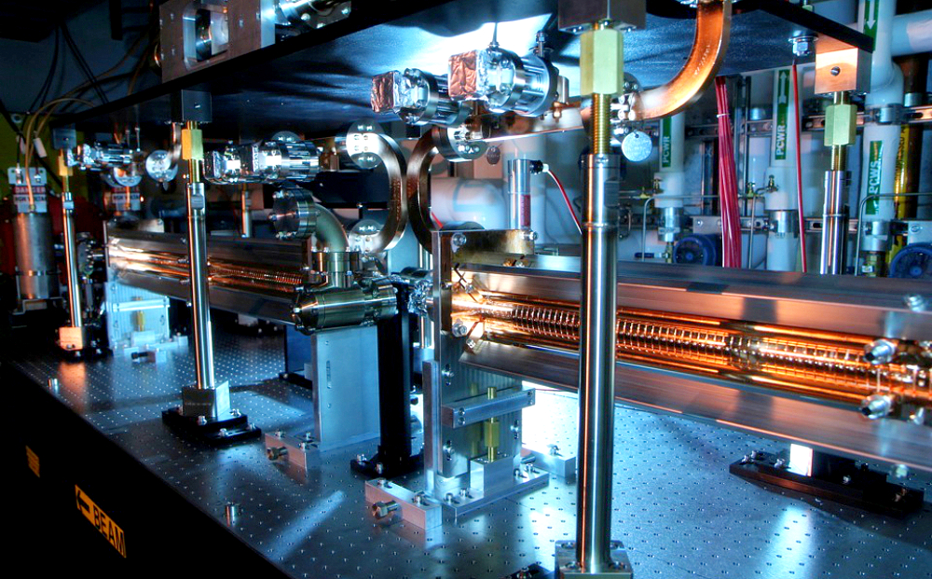
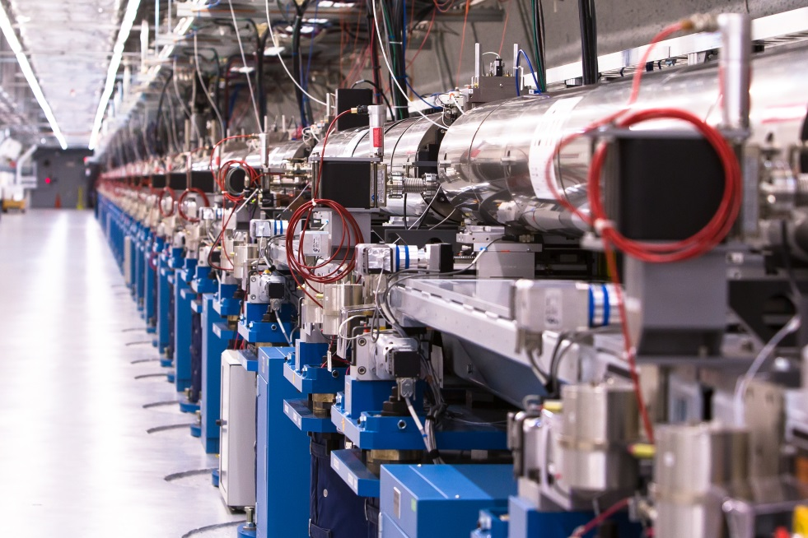
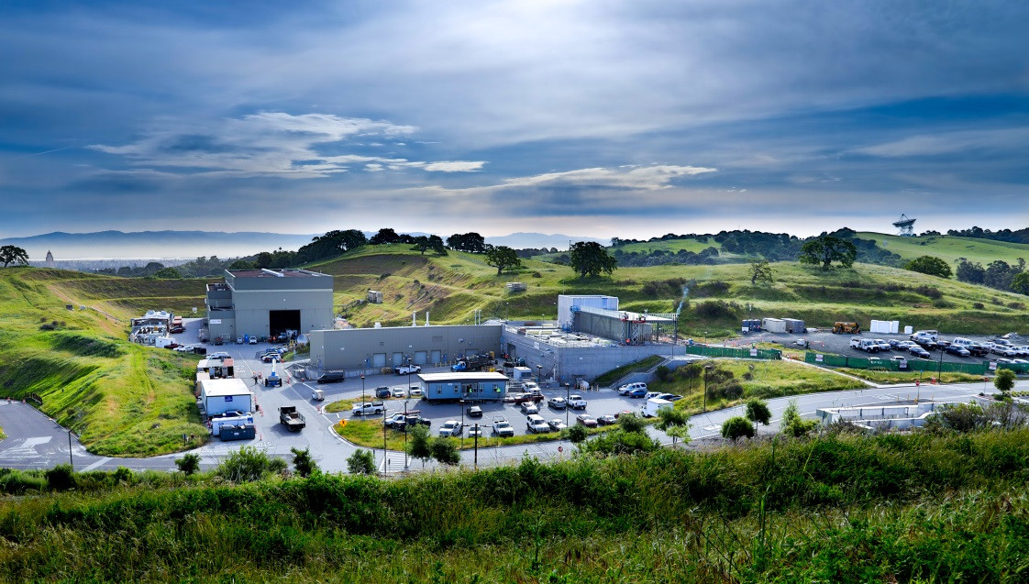
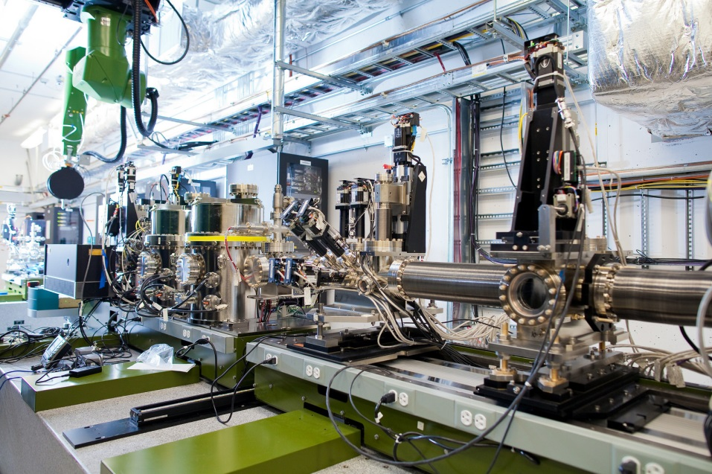
Running the LCLS FEL
XTCAV
UNDULATOR
Experimental Halls NEH/FEH
X-RAY PUMP-PROBE (XPP)

Slide 9
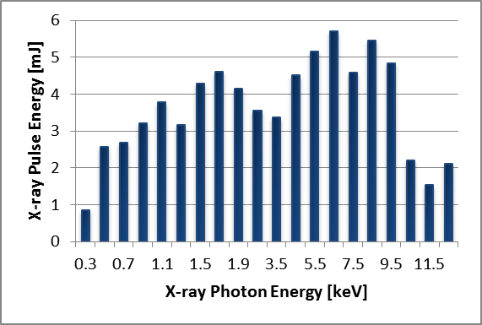
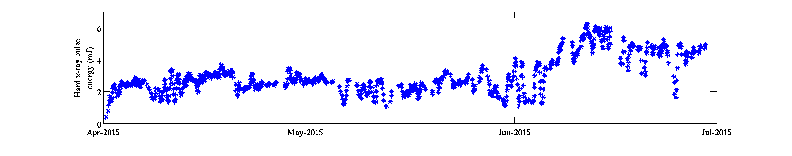
KPI – Pulse Energy and Energy Reach
Original LCLS design
envelope
Routine pulse energy approximately doubled in last 3 years.
Many small improvements, with a step-function due to ‘Horn-Cutting’
270 eV
12.8 keV
‘Horn-Cutting’ flat energy profile of electron bunch leads to improved matching of electron-bunch / lattice → improved beam transport and emittance preservation.
HXR gas detector history
Started collimation
5 - 6 mJ
Number of photons is key for most experiments → key for machine performance. Provides overhead for advanced techniques.

Slide 10
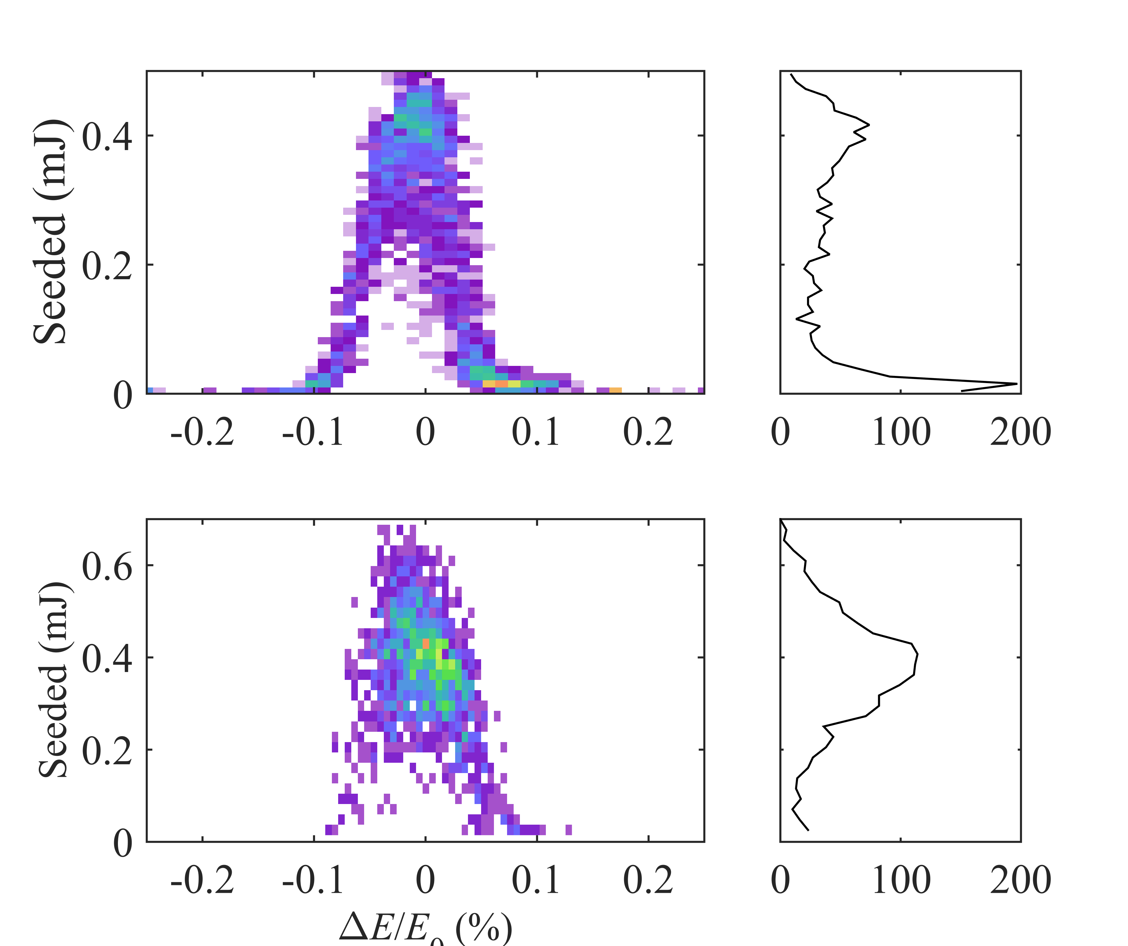
KPI – Energy Stability – Substantial Improvement Achieved
Energy stability has been a focus to address efficiency of monochromatic beam delivery – Seeded beams & Monochromator applications.
Goal: Energy jitter < 1/2 SASE bandwidth
Unoptimized System
RF Station improvements
Optimization of Linac Phasing
/ Configuration
Pre 2012
2012-2013
2014 - Present
High Power RF System Optimization:
Klystron Complement Optimization
“Best candidate” selection
Thyratron Instability Reduction
Implement Modulator PFN improvements
Seeding acceptance,
then and now.
50% → > 80%
Energy stability improvements accomplished → now in maintenance mode

Slide 11
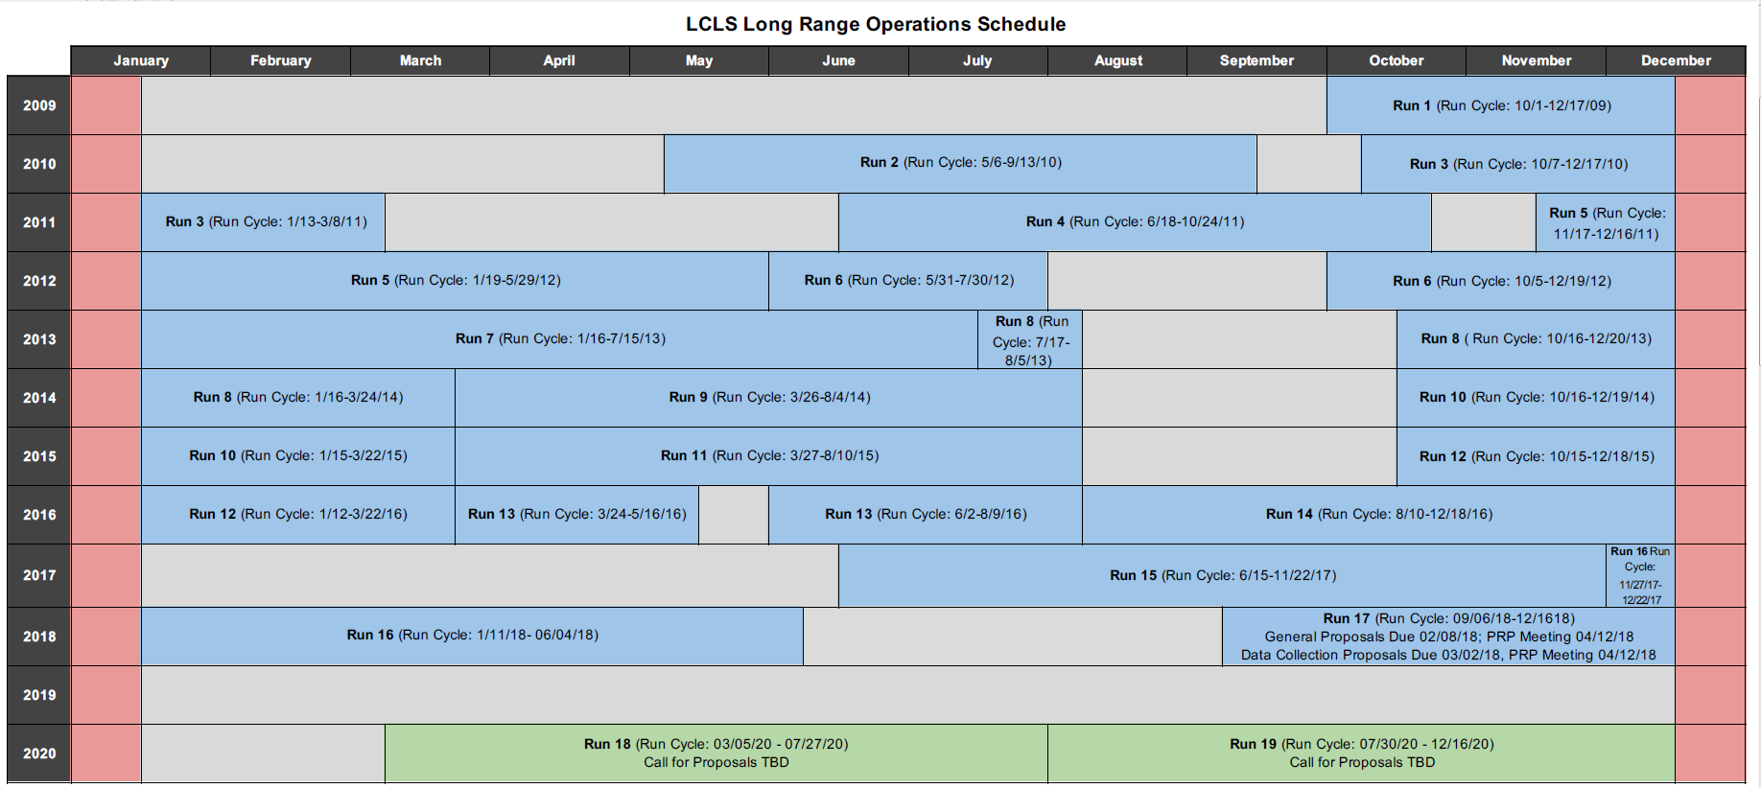
LCLS Run Schedule
Operation as a user facility since 2009, 17 Runs
→ 4500 – 5000 hours per year.

Slide 12
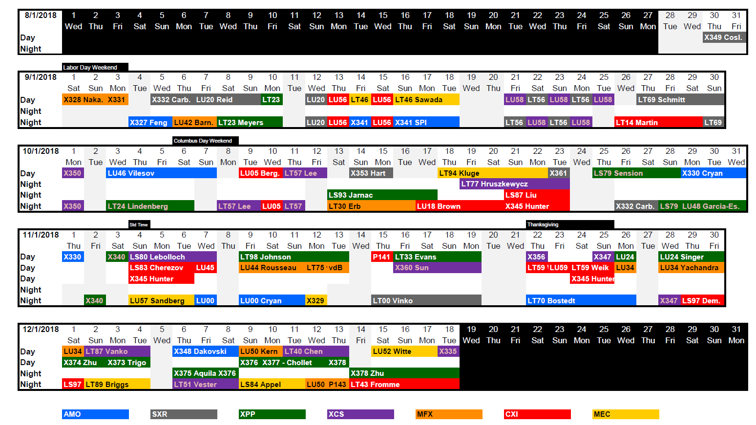
Typical Run Schedule
Operation of 2 (+) experiments alternating on 12 hour schedule. Additional experiments in parallel with multiplexed beams.

Slide 13
When we are not running for the user program …
1-2 days per week → ACC Physics, Maintenance and Setup
Table summarizes Number of Shifts per Run
Machine Development Program
Run # | Start Date | End Date | FEL Maint. | ACC Setup | X-Ray Setup | Capability | Beam Quality | Reproducibility | Beam Stability | Photon Dev. | Other
8 | 11/20/13 | 3/26/14 | 25 | 22 | 7 | 22 | 12 | 3 | 0 | 9 | 0
9 | 3/31/14 | 8/4/14 | 15 | 24 | 8 | 26 | 17 | 0 | 1 | 8 | 1
10 | 9/16/14 | 3/26/15 | 28 | 28 | 9 | 13 | 11 | 2 | 0 | 8 | 1
11 | 4/1/15 | 8/7/15 | 15 | 24 | 10 | 25 | 16 | 2 | 0 | 8 | 0
12 | 9/21/15 | 3/22/16 | 46 | 16 | 12 | 15 | 4 | 0 | 1 | 6 | 0
13 | 3/23/16 | 8/10/16 | 19 | 13 | 22 | 26 | 8 | 2 | 0 | 2 | 8
14 | 8/11/16 | 12/19/16 | 24 | 11 | 20 | 20 | 22 | 3 | 0 | 0 | 0
Less time spent on ACC setup for experiments
More time spent on Instrument setup due to the increased number of experiments
Largest fraction of available development time is allocated to extend FEL capabilities

Slide 14
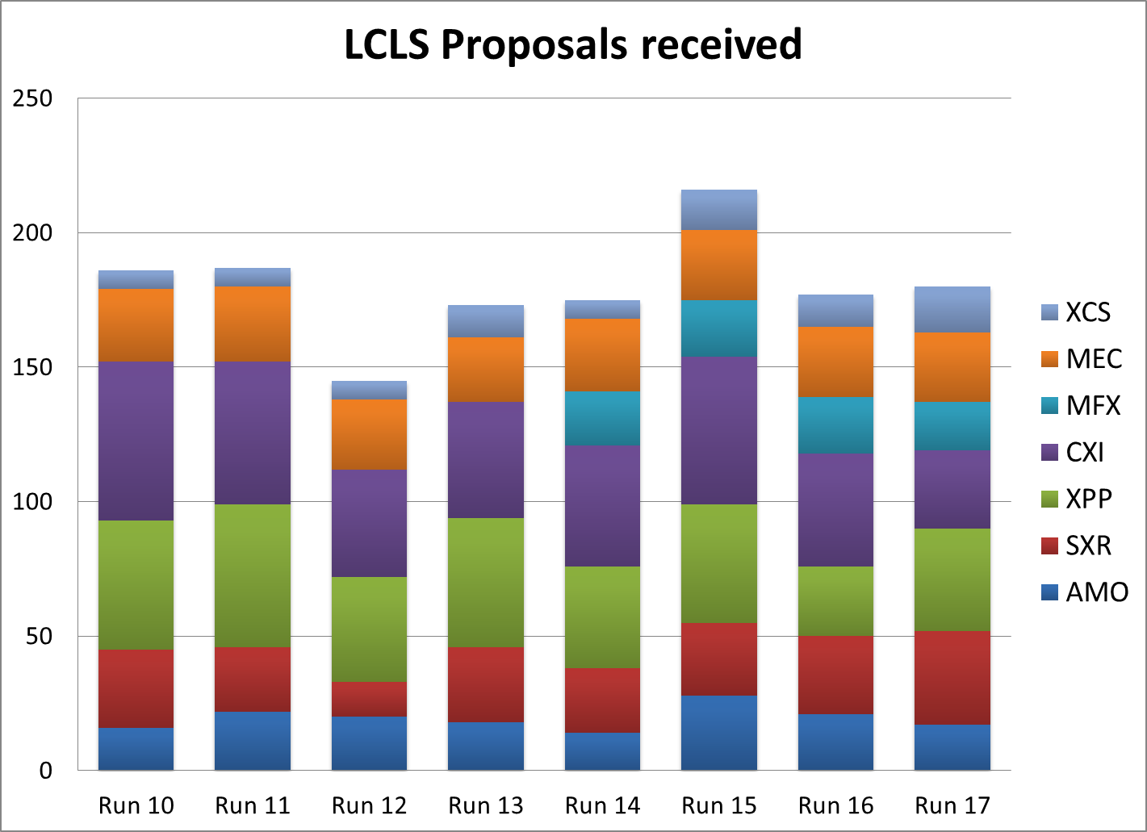
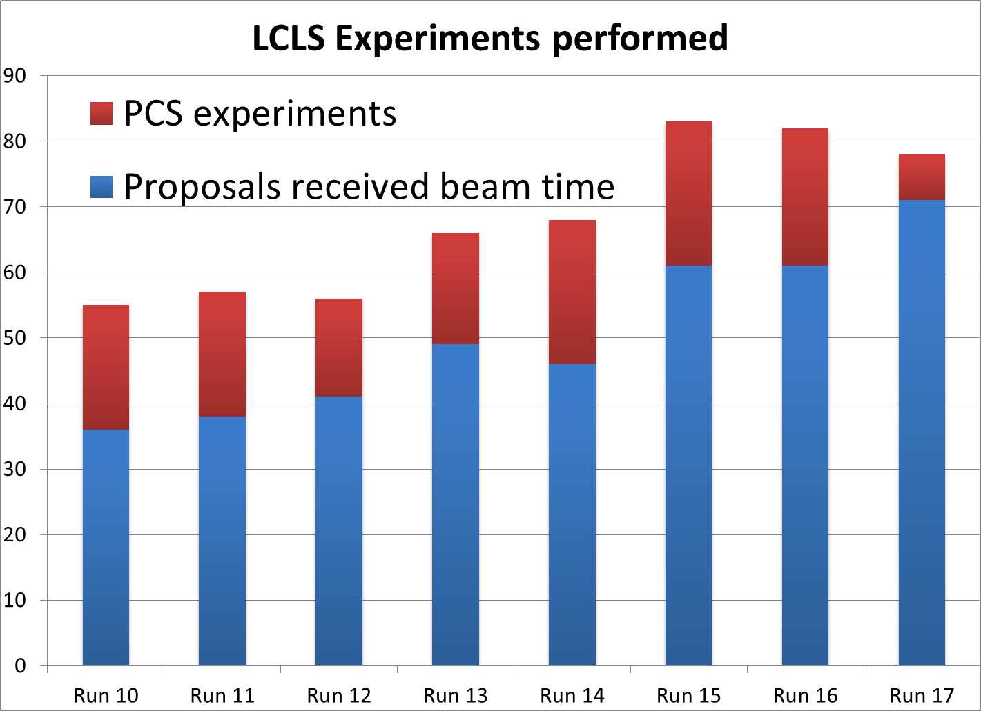
LCLS Proposal Statistics
The level of demand continues to far exceed supply.
Of ~ 150-200 Proposals per run, only 20-25% achieve success.
Capacity limited!
14

Slide 15
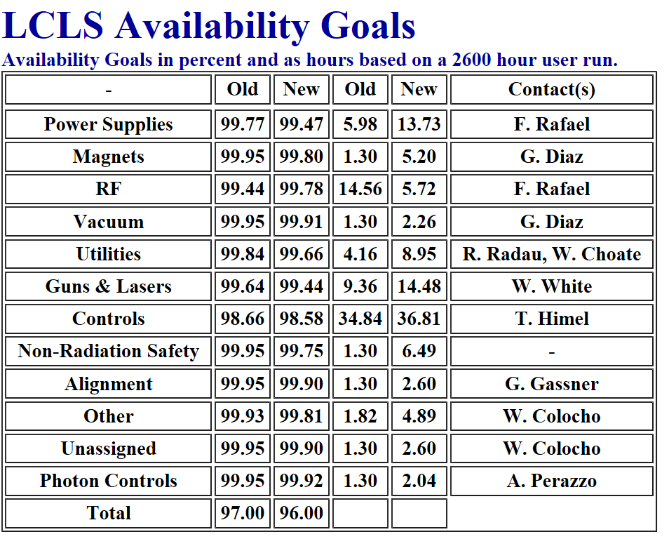
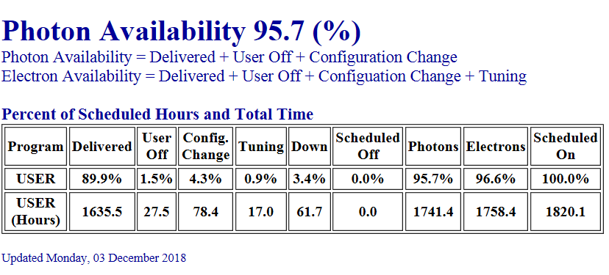
Accelerator / FEL Availability Management
Reported metric is photon beam availability at the transport shutter to x-ray instruments
‘Mission Readiness’ program addressed obsolescence issues for the ~ 60 year old LCLS accelerator systems
Semi automated system for availability tracking.
Downtime budget is assigned to each subsystem.
Availability Statistics (MTBF, MTTR) guide decisions for maintenance and repair.
Largest impact: Water, Fire, Electricity

Slide 16
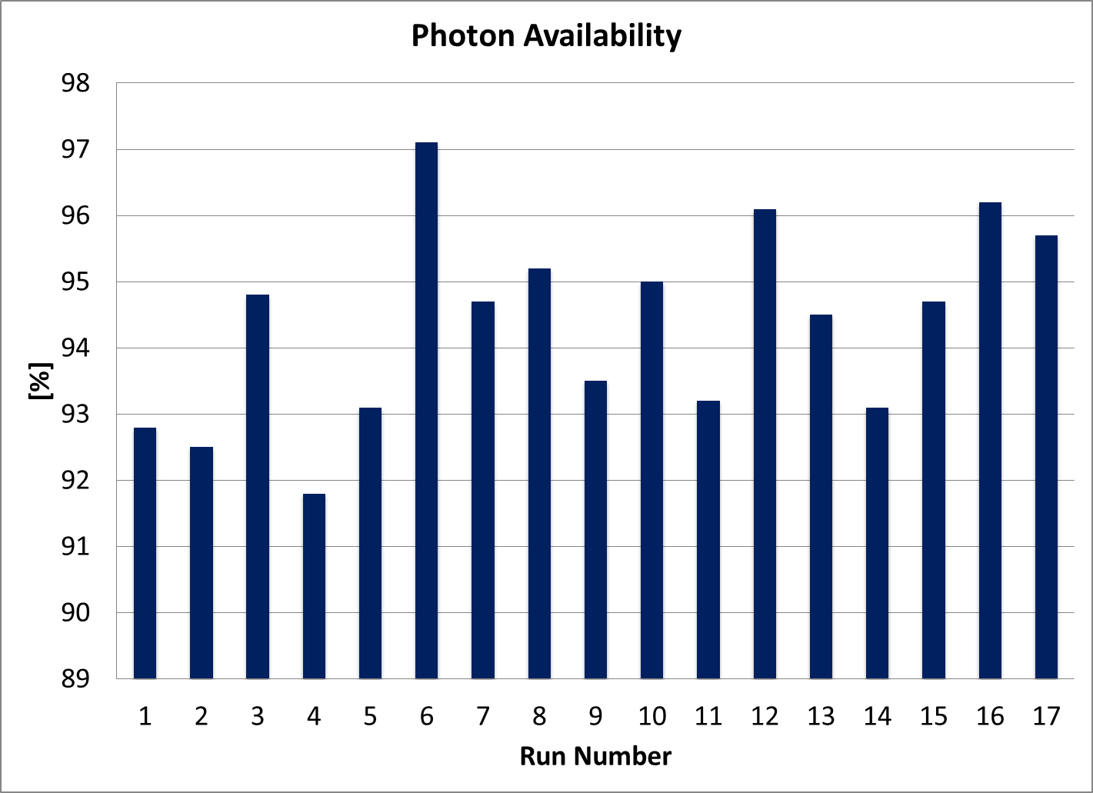
History of LCLS Photon Beam Availability
Reported metric is photon beam availability at the transport shutter to x-ray instruments
Electron availability typically ~ 1% higher
‘Mission Readiness’ program addressed obsolescence issues for the ~ 60 year old LCLS accelerator systems
LCLS internal goal
Goal set by funding agency
Downtimes measured in hours can have a disastrous impact on FEL user experiments. This is the key difference compared to a typical HEP experiment that can last many months.

Slide 17
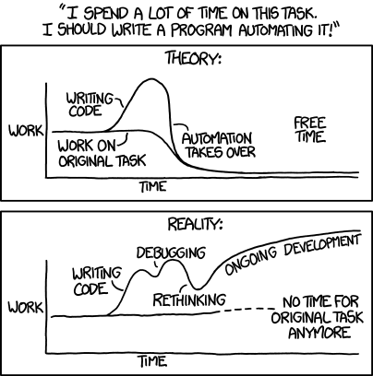
Reduction of Accelerator Tuning Time
Standard tuning tasks over 9 machine setups from 10/21/2015 – 01/25/2016 (11 hours total)
Reduce tuning time by 50%,
Task automation leads to ~ 200 h / a gain of time.
Focus on high gain tasks.
2016 data from Peter Schuh

Slide 18
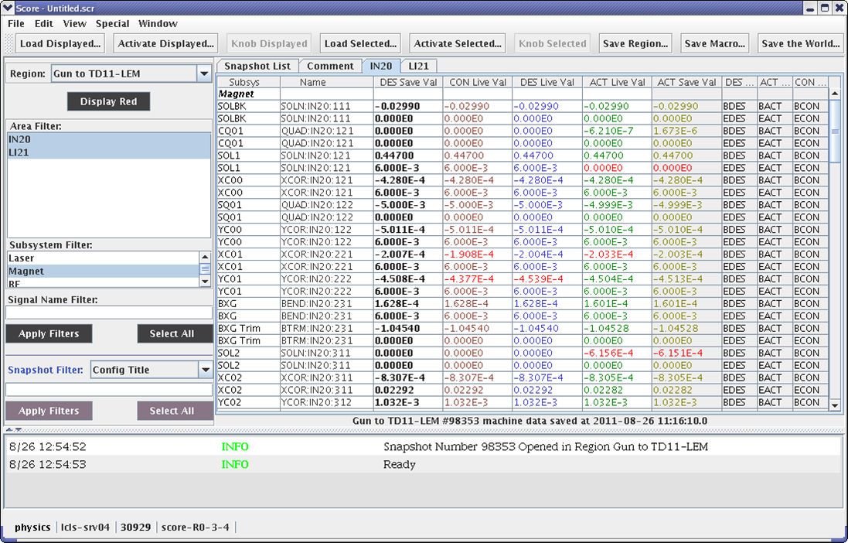
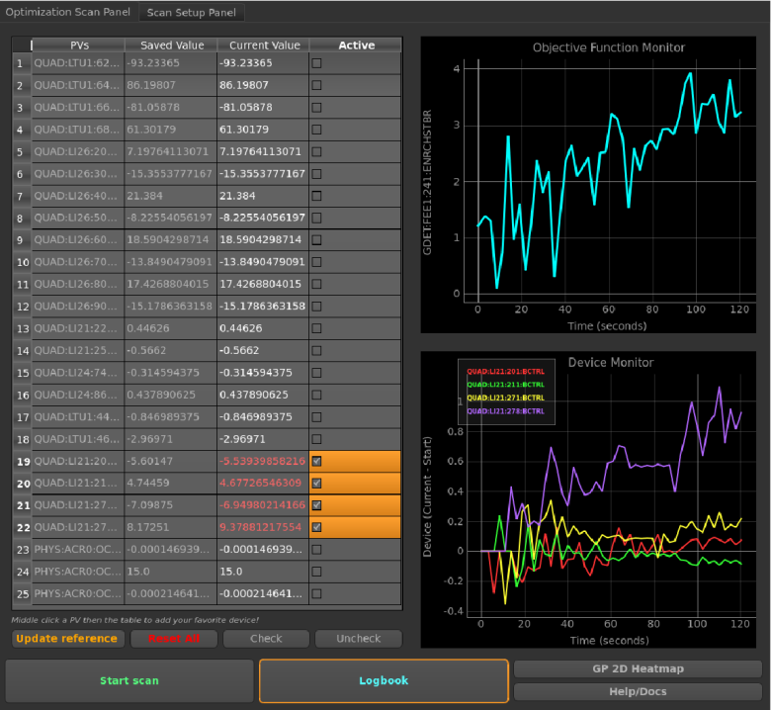
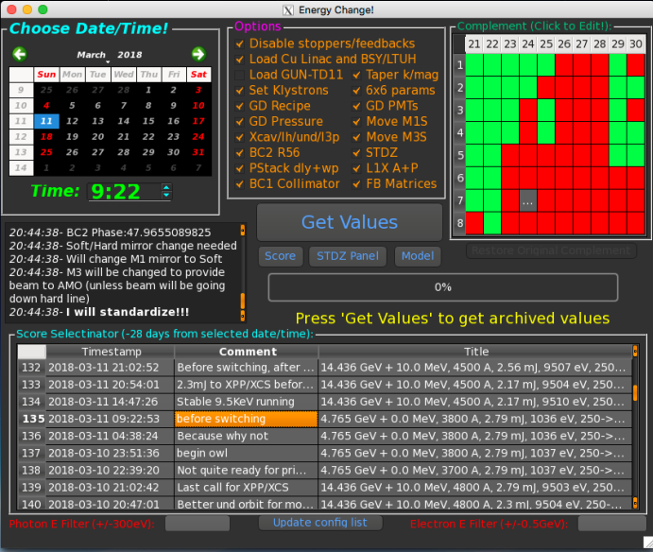
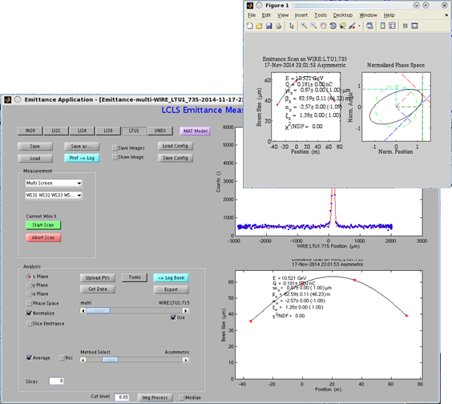
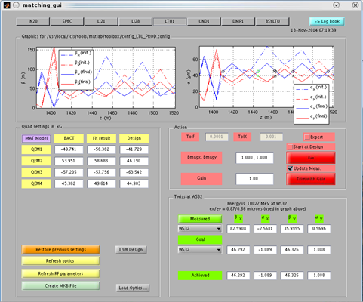
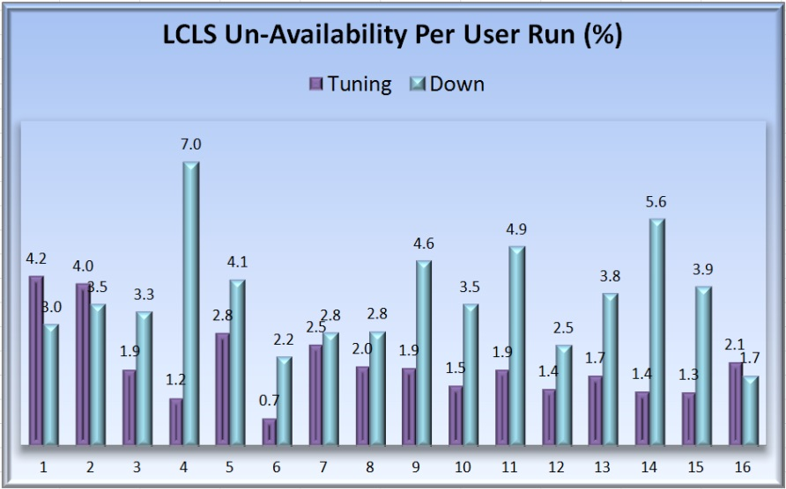
Automation of Accelerator Tuning
Tools for routine/daily machine configuration
Automated multi-parameter FEL optimization
Accelerator config database (SCORE)
Much more complex beam delivery w/o increase in tuning time.
Analytical tuning tools (matching, taper, etc)
Next step is to exploit Machine Learning → Emerging at SLAC/LCLS with support from Stanford University Computer Science Department.

Slide 19
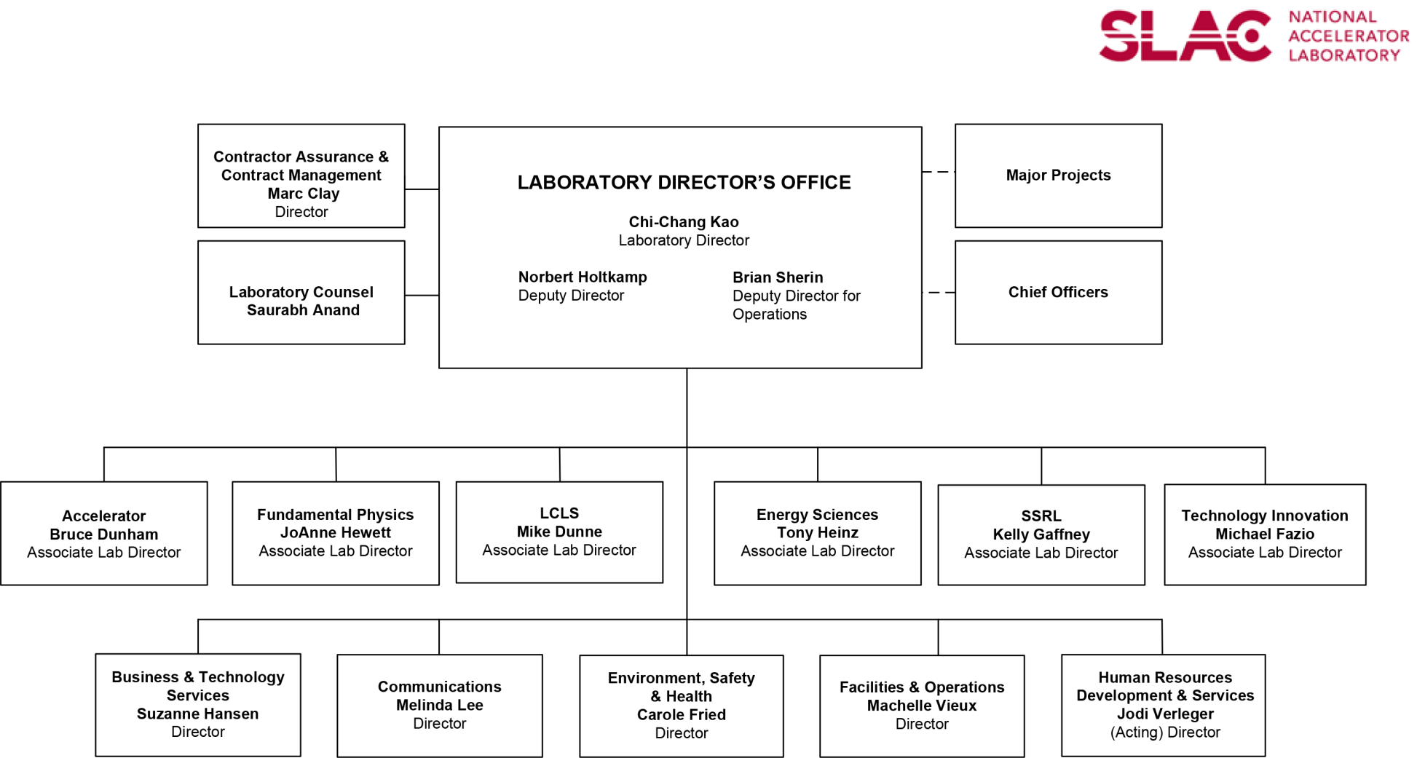
The Organization that supports the operation and development of LCLS
Large scale facilities are operated by complex organizations
Nearly every organization is involved in operating LCLS.
Each organization is at least 3 layers deep.
In addition, there are partner labs, e.g. LBNL. FNAL, ANL, JLAB
The key to make this organization work is to communicate efficiently.

Slide 20

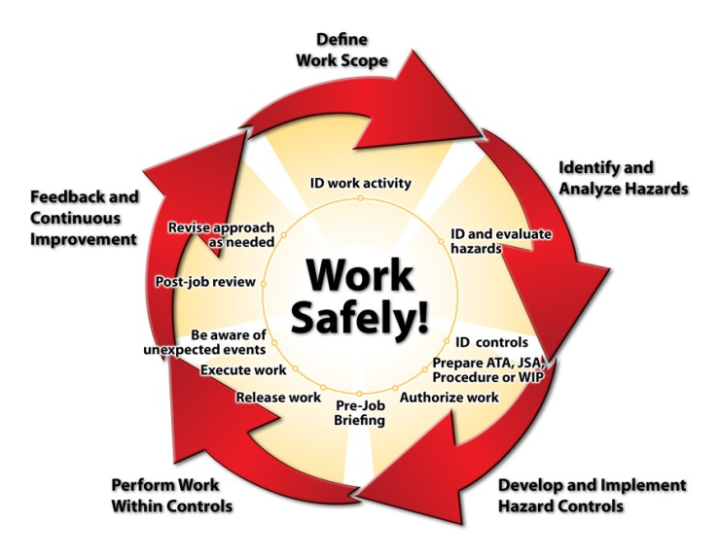
Working on Accelerator Systems - Work Planning and Control
‘CATER’ → Work and task management system
Lifecycle from Task creation → Resolution
Integrated Safety Analysis defines controls
Coordination of Operations, Maintenance
and Development
Scope, Priorities, Schedules
Coordination according to Management Level:
→ Strategic to Tactical
Laboratory Management Team
  Directorate level coordination (SMM)
    Division and Cross Division level
      Work Group Coordination (Department level)
Daily operations and maintenance meeting
Machine Development planning meetings
  programmatic and task planning
Division and Department head level coordination meetings including ‘cross directorate’.
  Management & Communication ensures effective work planning. Safety has highest priority.

Slide 21
Capability Development to support Users/Science program
Acc Science
Science Needs
FEL Capabilities
Science Program drives Accelerator and x-ray systems development
Includes exploratory Development.
Science needs and accelerator development often form a feedback loop.

Slide 22

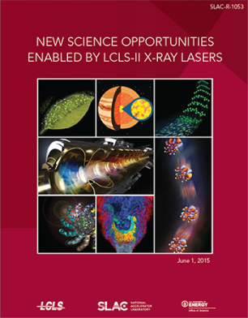
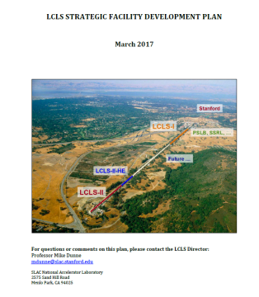
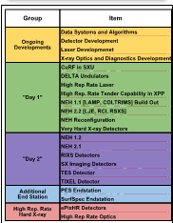
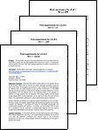

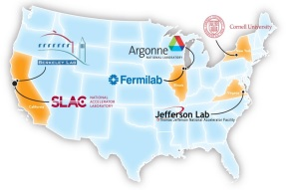
Top-level process used to define our plan of action for LCLS facilities (includes LCLS-I,II, HE)
Details on LCLS website:
Science Drivers
New instrument designs
First Experiments documents
Current Capabilities
Science Opportunities
Facilitiy Response
Prioritized Plan
First
Experiments
LCLS-II
Project
  Our current focus: optimizing the delivery plan for Early Science,
  consistent with available resources (people, $, time)

Slide 23
Capability Development to support Users/Science program
Seeded Beams (SXRSS, HXRSS)
  Self seeding in the soft and hard energy range
  (<2 kev up to ~ 10 keV)
Polarized x-rays → 99% circularly polarized
  DELTA undulator
Sub-femtosecond pulses in the soft and hard energy range
  XLEAP technique (SXR)
  Nonlinear Compression (HXR)
Ultrashort pulse length measurement
  XTCAV – electron bunch length (few femtoseconds)
  angular streaking of x-rays (sub femtoseconds)
Multi-bunch beams → large parameter space
  Injector laser based
  ‘Fresh slice’ technique
All capabilities will be duplicated and upgraded for LCLS – II. This is part of our plan to optimize capabilities and support LCLS-II science.
SXRSS-II
HXRSS-II
DELTA-II
XLEAP-II
XTCAV-II

Slide 24
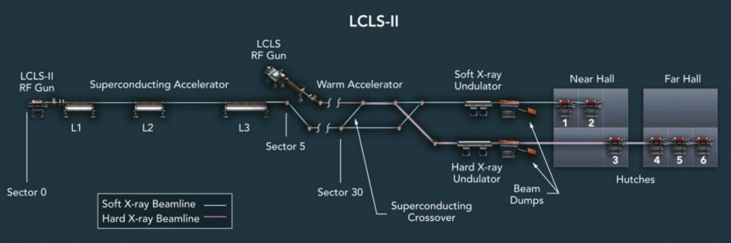
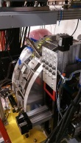
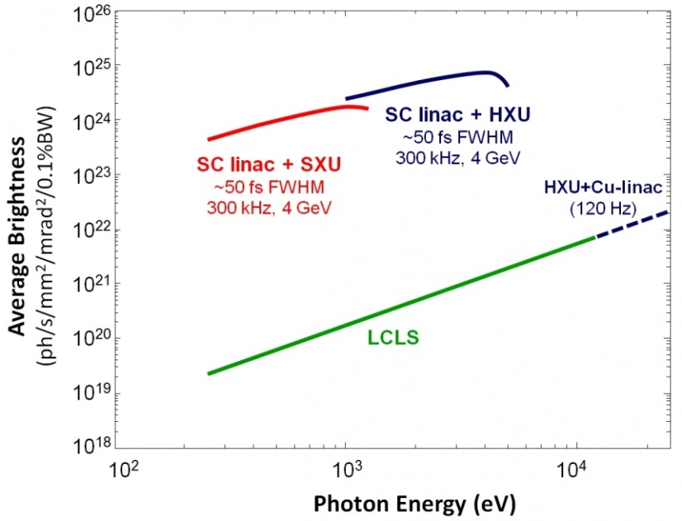
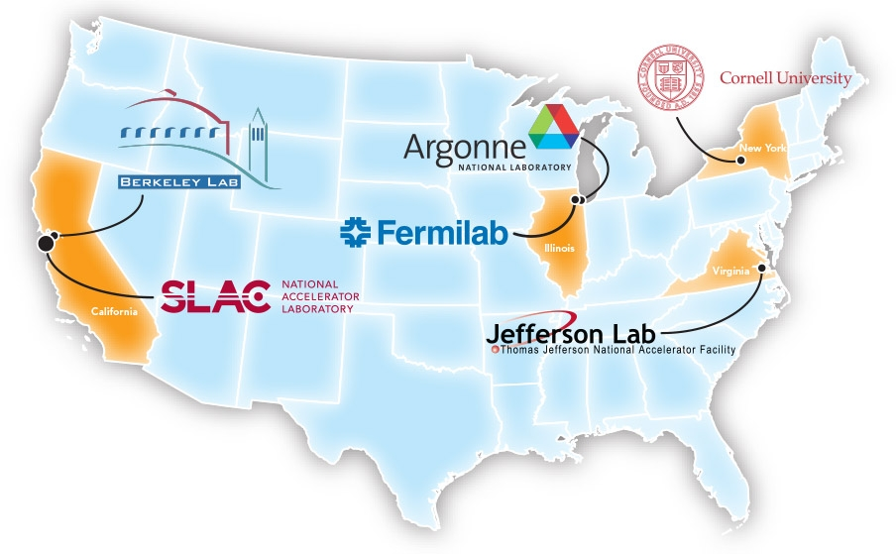
LCLS-II FEL Systems
3 additional instruments are planned for a total of 9.
✓
7, 8, 9
Additional instruments are planned for a total of 10.

Slide 25
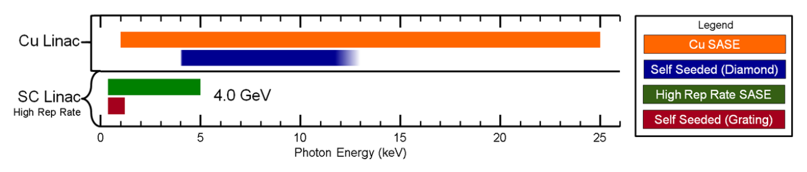
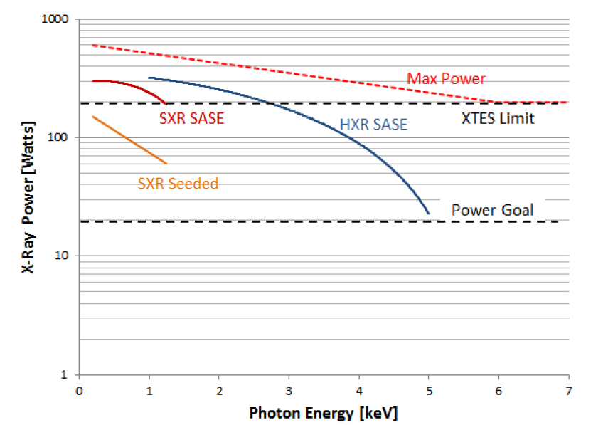
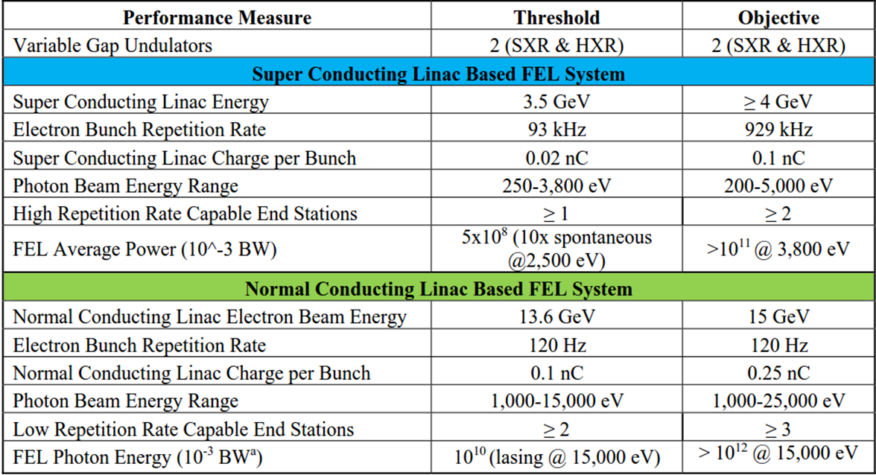
LCLS-II Key Parameters

Slide 26
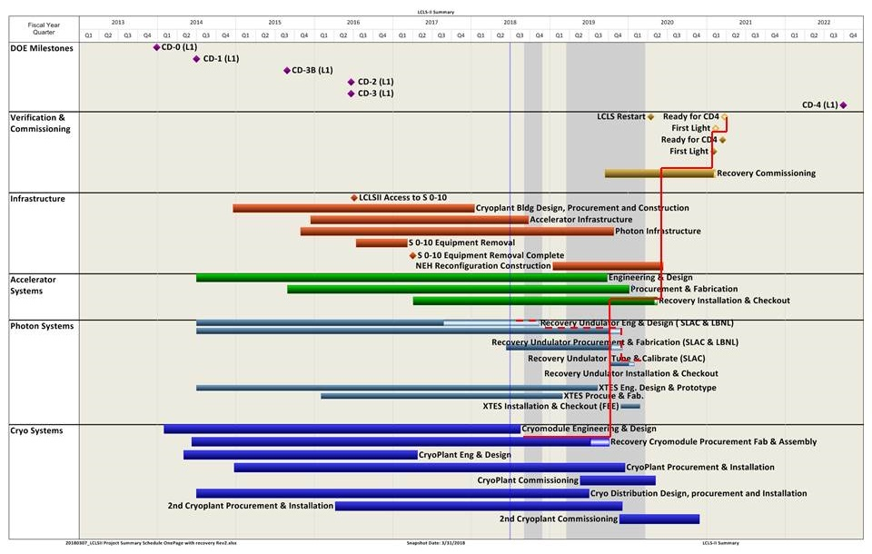
LCLS-II Project Schedule
We are here
“Ready for CD-4”
Q1FY2021
Restart user ops in March 2020.

Slide 27
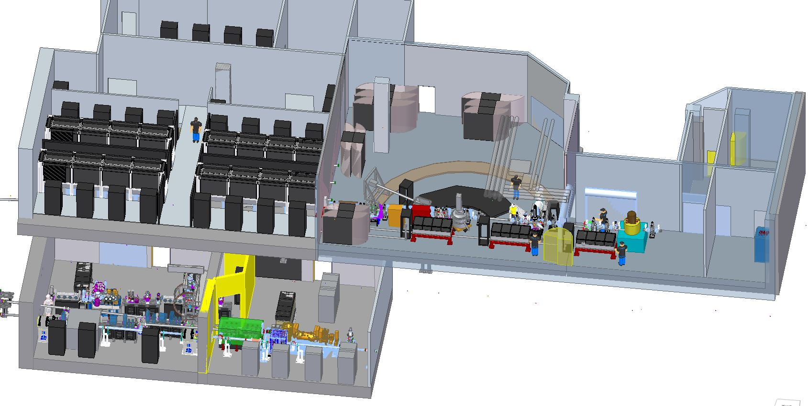
Near Experimental Hall extension for LCLS-II
New laser hall
Instrument development program for LCLS-II
NEH 1.2 (TXI) (2 XFEL beams)
Tender X-ray Instrument
400 – 7000 eV
NEH 2.2 (RIXS / MMI)
250 – 1350 eV
RIXS endstation (30,000 resolving power)
NEH 1.1 (TMO)
High Flux Soft X-ray
250 – 2000 eV
XPP modified for high rep-rate “tender X-ray” operation
  Extension of x-ray instrumentation in parallel with LCLS-II accelerator & FEL development.

Slide 28
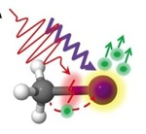
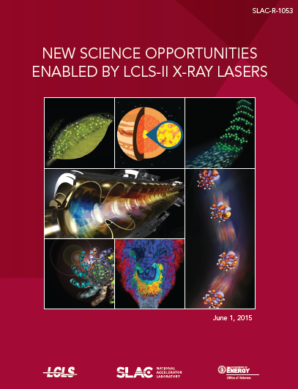
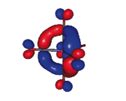
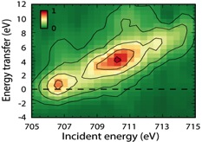
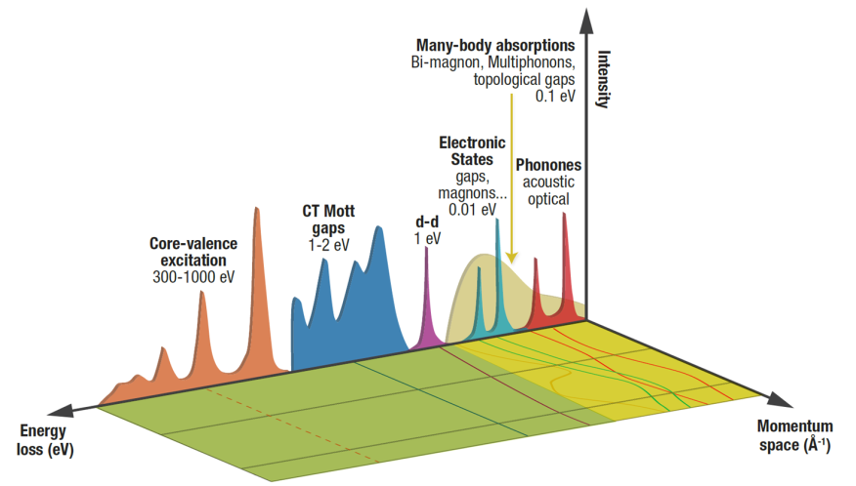
Science Enabled by LCLS-II High Repetition Rate
- element-specific electronic structure & dynamics -
Nanoscale Materials Dynamics, Heterogeneity and Fluctuations
Fundamental Dynamics of Energy and Charge
Catalysis and Photo-catalysis
Emergent Phenomena in Quantum Materials
Revealing Biological Function in Real Time
Matter in Extreme Environments
Δt = 350 fs
>200 contributors, 2015
Vast range of plans and opportunities,
Review LCLS website for detailed information.

Slide 29



LCLS-II Cryomodules are arriving at SLAC!
Transportation problems occurred → vacuum leak due to failed bellows → fixed.
  Installation of Cryomodules is about to begin.

Slide 30





Transformation of the undulator system fixed → variable gap for dedicated SXR and HXR
Existing fixed gap LCLS Undulators
Energy tuning range using undulator gap
Dedicated variable gap undulators for SXR and HXR

Slide 31
LCLS-II - Challenges for Performance and Reliability
SCRF Technology
    SCRF infrastructure including test facilities to support LCLS-II and beyond
    Cryomodule Maintenance
    SCRF R&D program (e.g. SCRF gun development)
    Plans are under development
    Discussion with funding agency has begun
Particle Free Systems
    Training, Procedures
    Reliance on partner labs and SCRF expertise worldwide
Efficient operation of variable gap undulators
    develop gap energy scanning systems
Coordination with partner labs across the country
    Learn from experience of other international projects
Very little experience with SCRF at SLAC.

Slide 32


LCLS-II Commissioning – Conservative Ramp of Power
  Concern: Undulator Radiation Damage
  Mitigation plan
  Start commissioning with Cu-linac beam
  Stepwise ramp of beam power during commissioning
  Beam optimized at tune-up dump upstream of the undulator
  Beam loss monitor and BPM interlocks will be required
  Measure dose rates in real time on each undulator and beam current administratively controlled to stay below defined dose rate threshold
  Developing real time magnetic measurement monitoring system that measures magnetic field as the gap is changed
EuXFEL data
Initial dose rate about 700 times higher than LCLS-I because of insufficient machine protection systems.
Slow ramp up of beam power to mitigate undulator radiation damage.

Slide 33

Beyond LCLS-II → HE Upgrades to reach 8 GeV (e⁻) /12.8 keV (γ)
Upgrading the LCLS-II superconducting linac to 8 GeV with nominal bunch frequency of 1 MHz to allow programmable FEL X-ray pulses up to 1 MHz repetition rate.
Installing a new cryogenic distribution box and transfer line between the cryoplant and the new L4 linac.
Addition of a pulsed low-energy extraction point in the superconducting linac at 3.8 GeV to allow quasi-independent operation of the soft-X-ray and hard-X-ray programs.
Use of an existing transport line to bypass the midsection of the SLAC linac and the LCLS linac along with installation of a new dump the at the end of the transport line.
Installation of a Hard X-ray Self Seeding capability in the hard X-ray undulator capable of operating at high repetition rate.

Slide 34









FACET-II: Premier R&D facility for PWFA
FACET Highlights:
  Apr. 2012 - Apr. 2016 Experimental program
  High impact results on efficient acceleration of e- and e+ in plasma
  Four researchers became professors
FACET-II Timeline:
  Nov. 2013, FACET-II proposal, Comparative review
  CD-0 Aug., 2015
  CD-1 Review Oct., 2015
  CD-2/3A Aug. 2016
  Commissioning. Q4FY19
FACET-II R&D Goals:
  High brightness beam generation, preservation, characterization
  e⁺ acceleration in e⁻ driven wakes
  Staging challenges with witness injector
  Generation of high flux gamma radiation
FACET-II will operate as a National User Facility
with experimental program between 2019 and 2026

Slide 35
Conclusions – Concepts for Performance and Reliability
Large facilities are run with large organizations
  Within facility
  National and international collaborations
Complex work environment → multi-programmatic environment.
Communication and management of human capital is critical.
Balance of R&D and operation is important to stay competitive.
Scientific goals should drive innovation. Allow exploratory research.
Reduce repetitiveness → automation and emerging tools of ML
Management of availability should be done professionally and should match programmatic needs.

Slide 36

Thank you for your Attention!

