Slide 1
GSI Contribution to CR beam diagnostics and common questions
O. Chorniy

Slide 2
Outlook
Future contracts :
400 mm diagnostics devices (SFRS, pBar, HEBT):
3 BPM pickups 400x400 and 3 BPM pickups 400x200
2 BPM LNA (amplifiers for pBar BPMs)
4 Screens vacuum chamber
Flanges modified to DN 400 CF
Status of “GSI” components:
CCC
Schottky
BTF
DAQ:
BPM
FCT
DCT
BLM
Screens
PLC control
Working questions:
Clarification drive type for beam stopper: pneumatic or stepper motor drive
BINP feedback and commitment on PDC procurement (update of motor number! 5x 4 motors for scrapers + 2x 1 for stoppers?)
Clarification In-Kind Slovenia: Pneumatic drives (number and type) to be built by Vacutech
...

Slide 3
Future Contracts

Slide 4
Table of known demand for 400 mm diagnostics (BPMs and Screens)
A. Reiter | 12th September 2018
Subproject | Det. type | No. of devices | PSP Code | Component | Aperture | Comments
 |  |  |  |  | (mm x mm)
SFRS | BPM | 1 | 2.4.6.1.5 | Pick-up | 400 x 400 | FAIR
 |  |  | 2.4.7.1.12.1 | vacuum chamber |  | separate PSP, assigned already to BINP
pBar Diagnostics | BPM | 1 | 2.9.6.2.1.1 | Pick-up | 400 x 400 | GSI in-kind
 |  | 1 | 2.9.6.2.2 | vacuum chamber |  | GSI in-kind
 | BPM | 2 | 2.9.6.2.1.1 | Pick-up | 400 x 200 | GSI in-kind
 |  | 2 | 2.9.6.2.1.2 | Pre-Amplifier |  | GSI in-kind consistency to other TCR1 BPMs
 |  | 2 | 2.9.6.2.2 | vacuum chamber |  | GSI in-kind
 | SCR | 2 | 2.9.6.3.2.2 | vacuum chamber | 450 x 450 as TCR1 Type 1 | GSI in-kind
 |  | 2 | 2.9.6.3.2.3 | Mechanics, alignment bridge |  | GSI in-kind , optional
 |  |  | 2.9.6.3.2.3.2 | Pneumatic Drive |  | GSI in-kind, optional
HEBT | BPM | 2 | 2.3.6.4.1.1.1.1 | Pick-up | 1x (400x400) 1x (400x200) | FAIR
 |  | 2 | 2.3.6.4.1.2.1 | vacuum chamber |  | FAIR
 | SCR | 2 | 2.3.6.5.2.2 | vacuum chamber |  | FAIR
 |  | 2 | 2.3.6.5.2.3.0 | Mechanics, alignment bridge |  | FAIR
 |  | 2 | 2.3.6.5.2.3.1 | Pressurized air drive |  | SLO (Tehnodrom)

Slide 5
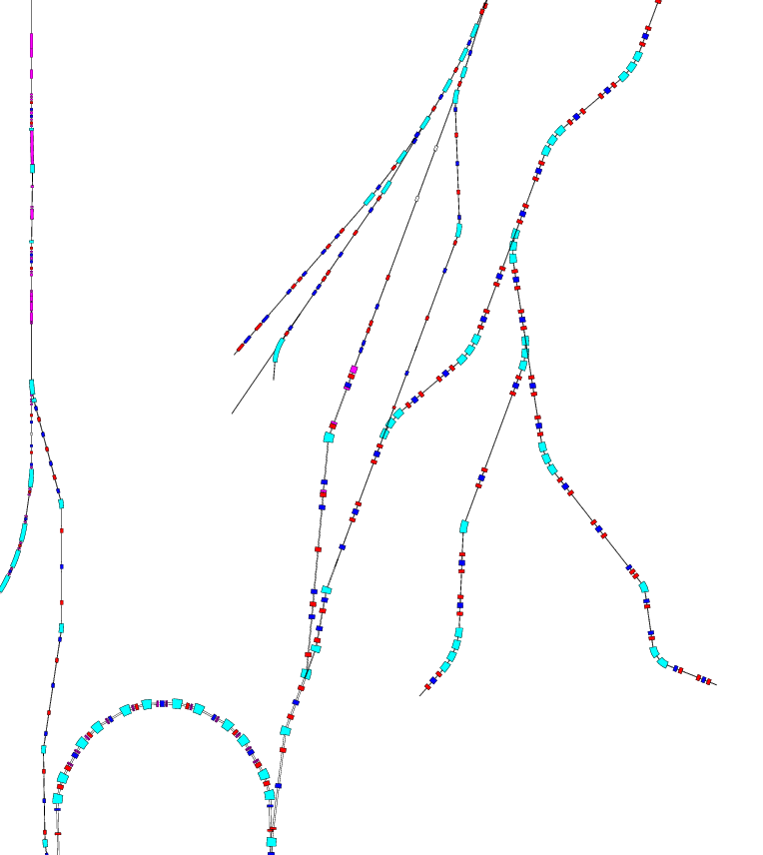
Areas of interest:
pBarSeparator PS01
Last part of SFRS transfer line to CR and following HEBT beam lines FREX and TFC1
pBarSeparator
BPM
SCR + BPM
PS01
SCR + BPM
FREXQS01-03
FRXKH01+KV01
FREXQS04
TFC1
SCR + BPM
SCR + BPM
(+ RT)
TCR1
HEBT

Slide 6
Comments / Remarks on BPMs
SFRS: - 1x BPM with round electrodes (400 mm hor. and vert. aperture)
- No amplifier (see HEBT)
- Special case: vacuum chamber already assigned to Budker institute
- Vacuum flanges: DN 400 CF
- Check: available installation length, suitability of geometry for primary beam (large plate
voltages)!
pBar: - 1x BPM with round electrodes (400 mm hor. and vert. aperture), special BPM in target hall -> no amplifier
- 2x BPM as TCR1 type 1 (400 mm x 200 mm apertures) in separator line PS01
- 2x BPM low-noise pre-amplifier LNA (to keep identical electronics chain for TCR1 beam line: 8 BPMs = 2x pBar + 6x TCR1 = 2x fully equipped Libera Platform B; possible cost reduction: GSI and BINP can combine HW -> 2 fully equipped Libera Hadrons!)
- Vacuum flanges: DN 400 CF
HEBT: - 1x BPM (400 mm x 200 mm aperture, corresponding to magnet aperture)
- 1x BPM (400 mm x 400 mm aperture)
- No amplifiers needed; Hadron HPA will be used as for HEBT BPM system
- Vacuum flanges: DN 400 CF

Slide 7
Working Questions

Slide 8
Component | BINP tasks | GSI tasks | Common tasks
FCT | Organize the procurement: to buy or provide money to FAIR | Procurement of DAQ hardware, Software development. | NO (everything clear)
DCT
BLM | Formal decision: Withdraw the detector or decide on alternative option - to buy from GSI | tbd. for detectors | tbd., probably NO
BPM | Order Libera from Slovenia? Clarify preamp interface to DAQ. | Provide the software for preamp tests ? | Planning when this all will be needed
BTF | Check interfaces to Vacuum systems | Contract preparation | To re-approve the corrected (ITEP and GSI QA modifications) version
Schottky
Screens, BStop | Contact the Slov. concerning pneumatic drives. Clarification drive type for beam stopper: pneumatic or stepper motor drive | Prepare table with PLC elements “pallet” | Engineering drawings approval interaction? Chose the proper PLC configuration for CR systems
Scrapers | Stepper motor controll status? (again, the custom solution PDC is hardly accepted, i.e. it must be ready product from Slovenia, the Programmable Multi-Axis Controller is already bought for CR) |  | PDC (Power Drive Case) procurement Update of motor number! 5x 4 motors for scrapers + 2x 1 for stoppers?)

Slide 9
Status of “GSI” components

Slide 10
DCCT, BLM and FCT DAQ
 | FCT |  | DCCT |  | BLM
 | Hardware | Software | Hardware | Software | Hardware | Software
Design | platform is defined, components under developm. | based on existing SIS18 FCT | defined | ready, formal steps to be clarified | defined | ready, formal steps to be clarified
Prototype | 1st version delivered, tests to be started | programming to be started | delivered and fully operational |  | delivered and tests are ongoing
FDR | next step, low priority at the moment
All systems will be used in SIS18/ESR beatimes during next year/s
All systems are “CR-ready“

Slide 11
Scintillating Screens
 | DAQ |  | PLC for pneumatic drives
 | Hardware | Software | Hardware | Software
Design | Fully operational (for non-rad camera) and used in GSI beam times since a long time |  | In operation at GSI and PLC scheme is under permanent improvement and optimization
Prototype
FDR | DAQ will be checked if it can be applied as is to CR |  | Configuration and Components to be chosen
Example of PLC Siemens components for possible CR prototype
CPU
1 | 6ES7516-3AN00-4AB3 | SIMATIC CPU 1516 PN/DP mit Software
2 | 6EP1334-3BA10 | SITOP PSU200M 10A
3 | 6GK7543-1AX00-0XE0 | Kommunikationsprozessor, CP 1543-1, Industrial Ethernet
IO-Station für 6 Antriebe pro Elektronikraum
1 | 6ES7155-6AU00-0AB0 | SIMATIC ET 200SP Digital PROFINET
2 | 6EP1334-3BA10 | SITOP PSU200M 10A
3 | 6ES7132-6HD00-0BB1 | RQ NO 4x120VDC/230VAC/5A ST
4 | 6ES7193-6BP20-0BB0 | BU-Typ B0, 12 Push-In, 4 AUX
5 | 6ES7131-6BF00-0CA0 | DI 8x24VDC/0,5A HF
6 | 6ES7193-6BP00-0BA0 | BU-Typ A0, 16 Push-In, 2 Einspeisekl. Gebrückt (Digital-/Analog, 24VDC/10A)
Gesamt Netzwerkinfrastruktur für Profinet LOBI ohne Kabel
1 | 6GK5206-2BS00-2AC2 | SCALANCE XC206-2SFP managebarer Layer 2 IE Switch

Slide 12
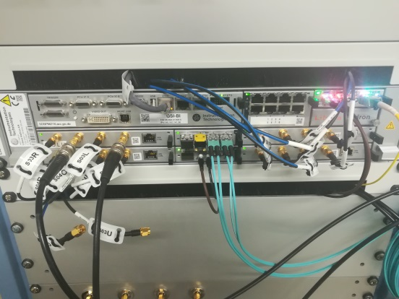
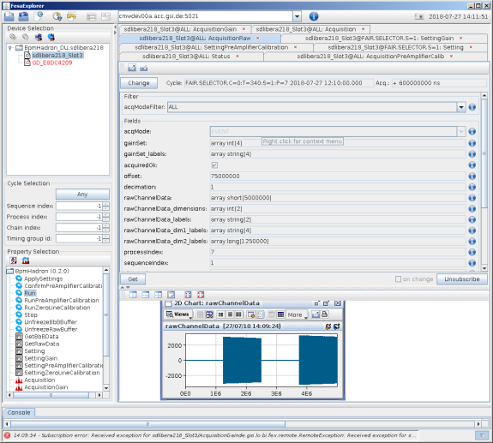
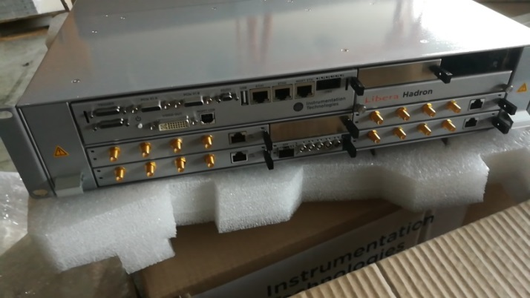
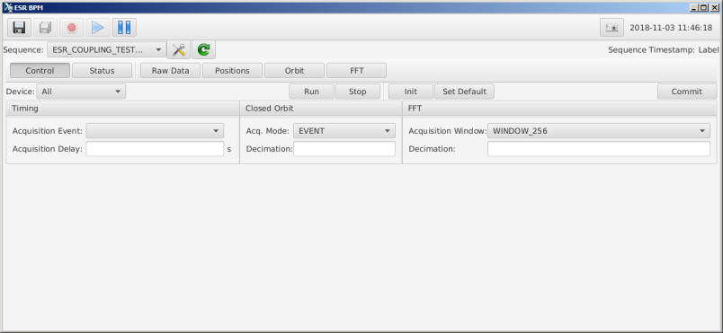
BPM DAQ status
Milestone | Libera Hadron | FTRN receiver | Frontend FESA class | Operational GUI app
Design | x | - | x | -
Prototype | x | - | x | x
FDR | x | - | to be done | -
Shipment | x | to be done |  | -
SatAa | x |  |  | -
SatAb | to be done |  |  | -
System is fully prepared to be used during ESR beam time 2018-2019
FESA class in FESA Explorer
LIBERA Hadron
Control panel of GUI

Slide 13
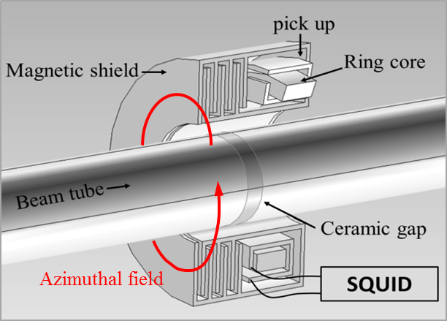
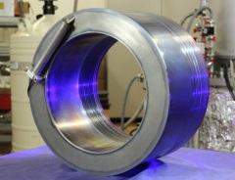
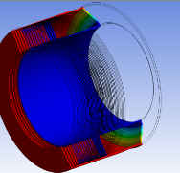
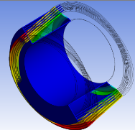
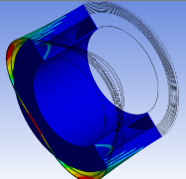
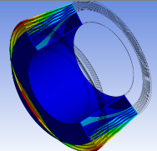
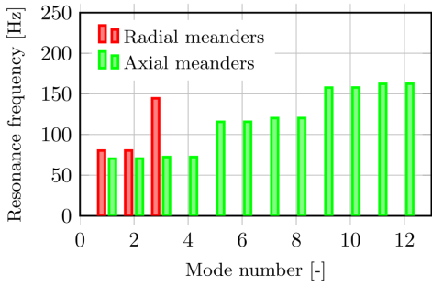
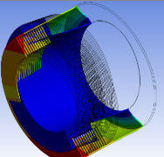
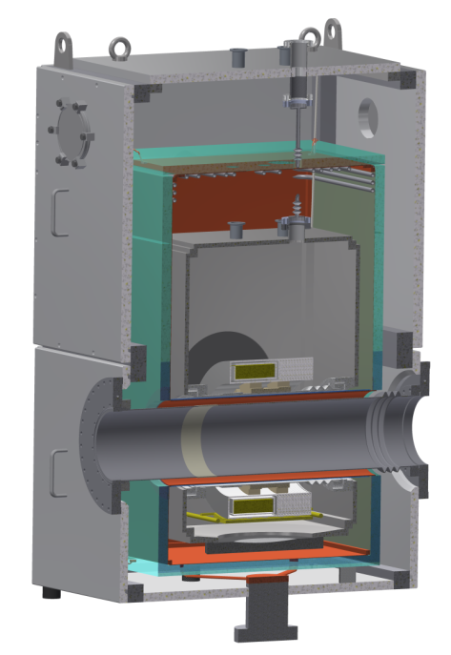
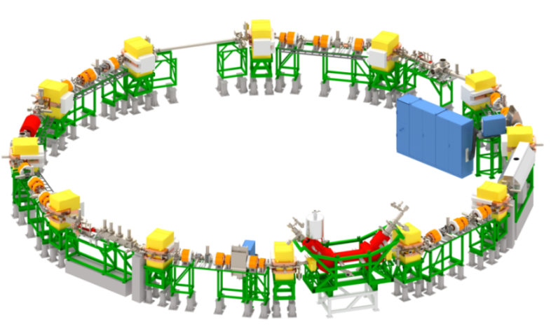
Cryogenic Current Comparator (CCC) Development for nA Beam Measurements
T. Sieber, D. Haider, N. Marsic, M. Schwickert, R. Stolz, T. Stoehlker, V. Tympel et al. / GSI, HI Jena, TUD, FSU and IPHT Jena
CCC Principle
250 mm
Superconducting shield/pickup -> detection of beam azimuthal field with SQUID sensor
CCC-XD Nb detector and shield for 150 mm beam tubes. Tested and ready for operation
Mechanical Eigenmode calculations (ANSYS) for improved geometry of shielding and cryostat
Space (temporary) available for CCC
CCC R&D in CRYRING (start 2019):
Demonstration of cryostat + CCC-XD functionality under UHV conditions
Improvement of system robustness
Improvement of cost efficiency
→ Material tests Pb vs. Nb
Shielding with axial meanders
Pickup without toroid
CCC in CRYRING (2018/2019):
→ tool for commissioning
→ support for exp. program
→ test bench for further development
Design of new UHV cryostat finished, production starts 06/2018

Slide 14
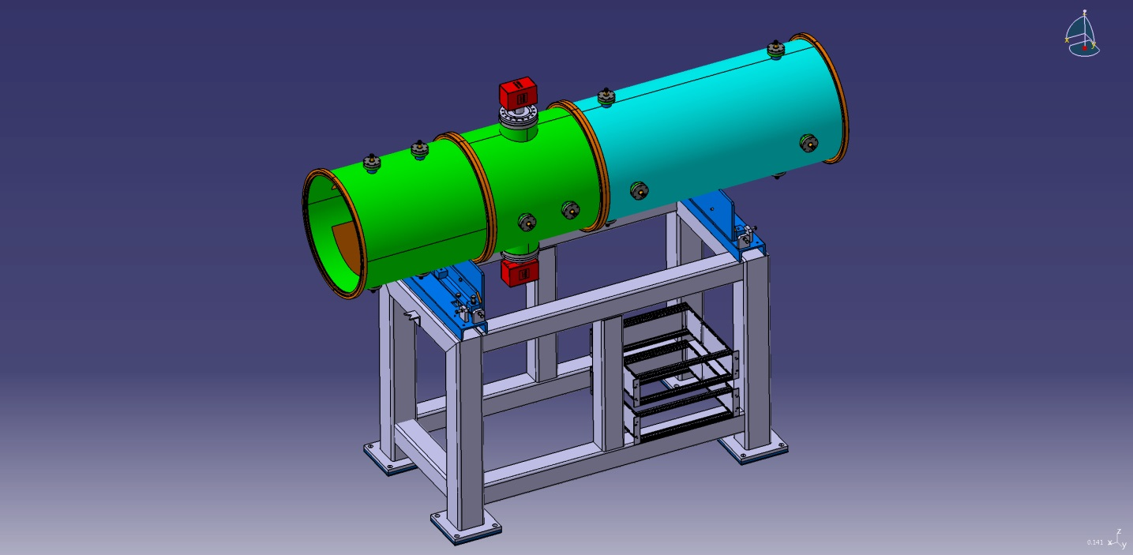
BTF and Schottky
The preliminary model of the CR Kicker (left half with two short vacuum chambers) and CR Shottky (right half with one long vacuum chamber) detectors with a common support.
Schottky
BTF
Status:
Split in delivery of components
DS are actualized (in EDMS)
Official letter with contract under preparation
DS do not bind the Contractor to specific interface:
...Contractor will have to accept the potential impact of possible CR modifications on the Pickup/Kicker design:
change of flange type
reduction of the total length of the Pickup/Kicker
adding of bellows at the ends of assembly
The exact parameters ... will be agreed by the Company and Contractor at CDR stage.

Slide 15
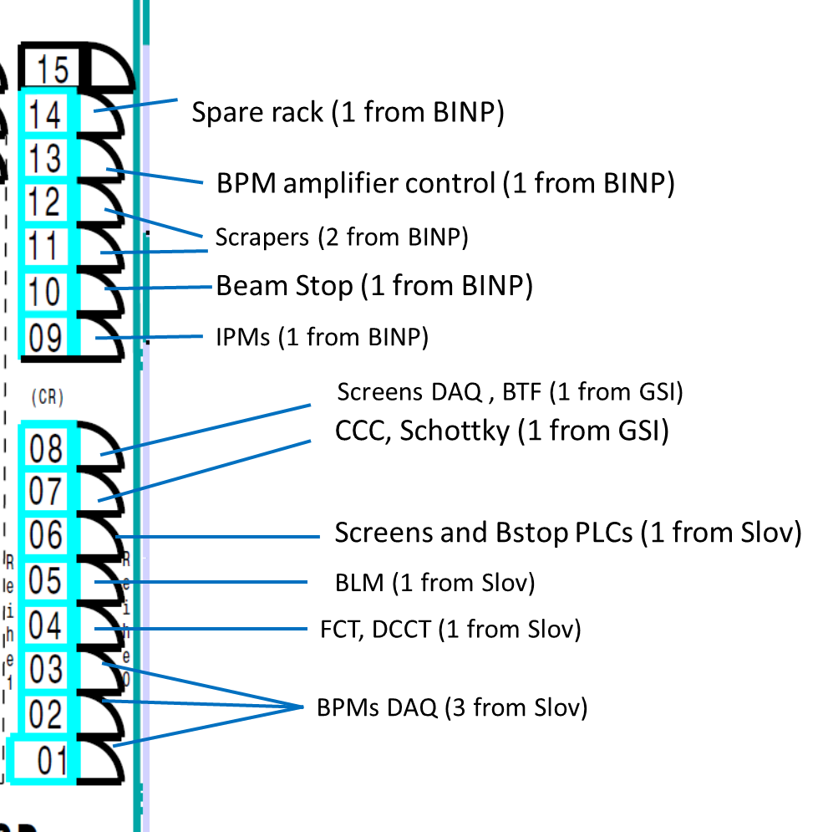
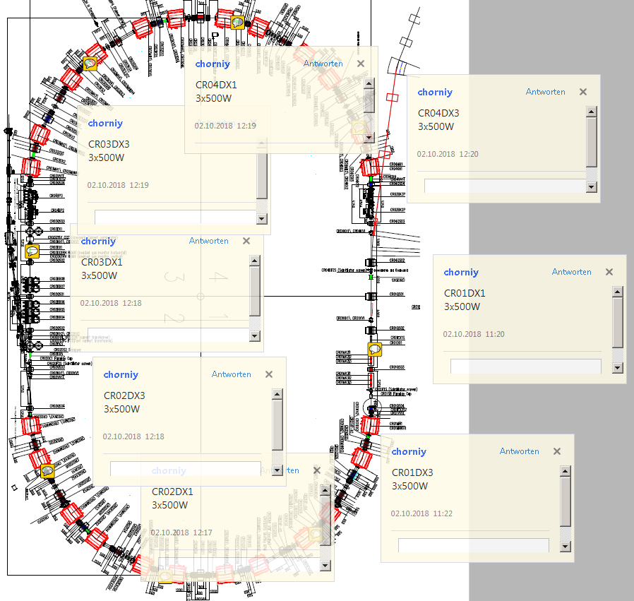
Recent clarifications: Electronic Racks and UPS/CPS
Preliminary share of the Racks
Clean Power Supply sources uniformly distributed in CR
DS are approved, BINP will join the delivery

Slide 16
Summary
There no obvious technical problems on the CR from the point of DAQ foreseen:
BPM will be tested in ESR with 12 BMPs
FCT prototype on a new platform will be tested in ESR (may be not very soon but certainly in 2019)
Schottky/BTF DAQ delivered by ITEP can be test with GSI rings
At least for the DAQ/software part of GSI deliverz , there no strict requirements for BINP to participate in ALL procedures till FDR,
On FDRs it will be OK to have their presence using videoconferense

