Slide 1


ILIMA Experiments in the CR
Helmut Weick, GSI
Budker-GSI collab. workshop Novosibirsk, 8th Nov 2018
Goals of Experiments
Detector Systems (Schottky, ToF, Heavy-Ion)
Integration into the CR
Requirements on CR

Slide 2
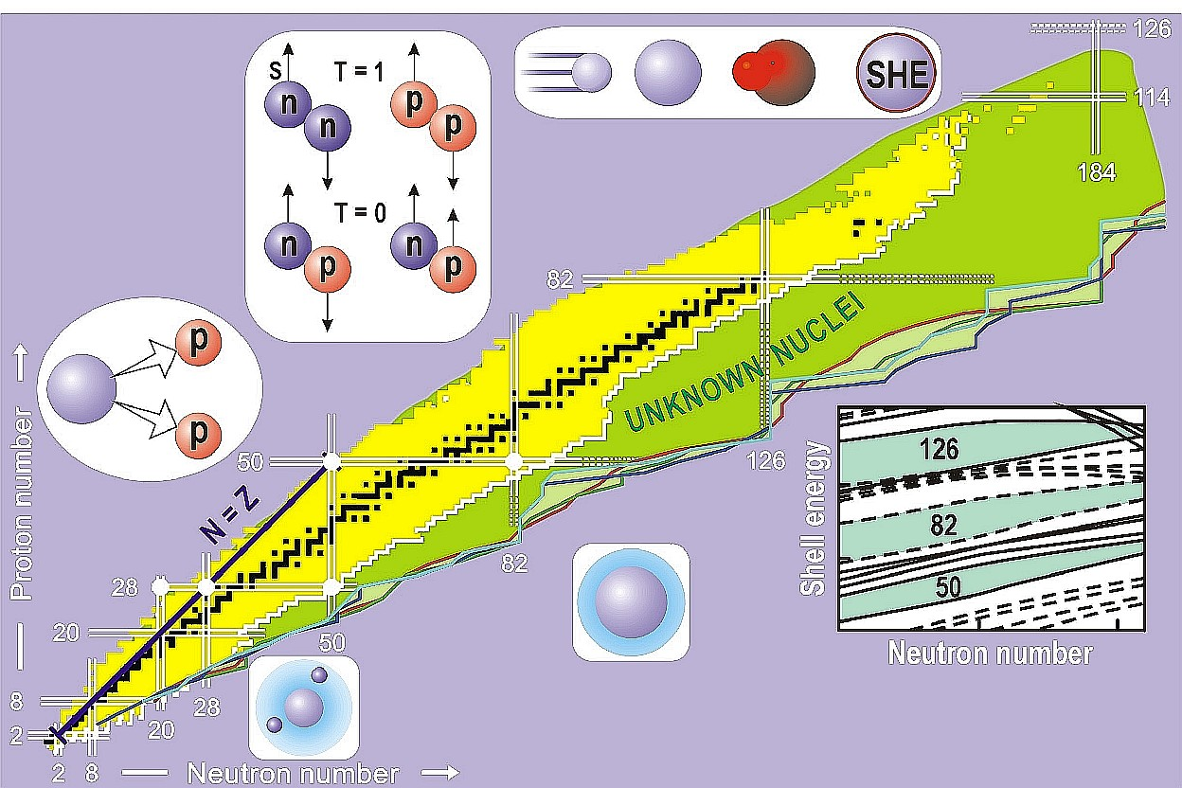
ILIMA = Isomeres, LIfetimes and MAsses
- Total binding energies
- Nuclear decay modes
- Separation energies
- Driplines
- Pairing correlations
- Deformations
- Shell closures
- Reaction Q-values
- Testing and
improving nuclear
theories

Slide 3
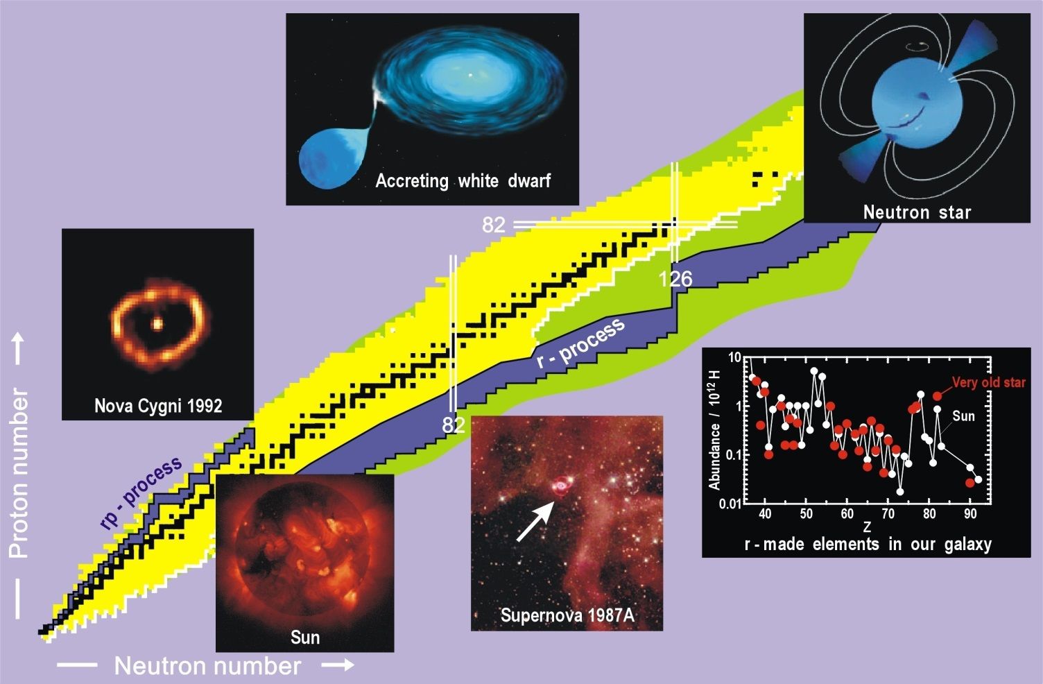
ILIMA = Isomeres, LIfetimes and MAsses
- Total binding energies
- Nuclear decay modes
- Separation energies
- Driplines
- Pairing correlations
- Deformations
- Shell closures
- Reaction Q-values
- Testing and
improving nuclear
theories
- Path ways of
nucleosynthesis

Slide 4
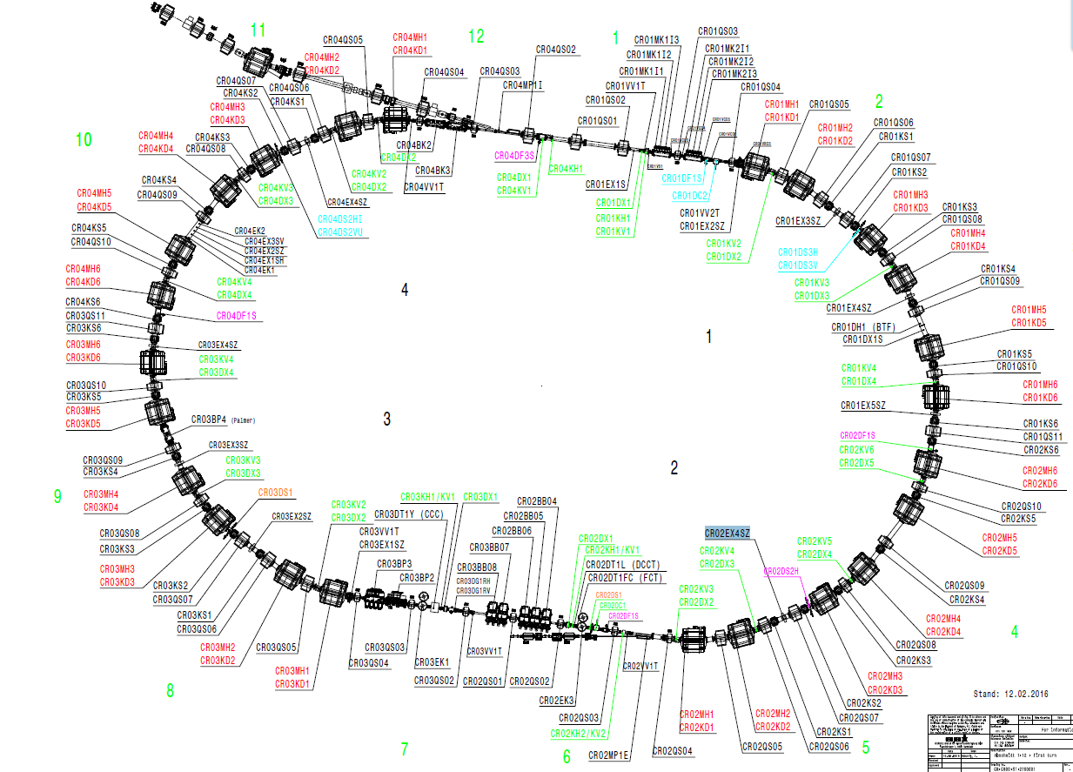
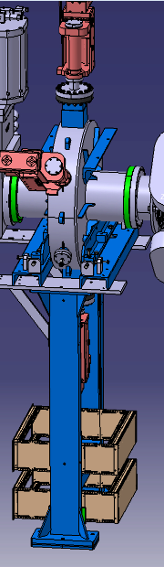
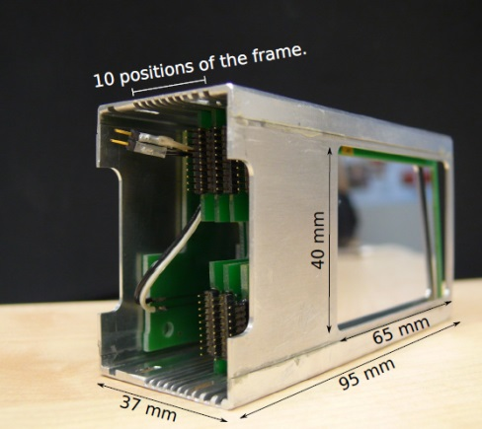
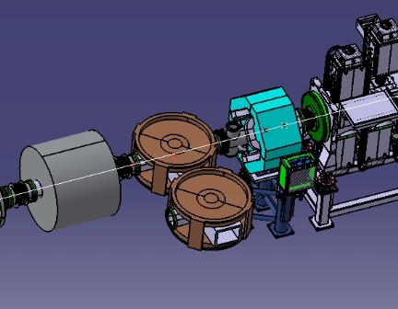
Schottky pickups
horizontal and longitudinal
Detector pockets
TOF-2
TOF-1
16.8m

Slide 5
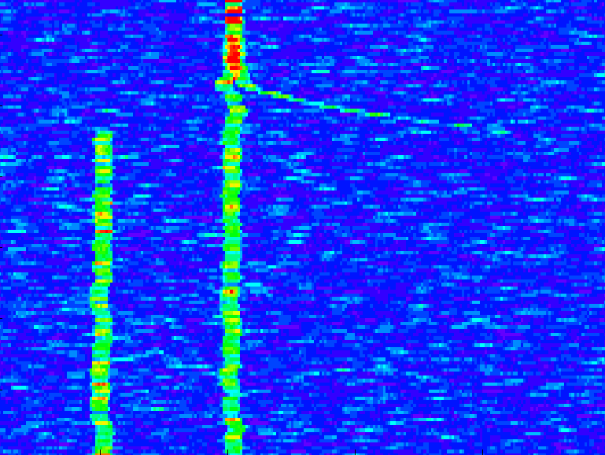
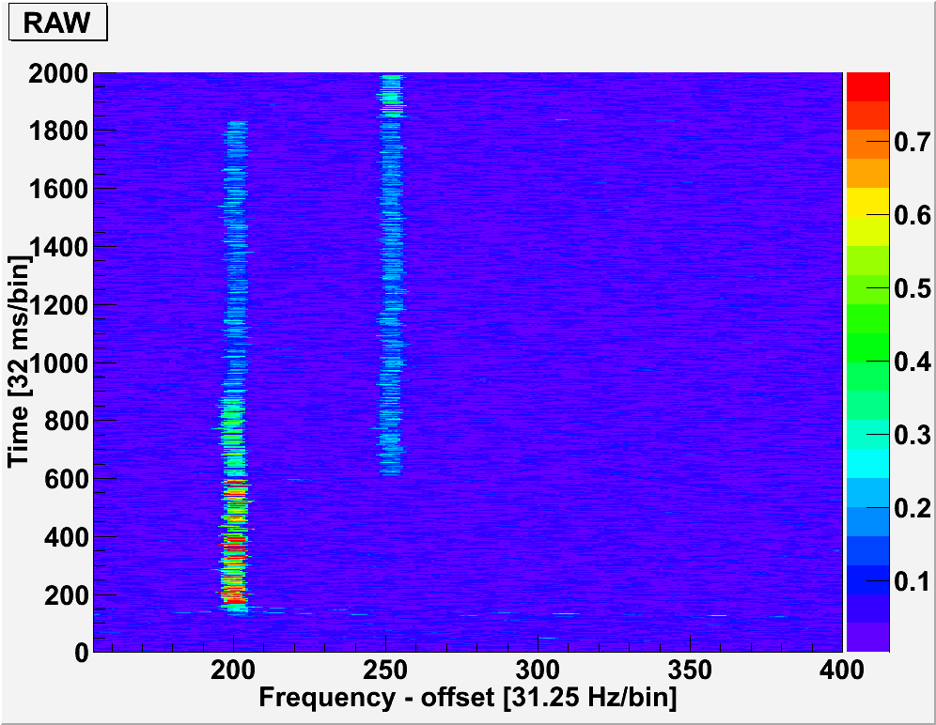
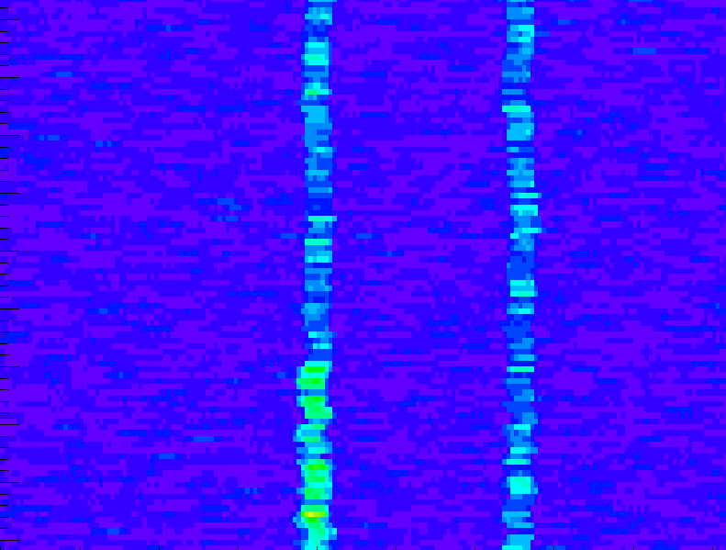
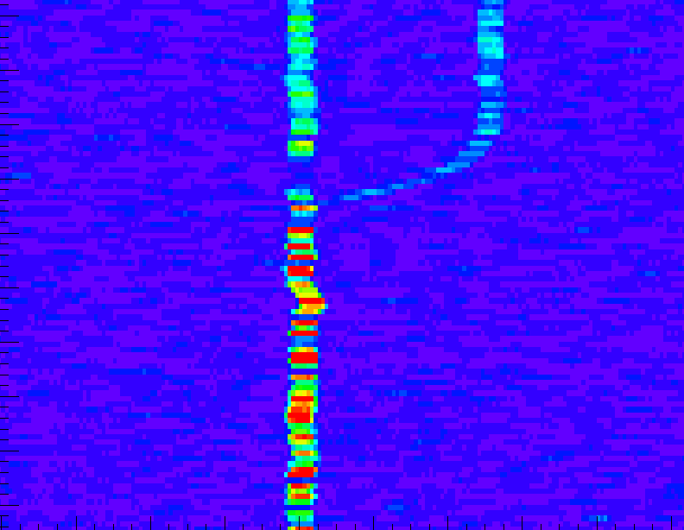
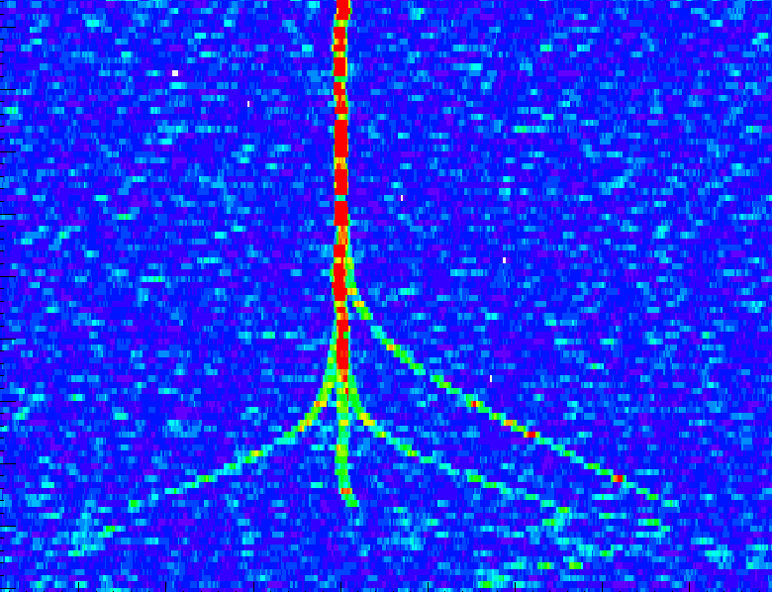
EC decay in ESR cooling, 2 EC and 2 β⁺ -decays
Δm/m = 3.7x10⁻⁵
4.9 MeV
EC
142 59+
142 59+
Pm
Nd
β⁺
EC + β⁺
cooling

Slide 6
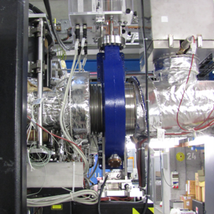
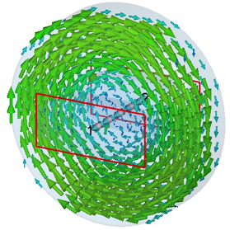
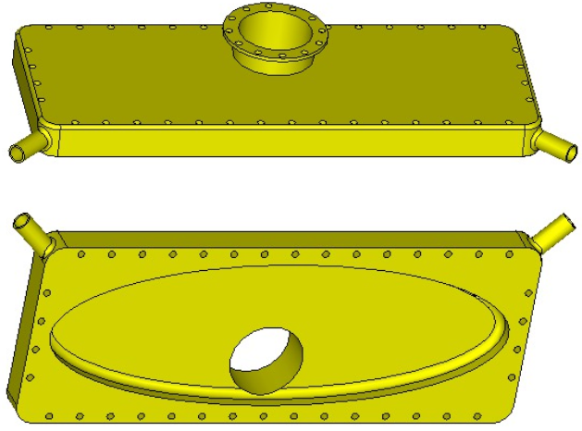
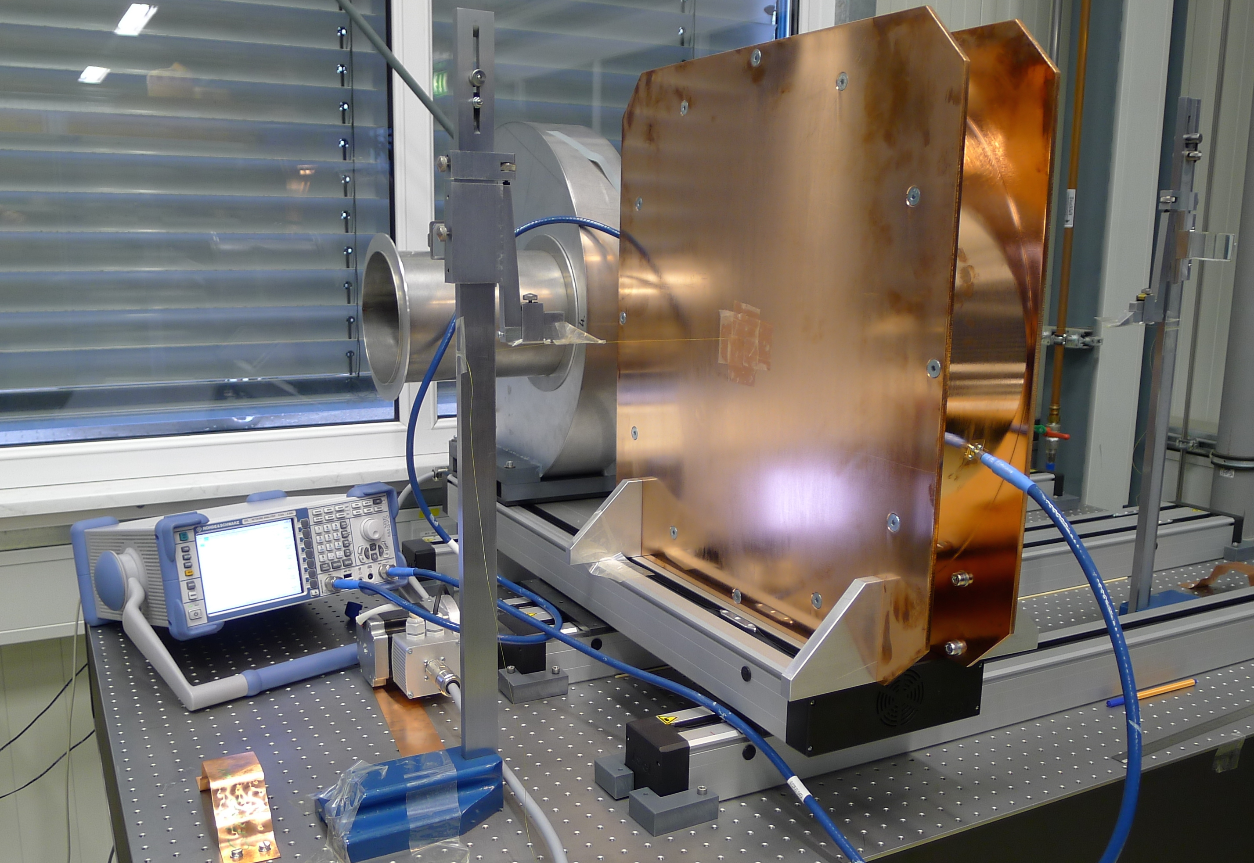
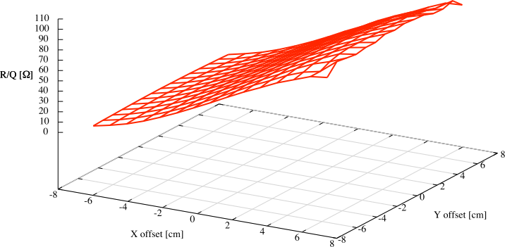
Resonant Schottky Pickup
(with transverse position measurement)
Use pill box cavity in
T010 monopole mode
f_{R} tunable,
quality factor Q
also adjustable.
Elliptical cavity possible
to introduce gradient in R/Q,
signal strength gives position
R/Q [Ω]
168cm
14 cm
y/cm
x/cm
S. Sanjari, X. Chen

Slide 7
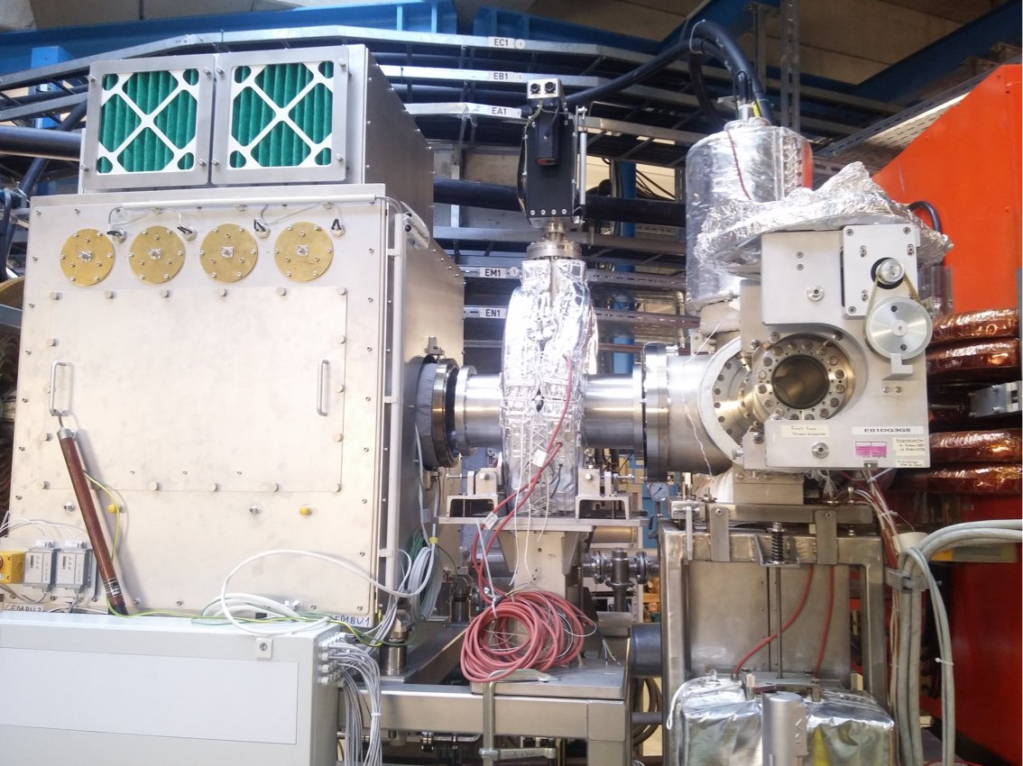
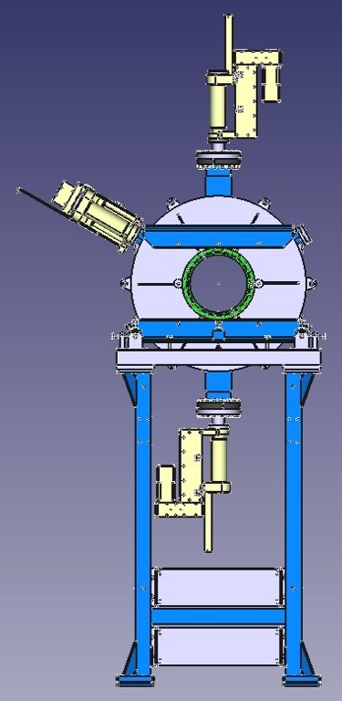
New prototype
Symmetric design
Made of 100% stainless steel
  Vacuum friendly
  Easy construction
  No movable parts in the support
No ceramic gap (hence no reliance on ceramic spec)
Variable sensitivity (Q value)
  “follow” the beam during cooling
  Dynamic loading
Variable Frequency (ca. 4 MHz at 410 MHz)
S.Sanjari et. al. GSI SciRep 2017

Slide 8
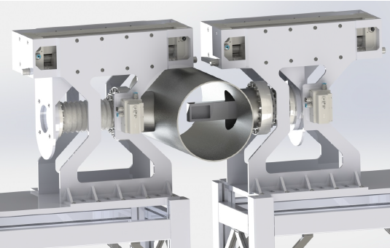
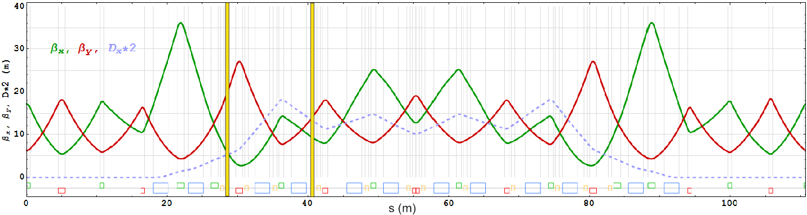
Detector Pockets e.g. for β delayed neutron emission
CR in RIB mode, x-width = sqrt(β_{x} ε_{x})
CR TDR, Annex 1, 2016
pocket out during injection
→ fast drive with servo motor
Δx = -72 mm
for Z=50, m=132
Δx = -130 mm
for Z=82, m=126
cooled beam (ε_{x} = 1 mm mrad)
➔ x-width = 2.2 – 3.2 mm
R. Gernhäuser

Slide 9

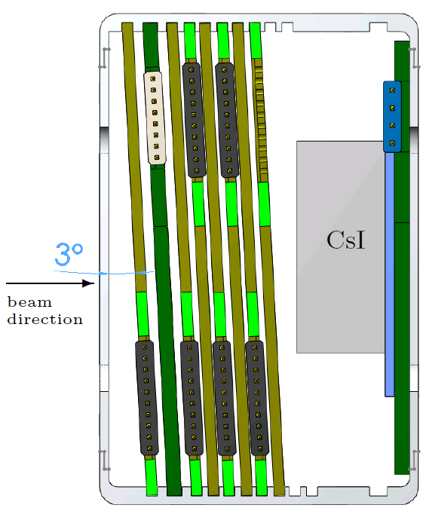
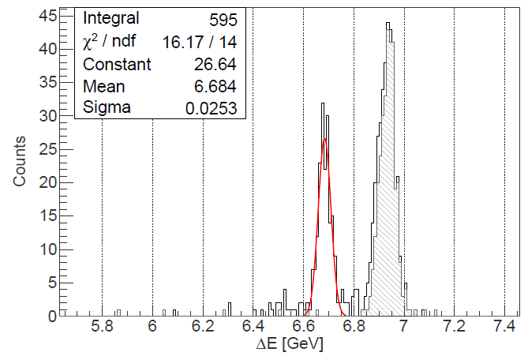
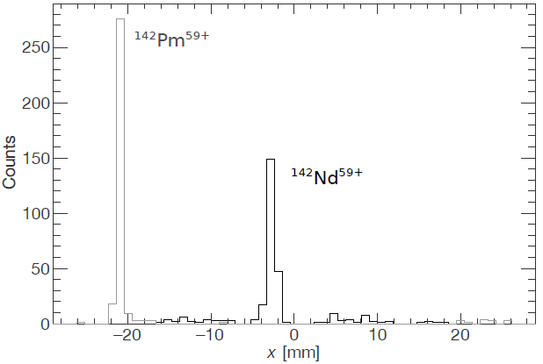
CsISiPHOS Heavy Ion Detector
S/DSSD stack for ΔE, x
active area 40mm x 60mm
with CsI calorimeter +
Si photo diode to identity
Z and A by ΔE, E.
Ali Najafi et al.
NIM A836 (2016) 1.
β⁺ decay: ¹⁴²Pm⁶⁰⁺ → ¹⁴²Nd⁵⁹⁺, electron capture ¹⁴²Pm⁵⁹⁺
position
ΔE
Mesytec amplifiers,
Digital readout with FEBEX cards
free running multi-event read out
fast PCI to optical -> to MBS
TRIXOR to create trigger.

Slide 10
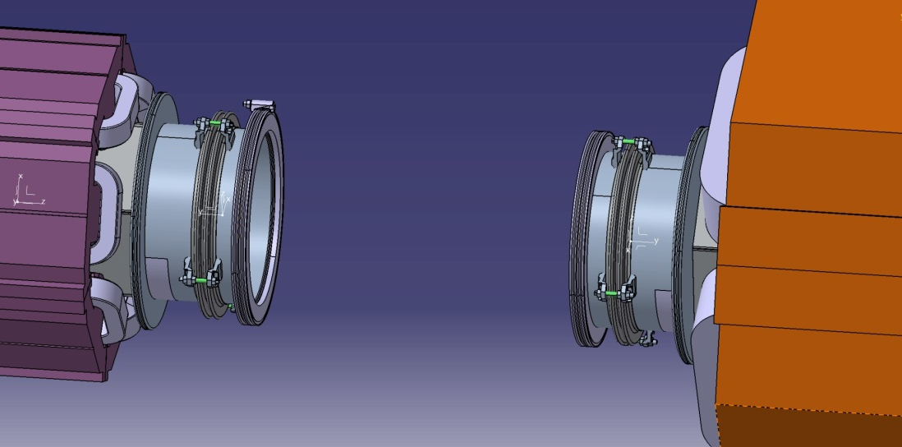
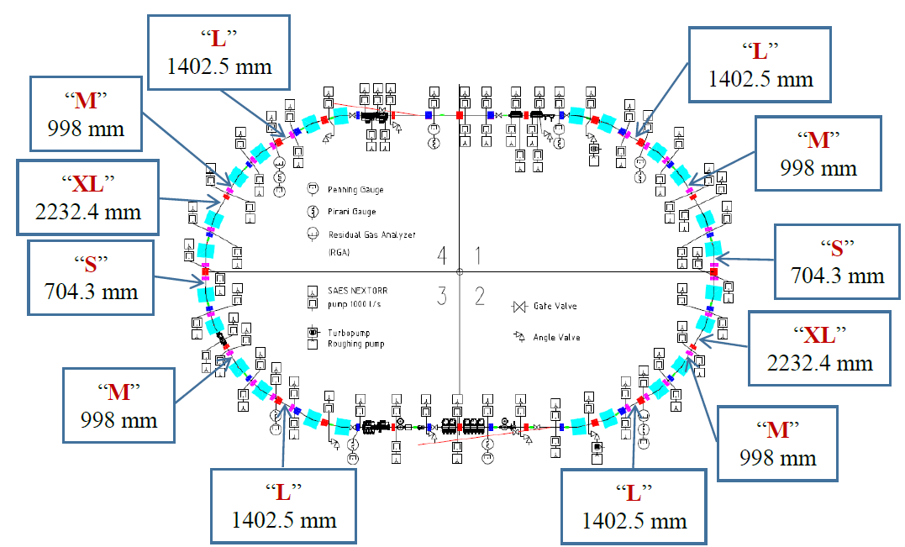
Detector Positions
ISO-K
flange
adaptor
space for
resonator
or detector
adaptor
ISO-K
flange
A. Krasnov, BINP

Slide 11
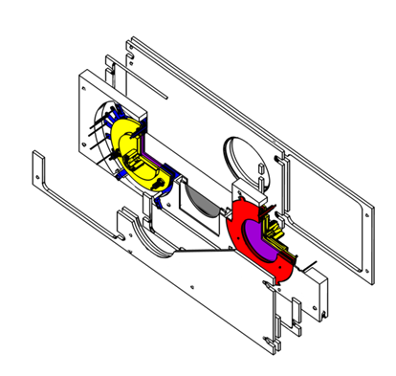
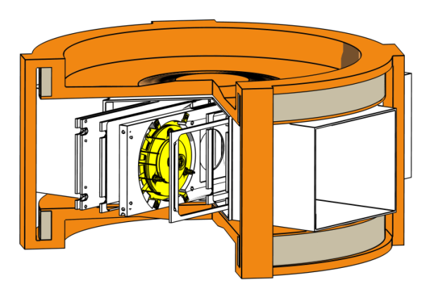
TOF Detector System for CR
d =80 mm
MCP and carbon foil
Isochronous electron transport
by crossed E, B fields.
ion
yoke diameter 900mm
magnet hom. ΔB/B = 10⁻³
Electron transport efficiency ≈ 98%
Timing accuracy ≈ 35 ps
Active area d=80mm wanted, accepted emittance (x * y) scales with d^4 !
Simulations + Tests for detector show even better timing than ESR detector
          M. Diwisch thesis, University Giessen 2014, N. Kuzminchuk et al., NIM B 821, 160 (2016), accepted TDR 2018.

Slide 12
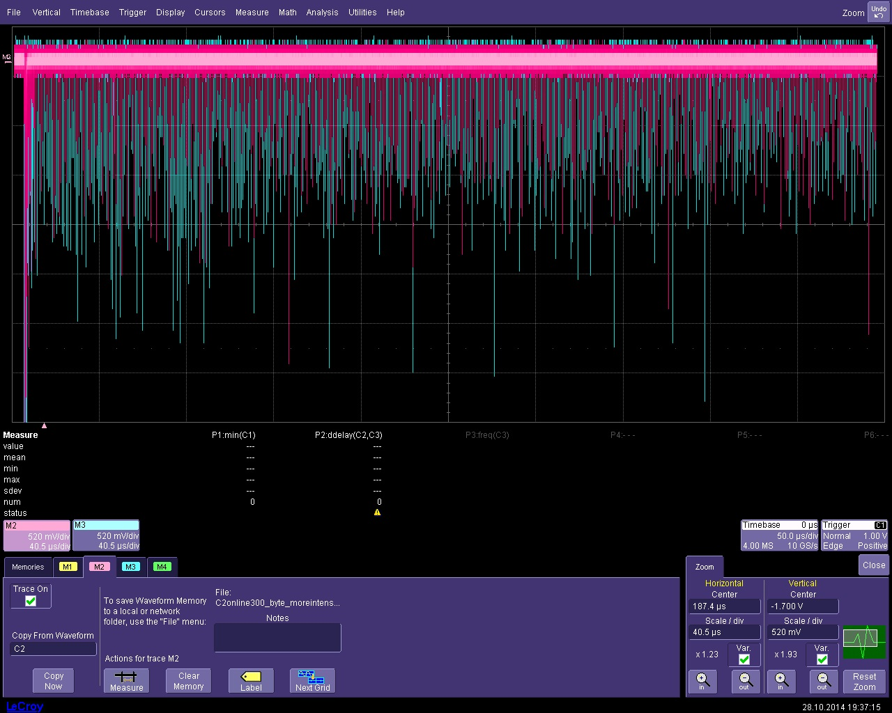
ToF Detector Signals
0
400 μs
2 V
U
²³⁸U beam on improved ToF detector in ESR, Oct 2014
old detector but new channel plates, new field settings,
Almost no decrease of pulse height even after 800 turns.

Slide 13
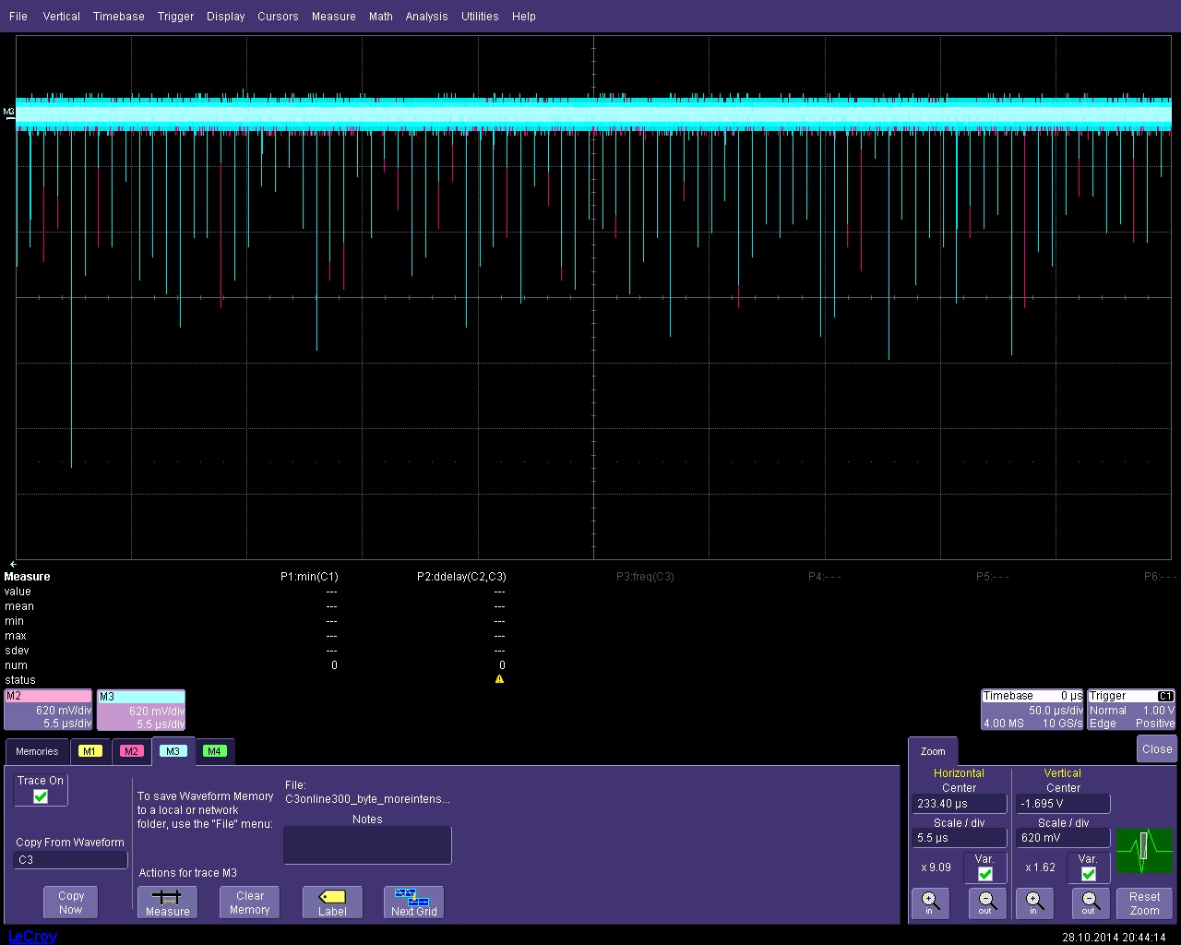
ToF Detector Signals 2
212.4
223.4
233.4
244.4
t / μs
2.5 V
U
A good signal from every turn on both sides (blue and red),
in the past only shorter sequences with gaps.

Slide 14
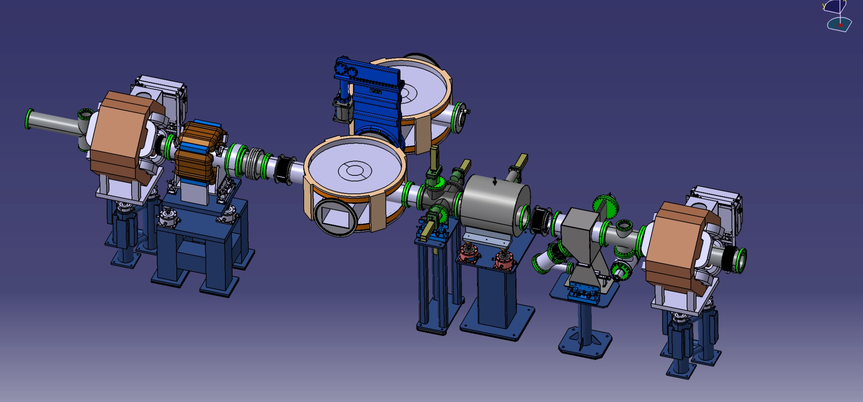
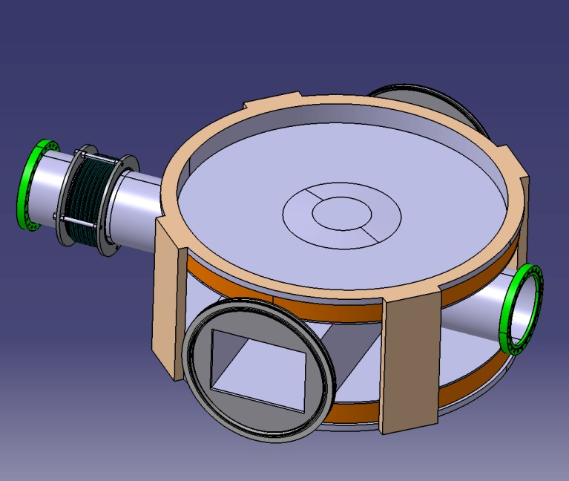
CR02EK3
Bellow
153
CF200
CF400
Extension
tube
Bellow: 6 Convolutions,
CR-standard thickness
Chamber + Bellow
129,5
Installation in ring
255
1462

Slide 15
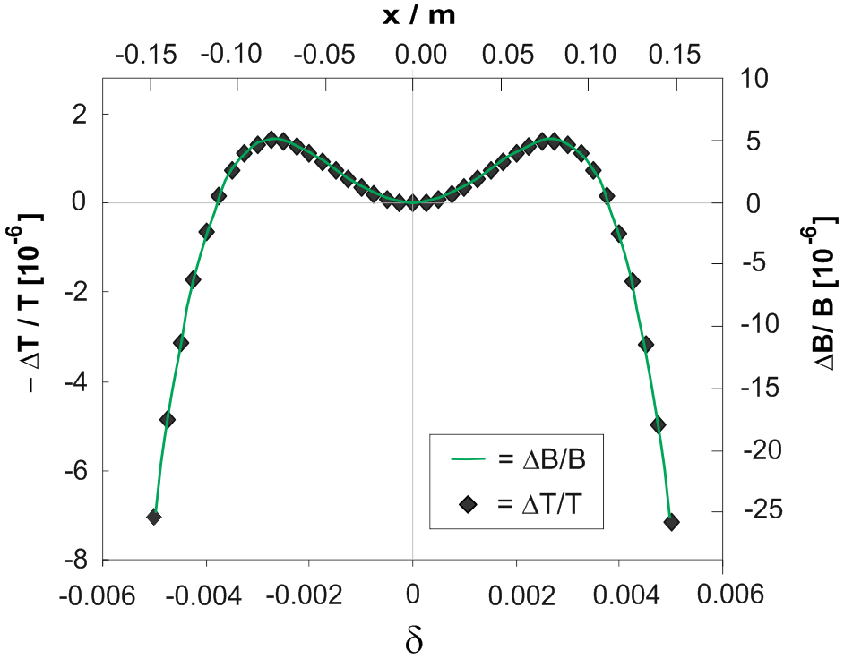
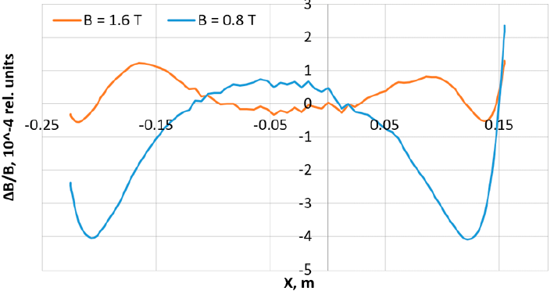
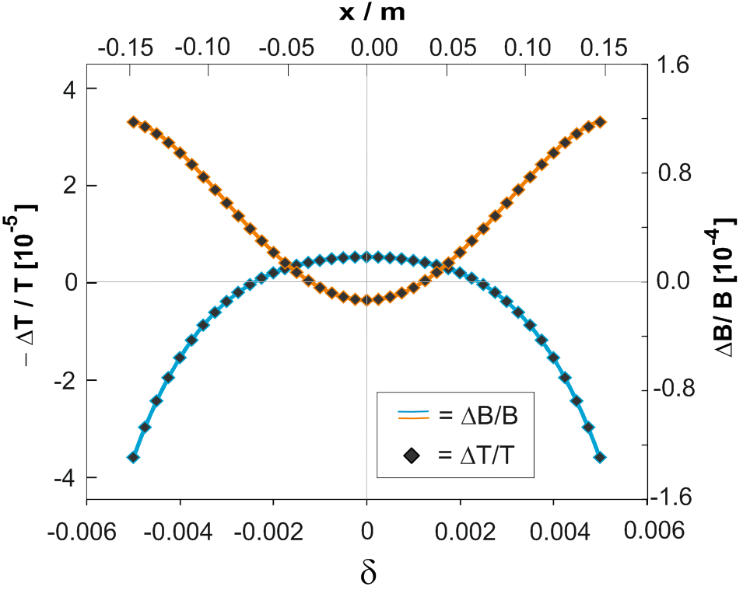
Decapole Corrector
With full correction
Sextupoles, octupoles are foreseen, but
also a 4th order corrector is needed.
ΔB/B [10⁻⁴]
from CR TDR-annex
in GICOSY
simulation
B⁽⁴⁾L = 80 Tm/m⁴ at best position
over one turn for Bρ = 13Tm, e.g.
B = 0.02 T on r₀ = 0.235 m, L = 0.5m
(Y-steerers have larger B-field)

Slide 16
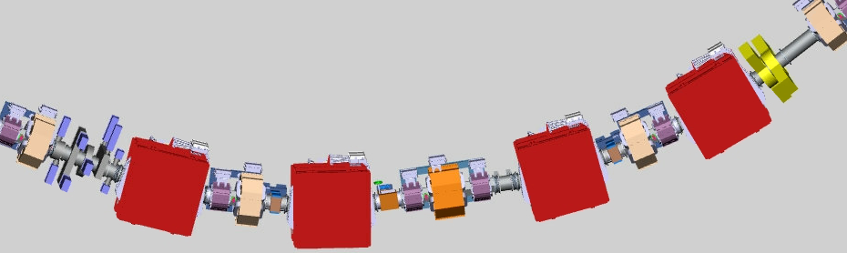
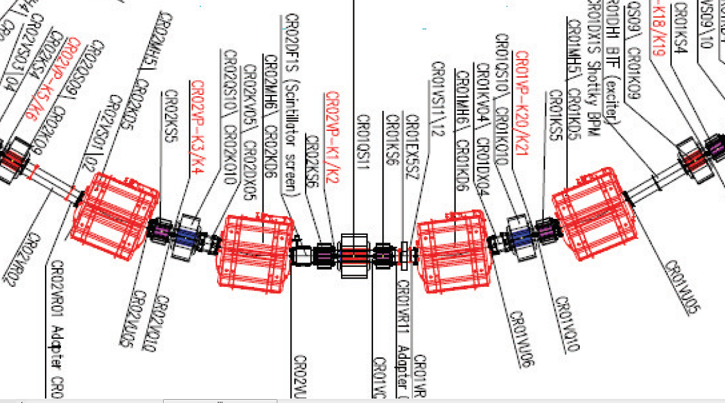
CR Arc
from DMU
from TDR annex

Slide 17
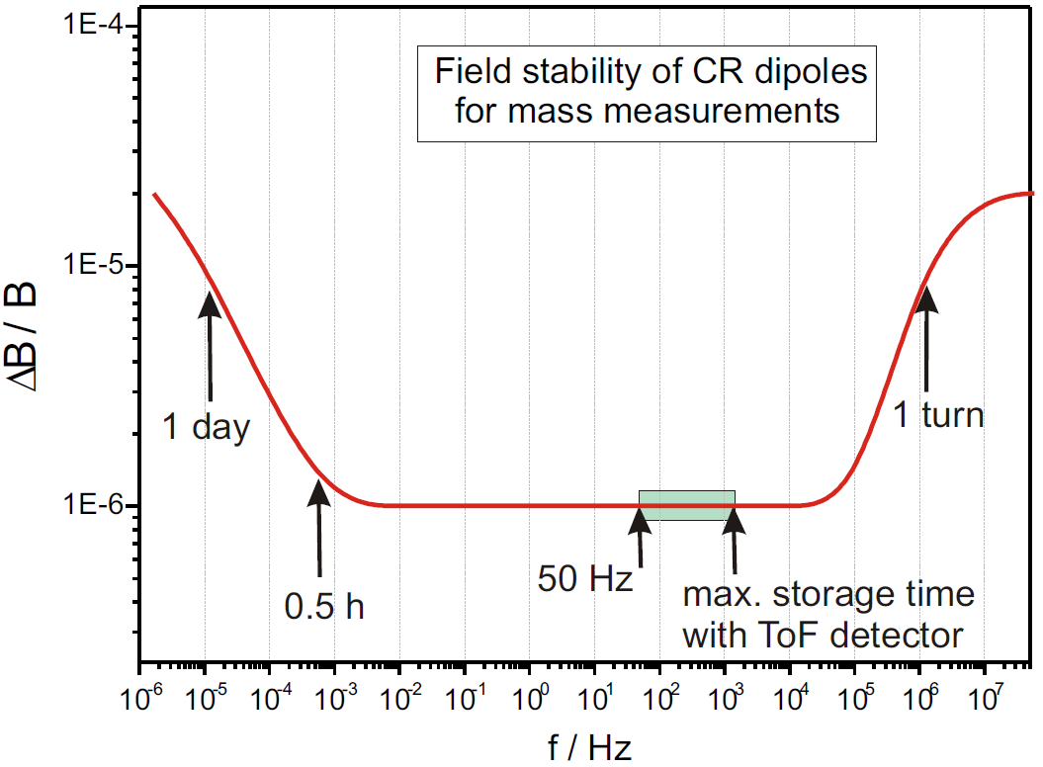
Power Supply Stability
~ ΔΙ/Ι
Δm/m =
correlation
resolution
Specs : ΔΙ / Ι = ±0.5x10⁻ ⁵

Slide 18
Conclusion
Scheme for integration of Heavy-ion detectors and Schottky pickups
found. Also just enough space for ToF detectors.
Heavy-ion and ToF TDR approved, Schottky still under approval,
asked for German in-kind funding at FAIR Council (Nov 2018).
740 k€ German project money (2005 prices) + few other sources
ToF detectors and some pockets can be provided at first installation,
Schottky pickups probably not all -> dummy tubes needed.
Still looking for decapole corrector, weak but very useful
to increase acceptance. Find a position!

