Slide 1
HEBT Magnets beyond Batch2&3
07.11.2018
F. Hagenbuck
Presenter C. Mühle

Slide 2
HEBT Magnets beyond Batch2&3
Direct connection SIS18 – CR
(„Forgotten beamline“, HEBT beam line sections TSN1 and TSR1)
9 quadrupole magnets quad2
1 quadrupole magnet quad1 (short version of quad2 with l_{yoke}=0.6m)
4 steering magnets s18
2 dipole magnets dip4 (same cross section as dip15_0 with R=8.125m, ϕ=22.34°, one magnet of branching type with bore for beam passage in straight direction)
All magnets are
specified in Detailed Specification Batch3 (F-DS-MT-03e_HEBT-NC-Magnets_Batch3_v1.1 https://edms.cern.ch/document/1541676/2)
not in ACB 7 (Accelerator Costbook)
proposed for ACB 8

Slide 3
HEBT Magnets beyond Batch2&3
HighEnergyDensity@FAIR beam matching section (APPA cave)
1 quadrupole magnet quad11
4 quadrupole magnets quad2_customized (long version of quad2 with l_{yoke}=1.2m)
2 steering magnets s100
Magnets are
not yet specified, however quadrupole magnet type quad11 and steering magnet type s100 are known from Batch2&3 and quad2_customized is a long version of known quad2
not in ACB 7
proposed for ACB 8

Slide 4
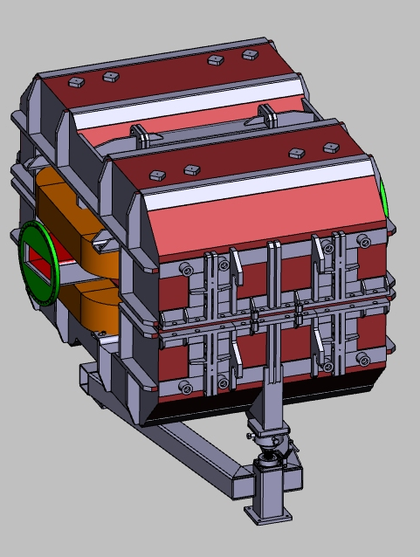
HEBT Magnets beyond Batch2&3
CR-like magnets (HEBT beam line sections FREX, TFC1)
5 quadrupole magnets quad3 (CR wide type) (PSP 2.3.2.2.3)
2 dipole magnets dip3_3 (PSP 2.3.2.1.3.4)
Adaption of CR-dipole design
Yoke cross section and coils cross section are identical to actual straight CR- dipole design (BINP-MT-Ptab 2016-07.1)
Lengthes are adapted to match a bending angle of 10.12°.
Magnets are
specified in
dip3_3 F-DS-MT-102e_HEBT_dipole3_3_v3 (https://edms.cern.ch/document/1474310/4)
quad3 F-DS-NCM-en_MT_0124_HEBT_quad3_2018_01_19-V003 (https://edms.cern.ch/document/1174040/3)
in ACB 7and assigned to BINP by Council decision XI.18.15

Slide 5
Summary
Magnet type | Quantity | Ptab | Det. Spec. | needed in | status
quad1 | 1 | ü | ü | FBL | proposed for ACB 8
quad2 | 9 | ü | ü | FBL | proposed for ACB 8
quad2_custom. | 4 | ü | - | HED@FAIR | proposed for ACB 8
quad3 | 5 | ü | ü | FREX, TFC1 | in ACB 7, Council Res. XI 18.15
quad11 | 1 | ü | - | HED@FAIR | proposed for ACB 8
s18 | 4 | ü | ü | FBL | proposed for ACB 8
s100 | 2 | ü | - | HED@FAIR | proposed for ACB 8
dip3_3 | 2 | ü | ü | TFC1 | in ACB 7, Council Res. XI 18.15
dip4 | 2 | ü | ü | FBL | proposed for ACB 8
All magnets needed until beginning of 2021, except CR-like magnets quad3 and dip3_3.
Schedule for CR-like magnets to be adapted to schedule of CR-magnets

