Slide 1
Systems Engineering for mechanical components
Requirement assurance during design und production
Christina Will

Slide 2
Why systems engineering and requirement assurance?
principle for mechanics = principle for electronics
Source: Ehrlenspiel, Kostengünstig Entwickeln und Konstruieren, Springer Verlag 2013 + http://imk.engineering/funktionsorientierter-entwurf.html

Slide 3
Legal aspects and target for FAIR
All partners which produce in the EU or will import into the EU
have to follow the legal rules of the EU.
The following regulations have to be followed:
2006/42/EG Machinery directive
89/391/EWG, 2007/30/EG Regulation to avoid accidents
ProdSG- Act on making products available for the market
2014/35/EU Low voltage regulation
2014/68/EU Pressure Vessel regulation (i.n.)
For certification: Information guide „Manufacturing and operation of equipment designed for research purposes”, CE conformity and workplace safety, BGI/GUV-I 5139 E
Development
Production
Assembly
Commissioning
Operation
Permission in reference to Radiation Legal authorization
Notes:
Equipment and Product safety Act

Slide 4
Development and Management Tasks
Physical solution
Technical solution
Function
Operation
prove of planning
change management
prove of installation space
check of practicability of parameter
check of physical dimensioning
structuring of data model for product
check of plausibility of the simulations
check of necessary prototypes
confirmation for planning of beam lines
structure of product model known and plausible?
definition of connecting and feeding components
definition of interfaces
check of requirements by components on the system
prove of compatibility of the component to the system
check of realization of the requirements in the design
takeover of additional information about the components
check for mount ability
planning of quality assurance during production
prove of interfaces
as built documentation
reports of quality assurance
analyses for completeness
allocation of identifiers for components
operation plan
risk analyses
certification
preparation of assembly documentation
verification of assembly results
documentation of modifications
verification of component identification
proving of interfaces
manuals
verification of manuals
documentation of modifications
verification of requirements on the system
documentation of deviations
documentation of modifications
recording of operation modi
check of spare parts
documentation of operation
Management of documents
Classification
Product lifecycle management
Management of product structure
Management of approval and changes
Integrated product development
Configuration management
Management of variants
Project management

Slide 5
Lessons learned
Definition of physical and technical requirements in context of system design as early as possible
Describing requirements in specifications and draft models
Conceptual design review (CDR) with model for checking of solution, checking of data integration, checking of interfaces, draft for documentation
Final design review (FDR) checking of data integration, checking of content incl. tolerances
First of Series (FoS): aim: no planned modification of design, only for checking if the design contains mistakes

Slide 6
Main tasks
Minimize development costs
Development costs = Physical development + Technical development
Physical development = Parameter table and specifications
Technical development = DMU + specification drawings
Costs calculations while development and design process
Checking integrity of models in comparision to GSI/FAIR CAD-system
Minimize assurance costs
Using checklists
Checking solutions as early as possible in comparison to the defined requirements
Establish checking procedures for all components for CDR, FDR, FAT
Minimize production costs
Development of production documents in reference to minimize the costs for material and production
Checking drawings to avoid mistakes during production
Reuse of components to minimze production costs
Minimize assembly costs
Participation of all involved departments in the development of the components
Implementation of experiences of previous projects
Reuse of components to develop a common knowledge

Slide 7
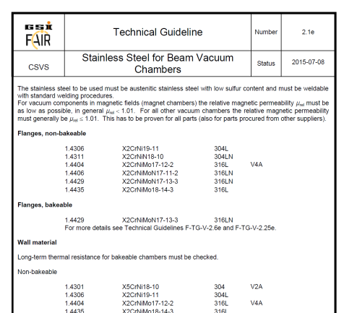
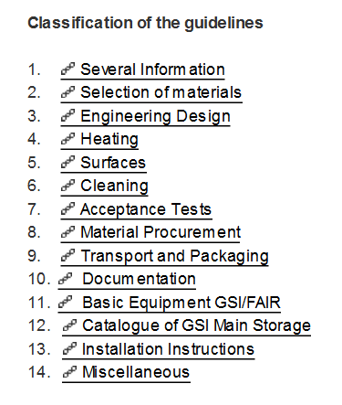
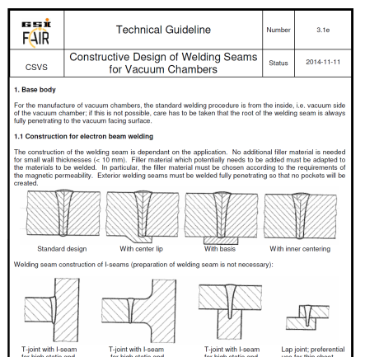
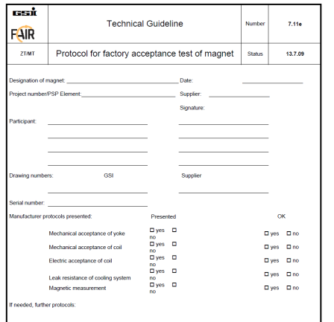
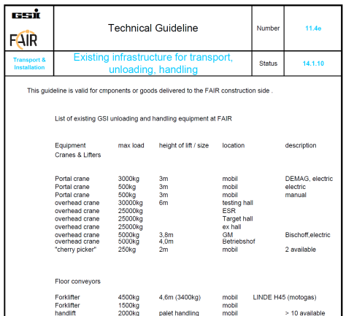
Technical Guidelines
Technical guidelines:
Are part of the specifications as common approved information
Are used for knowledge management
Combine knowledge of different subject domains with technical solutions
Are a collection of best practice experiences
Are generally available
Technical guidelines have to be seen:
As a collection of technical data that are used in GSI
As an intentionally written guideline and not as specification
In order to take into consideration the technical know-how
As information about for instance basic equipment of GSI/FAIR
As starting point for general standardization at GSI.
Content and Structure:
+ register with keywords
since 2005

Slide 8
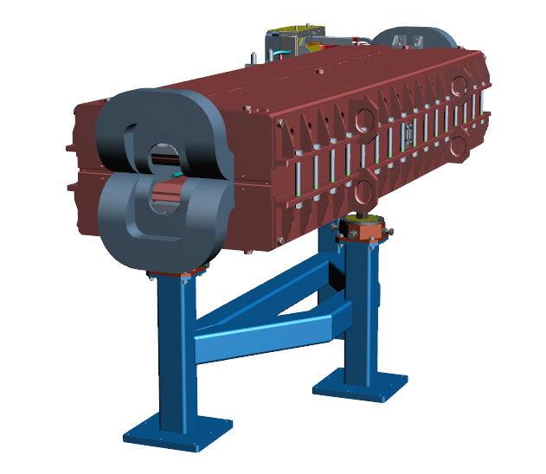
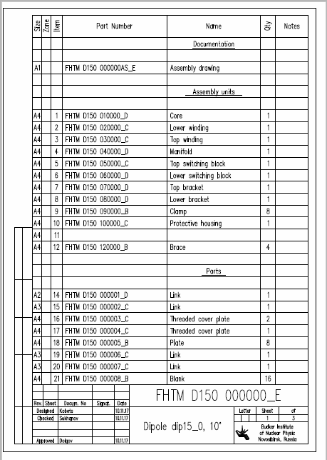
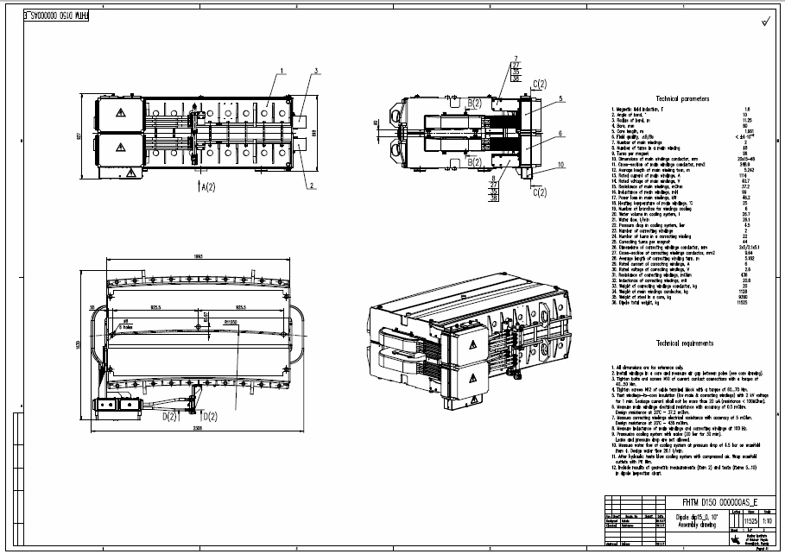
Model of Product data
Product definition
f.i.
Product structure
Description: dip13_0
Drawing no.: FT-BEMH-ZU-0000055
CID: 07-00001-040-4
Representation of product
f.i.
technical calculations
FEM-Model
production programms
parameter tables
Model of product
Presentation of product
adapted figure after : Aderl, Trippner, Step, Teubner Verlag Stuttgart, 20000

Slide 9
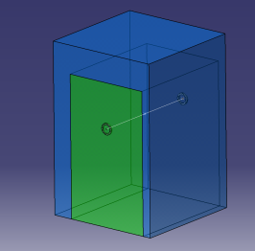
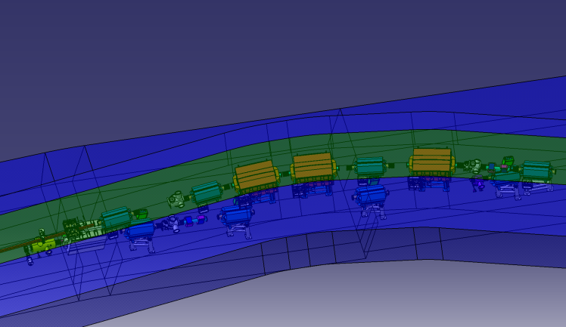
From Physical to Technical Solution
Transfer of the physical solution into technical requirements:
Choosing the active principle for realization of function
Positioning of the function in the system (Ion optical Layout)
Definition of necessary space of the function
Definition of necessary media
Adaption of requirements from product life-cycle
Maintenance
Alignment
Emergency scenario
etc.
IOL(Step)->CATIA SAP
Installation space for components
Requirements from product life-cycle
Civil construction
Specifications

Slide 10
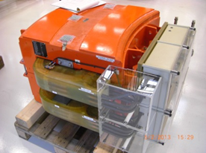
Testing of Technical Solution
Contribution partner
EDMS
DMU+WPL+SPL+ corresponding specialists
DMU + WPL+QA
DMU+WPL+SPL+QA+ corresponding specialists
Contribution partner
EDMS
Specifications
3D-model
Checklist
not ok
Checklist
not ok
Checklist
Quality of product model
Quality of model structure
Feasibility of data exchange
Check of interfaces
Check of mechanical representations of physical items
Draft of QA-Plan
Draft of documentation
Fit to installation space
etc.
1st step:
Conceptual design review
(CDR)
1st step:
Conceptual design review
(CDR)
ok
ok
EDMS
ok
not ok
EDMS
WPL+SPL+ QA+ Contribution partner
WPL+SPL+QA+ Contribution partner
Contribution partner
DMU+WPL+SPL+ QA+ corresponding specialists
QA-Plan, Drawings, CID
EDMS
QA-Plan
QA-Plan
Checklist
4th step:
Site
acceptance test
(SAT)
3rd step:
Factory acceptancetest
(FAT)
2nd step:
Final design review
(FDR)
Assembly
ok
ok
not ok
EDMS
DMU-Digital Mockup
WPL-Work package leader
SPL- Subproject leader
QA- Quality assurence
CID- Component Identification no.
EDMS- Electronical data management (CERN)
EDMS
DMU
PDM
(CATIA/SAP, Archiv)

Slide 11
CAD Integration
Scenarios for CAD data creation, implementation and use
Enterprise connector (Enco)
Catia
Archive for drawings
CATIA/SAP
STEP/DXF, PDF
Inventor
Archive for drawings
CATIA/SAP
Enterprise connector (Enco)
STEP
Inventor
mostly no PDM-System
STEP/DXF, PDF
Mechanical desktop
Mechanical desktop
mostly no PDM-System
EDMS
EDMS
Solid Edge
Solid Edge
Solid Edge
Solid Works
Solid Works
Assembly instruction
Pre-Assembly drawing
input Catia /SAP
Maintenance instruction
Assembly drawing
Beamline drawing
EDMS
Auxiliary device drawing
Installation preparation

Slide 12
Testing of Technical Solution
DMU
Combination of 3D-models from different sources to one common overview
Development of models for beamlines as basis for:
Interface drawings
Drawings for installation
Digital representations as basis for installation and maintenace
A basis for simulations for remote manipulation of radioactive components
Combination of:
Models of different sources like civil construction, GSI and contribution partners
3D-Scans with CAD-Models as As-built-documentation
Proof of:
Completeness of product structure
Interfaces
Installation scenarios
Maintenance scenarios
Emergency scenarios

Slide 13
Conclusions
Defining requirements of components in reference the needs of Systems Engineeing as early as possible
Definition of common product structures as basis for product management
Definition the conditions for data transfer
Common definition of design results
Definiton of roles for mutual information (following also processes of ISO9001)
Definition of approval procedures
…

Slide 14
Thank you for attention!
Questions?

