Slide 1
Radiation resistant Super-FRS magnets
November 6th, 2018

Slide 2
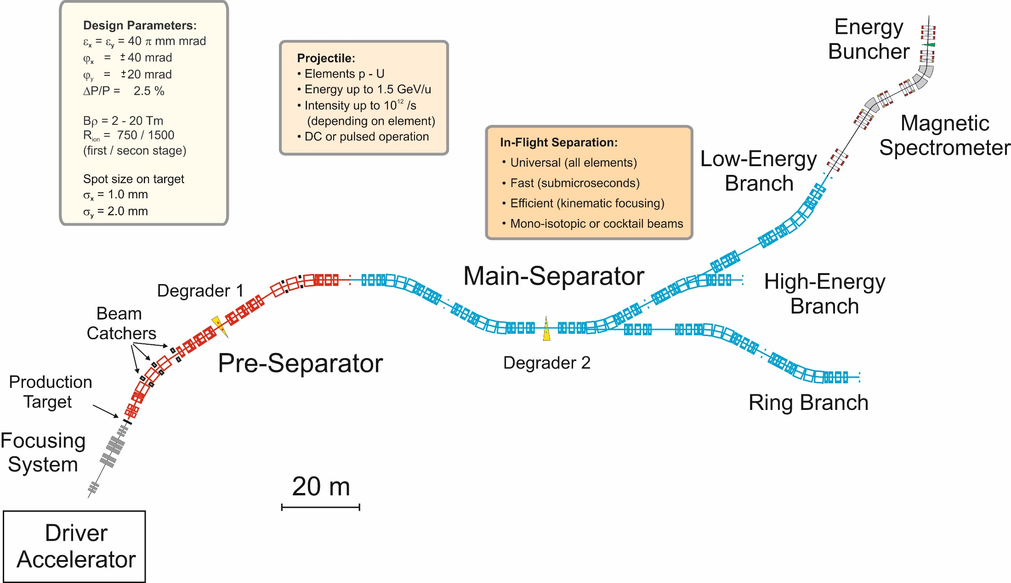
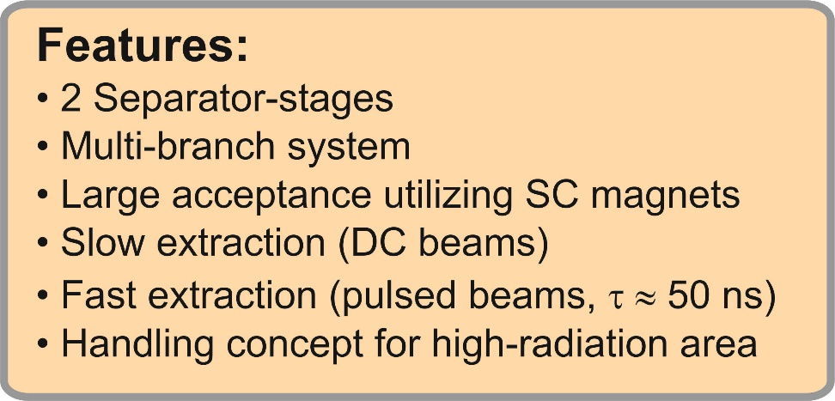
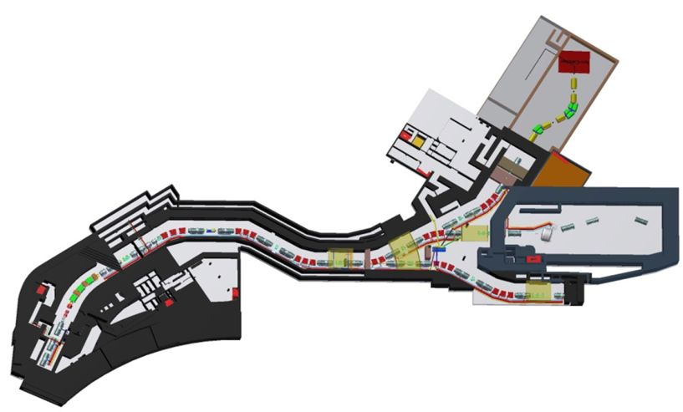
Super-FRS
±

Slide 3
Heavily shielded target area
The positions of radiation resistant quadrupoles FPF1QT11 (Quadrupole 1a), FPF1QT12 (Quadrupole 1b), FPF1QT13 (Quadrupole 2), the two sextupoles FPF1KS11, FPF2KS11 and the three dipoles FPFMH1, FPFMH12 and FPFMH13 are indicated.

Slide 4
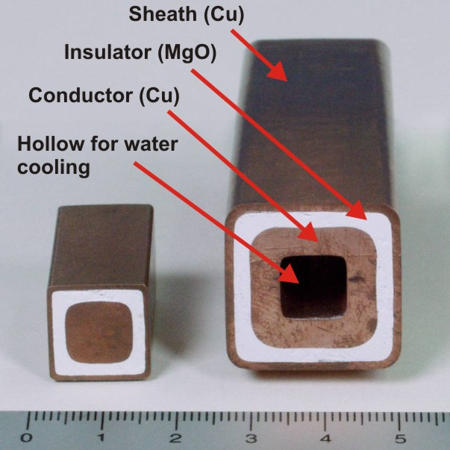
radiation resistant cables
Special mineral insulation (MgO) cables for those magnets.
These cables can withstand a radiological dose of more than 10¹¹ Gray.
Minimum bending radius of cables: 6 × diameter!
Dipoles are indirect cooled. Quadrupoles and sextupoles are direct cooled conductors.
MgO is hygroscopic.

Slide 5
Magnets of high radiation area
PSP code | Magnet | Number of magnets | Min. field strength | Max. field strength | Effective length (m) | Useable aperture (mm) | Field Quality
2.4.2.1.1 | Dipole 1 | 3 | 0.15 T | 1.6 T | 2.400 | 1200 × 140 | ±3∙10⁻⁴
2.4.2.2.1 | Quadrupole 1a | 1 | 1.6 T/m | 15.4 T/m | 0.933 | Ø 130 | ±1∙10⁻³
2.4.2.2.1 | Quadrupole 1b | 1 | 1.2 T/m | 11.8 T/m | 1.244 | Ø 180 | ±1∙10⁻³
2.4.2.2.2 | Quadrupole 2 | 1 | 0.6 T/m | 6.1 T/m | 1.200 | 380 × 240 | ±1∙10⁻³
2.4.2.3.1 | Sextupole 1 | 2 | 3.5 T/m² | 34 T/m² | 0.600 | Ø 380 | ±5∙10⁻³
At first only one kind Quadrupole 1 was planned. But our magnet design experts and a russian expert didn‘t find a feasible design of a radiation resistant quadrupole with 15 T/m gradient, 180 mm aperture and 0.1% field quality.
Solution: separation to two different magnet designs.
=> every radiation resistant quadrupole is unique.

Slide 6
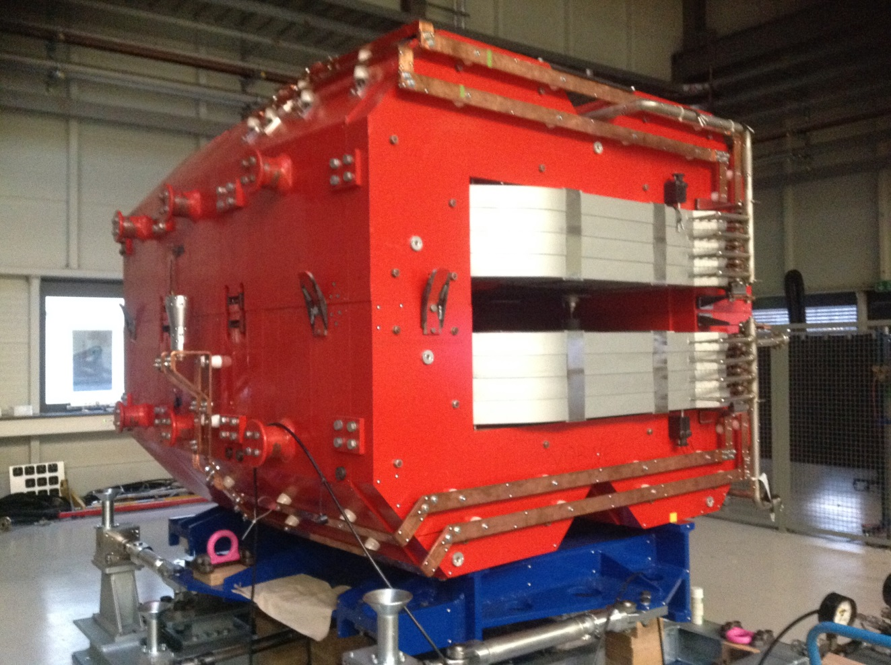
One dipole prototype exists
A prototype of the radiation resistant dipole has been made in Novosibirsk (Budker Institute).
H-type design was chosen for the dipoles.
The standard operation of the magnets in the Super-FRS will be DC. Only for the conditioning cycle, which is used before changing the settings, a ramp up from zero to maximum current within 120 s is needed.
Therefore, instead of using thin laminations the design could be based on iron plates. They are between 120 mm and 140 mm thick.
Magnetic tests of the 90 tons prototype were successful. Only two additional dipoles must be produced.

Slide 7
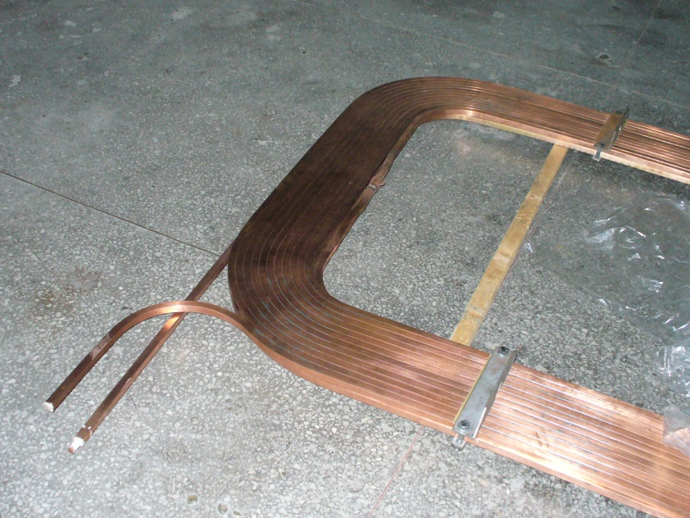
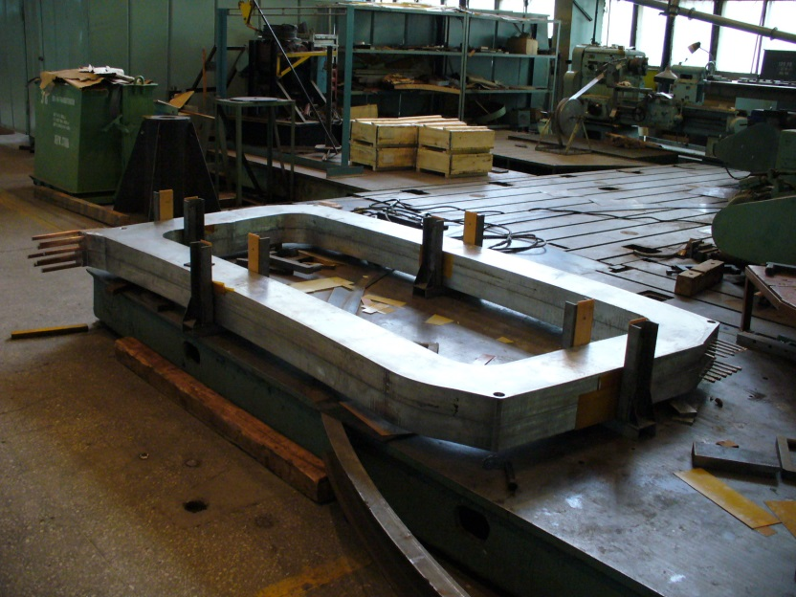
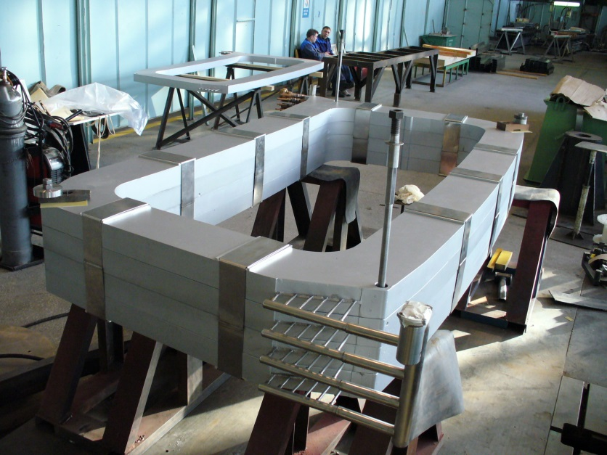
dipole coil
Double pancakes are potted with solder to stiff structures.
Only one soldering point inside a double (at the interconnection of two single pancakes).
The cooling of the coil is indirect. The radiator is made of a copper plate, the cooling tubes of stainless steel. The water connectors are separated to different ends of the coil.

Slide 8
Alignment
After the operation of the Super-FRS is started, direct access to the magnets is impossible because of the high radiation.
An one meter thick plate of steel will be installed above the magnets.
Misalignment due to settlement must be corrected with remote alignment.
The remote alignment will be done with bares and gears from above the steel screen.

Slide 9
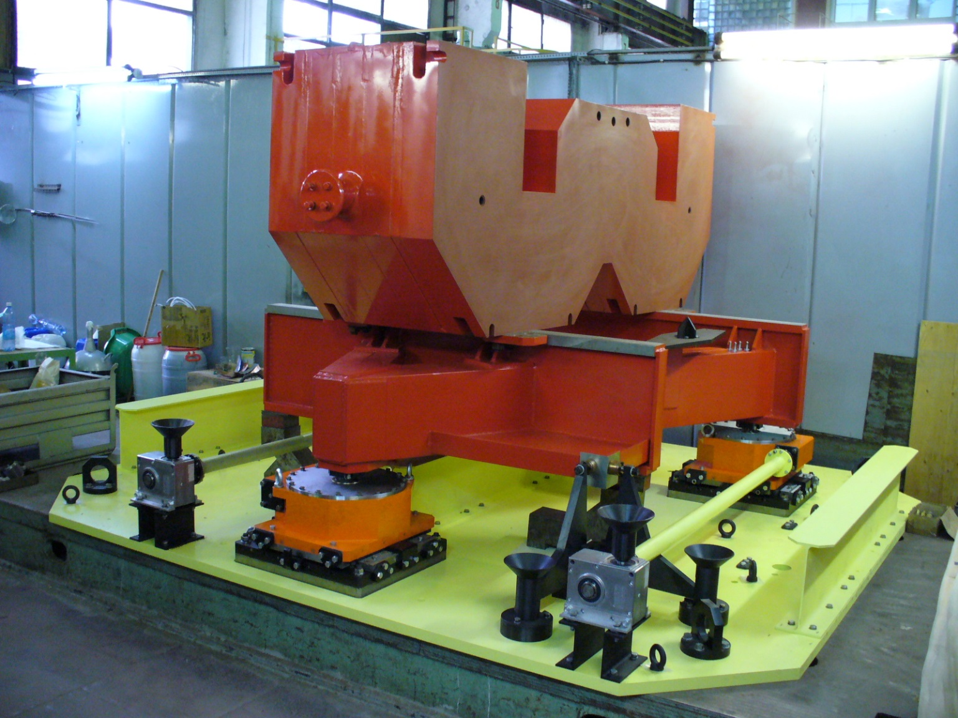
Alignment
Each dipole lies on one adjustable support frame
Each adjustable support frame stands on three feet. Every foot is vertically adjustable.
Two layers of needle bearing allows horizontal movements of each foot.
Feet allows the adjustment of height, roll and pitch.

Slide 10
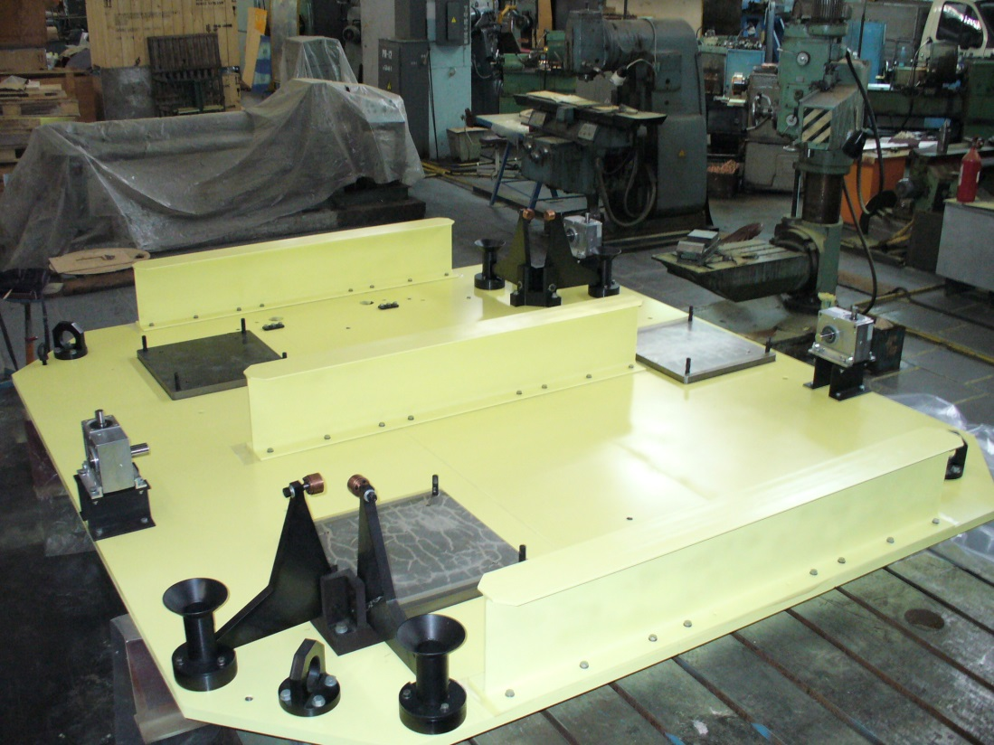
Alignment
4 stamps adjusted and fixed the horizontal position.
The support frame with the magnets moves uncontrollable after opening the stamps.
Our alignment team was not able to adjust support frame remotely (and without sight). It is not usable in our case.
GSI made a new design of an adjustable support frame.

Slide 11
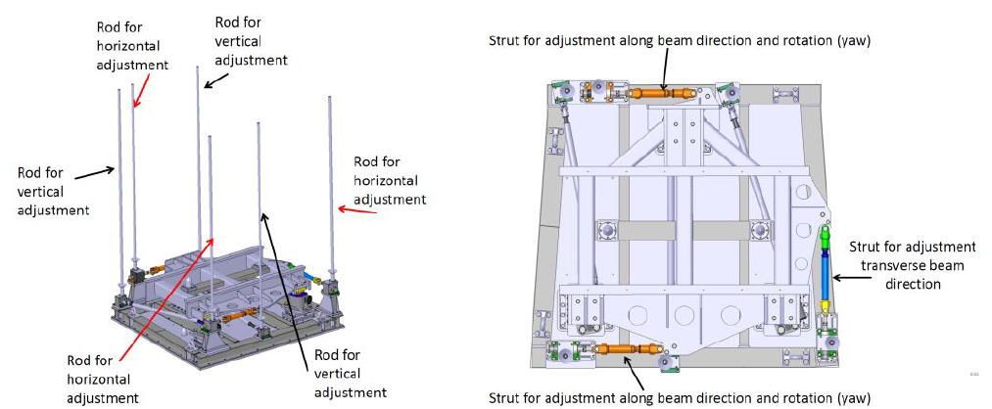
Alignment system of a dipole.
Left: overview with the six adjustment rods, right: top view on the support frame.
A 3-strut system is used for horizontal adjustments.
The same principle will be used for the quadrupol 1a/1b, quadrupol 2/sextupole and sextupole/beamcatcher .

Slide 12
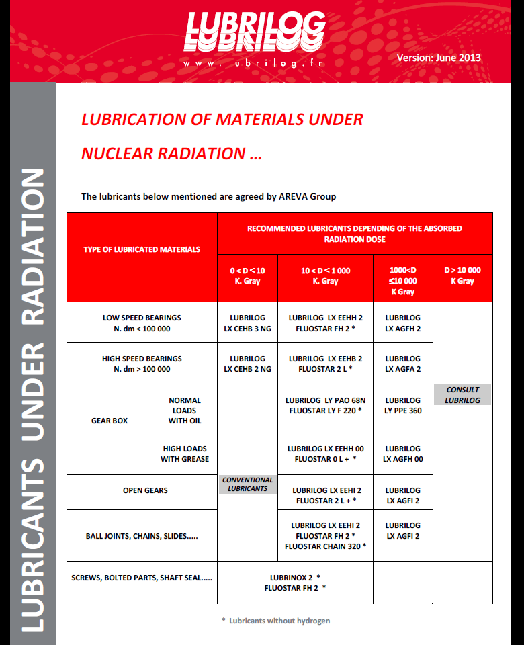


radiation resistant lubricant
All gears and bearings must be lubrified with the lubricant FLUOSTAR FH 2 of the company LUBRILOG (France). This lubricant is radiation resistant up to 1.0 MGy.

Slide 13
Positioning of the support frames
A round hole and a slotted hole on the bottom plate of the adjustable support frame together with the two cones on the floor will position the support frame with a high accuracy

Slide 14
Modifications on the prototype
The connections of current and water must be displaced due to radiation reasons.
Copper bars connect the coils with the current interfaces

Slide 15
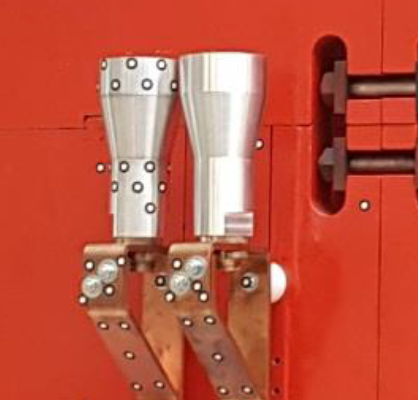
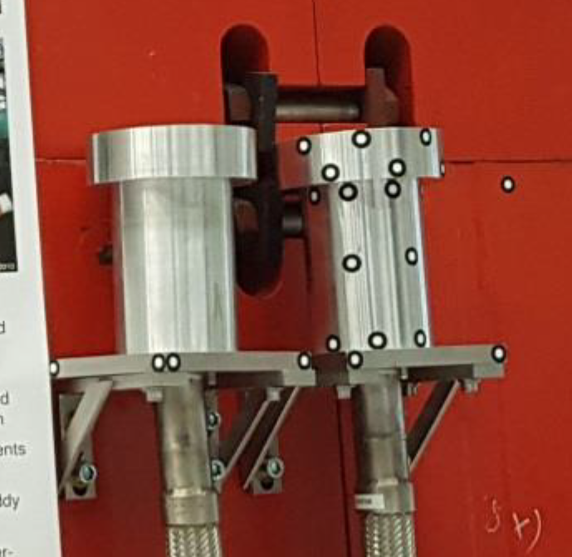
Modifications on the prototype
The connections of current.
The connections of water.
New cone-cylinder combinations for the positioning of the upper yoke half onto the lower yoke half.

Slide 16
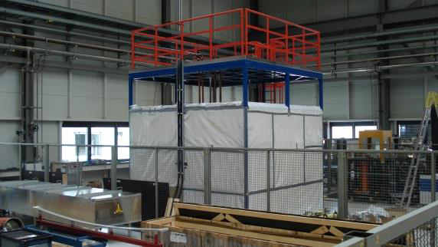
Radiation resistant dipole
Heating test done (>95% of heat into water)
Remote connectors for current and water successfully tested

Slide 17
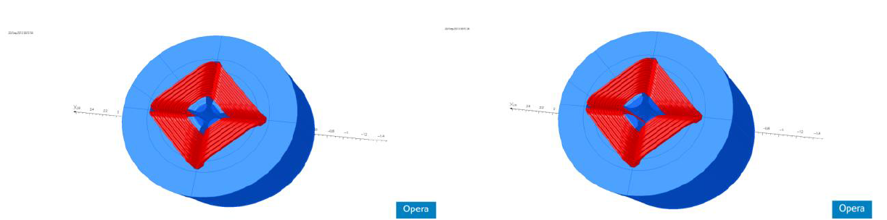
First two radiation resistant quadrupoles
quadrupole 1a
quadrupole 1b
PSP code | Magnet | gap (mm) | Dimension (m) (x,y,z) | Max. current | inductance (mH) | Resistance (mOhm) | Power (kw) | H2O (l/min)
2.4.2.2.1 | Quadrupole 1a | 70 | 1.19 / 1.8 / 1.8 | 981 | 72 | 49 | 47 | 27
2.4.2.2.1 | Quadrupole 1b | 95 | 1.15 / 1.8 / 1.8 | 1408 | 80 | 59 | 116 | 67
Magnetical design made by Peter Rottländer (GSI)

Slide 18
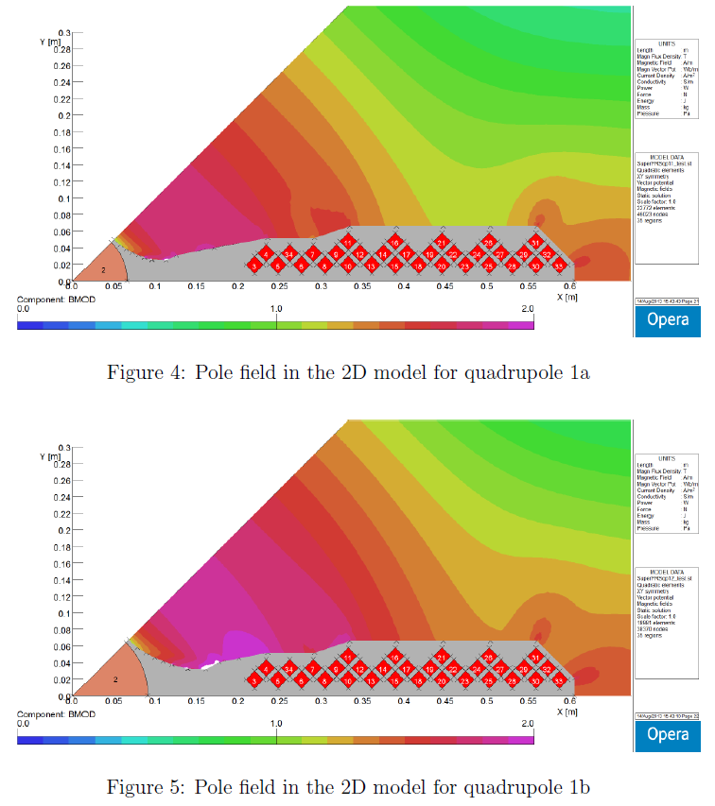
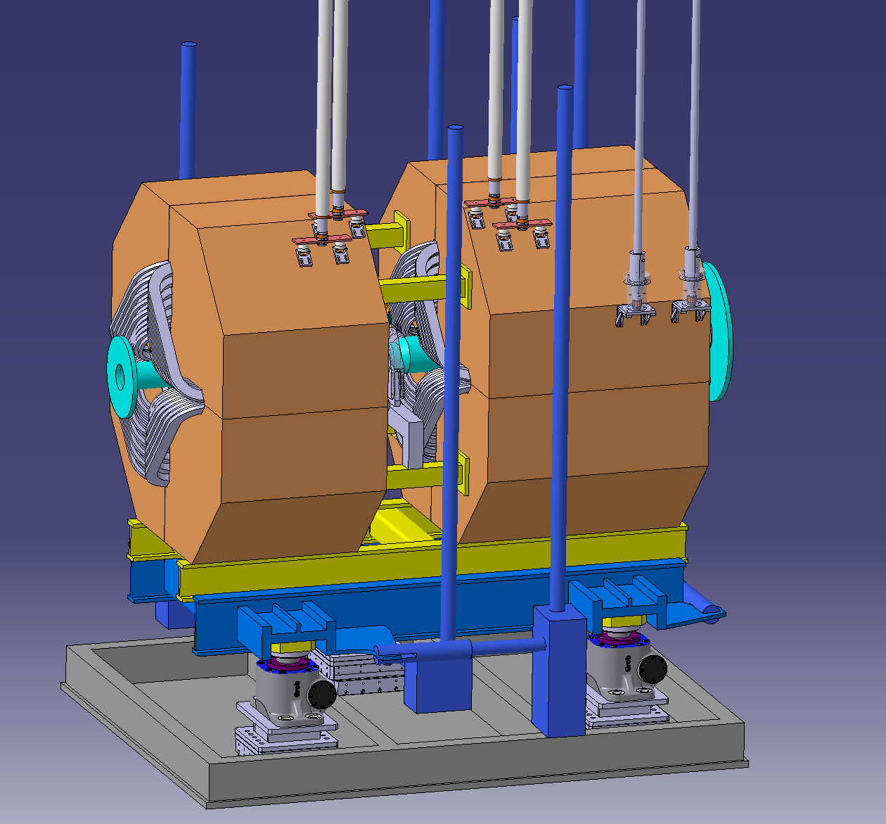
First two radiation resistant quadrupoles
Opera 2d models
quadrupole 1a
quadrupole 1b

Slide 19
Rods for horizontal adjustment
Rods for vertical adjustment
Lances for current
Rod for horizontal adjustment
Lances for current
Rod for vertical adjustment

Slide 20
plane surfaces
bayonet socket
plane surfaces
bayonet socket

Slide 21
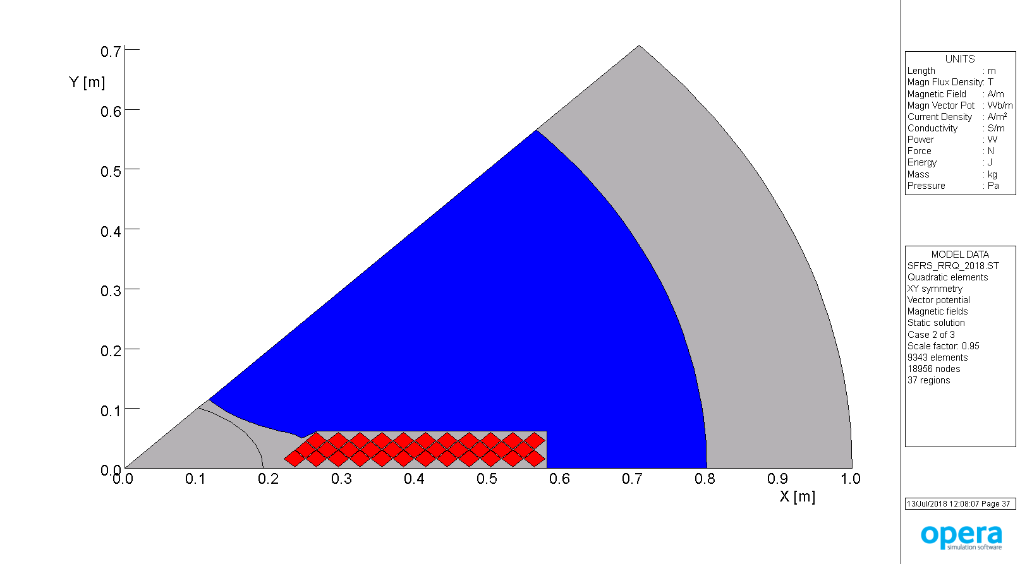
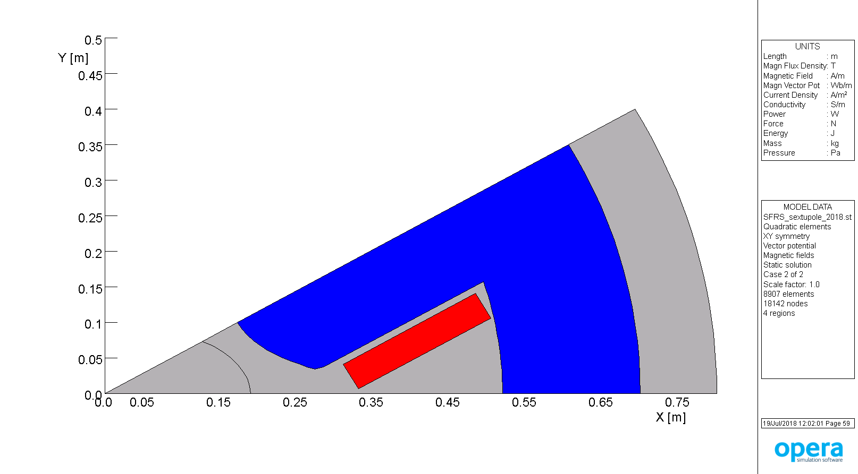
Third radiation resistant quadrupole and radiation resistant sextupole
quadrupole 2
sextupole 1
PSP code | Magnet | gap (mm) | Dimension (m) (x,y,z) | Max. current | inductance (mH) | Resistance (mOhm) | Power (kw) | H2O (l/min)
2.4.2.2.2 | Quadrupole 2 | 163 | 1.5 / 1.6 / 1.6 | 1800 | 61 | 64 | 205 | 115
2.4.2.3.1 | Sextupole 1 | 195 | 0.75 / 1.3 / 1.3 | 1800 | 18.3 | 28 | 90 | 52
Magnetical design made by Alexander Kalimov

Slide 22
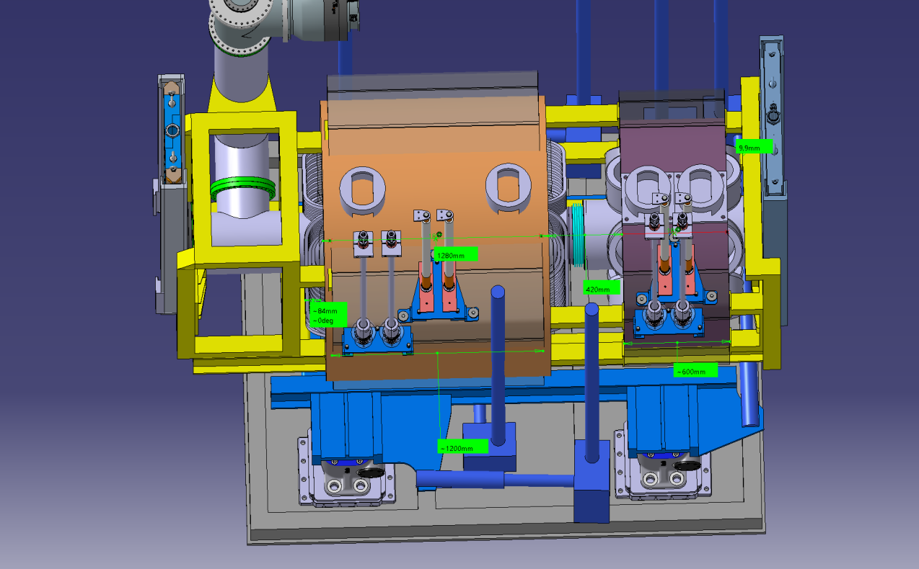
Quadrupole 2 – Sextupole combination

Slide 23
Sextupole-Beamcatcher combination

Slide 24
Sextupole-Beamcatcher combination

Slide 25
Status of specifications of radiation resistant Super-FRS magnets
Dipoles: specification is approved, a prototype exists. Modified water and current interfaces are tested (operated 1 month with maximum current). Last test of modified adjustable support frame is planned for December 2018
Quadrupole 1a/1b: specification is approved
Quadrupole 2 and sextupoles: magnetic design finished. The specification is under progress
Drawing of adjustable support frames of quads and sextupoles in preparation. Expected to be finished December 2018.

Slide 26
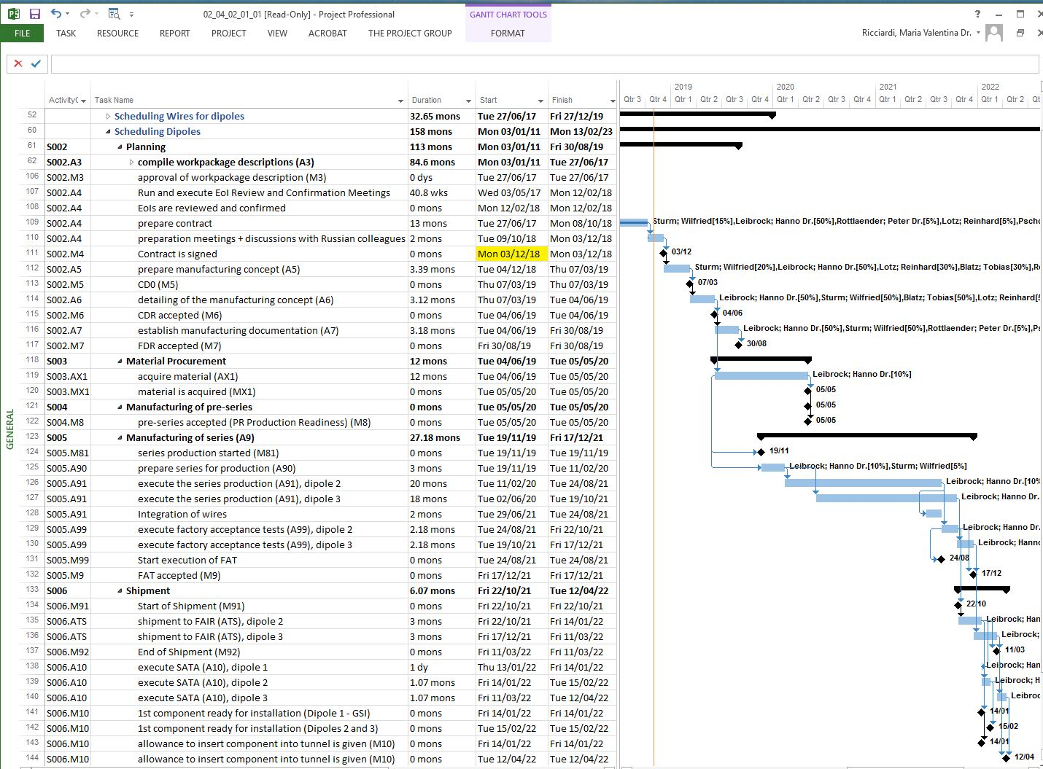

Slide 27
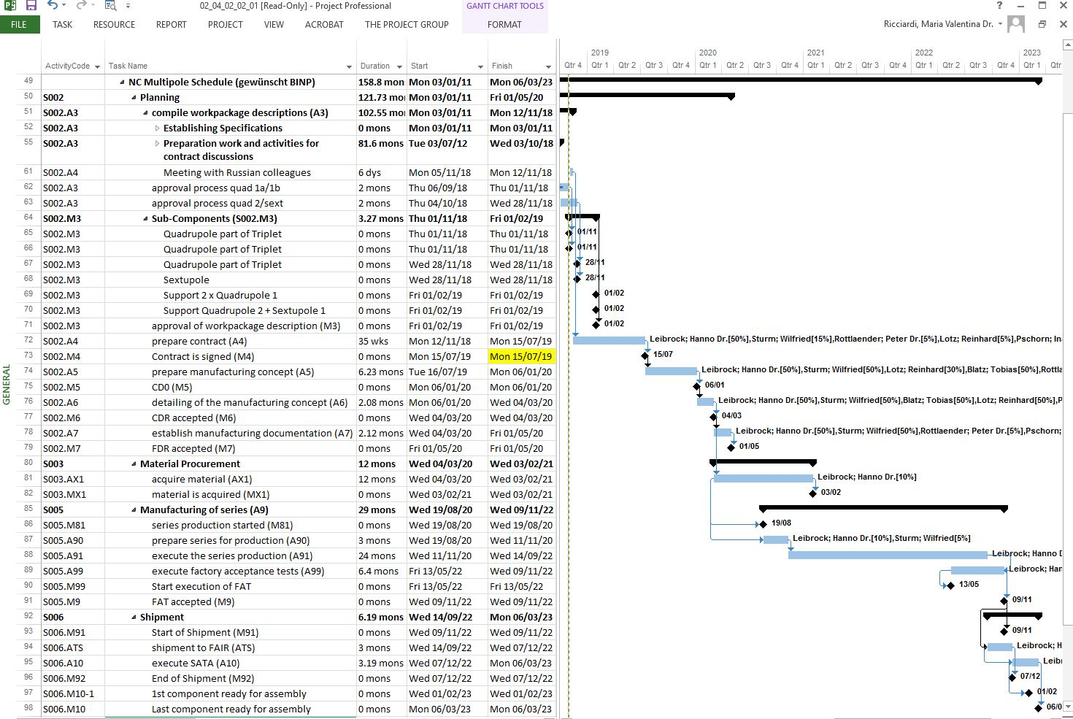

Slide 28
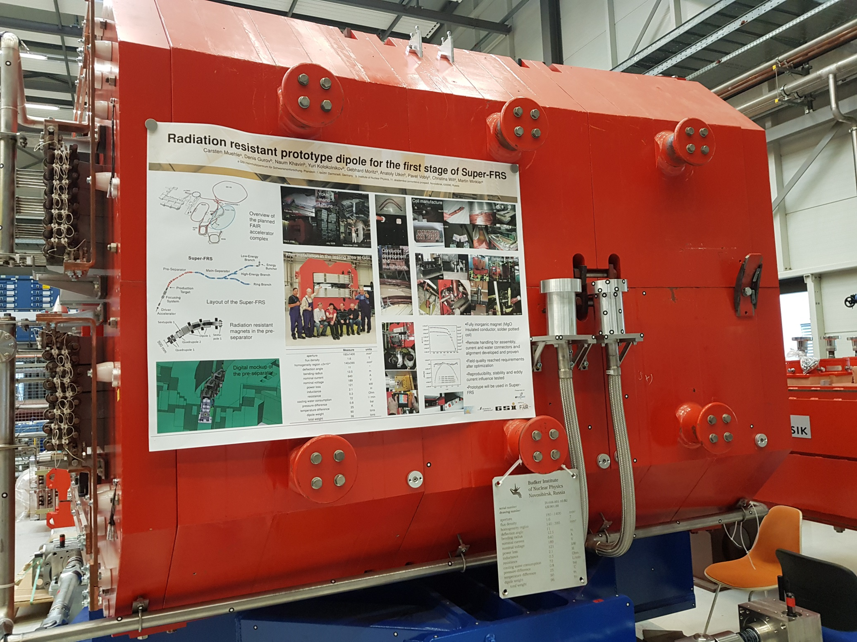

Slide 29
