Slide 1
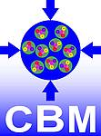
Experience of the Development of the Geometry Database for the CBM Experiment
Akishina E.P.¹, Alexandrov E.I.¹, Alexandrov I.N.¹,
Filozova I.A.¹, Friese V.², Ivanov V.V. ^{1,3}
^{for the CBM Collaboration}
¹LIT JINR, Dubna
²GSI, Darmstadt
³MEPhi, Moscow
Joint Institute for Nuclear Research

Slide 2
Motivation
Variety of detector modules;
Flexibility: combine different modules for different setups (e.g., sis100_electron, sis100_muon);
Evolution of geometries and variants in particular in the design and construction phase of the experiment;
The same module can be used in different contexts / setups with different placements;
Necessity to administer this variety and flexibility and the evolution of geometries in a fail-safe, reproducible and transparent way.
Tasks
Store the modules of CBM;
Load the geometry modules for setup construction;
Construct setup from the stored modules;
Show the CBM setup;
Support different versions of setup.

Slide 3
Basic Definitions
Geometry Module
File in ROOT format with content of detector geometry
Setup Module
Geometry module, link to the mother geometry module, its placement in the mother module (transformation matrix or object of class TGeoMatrix)
Setup
Combination of setup modules which represents the full CBM geometry

Slide 4
Setup Structure

Slide 5
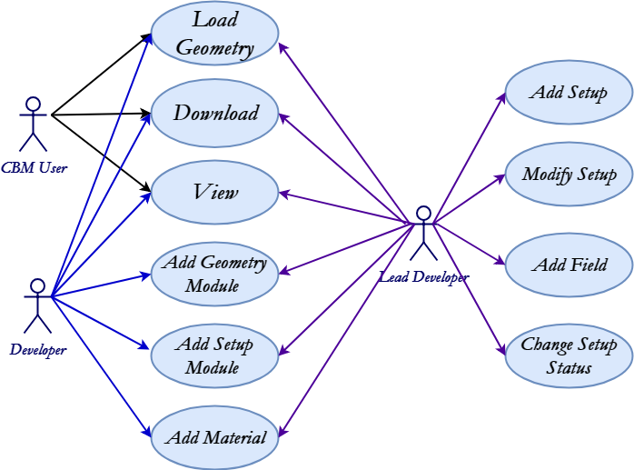
Geometry Database. Use Cases
The Geometry DB is used:
to provide interfaces to view, retrieve and update modules and setups
to store setups as combination of setup modules, magnetic fields and materials
to store setup modules as ROOT files and Transformation matrix

Slide 6
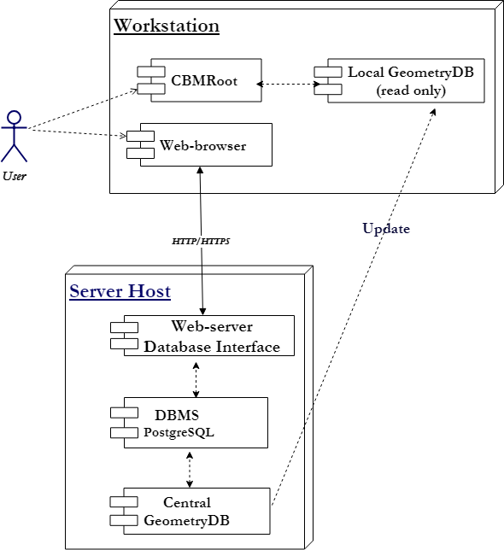
Component Diagram

Slide 7
The implementation
GUI (Graphical User Interface) implemented as Web-interface.
View;
Edit;
Download.
API (Application Programming Interface) implemented as macros of the ROOT environment. Any macro can be used as executable file or can be called from other ROOT macros.

Slide 8
Web-interface. Configure Access

Slide 9
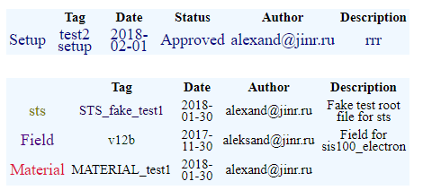
Web-interface. View Mode

Slide 10
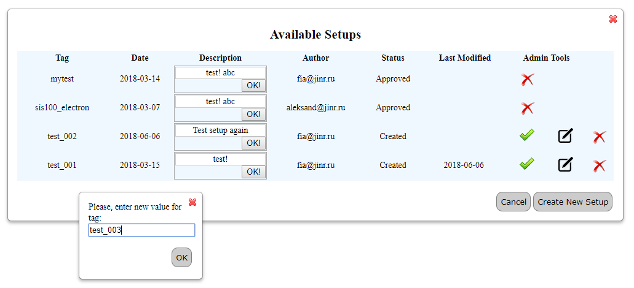
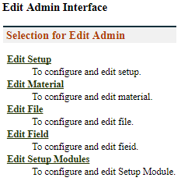
Web-interface. Edit Mode
Delete this setup: make this setup unavailable for usage
Approve this setup: change the status to Approved
Modify this setup: go to modification form
√
Go to the Form for Setup Compiling →

Slide 11
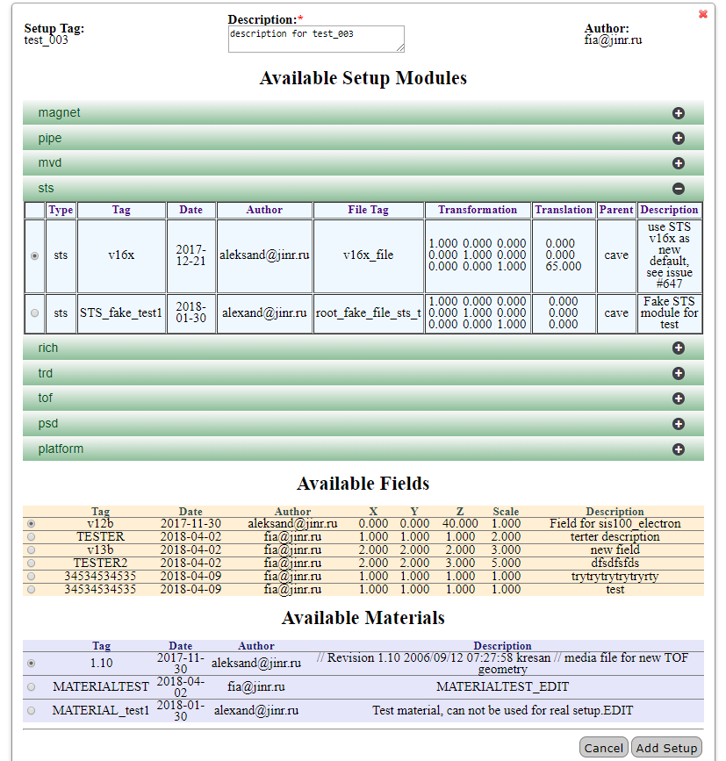
Web-interface. Setup Compiling
(Add New Setup)

Slide 12
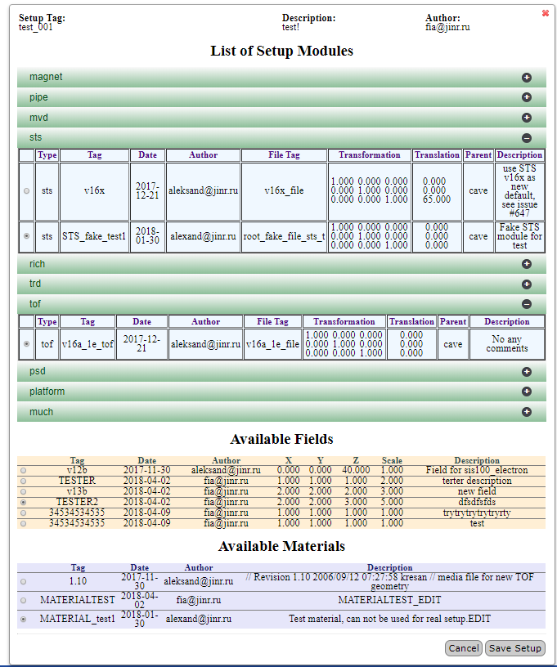
Web-interface. Setup Modifying
(Change the Selected Setup)

Slide 13
Macros
Signature | Description | Call Example | Comment
void getSetupList(); | Get the list of available setups. Print the list of available setups including tag, date of creation, author and description parameters for each approved setup. | getSetupList.c(); | Return the available setups’ list
bool loadSetup(const char* setupTag, const char* moduleName); | Load setup into the CBM ROOT framework. The Geometry can be used in ROOT framework afterwards. Return FALSE if setup is not loaded, and TRUE if the loading is successful. | bool res = loadSetup(“sis100_electron”, “*”); | “*” – all setup modules to be loaded
bool loadSetup(const char* setupTag, int moduleId); | Load setup into CBM ROOT environment by module Id to load setup into the CBM ROOT framework. The Geometry can be used in ROOT framework afterwards. Return FALSE if setup is not loaded, and TRUE if loading is successful. | bool res = loadSetup(“sis100_electron”,-1);
bool loadSetup(const char* setupTag, const char* moduleName, const char* xml); | Load setup into the ROOT environment. Geometry can be used in the ROOT environment after this operation. User can use xml file in order to move any setup module during loading. Return false if setup was not loaded because of errors and true if load is successful. | loadSetup("sis100_electron", ”*”, "local.xml") | xml file contains information on the setup modules and their shifts.

Slide 14
Conclusion and Next Steps
Geometry DB prototype for storing and retrieving the geometry of CBM modules has been developed:
DB (DBMS PostgreSQL, SQLite);
GUI (Graphical User Interface) tools;
API (Application Programming Interface) tools as a set of ROOT macros;
Beta Testing.
Continue filling DВ
Preparing to include into CBMRoot release

Slide 15
Thanks for your attention!

