Slide 1
”3D-Printed Detectors” and Detector Integration modern manufacturing technologies and functional materials in detector system design ATLAS and CMS Endcap Design and Engineering Challenges Christian J. Schmidt 13.06.2018

Slide 2
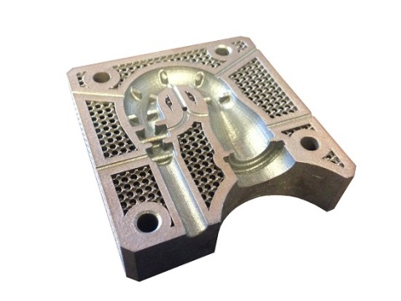
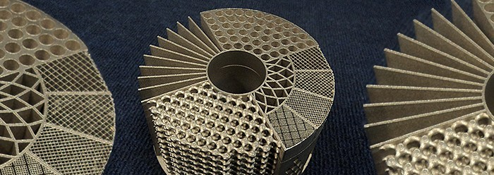
Towards 3D-printed Detectors and Detector Integration
Functional 3D-printing: Printed particle Detectors
from CAD to batch-size 1 production
include functionality beyond mechanical shape:
Low-Z, low R signal conductors → Laser/InkJet-Printed Circuits
Complex metallic capillary cooling structures (as e.g. in Belle II upgrade)
Semiconductor 3D-post processing (Si/Ge-Det. avoid rad. sensitive surface doping, integration of cooling lines etc.)
3D-printed mechanical structures and interconnect
Integration of optical and conductive data interconnect
precision field cage degraders
The forgotten realm in material thickness (2 to 50µm)
precision high purity electrolytic deposition of none copper materials
molecular plating of compounds for high purity surfaces
realization of low-Z power and signal lines as well as via-connections → e.g. Ink-Jet print on 3D-Surfaces, enhance through galvanic build-up

Slide 3
3D-Plastic-Extrusion Printing more and more comonly used
3D-Printing used in detectors and instrumentation for mock-ups and communication
David Anderson at DENIM 2015 on the neutron instrument VISION

Slide 4
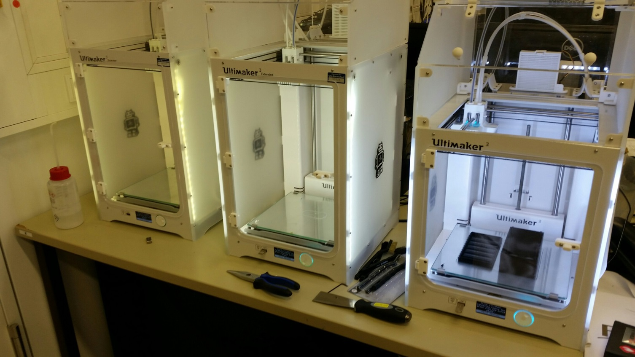
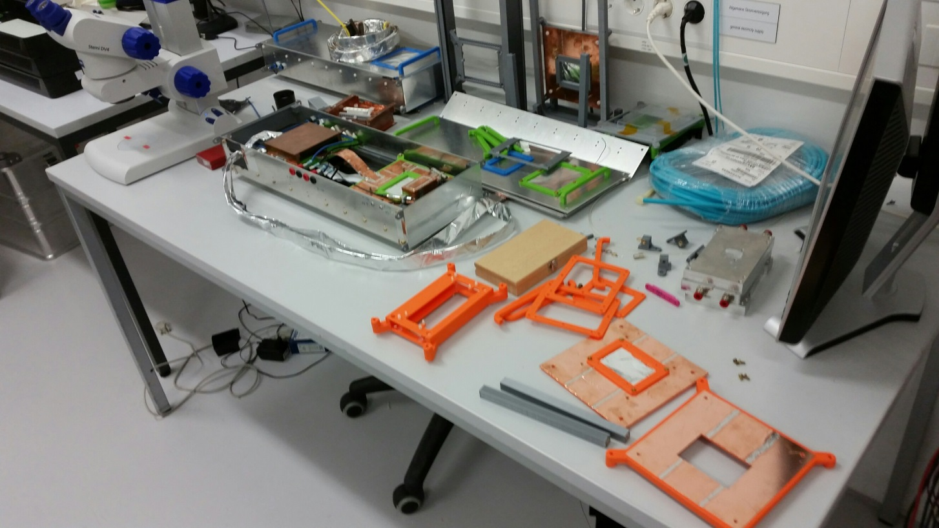
@ GSI recent heavy use of 3D-Print for ordenary experimental work
The CBM-STS developments heavily employ one of 5 Ultimakers
Devices rentate in no time
Even small series of parts are being printed (~ several hundred)
Cheap ~ 5k€ machines serve to provide parts for many applications with little particular demands in material specs.
Scientists can easily make their own part → and they do! → no need to wait weeks for the workshop

Slide 5
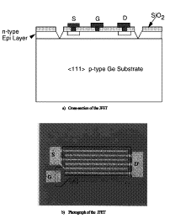
Detector Challenges
Full 4π coverage with negligible blind area and high granularity
Minimized material budget
Active Targets (the target itself enabled as detector) , structured targets
Detector power and DAQ
Detector power management
power distribution
cooling
GHz data transmission, impedance defined data lines
Integration of exotic, active materials
Integration of front-end electronics onto Germanium detectors

Slide 6
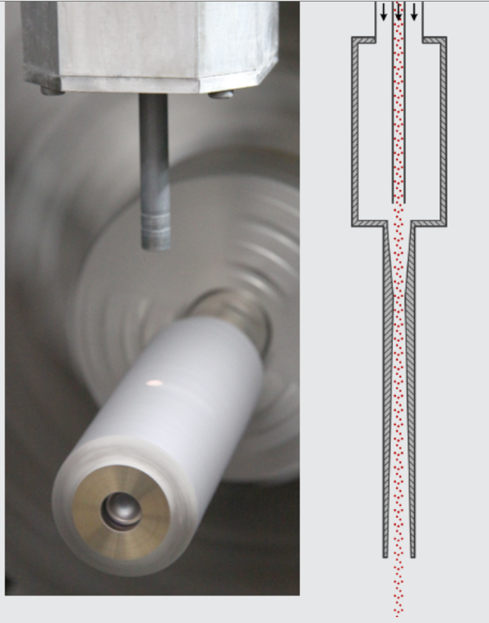
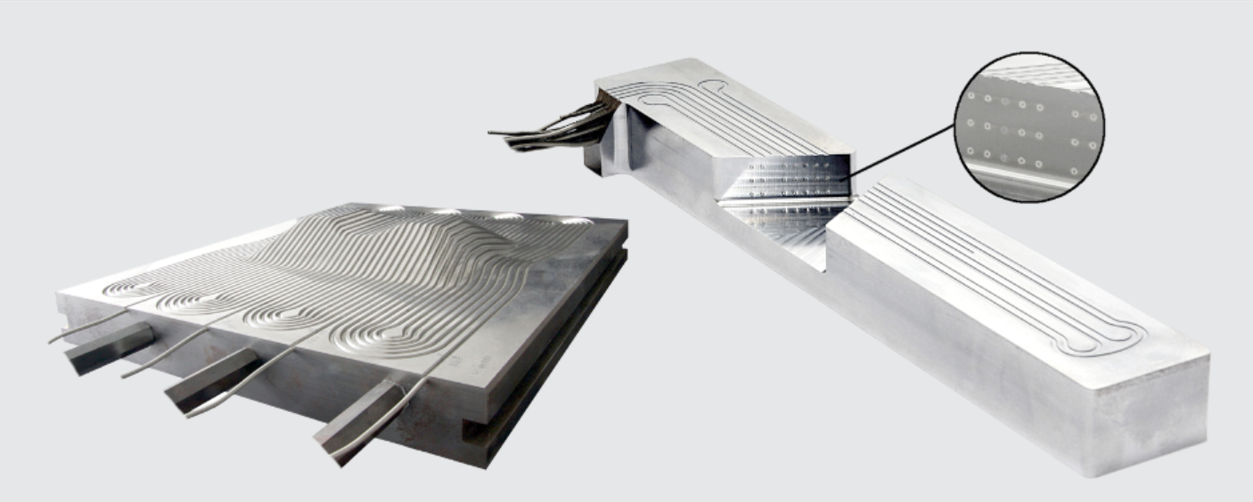
Beyond Slicing, beyond plastics
Example: Hermle Additive Manufacturing
Metal powder in a supersonic beam fused to substrate
Combination with 5-axis milling center

Slide 7
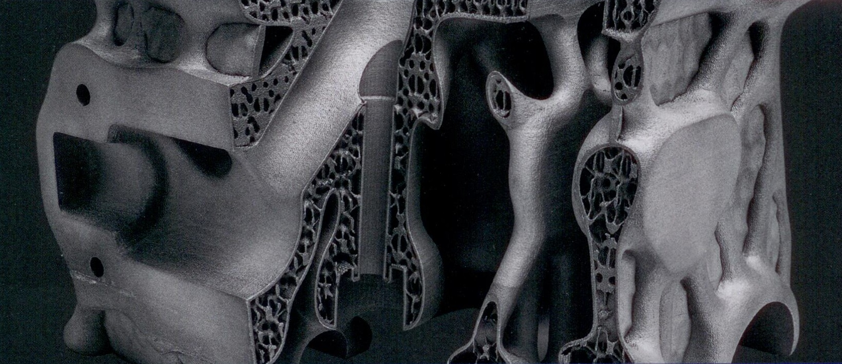
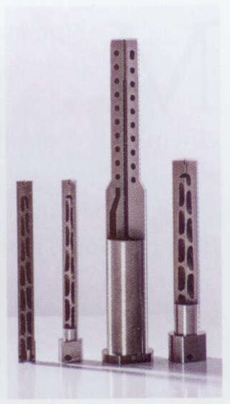
Extremely lightweight 3D-Cooling Structures
low mass in mobile technologies translates to low material budget
→ example motor cylinder head
direct cooling translates to electronics power densities
→ direct cooled drills and tools

Slide 8
Technologies rapidly evolving but still mostly island solutions
mechanical 3D-printing for shape prototyping
functionality beyond shape step by step added
electrical conductivity
mechanical strength, mechanical bonding strength
thermal conductivity
material properties (e.g. sensor materials)
modern laser structuring tools allow 3D-shaping of dedicated, highly specialized sensor material
→ CdZnTl high Z sensors
Diamond Sensors, Diamond membrane sensors, 3D-Diamond
Silicon/Germanium sensors
ultra low noise detector compounds for astronomy, satellites and astrophysics

Slide 9
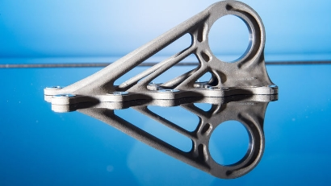
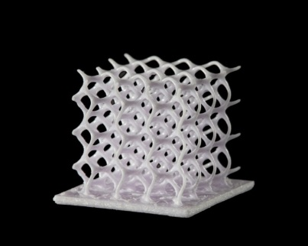
Bionic Design → Engineering to be learned anew
3D additive manufacturing introduces new dimensions in engineering options
Challenge for intellectual exploration
Only people can exploit the full potential for future detectors
→ need to let them work and play with new possibilities

Slide 10
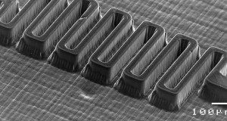
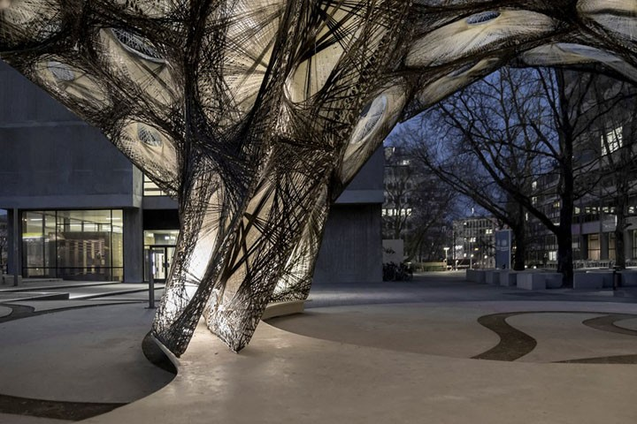
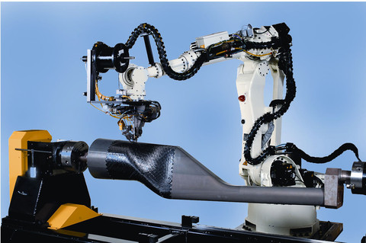
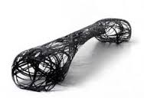
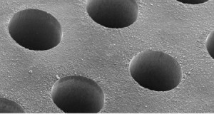
Equipment: Technological Directions
3D-Printers, additive manufacturing – ceramic, metallic, plastics....
Conductive ink-jet printers
Femtosecond ablation for high aspect ratio micro structures
Plasma etching along Bosch-Process
Laser Lithography
Laser assisted soldering and interconnect
LTO (low temperature oxide) capable LPCVD
Carbon-Fibre-Composite 3D laying robot

Slide 11
New materials, examples
Airex → foam with up to 98% air content for rugged sandwich structures
Carbon foam
Sinthetic graphite foil
heat spreader tape with conductivity like diamond
adhesive PET layer → assembly and HV isolation
conduction lateral
little conduction perpendicular to plane
Example taped CMS tracker module design, Wim de Boer et al

Slide 12
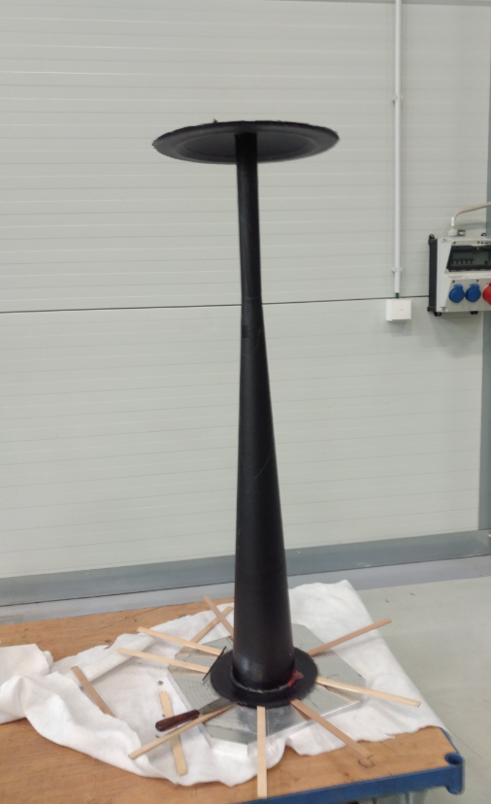
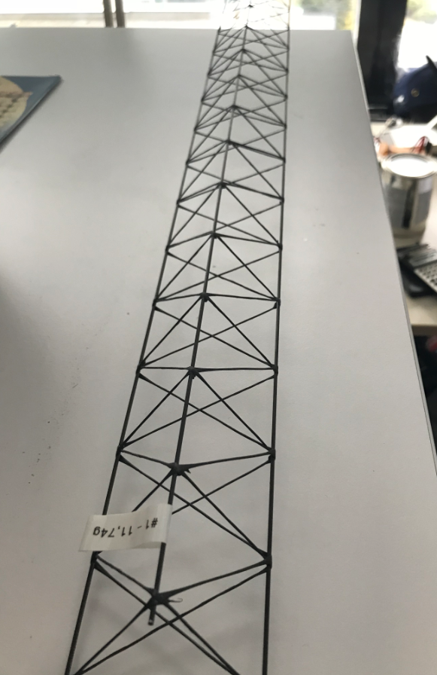
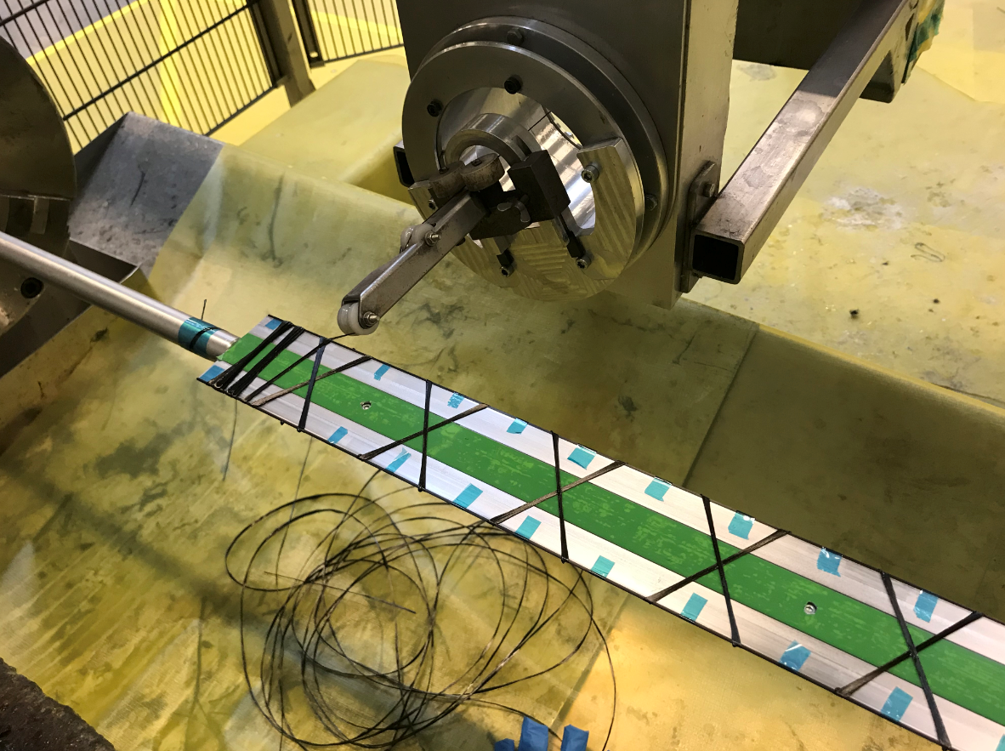
Example: fiber carbon composit structures
CBM-STS Beampipe
CBM-STS Silicon Detector Ladders

Slide 13
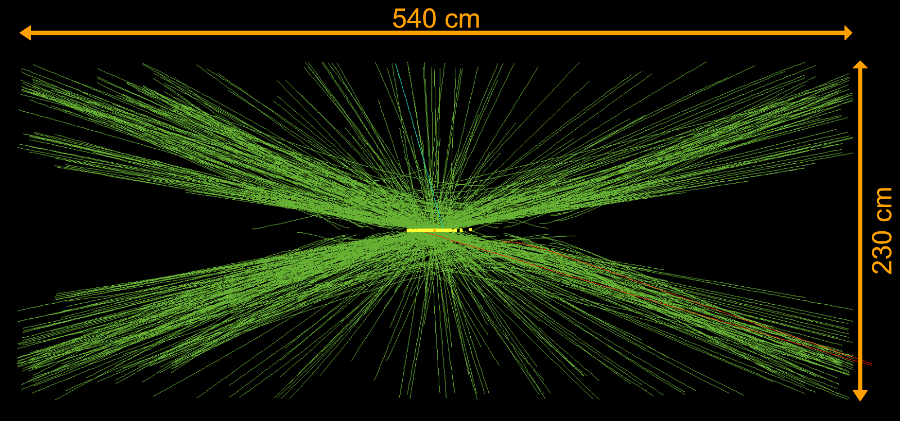
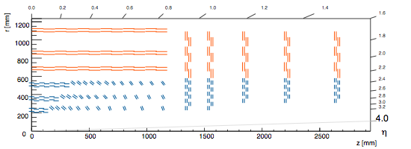
The Phase 2 Upgrades of the ATLAS & CMS Trackers
Examples of engineering challenges currently addressed
The High-Luminosity LHC
High-luminosity operation will start in 2026
4000 fb⁻¹ expected ultimate integrated luminosity over ten years
Both ATLAS & CMS will replace their inner tracking detectors
The new tracking detectors
Will consist of several thousands of detector modules
O(200) m² of silicon
Cooled with evaporative CO2 and operated below -30 °C

Slide 14
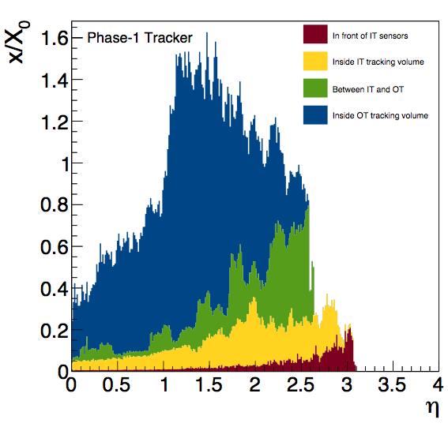
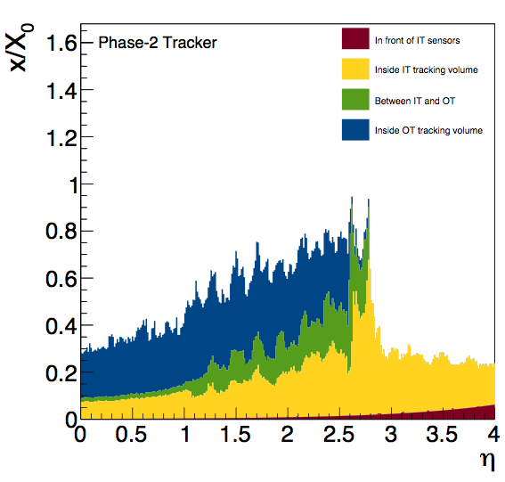
CMS Phase 2 Tracker End Cap Design
Goal is to reduce material budget by a factor of 2
Backbone is a carbon fibre sandwich half-disk structure
230 cm in diameter
10 mm thickness
Modules are mounted from both sides onto structure
< 100 μm positioning precision
20 half-disks are combined to build one end cap
150 cm total length
now
then

Slide 15
CMS Phase 2 Tracker End Cap Design
Six cooling sectors each with ~6 m length
Cooling pipes embedded in
480 cooling and positioning inserts
76 carbon foam heat spreaders spanning through the full thickness of the sandwich
Sandwich core is a mixture of structural and carbon foam
228 additional positioning inserts
Two types of glues used in the same assembly steps
Structural & thermally conductive (boron nitride doped)

Slide 16
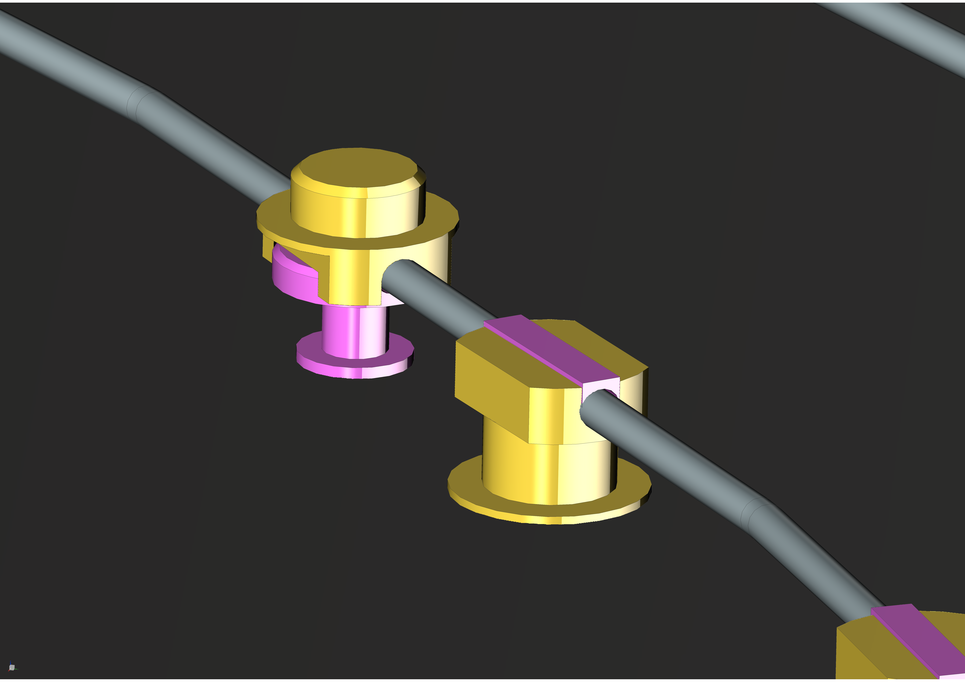
CMS Phase 2 Tracker End Cap Design
Cooling and positioning inserts are currently glued onto pipe
Grooves in inserts are closed by lids to increase contact area to pipe
What if the insert could be printed around the cooling pipe
no adhesive joint ➟ better thermal performance
less assembly work
Six cooling sectors each with ~6 m length
Cooling pipes embedded in
480 cooling and positioning inserts
76 carbon foam heat spreaders spanning through the full thickness of the sandwich
Sandwich core is a mixture of structural and carbon foam
228 additional positioning inserts
Two types of glues used in the same assembly steps
Structural & thermally conductive (boron nitride doped)

Slide 17
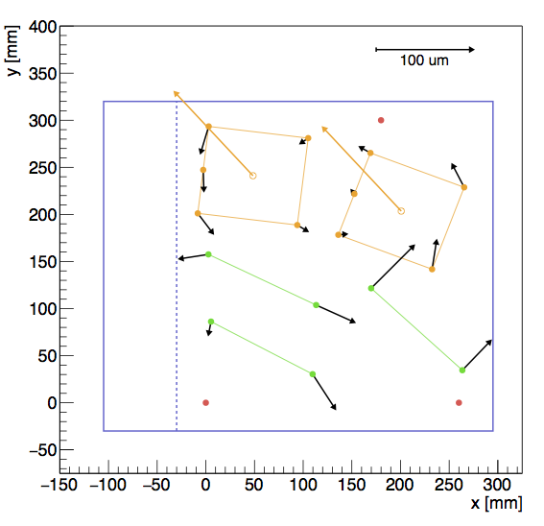
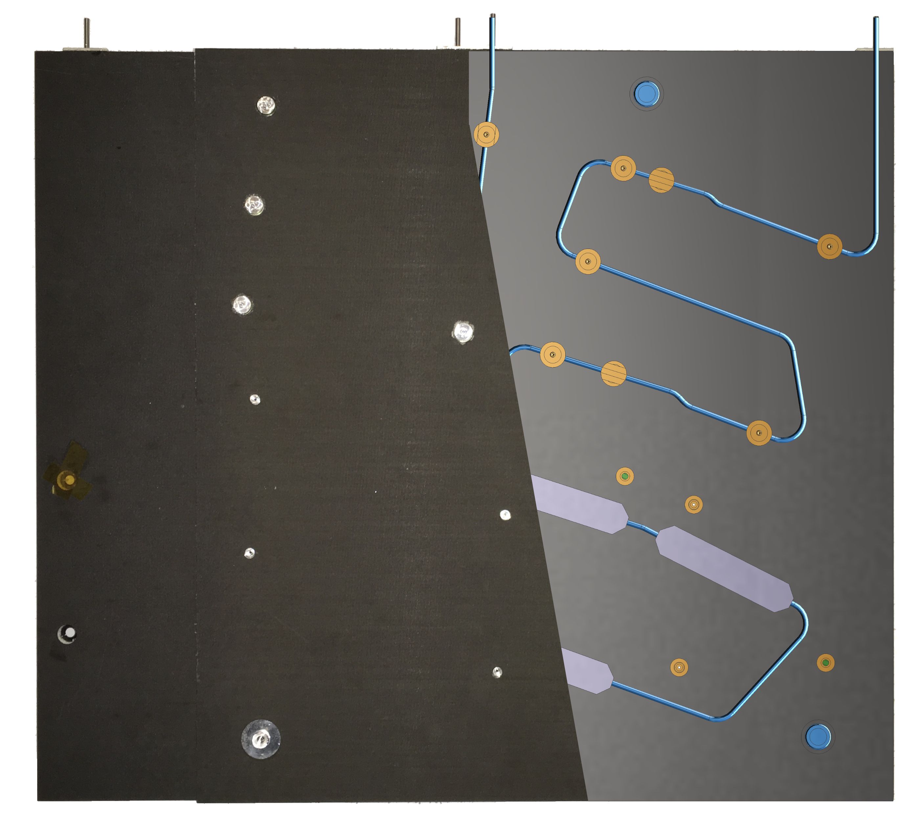
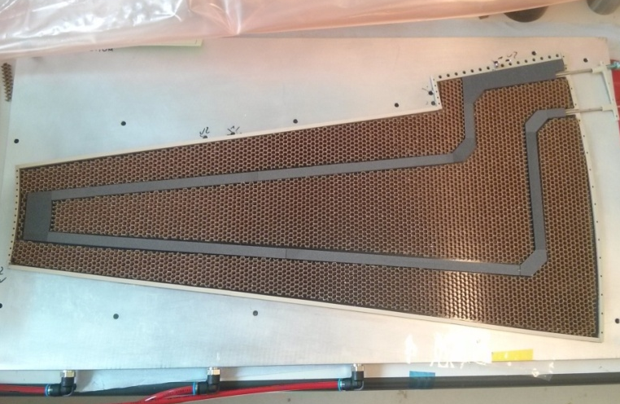
Prototyping of Support Structures
Small Scale Prototype CMS Half-Disk Structure
35 cm x 40 cm in size
Two cooling loops and corresponding inserts and cooling blocks
Study assembly sequence and precision, and cooling performance
Measured offset to nominal insert positions < 65 μm
< 50 μm
ATLAS prototype of full-sized petal
60 cm x 40 cm in size
One cooling loop fully embedded in carbon foam
CAD
< 65 μm
prototype

Slide 18
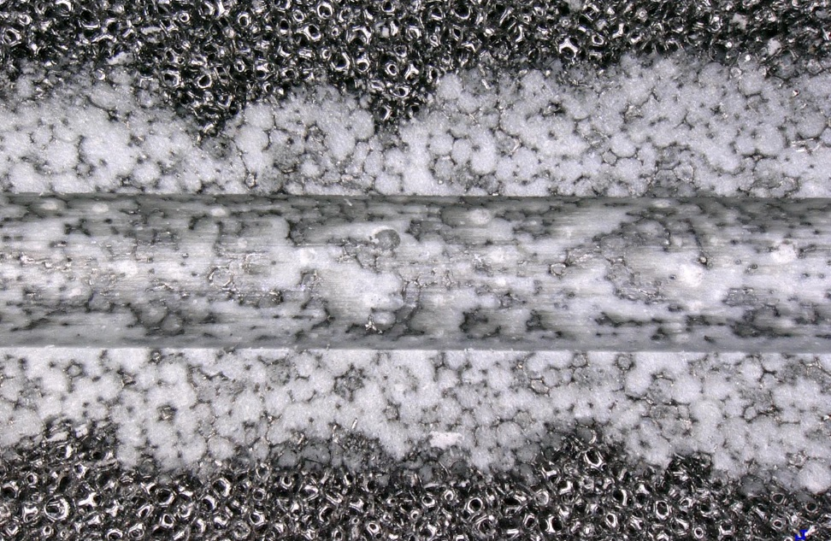
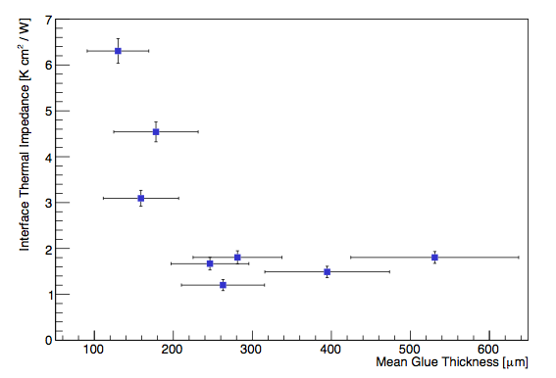
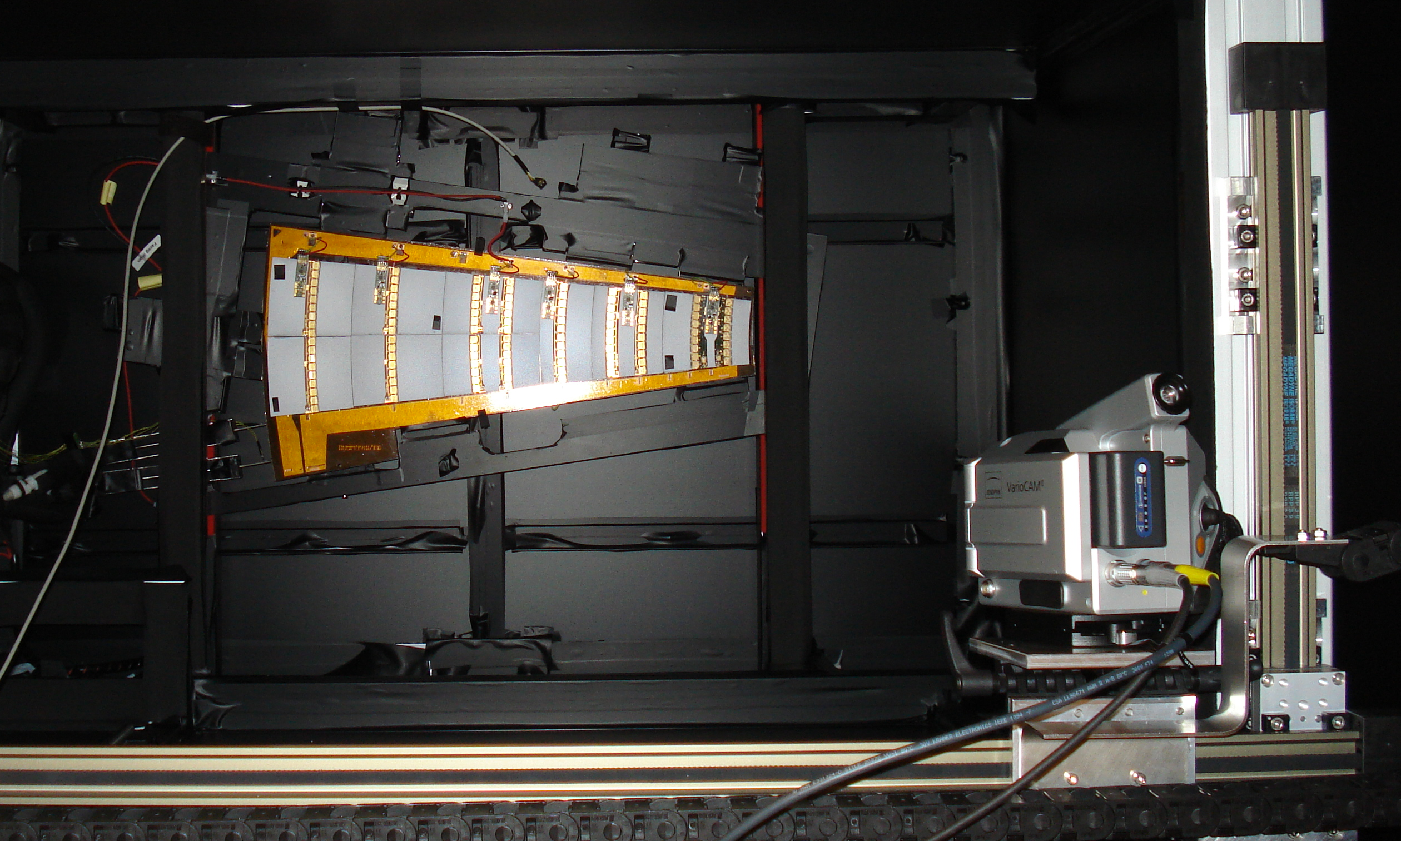
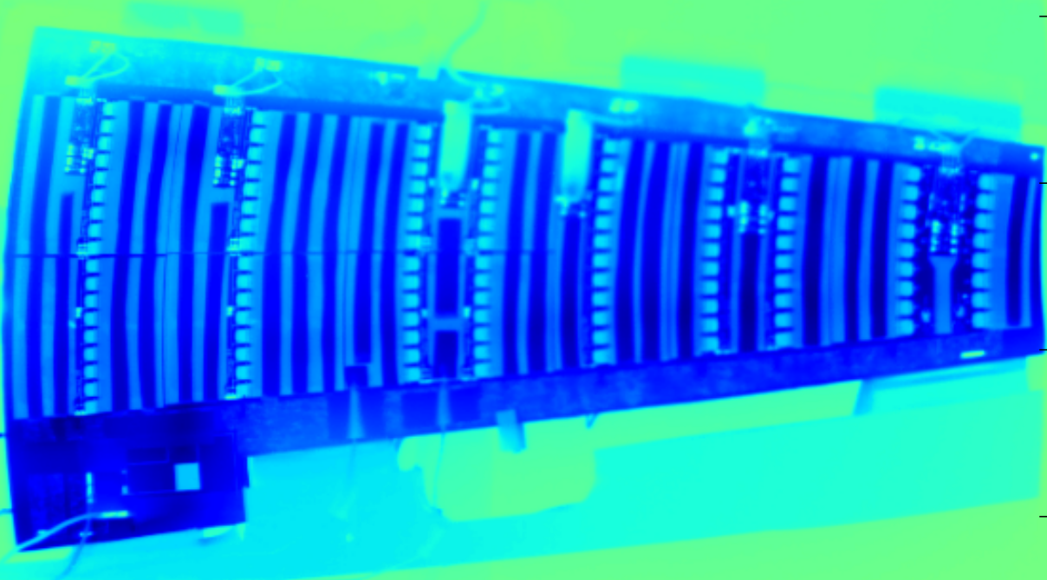
Thermal Testing
The Key to Good Thermal Performance
Understanding of novel raw materials
E.g. thermal impedance between cooling pipe and carbon foam
Development of machining, handling and processing techniques
Especially if we drive usage beyond the specified regime
2.5 mm
Qualification of final support structures
E.g. identify weak thermal contacts via IR thermography

Slide 19
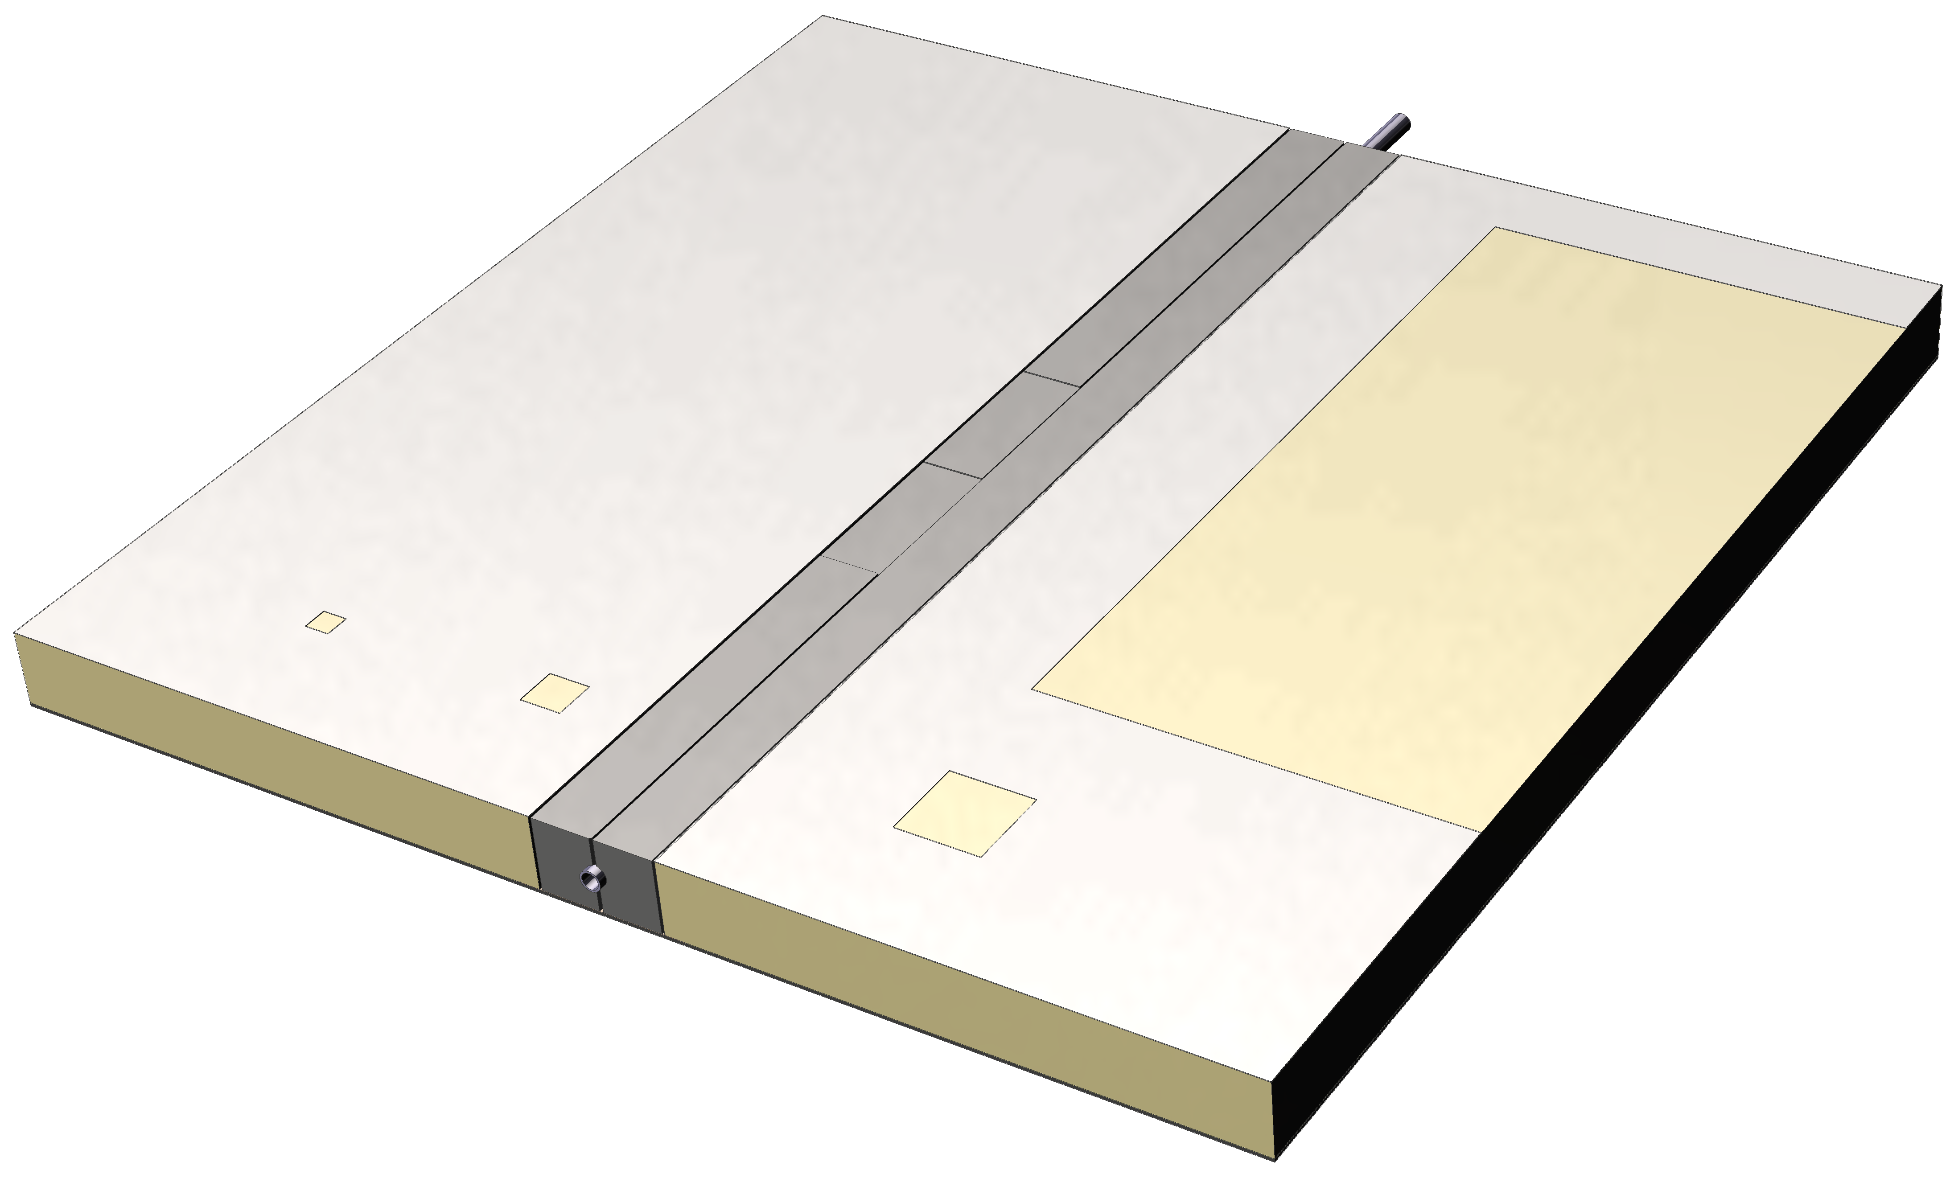
Diagnostics
Performance relies on high-quality adhesive bonds
For best mechanical stability and cooling performance
Ultrasonic inspection allows for non-destructive testing
Example: investigation of sandwich structure with carbon fibre facings
10 mm x 10 mm void in adhesive bond area
uniformity of adhesive bond between carbon foam and facing

Slide 20
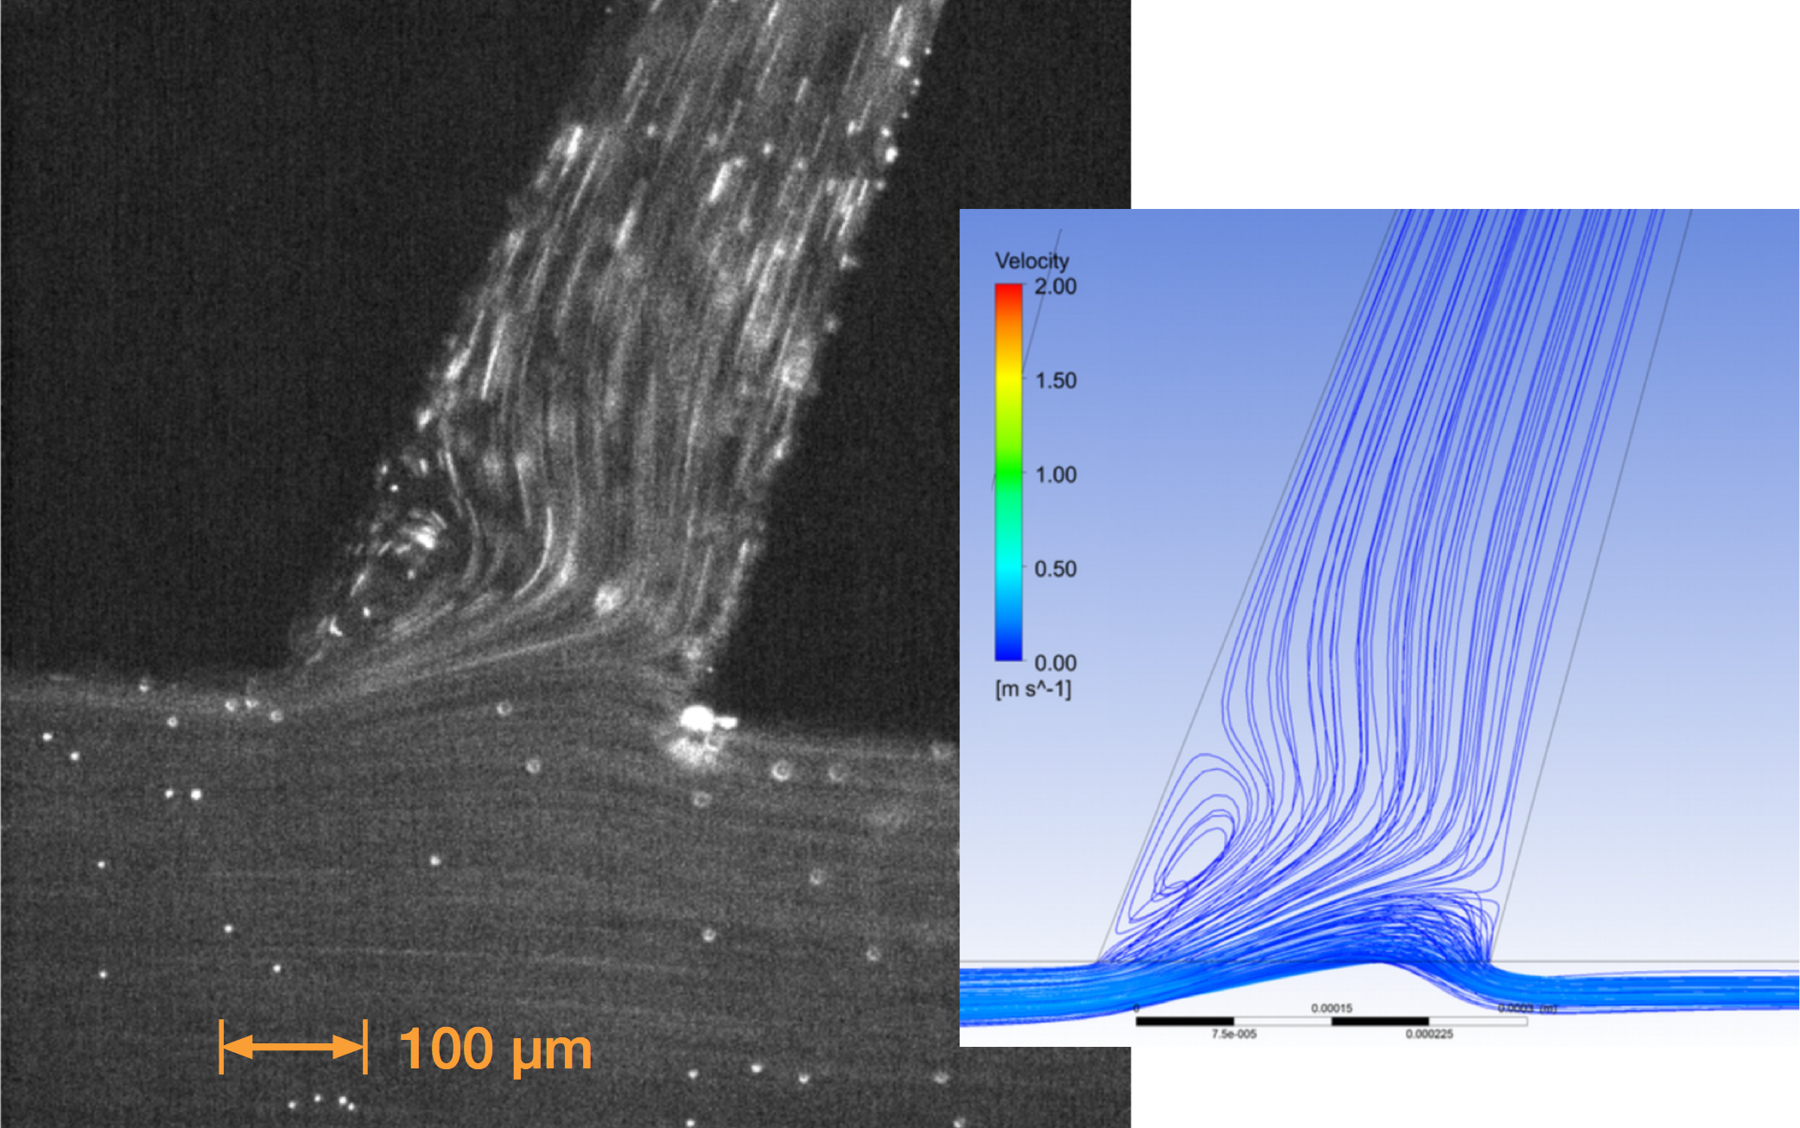
Microchannel Cooling
Cooling at the Next Level
Conventional cooling relies on thermal conduction between heat source and coolant
Smaller temperature gradient typically means more mass
What if coolant could be brought closer to the heat source?
Ideal for large power densities, e.g. pixel detectors
Microchannel cooling: ~100 μm wide channels etched in silicon substrate
Heat conduction path < 1 mm
Perfect match in terms of coefficient of thermal expansion (CTE)
➟ no thermal stress

Slide 21
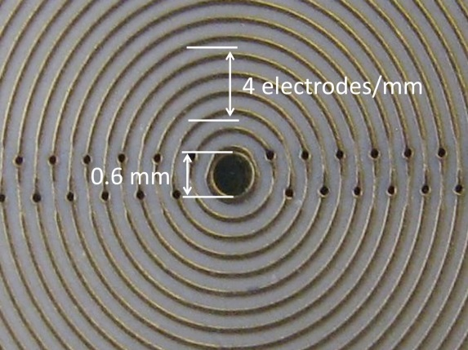
One Theme of Distributed Detector Lab: “3D-Printed Detectors” Modern Materials, Modern 3D Structuring Technologies, Modern Additive and Subtractive Machining and Engineering
Necessary invest can be financed through the DDL, the brains we need to supply ourselves.
3D-Printing-oriented Engineering
ultra lightweight structures
combined functionality
power management
complex metallic capillary cooling structures
Integration of optical and conductive data interconnect
RF carpets to stop
relativistic fragment ions
Stopping power ~ Structure³

Slide 22
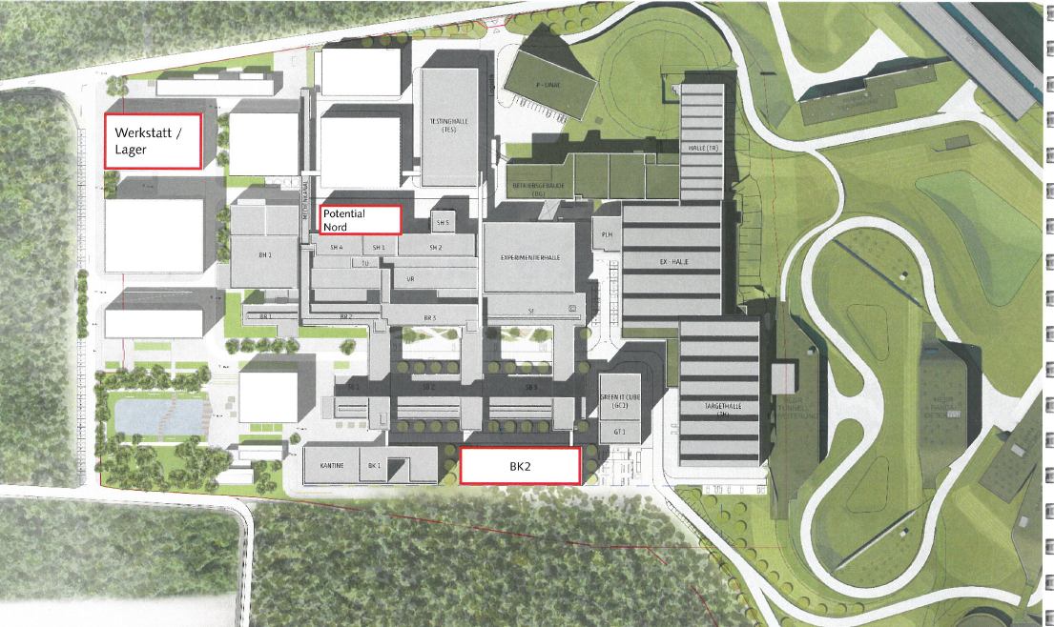
GSI/FAIR Campus Masterplan indicates Area for DDL Infrastructure
New lab could find a site:
850 qm real estate
Construction limit 23m
Could give central home to:
Germanium Detector Lab
Experiment Electronics
ASIC and Si-Pixel Lab
Cryo-Detectors Lab
3D-Printing Lab
Material Sciences and Nano-Technologies Lab

Slide 23
