Slide 1
The Silicon Tracking System of the CBM experiment at FAIR
Johann M. Heuser, GSI Helmholtzzentrum für Schwerionenforschung GmbH − for the CBM Collaboration − 4th Helmholtz Matter and Technologies Meeting, Berlin, 12-14 June 2018

Slide 2
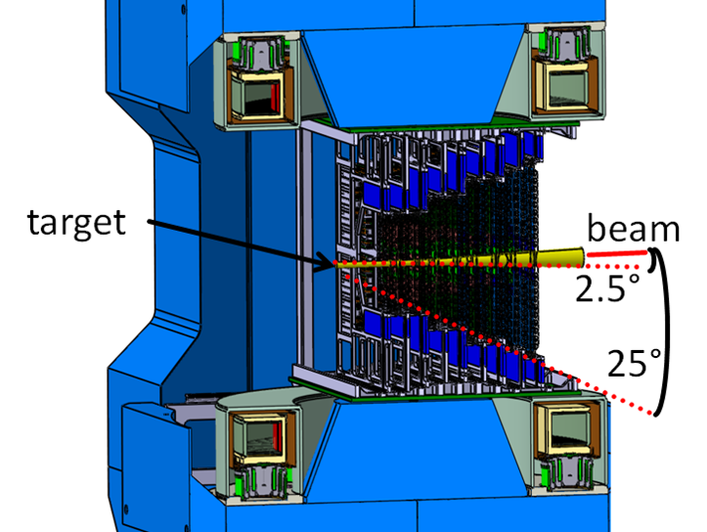
CBM: world-record high-rate heavy-ion physics experiment
Compressed Baryonic Matter; up to 10⁷ beam-target interactions/s
in preparation by the international CBM Collaboration at FAIR-SIS100
Silicon Tracking System STS: core CBM detector
identification of hundreds of charged particles per interaction
determination of their momenta in a dipole magnetic field

Slide 3
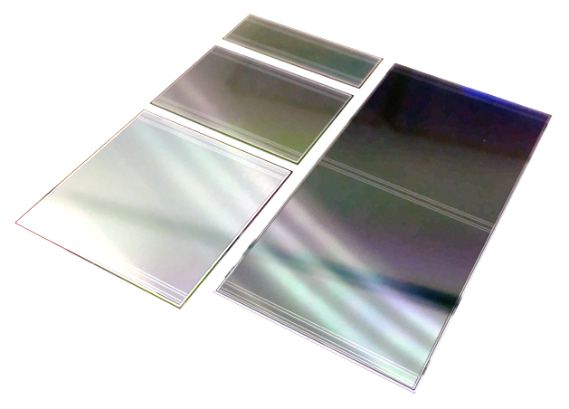
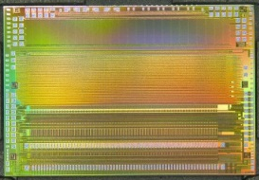
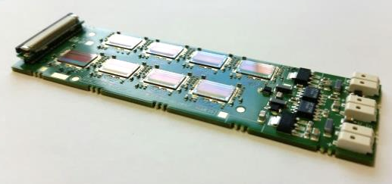
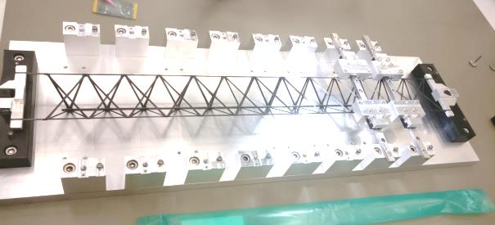
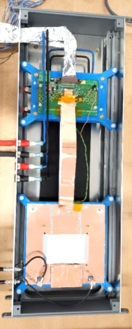
STS technical developments are advanced, construction starting in 2019
double-sided silicon microstrip sensors (high spatial segmentation, radiation tolerance)
self-triggering read-out electronics (high time resolution, charge measurement, high data throughput)
module + ladder assembly (low mass, handling, yield)
system integration, system demonstrators (performance tests: S/N, resolution, rate capability)

Slide 4
Germany, Russia, Poland are key STS contributors
distributed production of components
Helmholtz Centers play an important role:
GSI: * Project leadership, technical coordination * STS system integration * Detector Laboratory expertise + infrastructure * demonstrator experiment miniCBM at SIS18
Jülich: in-beam component tests with extracted proton beam at COSY
KIT: module assembly center
DESY: coordination of EU-H2020 Project CREMLIN: WP3: Joint development of STS by GSI and JINR

Slide 5
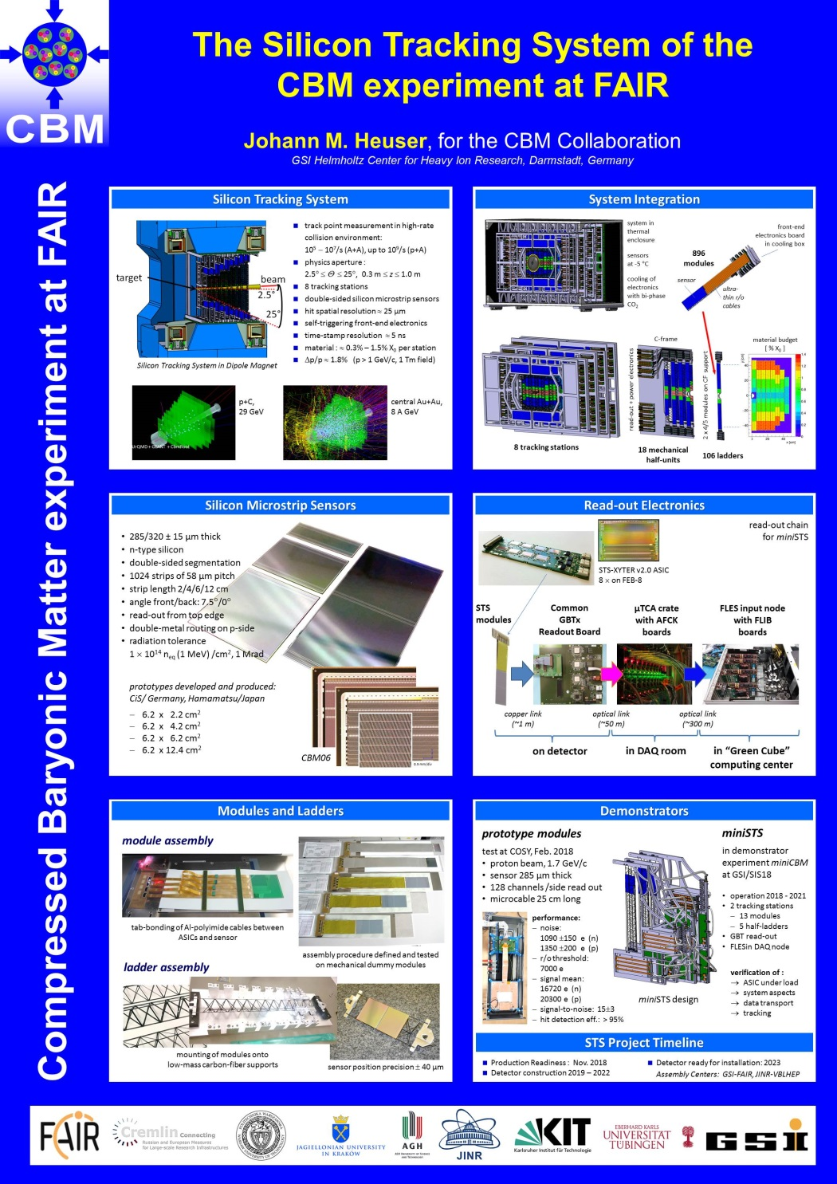
More at the posters:
+
P. Pfistner, KIT Module assembly technologies for the Silicon Tracking System of the CBM experiment at FAIR
+
A. Rodriguez Rodriguez, Univ. Frankfurt The front-end electronics of the CBM Silicon Tracking System
+
M. Dogan, GSI and Istanbul University STS-XYTERv2 and prototype FEB-B tests for the CBM Silicon Tracking System

