Slide 1
Cycle to cycle hysteresis and Timing issues? → as seen from BPMs R.Singh and S.H Mirza
What are these kinks on dipole ramp and the associated beam loss?
Red: Dipole ramp
higher injection
Timing?
Blue: DCCT
12.07.2018, Night shift → Orbit was moving by 2 mm at injection every 7-8 cycles

Slide 2
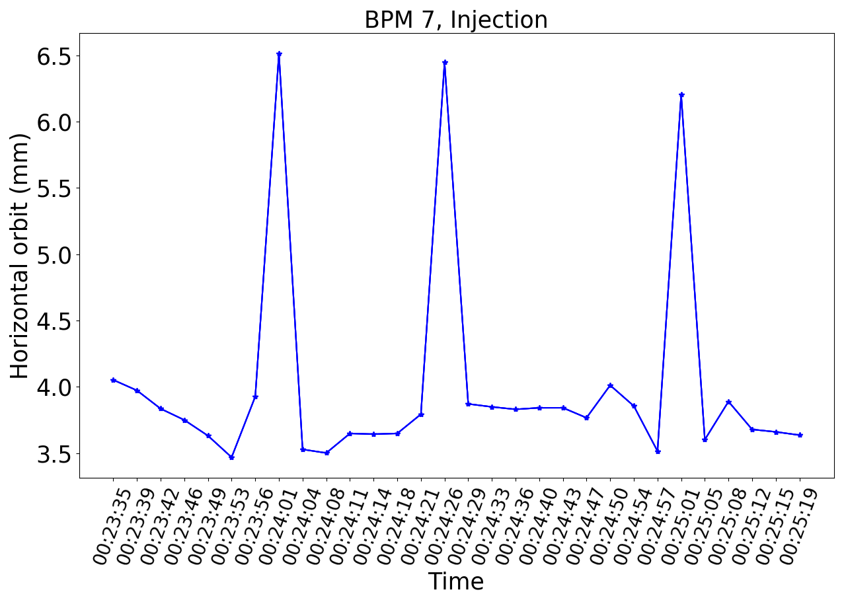
Hypothesis: A longer delay between dipoles ramps causes different magnetic field seen by the beam
The orbit changes significantly cycle to cycle in this case.
40

Slide 3
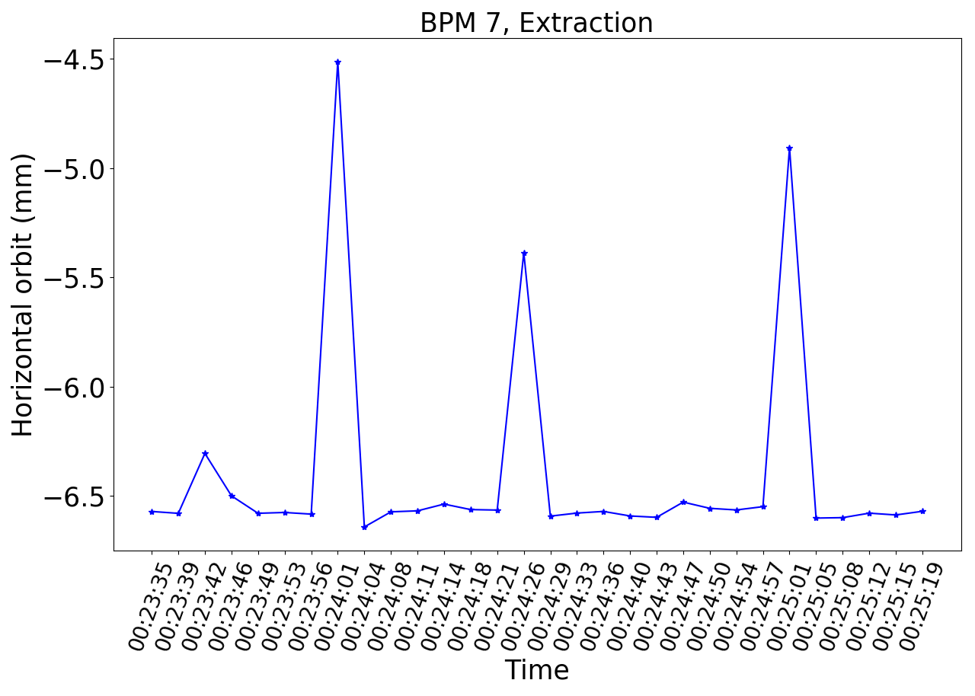
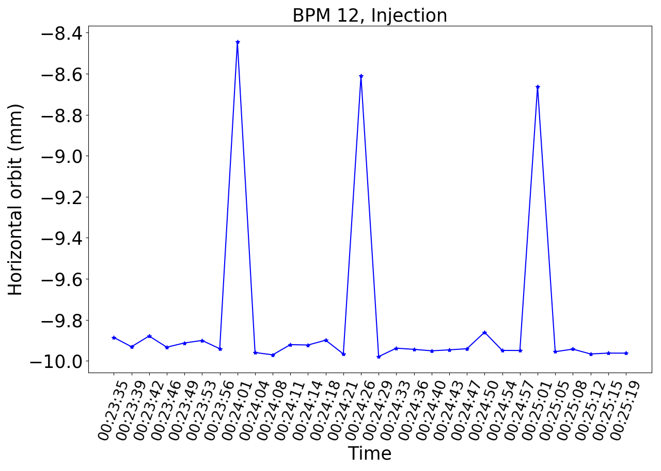
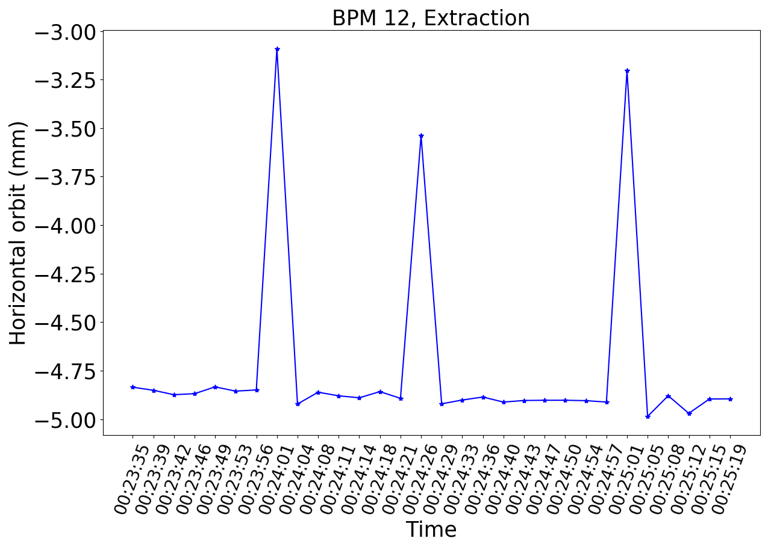
Position distortion till extraction, effect on slow extraction?
40

