Slide 1
Current status of SIS18 operation
stable operation mode has not yet established
main dipole frequent tripping off. This can happen as often as 5-10 mins
This has been under investigation. Attempts made, but not yet successful
SIS18/UNILAC timing issue
This seems to happen when UNILAC operation mode changes, ie number of virtual accelerators changes
Tuning of HEBT
no replacement of either SD program or MIRKO yet
very time consuming in searching key components: magnets, valves, etc
tripping of radiation protection
Not yet a consistent/obvious way to make sure the all the components (valves, grids, detectors) are out of the beam before taking the beam to the path
un-necessary radiation
can damage the detectors
Ring RF: large beam losses when NA cavity switch to MA cavity
more details from MK report

Slide 2
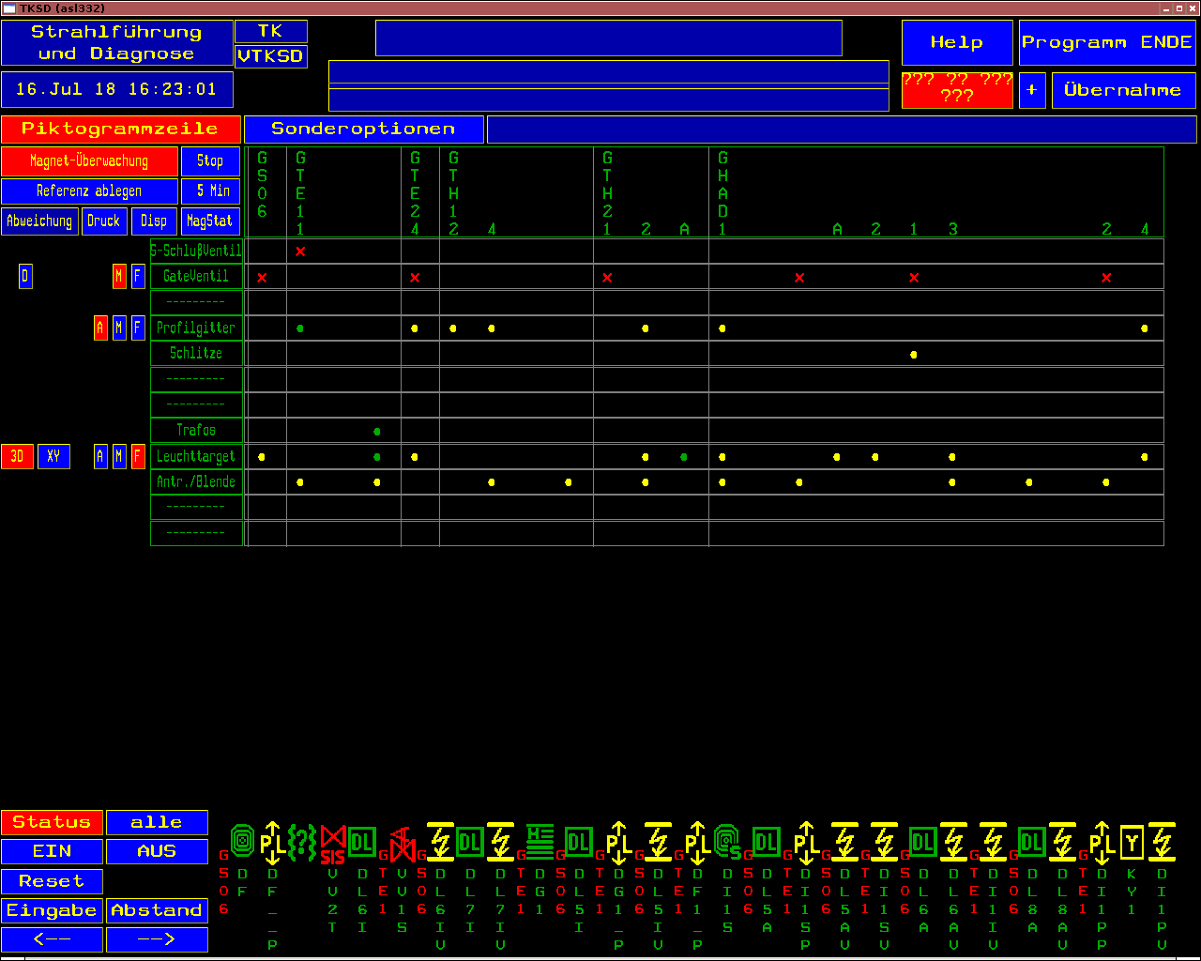
SD program

