Slide 1
PANDA The conceptual design of the control Dewar

Slide 2
PANDA control Dewar
The PANDA control Dewar is designed to the liquid and gas helium supply the solenoid in accordance with the flow scheme.
TL
- transfer lines (TL) connecting refrigerator and control Dewar
- transfer line (Chimney) connecting the vacuum vessels of the solenoid cryostat and control Dewar
D1600
2080
Chimney
Control Dewar
Figure 1. General view of the control Dewar.

Slide 3
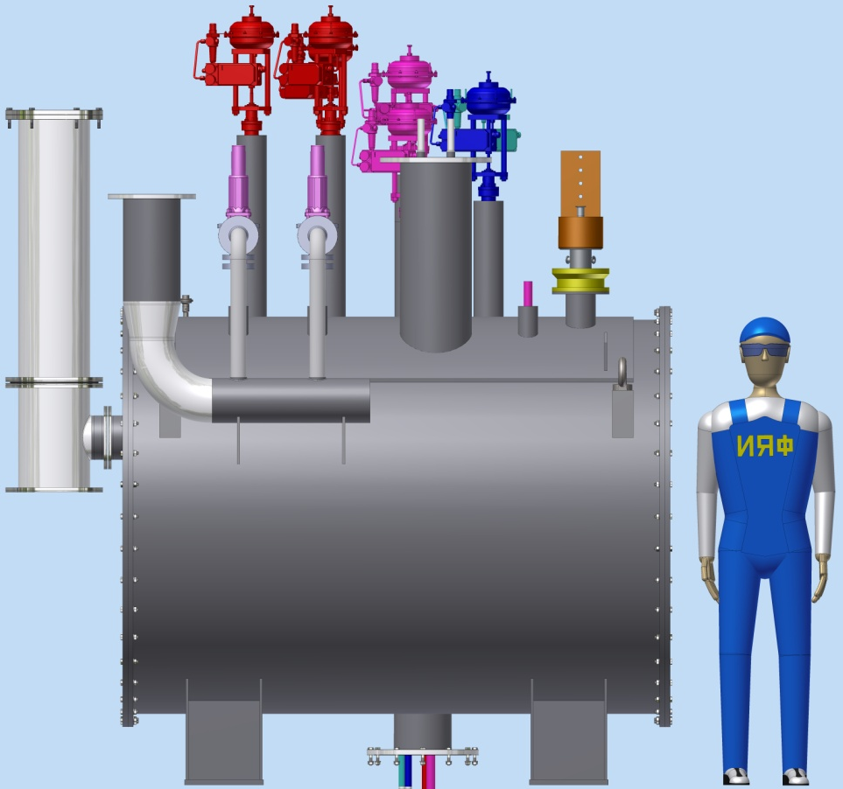
Control Dewar consists of:
• a vessel for liquid helium (~480L);
• current leads;
• thermal shields cooled by gaseous helium;
• valves, gauges;
• vacuum shell.
4
2
1
5
3
Figure 2. The main components of the control Dewar.

Slide 4
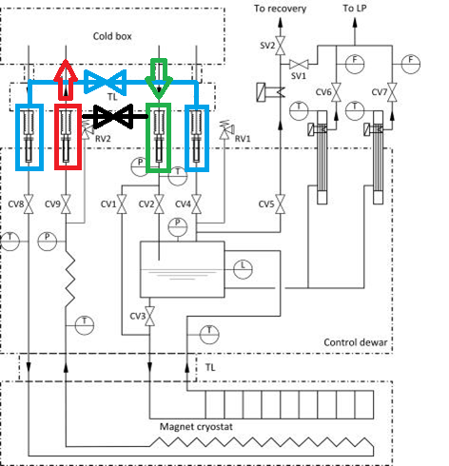
PANDA solenoid 2017, Flowscheme with comments of GSI
Selected valves that will be used when moving the detector from in the beam position to the assembling area.
Figure 3. Process Flow Diagram of the PANDA cryogenic system.

Slide 5
The stages of Assembly of the PANDA control Dewar:
1. Installation of pipelines on the cap plate of the control Dewar
Current
leads
Vessel
cap plate
-Pipeline 4,2K F red color
-Pipeline 5K R violet color
-Pipeline 40K F cyan color
-Pipeline 80K R blue color
He vessel
Figure 4. The stage 1.

Slide 6
The stages of Assembly of the PANDA control Dewar:
2. Installation of pipelines on the cap plate of the control Dewar
1100
4,2K F
5K R
40K F
80K R
1850
Figure 4. The stage 2.

Slide 7
The stages of Assembly of the PANDA control Dewar:
3. Installation of the thermal shields in the vacuum shell
Thermal
shield
Vacuum
shell
80K
Figure 5. The stage 3.

Slide 8
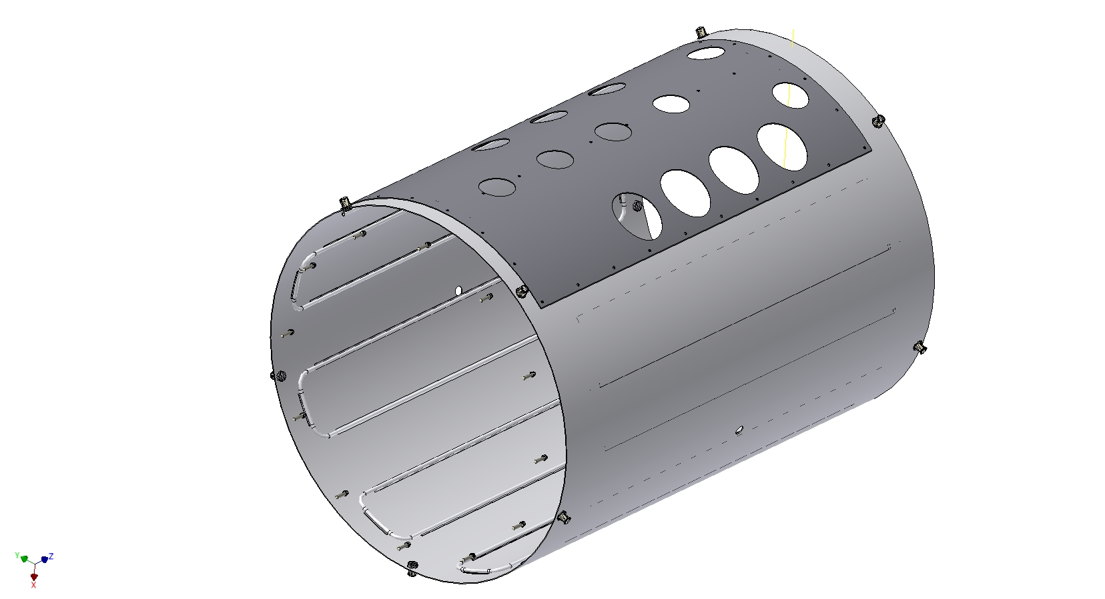
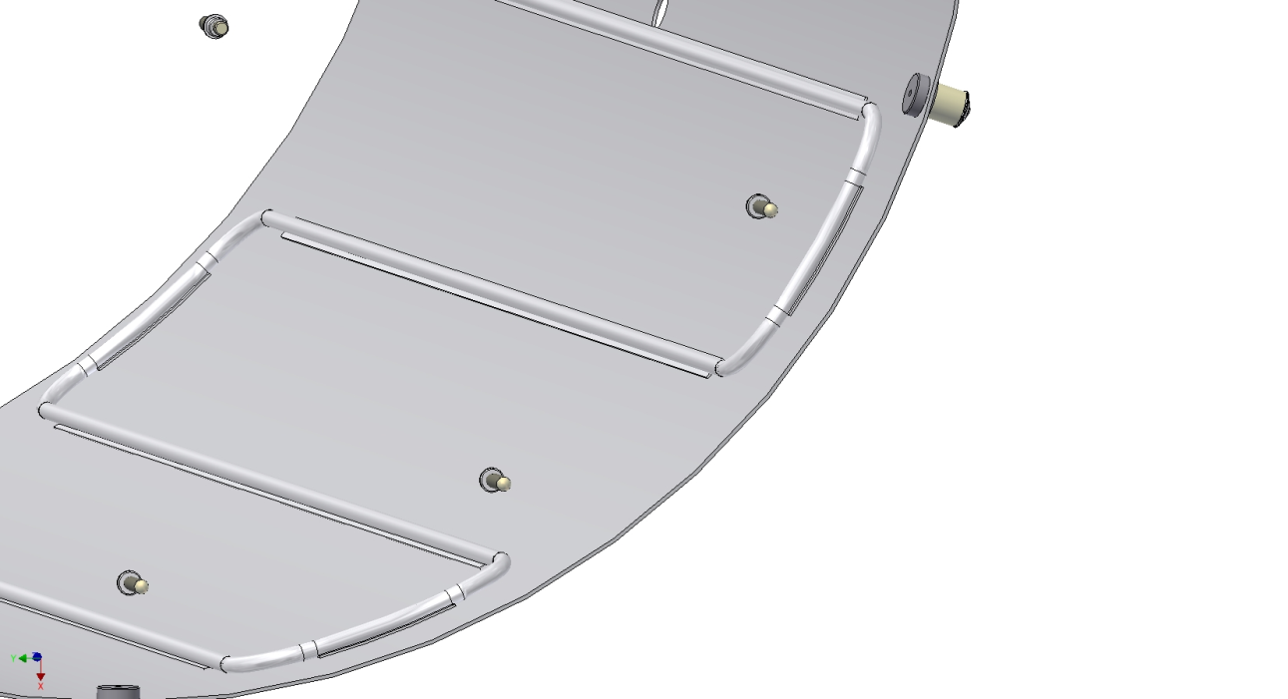
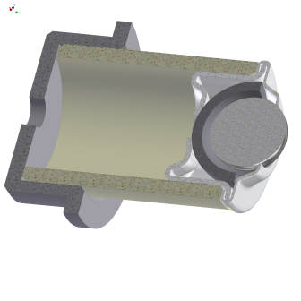
Design of the thermal shields
Al sheet S=3mm
Al profile Ø14 Ʊ-type
1400
Ball support
Figure 6. thermal shield.

Slide 9
The stages of Assembly of the PANDA control Dewar:
3. Installation pipelines into the thermal shields of the control Dewar
Figure 7. The stage 3.

Slide 10
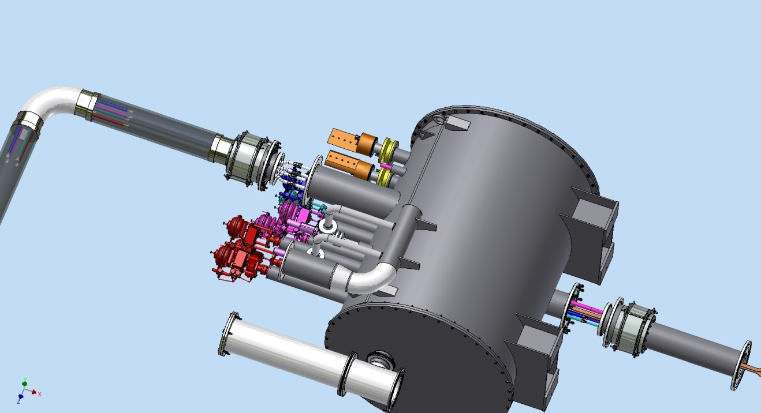
The interface of the PANDA control Dewar. Connection place of the cryogenic system to move the PANDA detector.
TL
Bellows unit
Shift the bellows unit;
Combine the pipes in
accordance with the
flow scheme;
-connect pipes;
Install super insulation;
Install the bellows unit in place;
Connection joints
Vacuum barrier
Control Dewar

Slide 11
The interface of the PANDA control Dewar – solenoid cryostat
Shift the bellows unit;
Combine the pipes in accordance with the flow scheme;
-connect the superconductor busbars;
-connect pipes by welding;
Install MLI super insulation covers;
Install the bellows unit in place.
Control Dewar
Chimney

Slide 12
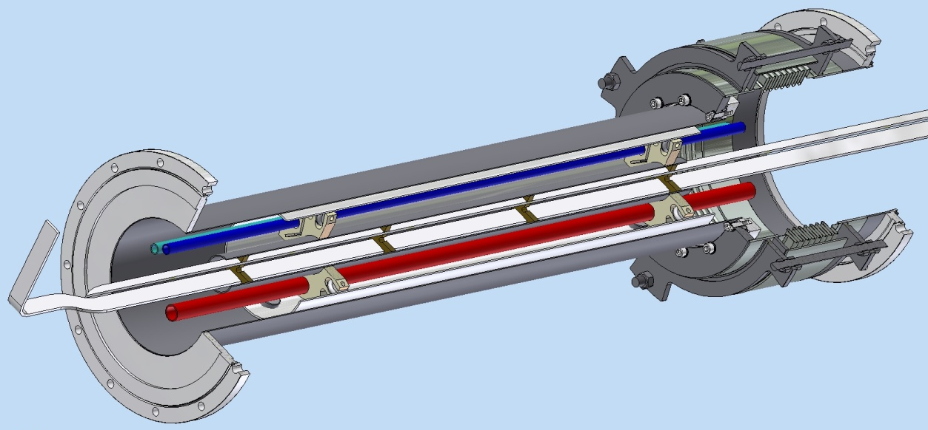
The Chimney design:
Chimney
Bellows unit
Flange ISO320RBR
Thermal shield
Spacer
Pipelines
Flange ISO320RBR
Superconductor

Slide 13
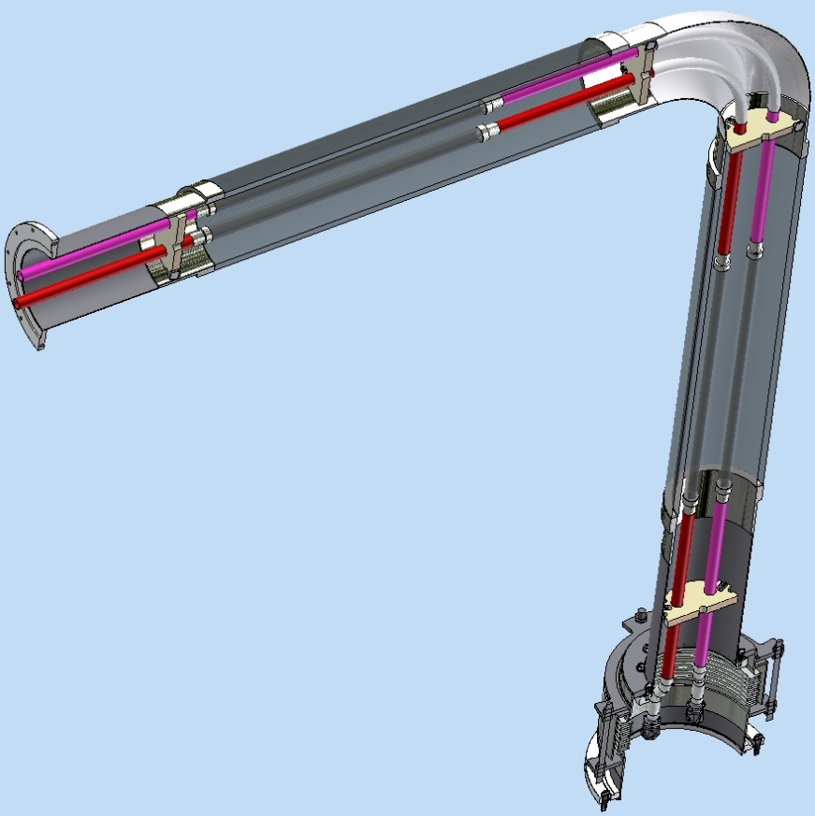
The TL design:
TL
Metal
Hoses DN20
Flange ISO250BF
Metal
Hoses DN200
Bellows
unit
Flange ISO320RBR
The end of the supplying TL has the ability to 3D move ±300mm
The bellows unit has the ability to move 450 mm up

Slide 14
Thank you for your attention

