Slide 1

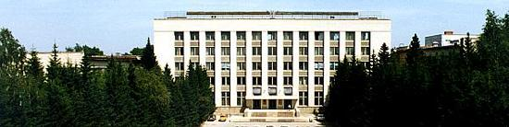
BINP
PANDA Magnet
S.Pivovarov, E.Pyta, M.Kholopov, BINP, Novosibirsk
PANDA Collaboration Meetig, 04-08th June 2018, Stockholm

Slide 2
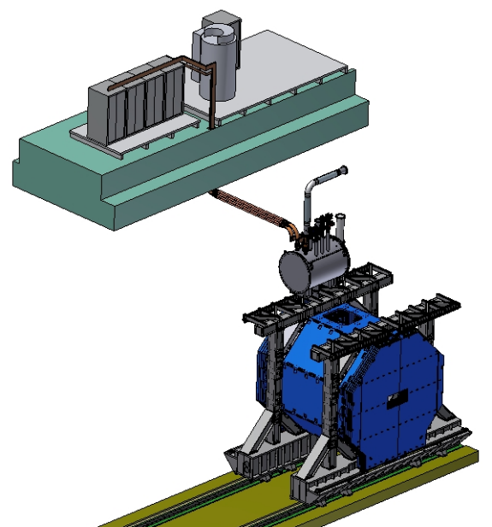
PANDA solenoid magnet, BINP responsibility.
Power supply and energy extraction system
Control Dewar box
Cable channel
Solenoid and yoke
Frame of solenoid
Arrangement of the components of the PANDA solenoid.

Slide 3
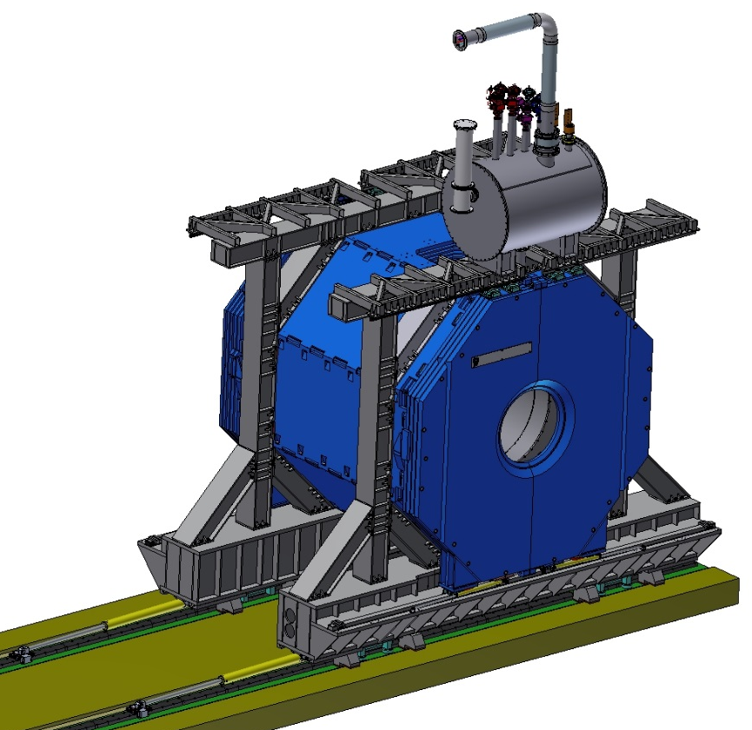
3D model of the Yoke, Platform and Frame, Cryostat, Control Dewar (for production at BINP).
Control Dewar
Yoke
Frame
Cryostat
The total weight of Yoke, Platform and Frame is ~340 t. The weight of Cryostat is 14.5 t. The weight of Control Dewar is ~2 t.

Slide 4
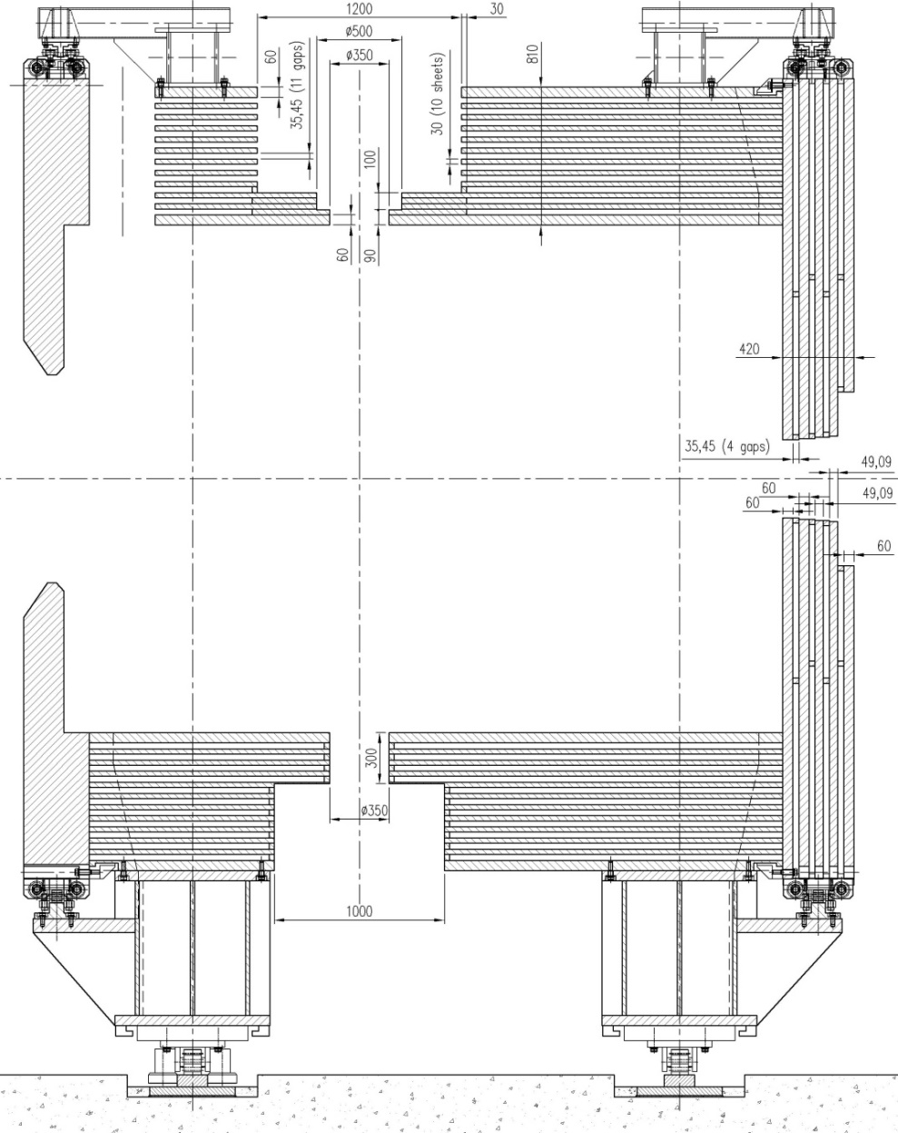
Configuration 12th layers of Yoke
The thickness of the outer and inner plates is 60 mm, the thickness of the inner plates is 30 mm. The gap between the plates is 35 mm for installation of the muon detectors.

Slide 5
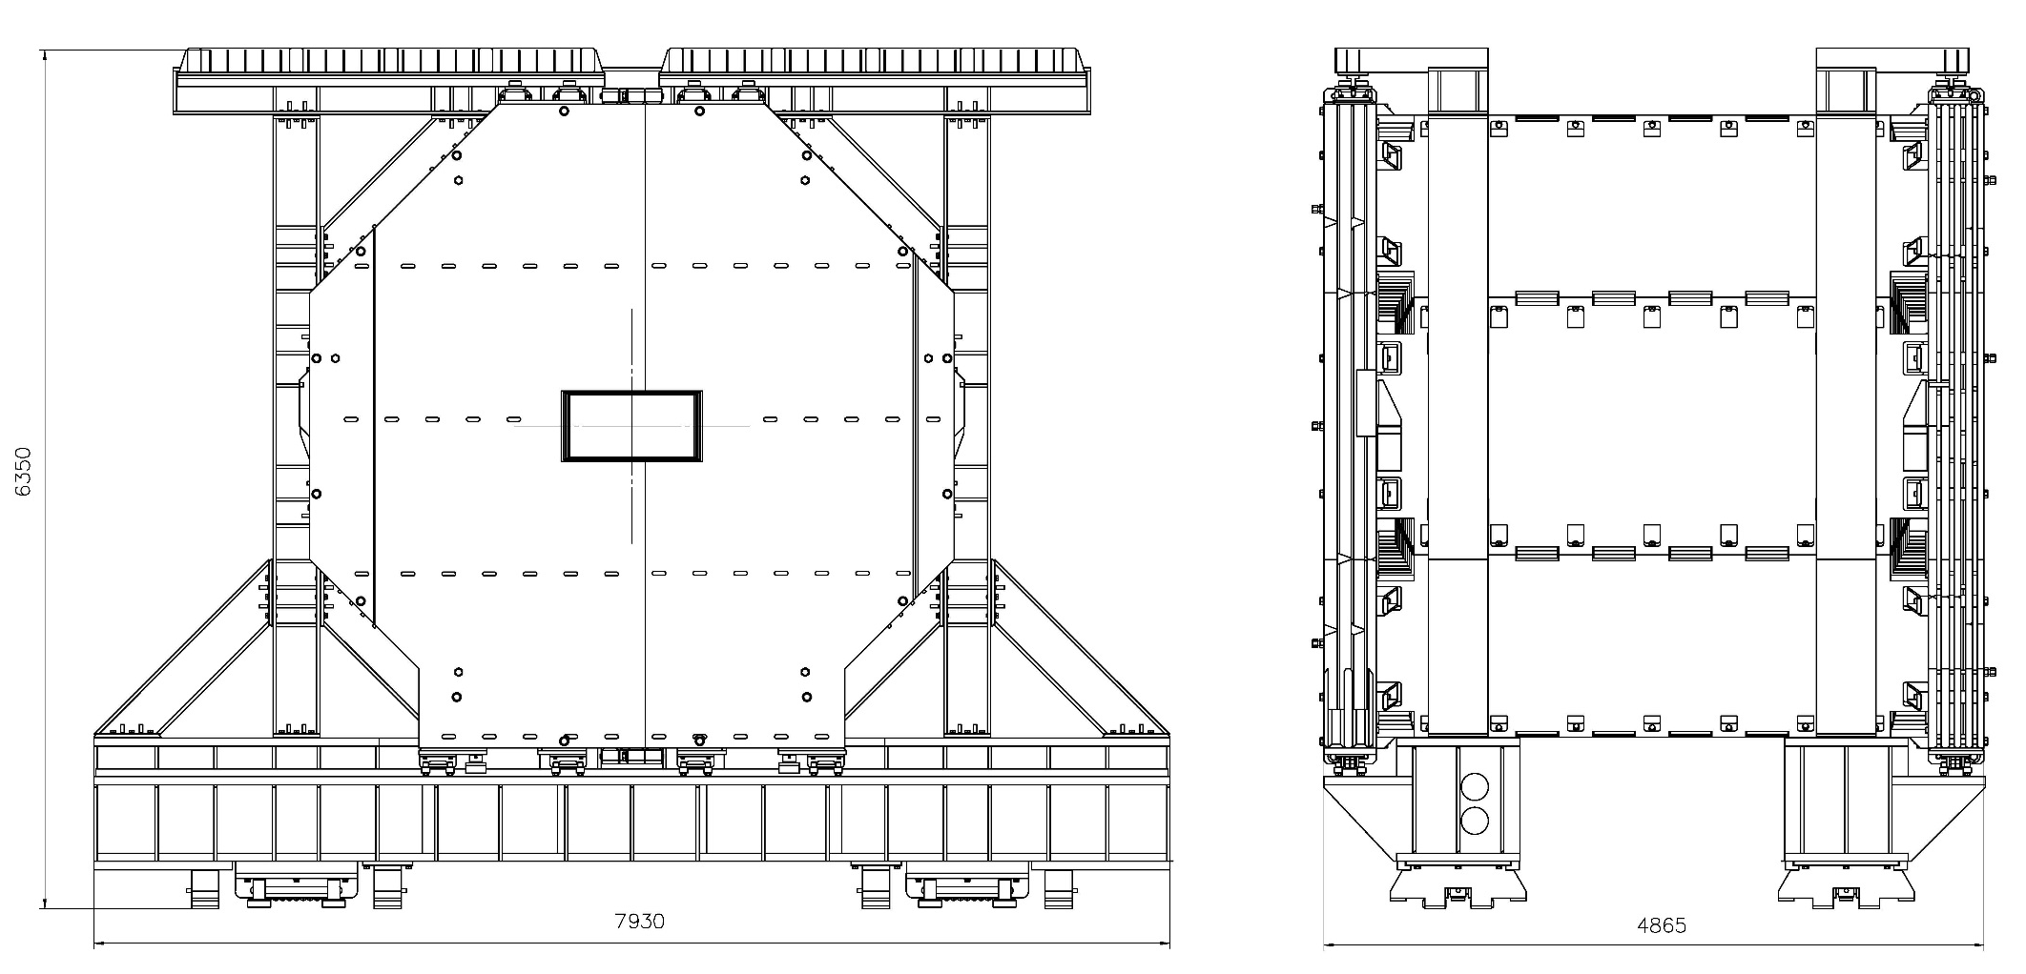
Dimensions of the Yoke, Platform and Frame.
Height - 6350 mm, Width - 7930 mm (doors closed), Length - 4865 mm

Slide 6
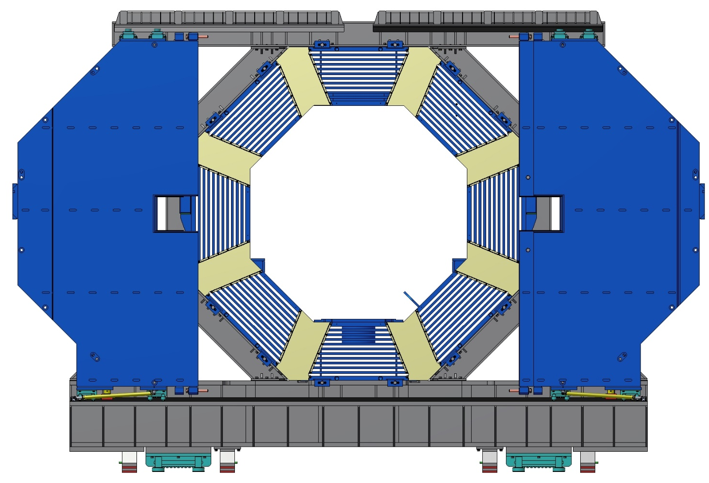
Dimensions of the Yoke, Platform and Frame.
(The Doors opened)
Width - 9600 mm (doors open)

Slide 7
Main Technical Data of Yoke
Upstream door with supports, rollers etc., weight | Left wing | t | 22.8
 | Right wing | t | 22.8
Downstream door with supports, rollers etc. | Left wing | t | 20.7
 | Right wing | t | 21.1
Octagonal barrel | Upper beam | t | 19
 | Inclined side beams, 4 pc. | t | 20.8
 | Vertical side beams, 2 pc. | t | 20.8
 | Bottom beam | t | 20.4
Platform beams, support frames and carriages |  | t | 57.8
Total weight |  | t | 341.1
Joke length |  | mm | 4875
Joke width | Closed wings | mm | 7930
 | Open wings | mm | 9600
Joke height |  | mm | 6350
Material |  |  | St3/St10

Slide 8
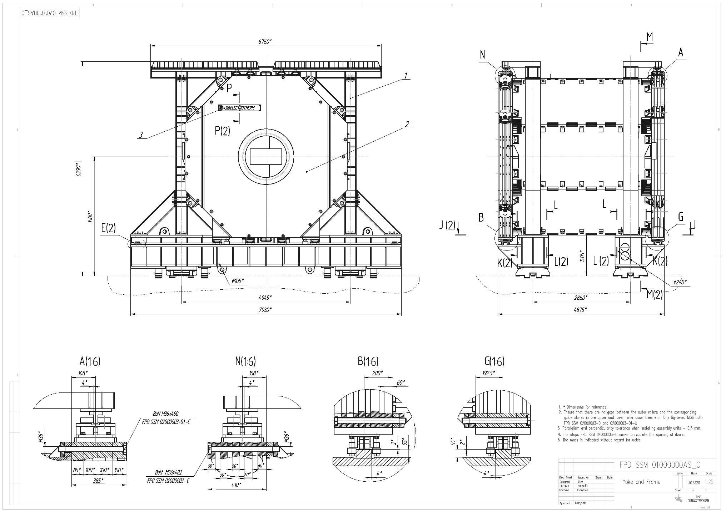
Drawing of the Yoke, Platform and Frame.

Slide 9
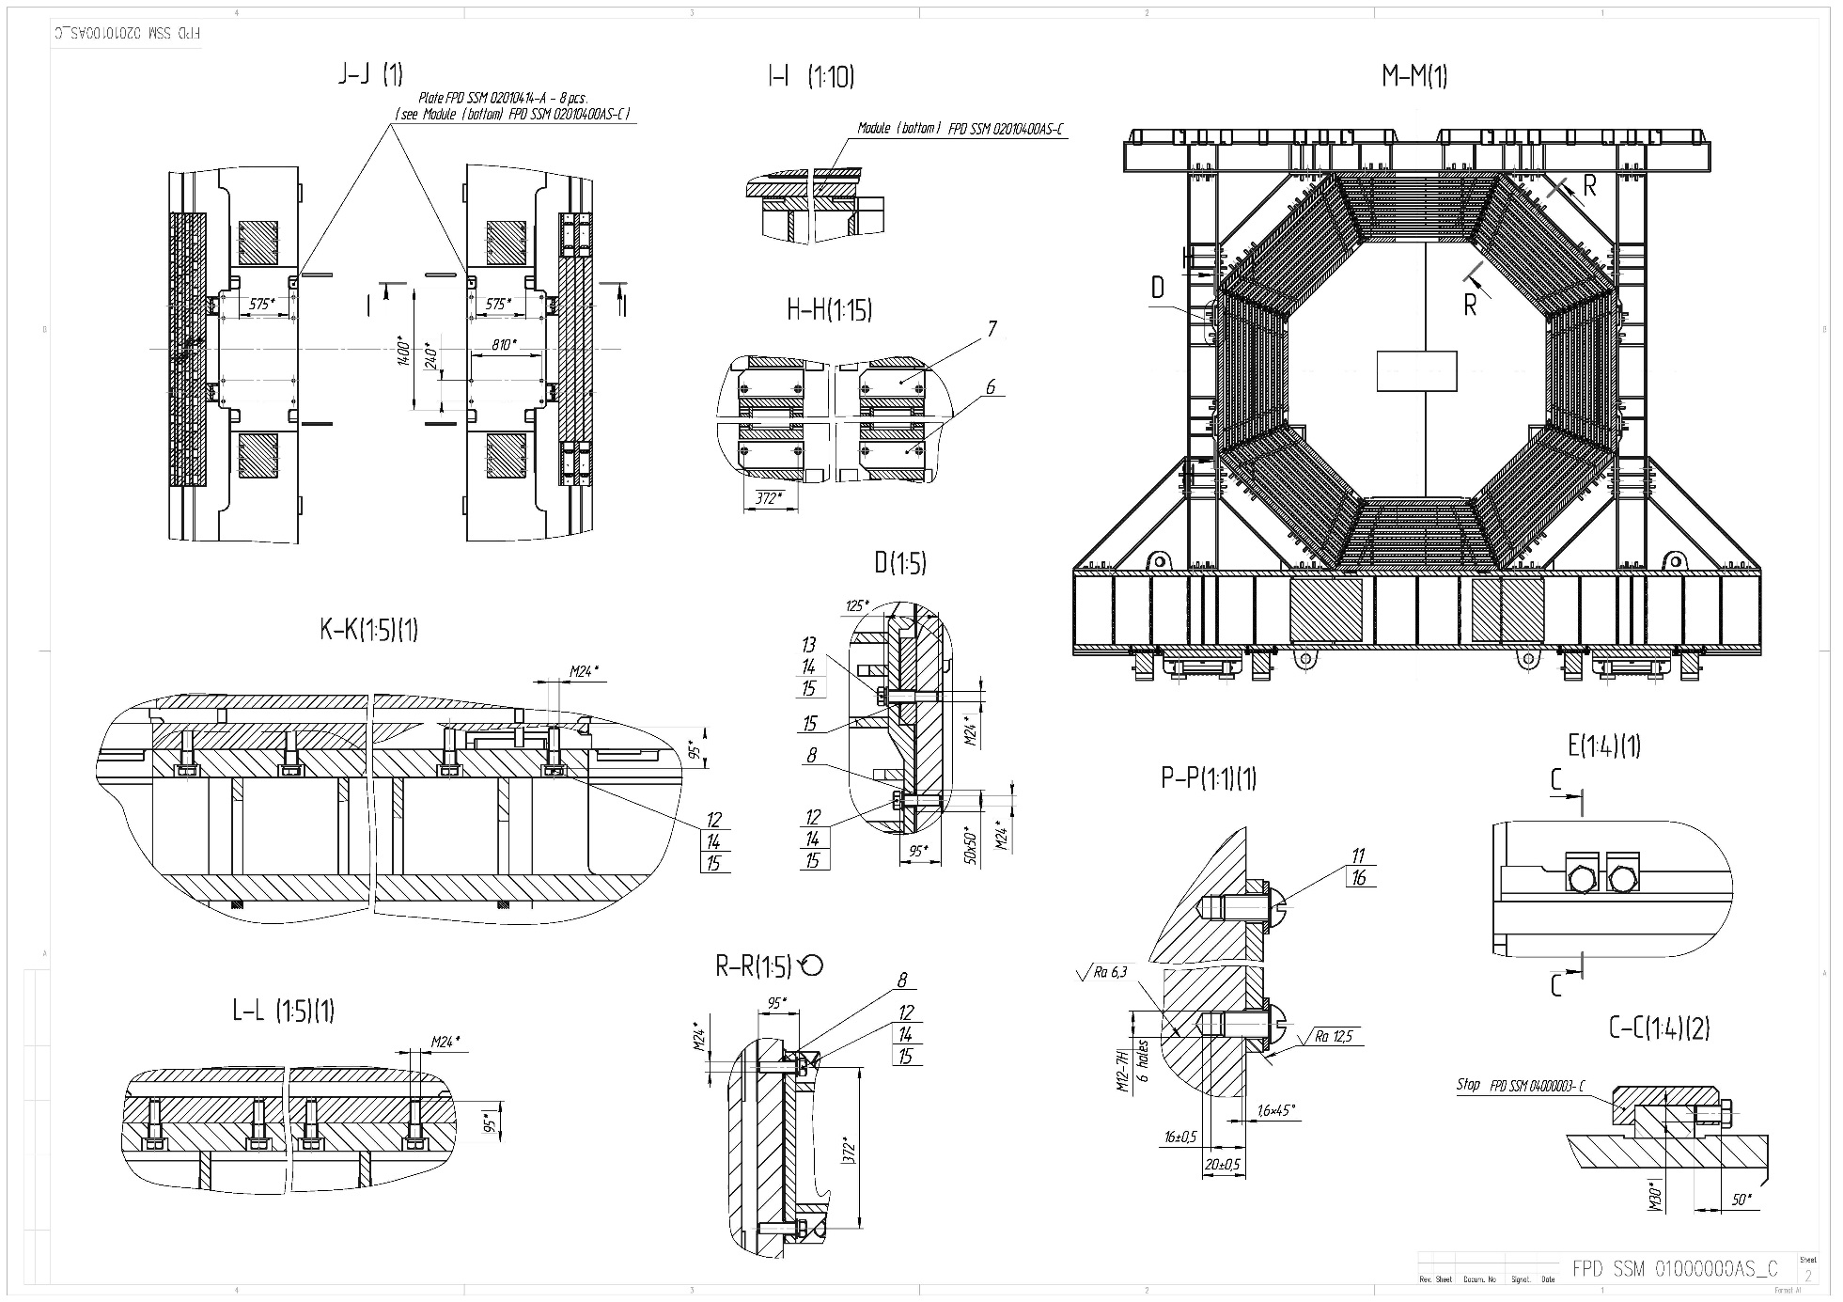
Drawing of the Yoke, Platform and Frame.

Slide 10
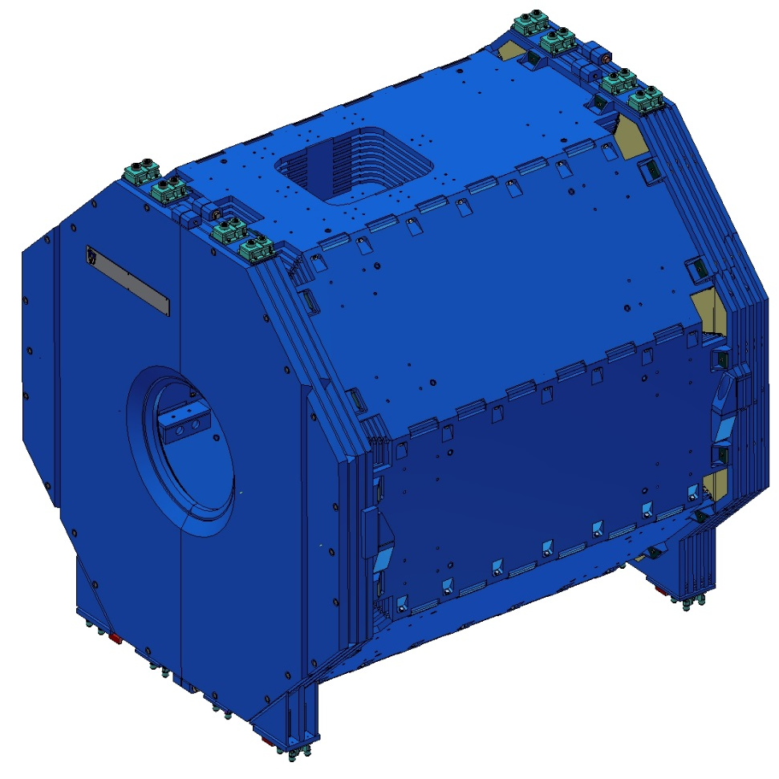
3D-Model of the Yoke of PANDA Magnet.
Downstream Door
Upstream Door
Barrel part
The iron yoke consists of a barrel part and sliding doors. The total weight of Yoke is ~280 t

Slide 11
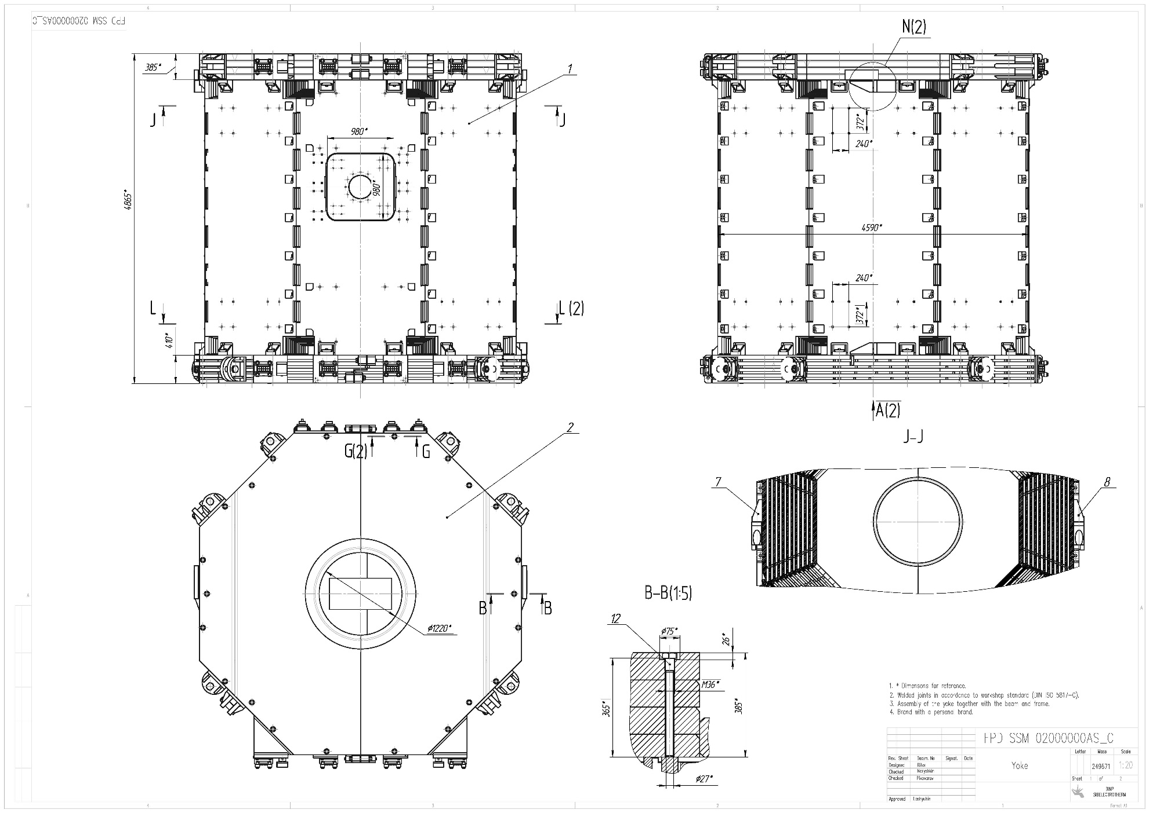
Drawing of the Yoke.

Slide 12
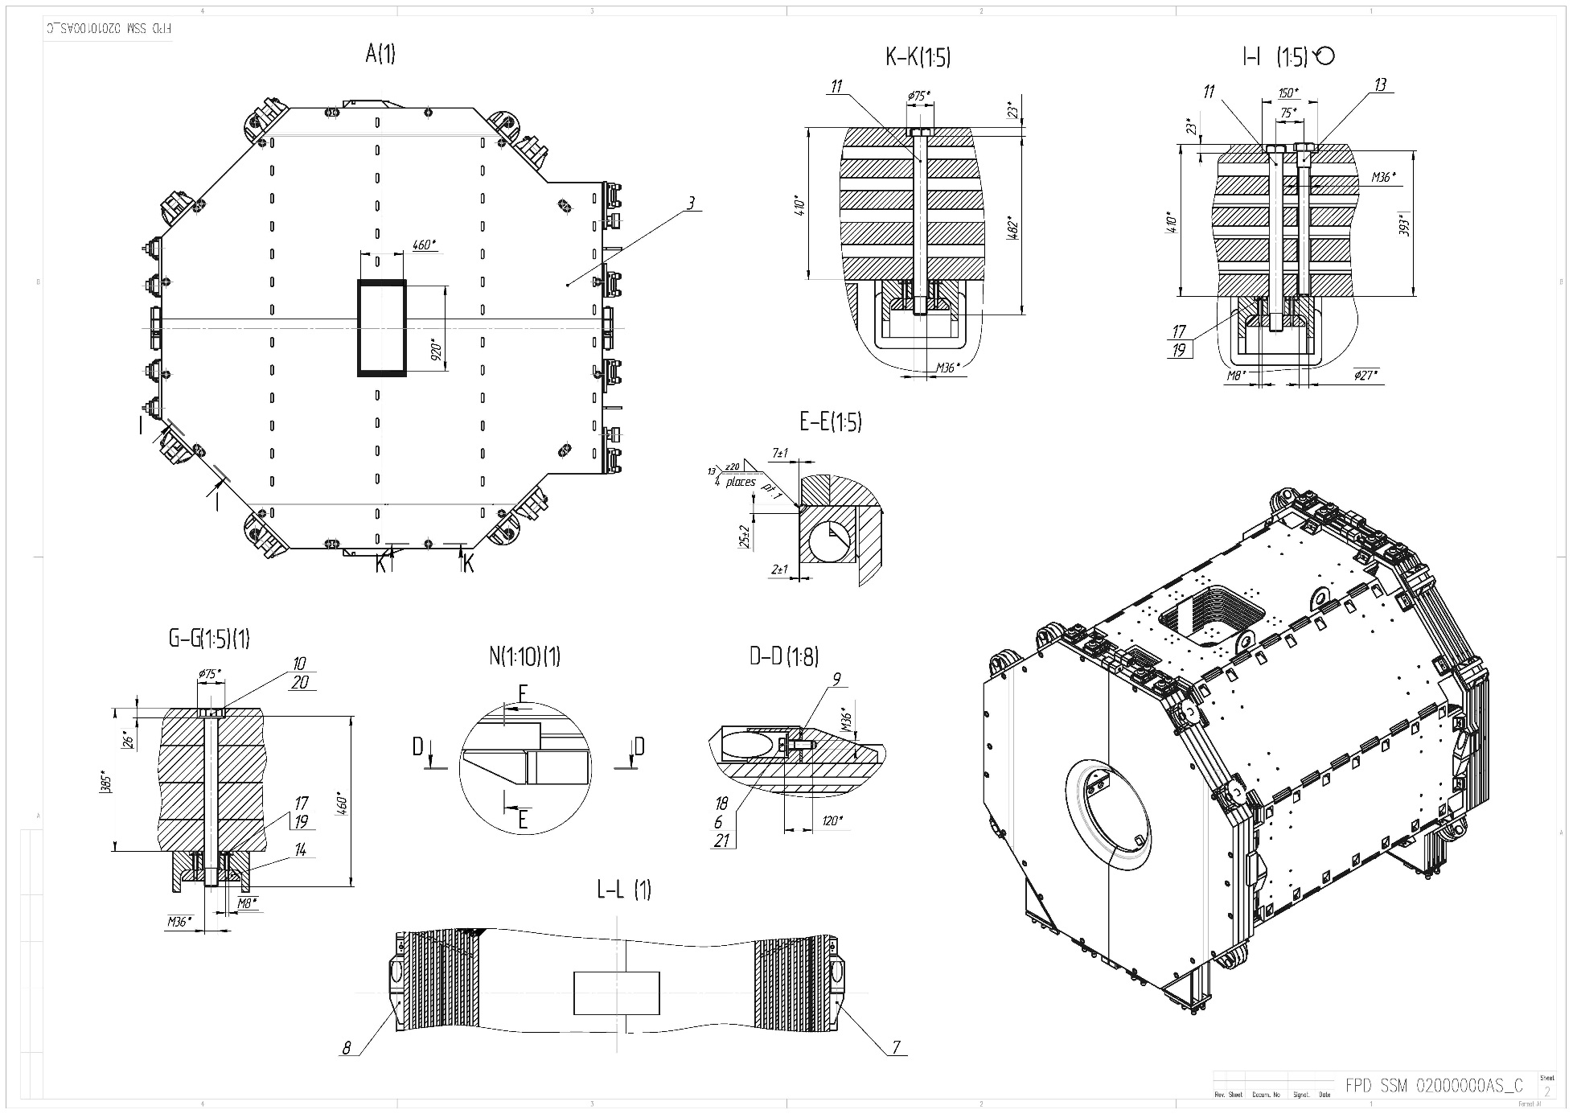
Drawing of the Yoke.

Slide 13
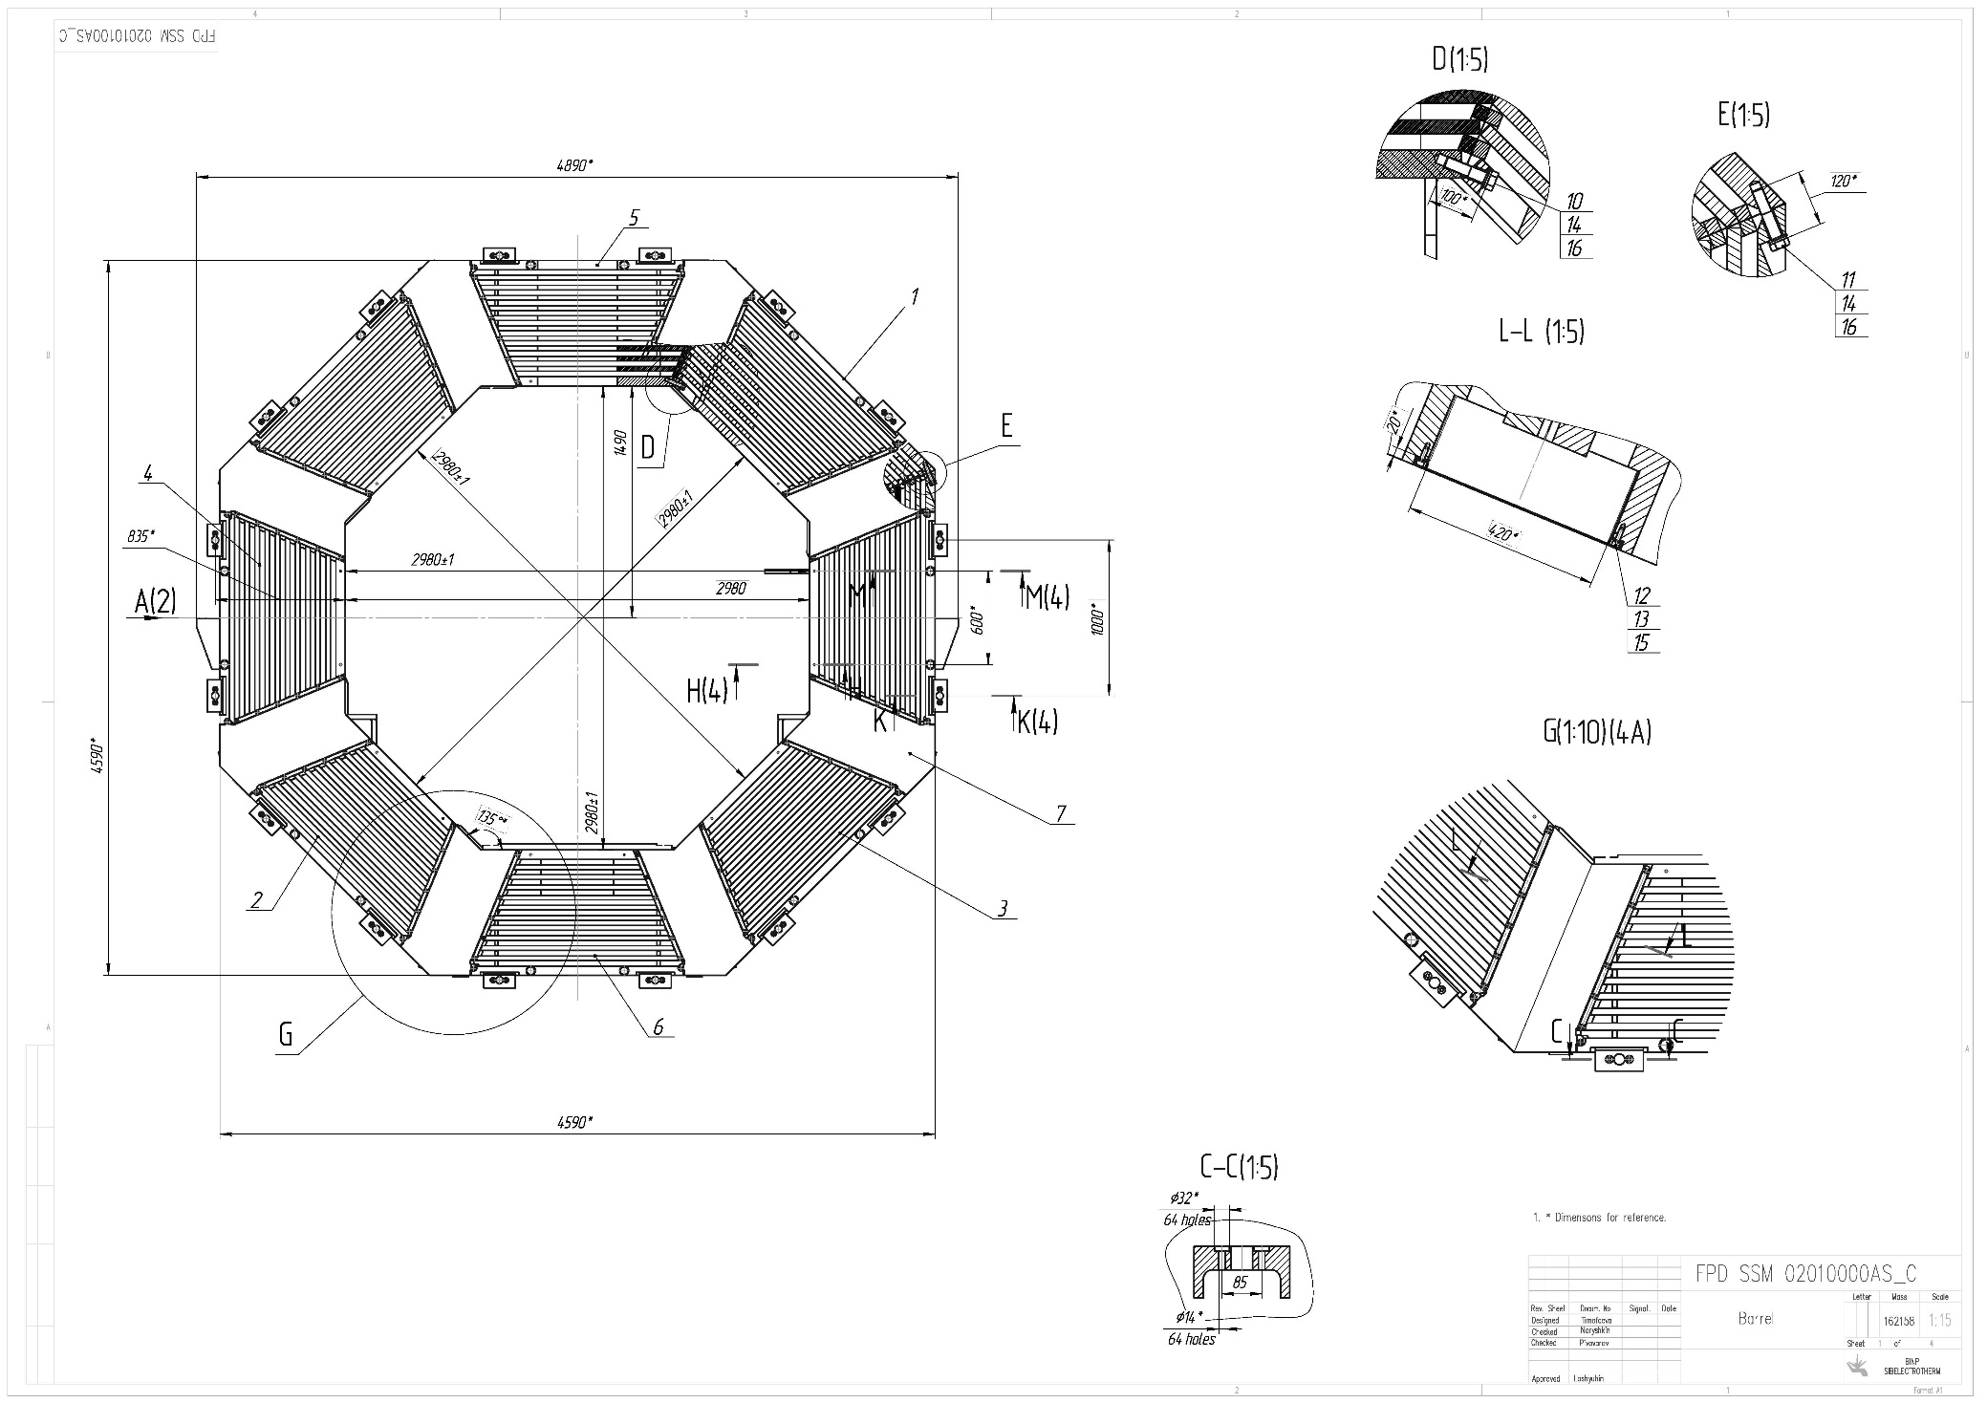
Drawing of the Barrel part of the Yoke.

Slide 14
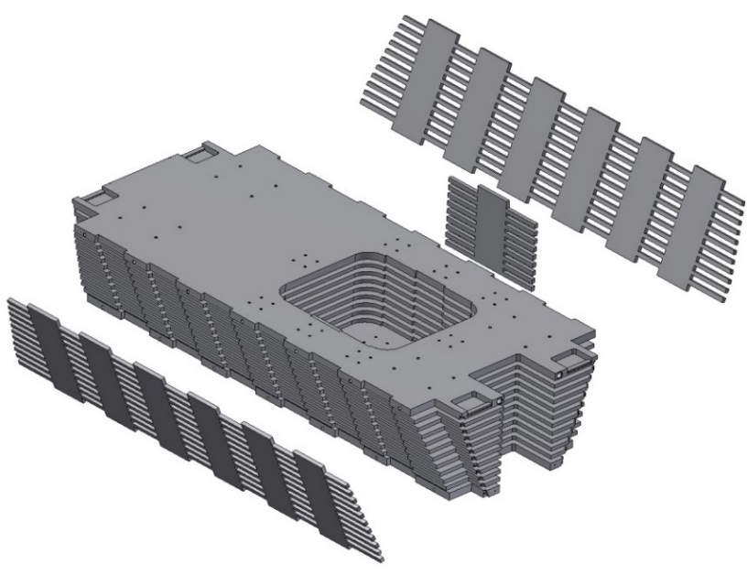
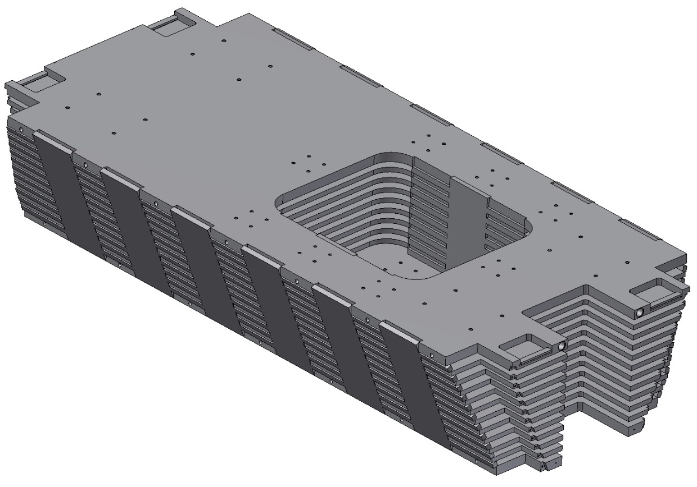
The octant of the Barrel part of the Yoke
Upper octant
Upper octant assembling scheme
The module consists of horizontal plates and side plates made by water cutting machine. This design of module has good rigidity and allows to reduce the number of welds.

Slide 15
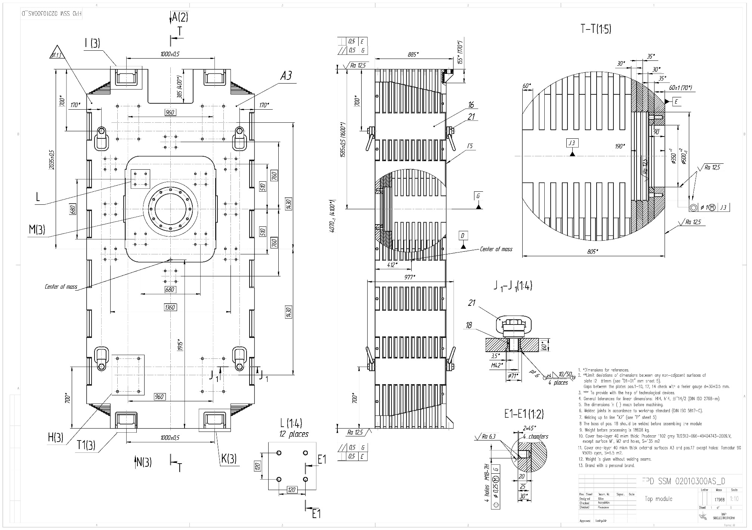
Drawing of the top Octant.

Slide 16
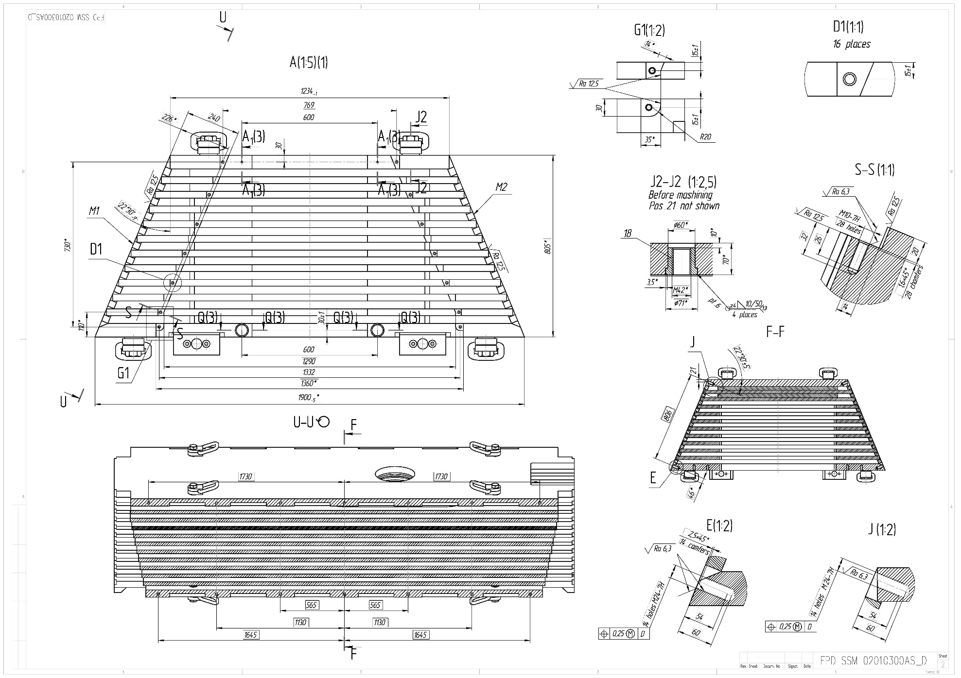
Drawing of the top Octant.

Slide 17
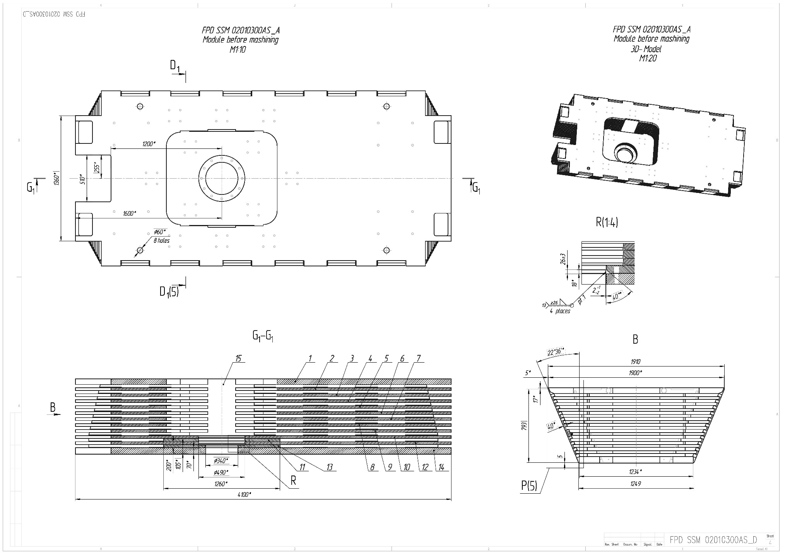
Drawing of the top Octant.

Slide 18
Drawing of the top Octant.

Slide 19
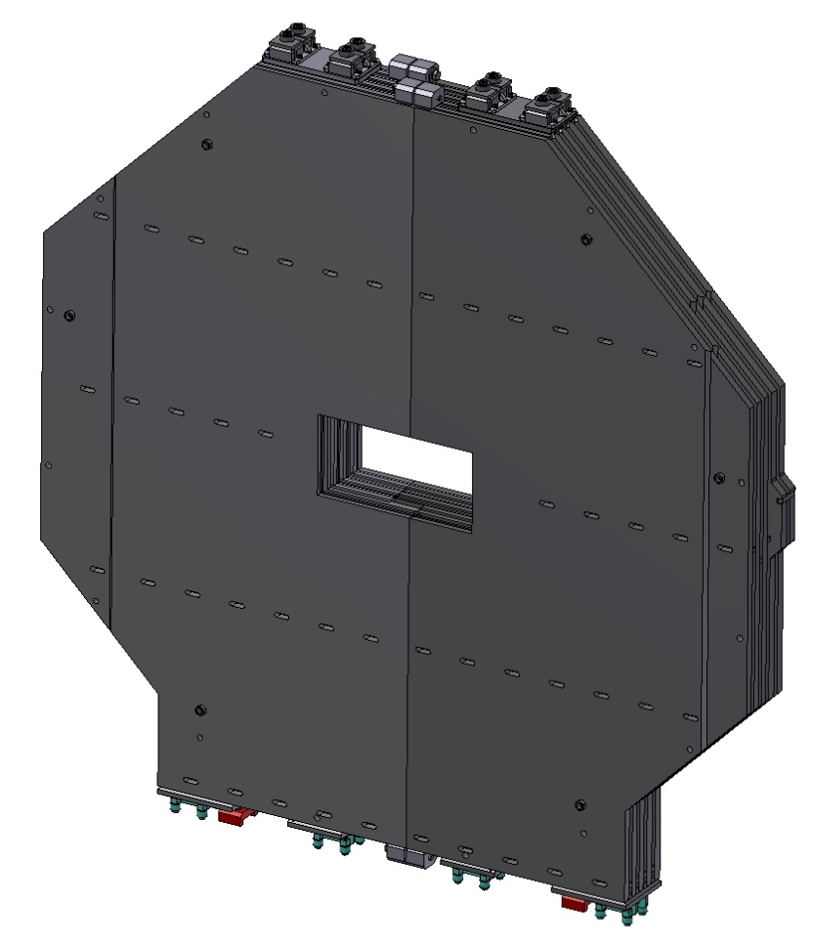
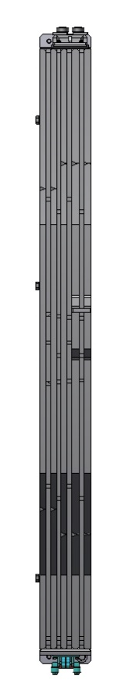
3D- Model of the Downstream Door.

Slide 20
Drawing of the Downstream Door.

Slide 21
Drawing of the half Downstream Door.

Slide 22
Drawing of the half Downstream Door.
35 mm gaps for installation of the muon chambers

Slide 23
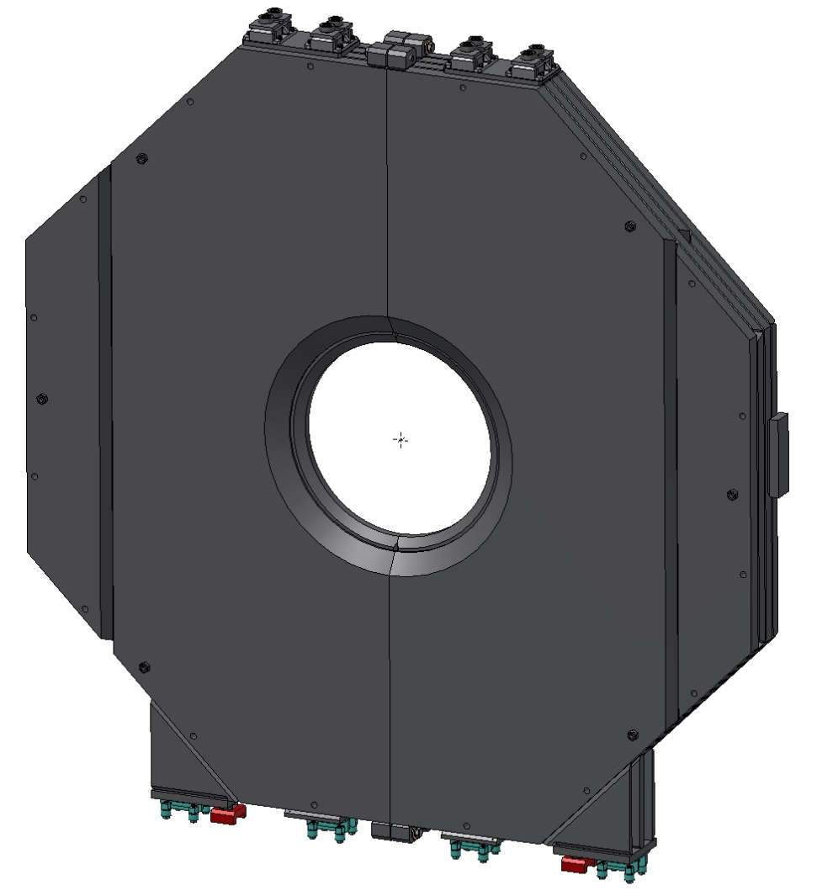
The Upstream Door.

Slide 24
Drawing of the Upstream Door.

Slide 25
Drawing of the half of Upstream Door.

Slide 26
Drawing of the half of Upstream Door.

Slide 27
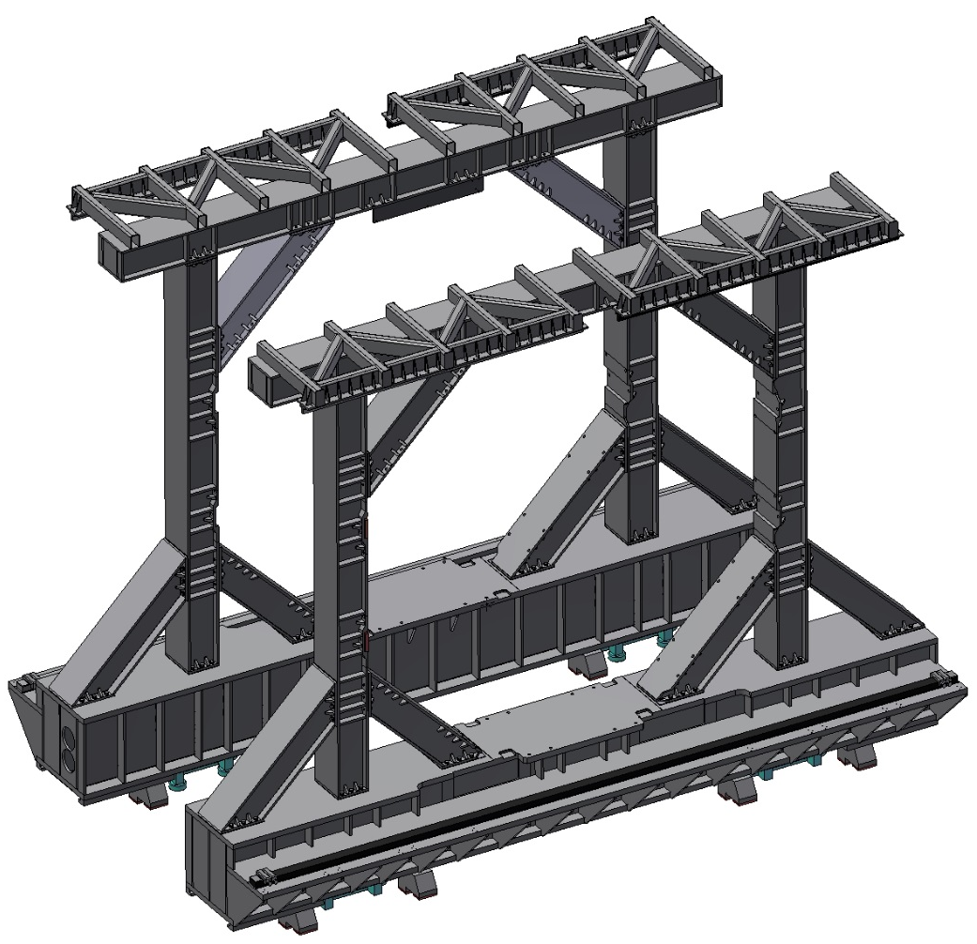
3D-Model of the Platform and Frame of PANDA Magnet.
Rail for the door wings close/open
Rollers for the detector moving
The total weight of Platform and Frame is ~58 t

Slide 28
Drawing of the Platform and Frame.

Slide 29
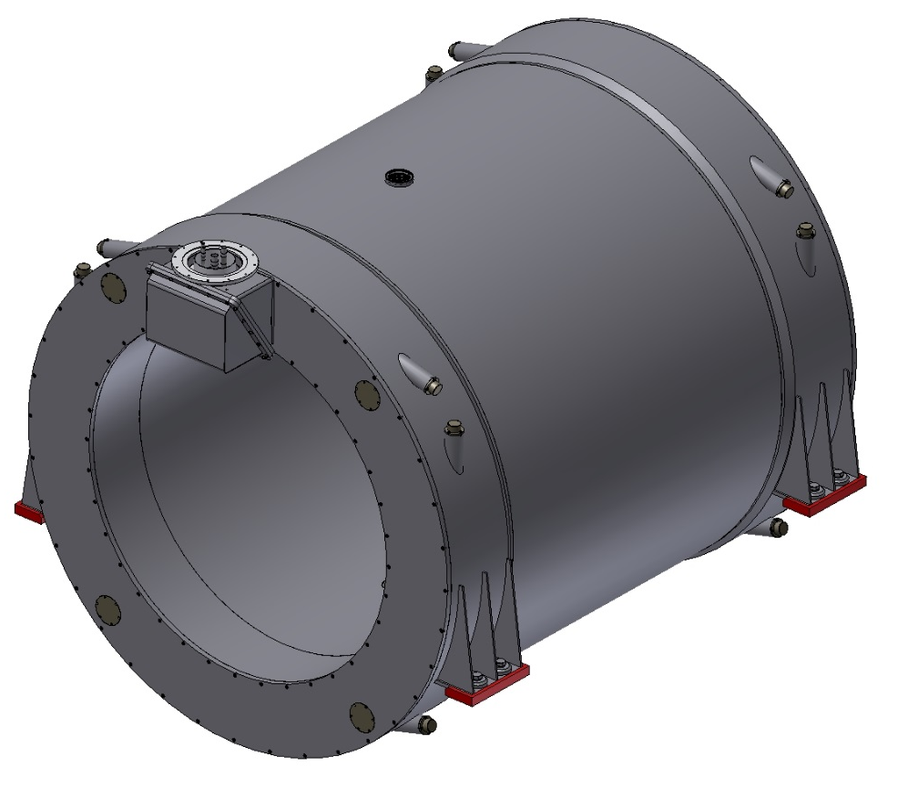
3D model of the solenoid magnet.
Material of the vacuum shell of cryostat is stainless steel. The weight of magnet is ~14,5 t.

Slide 30
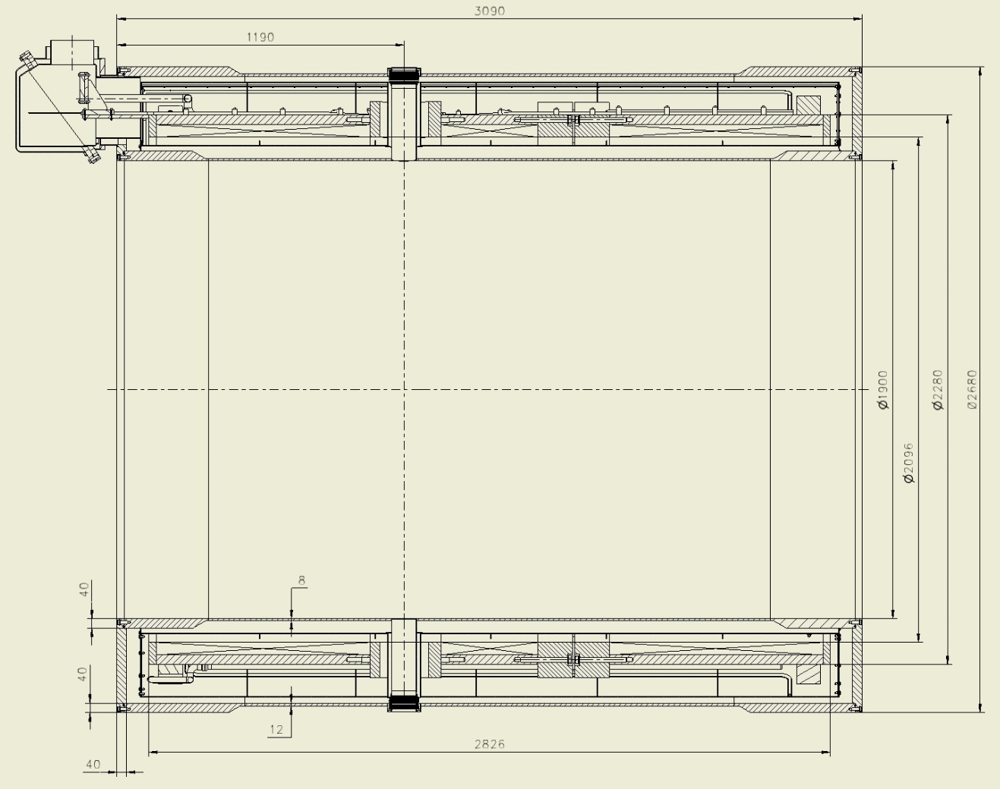
Dimensions of the Magnet.
Inner diameter is 1900 mm, Outer diameter is 2680 mm, length is 3090 mm

Slide 31
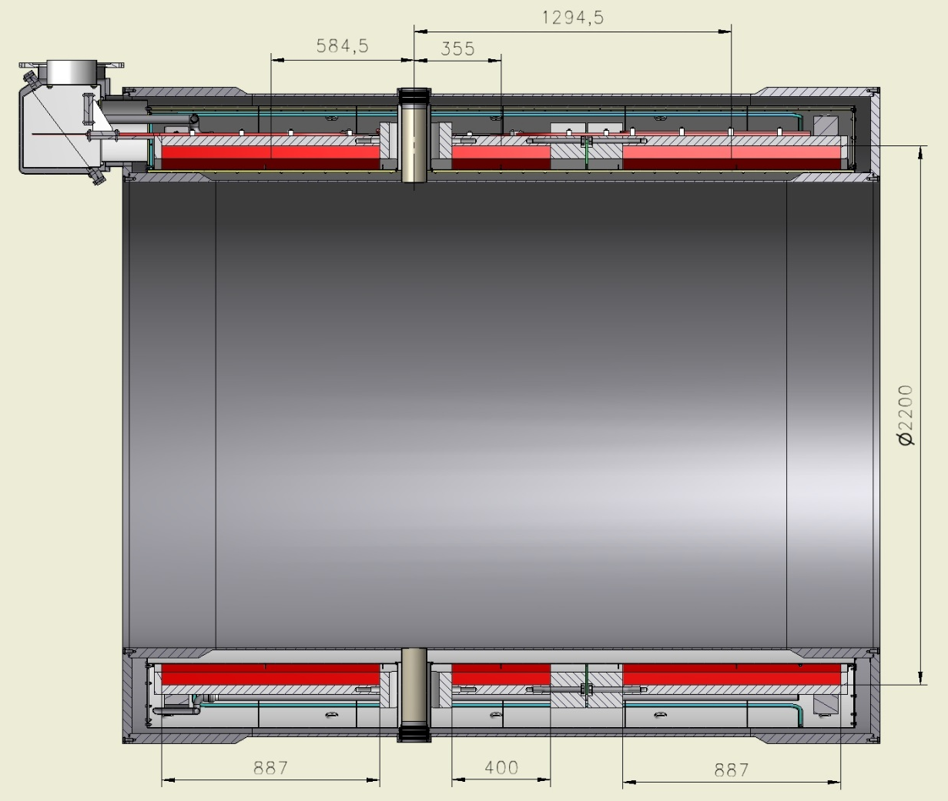
Dimensions of the Coils.
Holes for target pipe.
The position of the cold mass in axial direction is fixed in the area of the holes for the target. Solenoid consists from 3 coils. Outer diameter of coils is 2200 mm, length: two coils - 887 mm, one - 400 mm.

Slide 32
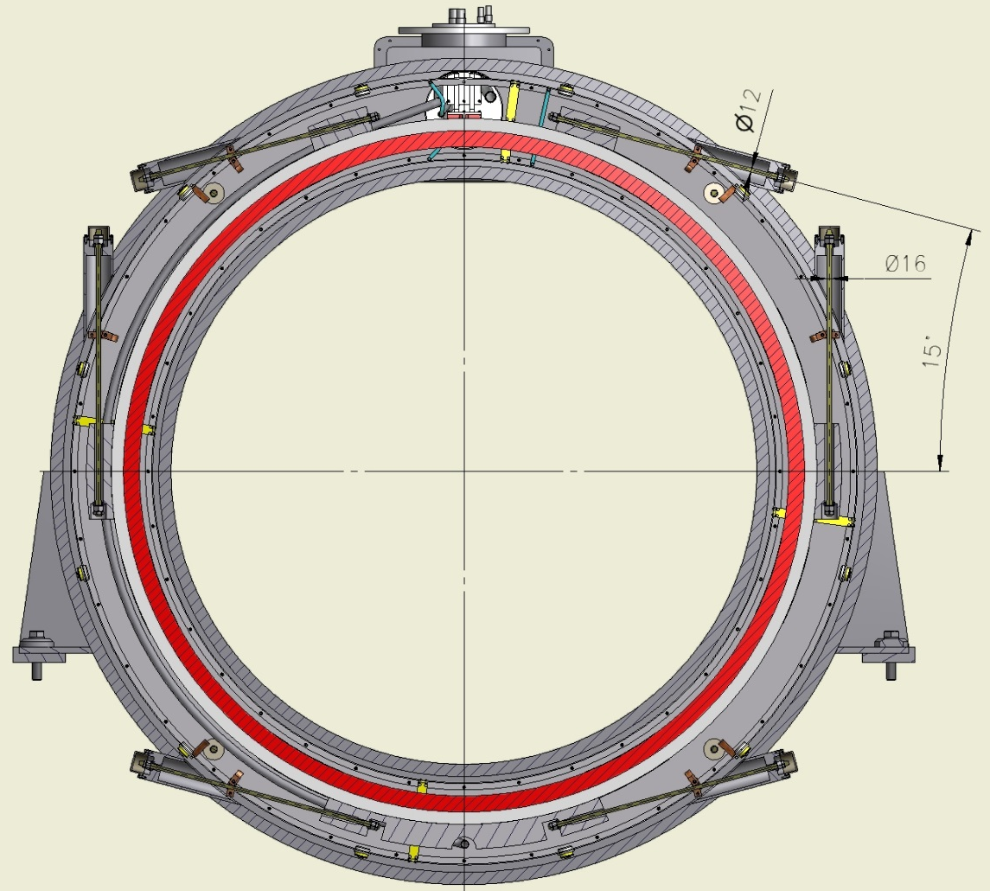
Cross section of the Magnet.
Cold mass is based into Cryostat by suspensions and axis rods.

Slide 33
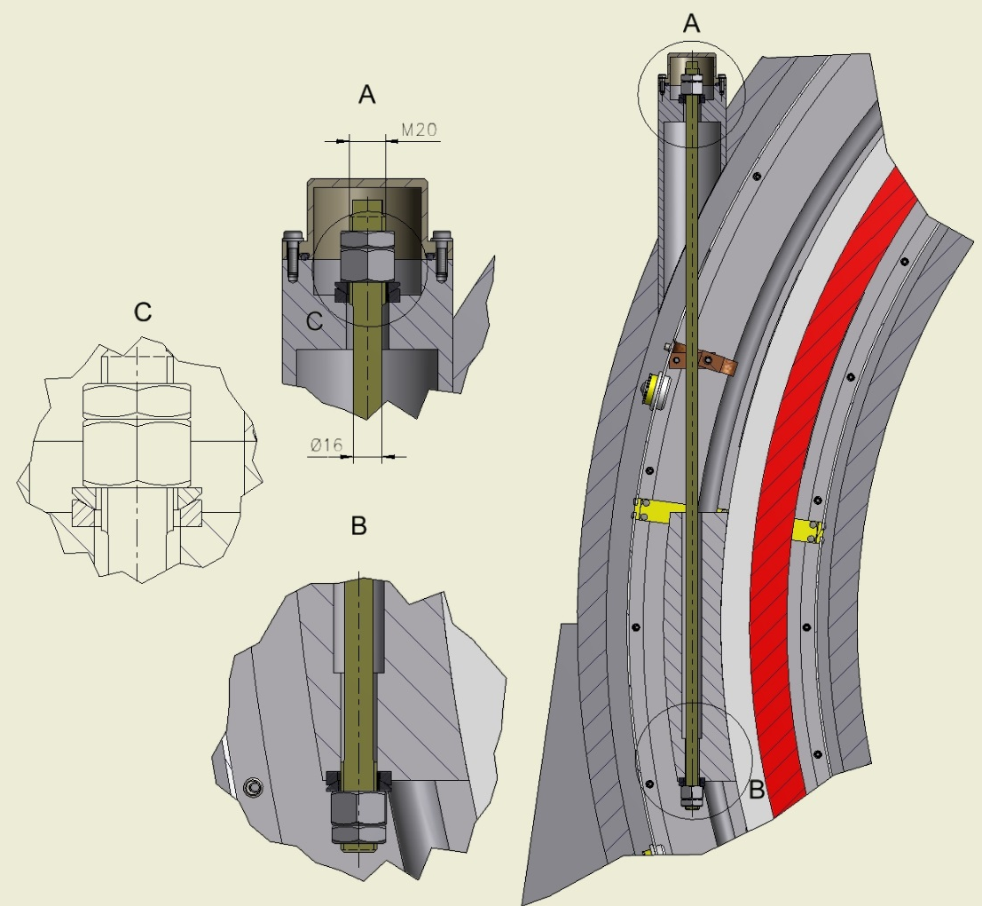
The Suspensions.
The diameter of suspensions is 16 mm, the length is 840 mm. Material is Ti-5Al-2.5Sn

Slide 34
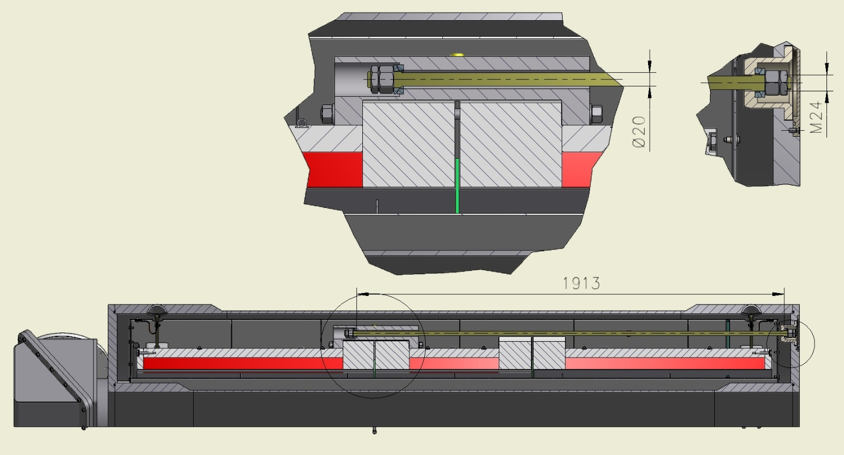
The Longitudinal rod.
(right side)
In the axial direction the Cold mass is fixed by longitudinal rods. The diameter of longitudinal rods is 20 mm, the length is 1913 mm (right side).Material is Ti-5Al-2.5Sn

Slide 35
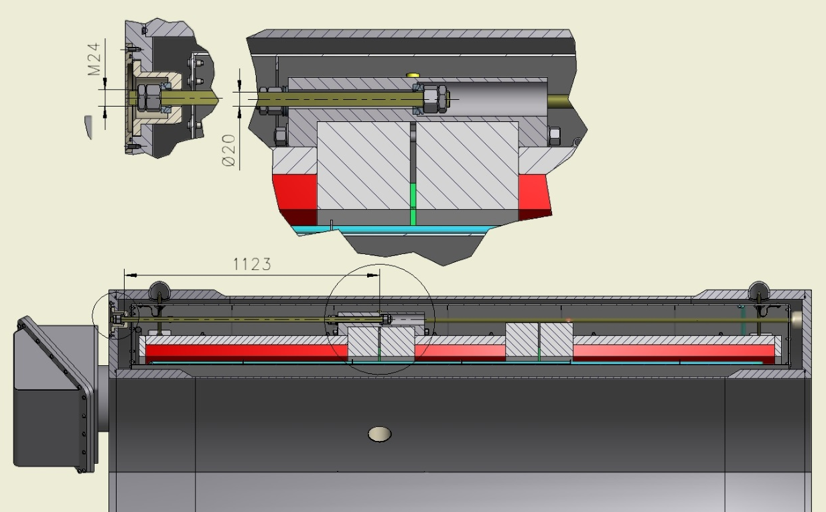
The Longitudinal rod.
(left side)
The diameter of longitudinal rods is 20 mm, the length is 1123 mm (left side).
Material is Ti-5Al-2.5Sn

Slide 36
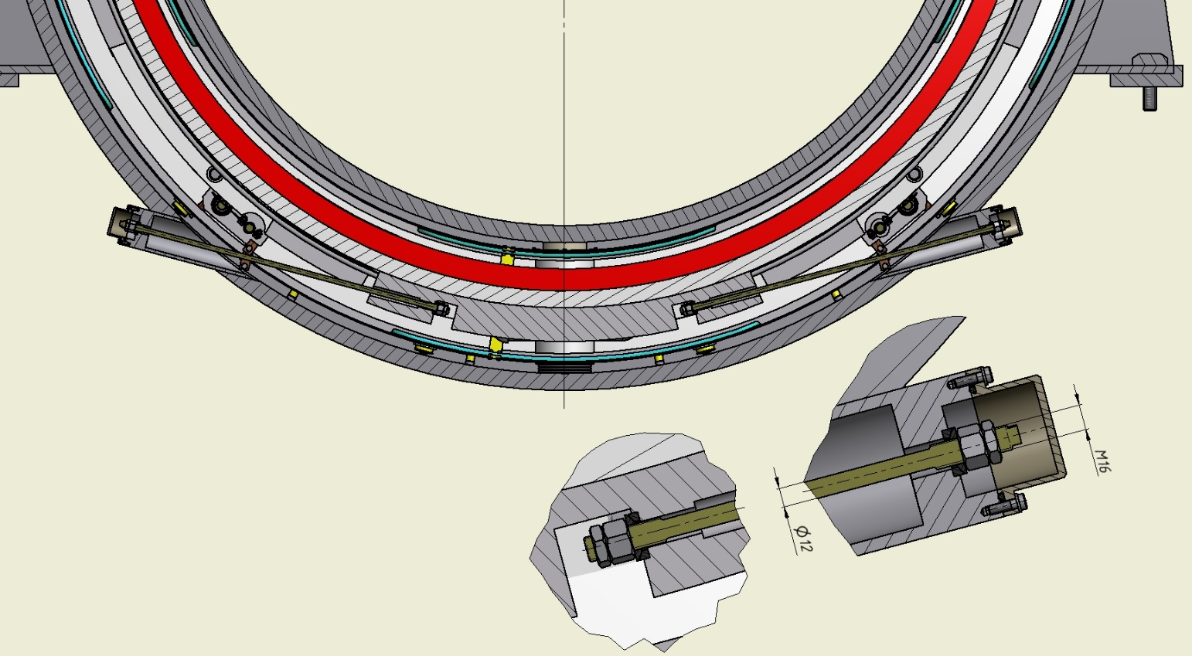
The Radial rods.
In the radial direction the Cold mass fixed by radial rods. The diameter of radial rods is 12 mm, the length is 720 mm. Material is Ti-5Al-2.5Sn

Slide 37
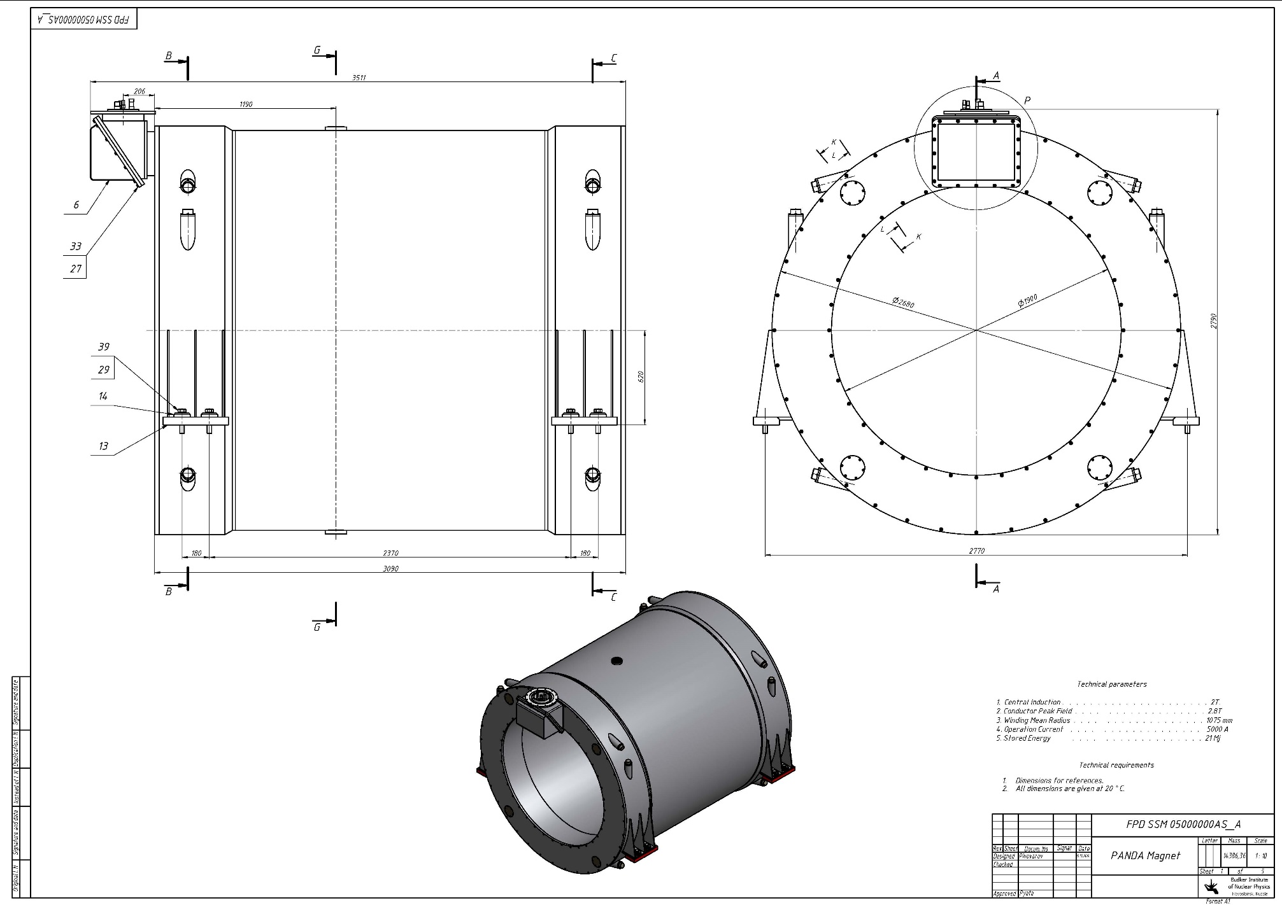
Drawing of the Magnet.

Slide 38
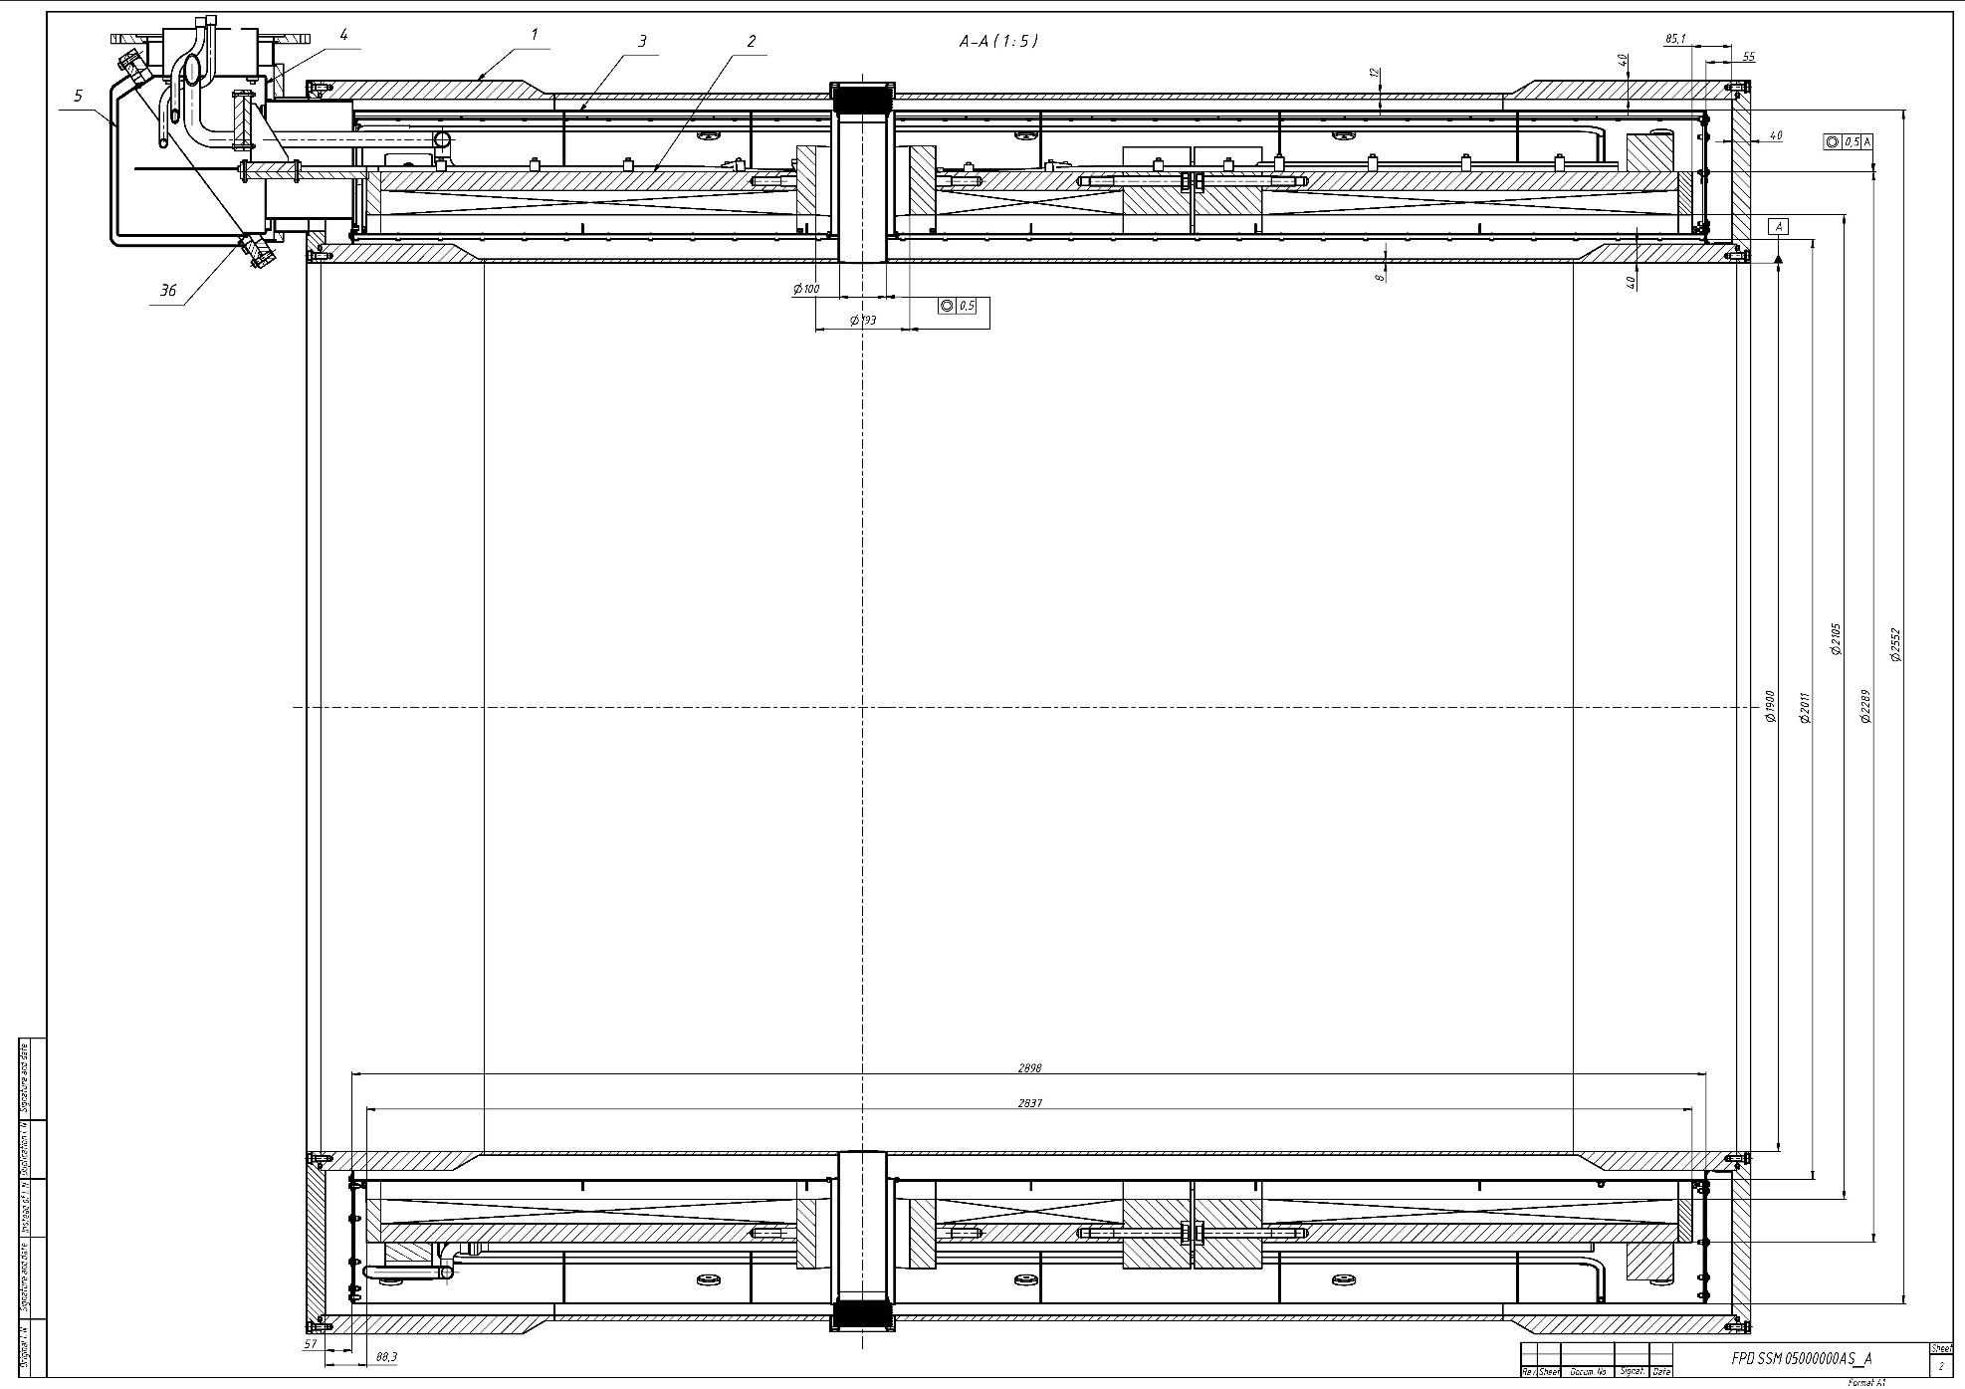
Drawing of the Magnet.

Slide 39
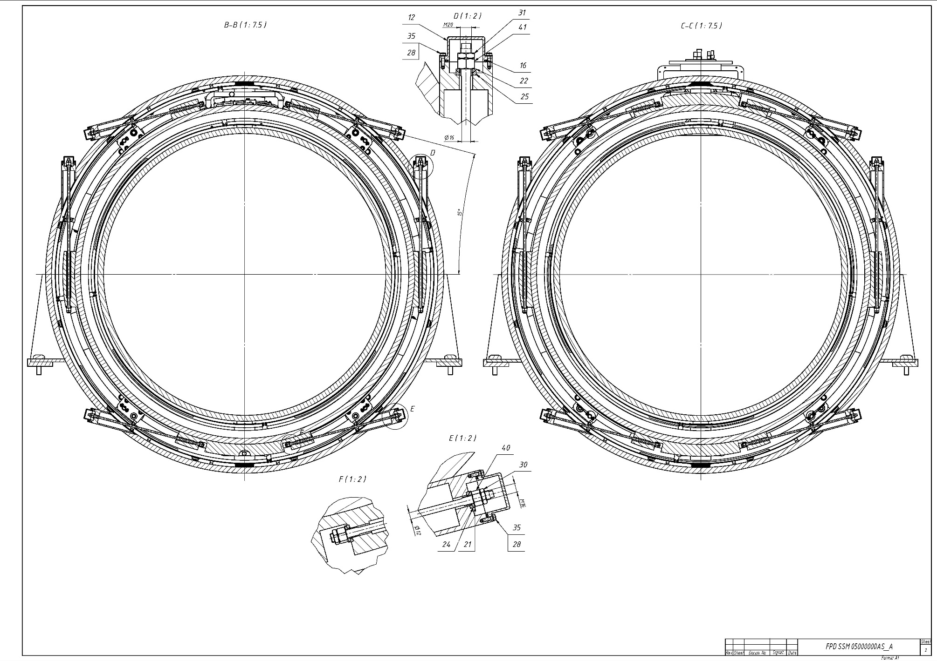
Drawing of the Magnet.

Slide 40
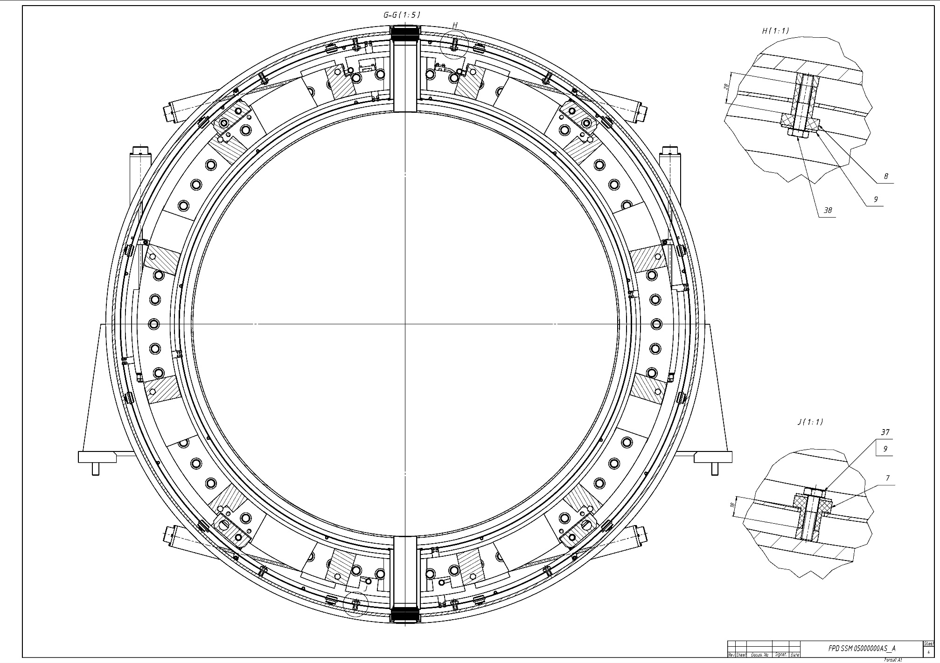
Drawing of the Magnet.

Slide 41
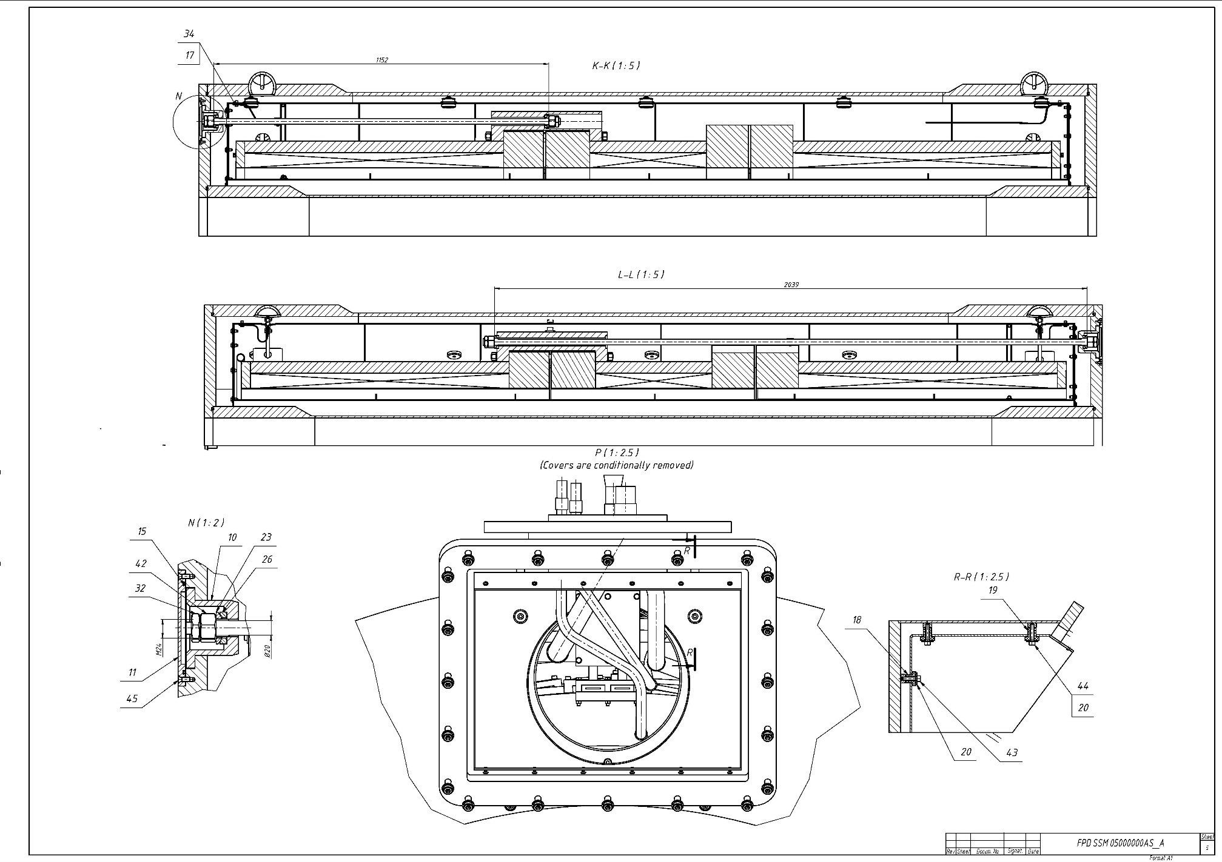
Drawing of the Magnet.

Slide 42
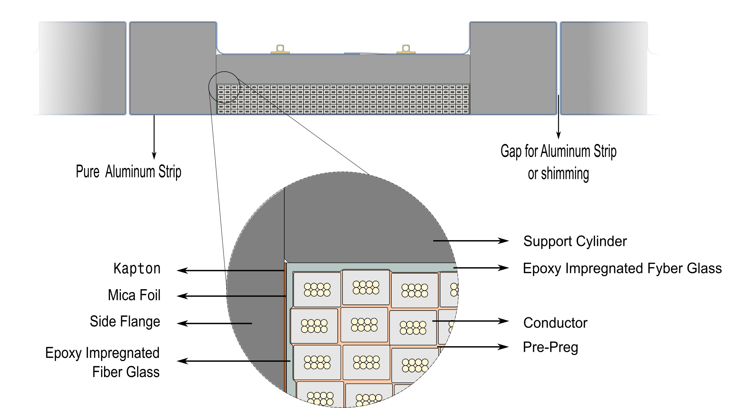
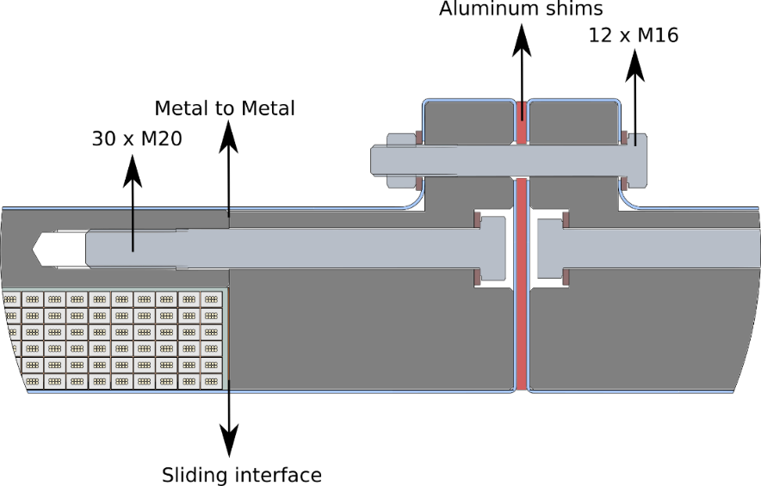
The design of Cold mass.
Coil connection
2 Coils - 6 layers - 78 turns (2x3300 м)
1 Coil - 6 layers - 35 turns (1500 м)
Magnetic field - 2 T
Current - 4.96 kA (3 T)
The design of Cold mass is based on the design of Cold mass of CERN.

Slide 43
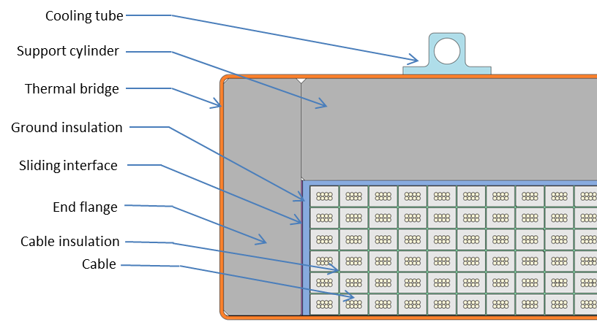
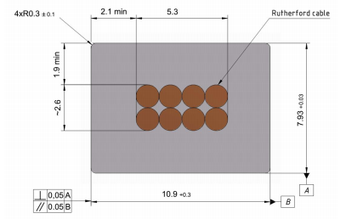
Conductor
Rutherford cable, 8 strands, extruded in Al matrix
Table 4. Conductor mechanical and electrical parameters.
Thickness (after cold work) at 300 K | mm | 7.93 | ± 0.03
Width (after cold work) at 300 K | mm | 10.95 | ± 0.03
Critical current (at 4.2 K, 5 T) | A | > 14690
Critical current (at 4.5 K, 3 T) | A | > 16750
Overall Al/Cu/sc ratio |  | 10.5/1.0/1.0
Aluminum RRR (at 4.2 K, 0 T) |  | > 1000
Al 0.2% yield strength at 300 K | MPa | > 30
Figure 5. Cold mass cross-section.
Figure 6. Drawing of the conductor.
Dimensions of cable: 10.9 x 7.93 mm

Slide 44
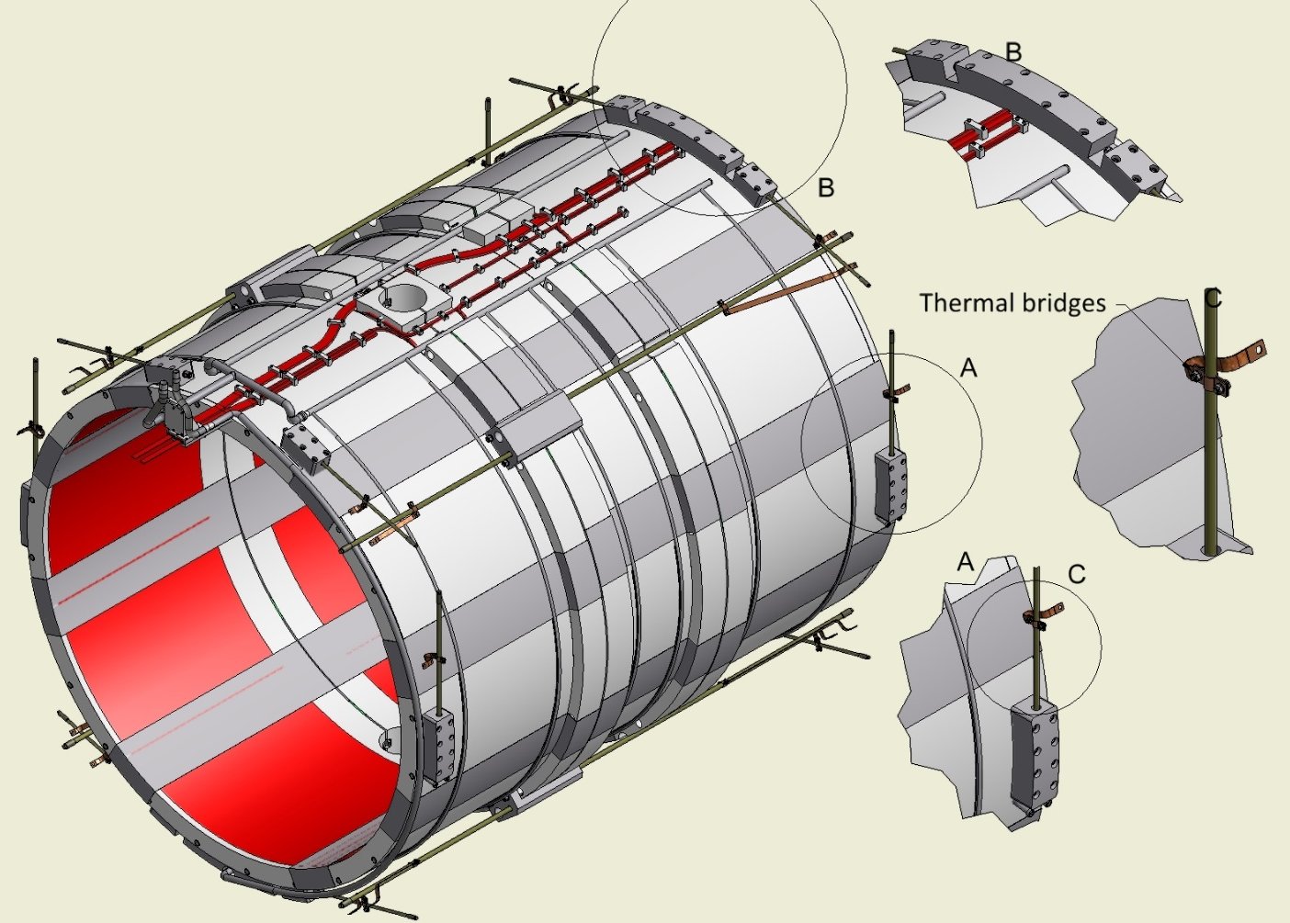
The Cold mass (3D-Model).
The Cold mass is based in to Cryostat by suspensions, radial rods and longitudinal rods. For thermal bridges is used the flexible copper.
The weight of cold mass is ~5.6 t

Slide 45
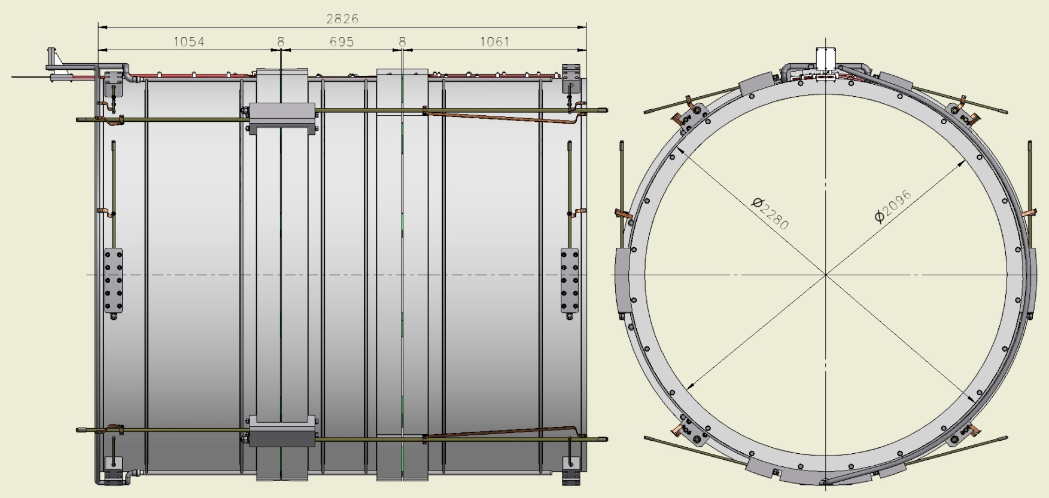
The Cold mass (dimension for condition 4.5K)
Inner diameter is 2096 mm, Outer diameter is 2280 mm, length is 2826 mm, Material of shell is Al 8083.

Slide 46
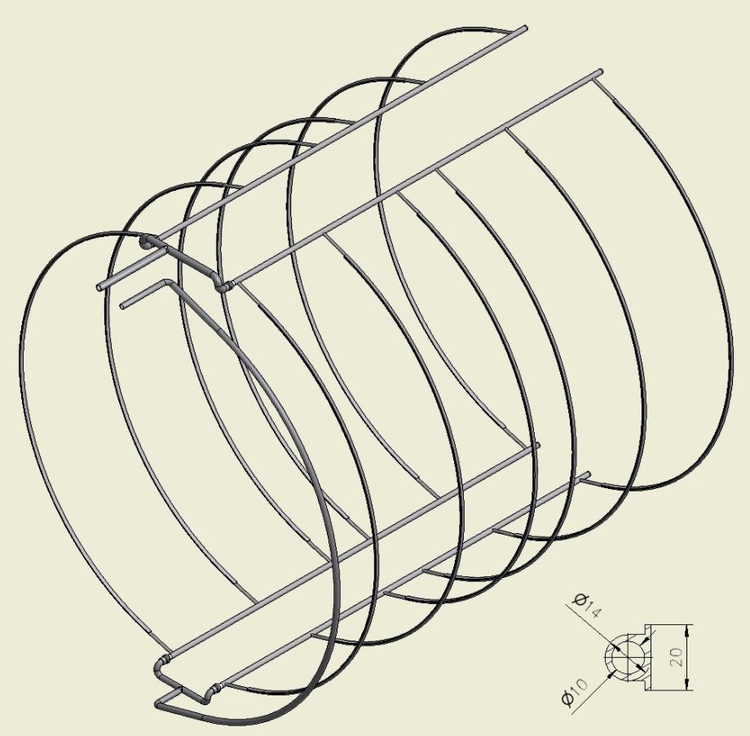
The Collector of Cold mass.
For cooling of Coil is used the collector with special aluminum profile which is welded on the outer shell of Cold mass.

Slide 47
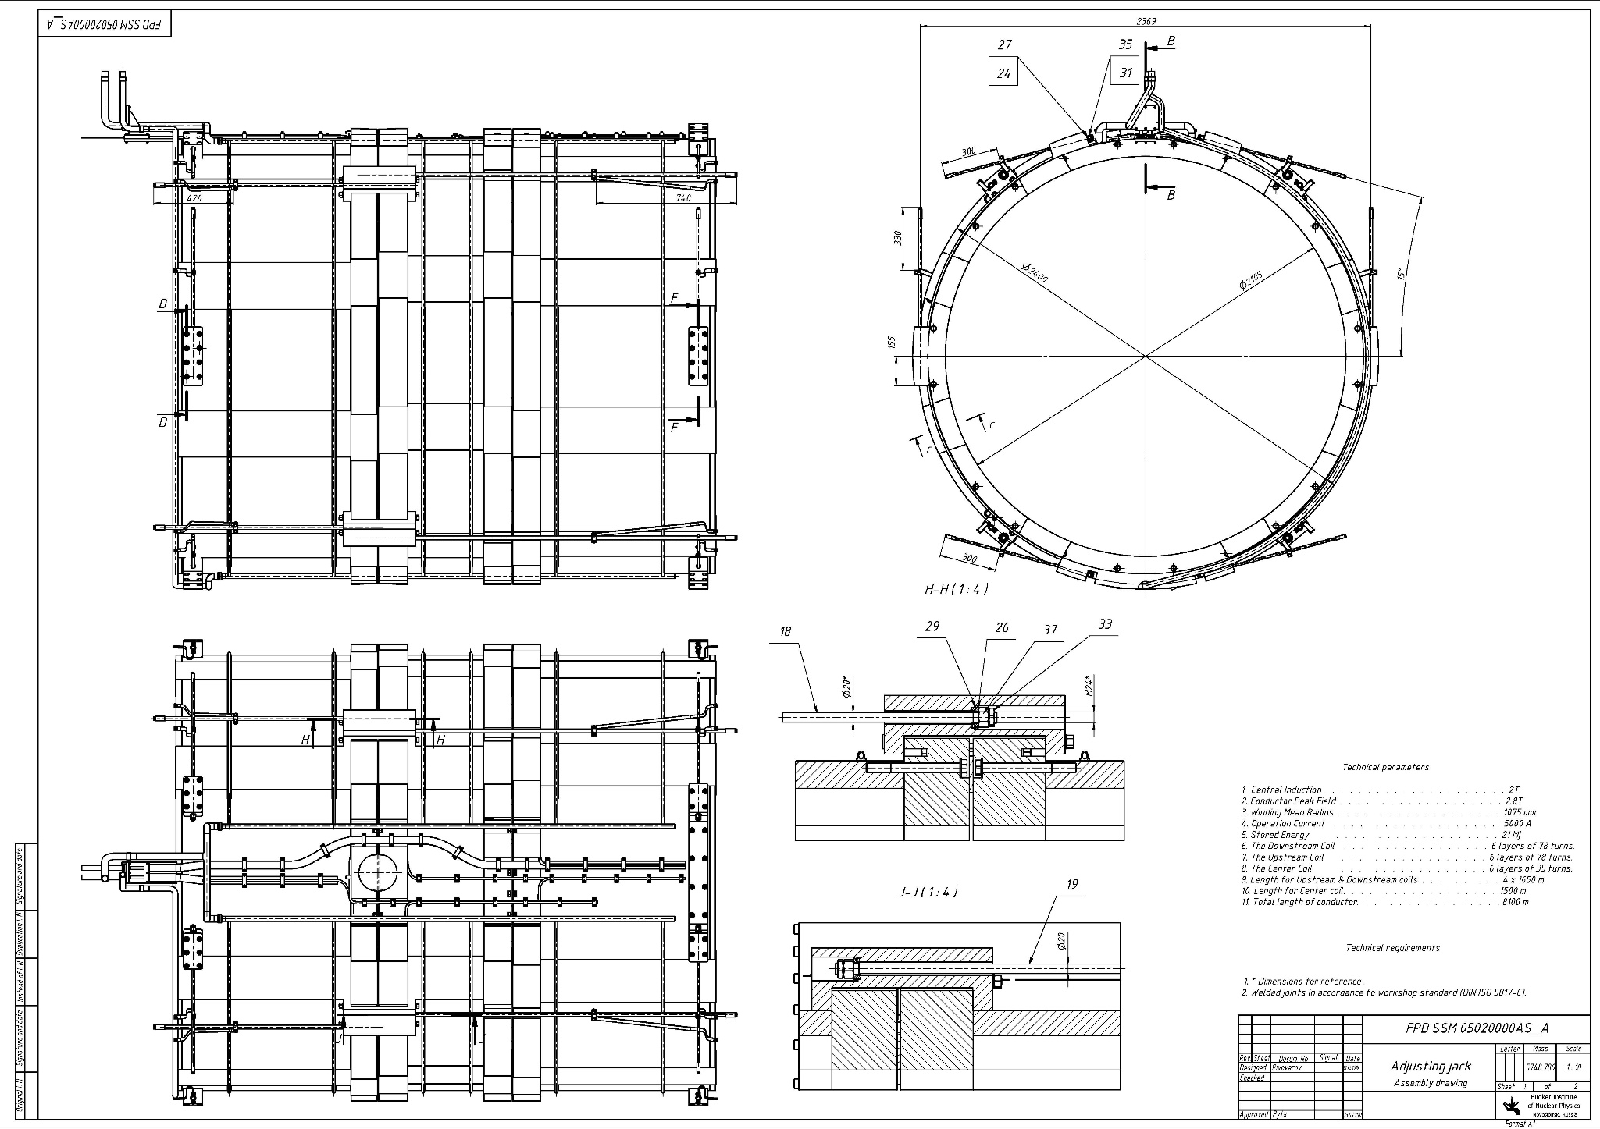
Drawing of the Cold mass.

Slide 48
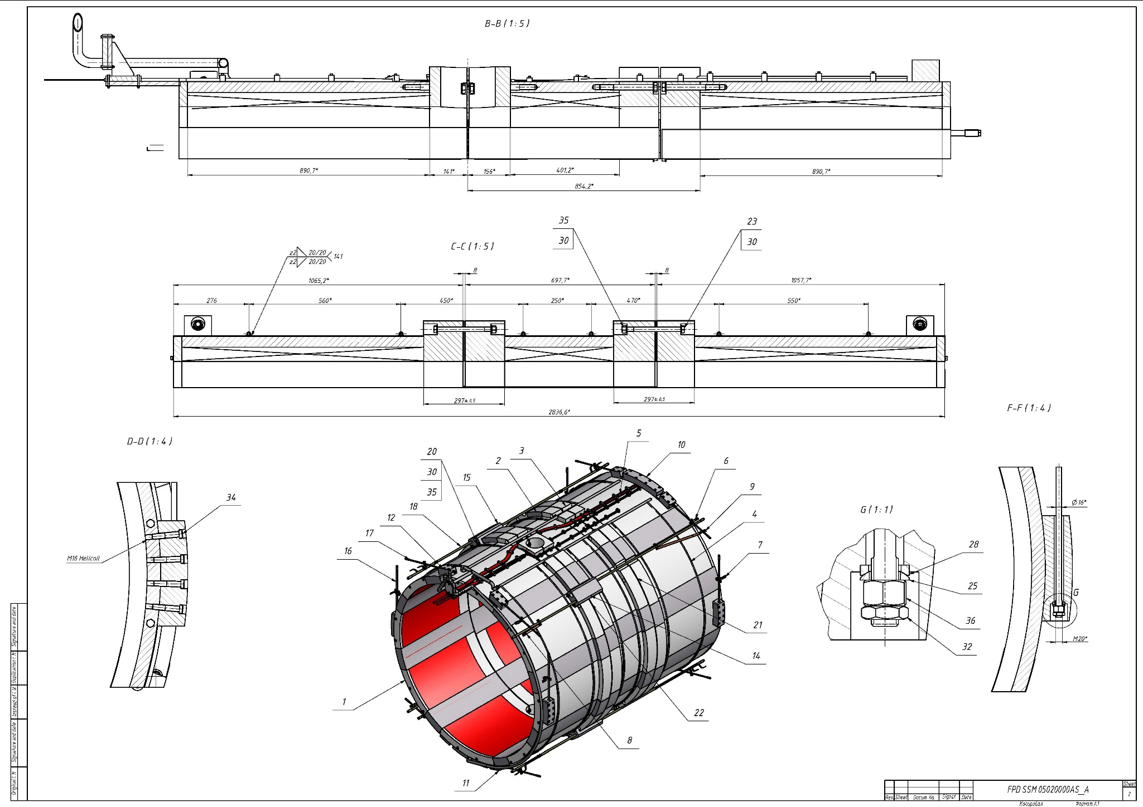
Drawing of the Cold mass.

Slide 49
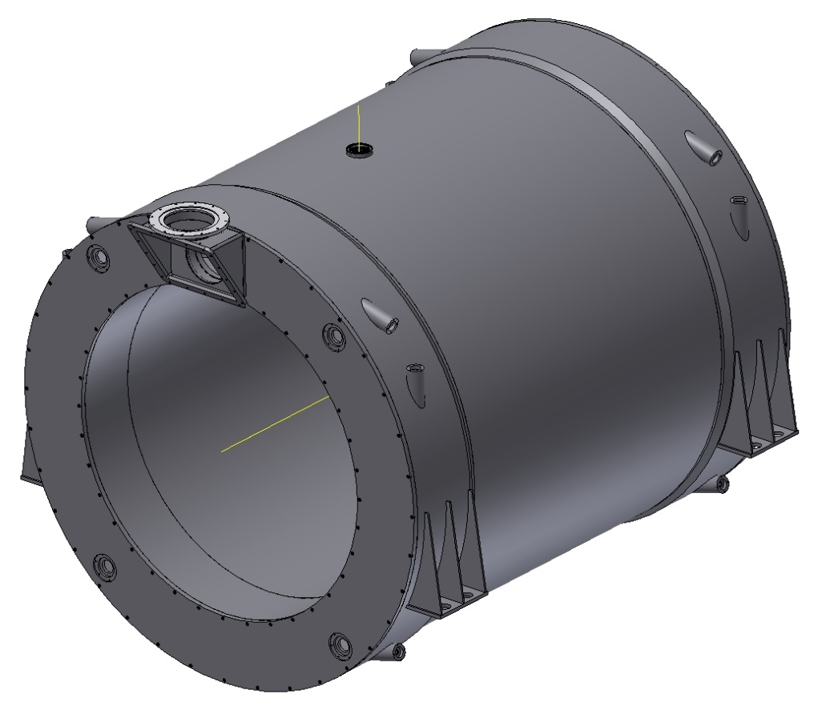
The Cryostat of The Magnet.
Inner diameter is 1900 mm, Outer diameter is 2680 mm, length is 3090 mm. Material is St.St. The weight is ~8 t

Slide 50
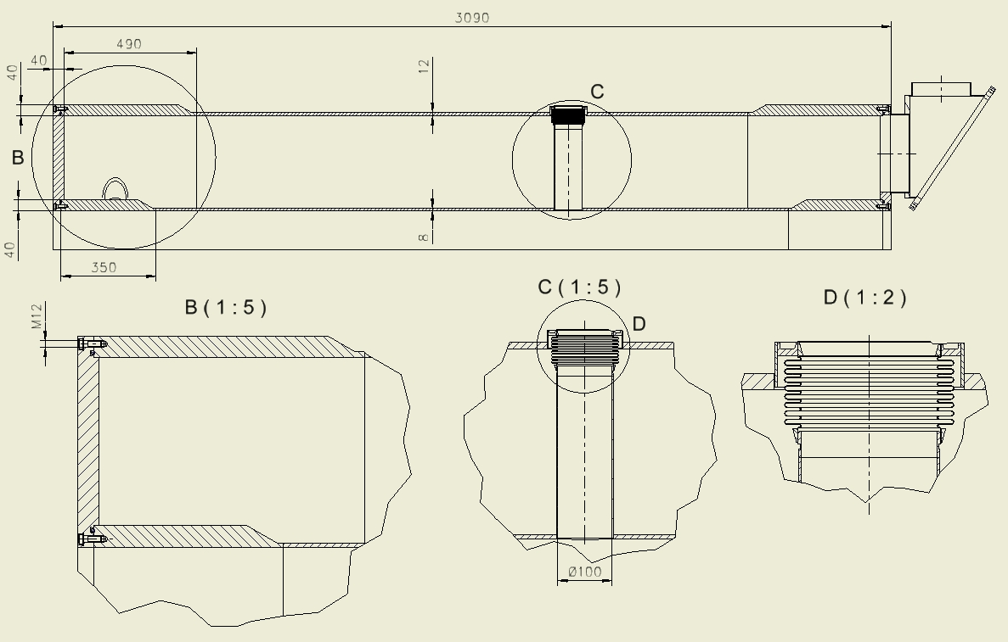
Configuration of the Cryostat
Thickness of the outer shell is 12 mm, Thickness of the inner shell is 8 mm , Thickness of the flanges is 40 mm, Thickness of the rings is 40 mm
The bolts – M12 – 2x36 ps. Sealing ring – d=8 mm

Slide 51
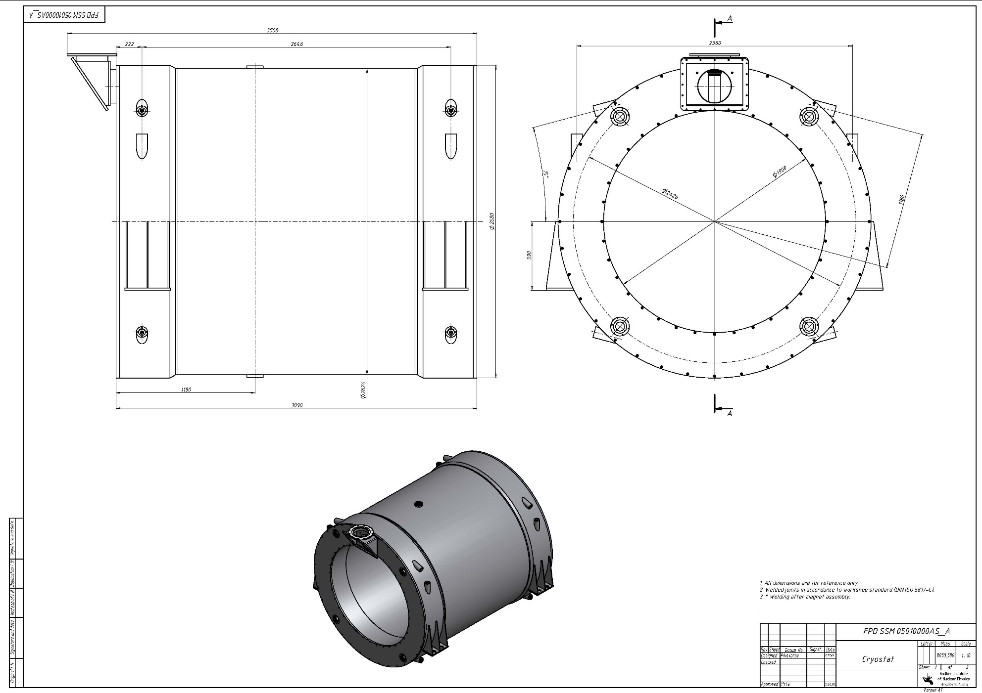
Drawing of the Cryostat.

Slide 52
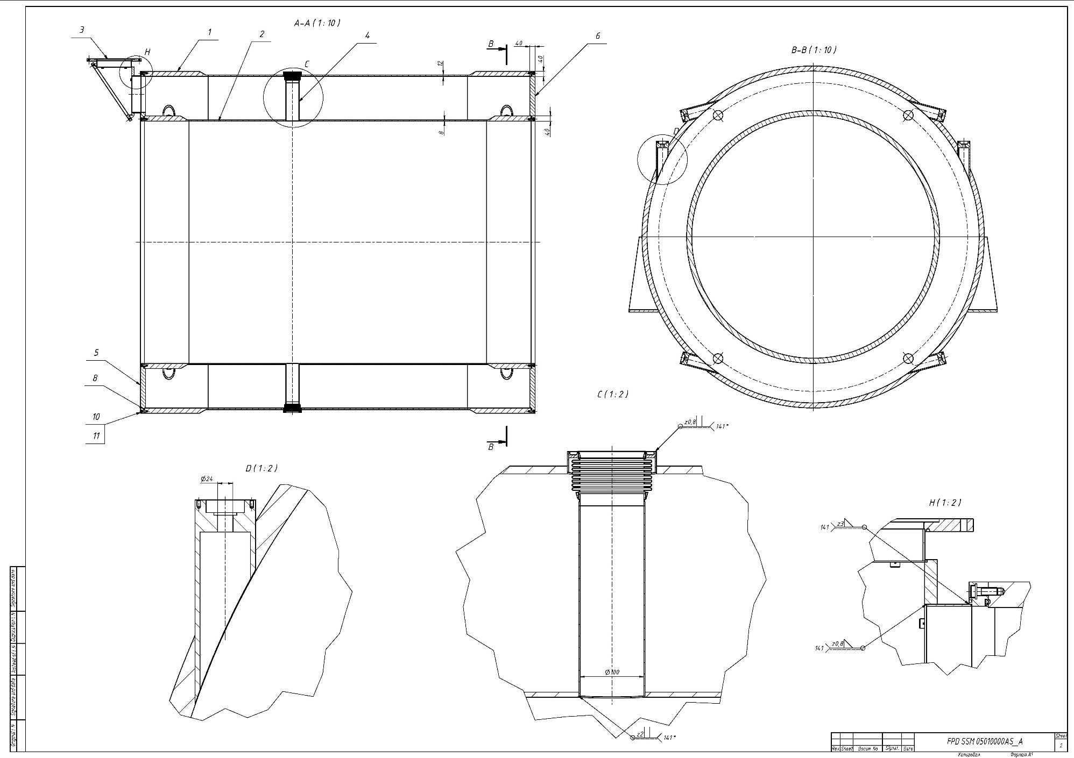
Drawing of the Cryostat.

Slide 53
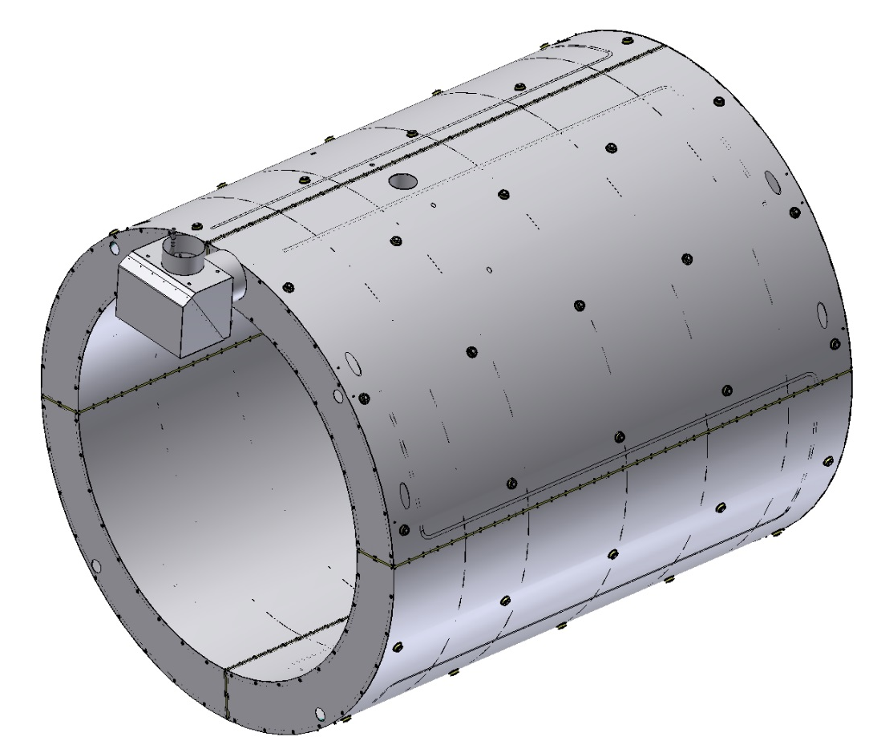
The Shield of the Magnet.
Outer diameter is 2552 mm, Inner diameter is 2020 mm, length is 2900 mm
Thickness is 3 mm, Material is Al 8083. The weight is ~0,45 t

Slide 54
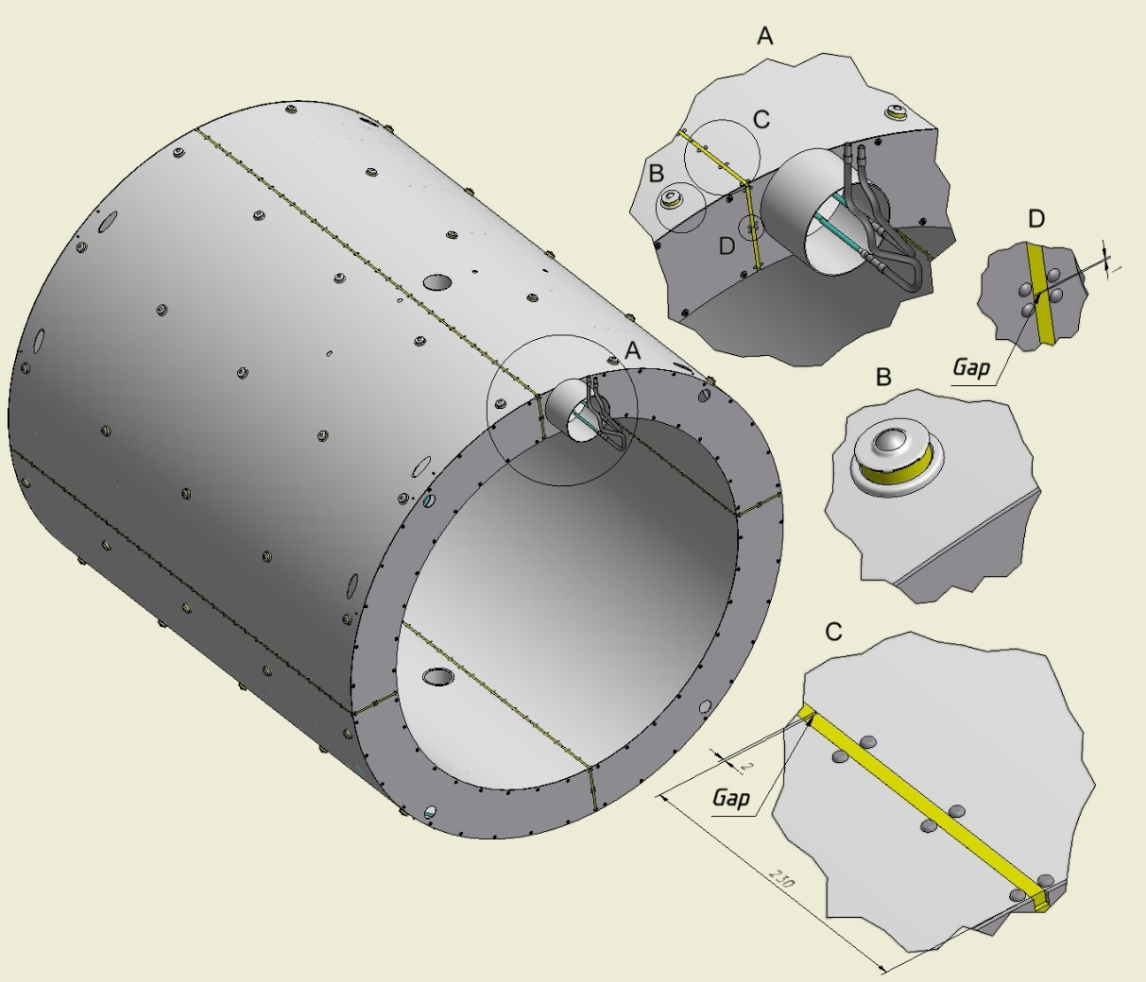
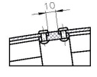
Break of the Shield .
The shield has 4 breaks isolated G11 bars with gaps. The shield is positioned into the cryostat by Balls transfer units with G11 ring.
On the outer and inner surface of the shield will be covered 30 layers of MLI.

Slide 55




The inner Shield.
Inner shell of the shield with flanges, ribs and pipeline .
For cooling of Shield is used the pipeline with special aluminum profile which is welded on the shell.

Slide 56


The outer Shield.
Outer Shell of the shield with ribs, Balls transfer units and pipeline with special aluminum profile which is welded on the shell.

Slide 57



The Shield into the Magnet.
The Shield is based on the outer shells of the cryostat by of Balls transfer units with G11 ring. Flanges of shield are fixed by of thread rivets and bolts.
Thermal bridges is fixed on the shell of shield by of thread rivets and bolts.

Slide 58

Fixation of the Shield into the Cryostat.
In the area of the target, the shield is fixed by of bushes (G11) and bolts (8 places). Position of bolts for fixing the shield into the cryostat.

Slide 59

Drawing of the Shield.

Slide 60

Drawing of the Shield.

Slide 61
Heat loads of the Cold mass and thermal Shield.
T=4.5K | Thermal load, W
Radiation | 2.2
Heat inflow to the cold mass supports | 0.52
Total: | 2.72
T=60K
Radiation | 95
Heat inflow to the cold mass supports | 13
Heat inflow to the shield supports | ?
Total: | 108

Slide 62

3D model of the Magnet and Control Dewar.

Slide 63

Drawing of the Magnet and Control Dewar.

Slide 64

Drawing of the Magnet, Feed Box and Frame.

Slide 65

Drawing of the Magnet, Feed Box and Frame.

Slide 66

3D model of the Magnet, Yoke, Platform and Frame.

Slide 67
Summary
Drawings of Iron Yoke and Frame are ready. The Novosibirsk Plant (Sibmash) started production of the first octant of the barrel part of the Iron Yoke.
Drawings of the Cryostat, Shield and Cold mass are ready.
The technology of winding coils and special tools are being developed in BINP.
PANDA solenoid magnet will be produced in the BINP Workshop.

Slide 68
Thanks for your attention

