Slide 1
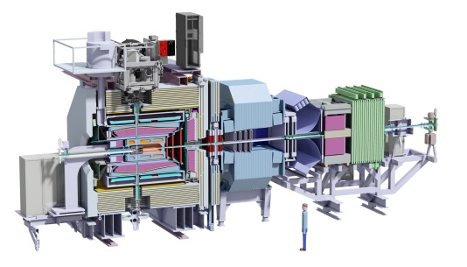
Status of the Cluster Target
PANDA Collaboration Meeting 18/2
Stockholm, June 4th – 8th, 2018

Slide 2
Studies at the Prototype Target and
Numerical Simulations

Slide 3
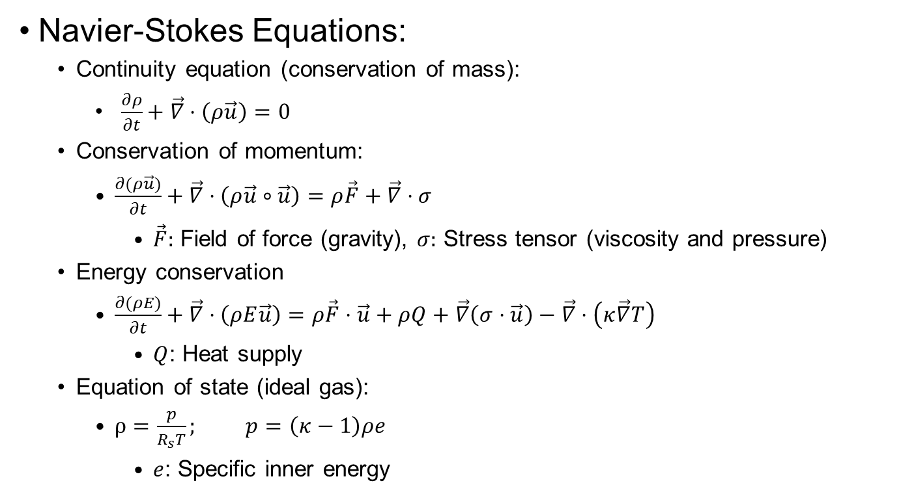
Simulations of Gas-Jet and Cluster-Jet Beams
Navier-Stokes Equations:
  Continuity equation (conservation of mass):
    $\frac{∂ρ}{∂t}+\vec{∇}⋅\left(ρ\vec{u}\right)=0$
  Conservation of momentum:
    $\frac{∂(ρ\vec{u})}{∂t}+\vec{∇}⋅\left(ρ\vec{u}∘\vec{u}\right)=ρ\vec{F}+\vec{∇}⋅σ$
      $\vec{F}:$ Field of force (gravity), $σ:$ Stress tensor (viscosity and pressure)
  Energy conservation
    $\frac{∂(ρE)}{∂t}+\vec{∇}⋅\left(ρE\vec{u}\right)=ρ\vec{F}⋅\vec{u}+ρQ+\vec{∇}\left(σ⋅\vec{u}\right)−\vec{∇}⋅\left(κ\vec{∇}T\right)$
      $Q$: Heat supply
  Equation of state (ideal gas):
    $ρ=\frac{p}{R_{s}T}; p=\left(κ−1\right)ρe$
      $e$: Specific inner energy

Slide 4
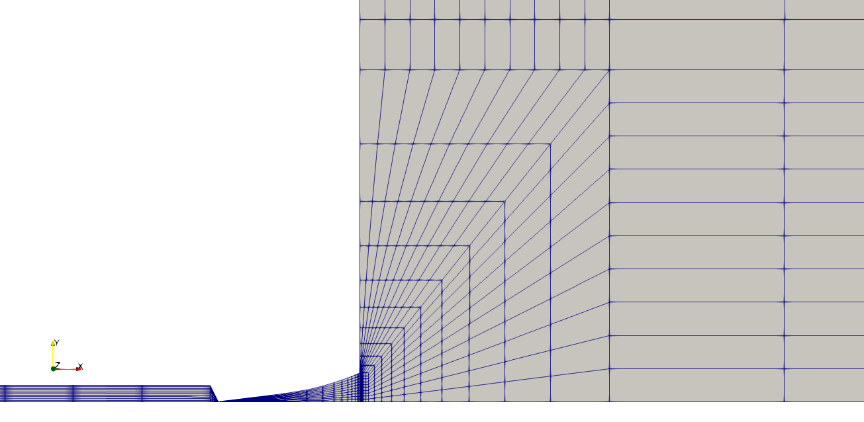
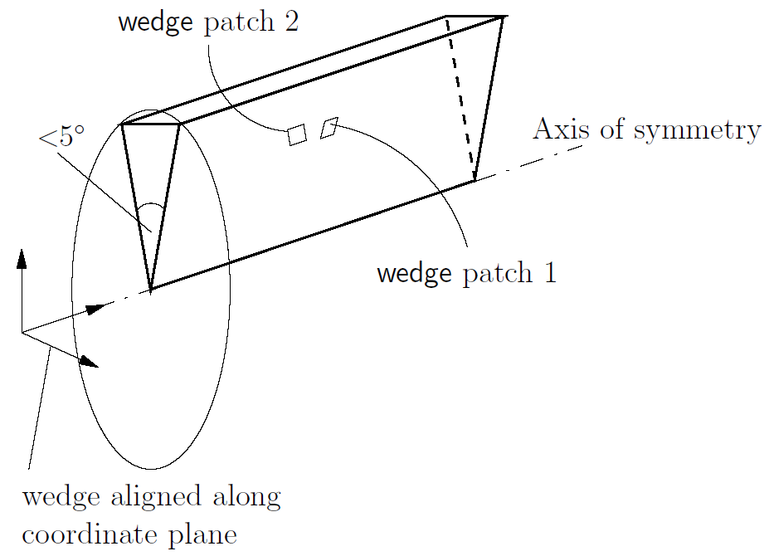
Simulations of Gas-Jet and Cluster-Jet Beams
Navier-Stokes equations:
  Numerical fluid dynamics:
    Finite volume method
    Block structured grids
  Axial-symmetrical model (3d):
    Axial-symmetrical boundary conditions
Simulation package: OpenFOAM

Slide 5
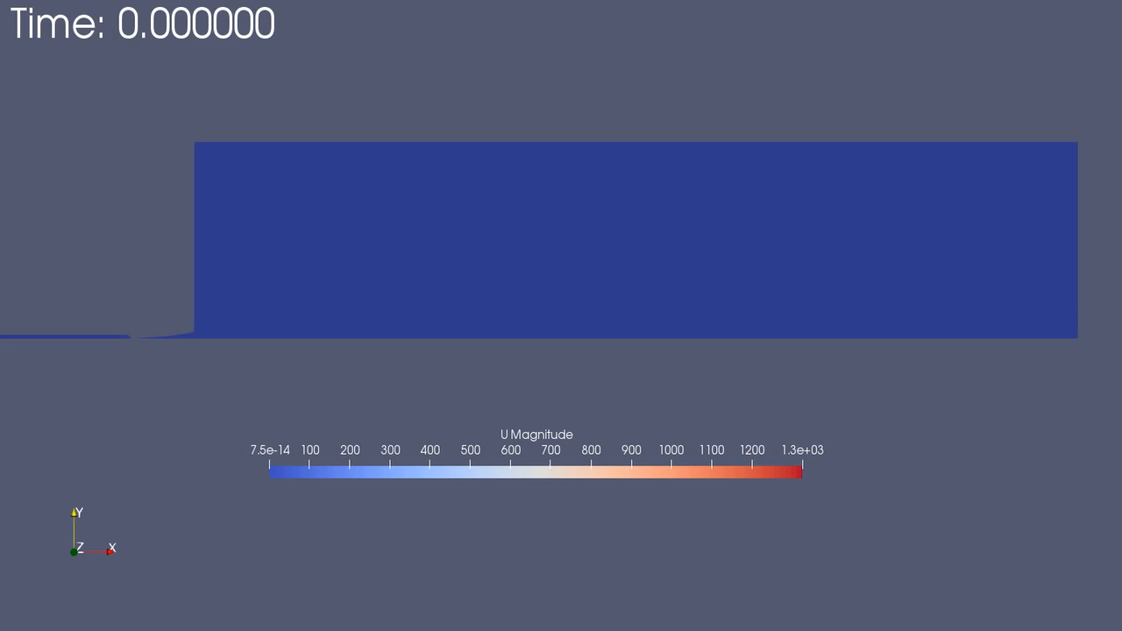

Simulations of Gas-Jet Beams: Velocity
Cern nozzle (Ø = 28 µm):
  $p_{nozzle}=10$ bar, $T_{nozzle}=50$ K, $p_{chamber}=10^{−3}$ mbar
Simulations by S. Vestrick and P. Brand (WWU)

Slide 6
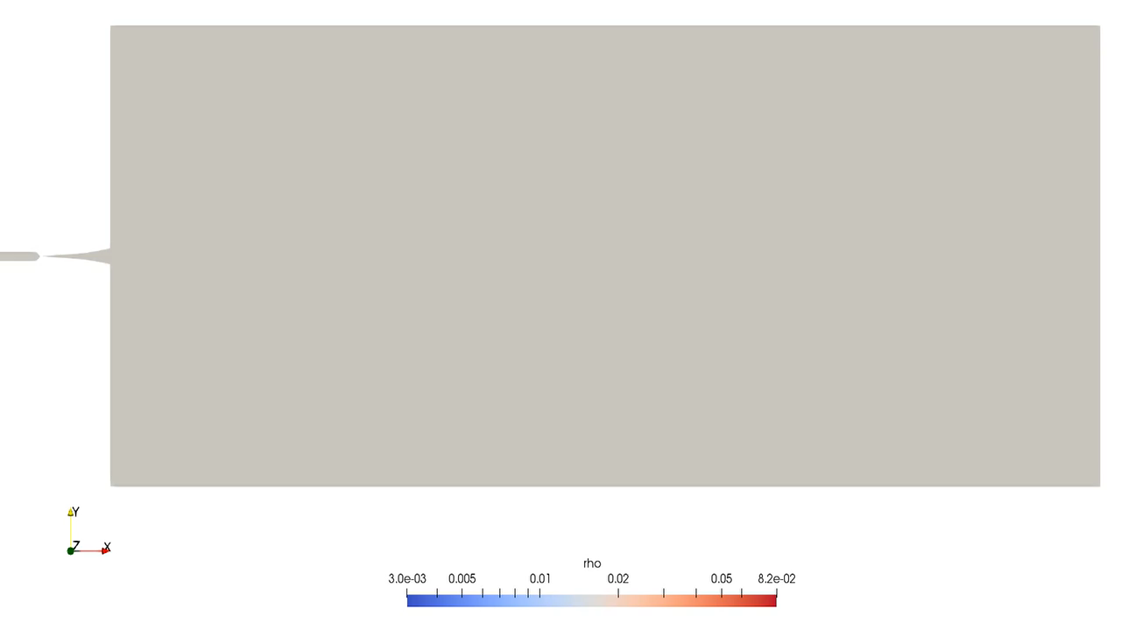

Simulations of Gas-Jet Beams: Density
(previously 1d)
Simulations by S. Vestrick and P. Brand (WWU)
Cern nozzle (Ø = 28 µm):
  $p_{nozzle}=10$ bar, $T_{nozzle}=50$ K, $p_{chamber}=10^{−3}$ mbar

Slide 7
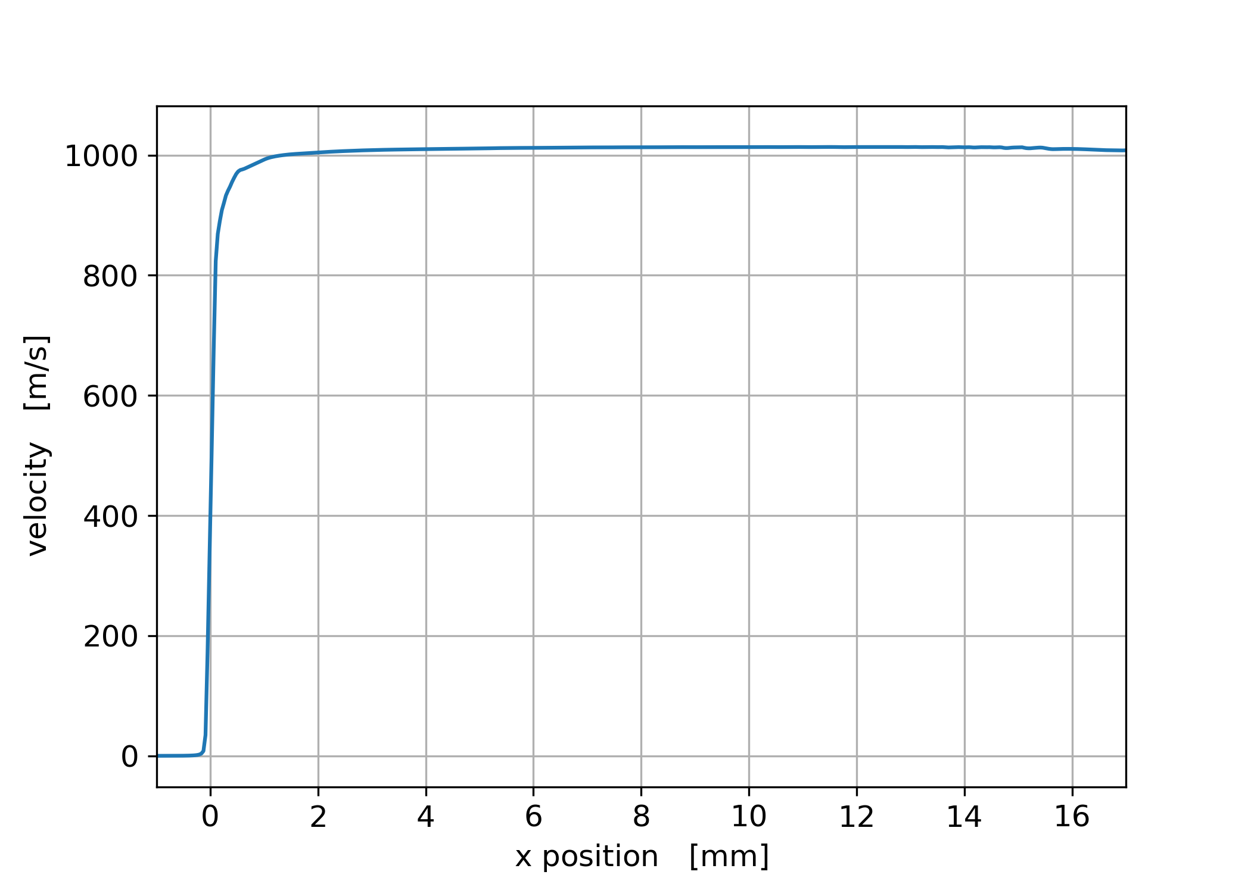

Simulations of Gas-Jet Beams
Cern nozzle (Ø = 28 µm):
  $p_{nozzle}=10$ bar, $T_{nozzle}=50$ K, $p_{chamber}={10}^{−3}$ mbar
  Nozzle inlet: x = -1 mm, narrowest inner diameter: x = 0 mm,
  nozzle exit: x = 17 mm
Simulations by S. Vestrick and P. Brand (WWU)

Slide 8
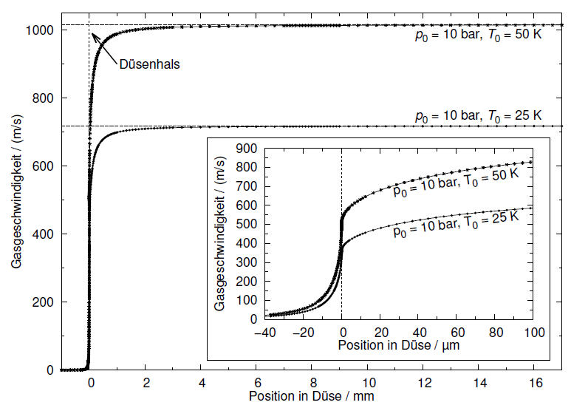

Simulations of Gas-Jet Beams
Cern nozzle (Ø = 28 µm):
  $p_{nozzle}=10$ bar Previous Simulations (2d):
  $T_{nozzle}=50$ K (A. Täschner, Münster, 2012)
  $p_{chamber}={10}^{−3}$ mbar

Slide 9
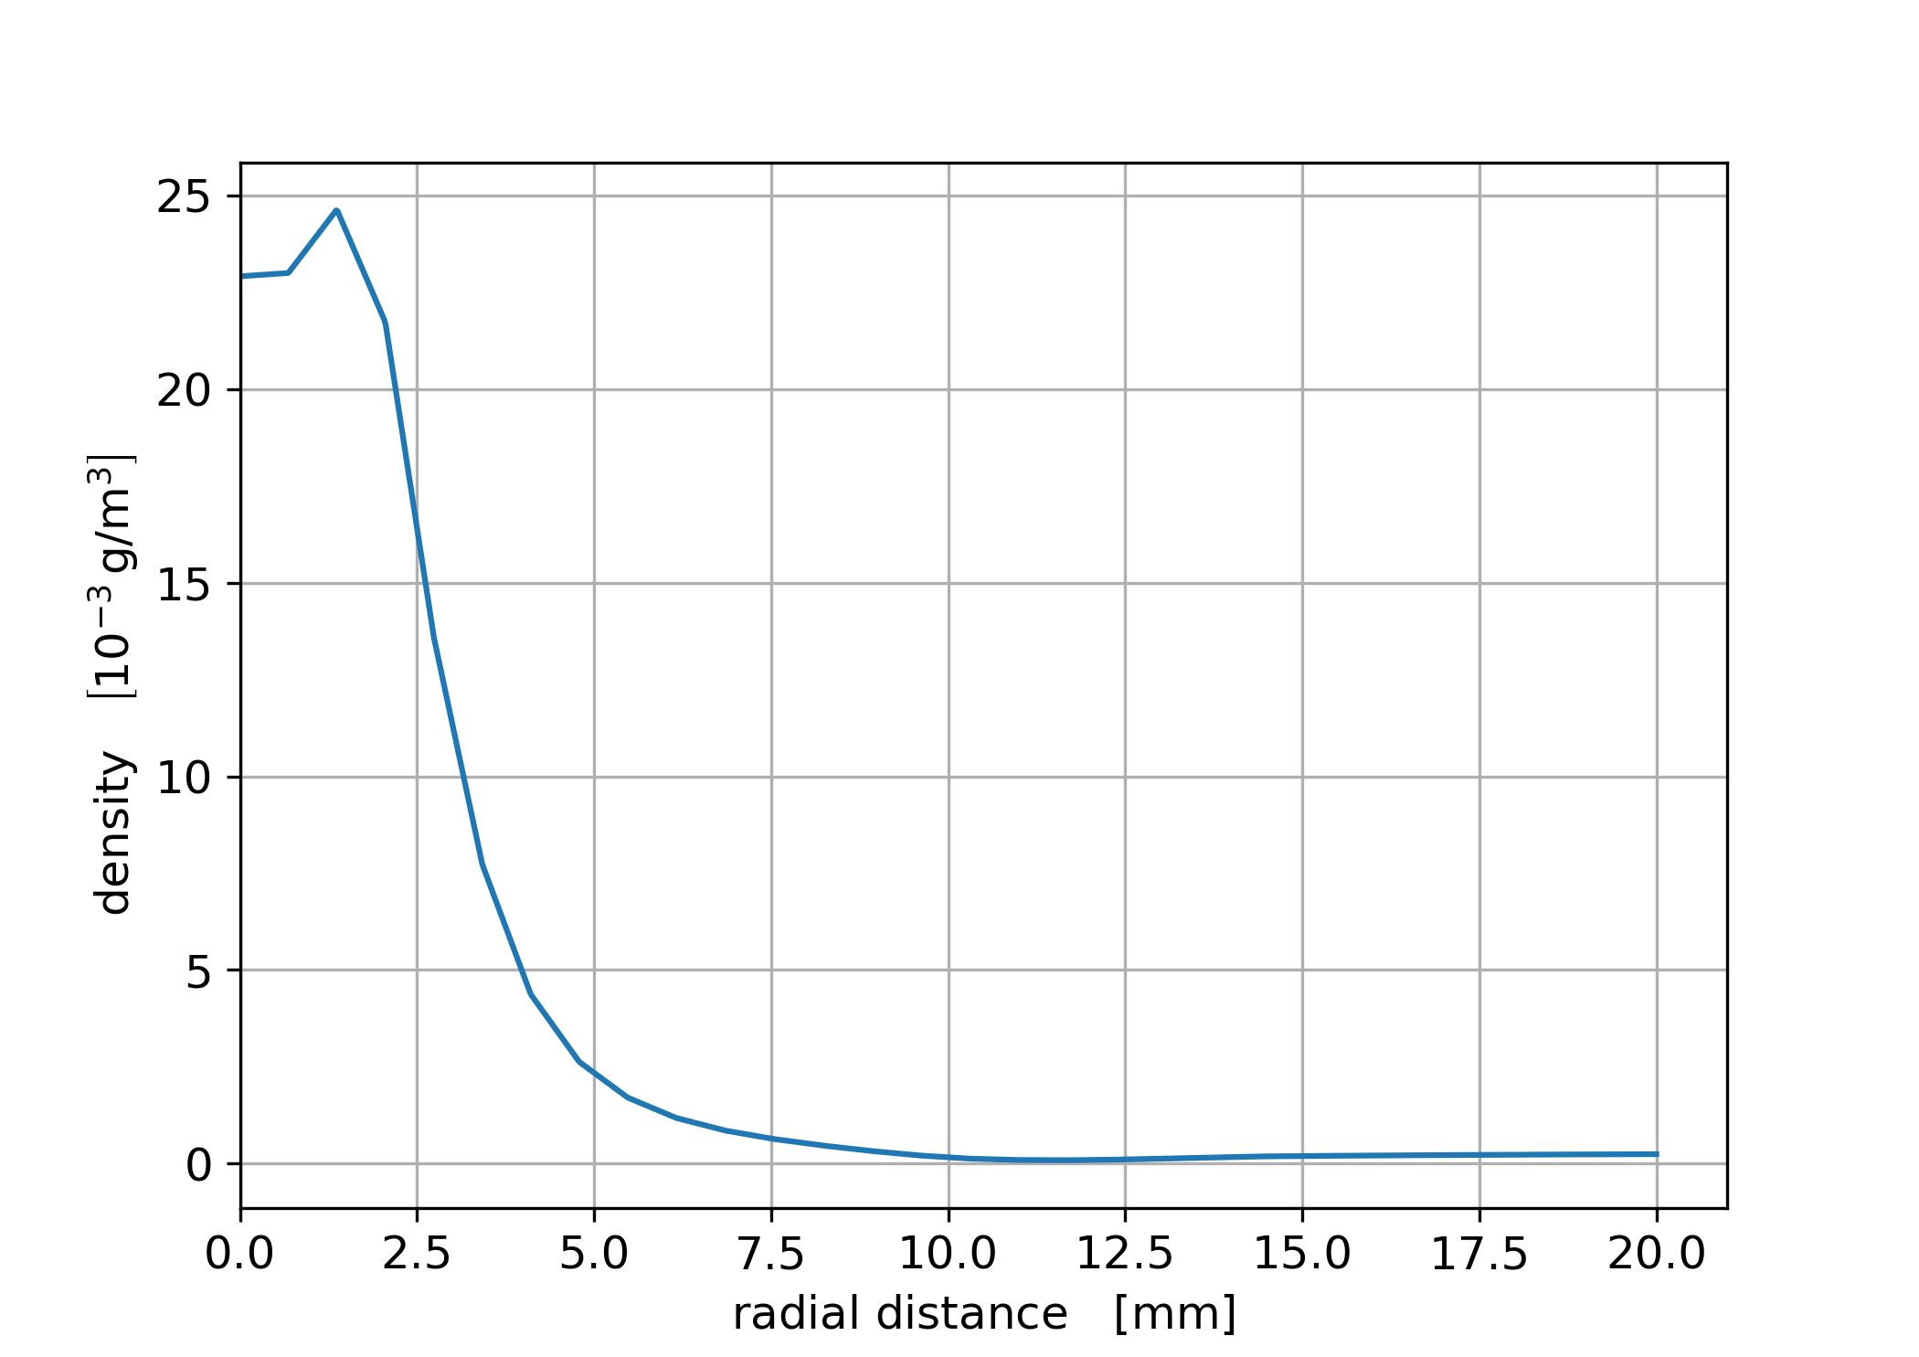

Simulations of Gas-Jet Beams
Cern nozzle (Ø = 28 µm):
  $p_{nozzle}=10$ bar, $T_{nozzle}=50$ K, $p_{chamber}={10}^{−3}$ mbar
                Distance from nozzle exit: 20 mm
                Axis of symmetry: r = 0 mm
Simulations by S. Vestrick and P. Brand (WWU)

Slide 10
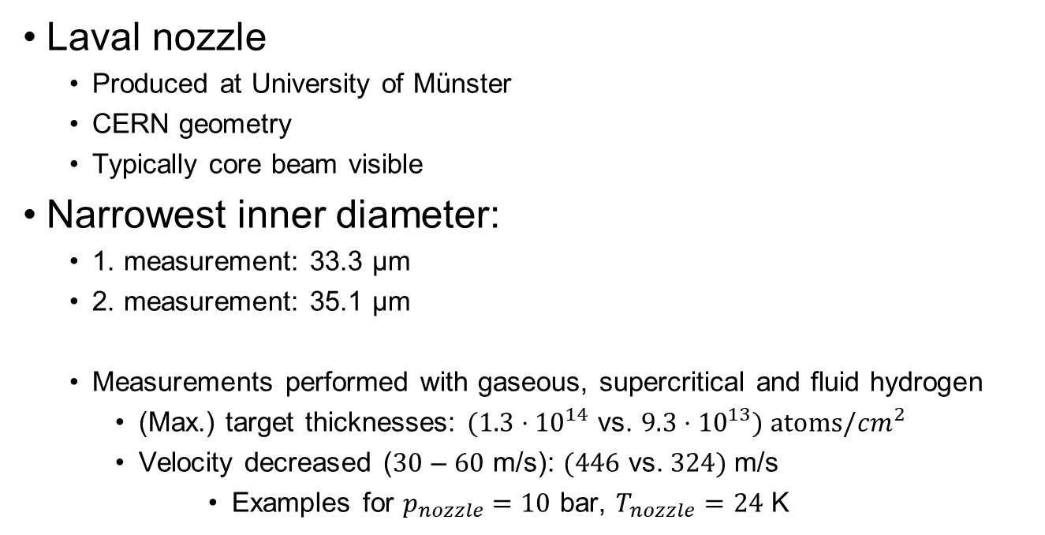
Measurement on Laval Nozzle Geometry
Laval nozzle
  Produced at University of Münster
  CERN geometry
  Typically core beam visible
Narrowest inner diameter:
  1. measurement: 33.3 µm
  2. measurement: 35.1 µm
  Measurements performed with gaseous, supercritical and fluid hydrogen
    (Max.) target thicknesses: $(1.3{⋅10}^{14}$ vs. $9.3{⋅10}^{13}) atoms/{cm}^{2}$
    Velocity decreased ($30$ – $60$ m/s): $(446$ vs.$324)$m/s
        Examples for $p_{nozzle}=10$ bar, $T_{nozzle}=24$ K

Slide 11
Measurement on Laval Nozzle Geometry: Length
Impact of the nozzle length:
Laval nozzle with Ø: 35.1 µm
Measurements performed with gaseous, supercritical and fluid hydrogen
1./2. measurements:
  Test of reproducibility at full nozzle length (18 mm)
Continuous turn off: 1 mm per step
  Mechanical Workshop of University Münster

Slide 12
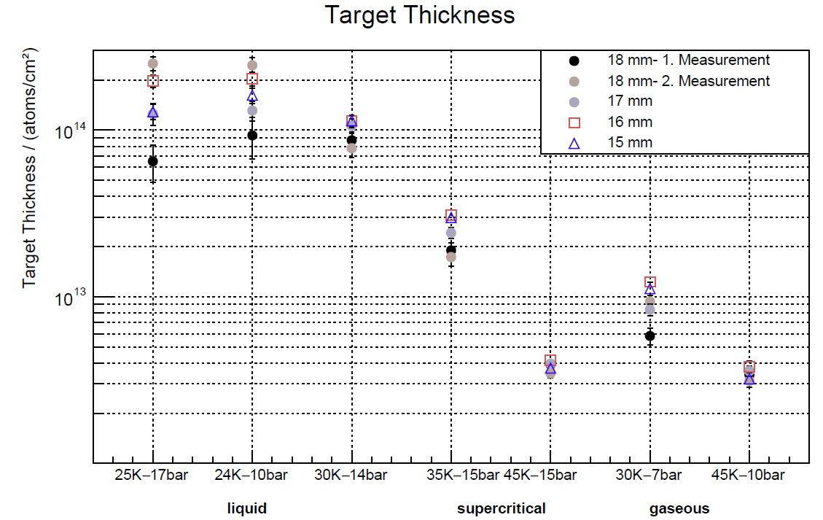
Measurement on Laval Nozzle Geometry: Length

Slide 13
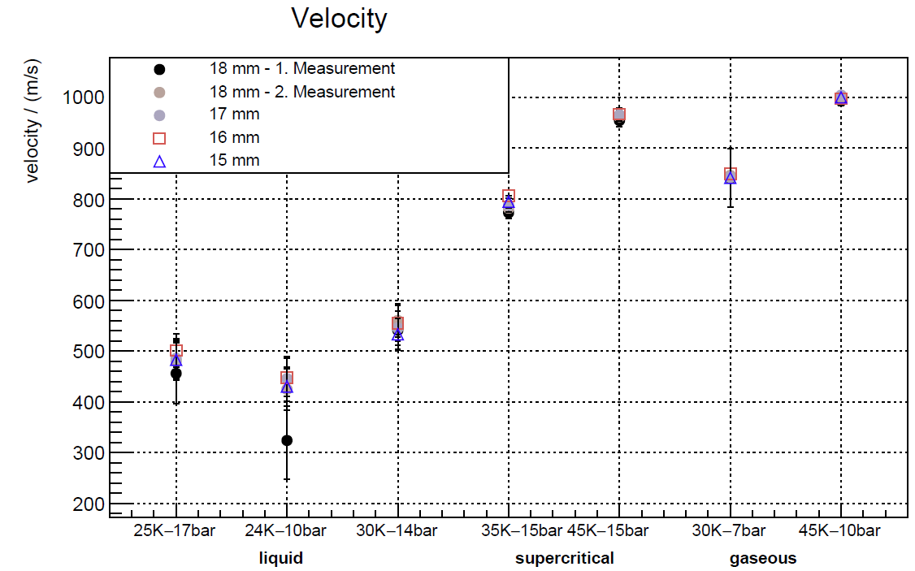
Measurement on Laval Nozzle Geometry: Length

Slide 14
Measurements at the PANDA Target

Slide 15
PANDA Cluster Target
Operation of the cluster target in „PANDA-like“ setup
Studies on vacuum situation
Test of different collimator types
Variation of orifices between pumping stages
Preparation for installation at COSY

Slide 16

Planned PANDA Setup with Cluster Target

Slide 17
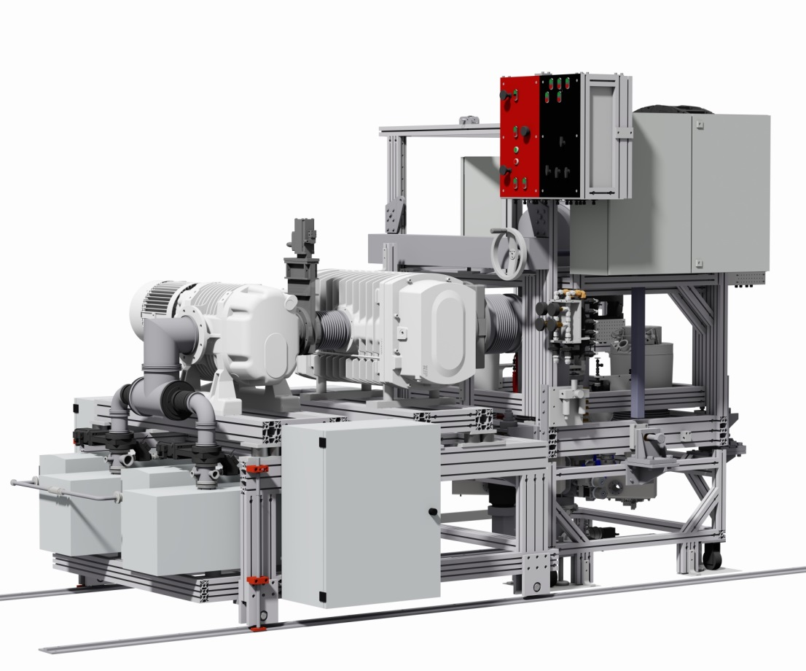
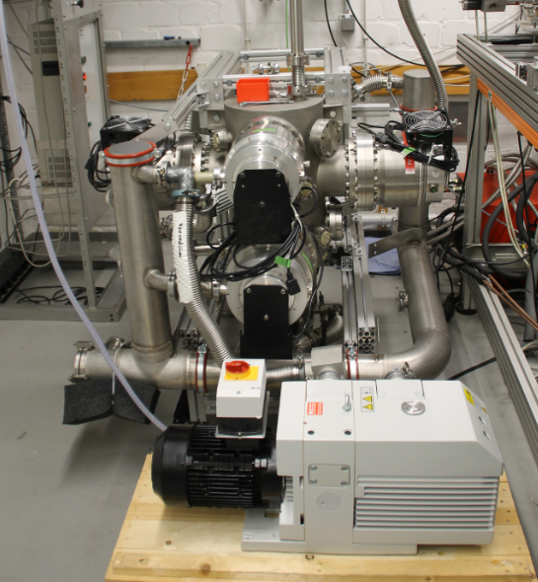
Beam dump
(prepared by the Genua group)

Slide 18
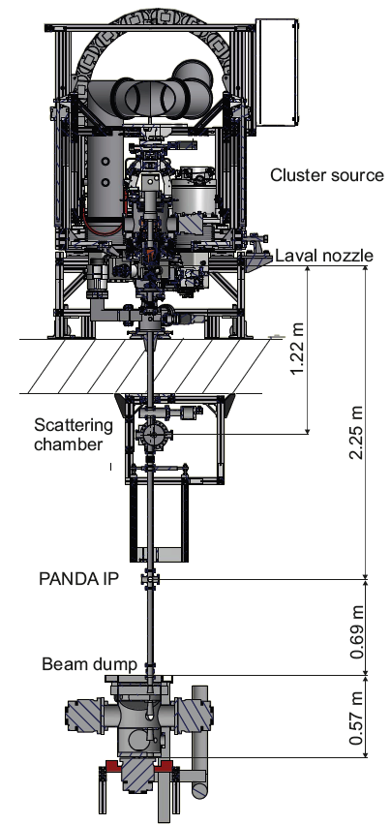
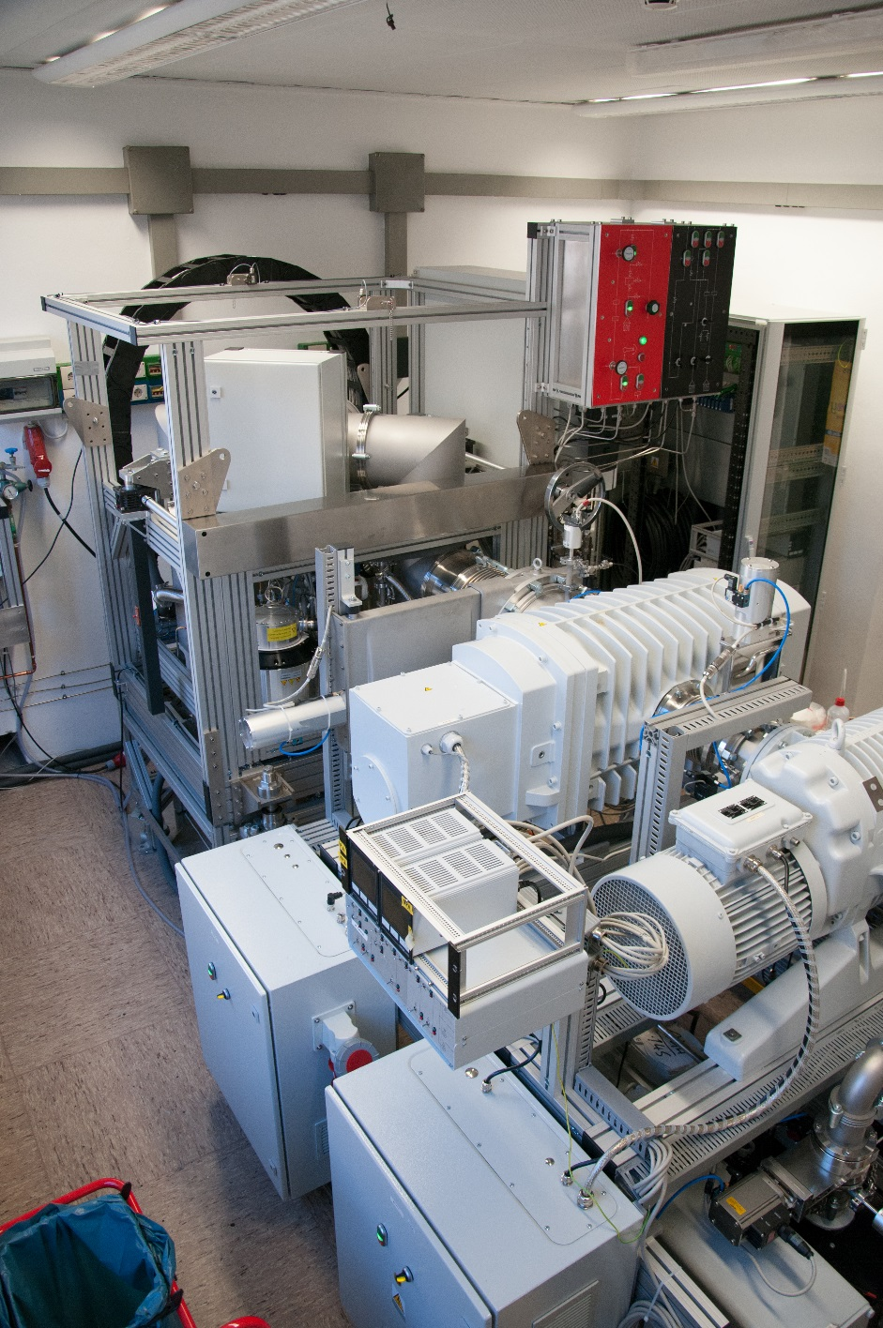

Slide 19
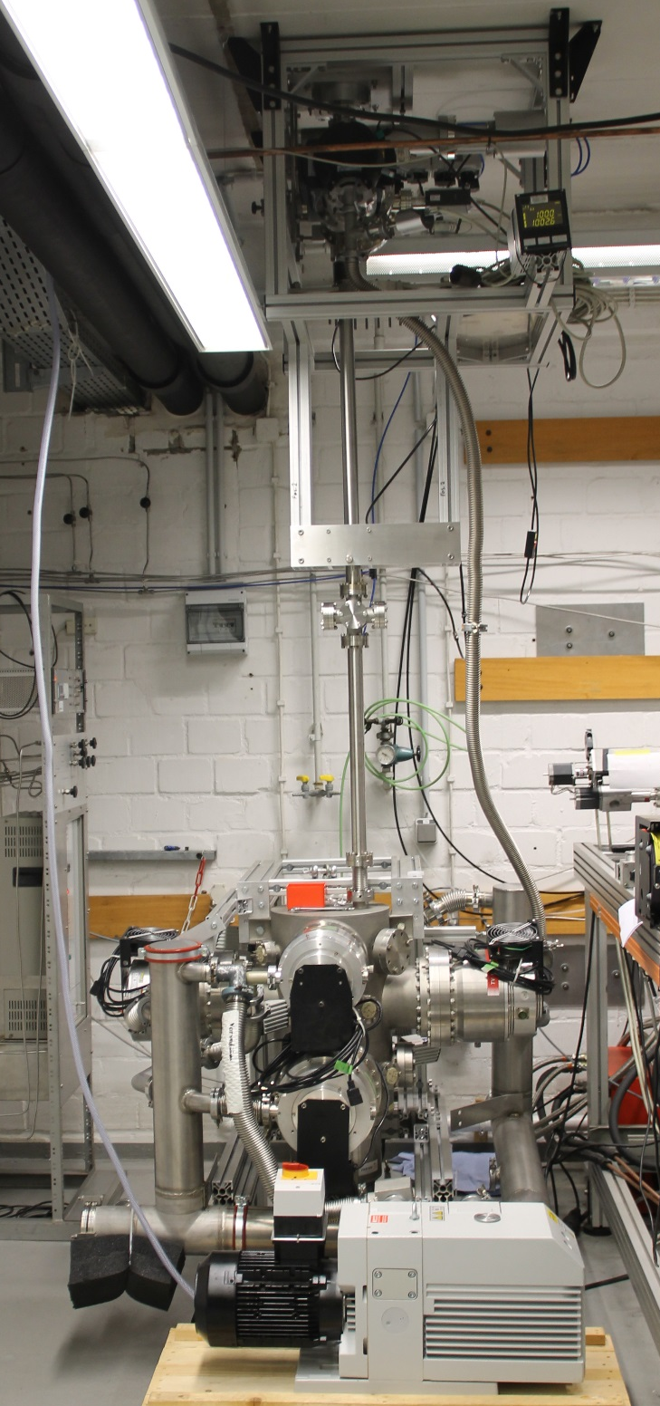

Slide 20
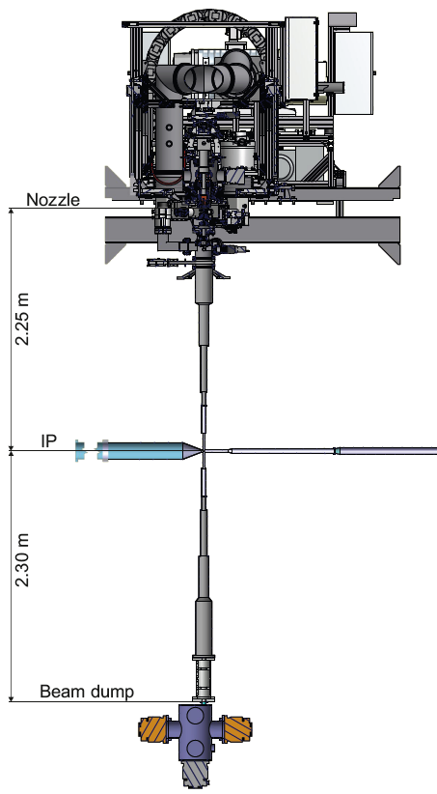
Münster PANDA
(today) (20xx)

Slide 21
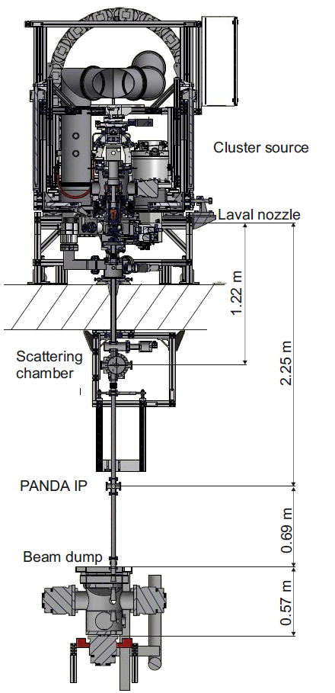
Measurement of Cluster Beam Properties
Measurement of cluster beam
position
thickness distribution
size
vacuum situation
gas load
at the scattering chamber and
at the PANDA IP

Slide 22
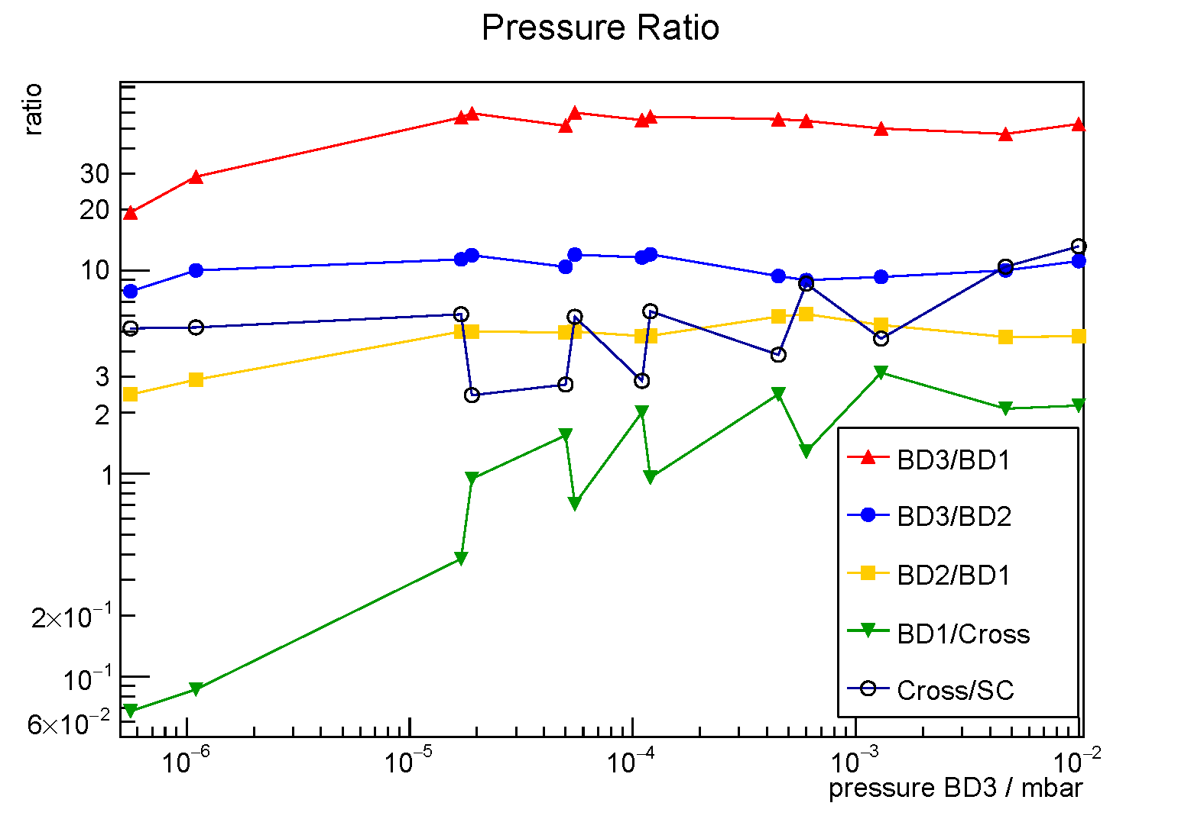
Beam Dump Efficiency: Gas in Last Dump Stage
Relevant pressure range

Slide 23
Vakuum Studies
Hydrogen partial pressures with cluster beam on
  4.1x10¹⁴ H-atoms/cm² at PANDA IP
  2.25 m behind the nozzle
Partial pressures from other gases and water completely negligible
Pumping speed at IP in Münster corresponds to the one later at PANDA (~ 100 l/s)

Slide 24
Vakuum Studies
Study the effect of bouncing clusters or evaporation from clusters
  Subtraction of backstreaming gas from 3rd beam dump stage
    Switch cluster beam off
    Load 3rd beam dump stage with hydrogen gas so that the same pressure with cluster beam is obtained (i.e. 4x10⁻⁵ mbar)
  Appreciable effect only in 2nd beam dump stage

Slide 25
Vakuum Studies
Obviously the obtained gas load to the IP result from
  Gas load from neighbouring chambers
  Conductance between the vacuum stages
  Possible evaporation of gas from clusters
  Possible bouncing clusters
The last two contributions seem to be significant

Slide 26
Vakuum Studies
Further studies on this aspect in preparation
  Variation of orifices (limitation by cluster beam size)
  Variation of working points, i.e. stagnation conditions at the nozzle
Estimation for given example measurement:
  1.2x10⁻⁵ mbar ≙ 6.4x10¹¹ atoms/cm³
  1 m of this pressure along the PANDA beam pipe corresponds to 6.4x10¹³ H-atoms/cm², i.e. 15.6% of the target thickness

Slide 27
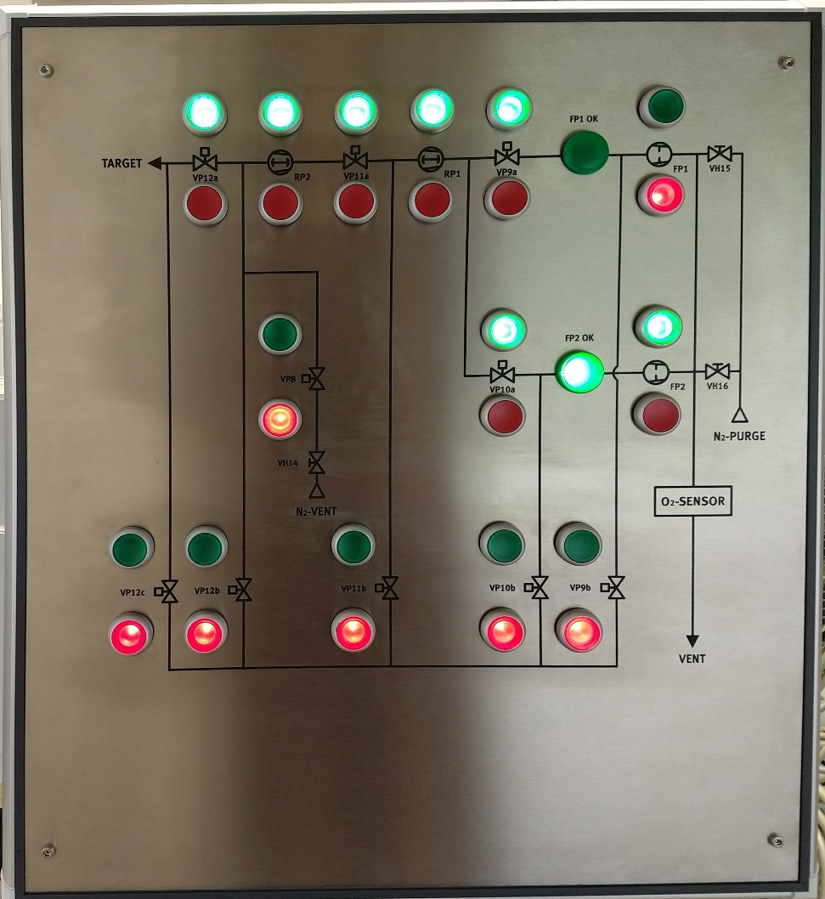
New Operation Panel for the Pumping System
Temporary switch board exchanged by final panel
Full manual operation and remote control possible
  Valves
  Pumps
  Control via CRIO
  Readout of status lines (pumps, shutter)

Slide 28
PANDA Target at COSY

Slide 29
Cluster Target at COSY
Installation and operation of the complete PANDA cluster target at an internal COSY beam position
Well suited: WASA-at-COSY position including partially use of detectors + DAQ
Comparison with results from WASA pellet target
Installation of the beam dump: week 25
Installation of the cluster generator: week 27
→ realistic test of important
beam and target parameter

Slide 30
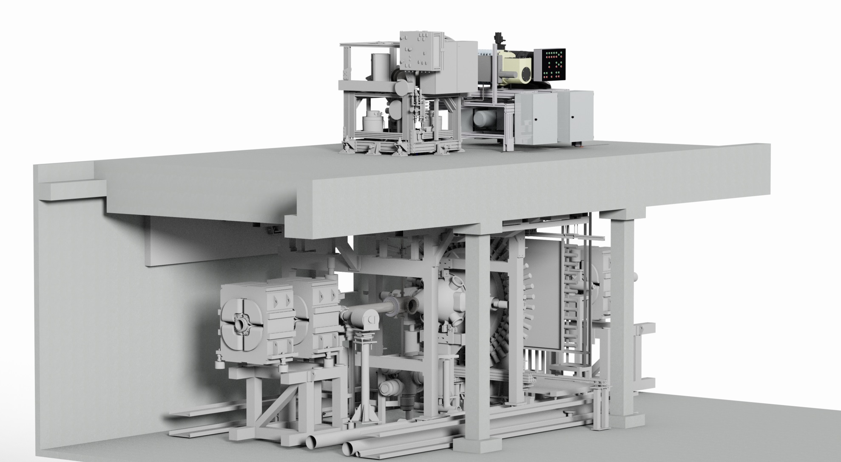
Installation of the Cluster Target at COSY

Slide 31
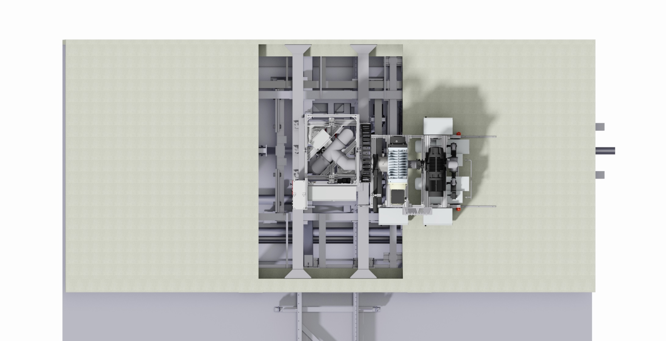
Installation of the Cluster Target at COSY

Slide 32
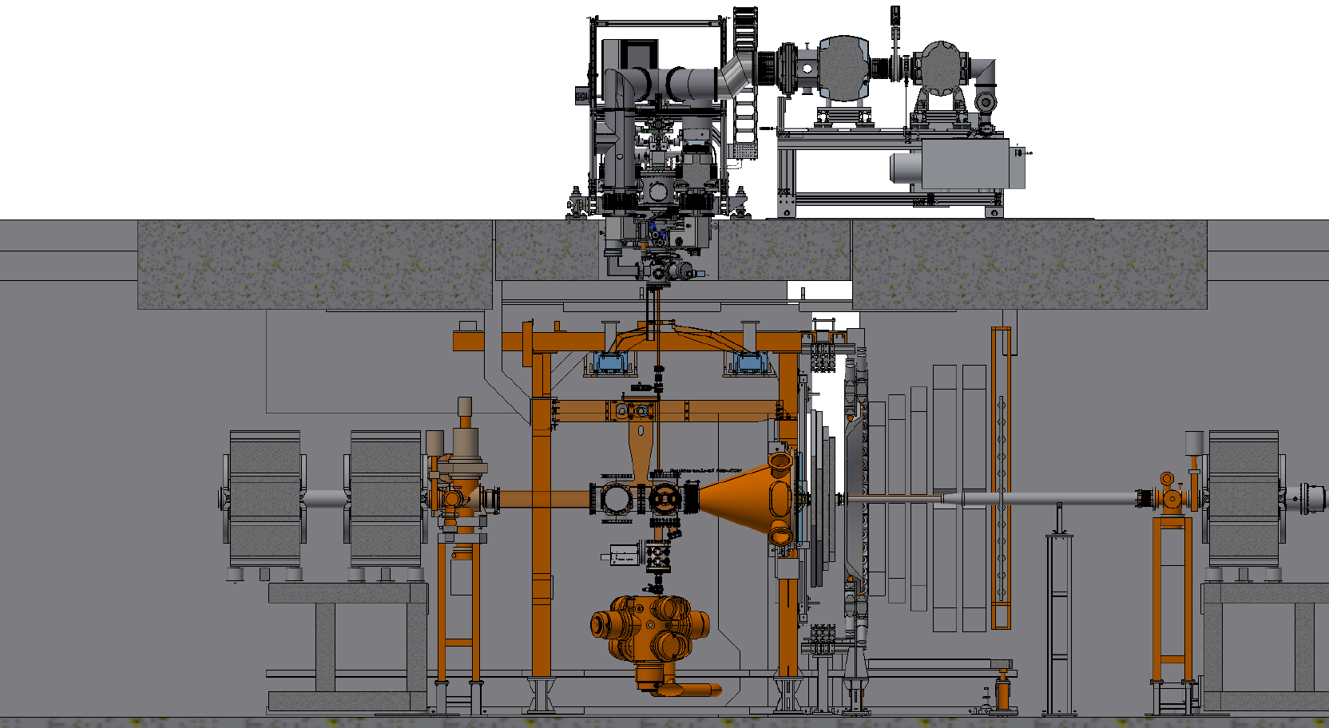
Installation of the Cluster Target at COSY

Slide 33
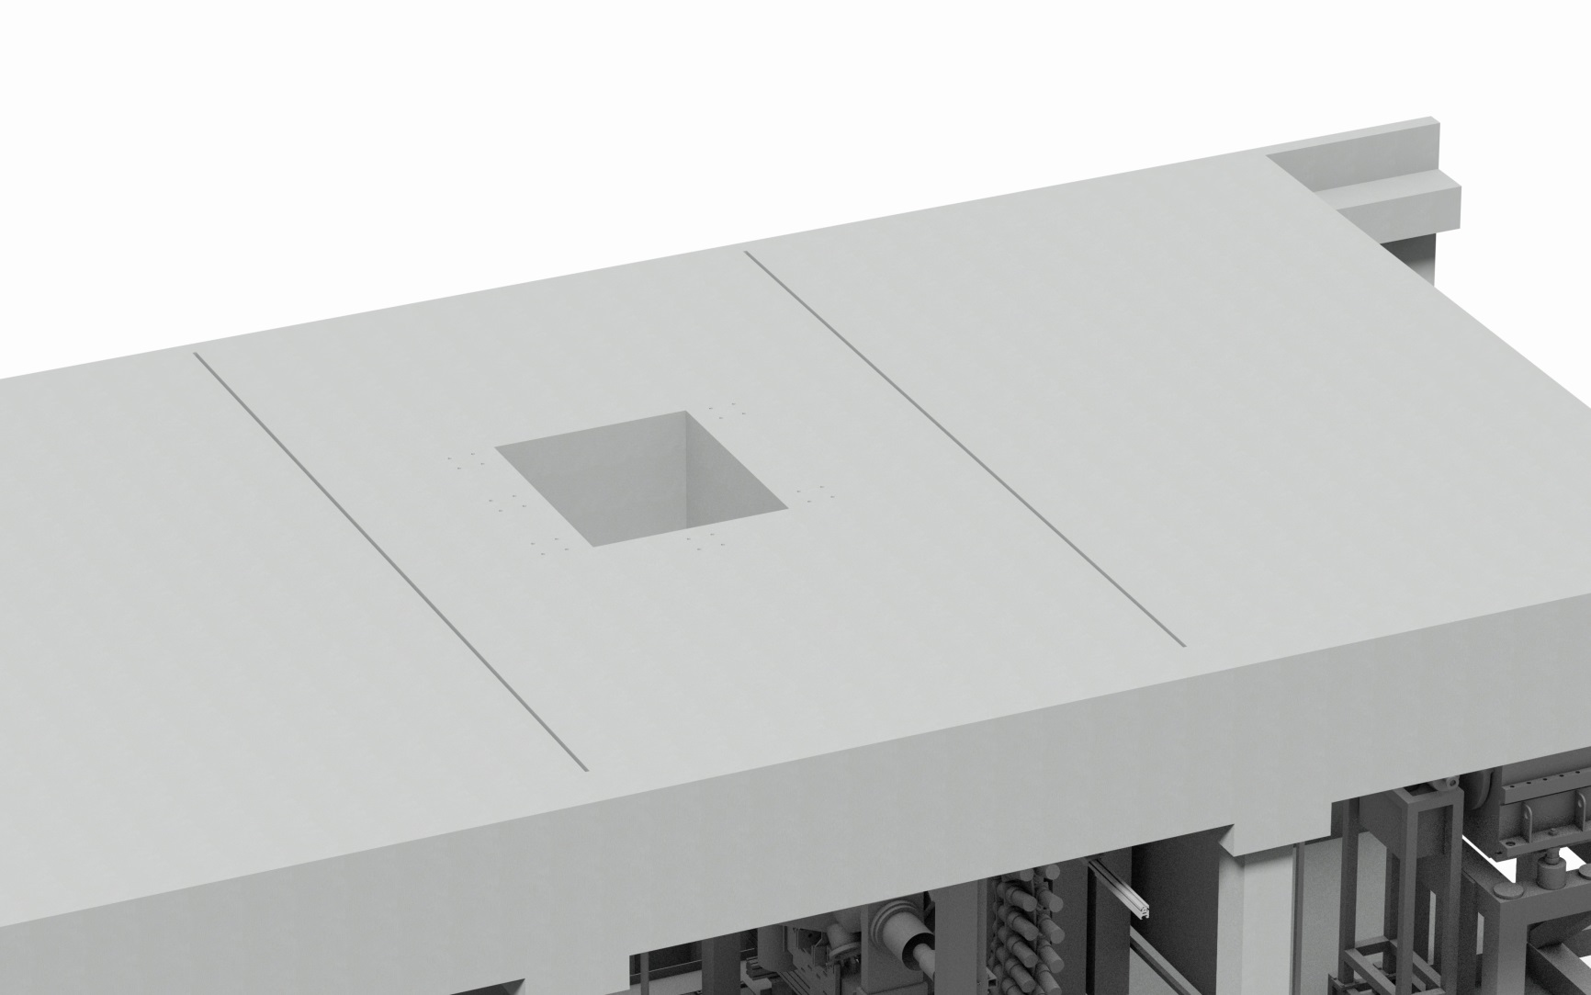
Installation of the Cluster Target at COSY
New concrete element ordered, but still not delivered

Slide 34
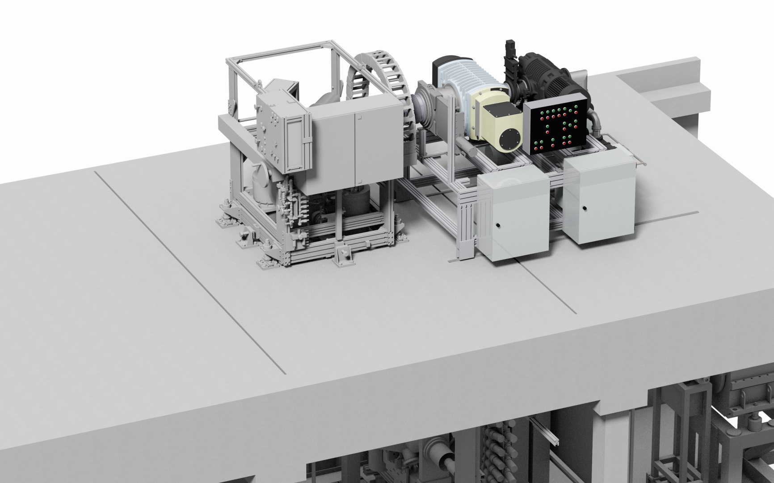
Installation of the Cluster Target at COSY

Slide 35
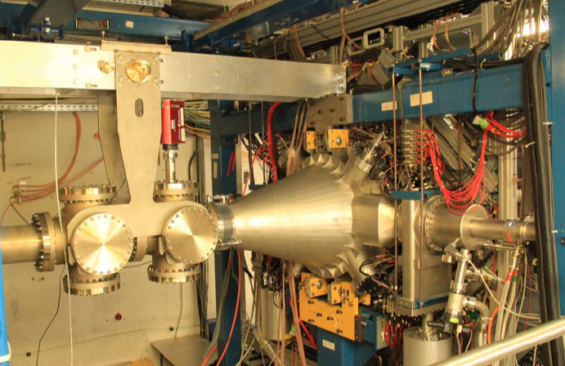
Modification of Beam Pipe and Scattering Chamber
Design and construction by FZ Jülich

Slide 36
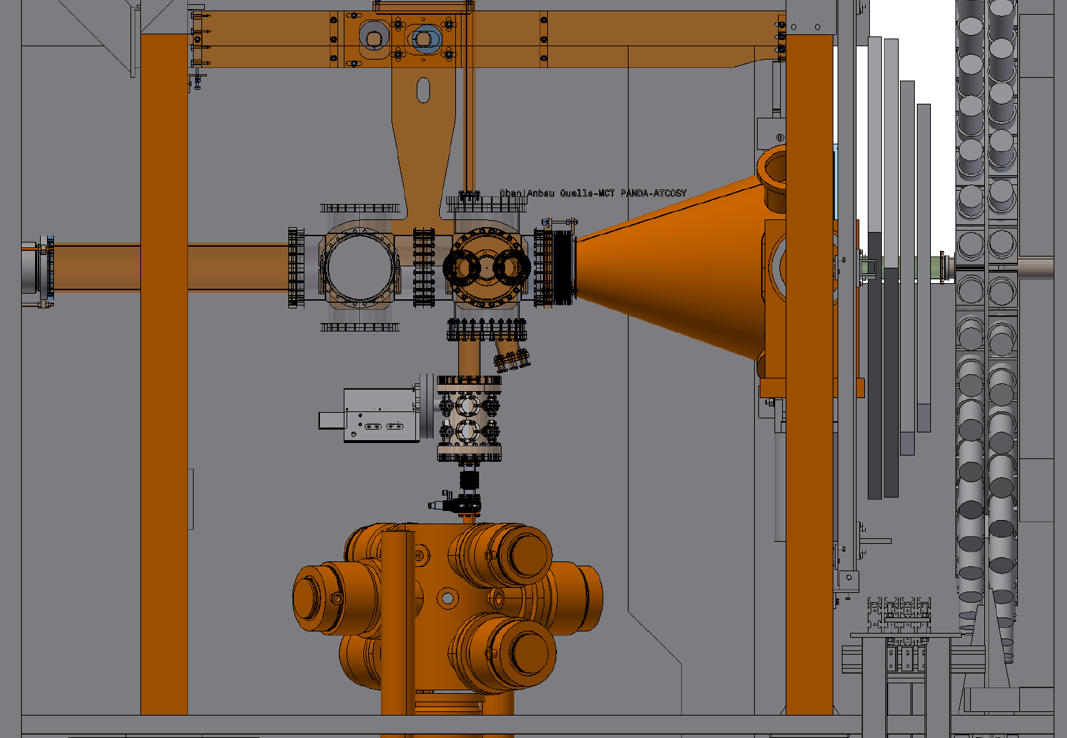
Modification of Beam Pipe and Scattering Chamber

Slide 37
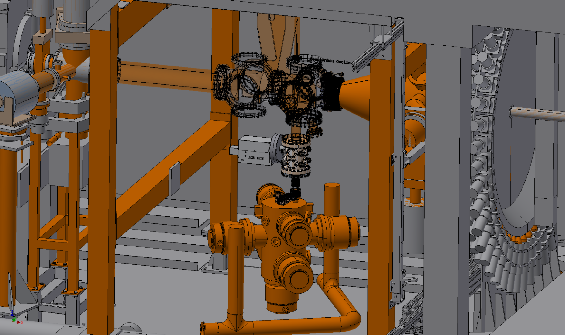
Modification of Beam Pipe and Scattering Chamber

Slide 38
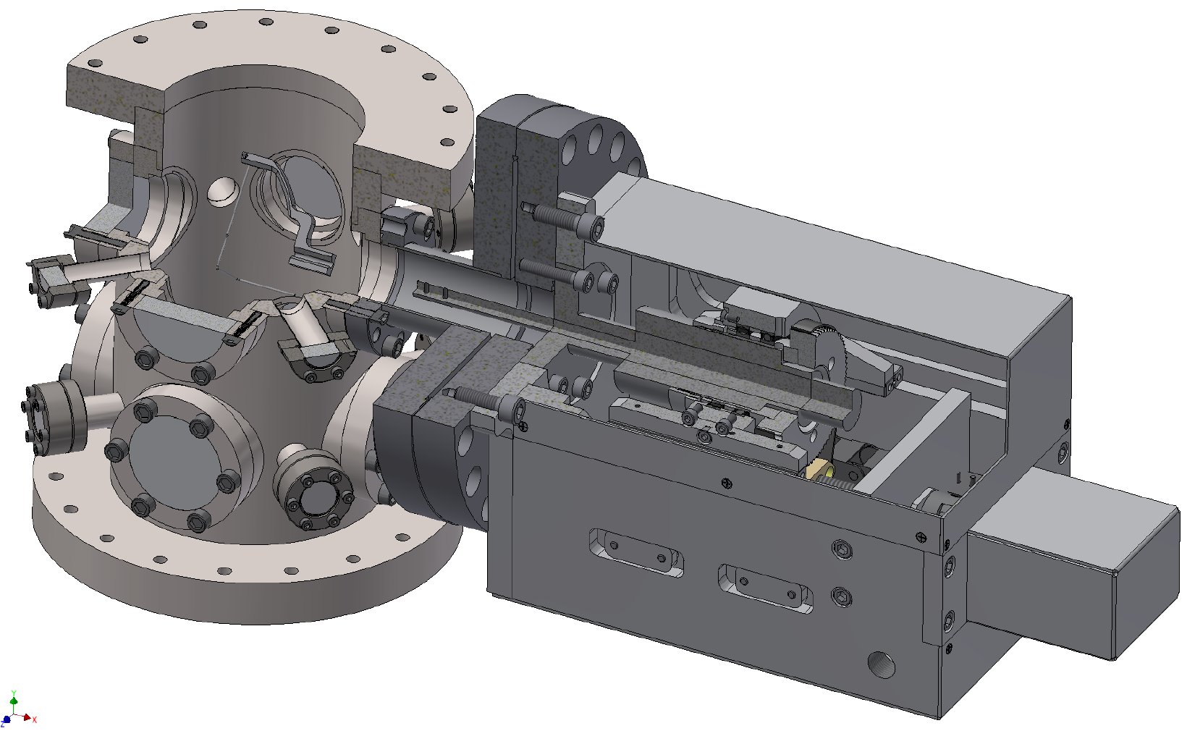
Monitoring System at the Beam Dump Section
In preparation at WWU

Slide 39
Beam Time Request
Beam time period | Required beam time | Topics to be investigated
2018, week 32 | 1 week | Target commissioning
2018, 2nd half year (request to CBAC) | 1 week | Vacuum at IP Target adjustment studies during experimental runs Beam-target interaction
2019, 1st half year (planned) | 2 weeks (2x 1 week) | Beam-target interaction Vacuum at IP Beam/target effects on recorded data Development of new technologies
2019, 2nd half year (planned) | 2 weeks (2x 1 week) | Beam-target interaction Beam/target effects on recorded data Development of new technologies

Slide 40
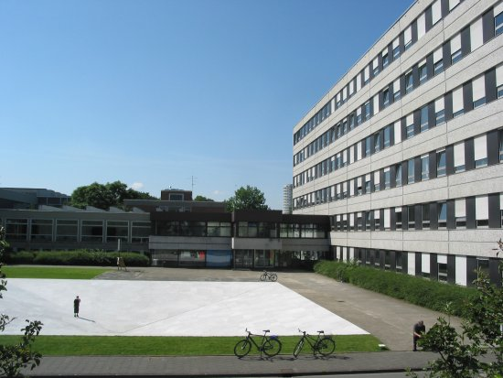
Thank you very much....

Slide 41
Vakuum Studies
Total pressures with cluster beam on

