Slide 1
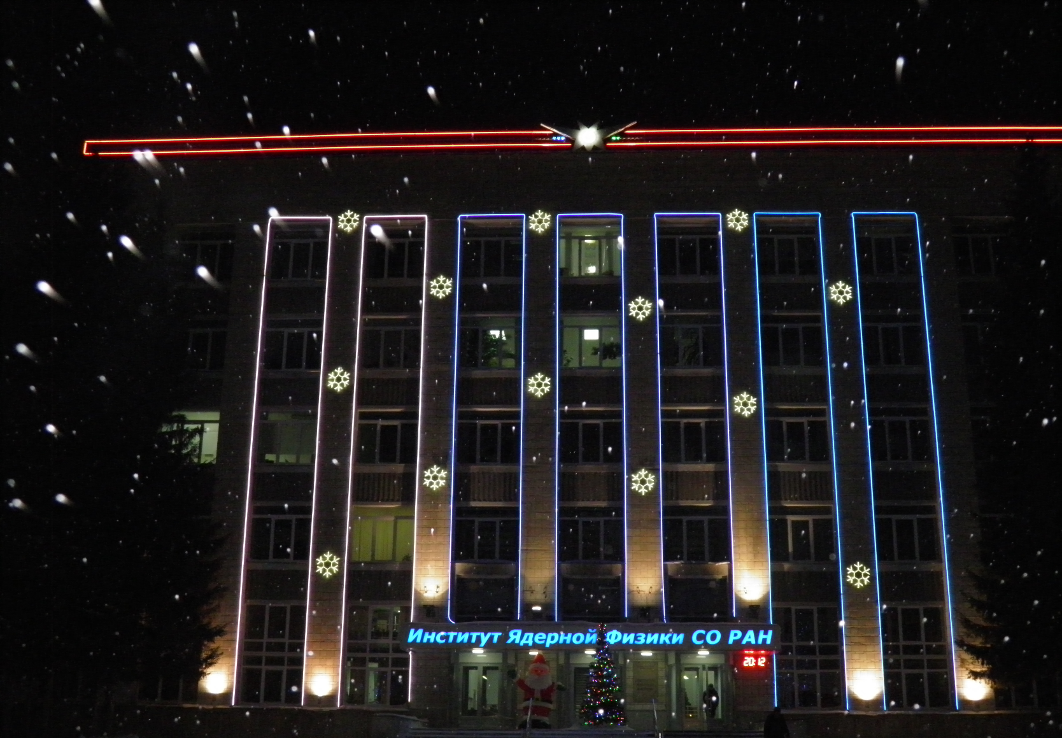
Status of the PANDA Solenoid Magnet Production in BINP March 14, 2018

Slide 2
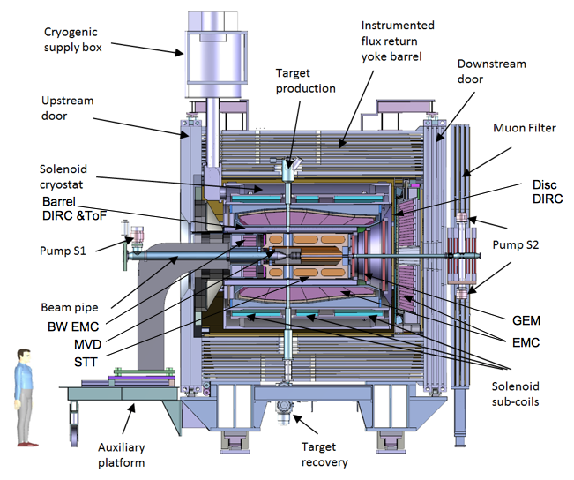
PANDA solenoid magnet
The PANDA solenoid is designed to provide a magnetic field of 2 T with a uniformity of ± 2% and radial magnetic field integral in the range 0 to 2 mm over the central tracking region. The magnet is characterized by a warm bore of 1.9 m diameter, a free length of 4 m and 22.4 MJ of stored energy.
Figure 1. Artistic cut side view of the solenoid magnet including contained detector systems.

Slide 3
The main milestones of production of the PANDA solenoid magnet
The scope of delivery includes:
Magnetic and engineering design of the magnet including tools and support;
Production and delivery of the magnet (consisting of yoke, cold mass and cryostat, alignment components, proximity cryogenics, support frame and platform beams) and all tools;
Power converter and quench protection and instrumentation.
Item | Date
Start contract | 03/2017
Control assembling of the Yoke of solenoid at the BINP site | 09/2019
Magnetic tests of the PANDA solenoid including safety system and electrical components at BINP (additional contract) | 07/2020 - 05/2021
Assembling and tests at the FAIR site
Assembling of the Yoke at Darmstadt | 11/2021
Acceptant tests at FAIR | 08/2022
Installation of the PANDA solenoid magnet at worked position and start final acceptance tests | 05/2023
Table 1. The main milestones.

Slide 4
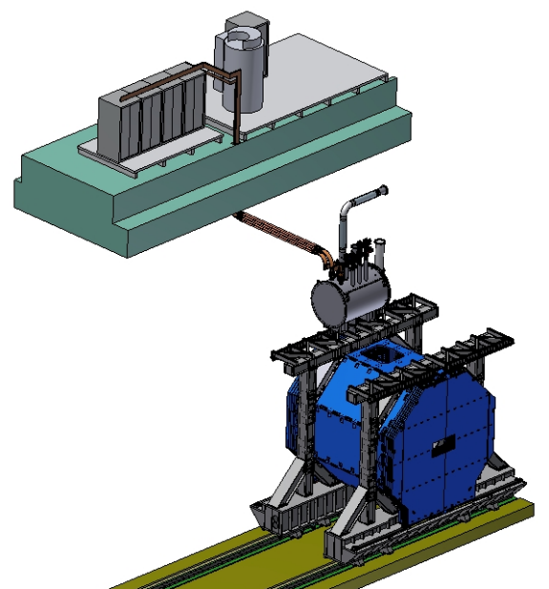
PANDA solenoid magnet, BINP responsibility
Power supply and energy extraction system
Control Dewar box
Cable channel
Solenoid and yoke
Frame of solenoid
Figure 2. Arrangement of the components of the PANDA solenoid.

Slide 5
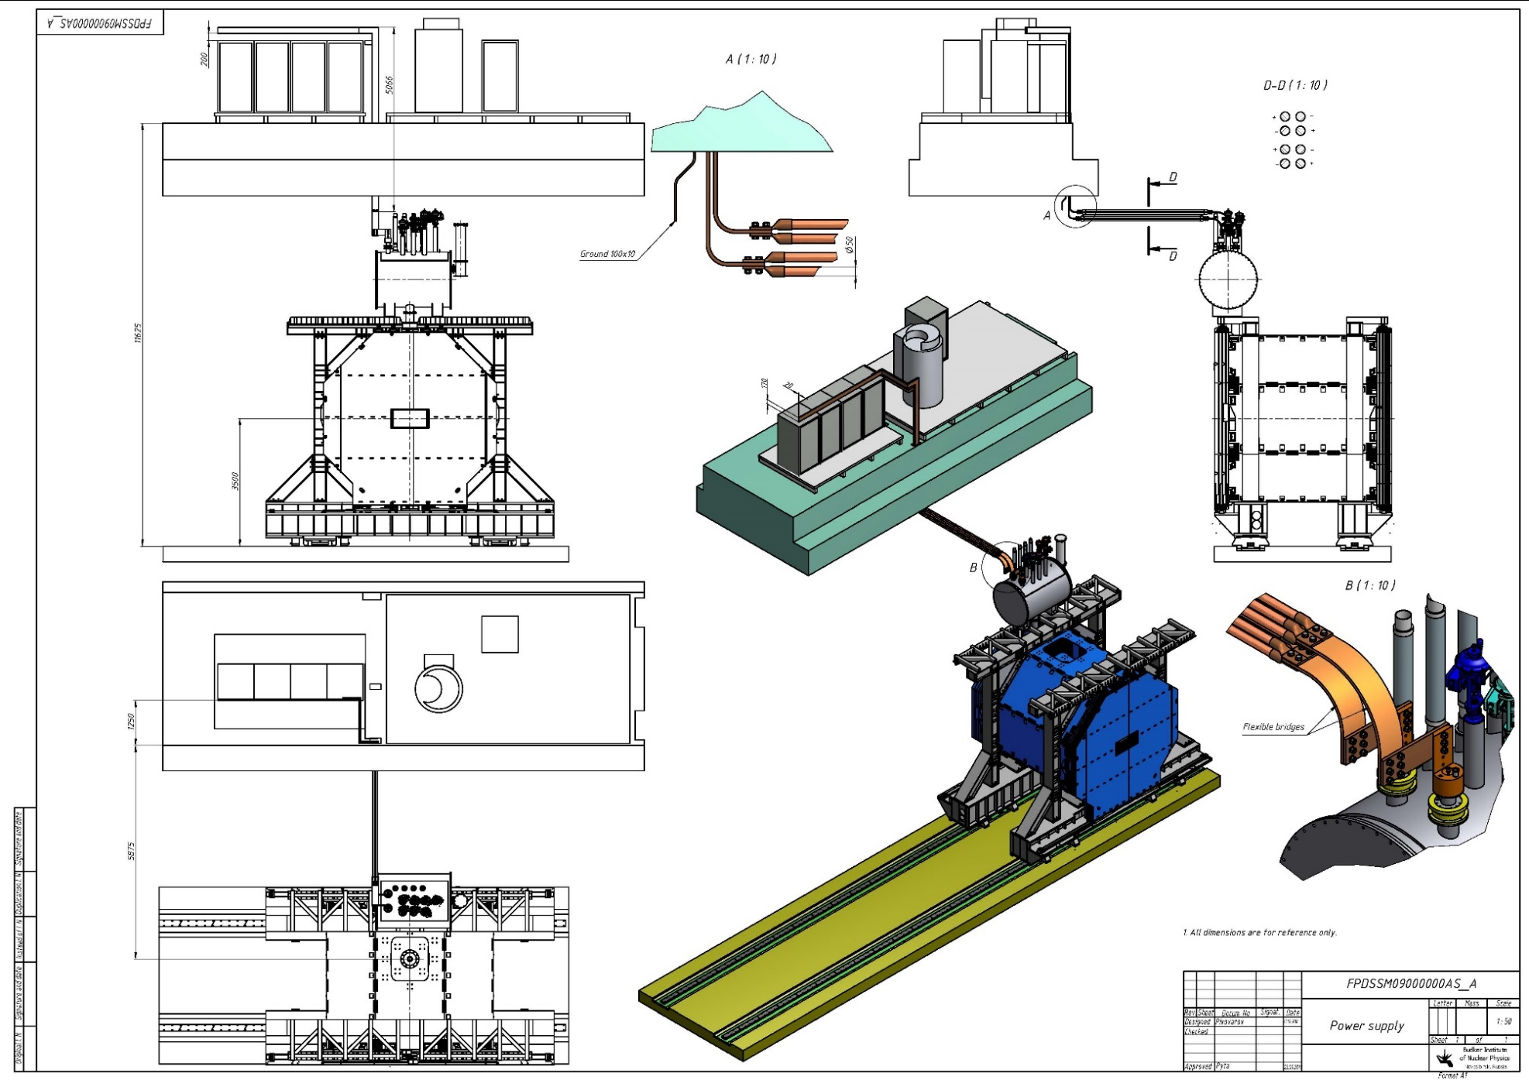
PANDA solenoid magnet, BINP responsibility
Figure 3. Arrangement of the components of the PANDA solenoid.

Slide 6
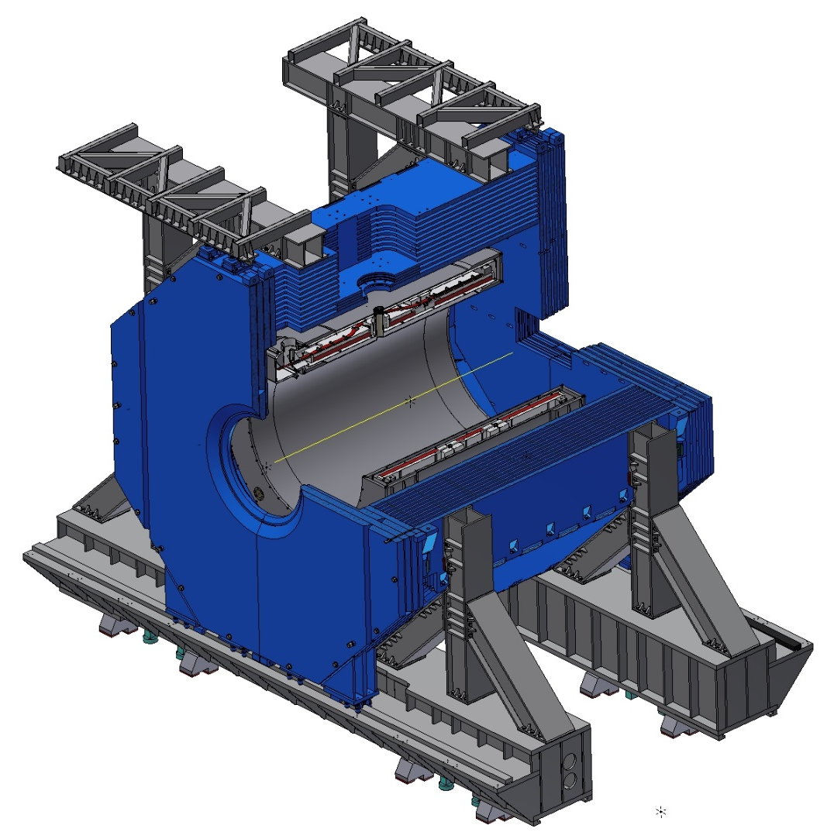
PANDA solenoid magnet
Figure 3. PANDA solenoid quarter section.

Slide 7
Development of the PANDA solenoid magnet
Name of item | Status of work
Yoke and frame | Design is ready, start production
Cryostat of solenoid | Design is ready, PDR 11th week 2018
Cold mass | Design is ready, PDR 11th week 2018
Conductor purchasing | Development work
Control Dewar box | Design in progress
Cable channel | Start design
Power supply and energy extraction system | Design in progress, PDR 17th week 2018
Magnet safety system | Start discussing 11th week 2018
Table 2. Status of work of the PANDA solenoid production.

Slide 8
The main milestones of the yoke production
Name of milestone | Date 2017/10
Memorandum BINP/ plant SibElectroTherm (SET) | 05/2017
Presentation design of the yoke after technological work of drawings in FAIR | 20-25/07/2017
PDR of the yoke | 04-07/10/2017
FDR of the yoke | 20-25/11/2017
Contract with SibMash (SET), signed | 2/11/2017
Purchasing raw materials (1st batch, 60 t) | 26/12/2017
Start of production of the 1st octant | 01/2018
Status production
Manufacturing parts of tooling for assembly of octants | ready
Welding and machining tooling | In process
Cutting sheets of the 1st octant | In process
Start assembling of the 1st octant | 12th week 2018
Control of the 1st octant | 15th week 2018
Delivery raw material to SibMash (SET) | 04 - 08/2018
Table 3. The main milestones of the yoke production.

Slide 9
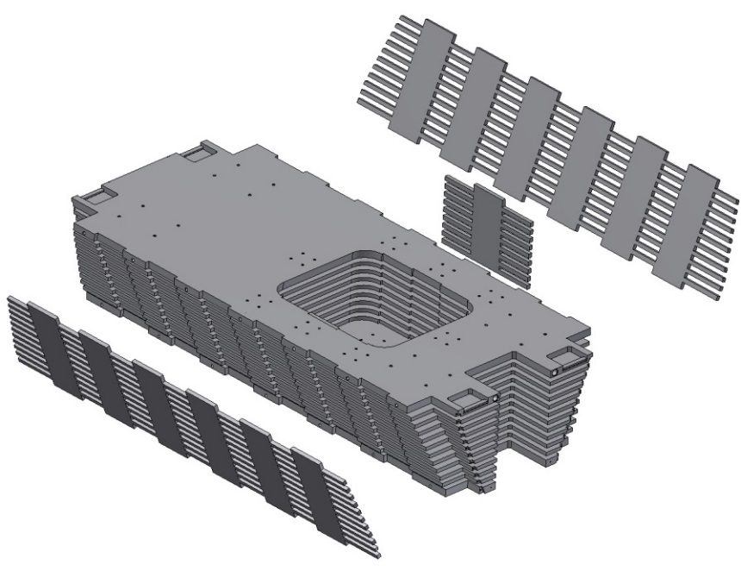
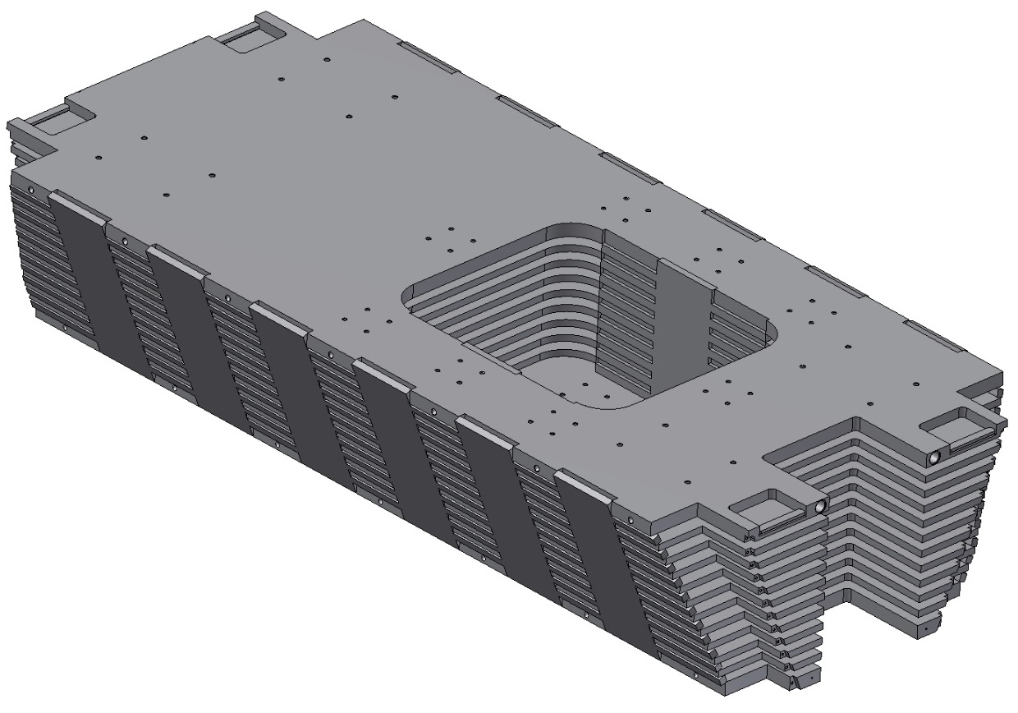
Status of the PANDA yoke and frame production
Table 2. Status of work of the PANDA solenoid production.

Slide 10
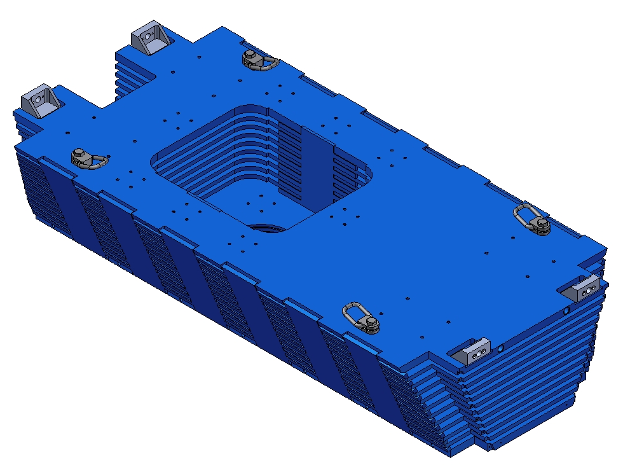
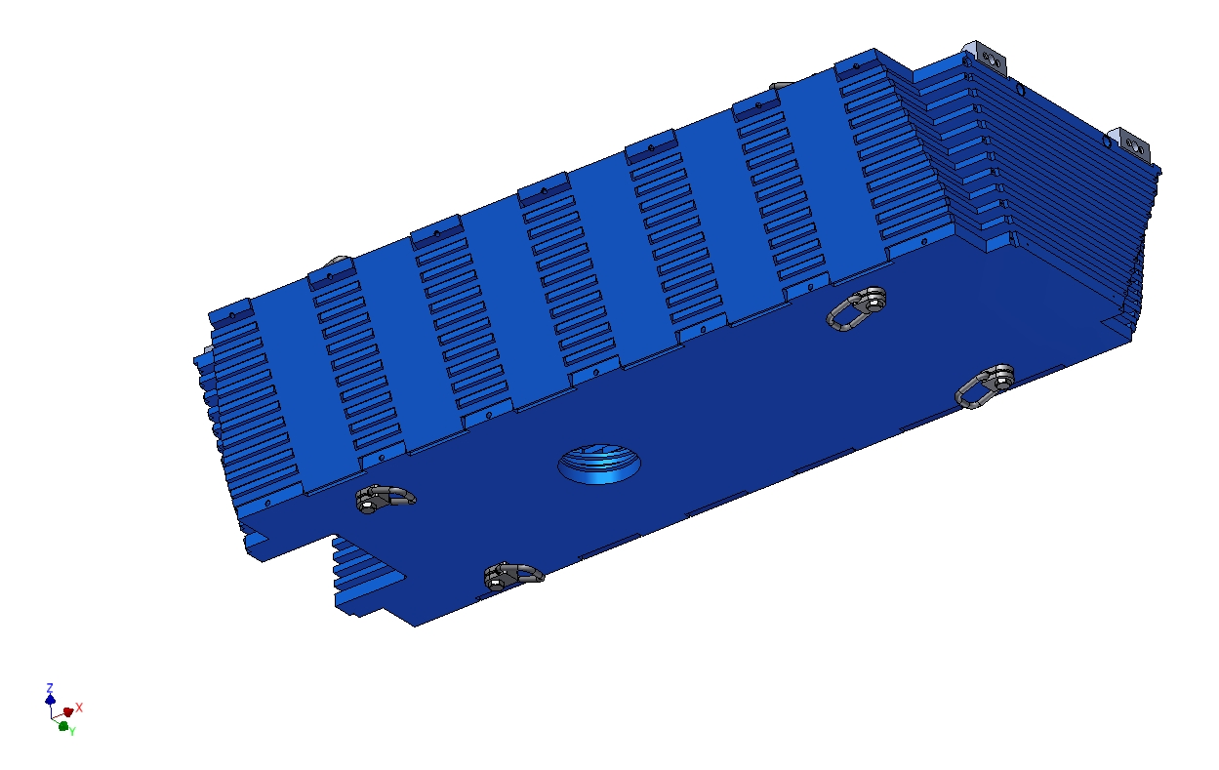
Status of the PANDA yoke and frame production
Figure . Status of work of the PANDA solenoid production.

Slide 11
Status of the PANDA yoke and frame production
Ringbolts should be used instead ears for transportation
Of the modules and during assembled procedure.

Slide 12
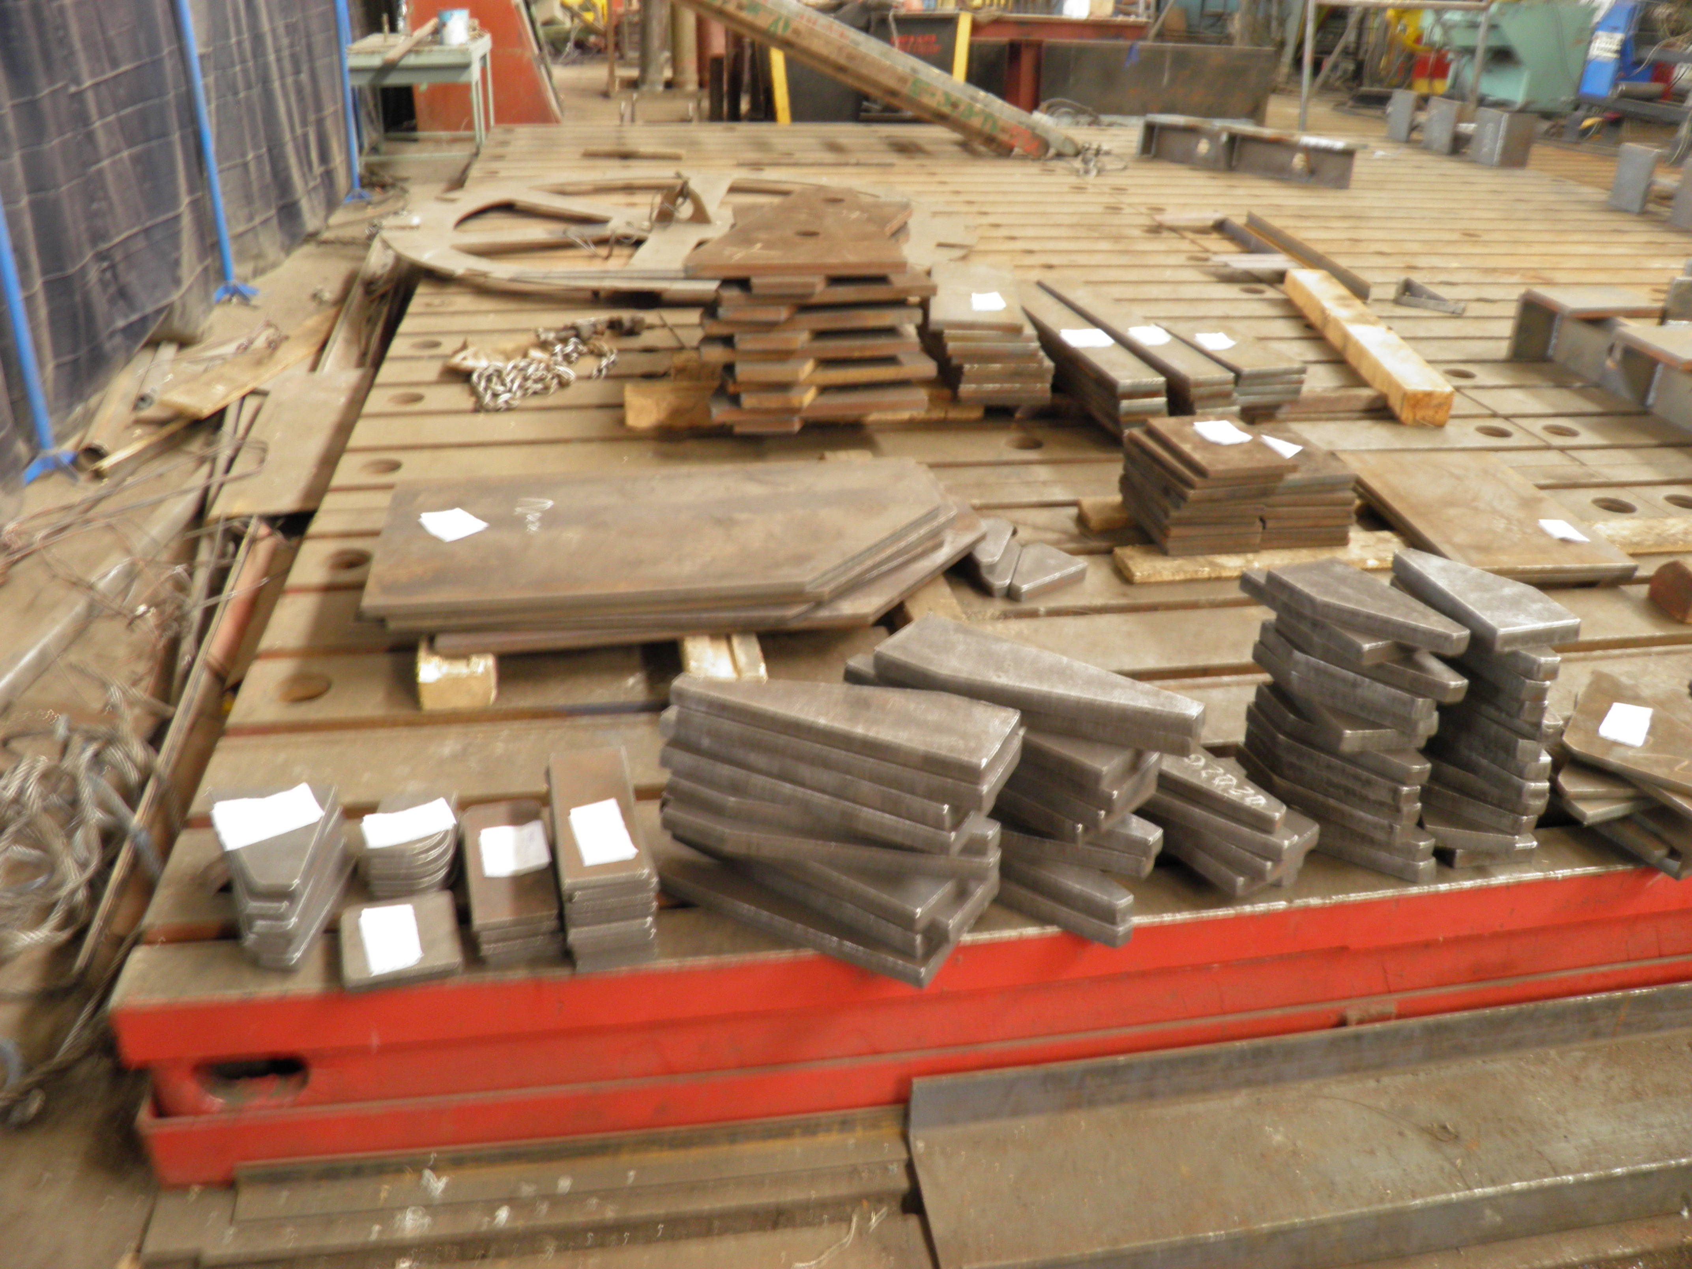
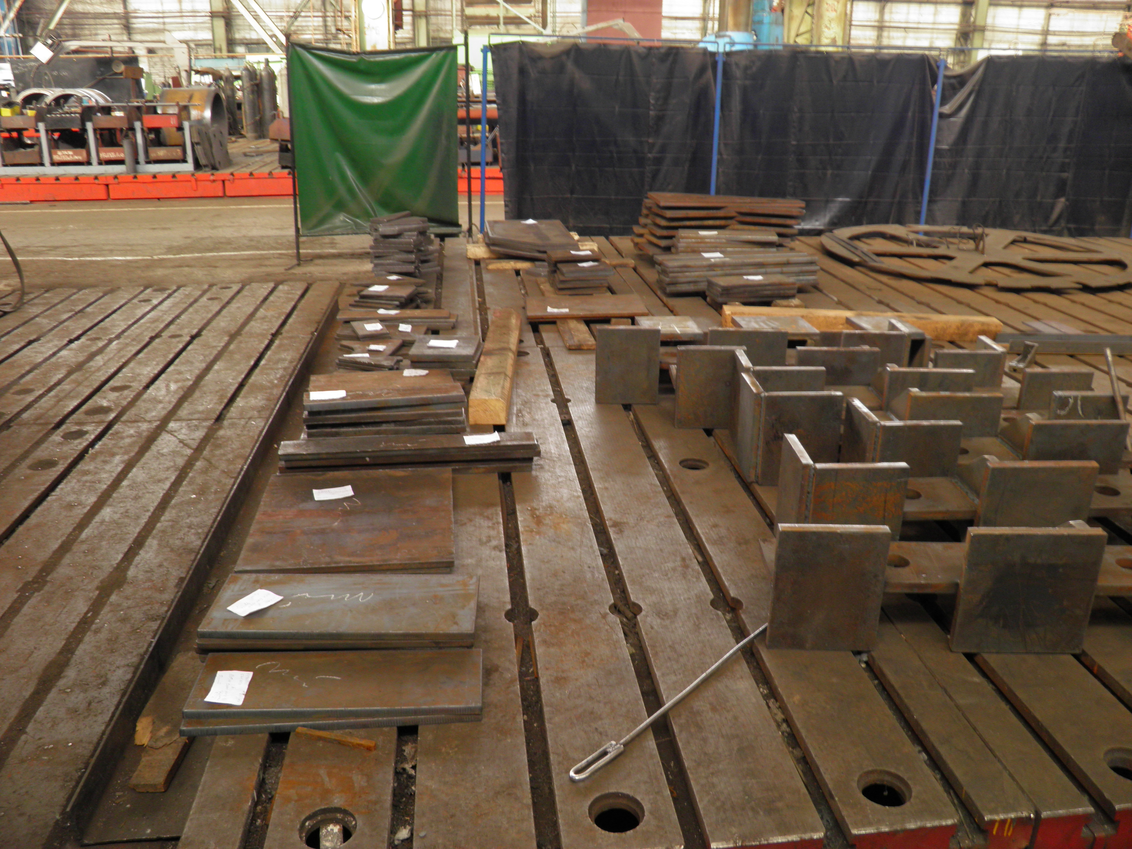
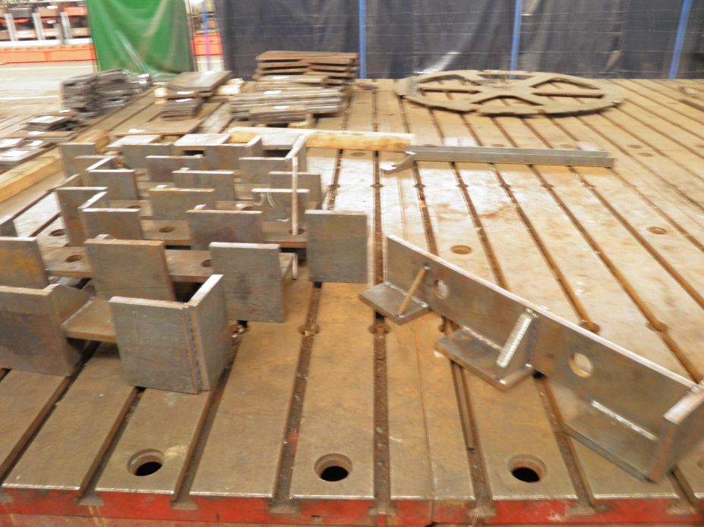
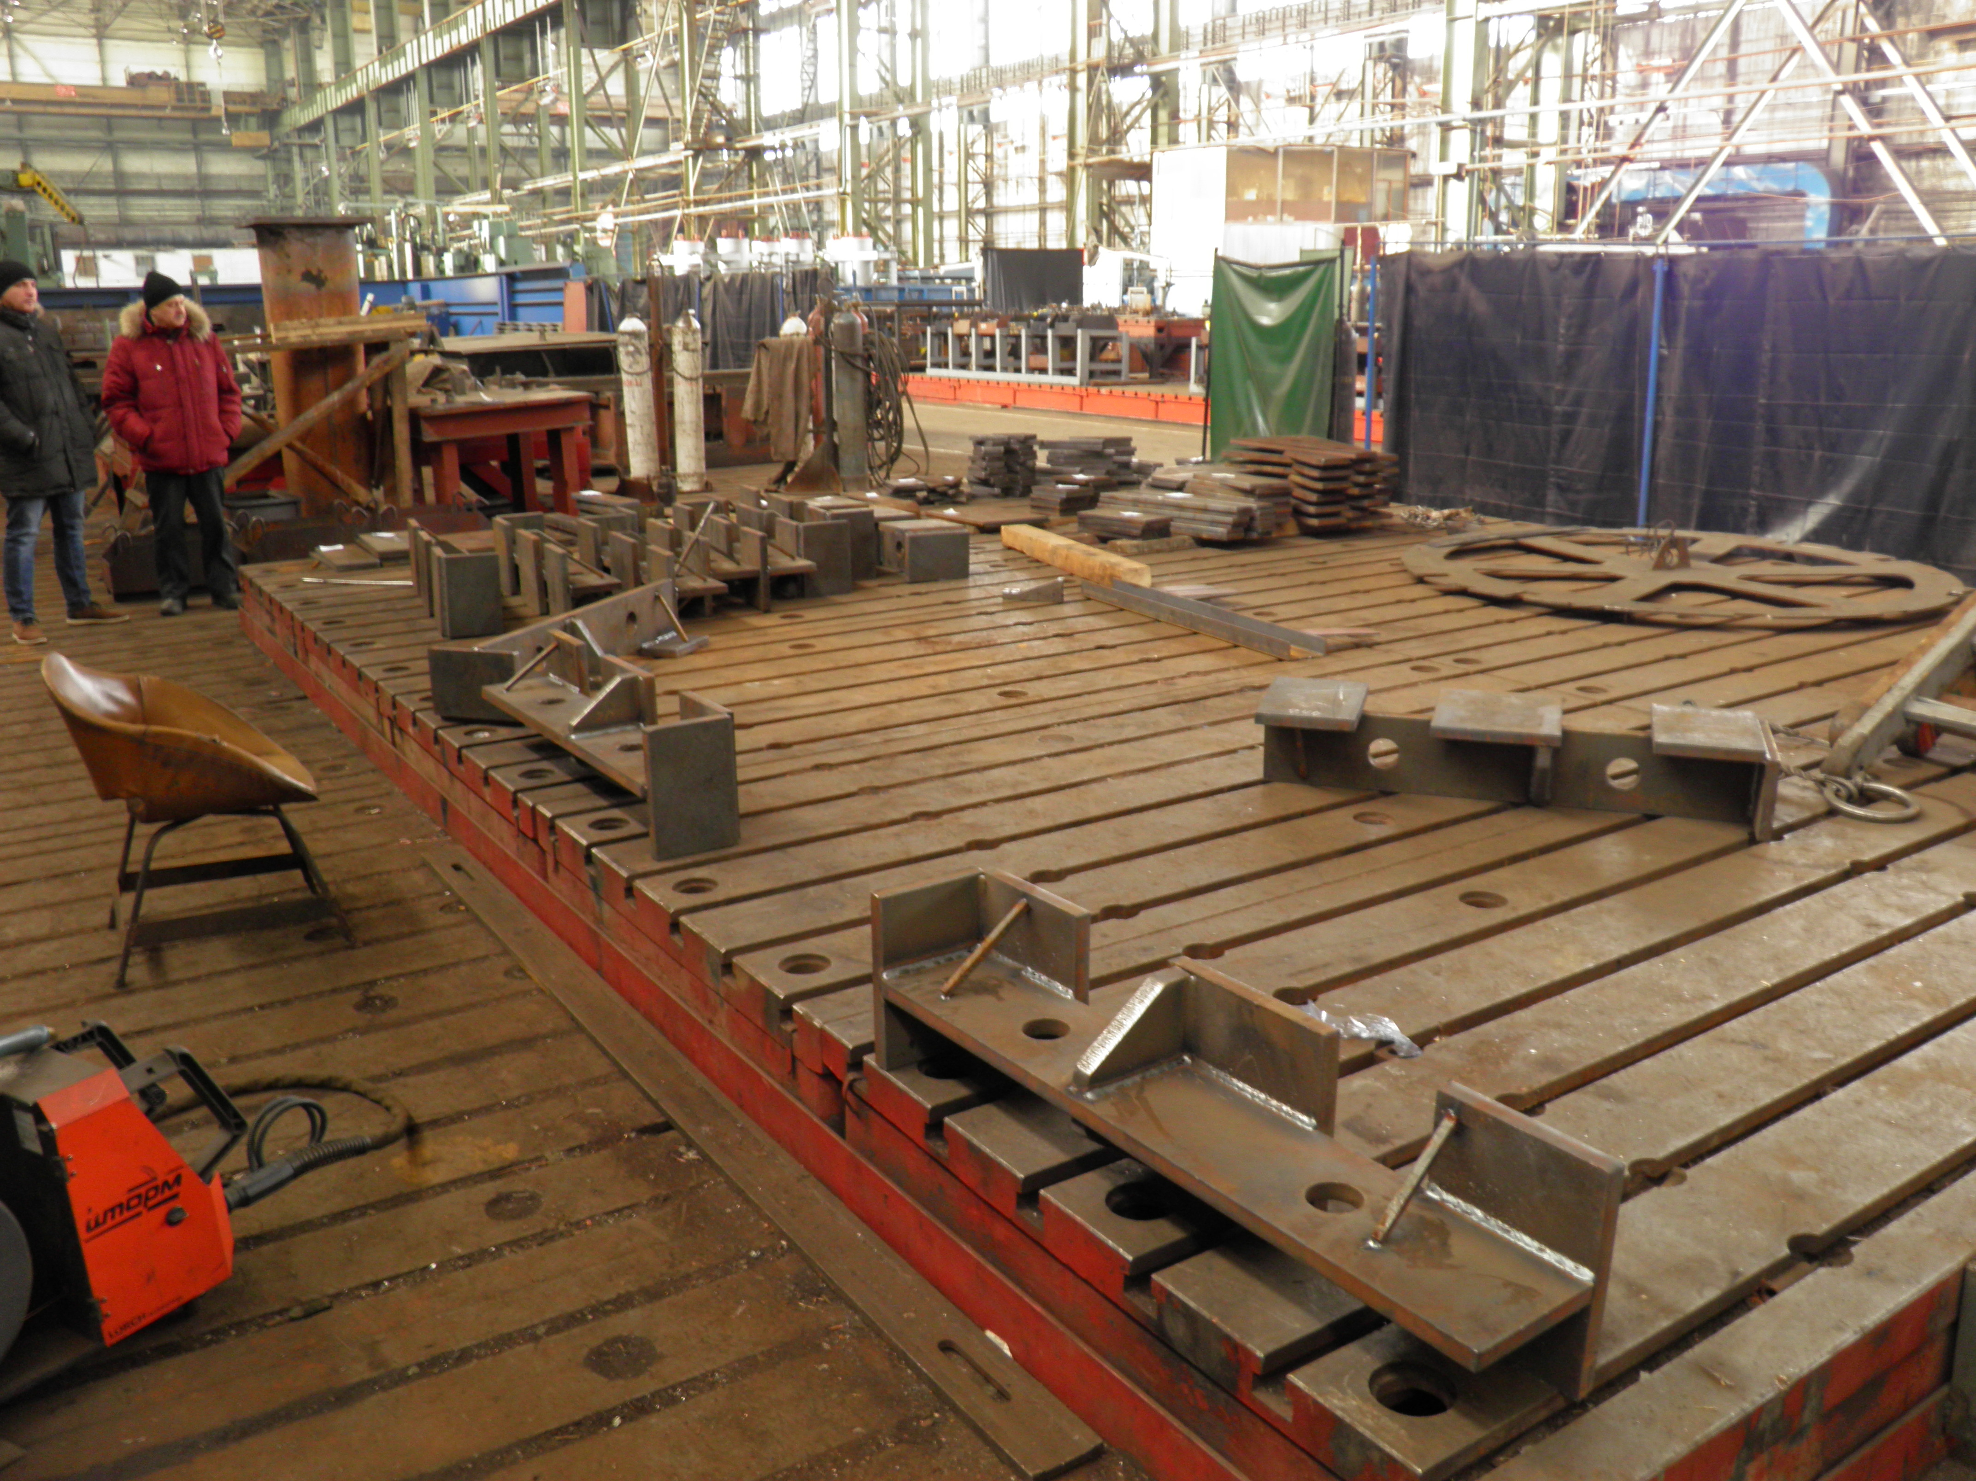
Status of the PANDA yoke and frame production

Slide 13
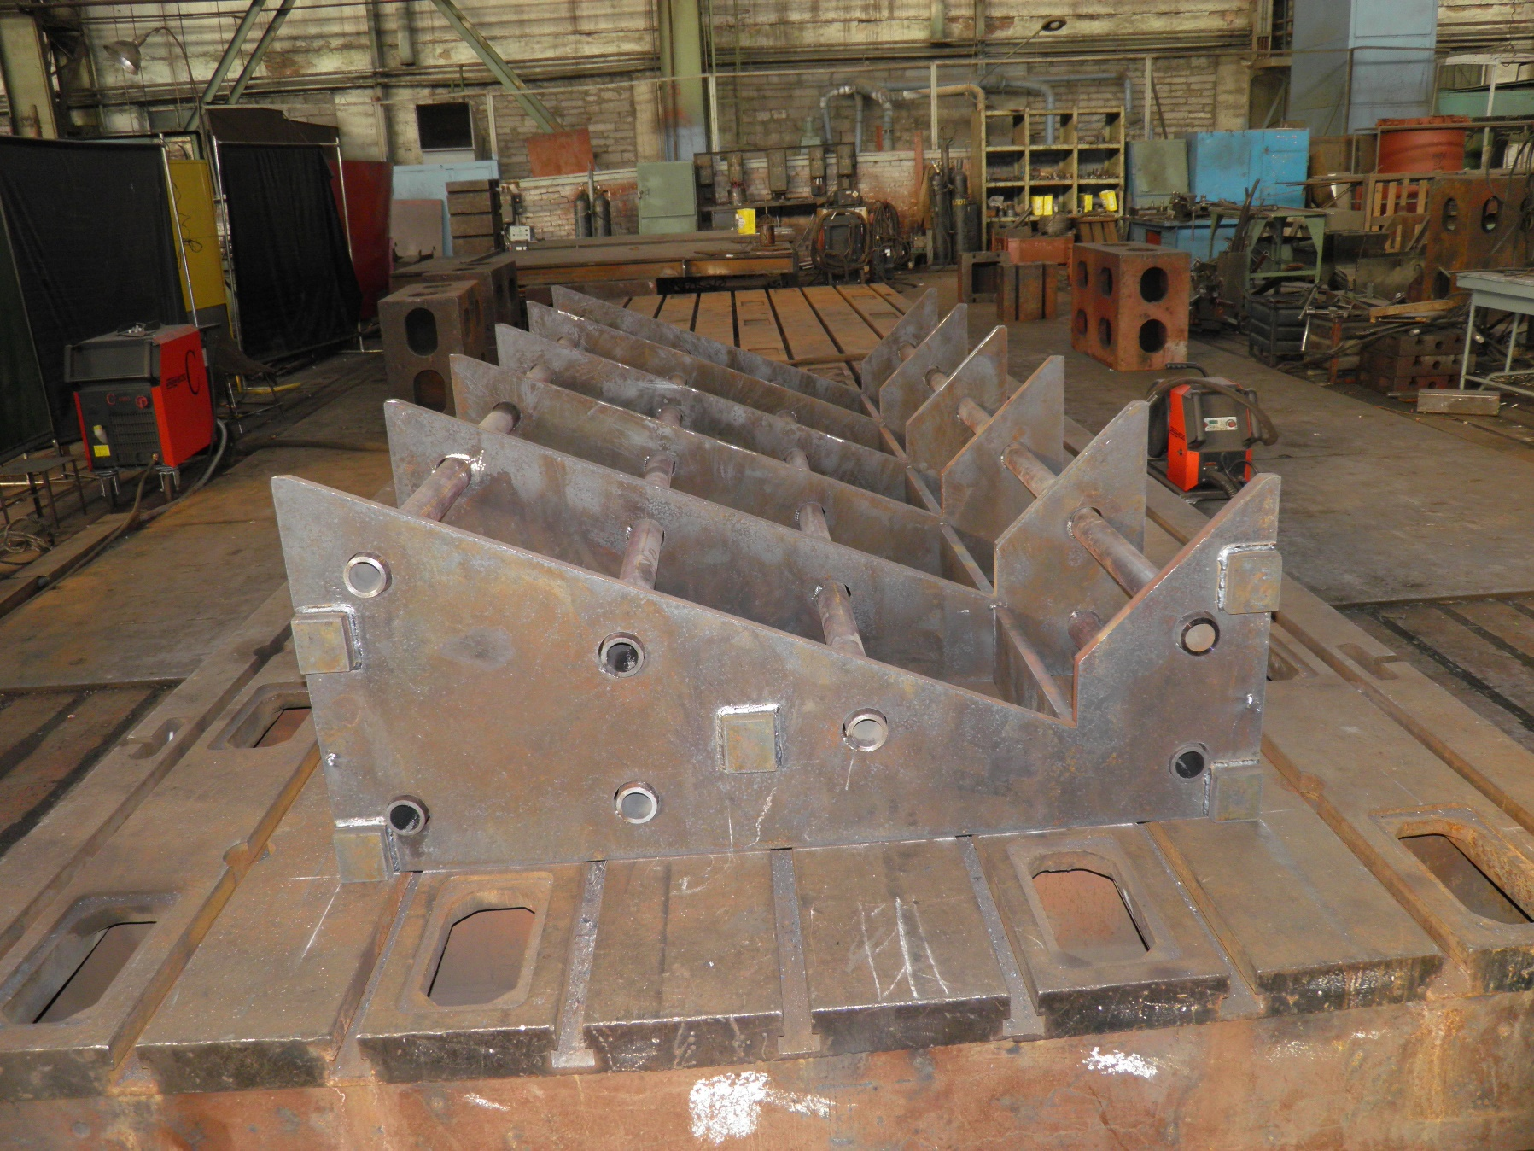
Status of the PANDA yoke and frame production

Slide 14
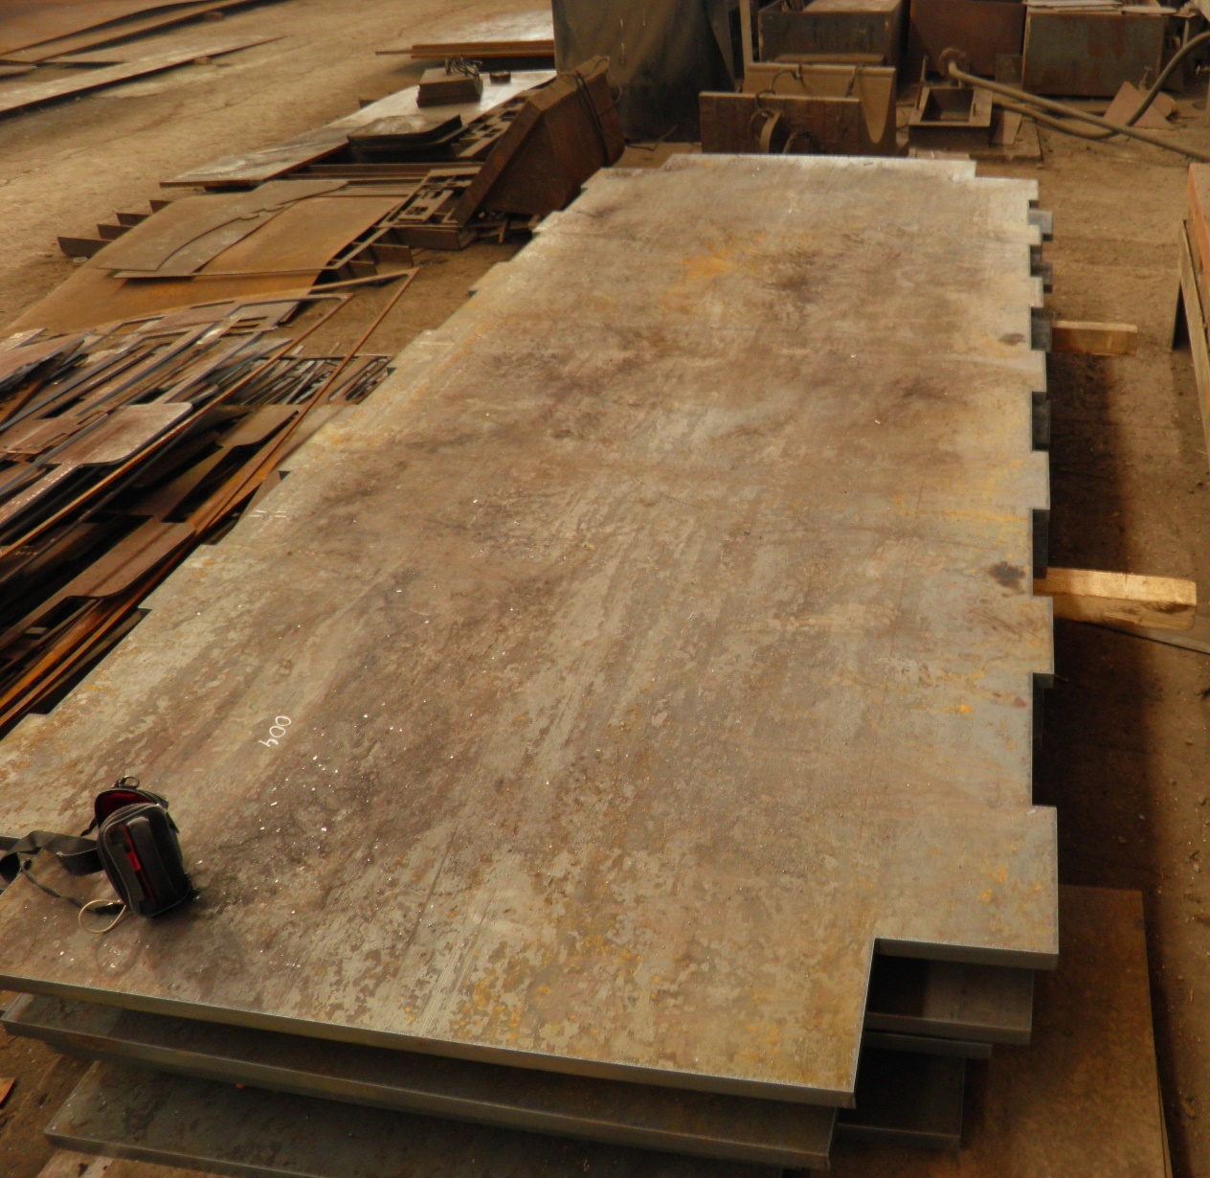
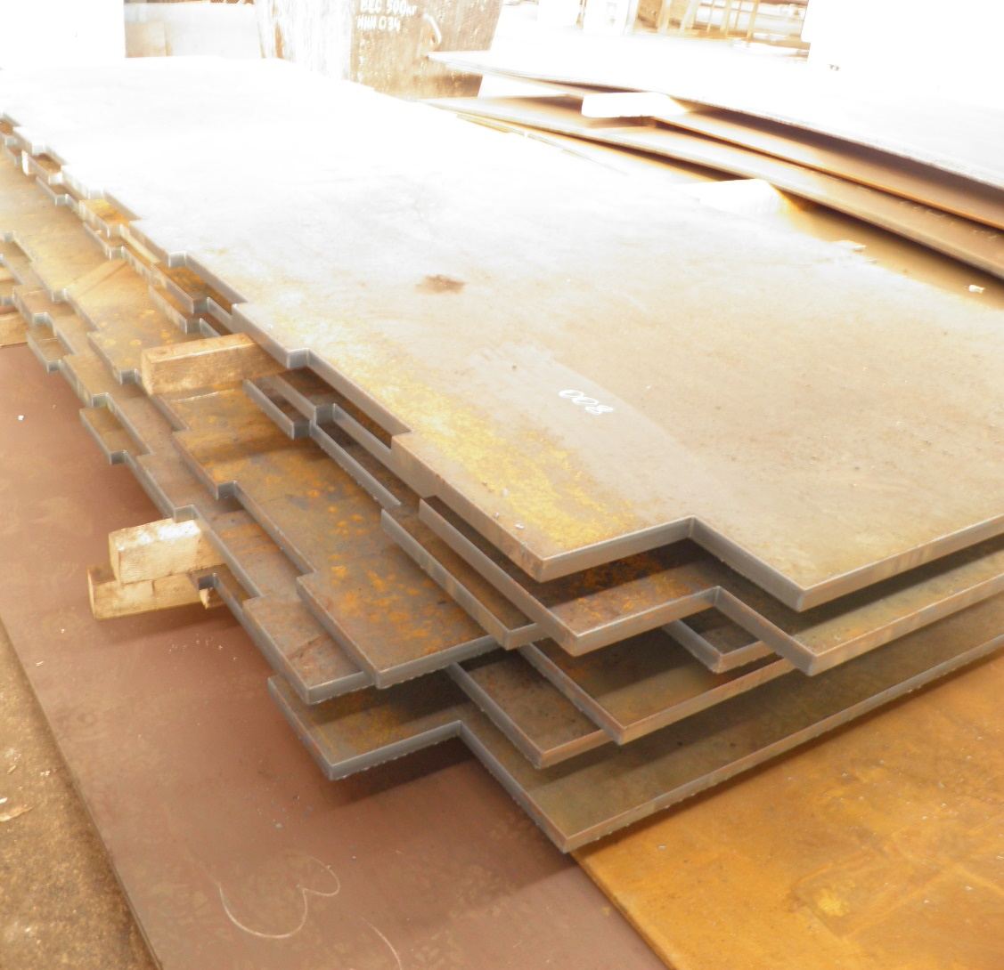
Status of the PANDA yoke and frame production
Module sheets by cutting

Slide 15
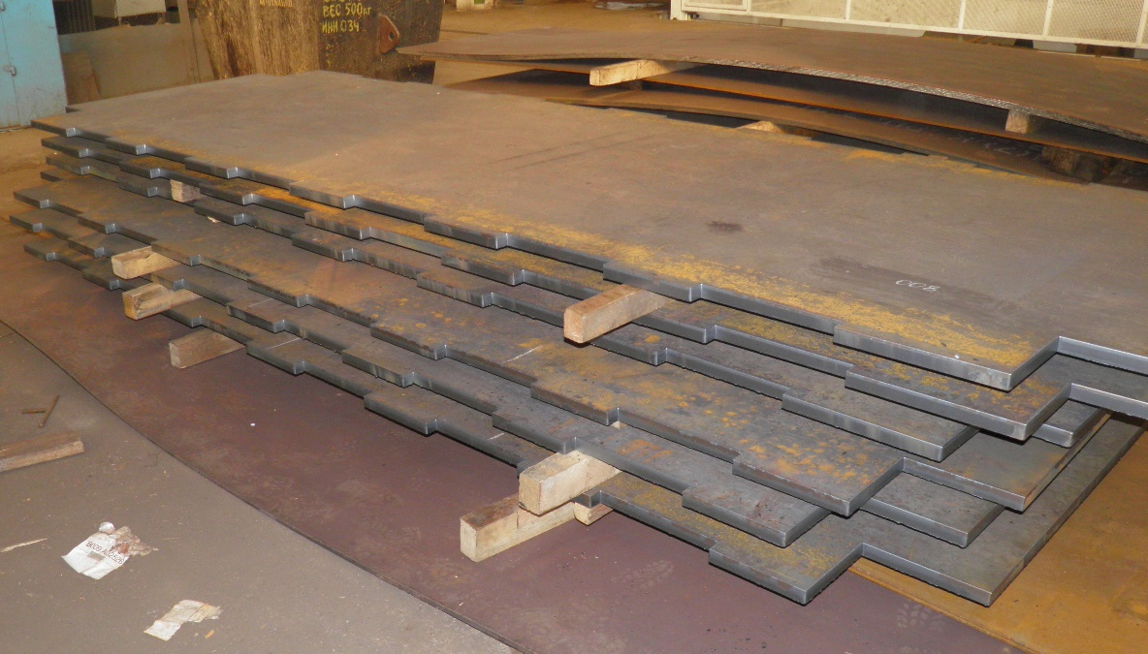
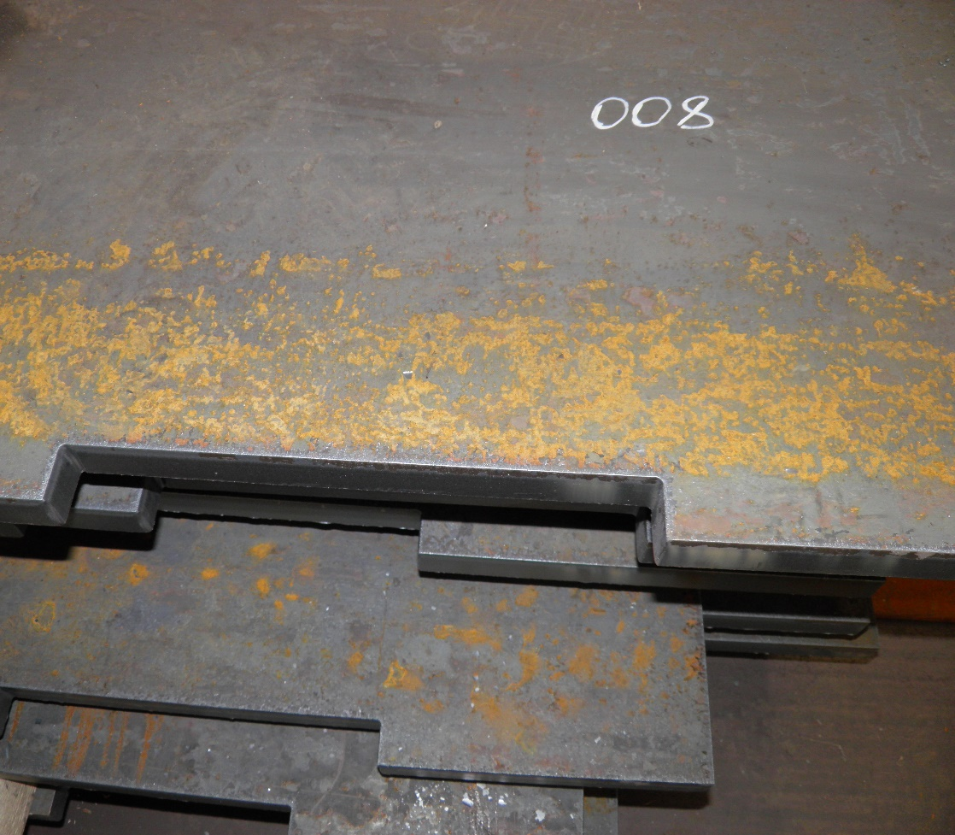
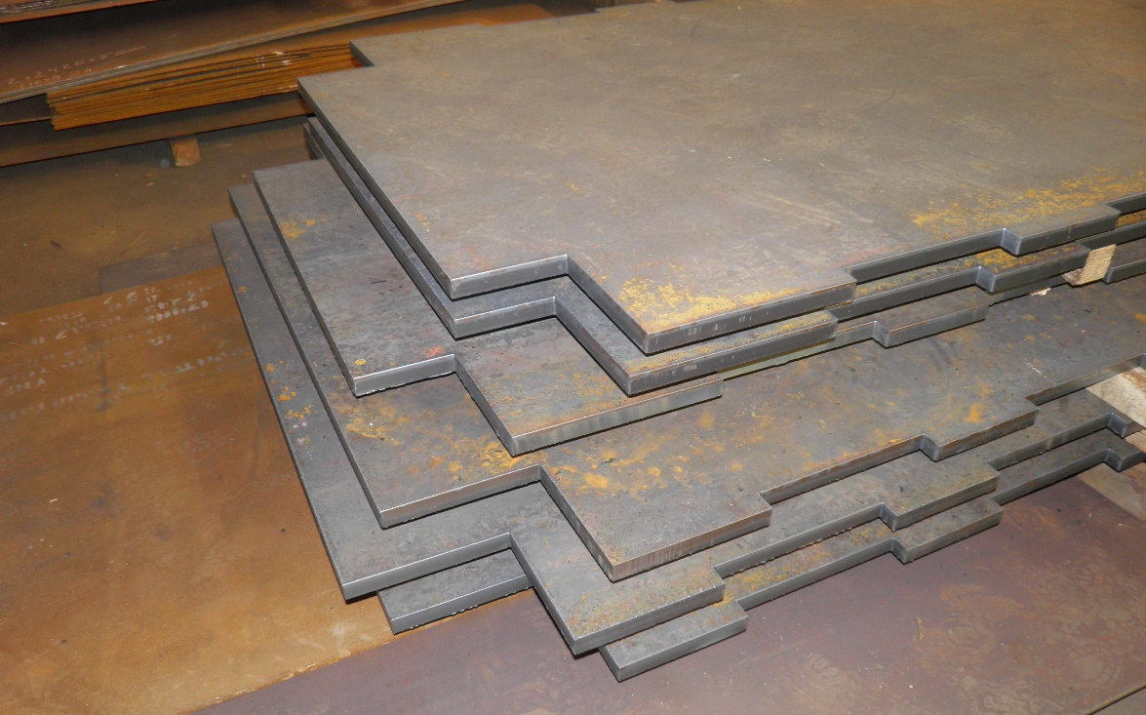
Status of the PANDA yoke and frame production
Module sheets by cutting

Slide 16
The main milestones of the yoke production
Name of milestone | Date 2017/10
Production of the all barrel octants | 12/2018
Production of the frame and beams | 11/2018
Production of the doors | 03/2019
Control assembling at SET | 04/2019
Finalization of the parts | 05/2019
Assembling of the Yoke at BINP | 09/2019
Table3. The main milestones of the yoke production.

Slide 17
Status of the PANDA conductor development/ procurement

Slide 18
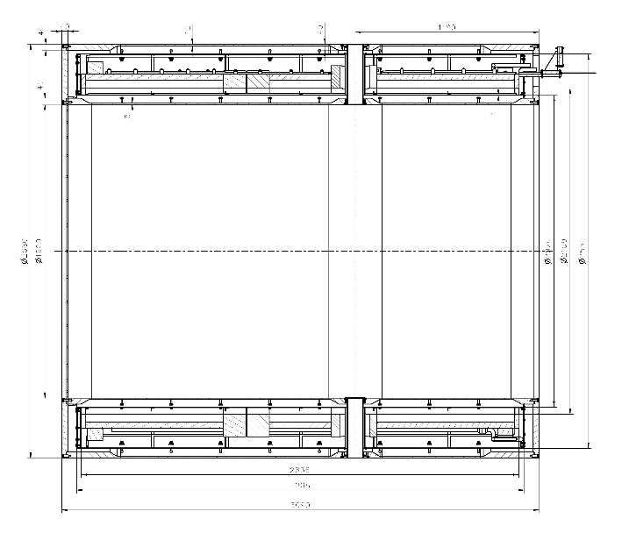
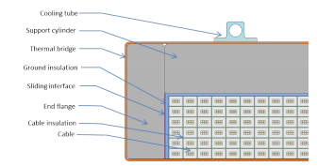
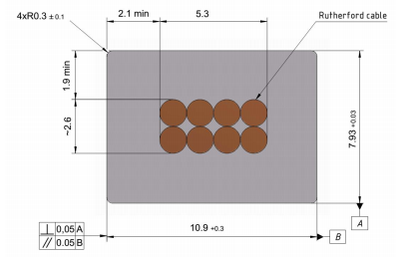
Main risks
Purchasing super conductive conductor - lack of a manufacturers
Rutherford cable, 8 strands, extruded in Al matrix
Thickness (after cold work) at 300 K | mm | 7.93 | ± 0.03
Width (after cold work) at 300 K | mm | 10.95 | ± 0.03
Critical current (at 4.2 K, 5 T) | A | > 14690
Critical current (at 4.5 K, 3 T) | A | > 16750
Overall Al/Cu/sc ratio |  | 10.5/1.0/1.0
Aluminum RRR (at 4.2 K, 0 T) |  | > 1000
Al 0.2% yield strength at 300 K | MPa | > 30
Table 4. Conductor mechanical and electrical parameters.
Figure 4. Longitudinal section of the cryostat with cold mass.
Figure 6. Drawing of the conductor.
Figure 5. Cold mass cross-section.

Slide 19
PANDA solenoid 2018, Conductor Cost ???
Conductor`s manufacturers
Furukawa, Japan - according to CERN specification, 1.5 year production time
But now absent possibility to produce extrusion of Rutherford cable to Al.
2. BINP, 1.1 year production time, if samples will produce according to CERN specification
A.A. BOCHVAR HIGH-TECHNOLOGY SCIENTIFIC RESEARCH INSTITUTE FOR INORGANIC MATERIALS (VNIINM), Russia – strands - according to CERN specification - ?
VNIIKP - Rutherford cable, according to CERN specification
BINP, extrusion of Rutherford cable to Al, according to CERN specification - ?

Slide 20
Status of the PANDA conductor production
Figure 2. Conductor cross section.

Slide 21
Status of the PANDA conductor production
A.A. BOCHVAR HIGH-TECHNOLOGY SCIENTIFIC RESEARCH INSTITUTE FOR INORGANIC MATERIALS (VNIINM), Russia
– strands - according to CERN specification - ?
Max. length of a strand – 20 000 m
For development
Manufactured strand:
Diameter – 1,4 mm;
Length - 1700 m.
Set up for study of strand parameters
Max. current - 1 kA
Max. magnetic field - 3 T
Measurement RRR - yes
Machine for production pure Al rods diameter 9,5 mm – yes
Weight loss pure Al - 10-20%

Slide 22
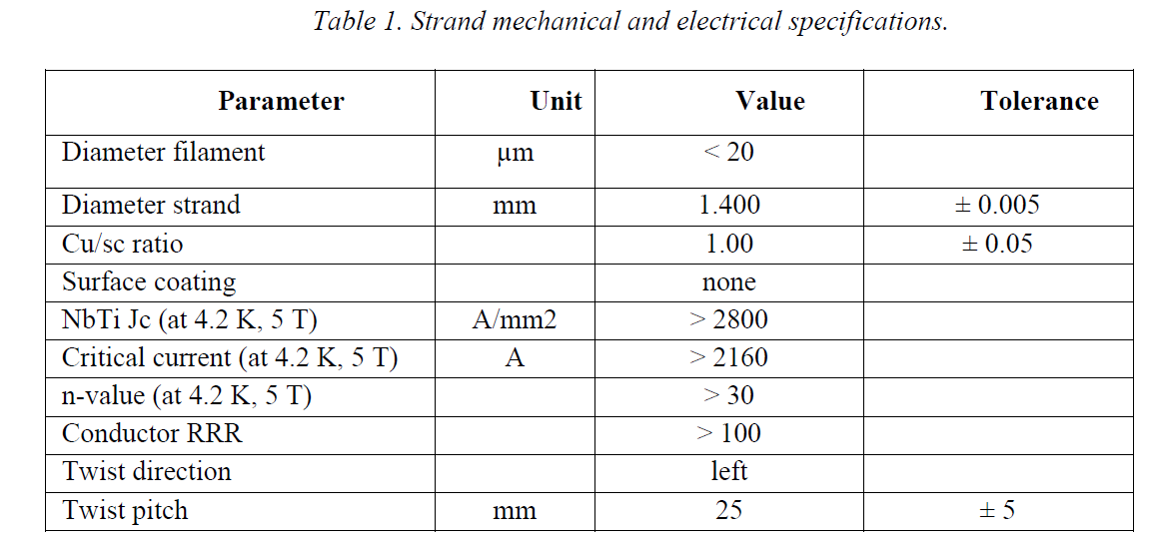
Status of the PANDA conductor production
Suggest changing
diameter filament 25 ÷ 35 µm
Jc ≥ 3000 A/mm²

Slide 23
4. CONTROLS
4.1 On strands
4.1.1 Continuous control during fabrication
Eddy current scan on each strand to check for cracks and metallic inclusions.
Diameter control of the strand.
Visual control.
Cleaning control to be specified by the contractor.
Speed and rotation direction of the twist machine.
Recording the copper to superconducting ratio versus the length.
4.1.2 At start and end of each unit length
Critical current and n-value at 4.2 K and 3, 4 and 5 T.
RRR of the copper.
Cu/NbTi ratio by weight method.
Visual control on twist and broken filaments after removal of Cu by etching.
Micrograph of the cross-section.
4.1.3 Material test
NbTi billet chemical composition must be produced by the contractor as a part of the quality assurance plan.
NbTi mechanical tensile strength, 0.2% yield strength and hardness must be given according to ISO 9000 norm.

Slide 24
Status of the PANDA conductor production
VNIIKP
Russian Scientific Research Design and Technological
Institute of Cable Industry
Adjustment and fitting machine to produce Rutherford cable (max. 28 strands) - according to CERN specification
The nominal cable insulation thickness is 0.200 mm per side.
Machines for installation kapton tape 25µm
and E-glass tape 50 µm - Yes

Slide 26
Control
4.2 On the cable
4.1.1 Continuous control during fabrication
Dimensional calibration under controlled conditions. The contractor shall describe the proposed system.
No cross-overs, nor swelling, nor kinking, no welds.
Speed and rotation direction of the cabling machine.
Visual control.
4.1.2 At start and end of each unit length
Critical current and n-value measurement on 2 strands extracted from each cable sample, one at the start and one at the end of each length. Strands must be of different billet number. The measurement shall be performed at 4.2 K and 3, 4 and 5 T. The critical currents shall be compared to the measured critical currents of the same strands before cabling.
RRR copper degradation measurement on 2 strands.
Control of broken filaments by etching.

Slide 27
Sarko
Pure Al co-extrusion/ plating
Two lines (China and England production) about 100 m length are working on today. Two additional lines are in process of shipping and preparation for montage.
The development of parameters of extrusion is our aims at the present time.
Lines work in automatic conditions with control temperatures, pressures and velocities of steel pipe/wire and Al rod moving.
The parameters possible to regulate in the ranges:
temperatures of steel pipe/wire - 300-450 degrees
Celsius temperatures of extrusion volume - 300-450 degrees Celsius
heating medium - N2
pressures of extrusion volume - 20-50 bars
diameter Al rod - 9.5 mm
quantity of inlet of Al rods – 2
velocity of pipe/wire - 30-100 m/min
velocity of pipe/wire - depend.
Used centering tooling, tolerance of non-centers smaller than 0.1 mm for standard process, for Rutherford cable - ?

Slide 28
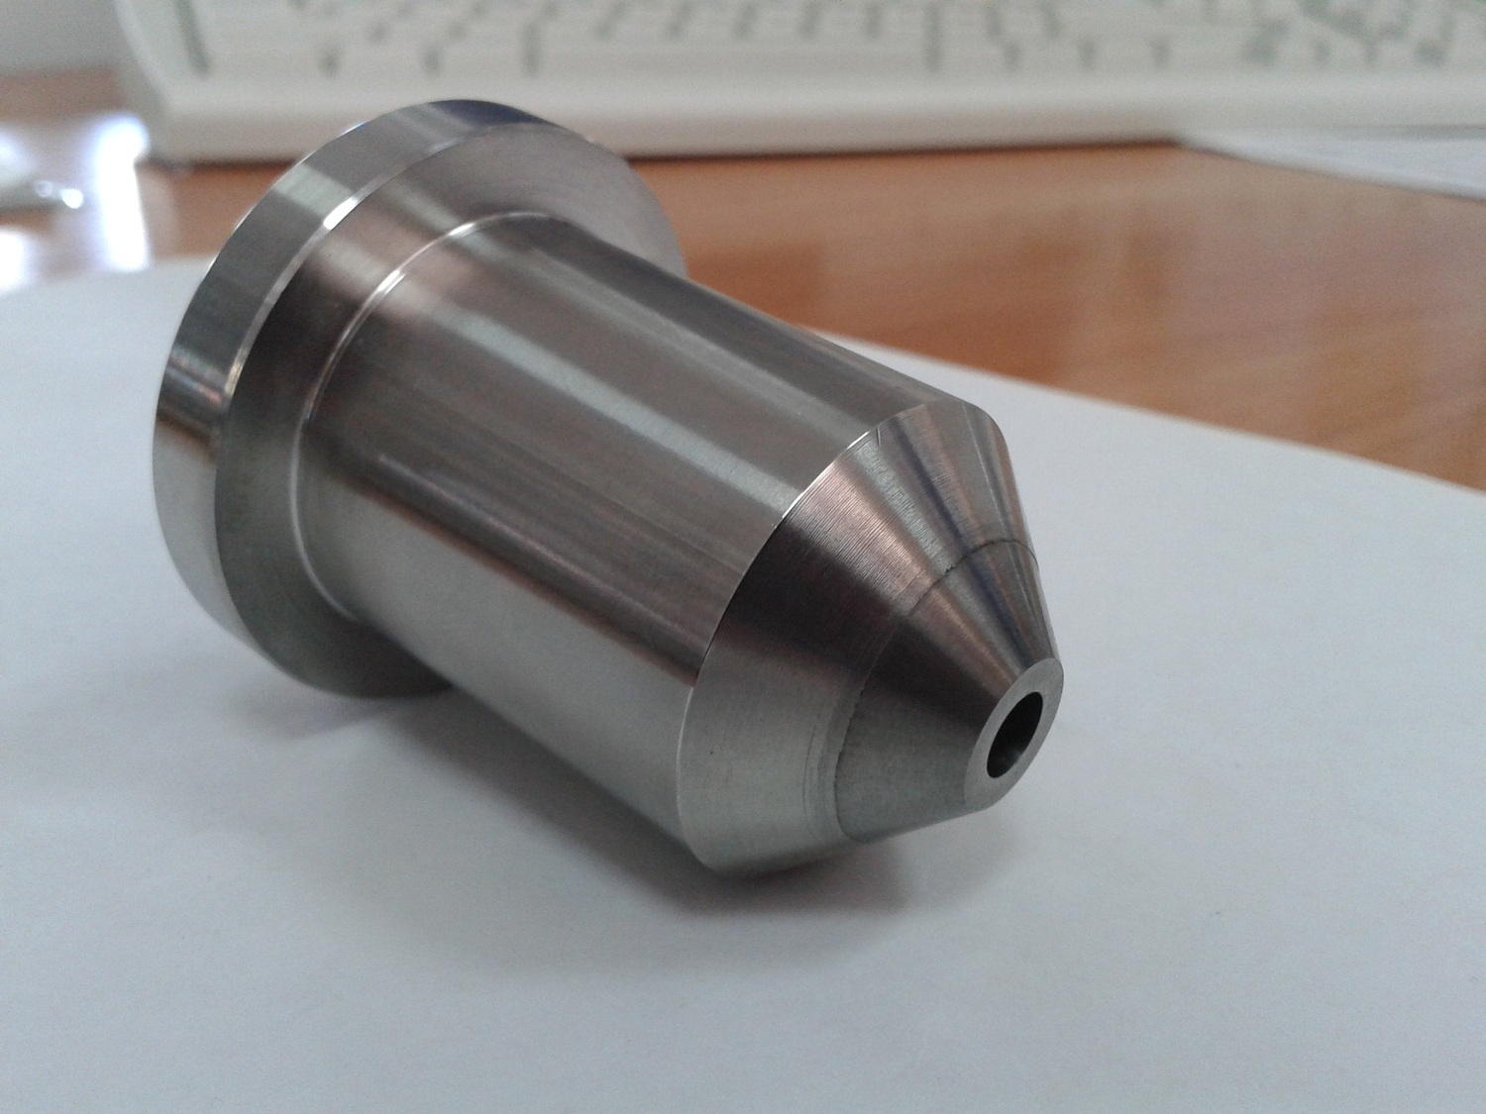
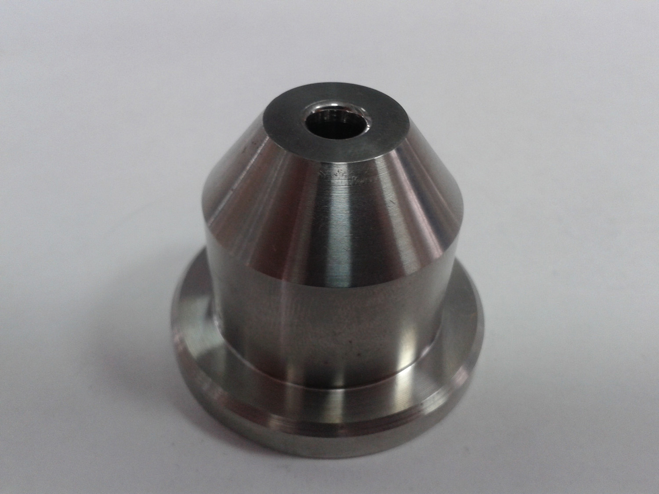
Sarko
Matrices for pipe and plating Al alloy.

Slide 29
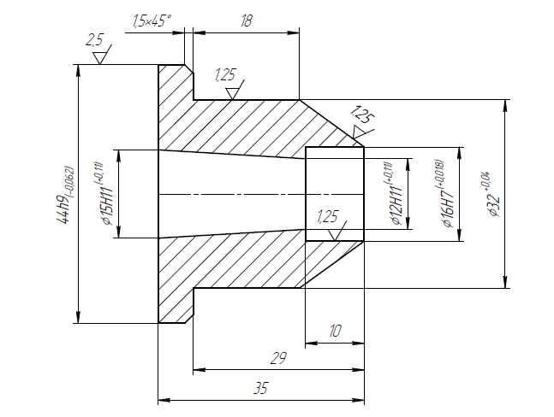
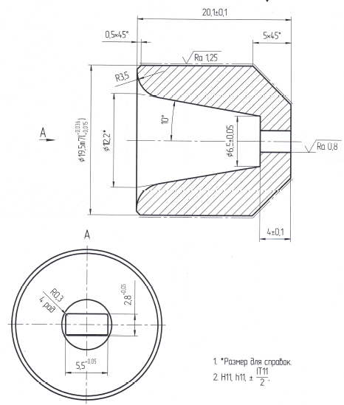
Sarko
Matrices for Rutherford cable and plating Al alloy.

Slide 30
Status of the PANDA conductor production
Thickness (after cold work) at 4.5 K | mm | 7.90 | ± 0.03
Minimum Al layer thickness in height | mm | > 1.9
Minimum Al layer thickness in width | mm | > 2.1
Surface roughness |  | Ra< 3.2
Critical current (at 4.2 K, 5 T) | A | > 14690
Critical current (at 4.5 K, 3 T) | A | > 16750
Critical current degradation of extracted strand w.r.t. virgin wire | % | < 15
Overall Al/Cu/sc ratio |  | 10.5/1.0/1.0
Extracted strand RRR |  | > 100
Aluminum RRR (at 4.2 K, 0 T) |  | > 1000
Al 0.2% yield strength at 300 K | MPa | > 30
Al 0.2% yield strength at 4.2 K | MPa | > 40
Shear strength Al to strands | MPa | > 20
Unit length for coils 1 & 3 | m | 4 x 1600
Unit length for coil 2 | m | 1500
Total length of conductor | m | 7900
Minimum bending radius during production and on spools | mm | > 1000

Slide 31
Status of the PANDA conductor production
4.3 On the conductor control
4.3.1 Aluminum batch
Chemical analysis with the full traceability.
RRR measurement on 2 samples.
4.3.2 During extrusion
Continuous recording of extrusion parameters:
oven temperature or aluminum billets temperature;
extrusion chamber temperature;
drawing die temperature;
cable preheating temperature;
extrusion speed in real time and date;
delay for changing aluminum billet or accidental hold up;
pressure (or force) of the press.
Control of the cleanliness of the finished conductor.
4.3.3 Continuous control after extrusion
Dimensional measurement.
Visual control.
Eddy current scanning to check for aluminum void.
Ultrasonic method to test the quality of bonding. Alternative methods can be proposed by the supplier.

Slide 32
Status of the PANDA conductor production
conductor control
4.3.4 Ατ σταρτ ανδ ενδ οφ εαχη υνιτ λενγτη
Μεασυρεμεντ οφ σηεαρ στρεσσ βετωεεν χαβλε ανδ αλυμινυμ (3 σαμπλεσ).
Ιντερ−μεταλλιχ διφφυσιον ζονε μιχρογραπηιχ αναλψσισ.
Μεασυρεμεντ οφ ΡΡΡ οφ τηε αλυμινυμ (∼ ον σποολ ατ ζερο φιελδ) (2 σαμπλεσ)
Χριτιχαλ χυρρεντ ανδ ν−ϖαλυε μεασυρεμεντ οφ 2 στρανδσ εξτραχτεδ φρομ εαχη χαβλε σαμπλε, ονε ατ σταρτ ανδ ονε ατ τηε ενδ οφ εαχη λενγτη. Στρανδσ μυστ βε οφ διφφερεντ βιλλετ νυμβερ. Τηε μεασυρεμεντ σηαλλ βε περφορμεδ ατ 4.2 Κ ανδ 3, 4 ανδ 5 Τ. Τηε χριτιχαλ χυρρεντσ σηαλλ βε χομπαρεδ το τηε μεασυρεδ χριτιχαλ χυρρεντσ οφ τηε στρανδσ υσεδ το μακε τηε αλυμινυμ σταβιλιζεδ χαβλε ιν θυεστιον.

Slide 33
RRR measurements
ELECTROMAGNETIC STUDY OF HIGH-PURITY ALUMINUM AND COPPER WIRES AT CRYOGENIC TEMPERATURE
Yu.V. Karasev, A.V. Malchenkov, I.N. Gubkin, E.V. Nikulenkov, Abdyukhanov I.M., P.A. Lukyanov, D.S. Novosilova, M.V. Polikarpova
Annealing, strain and external magnetic field application effects on residual resistivity ratio (RRR) of high-purity copper and aluminum wire samples intended for Nb-Ti superconductor elements are investigated. It is shown, that RRR-parameter reaches a value about 600 and 4000 for aluminum with a purity of 99.995% and 99,999% respectively. These RRR-values exceed RRR-level of high-purity oxygen-free copper (OFE). Moreover, aluminum wire samples reveals less sensitivity to annealing temperature and low degrees of deformation. The magneto resistive effect was studied in magnetic fields up to 10 T in relation to these grades of copper and aluminum and it was shown that the magnetoresistance of aluminum goes to saturation in fields above 3 T, while for copper it increases linearly over the entire range of fields.
Key words: High purity aluminum; high purity copper; Residual Resistance Ratio; magneto resistance effect.

Slide 34
RRR measurements
Fig. 1 Dependence RRR versus level of sample deformation, % for pure Al А995 and А999 (5N and 4N5)(а) and Cu/Nb-Ti strand, stabilized by Cu С10100 (б).

Slide 35
RRR measurements
Fig. 1 Dependence RRR versus temperature of sample for pure Al А995 (а) and А999 (б) (5N and 4N5). Bake up in vacuum during 30 minutes.

Slide 36
Status of the PANDA conductor production
Suggests
To decrease the value of critical current , 5T - ≥ 10 000 A
Specify RRR Al 99,995 - ≥ 500
Specify units length 1 & 3 - 3300 m

Slide 37
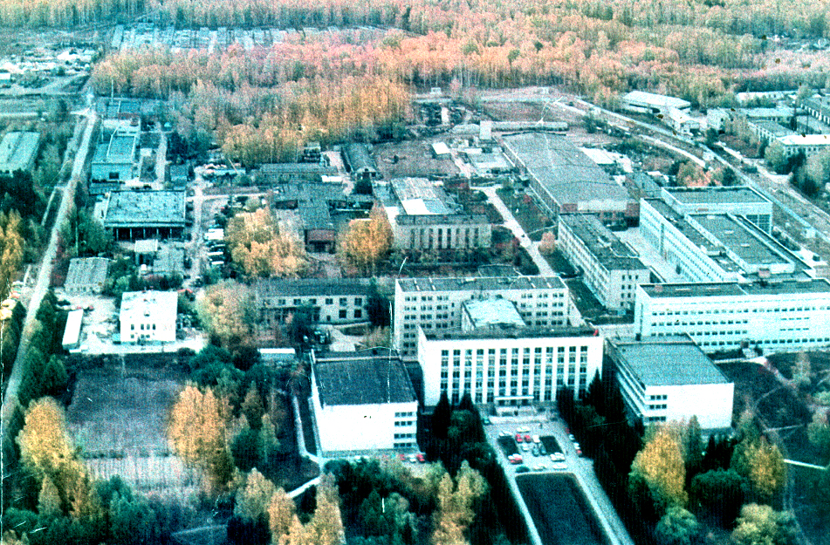

Thank you for your attention

