Slide 1
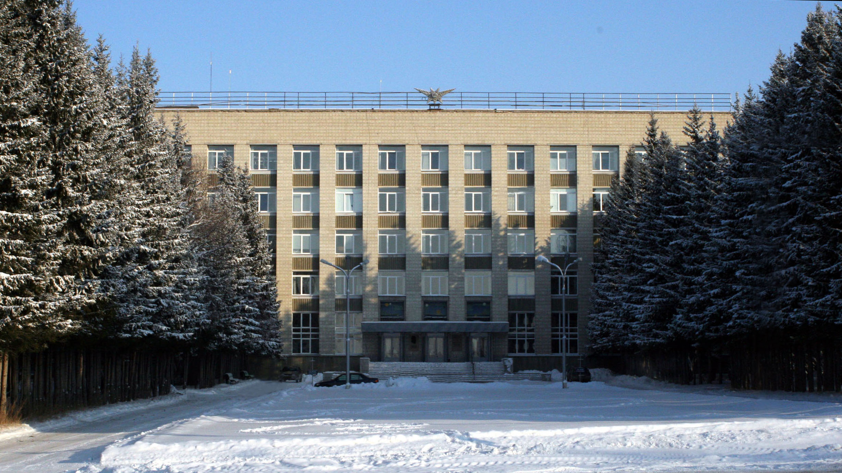
The Budker Institute of Nuclear Physics

Slide 2

PANDA
Magnet
Preliminary Design Report

Slide 3
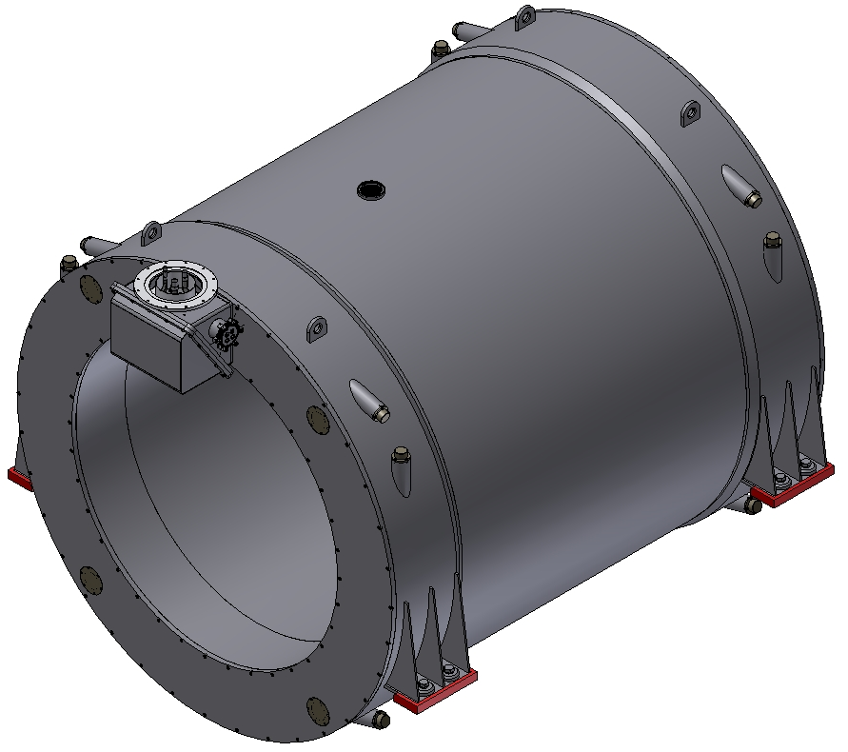
3D model of the Magnet.
Magnet with St. Steel Cryostat. The weight of magnet is ~14,5 t

Slide 4
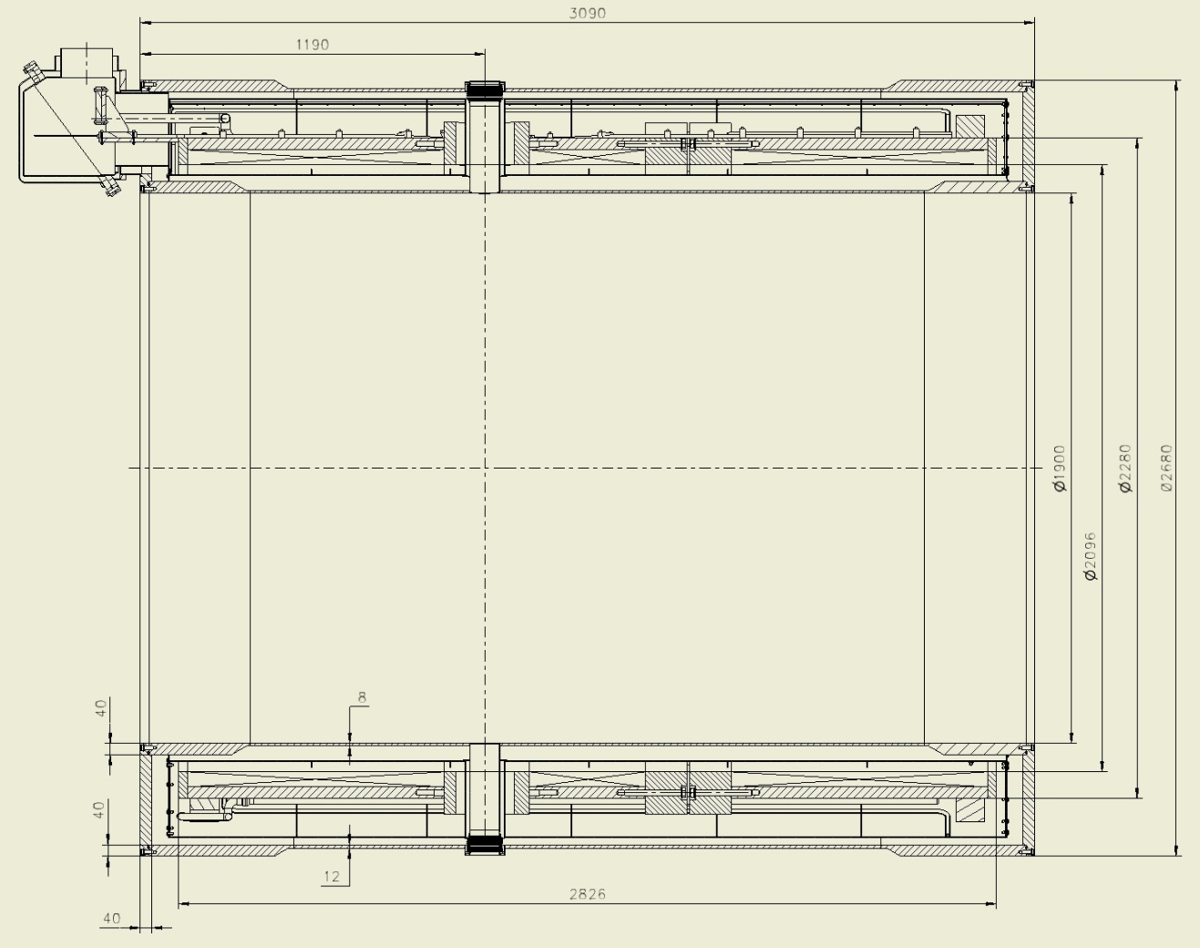
Dimensions of the Magnet.
Inner diameter is 1900 mm, Outer diameter is 2680 mm, length is 3090 mm

Slide 5
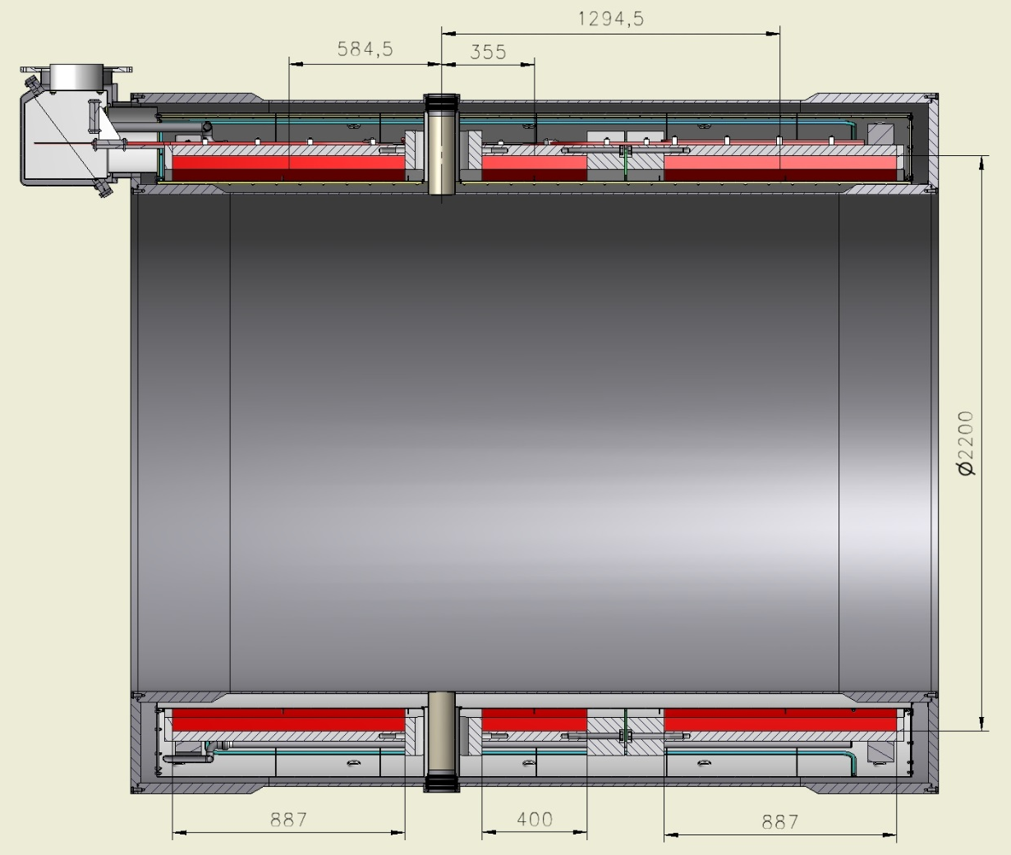
Dimensions of the Coils (worked condition 4.5 K).
Outer diameter of coils is 2200 mm, length: two coils - 887 mm, one – 400 mm.

Slide 6
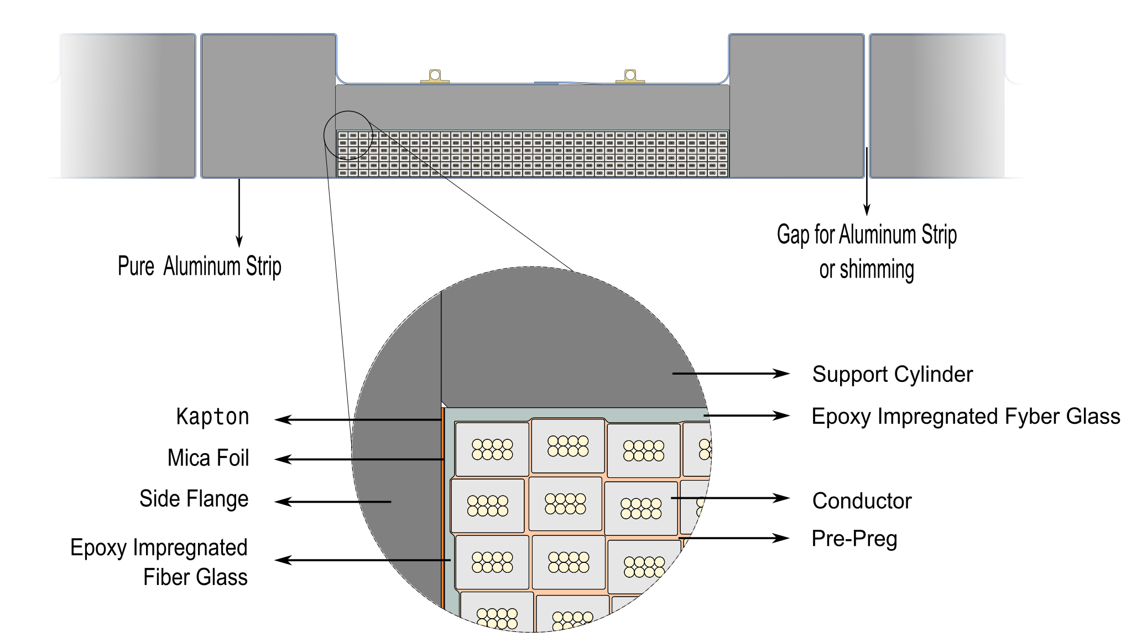
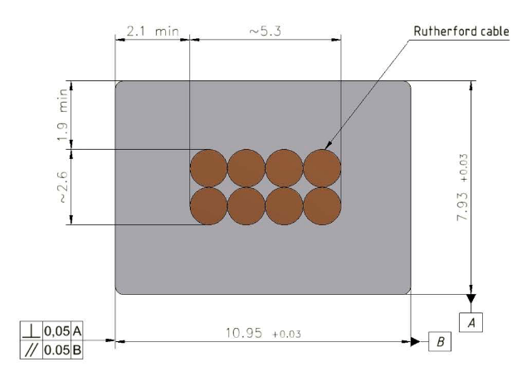
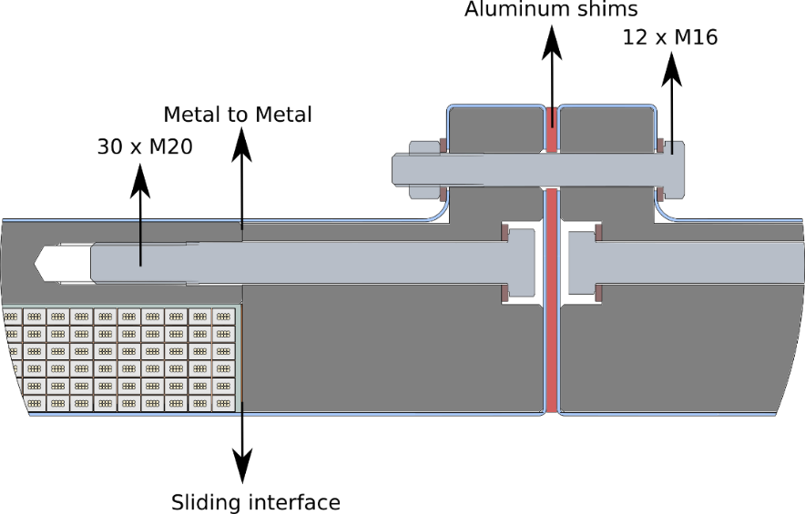
The Cold mass. (CERN design)
2x 6 layers - 78 turns
1x 6 layers - 35 turns
Magnetic field - 2 T
Current - 4.96 kA (3 T)
10,95 мм x 7.93 мм,
NbTi / Cu d=1.4 мм
The design of Cold mass is based on the design of Cold mass of CERN.

Slide 7
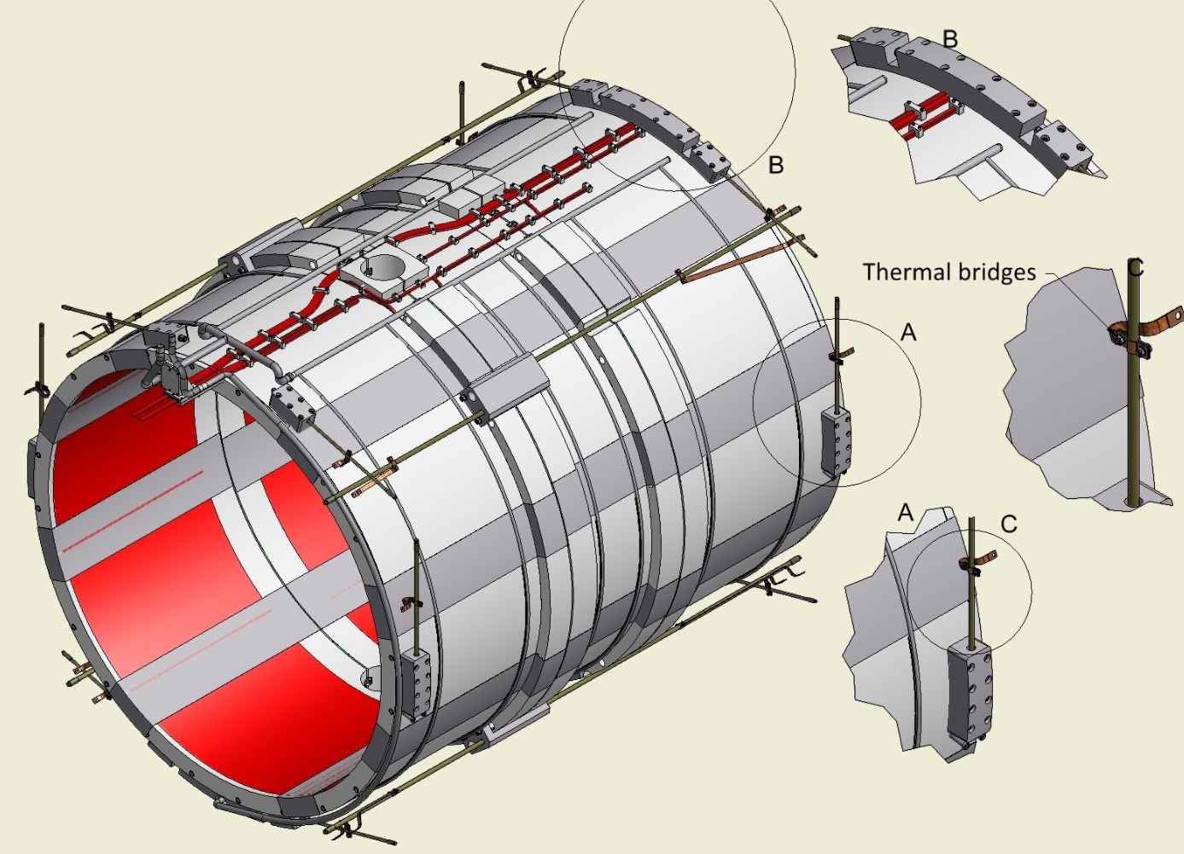
The Cold mass (3D-Model).
The Cold mass is based in to Cryostat with help of suspension, radial rods and longitudinal rods. For thermal bridges is used the flexible copper.
The weight of cold mass is ~5.6 t

Slide 8
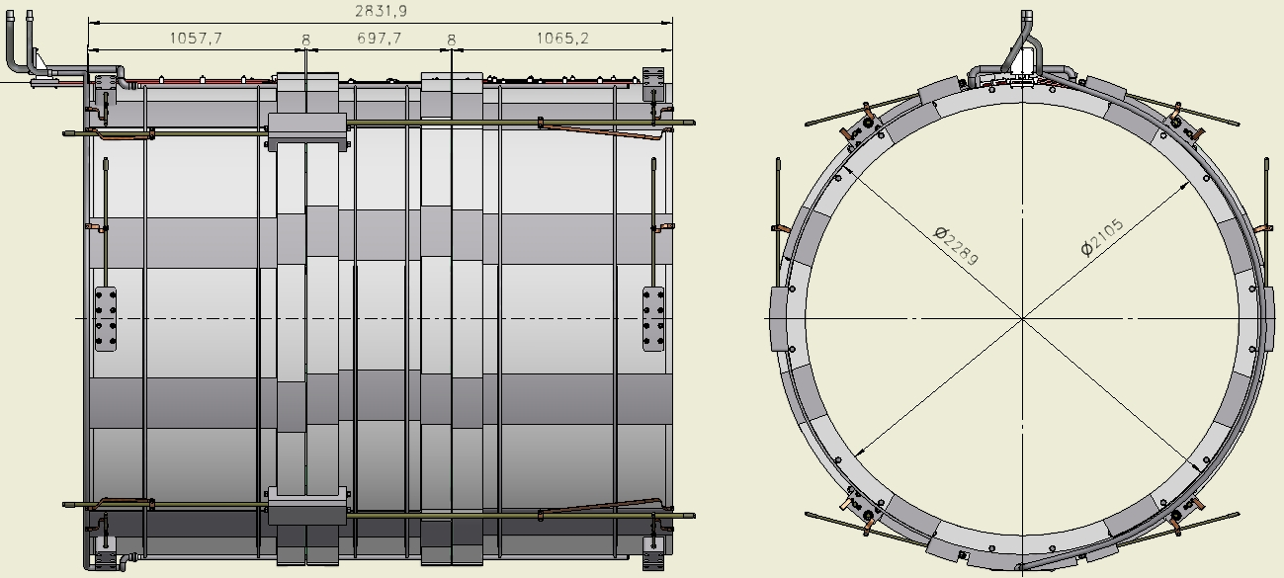
The Cold mass (dimension)
Inner diameter is 2096 mm, Outer diameter is 2280 mm, length is 2826 mm

Slide 9
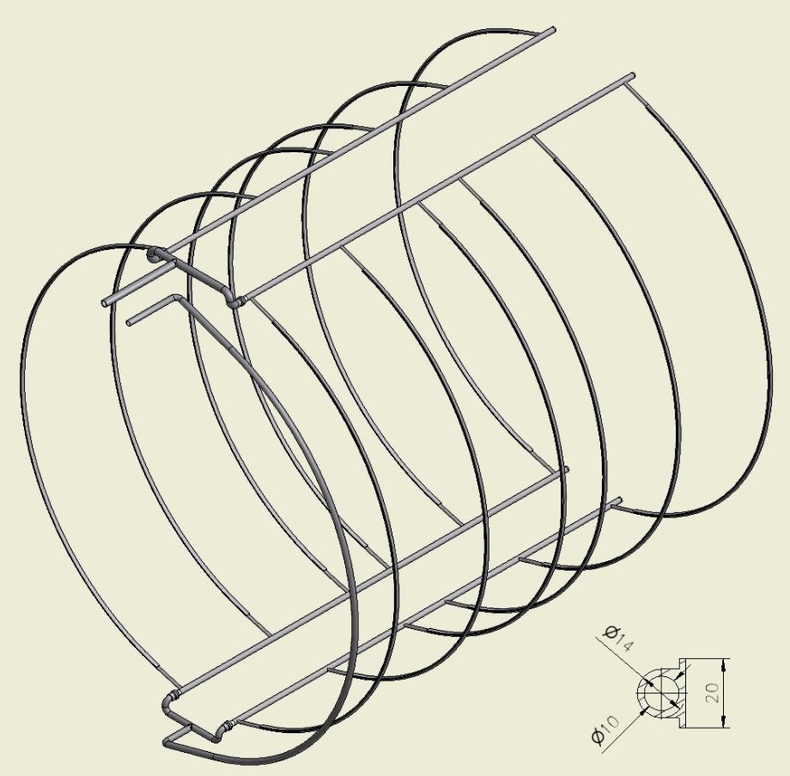
The Collector of Cold mass.
For cooling of Coil is used the collector with special aluminum profile which is welded on the outer shell of Cold mass.

Slide 10
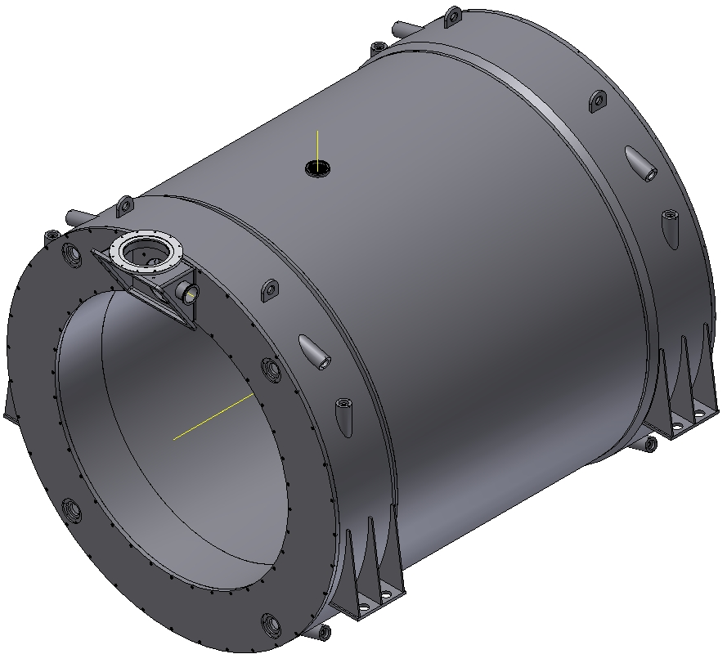
The Cryostat of The Magnet.
Inner diameter is 1900 mm, Outer diameter is 2680 mm, length is 3090 mm Material is St.St. The weight is ~8 t

Slide 11
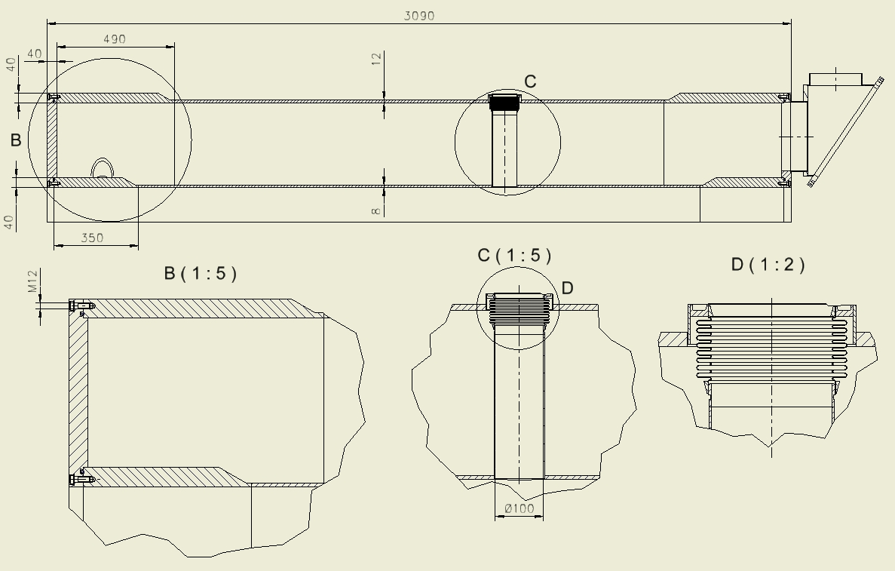
Configuration of the Cryostat
Thickness of the outer shell is 12 mm, Thickness of the inner shell is 8 mm , Thickness of the flanges is 40 mm, Thickness of the rings is 40 mm
The bolts – M12 – 2x36 ps. Sealing ring – d=8 mm

Slide 12
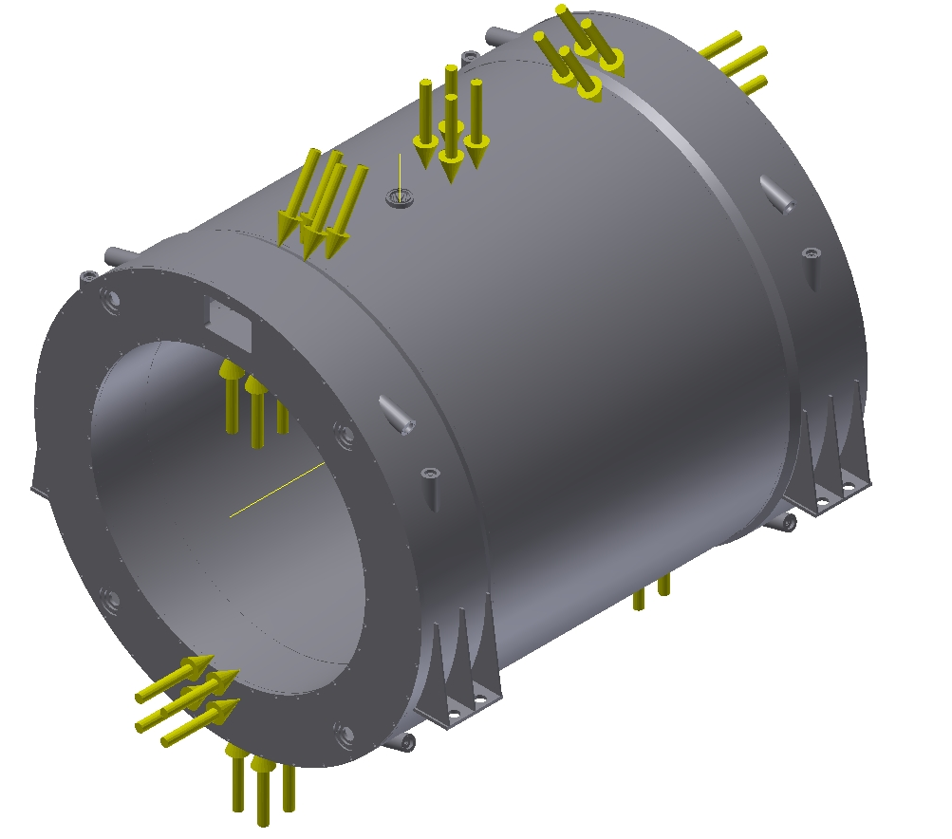
Results of calculation of the Cryostat.
Operation condition (p=0.1 MPa)

Slide 13
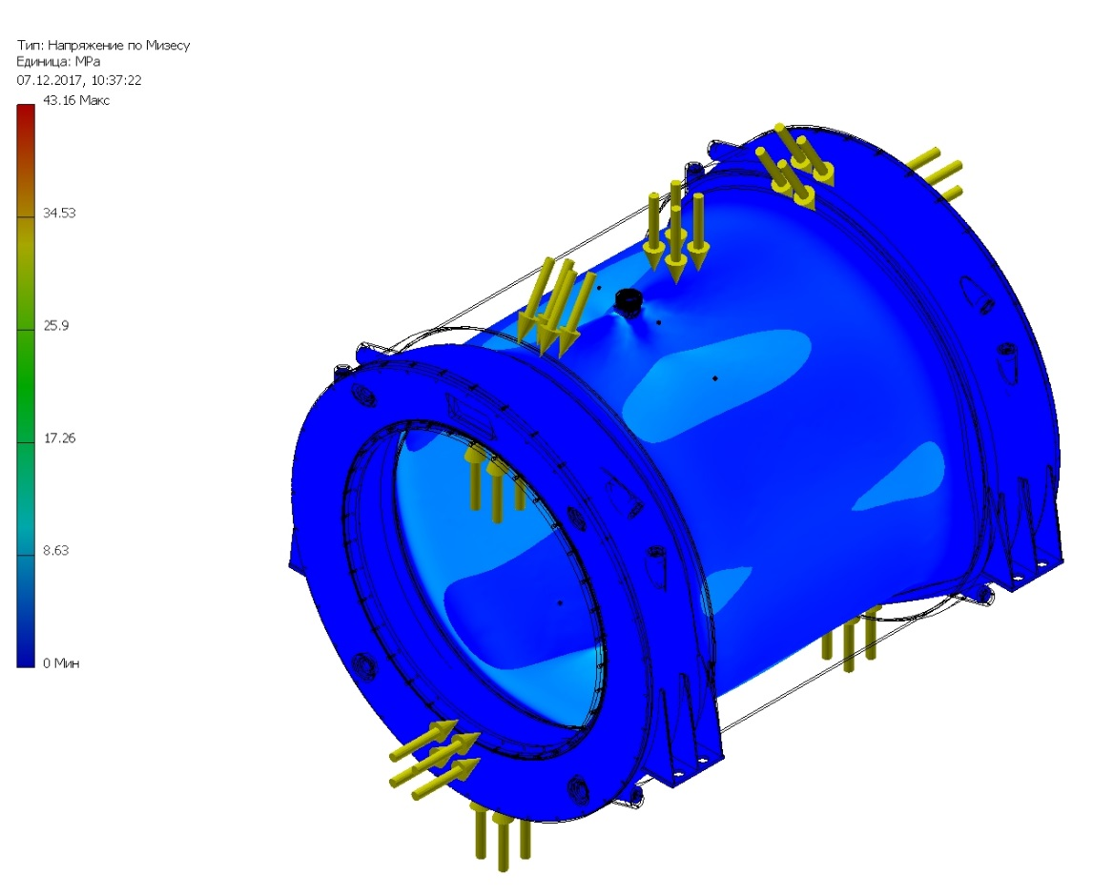
Results of calculation of the Cryostat.
Stress
The maximum equivalent stress is 43 MPa.

Slide 14
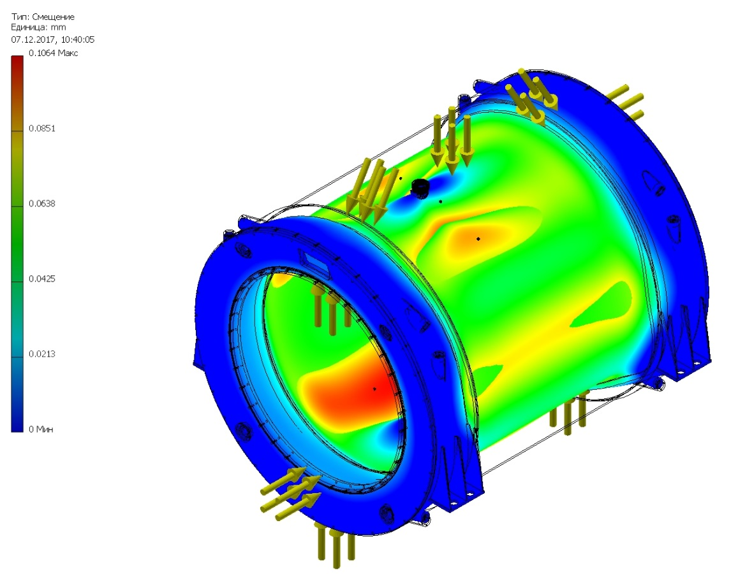
Results of calculation of the Cryostat.
Deformation
The maximum deformation is 0,1 mm.

Slide 15

Results of calculation of the Cryostat.
Operation condition (p=0.05 MPa)

Slide 16
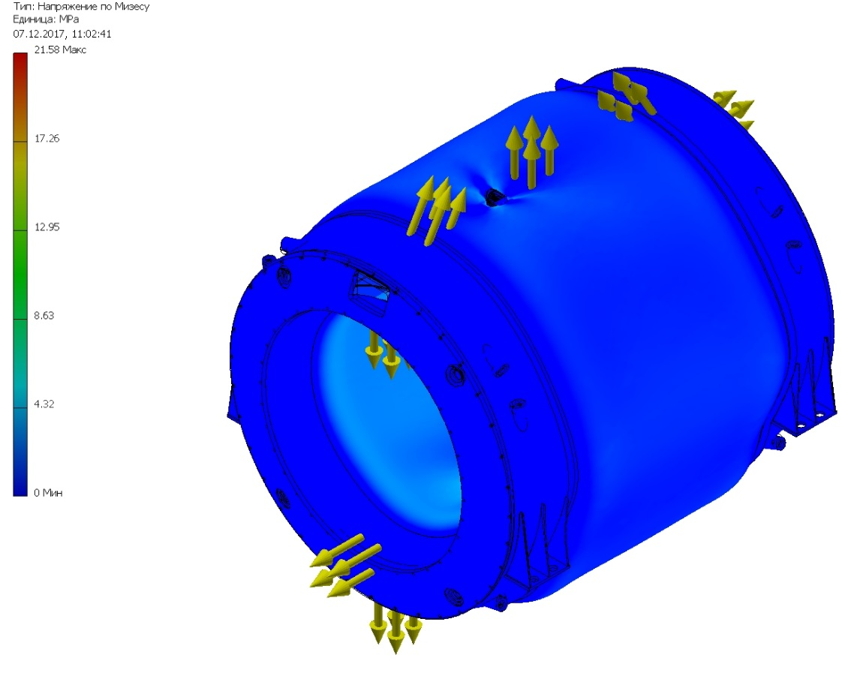
Results of calculation of the Cryostat.
Stress
The maximum equivalent stress is 21.5 MPa.

Slide 17
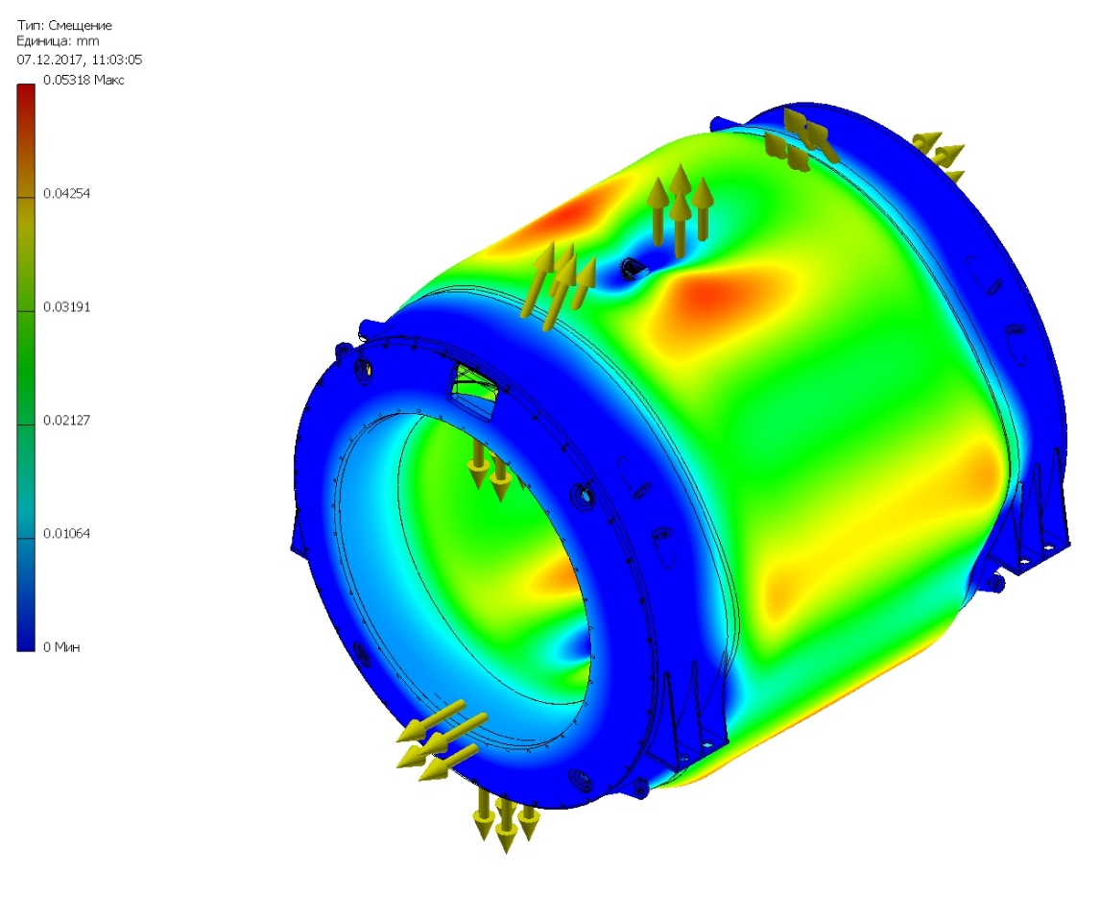
Results of calculation of the Cryostat.
Deformation
The maximum deformation is 0,06 mm.

Slide 18
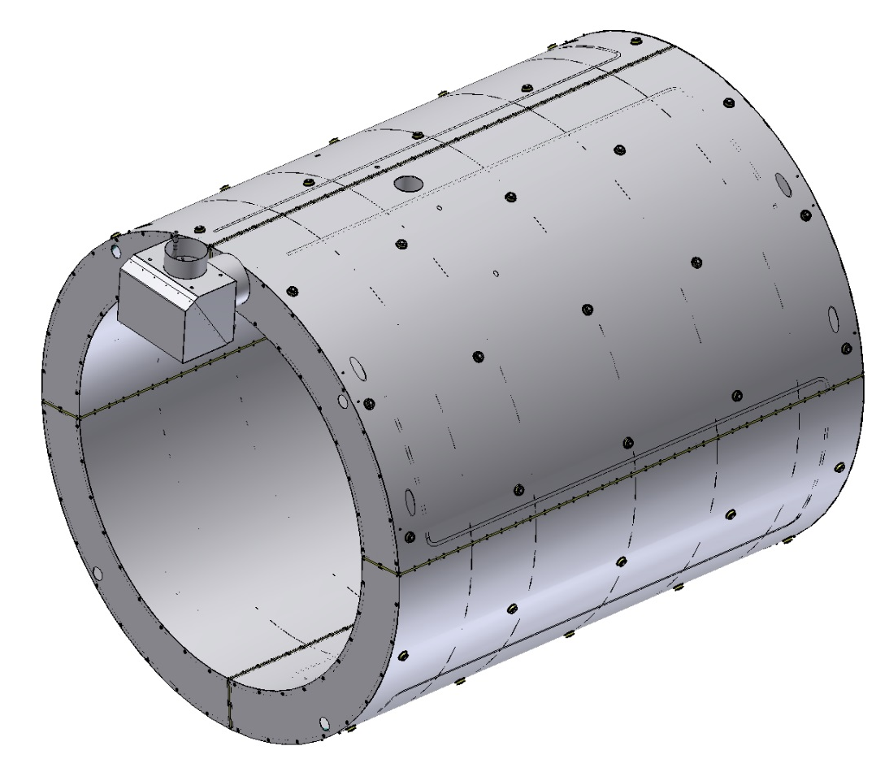
The Shield of the Magnet.
Outer diameter is 2552 mm, Inner diameter is 2020 mm, length is 2900 mm
Thickness is 3 mm, Material is Al. The weight is ~0,45 t

Slide 19
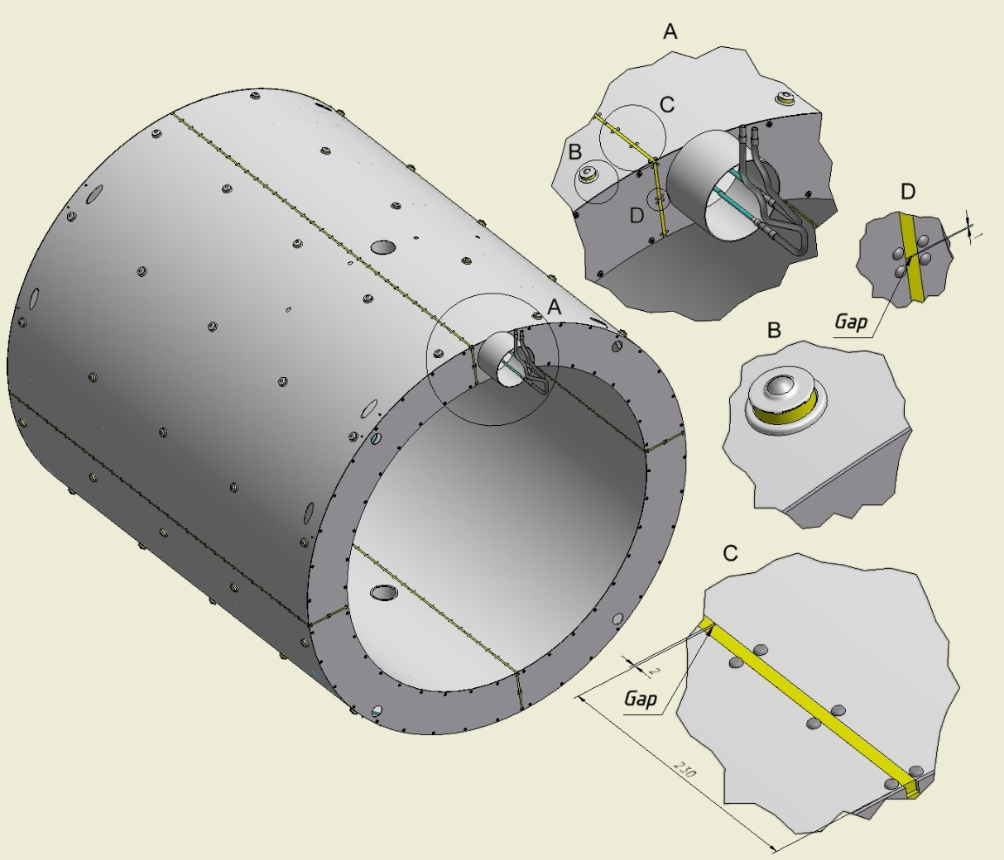
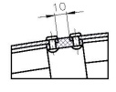
Break of the Shield .
The shield has 4 breaks isolated G10 bars with gaps. The shield is positioned into the cryostat with help Balls transfer units with G10 ring. On the outer and inner surface of the shield will be put 30 layers of superinsulation.

Slide 20
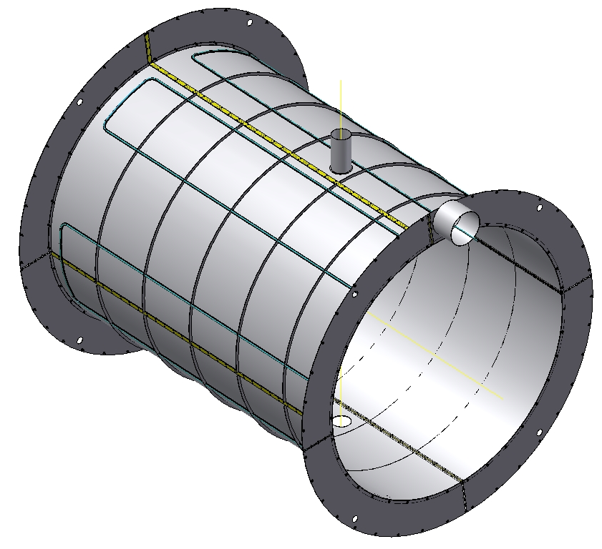
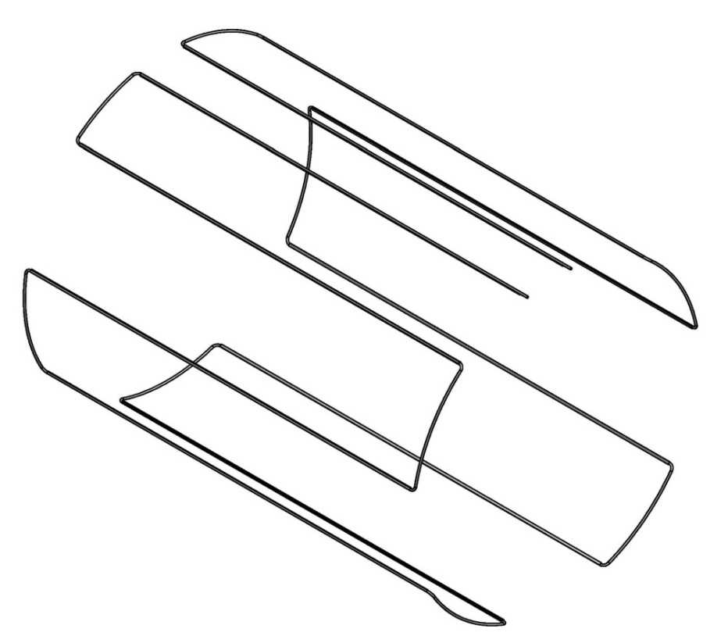
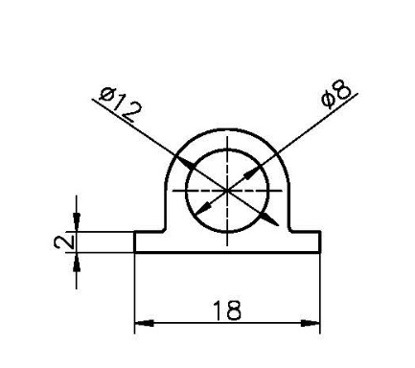
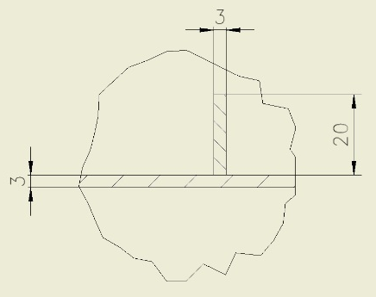
The inner Shield.
Inner shell of the shield with flanges, ribs and pipeline.
For cooling of Shield is used the pipeline with special aluminum profile which is welded on the shell.

Slide 21
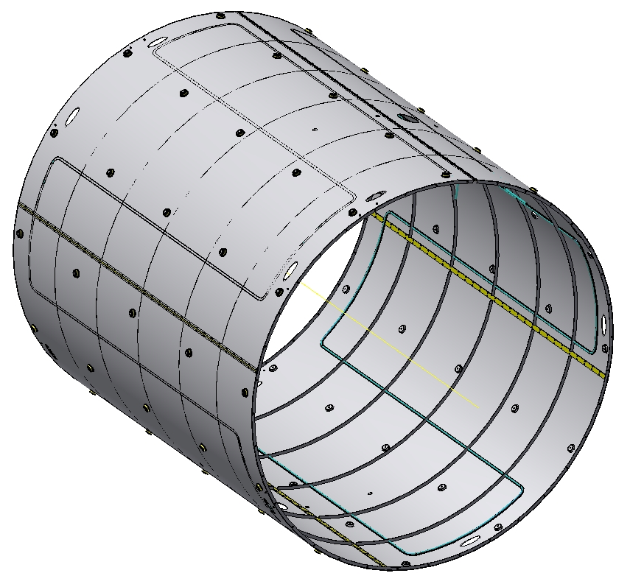
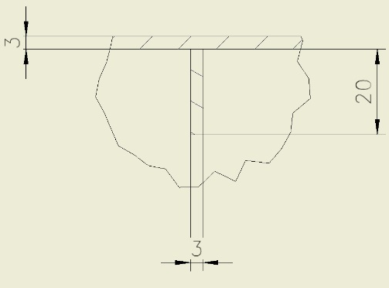
The outer Shield.
Outer Shell of the shield with ribs, Balls and pipeline with special aluminum profile which is welded on the shell.

Slide 22
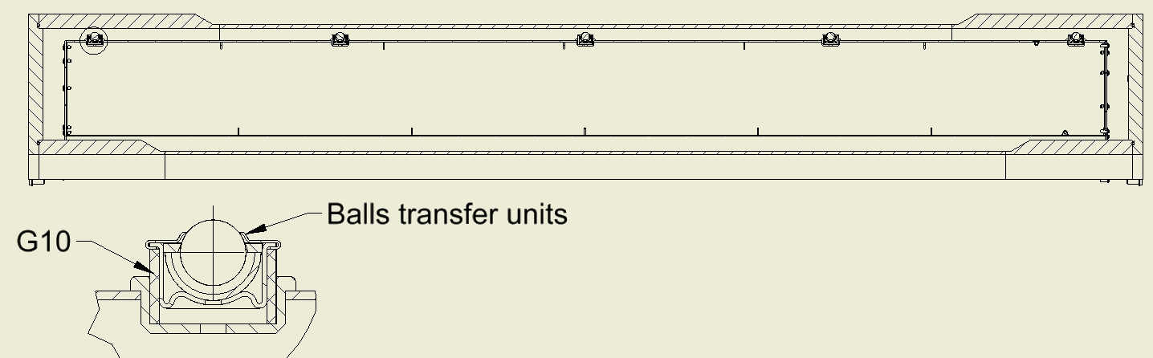
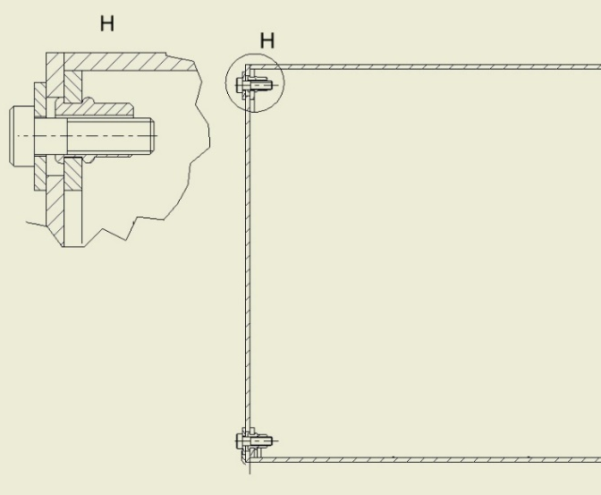
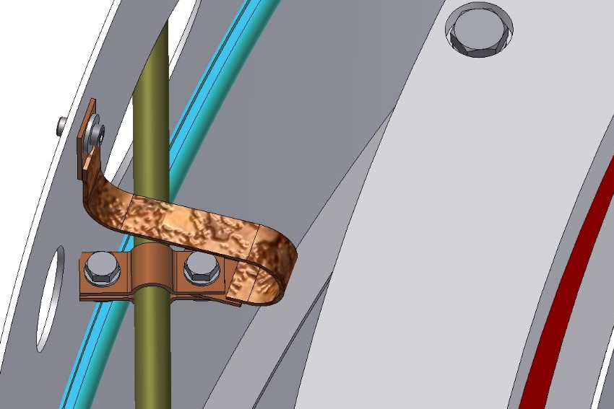
The Shield into the Magnet.
The Shield is based on the outer shells of the cryostat with help of Balls transfer units with G10 ring. Flanges of shield are fixed with help of thread rivets and bolts.
Thermal bridges is fixed on the shell of shield with help of thread rivets and bolts.

Slide 23
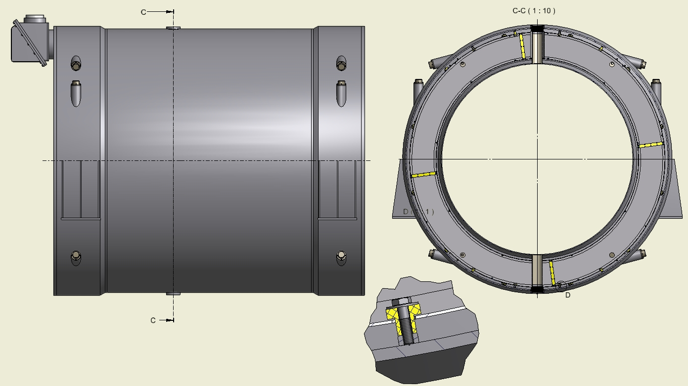
Fixation of the Shield into the Cryostat.
In the area of the target, the shield is fixed with help of bushes (G10) and bolts (8 places). Position of bolts for fixing the shield into the cryostat.

Slide 24
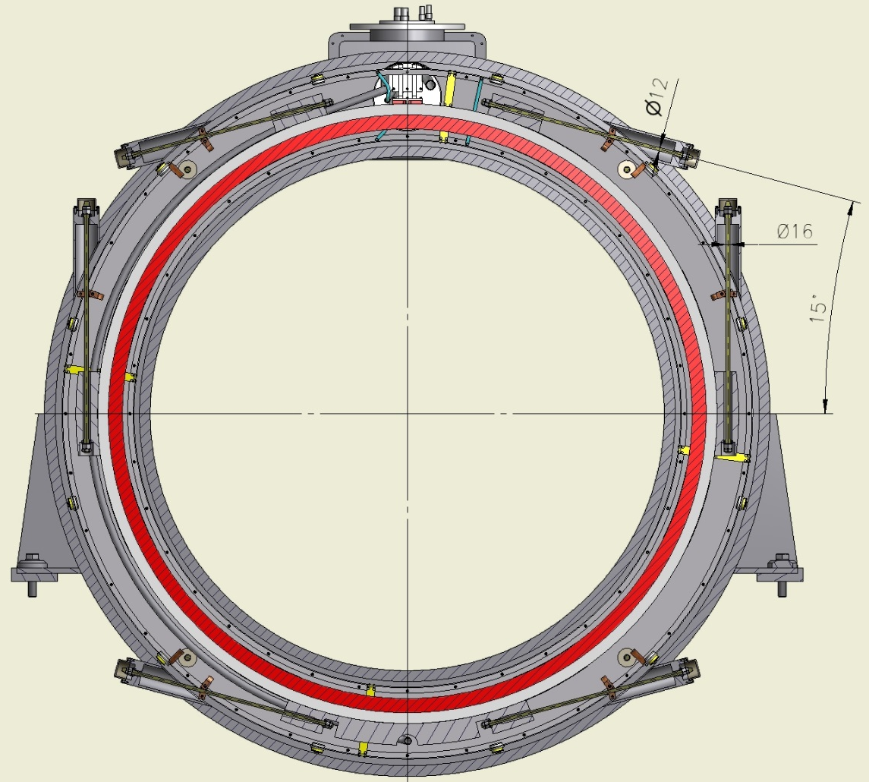
Cross section of the Magnet.
In the radial direction the Cold mass is based into Cryostat with help suspensions and axis rods.

Slide 25
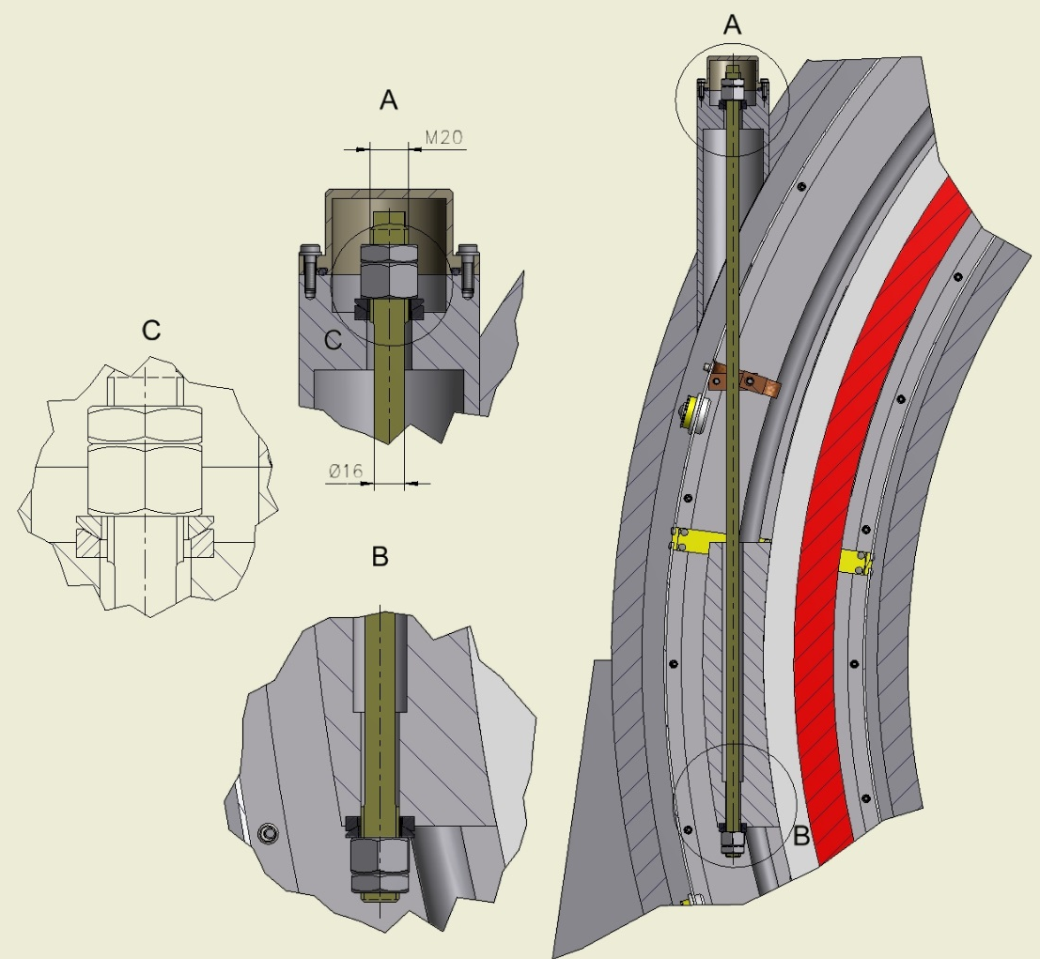
The Suspensions.
The diameter of suspension is 16 mm, the length is 840 mm.
Material is Ti-5Al-2.5Sn

Slide 26
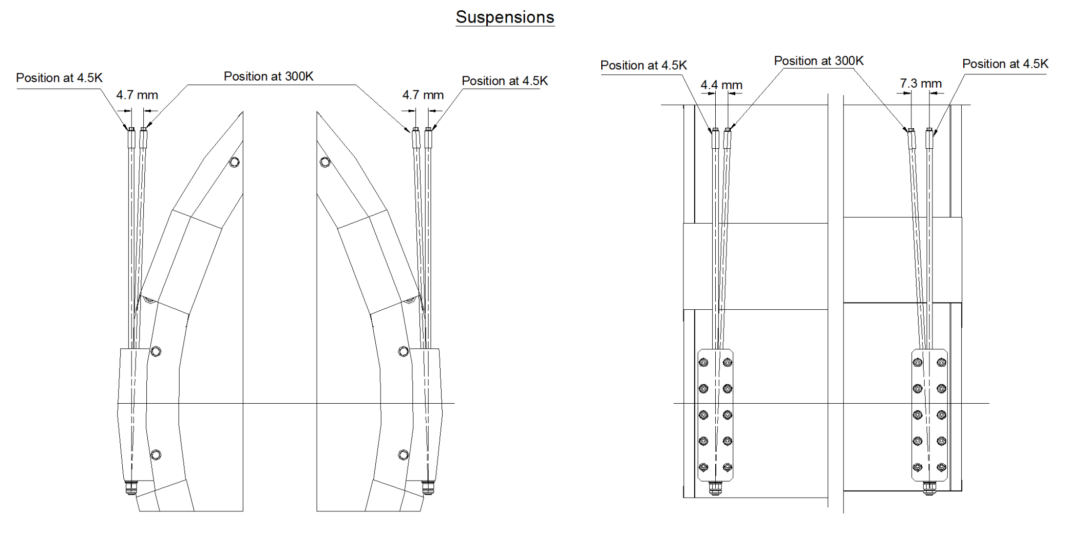
The position of the suspension before and after cooling down.
After cooling down the suspension take a vertical position.

Slide 27
Results of calculation of the Suspension.
(temperature loads)
The weight load of the cold mass of ~63 kN.
Maximum radial decentering magnetic force of 51 kN (Specification F-DS-PND-004)

Slide 28
Results of calculation of the Suspension.
(temperature distribution)

Slide 29
Results of calculation of the Suspension.
(fixation)

Slide 30
Results of calculation of the Suspension.
Stress.
The equivalent stress of suspension is ~150 MPa.

Slide 31
Results of calculation of the Suspension.
Stress.
The maximum equivalent stress is 545 MPa.

Slide 32
Results of calculation of the Suspension.
Stress.
The maximum equivalent stress of fixing bolts is 250 MPa.

Slide 33
Results of calculation of the Suspension.
Stress.

Slide 34
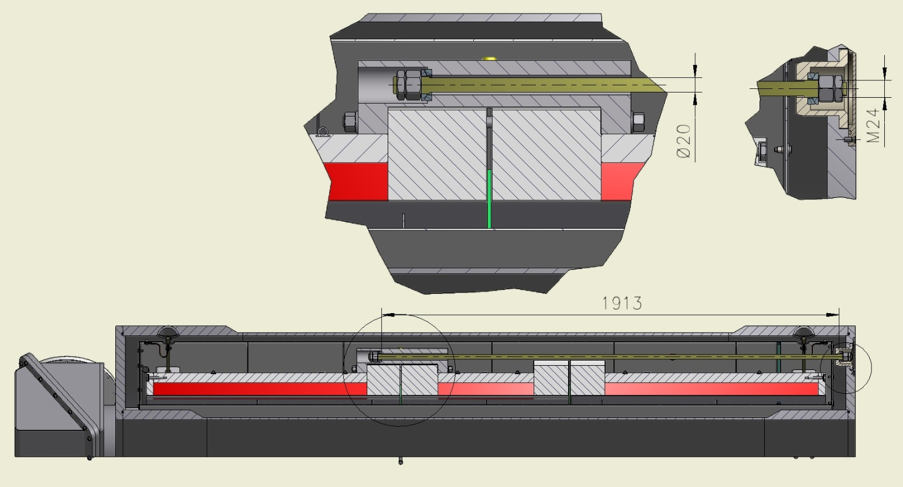
The Longitudinal rod.
(right side)
In the axial direction the Cold mass is fixed with help longitudinal rods.
The diameter of longitudinal rods is 20 mm, the length is 1913 mm (right side).
Material is Ti-5Al-2.5Sn

Slide 35
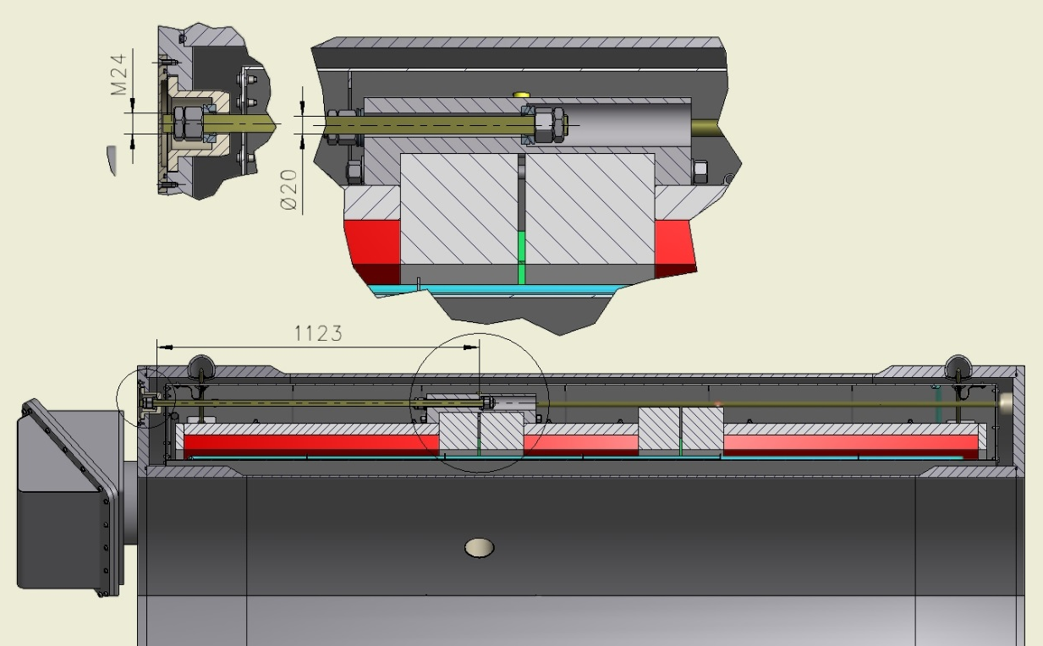
The Longitudinal rod.
(left side)
The diameter of longitudinal rods is 20 mm, the length is 1123 mm (left side).
Material is Ti-5Al-2.5Sn

Slide 36
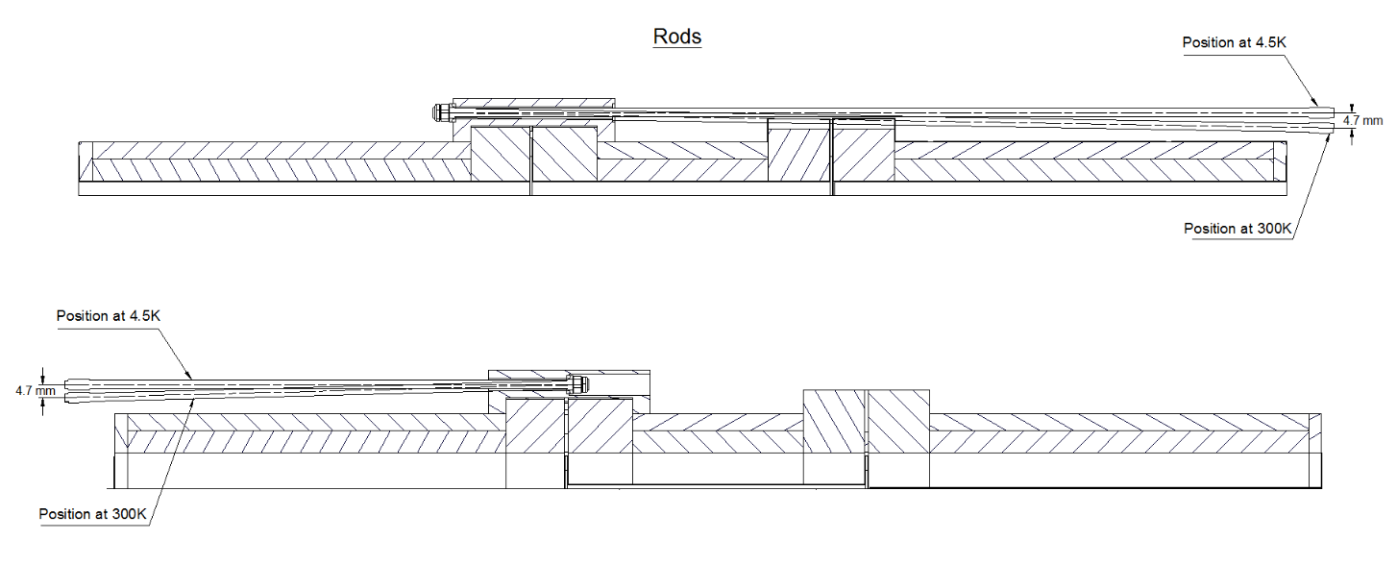
The position of the longitudinal rods before and after cooling down.
After cooling down the axial rods take a horizontal position.

Slide 37
Results of calculation of the longitudinal rods .
(temperature loads)
Maximum axial decentering magnetic force of up to 168 kN
The initial tightening force is 3.7 kN (Specification F-DS-PND-004)

Slide 38
Results of calculation of the longitudinal rods .
(temperature distribution)

Slide 39
Results of calculation of the longitudinal rods .
(fixation)

Slide 40
Results of calculation of the longitudinal rods .
Stress
The equivalent stress of longitudinal rods is ~140 MPa.

Slide 41
Results of calculation of the longitudinal rods .
Stress
The maximum equivalent stress is 545 MPa.

Slide 42
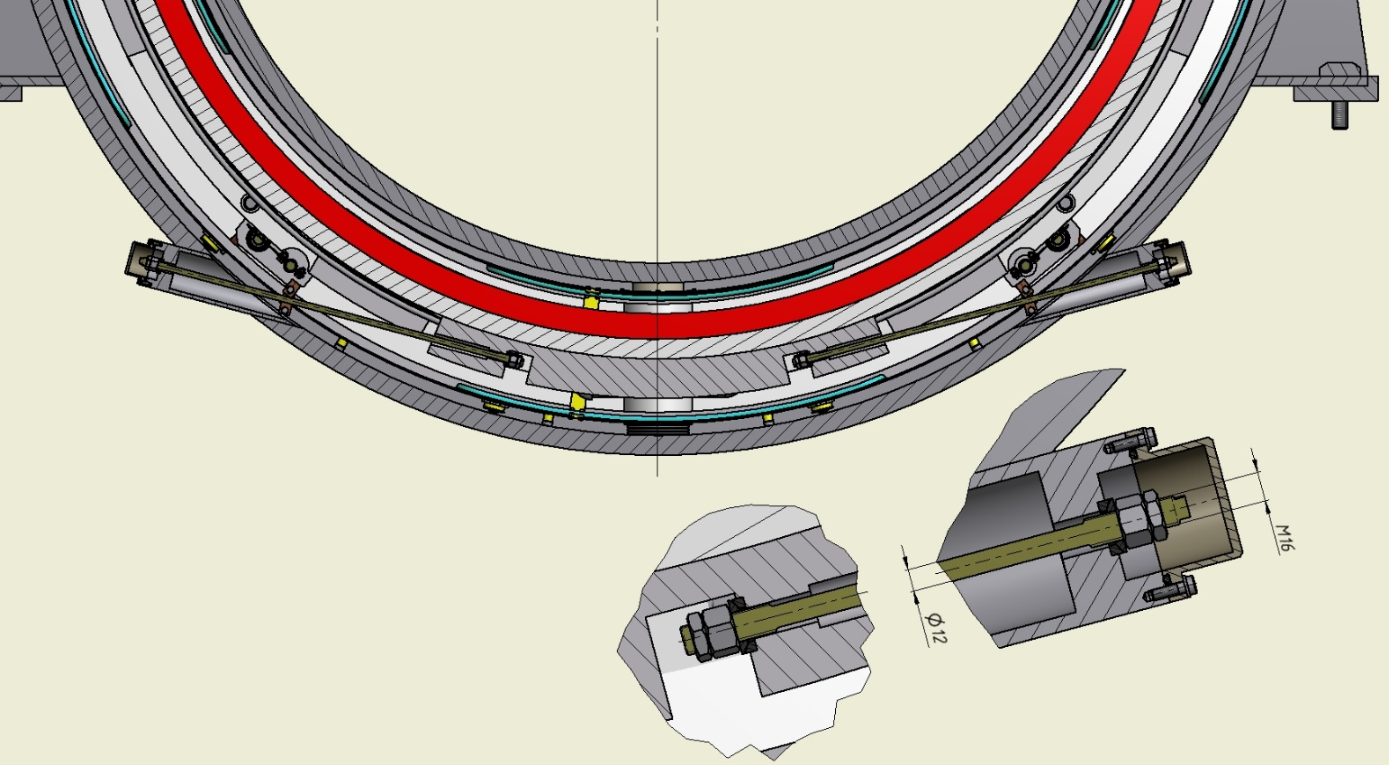
The Radial rods.
In the radial direction the Cold mass fixed with help radial rods. The diameter of radial rods is 12 mm, the length is 720 mm.
Material is Ti-5Al-2.5Sn

Slide 43
Results of calculation of the radial rods .
(temperature loads)
Maximum radial decentering magnetic force of 51 kN
The initial tightening force is 3.7 kN (Specification F-DS-PND-004)

Slide 44
Results of calculation of the radial rods .
(temperature distribution)

Slide 45
Results of calculation of the radial rods .
(fixation)

Slide 46
Results of calculation of the radial rods .
Stress
The equivalent stress of radial rods is ~120 MPa.

Slide 47
Results of calculation of the radial rods .
Stress
The maximum equivalent stress is 478 MPa.

Slide 48
Results of calculation of the radial rods .
Stress
The maximum equivalent stress of fixing bolts is 260 MPa.

Slide 49
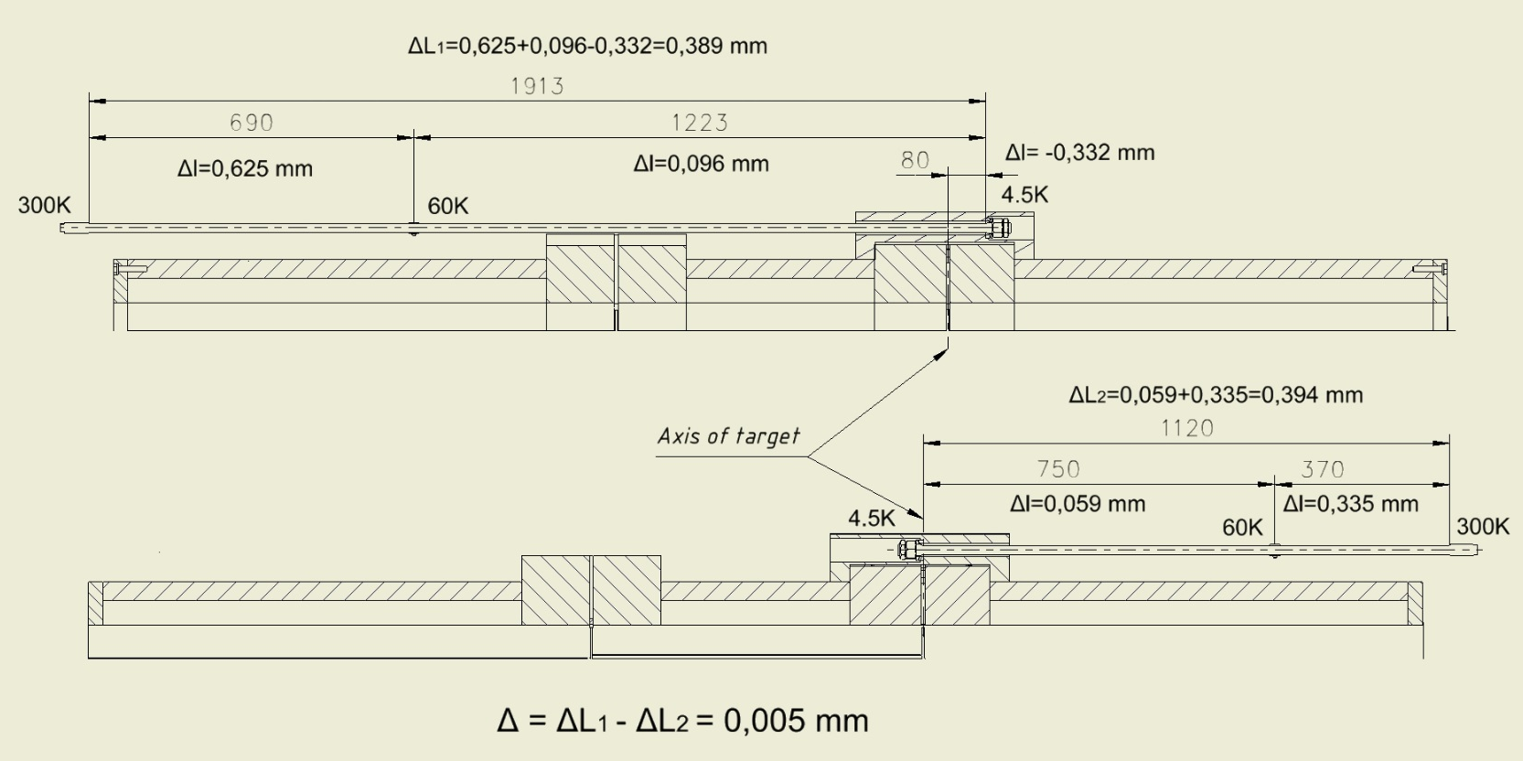
Diagram of position of the target`s axis in worked condition.
The length and position of fixation of the longitudinal rod, and position of the thermal bridges allow not to move the axis of the hole of the target.

Slide 50
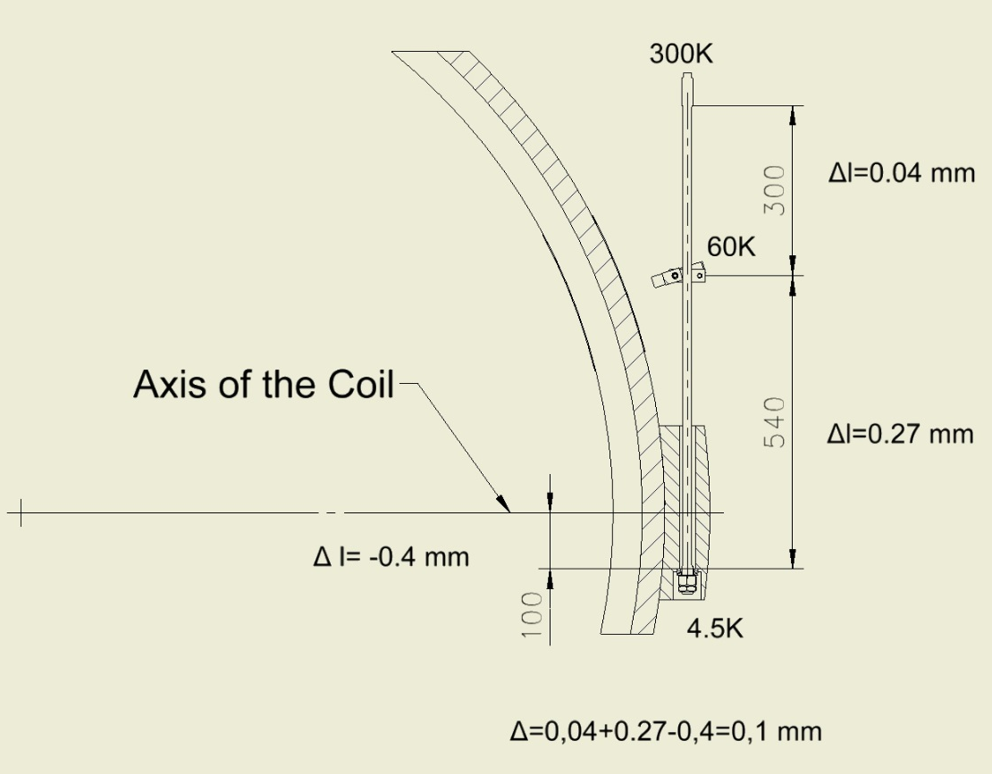
Diagram of position of the Cold mass axis in worked condition.
The length and position of fixation of suspensions, and position of the thermal bridges allow to move the axis of the Cold mass for 0,1 mm.

Slide 51
Heat loads of the Cold mass and thermal Shield.
T=4.5K | Thermal load, W
Radiation | 2.2
Heat inflow to the cold mass supports | 0.52
Total: | 2.72
T=60K
Radiation | 95
Heat inflow to the cold mass supports | 13
Heat inflow to the shield supports | ?
Total: | 108

Slide 52
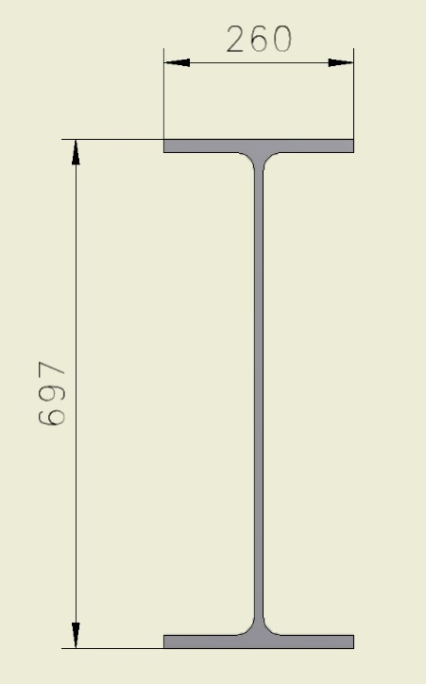
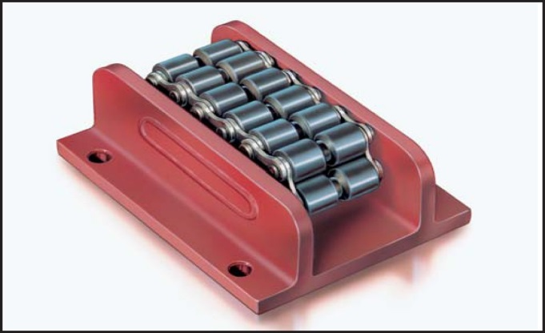
Magnet assembly procedure
For assembling the magnet, it is possible to use an I-beam steel hot-rolled with parallel faces of shelves 70B2 (697 x 260 mm) GOST 26020-83.
The length of the beam is L = 9 m.
To roll inside, we can use rollers that are used to open doors (Roller skate Boerkey model AM-H)

Slide 53
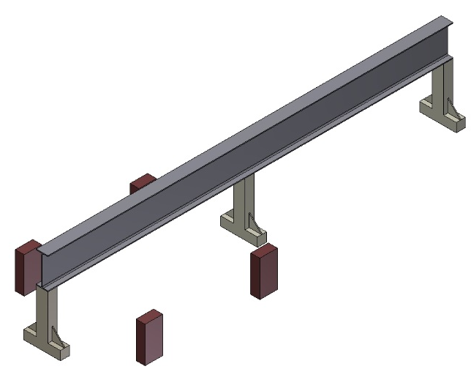
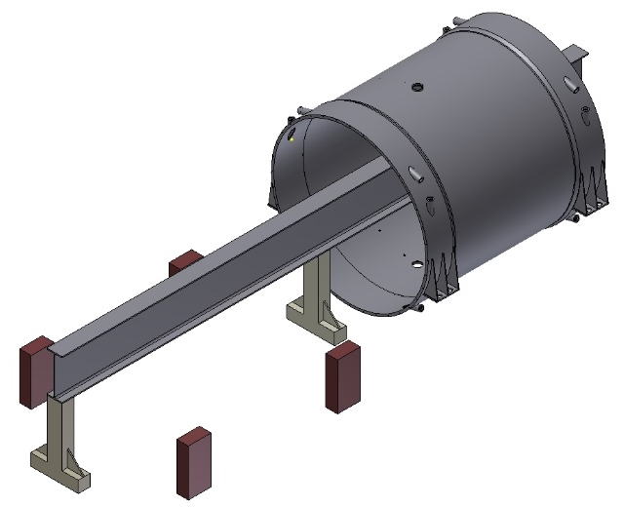
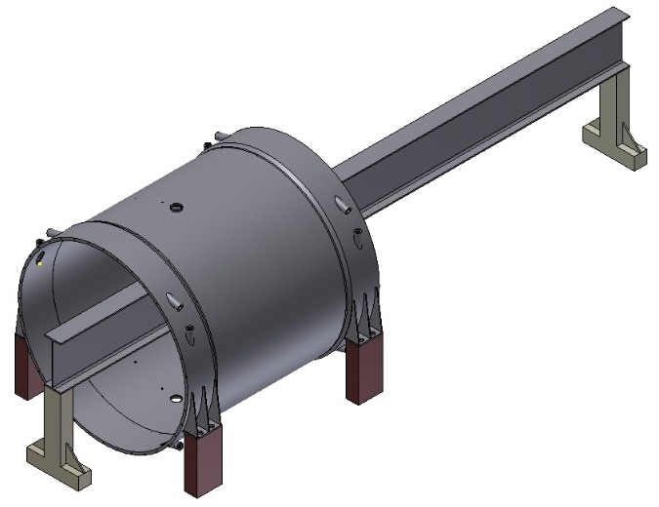
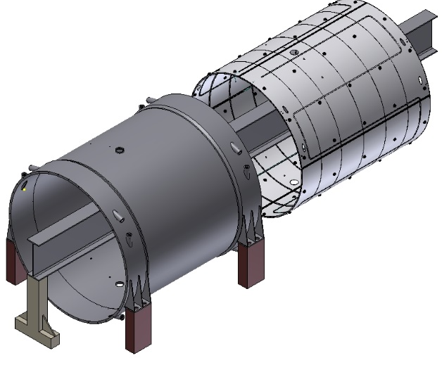
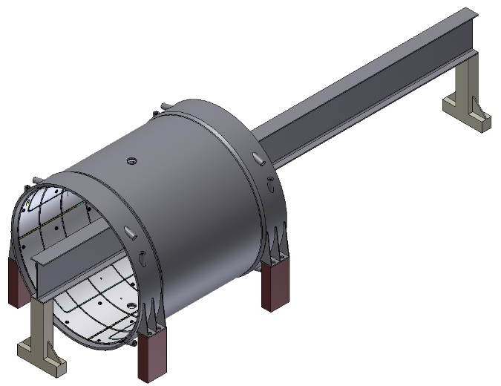
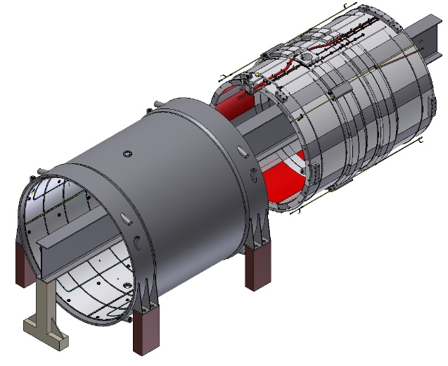
Magnet assembly procedure
Pic.1. Stand
Pic.2. Outer shell of cryostat
insertion.
Pic.3. Outer shell of cryostat
position.
Pic.4. Outer shield insertion.
Pic.5. Outer shield position.
Pic.6. Cold mass insertion.

Slide 54
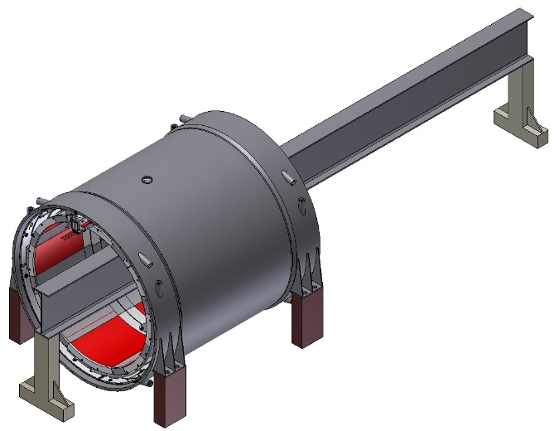
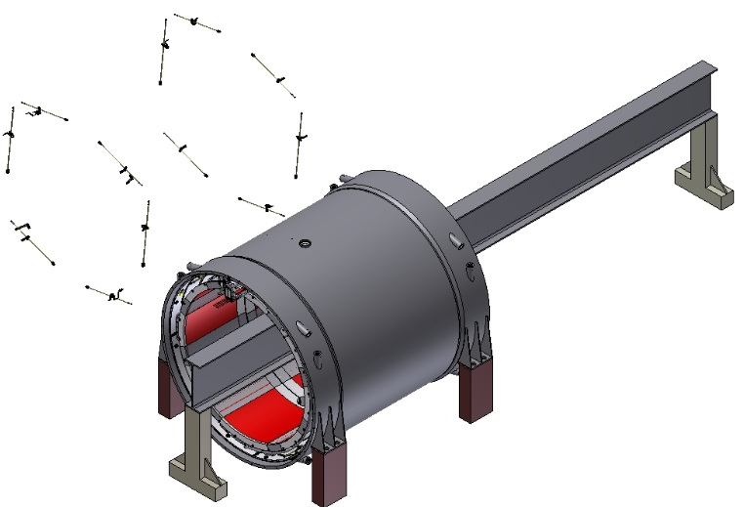
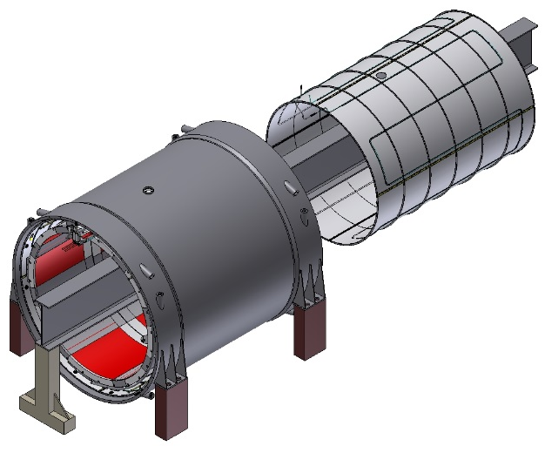



Magnet assembly procedure
Pic.7. Cold mass position.
Pic.8. Suspensions and axial
rods insertion.
Pic.9. Inner shield insertion.
Pic.10. Inner shield position.
Pic.11. Flange of shield insertion
and position.
Pic.11. Flange of shield insertion.

Slide 55






Magnet assembly procedure
Pic.13. Flange of shield position.
Pic.14. Inner shell of cryostat
insertion.
Pic.15. Inner shell of cryostat
position.
Pic.16. Flange of cryostat
insertion and pos.
Pic.17. Flange of cryostat
insertion.
Pic.16. Flange of cryostat
position.

Slide 56
Drawings of the PANDA Magnet

Slide 57

Drawing of the Magnet.

Slide 58

Drawing of the Magnet.

Slide 59

Drawing of the Magnet.

Slide 60

Drawing of the Magnet.

Slide 61

Drawing of the Magnet.

Slide 62

Drawing of the Cryostat.

Slide 63

Drawing of the Cryostat.

Slide 64

Drawing of the Cold mass.

Slide 65

Drawing of the Cold mass.

Slide 66

Drawing of the Shield.

Slide 67

Drawing of the Shield.

Slide 68

Drawing of the Magnet and Feed Box.

Slide 69

Drawing of the Magnet, Feed Box and Frame.

Slide 70

Drawing of the Magnet, Feed Box and Frame.

Slide 71

3D model of the Magnet and Feed Box.

Slide 72

3D model of the Yoke, Magnet, Feed Box, Frame.

Slide 73

3D model of the Yoke, Magnet, Frame, Feed Box and Platform.
To service the box, it is necessary to have the length of the Working platform min 600 mm from the box.

Slide 74

3D model of the Magnet, Yoke and Frame.

Slide 75

Power supply of PANDA Magnet.

Slide 76
Thank you for your attention!

