Slide 1
Control System Architecture
10.04.2018 Hanno Hüther

Slide 2
Motivation and Approach
Question
What happens between the application and the hardware?
Implication
It would be helpful for Operators to know what’s going on behind the scenes
Challenge
Explain system architecture of (a part) of the control system in a way that the information provided is useful for commissioning and operating
Idea
Explain some of the most common use cases by the systems involved and the data flows between them

Slide 3
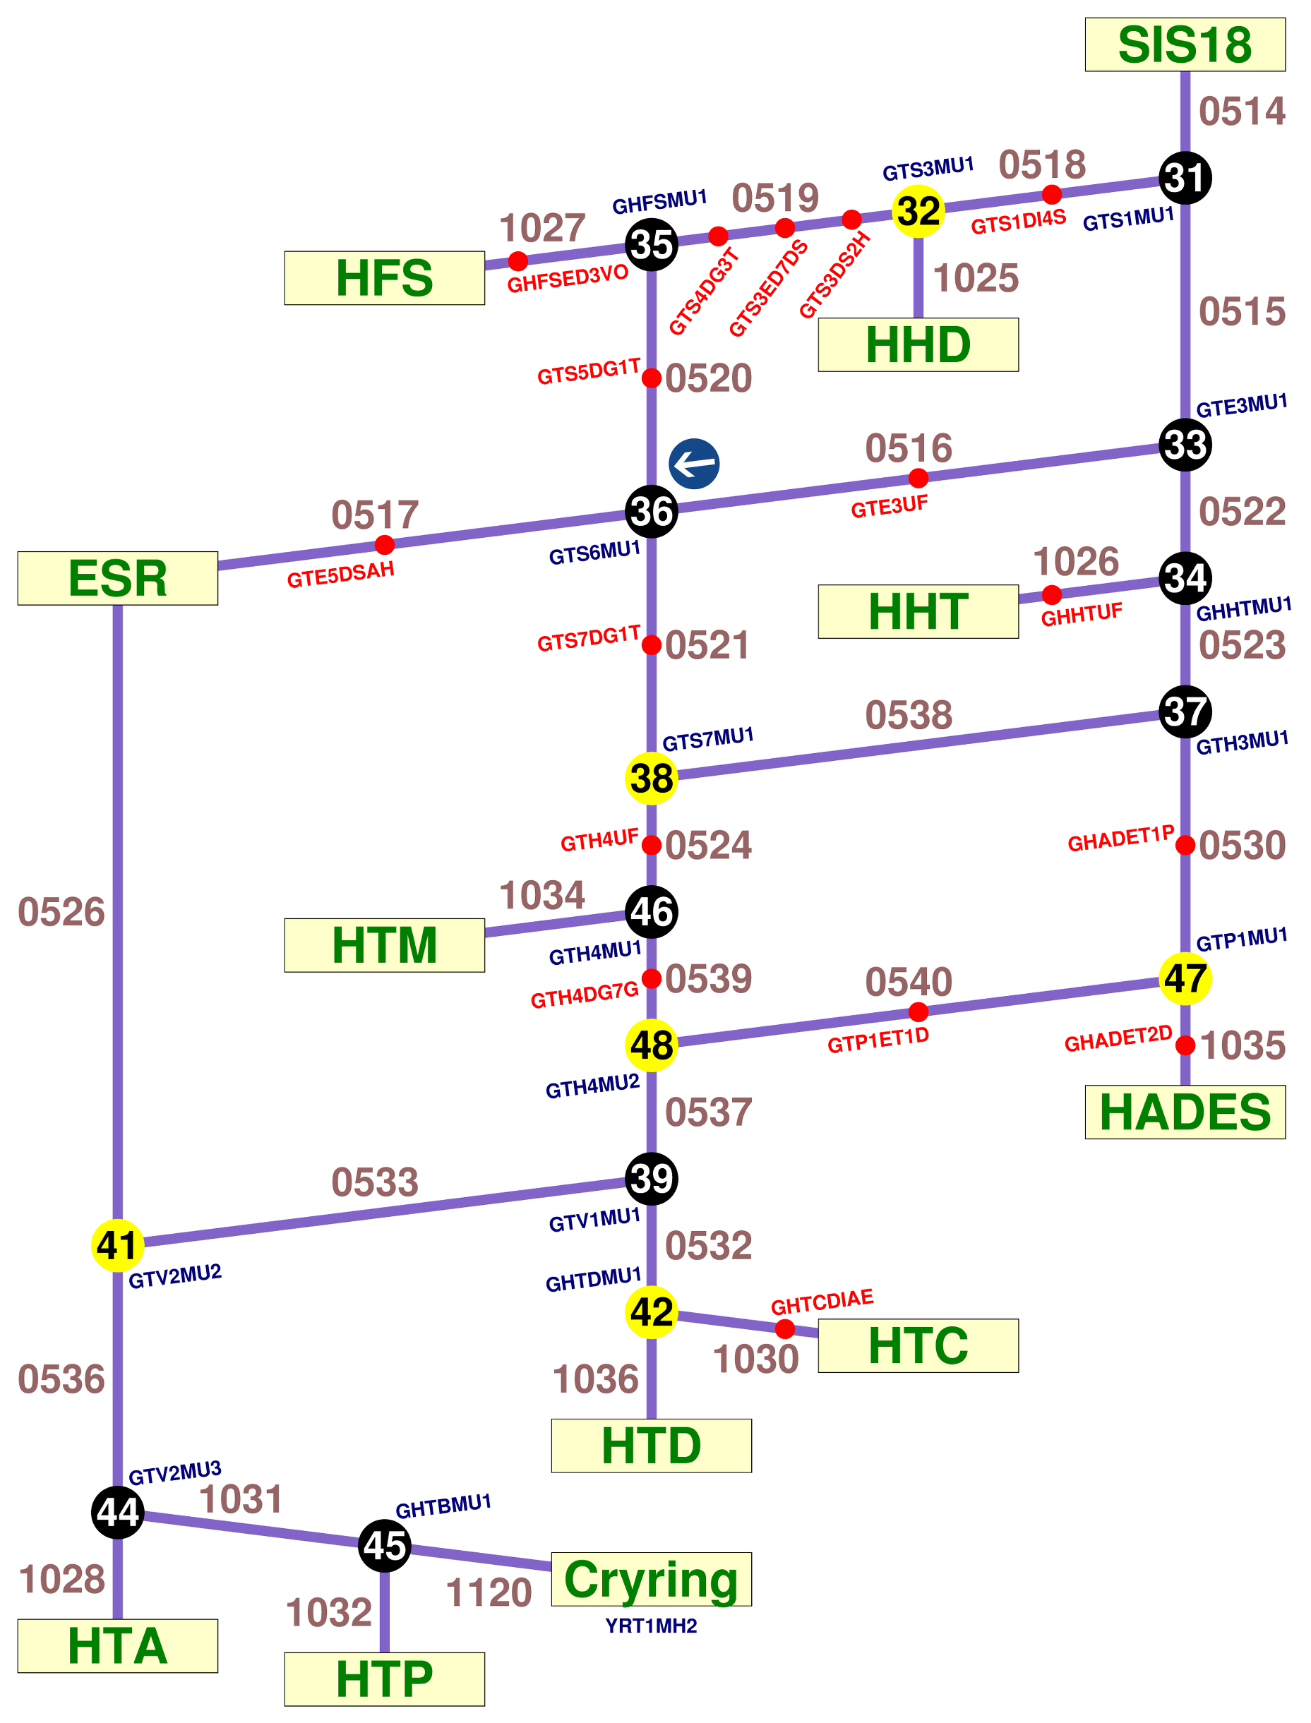
Terminology (I)
Particle Transfer
Section of accelerator with identical timing
Beam Process
Temporal section within a Particle Transfer with specific purpose (e.g. injection, ramp, extraction, transfer, ...)
Parameter
Physics or hardware quantity
Associated with a device
Setting
Value of a parameter in a Beam Process
Particle transfers in GSI_HEBT:
from forking point to forking point

Slide 4
Terminology (II)
Beam Production Chain (BPC)
Organizational structure to manage parallel operation and beam transfer through FAIR accelerator facility
Defines sequence and parameters of beam line from the ion-source up to an experiment
Pattern
Grouping of Beam Production Chains that are executed periodically
For 2018
One BPC per Pattern
Multiple Patterns in Round Robin
Similar to working with Virtual Accelerators
Chains
SIS18
SIS100
CR
SIS18
SIS100
CR
Pattern
SIS18
SIS100
CR

Slide 5
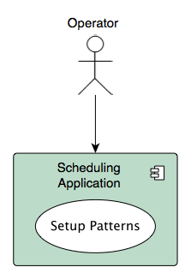
Use Case 1: Setting up Patterns

Slide 7
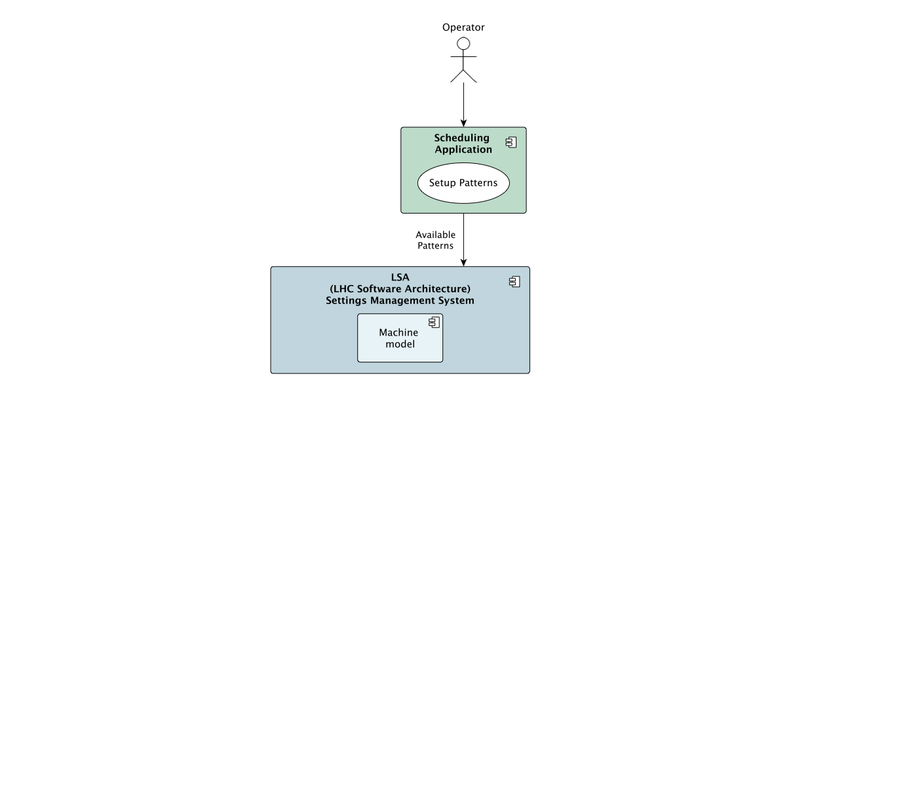

Slide 8
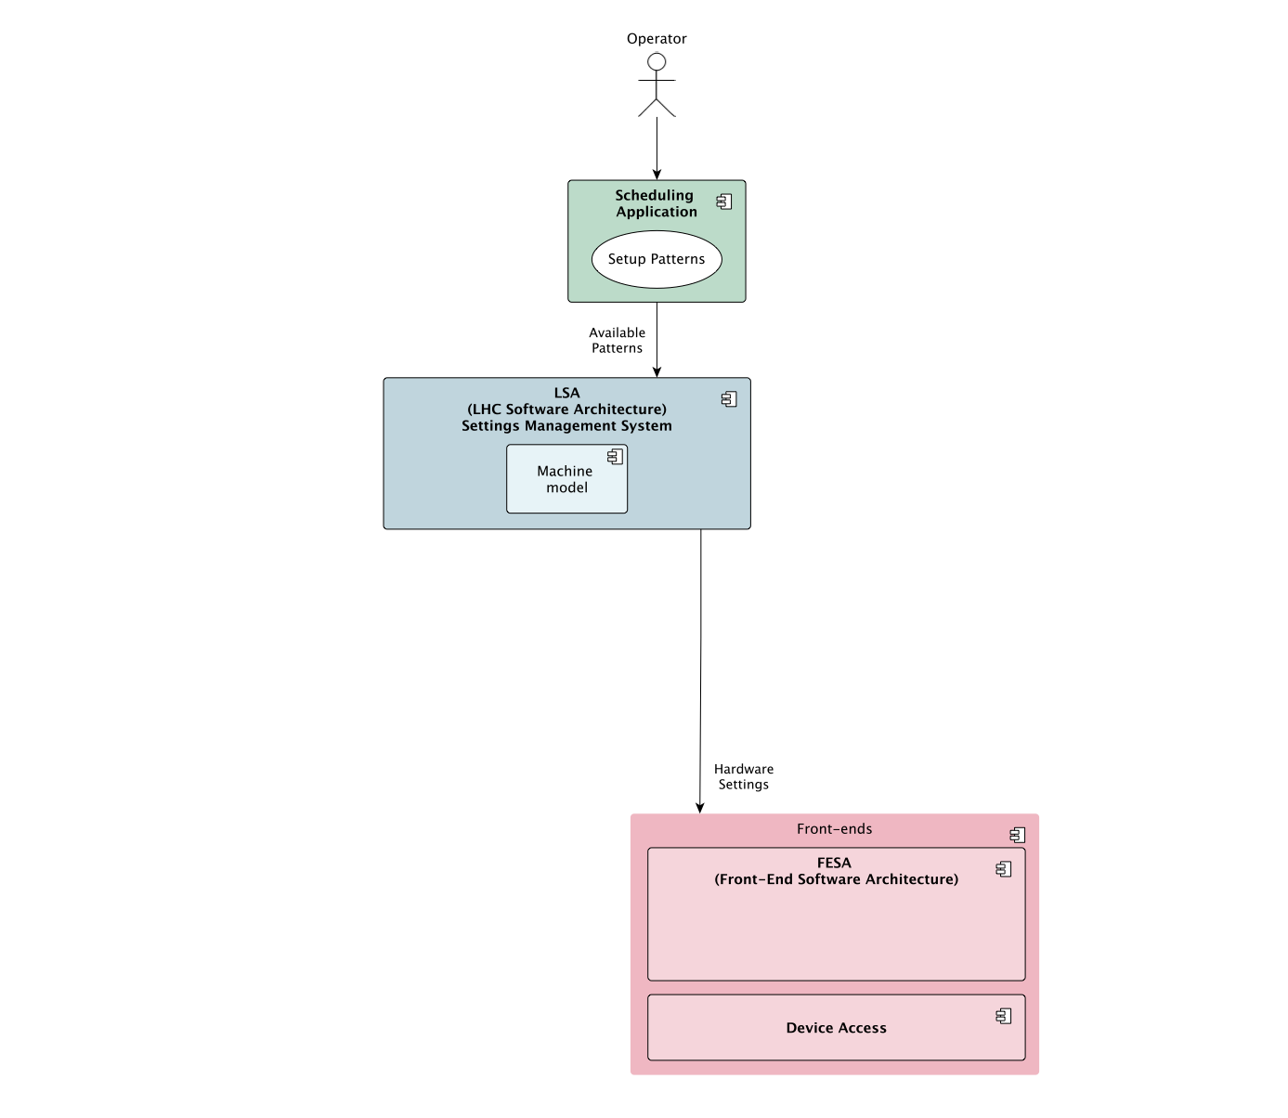

Slide 9
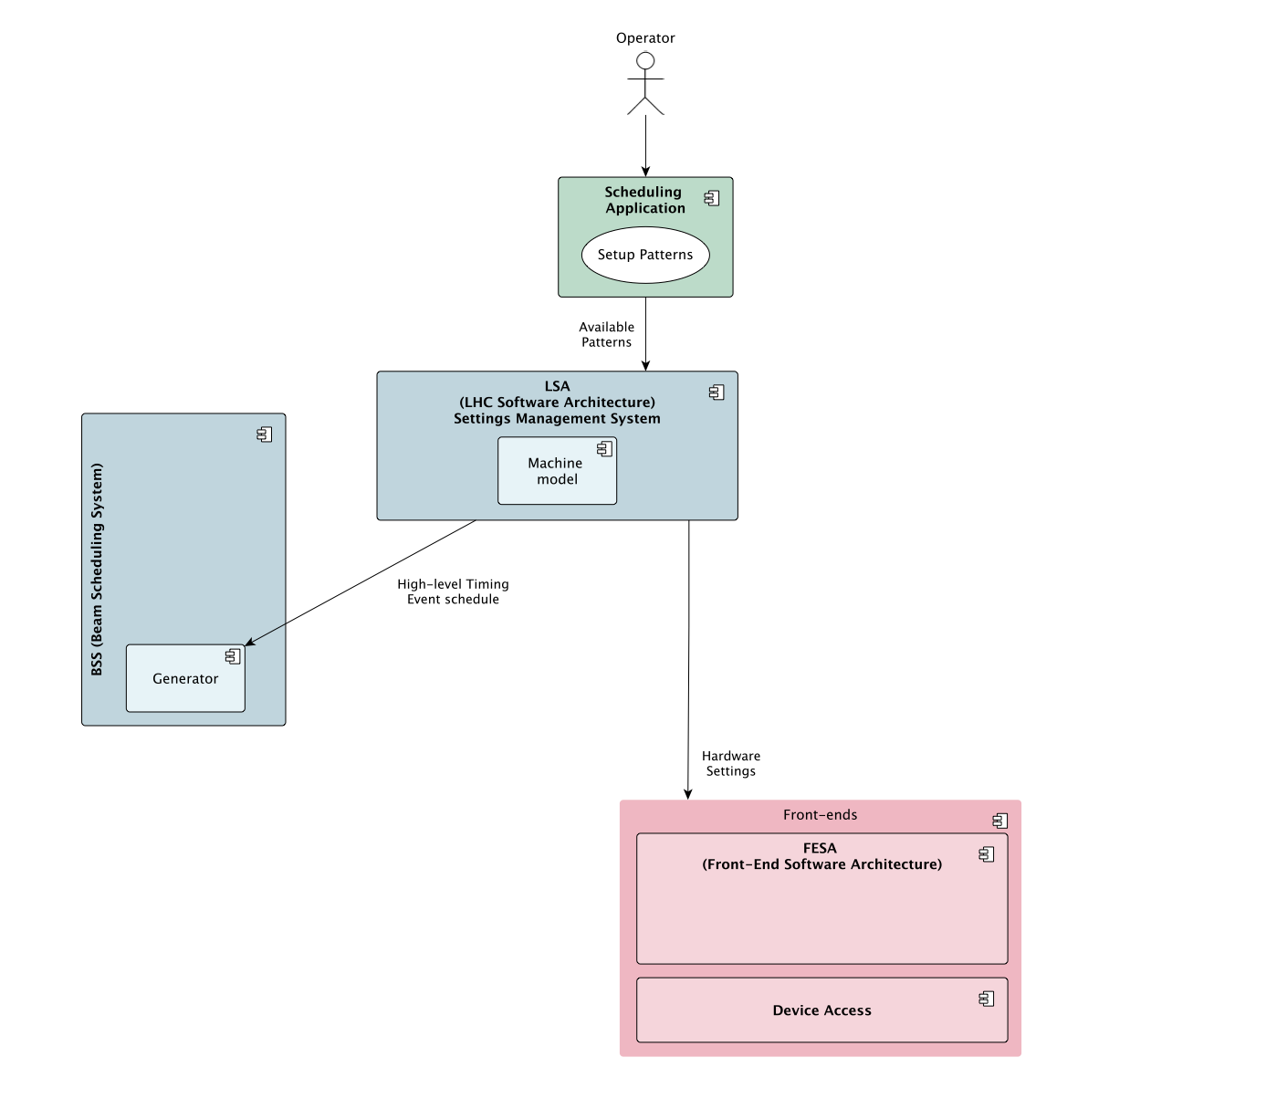

Slide 10
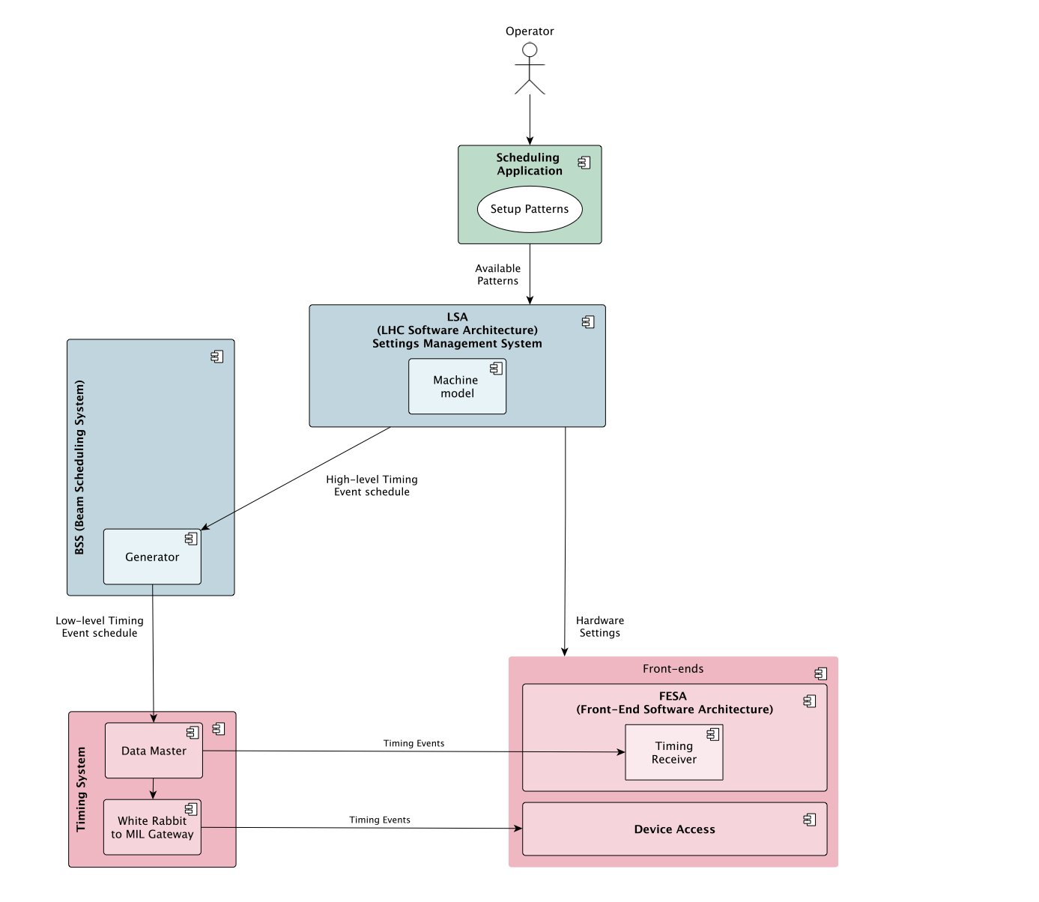

Slide 11
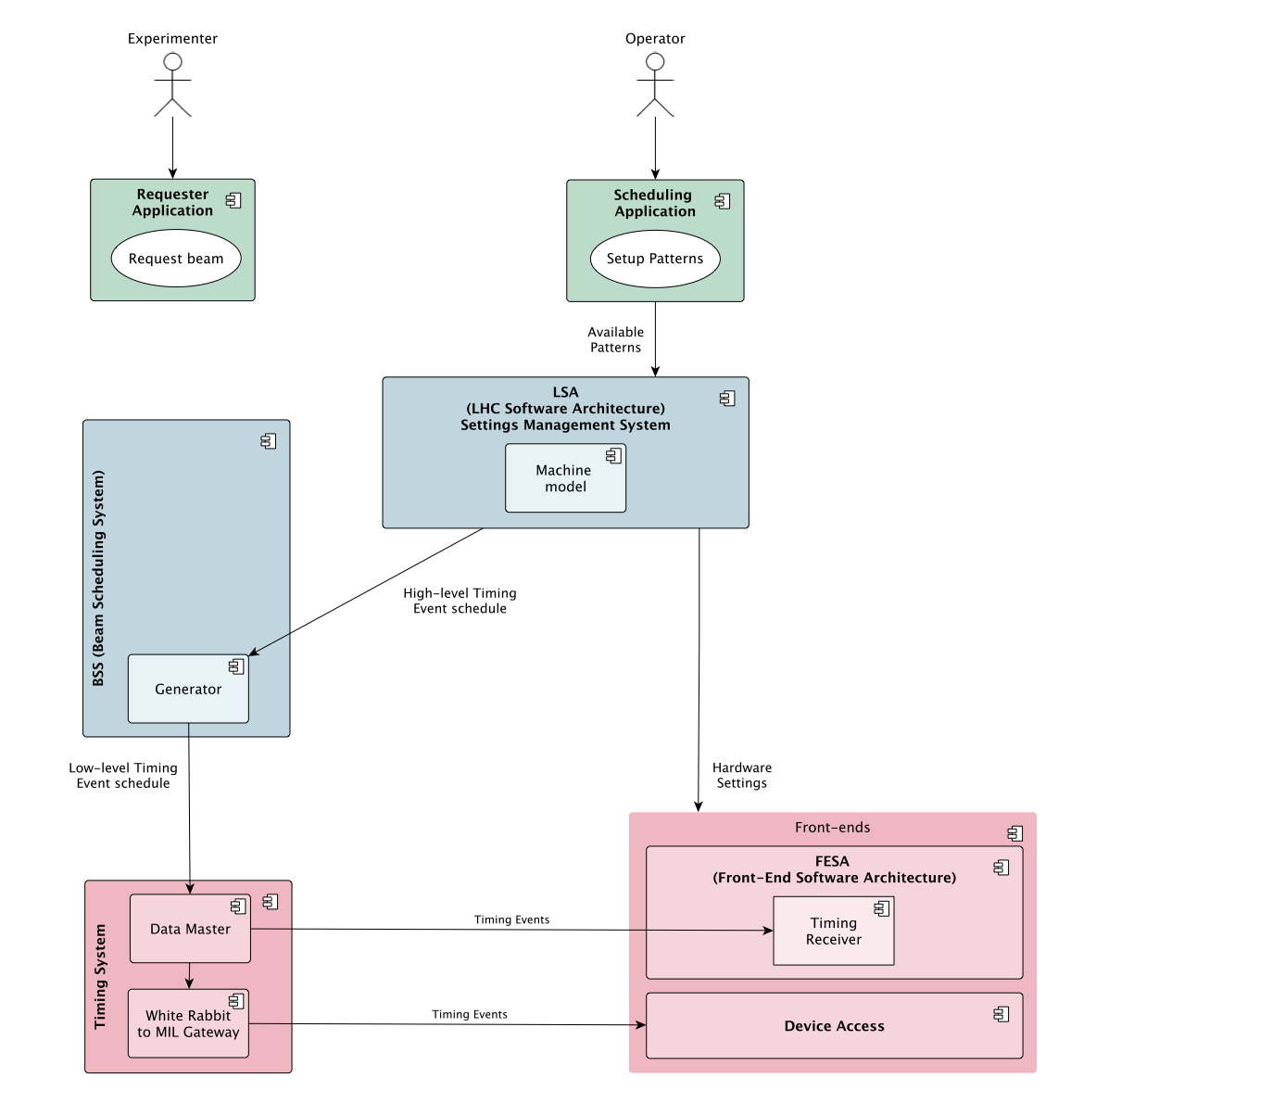

Slide 12
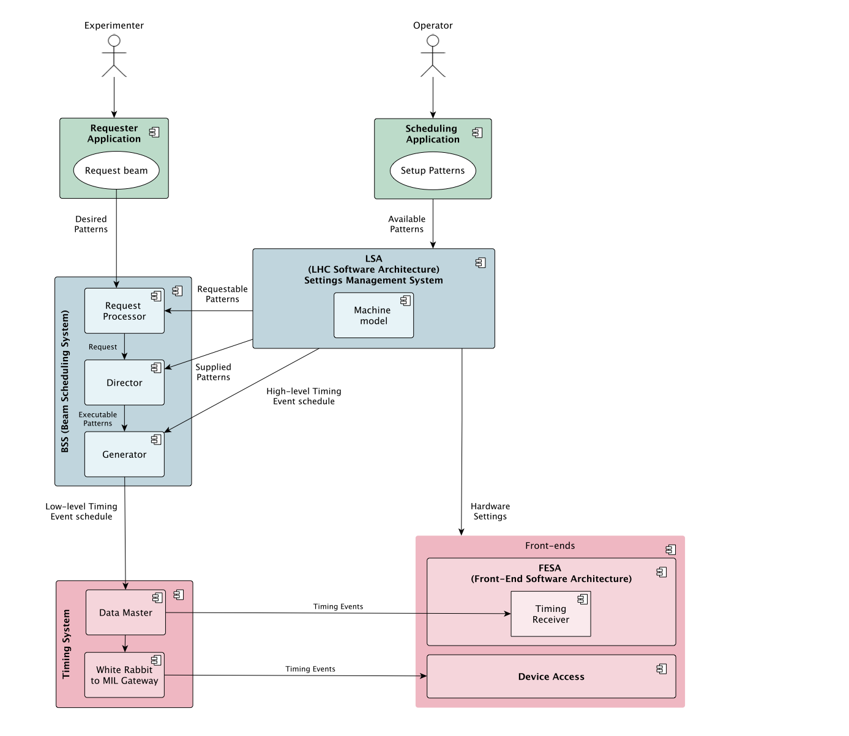

Slide 13
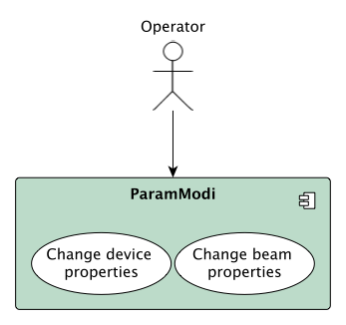
Use Case 2: Changing Settings

Slide 14
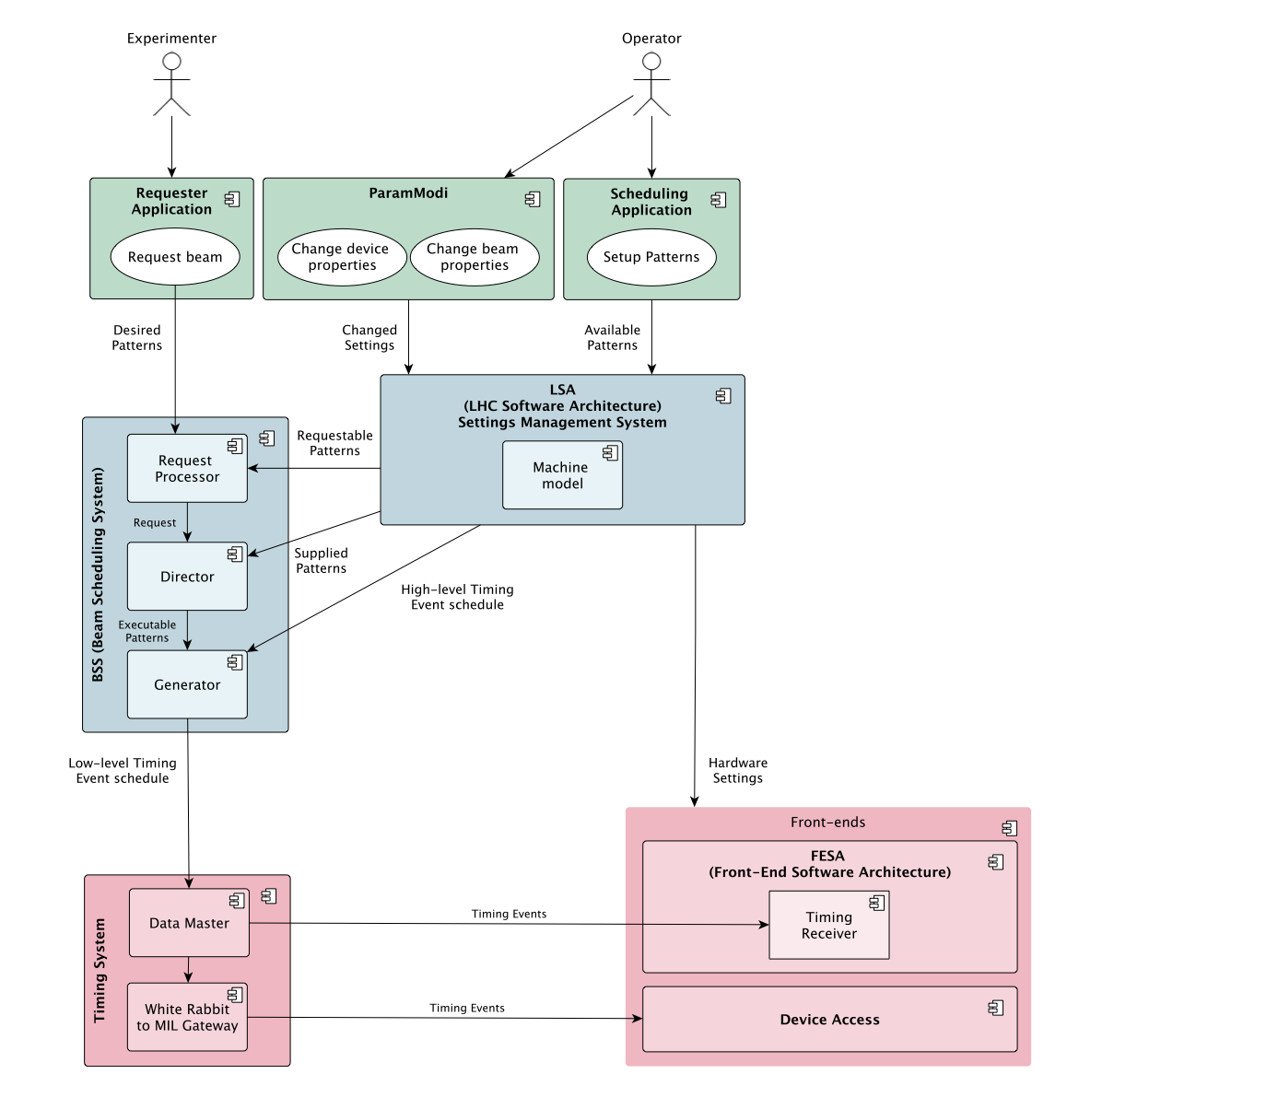

Slide 15
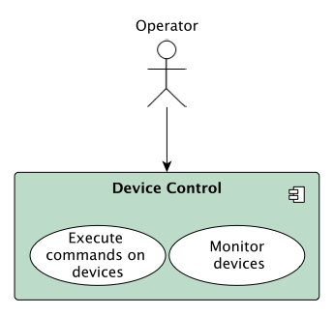
Use Case 3: Device commands and monitoring

Slide 16
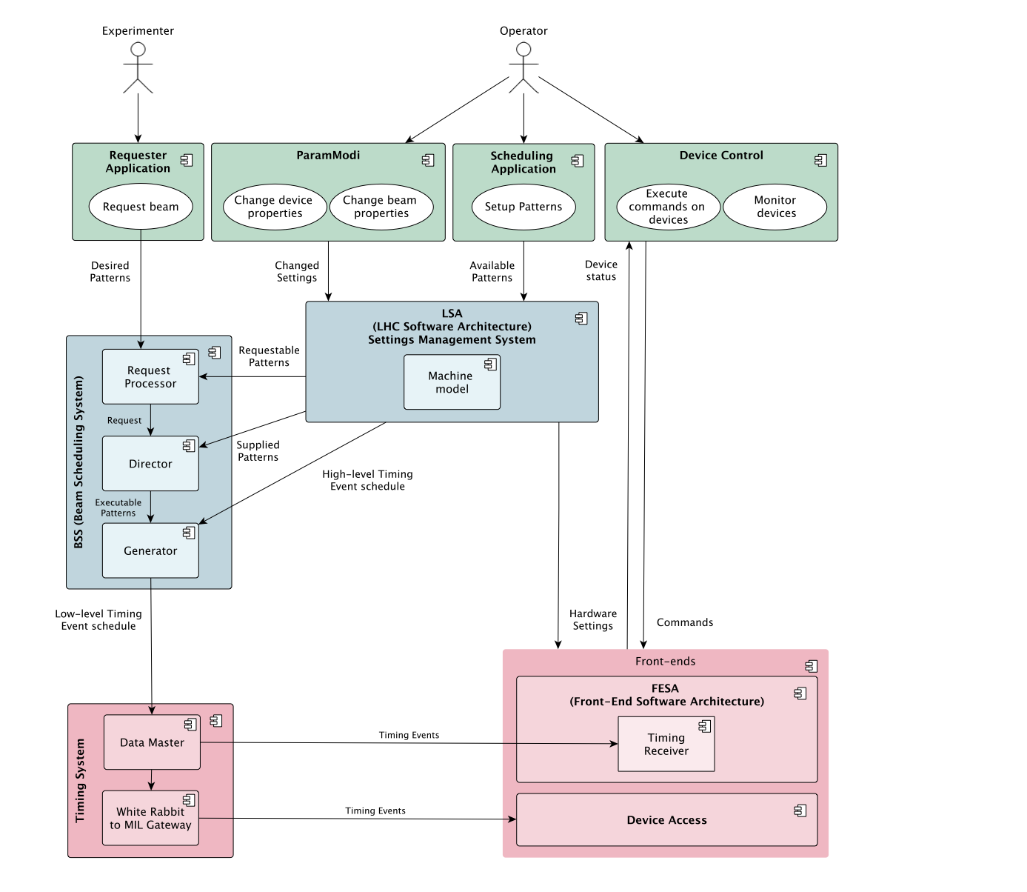

Slide 17
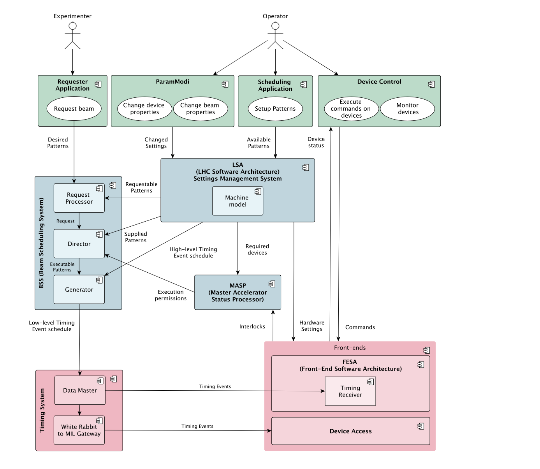

Slide 18
Use Case: Device commands and monitoring

Slide 19
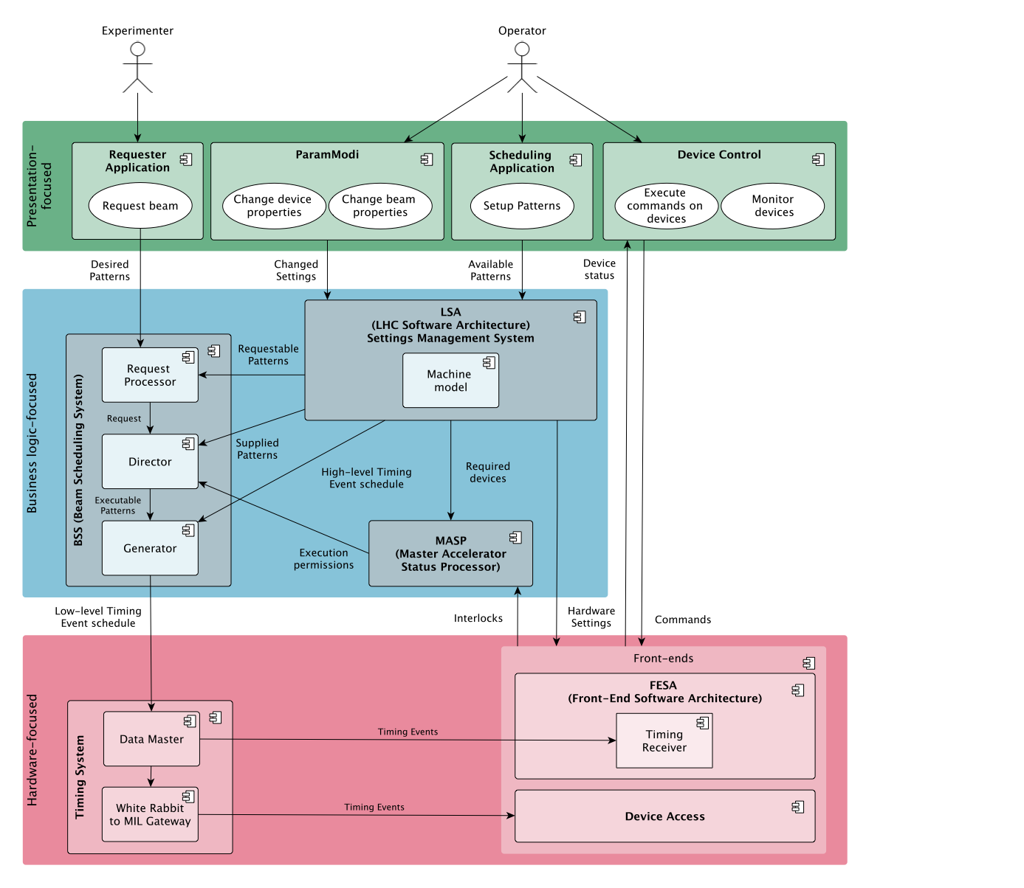

Slide 20
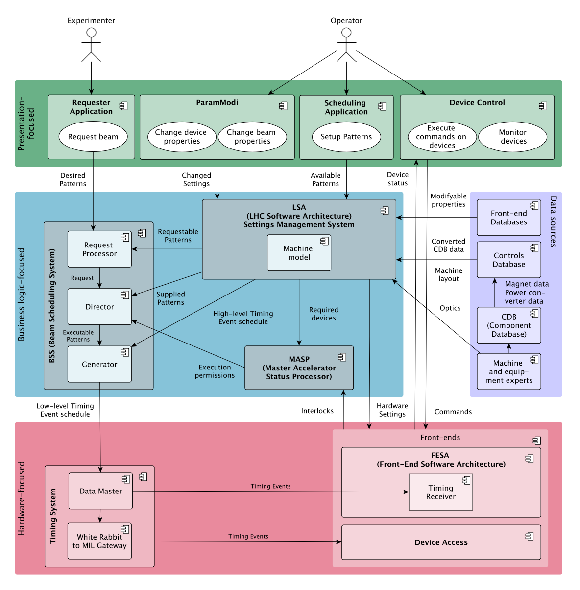

Slide 21
Thank you!
Questions?

