Slide 1
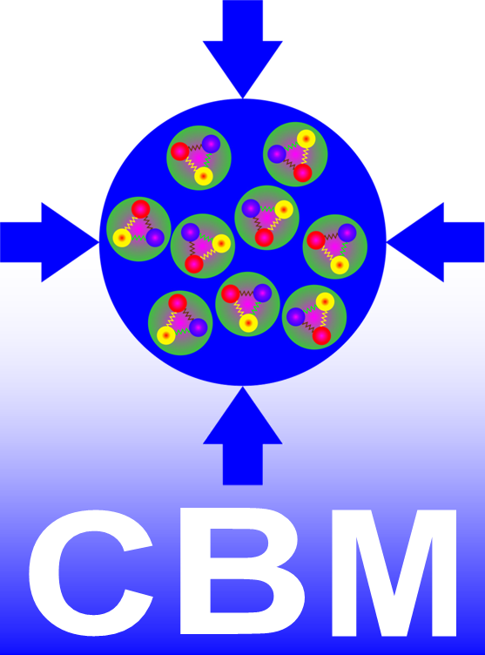
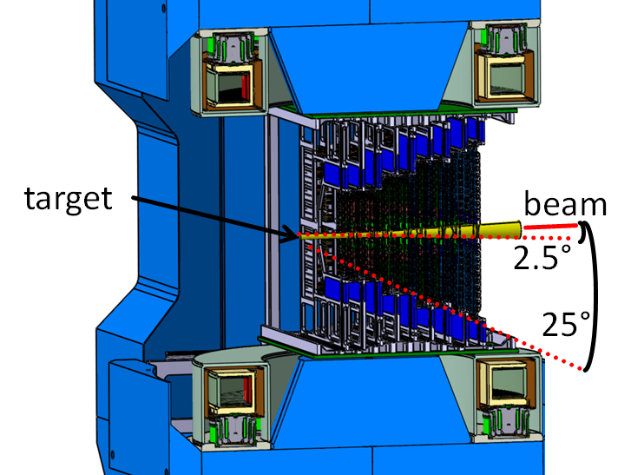
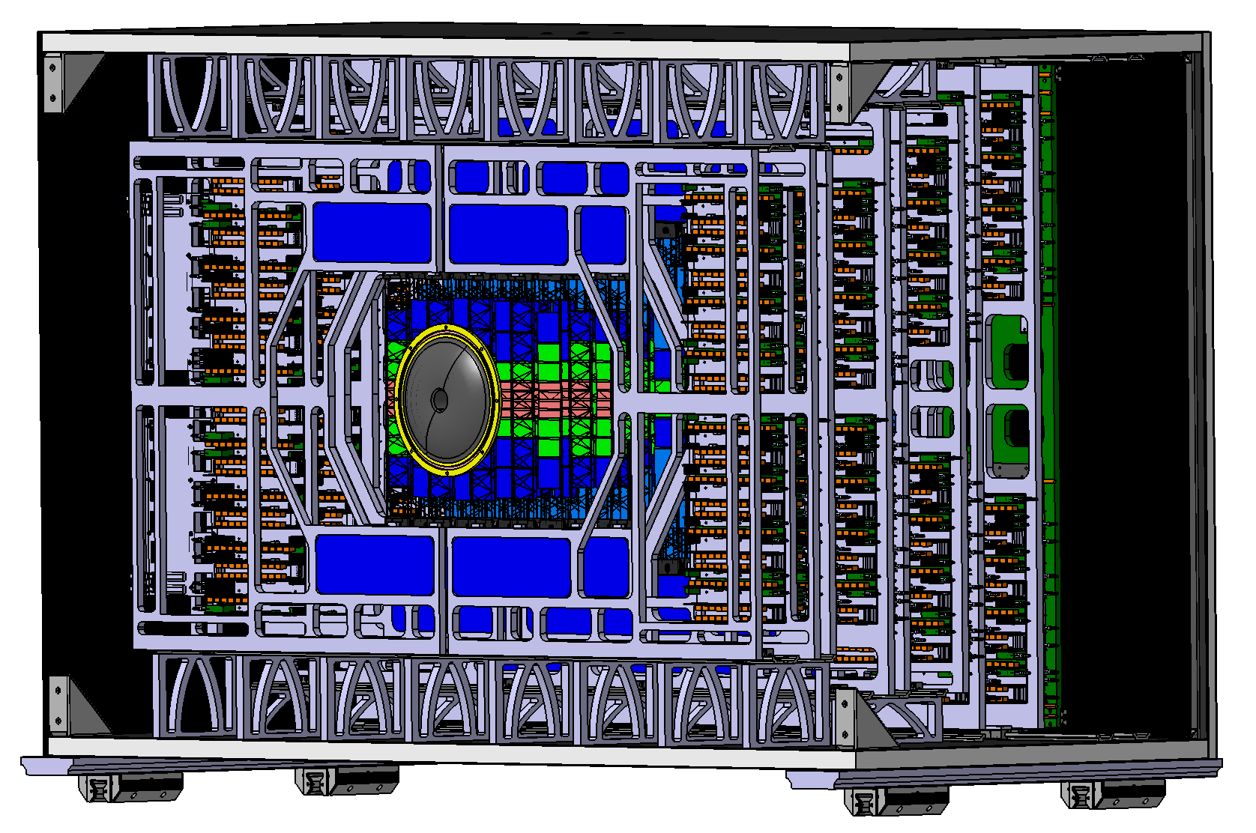
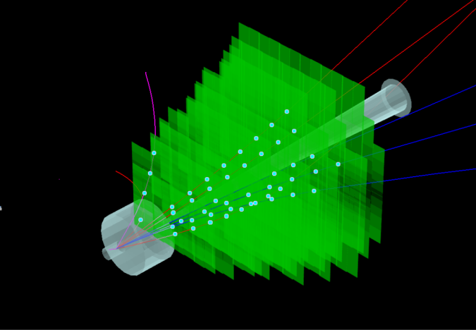
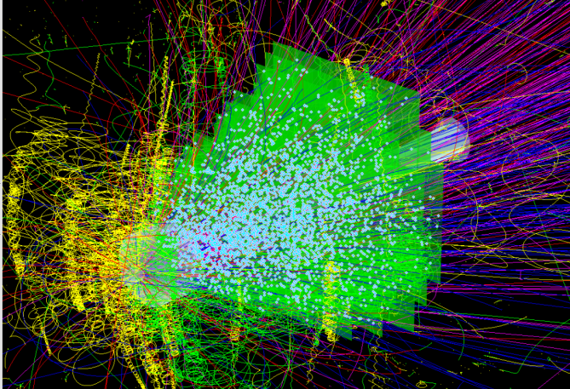
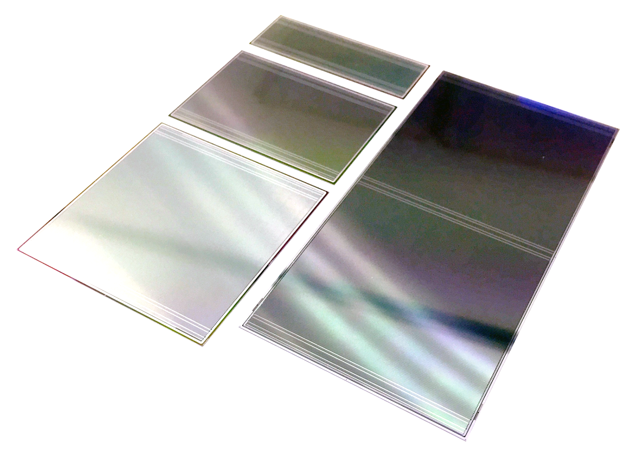
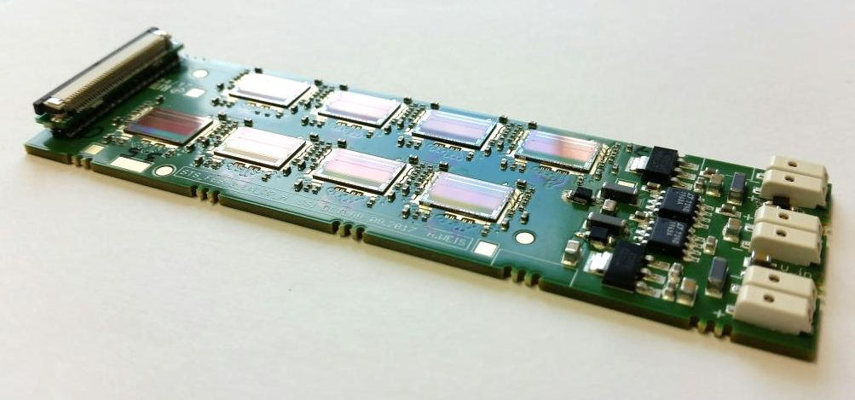
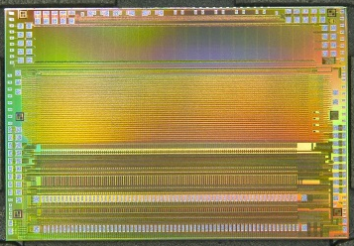
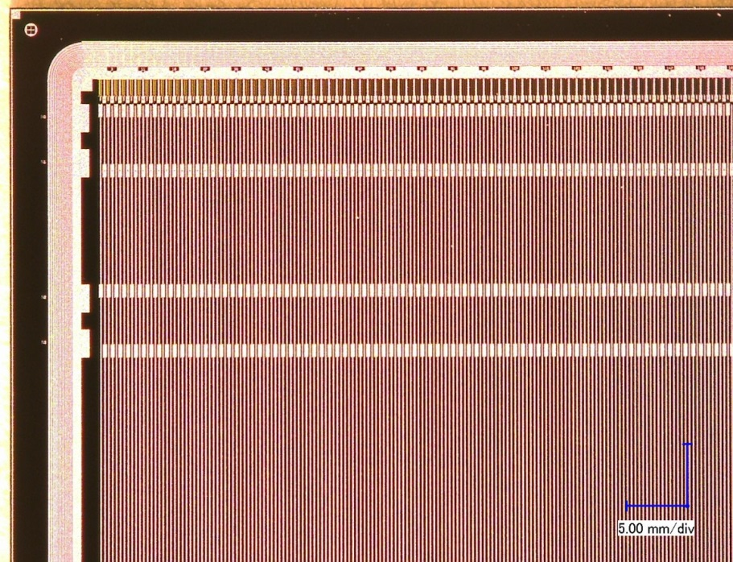
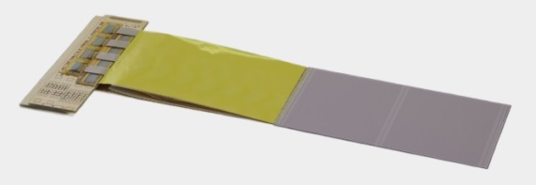
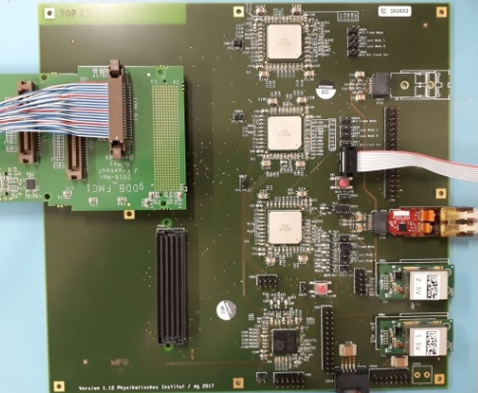
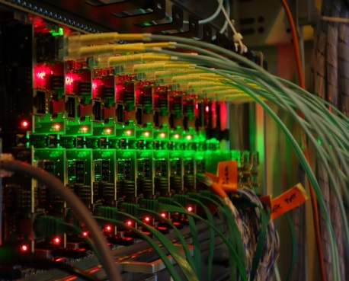
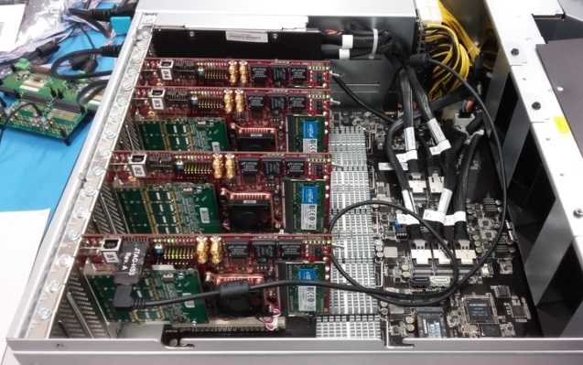
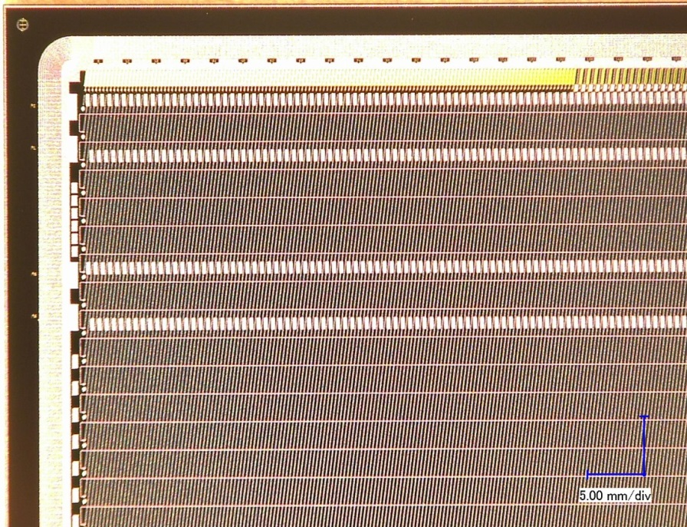
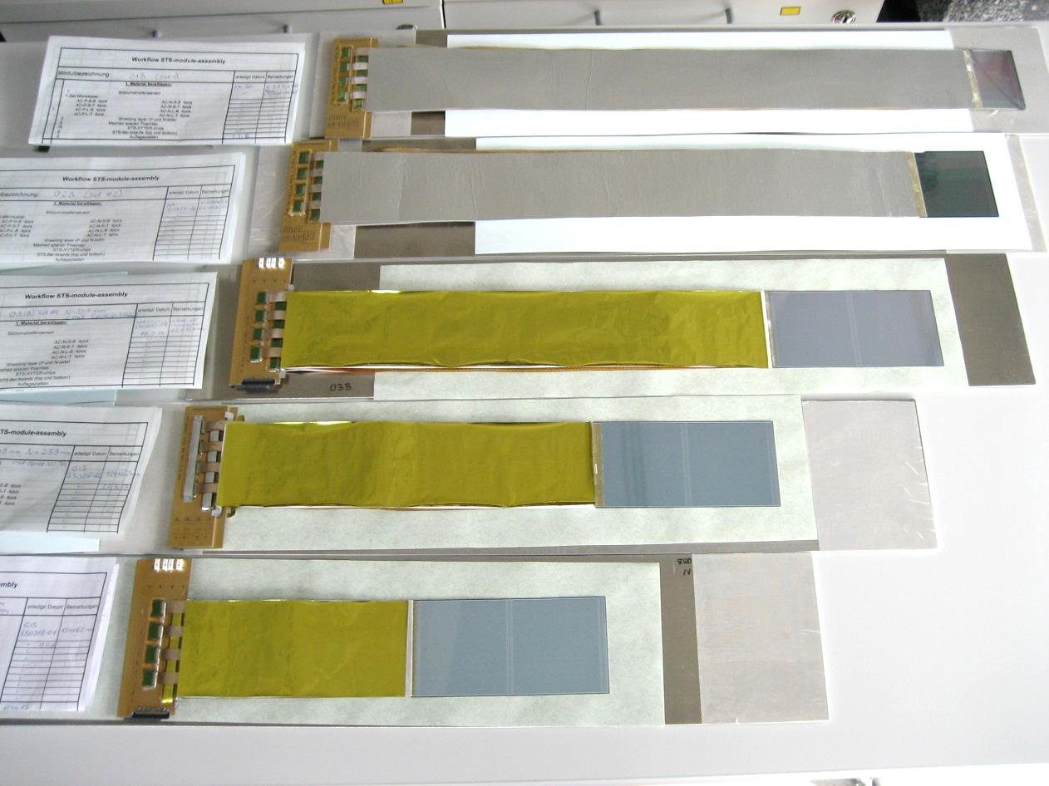
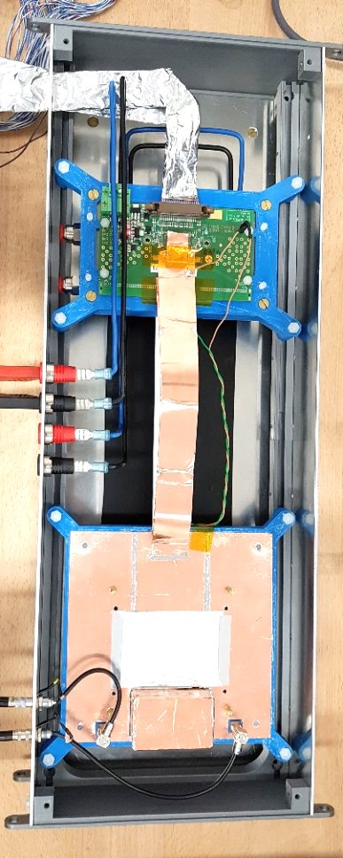
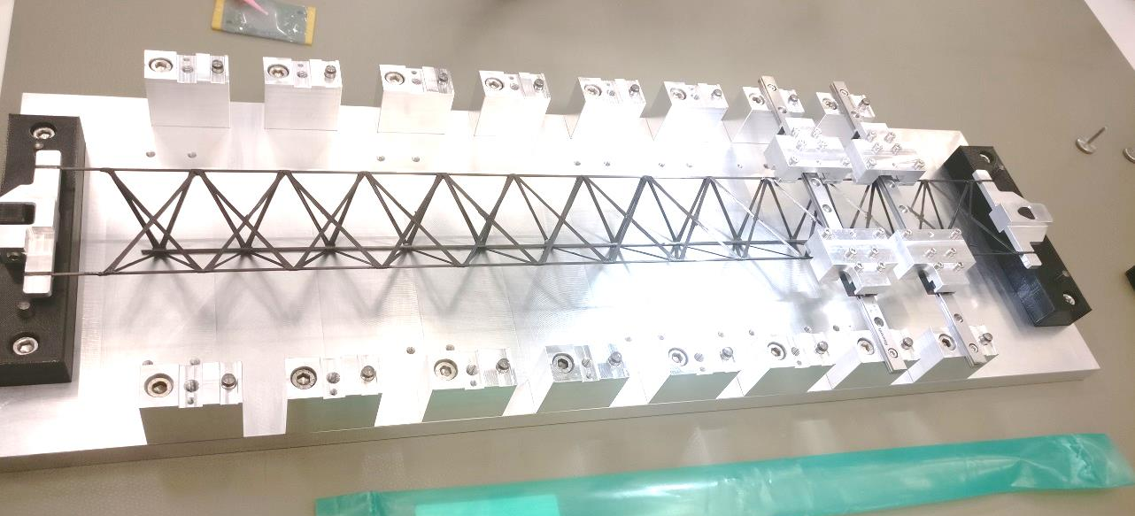
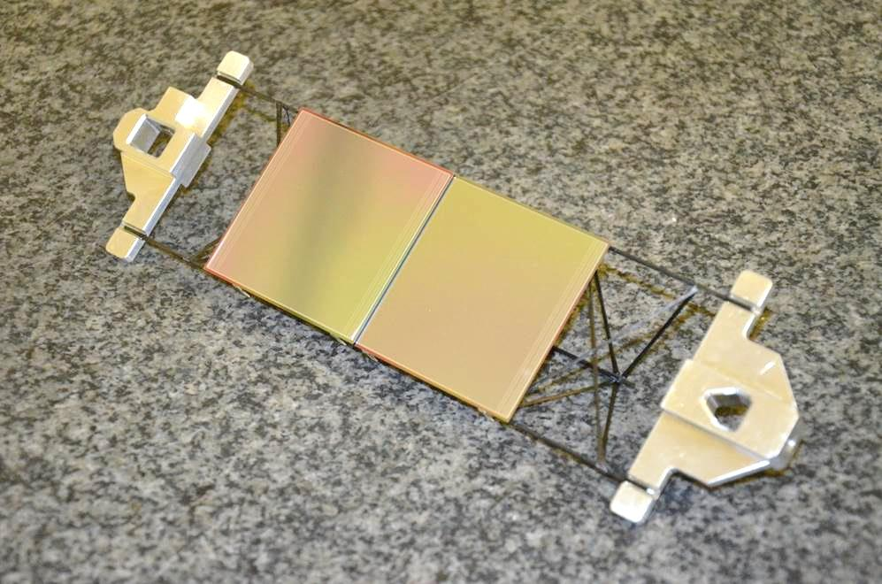
The Silicon Tracking System of the CBM experiment at FAIR
Johann M. Heuser, for the CBM Collaboration
GSI Helmholtz Center for Heavy Ion Research, Darmstadt, Germany
Silicon Tracking System
System Integration
track point measurement in high-rate collision environment: 10⁵ − 10⁷/s (A+A), up to 10⁹/s (p+A)
physics aperture : 2.5° ≤ Θ ≤ 25°, 0.3 m ≤ z ≤ 1.0 m
8 tracking stations
double-sided silicon microstrip sensors
hit spatial resolution ≈ 25 µm
self-triggering front-end electronics
time-stamp resolution ≈ 5 ns
material : ≈ 0.3% – 1.5% X₀ per station
Δp/p ≈ 1.8% (p > 1 GeV/c, 1 Tm field)
system in thermal enclosure
sensors at -5 °C
cooling of electronics
with bi-phase CO₂
front-end electronics board in cooling box
896 modules
sensor
ultra-thin r/o cables
C-frame
material budget [ % X₀ ]
Silicon Tracking System in Dipole Magnet
p+C, 29 GeV
central Au+Au, 8 A GeV
read-out + power electronics
2 x 4/5 modules on CF support
UrQMD + GEANT + CbmRoot
8 tracking stations
18 mechanical half-units
106 ladders
Silicon Microstrip Sensors
Read-out Electronics
285/320 ± 15 µm thick
n-type silicon
double-sided segmentation
1024 strips of 58 µm pitch
strip length 2/4/6/12 cm
angle front/back: 7.5°/0°
read-out from top edge
double-metal routing on p-side
radiation tolerance 1 × 10¹⁴ n_{eq} (1 MeV) /cm², 1 Mrad
read-out chain for miniSTS
STS-XYTER v2.0 ASIC 8 × on FEB-8
STS modules
Common
GBTx
Readout Board
μTCA crate
with AFCK
boards
FLES input node
with FLIB
boards
Compressed Baryonic Matter experiment at FAIR
prototypes developed and produced: CiS/ Germany, Hamamatsu/Japan
6.2 x 2.2 cm²
6.2 x 4.2 cm²
6.2 x 6.2 cm²
6.2 x 12.4 cm²
copper link (~1 m)
optical link (~50 m)
optical link (~300 m)
CBM06
0.5 mm/div
on detector
in DAQ room
in “Green Cube” computing center
Modules and Ladders
Demonstrators
module assembly
prototype modules
test at COSY, Feb. 2018
proton beam, 1.7 GeV/c
sensor 285 µm thick
128 channels /side read out
microcable 25 cm long
miniSTS
in demonstrator experiment miniCBM at GSI/SIS18
operation 2018 - 2021
2 tracking stations
13 modules
5 half-ladders
GBT read-out
FLESin DAQ node
tab-bonding of Al-polyimide cables between ASICs and sensor
performance:
noise: 1090 ±150 e (n) 1350 ±200 e (p)
r/o threshold: 7000 e
signal mean: 16720 e (n) 20300 e (p)
signal-to-noise: 15±3
hit detection eff.: > 95%
ladder assembly
assembly procedure defined and tested on mechanical dummy modules
verification of :
ASIC under load
system aspects
data transport
tracking
miniSTS design
mounting of modules onto low-mass carbon-fiber supports
STS Project Timeline
sensor position precision ± 40 µm
Production Readiness : Nov. 2018
Detector construction 2019 – 2022
Detector ready for installation: 2023
Assembly Centers: GSI-FAIR, JINR-VBLHEP

