Slide 1
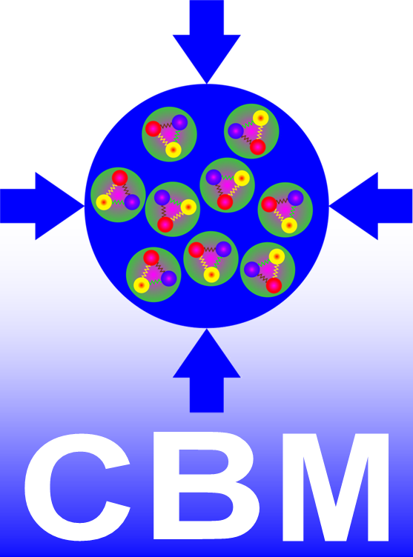
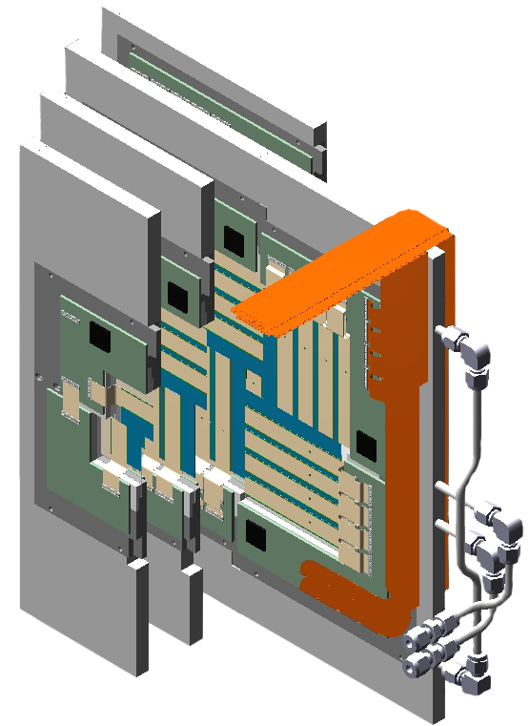
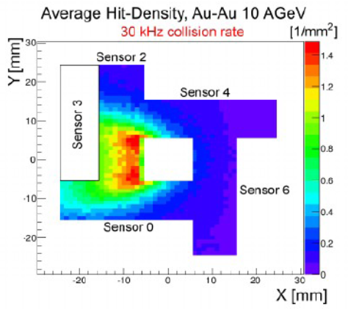
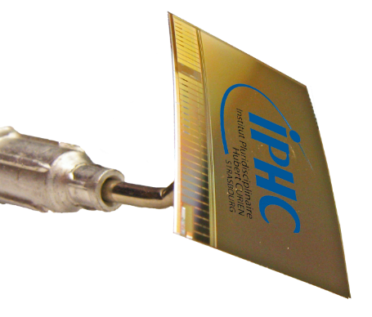
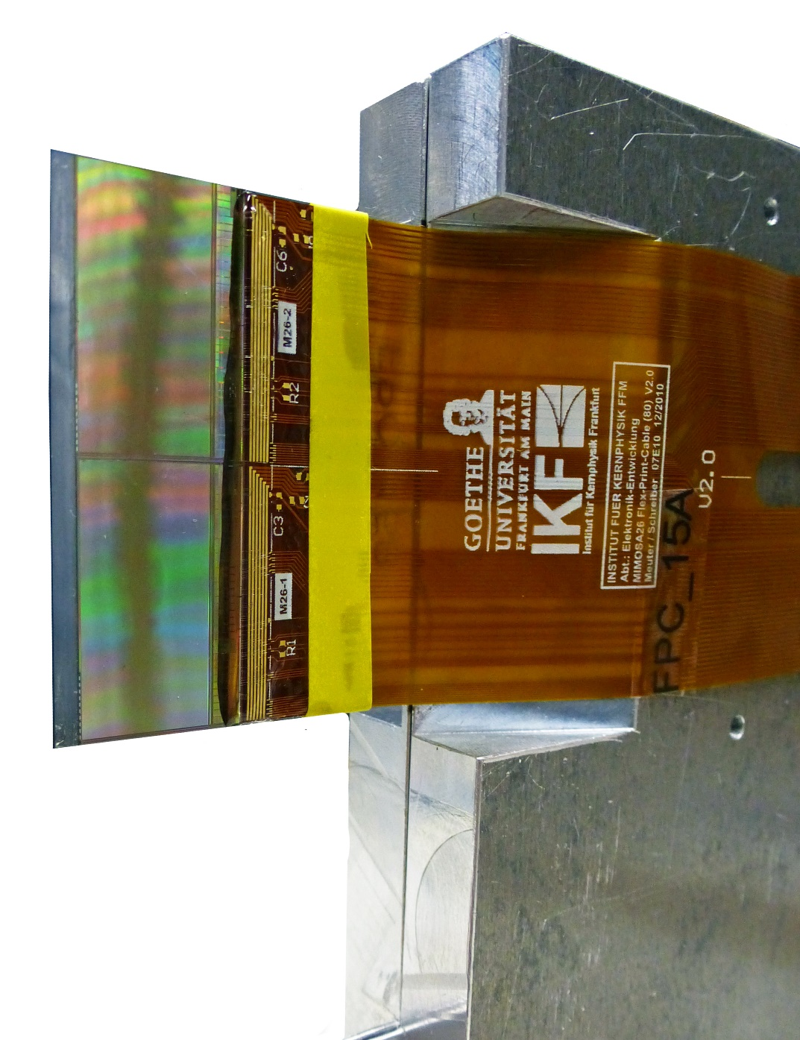
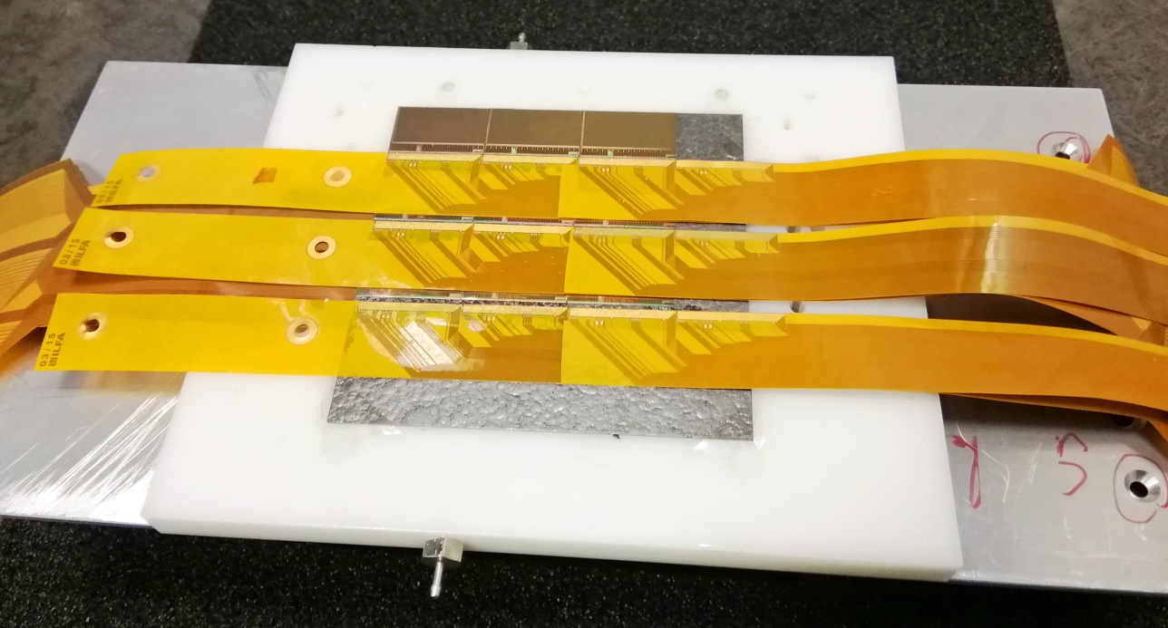
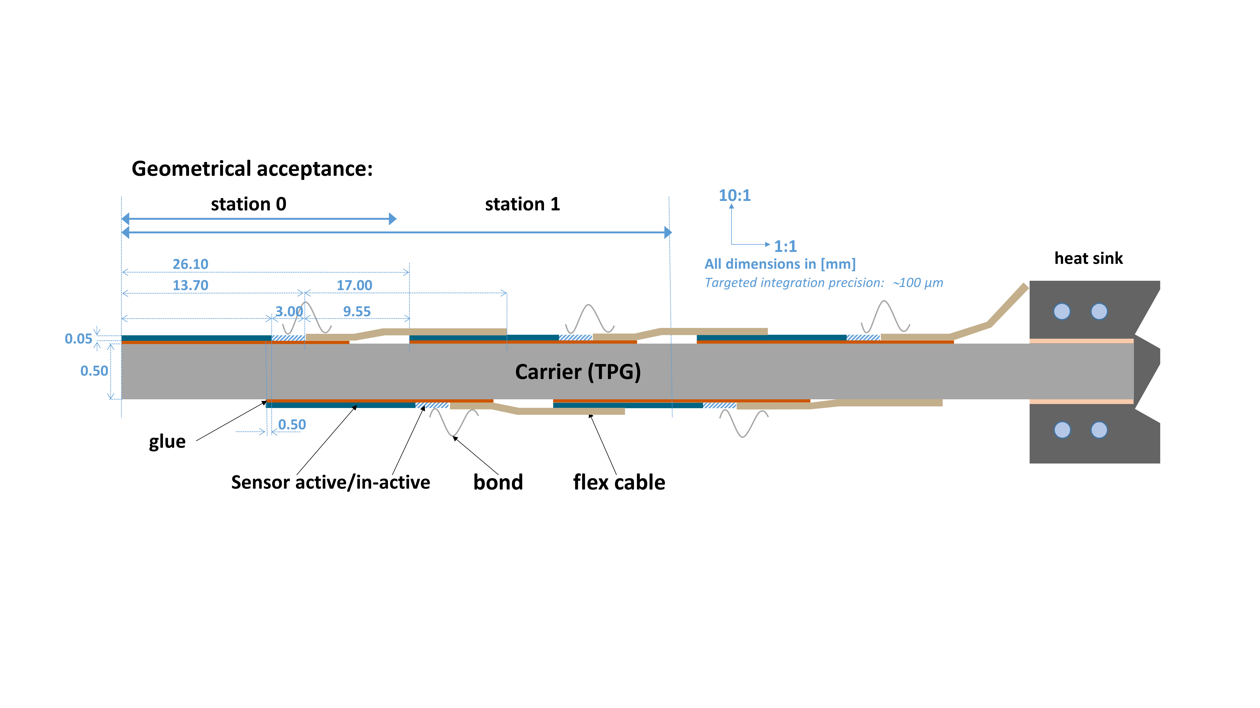
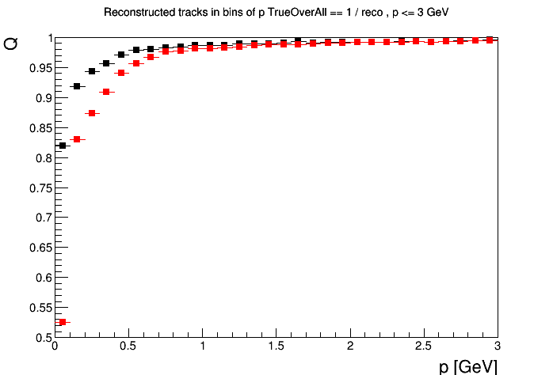
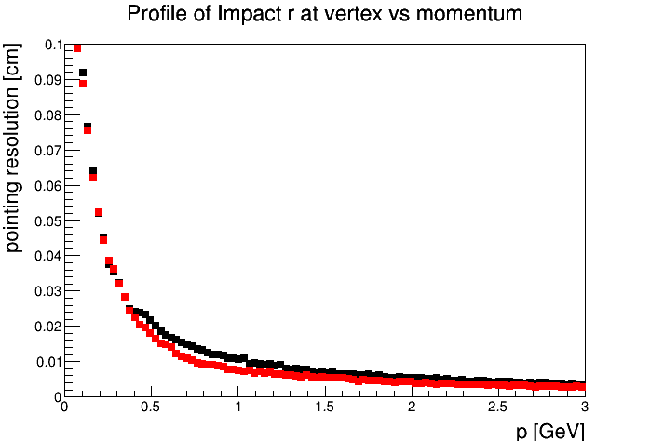
News from the Micro Vertex Detector of CBM
Philipp Sitzmann¹ for the CBM-MVD Collaboration²
¹ Goethe Universität Frankfurt, Germany
²Goethe Universität Frankfurt, Germany / Pusan National University (PNU), Korea / IPHC Strasbourg, France
The Micro Vertex Detector (MVD) of CBM
The task of the MVD) of CBM
Open Charm reconstruction → Provide ~50 μm sec. vertex reconstruction.
Support e⁺/e⁻ spectroscopy → Provide excellent low momentum tracking.
Charged $Σ$ reconstruction in HIC (first time)
Operate at 100 kHz Au+Au (10 AGeV) and 10 MHz p+Au (30 GeV)
The technological challenge
Delta electrons from target
Needs ultra thin (0.3% X₀) stations.
Operation in target vacuum needed.
High track density (700 kHz/mm² peak)
High radiation load:
- $3×{10}^{13} n_{eq}/cm²$
- $3 Mrad$
X
Beam
Hit density on first station
Beam
Sensors
The sensor technology
CMOS Monolytic Active Pixel Sensor
Excellent compromise between high precision
tracking and high rate capability.
Used in STAR/HFT and ALICE/ITS (upgrade).
Dedicated sensor required for CBM (MimoSIS):
The CBM Micro Vertex Detector
 | ALICE ALPIDE (demonstrated) | MimoSIS (design goal) | Improvement factor
Pixel count | 512 x 1024 | 504 x 1024 | ok
Pixel pitch | 29.2 μm x 26.9 μm | 30.2 μm x 26.8 μm | ok
Spacial resolution | < 5 μm | < 5 μm | ok
Time resolution | 5 - 10 μs | ~5 μs | ok
Radiation load TID | 500 krad | 3 Mrad | x 6
Radiation load NIEL | 1.7 x 10¹³n_{eq}/cm² | 3 x 10¹³n_{eq}/cm² | x 2
Peak hit rate | > 12 kHz/mm² | 700 kHz/mm² | x 56
Results of prototyping
Compressed Baryonic Matter experiment at FAIR
M.Koziel et.al., NIM A 732 (2013) P. 515
M.Koziel et.al., NIM A 845 (2017) P. 110
The integration concept
MVD - Prototyp
PRESTO
(2nd gen. Prototype)
Place sensors on carbon based cooling support
Evacuate dissipated power to liquid cooled heat sink outside of acceptance
Integration feasible.
Excellent tracking performance > 99% det.eff.
(with Mimosa26 @ CERN SPS)
Long term vacuum operation under study
Tracking performance simulations
Aim - Test MVD geometry options
Results
station @ 5 cm
expect improved IP resolution,
tracking complicated by high track density.
first station @ 8 cm
reduced track density expect robust tracking
expect reduced pointing resolution
Q$=\frac{reconstructedtrackswithperfectMCmatch}{reconstructedtracks}$
Region of interest
Particles rejected in
open charm reconstruction
Region of interest
Poor geometrical acceptance
Simulation details:
50 primary Pions/event (white spectrum)
Full delta electron background
CBMRoot standard geometry
L1-Trackfinding and Kalman filter applied
Conclusion: Both geometries provide robust performances.
Next step: Full physics case simulation

