Slide 1
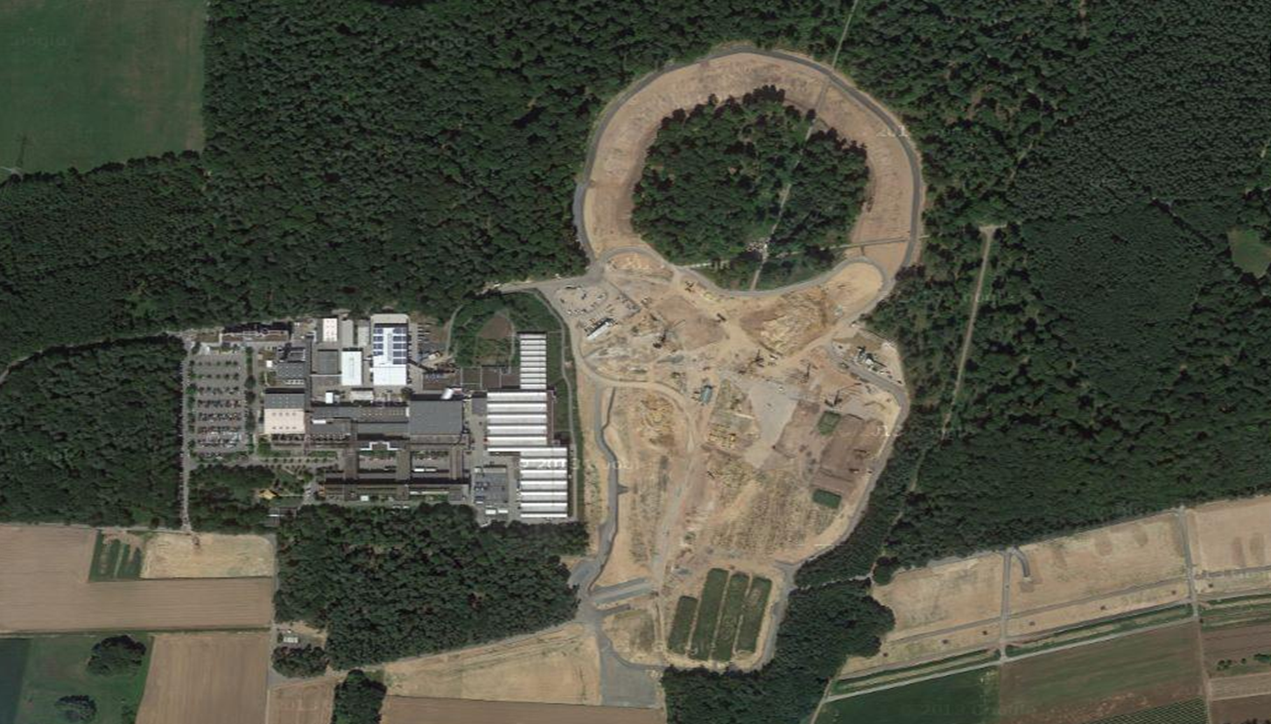

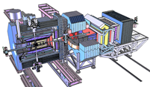
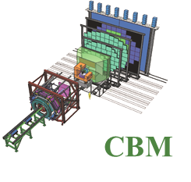
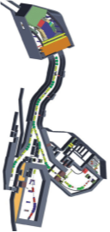
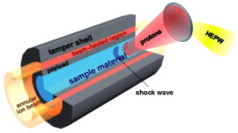
Facility for Antiproton & Ion Research
Experimental programs:
FAIR construction status April 2018
APPA: Atomic & Plasma Physics & Applications
➢ Highly charged atoms
➢ Plasma physics
➢ Radiobiology
➢ Material science
SIS18
SIS100/300
p-Linac
Peter Senger, GSI
Compressed Baryonic Matter
HESR
CBM: Nucleus-nucleus collisions
➢ Nuclear matter at neutron
star core densities
➢ Phase transitions from
hadrons to quarks
Anti-Proton Physics
Super Fragment-Separator:
Nuclear Structure and Astrophysics
NUSTAR: Rare Isotope beams
➢ Nuclear structure far off stability
➢ Nucleosynthesis in stars and supernovae
CR
PANDA: Antiproton-proton collisions:
➢ Charmed hadrons (XYZ)
➢ Gluonic matter and hybrids
➢ Hadron structure
➢ Double Lambda hypernuclei
FAIR phase 1
FAIR phase 2
100 m
1

Slide 2
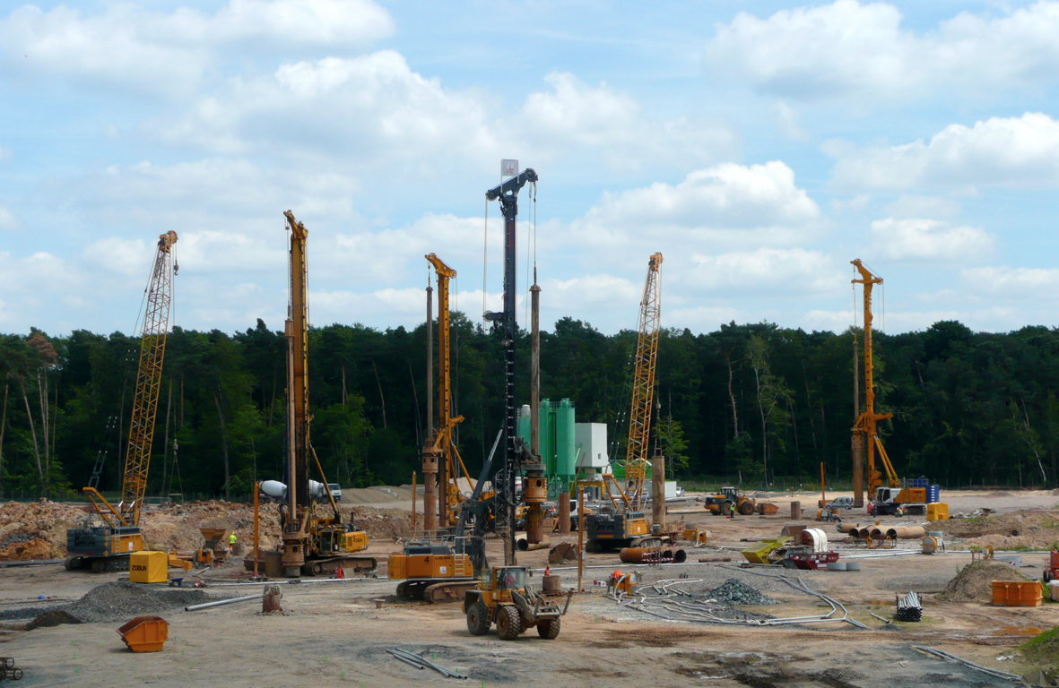
Civil construction (Status 2014)
The four most powerful drilling machines worldwide put down 1350 reinforced concrete pillars of 60 m depth and 1.2 m diameter.

Slide 3
3

Slide 4
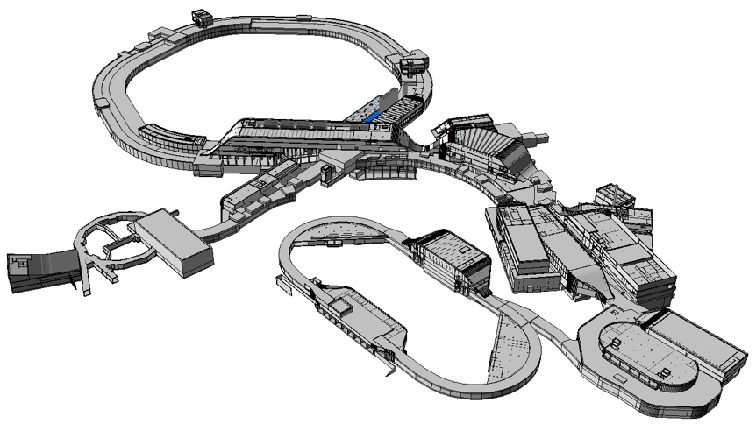
FAIR Civil Construction
Synchrotrons: 1.1 km
HESR: 0.6 km
With beamlines: 3.2 km
Existing SIS 18
Total area > 200 000 m²
Area buildings ~ 98 000 m²
Usable area ~ 135 000 m²
Volume of buildings ~ 1 049 000 m³
Substructure: 1350 pillars, 60 m deep

Slide 5
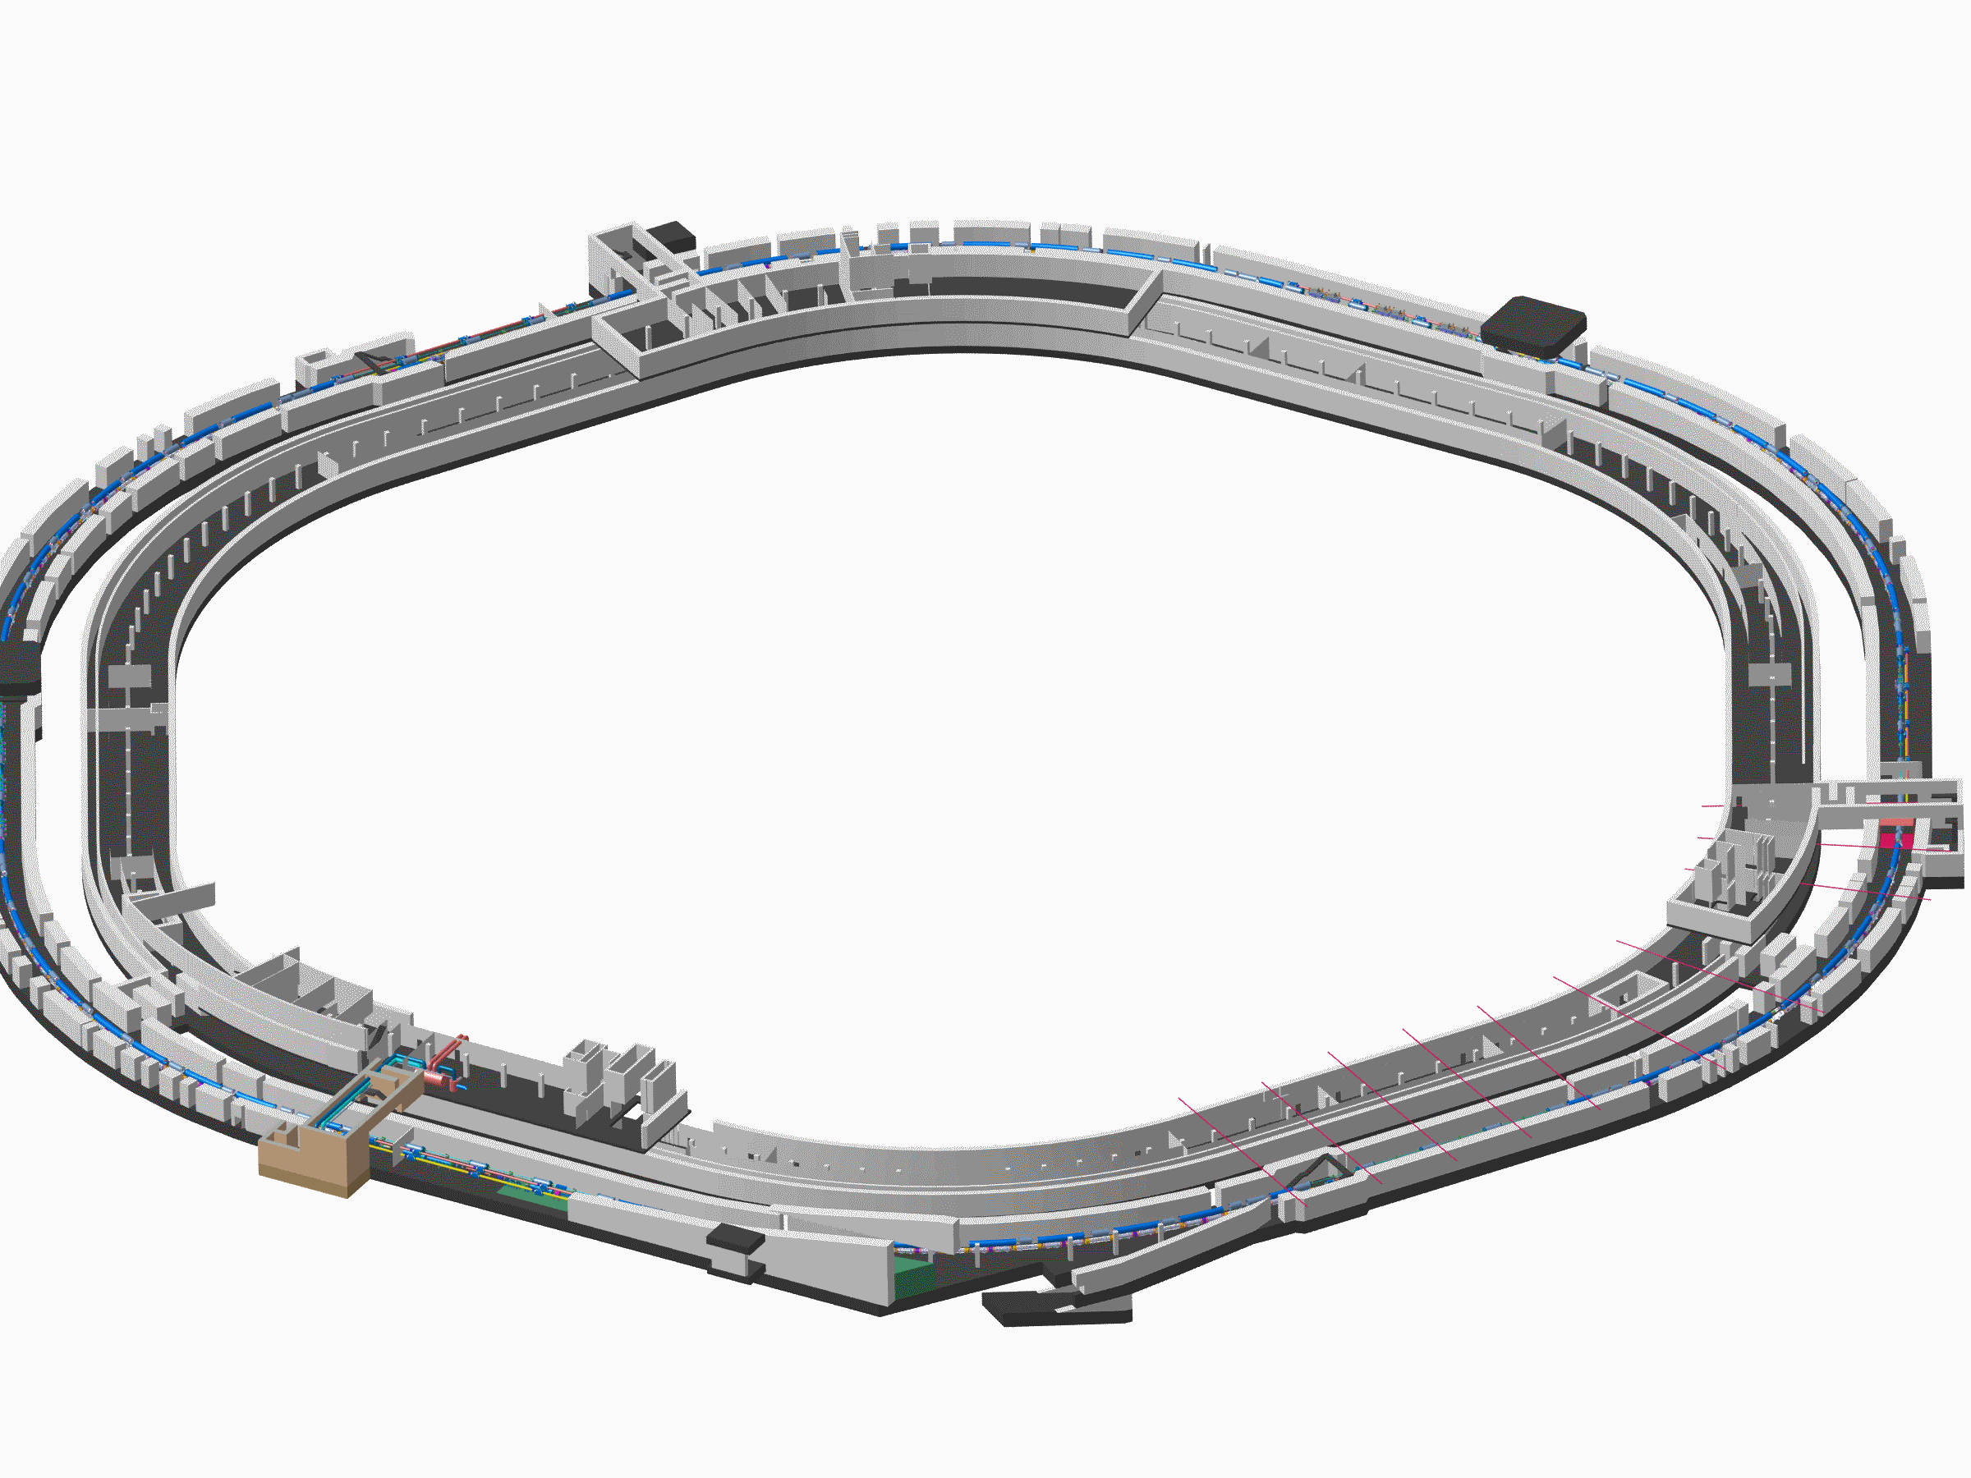
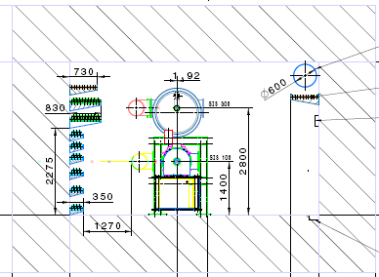
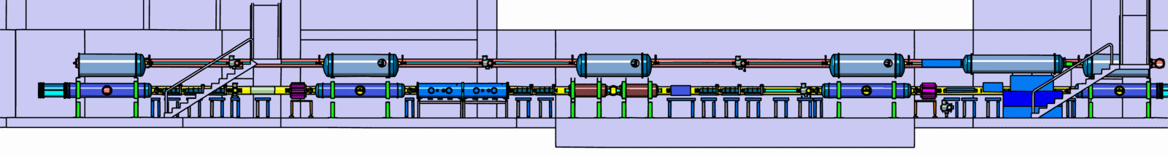
Tunnel for SIS100/300

Slide 6
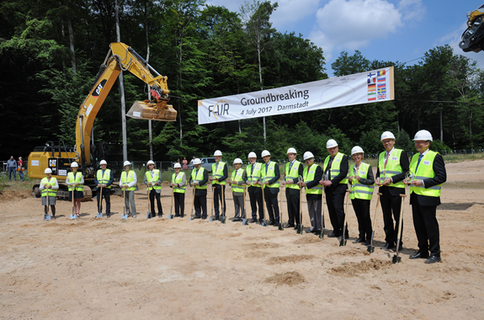
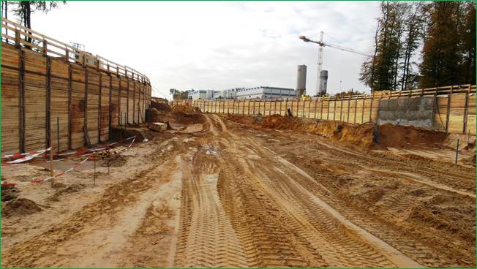
FAIR Project Status 2018
Successful restart in 2015 and 2016
Start of excavation and trench sheeting in July 2017
Civil construction Area North, i.e. SIS-100 tunnel plus adjacent buildings including the CBM building, has been awarded on January 29th 2018.
Shell construction will start mid 2018.
Completion of all buildings by 2022
Full integrated planning for construction and commissioning
of the entire project: Completion of the full FAIR facility by 2025.
Ground breaking - 4 July 2017
Excavation SIS100 tunnel - Nov 2017

Slide 7
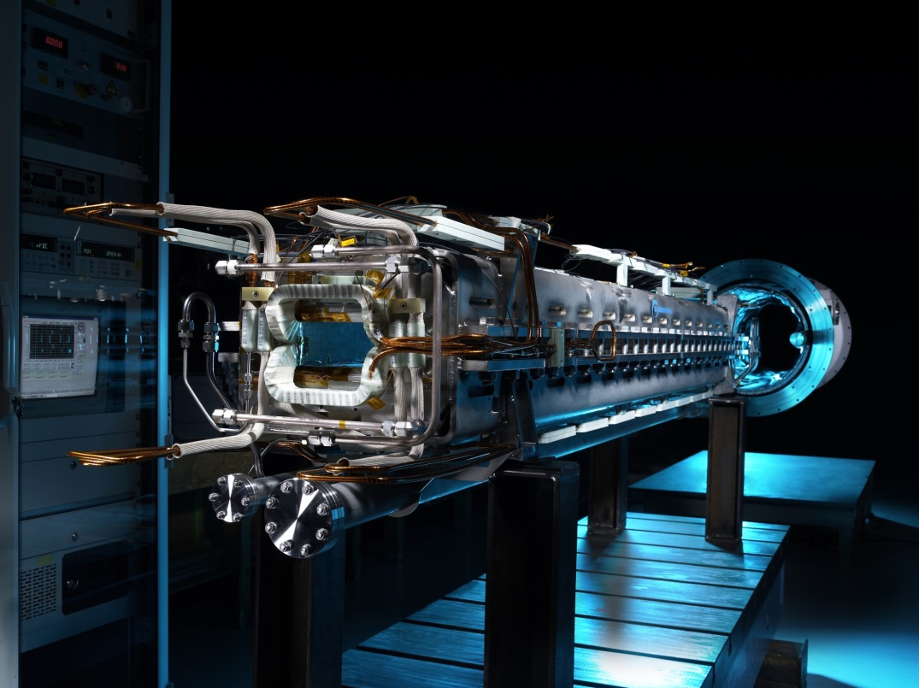
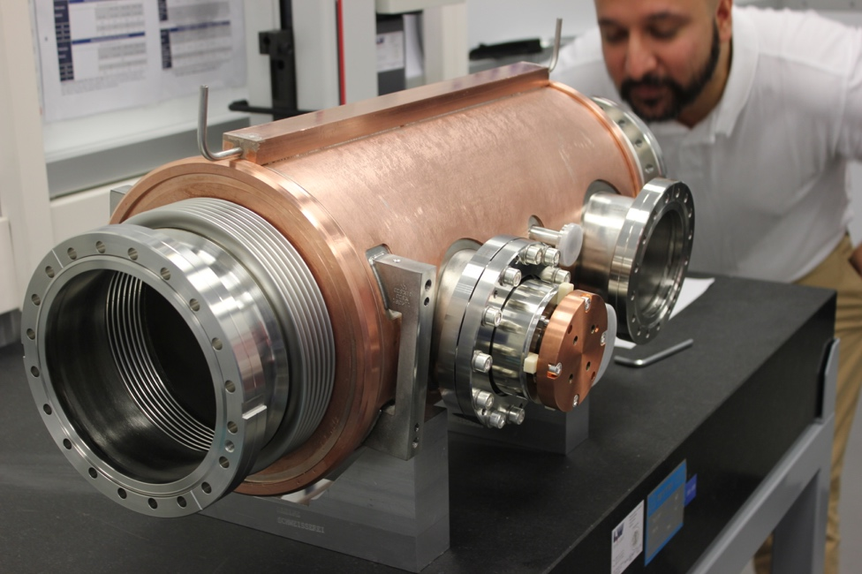
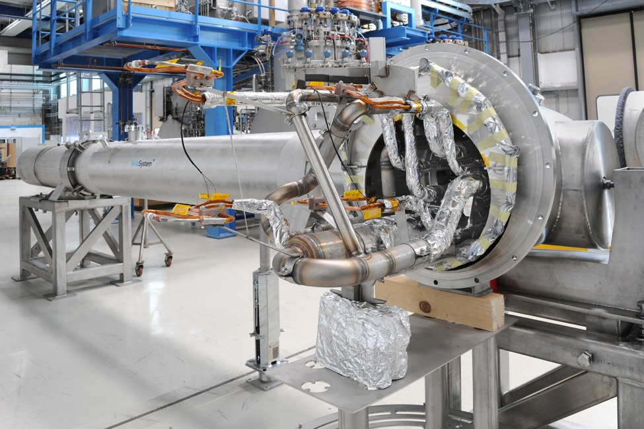
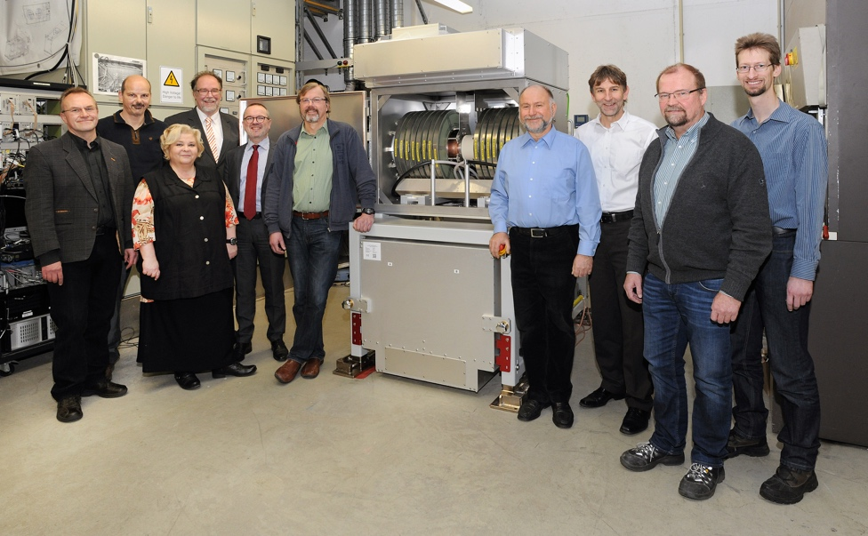
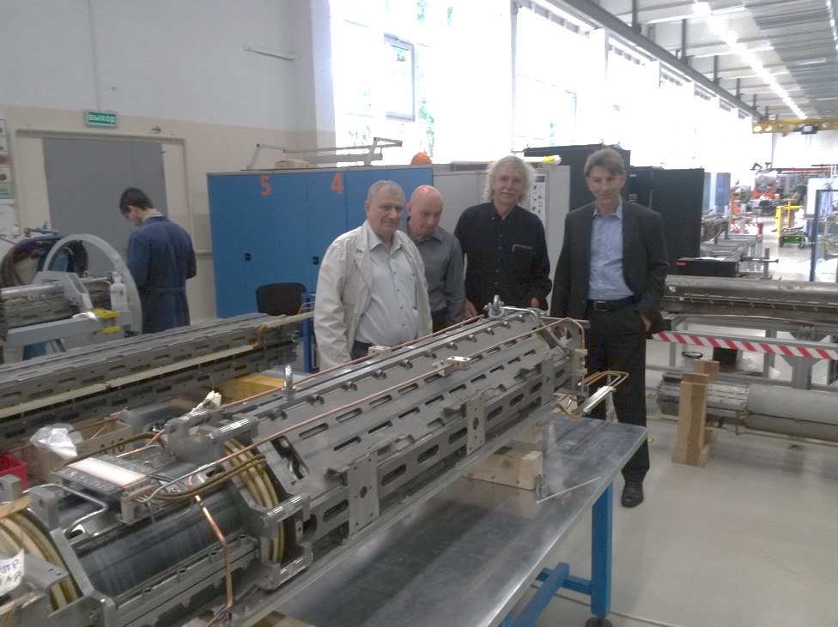
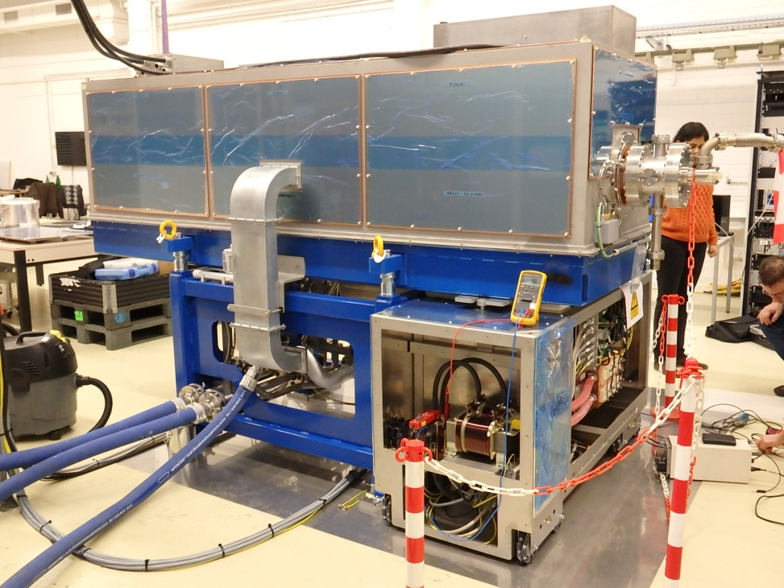
Construction of accelerator components
First of Series (FoS) of major components for SIS 100
FoS Dipole Magnet
FoS Cryo Catcher
FoS Cro-Bypass Line
FoS Dipole
Quadrupole Unit
FoS Bunch Compressor
FoS RF Cavity System

Slide 8
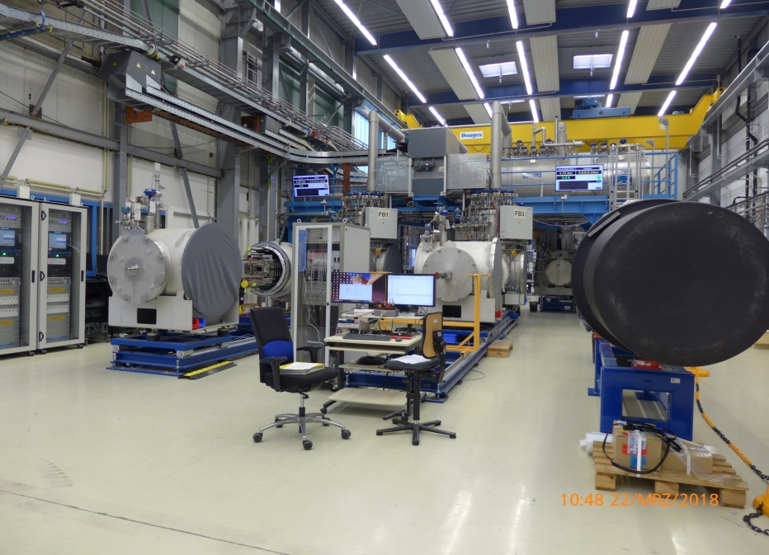
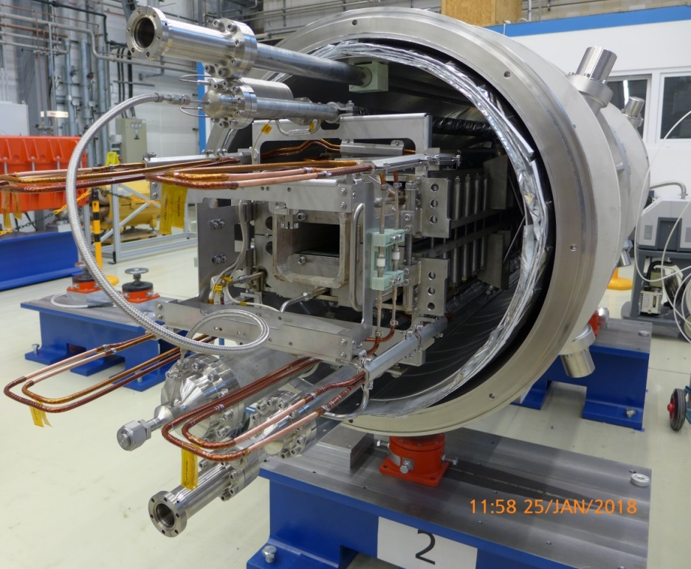
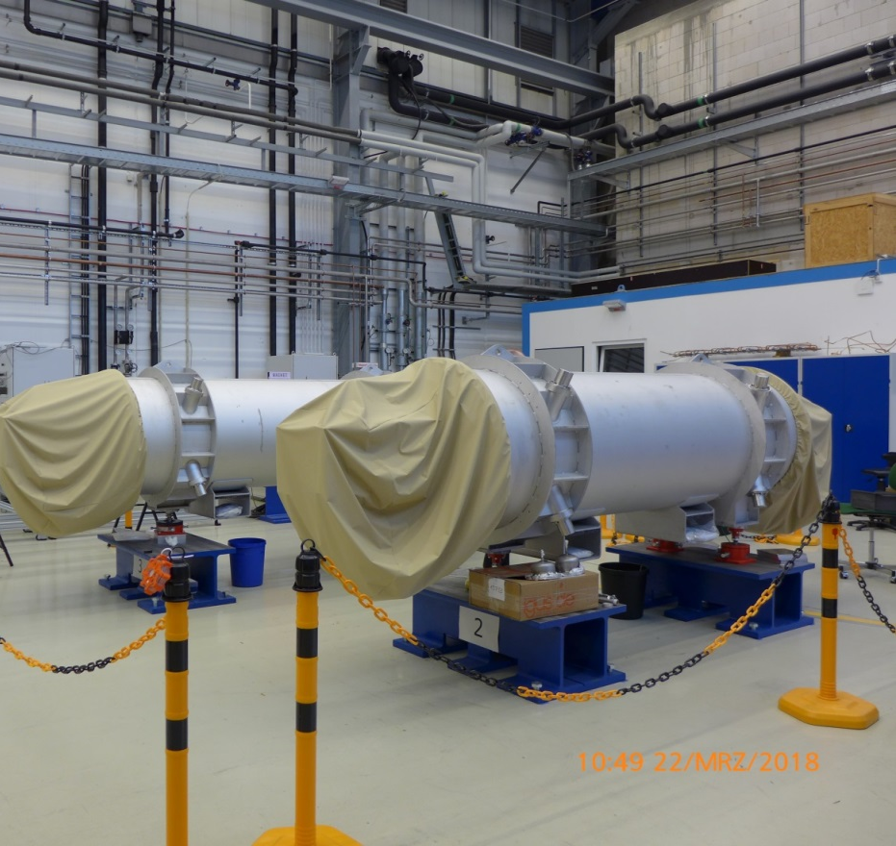
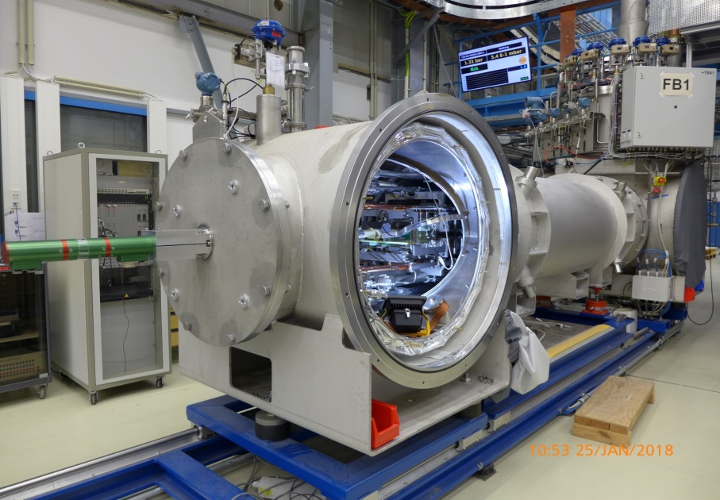
19 SIS100 dipole magnets have been delivered and are being cold-tested …

Slide 9
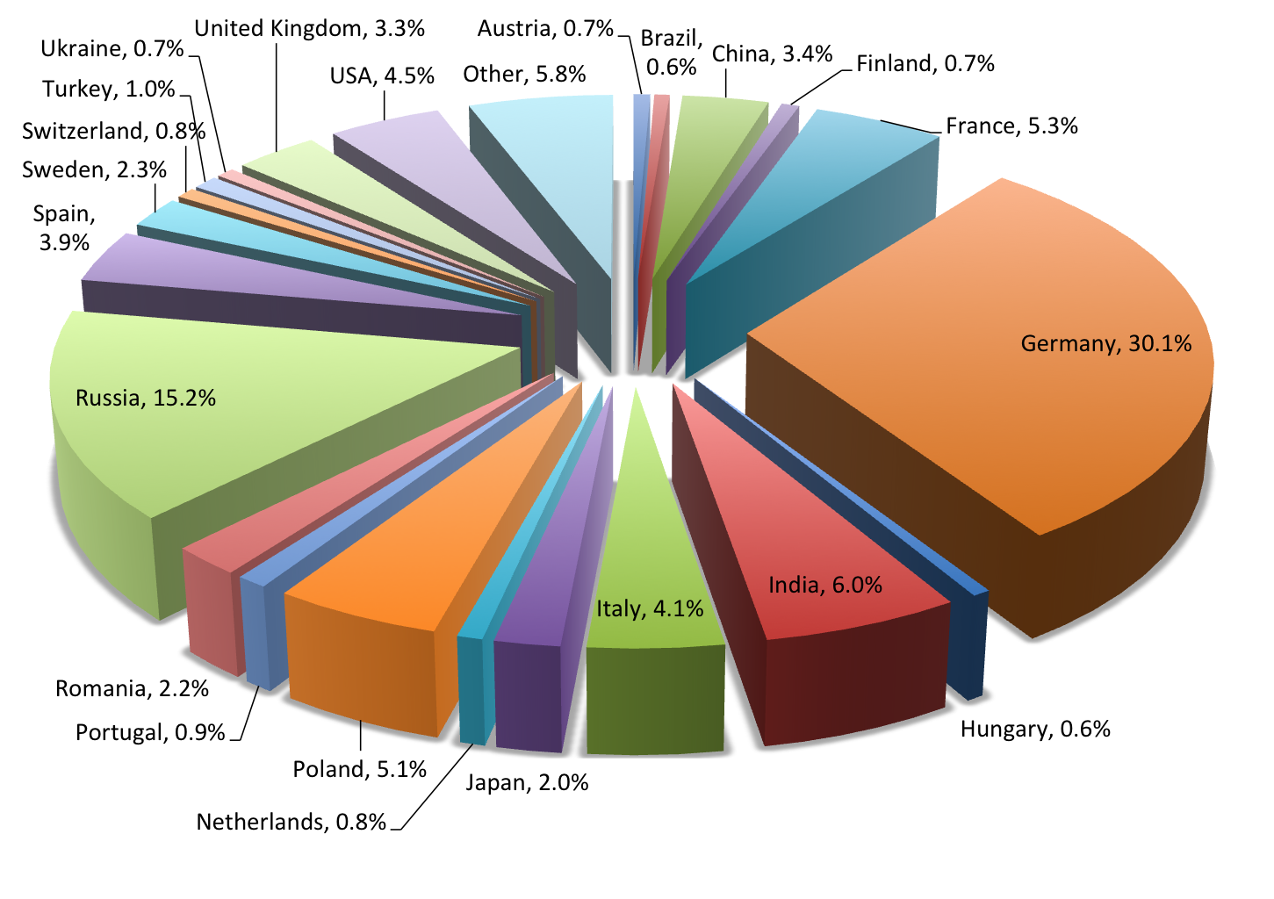
Collaboration Members by Country

Slide 10
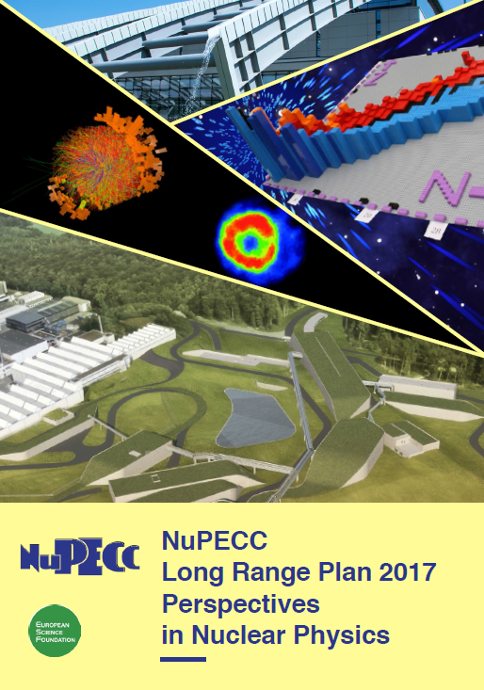
  Instead of conclusions ...
  Key Summary Recommendation of the NUPECC Long Range Plan 2017 presented in Brussels on Nov 27th :
  Complete urgently the construction of the ESFRI* flagship FAIR and develop and bring into operation the experimental program of its four scientific pillars APPA, CBM, NUSTAR and PANDA.
FAIR is a European flagship facility for the coming decades. Worldwide unique it will allow for a large variety of unprecedented fore-front research in physics and applied science. It focuses on the structure and evolution of matter. Its multi- faceted research opens a new era in our understanding of the fundamental building blocks of matter and the forces as well as of the evolution of our Universe: the new possibilities for research in Darmstadt are unique and are expected to produce ground breaking new insights for nuclear research.
*European Strategy Forum on Research Infrastructures

