Slide 1
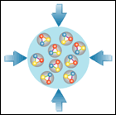
Status of the CBM Experiment – Key Dates for CBM Magnet
Walter F.J. Müller, FAIR, Darmstadt
CBM Magnet CDR Round 2, GSI 24-25 April 2018

Slide 2
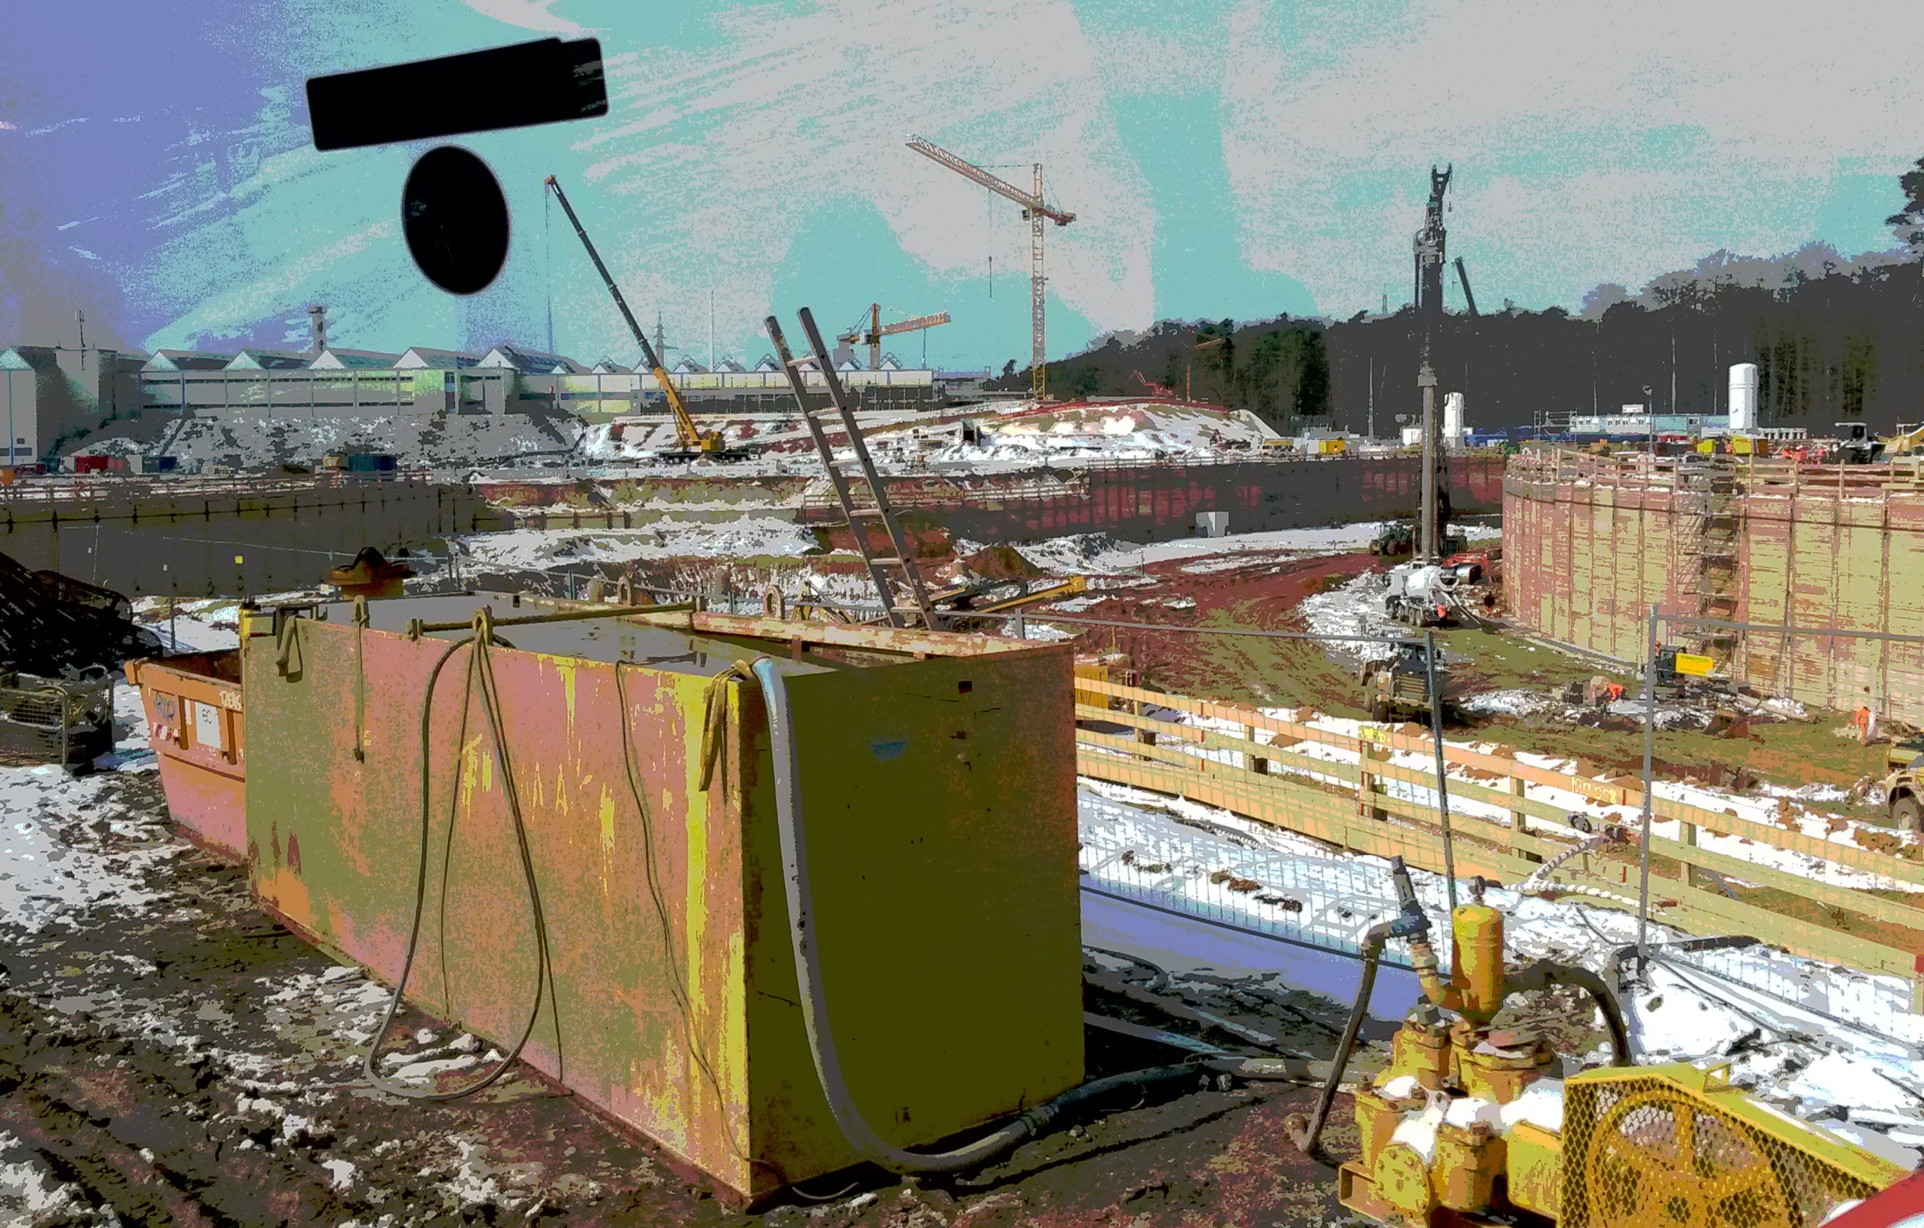
FAIR Construction on Track
picture taken March 19th, 2018

Slide 3
Major External Milestones for CBM
Very often shown slide
Dates checked & updated 2018-04-22
G014 (CBM building)
shell completed Dec ‘20
installation window Dec ‘21 to Mar ‘22
transition to ‘user mode’ Dec ‘22
Cryogenics and Accelerator
Cryogenics ready in G014 Mar ’23
SIS-100 ready for beam Jun ‘24
HEBT ready for beam Aug ‘24
SIS-100 pilot beam Nov ’24
SIS-100 ‘1 user, low intensity’ Feb’ 25
Notes:
- during ‘installation window’ building is still in ‘construction site’ mode - only very basic ventilation and power services available - mainly useful for bringing in robust mechanical structures
Cryo plant still on commissioning
Depending on whom one asks first opportunistic test beam (few hours parasitic to SIS-100 commissioning) might start between Jul and Nov ‘24.
Go for CBM M11 Mar’24

Slide 4
Installation Options for Magnet
Use installation window
install magnet in Dec’21 to Mar’22 window
Note 1: window will most likely be longer !
Note 2: only basic construction site services available
Note 3: other installation work in parallel (e.g mounting structs)
do bring-up starting when Cryo is ready, earliest Mar’23
After building acceptance
install magnet starting Dec’22
Note 1: now full services available, except Cryo
Note 2: many parties in the cave !
bring-up when Cryo is ready, earliest Mar’23

Slide 5
Time required for commissioning
Many other activities depend on the milestone Magnet ready for operation [M11] the most notable ones are
magnet upstream remap with MUCH absorber
installation STS in magnet
commissioning STS
It is essential to understand the time required for
cold-commissioning
quench testing
etc.

Slide 6
The End
Thanks for your attention

Slide 7
FAIR Schedule: SIS100 and CBM
Slide shown on Spring 17 CBM Week in plenary on 23rd March 2017
The CBM bottom line:
Dec 2021 to Jul 2022 1st installation window
Dec 2022 Building acceptance
Dec 2022 to Jun 2024 Installation & commissioning w/o beam
Jun 2024 to Mar 2025 Commissioning beam from SIS100
→ Schedule Quite Stable

Slide 8
Backup Slides

