Slide 1



Applicability of digital silicon photomultipliers in RICH detectors
A.Yu. Barnyakov, M.Yu. Barnyakov, S.A. Kononov, E.A. Kravchenko, I.A. Kuyanov,
A.P. Onuchin, V.G. Prisekin
ª Budker Institute of Nuclear Physics
^{b} Novosibirsk State University
^{c} Novosibirsk State Technical University
International Conference on the Advancement of Silicon Photomultipliers
11-15 June 2018
Schwetzingen, Germany

Slide 2
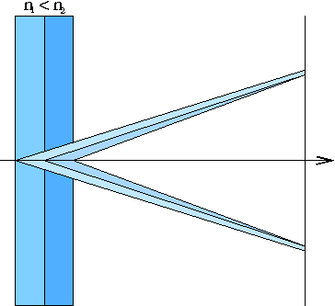
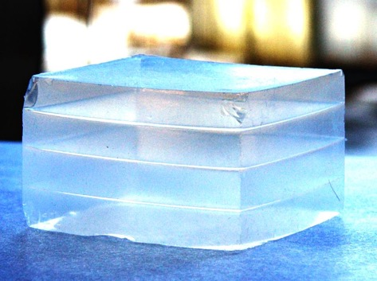
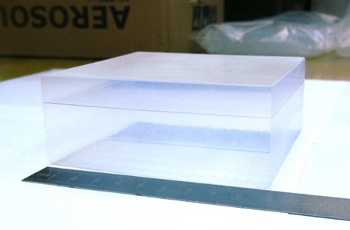
Focusing Aerogel RICH (FARICH)
First sample of 4-layer aerogel
n=1.030 6.0mm
n=1.027 6.3mm
n=1.024 6.7mm
n=1.022 7.0mm
3-layer aerogel 115x115x41 mm³
Focusing aerogel improves proximity focusing design by reducing the contribution of radiator thickness into the Cherenkov angle resolution
Multi-layer monolith aerogels have been being produced by the Boreskov Institute of Catalysis in cooperation with the Budker INP since 2004.
T.Iijima et al., NIM A548 (2005) 383
A.Yu.Barnyakov et al., NIM A553 (2005) 70
Notes:
Идея ФАРИЧ появилась в 2004 г.
Точность измерения черенковского угла связана с точностью измерения скорости, а значит с качеством разделения частиц.

Slide 3
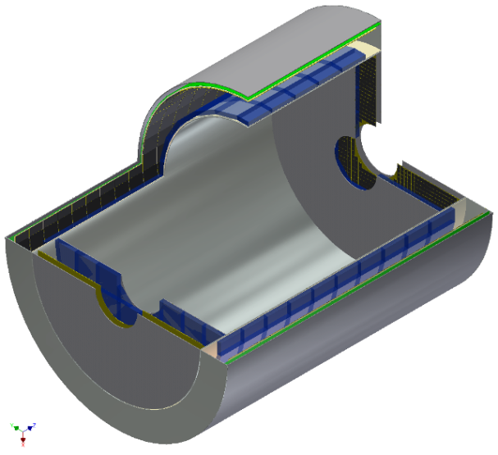
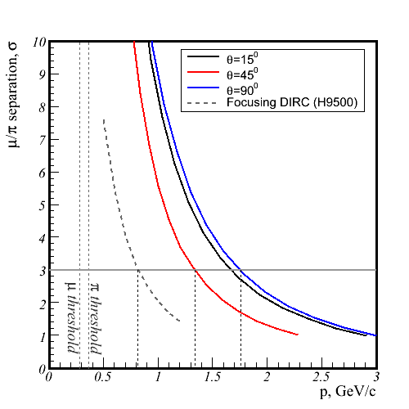
FARICH for Super Charm-Tau Factory
μ/π: MC simulation
MPPC S10362 3x3mm, D=200mm,
4-layer aerogel
μ momentum range for
τ → μγ at E_{cm}=4.2GeV
Proximity focusing RICH
21 m² photon detector area
Use SiPMs due to 1T magnetic field
~10⁶ pixels with 4 mm pitch
4-layer or gradient aerogel radiator
μ/π is required for LFV search in τ→μγ.
Target sensitivity on Br(τ→μγ) ~10⁻⁹

Slide 4
SiPMs in RICH application
(single photons)
Pros
High PDE
Sub-ns timing resolution
Immune to magnetic field
Active/Total area ratio
Very compact with low material budget
Cons
High dark count rate
(10-100 kHz/mm²)
Radiation induced damage (~10¹⁰ n_{1MeV}/cm²)
S. Korpar et al., NIM A 594 (2008) 13
A.Y. Barnyakov et al., NIM A 732 (2013) 352
S. Korpar et al., NIM A 766 (2014) 107
M. Contalbrigo, NIM A 787 (2014) 224
I. Balossino et al., NIM A 876 (2017) 89

Slide 5
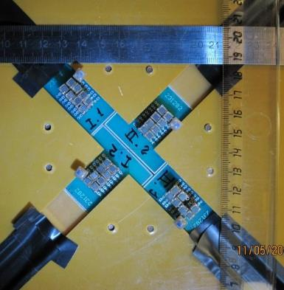
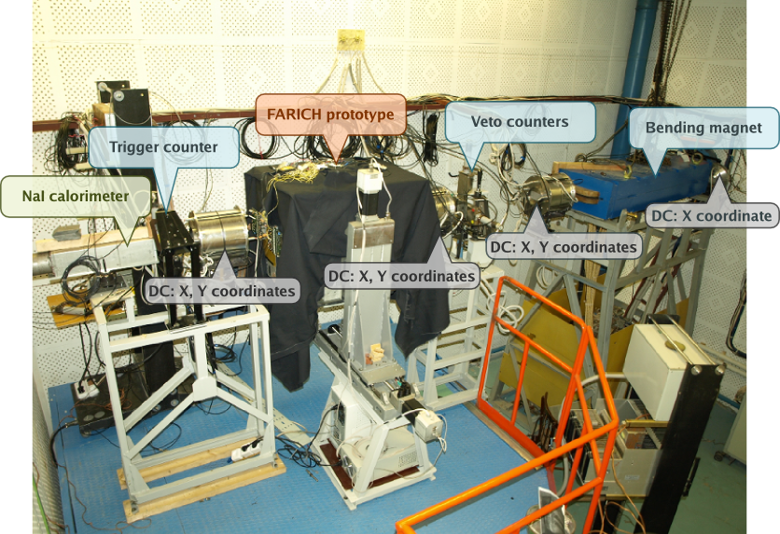
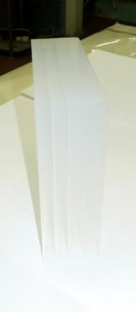
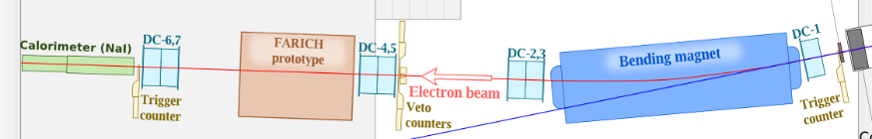
FARICH detector prototype with CPTA MRS APDs BINP e⁻ test beam in 2011
32 CPTA MRS APDs with active pixel size 2.1x2.1mm²
DCR ~ 5 MHz/device
4-layer aerogel focusing at 62 mm
n₁=1,050 t₁=6,2mm
n₂=1,041 t₂=7,0mm
n₃=1,035 t₃=7,7mm
n₄=1,030 t₄=9,7mm
Size: 100x100x31mm³
L_{sc}(400nm) = 43mm

Slide 6
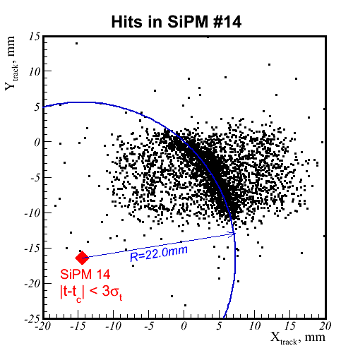
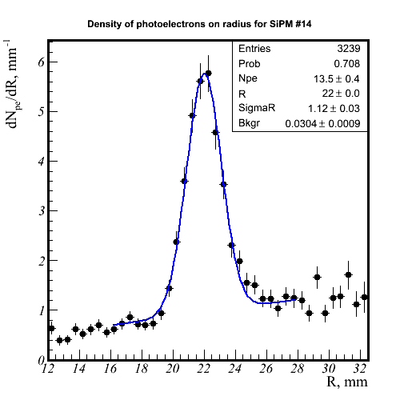
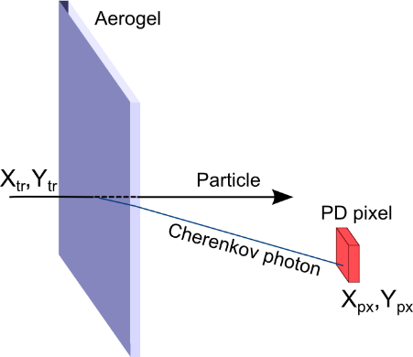
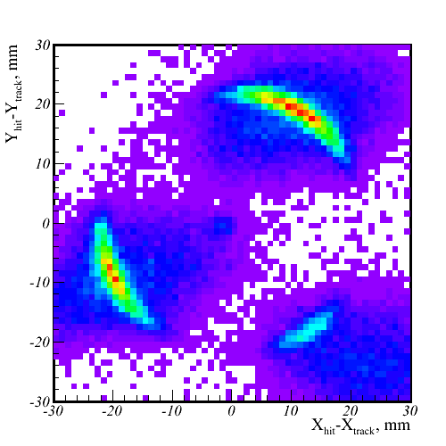
Cherenkov ring observation with single pixels
Dark count background
Sum of all pixels w.r.t. track position
Given a tracking system, wide beam and enough particle statistics, a single PD pixel is enough to build the distribution of Cherenkov photons on R_{ch} (θ_{ch}).
Many pixels can be combined to improve accuracy and align the tracking system with the photon detector

Slide 7
Analog SiPM vs Digital SiPM
Analog
Established technology
Great progress in improving parameters: PDE, DCR, RadHard
High active/total area ratio
Availability from different vendors
Need for external analog-to-digital readout electronics – bulky detector, higher power consumption
No control of individual SPADs
Digital
On-chip integration of readout electronics – no need for ASICs
Possibility to locate firing SPAD in low light applications – ~10 um resolution
Better timing resolution
Control of individual SPADs for inhibiting noisy ones
Different designs for different applications – cost issue
Limited possibilities for custom modifications due to CMOS production process

Slide 8

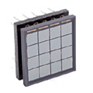
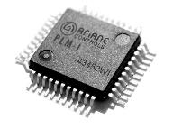
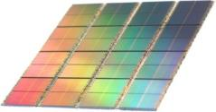
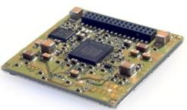
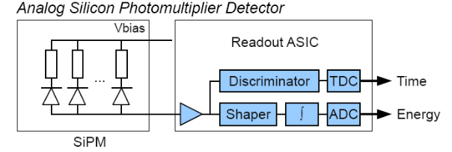
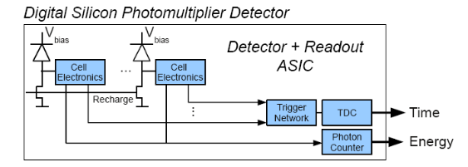
DPC is an Integrated, Scalable Solution
Analog SiPM
Digital SiPM
discrete, limited integration
analog signals to be digitized
dedicated ASIC needed
difficult to scale
fully integrated thanks to CMOS
fully digital signals
no ASIC needed
fully scalable
Courtesy of Philips Digital Photon Counting

Slide 9
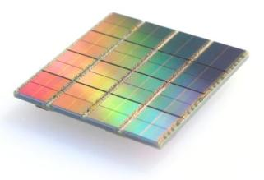
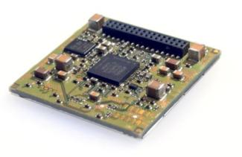
DPC is an Integrated “Intelligent” Sensor by Philips Digital Photon Counting
DPC3200-22-44 – 3200 cells/pixel
DPC6400-22-44 – 6396 cells/pixel
FPGA
Clock distribution
Data collection/concentration
TDC linearization
Saturation correction
Skew correction
Flash
FPGA firmware
Configuration
Inhibit memory maps
32.6 mm
Courtesy of Philips Digital Photon Counting

Slide 10
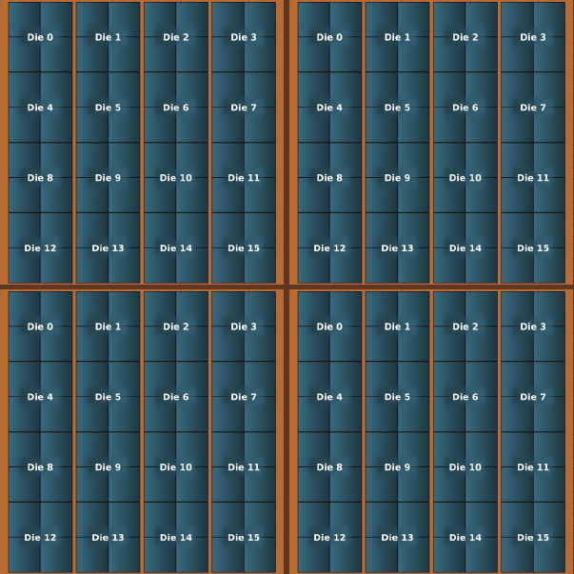
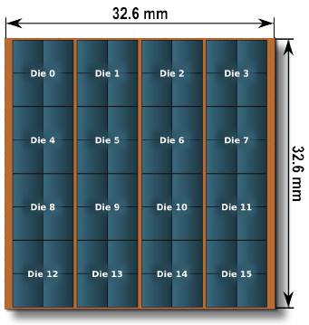
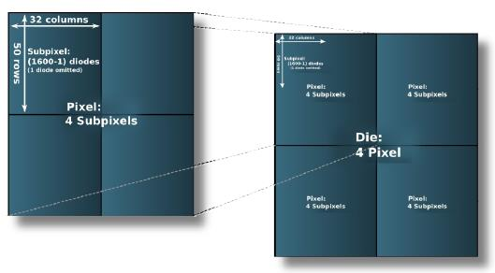
DPC readout units
3.20
7.15
Module
3.88
Tile
7.88
pixel - single amp. channel
6396 cells (DPC6400-22)
3200 cells (DPC3200-22)
sensor - single time channel
Geometrical efficiency ≈70%

Slide 11
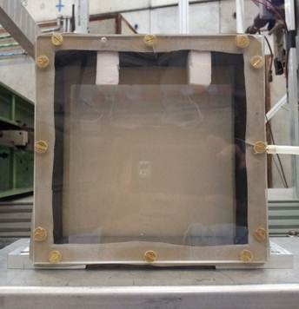


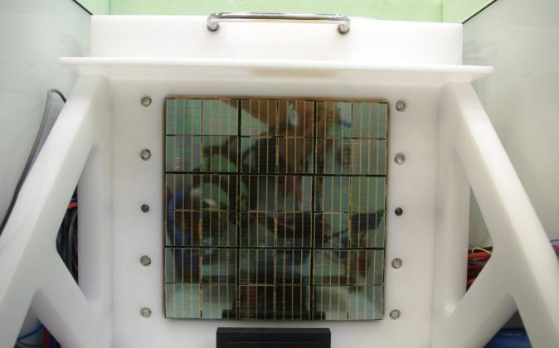


FARICH prototype with DPC
4-layer aerogel
n_{max} = 1.046
Thickness 37.5 mm
Calculated focal distance 200 mm
Hermetic container with plexiglass window to avoid moisture condensation on aerogel
Square matrix 20x20 cm²
Sensors: DPC3200-22-44
3x3 modules = 6x6 tiles = 24x24 dies = 48x48 pixels in total
576 timing channels
2304 amplitude channels
(pixels 3.2x3.9 mm²)
4 levels of FPGA readout: tiles, modules, bus boards, test board

Slide 12
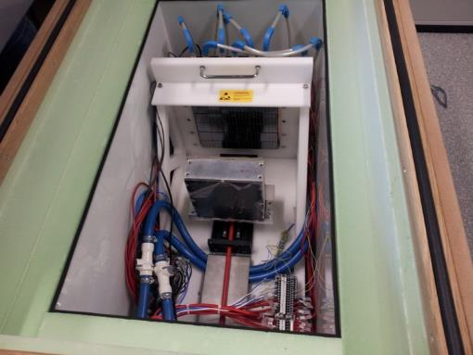
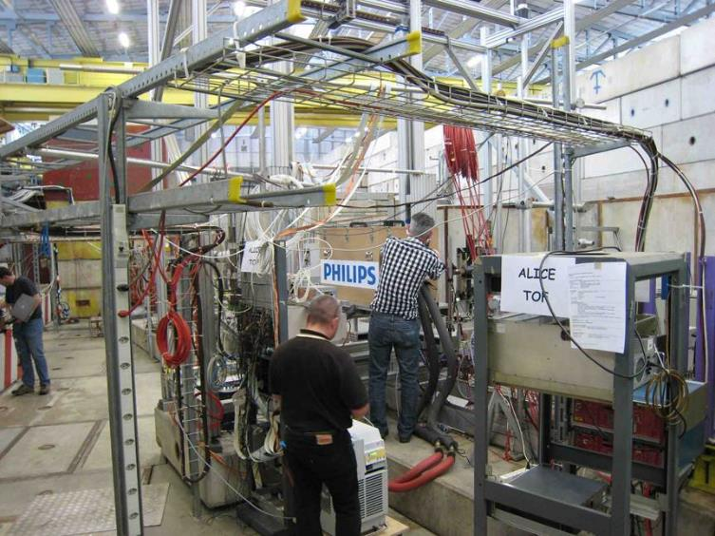
PDPC-FARICH prototype beam test
CERN PS/T10, 2012
Main objective:
  Proof of concept: full Cherenkov ring detection with a DPC array
Details:
Operation temperature is −40°C to suppress dark count rate
  Dead time is 720 ns.
  DCR(+25°C) ≈ 10 Mcps/sensor
  single photon detection is not feasible!
  DCR(-40°C) ≈ 100 kcps/sensor
  inefficiency is 7% .
2 stage cooling: LAUDA process thermostat + Peltiers.
Dry N₂ constant flow to avoid condensation.

Slide 13
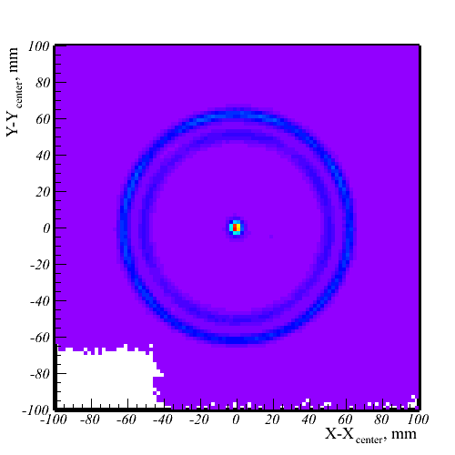
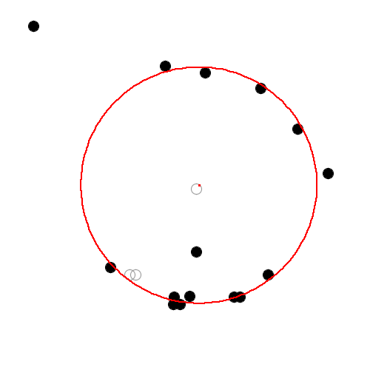
PDPC-FARICH: Cherenkov ring
P = 6 GeV/c
e, μ, π, K
p
A.Yu. Barnyakov et al, NIM A 732 (2013) 352

Slide 14
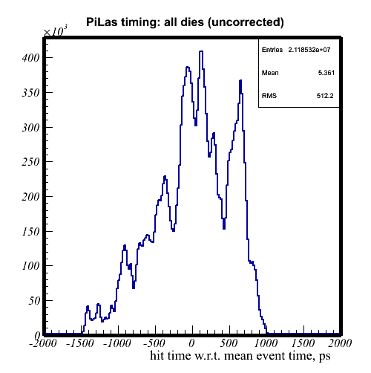
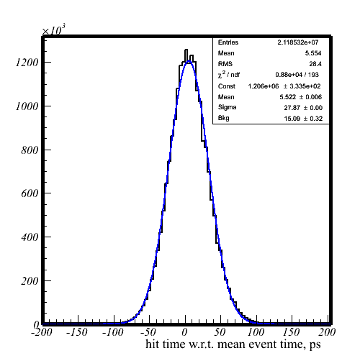
Clock skew correction between dies
~80 photons/die
PiLas
optical fiber
diffusor
DPC
Hit times w.r.t. mean hit time in event
Clock skew correction between dies
FWHM 66 ps

Slide 15
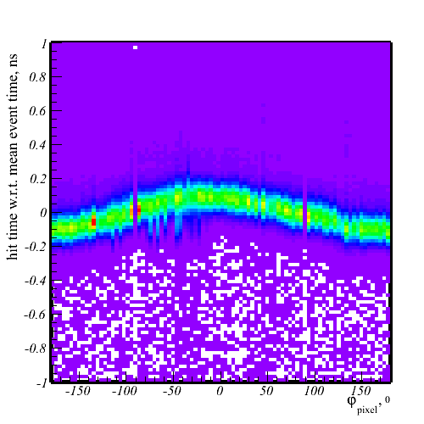
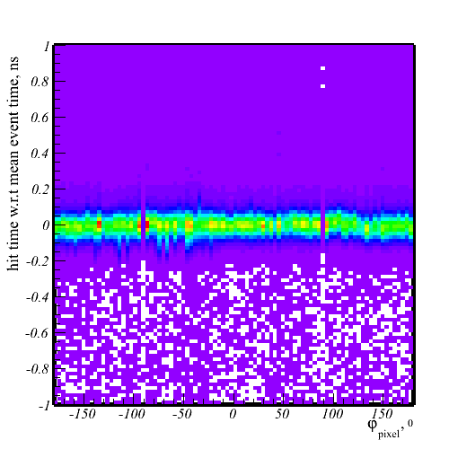
Timing correction by Cherenkov ring data
Hit timing vs φ-position
Before
After

Slide 16
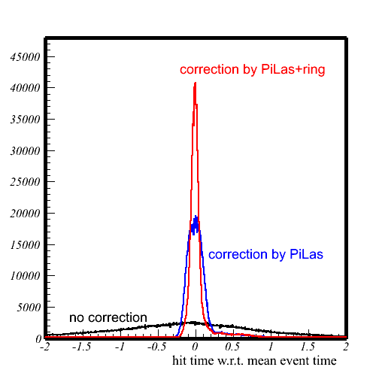
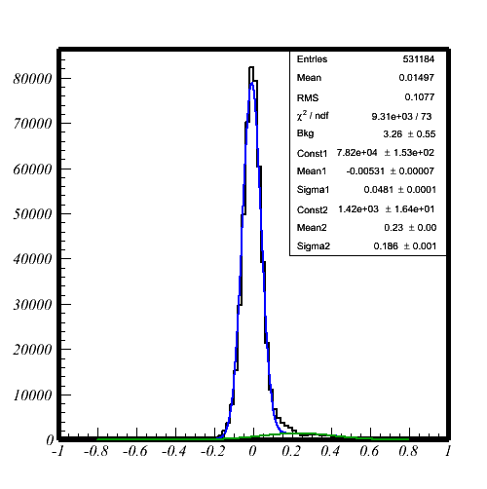
Single photon timing resolution for Cherenkov light
σ_{narrow}=48ps
Hit time w.r.t. fitted event time, ns
Hit time w.r.t. fitted event time, ns
Fit two gaussians plus constant.
90% of area is contained in the narrow gaussian.

Slide 17
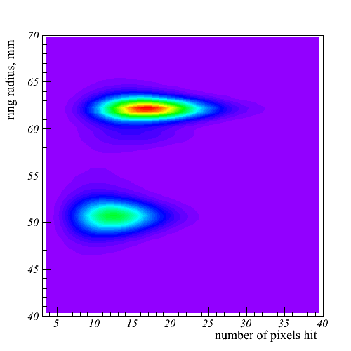
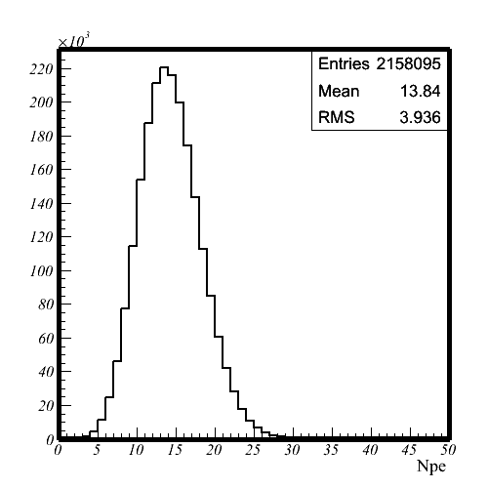
Number of photoelectrons
e, μ, π
K
protons
N_{pe} = 12 after taking into account crosstalks. ~2x lower then expected.

Slide 18
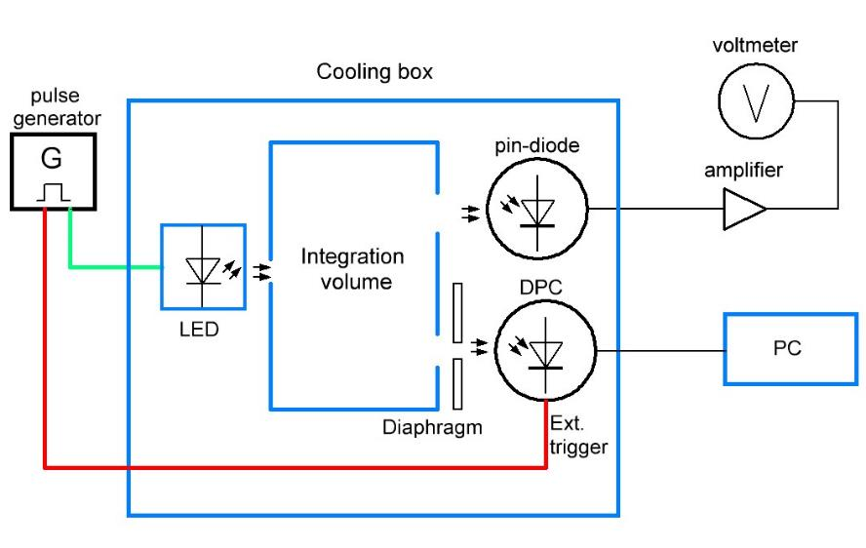
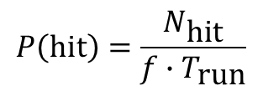
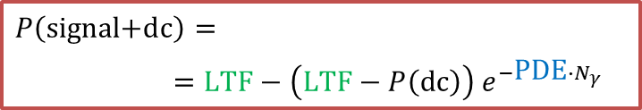
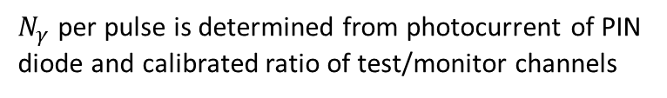
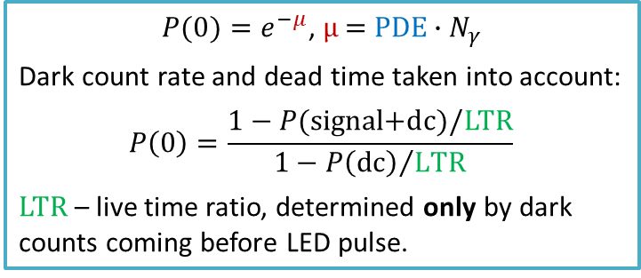
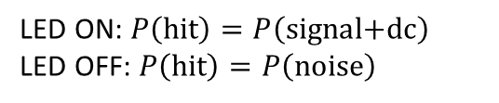
Absolute PDE measurement of DPC
Hamamatsu S1336-8BQ
$$P\left(hit\right)=\frac{N_{\text{hit}}}{f∙T_{\text{run}}}$$
Thermostat
T = −30°C
hit
missing
1/f
timestamps
Hit enable window
LED ON: $P\left(hit\right)=P\left(\text{signal}\text{+}\text{dc}\right)$
LED OFF: $P\left(hit\right)=P\left(\text{noise}\right)$
$P(0)=e^{−μ}$, $μ \text{=} \text{PDE}{∙N}_{γ}$
Dark count rate and dead time taken into account:
$$P\left(0\right)=\frac{1−P(\text{signal}\text{+}\text{dc})/\text{LT}\text{R}}{1−{P\left(\text{dc}\right)}/{\text{LT}\text{R}}}$$
$LTR$ – live time ratio, determined only by dark counts coming before LED pulse.
$$P\left(\text{signal}\text{+}\text{dc}\right)=$$
$=LTF−\left(LTF−P\left(\text{dc}\right)\right) e^{−\text{PDE}{∙N}_{γ}}$
$N_{γ}$ per pulse is determined from photocurrent of PIN diode and calibrated ratio of test/monitor channels

Slide 19
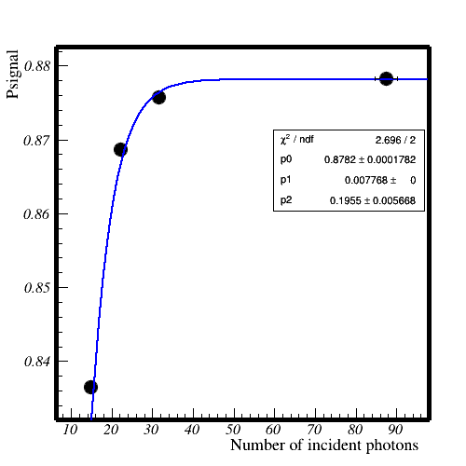
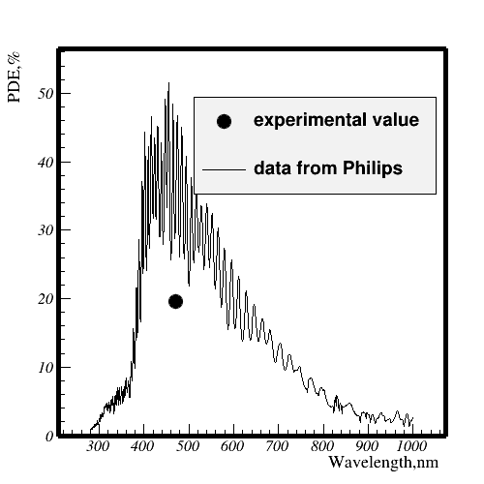
Absolute PDE of DPC
Fit P(signal+dc) as function of N_{γ} and extract PDE
P(signal+dc)
PDE(470 nm)
19±1% in our measurement vs 36% by PDPC measurement

Slide 20
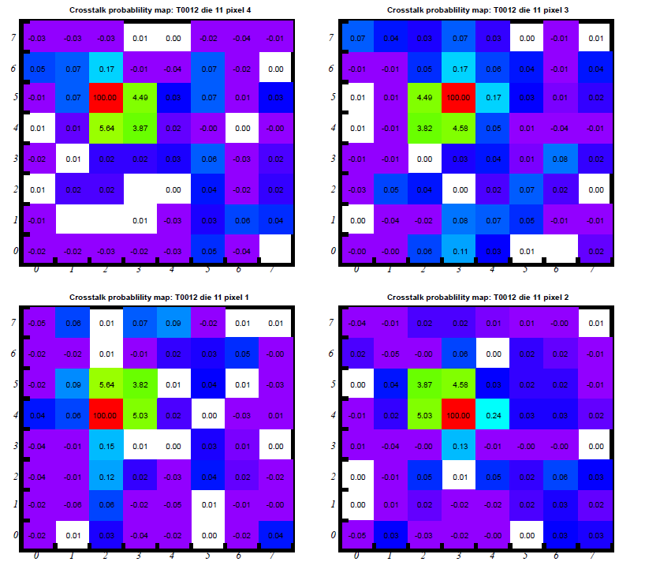
Optical crosstalks in DPC
X-talks between pixels deteriorate position resolution
Crosstalk ways:
between pixels of the same die (3-4%) go likely via Si substrate
between neighboring dies (0.1-0.2%) go via protection glass
Protection glass
Epoxy OC
Pixel
Pixel
Pixel
Pixel
PCB

Slide 21
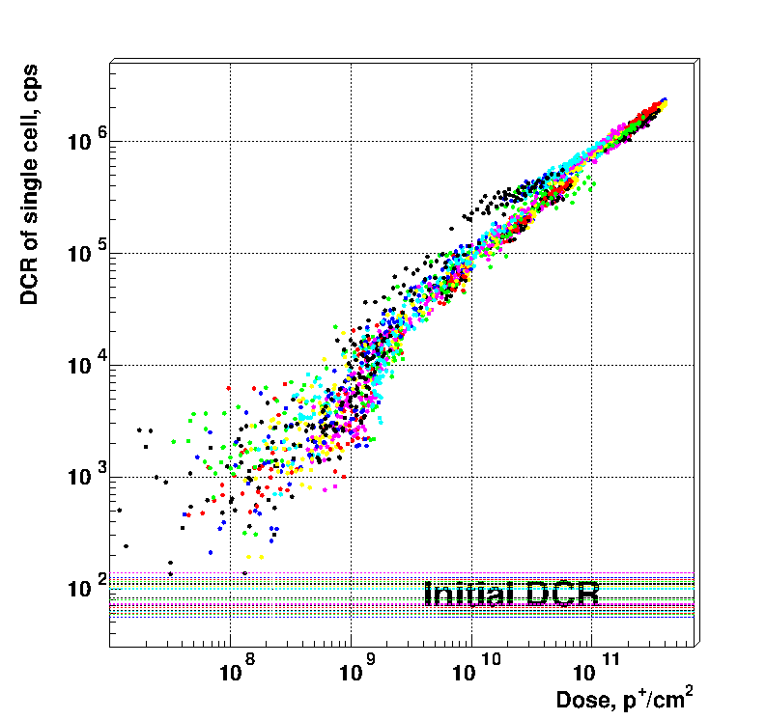
Irradiation of DPC tiles proton beam (800 Mev/c) at COSY PS in FZ Jülich
Die-averaged cell DCR vs fluence
DPC tiles cooled to −18°C. Maximum fluence accumulated: 4∙10¹¹ p/cm²

Slide 22
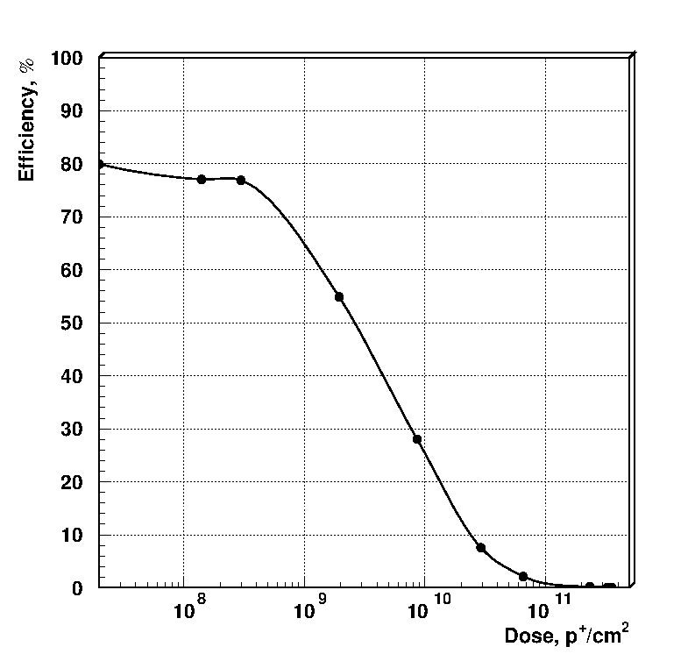
Radiation hardness study of DPC
Estimated PDE degradation due to DCR increase
with inhibiting most noisy cells
Estimated die DCR vs active cell fraction
Effect of radiative damage on DCR
2 times drop
4∙10⁹ n_{1MeV}/cm²
M.Yu. Barnyakov et al, NIM A 824 (2016) 83

Slide 23
Desired characteristics of digital SiPMs for aerogel RICH
  PDE as high as possible: high active area ratio → amplitude dynamic range does not matter → large SPAD
  Room temperature operation → dark count rate at room temperature ≤ 10 kHz/mm²
  Dead time ratio ≤ 1%
  Position resolution σ_{x} ≤ 1 mm: may be realized by determining position of a fired SPAD in an array of size ~3x3 mm²
  SPTR ≤ 100 ps would be useful for DIRC-like detectors or suppressing uncorrelated background
  Radiation hard ≥10¹¹ n_{1MeV}/cm², dead time ratio after irradiation ≤ 10-20%, or cheap enough to be replaced after degradation
  Fast analog output for generating trigger from rings

Slide 24
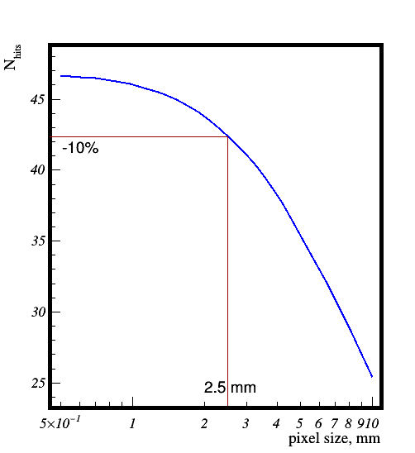
Density of photoelectrons in aerogel RICH
Number of fired pixels vs
pixel size
PDE of MPPC S13361-3050
Pixel packing factor - 80%
Ring radius ~ 55 mm
Ring width FWHM ~ 3mm
→ 10% loss of photons for
pixel size 2.5 mm
N_{ph.e.}

Slide 25
Summary & conclusion
Digital SiPMs are promising sensor candidates for RICH applications in visible & NUV range and only one in strong magnetic fields
DPC parameters were studied: not quite suitable for aerogel RICH due to large dead time
Looking for other dSiPM solutions for application in Super Char-Tau Factory (Novosibirsk)
Welcome to collaboration!

Slide 26
Thank you for your attention!

Slide 27


Nice Cherenkov rings from aerogel detected by DPC at the e⁻ beam at BINP
2-layer aerogel of 40mm thick
D=160 mm

