Slide 1
PANDA Yoke and Magnet

Slide 2
3D model of the Magnet, Yoke, Platform and Frame.
The Yoke Platform and Frame of the detector PANDA for production at BINP

Slide 3
Dimensions of the Yoke, Platform and Frame.

Slide 4
Dimensions of the Yoke, Platform and Frame. (The Doors opened)

Slide 5
Main Technical Data
Upstream door with supports, rollers etc., weight | Left wing | t | 22.8
 | Right wing | t | 22.8
Downstream door with supports, rollers etc. | Left wing | t | 20.7
 | Right wing | t | 21.1
Octagonal barrel | Upper beam | t | 19
 | Inclined side beams, 4 pc. | t | 20.8
 | Vertical side beams, 2 pc. | t | 20.8
 | Bottom beam | t | 20.4
Platform beams, support frames and carriages |  | t | 57.8
Total weight |  | t | 341.1
Joke length |  | mm | 4875
Joke width | Closed wings | mm | 7930
 | Open wings | mm | 9600
Joke height |  | mm | 6350
Material |  |  | Ct.3

Slide 6
Drawing of the Yoke, Platform and Frame.

Slide 7
Drawing of the Yoke, Platform and Frame.

Slide 8
3D-Model of the Yoke of PANDA Magnet.

Slide 9
Drawing of the Yoke.

Slide 10
Drawing of the Yoke.

Slide 11
Drawing of the Barrel part of the Yoke.

Slide 12
Drawing of the Barrel part of the Yoke.

Slide 13
Drawing of the Barrel part of the Yoke.

Slide 14
Drawing of the Barrel part of the Yoke.

Slide 15
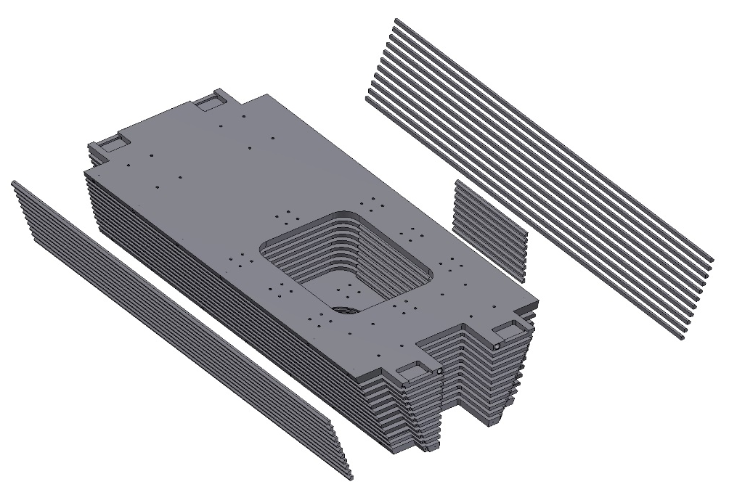
The old design of the octant of the Yoke
The Octant consists of the plates and bars. The bars connect the plates of the octant by welding. Disadvantage of such design:
1. A lot of welds.
2. Final machining on the surface of welded joints. It's very bad for a tools.
3. Octant construction is not so rigid.

Slide 16
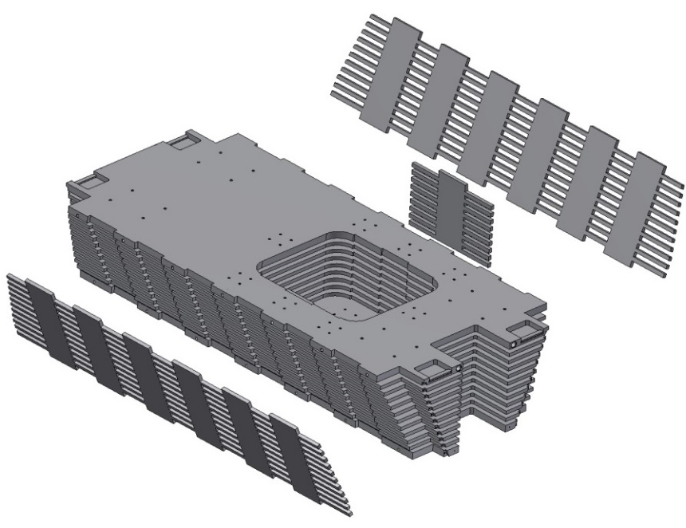
The modified octant of the Yoke
The bars was replaced by a side plates. The side plates are manufactured using water cutting machine. Advantage of such design:
The number of welds is reduced.
Final machining on the surface of the side plates (not welded joints).
3. Octant construction is more rigid.

Slide 17
Drawing of the top Octant.

Slide 18
Drawing of the top Octant.

Slide 19
Drawing of the top Octant.

Slide 20
Drawing of the top Octant.

Slide 21
Drawing of the top Octant.

Slide 22
The Downstream Door.

Slide 23
Drawing of the Downstream Door.

Slide 24
3D-Model of the half Downstream Door of Yoke.

Slide 25
Drawing of the half Downstream Door.

Slide 26
Drawing of the half Downstream Door.

Slide 27
Drawing of the half Downstream Door.

Slide 28
Drawing of the half Downstream Door.

Slide 29
The Upstream Door.

Slide 30
Drawing of the Upstream Door.

Slide 31
3D-Model of the half Upstream Door of Yoke.
The door is made of 100 mm thick plates by welding.

Slide 32
Drawing of the half of Upstream Door.

Slide 33
Drawing of the half of Upstream Door.

Slide 34
3D model of the Platform and Frame.

Slide 35
Drawing of the Platform and Frame.

Slide 36
3D model of the Magnet.
Magnet with St. Steel Cryostat. The weight of magnet is ~14,5 t

Slide 37
Dimensions of the Magnet.
Inner diameter is 1900 mm, Outer diameter is 2680 mm, length is 3090 mm

Slide 38
Dimensions of the Coils (worked condition 4.5K).
Outer diameter of coils is 2200 mm, length: two coils - 887 mm, one – 400 mm.

Slide 39
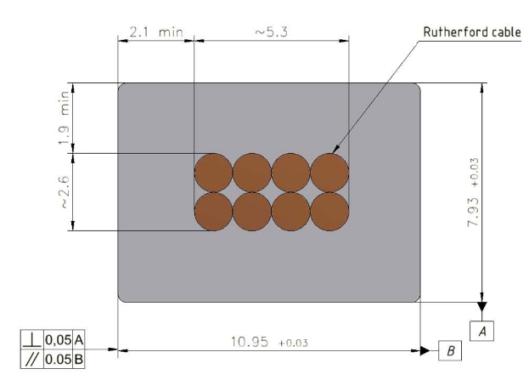
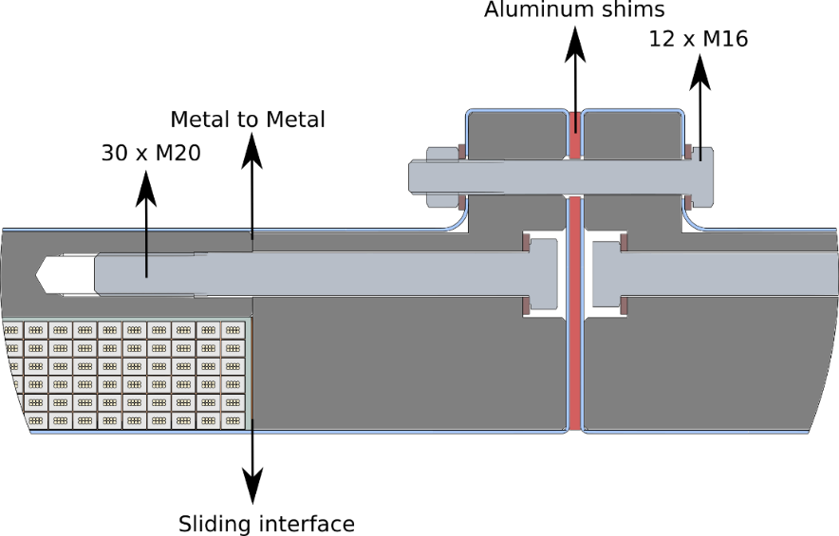
The Cold mass. (CERN design)
2x 6 layers - 78 turns
1x 6 layers - 35 turns
Magnetic field - 2 T
Current - 4.96 kA (3 T)
10,95 мм x 7.93 мм,
NbTi / Cu d=1.4 мм
The design of Cold mass is based on the design of Cold mass of CERN.

Slide 40
The Cold mass (3D-Model).
The Cold mass is based in to Cryostat with help of suspension, radial rods and longitudinal rods. For thermal bridges is used the flexible copper.
The weight of cold mass is ~5.6 t

Slide 41
The Cold mass (dimension for worked condition 4.5K)
Inner diameter is 2096 mm, Outer diameter is 2280 mm, length is 2826 mm

Slide 42
The Collector of Cold mass.
For cooling of Coil is used the collector with special aluminum profile which is welded on the outer shell of Cold mass.

Slide 43
The Cryostat of The Magnet.
Inner diameter is 1900 mm, Outer diameter is 2680 mm, length is 3090 mm Material is St.St. The weight is ~8 t

Slide 44
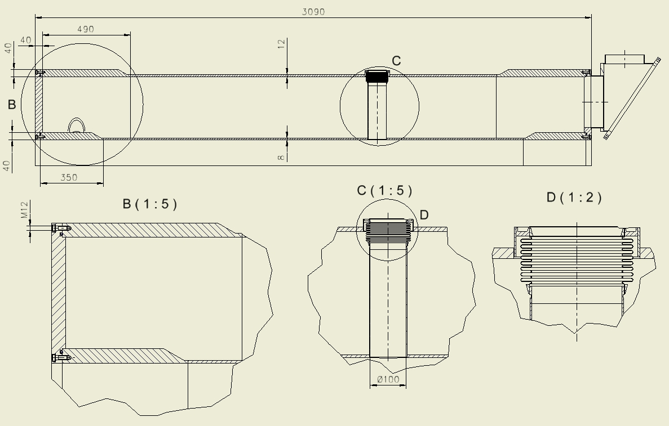
Configuration of the Cryostat
Thickness of the outer shell is 12 mm, Thickness of the inner shell is 8 mm , Thickness of the flanges is 40 mm, Thickness of the rings is 40 mm
The bolts – M12 – 2x36 ps. Sealing ring – d=8 mm

Slide 45
The Shield of the Magnet.
Outer diameter is 2552 mm, Inner diameter is 2020 mm, length is 2900 mm
Thickness is 3 mm, Material is Al. The weight is ~0,45 t

Slide 46
Break of the Shield .
The shield has 4 breaks isolated G10 bars with gaps. The shield is positioned into the cryostat with help Balls transfer units with G10 ring.

Slide 47
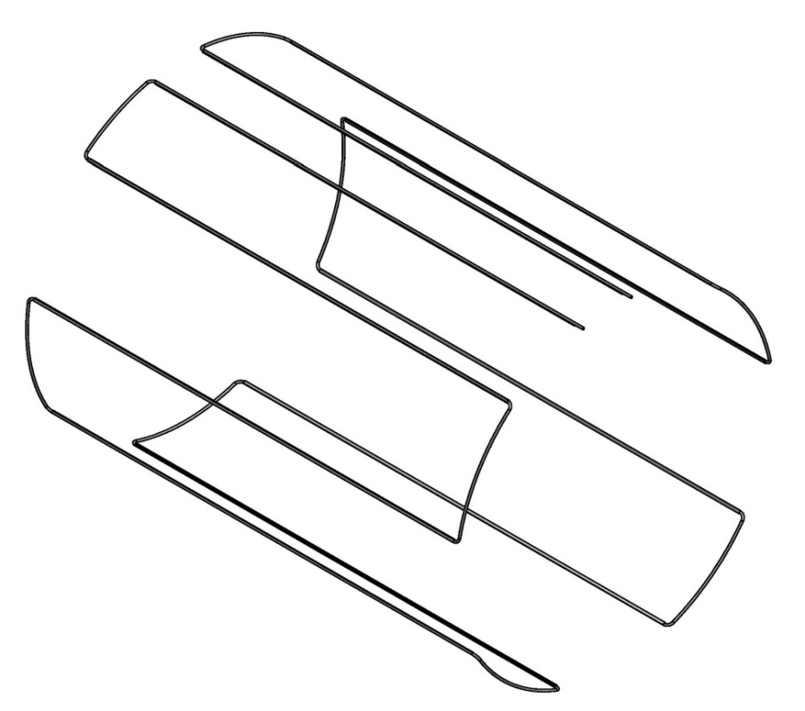
The inner Shield.
Inner shell of the shield with flanges, ribs and pipeline.
For cooling of Shield is used the pipeline with special aluminum profile which is welded on the shell.

Slide 48
The outer Shield.
Outer Shell of the shield with ribs, Balls transfer units and pipeline with special aluminum profile which is welded on the shell.

Slide 49
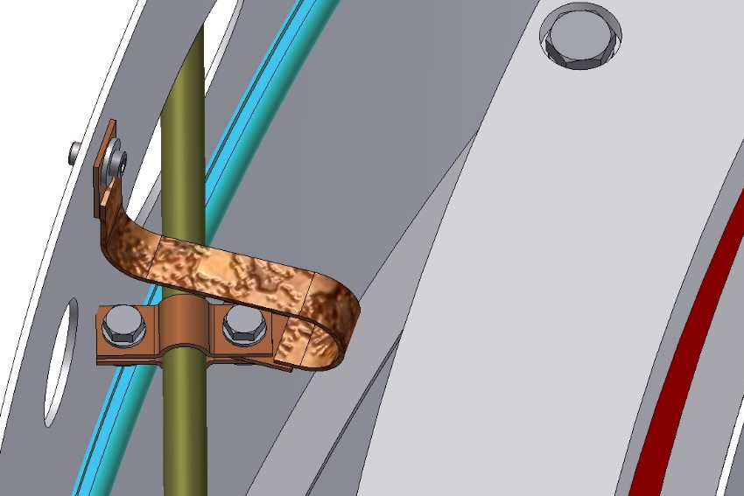
The Shield into the Magnet.
The Shield is based on the outer shells of the cryostat with help of Balls transfer units with G10 ring. Flanges of shield are fixed with help of thread rivets and bolts.
Thermal bridges is fixed on the shell of shield with help of thread rivets and bolts.

Slide 50
Fixation of the Shield into the Cryostat.
In the area of the target, the shield is fixed with help of bushes (G10) and bolts (8 places). Position of bolts for fixing the shield into the cryostat.

Slide 51
Cross section of the Magnet.
In the radial direction the Cold mass is based into Cryostat with help suspensions and axis rods.

Slide 52
The Suspensions.
The diameter of suspension is 16 mm, the length is 840 mm.
Material is Ti-5Al-2.5Sn

Slide 53
The Longitudinal rod. (right side)
In the axial direction the Cold mass is fixed with help longitudinal rods.
The diameter of longitudinal rods is 20 mm, the length is 1913 mm (right side).
Material is Ti-5Al-2.5Sn

Slide 54
The Longitudinal rod. (left side)
The diameter of longitudinal rods is 20 mm, the length is 1123 mm (left side).
Material is Ti-5Al-2.5Sn

Slide 55
The Radial rods.
In the radial direction the Cold mass fixed with help radial rods. The diameter of radial rods is 12 mm, the length is 720 mm.
Material is Ti-5Al-2.5Sn

Slide 56
Diagram of position of the target`s axis in worked condition.
The length and position of fixation of the longitudinal rod, and position of the thermal bridges allow not to move the axis of the hole of the target.

Slide 57
Diagram of position of the Cold mass axis in worked condition.
The length and position of fixation of suspensions, and position of the thermal bridges allow to move the axis of the Cold mass for 0,1 mm.

Slide 58
Heat loads of the Cold mass and thermal Shield.
T=4.5K | Thermal load, W
Radiation | 2.2
Heat inflow to the cold mass supports | 0.52
Total: | 2.72
T=60K
Radiation | 95
Heat inflow to the cold mass supports | 13
Heat inflow to the shield supports | ?
Total: | 108

Slide 59
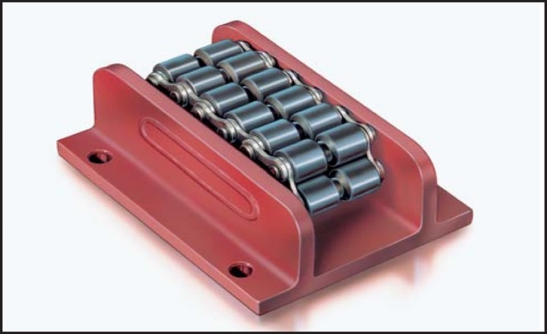
Magnet assembly procedure
For assembling the magnet, it is possible to use an I-beam steel hot-rolled with parallel faces of shelves 70B2 (697 x 260 mm) GOST 26020-83.
The length of the beam is L = 9 m.
To roll inside, we can use rollers that are used to open doors (Roller skate Boerkey model AM-H)

Slide 60
Magnet assembly procedure
Pic.1. Stand
Pic.2. Outer shell of cryostat
insertion.
Pic.3. Outer shell of cryostat
position.
Pic.4. Outer shield insertion.
Pic.5. Outer shield position.
Pic.6. Cold mass insertion.

Slide 61
Magnet assembly procedure
Pic.7. Cold mass position.
Pic.8. Suspensions and axial
rods insertion.
Pic.9. Inner shield insertion.
Pic.10. Inner shield position.
Pic.11. Flange of shield insertion
and position.
Pic.11. Flange of shield insertion.

Slide 62
Magnet assembly procedure
Pic.13. Flange of shield position.
Pic.14. Inner shell of cryostat
insertion.
Pic.15. Inner shell of cryostat
position.
Pic.16. Flange of cryostat
insertion and pos.
Pic.17. Flange of cryostat
insertion.
Pic.16. Flange of cryostat
position.

Slide 63
Drawings of the PANDA Magnet

Slide 64
Drawing of the Magnet.

Slide 65
Drawing of the Magnet.

Slide 66
Drawing of the Magnet.

Slide 67
Drawing of the Magnet.

Slide 68
Drawing of the Magnet.

Slide 69
Drawing of the Cryostat.

Slide 70
Drawing of the Cryostat.

Slide 71
Drawing of the Cold mass.

Slide 72
Drawing of the Cold mass.

Slide 73
Drawing of the Shield.

Slide 74
Drawing of the Shield.

Slide 75
Drawing of the Magnet and Feed Box.

Slide 76
Drawing of the Magnet, Feed Box and Frame.

Slide 77
Drawing of the Magnet, Feed Box and Frame.

Slide 78
3D model of the Magnet and Feed Box.

Slide 79
3D model of the Yoke, Magnet, Feed Box, Platform. Frame.

Slide 80
3D model of the Magnet, Yoke, Platform and Frame.

Slide 81
Power supply of PANDA Magnet.

Slide 82
Thank you for your attention!

