Slide 1

Ge detectors for 2018
I. Kojouharov, GSI Darmstadt

Slide 2
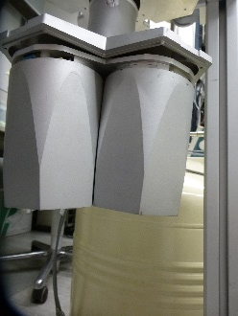
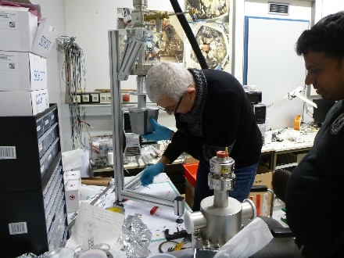
Ge detectors for 2018
I. Kojouharov, GSI Darmstadt
DEGAS Assembly
Vacuum test - ~ 10⁻⁷ – reliable assembly of the cryostat. Difficult to handle – missing holding and manipulation platform.
Produced by TUD: - Heads (full set) – 10 sets
In production at TIFR Mumbai: - Heads (full set) – 10 sets
- Decks (full set) – 10 sets
In production by GSI: - Cold flex – 15 sets
- Cold line – 10 sets
- transition modules (full set) – 7 sets
In cooperation with ORTEC: - modification of the CT-cooler for low vibrational
DEGAS compatible formfactor (available for 2019).

Slide 3
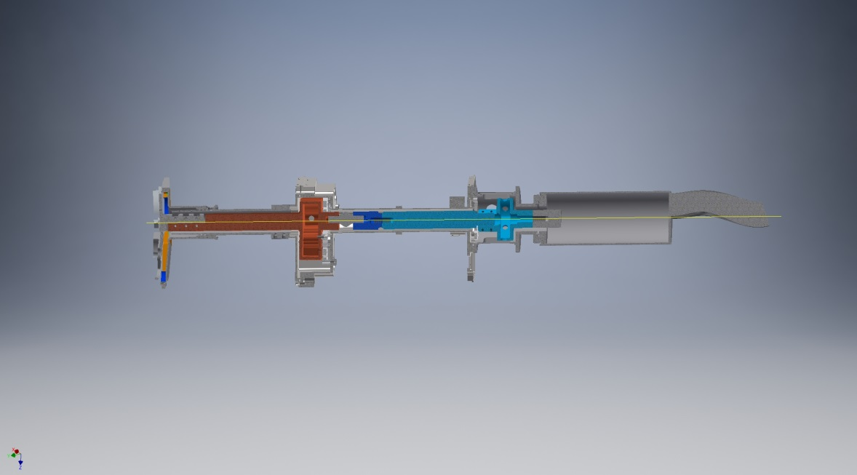
Ge detectors for 2018
I. Kojouharov, GSI Darmstadt
DEGAS Assembly – thermal test
Cooling: 4 Pt100 sensors installed
Pt-1
Pt-2
Pt-3
Pt-4

Slide 4
Ge detectors for 2018
I. Kojouharov, GSI Darmstadt
DEGAS Assembly – thermal test
Thermal tests (carried by XC2 cooling engine, vacuum provided by the turbo pump unit) at different assembly stages: a) – only the Transition module and corresponding cold line section, sensor Pt-4; b) - assembly until the entrance of the main absorber container, sensor positions 2,3 and 4; c) – assembly until the cold frame, sensor positions 1,2,3 and 4.

Slide 5
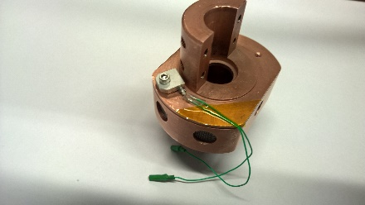
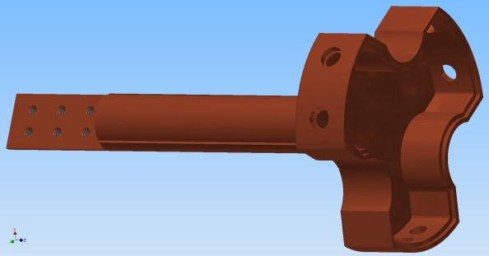
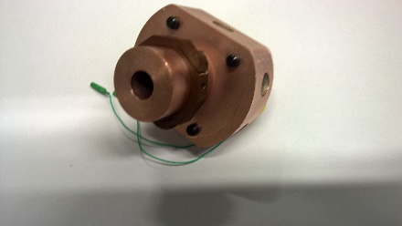
Ge detectors for 2018
I. Kojouharov, GSI Darmstadt
DEGAS Assembly – thermal test
Thermal calibration of XC2 – fixture the used – Pt100 sensor and 22 Ohm heat resistor installed on a small Cu-block connected to the cold finger of the XC2. The block does not have any thermal contact to the outer cryostat, the wires (Pt100, 2x0.07 mm², 10 cm, heat element – 2x0.14 mm², 20 cm) are chosen sufficiently long not to distort the results.
Some findings: 1. The start container supports have 1W
thermal losses.
2. The cold line in the section within and
after the main container absorber has
very high thermal losses – ca. 3.7 W.

Slide 6
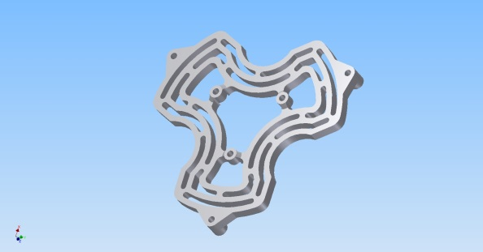
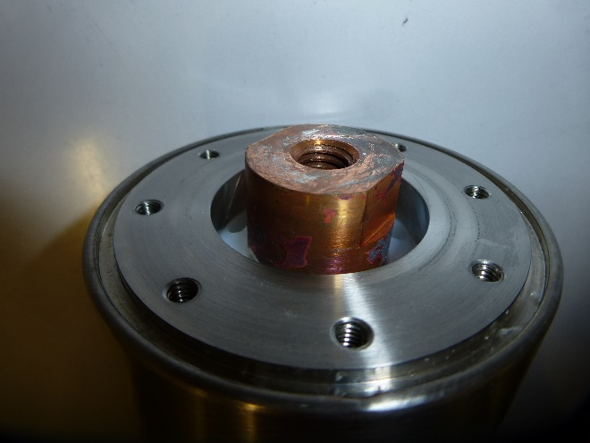
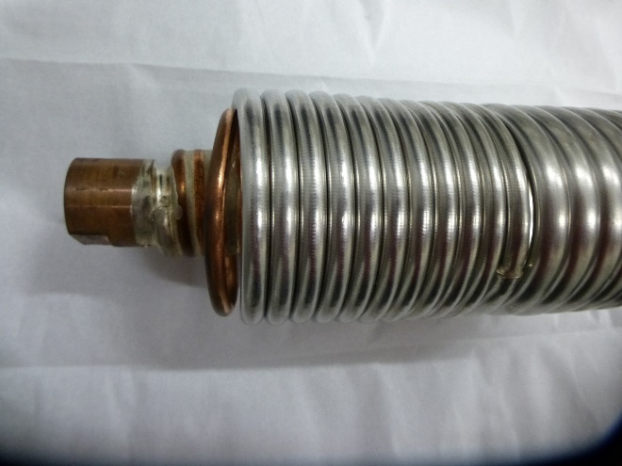
Ge detectors for 2018
I. Kojouharov, GSI Darmstadt
DEGAS Assembly – thermal test
Conclusions: 1. The calculated thermal losses of the main labyrinth (110 mW) even with
wrong thermal conductivity cannot explain the losses observed.
2. The most probable reason is the vacuum state. Even with continuous
pumping the gradient is too high. One has to take care for enhancing the
evacuating capability of the cryostat construction, mainly the cold line
improvement. Redesign of the main absorber container and stretching of
the cold finger.
3. Reducing the number of the supports.
4. Change of the cold line in the Transition module section in order to fit
with the variations of the XC2 assembly.
D
DEGAS preamplifier development – see r. Donthi contribution

Slide 7
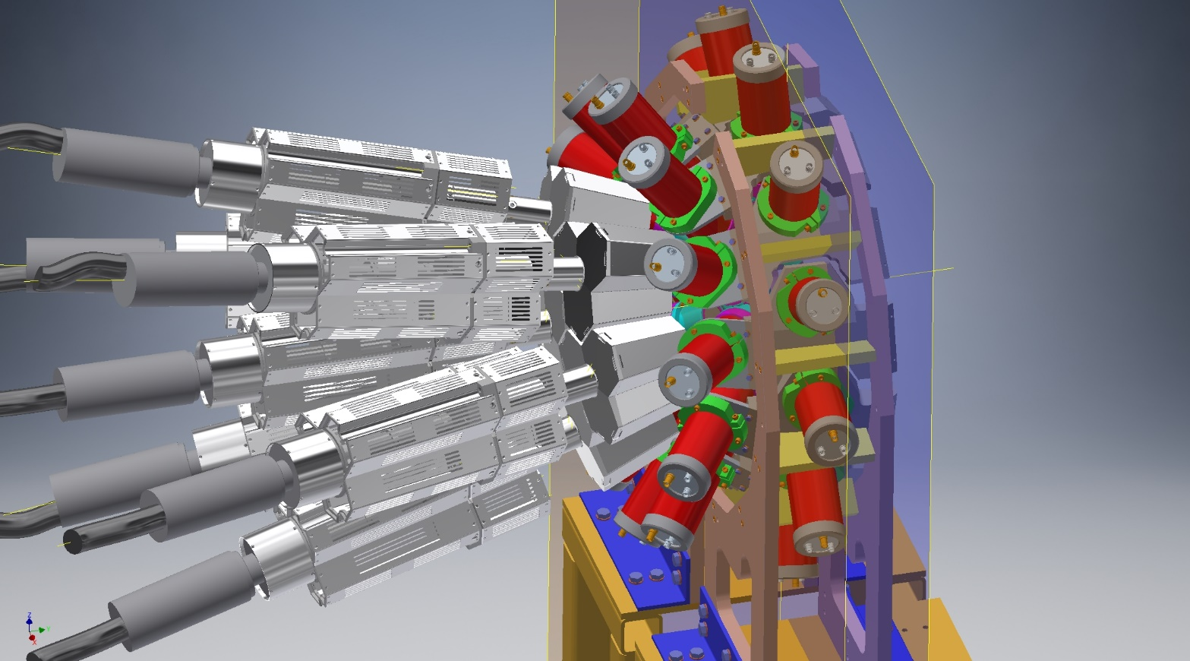
Ge detectors for 2018
I. Kojouharov, GSI Darmstadt
DESPEC assemblies for the experiments in 2018
FATIMA+DEGAS assembly

Slide 8
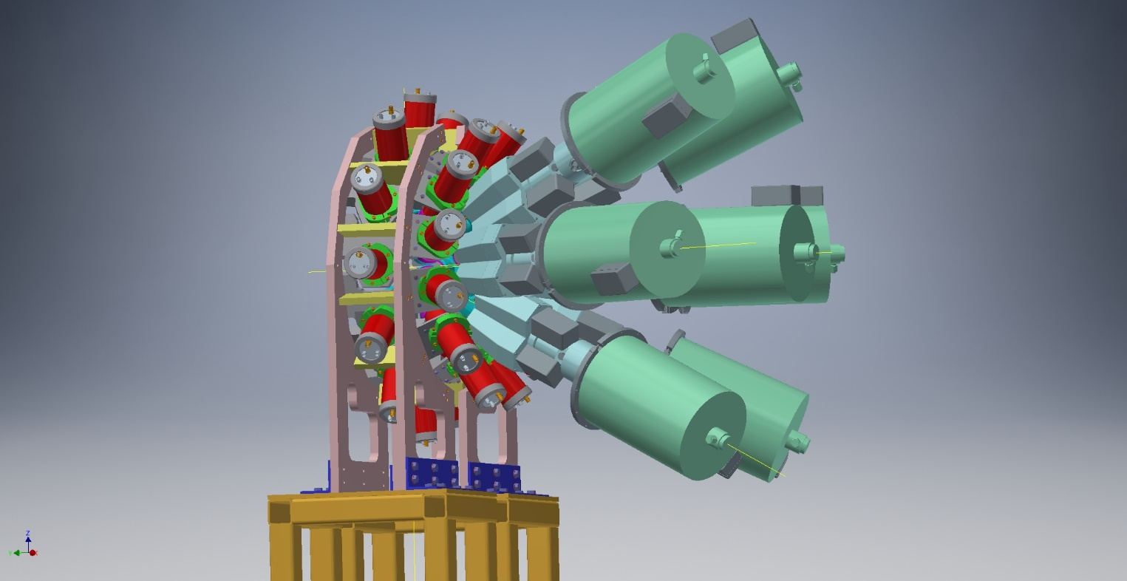
Ge detectors for 2018
I. Kojouharov, GSI Darmstadt
DESPEC assemblies for the experiments in 2018
FATIMA+GALILEO assembly

Slide 9
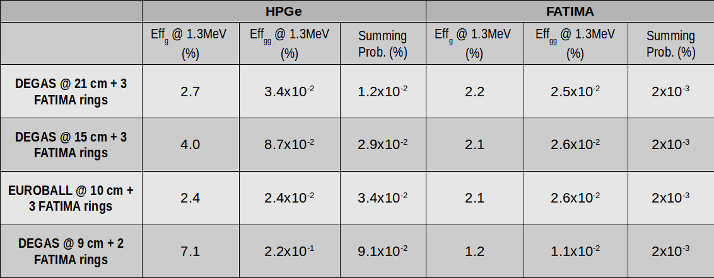
Ge detectors for 2018
I. Kojouharov, GSI Darmstadt
DESPEC assemblies for the experiments in 2018 – efficiencies (Anabel Morales)
1. 7 DEGAS triples + 3 FATIMA rings, AIDA in the center of FATIMA (~21cm from DEGAS to AIDA center)
2. 7 DEGAS triples + 3 FATIMA rings, AIDA moved 6 cm towards DEGAS (~15cm between DEGAS and
center of AIDA)
3. 1 EUROBALL cluster @ 0 deg + 3 FATIMA rings, AIDA in the center of FATIMA (~10cm between
EUROBALL and center of AIDA)
4. 7 DEGAS triples + 2 FATIMA rings, AIDA in the center of FATIMA (~9cm from DEGAS to AIDA center)

Slide 10
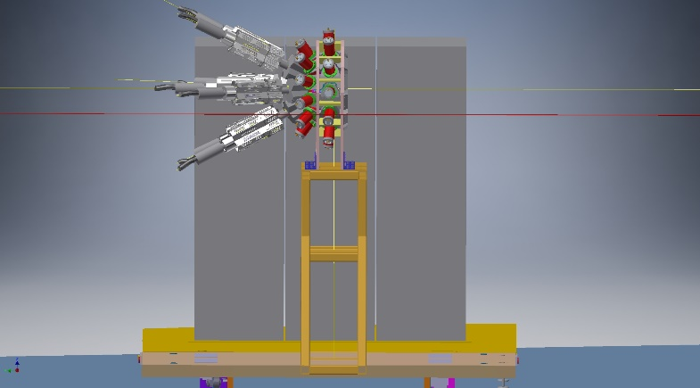
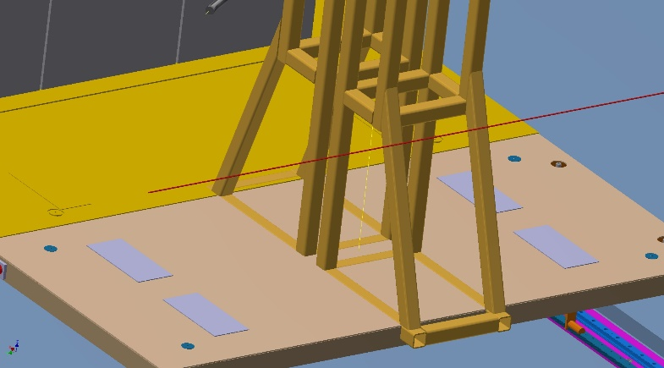
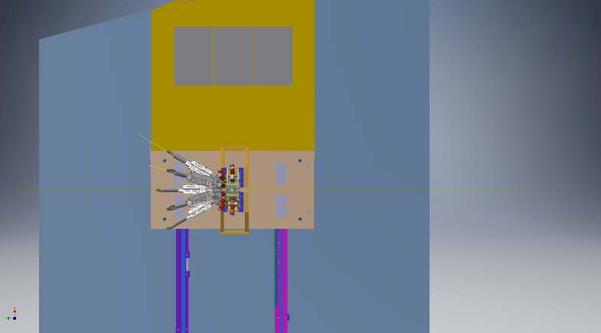
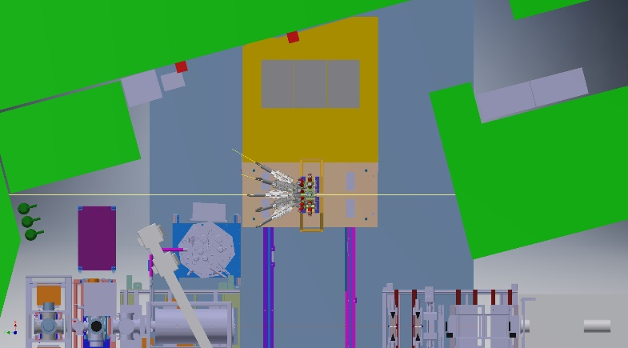
Ge detectors for 2018
I. Kojouharov, GSI Darmstadt
DESPEC assemblies for the experiments in 2018 – setup situated at S4 (without AIDA)
The setup utilizes the ring of FATIMA as it is and supposes a new platform (on parallel to the beam rails) holding DEGAS/GALILEO ring. The DEGAS/GALILEO ring is universal one, which allows any of these detectors to be installed there. The difference (~10 cm) can be absorbed by spacers. Certain adjustment the height is needed. This setup is currently on development at TIFR, any components will be produced as soon as the design ready.

Slide 11
Ge detectors for 2018
I. Kojouharov, GSI Darmstadt
Thank you

