Slide 1
Staged approach of Barrel EMC integration: study of the only possible design
VALERIY FERAPONTOV DESIGN ENGINEER
on behalf of the NRC “Kurchatov Institute” – IHEP Protvino group
March 2018
GSI

Slide 2
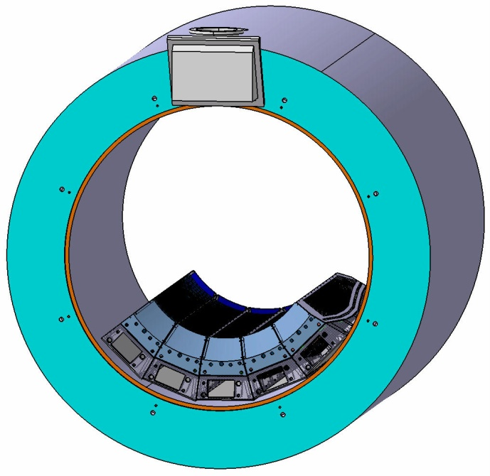
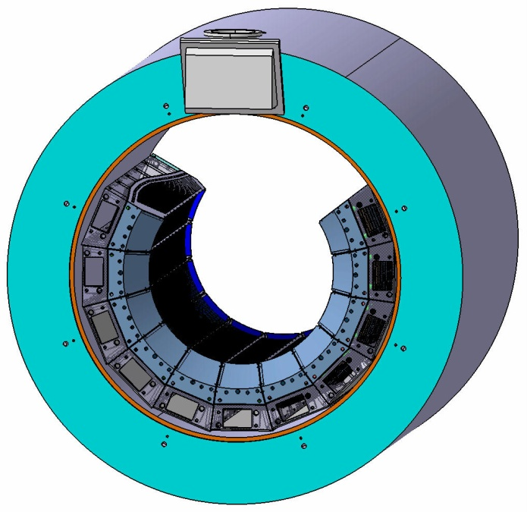
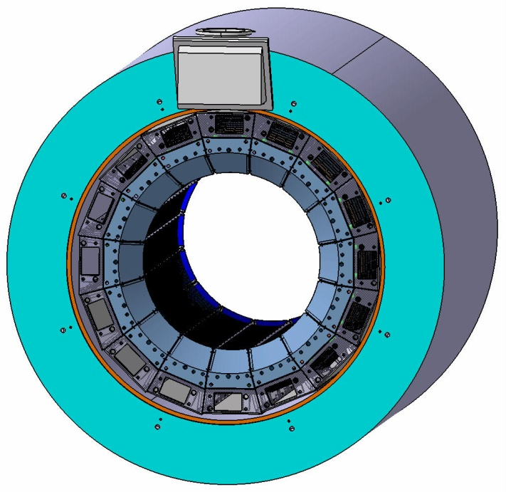
The main goal of this Report is to choose the only possible design of Barrel mechanics.
To do it we studied two scenarios of Barrel assembly:
- the Main version (described in TDR and Technical Specifications).
- five different versions of Modular approaches.
1. Why Modular approach?
- Not all crystals can be produced in time;
- Modular approach would allow one to assemble Barrel EMC in few stages with minimum disassembling of PANDA setup between experimental runs.
Stage N1
Stage N2
Stage N3

Slide 3
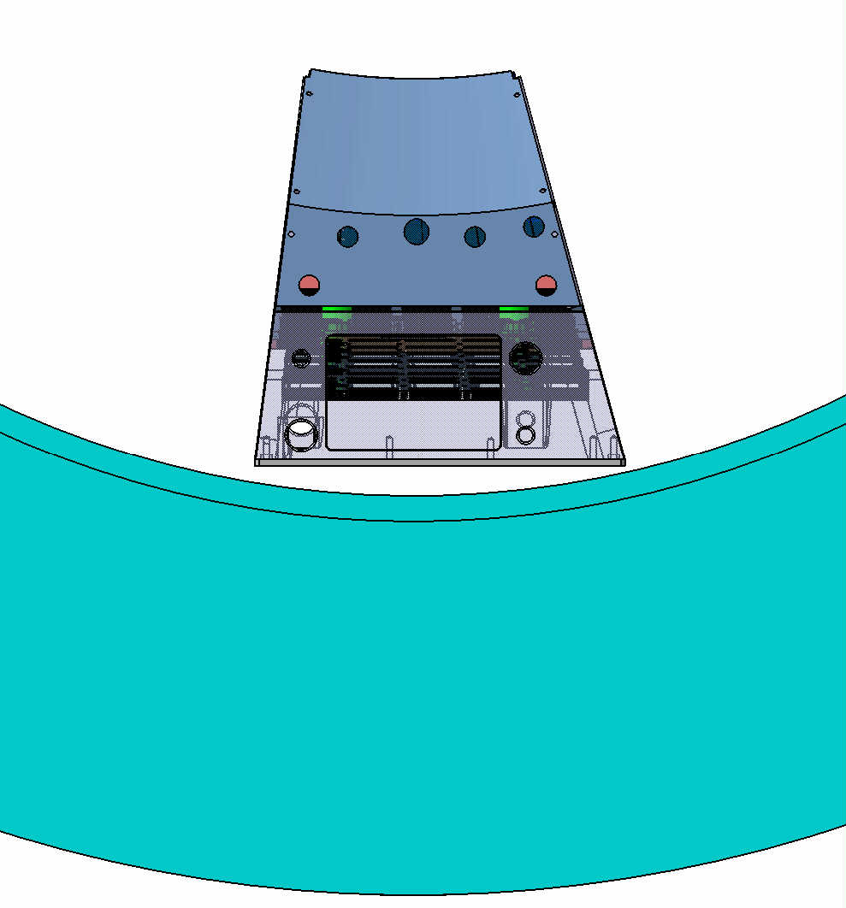
2. Boundary conditions
The minimal gap between inner surface of cryostat and a cover of the slice is only 6 mm
Cover
The gap in this area ~29 mm

Slide 4
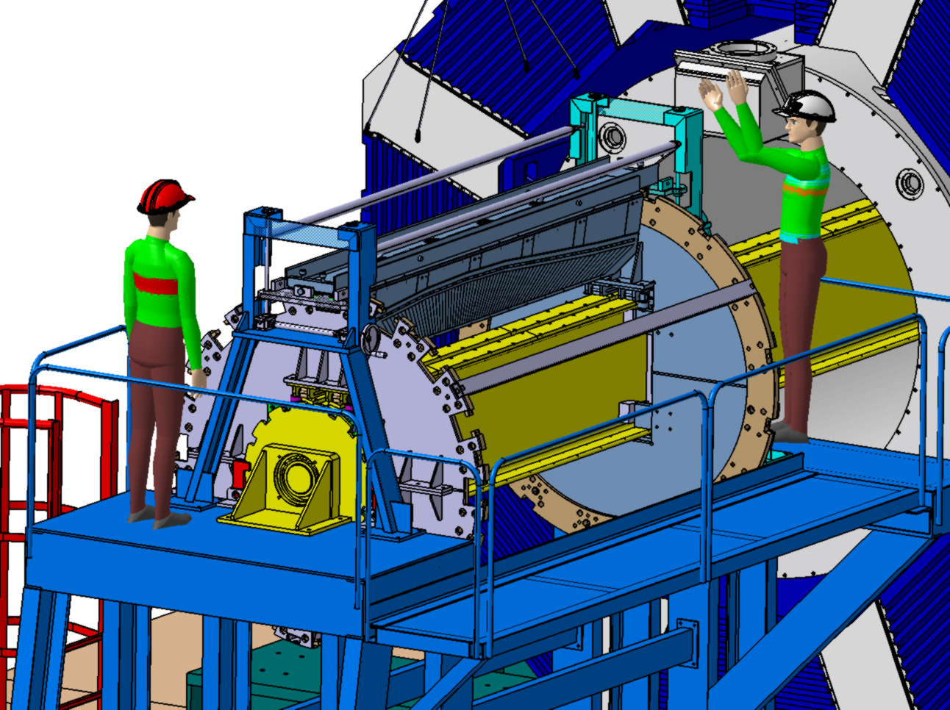
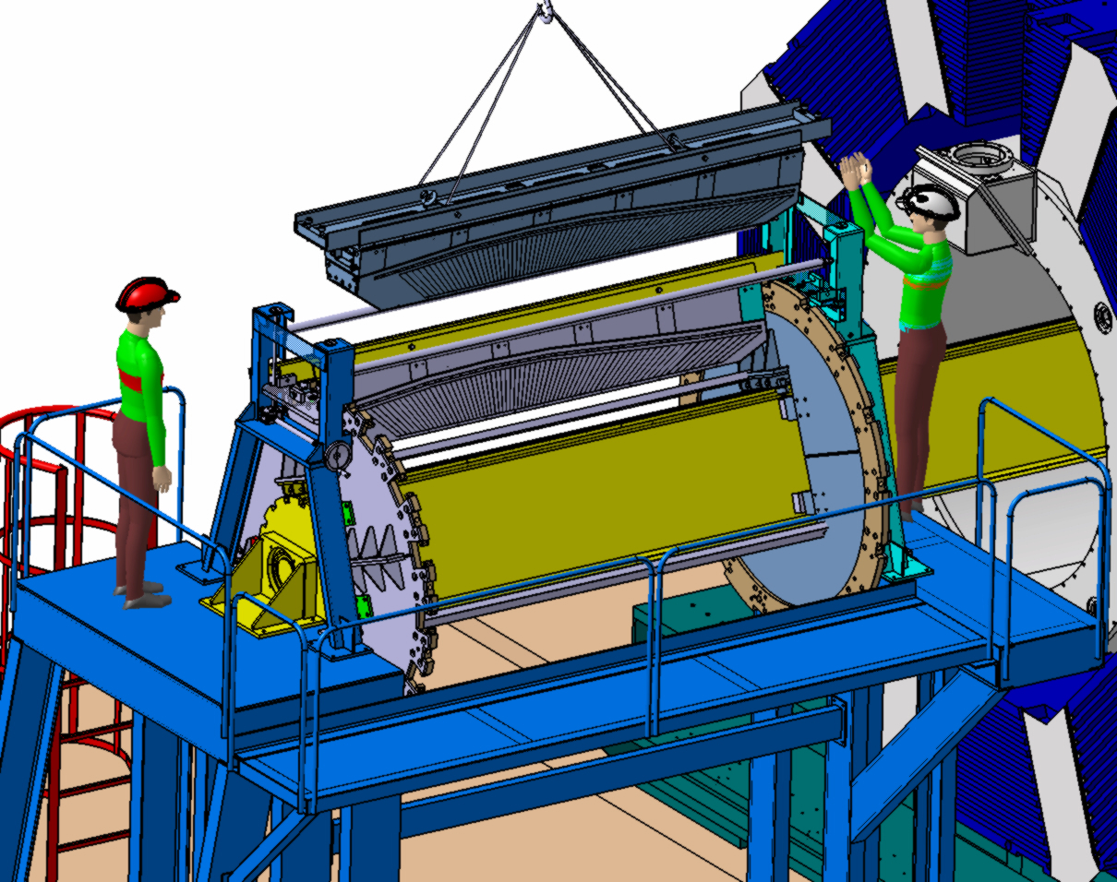
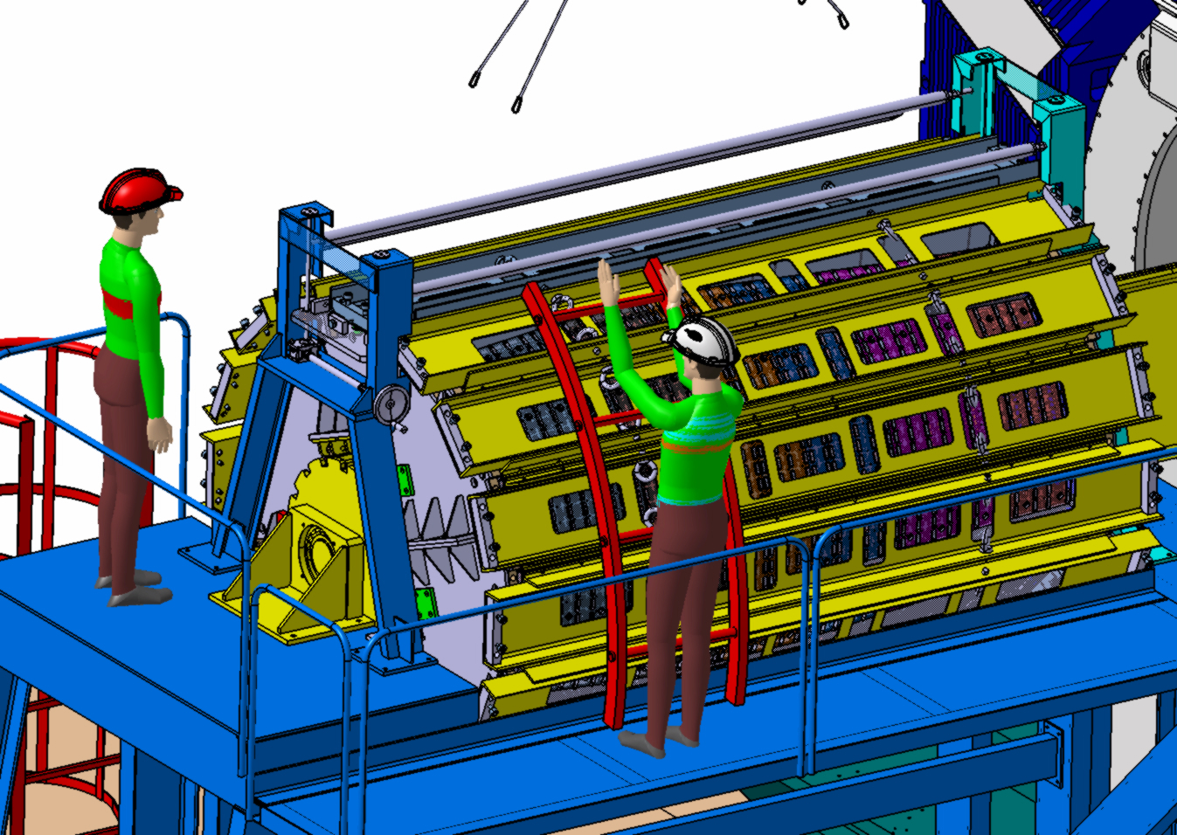
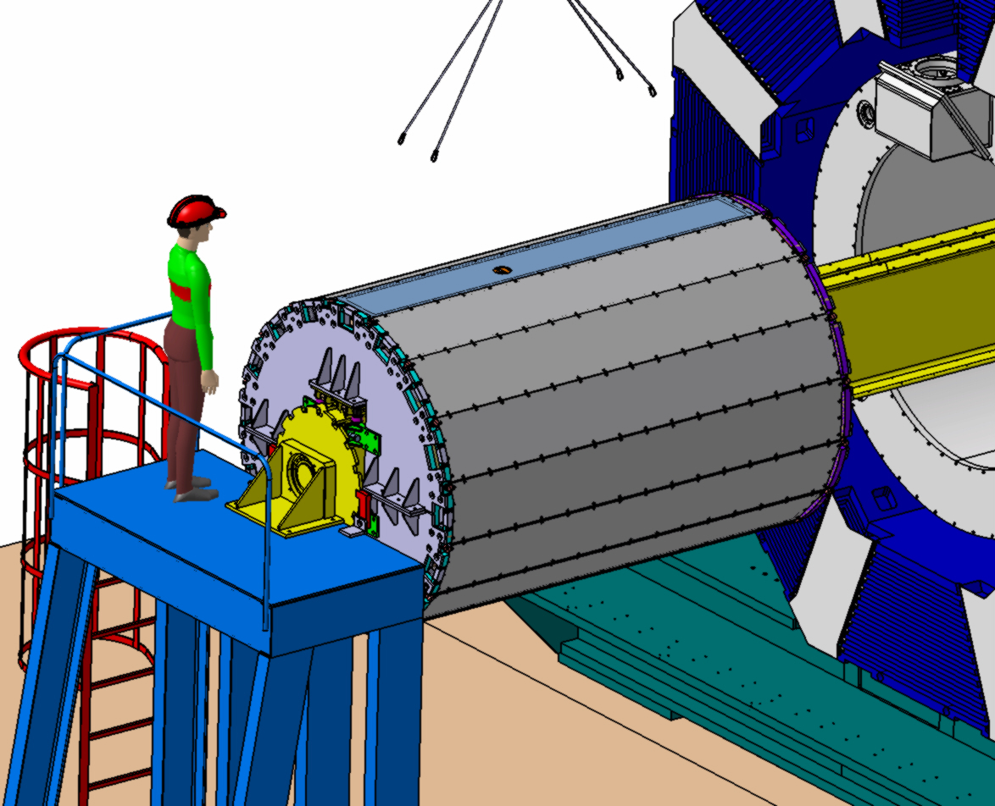
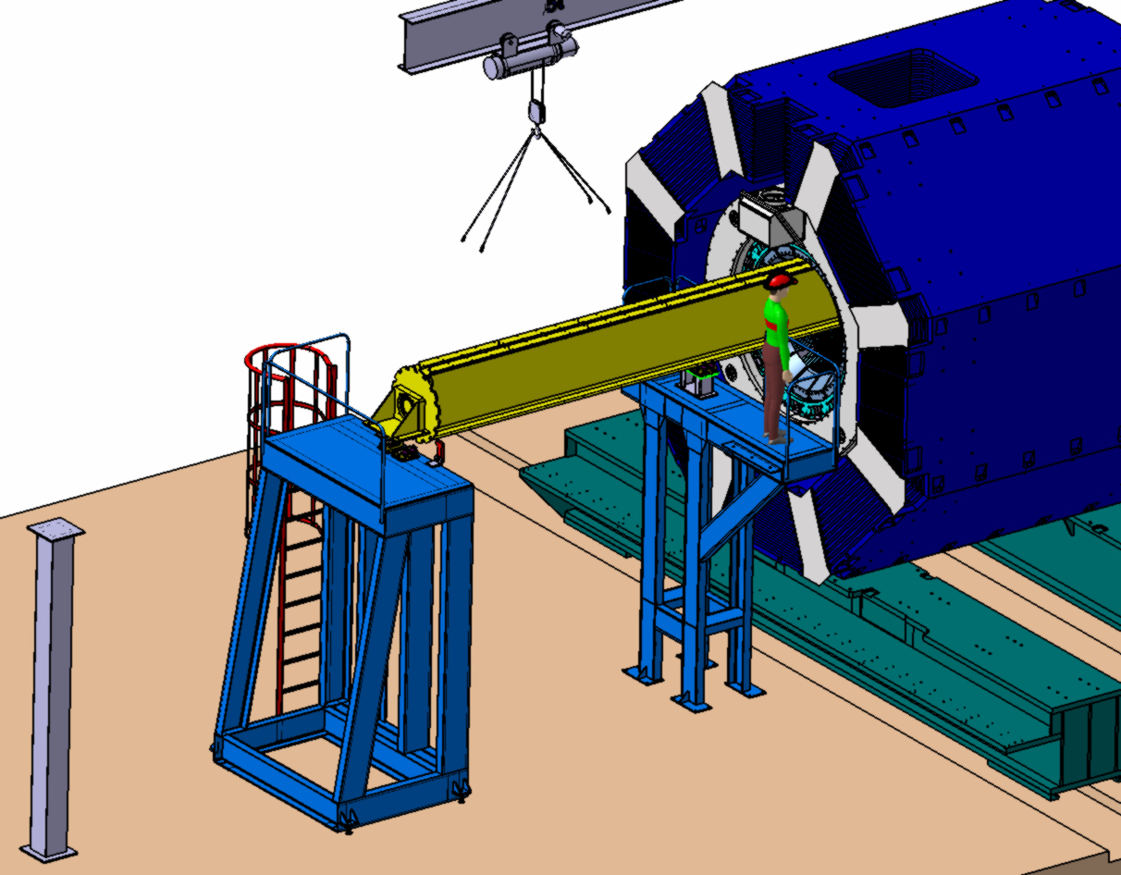
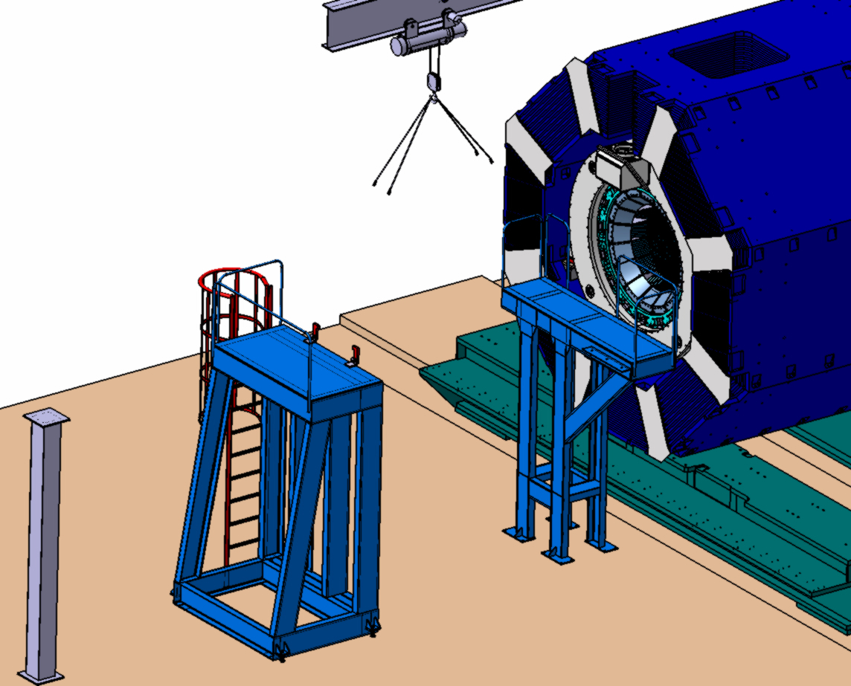
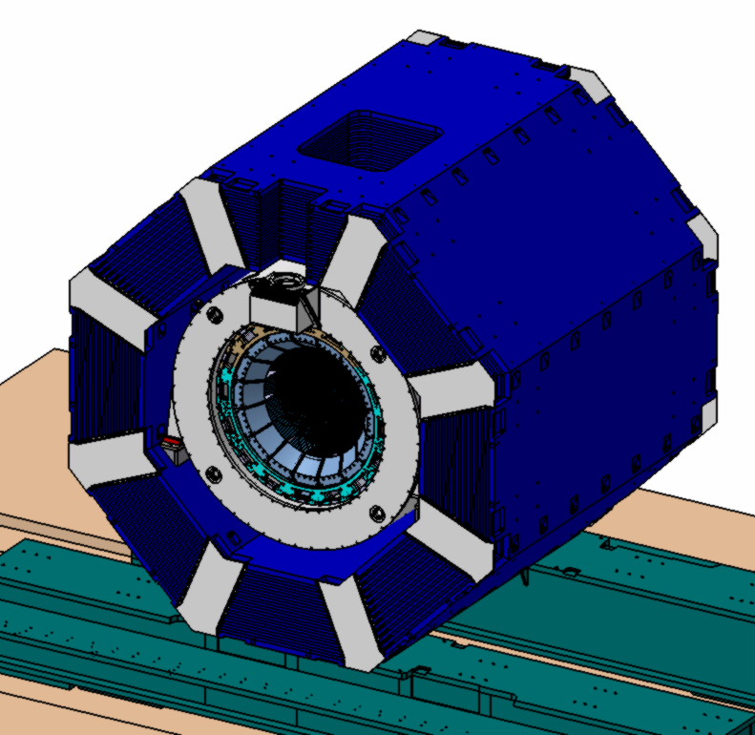
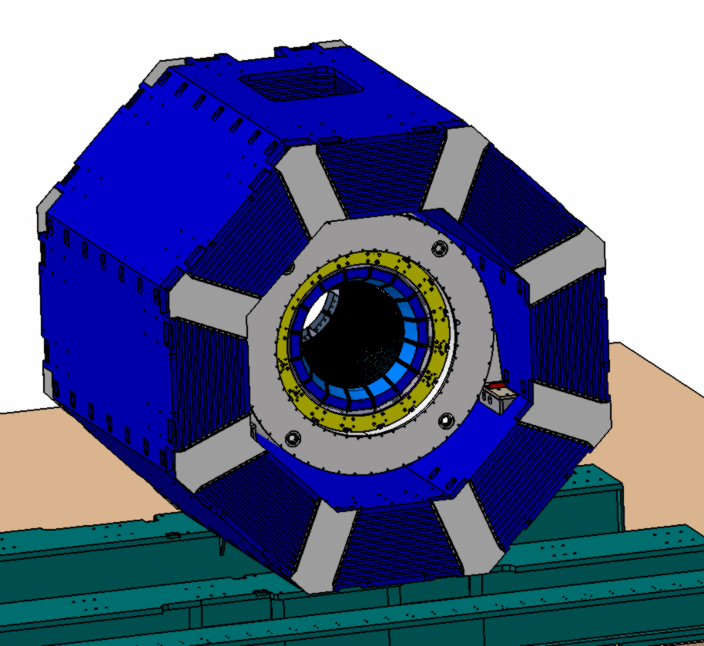
3. Short explication of Main Version

Slide 5
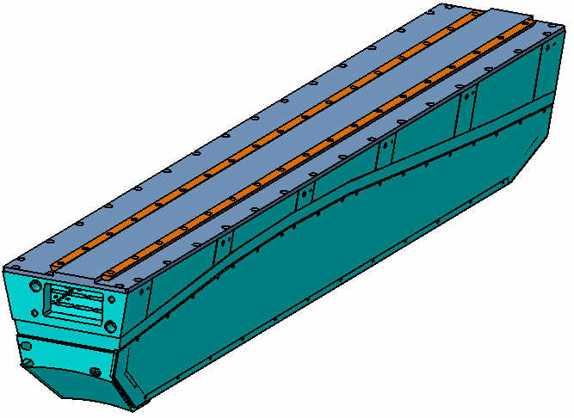
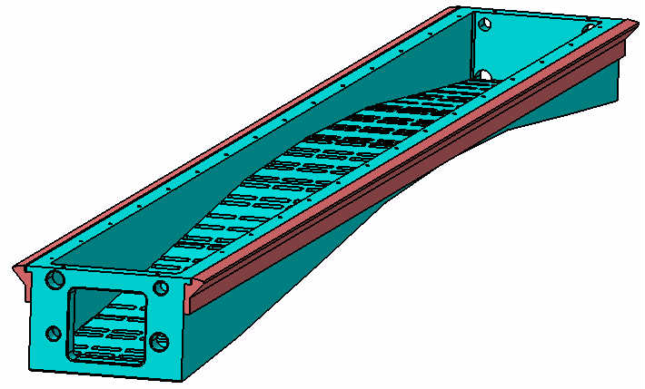
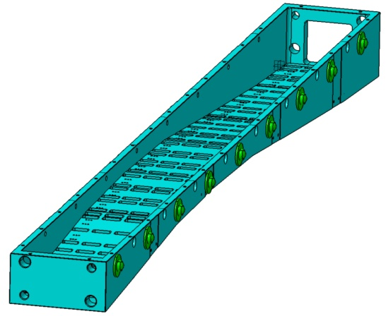
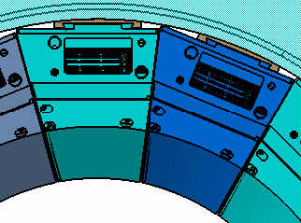
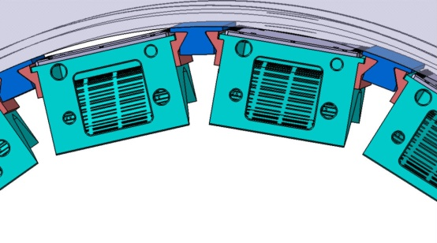
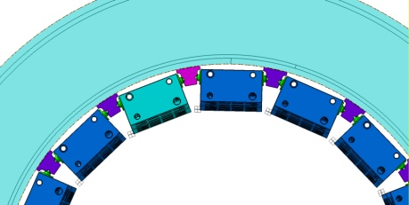
4. COMPARATIVE ANALYSIS OF 5 ALTERNATIVE (MODULAR) VERSIONS
Modular Version N1
Modular Version N2
Modular Version N3
ADVANTAGES:
More space for the Cables, Services.
ADVANTAGES:
More stiffness.
(Rails on the Beam)
ADVANTAGES:
More stiffness. (Ball Transfer Units on the Beam)
DISADVANTAGES:
More requirements to
stiffness for the Cover.
2. Insufficient space for
Rails installation- the
Version does NOT fit
DISADVANTAGES:
Less space for the Cables, Services-
the Version does NOT fit
DISADVANTAGES:
Less space for the Cables, Services-
the Version does NOT fit

Slide 6
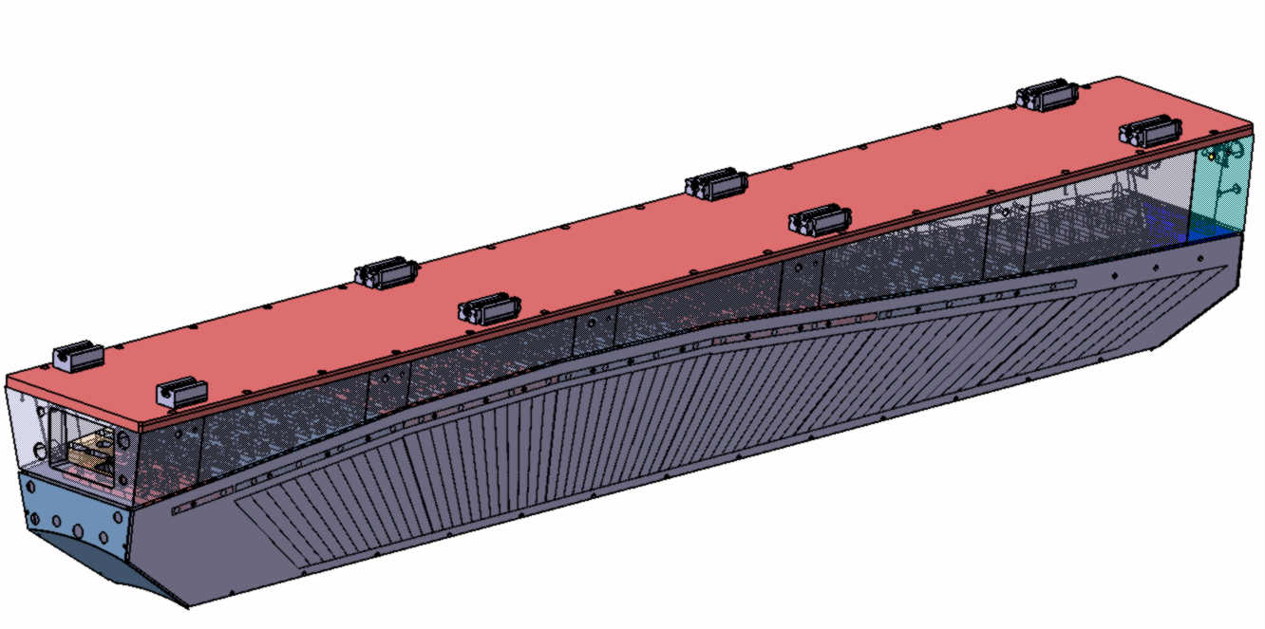
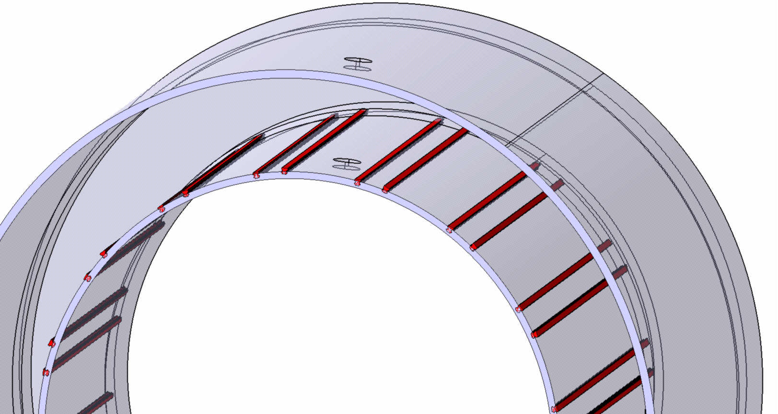
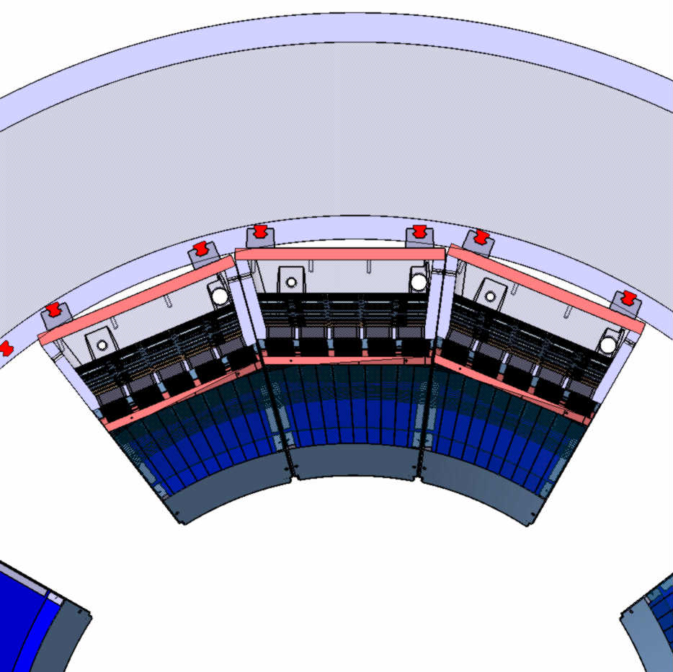
COMPARATIVE ANALYSIS OF 5 ALTERNATIVE (MODULAR) VERSIONS (continue)
Modular Version N4
Cryostat’s inner surface
(actual size D1900 )
Cryostat’s inner surface
(size D1980 is necessary)
Rails must be fixed to Cryostat
Conclusion- this version does NOT fit without enlargement
of inner diameter of Cryostat

Slide 7
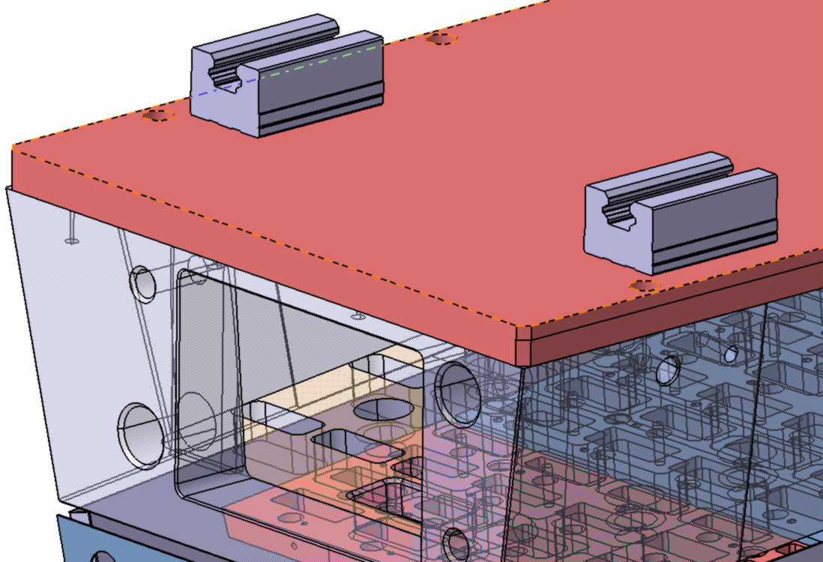
Cryostat’s inner surface
(actual size D1900 )
Cryostat’s inner surface
( size D1980 is necessary)
Standard linear rails
Standard linear moving carriage
“Зарезанная” зона криостата

Slide 8
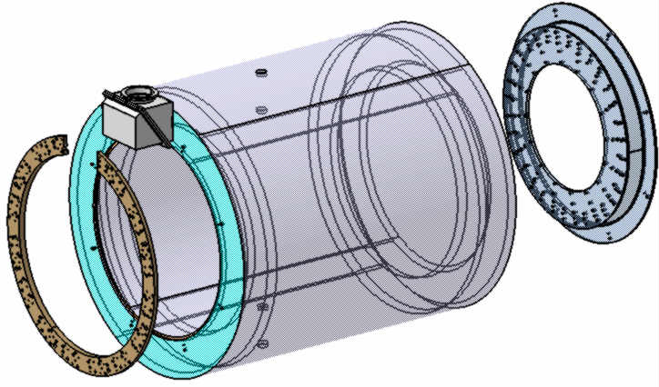
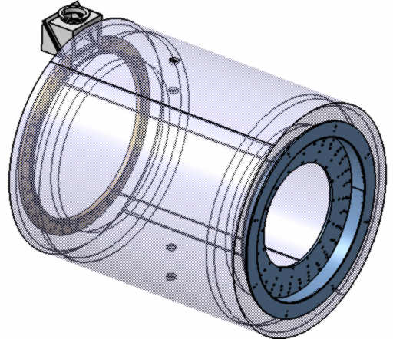
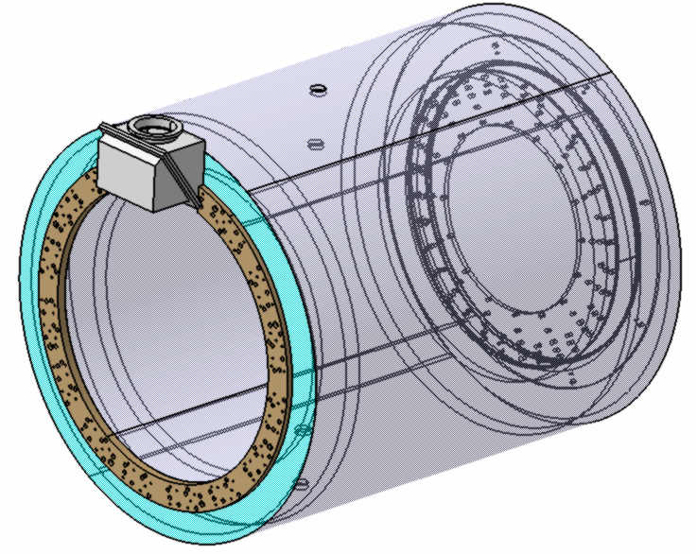
COMPARATIVE ANALYSIS OF 5 ALTERNATIVE (MODULAR) VERSIONS (continue) VERSIONS N5 (more realistic)
STEP 1- Cryostat preparation ( Magnet is not shown)
Procedures:
- Mounting and fixation of 2 Rings from both sides to the Cryostat;
(Upstream side ring has an incision. In this case it has a reduced stiffness)

Slide 9
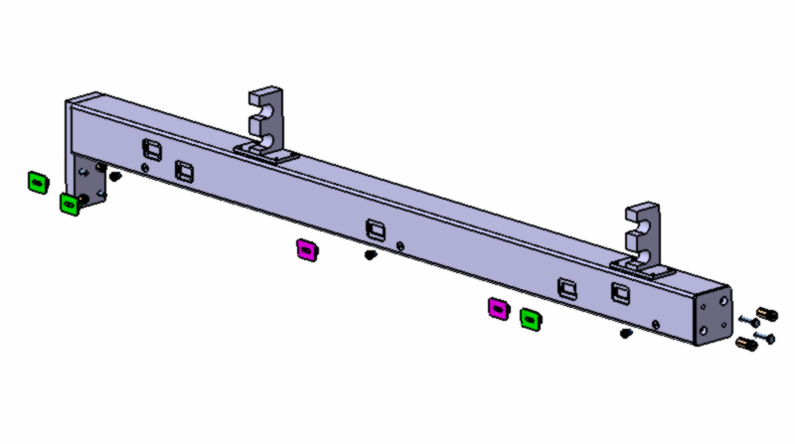
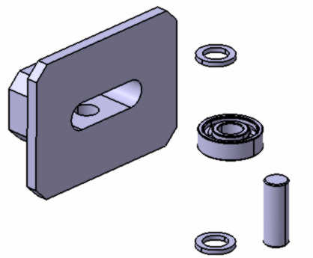
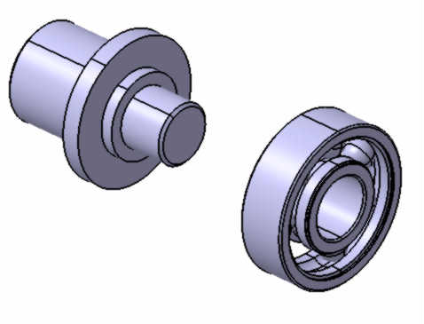
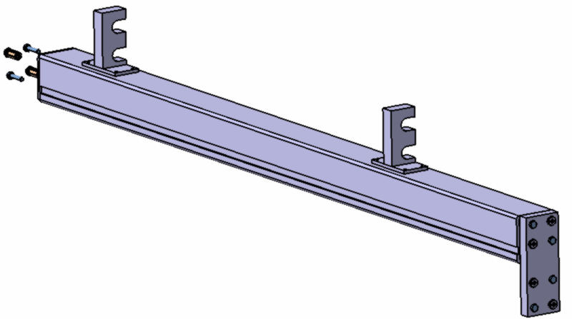
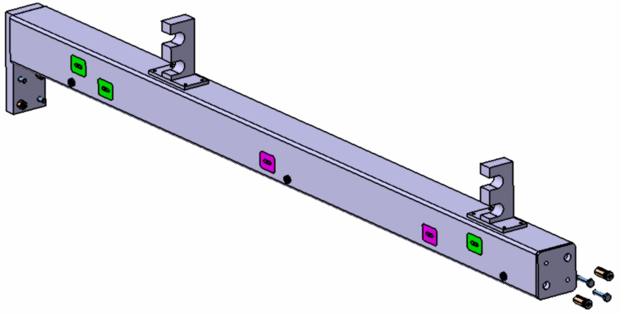
STEP 2- Preparation of 2 special technological beams
Precise slot for bearings moving have to be machined
radial ball bearing
6000 series
C static= 1960 N
Procedures:
- Mounting and fixation of 4 centering pins and 4 bolts M16
and 5 bearing assemblies on technological beam (black steel square tube 160x160x12 mm);

Slide 10
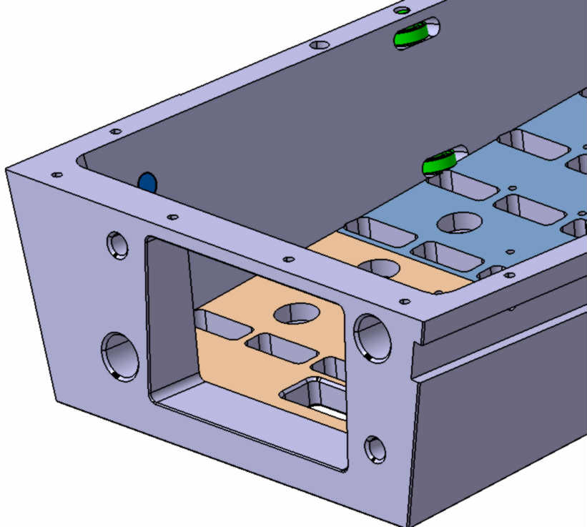
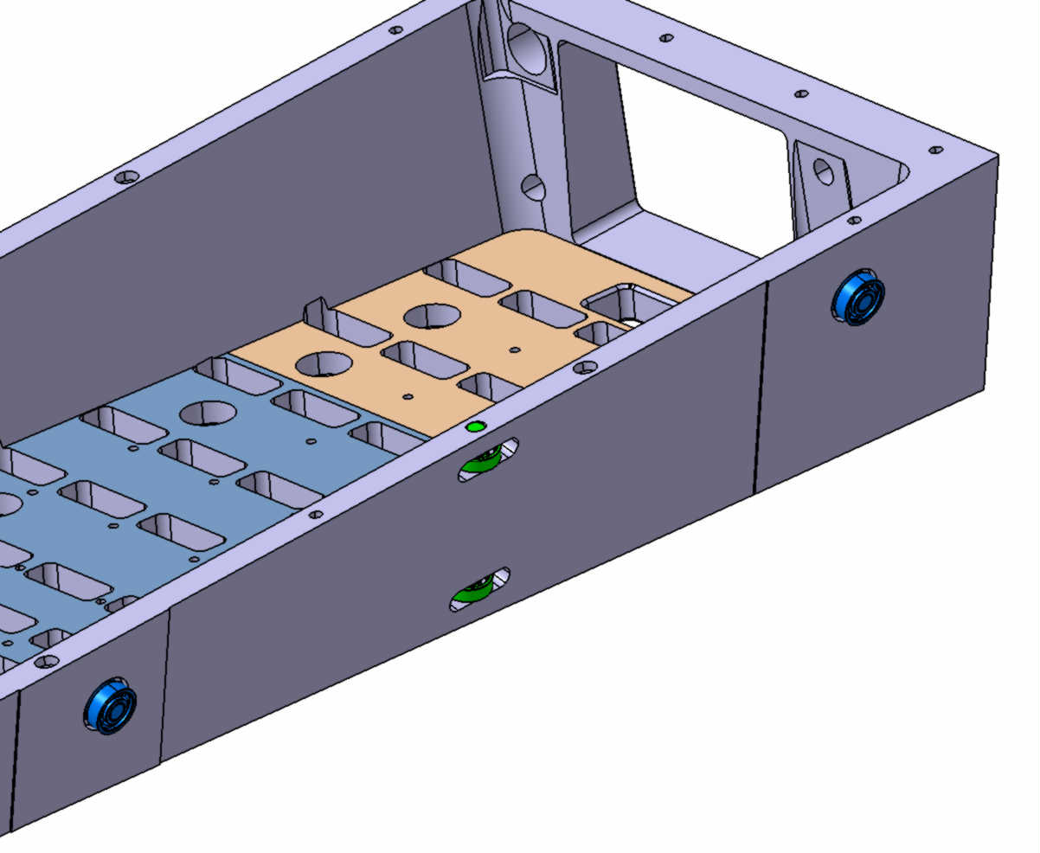
STEP 3- Support beam preparation (simplified view)
radial ball bearing
6000 series
C static= 1960 N
Procedures:
- Machining of special precise slot for bearing moving;
- Mounting and fixation of 16 bearing Assemblies on the support beam.

Slide 11
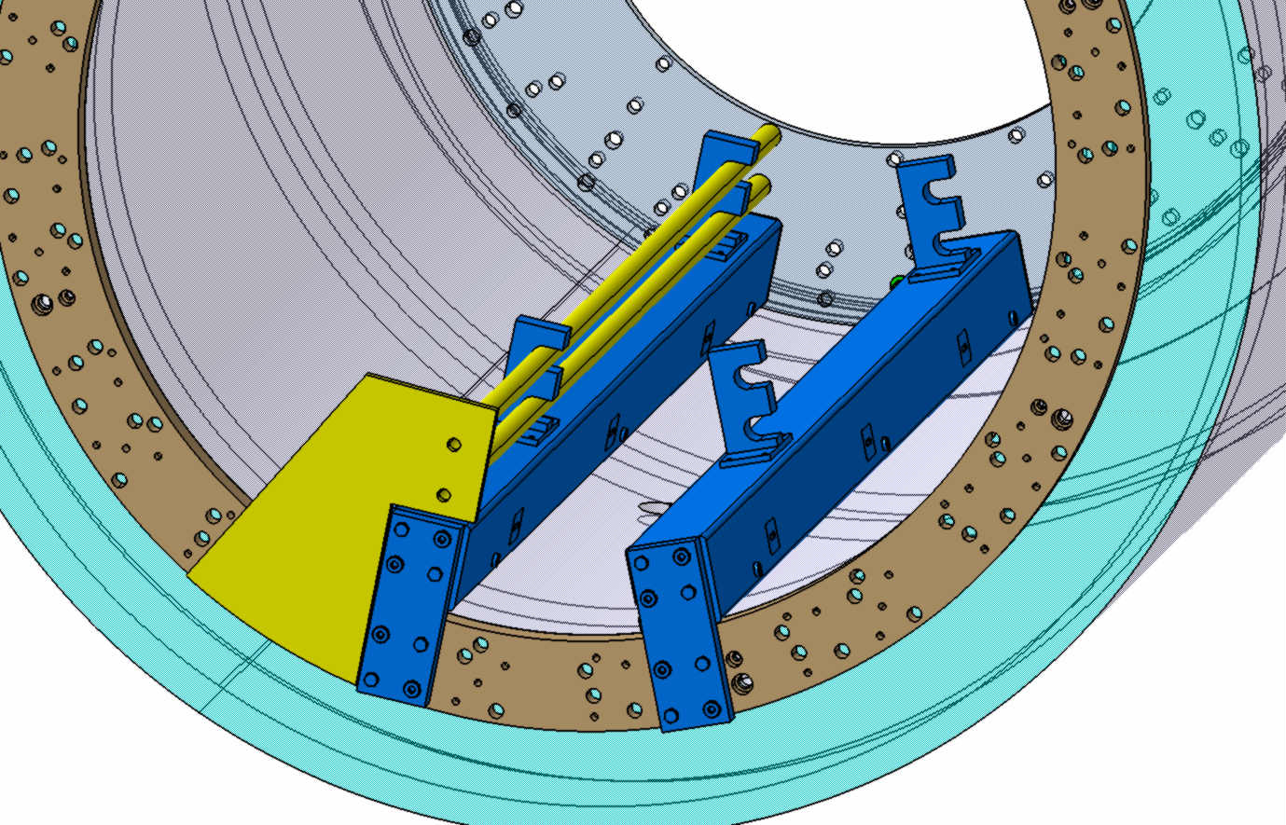
STEP 4- Technological Beams installation ( Magnet is not shown)
because of the high weight of the technological Beams (~180 kg) it is necessary to use
special guide for technological beams installation
Procedures:
Mounting and fixation of guide (yellow on the picture) ;
Pushing and sliding technological beam along the guide;
- Mounting and fixation of technological beam by means of 2 centering pins and 2 bolts from downstream and upstream sides.

Slide 12
STEP 5- Installation of the tilting device (cantilever) in the preliminary position.
Installation and attachment of the slice to the rotating platform. ( Magnet is not shown)
Procedures:
The slice to be installed on the rotating platform of the cantilever;
Adjusting of the slice and installation of special guide rails to fix the slice on the platform.

Slide 13
STEP 6- Rotating and adjusting of technological device
according to the position of technological beams
Procedures:
Rotating of technological device by means of transfer worm;
Adjusting of the tilting according to position of technological beams;

Slide 14
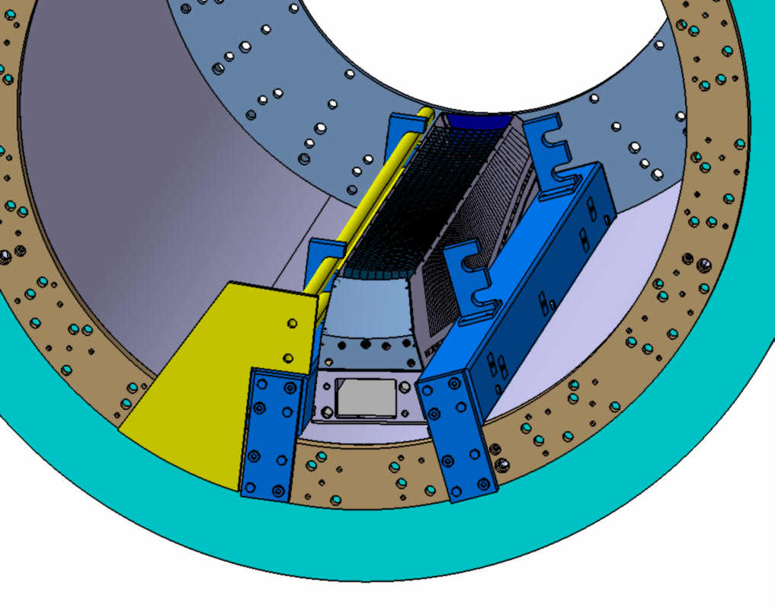
Procedures: - Slice to be rolled in till the stop on the flange;
STEP 7- Rolling in of Slice to the working position

Slide 15
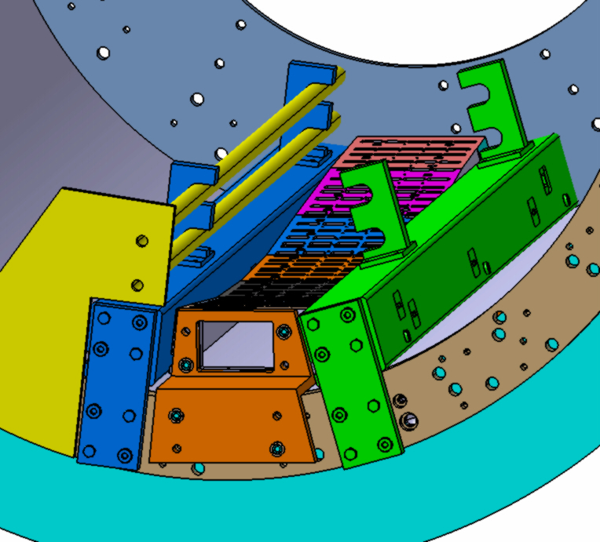
STEP 8- Slice mounting at the working position
Procedures: - Slice to be fixed to the downstream ring with the use of 2 centering pins and 2 bolts M16 and by the bracket from upstream side.

Slide 16
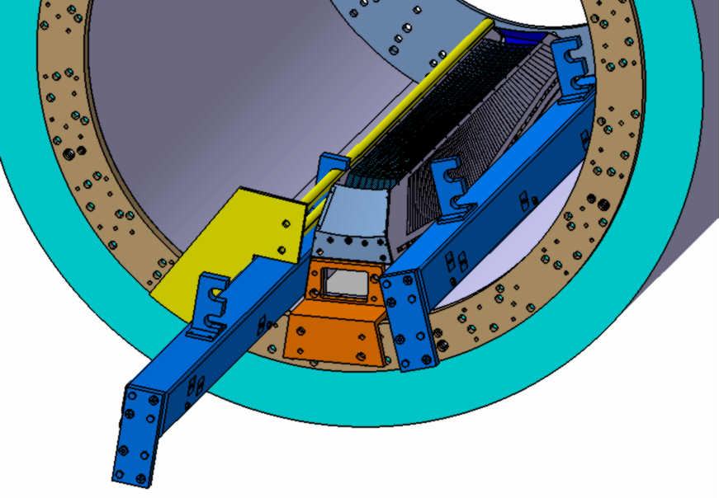
STEP 9- Dismounting of the technological bracket
Procedures: - Removal of the left technological beam (blue color); - Removal of the guide (Yellow color).

Slide 17
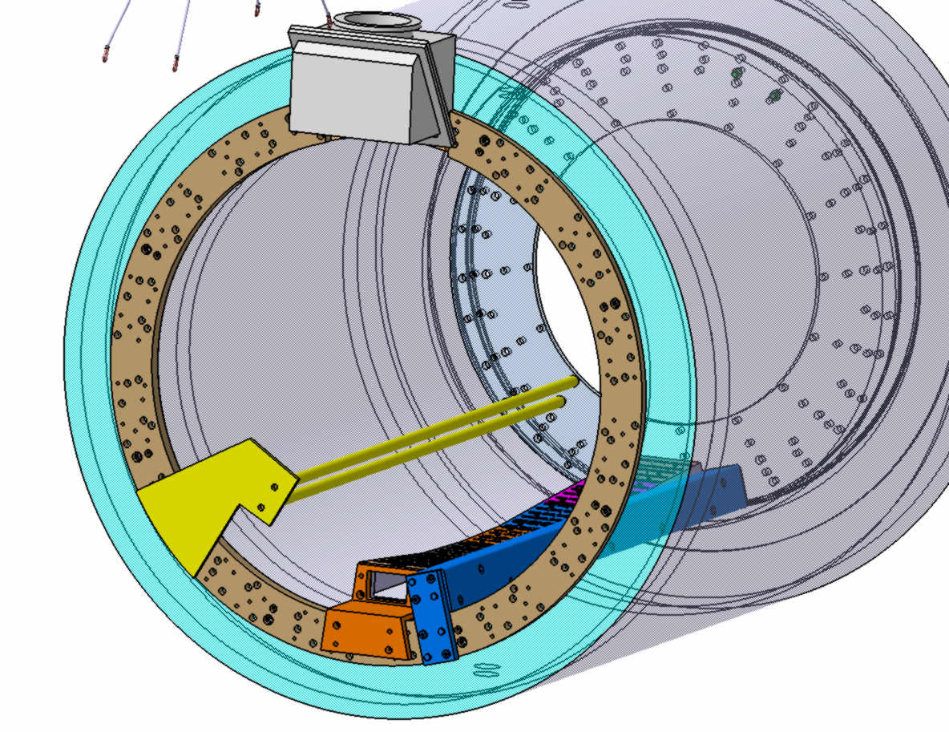
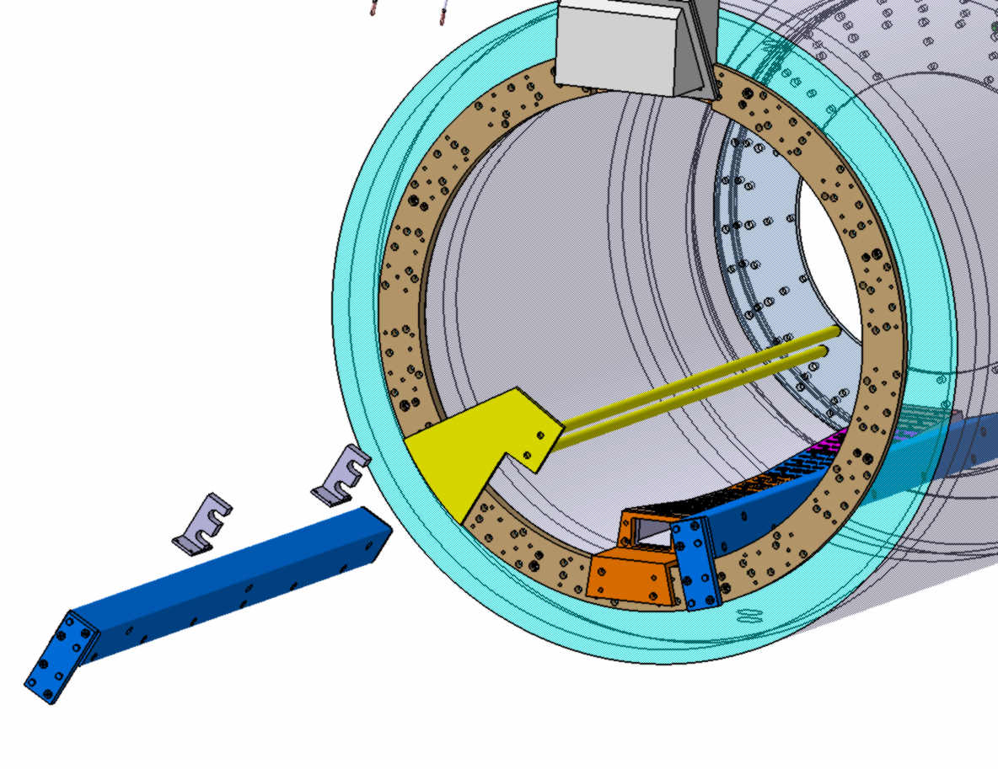
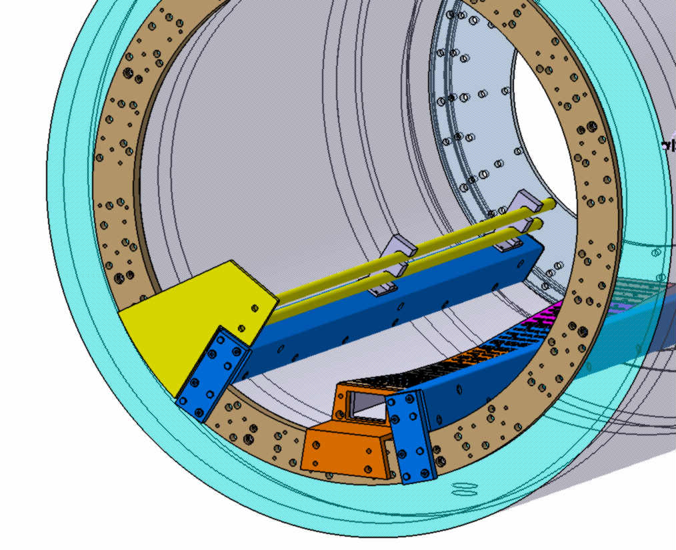
STEP 10- Installation of the technological beam in the next position
Procedures: - Installation of the guide (yellow color) in new position;
- Installation of the technological beam in new position.

Slide 18
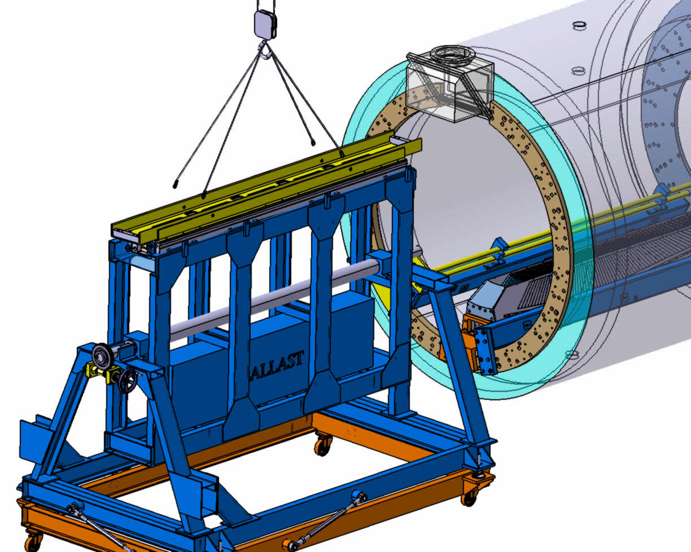
STEP 11- Installation of the rotary device (cantilever) in the preliminary position.
Installation and attachment of the slice to the rotating platform .
Procedures:
The following slice to be install on the rotary platform of technological device;
Adjusting of the slice and installation special guide rails to fix the slice on the platform.

Slide 19
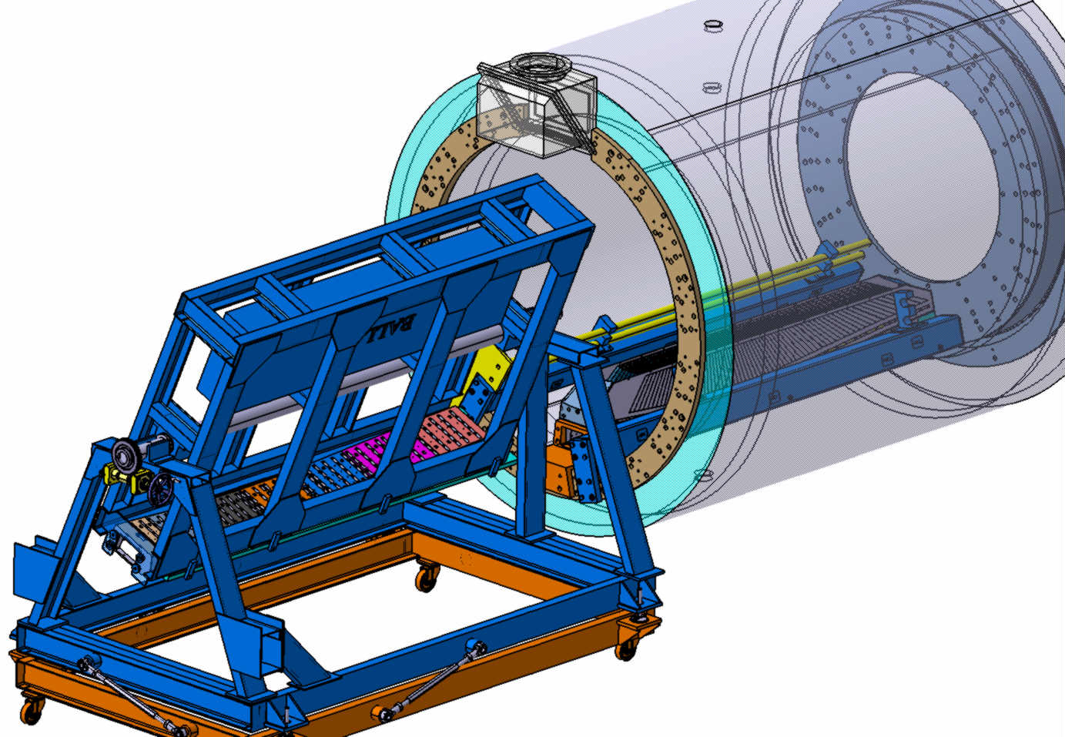
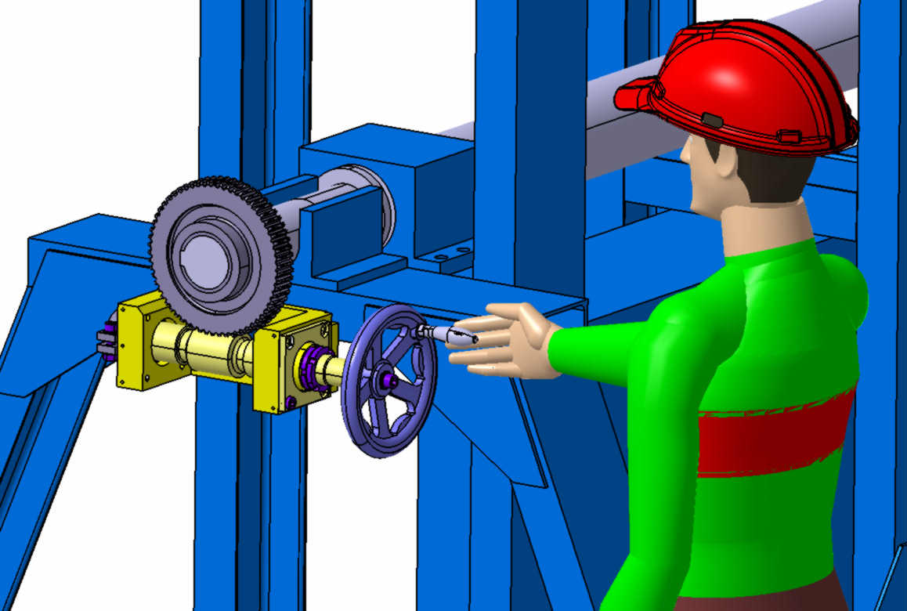
STEP 12 Rotating and adjusting of technological device
according to the position of technological beam and previous slice
Procedures:
Rotating technological device by means of transfer worm;
Adjusting of the tilting according to position of technological beam and previous slice;
Push the slice till contact with rear flange.

Slide 20
STEP 13- Slice mounting at the working position
Procedures:
Slice to be fixed to the downstream ring with the use of 2 centering pins and
2 bolts M16 and by the bracket from upstream side.

Slide 21
STEP 14- Assembly continue
Procedures: - The same procedures as with the following slice.

Slide 22
STEP 16- Assembly continue
PROBLEM- The installation of the slice is impeded by the current lead.
The technological beam and the bracket have to be original

Slide 23
STEP 17- Assembly continue
The same procedures for right side slices as with the left side slices

Slide 24
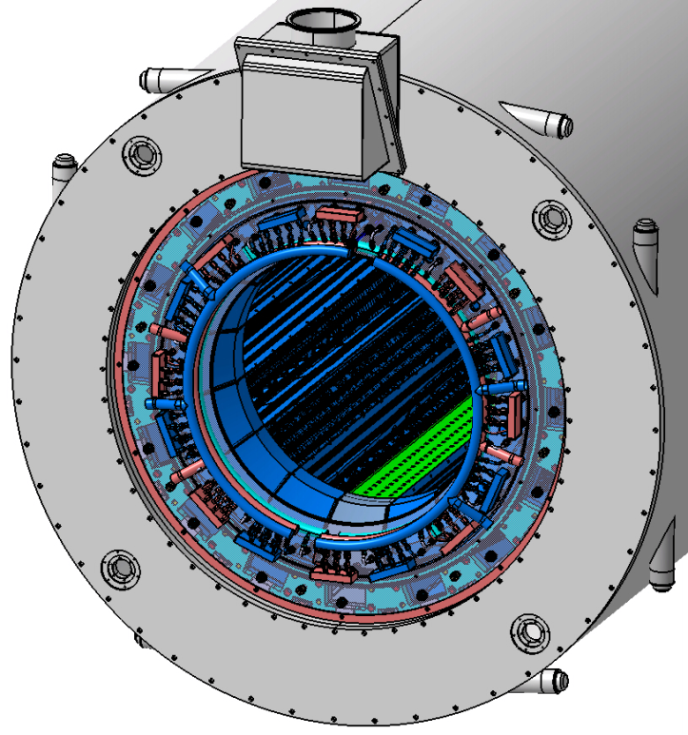
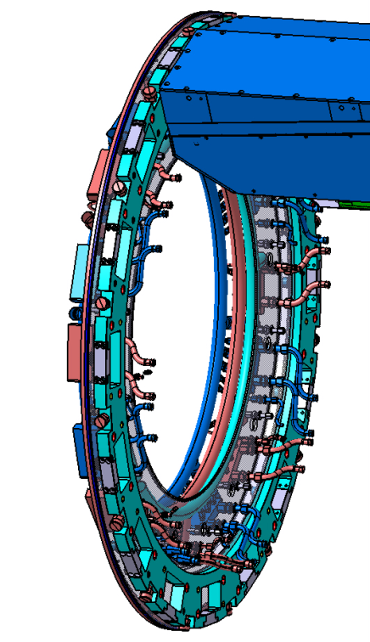
STEP 18- Assembly continue
PROBLEMS- There is no place for fixing bracket, problem with cooling system for the Barrel
Cooling system

Slide 25
Вид на баррель со стороны Downstream
STEP 19- Assembly continue
View from downstream side

Slide 26
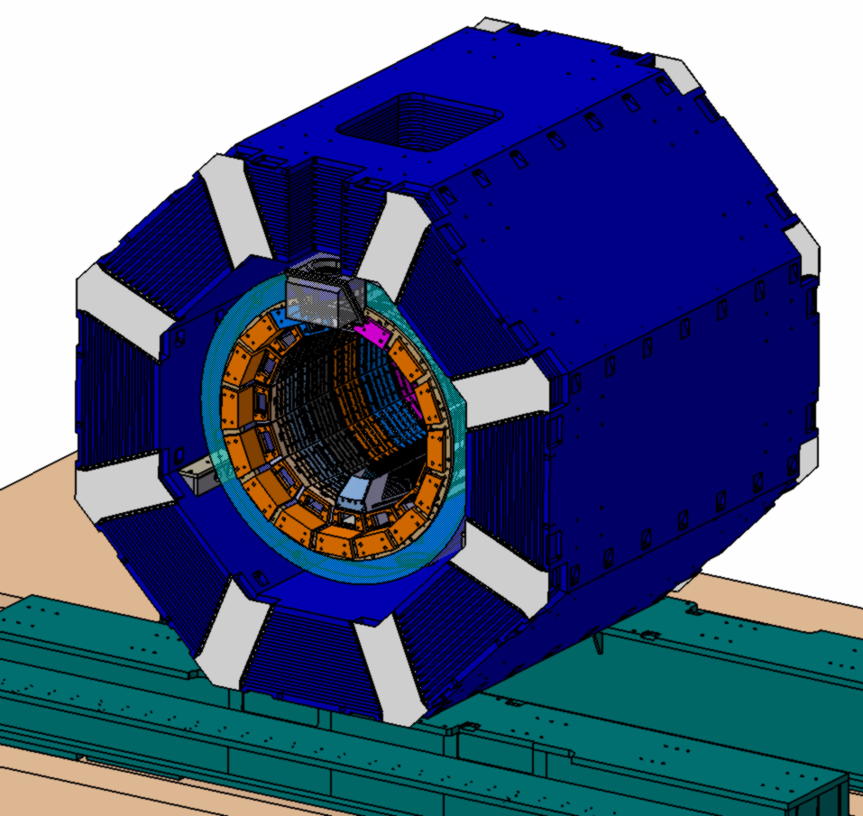
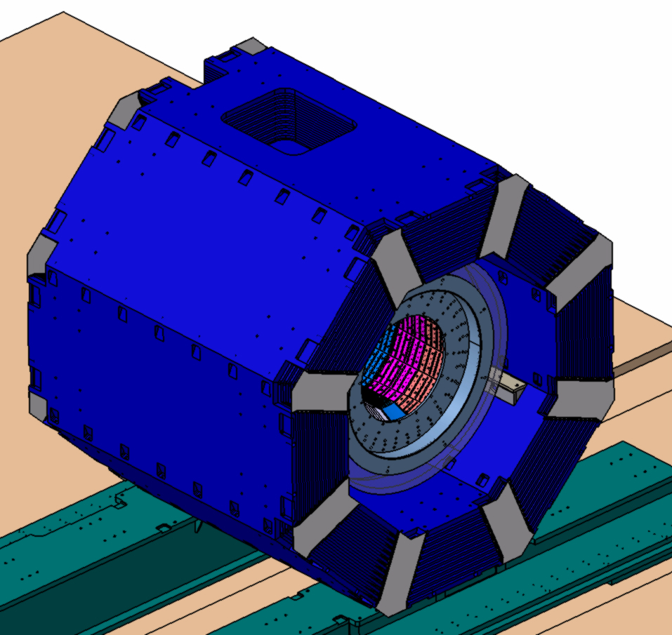
Completely simplified view of EMC
Barrel + Cryostat + Magnet Assembly
(Upstream side view)
Barrel + Cryostat + Magnet Assembly
(Downstream side view)

Slide 27
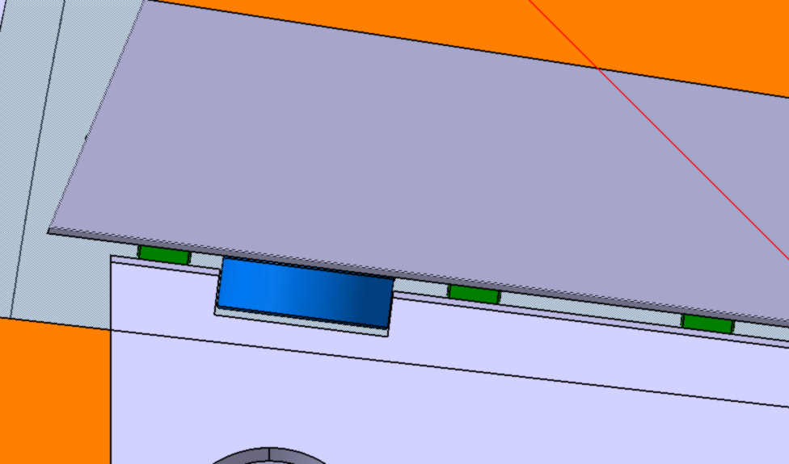
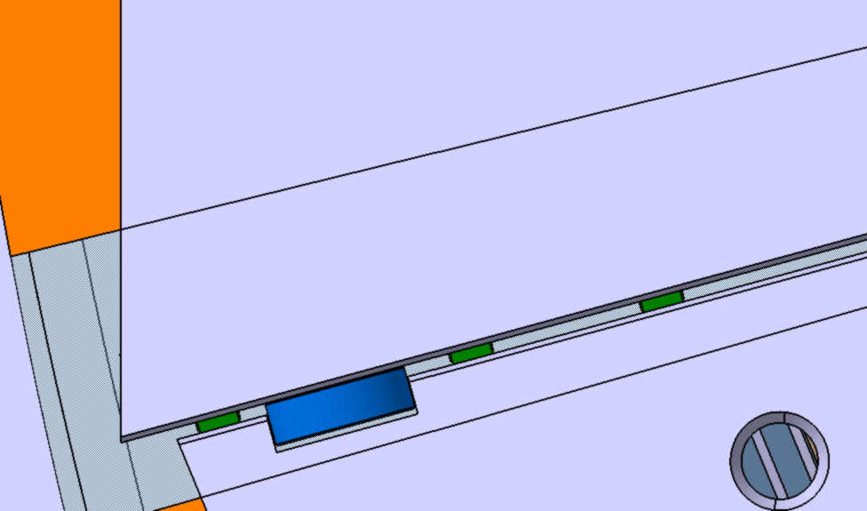
Поперечный разрез барреля. Подшипники закатные и позиционирующие
Transversal section of the barrel (simplified view) Disposition of the bearings
Positioning bearings
6000 series D26 mm
Rolling bearings 6000 series D26 mm

Slide 28
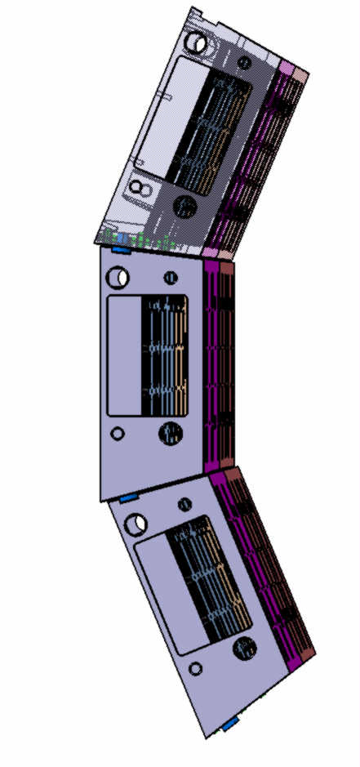
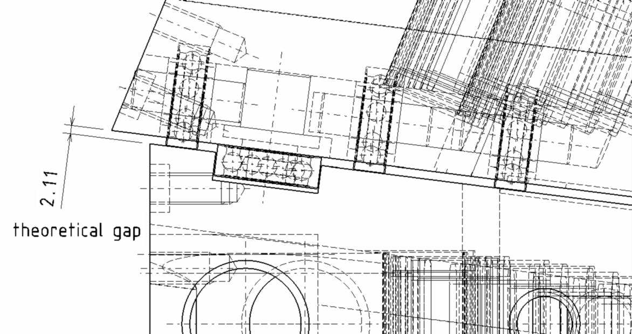
Partial view of Barrel
(left view)
Transversal section of the barrel (simplified view) Disposition of the bearings
Rolling bearings 6000 series D26 mm
Positioning bearings
6000 series
Beginning from this slice
upper slice supports on
inner surface of the slot
Positioning bearings
6000 series
Beginning from this slice upper
slice supports on outer surface
of the slot
Rolling bearings 6000 series D26 mm
It means that transversal dimension of the slot must be max 27 mm if we have outer diam. of the bearing 26 mm. In this case we can adjust slice to the rings by means of centering pins.

Slide 29
5. CALCULATIONS

Slide 30
CALCULATIONS

Slide 31
CALCULATIONS

Slide 32
CALCULATIONS

Slide 33
Situation during installation of the next slice
(very simplified view)
Slice inside of the cryostat has fixed from both sides ( Simplified 3d model)
Slice outside of the cryostat during of rolling in to Cryostat (Simplified 3d model)
According to the calculation the slice inside of the cryostat has deformation 2,89 mm in the middle part of the beam, it’s slot also has the deformation.
During the rolling in the jamming may occurs because the diameter of the bearing
is 26 mm and the dimension of the slot is 27 mm.

Slide 34
OVERALL DISPLACEMENT IN MAIN VERSION OF BARREL STRUCTURE
FOR COMPARISON
31

Slide 35
6. STAGED APPROACH FOR THE MAIN VERSION OF BARREL STRUCTURE
Ribs for stiffness

Slide 36
7. ADVANTAGES AND DISADVANTAGES OF MODULAR VERSION,
CONCLUSIONS
1. Modular approach would allow one to assemble Barrel EMC in few stages
with minimum disassembling of PANDA setup between experimental runs.
2. Procedures of additional assembly are easier because it is not needed to install
support frames and central technological beam but only rotary device (cantilever) .
1. In comparison with Main Version the Modular version is more complicated.
2. Manufacturing of support beam must be done more precisely because in case of the Main
version we can install spacers between slices to adjust gaps.
In the Modular version there is NO possibility of gap adjustment between neighboring slices at all.
Problem with insertion of slice may occurs (jamming) due to deformations.
3. The stiffness of Modular Assembly much less then in case of Main Version because in Main
Version all Slices are joint together by means of spacers and fixing bolts.
4. Thermal insulation of Modular Version will be more complicated.
5. We will have some problem with installation of the upper slice because of current lead.
6. Removal of any slice from EMC and returning it back may be problematic because of deformation of upper slice (it looses its support).
That’s why we must make assembly procedure beginning from the lower slice.
According to design analysis and calculations of Main Version and alternative Modular Version N5 we can make a conclusions:
1. With the use of Modular Version we can NOT guaranty practical possibility and reliability of assembly.
2. The Main Version of Barrel EMC assembly is more realistic and reliable.

Slide 37
THANK YOU FOR ATTENTION !!!

