Slide 1

CBM: Experiment, Physics and Trigger
Volker Friese
Helmholtzzentrum für Schwerionenforschung
Triggering Discoveries in High-Energy Physics II
Puebla, 29 January - 2 February 2018

Slide 2
Outline
Heavy-Ion Collisions and the CBM Experiment
The Physics of CBM
Trigger Concept

Slide 3
I. Setting the Stage
Heavy-Ion Collisions and the CBM Experiment

Slide 4
Intro
Compressed
Baryonic
Matter
We study hot and dense matter
Strongly interacting, baryon-rich matter
We study extended matter,
not particles

Slide 5
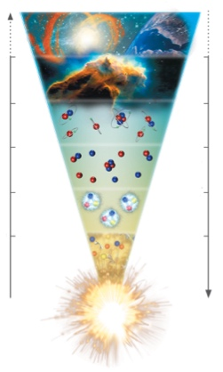
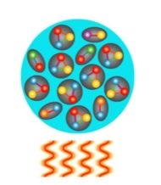
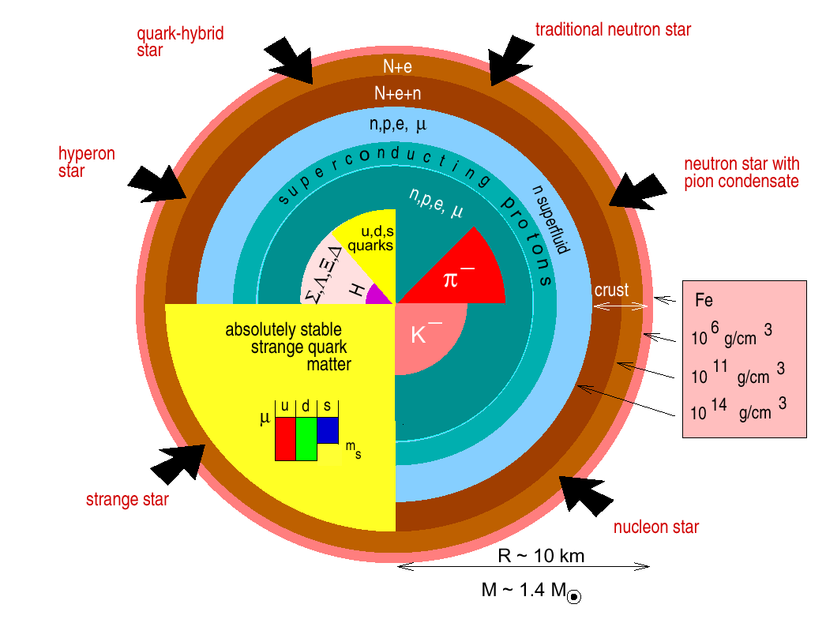
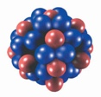
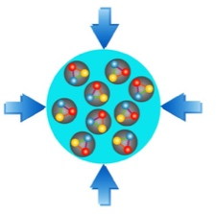
Matter at extreme conditions
T
early universe
heating
neutron stars
ρ₀
ρ
compression

Slide 6
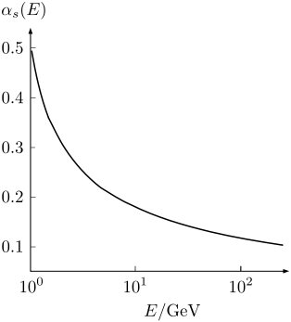
Strongly Interacting Matter
To understand matter, one needs to know
The basic constituents: quarks and gluons
The force between them: strong interaction
  The theory of the strong interaction is QCD
  Which is unfortunately in general not calculable
Properties of the strong interaction in vacuum:
Asymptotic freedom: the interaction is weak at small distances (large energies)
Confinement: in vacuum, quarks are bound into hadrons; no free colour charges
Chiral symmetry breaking: compound objects (hadrons) are much heavier than the sum of their constituents
Driving question: do these properties change with temperature and/or density?

Slide 7
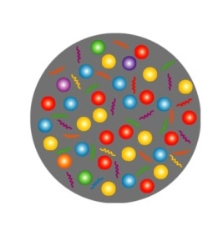
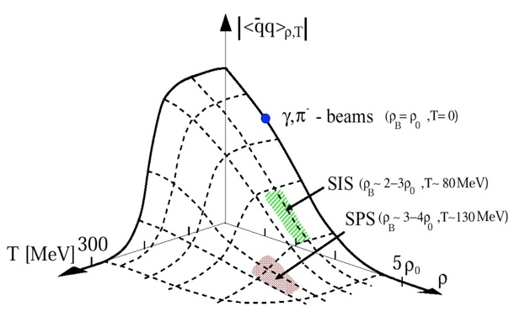
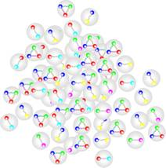
Matter at extreme conditions
T
early universe
QGP
heating
We expect at high enough temperature and / or density:
Breakdown of confinement (quark-gluon plasma)
Restoration of chiral symmetry
hadron gas
neutron stars
ρ₀
ρ
compression

Slide 8
Theoretical Access
Perturbation Theory
  only possible for large momentum transfer (some observables)
Lattice QCD: statistical sampling of QCD on a discrete space-time grid
  Restricted to small densities
Effective QCD models: simplified Lagrangian
  Tuned to LQCD; hope that behaves like real QCD where LQCD not applicable

Slide 9
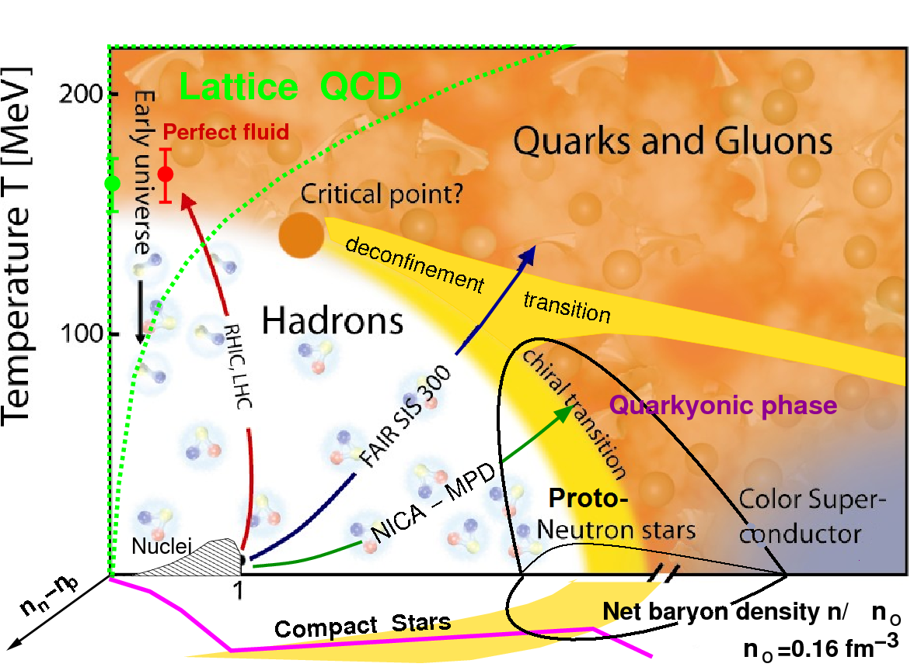
The Phase Diagram of QCD Matter
Possibly a very complex structure!
Landmarks:
Cross-over at low densities,
first-order (?) transition at high densities,
both separated by a critical point.
Chiral transition /
quarkyonic matter ?
Exotic phases at extreme densities

Slide 10
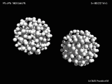
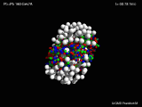
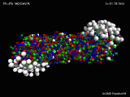
Experimental Access
In high-energy collisions of heavy nuclei, matter at high energy densities (hot and dense) is created – for a very short time and in a very limited volume.
Control parameters:
Collision energy
System size (ion species / collision centrality)

Slide 11
Exploring the QCD Phase Diagram
Nuclear collisions at high energies (LHC, RHIC):
  Incoming nucleons leave the reaction zone (transparency) after depositing a part of their kinetic energy
  No baryon number transfer to the fireball
  Produce a medium with high temperature and vanishing net-baryon density
At lower energies (SPS, FAIR, NICA):
  A part (or all) of the baryon number is transferred into the fireball (stopping)
  Create a medium with moderate temperature but high net-baryon density
Variation of the collision energy, allows to study different parts of the phase diagram

Slide 12
Exploring the QCD Phase Diagram
LHC: study the QCD properties
Lower energy programmes: study the phase transition and other landmarks
Key questions:
Is there a critical point, and if yes, where?
Where is deconfinement first reached?
Is there a first-order phase transition?
Is there a difference between chiral and deconfinement transition?

Slide 13
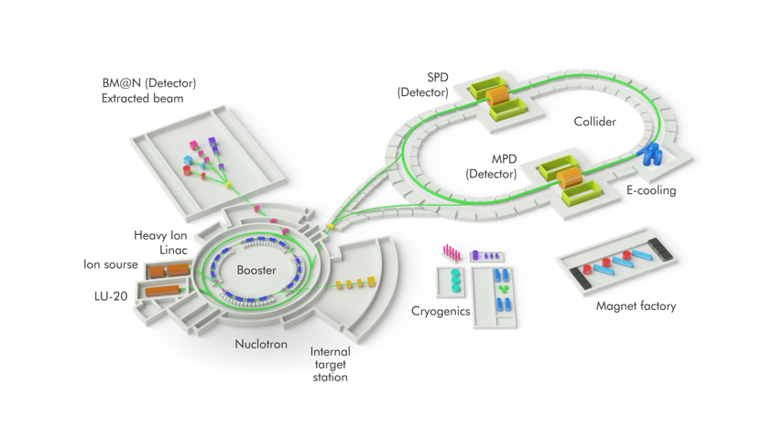
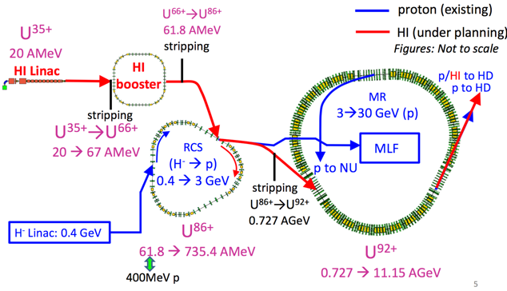
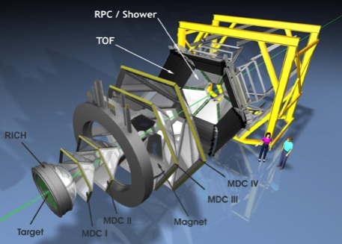
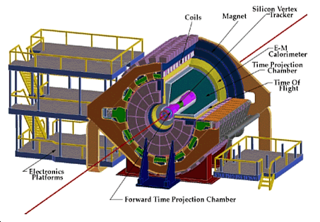
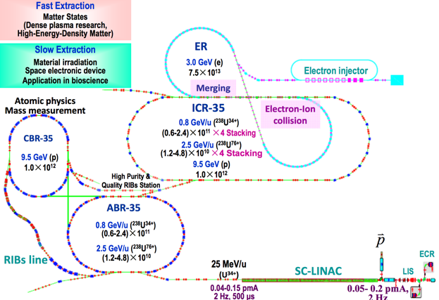
Facilities for Baryon-Rich Matter
JPARC (Japan)
proposed
NICA (JINR, Russia)
under construction
HADES (GSI, Germany)
running
FAIR (Germany)
STAR (BNL, USA)
running
HIAF (China)
in planning
NA61 (SPS, CERN)
running

Slide 14
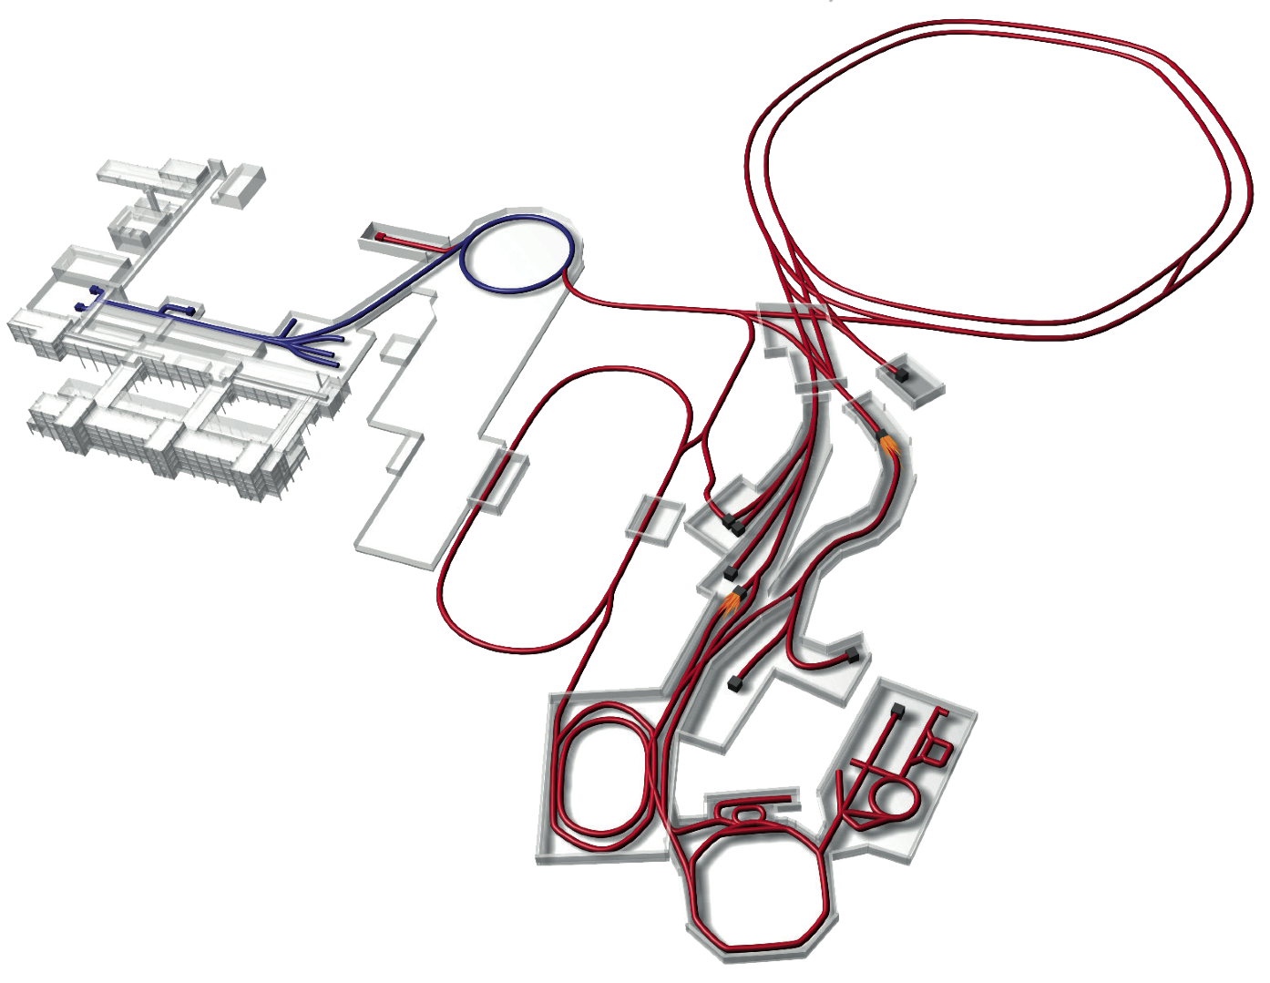
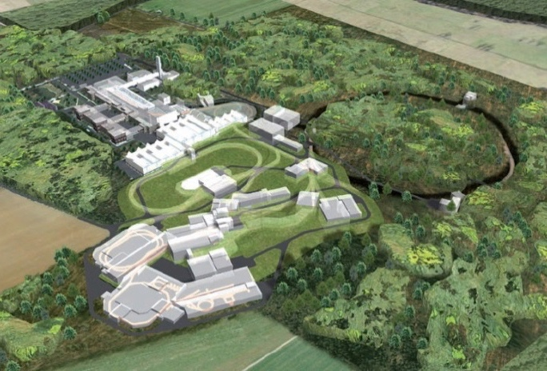
The FAIR Project
Nuclear Structure & Astrophysics
(Rare-isotope beams)
Hadron Physics
(Stored and cooled
14 GeV/c anti-protons)
p-Linac
SIS18
SIS100/300
UNILAC
QCD-Phase Diagram
(HI beams 2 to 45 GeV/u)
HESR
Rare-Isotope
Production Target
Fundamental Symmetries
& Ultra-High EM Fields
(Antiprotons & highly stripped ions)
Anti-Proton
Production Target
Dense Bulk Plasmas
(Ion-beam bunch compression
& petawatt-laser)
CR &
RESR
Cryring
Materials Science & Radiation Biology
(Ion & antiproton beams)
NESR
100 m
Accelerator Physics

Slide 15
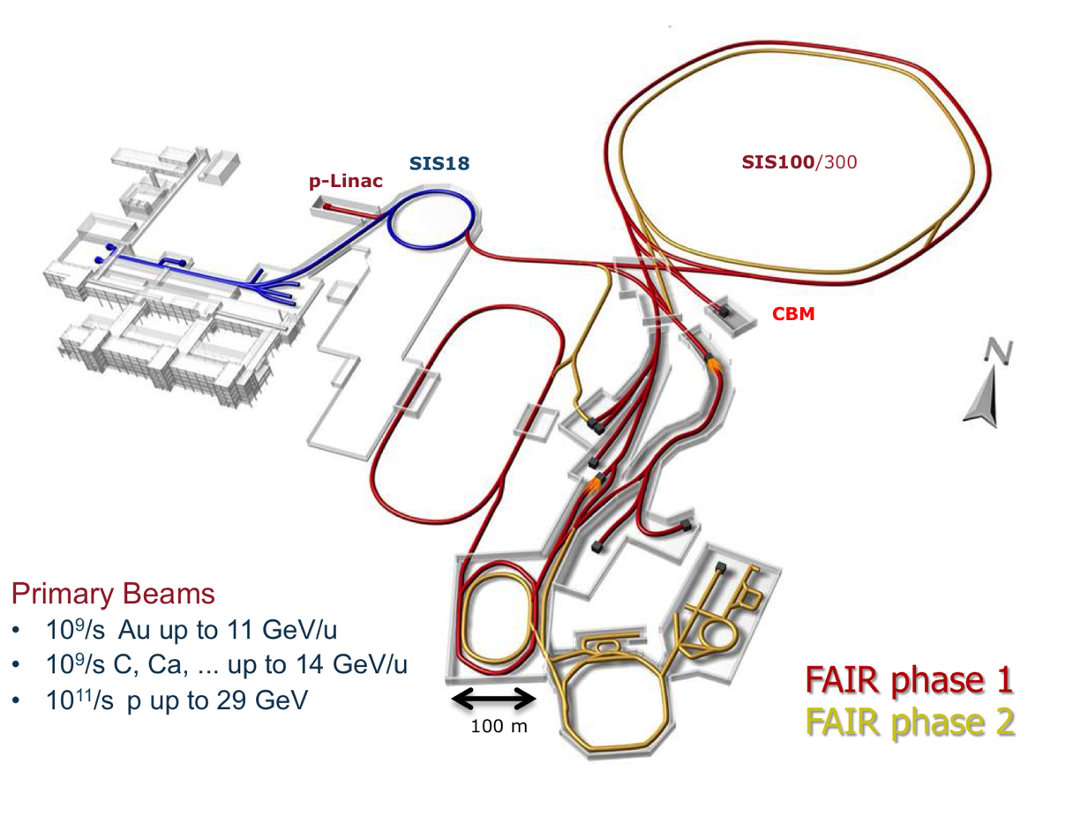
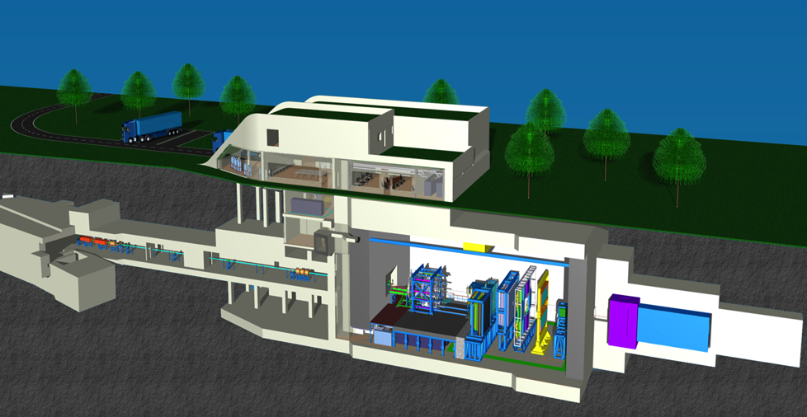
FAIR Accelerator Complex and CBM

Slide 16
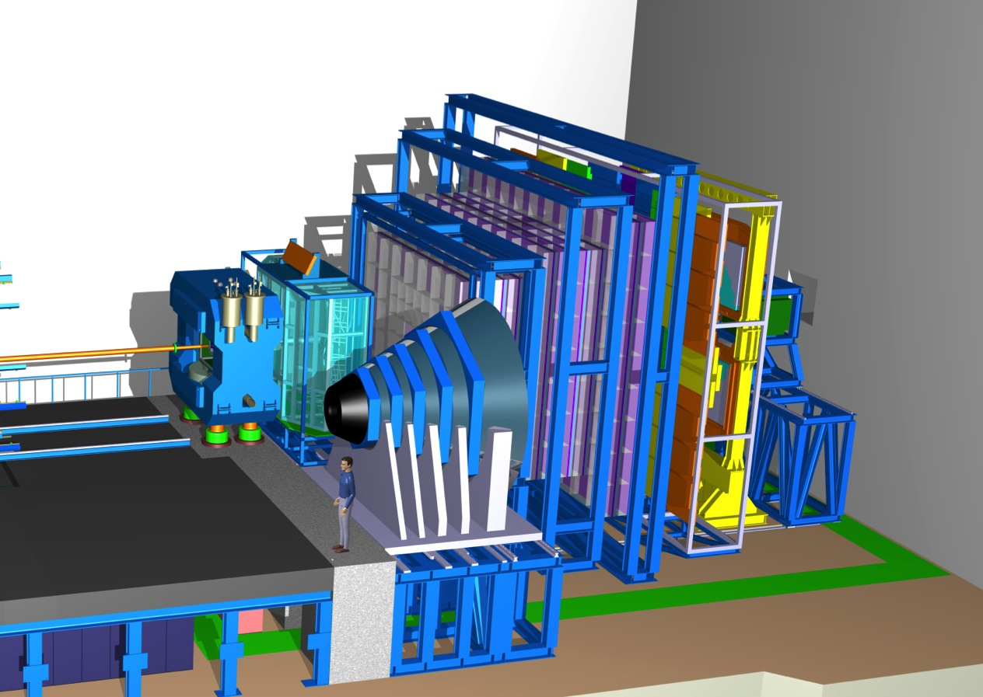
CBM: Experiment Systems
TRD
TOF
RICH
Dipole magnet +
Silicon Tracking System
PSD
Muon System

Slide 17
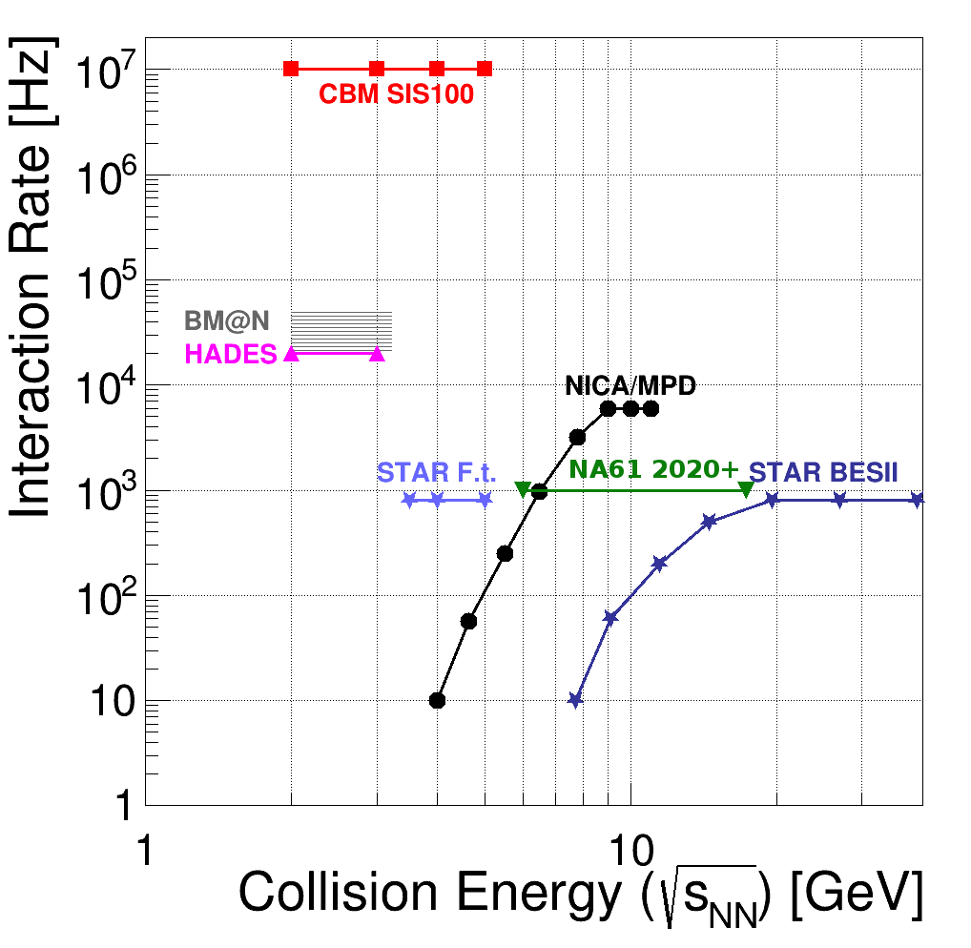
CBM in the experimental landscape
Uniqueness of CBM: very high rate capability
Comes with huge challenges in terms of:
Speed and radiation hardness of detectors and read-out electronics
Data processing on- and offline
SIS300

Slide 18
II. CBM Physics
(parforce, not exhaustive)

Slide 19
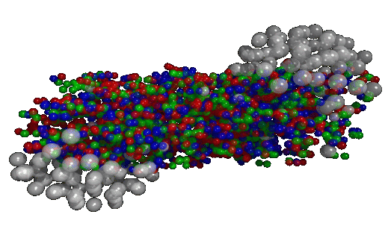
The Experimental Task
The Hope:
Learn from the multitude of emitted particles (final state) about the state of the matter immediately after the collision (early state)
The Task:
Detect the final-state particles as completely as possible and characterise them w.r.t. momentum and identity (π, K. p, …)

Slide 20
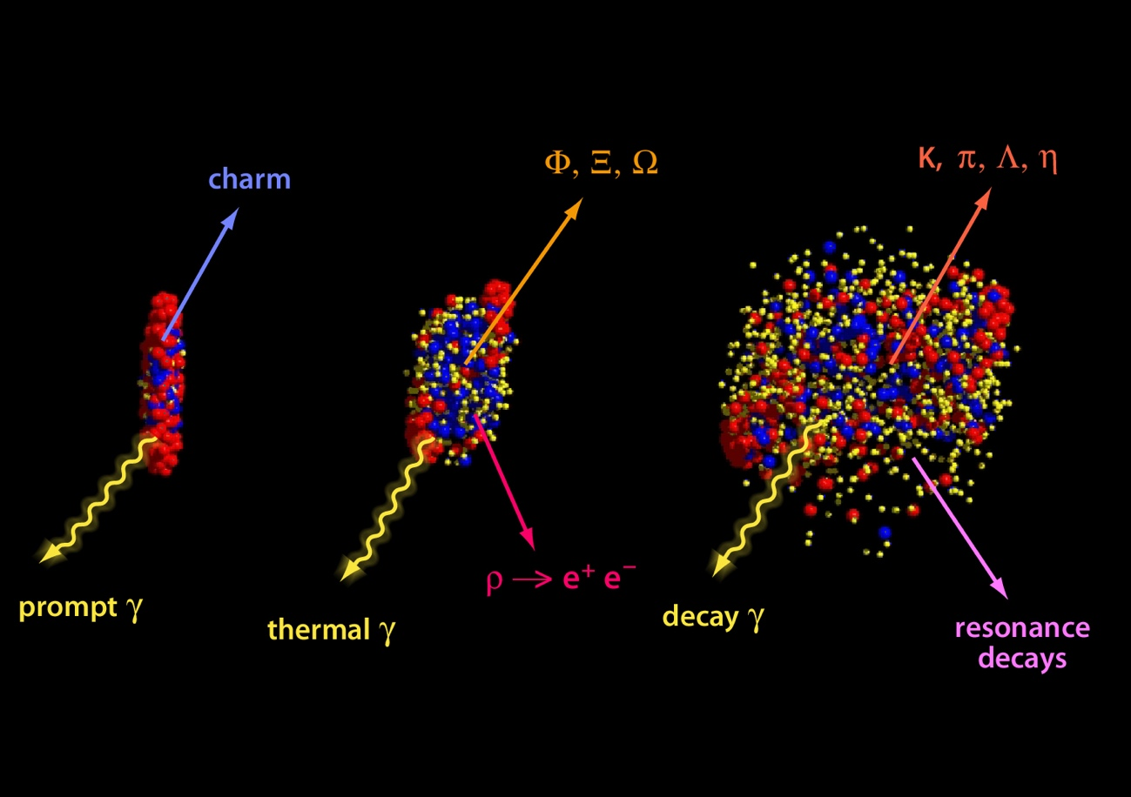
Observables
U+U collision at 23A GeV from UrQMD
initial state
equilibrated medium
freeze out
Different probes give access to various stages of the collision

Slide 21
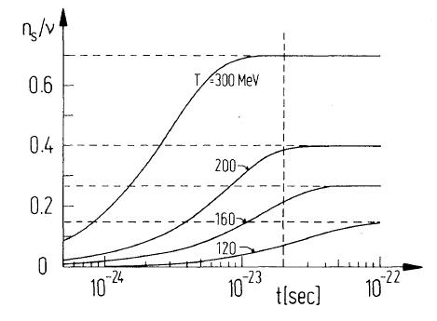
Strangeness is interesting
No strangeness in entrance channel (nucleons): strangeness is produced in the reaction
Hadronic production (e. g. p+p -> KΛp): m_{K} ≈ 500 MeV >> T_{H}
Partonic production (e.g. g + g -> s sbar): m_{s} ≈ 100 MeV <= T_{H}
Relaxation of s-Quarks in a QGP within few fm/c ≈ lifetime of the fireball
Expectation: More strangeness production in A+A relative to p+p, if QGP was formed
„Strangeness enhancement“
Koch, Müller, Rafelski, Phys. Rep. 142 (1986) 167

Slide 22
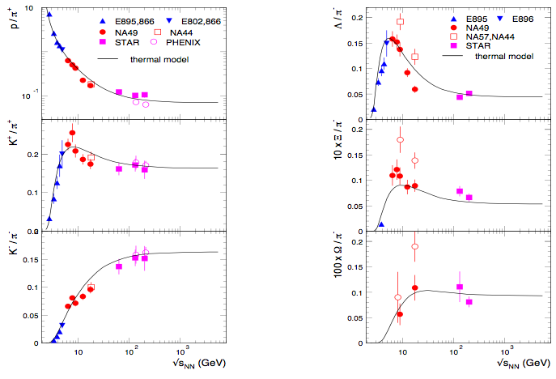
Multi-Strange Hyperons
A long-lasting debate: pure hadronic description or signal of drastic change in matter properties?
Data on multi-strange baryons will be decisive!

Slide 23
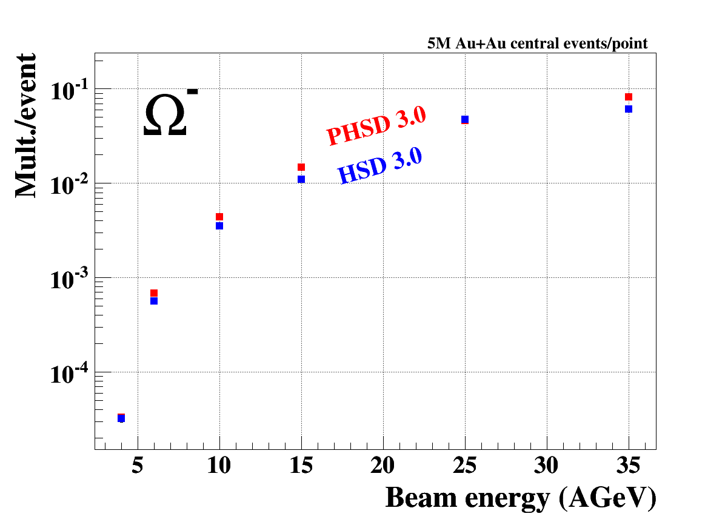
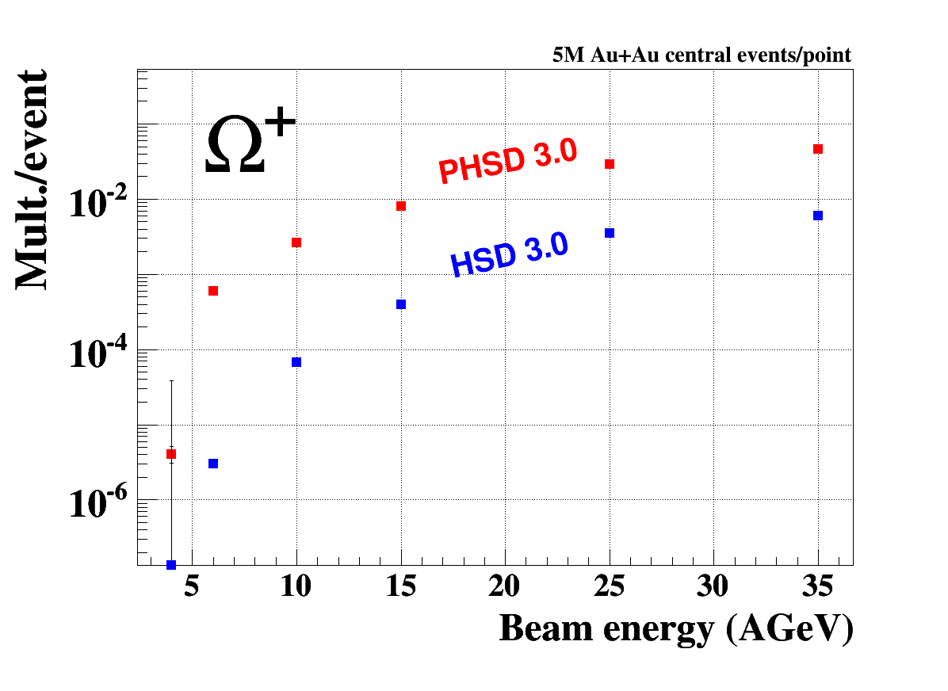
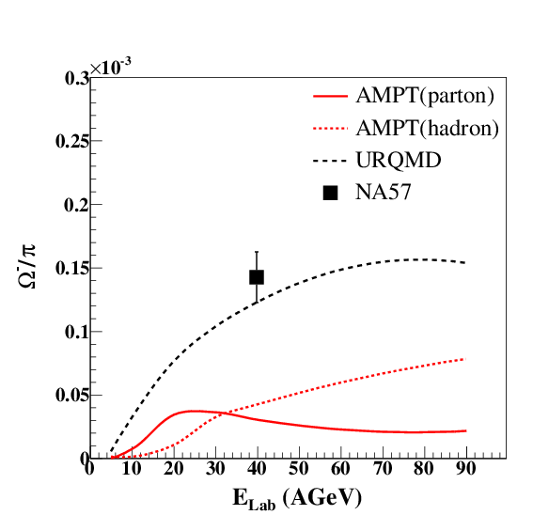
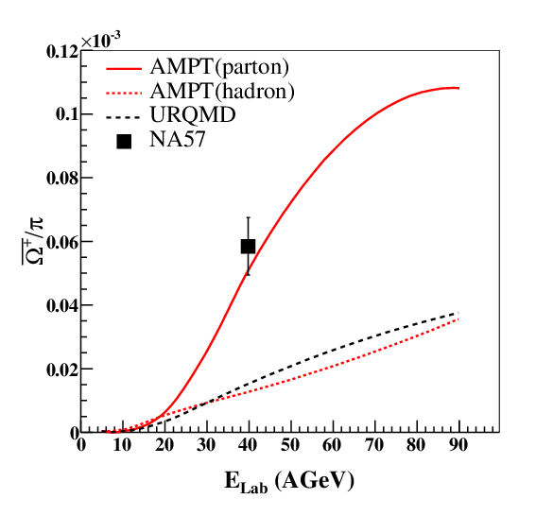
Strange Anti-Baryons
HSD / pHSD
AMPT
Microscopic models (including partonic production) predict the anti-hyperons to be very sensitive to partonic production mechanisms (hyperons much less)

Slide 24
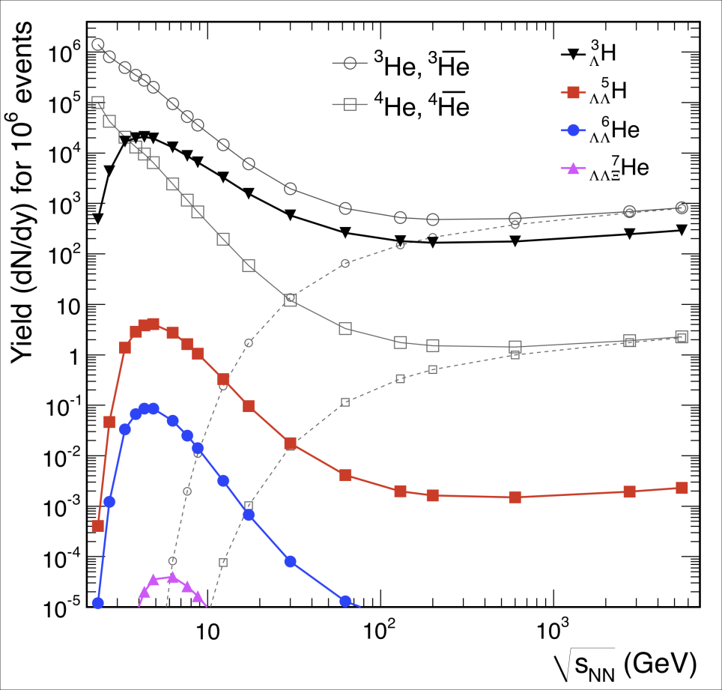
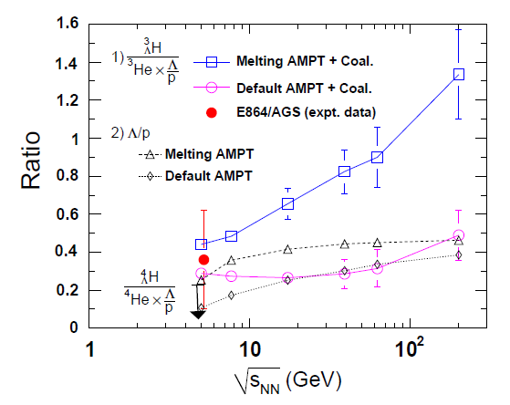
CBM Physics: Hyper-Matter
In heavy-ion collisions: produced through capture of Λ in light nuclei
A. Andronic et al., PLB 697 (2011) 203
S. Zhang et al., PLB 684 (2010) 224
Thermal model: maximum production at CBM energies
Transport: sensitive to medium properties (correlation of strangeness and baryon number)

Slide 25
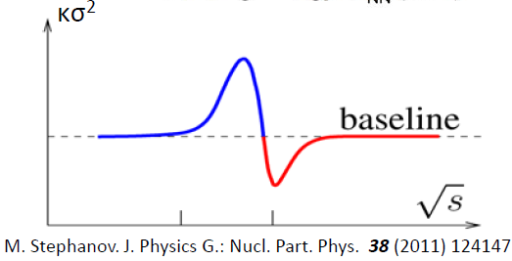
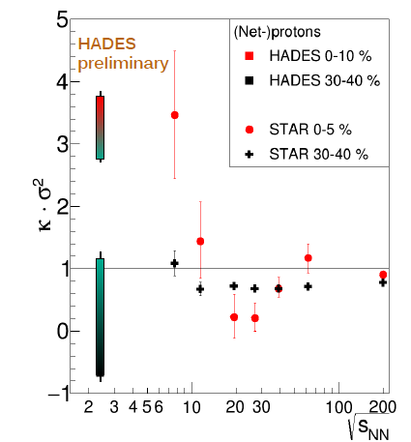
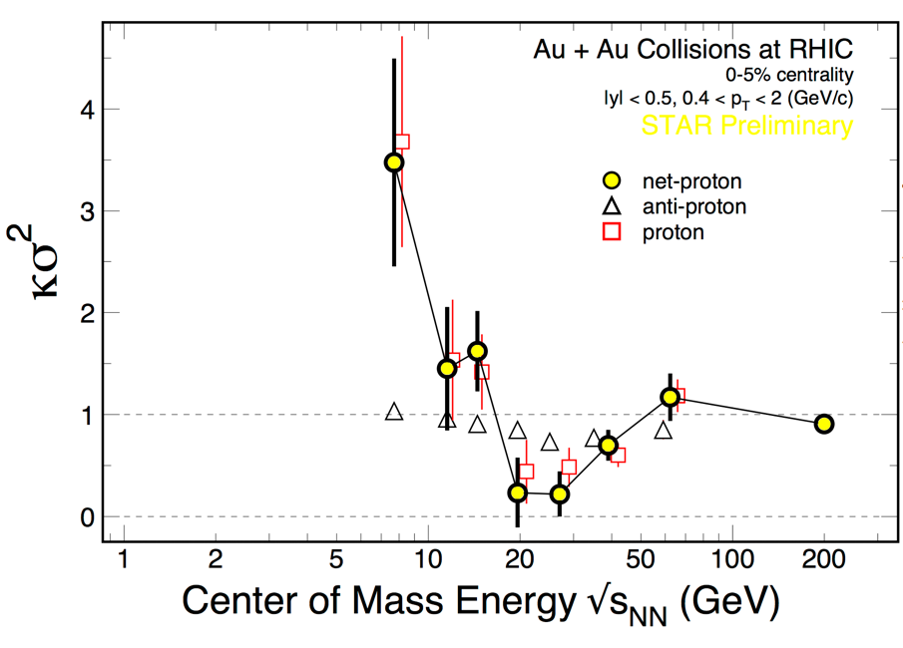
Fluctuations
Should signal the critical point...
M. Lorentz, QM 2017
?
STAR, NPA 956 (2016) 320c
...or spinodial decomposition of a mixed phase?

Slide 26
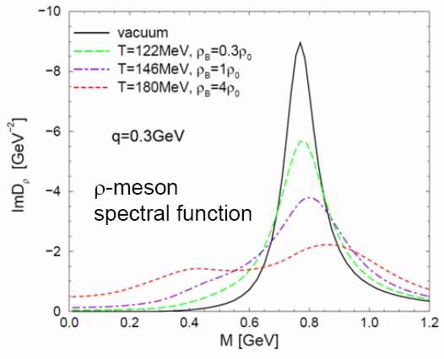
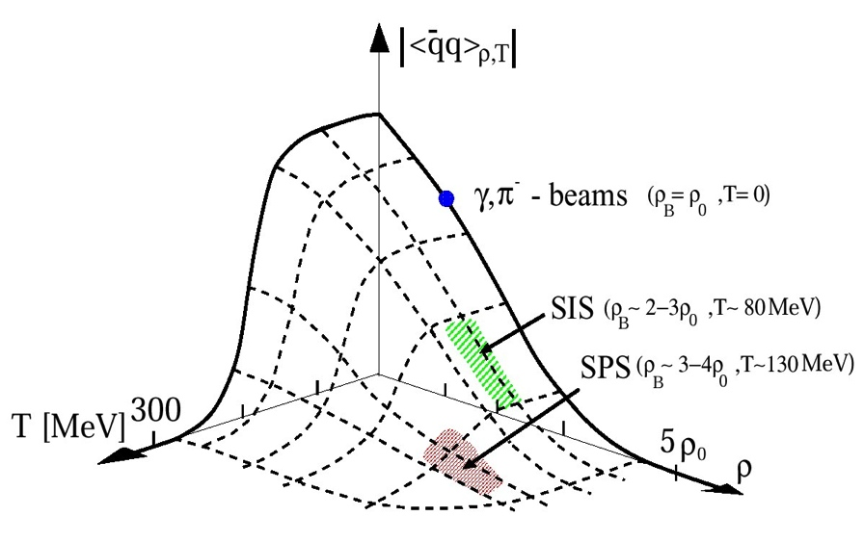
Vector Mesons and the Generation of Mass
Hadrons are expected to change their properties (mass / width) in presence of dense medium
  vanishing of chiral condensate; restoration of chiral symmetry (?)
Experimental access: short-lived vector mesons (ρ)
  decay inside the fireball -> retain information on dense environment
  decay into lepton pairs: no strong interaction, carry information out of the medium
R. Rapp and J. Wambach, Act. Nucl. Phys. 28 (2000) 1

Slide 27
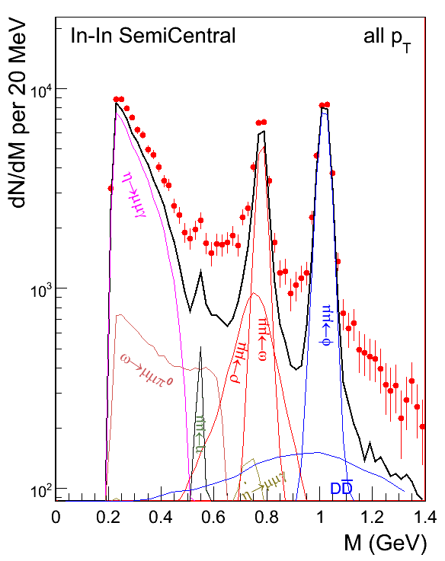
CBM Physics: Lepton Pairs
Emitted throughout the lifetime of the fireball: probe its space-time evolution
Low mass (< 1 GeV): in-medium properties of rho meson; excess yield (over vacuum hadronic cocktail) is sensitive to the lifetime of the system
Intermediate mass (1 – 2.5 GeV): no hadronic sources; measure directly the temperature of the fireball.
NA60, EPJC 59 (2009) 607

Slide 28
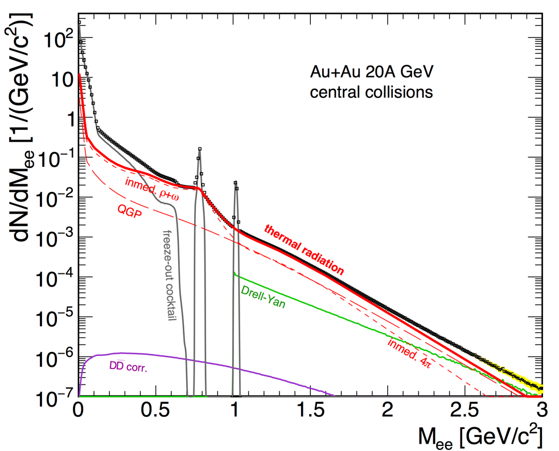
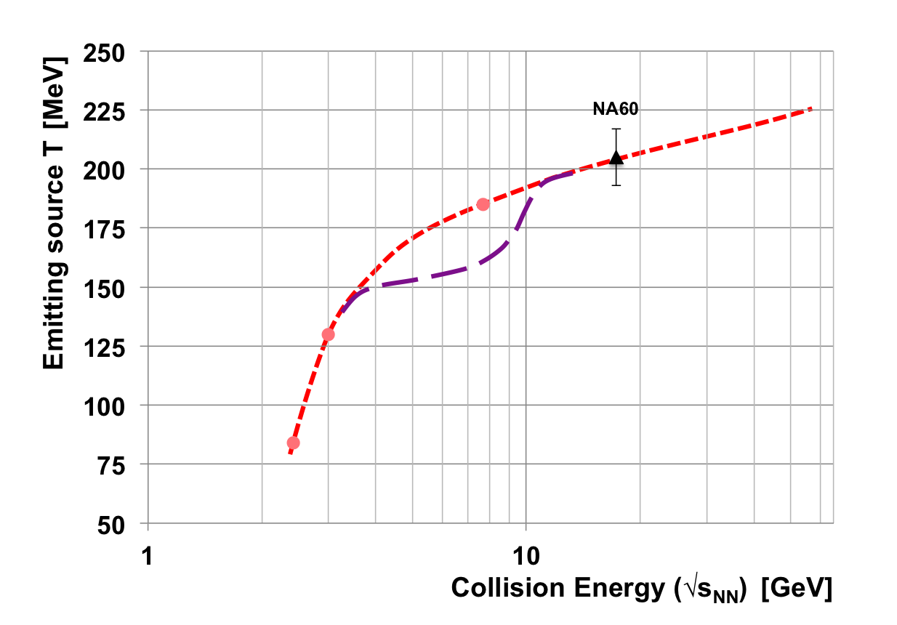
CBM Physics: Lepton Pairs
No di-lepton data exist between HADES and NA60!
CBM will provide di-lepton mass spectra and measure the caloric curve in the FAIR energy range. Interpretation almost model-independent!
Extracted temperature at intermediate masses; violet: speculated signature of a mixed phase
CBM Simulation

Slide 29
Charm
Important (if not decisive) probe of the created medium
  that holds at all energies!
Fraction of charm hadronising in J/psi is sensitive to the medium properties (e.g. suppression in QGP)
Particular at lower energies (below top SPS):
  N_{ccbar} << 1 -> no regeneration, ”clean” probe
  Softer J/psi, longer-lived fireball: charm has a chance to see the medium
Proper interpretation of data requires the measurement of both open and hidden charm
  Important part of the CBM physics programme

Slide 30
Charm in Heavy-Ion Collisions
Unlike lighter quarks, m_{c} >> T
  thermal production of charm negligible
  production of charm in first-chance N-N collisions
  charm probes the produced medium
    c quark diffusion in QGP
    D meson / J/ψ propagation in hadronic medium
courtesy R. Rapp

Slide 31
Open Charm Below Threshold
J. Steinheimer et al., PRC 95 (2017) 014911
Sub-threshold production through heavy baryonic resonances:
N* → Λ_{c} + D and N* → N +J/ψ

Slide 32
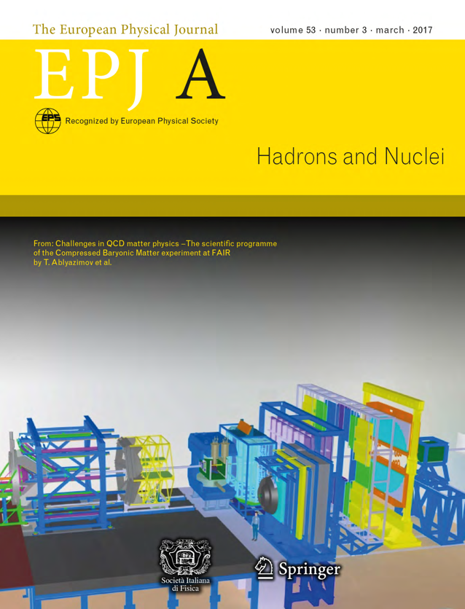
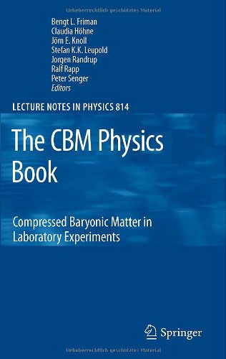
CBM Physics Programme
A long menu of observables from strange hadrons over lepton pairs to charmed hadrons
For more exhaustive information:

Slide 33
III. Online Data Selection
(in order to avoid the term “trigger”)

Slide 34
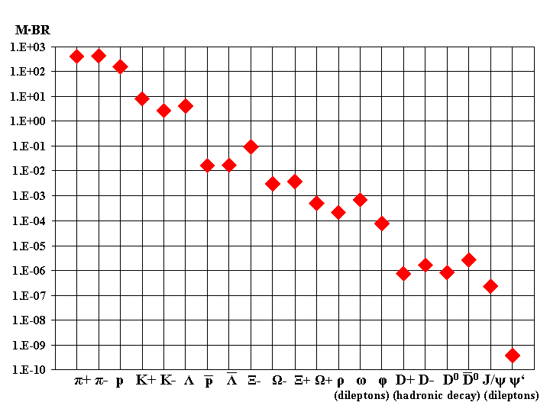
Rare Observables
Model predictions of particle multiplicities ( x branching ratio)
(central Au+Au, 25A GeV)
Some of the (most interesting) probes are extremely rare.
Decent measurement in reasonable time necessitates high interaction rates.
Current heavy-ion experiments run with very moderate rates (100 Hz - several kHz).
When designing a new experiment: what is the rate limit?

Slide 35
Rate Limitations
The measured interaction rates are limited by:
what the accelerator can deliver: beam luminosity (collider) or intensity (fixed-target)
what the experiment can take:
  speed of detectors (fast: e.g. ECAL, solid-state detectors; slow: e.g. gas drift detectors)
  speed of read-out electronics (e.g. shaping time of the ADC)
  trigger latency
  DAQ throughput
  archival rate
Current experimental upgrade plans usually target higher interaction rates (LHC experiments, STAR, NA61)
CBM is designed as a high-rate experiment from the beginning.

Slide 36
Natural Time Scales
Considerations for the design interaction rate:
The accelerator promises 2 x 10⁹ ions/s. With a (typical) 1% target, this would give 20 MHz interaction rate -> 50 ns on average between collisions.
Event duration
  typical experiment size 10m
  Difference of time-of-flight through the setup between β = 1 and β = 0.7 particles is 20 ns
Event pile-up should be avoided
  hard to resolve different events in fixed-target mode (are all within several 100 μm inside the target)
CBM design rate: 10 MHz

Slide 37
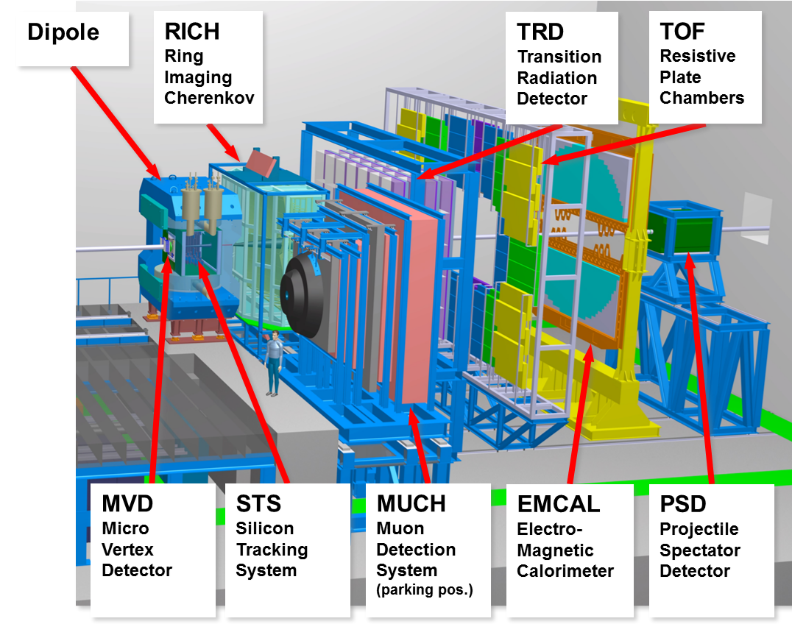
Experimental Setup
Mission: build a
a fixed-target heavy-ion experiment
for collisions in the FAIR energy range
which can measure hadrons, electrons, muons and open charm
at event rates up to
10 MHz.

Slide 38
Data Rates
Raw data event size: 100 kB / min. bias event (Au+Au)
At 10 MHz event rate: raw data rate 1 TB/s
Archival rate:
  technologically possible are rates of 100 GB/s and above
  limiting factor are the storage costs
  typical runtime scenario 2 effective months / year (5 x 10⁶ s)
  At 1 GB/s: gives a storage volume of 5 PB/year
We aim at an data archival rate of a few GB/s, meaning that the raw data volume has to be suppressed online by factors 300 - 1000.

Slide 39
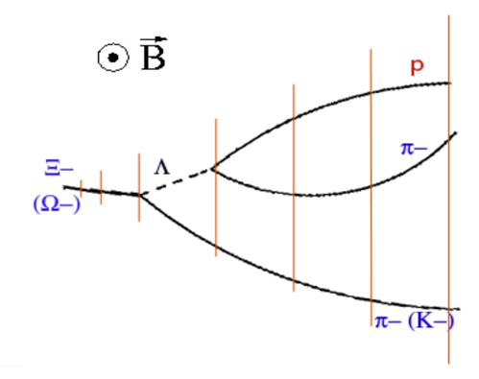
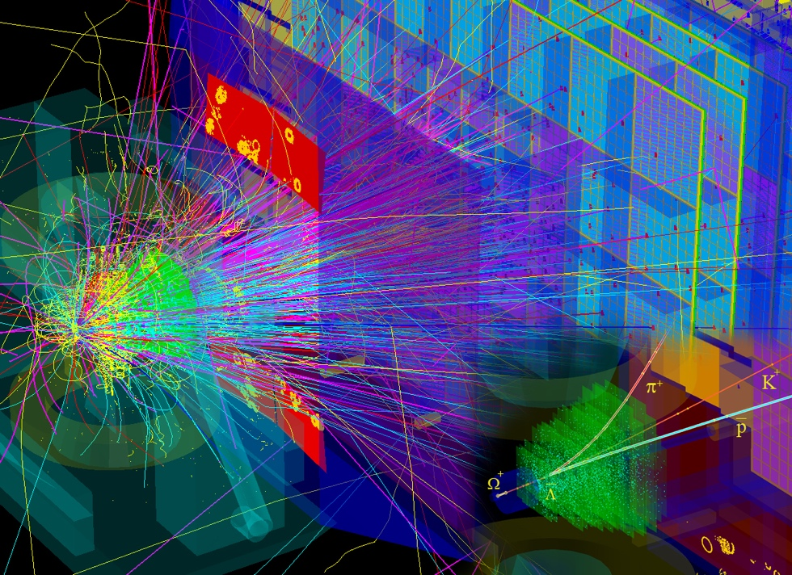
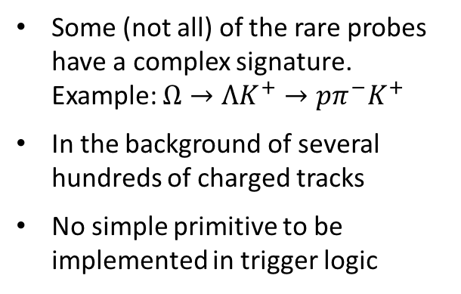
Selecting Data Online
Some (not all) of the rare probes have a complex signature.
Example: $Ω→ΛK^{+}→pπ^{−}K^{+}$
In the background of several hundreds of charged tracks
No simple primitive to be implemented in trigger logic

Slide 40
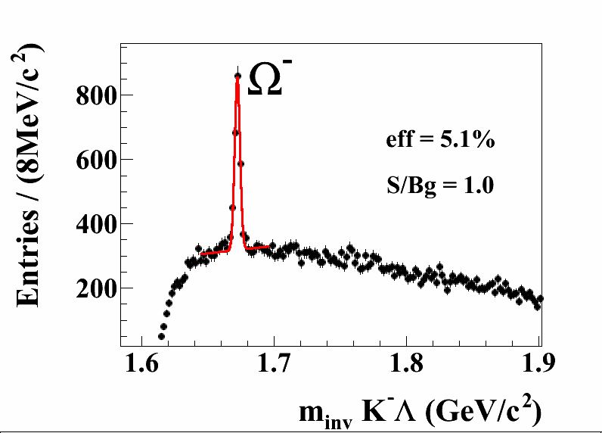
Selecting Data Online
Selection requires reconstruction of all tracks plus combinatorial search for two decay vertices: typical software task
Offline performance for Omega: S/B ~1
If realisable online: excellent software trigger
CBM simulation, central Au+Au, 10A GeV
Similar argument for many topology-based observables (hyper-nuclei, exotic strange objects, charm)
Simpler patterns e.g. for lepton pairs (J/ψ or low-mass)
R/O design must be based on the most challenging case

Slide 41

DAQ and Trigger Concept
No hardware trigger at all
Continuous readout by autonomous FEE
FEE sends data message on each signal above threshold
(“self-triggered”)
Hit message come with a time stamp; readout system is synchronised by a central clock
DAQ aggregates messages based on their time stamp into “time slices”
Time slices are delivered to the online computing farm (FLES)
Decision on data selection is done in the FLES (in software)

Slide 42








Triggered and Free-Running Readout
Trigger: snapshots of the detector
Trigger-less: a movie of the detector
N.b.: Too large to be stored! Will be cut into pieces (events) in the photo lab (= FLES).

Slide 43
Advantages
no latency issues; the system is limited by throughput
no buffers on FEE ASICS (inside radiation zone) needed
data selection is shifted to software
  in principle, everything which is usually done in the offline analysis can be implemented for online data selection
  very flexible: easy to switch between triggers, to use different triggers in parallel
  assessing the trigger efficiency is straightforward: no emulation of trigger logic needed
So, why was it not done before?
Requires an online compute farm powerful enough to process the entire data stream
Throughput is defined by the size of the compute farm and the speed of the algorithms.
CBM estimate: equivalent to ~10⁵ CPU cores needed
Some years ago, this was the entire LHCgrid
Nowadays (let alone in some years), feasible to finance and to host close to the experiment

Slide 44
Issues of a Trigger-less System
Noise from detectors and electronics
  tight threshold in order to suppress the contribution of noise to the total data rate
  good signal-to-noise ratios in detectors are needed in order not to lose signals
Example: fraction of noise from the STS
M.b. event rate | 10 MHz | 1 MHz | 100 kHz | 10 kHz
Threshold / noise = 3 | 40 % | 86 % | 98 % | 99.8 %
Threshold / noise = 3.5 | 11 % | 55 % | 92 % | 99.2 %
Threshold / noise = 4 | 2 % | 15 % | 65 % | 95 %
No events given to software
  Unlike in conventional HLTs, where events are build before by DAQ
  Online reconstruction starts from time-sorted data stream
  Algorithms have to take into account time coordinate (“4D reconstruction”)

Slide 45



Online Data Flow
Green Cube, GSI

Slide 46

FLES Architecture

Slide 47

Time Slice: Interface to Online Reconstruction

Slide 48
Real-Time Reconstruction
In our concept, the task of online data selection is shifted from electronic engineering to software engineering.
For a given event / data rate, the speed of the algorithms determines the required size of the online compute farm.
For a given financial budget / size of the online farm, the speed of the algorithms determine the physics output of the experiment.
High-performance online software is a pre-requisite for the successful operation of CBM.
  Make optimal use of available parallel computer architectures: many-core, GPU, accelerators
  Be flexible to upcoming new architectures
Parallelism is the key word
  Data-level parallelism: one time slice per compute node
  Task-level and data-level parallelism within time slice

Slide 49

Parallelisation within time-slice
Task Level Parallelism
MVD
hit finding
STS
cluster finding
RICH
ring finding
TRD
hit finding
TOF
hit finding
ECAL
cluster finding
STS
hit finding
STS
track finding
track fitting
> 1000 sensors
TRD
track finding
track fitting
Global Tracking
Vertexing, PID
Data Level Parallelism

Slide 50


Track Finding
Usually, the most compute-intensive task in reconstruction
Approach: Cellular Automaton, operating on time-ordered stream of detector hits (no event association)
track finder
After track finding, events can be defined as time-clusters of tracks

Slide 51

CA track finder: performance and scalability
High efficiency for primary tracks
Rate effects become visible above 1 MHz interaction rate
Good scaling behaviour: well suited for many-core systems

Slide 52

Particle Reconstruction in Real-Time
KFParticleFinder: Simultaneous access to multitude of particles
Real-time reconstruction allows online selection of rare probes.

Slide 53

Real-Time Reconstruction - Status
Not all problems yet solved - but the major hurdles are taken.
Results so far give confidence that online event reconstruction and selection will be possible on a computer farm of < 10⁵ cores.

Slide 54
Summary
CBM: A heavy-ion experiment to investigate baryon-rich QCD matter at energies from 2A to 45A GeV at FAIR/Darmstadt
The physics programme comprises a suite of observables including very rare ones. The design punchline is thus to be capable to take interaction rates in the MHz range.
Novel read-out concept without hardware trigger; real-time data selection exclusively on CPU.
Timeline: Facility under construction; experiment starts mass production of components soon; operation from 2024 on.

