Slide 1
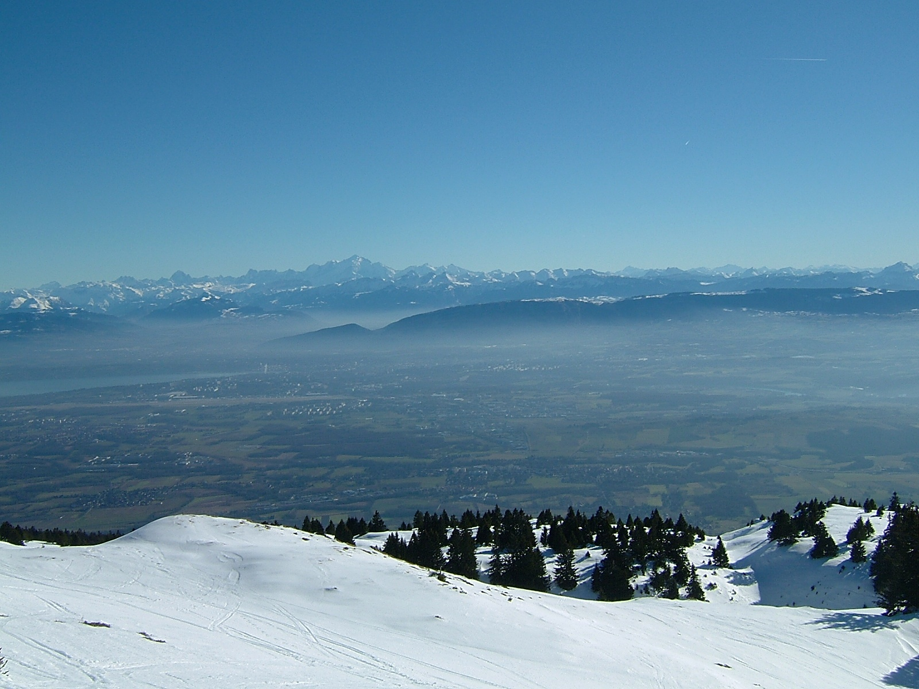
CERN Accelerator Complex in the LHC Area
GSI seminar
14 February 2019
Jörg Wenninger
CERN Beams Department
Operation Group / LHC

Slide 2
Outline
The CERN accelerator complex
From pre-LHC to LHC area
Operation of the complex
Outlook

Slide 3
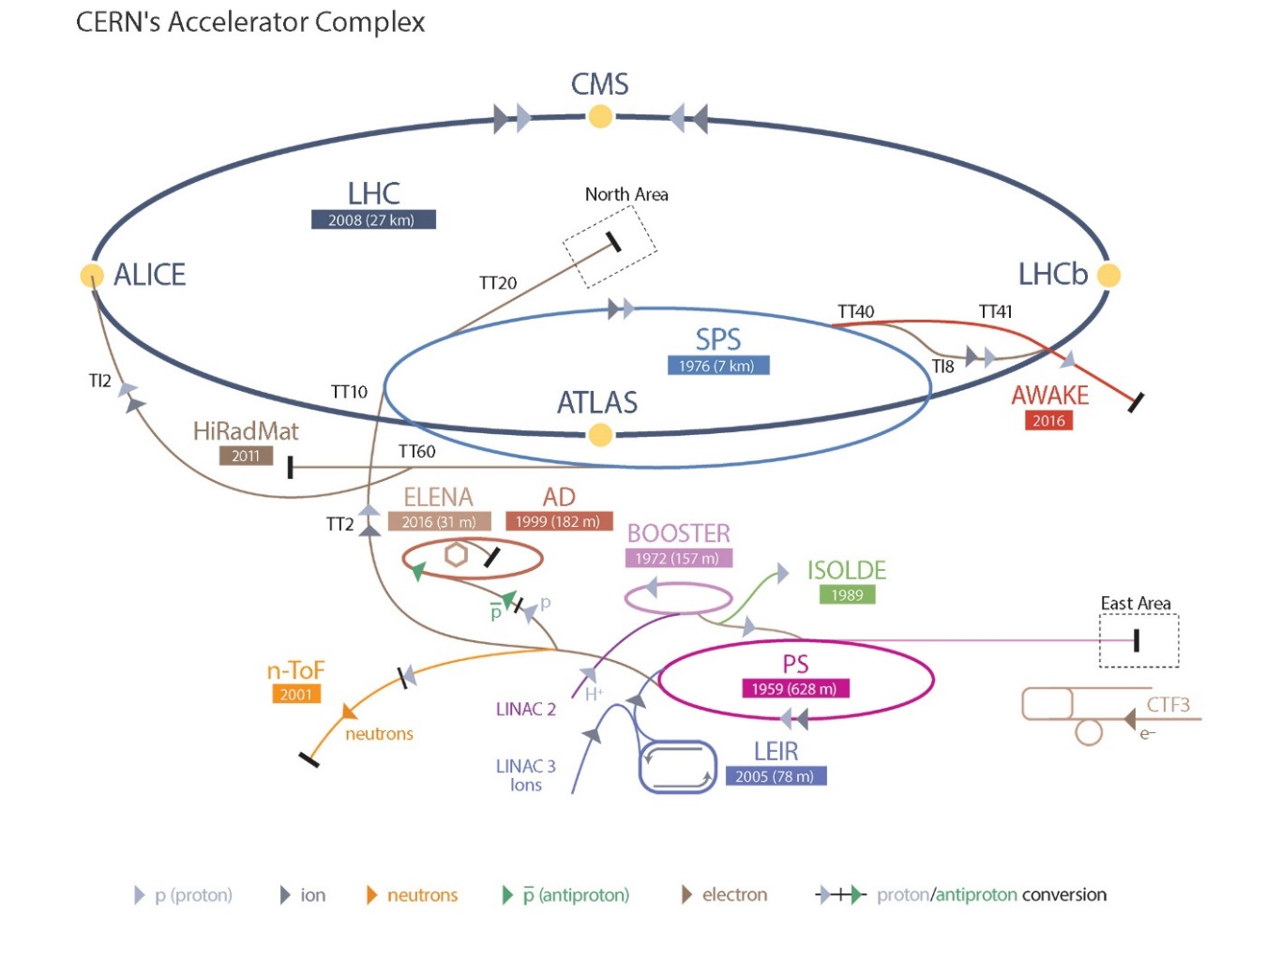
CERN accelerator complex
Proton chain
 | Max. P (GeV/c) | B (T) | Length / Circ. (m)
LINAC2* | 0.050 | - | 30
LINAC4* | 0.160 | - | 90
Booster* | 1.4 (2) | 0.9 (1.1) | 157
PS | 26 | 1.25 | 628
SPS | 450 | 2 | 6’911
LHC | 6’500 | 7.7 | 26’657
LINAC 4
H-
LINAC2 was stopped on 12.11.2018
In 2020 the CERN complex with restart with LINAC4 !
*: kinetic energy

Slide 4

CERN complex foot-print
Lake of Geneva
LHC (LEP) ring
Control Room
SPS ring
PS ring
4

Slide 5
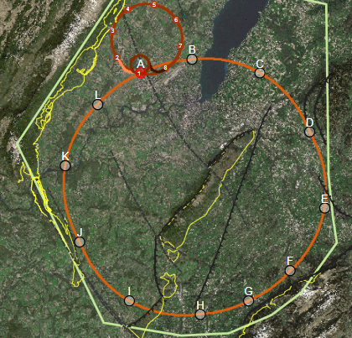
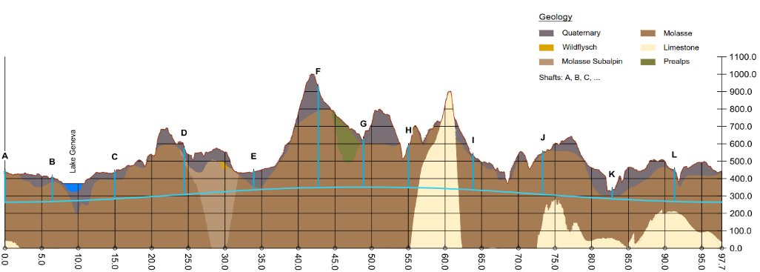
Future foot-print?
LHC ring
Below the lake and around the mountain
(depth ~300-400 m)
FCC ring

Slide 6
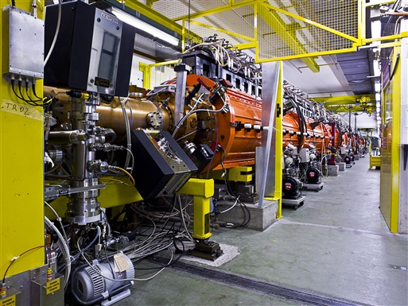
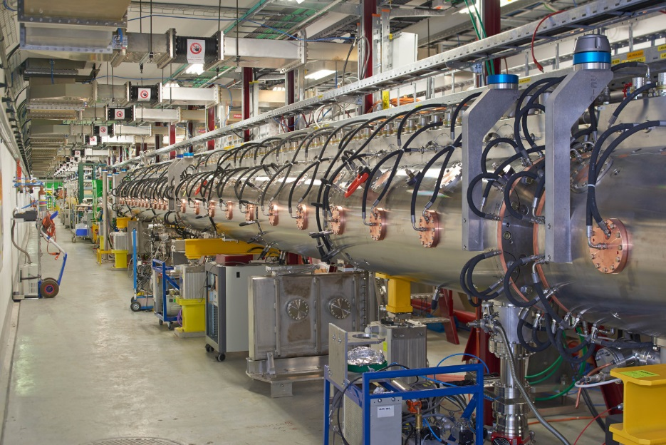
LINAC2 & LINAC4
The CERN complex is operated with a fixed basic period of 1.2 s.
  Every cycle is a integer multiple of this basic period.
LINAC2 accelerated protons to a kinetic energy of 50 MeV.
Provided a beam pulse every 1.2 s.
30 m
LINAC4 accelerates H⁻ to a kinetic energy of 160 MeV.
  Much more complex than LINAC2.
  Challenging source.
Currently in commissioning, it will replace LINAC2 in 2020.
Provides a beam pulse every 1.2 s.
90 m

Slide 7
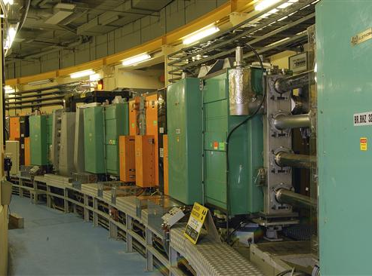
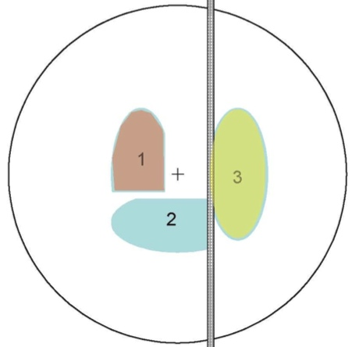
Booster (PSB)
1st Synchrotron in the chain with 4 superposed rings operating in //.
Increases the proton kinetic energy from 50 MeV to 1.4 GeV in 1.2 s.
  Pushed to 160 MeV → 2 GeV in 2020 as part of the LHC injector upgrade.
PSB serves the PS and the ISOLDE isotope facility.
157m
The PSB defines the LHC beam brightness.
LINAC2: beam was accumulated over multiple turns in horizontal phase space.
  Transverse emittance increased with intensity, ~ constant brightness.
LINAC4: H- will be stripped (foil) and interleaved with circulating protons.

Slide 8
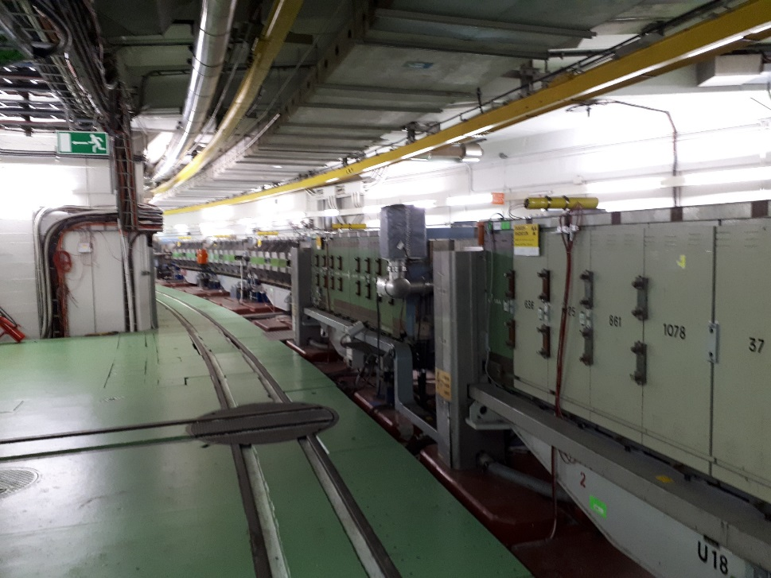
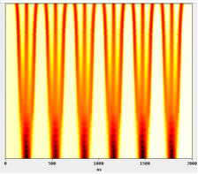
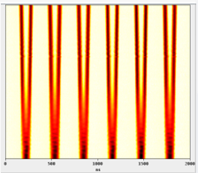
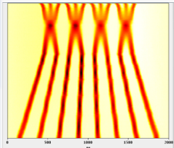
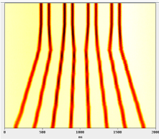
Proton Synchrotron (PS)
The oldest operating synchrotron at CERN.
Increases the proton energy from 1.4 GeV up to 26 GeV.
Cycle length: 1.2 s, 2.4 s or 3.6 s.
Serves SPS, AD (Anti-p decelerator), nTOF (neutron Time-of-Flight) and East Area (fixed target).
Many RF systems (10 MHz to 200 MHz) to provide a wide range of beam structures.
The PS defines bunch spacing and bunch train length for LHC beams.
  25 ns, 50 ns, 75 ns, 100 ns or single bunches.
628 m = 4 x PSB
25 ns
8b4e
LHC beam variants
25 ns BCMS
8b4e BCS

Slide 9
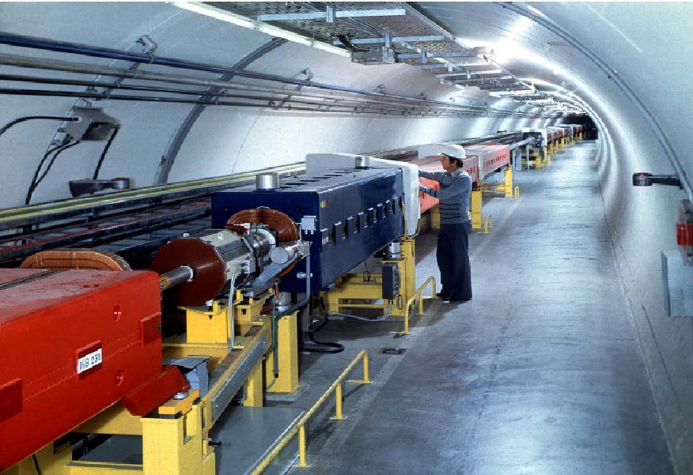
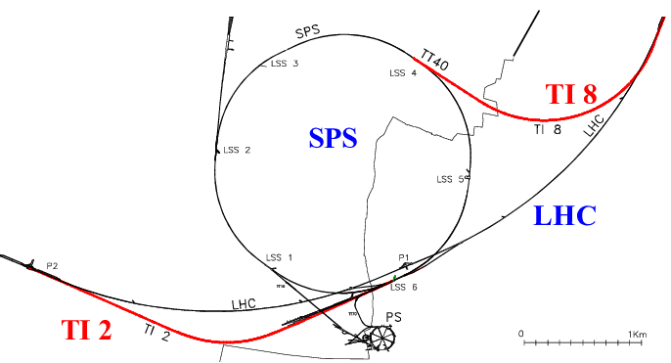
Super Proton Synchrotron (SPS)
Increases the proton beam energy up to 450 GeV.
  Injection at 14 GeV (fixed target), 26 GeV (LHC, AWAKE, HiRadMat).
SPS serves LHC, North Area (fixed target), AWAKE (plasma acceleration) and HiRadMat (material test facility).
For the LHC SPS assembles PS beam trains and boosts them to 450 GeV.
  Up to 288 bunches.
Two ~3 km long transfer lines (TI2 and TI8) are used for injection into the LHC.
  Normal conducting magnets.
6.9 km = 11 x PS

Slide 10
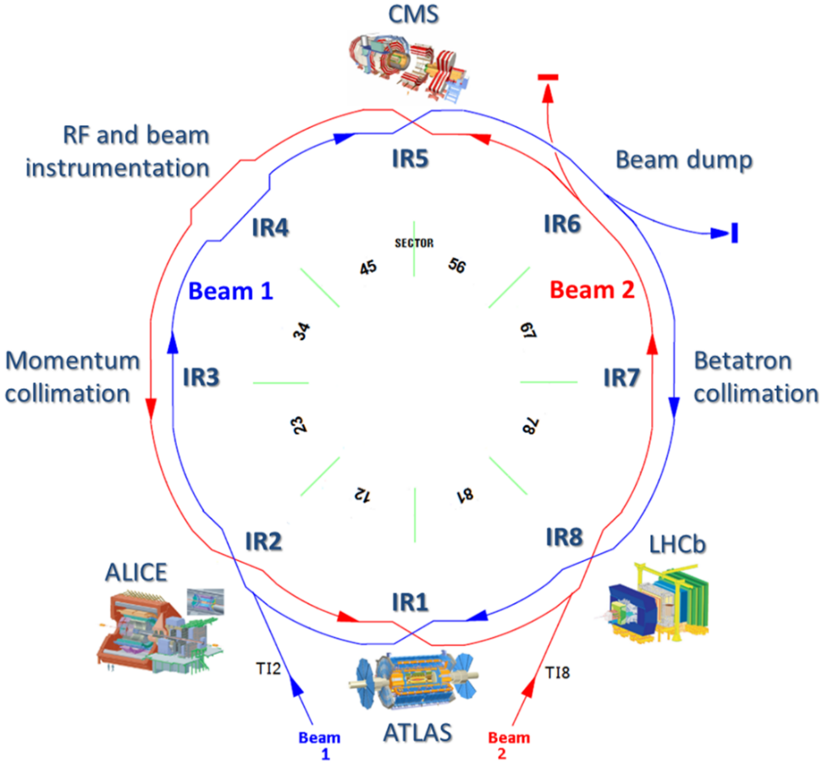
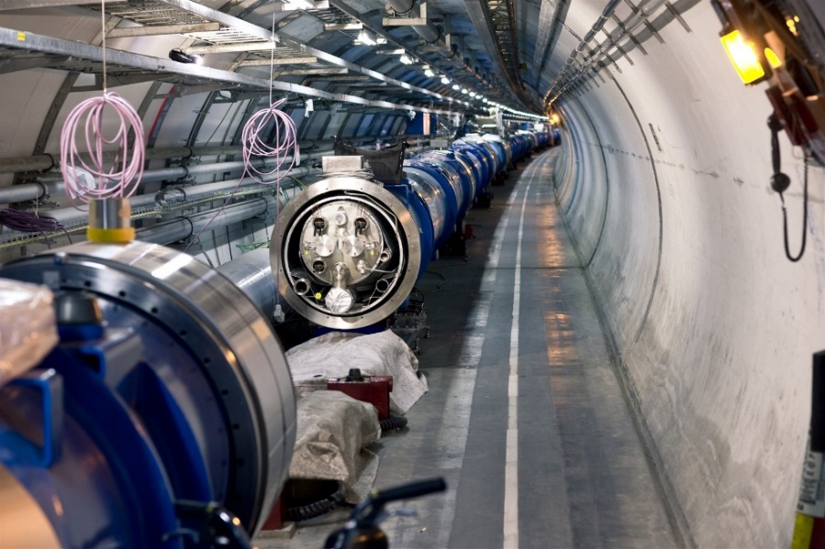
LHC
Circumference of 26.66 km.
Operating energy 6.5 TeV.
  Not yet at the 7 TeV design.
Two counter-rotating beams cross in the middle of 4 long straight sections.
Almost entirely superconducting magnet system.
  2-in-1 magnet design with separate vacuum chambers - coupled rings.
Serves 4 main experiments: ATLAS, ALICE, CMS and LHCb.

Slide 11
Magnet training and energy
All dipole magnets were trained for 6.5 TeV operation in 2015. Just over 150 quenches were required to reach 6.5 + 𝛆 TeV
  Spread in number of quenches between sectors is due to the mixture of producers.
So far the estimate to train magnets to 7 TeV was ~ 500 training quenches.
  The slowest sector will take ~2 months to train.
But a recent campaign to train a sector to 7 TeV showed a slow down of the training curve – magnets of a second producer began to quench.
Magnet training campaign to 6.5 TeV (2015)

Slide 12
Outline
The CERN accelerator complex
From pre-LHC to LHC area
Operation of the complex
Outlook

Slide 13
The CERN complex in 2000
With the exception of the LHC and the transfer lines from SPS to LHC, the key elements of the LHC-area CERN injector complex were already in place in 2000.
A first wave of changes and upgrade was applied to the machine to comply with LHC beams in 2000-2005:
  SPS ring cleaning for impedance (remove ‘obsolete’ lepton elements).
  SPS extractions and transfer lines to LHC.
  PS-PSB transformation for LHC: PSB from 1 GeV to 1.4 GeV, many changes to the RF systems.
In 2006 all changes had been essentially completed, first LHC beams were ready in the injectors, waiting for the LHC to come online.

Slide 14
Accelerator organization in 2000
In 2000 the CERN accelerator organization was split in two divisions, for the PS complex and for the SPS-LEP(LHC) complex.
  Duplicated group structure – powering, RF, instrumentation, controls, operation etc.
    With different solutions for many things.
    Groups were often split geographically (offices and workshops) on the two CERN sites (Meyrin/CH & Prevessin/F).
In 2003 the accelerator sector was restructured and former PS – SPS/LEP groups were merged into single groups to rationalize the organization and remove duplication at many levels.
  It took years to level out the difference in culture and in equipment (end of life of hardware and software). Traces of the old structure can still be observed at CERN.

Slide 15
Beam operation in the LHC area
Between 2003 and 2006 the operation groups were merged into a unique group and moved into a new control room.
  Two controls / operation cultures coming together.
  Operation of the technical infrastructure (another OP group in 2000) was merged with the beam operation group.
  Operation of the cryogenic systems was moved to the same control room but remained in a separate group.
The new central control room, commissioned in 2006, helped a lot to smooth out differences, but it takes time – ongoing process in certain areas.
  AD and ISOLDE are operated from local CRs.

Slide 16
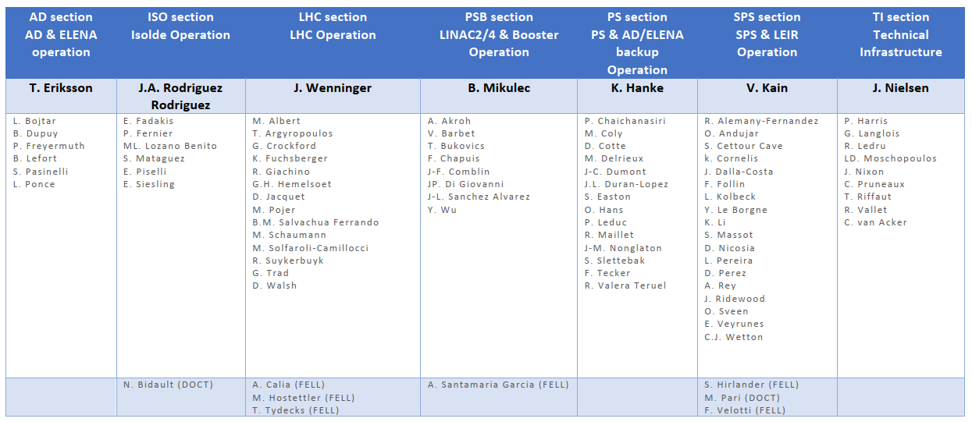
CERN operation group
The OP group in 2018: 83 staff in 7 sections + fellows/students
  Sections: PSB, PS, SPS, LHC, AD, ISOLDE, Technical Infrastructure.
    No shift rotation for AD and ISOLDE.
  1 shift position => 7 staff.
  1-3 accelerator physicists / section (→ machine coordinators).
    Plus 7 ‘physicists on shift’ in LHC section – CERN ‘collider’ tradition.
Number of persons on shift
2
1
2
2
1

Slide 17
Beam versus user area operation
The operation sections of PSB, PS, SPS and LHC setup and operate the beams up to the targets or to experiments installed inside the ring or directly on beam lines.
User beam lines (behind targets) at PS and SPS are setup by a dedicated team (not OP) that also manages reshuffling of areas etc.
  With OP support for operating the beam lines.
The ISOLDE isotope facility with targets, isotope separators, ion post accelerators is setup and operated by the OP ISOLDE section.
  No shift coverage, on call intervention outside of working hours.
The anti-proton accelerator AD operates like ISOLDE, the AD OP section sets up and operates AD up to the experiments.
  Overnight support by PS OP section, on call interventions if required.

Slide 18
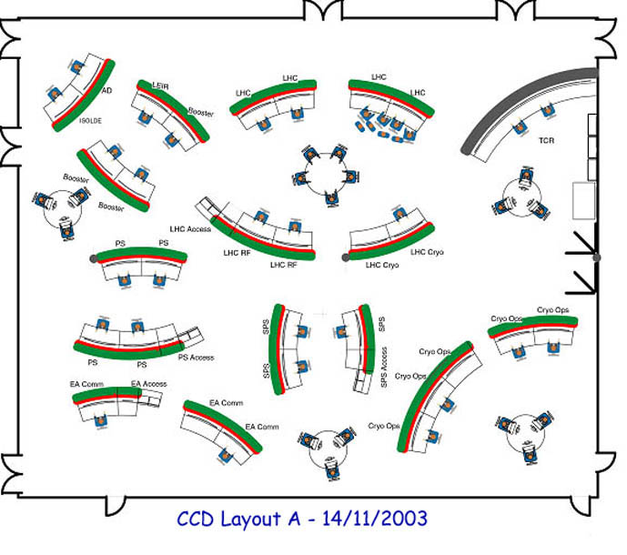
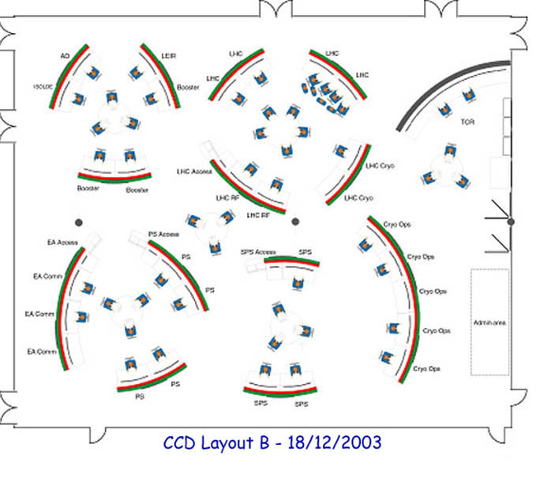
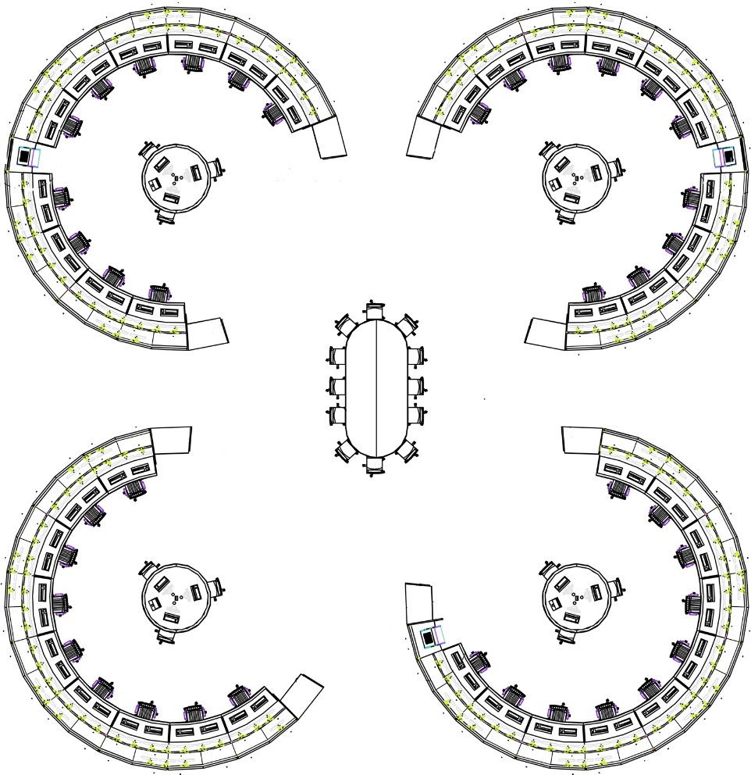
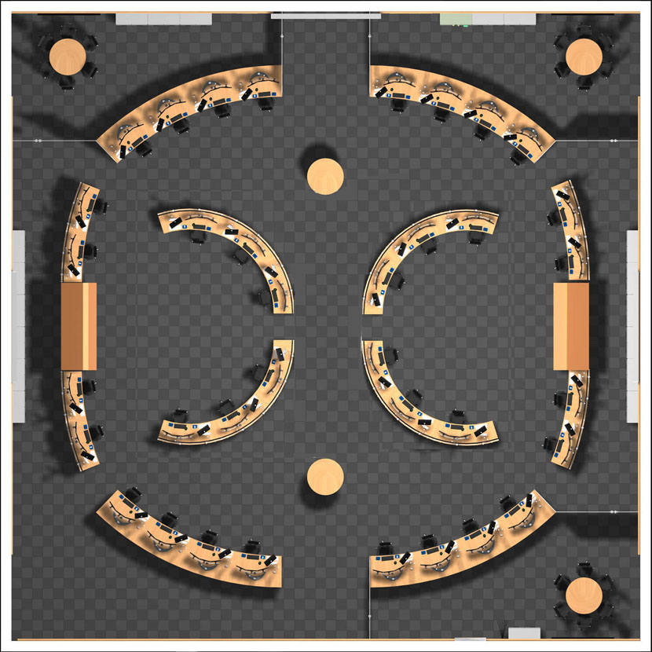
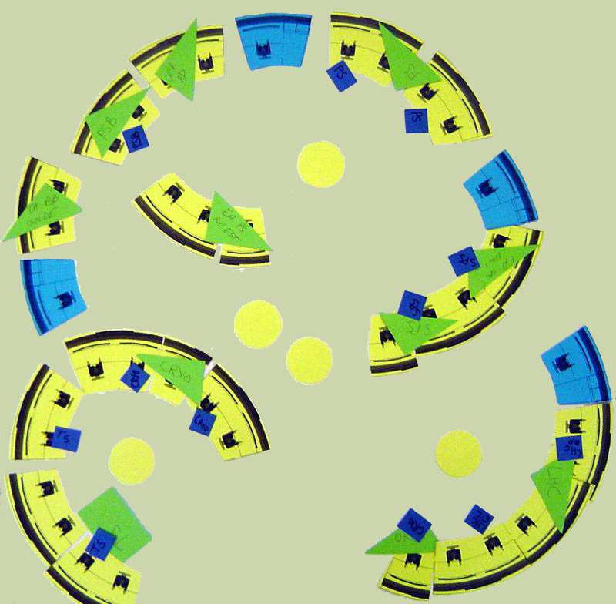
Control room layout
Proposals for CR layouts.
  Balance between closed areas and open space.
External firm
Control Centre Working Group
External firm
CERN WG

Slide 19
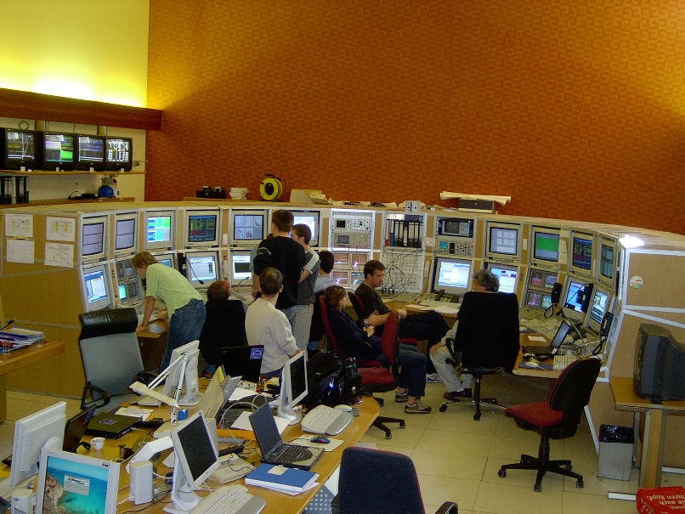
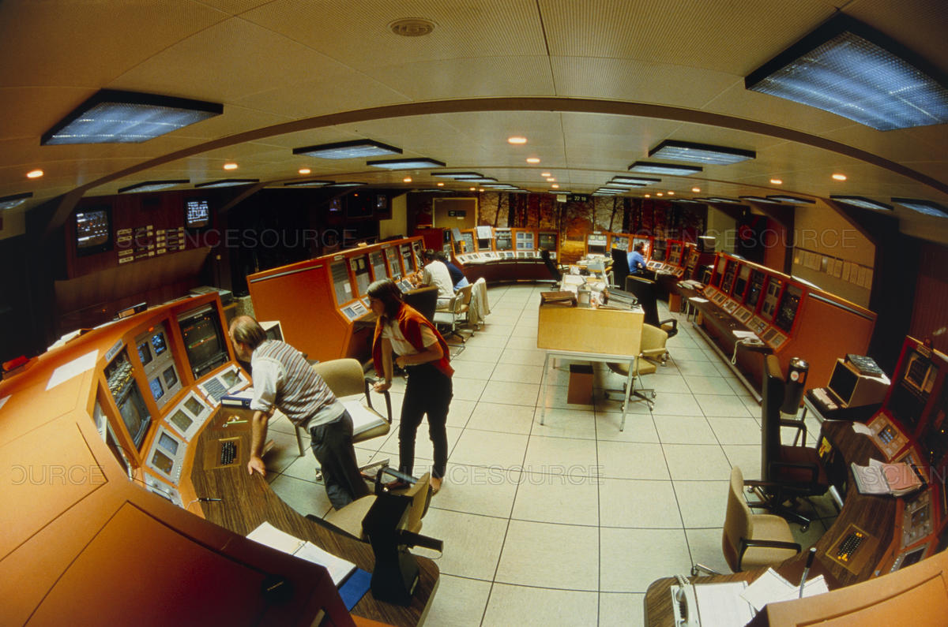
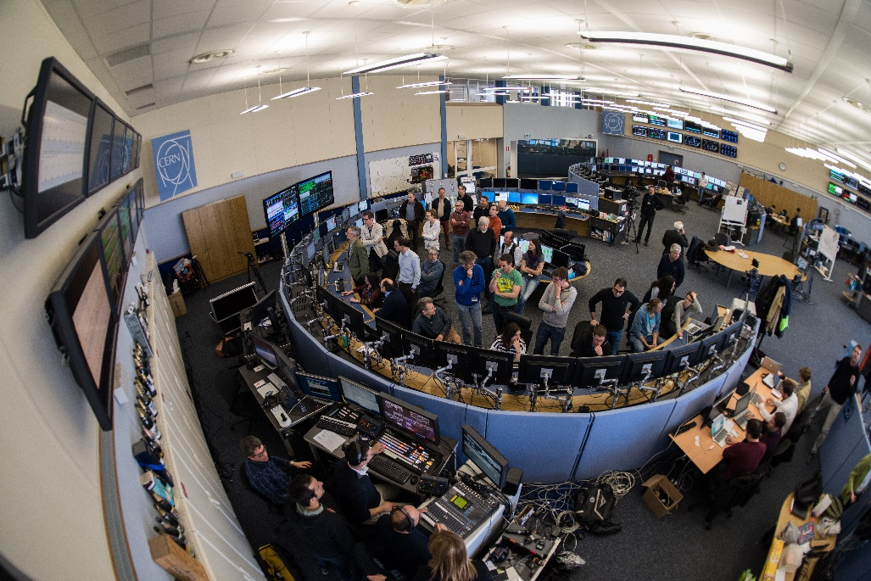
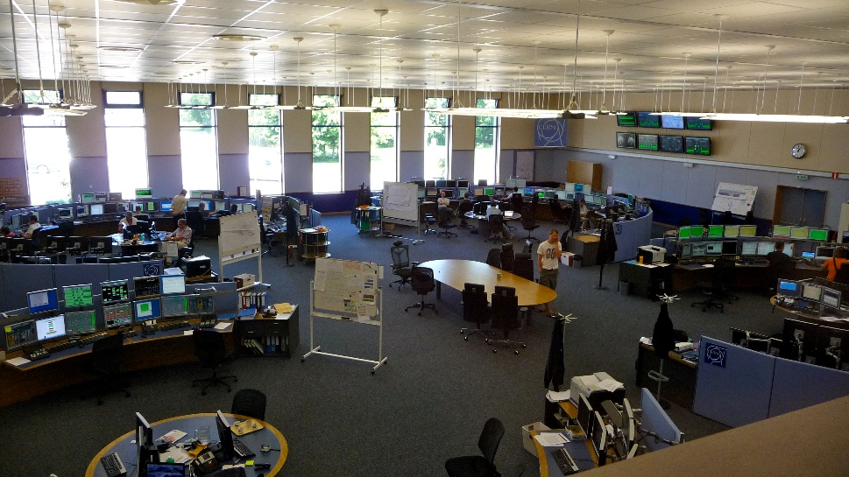
Towards a central control room
SPS-LEP control room
CPS control room
Final choice with semi-open islands.
  Reasonable mix of privacy and openness, contains crowds within concerned island.
  Clearly not the only viable option.
Common control room (CCC)

Slide 20

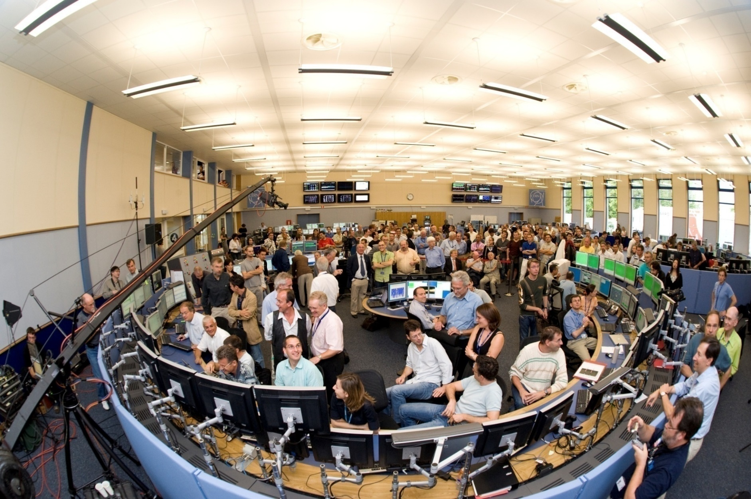
LHC D-day
Not exactly ideal for a commissioning – I do not recommend…

Slide 21
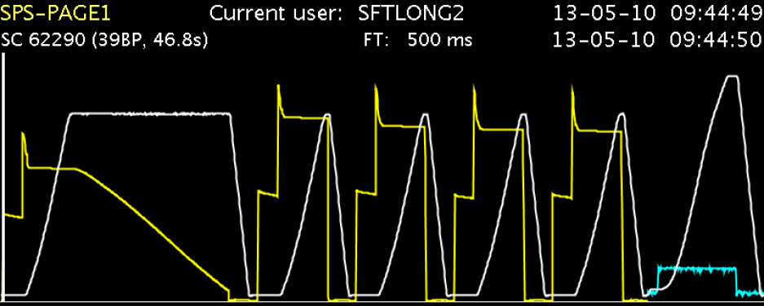
Cycles and super-cycles
A cycle is associated to a beam and has a characteristic time structure of the magnetic / energy field in one of the machines,
  A real beam requires cycles in the different accelerators coupled coherently from source to destination.
A super-cycle is composed of individual cycles. A super-cycle is replayed until there is a request to change its composition.
  Changed few times / day (LHC filling vs non-LHC operation, day vs night).
  Not very dynamic.
Cycles & super-cycle couple the accelerators in the complex.
SPS Supercycle
cycles
machine super-cycle

Slide 22
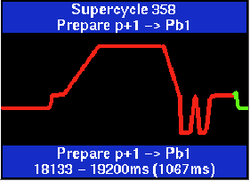
Controls for the LHC area
In 2000 the SPS/LEP – PS complex split was very visible in controls:
  The PS complex was very flexible, with the ability to rapidly change the super-cycle composition.
  The SPS operated with ‘almost hardcoded’ super-cycles.
    Changing the SPS super-cycle composition could take hours !
  Unacceptable for operation in the LHC area, SPS = bottleneck
In the 1990’s a new controls style based on physics parameter modelling was applied to the LEP collider (and to some extend to SPS).
  Trim the tune, not quadrupole currents etc.
    The database and the control system take care of propagation to low level parameters that are send to equipment.
  Machine settings were constructed directly from (MAD) machine models.
The LHC high level control system was born out of the LEP design, improved and generalized to include the SPS and its lines in view of breaking up the rigidity of the SPS.
  This effort started before the accelerator restructuring.

Slide 23
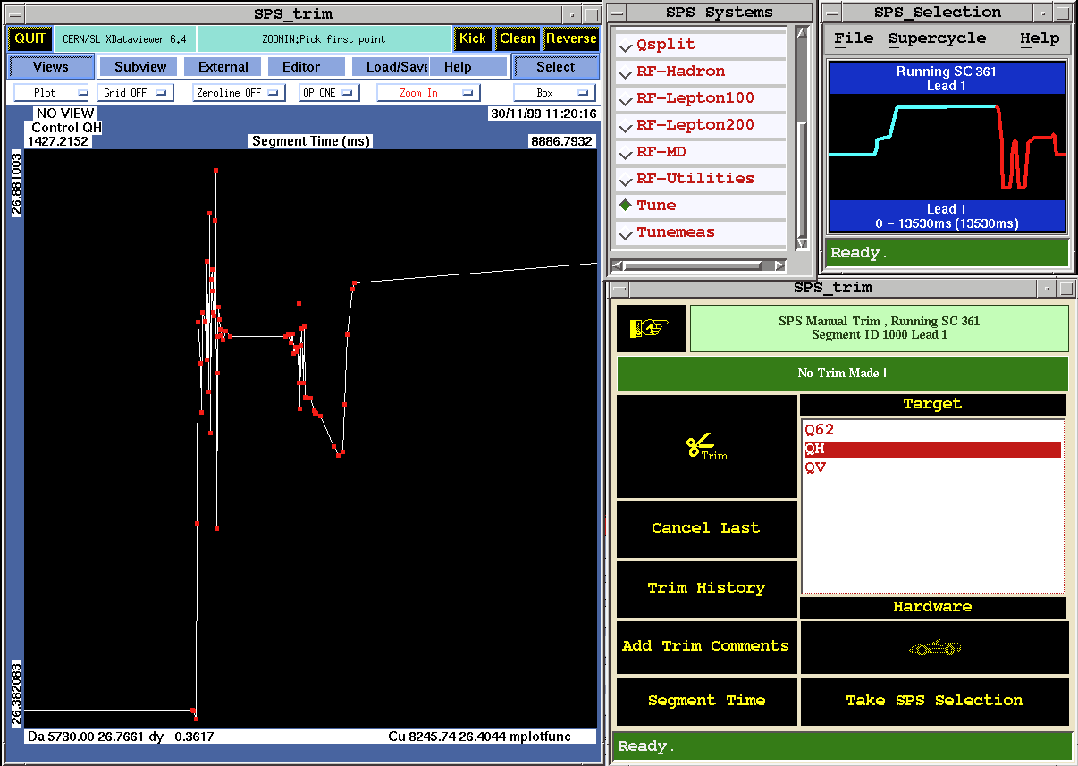
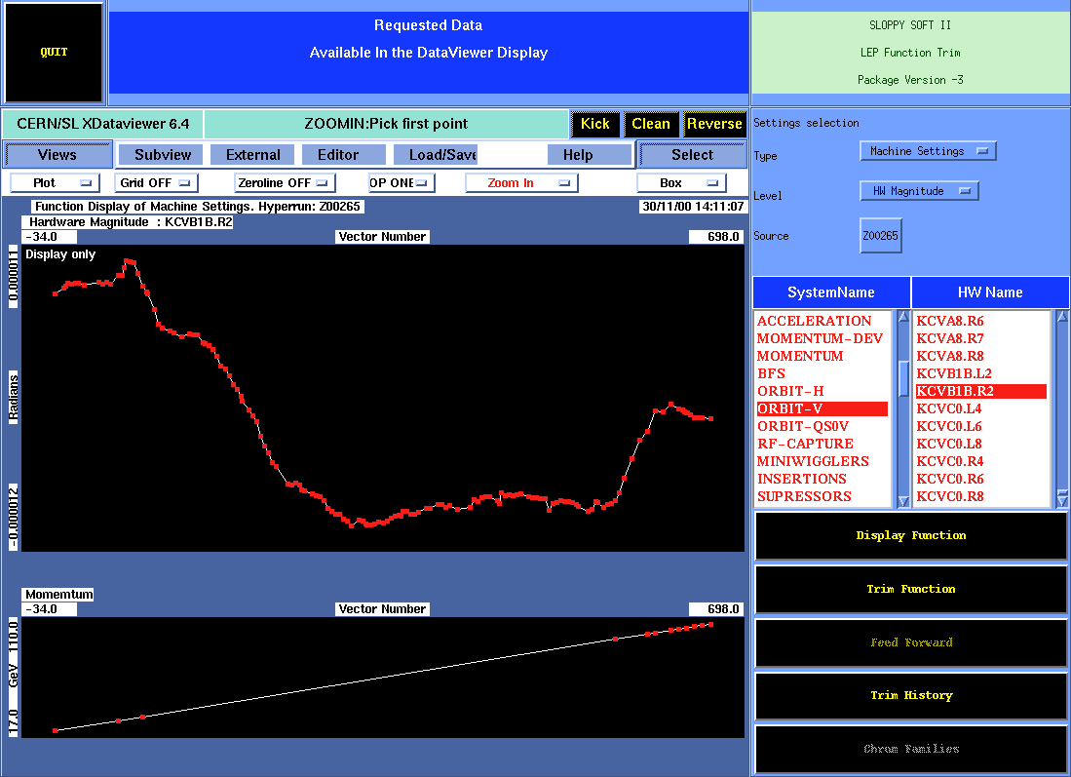
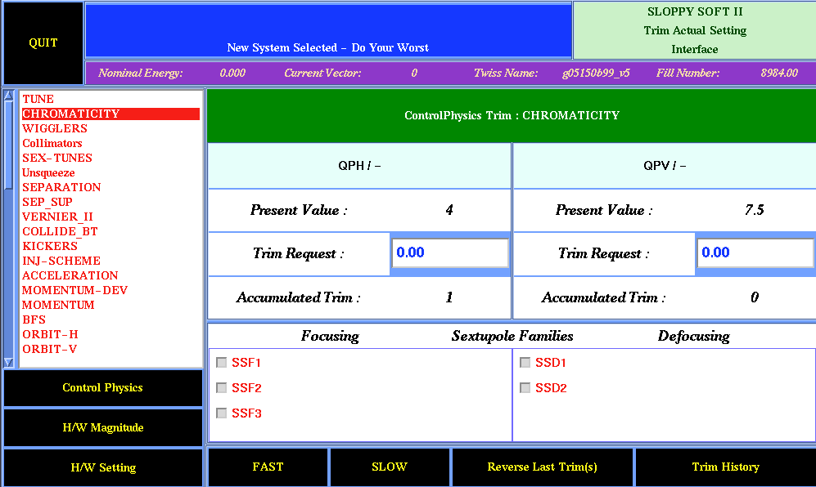
In the 1990’s…
SPS / LEP control system user interfaces – ‘SloppySoft’ – written in C/C++.
  Designed and written mainly by the SPS-LEP operation group.
LEP orbit corrector kick ramp function (in rad)
SPS horizontal tune trim function

Slide 24
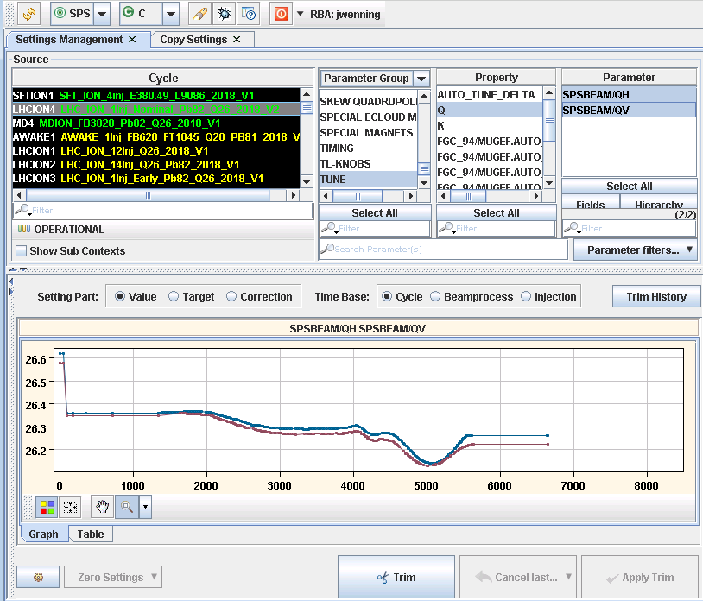
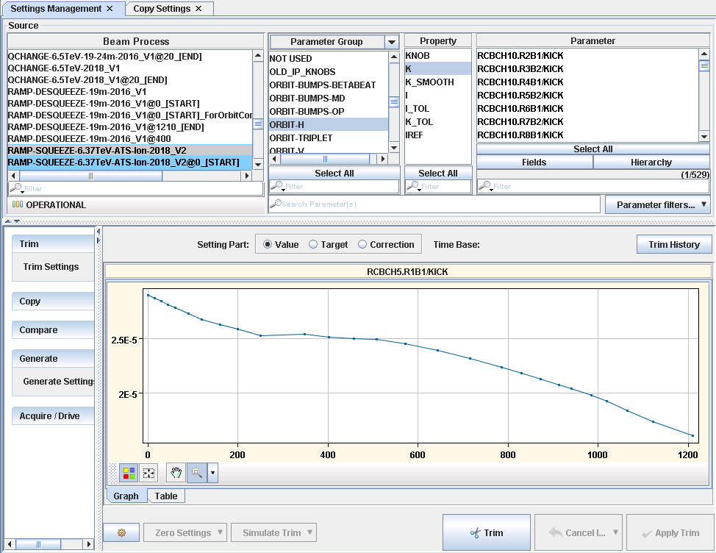
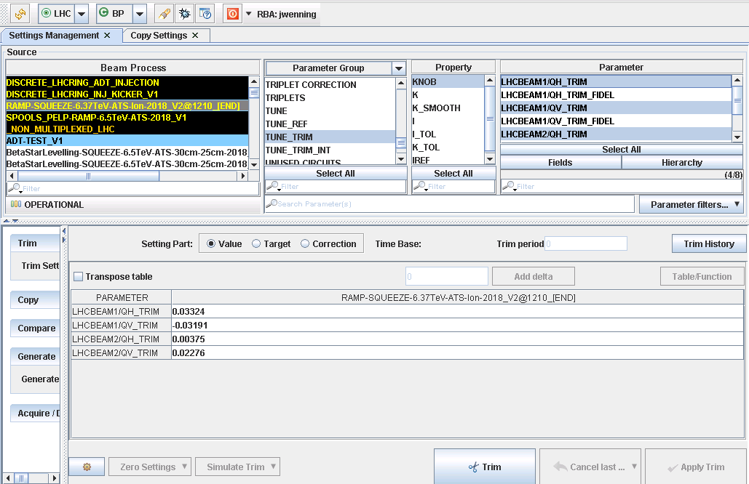
… now
JAVA high level world and look-and-feel – LSA (LHC Software Architecture) – but the concepts are still the same than in the 1990’s.
  Collaboration between operation and controls groups.
  Design and code vastly improved by software engineers.
  Embryos of python code appearing on the scene now.
SPS tune trim functions
LHC orbit corrector kick ramp function (in rad)

Slide 25
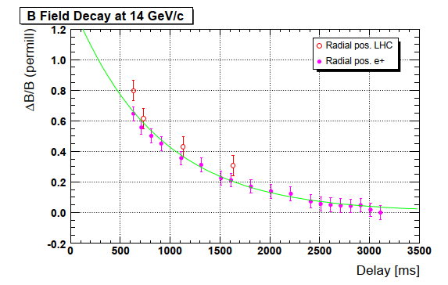
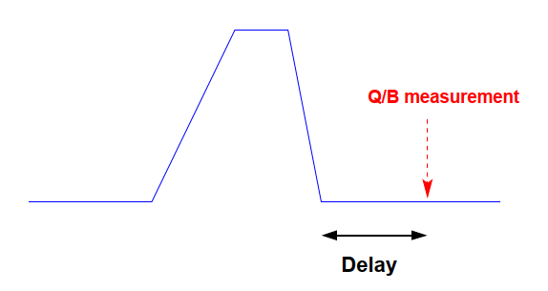
From super-cycle to cycle @ SPS
At the SPS, dynamic effects (eddy currents) and hysteresis on injection energy, tune and chromaticity due to a preceding cycle can be strong.
  PS & PSB not impacted so much due to lower fields (0.8-1.25 T versus 2 T for SPS) and less flat top energy diversity.
Historically the SPS settings were optimized for a given supercycle – not scalable to fast SC changes due to the vast amount of settings to maintain.
Moving to a concept with a unique instance of a SPS cycle that is played in different SCs meant:
  (sometimes) accepting slightly reduced quality,
  or enforcing a cycle order,
    For example LHC cycle always after fixed target (and never the reverse).
  or adding empty ‘reset’ cycles at the expense of some duty cycle.

Slide 26
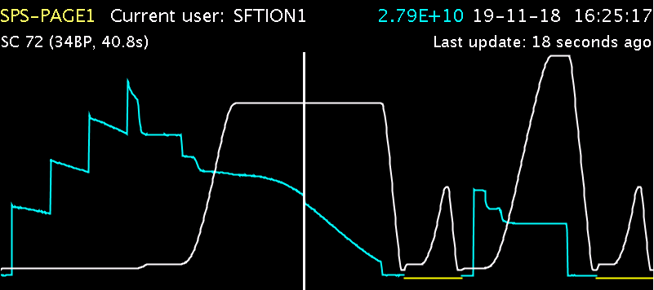

SPS settings by cycle
Nowadays the SPS uses cycle order, short MD cycles or empty reset cycles to overcome dynamic / hysteresis effects.
  Sometimes empty SPS are also needed / useful to provide space for more PS/PSB users in the SC.
Example of empty reset cycles in the SPS supercycle during lead ion operation
Reset cycles
450 GeV LHC
400 GeV fixed target
LSA was rolled out on SPS in 2006. When SPS moved to settings by cycle in 2008, operation was massively simplified and SPS SC changes became the fastest of the complex.
  8 years of controls work paid off !
  PS & PSB complex moved to LSA ~ 2013-14.

Slide 27
Outline
The CERN accelerator complex
From pre-LHC to LHC area
Operation of the complex
Outlook

Slide 28
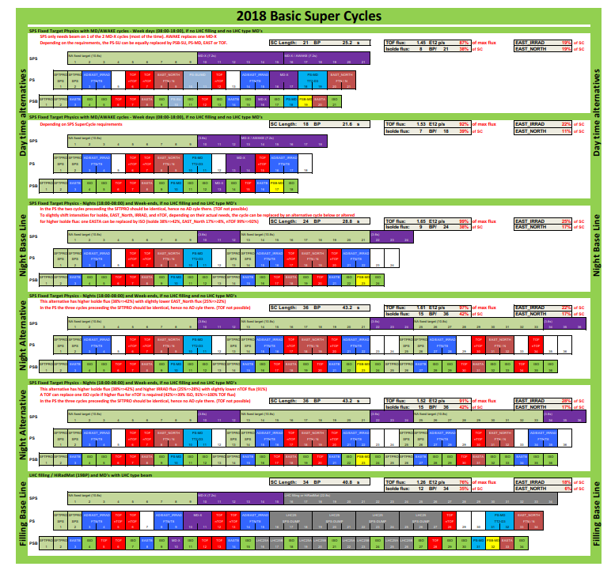
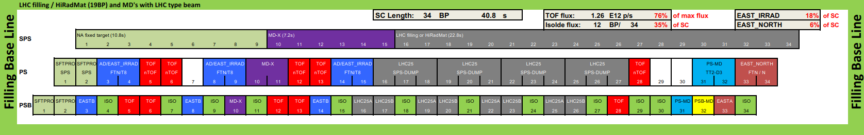
Operation super-cycles
Baseline SC compositions for the 2018 run – used to estimate the yearly performance (protons on target etc).
PSB user
PS user
SPS user
LHC
LHC filling baseline

Slide 29
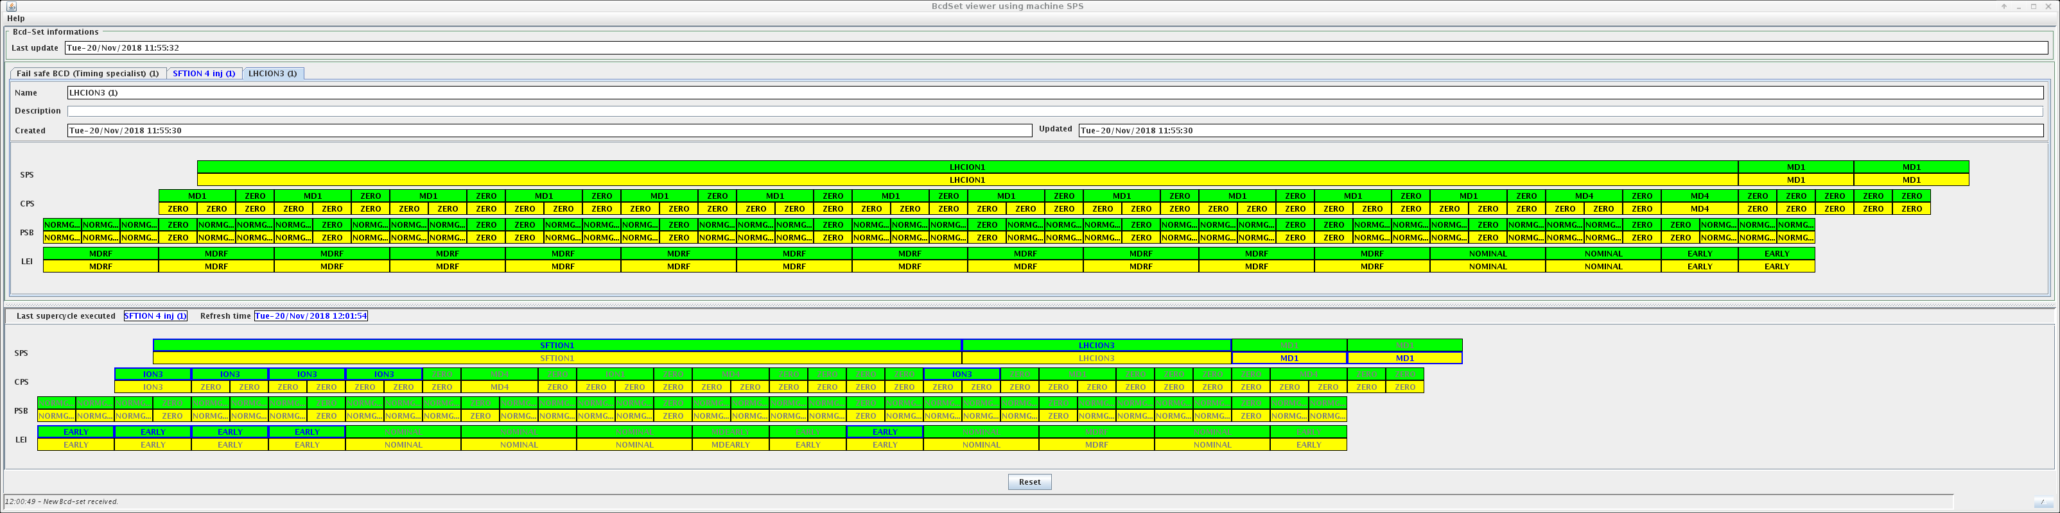
Cycle editor
A timing sequence editor is used to edit the SC composition of the CERN injector complex.
  ‘Beams’ within the sequence define the coupling between machines and the final beam destination.
    A spare beam is played when the main beam is blocked by an external condition.
  LHC and AD are operated as standalone machines, only coupled to the complex during injection.
  This UI will be revised to ease edition of the SC.
Example of sequences for ion operation
LHC ion beam with 12 injections into the SPS
SPS
PS
Booster (PSB)
LEIR
LHC ion beam with 1 injection into the SPS
LEIR = Low Energy Ion Ring (ion accumulator ring → PS).

Slide 30
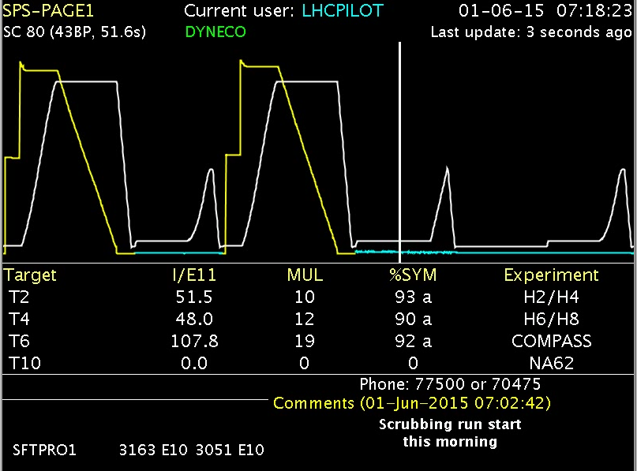
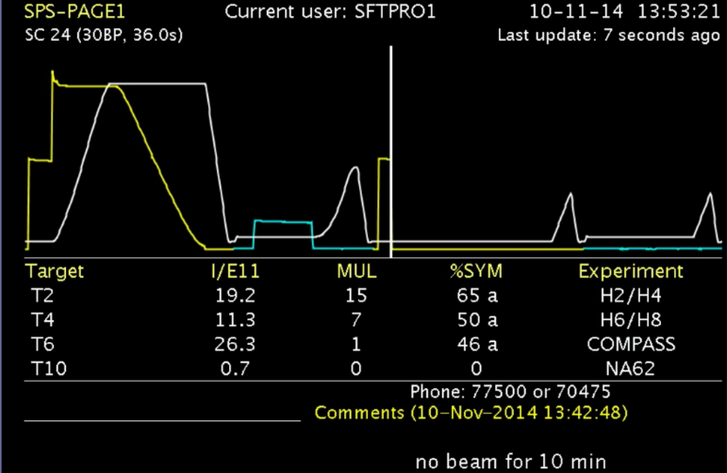
Cycling and saving energy
The CERN electrical consumption amounts to 150-180 MW for the full complex, mainly provided by EDF (French electricity company).
  Big consumers: SPS (up to 40 MW), LHC cryogenics (30-35 MW).
Due to its high power consumption of up to 40 MW, saving magnet pulses at the SPS was always an important aspect of operation.
  Dynamic economy cycles: no beam detected
    Cycling change applied on the fly after cycle execution has started.
  Destination economy cycles: no beam requested
  For the SPS the yearly saving is at the level of 1-1.5 MEuro.
Normal
Normal
Economy

Slide 31
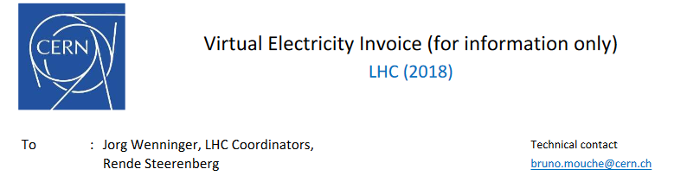
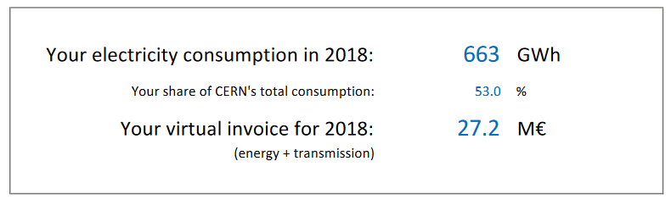
My electricity bill…

Slide 32
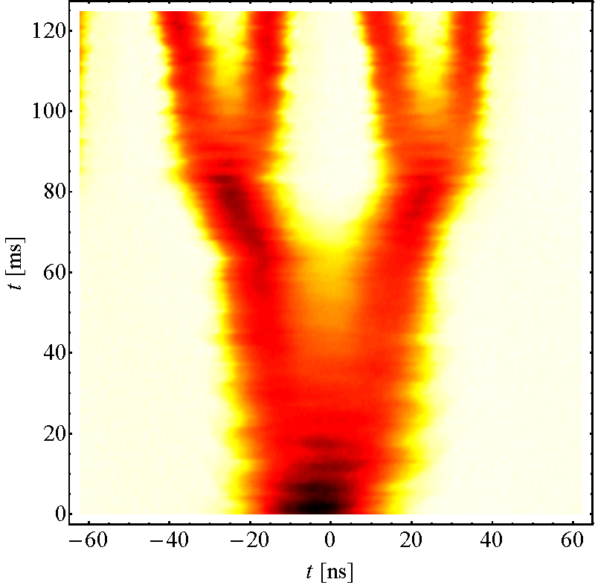
LHC proton beam structure
PS @extraction (26 GeV)
The PSB accelerates 1 bunch / ring in 1-4 rings.
Between 1 and 8 PSB bunches (1-2 cycles) are injected into the PS.
  At injection 3-splitting, merging, empty bucket insertion.
    Empty buckets generate holes in the trains that reduce electron cloud effects in the LHC.
  At 26 GeV two double splittings.
  Beam spacing at exit of PS:
    25 ns, 50 ns, 75 ns, 100 ns,
    Single bunches (1-4).
SPS injects up to 4 trains from the PS, beam destination to ring 1 or ring 2 according to the LHC request.
PS @injection
25 ns
8b4e***
25 ns BCMS*
8b4e BCS**
(*) Batch Compression Merging Scheme
(**) Batch Compression Scheme
(***) 8 bunches 4 empty (slots)

Slide 33
Injector complex – filling LHC
Typical LHC high intensity beam cycles in the injectors:
  8 PSB cycles, 4 PS cycles, 1 SPS cycle.
  For the SPS filling is general done in parallel with fixed target.
To LHC
= Field in main magnets
= Proton beam intensity (current)
450 GeV
= Beam transfer
SPS
26 GeV
PS
1.4 GeV
PSB
Time
1.2s

Slide 34
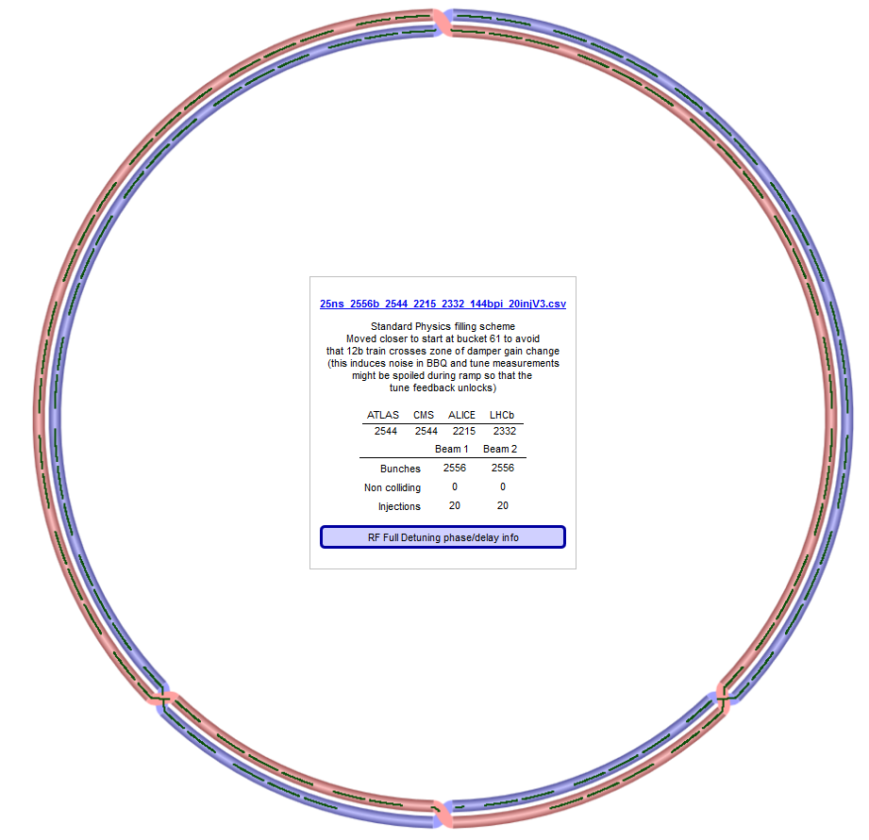
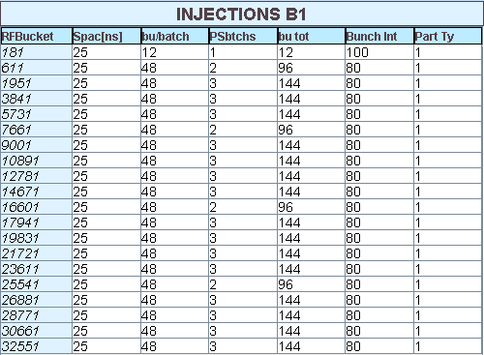
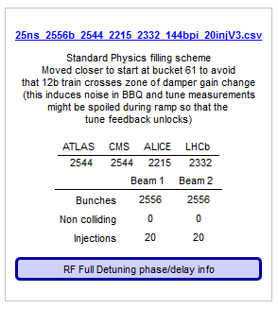

LHC filling schemes
The LHC is ultra-flexible in terms of filling schemes, different beam types can be mixed (but beware of instrumentation, RF, transverse feedbacks).
  Dedicated filling software for operation and physics coordination.
Nominal 2018 filling scheme (2556 bunches)

Slide 35

LHC cycle
Beams are injected and accumulated at 450 GeV (up to ~2800 bunches) with a detuned optics (large β at the interaction points (IP)).
The beams are accelerated to 6.5 TeV in a 20 minute ramp during which the optics is already partially squeezed (lower β at IPs).
At higher energy the final beta squeeze is applied and the beam are brought into collision for ~ 12 hour long physics data taking.
Achieved
≥ 2 hours

Slide 36

Proton statistics
The total number of protons delivered per year is ~1.5×10²⁰.
2/3 of the protons are sent to the rare isotope facility ISOLDE.
The 1/3 of the protons are used by PS, SPS and LHC.
  AD produces ~3×10¹² anti-protons from ~2×10¹⁸ protons on target.
The LHC uses only ~0.1% of the protons.
2017 proton statistics

Slide 37
Peak performances
Approximate peak performances in terms of particles / cycle.
All proton beams
Pb ion beams
Machine | Protons/cycle
PSB (4 rings) | 2.5×10¹³
PS | 2.5×10¹³
SPS | 4.5×10¹³
LHC | 3.2×10¹⁴
Machine | Pb ions/cycle
LEIR (Pb⁵⁴⁺) | 1.8×10⁹
PS (Pb⁵⁴⁺) | 1.6×10⁹
SPS (Pb⁸²⁺) | 9×10⁹
LHC | 1.6×10¹¹
2018 LHC production beam
Machine | Protons/cycle
PSB (4 rings) | 2×10¹²
PS | 4×10¹²
SPS | 1.6×10¹³
LHC | 3.2×10¹⁴
Numbers will be doubled in 2022-2023 (injector upgrade)

Slide 38

LHC performance
The LHC performance currently reached twice design luminosity thanks to:
  Excellent hardware performance and good availability,
  An excellent reproducibility and precise setup – machine & SW tools,
  Smaller β (~ design / 2 ) at the interaction points (IP),
  Brighter proton beams (~ 2 × design) from the injector chain.
Luminosity limited to ≈2.2×10³⁴ cm⁻²s⁻¹ by the cryogenic cooling capacity of the low-beta quadrupoles
Design luminosity
The luminosity gain wrt design is due to beam brightness and β at IP !

Slide 39
Many users, never enough time
Besides the main programs, there are many additional users, in particular at the SPS:
  AWAKE experiment on plasma acceleration by p+ beam.
  HiRadMat material resistance / damage test facility.
  Coast experiments for crystal extraction.
  Crab-cavity test assemblies for the LHC upgrade.
  Machine experiments users (–> accelerator physics group).
  Beam setup for all users.
  … and the LHC that tries to maintain its priority.
There is a trend to be overbooked, in particular beam setup time is frequently underestimated (partly due to changing requirements).
  Tensions can build up when major technical issues strike (electrical network issues, septa magnet failures etc).

Slide 40

Availability
A few years ago a concerted effort to track faults and downtime (more) consistently was initiated for LHC, now extended to all machines.
  Faults are introduced by operation through the electronic logbook.
  ~ weekly fault reviews to clean up registered faults.
  Hardware faults tend to be better tracked, software (and ‘staff management’) issues often escape statistics !
Availability numbers were used to steer electronics upgrades for LHC to mitigate radiation to electronics issues, and they are currently input to the CERN equipment consolidation plans.

Slide 41


Availability tools – examples
LHC ‘cardiogram’
PS ‘dashboard’

Slide 42

Machine availabilities
The typical machine availabilities are rather reproducible from year to year.
  Numbers include the un-availability of the injector machine.
  LINAC4 is in the commissioning phase.
Machine | Availability
LINAC2 | > 99%
LINAC4 | ~95%
PSB | 97-98%
PS | 92-95%
SPS | 85-90%
LHC | 75-80%
LHC collisions | 50%
LHC availability breakdown (2017)
Stable beams (= collisions) fraction of 50% stable in the past 3 years
Max / ideal stable beam fraction ~ 85%.

Slide 43
Outline
The CERN accelerator complex
From pre-LHC to LHC area
Operation of the complex
Outlook

Slide 44
Long term plan
CERN just entered a long shutdown (LS2) for all machines.
  Infrastructure: general maintenance of the large electricity, cooling & ventilation, cryogenic etc systems.
  Injectors: complete upgrade in view of High Luminosity LHC (HL-LHC) with the aim to double the LHC beam intensity and improve the brightness.
  LHC: consolidate dipole magnet bypass diodes to safely reach 7 TeV beam energy in 2021. Maintenance and upgrade of experiments.
LS2 will be followed by a 3/4 years (LHC/injectors) long Run 3.
Run 2
Run 3
HL-LHC installation
Run 4

Slide 45

Beam commissioning Run 3
After Long Shutdown 2, long hardware commissioning and checkout phases leading to the beam commissioning:
  April 2020: LINAC4 – 5 months,
  Sept 2020: PSB – 2.5 months,
  Nov 2020: PS – 2 months,
  Jan 2021: SPS – 1.5 months,
  Mar 2021: LHC – 2 months.
Organized and driven by op group

Slide 46

Commissioning tools for post LS2
The experience of the long and (relatively) structured LHC equipment and beam commissioning is used prepare improved tools for organizing and tracking machine start-ups of all machines.
But we are still looking for the ideal tool !
  Circuit commissioning toolbox and google spreadsheets at the LHC.
  OP built web tool for test tracking tested in the injectors.

Slide 47


Circuit commissioning - LHC
The powering tests of the LHC super-conducting magnet system is highly automated and can be easily configured for any test campaign.
  Predefined and approved test sequences,
  Automated execution of the tests that are ready,
  Test sequence blocked until tests are signed,
  Tracking of results – no step is missed !
encoding in a test sequence
1 block = 1 test

Slide 48
Evolution of operation
The current CERN operation mode with 3-4 year long runs followed by 1-2 years long shutdowns is not ideal for the operation group.
  The run periods are very dense, making it difficult to integrate operation staff into technical groups as it was one in the past.
    Closer integration with technical groups provides better exit paths for OP staff.
  During the long shutdowns operation staff work on controls, or must be incorporated into shutdown activities.
    Many become shutdown activity or (re)commissioning coordinators.
After more than 10 years of operation in the CCC, the upcoming long shutdown is a moment to reflect on how the complex is operated.
  Optimize/adapt operation of the complex in the future.
    Example: the LHC has grown into a mature and highly automated machine, yet its shift crew of 1 physicist + 1 operator has not evolved.
  Facilitate and encourage mobility between machines.
  In parallel software development is moving from massive software creation to massive maintenance (with authors no longer in the group or at CERN) that has a significant impact on OP resources and motivation.

Slide 49

Thank you for listening !
LHC collisions for < 200 Euro

Slide 50

Architecture
A slide from ICALEPS 2005 – the structure is essentially unchanged.

Slide 51

Settings management evolution
Settings management is still an important subject with ongoing developments – OP settings working group – with smaller machines starting to adopt control through high level physics parameters:
  Tune and chromaticity knobs, kick angles in LSA etc instead of direct changes to currents or dedicated applications for each parameter.
Many settings that used to be stored only in front end computers (like gains, calibrations…) are migrated to the central settings management.
  Bonus of change history, avoids loss of settings after FEC crashes etc …
The import of settings structures for control system devices from the Controls Configuration DB (CCDB), where devices are described, into the settings management of LSA has been greatly simplified.
  A similar strategy is now also applied for the new data logging system.
Parameters and all dependencies are defined in LSA code & DB

Slide 52
Data logging
The first CERN data logging appeared for LEP in the mid-1990’s.
The LHC logging project (CALS) grew out of the LEP experience, later extended to include more and more injector data.
  The growing data logging needs of the entire complex, exceeding 3 TB per day, call for a replacement of the current ORACLE DB logging.
A new logging system (NXCALS) is under development, based on Hadoop open source framework.
  Distributed storage and parallel processing,
  Data analysis within the cluster as opposed to local analysis on extracted data.
    Unfortunately it seems the performance for small data extraction volumes is degraded…
1.5 years later…

