Slide 1
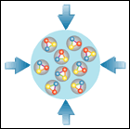
CBM Project
Walter F.J. Müller, FAIR, Darmstadt
CBM-India Meeting, BI, Falta 15-17 February 2018

Slide 2
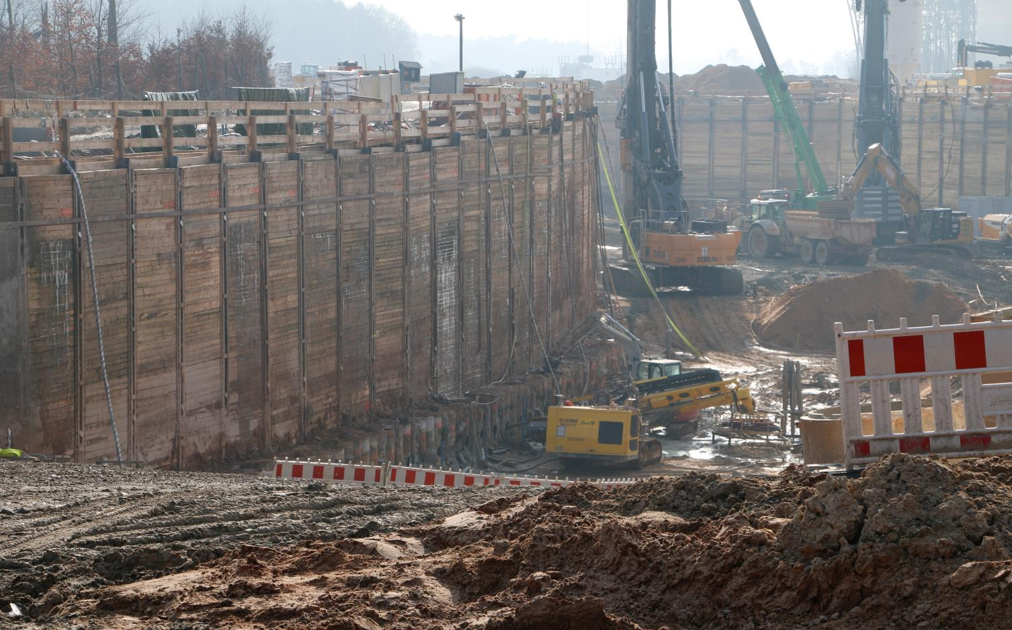
FAIR Construction on Track
picture taken February 7th, 2018

Slide 3
Major External Milestones for CBM
G014 (CBM building)
shell completed Nov ‘20
installation window Dec ‘21 to Mar ‘22
transition to ‘user mode’ Dec ‘22
Cryogenics and Accelerator
Cryogenics ready in G014 Mar ’23
SIS-100 ready for beam Apr ‘24
HEBT ready for beam Aug ‘24
SIS-100 pilot beam Nov ’24
SIS-100 ‘1 user, low intensity’ Feb’ 25
Notes:
- during ‘installation window’ building is still in ‘construction site’ mode - only very basic ventilation and power services available - mainly useful for bringing in robust mechanical structures
Cryo plant still on commissioning
Depending on whom one asks first opportunistic test beam (few hours parasitic to SIS-100 commissioning) might start between Jul and Nov ‘24.
Go for CBM M11 Mar’24

Slide 4
FAIR Schedule: SIS100 and CBM
Slide shown on Spring 17 CBM Week in plenary on 23rd March 2017
The CBM bottom line:
Dec 2021 to Jul 2022 1st installation window
Dec 2022 Building acceptance
Dec 2022 to Jun 2024 Installation & commissioning w/o beam
Jun 2024 to Mar 2025 Commissioning beam from SIS100
→ Schedule Stable

Slide 5
CBM Construction Planning I
Construction planning priorities
get it right
get it in time
→ use the available time wisely
→ always remember: construction can only be spend once
Ensure that
responsibilities are all defined
essential dependencies are understood
essential decision points are defined

Slide 6
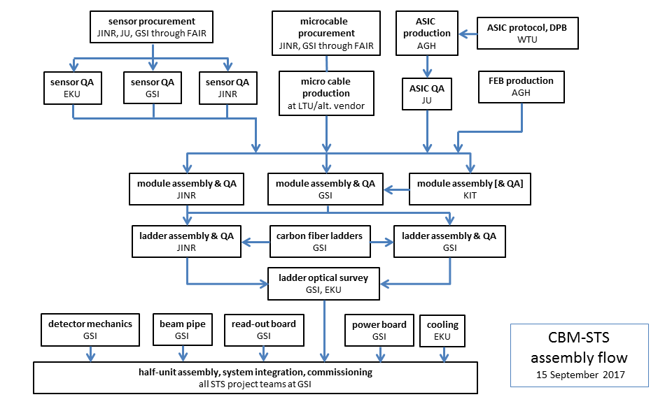
Example: STS Construction Flow

Slide 7
CBM Construction Planning II
Milestones
have clear list of objectives and acceptance criteria
follow a modular approach (handle sub-topics separately)
use several levels
M5: CDR (conceptual design)
M6: PDR (e.g. full 3D model)
M7: FDR (e.g. manufacturing drawings) (aka PRR)
M8: FOS (First-of-Series acceptance)
M9: FAT (Factory acceptance test)
M10: SAT (Site acceptance test → ready for installation)
M11: Ready for beam
Notes:
- apply the levels as appropriate for an entity - define clear objectives and acceptance criteria - there are several M10 per detector: mechanics, services, detectors

Slide 8
Example: STS Milestones
M6 (PDR)
LDO ASIC Feb ‘18
STS-XYTER V2.1 updates Mar ‘18
STS-XYTER final Nov ’18
STS core (‘... the big one...’) Nov ’18
M7 (FDR/PRR)
sensors Apr ‘18
LDO ASIC
STS-XYTER ASIC Jan ‘19
FEB Apr ‘19
micro cables Apr ‘19
ROB/POB
and 12 more .... (services, mechanical key structures,....)

Slide 9
CBM Construction Planning III
change planning mode ...
there is no need to impress anymore with aggressive time scales anymore (as we tried so often in the past)
we’ll be finally judged by the quality of the detectors, and not by how many year we were early, as long we stay in time
... and use the time wisely
do proper long term testing (long = 1 year)
do proper beam testing (mCBM, ....)
Examples of schedule updates
STS: STS-XYTER PDR after mCBM 2018 run (Nov ‘18)
TOF: counter PRR after 20 weeks STAR-BESII (Jun ‘19)

Slide 10
CBM Installation Planning
It’s also time to review the installation planning
Separate between
Mechanics
could/should be brought in during installation window (Dec ‘21)
Services (LV/HV, gas, cooling)
installed in service areas, can start on Dec ‘22
Detectors
usually done after services are in place (test after install)
in general starting in Q2’23
Plan Pre-Assembly activities at FAIR
that covers all activities on FAIR site, but outside of Cave
e.g. RICH mirror mounting or MUCH station assembly
Space must be allocated now !!

Slide 11
CBM MUCH Specifics
Consolidate Station 1+2 planning
steps toward st 1+2 PRR
include new HV concept and it’s validation
potentially separate between chamber and readout
Setup station 3+4 planning
timeline and criteria for CDR
involve external experts on CDR
Setup pre-assembly planning
what needs to be done at FAIR site ?
are there significant activities outside of Cave area ?
Review Assembly sequence
is a field map with mounted MUCH absorber needed ? (this is the 500 pound gorilla dictating the time planning around the magnet)

Slide 12
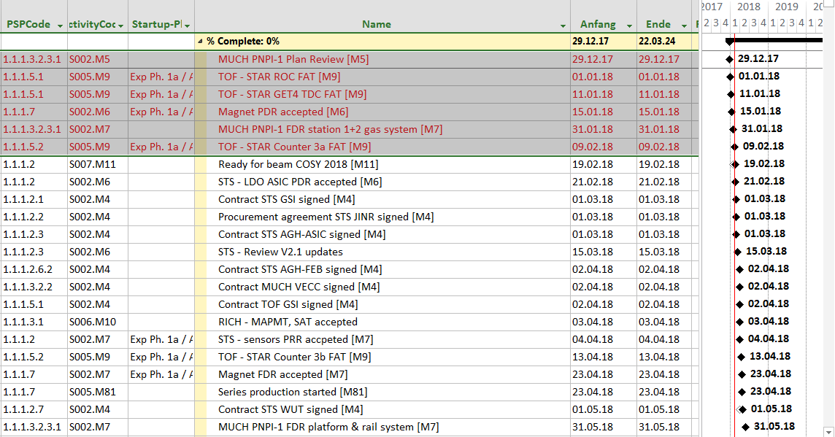
Late and Next Milestone Report
Report on Late and Next-to-come Milestones now send monthly to CBM TB

Slide 13
Progress Summary for Higher-Ups
Frist Draft of an ‘all-in-one-slide’ overall status summary shown in ECE on February 12th

Slide 14
... and a Final Word
Don’t equate planning == reporting !
Yes, the higher-ups love look at milestone-trend-analysis
But key purpose of planning is to help us !
Only with good planning we
know objectively where we stand
can decide on priorities
can use the time wisely
understand impact of changes quantitatively
And keep in mid
a plan is a living document, can and will be changed
Planung ersetzt den Zufall durch Irrtum – und aus Irrtum kann man lernen
attributed to Albert Einstein
Planning replaces coincidence with error – and from errors one can learn

Slide 15
The End
Thanks for your attention

Slide 16
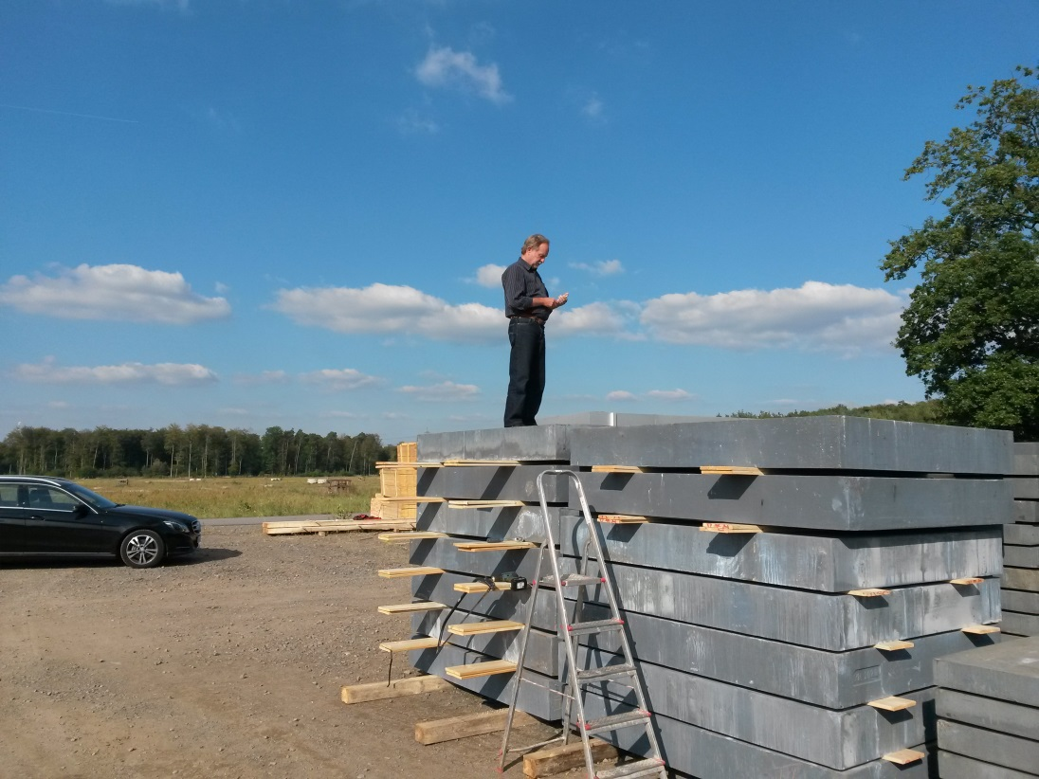

Slide 17
Backup Slides

