Slide 1
CBM-India meeting
Falta
15-18 February 2018

Slide 2

file:///.file/id=6571367.2830764

Slide 3
This meeting
CBM physics programme and what our theorists are thinking about it..
When does CBM take data and the status
How are you doing mUCH??

Slide 4
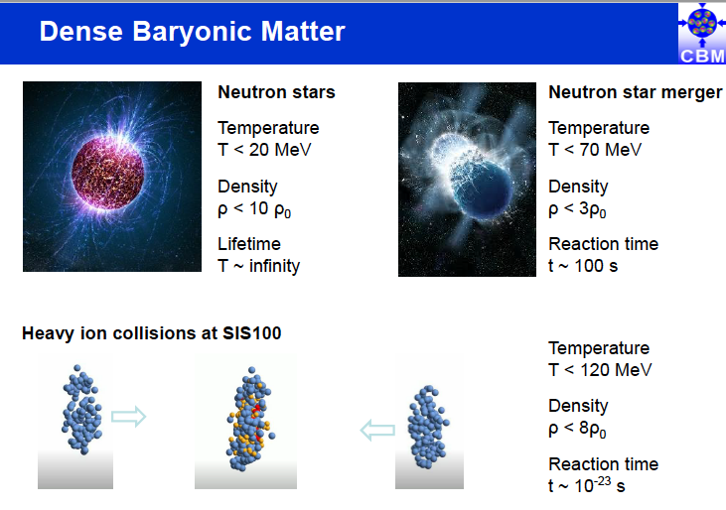

Slide 5
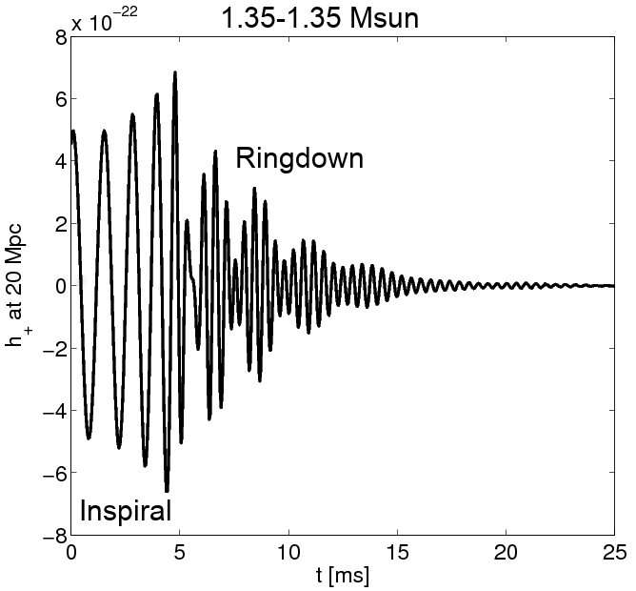
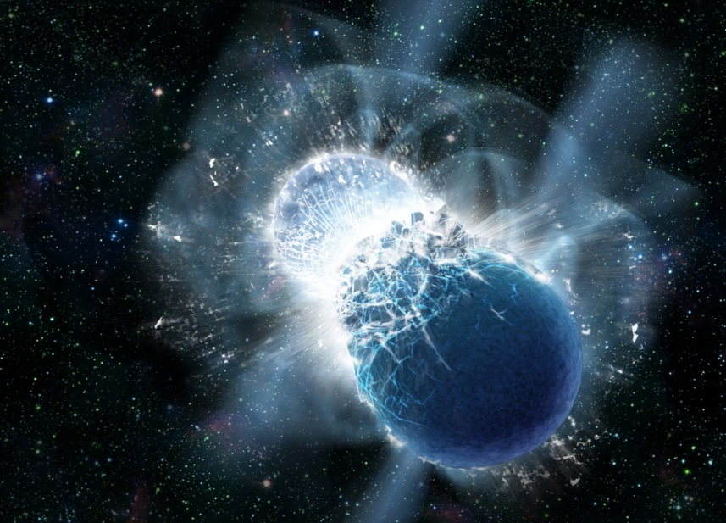
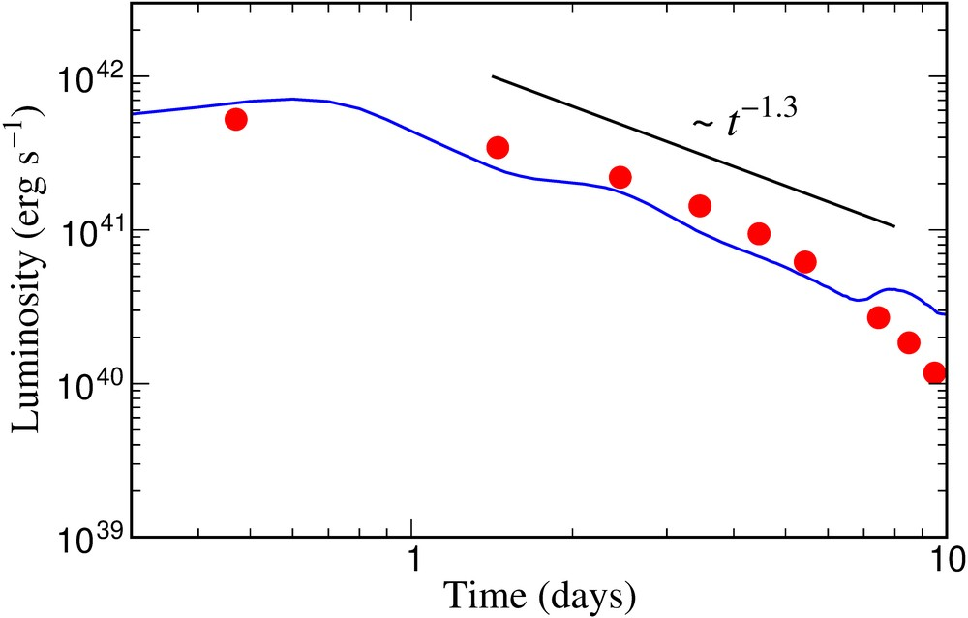
Astrophysical site of heavy element production (r process) in the universe: Neutron star merger !
A. Bauswein
Neutron star merger
Metzer, Martinez-Pinedo, Arcones et al. (2010)
Astrophys. J. 848, L17 (2017)
Gravitational
Wave Signal
Electromagnetic “Kilonova” Signal
Copyright: Dana Berry, SkyWorks Digital, Inc
Electromagnetic “Kilonova” signal due to “r process” in neutron star merger theoretically predicted by GSI scientists in 2010.
Confirmation by recent astronomical observations after gravitational wave detection from GW170817 (September 2017).
Source of heavy elements including gold, platinum and uranium.
Sun

Slide 6
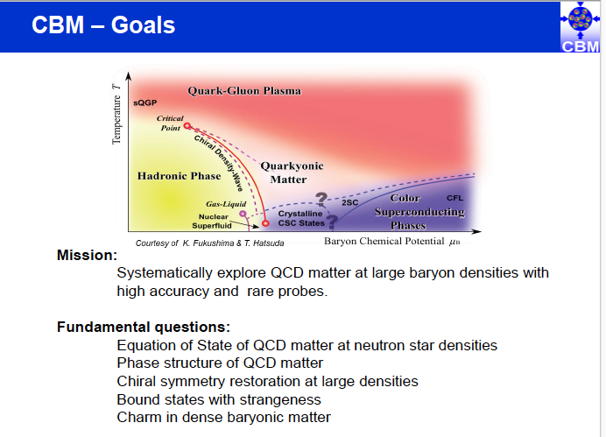

Slide 7
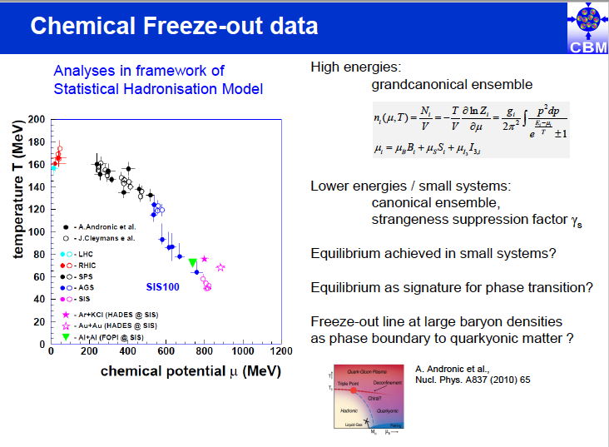

Slide 8
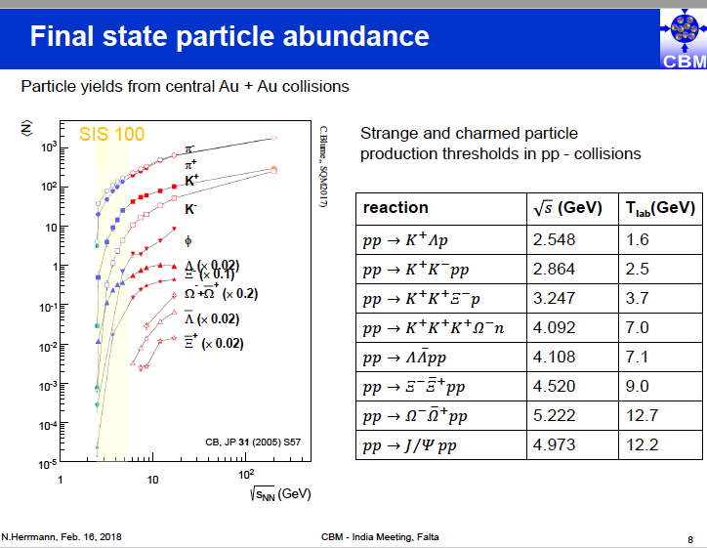

Slide 9
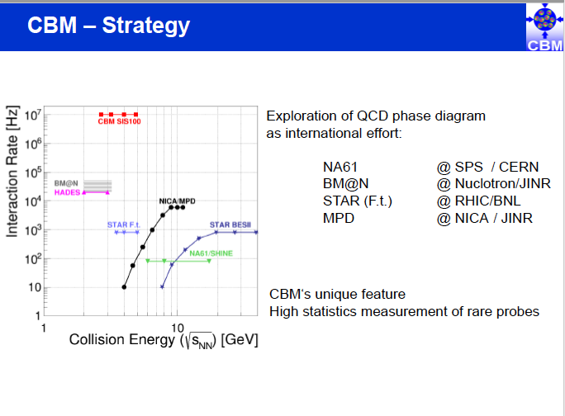

Slide 10
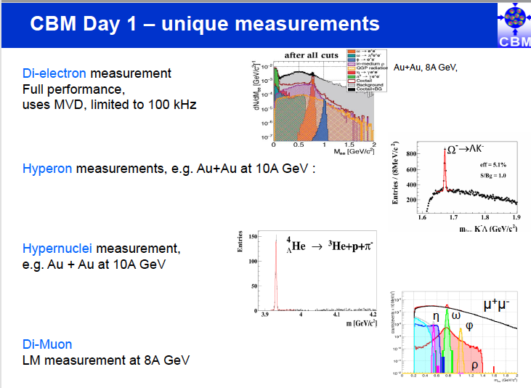

Slide 11
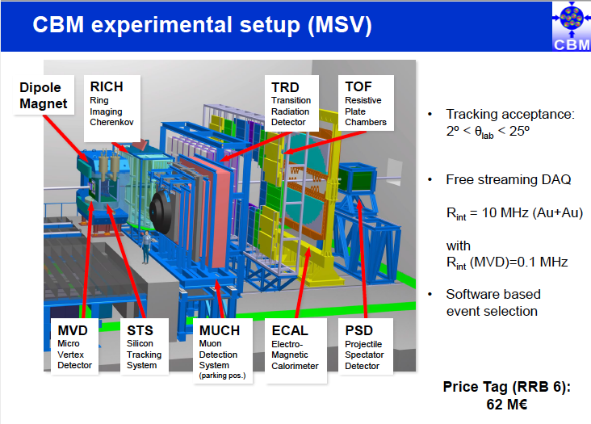

Slide 12
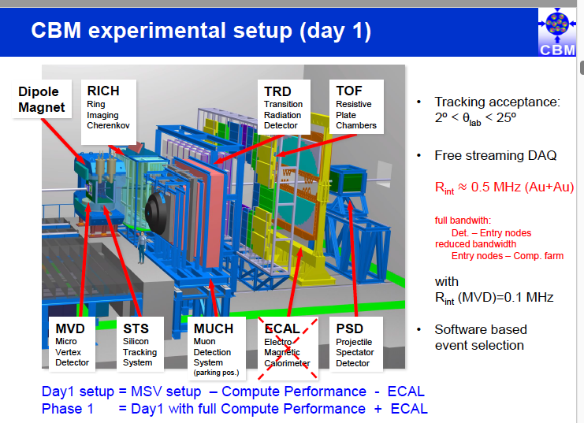

Slide 13
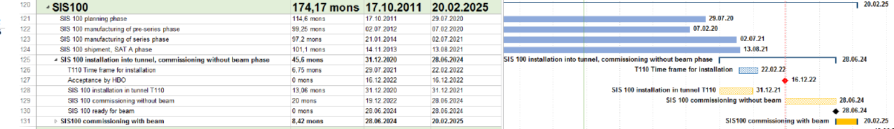
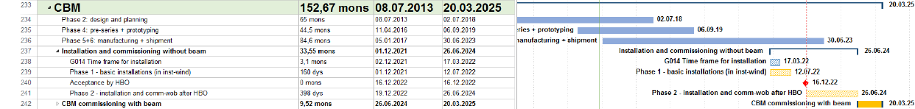
FAIR Schedule: SIS100 and CBM
Slide shown on Spring 17 CBM Week in plenary on 23rd March 2017
The CBM bottom line:
  Dec 2021 to Jul 2022 1st installation window
  Dec 2022 Building acceptance
  Dec 2022 to Jun 2024 Installation & commissioning w/o beam
  Jun 2024 to Mar 2025 Commissioning beam from SIS100
→ Schedule Stable

Slide 14
CBM Construction Planning II
Milestones
  have clear list of objectives and acceptance criteria
  follow a modular approach (handle sub-topics separately)
  use several levels
    M5: CDR (conceptual design)
    M6: PDR (e.g. full 3D model)
    M7: FDR (e.g. manufacturing drawings) (aka PRR)
    M8: FOS (First-of-Series acceptance)
    M9: FAT (Factory acceptance test)
    M10: SAT (Site acceptance test → ready for installation)
    M11: Ready for beam
Notes:
- apply the levels as appropriate for an entity
- define clear objectives and acceptance criteria
- there are several M10 per detector: mechanics, services, detectors

Slide 15
... and a Final Word
Don’t equate planning == reporting !
Yes, the higher-ups love look at milestone-trend-analysis
But key purpose of planning is to help us !
Only with good planning we
  know objectively where we stand
  can decide on priorities
  can use the time wisely
  understand impact of changes quantitatively
And keep in mid
  a plan is a living document, can and will be changed
Planung ersetzt den Zufall durch Irrtum – und aus Irrtum kann man lernen
attributed to Albert Einstein
Planning replaces coincidence with error – and from errors one can learn

Slide 16
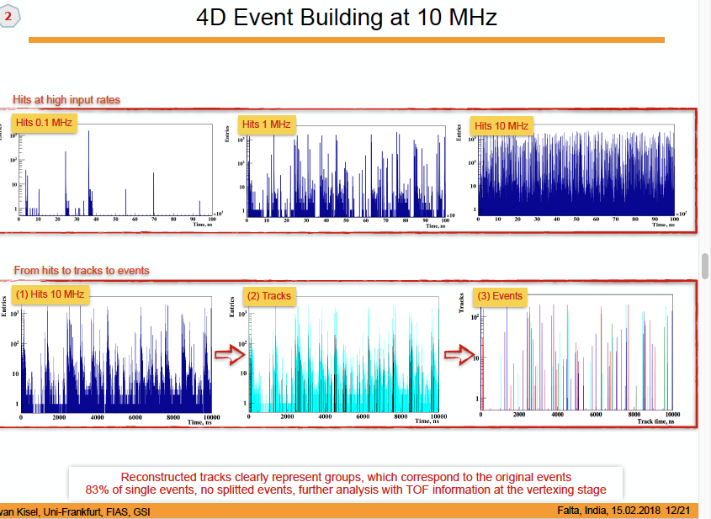

Slide 17
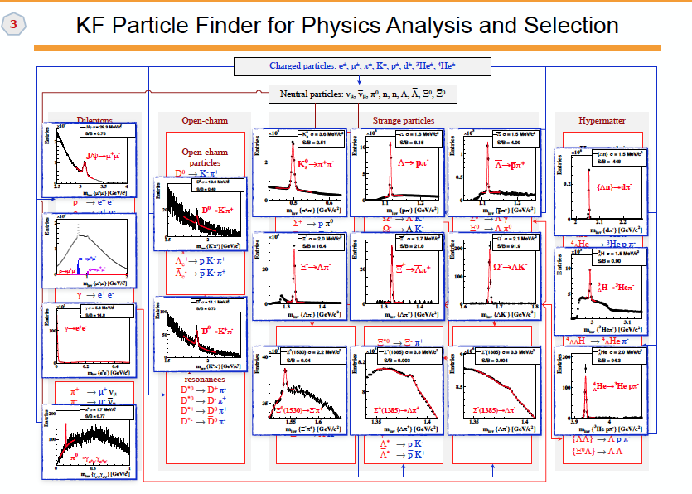

Slide 18
MUCH: Indian responsibility
1st two stations: GEM
3rd and 4th stations: ???
Readout ASIC: MUCHXYTER
Prototype chamber built and
tested at SPS-CERN with
P+Pb collisions

Slide 19
Overall MUCH status
GEM
Large size prototype chamber built and tested using nXYTER electronics
with p+Pb collisions at CERN
Two real size chambers with home-made readout PCBs built at VECC and tested with X-rays
Gain seems to be low , investigation ongoing
For the first time, a optocoupler based HV distribution system installed, will reduce the
HV cost significantly
4. LV distribution system and control developed (VECC, IOP)
5. All critical components tested with gamma (IUC) and neutron (BARC-Purnima) radiations
with twice the expected dose
6. For the first time, MUCH-XYTER based readout system integrated with GEM chamber and
data taken
7. channel-by-channel calibration ongoing
8. Microprocessor and FPGA based control systems developed
9. Production planning ON in BI and VECC
RPC
30cm x 30cm low-rate chamber built and tested with cosmic rays
Two low-resistivity (high rate) chambers procured from ALICE, reported to have rate
capability suitable for CBM 3rd and 4th stations
3. Chambers tested with cosmic rays and PADI electronics
4. High rate tests to be performed
5. 3rd and 4th station review on 17th February at Falta

Slide 20
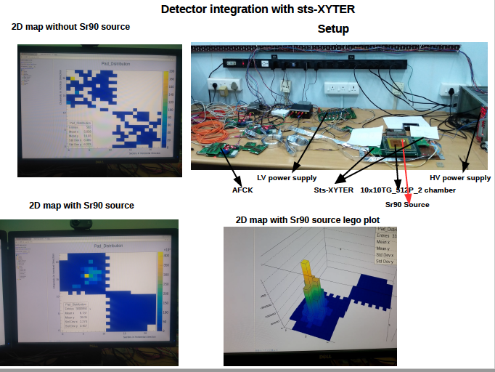

Slide 21
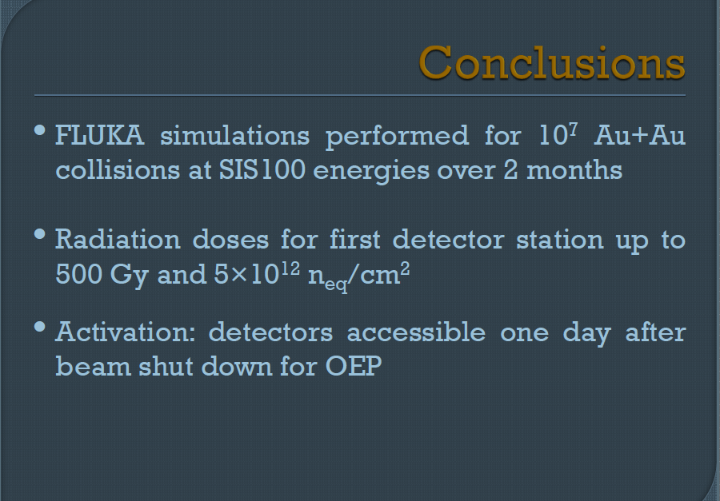

Slide 22

STS-XYTER R. Szczygiel et al. AGH Krakow
STS-XYTER turns into MuCH-XYTER via Gain Switch
Submission Review in Feb. 2015: Noise is an issue →
system issue, optimization with complete system perspective, extensive architectural studies → goal < 1000 ENC
Submission Review in Oct. 2015 → full go for submission
STS-XYTER 2.0: adaptation to GBTx-eLink-readout, STS-r/o protocol
  → all architectural elements included!
in 2018: STS-XYTER 2.1: fix of minor bugs prior to large scale production

Slide 23
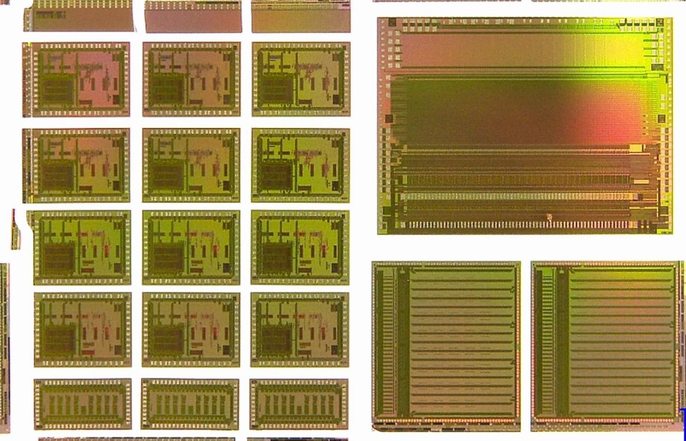
STS-XYTER 2.0 Submission Mai 2016
...evolved to a grand CBM-Joined 6-Chip Submission
STS-XYTER 2.0 → yield 930 chips for STS- and MUCH-prototyping
TOF readout ASICs, Volume production for operation at STAR
  Get4-TDC in two versions:
    Bug-fix version
    Version for robust operation at 40MHz
  PADI – fast 8-channel TOF pre-amp
SPADIC V2 → prototype run with CBM compatible e-link interface

Slide 24
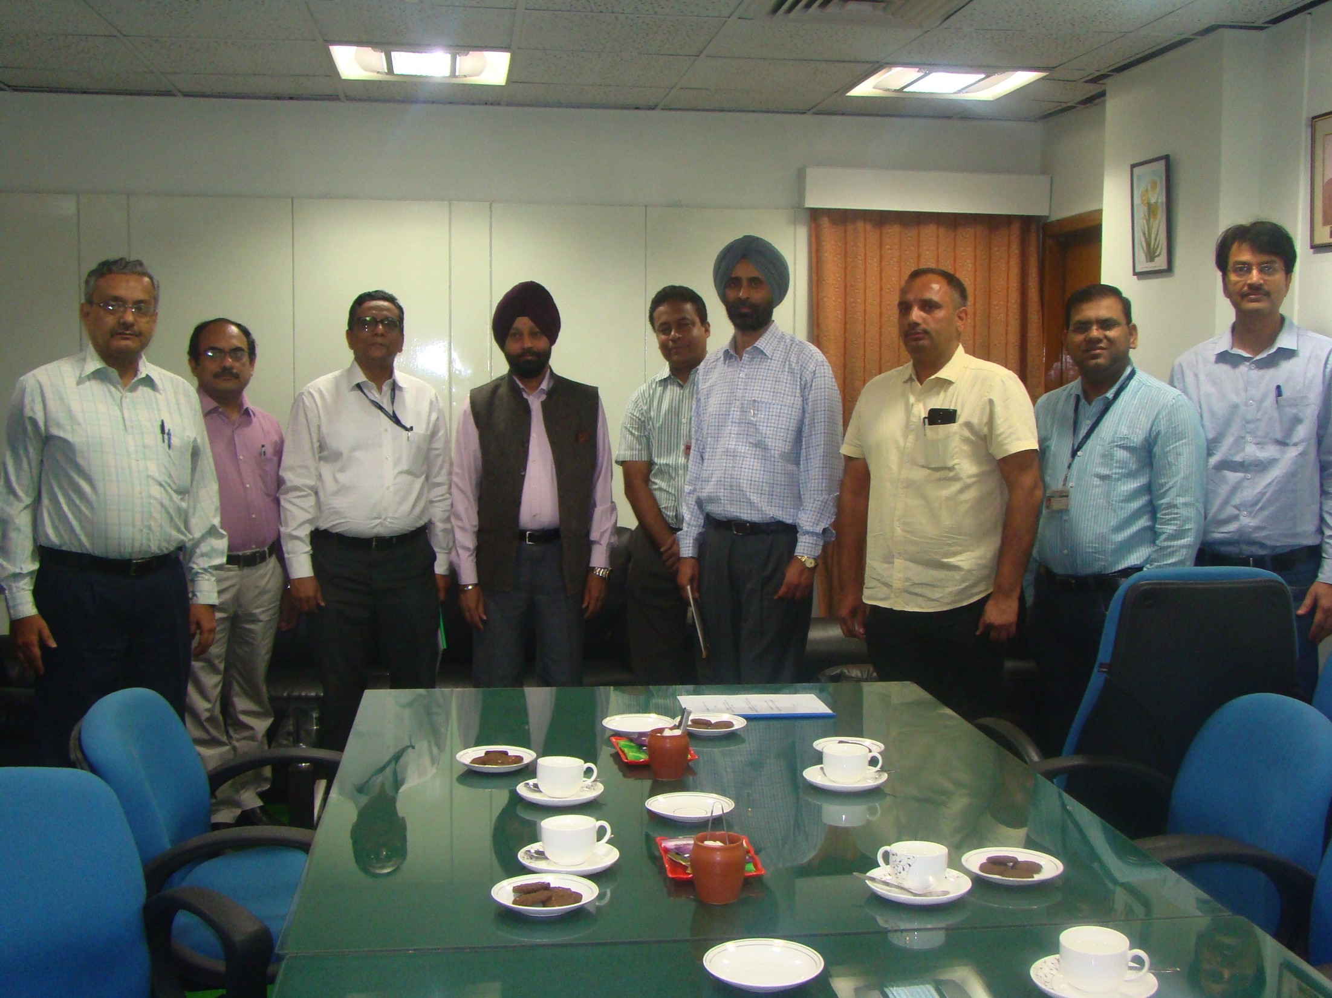
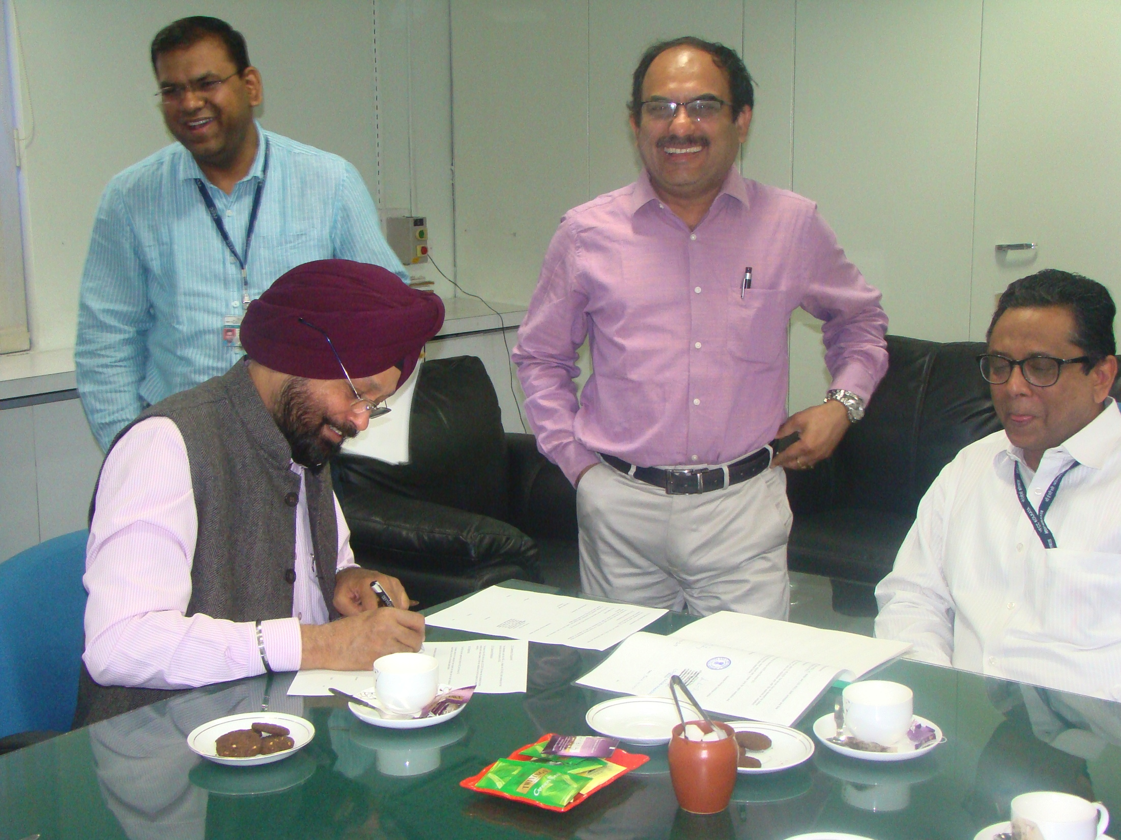
MoU signed with SCL-Chandigarh
for LDO development and production
(11/3/2017)
First fund to be transferred in week’s time
Any group requiring more LDOs ,
pl. let us know

Slide 25
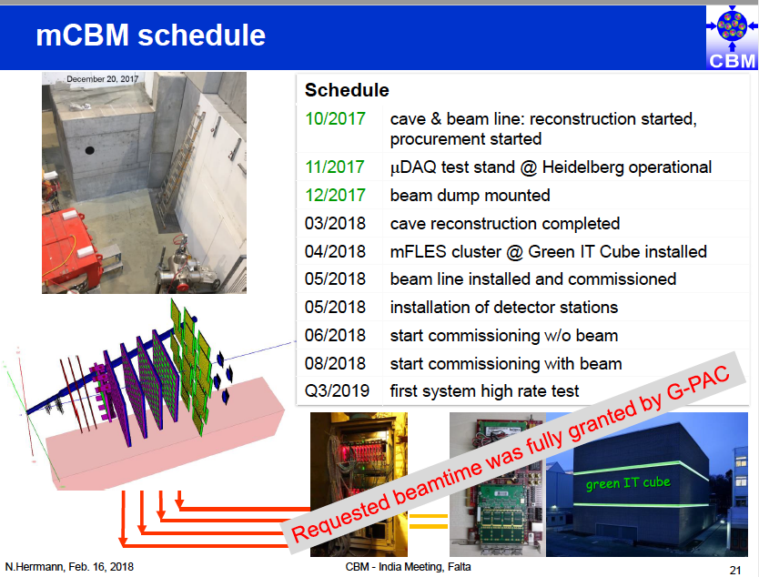

Slide 26
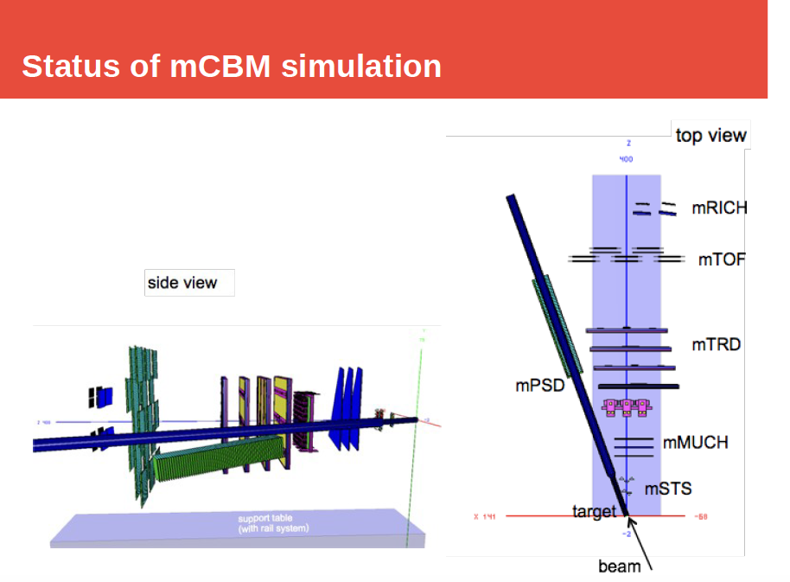

Slide 27
