Slide 1
Status of MUCH Electronics
J. Saini, VECC, Kolkata

Slide 2
Final Layout of CBM-MUCH readout to be used at FAIR
Experimental cave
Green Cube
120m
FLES
FEE
GBTx
CRI-Board
DPB board
FLIB
DPB board
FLIB
FEE
DPB board
MUCH-Detector
FEE
GBTx
DCS
DCS
DCS
FEE
Low Voltage Distribution
Timing Network
High Voltage Distribution
Control Network
Temperature and Gas flow Control units
ECS

Slide 3
Present Layout of CBM-MUCH readout Chain for testing in India
Dual gain
STS/MUCH-XYTER
FEE
DPB board
FLIB
FLES
GBTx
DPB board
FEE
DPB board
MUCH-Detector
GBTx
FEE
DCS
DCS
DCS
FEE
Low Voltage Distribution
Timing Network
High Voltage Distribution
Control Network
Switch (IP Bus)

Slide 4
Test setup at VECC
STS/MUCH-XYTER FEB-B based setup is ready for testing at VECC
Present chain is with TP-link media convertor based setup
First integration with GEM detector was done
Calibration of FEE is ongoing and we are facing major issues while calibrating this FEE board

Slide 5
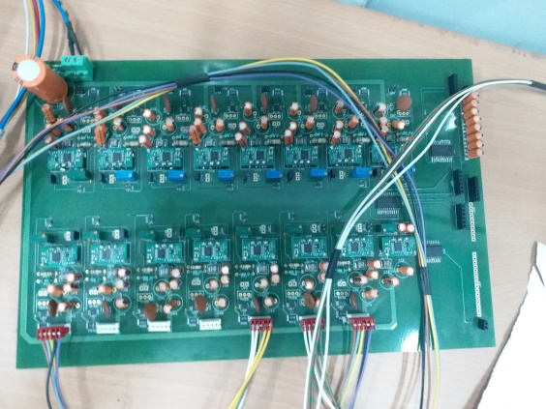
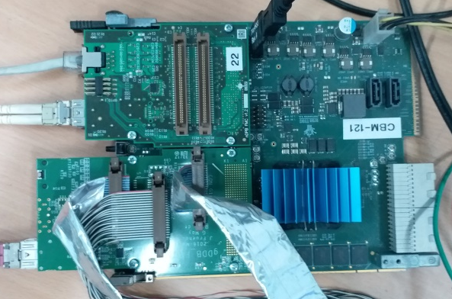
Setup at VECC
LV Distribution Board
TP-Link and Switch for IP-Bus
AFCK with tDPB FMC
DAQ Machine with FLIB board
4-channel LV supply with each 300W channel output
MUCH/STS-XYTER FEB-B
AFCK Board with one gDPB and one nDPB FMC

Slide 6
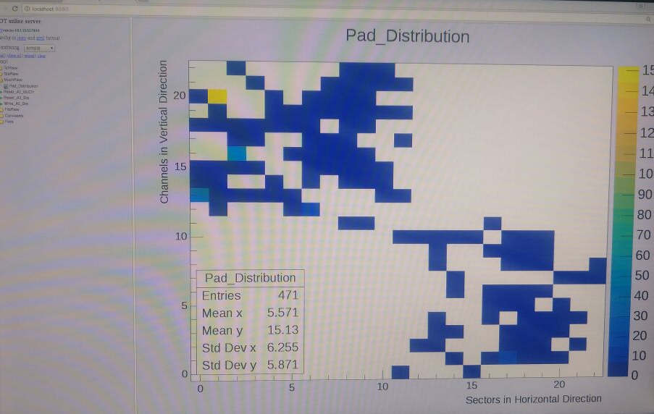
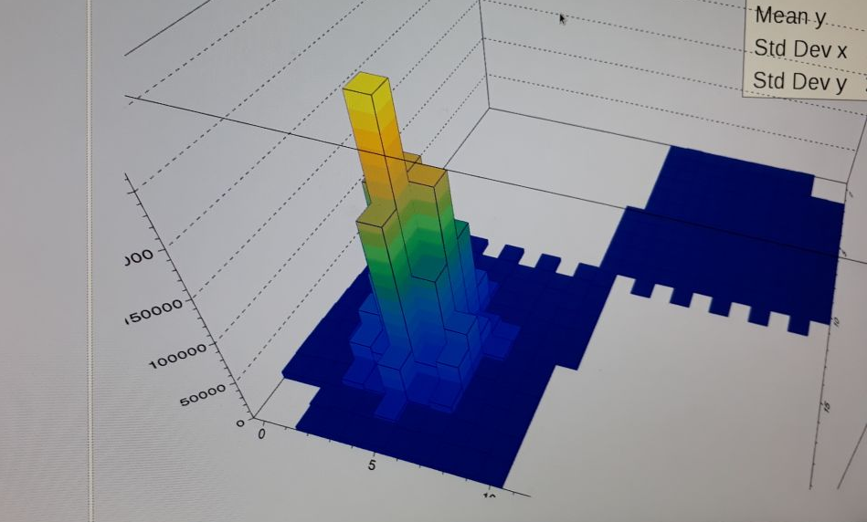
First integration of GEM with MUCH-XYTER test result of VECC setup
Beam spot with Sr90 source
Photos Courtesy “Anand ji”

Slide 7
Few STS/MUCH-XYTER calibration results from the test setup at VECC
Calibration done by internal pulser is not validated by external pulser
Calibration value calculated with internal and external pulser are giving same results
Online register update v/s offline register update are giving different results
V-ref_P and V-ref_N were varied to see the effect. Threshold changes but effect not stable.
Either initializing procedure or the chip setting is a problem. More results will be discussed by Gitesh in next presentation.

Slide 8
Other Electronics development status at VECC for GEM-MUCH detector
MUCH specific FEE board
FMC’s for ROB-3 board for mCBM setup
Station-1 chamber PCB
Station-2 chamber PCB
HV distribution for GEM detectors
LDO’s for STS and MUCH detectors

Slide 9
MUCH specific FEE board
Two ASIC design schematic ready
Basic features of the FEE board
64-channels per ASIC will be used
2-uplink per ASIC and common clock and downlink for both the ASIC
Size of maximum 11cms X 3.5cms
Layout will be made considering new LDO’s from SCL Chandigarh
Layout work will start soon…!!!

Slide 10
10cms
3cms
Illustrative figure for MUCH-XYTER based front end board

Slide 11
Issues with ROB-3 FMC design
Till now link confusion is still going on to whether to use 6-FEE per ROB3 or 9-FEE per ROB3 as missing downlink and clock
We have total 42 uplinks, 8-downlinks and 8-clock while to use 9 independent FEE board it requires 9-downlinks and 9-clocks.
Wojtek suggested other lines on ROB-3 can be configured as downlink and clock (may be better then line jump over FEE’s)

Slide 12
FMC’s for ROB-3 board for mCBM setup
Preliminary ROB-3 design is already received from Joerg Lennart
Preliminary FMC design received from Jochen Fruehauf
Design yet to get started at VECC.
Very urgent needs to get started soon…!!!

Slide 13
Chamber PCB active region size
Slide From Ekata

Slide 14
Station-1 chamber PCB
There were few errors in the last design so new design is ongoing
Parallel purchase procedure is started from Bose Institute to minimize time delays
Layout at very preliminary stage needs to gear up to meet the timeline of mCBM else we only have two M2 modules with bad sectors…!!!

Slide 15
Station-2 chamber PCB
Basic pads are made in the layout
Boundaries are identified for FEE placements
Right now no idea of the technologies as communicating to vendors is still ongoing…!!!

Slide 16
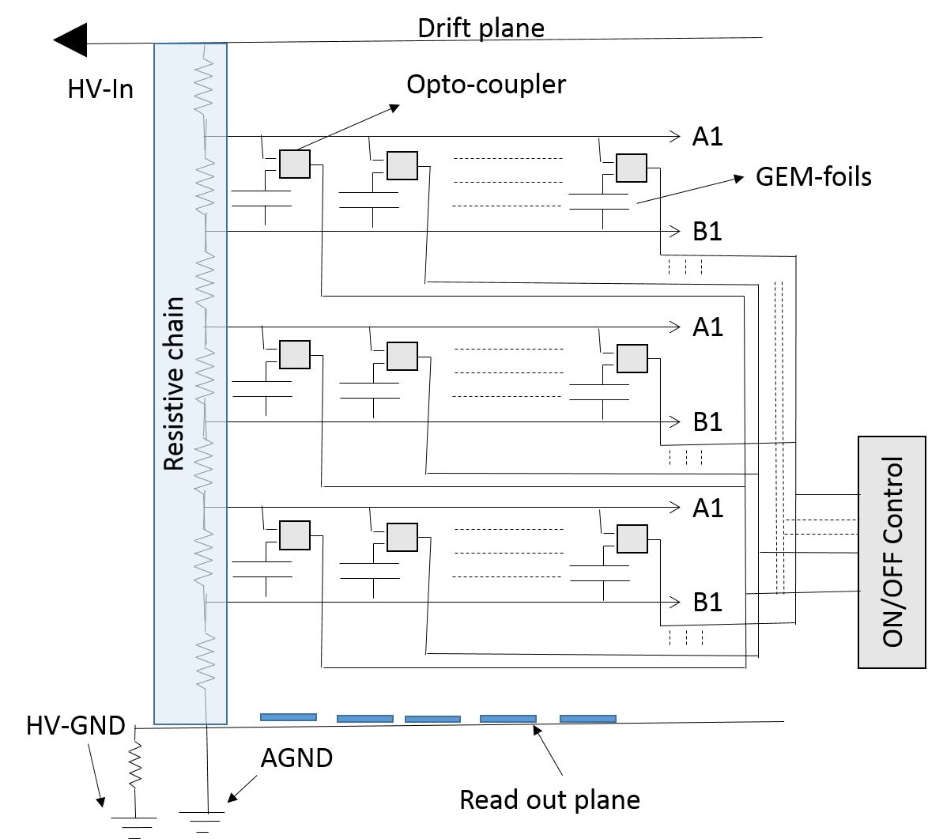
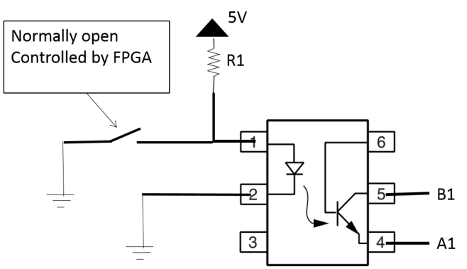
HV distribution system for CBM-MUCH-GEM detectors

Slide 17
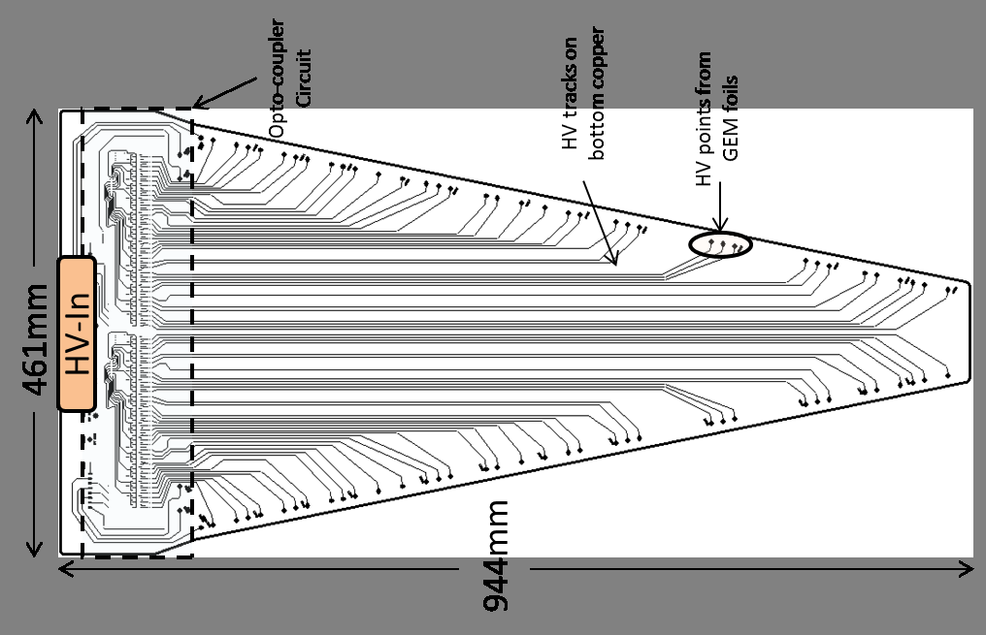
HV Segmentation on Drift PCB
It is a two layered PCB. For station 1 size is mentioned above. Thickness of this PCB is 3.2mm. This PCB contains both high and low voltage tracks

Slide 18
Test Results of opto-coupler
Passed the Neutron dose test done at BARC-Mumbai which is required at 1meter away from beam line at MUCH station-1
Passed the required TID tests done at IUC-Kolkata.
Passed the basic tests along with detector performed with both 10cms X 10cms and final sized sector shaped detector for station-1

Slide 19
Radiation hard LDO’s first prototype received from SCL Chandigarh
LDO delivered by SCL Chandigarh
Test circuit prepared by Piotr
LDO’s in the beam-line at COSY
Radiation hardness test was done by Piotr Koczon and group.
Three LDO chips have been irradiated with 2 GeV protons
and survived 4x10¹³ /cm² (fourth board broken in preparation)

Slide 20
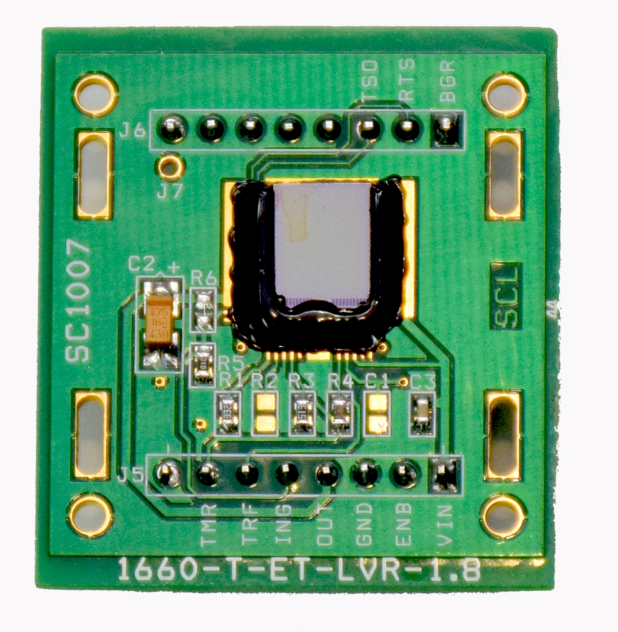
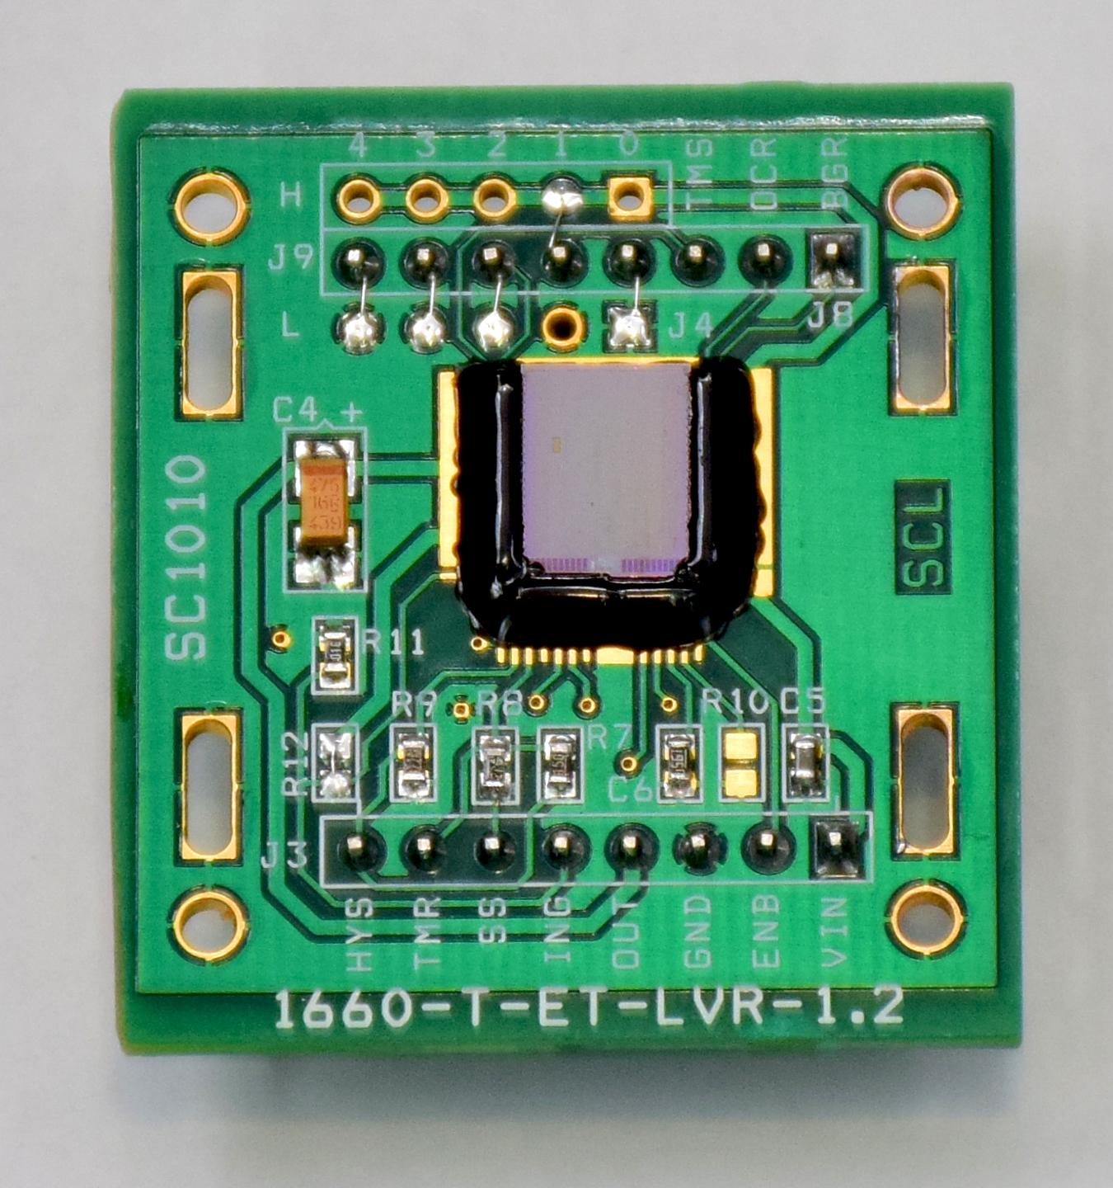
Initial Prototypes received at VECC having desired current values
Two prototype meeting final electrical specifications were delivered to VECC i.e.
1.8 V / 1.6 A 1.2 V / 1.6 A

Slide 21
Electrical test results
1.2V LDO was giving very good noise performance as compared to any other commercially available low noise LDO’s
These LDO’s showed good performance even on hanging arrangement made for the connections.
Radiation tests yet to be performed on these LDO’s

Slide 22
Thank you for attention…!!!!

