Slide 1
Much simulation overview @ India
Partha Pratim Bhaduri
VECC, Kolkata, India
(for the CBM Collaboration)
CBM India Meeting, BI, Falta

Slide 2
Di-muon physics at a glance
Reconstruction of di-muon spectrum with full glory
Low mass region (LMR): in-medium modification of vector mesons
Intermediate Mass Region (IMR): Thermal radiation from the partonic phase
High Mass Region (HMR): Charmonium suppression)

Slide 3
Different di-muon sources @ SIS-100 energies
Superposition of different sources with continuous falling spectrum and several distinct resonances
Continuous processes include:
Drell-Yan di-muons: hard process and dominating at large pair masses
Open charm di-muons are kinematically forbidden
At lower end dominating processes are electromagnetic decays of pseudo-scalar and vector mesons adding to continuous spectrum via Dalitz decays and distinct peaks via 2-body decays – hadronic cocktail
At intermediate region thermal radiation from the partonic fireball
Resonance peaks J/ψ , ψ’ at higher masses (~ 3 GeV) (p+A collisions)

Slide 4
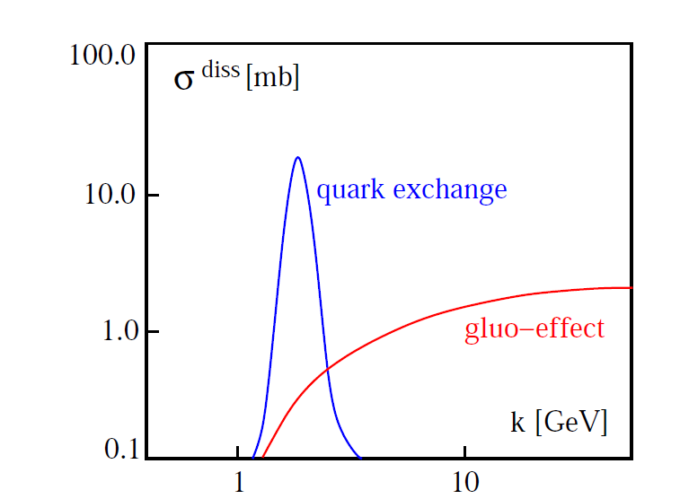
High mass di-muons: physics potential
Charm propagation in baryonic medium
J/ψ measurements in SIS 100 p+A collisions
H. Satz, HICforFAIR, 2014
PPB, M. Deveaux, A. Toia, arXiv:1712.05951
J/ψ would be produced close to kinematic threshold (E_{th} ~ 12 GeV)
Different dissociation cross sections as predicted by different models
Suppression pattern distinguishably different

Slide 5
Priority issues in Much simulation
Development of Much software (Omveer Singh, PPB)
Rootification of much geometry
Development of geo-handler classes compatible with rootified geometries
Testing full chain till track reconstruction
Optimization of Much geometry (Ekata Nandy, PPB)
Modify the design of first absorber
Optimization of muon beam pipe design
Investigation of suitable detector technology for 3rd & 4th stations
(Ekata Nandy)
Feasibility study of RPC
Rate capability
Segmentation option
Mini CBM simulation (Omveer Singh, Ekata Nandy, PPB)
Mini much geometry
Development of detector segmentation
Explore the effect of additional material budget (cooling plates)
Development of time base Much digitizer (Vikas Singhal)

Slide 6
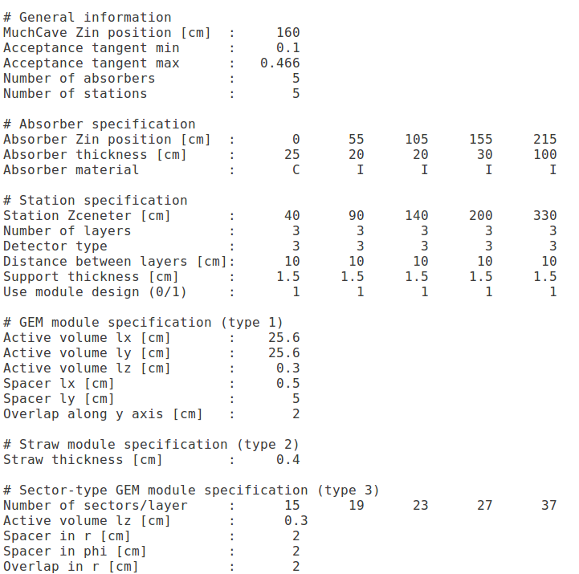
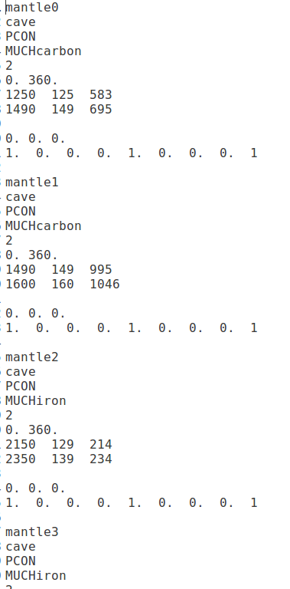
Rootified Much Geometry
Talk by Omveer Singh
Earlier MuCh geometry specified via ASCII files.
Seperate files for MuCh geometry and shielding geometry

Slide 7
Rootified Much geometry
Much geometry can be created using a macro
Modular structure: separate functions for different volumes
Stations+Abosrebrs+Shields
No additional file for shielding
All the parameters can be tuned (eg: no. of absorbers, stations, layers, material, thickness, shapes …)
User friendly
Different macros for different Muchconfigurations
Submitted to repository
Located in cbmroot/macro/much/geometry
Supporting classes also developed
Full simulation chain working

Slide 8
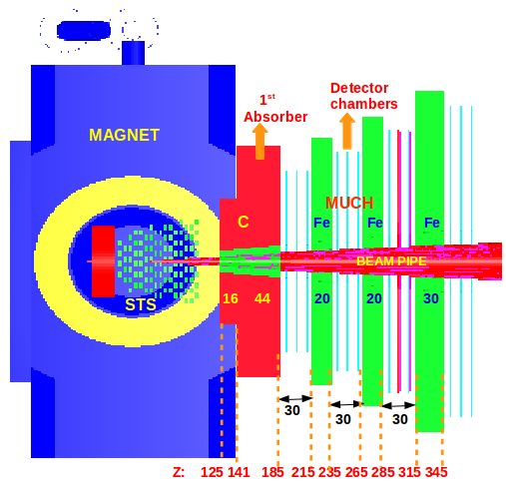
General Specifications:
Much cave starts from 125 cm from the target
Detector angular coverage 5.7 to 25 degree
Segmented absorebr, diatance between two consecutive absorbers 30 cm
Chambers in between; each station made up of 3 chambers
3 mm Argon as active medium
1st absorber made up of carbon rest iron
Modifications after TDR
Beam pipe design has been changed
shift of the position of MUCH cave
Absorbers design have been modified
First absorber shape modified
Magnet shielding bars have been removed
Investigation on 2nd station size have been done
Investigation going on for 3rd and 4th station
See talk by Ekata Nandy for details

Slide 9
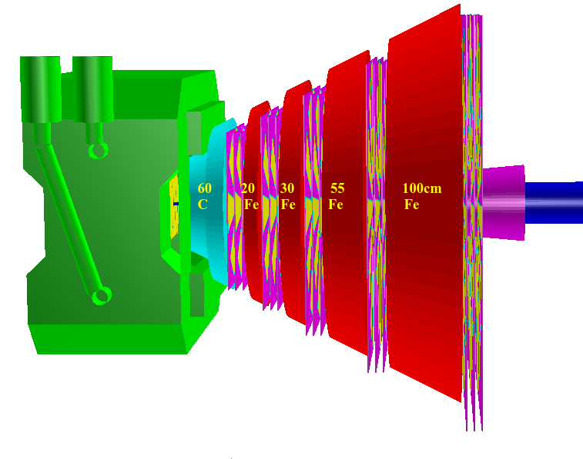
Implementation of new absorber design
Modification of the shape of first (graphite) absorber
OLD
NEW
First absorber in old geometry:
Bi-conical shape
First cone inside the magnet, thickness 24 cm
Second cone outside the magnet thickness 36 cm
First absorber in new geometry:
Trapezoid + box
Trapezoid inside the magnet, thickness 16 cm
Box outside the magnet thickness 44 cm

Slide 10
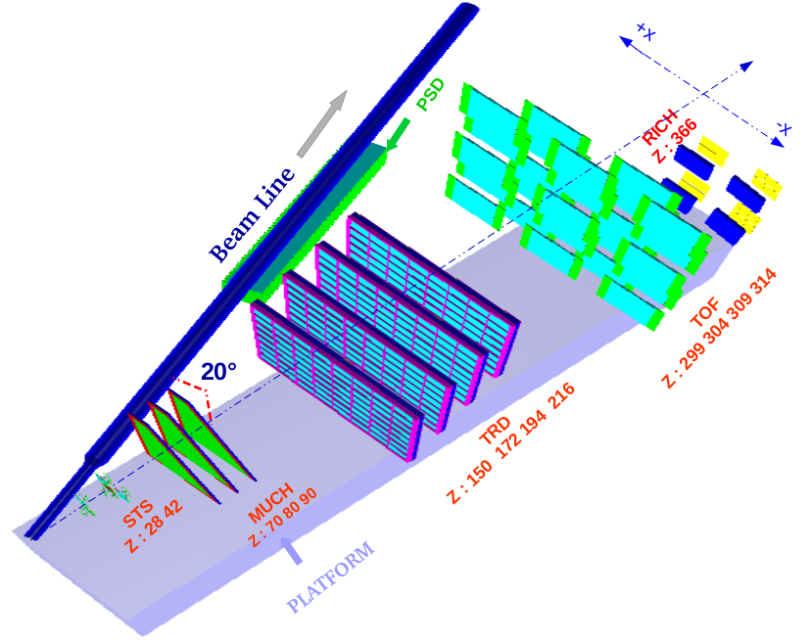
Mcbm Setup
Talk by Omveer Singh

Slide 11
Mini-MuCh (Schematic View)
Back Side
Front Side
Active Volume
Al Cooling Plates
Frame
Geometry created using ROOT macro
3 real size GEM modules have been placed at 70, 80 and 90 Cms respectively.
Al plates as of maximum 1 cm thickness to provide cooling
No additional support structure

Slide 12
mMuCh simulation set up
System: Central (Au + Au)
Beam Energy: 1.24 A GeV
Event Generator: UrQMD
Event Statistics: 10K
Target :
Element = Gold
Thickness = 0.1 cm.
Diameter = 0.5 cm.
Position = (0,0,0).
RotY = 0 Deg.
BeamRotY = 20 Deg
No Magnetic Field.
Transport: GEANT3

Slide 13
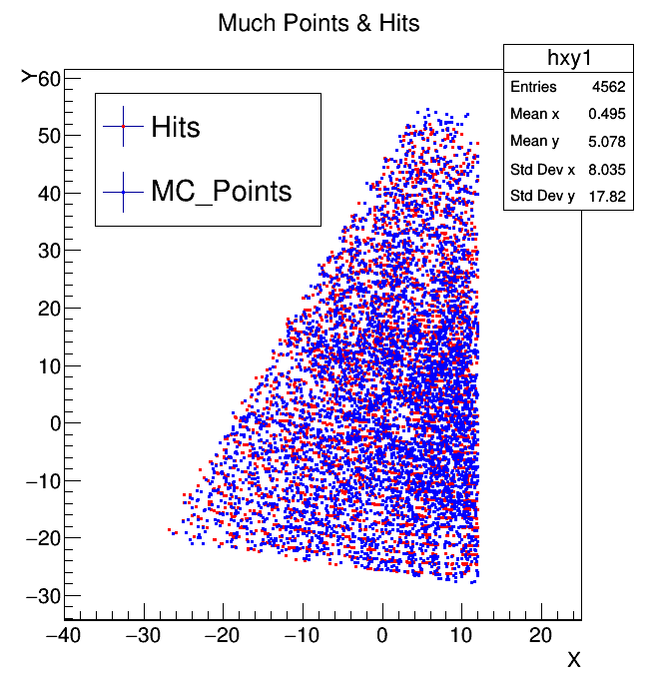
XY distribution of Much Points & Much Hits

Slide 14
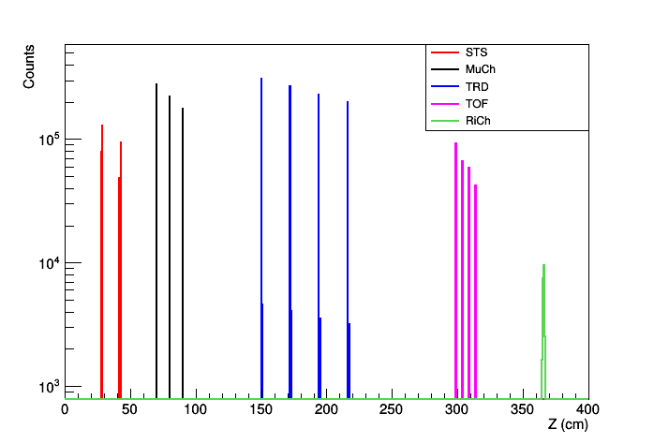
Position Distribution of MC points

Slide 15
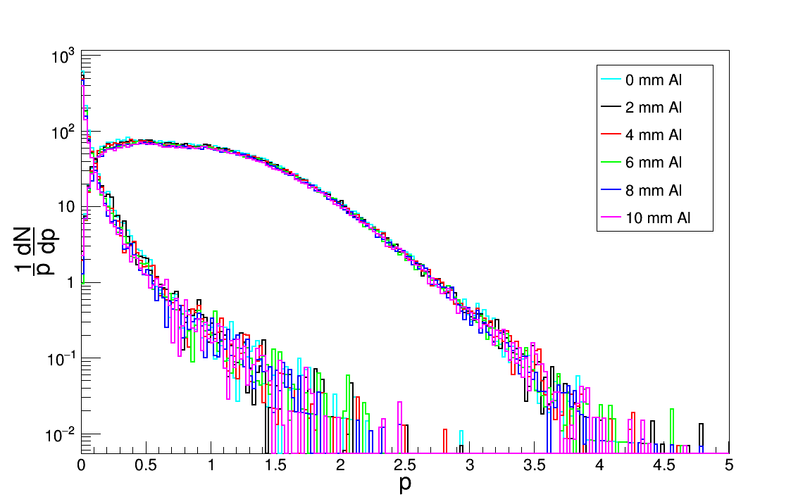
Track (MC) Momentum distribution
Primary
Secondary
(GeV/c)
To estimate the effect of cooling plate, need to have full tracking
Tracking under development

Slide 16
Thank You

Slide 17
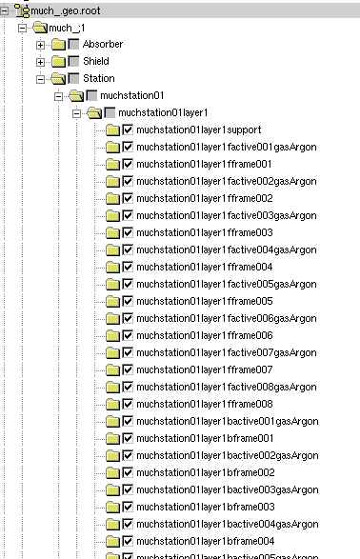
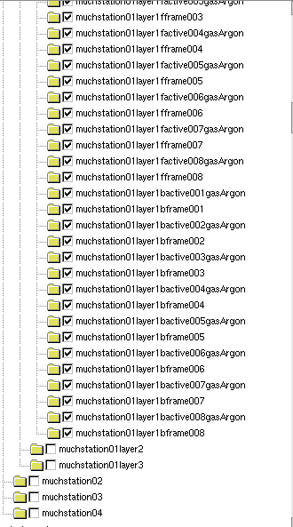
Structure of geometry root file

Slide 18
Development of Geohandler classes (For adding modified geometry to transport)
CbmMuch
CbmMuchGeoScheme
ConstructRootGeometry()
ExtractGeoParameter(TGeoNode* , const char*)
ExpandMuchNodes(TGeoNode*)
IsNewGeometryFile(TString &FileName)
StationNode(TGeoNode*, TString &path)
CheckIfSensitive(TString &VolmeName)
AddSensitiveVolume(TGeoVolume*)
NavigateTo(const TString& path)
GetSizeX(const TString& path ) GetSizeY(const TString& path )
GetSizeZ(const TString& path ) GetX(const TString& path )
GetY(const TString& path ) GetY(const TString& path )
NavigateModule(const TString& path)
GetModuleDZ(const TString& path) GetModuleZ(const TString& path)
GetModuleX(const TString& path) GetModuleY(const TString& path)
GetModulePhi(const TString& path) GetModuleH1(const TString& path)
GetModuleBl1(const TString& path)
CbmMuchStation(Int_t iStation
, Double_t z)
LayerNode(TGeoNode* ,Int_t iStation,
TString &StationPath)
CbmMuchLayer(Int_t iStation, Int_t iLayer,
Double_t z, Double_t zRel)
ModuleNode(TGeoNode* layerNode, Int_t iStation,
Int_t iLayer, TString &layerPath)
CbmMuchModuleGemRadial(Int_t iStation,
Int_t iLayer, Bool_t iSide, Int_t iModule,
TVector3 position, Double_t dx1, Double_t dx2,
Double_t dy, Double_t dz, Double_t cutRadius)
ActiveModuleNode(TGeoNode* moduleNode,
Int_t iStation, Int_t iLayer, TString &modulePath)

Slide 19
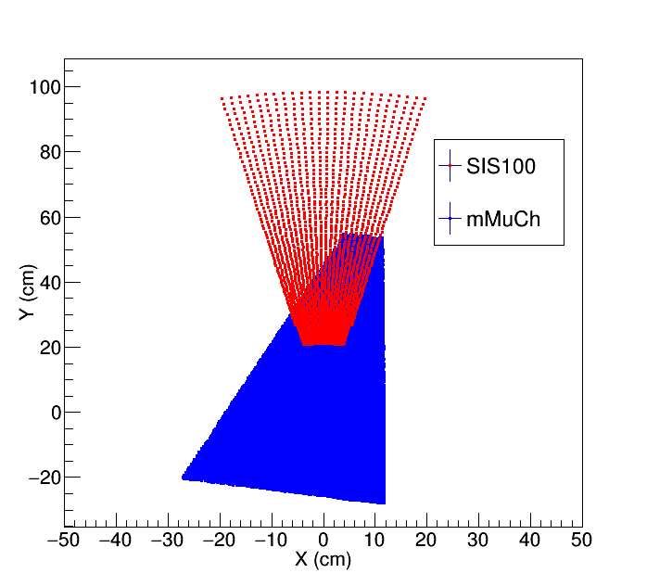
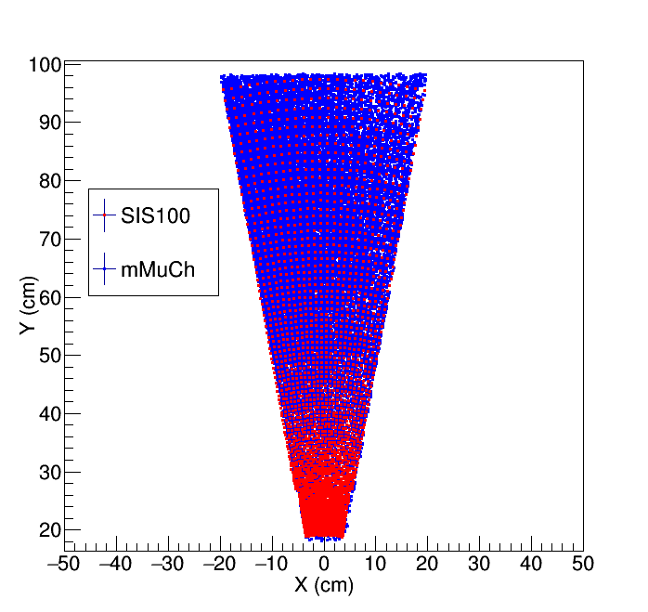
Segmentation in mMuCh
Transformation Equations:
X’ = (X-11.8) Cos(168.5°) +(Y-72.0) Sin(168.5°)
Y’ = - (X-11.8) Sin(168.5°) +(Y-72.0) Cos(168.5°)

