Slide 1
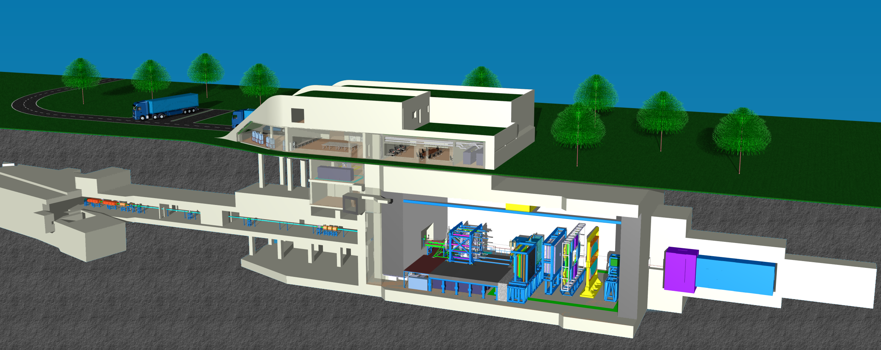
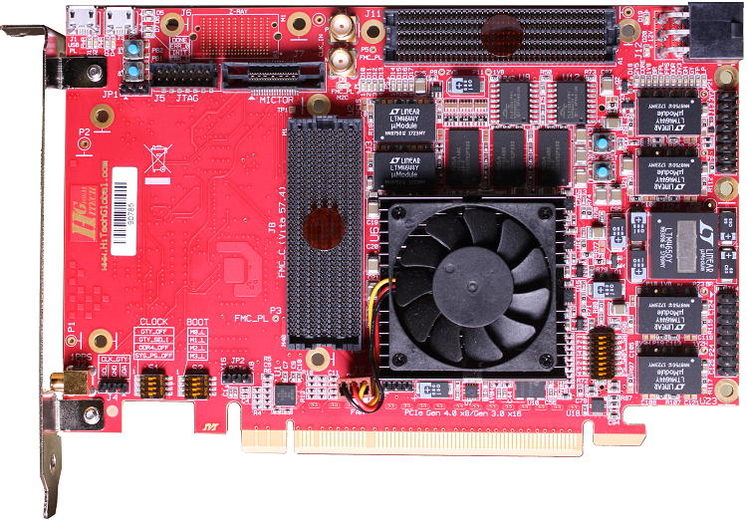
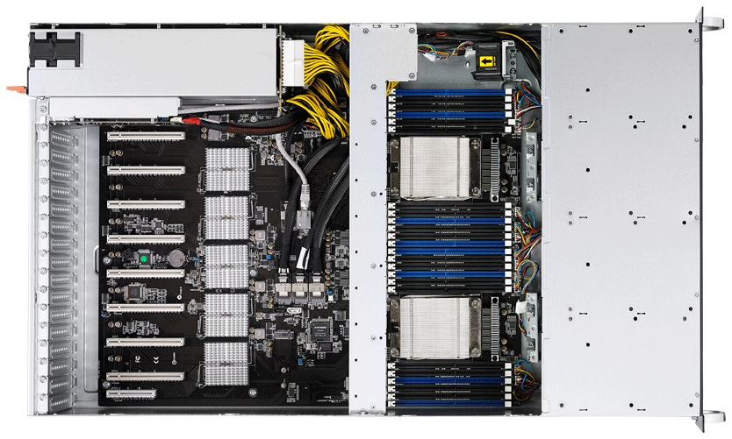
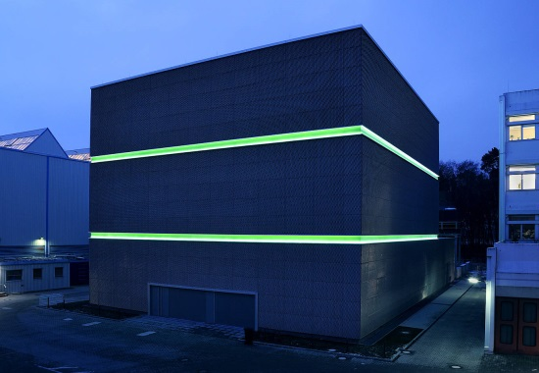
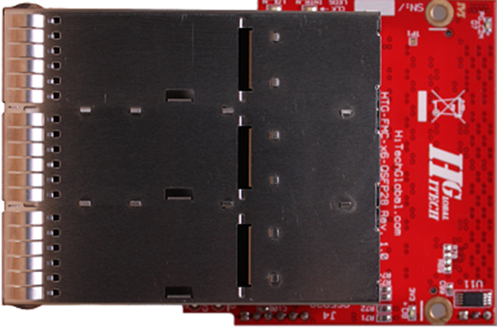
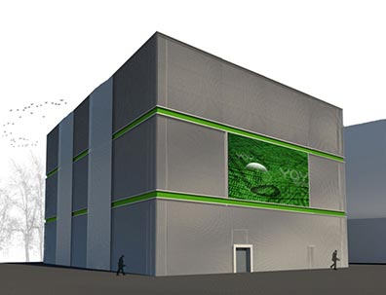
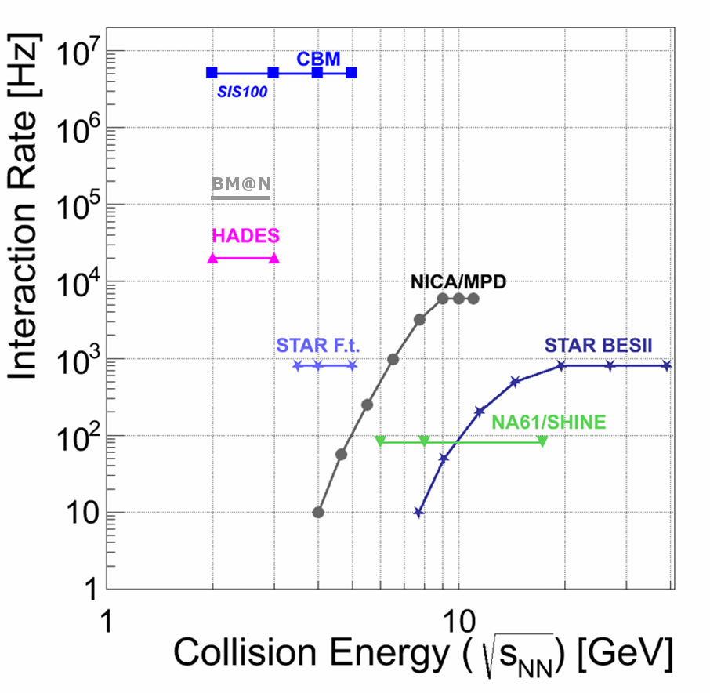
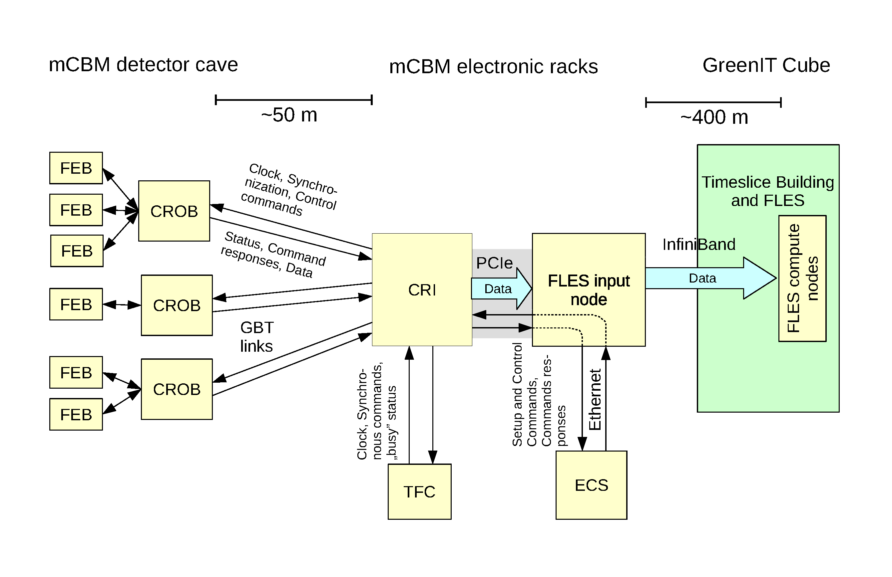
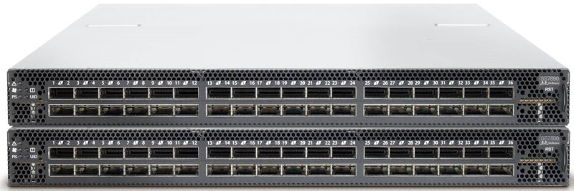
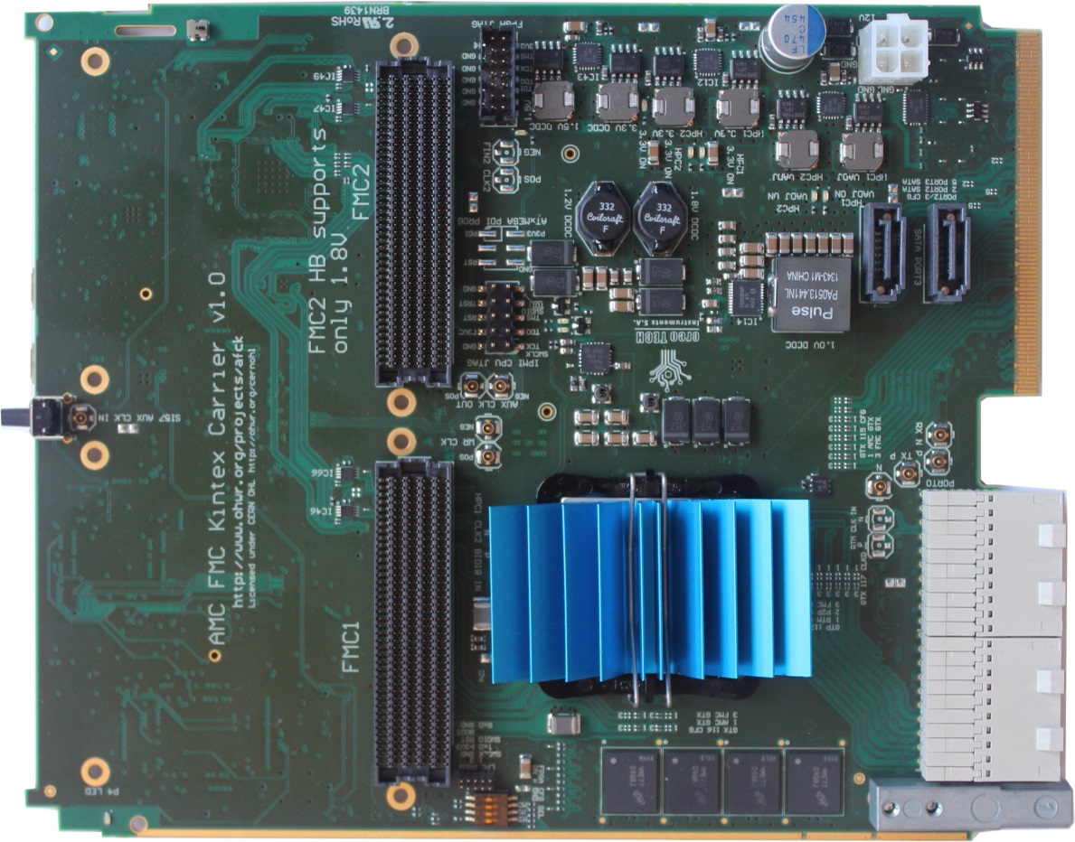
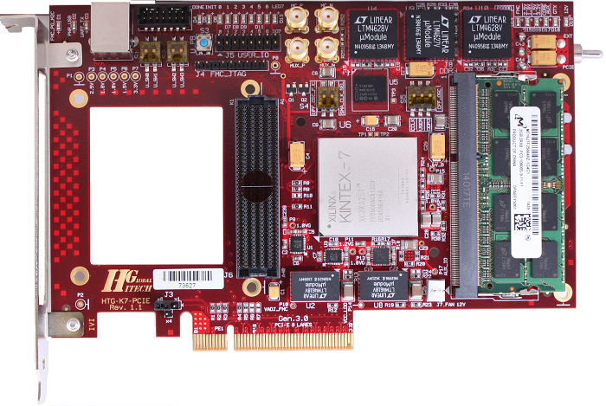
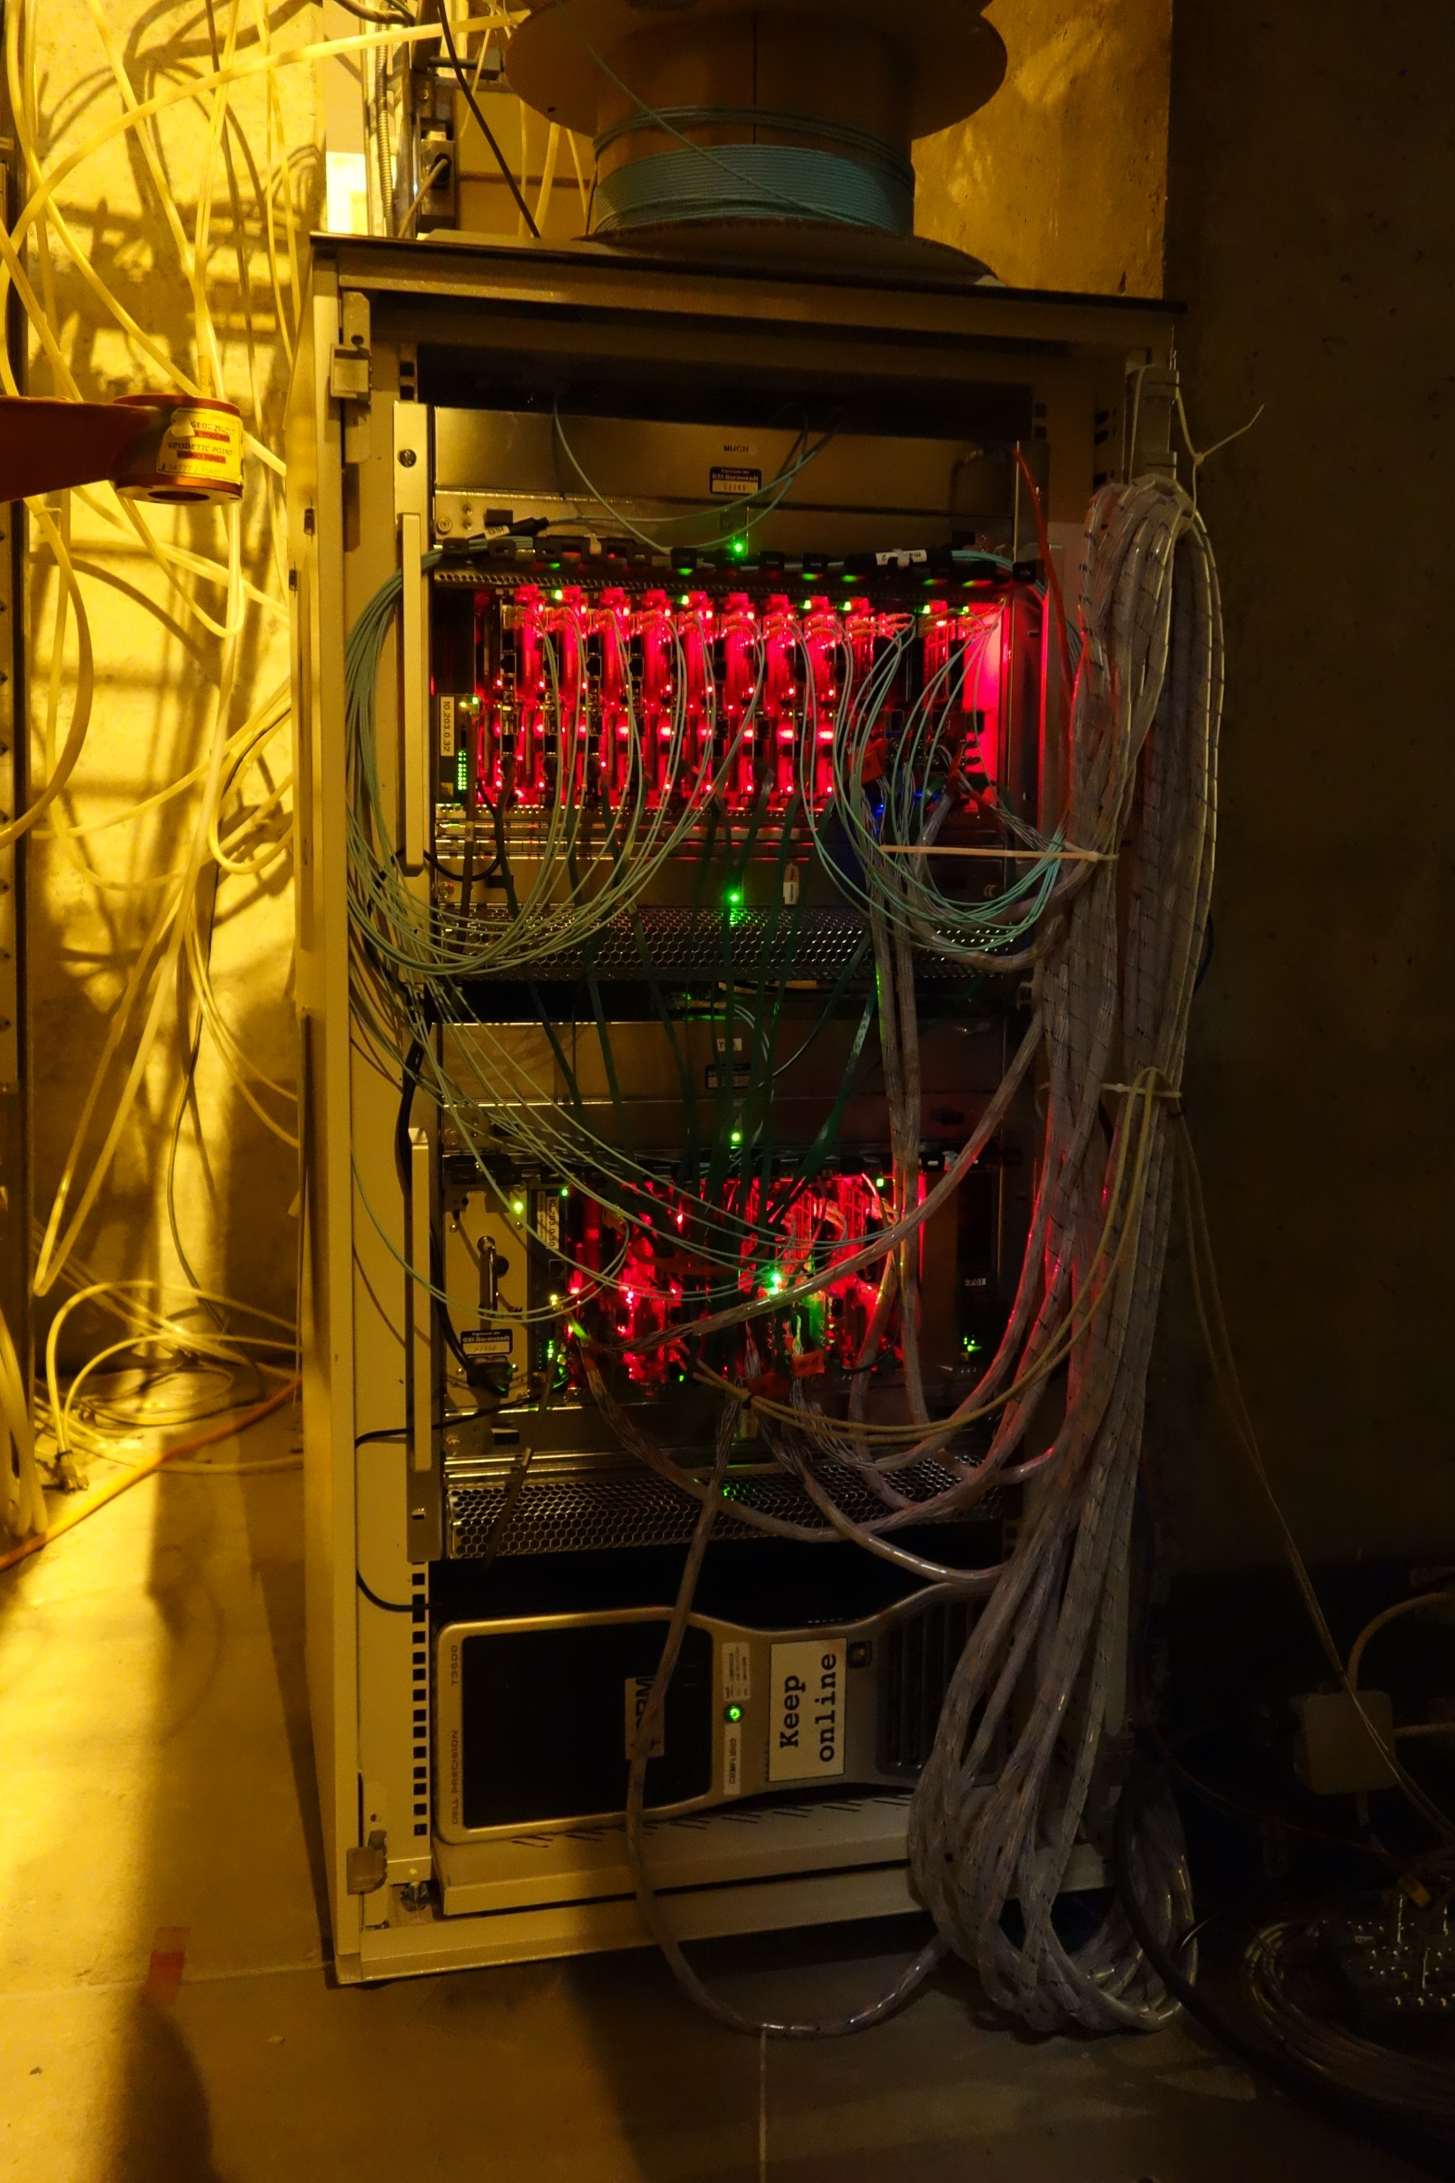
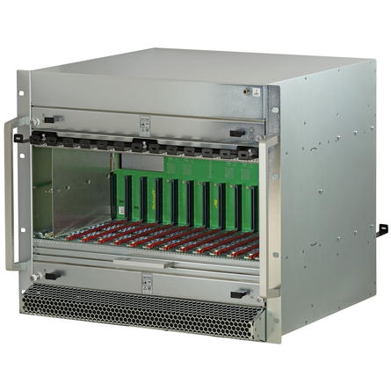
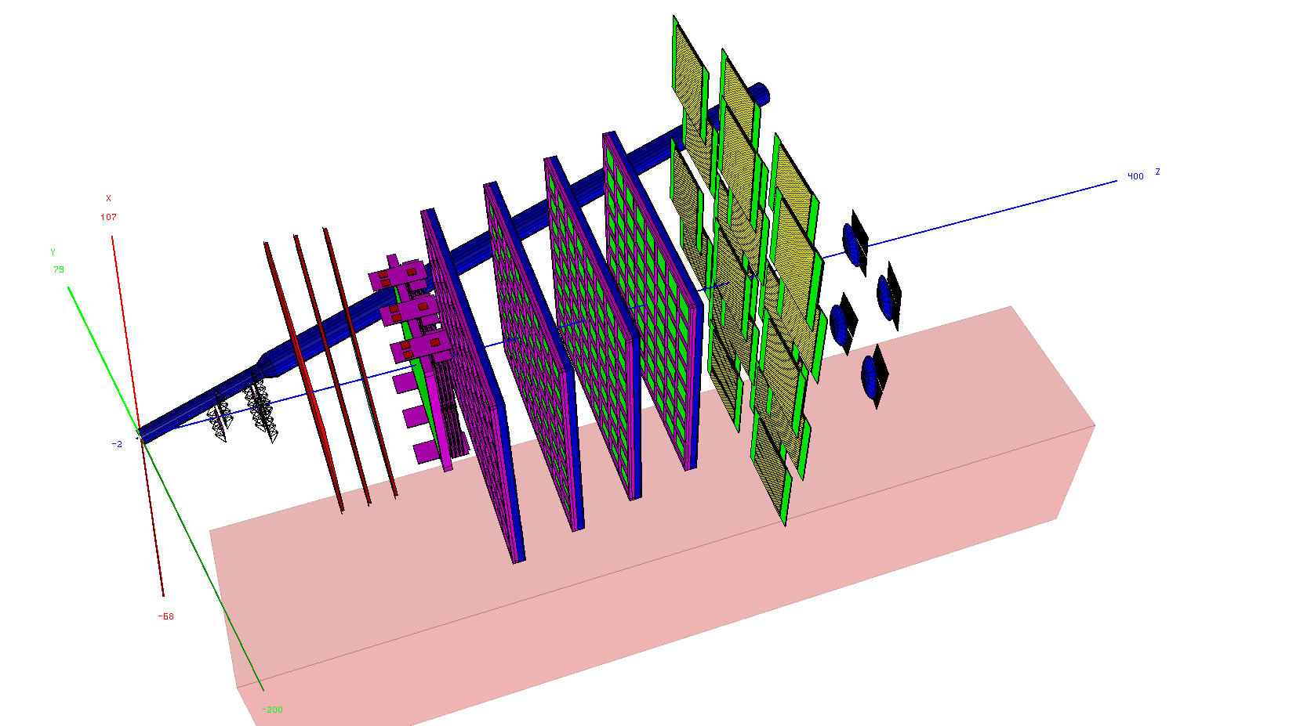
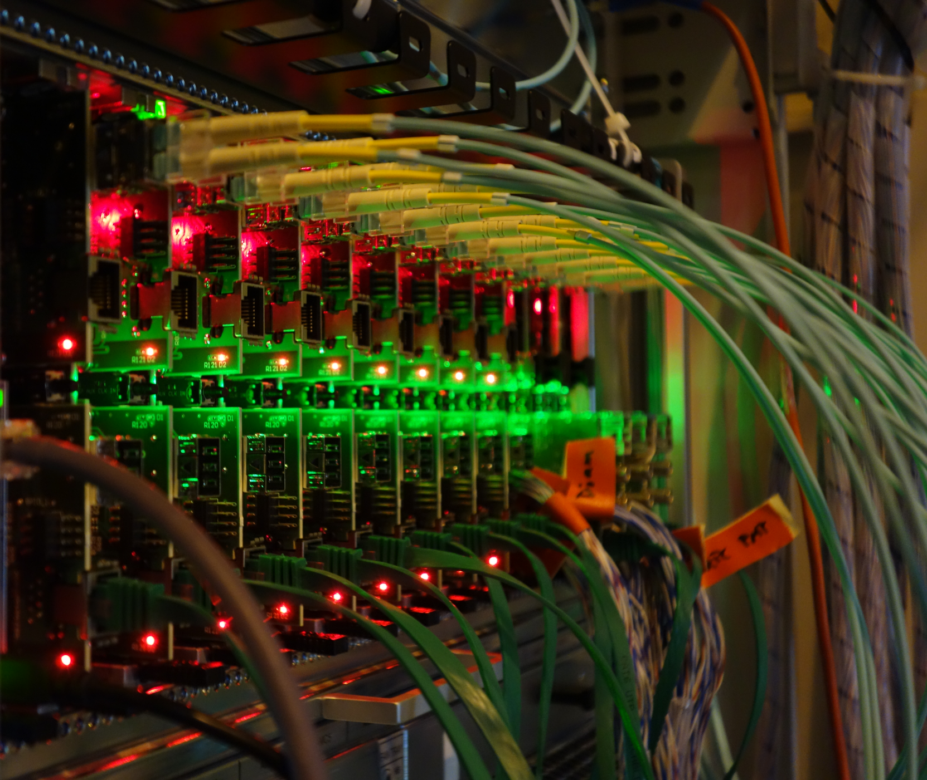
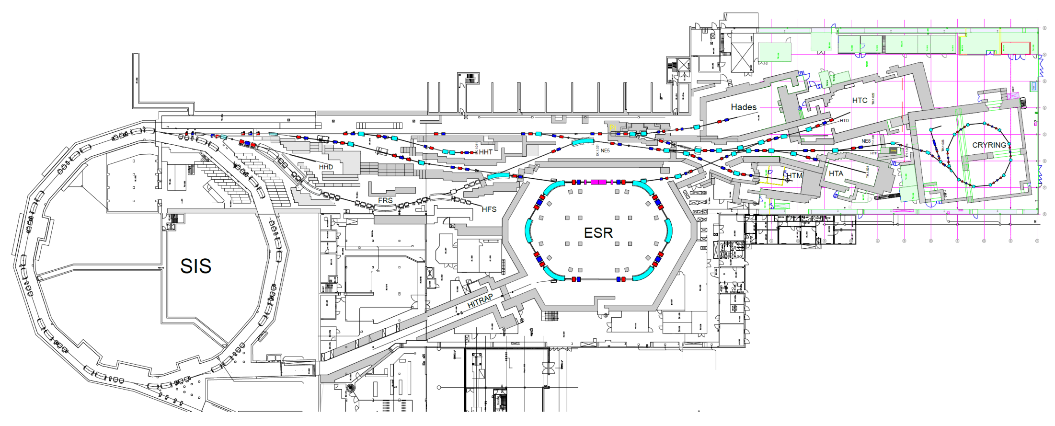
The high performance, free-streaming data acquisition system of CBM
The CBM data challenge
CBM readout topology with CRI (2019)
CBM: a fixed target,
high interaction rate,
heavy ion physics
experiment
DAQ room:
data pre-processing
on FLES input cluster
Green Cube: online timeslice building
and event selection
μ-slices
green
cube
flow
2 TB/s
green cube
data
~80m
~700m
raw
fixed target setup to investigate the QGP phase diagram in region of high baryon-densities
very high interaction rate environment: 10⁵ − 10⁷/s (A+A), up to 10⁹/s (p+A)
fast and radiation hard detectors with free-streaming readout electronics
high-speed Data AQuisition (DAQ) system
FPGA based readout chains complemented by state of the art computing infrastructure allowing for online event reconstruction
more than 5.000 GBT links operating at 4.8 Gbps as data source
about 2 TB/s bandwidth to the Green Cube
HTG-Z920 - Common Readout Interface (CRI) prototype
country of origin: California
ASUS ESC8000 G3 Server (FLES Input Node)
country of origin: Taiwan
Xilinx ZYNQ UltraScale+ FPGA - next generation board
will be operated in the FLES input node
to cover the functionality of both the AFCK and FLIB in a single FPGA board
FLES input node
can take up to 8x FLIB or 4x CRI
used to receive data in micro-slices
forwards data to the FLES compute nodes
1
2
3
4
5
Mellanox SB7800 – EDR 100 Gb/s InfiniBand Smart Switch
country of origin: Israel
Interaction Rate for CBM at SIS100
mCBM readout scheme for 2019
interface between FLES input and FLES compute stage
will allow to transfer up to 1.2 Tb/s over 96 optical fibers
Readout chain hardware components (2018)
CBM readout in a nutshell
Collect raw data from subsystems
Pre-process data in FPGAs
Send micro-slices to Green Cube
Pack data into time-slices
Deliver time-slices to online analysis
Digest a total bandwidth of 2 TByte/s
AMC FMC Carrier Kintex (AFCK)
country of origin: Poland
HTG-K700 - FLES Interface Board (FLIB)
country of origin: California
Xilinx Kintex 7 FPGA
operated in a microTCA crate
1st stage data processing board (DPB)
transmits micro-slices to the FLIB
Xilinx Kintex 7 FPGA
operated in the FLES input node
2nd stage data processing board
receives micro-slices from DPB
Readout chain development
Activities at GSI:
Key Project Institutes:
Coordination of collaboration-wide DAQ activities
Identification and procurement of DAQ hardware
Firmware development for FPGA components
Pooling of DAQ hardware for CBM subsystems
Setup and test of readout chains under development
Support of readout chain operation for beam-tests
Development of DAQ controls and online monitoring
Preparation of “Online Technical Design Report - Part I”
GSI, Darmstadt, Germany;
CQU, Chongqing, China;
FIAS, Frankfurt, Germany;
IRI, Frankfurt, Germany;
KIT, Karlsruhe, Germany;
USTC, Hefei, China;
VECC, Kolkatta, India;
WUT, Warsaw, Poland;
Pentair microTCA crate
country of origin: Germany
equipped with up to 12 AFCK boards
GBT links are converted to micro-slice streams
CBM DAQ rack in operation (SPS 2016)
mCBM – the DAQ experimental test bench (2018)
green IT cube
multi-mode fiber cave – DAQ container, about 50m distance
single-mode fiber DAQ container - GC, about 300m distance
mCBM experimental setup in the GSI Target Hall
data processing on AFCK boards in the mCBM DAQ container
optical fiber connection between the mCBM cave, DAQ container and the Green IT Cube
by David Emschermann, November 2017
Notes:
1

