Slide 1
PANDA MEC workshop 14-Dec-2017

Slide 2
MEC meetings
Monthly TEC meetings
MEC workshop today

Slide 3
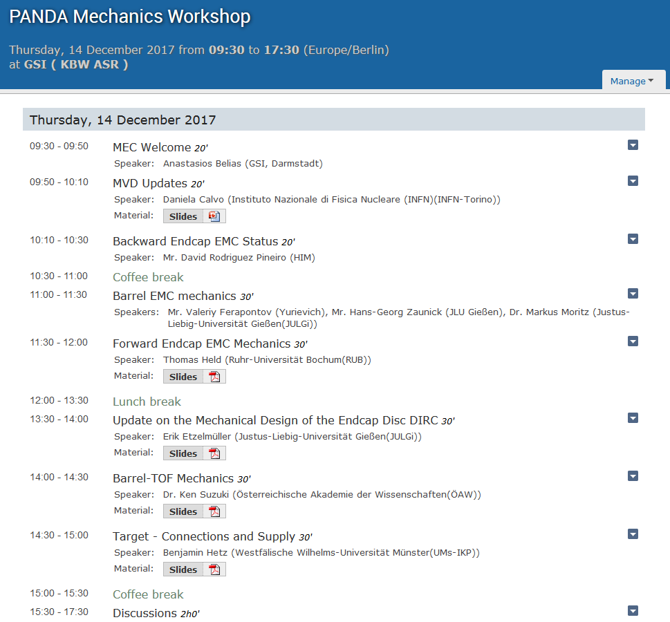

Slide 4
Ongoing actions
Services
Routing & cable data
Services: Detector - Patch Panels - Racks
Power requirements
Alignment
Requirements for each sub-detector
Survey strategy during installation
Advise by GSI Alignment group, surveys by contractor
Dedicated meeting possibly in CM 1/18

