Slide 1
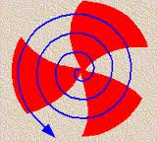
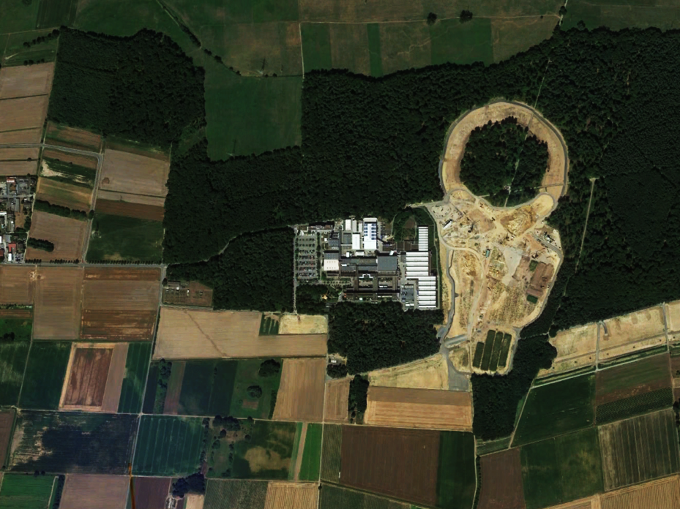

The Physics Program of FAIR
Subhasis Chattopadhyay
VECC-Kolkata, India
Outline:
The Facility for Antiproton and Ion Research
Science at FAIR (with special emphasis on CBM)
Google Earth for FAIR 7.12.2013

Slide 2










Facility for Antiproton & Ion Research
Germany
Russia
Finland
France
India
Poland
Romania
Slovenia
Sweden
UK (associated)
FAIR is the largest upcoming fundamental science project worldwide this decade.
Forefront research in nuclear, hadron, atomic, plasma and applied physics.
Construction until 2018
10 member states up to date
2500 - 3000 users
Total cost ~1.6 Billion € (2018)
(German funds 70%, rest
from International partners)
FAIR Signatory Countries

Slide 3
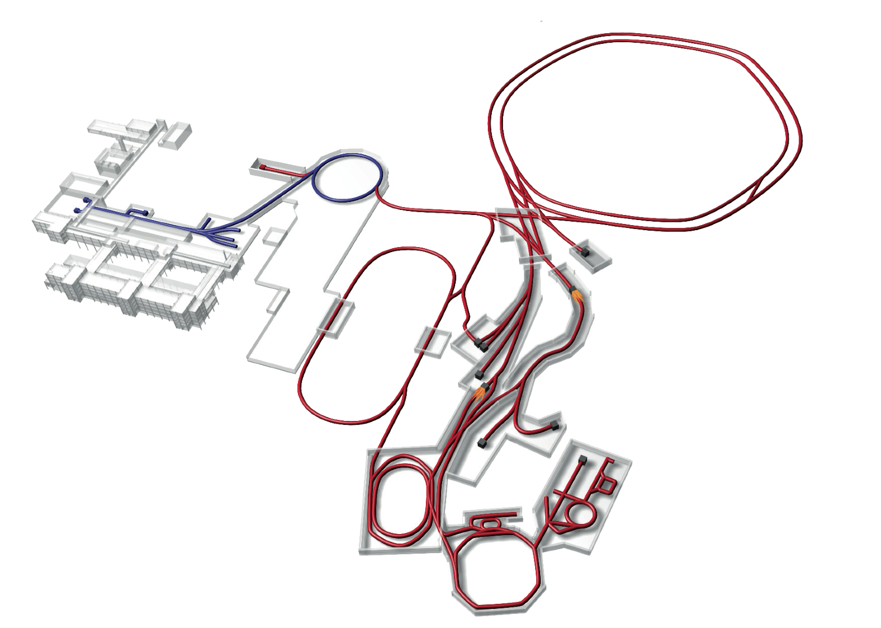
Facility for Antiproton & Ion Research
Primary Beams
10¹²/s; 1.5 GeV/u; ²³⁸U²⁸⁺
10¹⁰/s ²³⁸U⁹²⁺ up to 35 GeV/u
3x10¹³/s 90 GeV protons
p-Linac
SIS18
SIS100/300
Technical Challenges
UNILAC
cooled beams
rapid cycling superconducting magnets
dynamical vacuum
HESR
Rare-Isotope
Production Target
Secondary Beams
radioactive beams up to
1.5 - 2 GeV/u; up to factor 10000
higher in intensity than presently
antiprotons 3 - 30 GeV
Anti-Proton
Production Target
CR &
RESR
Storage and Cooler Rings
NESR
radioactive beams
10¹¹ antiprotons 1.5 - 15 GeV/c,
stored and cooled
100 m

Slide 4
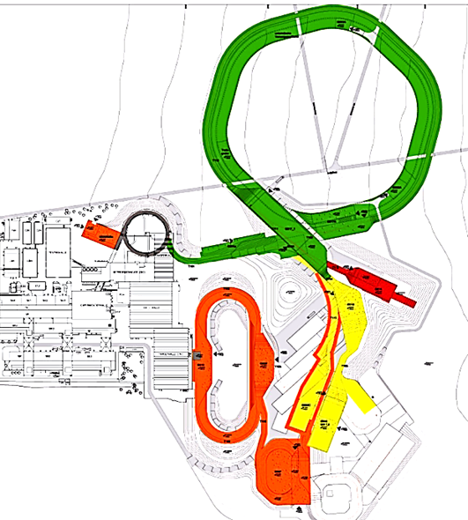
The FAIR Modularized Start Version
Talk: U. Weinrich
Poster: C. Omet
Experiments
M0: APPA
(Atomic Physics Plasma and Applications)
M1: CBM (Compressed Baryonic Matter)
M2: NUSTAR (Nuclear Structure, Astrophysics and Reactions)
M3: PANDA
SIS100
M1
M3
M2
M0

Slide 5
FAIR Experiments
APPA

Slide 6
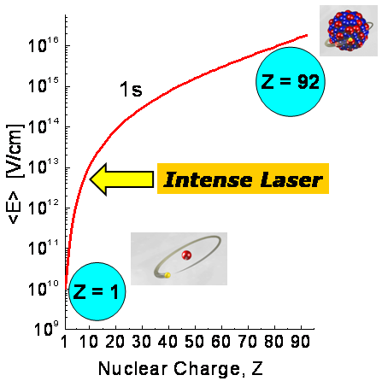
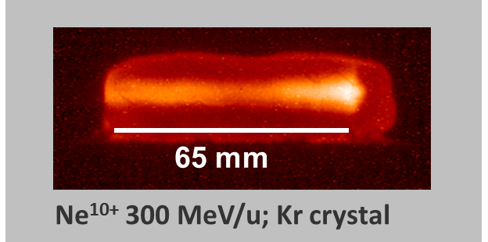
APPA: Atomic Physics, Plasma Physics,
Bio Physics and Applied Sciences
Dynamic electric fields (upto 10²⁰ V/cm) produced in collisions of
heavy ion beams give access to
Spectroscopy upto the limits of atomic matter
QED in non-perturbative regime
Precision determination of fundamental constants
Infuence of atomic structure on nuclear decay properties
Atomic
Physics
(SPARC &
FLAIR)
High intensity beams stopped inside a target produce plasma
of extreme density (similar to the core of planets)
Equation of state, phase transitions, transport phenomena
Matter under high pressure
Interaction of ions and photons with plasma
Plasma
Physics
(Hedgehob
& WDM)
Bio Physics
&
Materials
Science
(BIOMAT)
High intensity beams will be used on bio and material targets to access:
Cosmic radiation study: A hindrance in space
Cancer therapy
Material modifications, radiation hardness
High-pressure irradiation
Notes:
6

Slide 7
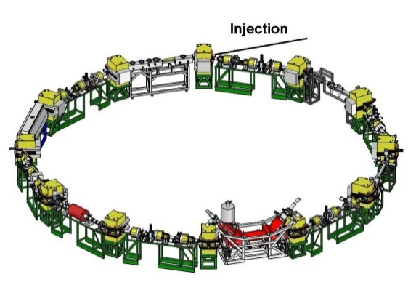
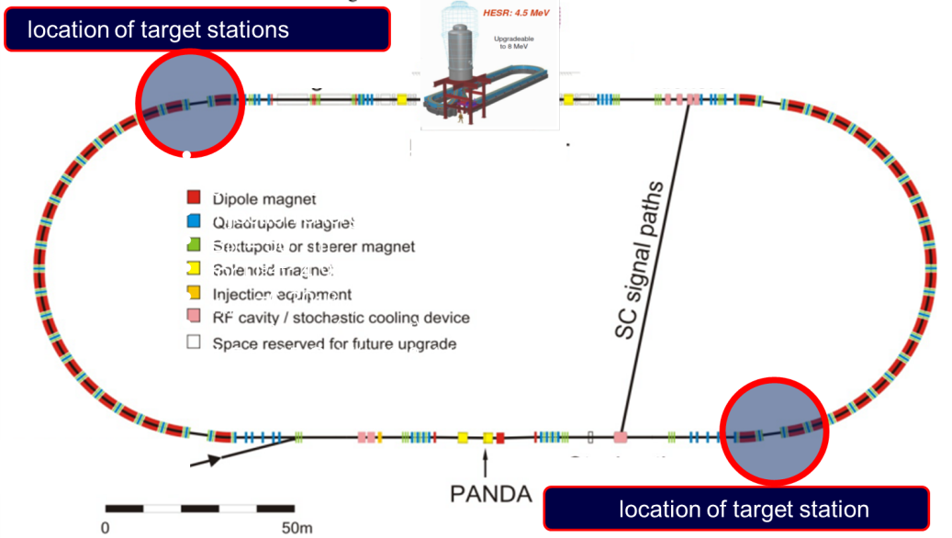
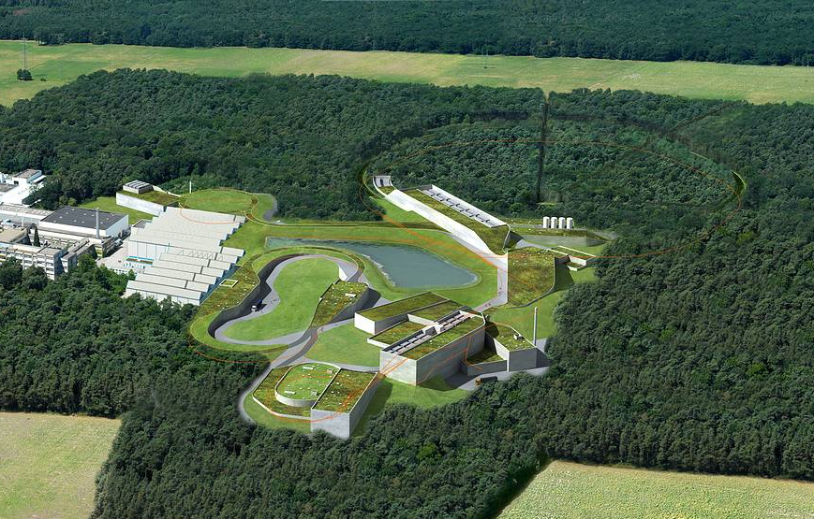
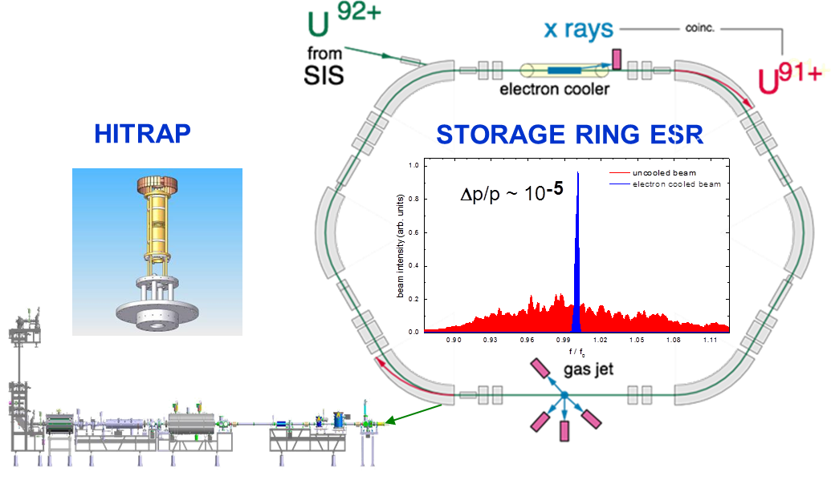
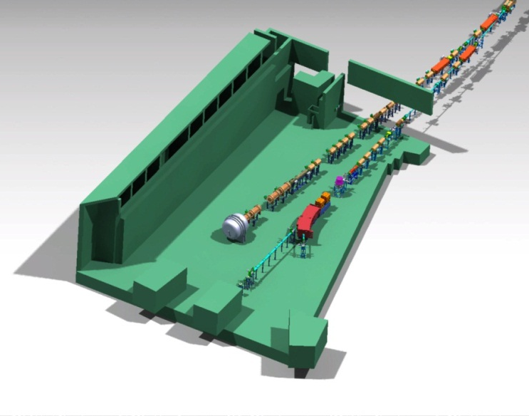
The APPA experimental facilities at FAIR
Cold High- to Low- + Energy Heavy Ions
CRYRING
HESR
ESR
Later Anti-Protons
Cold Relativistic Heavy Ions
APPA Cave
Notes:
7

Slide 8
FAIR Experiments
APPA
Super-FRS
NuSTAR

Slide 9

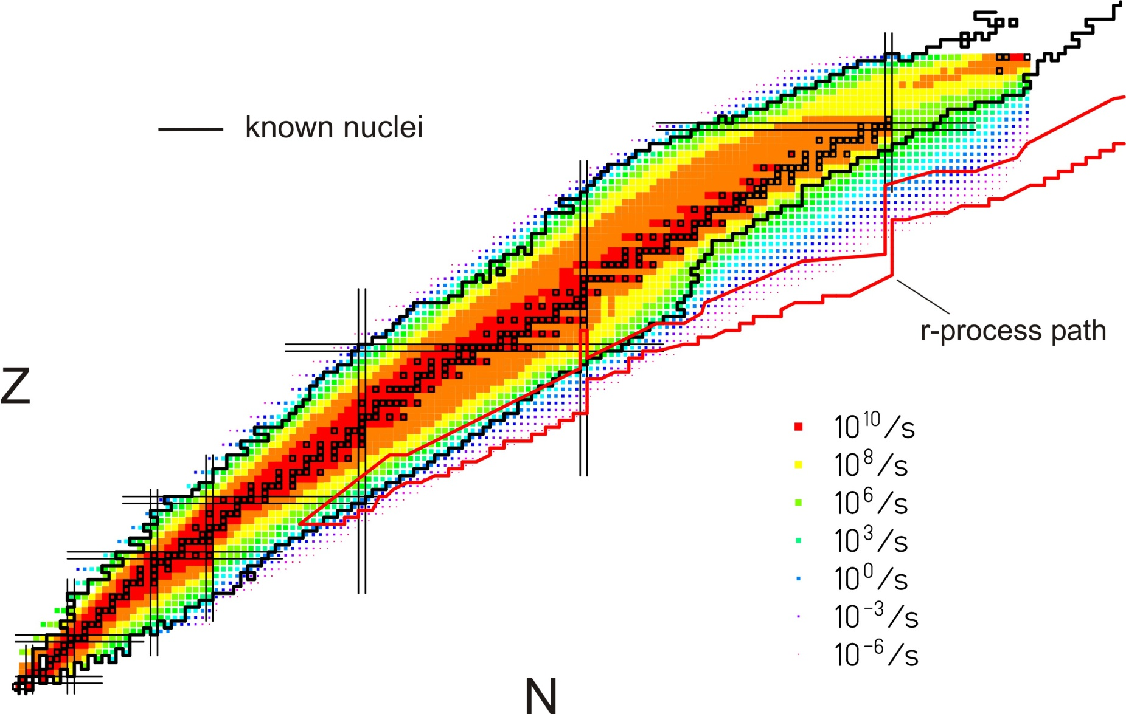
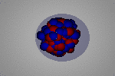
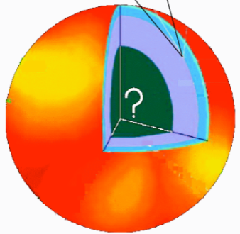
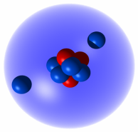
NuSTAR: Nuclear Structure,
Astrophysics, Reactions
Quest for the limits of existence
Halos, Few Body Correlations
Changing shell structure far away from stability
Skins, new collective modes, nuclear matter, neutron stars
Origin of the elements
FAIR will provide unique access to many nuclei relevant in explosive nucleosynthesis
➔ Combine accurate nuclear physics with precision astronomy to constrain astrophysical scenarios
Neutron Skins
Pygmy Resonance
Neutron stars
Halos
EOS
9
Notes:
9

Slide 10
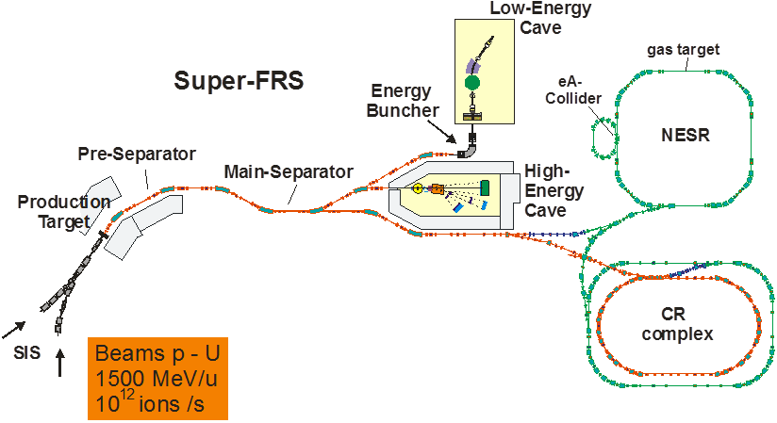
The NuSTAR experimental facilities at FAIR
Important beam parameters:
- all elements (H through U)
- intensity ~ 10¹² ions/sec.
- beam energies up to 1.5 GeV/u
- fast and slow (DC-type) extraction
Four experimental areas:
- superconducting fragment separator
- high-energy branch with reaction setup
- storage-ring complex (CR, RESR, NESR, eA)
- low-energy branch with energy focusing and re-acceleration

Slide 11
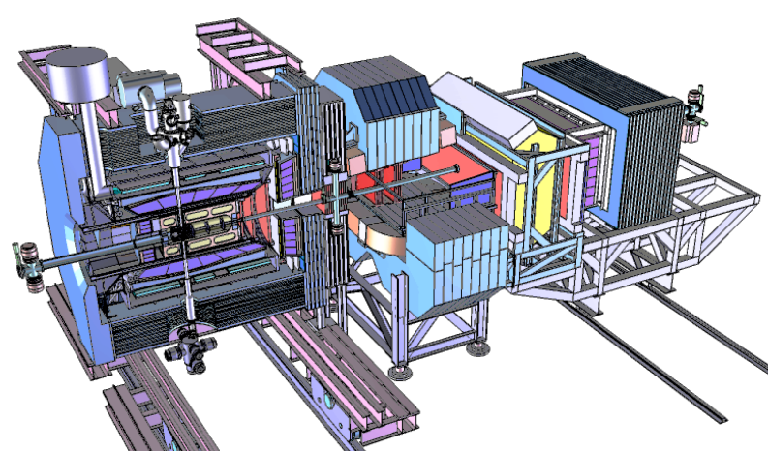
FAIR Experiments
APPA
Super-FRS
PANDA
NuSTAR

Slide 12
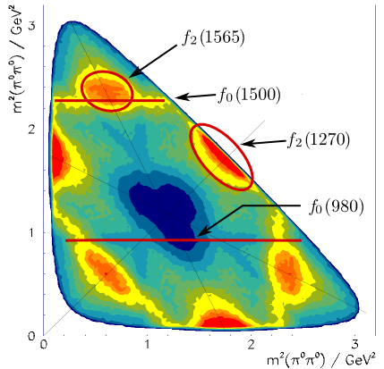
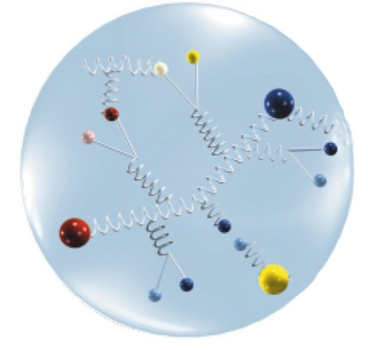
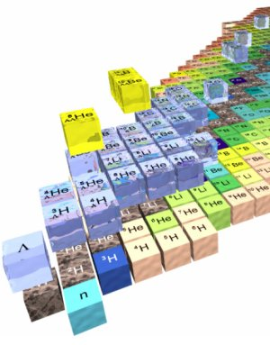
The PANDA physics program
Hadron Spectroscopy
Experimental Goals: mass, width & quantum numbers of resonances
Charm Hadrons: charmonia, D-mesons, charm baryons
➔ Understand new XYZ states, Ds(2317) and others
Exotic QCD States: glueballs, hybrids, multi-quarks
Spectroscopy with Antiprotons:
Production of states of all quantum numbers
Resonance scanning with high resolution
Hadron Structure
Generalized Parton Distributions
Timelike Nucleon Form-factors
Nuclear Physics
Hypernuclei: Production of double Λ-hypernuclei
➔ γ-spectroscopy of hypernuclei, YY interaction
Hadrons in Nuclear Medium

Slide 13
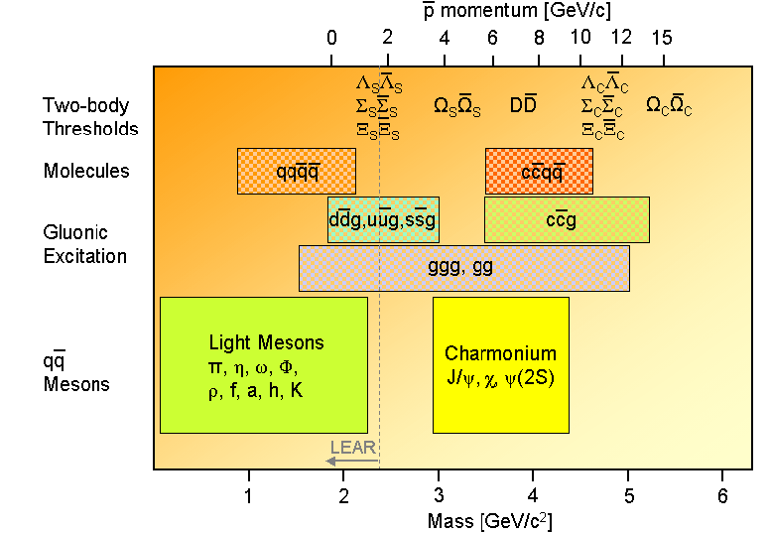
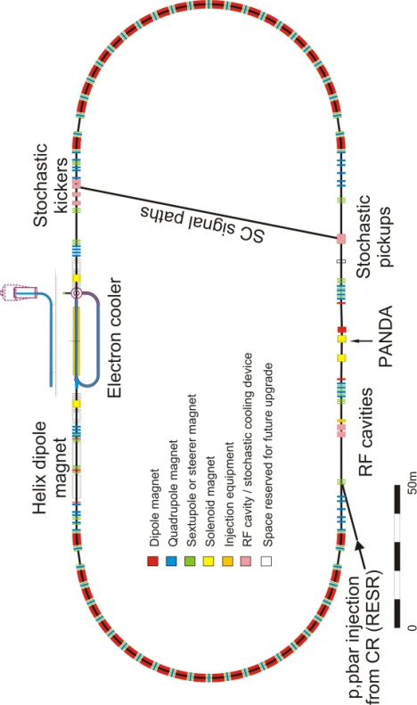
Anti-Proton Annihilation @ DA
HESR:
High-Energy
Storage Ring
Luminosity up to L~ 2x10³² cm⁻²s⁻¹
Stochastic & electron cooling
Resolution ~50 keV
Tune E_{CM} to scan resonance
Get precise m and Γ

Slide 14
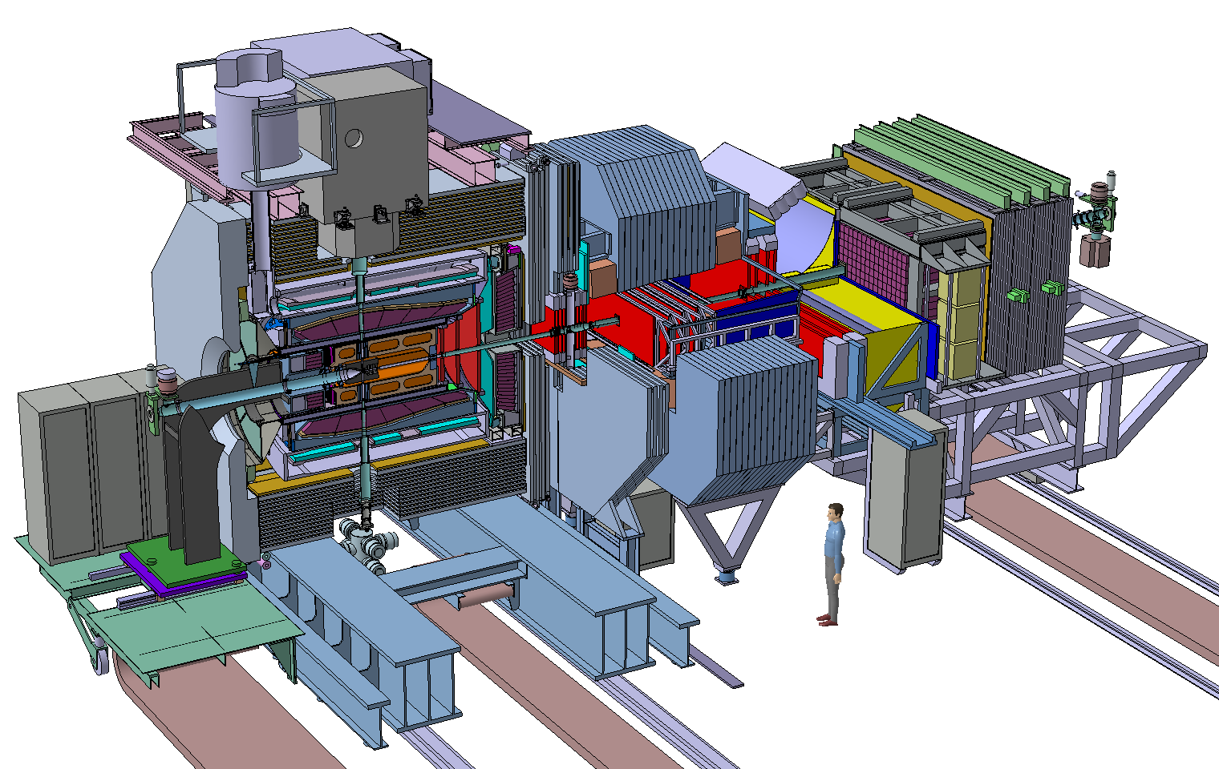
The PANDA spectrometer at FAIR
Detector requirements:
4π acceptance
High rate capability:
2x10⁷ s⁻¹ interactions
Efficient event selection
➔Continuous acquisition
Momentum resolution ~1%
Vertex info for D, K⁰_{s}, Y
(cτ = 317 μm for D±)
➔Good tracking
Good PID (γ, e, μ, π, K, p)
➔Cherenkov, ToF, dE/dx
γ-detection 1 MeV – 10 GeV
➔Crystal Calorimeter

Slide 15
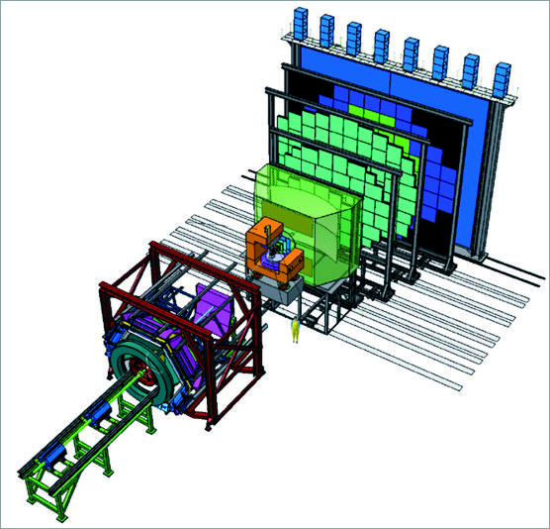
FAIR Experiments
CBM
APPA
Super-FRS
PANDA
NuSTAR

Slide 16
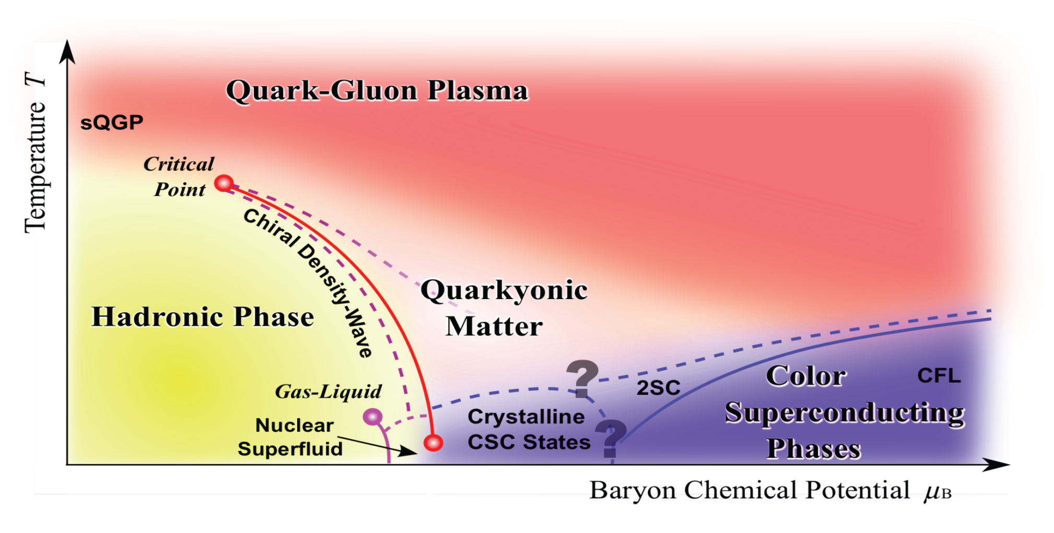
Exploring the QCD phase diagram
Courtesy of K. Fukushima & T. Hatsuda
Probing the QCD diagram at very high T and ρ_{B} ∼ 0 (early universe):
ALICE, ATLAS, CMS at LHC
STAR, PHENIX at top RHIC energies
Probing the QCD diagram at moderate T and very high ρ_{B} (neutron star):
BES at RHIC, NA61 at CERN SPS, CBM at FAIR, MPD at NICA, J-PARC, NA60+

Slide 17
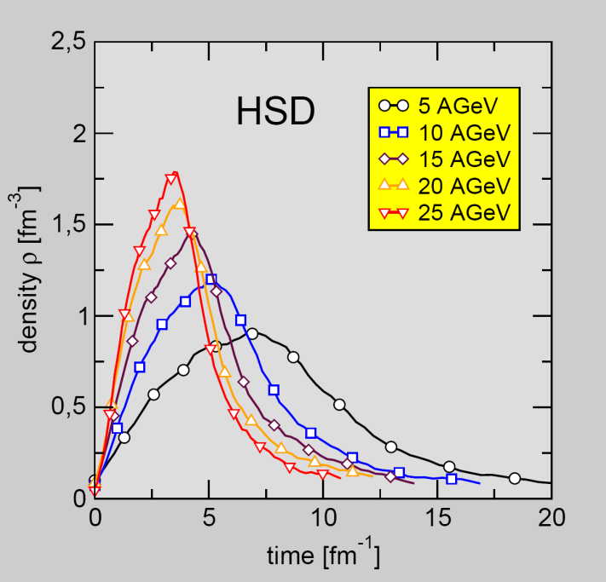
Exploring the QCD phase diagram
Courtesy of K. Fukushima & T. Hatsuda
Baryon density
in central Au+Au
collisions
SIS100
time [fm/c]

Slide 18
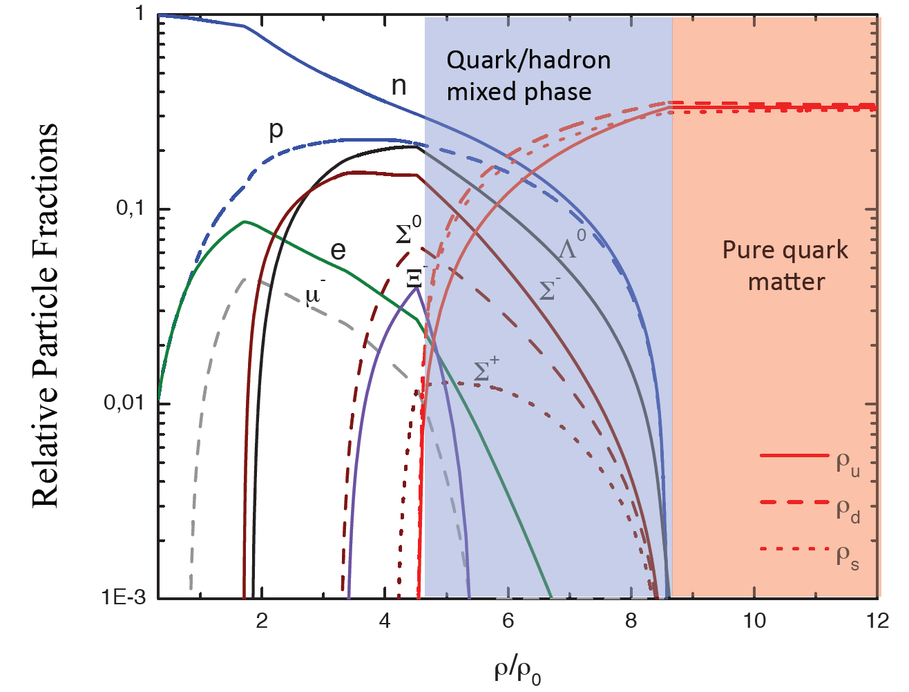
Quark matter in massive neutron stars?
Equation-of-state: Non-local SU(3) NJL with vector coupling
M. Orsaria, H. Rodrigues, F. Weber, G.A. Contrera, arXiv:1308.1657

Slide 19
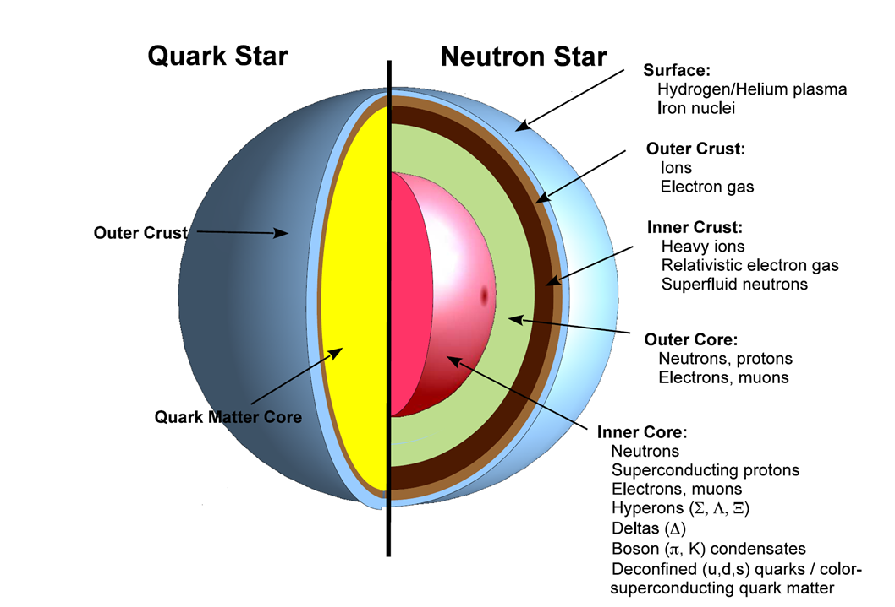
CBM physics program I
Strangeness
Excitation function of yields, spectra, and collective flow of strange particles in heavy-ion collisions from 2 - 45 A GeV
Physics case
Phase transitions from hadronic matter to quarkyonic or
partonic matter at high net-baryon densities
Equation-of-state of matter at neutron star core densities

Slide 20
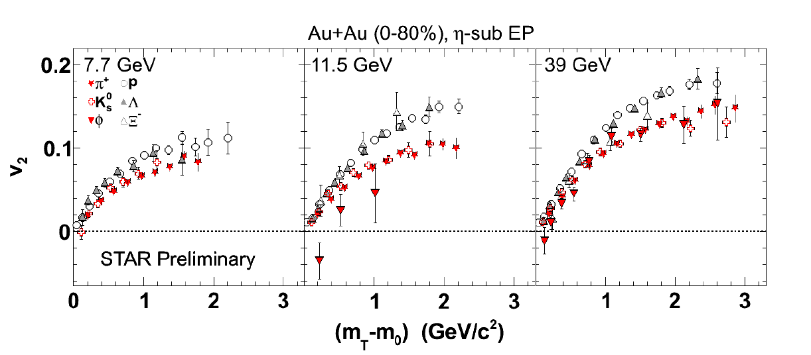
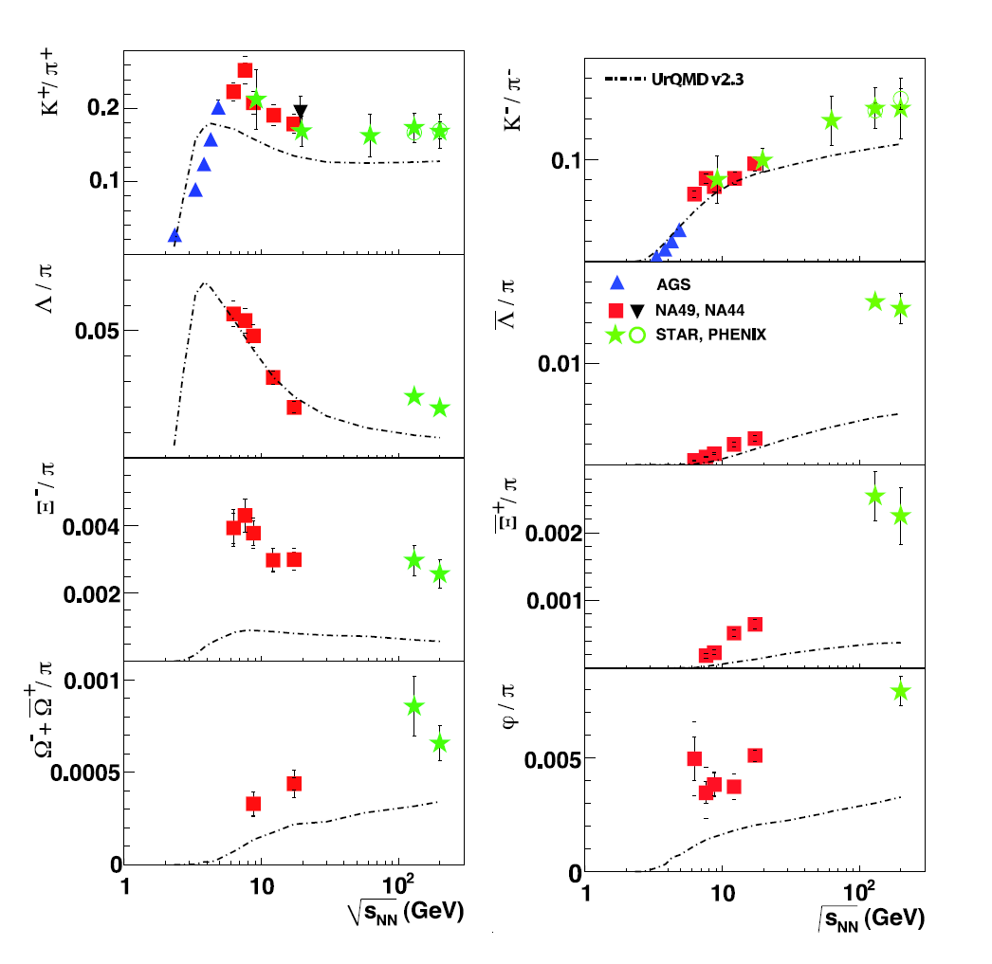
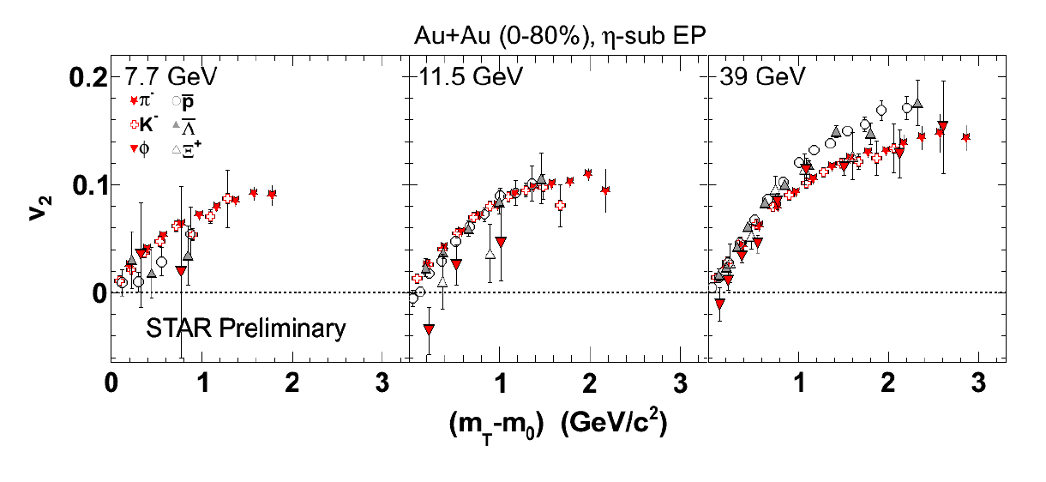
CBM physics program I
Strangeness
Excitation function of yields, spectra, and collective flow of strange particles in heavy-ion collisions from 2 - 45 A GeV
Pb+Pb, Au+Au (central)
RHIC beam energy scan
FAIR
FAIR

Slide 21
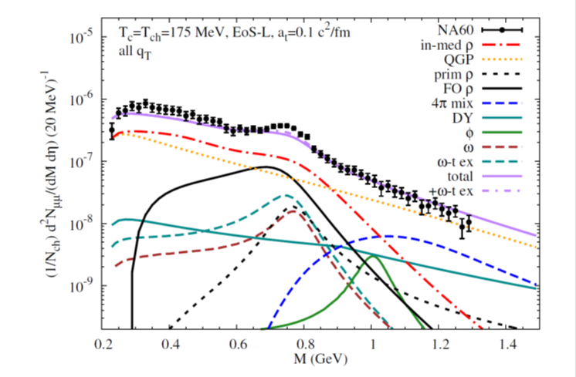
CBM physics program II
Dileptons
Excitation function of yields and phase-space distributions of lepton pairs in heavy-ion collisions from 2 - 45 A GeV
Physics case
Electro-magnetic radiation from the dense fireball
Chiral symmetry restoration in dense baryonic matter
Experiment:
R. Arnaldi et al. [NA60 Coll.],
Phys. Rev. Lett. 96, (2006) 162302,
Eur. Phys. J. C 61, (2009) 711
Theory:
R. Rapp, J. Wambach and H. van Hees, in Relativistic Heavy-Ion Physics,
edited by R. Stock,
Landolt Börnstein (Springer), New Series I/23A (2010), arXiv:0901.3289 hep-ph

Slide 22
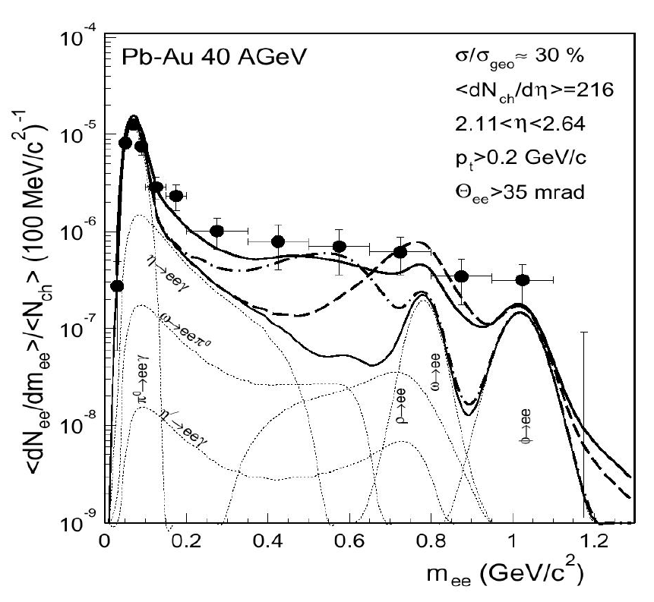
CBM physics program II
Dileptons
Excitation function of yields and phase-space distributions of lepton pairs in heavy-ion collisions from 2 - 45 A GeV
G. Agakishiev et al., Phys. Rev. C 84 (2011) 014902
D. Adamova et al., Phys. Rev. Lett. 91 (2003) 042301

Slide 23
CBM physics program III
Fluctuations
Event-by-event fluctuations of conserved quantities like strangeness, baryons, and net-charge in heavy-ion collisions as function of beam energy from
2 - 45 A GeV
Physics case
First-order phase transition
QCD critical point
L. Adamczyk and the STAR Collaboration,
Phys. Rev. Lett. 112, 032302 (2014)

Slide 24
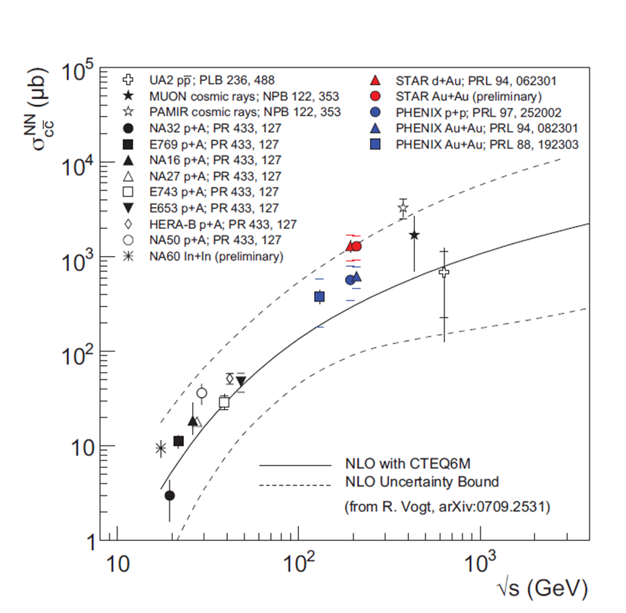
CBM physics program IV
Charm
Cross sections and phase-space distributions of open and hidden charm in proton-nucleus collisions and nucleus-nucleus collisions at
SIS100/300 energies
Physics case
Charm production at threshold energies
Charm propagation in (dense) nuclear matter
Charmonium suppression in partonic matter
FAIR
A. Frawley,T. Ulrich, R. Vogt, Phys.Rept.462:125-175,2008

Slide 25

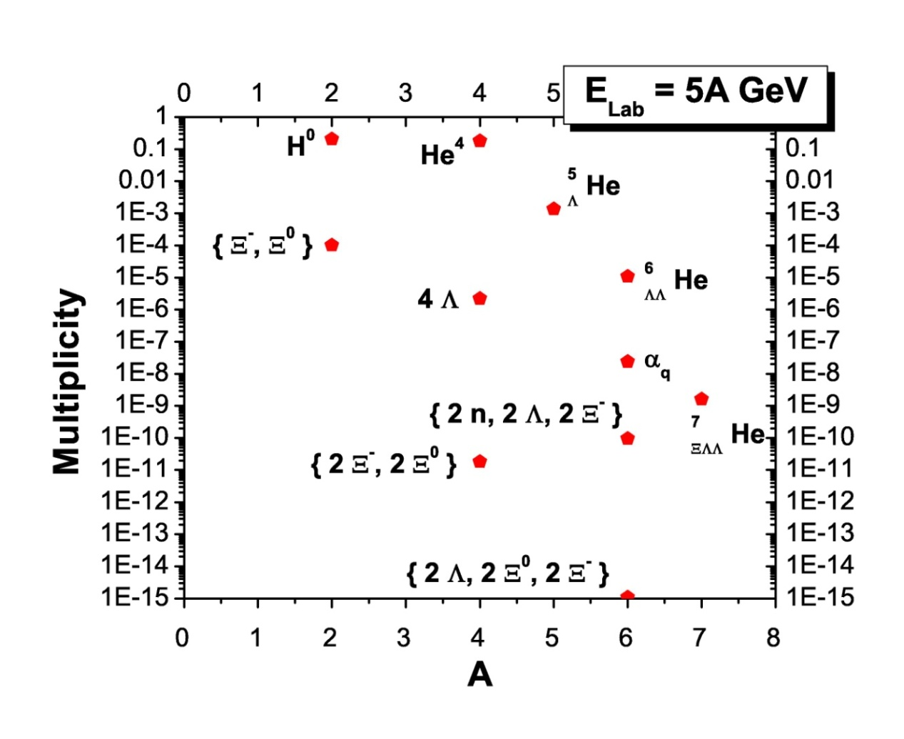
CBM physics program V
Strange matter
Hypernuclei, strange dibaryons and massive strange objects
Production of hypernuclei via coalescence
of hyperons and light nuclei
A. Andronic et al., Phys. Lett. B697 (2011) 203
H. Stöcker et al., Nucl. Phys. A 827 (2009) 624c

Slide 26
Exploring high net-baryon densities
Experiment | Energy √s_{NN} (Au/Pb beams) | Observables | Reaction rates Hz
STAR@RHIC BNL | 7 – 200 GeV | protons, pions strangeness charm electrons, muons | 1 – 800 (limitation by luminosity)
NA61@SPS CERN | 6.4 – 17.4 GeV | protons, pions strangeness | 80 (limitation by detector)
CBM@SIS FAIR | 2.7 – 8.3 GeV | protons, pions strangeness charm electrons, muons | 10⁵ – 10⁷ (limitation by detector)

Slide 27
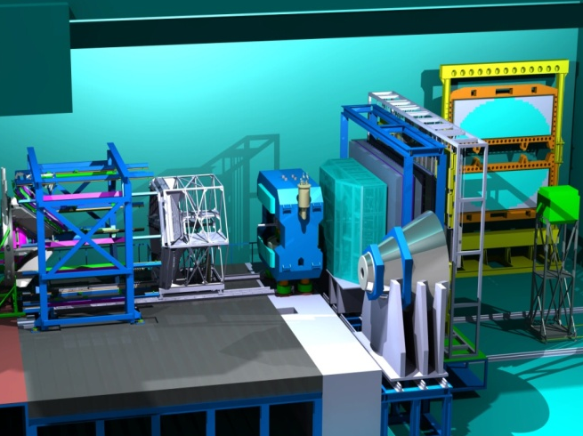
The Compressed Baryonic Matter Experiment
Ring Imaging
Cherenkov
Detector
Transition
Radiation
Detector
Resistive Plate
Chambers
(TOF)
Electro-
magnetic
Calorimeter
(parking
position)
Projectile
Spectator
Detector
Vertex
Detector
Silicon
Tracking
System
Dipole
magnet
HADES
Muon Detection System
(parking position)

Slide 28
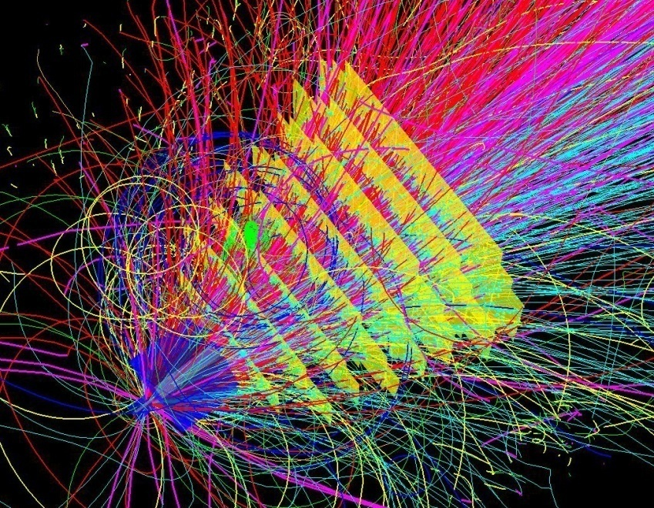
CBM experimental challenges
10⁵ - 10⁷ Au+Au reactions/sec
determination of (displaced) vertices (σ ≈ 50 μm)
identification of leptons and hadrons
fast and radiation hard detectors
free-streaming readout electronics
high speed data acquisition and high performance
computer farm for online event selection
4-D event reconstruction
Notes:
28
28
28

Slide 29
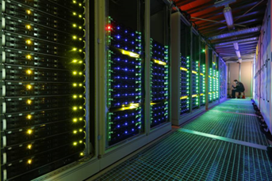
CBM First Level Event Selection (FLES)
The FLES package is vectorized, parallelized, portable and scalable
Example:
Full track reconstruction including KF particle analysis of multi-strange
(anti) hyperons for min. bias Au+Au collisions at 25 A GeV.
Single node with up to 80 cores
GSI „Minicube“ with 10.000 cores

Slide 30
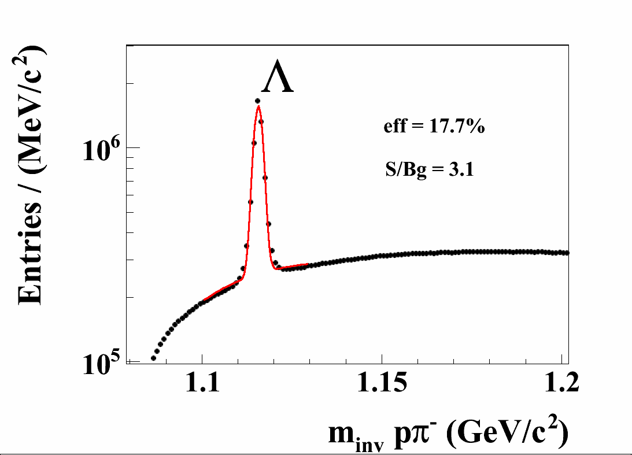
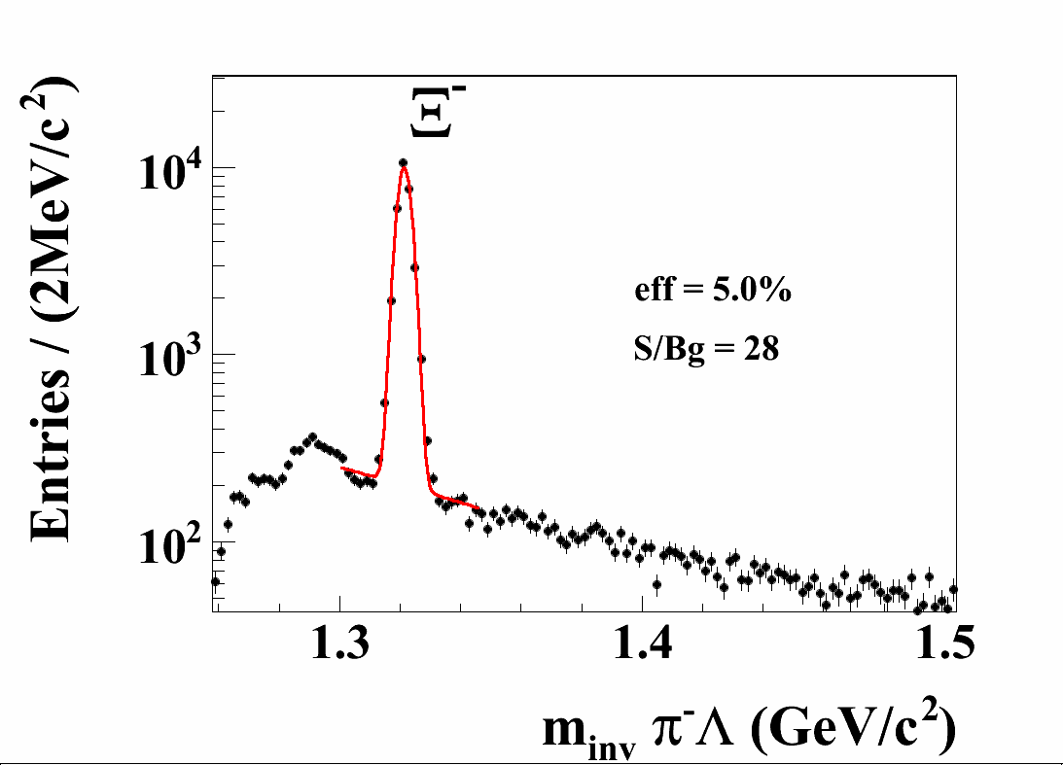
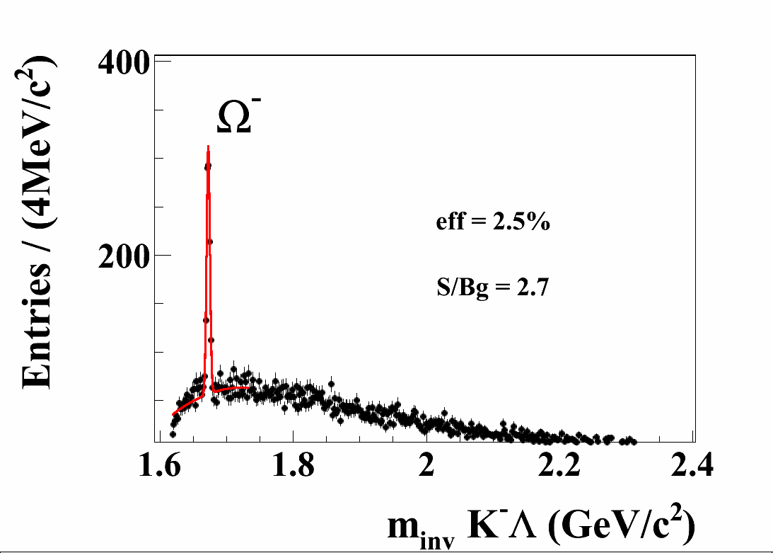
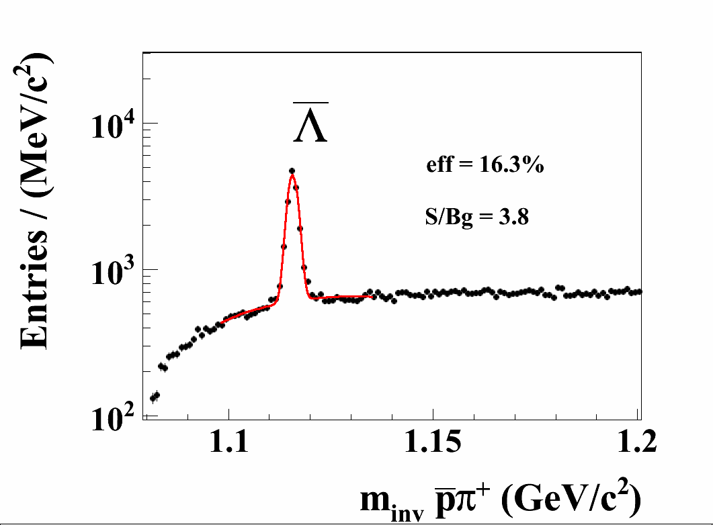
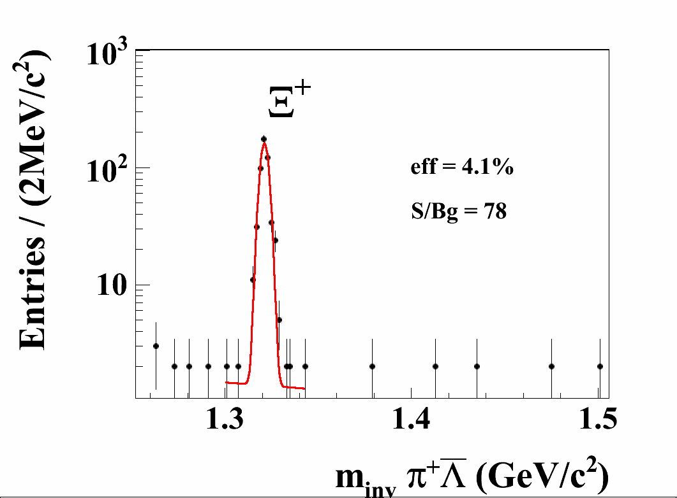
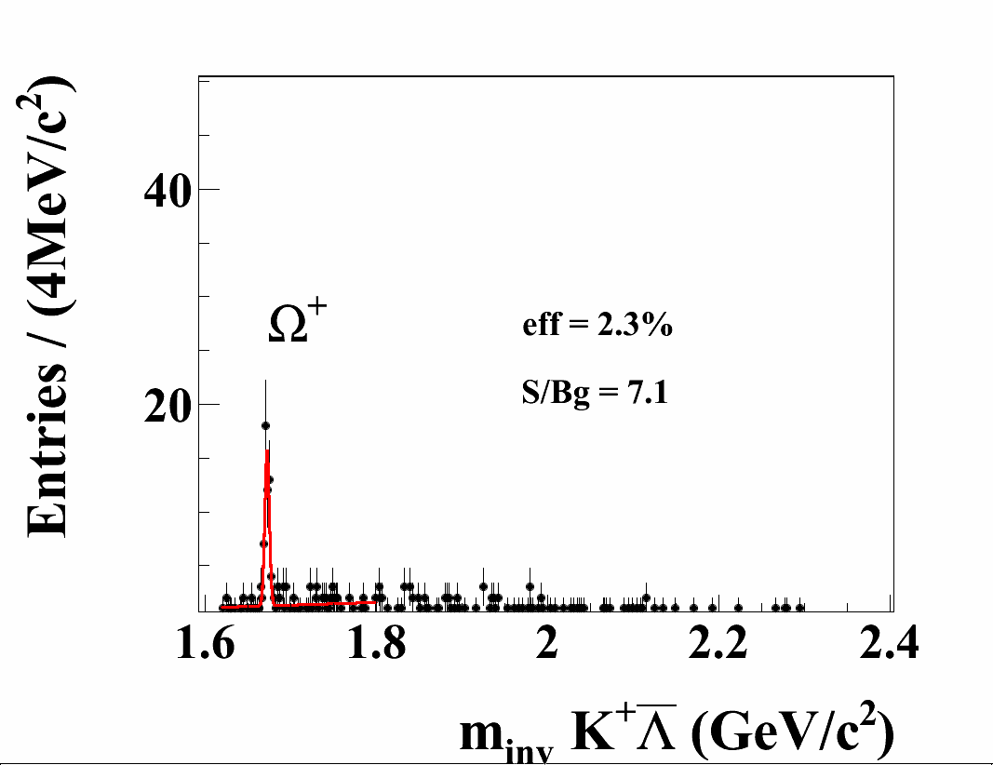
Hyperons from Au+Au 25 AGeV
1M central events
Talk: J. Heuser
Poster: M. Singla
P. Ghosh
T. Balog

Slide 31
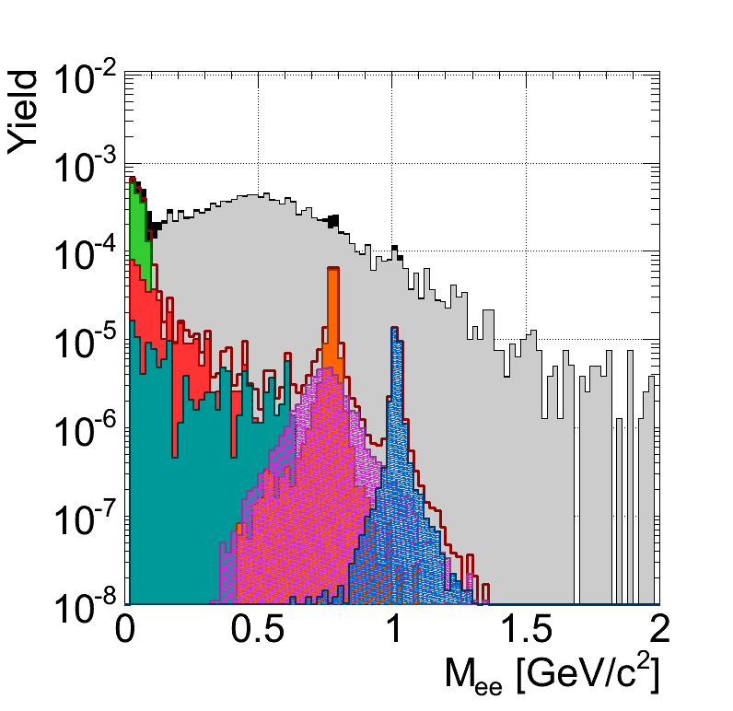
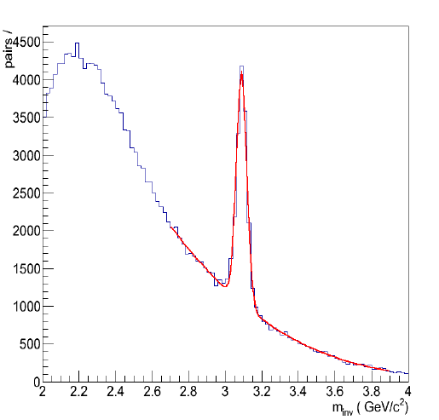
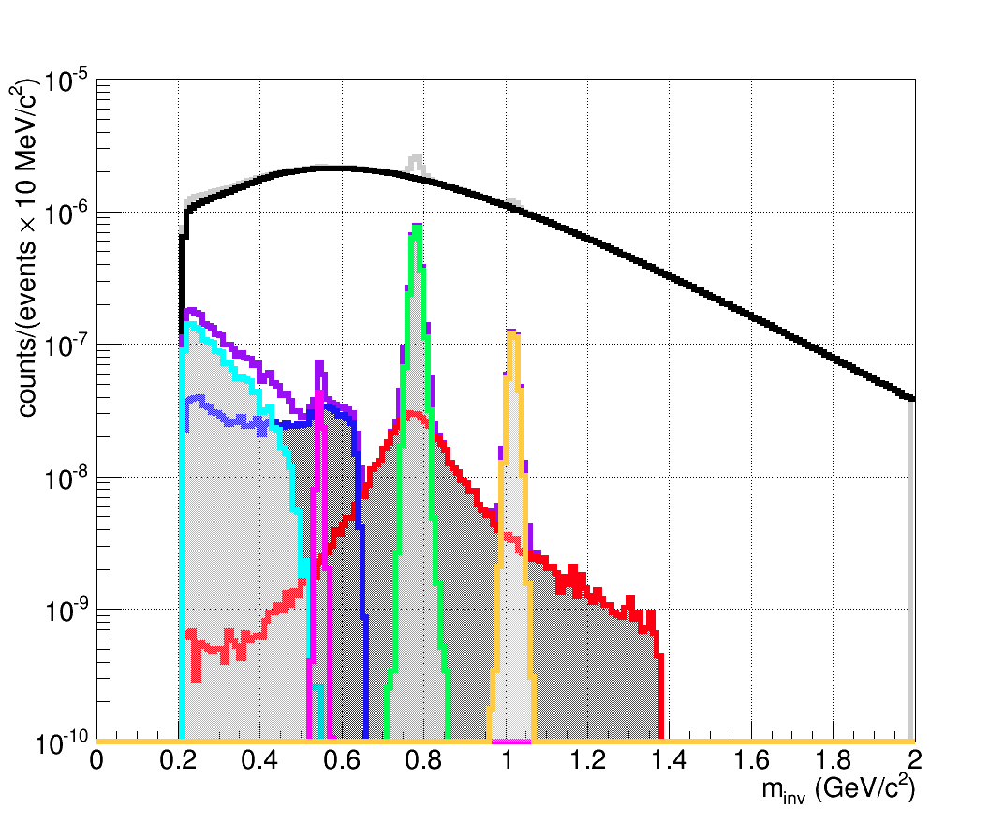
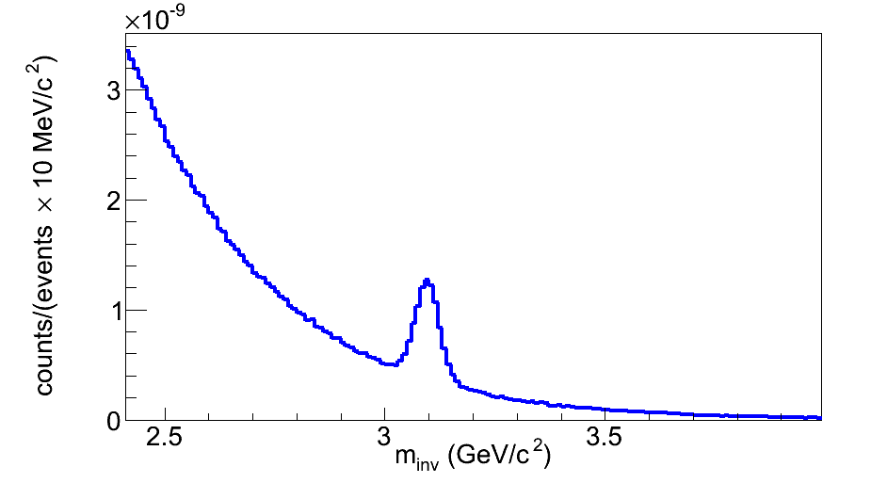
Di-lepton invariant mass spectra
for central Au+Au collisions at 25 A GeV
Detector systems: STS, RICH+TRD or MUCH, ToF
e⁺e⁻
Talk:
C. Höhne
Posters:
T. Mahmoud
J. Kopfer
C. Pauli
E. Lebedeva
A. K. Dubey
μ⁺μ⁻

Slide 32
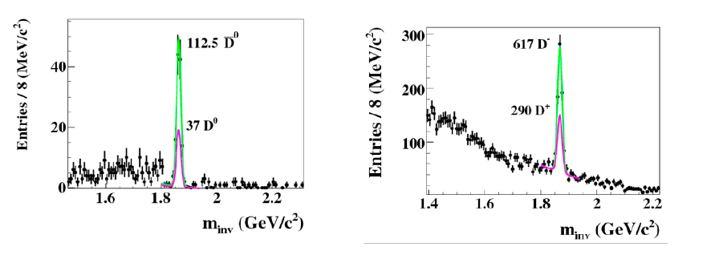
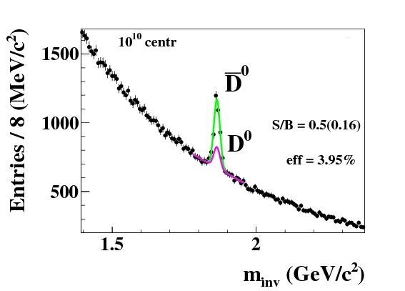

D-meson production
no particle identification by time-of-flight
30 GeV p + C (SIS100)
D⁰ →Kπππ
D± →Kππ
Au+Au 25 A GeV (SIS300)
D± →Kππ
D⁰ →Kπππ

Slide 33










CBM Technical Developments
SC Magnet: JINR Dubna
Micro-Vertex Detector:
Frankfurt, Strasbourg
Silicon Tracking System: Darmstadt, Dubna, Krakow, Kiev, Kharkov, Moscow, St. Petersburg, Tübingen
MRPC ToF Wall: Beijing, Bucharest, Darmstadt, Frankfurt, Hefei, Heidelberg, Moscow, Rossendorf, Wuhan
RICH Detector:
Darmstadt, Giessen, Pusan,
St. Petersburg, Wuppertal
Muon detector:
Kolkata + 13 Indian Inst.,
Gatchina, Dubna
Transition Radiation Detector:
Bucharest, Dubna, Frankfurt, Heidelberg, Münster
Forward calorimeter:
Moscow, Prague, Rez
DAQ and online event selection:
Darmstadt, Frankfurt, Heidelberg, Kharagpur, Warsaw

Slide 34







CBM Technical Design Reports
# | Project | TDR Status
1 | Magnet | approved
2 | STS | approved
3 | RICH | approved
4 | TOF | evaluation
5 | MuCh | evaluation
6 | PSD | evaluation
7 | MVD | submission 2014
8 | DAQ/FLES | submission 2014
9 | TRD | submission 2014

Slide 35

FAIR Civil Construction
Synchrotrons: 1.1 km
HESR: 0.6 km
With beamlines: 3.2 km
Existing SIS 18
GSI news: 22.05.2014 | Safety inspection of the FAIR construction plans: Environment Ministry hands over final construction permit for FAIR
Total area > 200 000 m²
Area buildings ~ 98 000 m²
Usable area ~ 135 000 m²
Volume of buildings ~ 1 049 000 m³
Substructure:~ 1500 pillars, up to 65 m deep

Slide 36



Tunnel for SIS100/300

Slide 37

FAIR Civil Construction
Most powerful drilling machines available worldwide: 36 m hight, 136 t weight.
Four of these machines needed to drill holes for 1350 pillars of 60 m depth and 1.2 m diameter. As of 21/05/2014, 10 were to be drilled

Slide 38
Timeline FAIR start version
2011
2012
2013
2014
2015
2016
2017
2018
2019
6
7
8
9
10
11
12
6
Submission of construction application
Start Site preparation
First civil construction contracts
Building of accelerator & detector components
Civil construction partly finished
Start installing & commissioning accelerator and detector components
Start commissioning with beam
7
8
9
10
11
12

Slide 39
Summary
FAIR construction (buildings and accelerator) is in progress
First beams are expected in 2018/2019
Unique feature of FAIR accelerators: high-intensity primary and secondary beams
Broad research program on hadron, nuclear, atomic, plasma, material and bio-physics
CBM experiment @FAIR
Exploration of the QCD phase diagram in the region of high net-baryon densities with both rare and bulk probes→ unchartered territory
Challenging detector and computing requirements
Realisation of the experiment is progressing well

Slide 40






FAIR Collaborations

Slide 41
Back-up slides

Slide 42
CBM @ SIS-100 & SIS-300
The first years of CBM operation will be at SIS-100 with a start setup
Beam | p_{lab, max} | √s_{NN, max}
heavy ions (Au) | 11A GeV | 4,7 GeV
light ions (Z/A = 0.5) | 14A GeV | 5,3 GeV
Protons | 29 GeV | 7,5 GeV
CBM at SIS-300
Beam | p_{lab, max} | √s_{NN, max}
heavy ions (Au) | 35A GeV | 8.2 GeV
medium ions (In) (Cu) | 38A GeV 41A GeV | 8.5 GeV 8.9 GeV
light ions (Z/A = 0.5) | 45A GeV | 9.3 GeV
protons | 90 GeV | 13 GeV
…. at interaction rates up to 10 MHz (J/ψ)

Slide 43



Simulations
Event generators UrQMD 3.3
Transport code GEANT3, FLUKA
Realistic detector geometries, material budget and detector response
reconstruction
Track reconstruction efficiency
min. bias Au+Au 25 A GeV
Notes:
43
43
43

Slide 44

The equation-of-state of symmetric nuclear matter at neutron star core densities
Observable: multistrange hyperon production at (sub)threshold energies
Direct multi-strange hyperon production:
pp → Ξ⁻ K⁺K⁺p (E_{thr} = 3.7 GeV)
pp → Ω⁻ K⁺K⁺K⁰p (E_{thr} = 7.0 GeV)
pp → Λ⁰Λ⁰ pp (E_{thr} = 7.1 GeV)
pp → Ξ⁺ Ξ⁻ pp (E_{thr} = 9.0 GeV)
pp → Ω⁺ Ω⁻ pp (E_{thr} = 12.7 GeV
Ω⁻ production in 4 A GeV Au+Au
Hyperon production via multiple
strangeness exchange reactions:
Hyperons (s quarks):
pp → K⁺Λ⁰p, pp → K⁺K⁻pp,
pΛ⁰→ K⁺ Ξ⁻ p, πΛ⁰→ K⁺ Ξ⁻ π,
3. Λ⁰Λ⁰→ Ξ⁻ p, Λ⁰K⁻ → Ξ⁻ π⁰
4. Λ⁰ Ξ⁻ → Ω⁻ n, Ξ⁻K⁻ → Ω⁻ π⁻
Antihyperons (anti-s quarks):
1. Λ⁰ K⁺ → Ξ⁺π⁰ ,
2. Ξ⁺ K⁺ → Ω⁺ π⁺.
HYPQGSM calculations , K. Gudima et al.

