Slide 1
Super-FRS plans for commissioning and day-1 beams
H. Simon
FAIR Exp. & Acc. 20171215

Slide 2
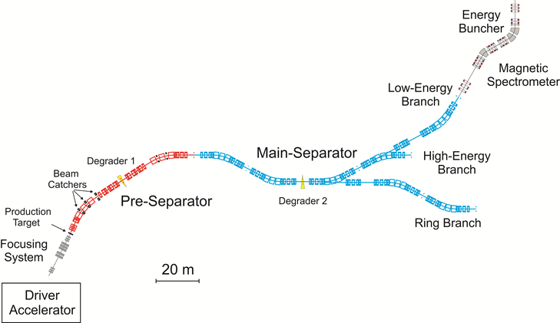
Outline
Timeline
No-beam activities
Phase-0 activities
Commisioning with beam
Phase-1
Notes:
In-Flight → energies as high as 1500 MeV/u

Slide 3

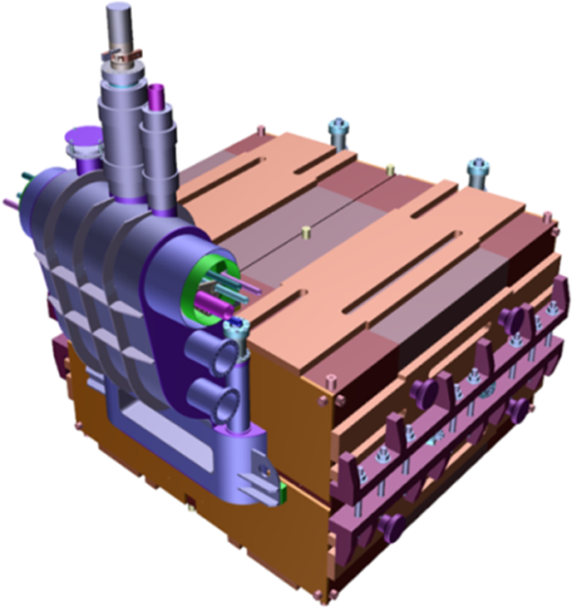
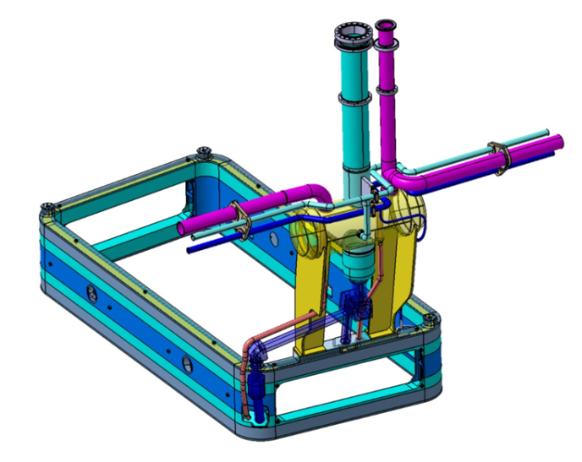
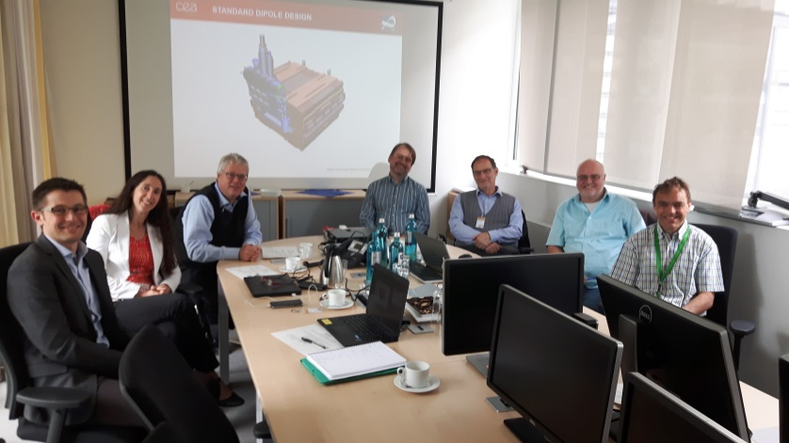
Timeline
(Status Standard SC Dipole Magnets)
Magnetic systems define timeline
of the project ➔
tendering and testing
Scope
3 units 11°, 18 units 9.75°
Warm iron, SC coil
Aperture ±190mm x ±70mm
Weight: 50 to 60 ton
Tender Status :
Announcement published April 7, 2017
Qualifying submission closed May 12, 2017
  6 out of 7 companies invited to tender
Offers received by mid of July, 2017
Offers analyzed (with CEA colleagues);
Last negotiation round KW2 2018
Contract award expected soon after

Slide 4
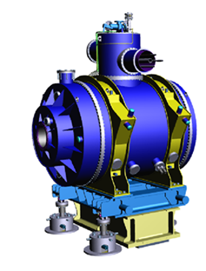
Timeline
(SC Multiplets, Overview)
H. Müller,
E.J. Cho et al.
8 short multiplets (PS)
  QS configuration
25 long multiplets (mainly MS)
  Quadrupol triplet
include corrector elements & steerer
Main characteristics:
iron dominated, cold iron (up to 37 tons)
common helium bath
warm beam pipe (38 cm inner diameter)
per magnet 1 pair of current leads
max. current <300A for all magnets
≈25 ton
Schedule First of Series SC multiplets
Contract closed 07/2015
  (ASG, Genova)
Design phase for SM done, for LM running
  PDR 07/2016
  FDR 12/2016
  PRR 07/2017 (short multiplet)
  PRR LM Q4/2017
  FAT FOS short multiplet Q1/2018
2.5 m
7 m
≈60 ton

Slide 5
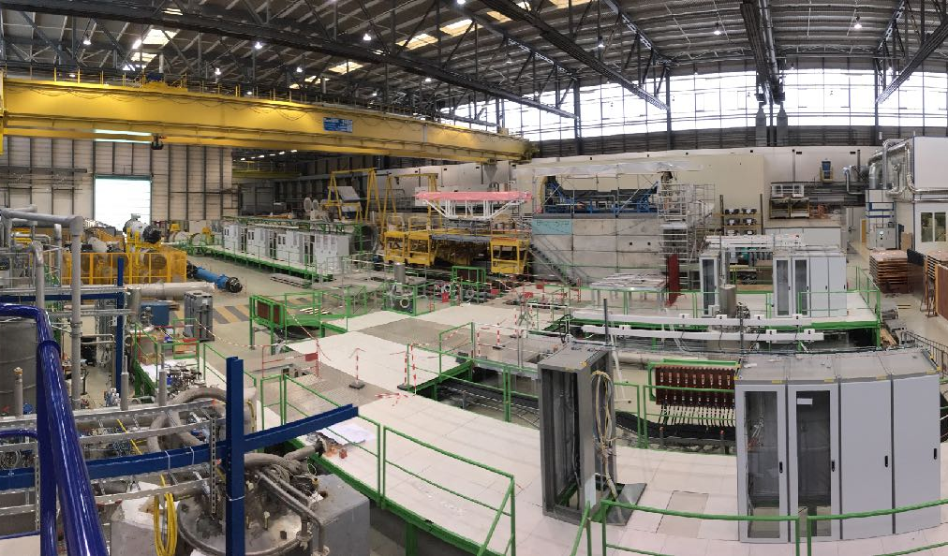
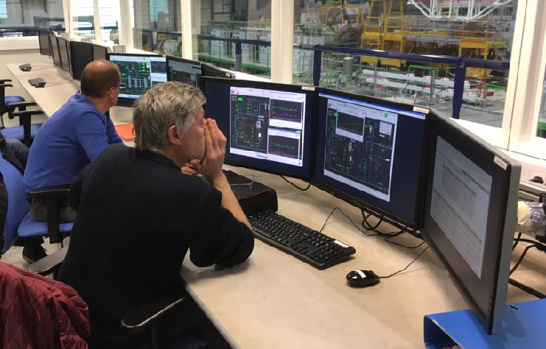
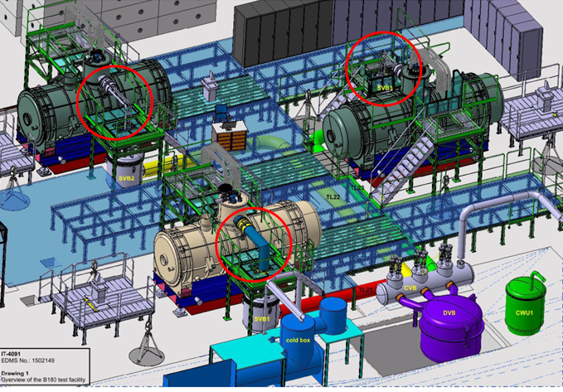
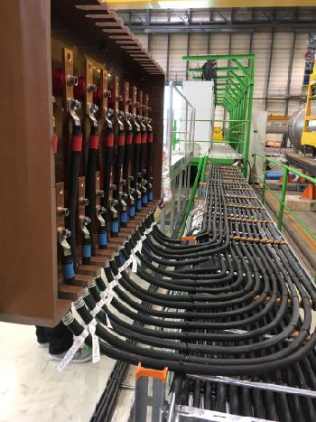
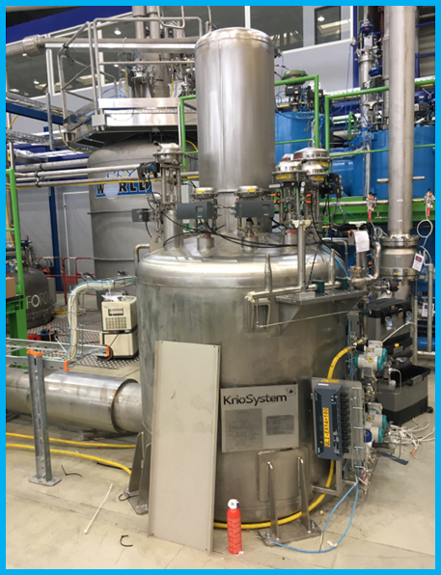
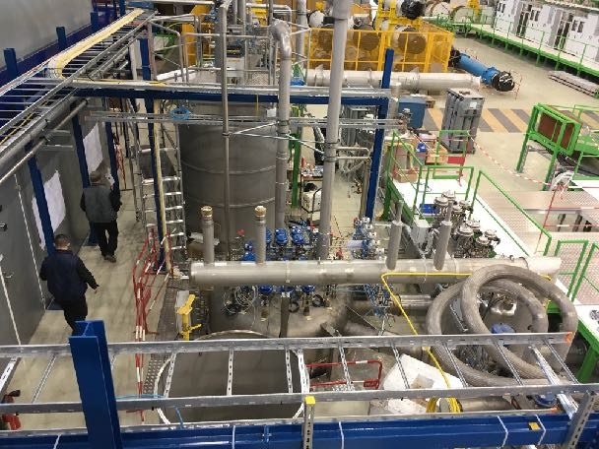
Timeline
(Magnet Testing CERN)
K. Sugita,
G. Golluccio,
B.180 CERN
Collaboration between CERN and GSI
  CERN Building 180: Infrastructures, renovation done.
Cold (4K) testing of the SC dipoles and multiplets
  3 test benches installed, 59 magnet cryo-modules
Commissioning of the cryo-facility running
Procurement of last missing components in
progress (Jumper-line/elec. cabinets)
FoS SM testing foreseen to start in Q2 2018
Power
cable
Control room

Slide 6
Timeline
Schedule SC Magnet Procurement incl. Testing
+ LEB
India !

Slide 7
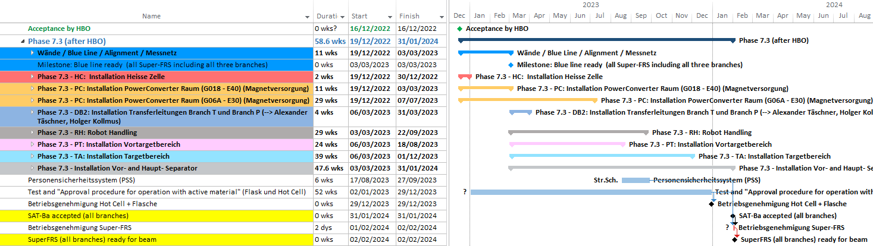
Timeline
Installation expected to be finished early 2024
➔ commisioning phase starts

Slide 8
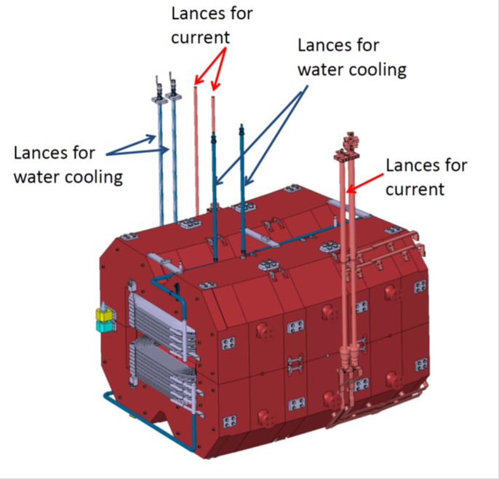
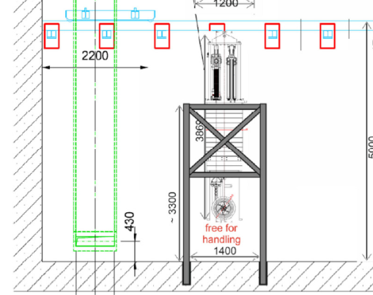
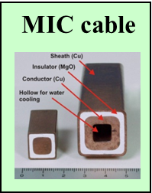
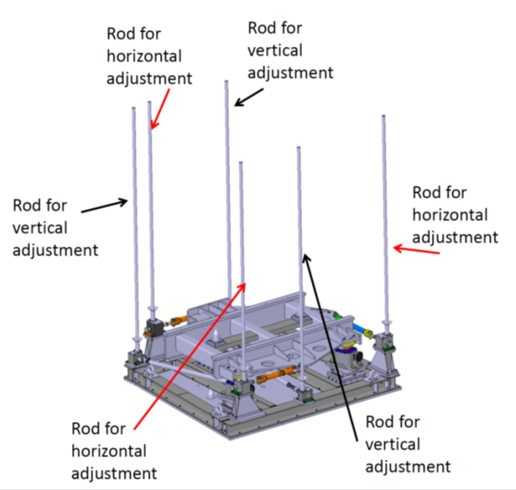
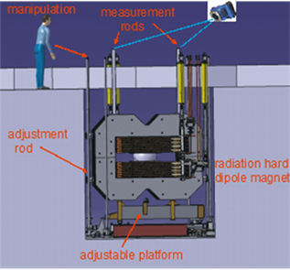
No-beam activities
Target area
H. Weick,
C. Karagiannis et al.
Super-FRS target area will be heavily shielded
remote handling & robotics
Hot cell (2023+)
Plug concept
Flask and cranes/roboters
➔ Lots of testing and commisioning!
Plug support HC
H. Leibrock,
T. Blatz, et al.
Installation of NC magnets within the target-area shielding

Slide 9
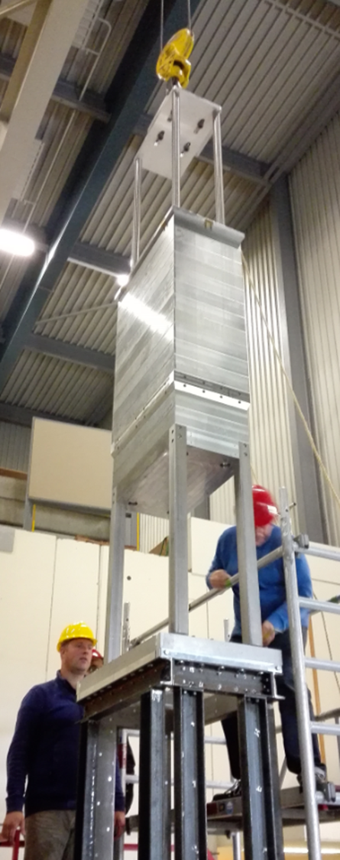

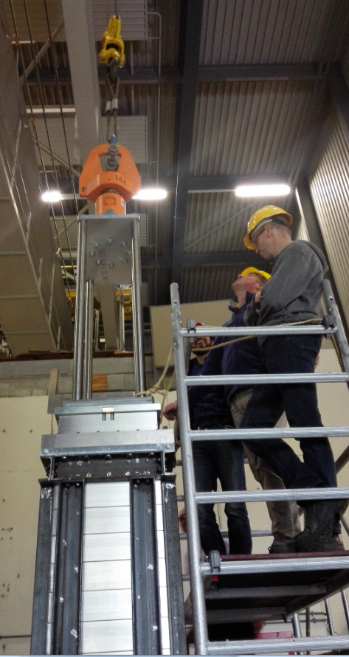
No beam activities
(Handling, Plug Guidance)
Michel Lindemulder,
Henk Smit, KVI-CART
top plate
= support
automatic hooking,
by rotating square pin
chamfered step
required: ± 20mm shift,
± 2 mrad tilt
tested up to 70 mm
or 7 mrad
corner rods
chamfered collar
(removable)
Mock up studies ➔ prepare for SAT

Slide 10
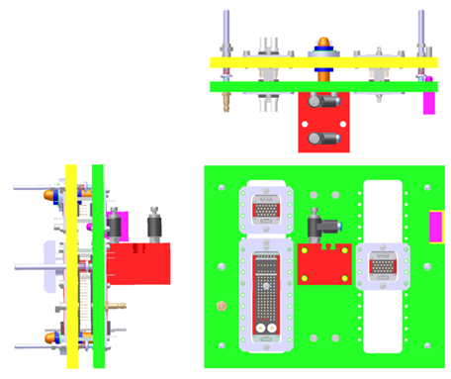
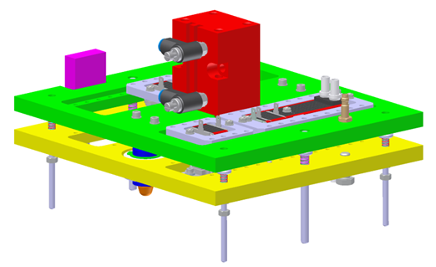
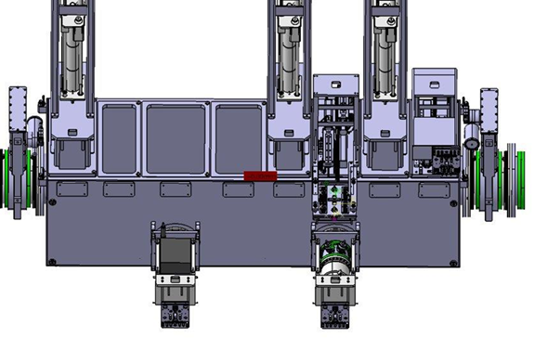
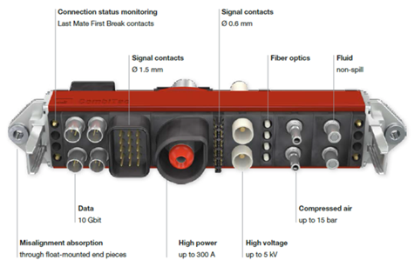
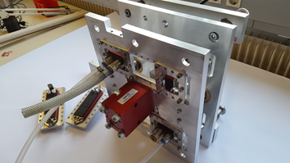
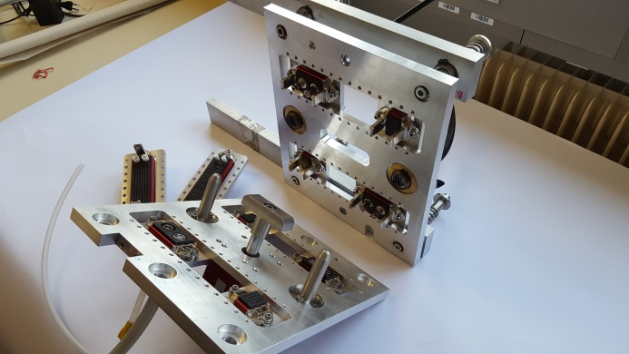
No beam activities
(Media Board development)
C. Schlör,
C. Karagiannis,
T. Blatz
Media board prototype designed and manufactured at GSI
One board part of beam instrumentation equipment (prototype developed for slits)
Large connector variety (high power, high voltage, data (10 Bbit), signals, fiber optics, fluids, compressed air, ...)
associated tests at FRS target area
pre-qualified systems will be available
robot training !

Slide 11
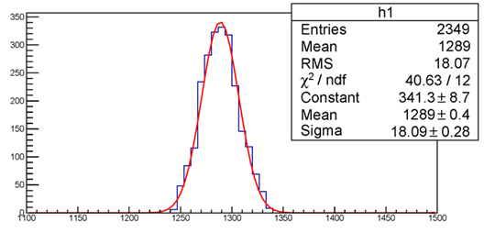
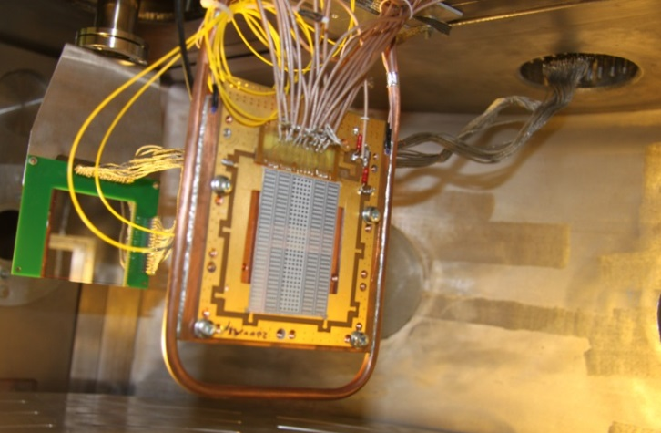
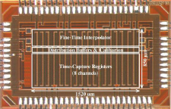
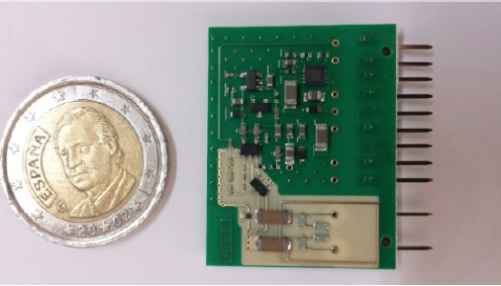
Phase-0
R&D (ToF and ΔE)
C. Nociforo,
O. Kiselev,
B. Voss et al.
Time-of-Flight (Russian in-kind, IOFFE StP)
  Specification released
  IKC close to be signed
  R&D on diamond and silicon ongoing
  (use of CERN/EP-ESE picoTDC under investigation)
MUSIC (energy-loss, Finnish in-kind)
  Specification released
  IKC signed
  PreAmps by CEA Bruyeres
    successfully tested at beam time in 2016
    contract ready for signature
Plastics (Swedish in-kind)
  Specification released
  IKC running
  ➔ Expect SAT tests with beam
Si-strip
prototype
MUSAMP v.2

Slide 12
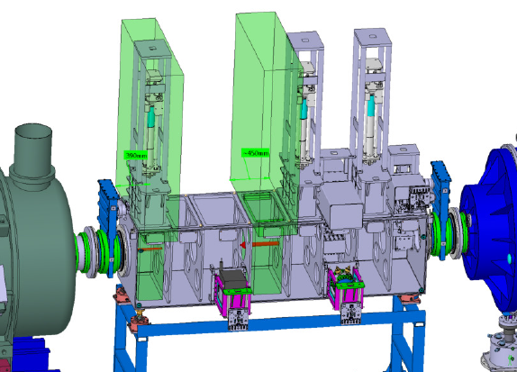
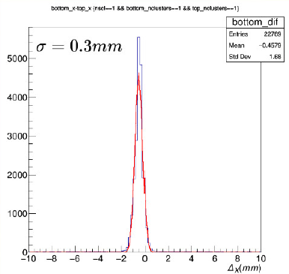
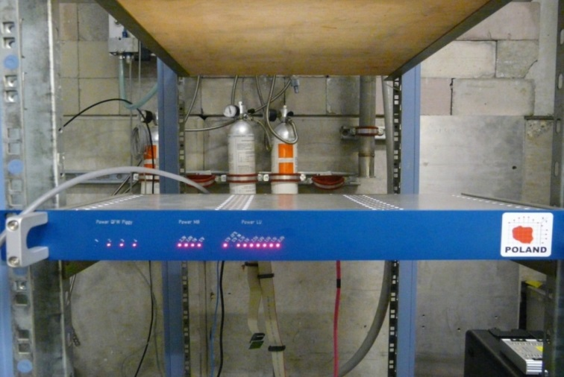
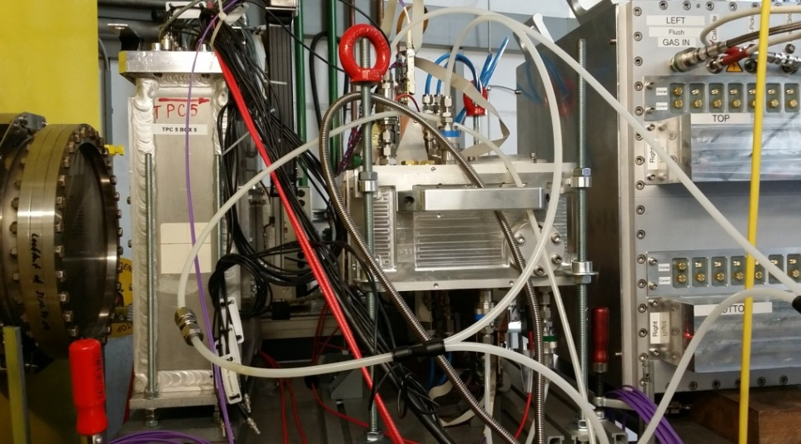
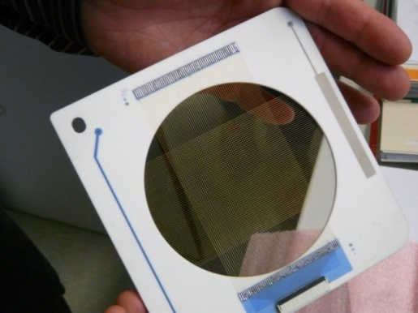
Phase-0
Detector R&D for FOS
C. Nociforo,
A. Prochazka,
C. Caesar et al.
SEM Grid (profile monitor), Finnish In-kind
  Specifications released (Q1/2016)
  IKC running
  prototype SEM in-house (Ti & C wire)
  beam test at JYFL Q4/2017
GEM-TPC (tracking), Finnish in-kind
    combined with SEM on a common drive
    several prototype tested at JYFL and GSI
    including new readout electronics
  Specification released
  IKC in preparation
  Beam test 2017/18
Position drive,
Finnish In-kind
C beam
POLAND digitizer
Fermilab design
´cluster finding‘
GEM-TPC
prototype

Slide 13
Phase-0
R&D for series production for many detector systems
Beam tests required (SAT)
„all ions/all energies“
10³-10⁹ pps
2018 - 202x ?
Transition to Phase-1
Beam optics tests @ low intensity (~10³ pps)
Commisioning of tracking system

Slide 14
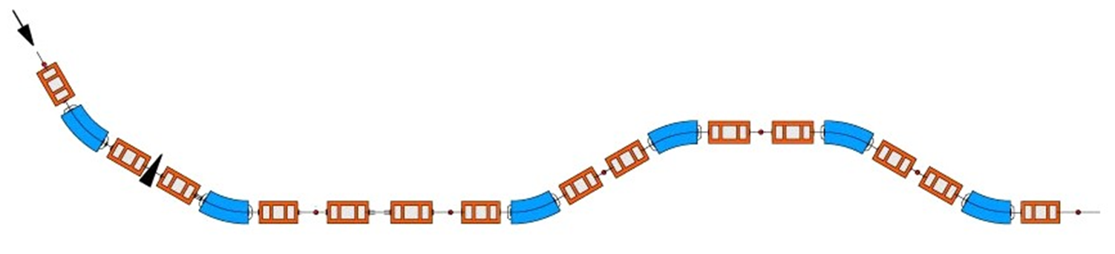
Ex.: BigRIPS beam optics tests
H. Takeda
BigRIPS Team, RIKEN Nishina Center
In-flight RI beam separator at RIBF
Two-stage scheme
  First stage: production and separation
  Second stage: particle identification (A,Z,Q)
Large acceptance
Large magnetic rigidity
}
key issues to achieve
high particle identification power
F0
First stage:
Production and
Separation
Second stage:
PID & Tagging
F2
F3
F5
F7
F1
F4
F6

Slide 15
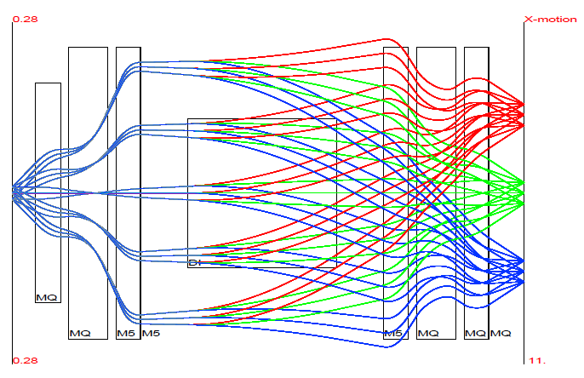
Track reconstruction
Numerical method is needed to solve
when higher order terms are considered.
➔ N. Fukuda’s talk
Final goal is to achieve high resolution in A/Q only with COSY calculation.
Among these terms, (x|a) is very sensitive to magnetic fields. In other words,
(x|a) can be optimized by relatively small tuning. Errors due to uncertainty in a_{i}
can be minimized by eliminating the (x|a)a_{i} term.

Slide 16
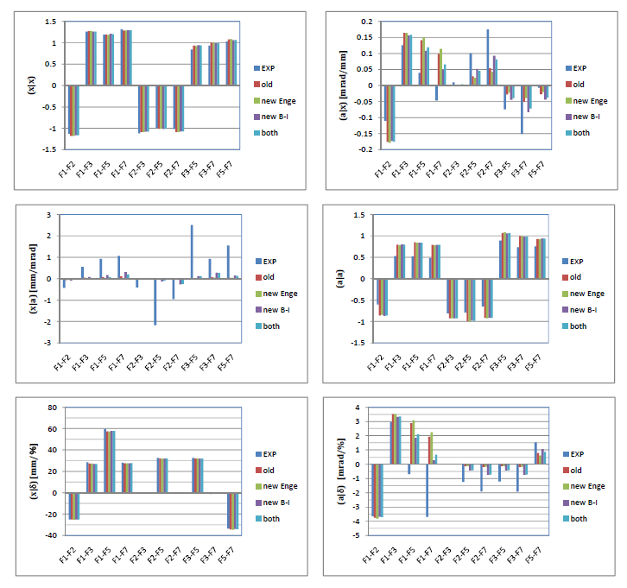
Experience:
➔
2-3 m of
beam time
(1 branch!)

Slide 17
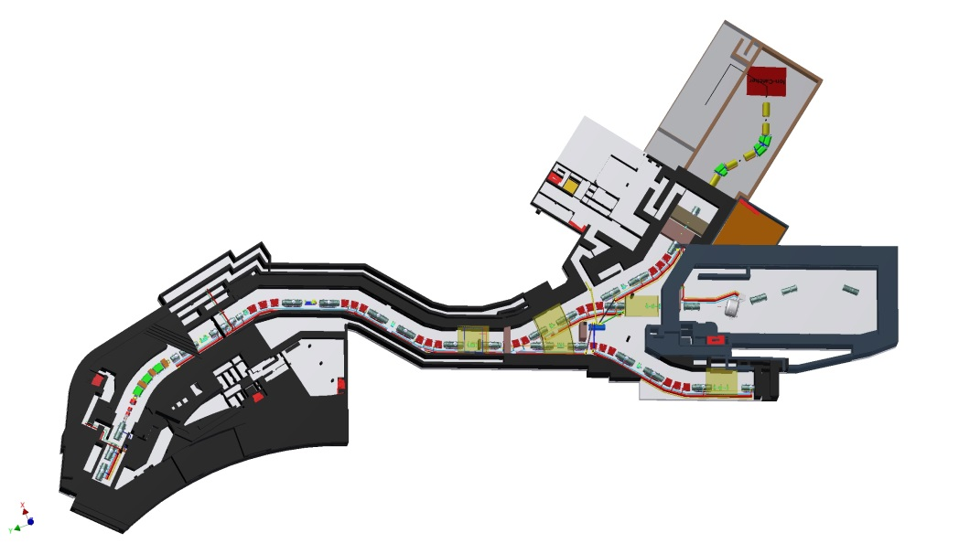
SuperFRS will have 3 branches ...
MATS /
LaSpec
Cryogenic
stopping
cell
❸
Q=Z 95%
HISPEC/
DESPEC
R³B
❶
Super-FRS collab.
parts from HISPEC / R³B
❷
to storage rings
ILIMA, EXL,...

Slide 18
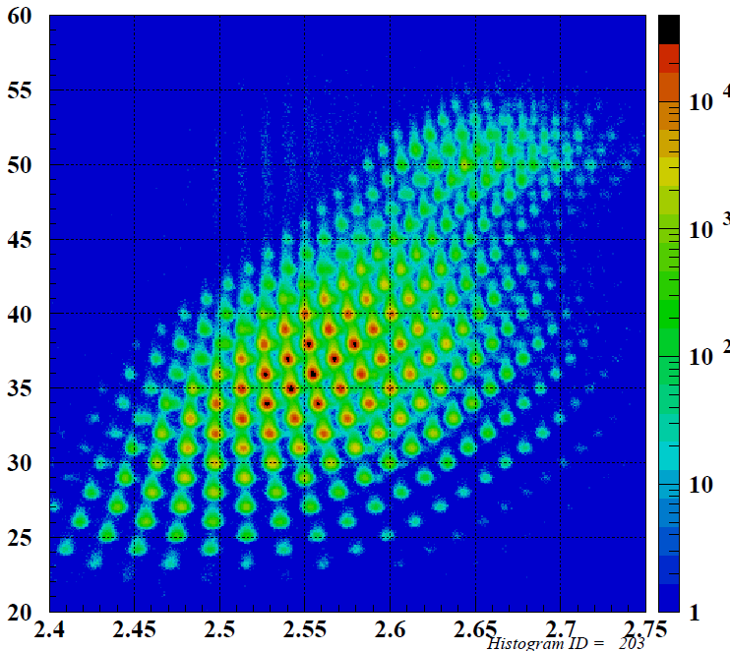
Commissioning ➔ phase-1
Takeda
RIBF
Initial Commisioning (slow extraction)
  e.g. C/U small intensity (~10³ pps)
  Bρ Range: 2Tm-20Tm optic tests
  RIBF: 2-3m, parasitic
  alignment (vs. beam axis) – Tracking Detector Commissioning
  remaining SAT tests 2-3 m (paras. beam)
Ramp up: SIS18/SIS100 medium intensity tests (~10¹⁰ pps, slow extraction)
(all beams desirable (U, Sn, C at least)
  Thickness measurements (degraders etc.)
  Full identification including ΔE, TOF system commissioning
  Initial physics programme (e.g. spec. isotope search) 2-3 m (full beam)
Ring Branch: Fast extraction, dedicated tests

Slide 19

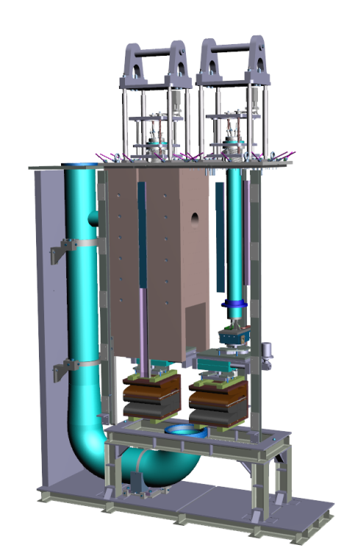
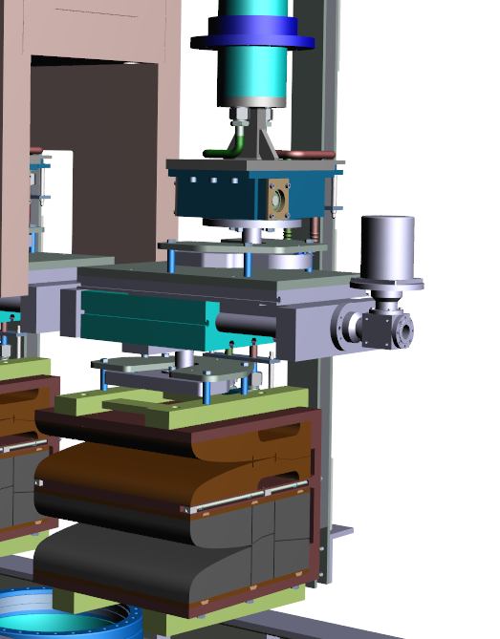
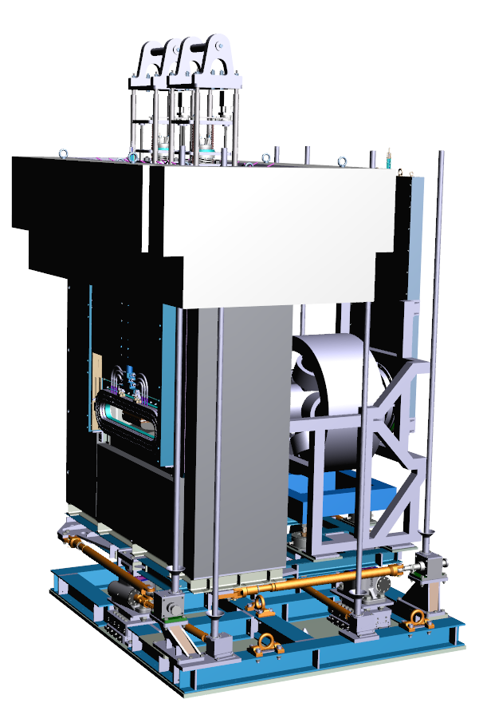
phase-1
(e.g. Beam Catcher Plugs)
BC3
  Instrumentation Checks
  Verify Modelling
  „Training“
  Low activation
BC1
BC2
BC3 movable / linear drive
cut through BC chamber including pumping duct
CAD model of BC3 and sextupole on common adjustment platform
plug assembly (BC1)

Slide 20
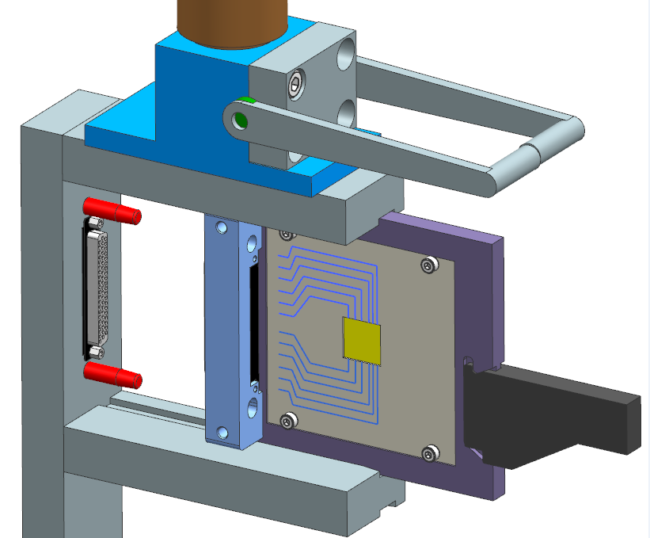
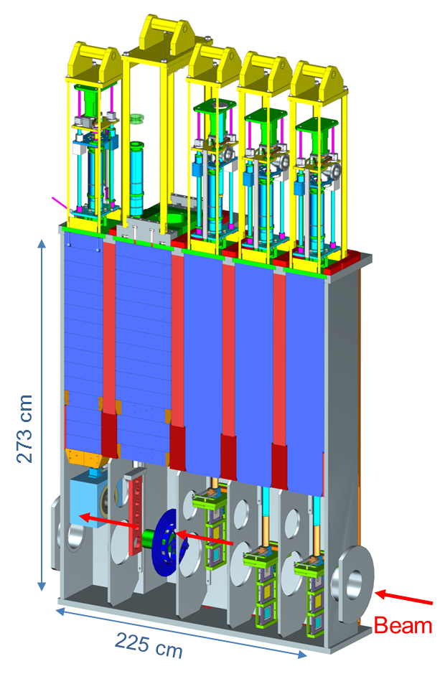
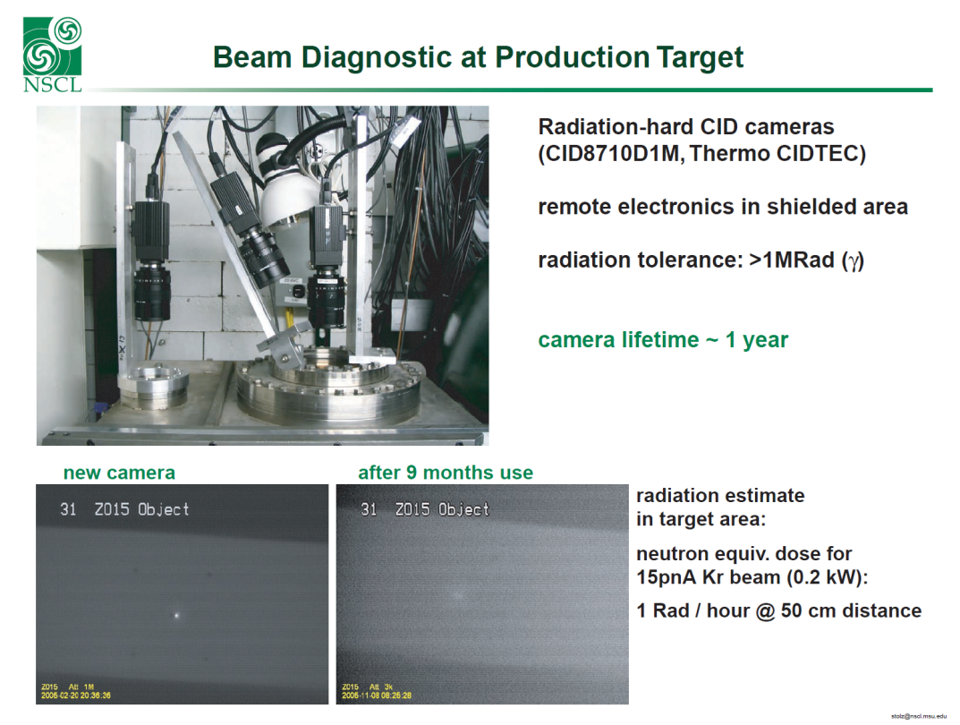
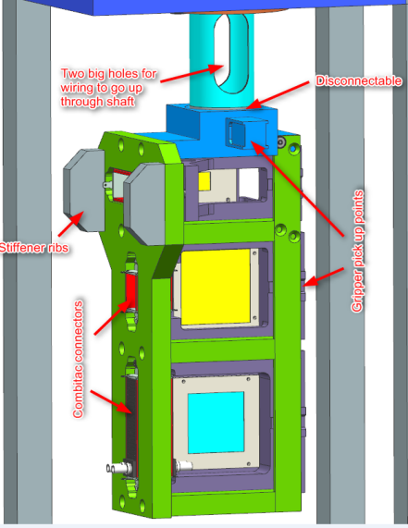
phase-1
(Target Chamber & Plug Systems @ low activation)
H. Weick,
C. Karagiannis et al.
R&D with KVI-CART
A. Stolz NSCL
Verify machine protection
system
Reliable detector operation
„Training“
Michel Lindemulder, Henk Smit, KVI-CART

Slide 21
Summary
  Beam time is required during all phases of the Super-FRS construction
  Parameters for phase-0, initial commissioning, phase-1 provided
  Extend of phase-0 should be defined
  Time for „no-beam“ commissioning is substancial for the Super-FRS
    hot cell
    remote handling
  Schedule for the branches not yet final
    Indian in-kind to LEB
  Experiments within phase-0 and phase-1 foreseen & possible

